Slide 1
Needfinding in Learning and Education
Filippa Karfelt
Gerardo Sanz
Ikechi Akujobi
Priyanka Rao

Slide 2
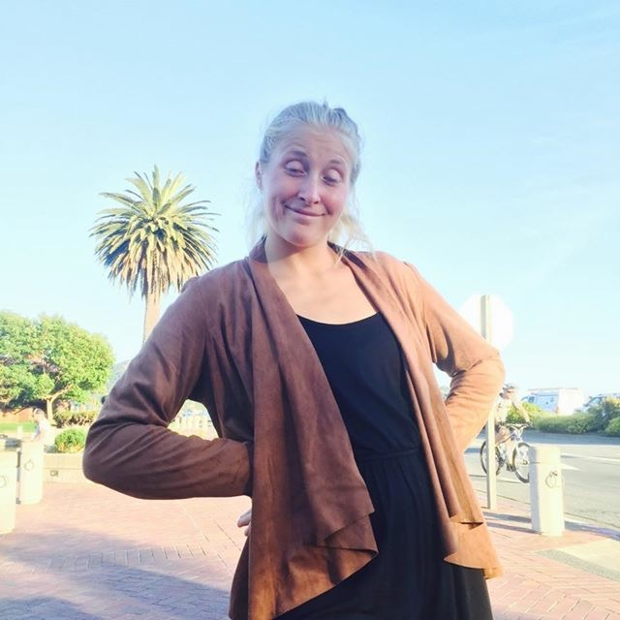
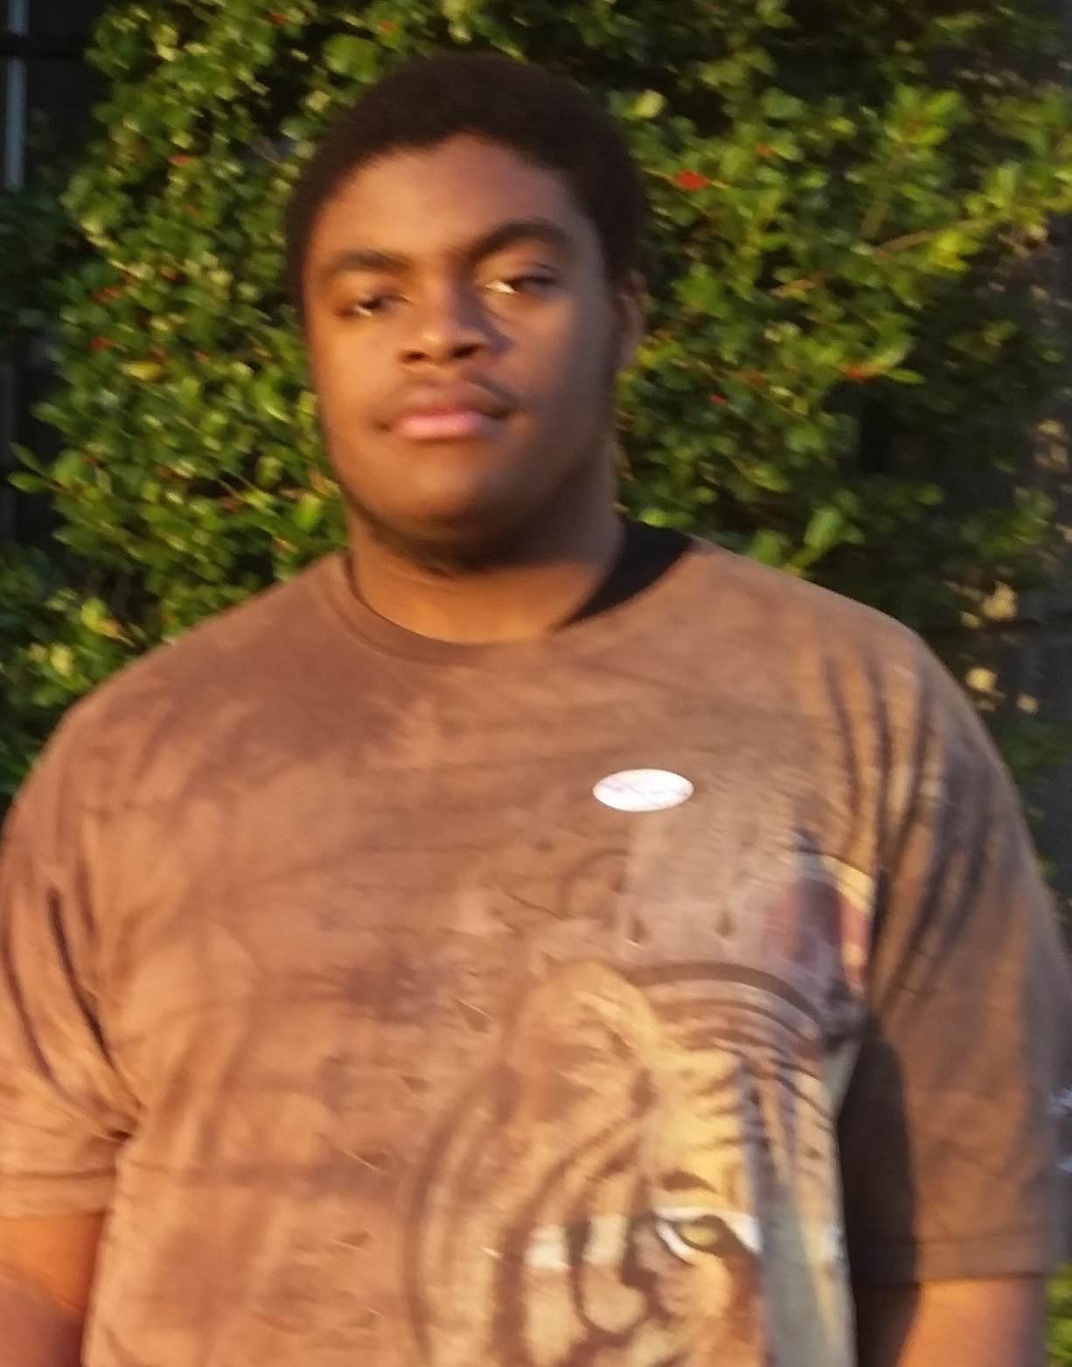
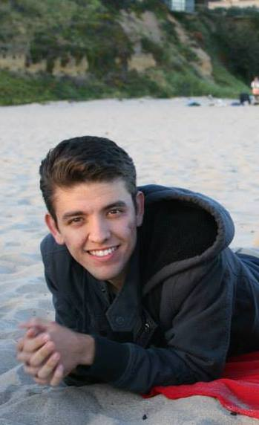
Our Team
Filippa Karrfelt ‘17
Priyanka Rao ‘16
Gerardo Sanz ‘16
Ikechi Akujobi ‘17
Notes:
Introduce team:
Gerardo – Senior in Econ
Filippa – Junior in CS
Ikechi – Junior in CS
Priyanka – Senior in EE

Slide 3
Focus: Elementary Schools
Notes:
To narrow it down a little bit we decided to focus on elementary schools, because of a few different reasons:
Experience in elementary really affects the rest of our lives
Elementary schools don’t have as many resources as, for example, universities

Slide 4
Learning and Education
Classroom Management
Building Friendly Environments
Information Flow
Notes:
Broad problem domain = learning/education
Subtopics we were particularly interested in were classroom management (projects/assignments/grading, etc), information flow, building friendly environments. The common theme between all these is communication.
Classroom management – how do teachers communicate information to students?
Building friendly environments – how are relationships built and ideas/classwork discussed?
Information flow – how do teachers, parents, and students interact and communicate?

Slide 5
Notes:
The primary roleplayers in the elementary school learning/education space are students, parents, and teachers.

Slide 6
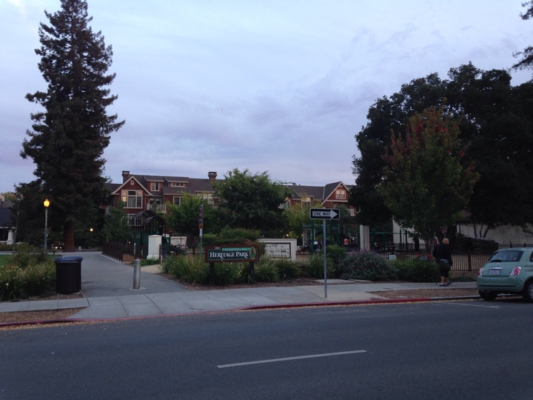
How We Found Our Interviewees
Plan A: Going directly to schools
Issue
Plan B: Find kids with parents around
Playgrounds in PA
Notes:
To find students, parents, and teachers in the learning/education space, we initially wanted to go into the field and observe/talk to students and teachers during school hours.
This was our Plan A. However, we were told by the principal of the elementary school we contacted that confidentiality forms need to be publicized and completed prior to our interviews, so we moved to Plan B.
For Plan B, we tried to find children with parents we could directly ask for permission. We went to two playgrounds in downtown Palo Alto and observed/chatted with young children and their parents. We acknowledge that this demographic is biased since downtown Palo Alto tends to have a higher-income population than the rest of California or the nation.

Slide 7
Students
Zilan (6th grader) & Ivan (1st grader)
Feelings about school
What subjects they liked and why
Communication with teachers and peers
Notes:
We talked to two students – Zilan and Ivan – for about 15 min each.
Because of the age gap between them, we had to phrase questions differently but some common themes we talked about were feelings about school, what subjects they enjoyed and why, and communication between teachers and peers. Examples of questions were:
What do you like about school?
What was your favorite project?
Tell us a story about something you loved in class.
While we had prepared more questions, the conversation flowed from a few of these questions and we went with the flow to not pressure the students.

Slide 8
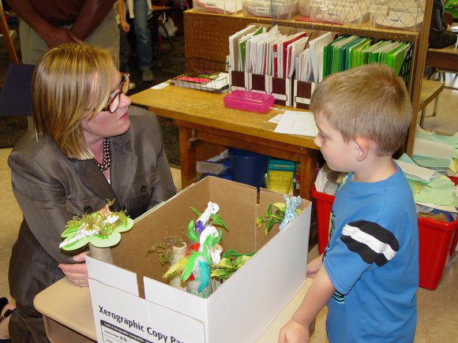
Highlights
Zilan
Tech is intuitive
International
Loves projects
Ivan
“I just know”
Trusts teachers
Notes:
Some common themes we found were that tech was very intuitive for Zilan, a 6th grader. And that Ivan also found school very intuitive. This could be crucial when designing something for students – whatever we design is best when intuitive. Zilan’s parents were from Turkey and didn’t speak English, so we found it surprising that she was so at home in her school. What caused this? How can we bring this comfort to other students who may not have parents who speak English?
Another common theme between Zilan and Ivan was that they both enjoyed projects and remembered them the most. They lit up when talking about these. They also trusted their teachers above their parents on how to do homework. Maybe they need a way to communicate with teachers outside of school if they can’t rely on their parents to help with homework.

Slide 9
Parents
Anna & AIT & Prof. Ellis
Thoughts about school
Interaction with teachers
Desired learning environment for children
Notes:
We interviewed three separate parents – Anna, AIT, Prof. Ellis – for 30-40 min each. We talked to Prof. Ellis for almost an hour. They have different professions but are in the same age range and have children in elementary school.
Some common themes in the questions we asked them were their thoughts about school, interaction with teachers, and what they liked/disliked about their child’s education.
We asked questions such as:
Do you feel in the loop when it comes to your child’s education?
What do you like/dislike about your child’s school?
Tell us a story about your child’s teacher.
We went with the flow from these questions and tried to observe their emotions.

Slide 10
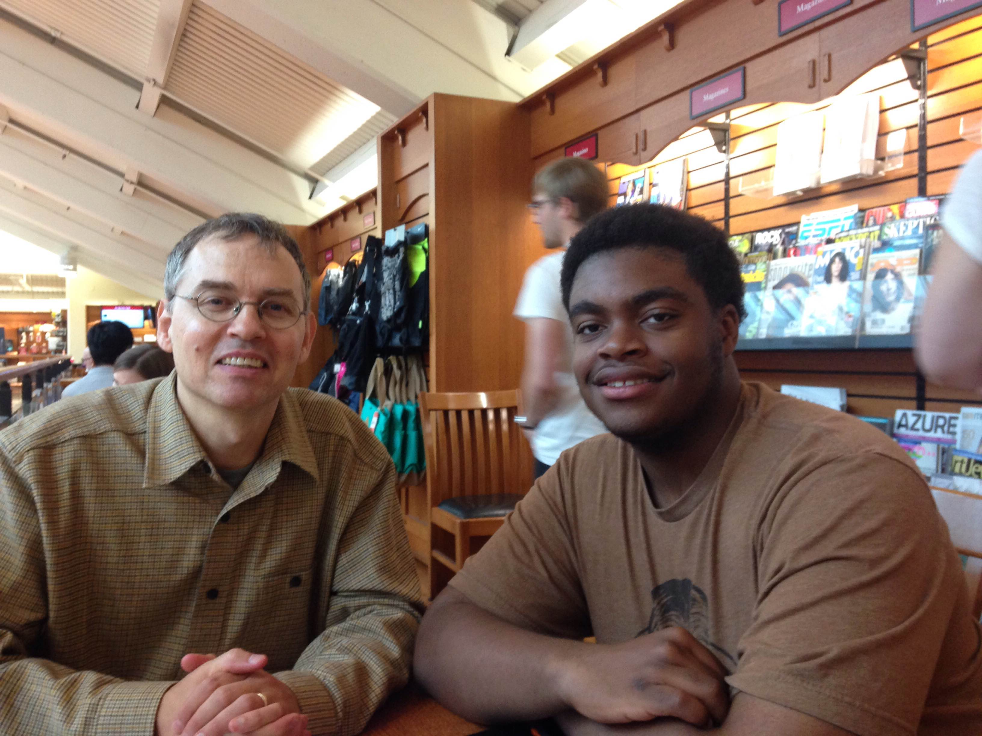
Highlights
Conflicts with teachers
Communication over email
Remember projects
Prefer small class sizes, challenging environment
Surprising story: Prof. Ellis
Notes:
Some highlights we gleaned were that:
Conflict with teachers was hard to resolve. Teachers were often unresponsive or didn’t understand the parents POV. This was particularly true with Prof. Ellis who eventually homeschooled his child.
Communication occurred over email and was hard to find in the midst of other work emails
Projects were the most memorable assignments they remembered teachers giving
All parents wanted their children to have small class sizes and a challenging environment.
One other interesting thing Prof. Ellis (an extreme user since he ended up homeschooling his child) said is that he wishes he could connect with other parents.

Slide 11
Teachers
Rachel Baker
Stories about challenges teaching
Interaction with parents
Management of large classes
Notes:
We interviewed one teacher, Rachel Baker, who worked at a school for the deaf.
For her, we specifically asked her to tell us stories about challenges teaching students with disabilities, how she interacted with the parents, and how she managed large classes. We also digged deeper into her responses and went with the flow.
Some questions we asked:
Can you tell us about a time where you found it challenging to convey information to students?
What do you like/dislike about teaching?
How do you manage so many students, especially when they have challenges that prohibit their learning?
Are there any incidents that demonstrate how student’s parents/backgrounds affected their learning? How did you approach those incidents?

Slide 12
Highlights
Communication between teachers is strong while communication from administrators is lacking
Increase in use of technology
Students work hard but their backgrounds affect them
Notes:
While this was a shorter interview, we found some interesting insight from Rachel.
She said that communication between teachers is strong and they are able to share curriculums and lesson plans and work together very well, but communication from administrators and management is somewhat lacking about standardized testing.
She also said that they are beginning to use more technology in her school and are having databases to prepare students for standardized testing.
She also shared stories that indicated her students work very hard but their backgrounds at home or their physical challenge of being deaf can prohibit them from doing well in school.

Slide 13
Two Empathy Maps: Students and Adults
Notes:
We decided to make two empathy maps, one for students and one for parents/teachers. We chose this grouping because parents/teachers are adults and tend to have different ways of thinking than young children.

Slide 14
Students
SAY
THINK
Projects
Email
Like to work with others
Chromebooks
School separate from play
“I just know where to go” - Ivan
Believe everything is taught in school
Trust teachers
Light up for projects
Boredom/excitement dependent on activity
Shy until interesting topic
At ease with technology
Go with the flow
DO
FEEL
Notes:
SAY/THINK: Some things said were that projects were really fun, there was use of email and chromebooks in the classroom, and “I just know where to go”.
We think that since both children we interviewed enjoyed projects, they like to work with others. Since they couldn’t say much about what they learned at home, we think that school is separate from play and they believe everything is taught in school. Their citing of “email” and “Chromebooks” in the classroom makes us think they have an intuition for technology.
DO/FEEL: Both of them lit up when we hit topics about projects, which makes us think they are either bored or excited based on their activity. Since Ivan hid behind his mother, we believe he trusts his parents and teachers since he also said that he only listens to his teacher about HW. In general, we got the feeling that they liked to go with the flow and live in the present.

Slide 15
Parents & Teachers
SAY
THINK
Challenged
Email
Teacher > School
Small classes good
School is responsible for focusing on students
Regular assessments
“Field trips, awesome!” - AIT
Learn by doing
Communicate during conflict
Involved with kids
Help with projects
Disappointed in responsiveness
Confident about safety
Approach teachers
DO
FEEL
Notes:
SAY/THINK: Parents and teachers alike said they wanted to have small class sizes and challenge students. They also shared in the same line that they expected the school administrators to be a part of this process and help them have smaller class sizes. This makes us think they believe the school is responsible not for its reputation but for its ability to focus on students and individual learning. One parent (Prof. Ellis) said he selected the school based on the teacher and not the school’s reputation, which makes us think he values the teacher over the school.
DO/FEEL: Prof. Ellis tried to communicate with his child’s teacher during conflict about course grades but met with very unresponsive emails and felt disappointed. Other parents found themselves enjoying the projects they could work on with their kids and this made them feel involved in the learning process. In general, from what AIT said about field trips, it seems like there are no concerns about safety though there are concerns about responsiveness with schools.
Side note: It is interesting to note that Prof. Ellis wanted his child’s teacher to be more responsive though he selected the school based on the teacher (this could be an extreme case). Maybe this contributed to the problems he had and isn’t representative of the general population. Also, from another teacher’s perspective, Rachel said that she believes communication with parents should be facilitated by the school itself. Maybe parents/teachers/administrators are working towards a common goal of education children but have gaps in their communication.

Slide 16
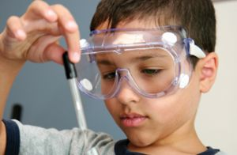
Inferences
Parents and teachers want school to be an intimate and challenging environment
Kids want to learn by having fun
Communication is still email-based
Everyone wants a buddy
Notes:
The key inferences we made were that parents and teachers want school to be an intimate and challenging environment. At the same time, kids enjoy challenges that they can do and have fun with. Communication is somewhat archaic between teachers and parents and there exists a lack of three-way communication. And both parents and students and teachers felt communication between their peers would give them insight that would help them feel more comfortable and make better decisions.

Slide 17
Summary
Some edge cases
Interview biased because of demographics
Shorter interviews
Notes:
Good interviews and we learned a lot about what was working well/not working well for students, parents, and teachers in elementary school.
Since Prof. Ellis was homeschooling his daughter, we would say that’s an edge case. Same with Rachel Backer, since she teaches at a school for the deaf. Also, we consciously reminded ourselves that the demographic we talked to was biased and based around upper-middle class people. We also acknowledged that we had limited observations of students and teachers in the actual learning environment as we had issues with confidentiality forms. We also had shorter interviews with the children as they soon became eager to play.

