Slide 1
POVs and Experience Prototypes
Presentation by Nicole Crawford
Team: Nicole Crawford, Jorge Cueto, Lynne Sneed, & Musila Munuve

Slide 2
Problem Domain
Learning Disabilities
Studio: Learning & Education

Slide 3
Initial POV
We met Jordan Kortenhoven, a 24-year-old woman with autism and Nonverbal Learning Disorder
We were surprised to learn she has trouble making exact change and someone had once tricked her
It would be game-changing to help her make exact change

Slide 4
New POV #1
Initial POV
Notes:
after further analysis of our results, we determined our initial POV was too specific and didn’t encompass the root of the problem
thus, we decided on a more general POV, and also generated 2 more to fully address the major problems we uncovered in our needfinding round

Slide 5
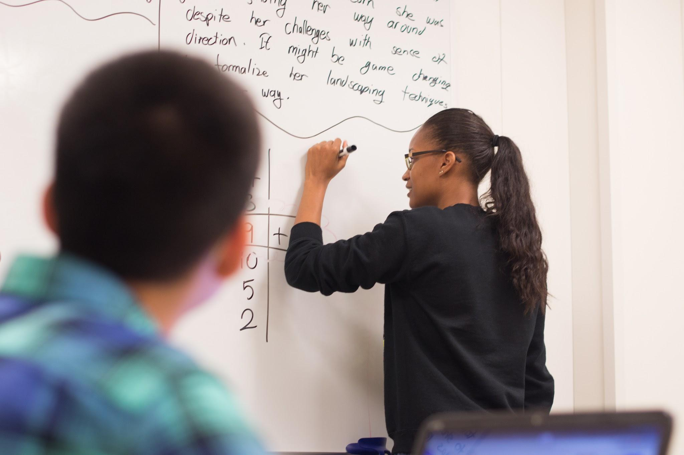
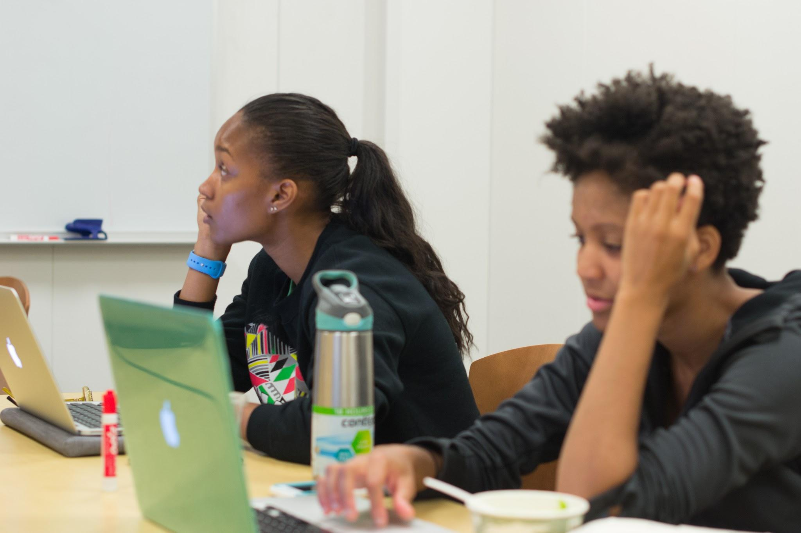
Revised POVs

Slide 6
POV 1
We met Jordan Kortenhoven, a 24-year-old woman with autism and Nonverbal Learning Disorder
We were surprised to find that Jordan has difficulty making basic number calculations which affects telling time and calculating change
It would be game changing to make it easier for Jordan to make basic number calculations in order to perform daily tasks independently

Slide 7
POV 2
We met Jordan Kortenhoven, a 24-year-old woman with autism and Nonverbal Learning Disorder
We were surprised to discover she was good at finding her way around familiar places using landmarks despite her lacking a sense of direction
It would be game changing to formalize her landmarking techniques to help others with a poor sense of direction travel independently in unfamiliar places

Slide 8
POV 3
We met Bob Smith, a USC student with ADD
We were surprised to learn it was easy for him to focus on material he liked and learn more than what was presented in class
It would be game changing to create a learning environment in which Bob can feel more engaged and acknowledged

Slide 9
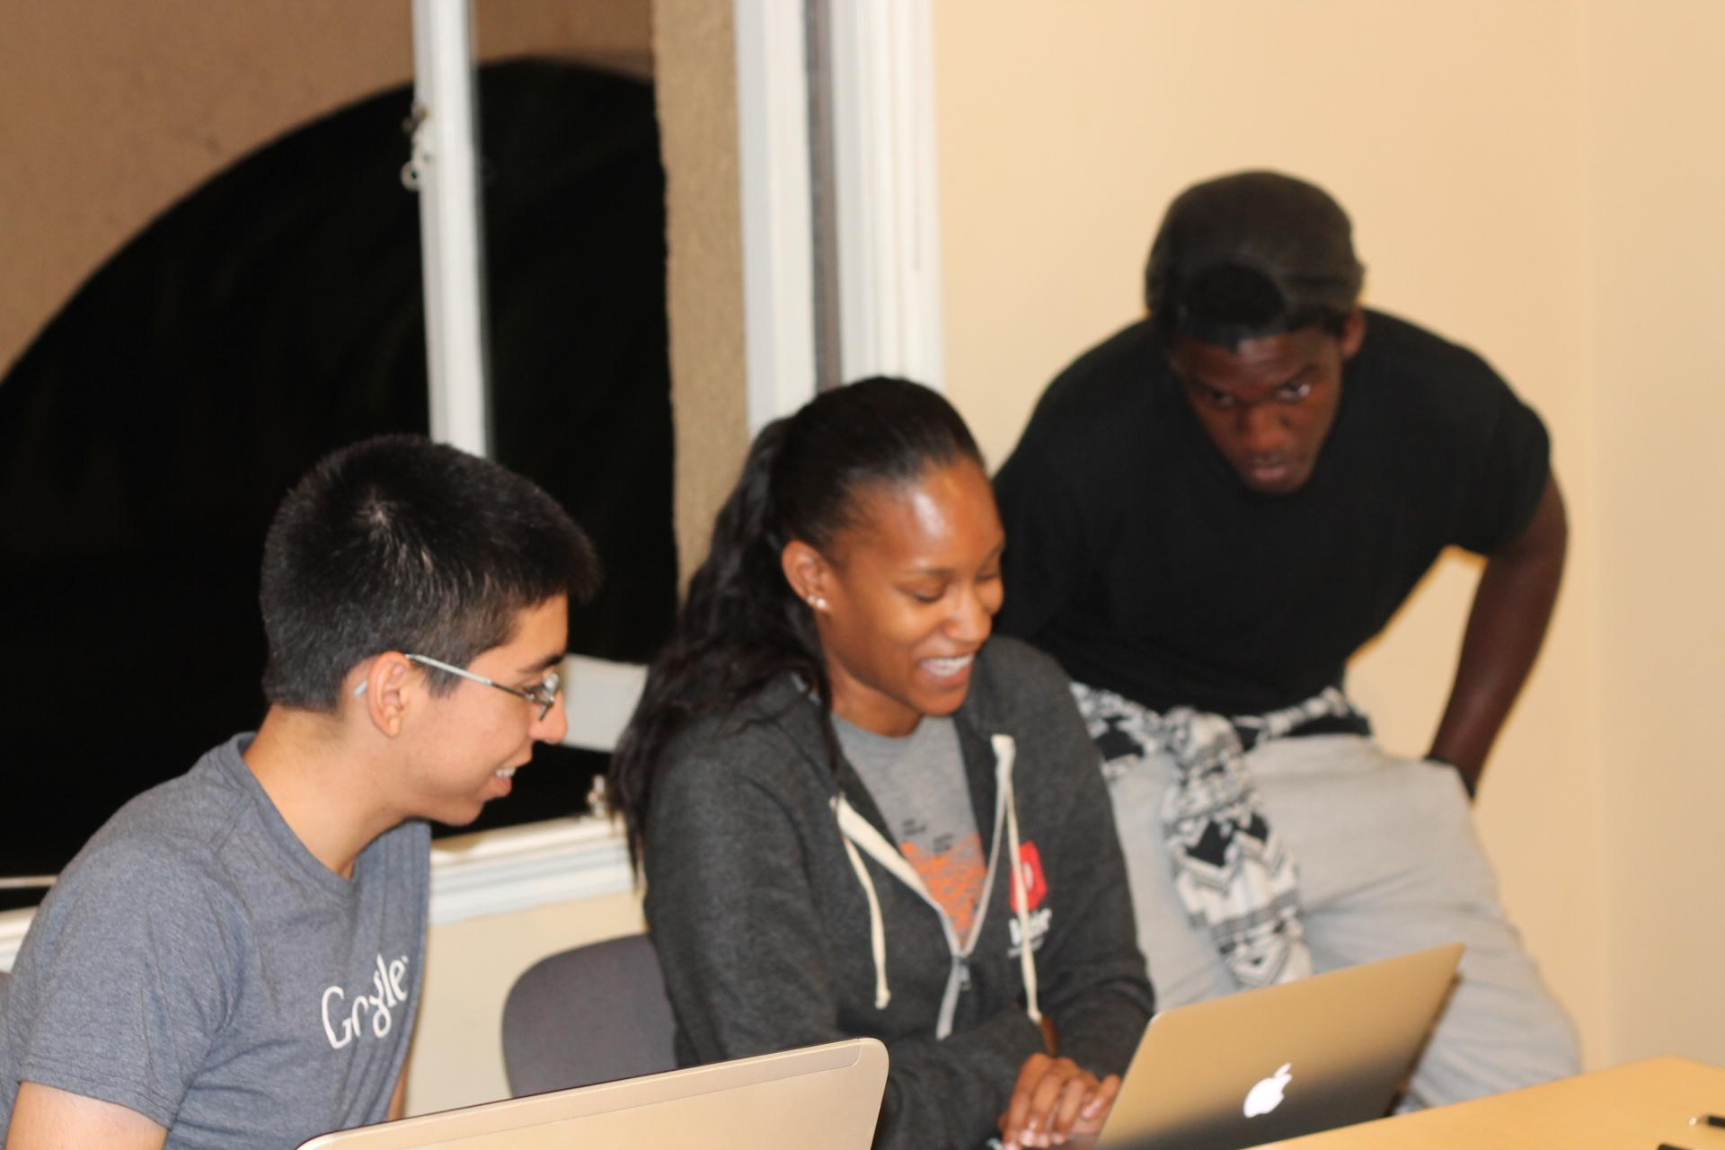
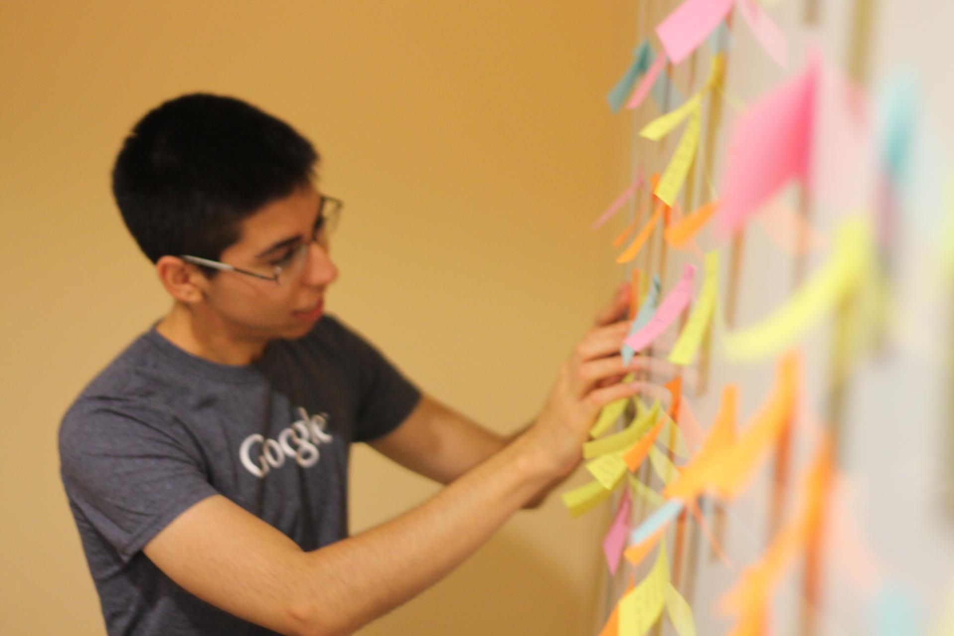
Top HMW statements

Slide 10
HMW 1
How might we make it easier for Jordan to pay?

Slide 11
HMW 2
How might we help Jordan understand how much time has passed?

Slide 12
HMW 3
How might we help teachers gauge, and therefore teach, what students are interested in?

Slide 13
Experience Prototypes
Notes:
make clear how we got from POV to HMW to prototype

Slide 14
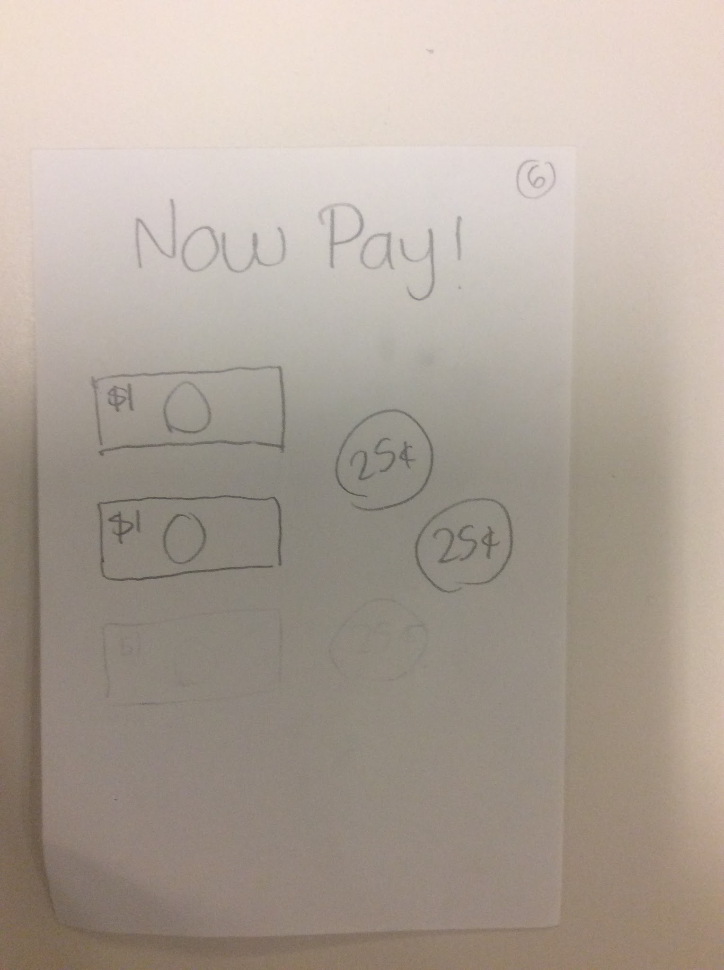
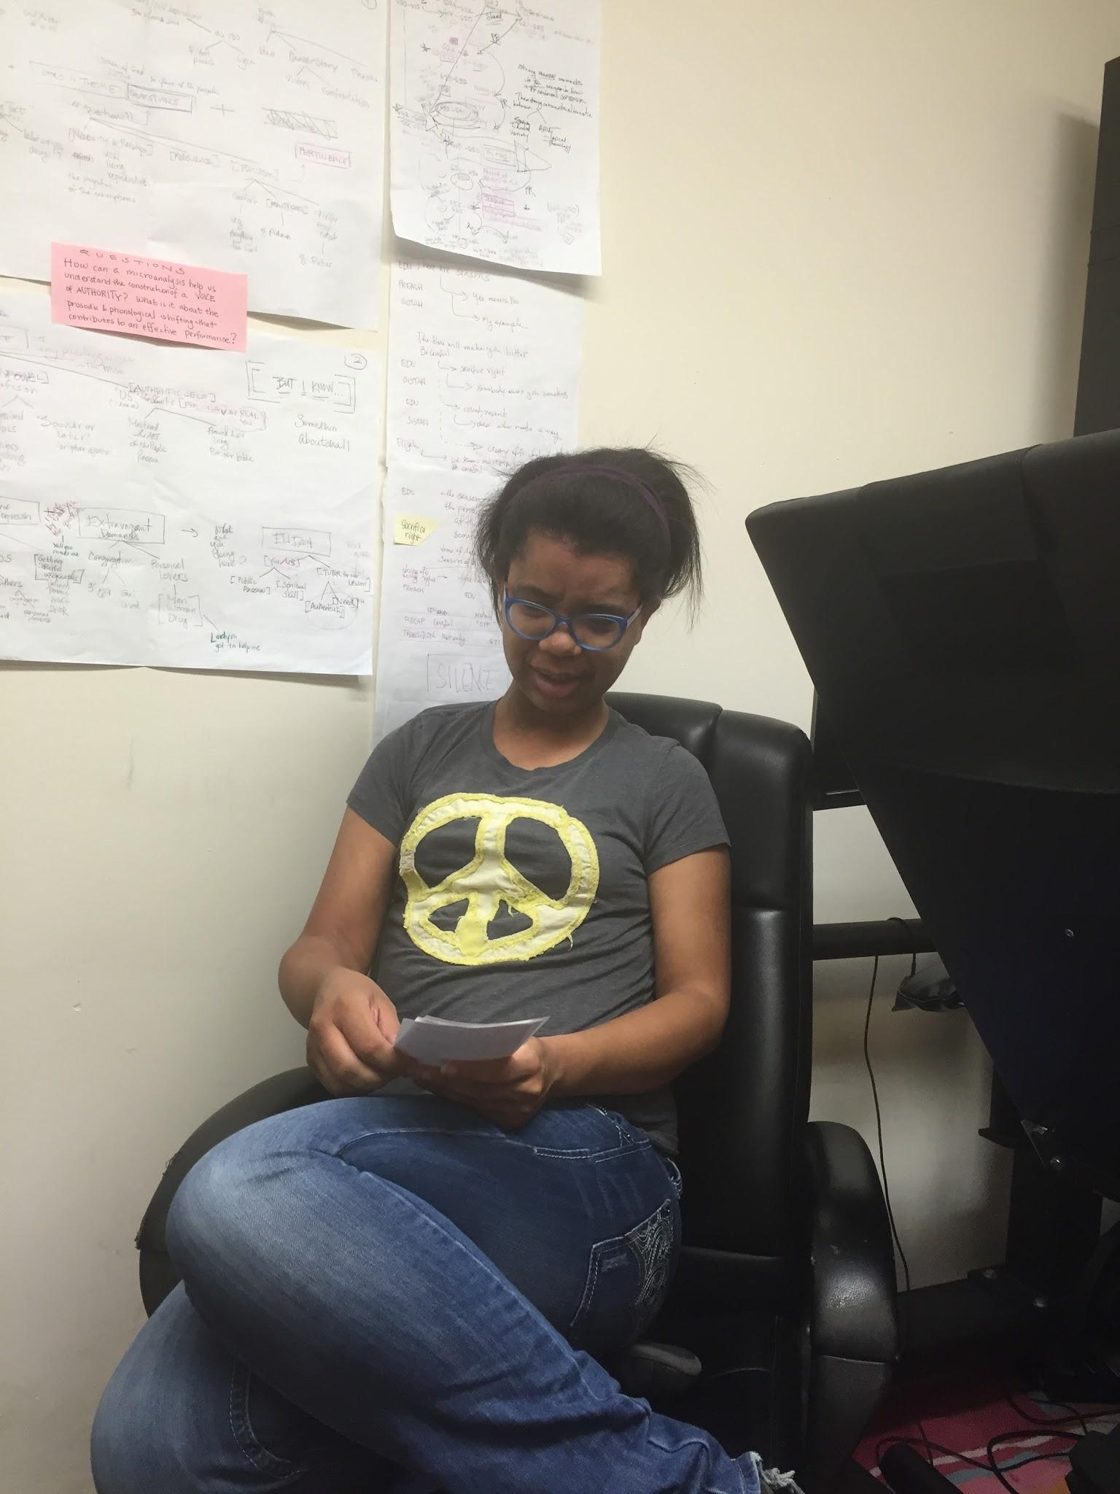
Prototype 1: app to learn money visually
Notes:
Prototype: pieces of paper mocking a phone app
we gave her a scenario where she is in an aisle at a store picking out a notebook
she used the app to learn what bills & coins to use to pay for her selection
Worked: the use of pictures at the end to tell her how to pay for her items
Didn’t work: the use of tax & tip were too confusing; she didn’t understand the screen where the new total including tax came up
Surprises: she really didn’t like the microphone only option and would prefer to type in the amount
New learnings: her mom said adding a budget/limit would be helpful, since she wouldn’t know whether her total amount is more than she is allowed to spend or currently has in her wallet
validity of assumption: we assumed talking would be easier for Jordan, rather than typing in the numbers; however, she doesn’t like the mic idea and definitely prefers typing
any new assumptions that emerged: she said landscape mode would be better; we assume this is because she finds it difficult to type on small screens

Slide 15
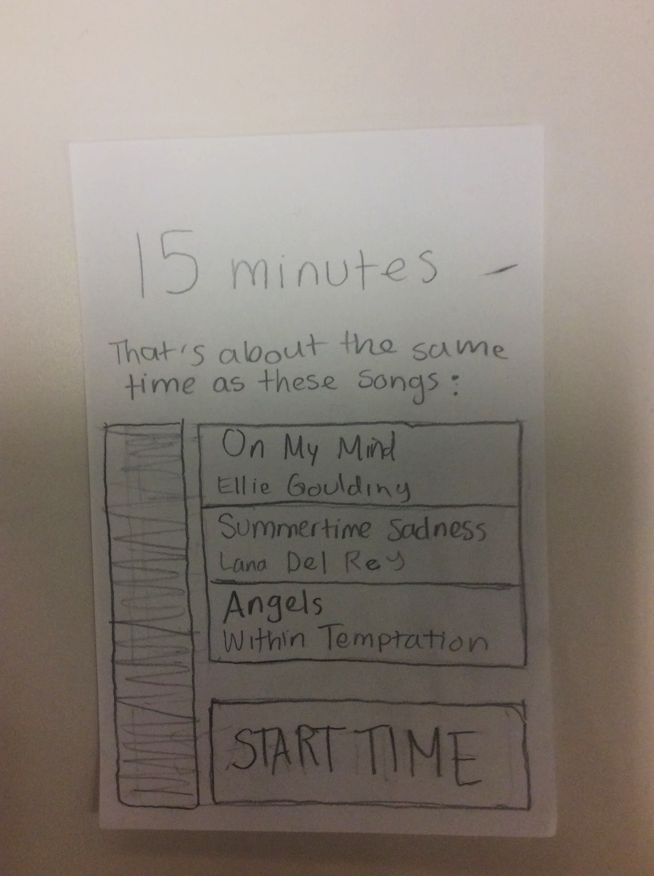
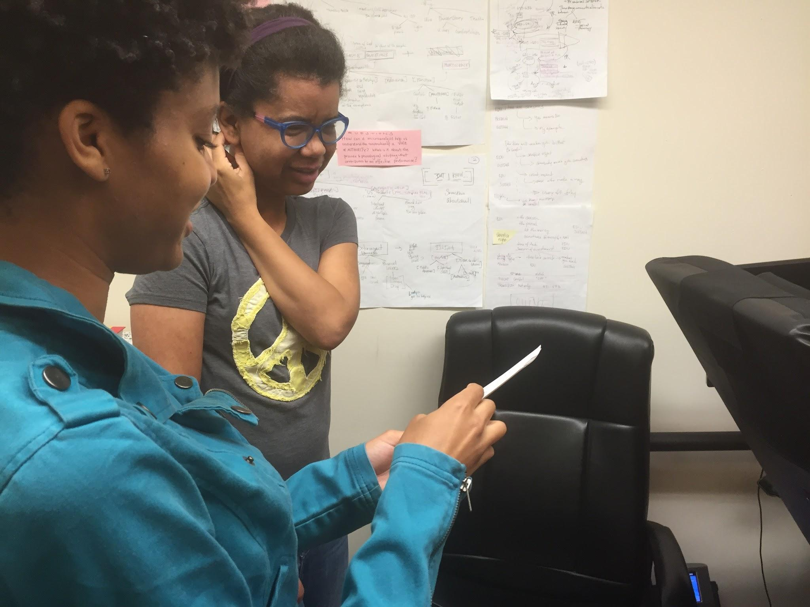
Prototype 2: alternative format timer app
Notes:
Prototype: pieces of paper mocking a phone app
scenario: she’s at the movie theater waiting for her mom to pick her up, who says she needs to wait 15 min
the app tells her the period of time she input is the same amount of time as 3 songs
idea was to represent time in a format she was comfortable & familiar with (music)
Worked: the could use existing songs in her library, liked the straightforward UI
Didn’t work: no audible notification when the time ran out, limited media selection (only music in prototype)
Surprises: she would want to use this in a location she visits frequently without without wifi (laundry room), so our ideas for extending to resources like YouTube wouldn’t work in this case
New learnings: “No Adele today, please” → should be able to fine tune the musical selection without having to choose specific songs
validity of assumption: we assumed the use of music or TV shows, something she’s very comfortable with, would assist her in keeping track of time; a valid assumption!
any new assumptions: we need a solution that would work completely disconnected from wifi and without data sources

Slide 16
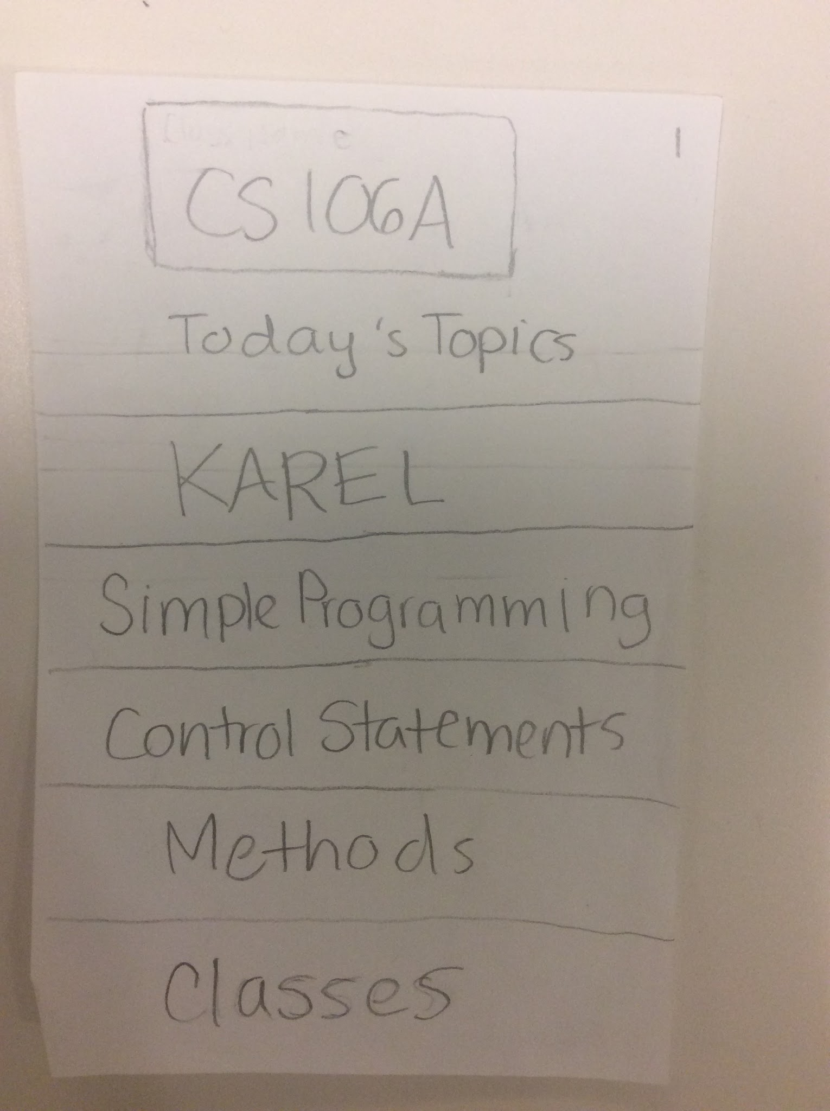
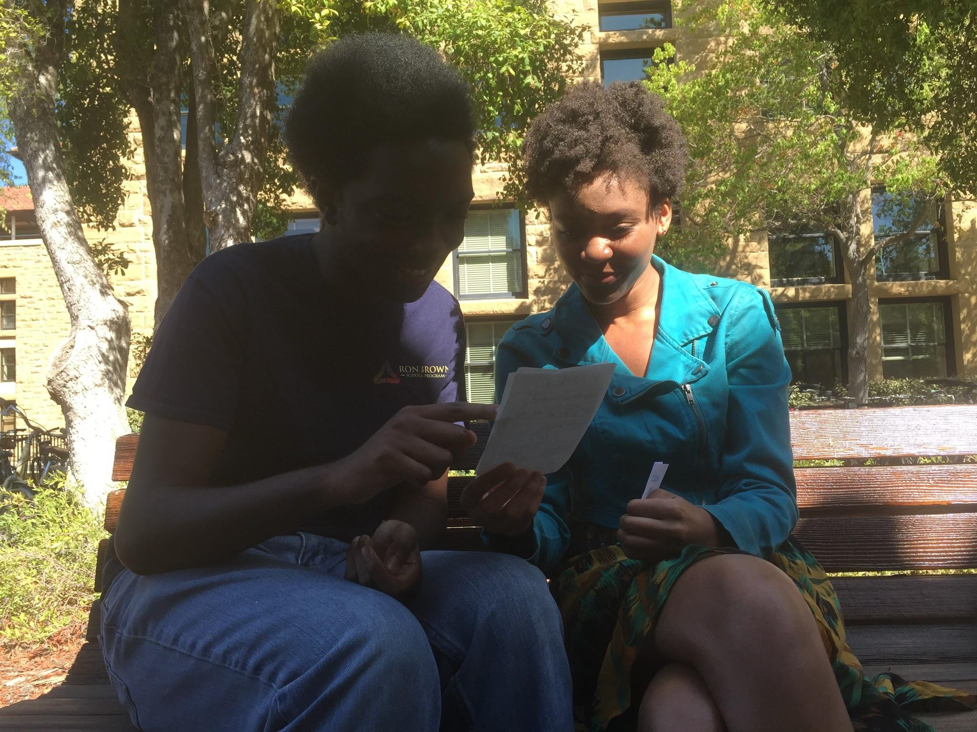
Prototype 3: app to crowdsource lesson plans
Notes:
Prototype: had Chris Middleton, a Stanford student test
another phone app mocked using paper
scenario: he’s using the app for CS106A so that he can better understand material he’s confused about, and find a relevant post about that topic in the app (organized according to class syllabus)
Worked: overall flow of the app made sense
Didn’t work: no filter, so would have to scroll through all of the posts to find something relevant to his needs
Surprises: he thought teachers would need an incentive to use this in their classes because it would require extra work for them; however, Andrea Kortenhoven, a linguistics grad student who has taught classes loved the idea when we briefly discussed it with her, but thought students would need an incentive, like extra credit, to use it
New learnings: really liked the idea for small seminar classes, because it could lead to better in class discussions
validity of assumption: assumed the app would work well for large lectures; he didn’t like the idea for large classes, since there would be a frequent posts that might not necessarily be helpful/interesting to him
any new assumptions: should break up large classes into smaller chunks to avoid overloading user with too many posts

