Slide 1
Needfinding
Presented by Jorge Cueto
Studio: Learning and Education Team: Jorge Cueto, Lynne Sneed, Nicole Crawford, & Musila Munuve
Notes:
Hello my name is Jorge, and today I will be presenting my team’s needfinding experience.
The other members of my team include Lynne Sneed, Nicole Crawford, and Musila Munuve.

Slide 2
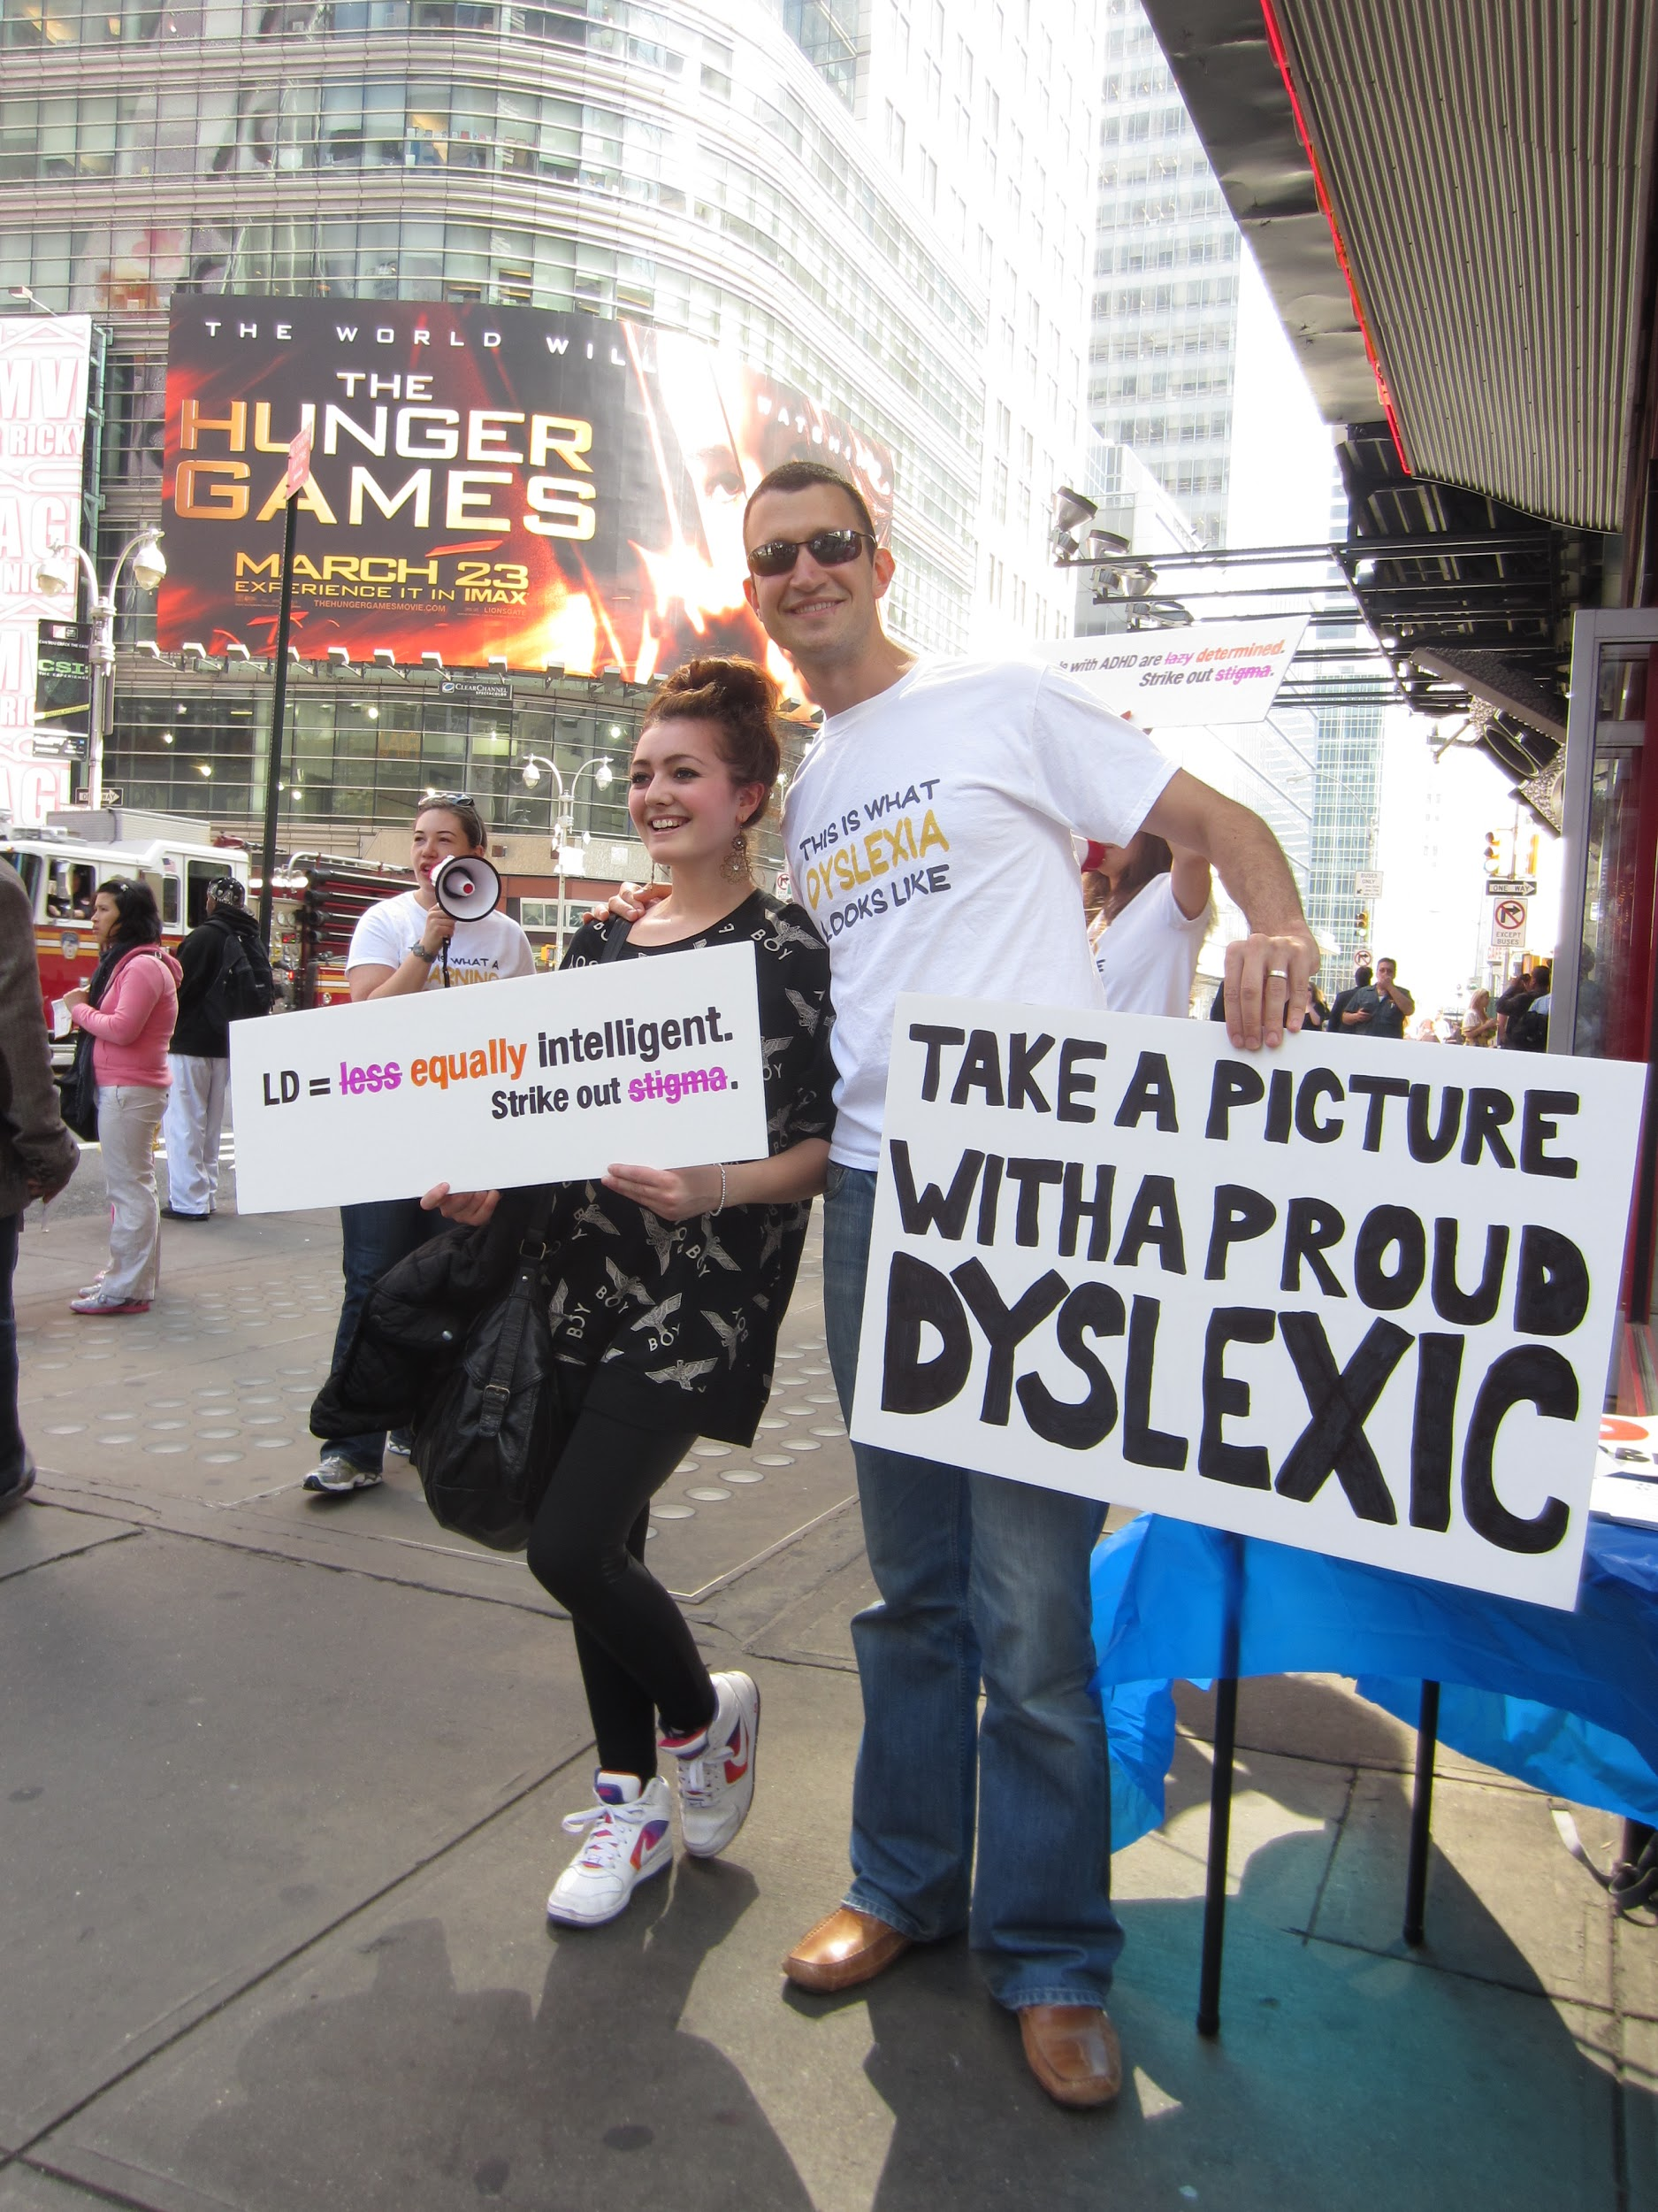
Problem Domain: Learning and Invisible Disabilities
Notes:
Within our studio’s theme of learning and education, we decided to focus on learning and invisible disabilities because we felt that this is an important area that is often overlooked by the tech industry. Disabilities in this space include dyslexia (difficulty reading), dyscalculia (difficulty doing math), ADD (attention deficit disorder), and autism.

Slide 3
Needfinding Methodology
Notes:
As for our needfinding methodology, we wanted to get a diversity of perspectives, so we interviewed young adults with disabilities and a parent, intervention developers, and a clinical researcher.

Slide 4
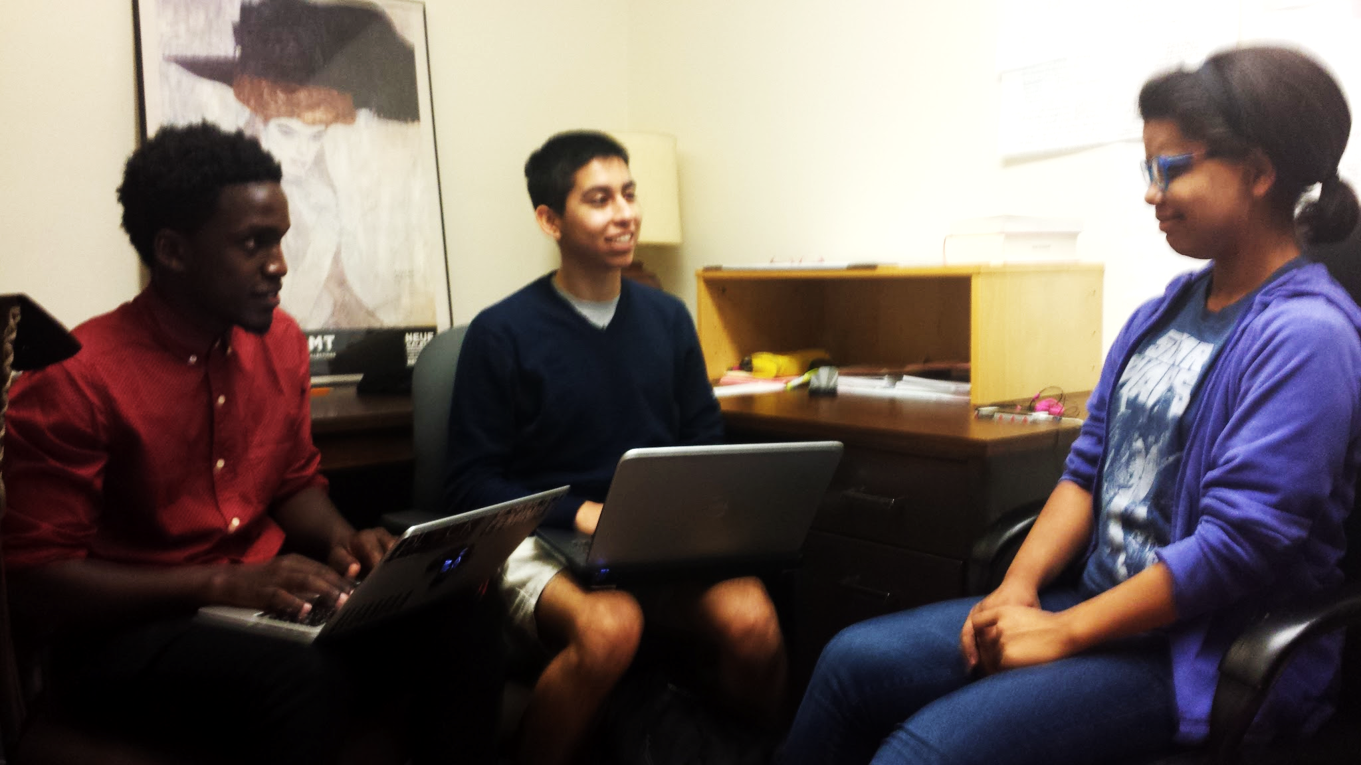
Young Adults with Disabilities + Parent
Jane Martinez MIT student with Visual Perception Deficit Disorder
Bob Waverly USC student with ADD
Lucy Hill bipolar Stanford student
Jordan Kortenhoven Palo Alto resident with autism
Andrea Kortenhoven Jordan’s mom, Stanford PhD student
Notes:
We wanted to get the first-hand perspective of people impacted by a variety of learning and invisible disabilities in their daily lives. We reached out to our own personal friends who we knew had disabilities, which is how we got in touch with Jane Martinez, an MIT student with Visual Perception Deficit Disorder, and with Bob Waverly, a USC student with ADD. We interviewed Jane and Bob through Skype since they live far away. We sent out emails to our dorms, which is how we got in touch with Lucy Hill, a bipolar Stanford student. We interviewed Lucy in her dorm room.
We also reached out to Power to ACT, a local resource group for people with disabilities and their allies, which is how we got in touch with Jordan Kortenhoven, a Palo Alto resident with autism, and her mom Andrea. We interviewed them in the main quad.
We asked the students, “Share a specific story about a time in which your disability impacted your learning experience or your daily life. How did it make you feel? What would we find surprising about how you’ve adapted to your disability? Do you use any existing technology to help with your disability?”
We asked Jordan’s mom, “Share a specific story about raising a child with a disability. How did it make you feel? What additional resources do you wish you had as a parent?”

Slide 5
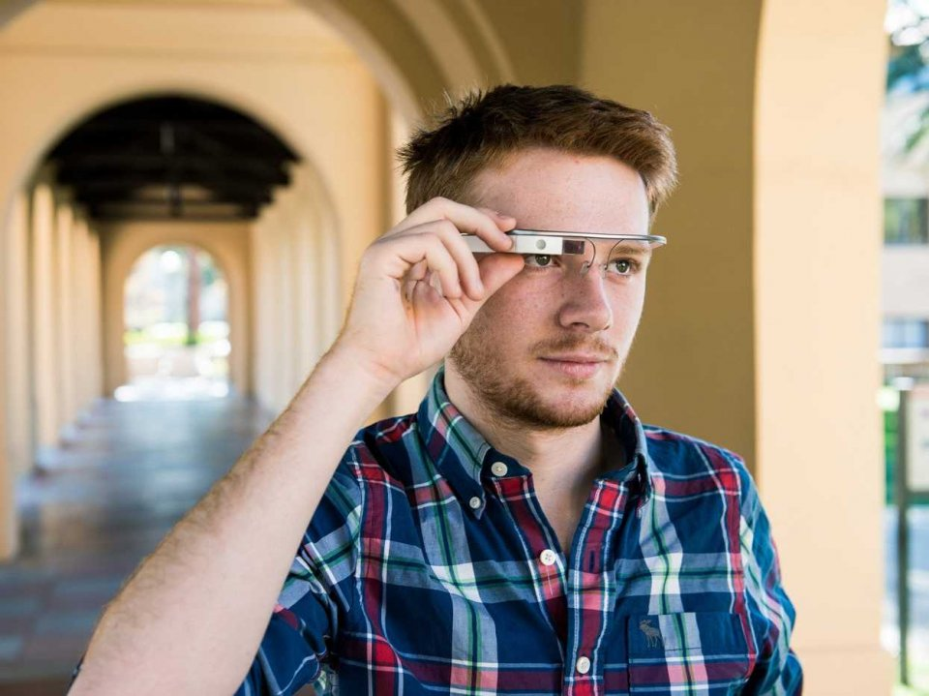
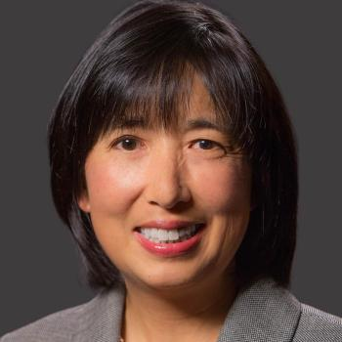
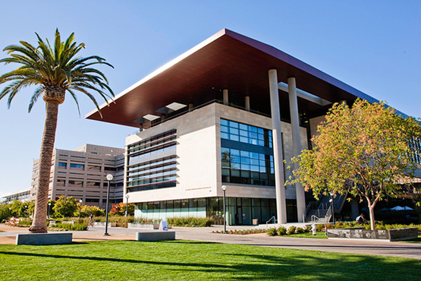
Intervention Developers
Catalin Voss Google Glass Autism App Developer Stanford School of Medicine
Alice Wong Alternate Format Producer Office of Accessible Education
Notes:
We also interviewed intervention developers because we wanted to get the perspective of people who build tools that help people with disabilities succeed.
Searching through Google, we found an article about a Google Glass application developed at the Stanford Med School that helps students with autism learn how to identify emotions in facial expressions. We reached out to the developer of the app, Catalin Voss, and we interviewed him at his apartment in Munger.
We also visited the Office of Accessible Education here at Stanford, where we met Alice Wong, an Alternate Format Producer who specializes in using software to transcribe learning materials such as textbooks into braille to help students with visual impairments. We interviewed Alice in her lab.
We asked Catalin and Alice,“What is your motivation for doing what you do? Tell us a story about a challenge you faced in the development process? What other opportunities do you see for using technology to help people with disabilities?”

Slide 6
Interview Results

Slide 7
Results
Tensions
“I wish I had local friends. All of my friends live in other cities, or in other countries.” - Jordan
“I miss being able to focus. Taking my medication actually makes me less focused. When I was unstable, I could really pay attention.” - Lucy
Notes:
There were tensions in students feeling lonely. And also having to choose between trade offs - feeling stable or being able to focus.

Slide 8
Results
Contradictions
“I can fit in just fine…Sometimes I get uncomfortable when there are a lot of people around. During my graduation, there were over 300 people, and I went to hide in the bathroom.” - Jordan
“I feel pretty normal now...Regular college students get to go out and drink and have fun. I don’t have that. I’ll never have that.” - Lucy
Notes:
We noticed contradictions in students saying that they feel normal and showing signs that in reality they are afraid of fitting in.

Slide 9
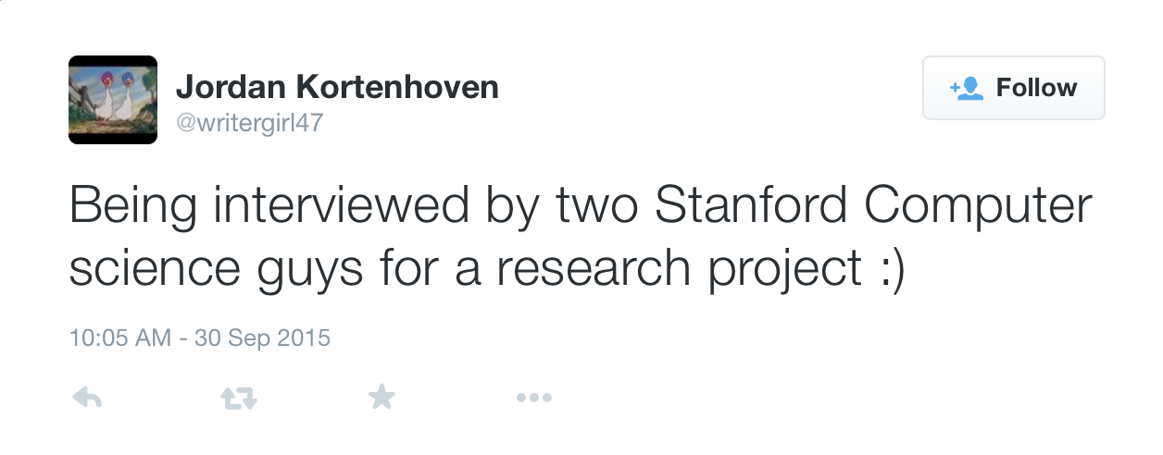
Results
Notes:
When we mentioned how her disability impacted her daily life, Jordan never mentioned that it obstructed her physical coordination. But when we asked her to type a tweet for us, she kept on hitting the wrong key and having to backspace. It took her a while. I also noticed that when she needed to charge her phone, it took her 3 tries to plug the charger into the phone.
We also asked Jane to walk through a homework assignment with us, and she grimaced and changed the subject to avoid doing it.

Slide 10
Results
Surprises
Diversity within the disability space.
Notes:
We were surprised by the diversity that exists within the disability space and how these disabilities manifest themselves. Jordan seemed very normal. She speaks well, and she showed us samples of her writing. She writes well too, and she has really neat handwriting! And yet, when it comes to doing number calculations, she has a lot of trouble. Her mom asked her whether the number 6 or 10 was bigger and she struggled to come up with an answer.
Catalin mentioned he has ADD and during the interview he kept fidgeting with a pen and a lighter, and he would randomly get up to pick up paper from the printer. And yet he’s been able to focus on building the autism Google Glass app for nearly 2 years.
Students really valued holding physical objects. Holding a textbook. writing down stories on a notebook. Writing reminders in a planner. Touching the screen on an iPad.

Slide 11
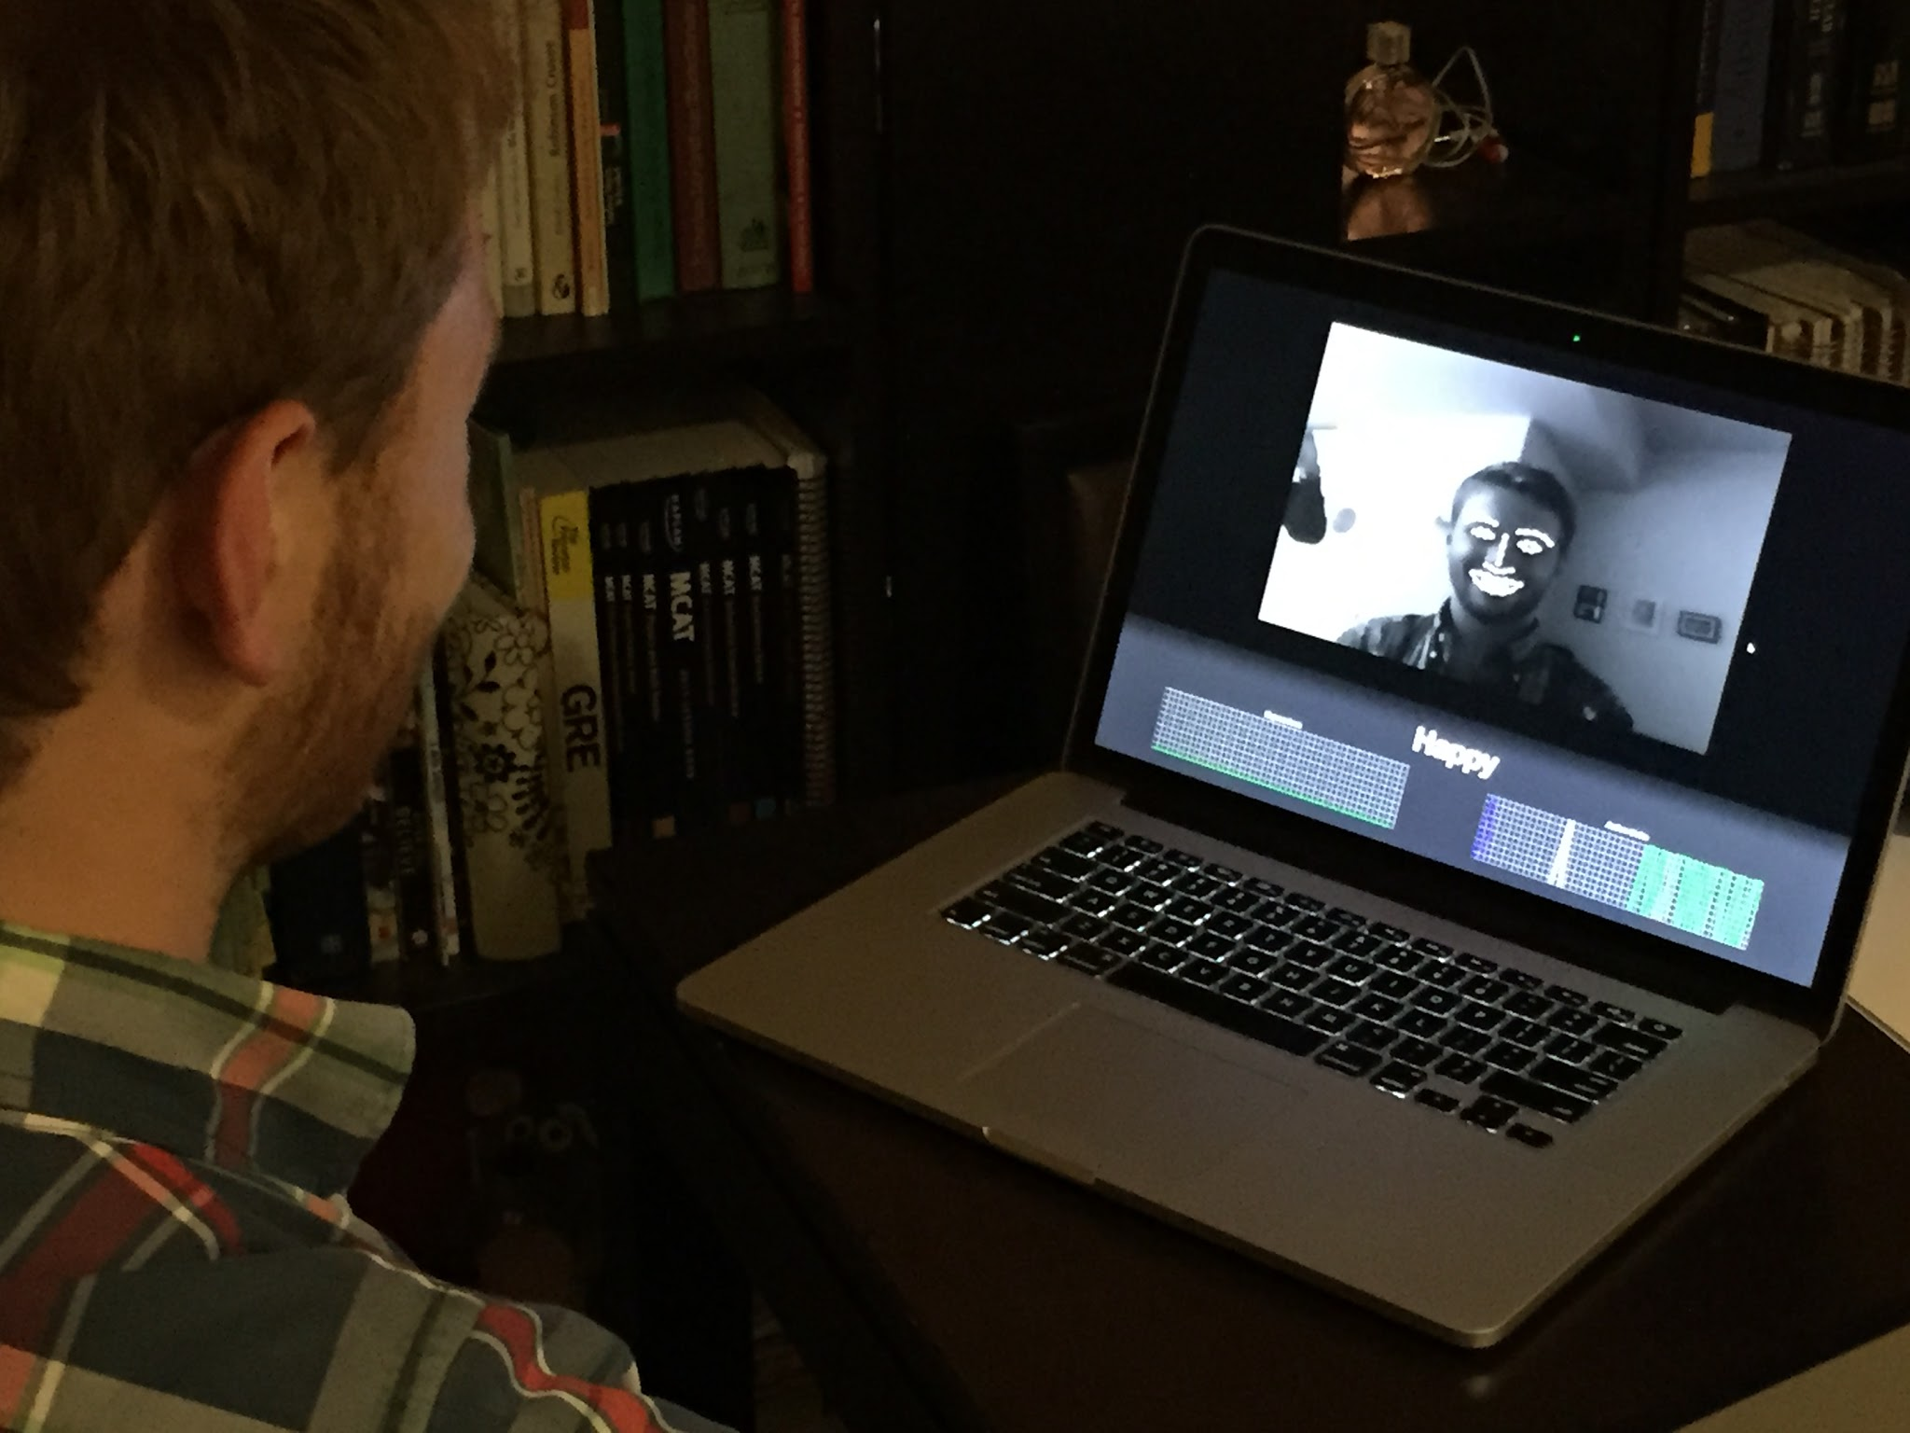
Braille Math Textbook
Autism Google Glass App Demo

Slide 12
Analysis

Slide 13
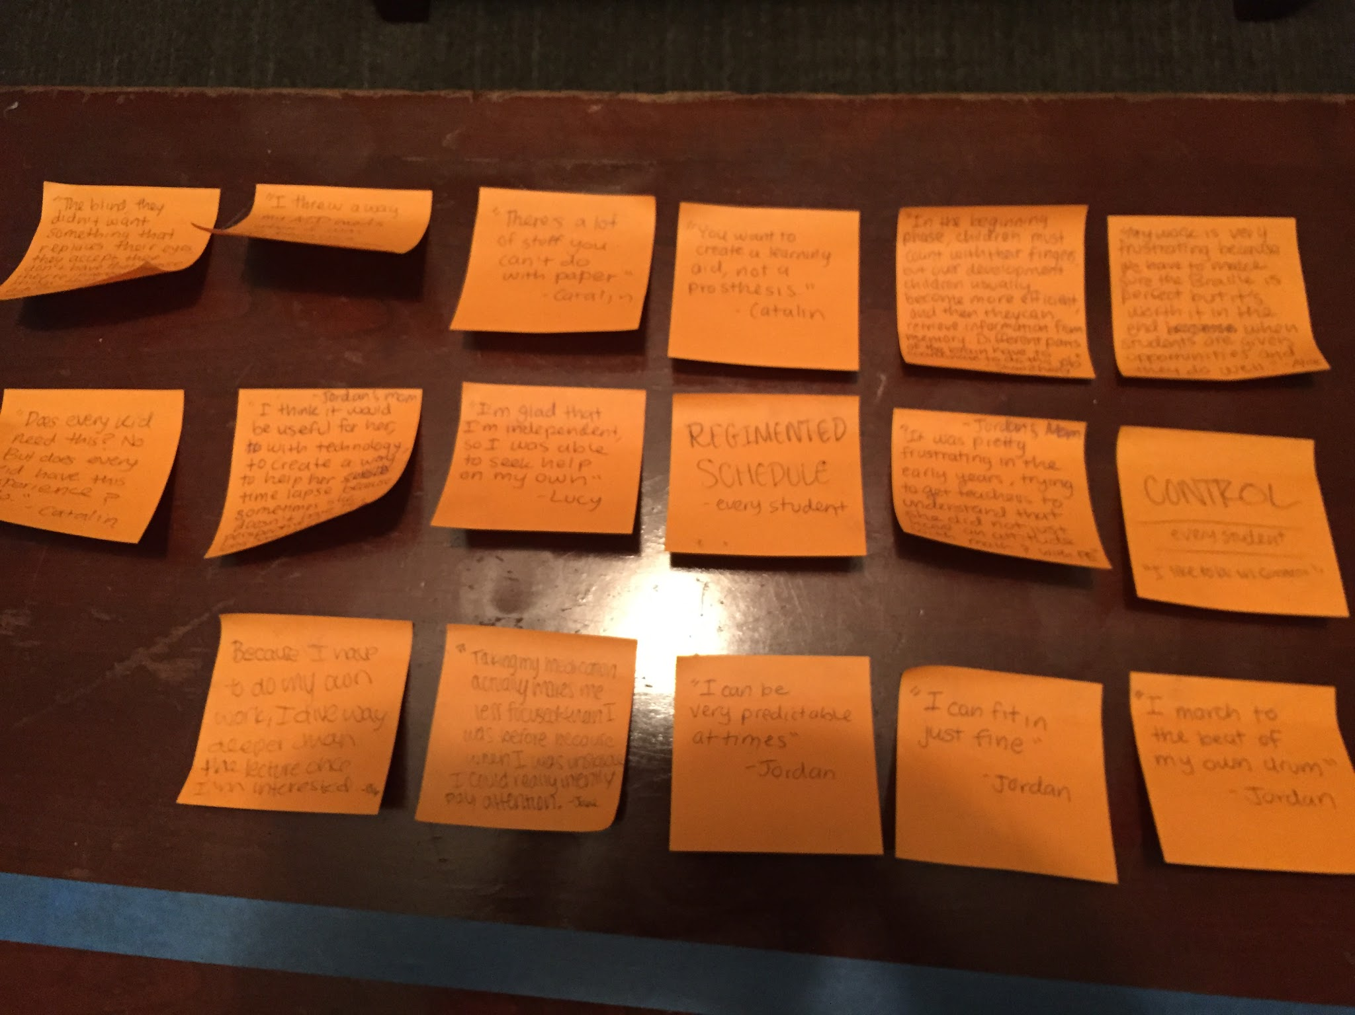
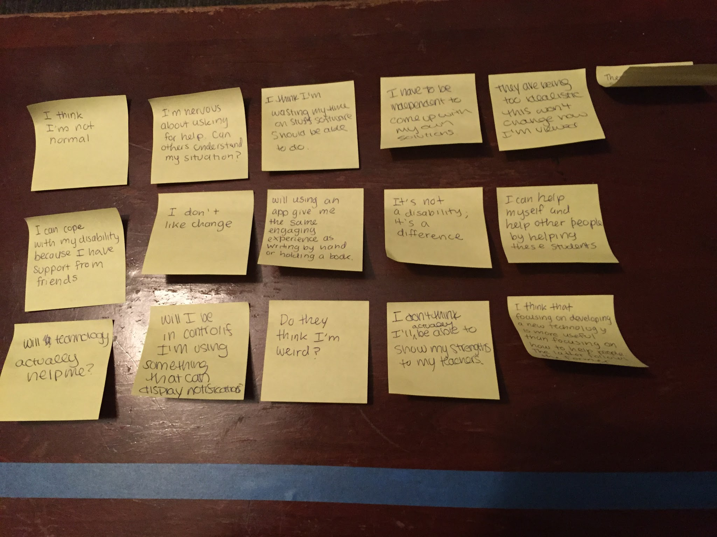
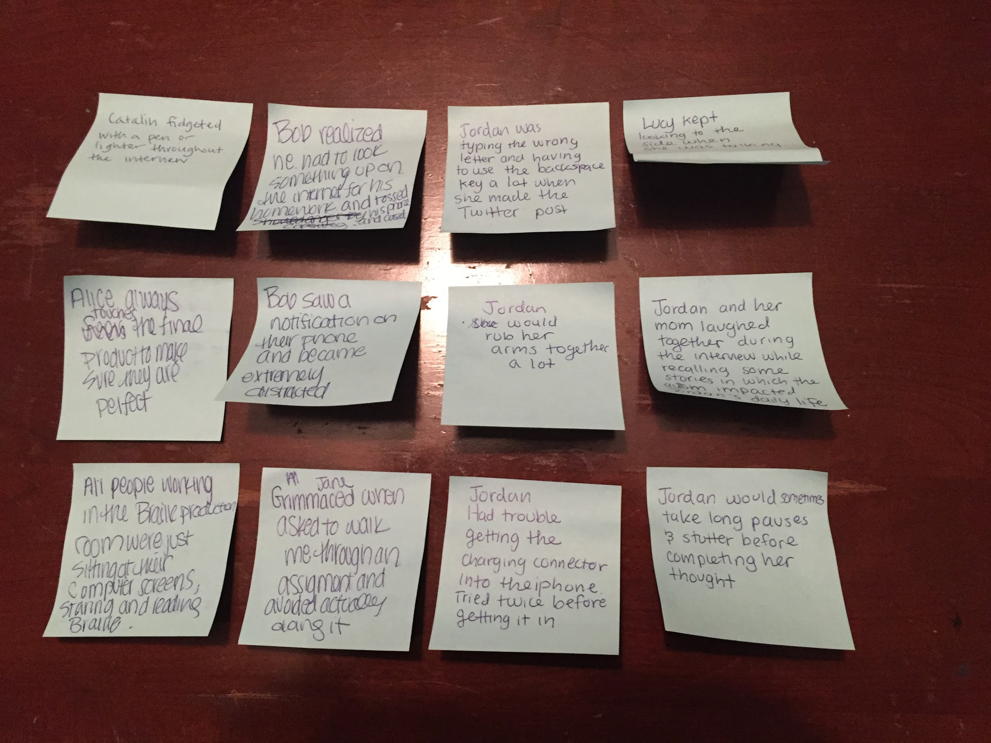
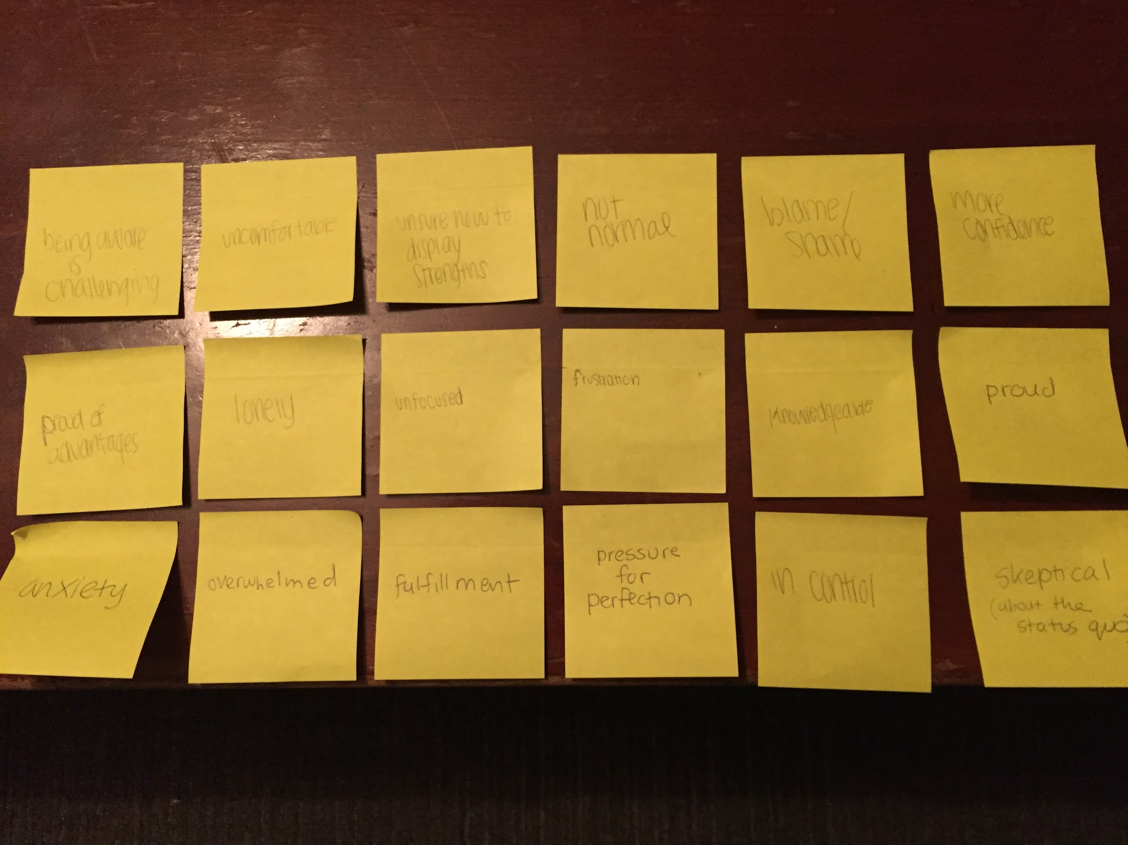

Slide 14
SAY
THINK
DO
FEEL
- Do they think I’m weird?
- I don’t like change.
- It’s not a disability, it’s a difference.
- Therapy methods for people with disabilities are outdated and contrived.
- Will using an app give me the same experience as writing by hand or holding a book?
- Do they think I’m weird?
- Can others understand my situation?
- I have to be independent & create my own solutions.
- I can cope with my disability because I have support from friends.
- “You want to create a learning aid, not a prosthesis.” - Catalin
- “I march to the beat of my own drum” - Jordan
- “I’m glad that I’m independent so I was able to seek help on my own” - Lucy
- “I can be very predictable at times” - Jordan
- “I need to follow a strict schedule” - Lucy
- “It was frustrating in the early years, trying to get teachers to understand she didn’t just have an attitude with math and PE.” - Jordan’s mom
- “I dive way deeper than the lecture when I’m interested.” - Bob
- Bob tossed his phone and cursed
- Jordan and her mom laughed together
- Lucy kept looking to the side while talking
- Jordan kept making typos while Tweeting
- Catalin fidgeted with a pen during the interview
- Alice touches the final product to ensure perfection
- Bob was distracted by phone notification
- Jordan had trouble plugging in her charger
- All of the employees in the Braille production room just stared intently at their screens
- Jane grimaced when asked to show homework
unsure how to display strengths
knowledgeable
not normal
more confident
frustration with the status quo
overwhelmed
lonely
in control
anxiety
blame/shame
overwhelmed
unfocused
skeptical
fulfillment
pressure for perfection
proud

Slide 15
Needs
To fit in
To focus better
To maintain a routine
To build supportive relationships at school and in the local community
Insights
Everyone felt some level of frustration
Students are proud of their strengths and wish there was some way for others to see those strengths
Questions
Although we see common themes in our results, will it be impactful to try to help everyone or should we focus on a specific use case?

Slide 16
Thank You

Slide 17
Removed Slides

Slide 18
Needfinding Methodology
8 interviews: 4 young adults with disabilities + 1 parent 2 intervention developers 1 researcher
Notes:
As for our needfinding methodology, we wanted to get a diversity of perspectives, so we interviewed young adults with disabilities and a parent, intervention developers, and a clinical researcher.

Slide 19
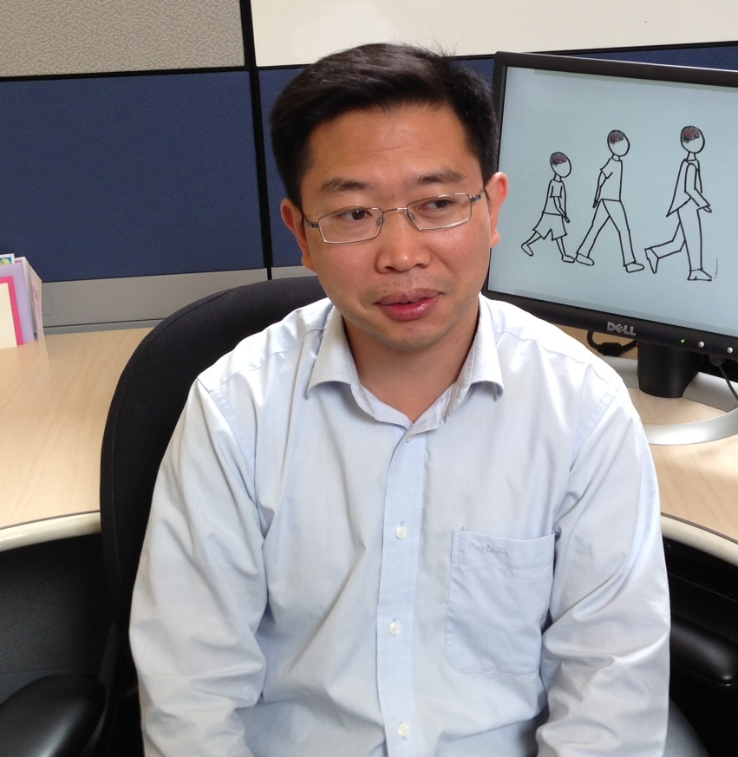
Learning Disability Researcher
Dr. Shaozheng Qin Brain Development Researcher Stanford School of Medicine
Notes:
Finally, we wanted to get the perspective of someone who studies learning disabilities. We Googled local specialists in the field and found Dr. Shaozheng Qin, a brain development researcher at the Stanford Med School who specializes in math learning disabilities. We interviewed Dr. Qin in his office.
We asked Dr. Qin “What is your motivation for doing your research? How are math learning disabilities diagnosed? How do these disabilities impact learning How does technology help with your research?”

Slide 20
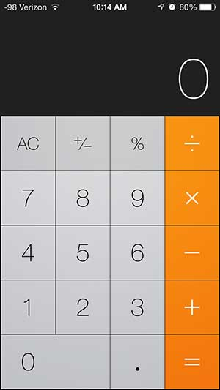
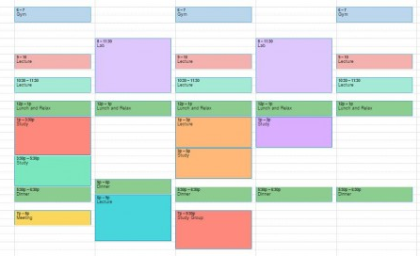
Results
Surprises
Diversity within the disability space.
Simple applications can be extremely helpful
Notes:
We were surprised by the diversity that exists within the disability space and how these disabilities manifest themselves. Jordan seemed very normal. She speaks well, and she showed us samples of her writing. She writes well too, and she has really neat handwriting! And yet, when it comes to doing number calculations, she has a lot of trouble. Her mom asked her whether the number 6 or 10 was bigger and she struggled to come up with an answer.
Catalin mentioned he has ADD and during the interview he kept fidgeting with a pen and a lighter, and he would randomly get up to pick up paper from the printer. And yet he’s been able to focus on building the autism Google Glass app for nearly 2 years.
Students really valued holding physical objects. Holding a textbook. writing down stories on a notebook. Writing reminders in a planner. Touching the screen on an iPad.

Slide 21
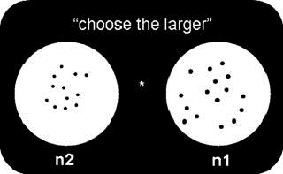
Dyscalculia Diagnostic Test
Autism Google Glass App Demo
Braille Math Textbook

Slide 22
Summary
Learning and invisible disabilities manifest themselves and impact people in many different ways: socially, emotionally, and cognitively.
Focusing, maintaining a routine, and fitting in are important for people with learning and invisible disabilities.
Technology can empower people with learning disabilities.

