Slide 1
Low-fi Prototyping & Pilot Usability Testing
Presentation by Lynne Sneed
Team: ThisAbility

Slide 2
Overview
Mission Statement
Lo-Fi Prototype and Testing
Changes
Notes:
tell story of percent of people affected

Slide 3
Mission Statement:
To empower people with math learning disabilities to compare prices, stay within budget and pay with exact change.

Slide 4
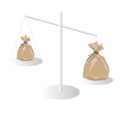
Selected Interface & Rationale
Rationale:
Easier input method
Incorporating emotions
Making numbers visual and interactive
Interface:
Mobile phone app
Touch input
Barcode scanning with camera
Notes:
camera to scan barcode

Slide 5
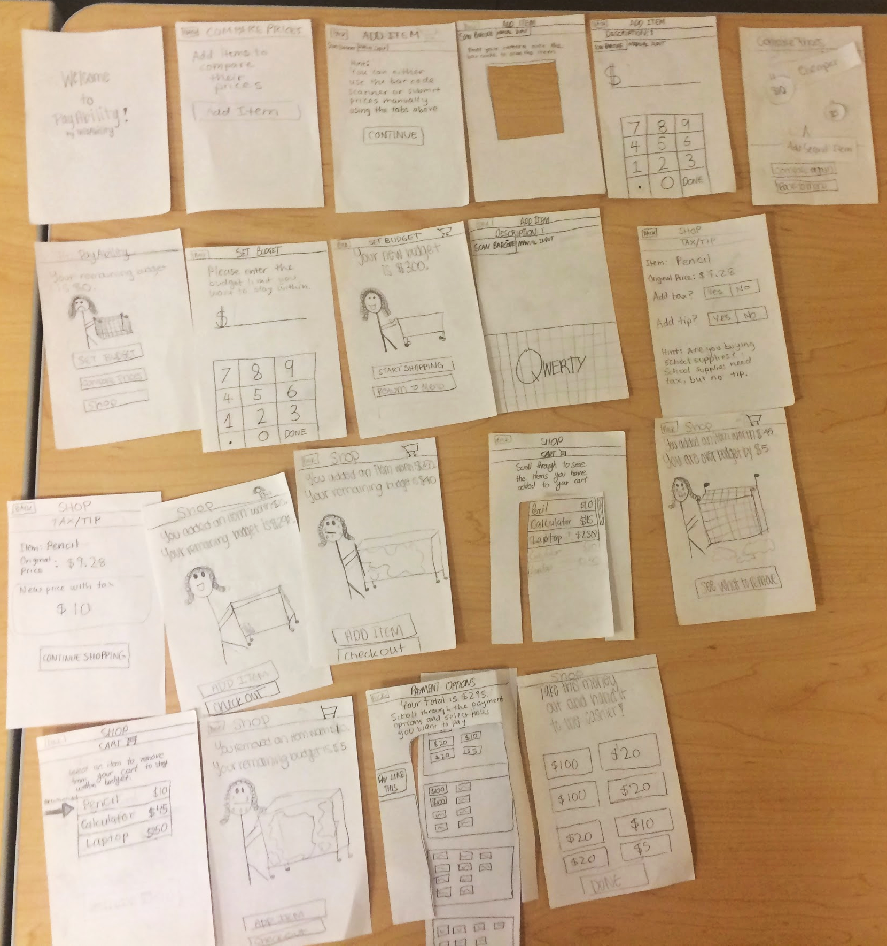
Low-fi Prototype Structure
Paper with pencil drawings of UI
Long paper to simulate scrolling
Moving around paper cutouts to simulate animations
Hole to simulate barcode scanner
“Beep” sound to show successful scan
1
1
4
3
2
3
4
5
Beep!
5
2
Notes:
Beep sounds, sliding paper for scrolling, hole for barcode scanner
All picture slide

Slide 6
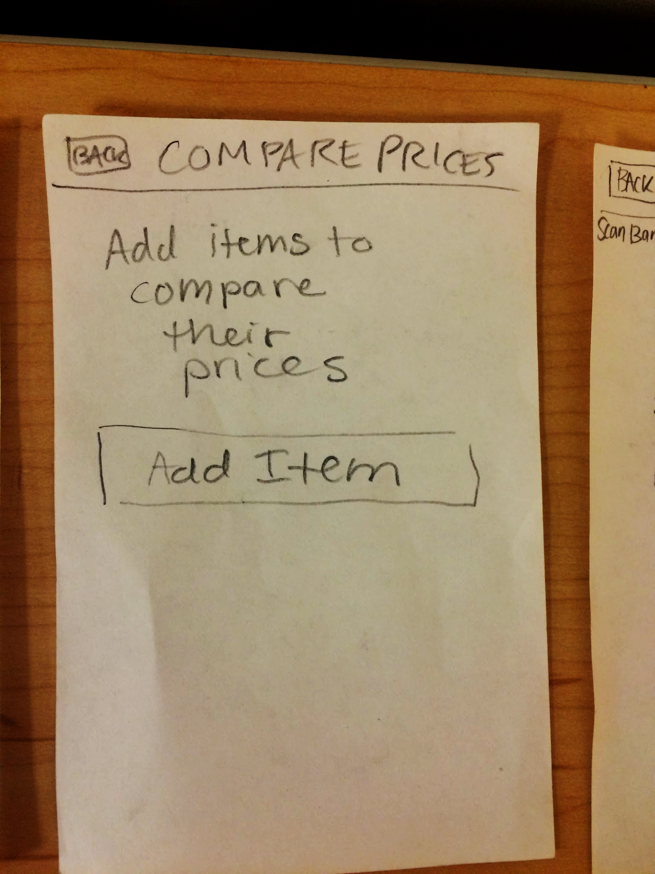
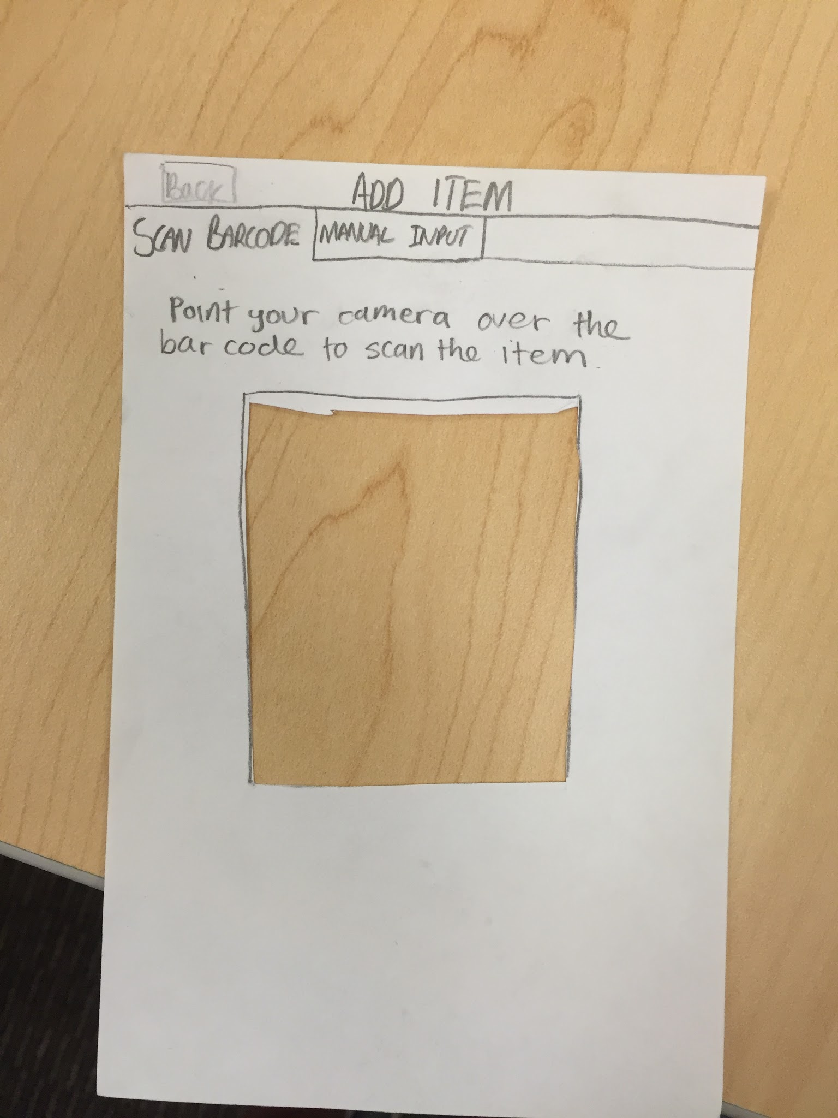
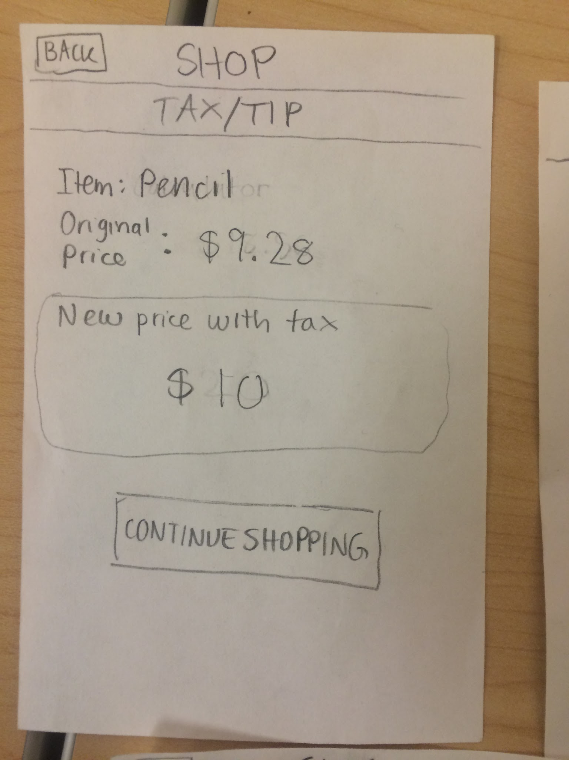
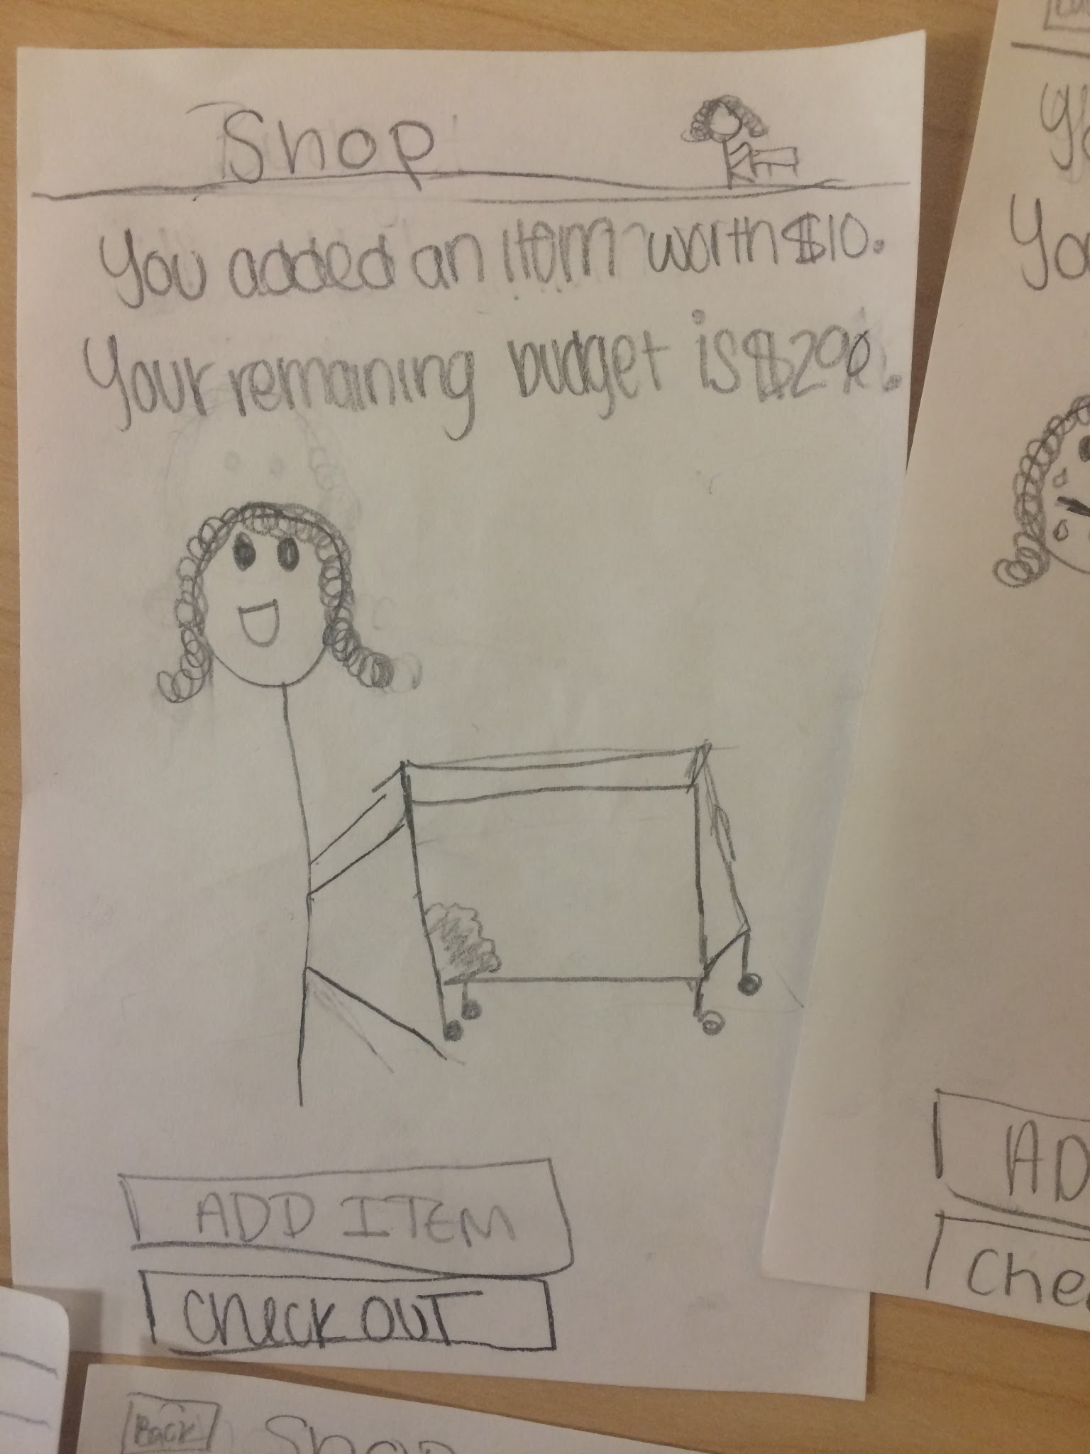
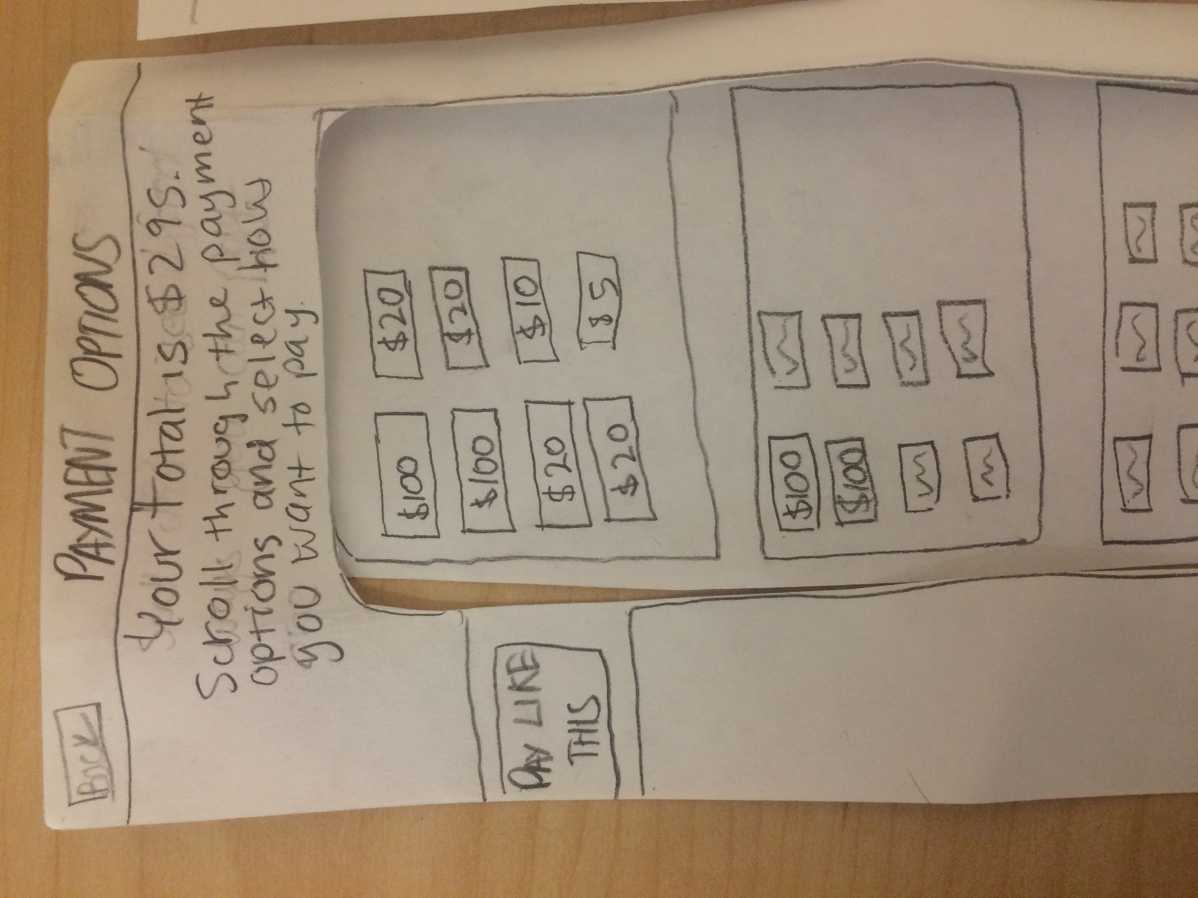
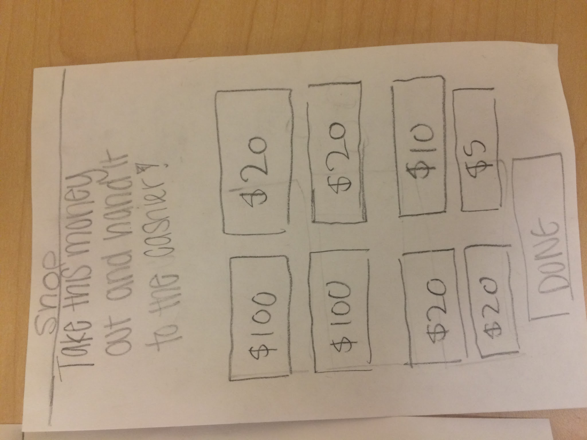
Task 1:
Comparing prices
Task 2:
Setting
a budget
Task 3:
Shopping & paying with exact change
1
2
3
4
5
1
2
3
4
1
2
3
4
5
6
Notes:
All picture slide

Slide 7
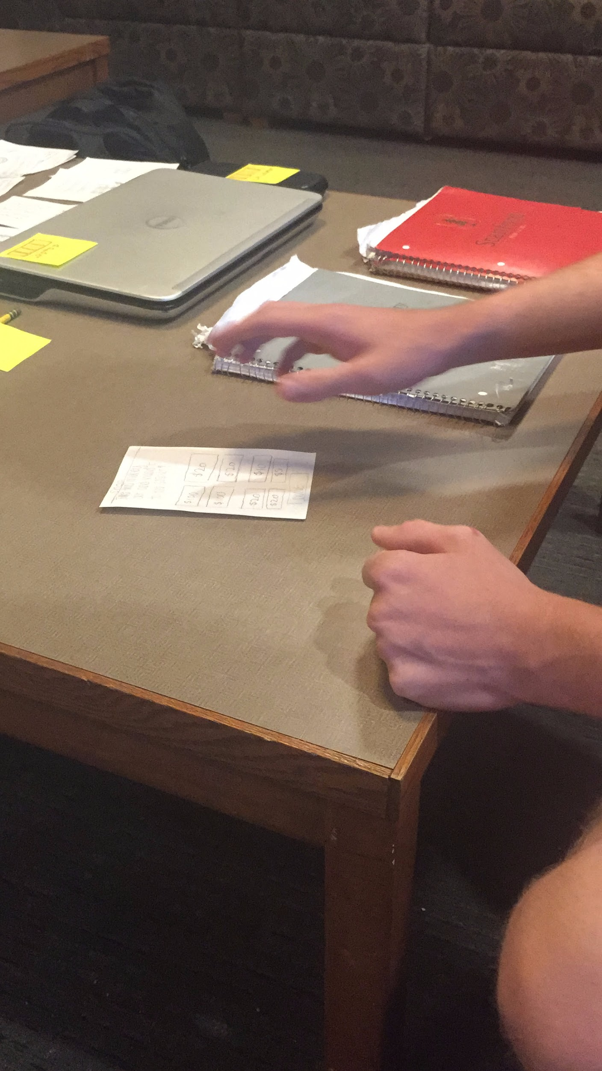
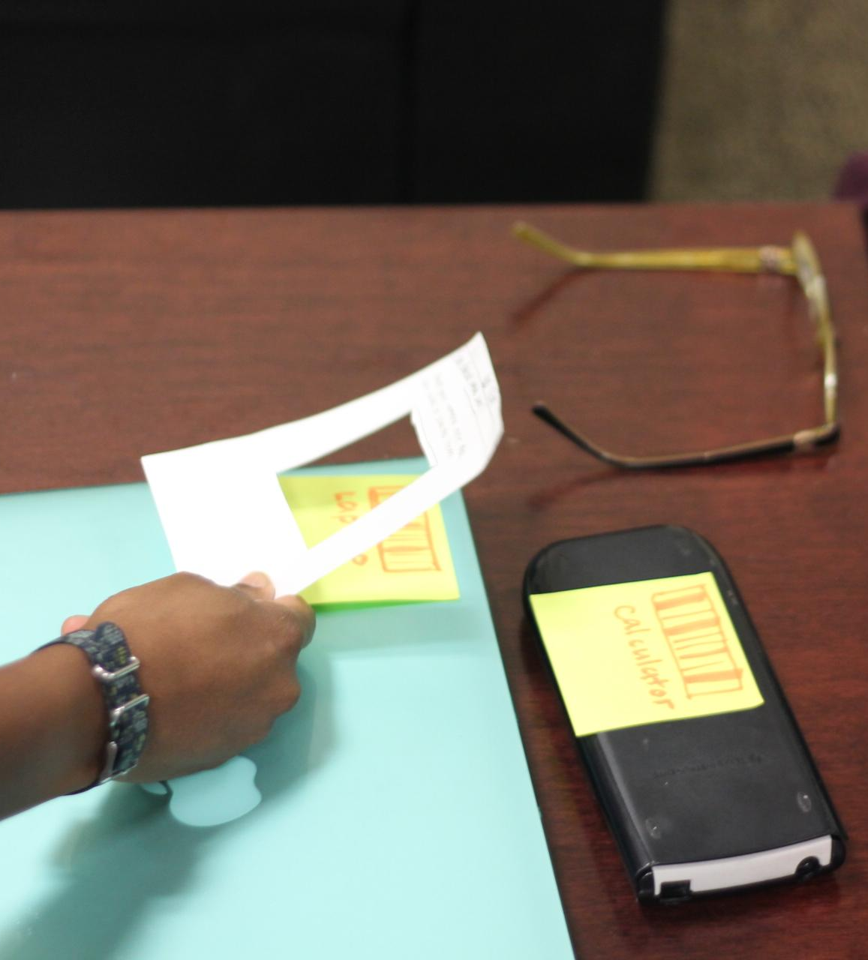
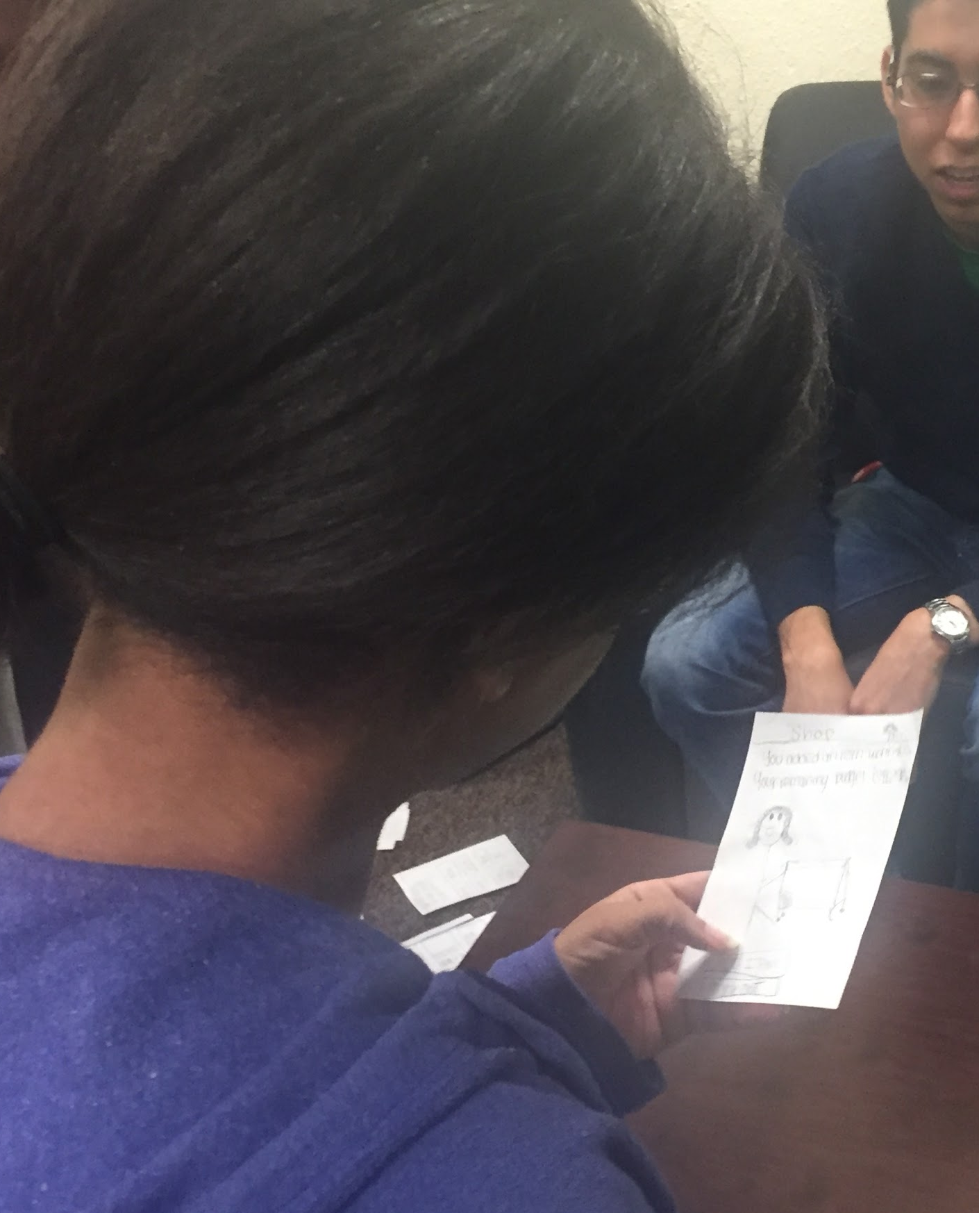
Experimental Methods
simulated office supply store using props

Slide 8
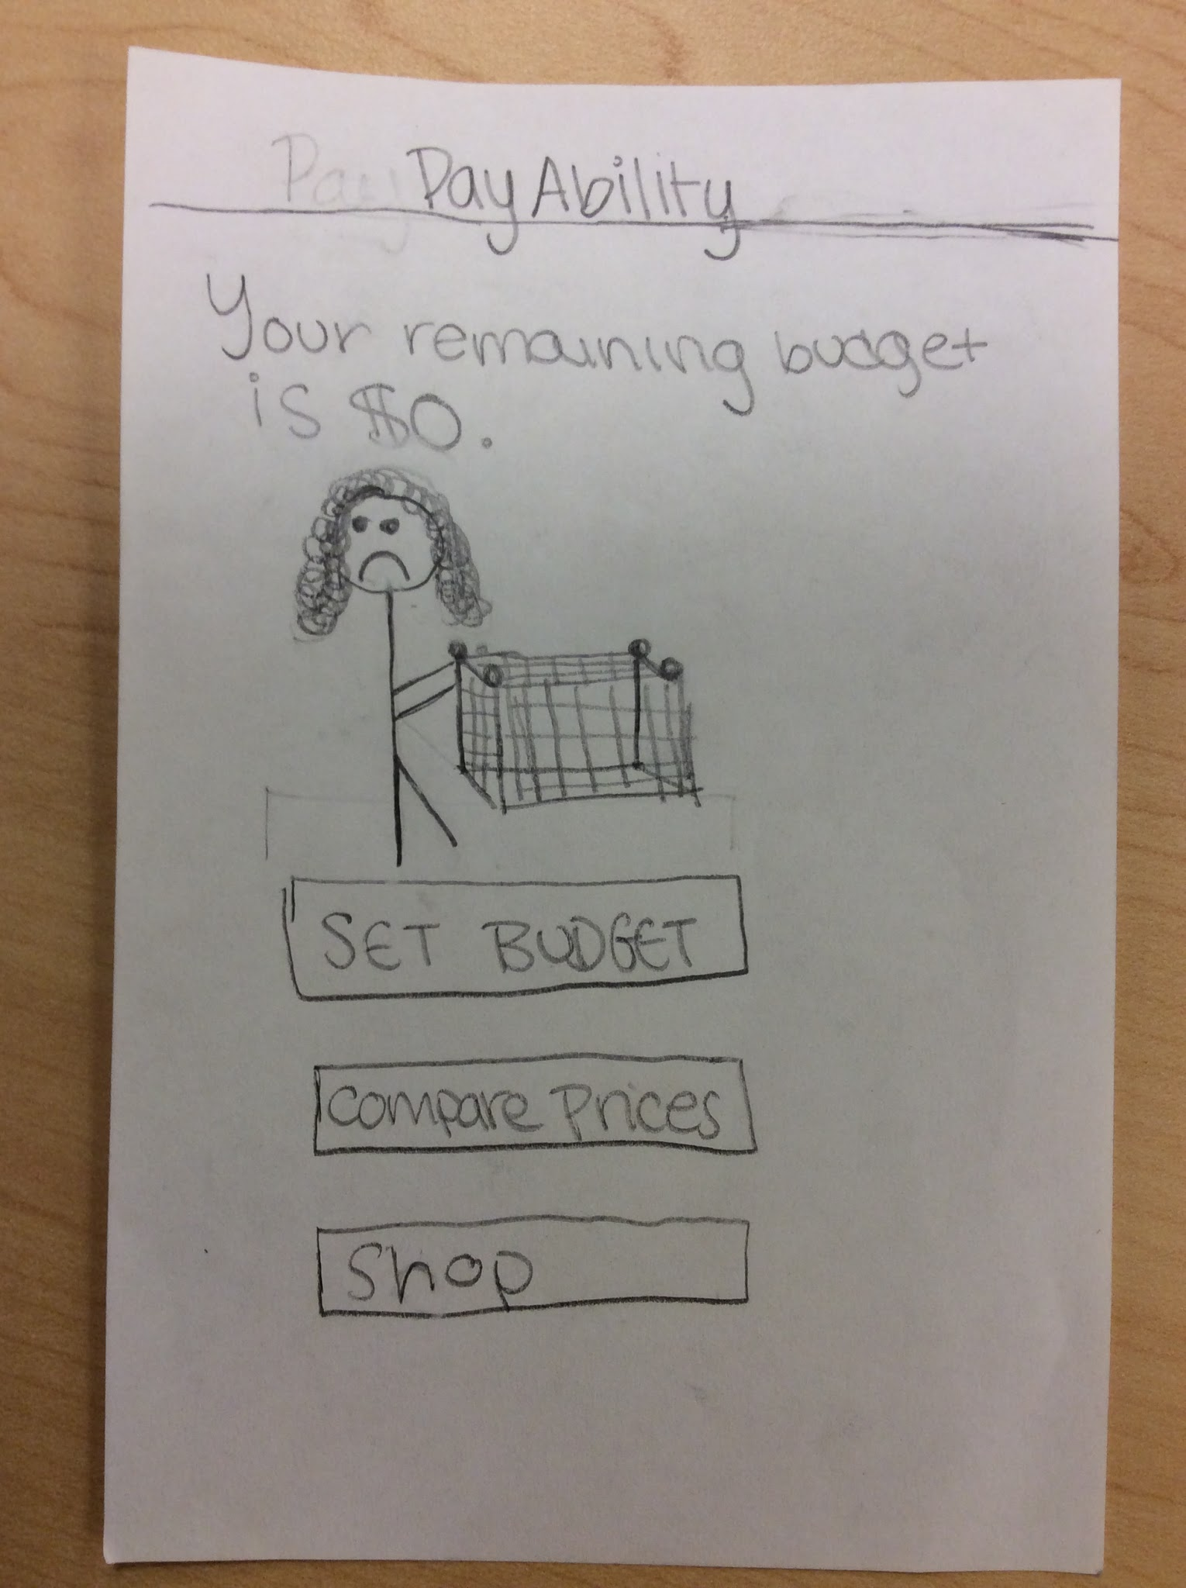
Experimental Results: Positives
Clear flow
Useful animations

Slide 9
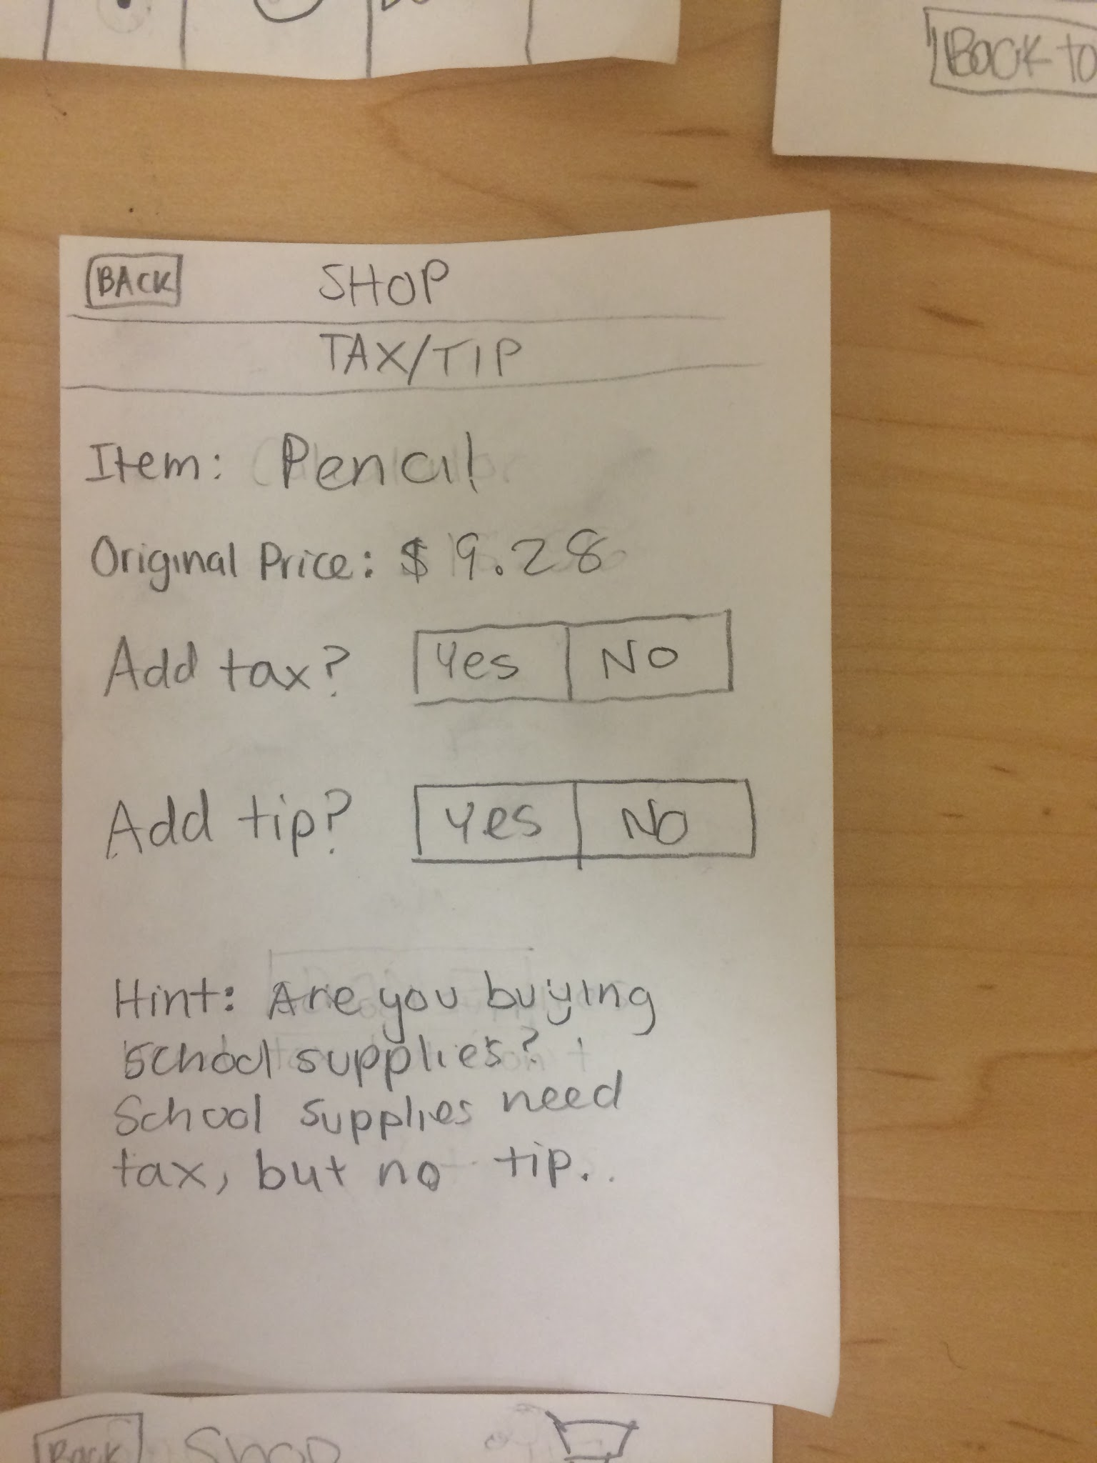
Experimental Results: Negatives
Unclear how to change between manual input and barcode scanner.
Unclear how to select the desired money option.
Confusion about tax and tip not showing up after barcode scan.

Slide 10
Suggested UI Changes
Splash screen clearly stating how to change between manual input and barcode scanner
Notes:
Participant 1 didn’t know how to switch between manual and barcode, participant 2 had a hint and got it

Slide 11
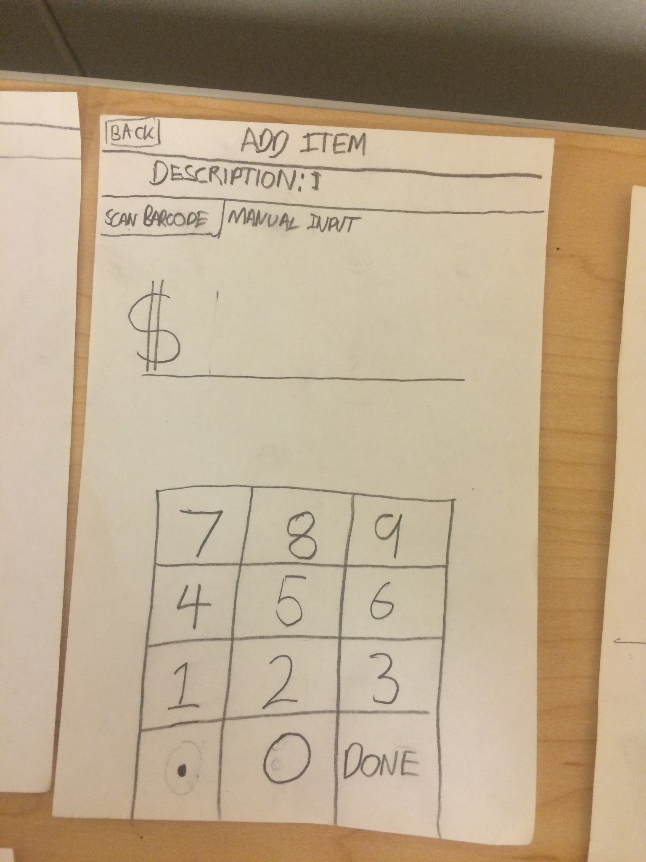
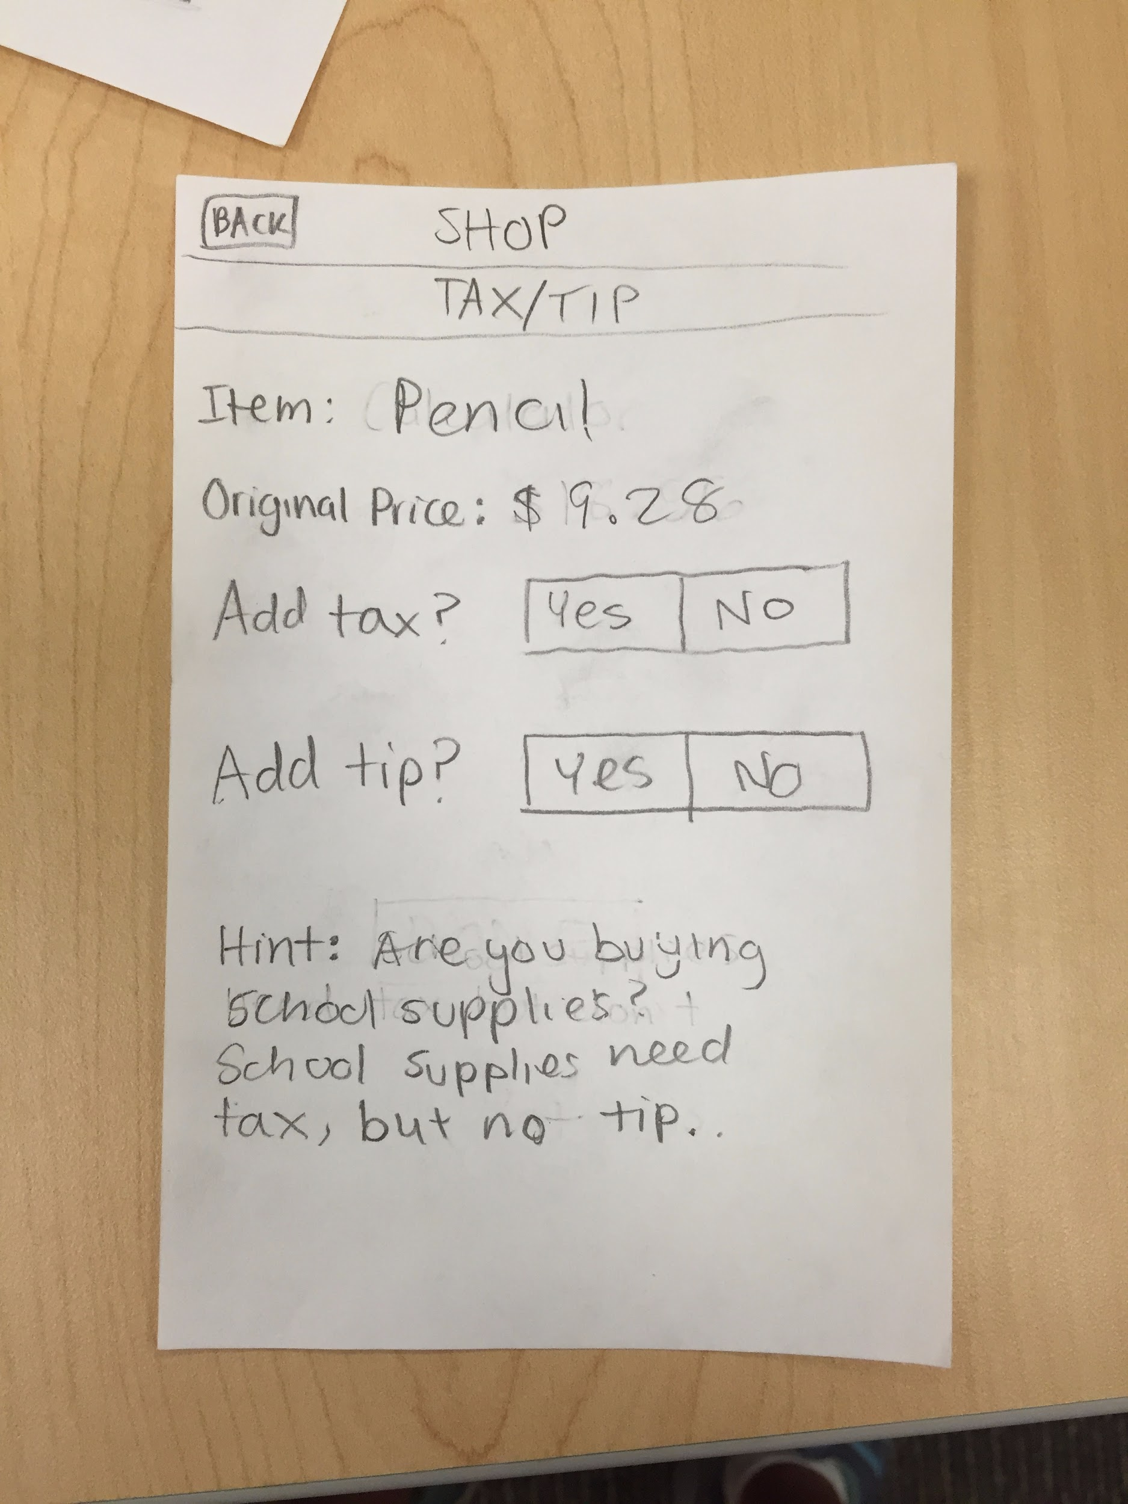
Suggested UI Changes (Continued)
Uniform flow showing tax and tip calculation screen for both manual input and barcode input.

Slide 12
Suggested UI Changes (Continued)
Clearer instructions and removing button on the side for money option selection.

Slide 13
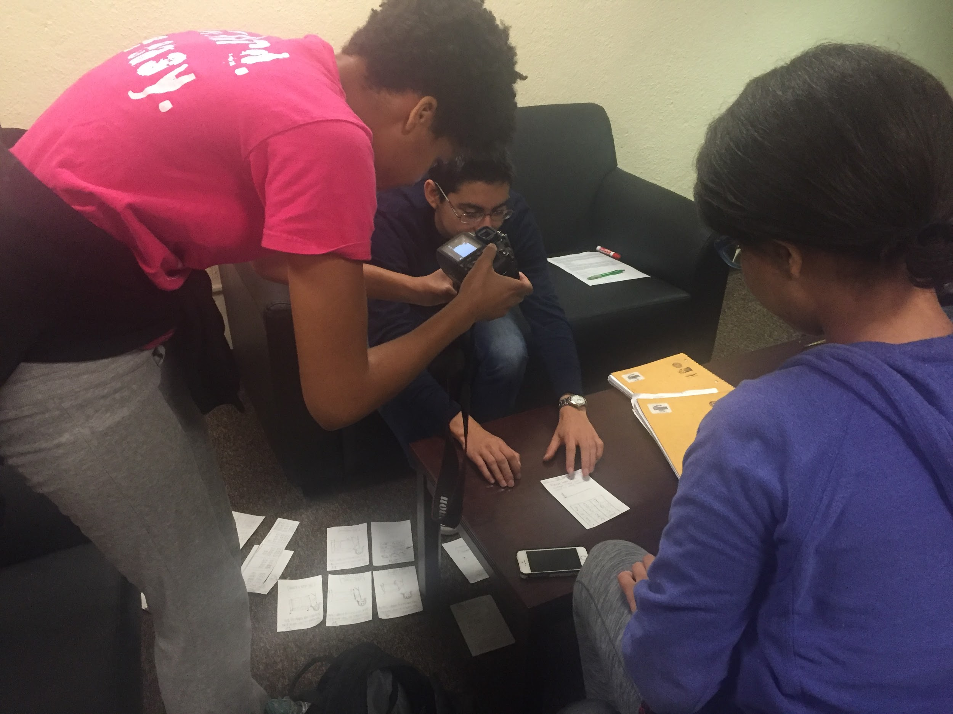
Summary
Improvement from experience prototype
All 3 people had the same critiques

