Slide 1
NEEDFINDING
Minmin Hou, Santos Hernandez, Andrés Camperi

Slide 2
MODERN EDUCATION, IN THE CLASSROOM AND OUTSIDE OF IT

Slide 3
Minmin’s methodology
 | Who | Why | How they were recruited | Where they were interviewed
Tom | Professor | Teach SCPD class | Email | on campus
Shannon, Nate, John | Technical consultant Air force Field eng. manager | Former SCPD student | Email | via phone
Tell me about things that you went like “Oh , I wish I could change this!”
Tell me a moment when you felt frustrated.

Slide 4
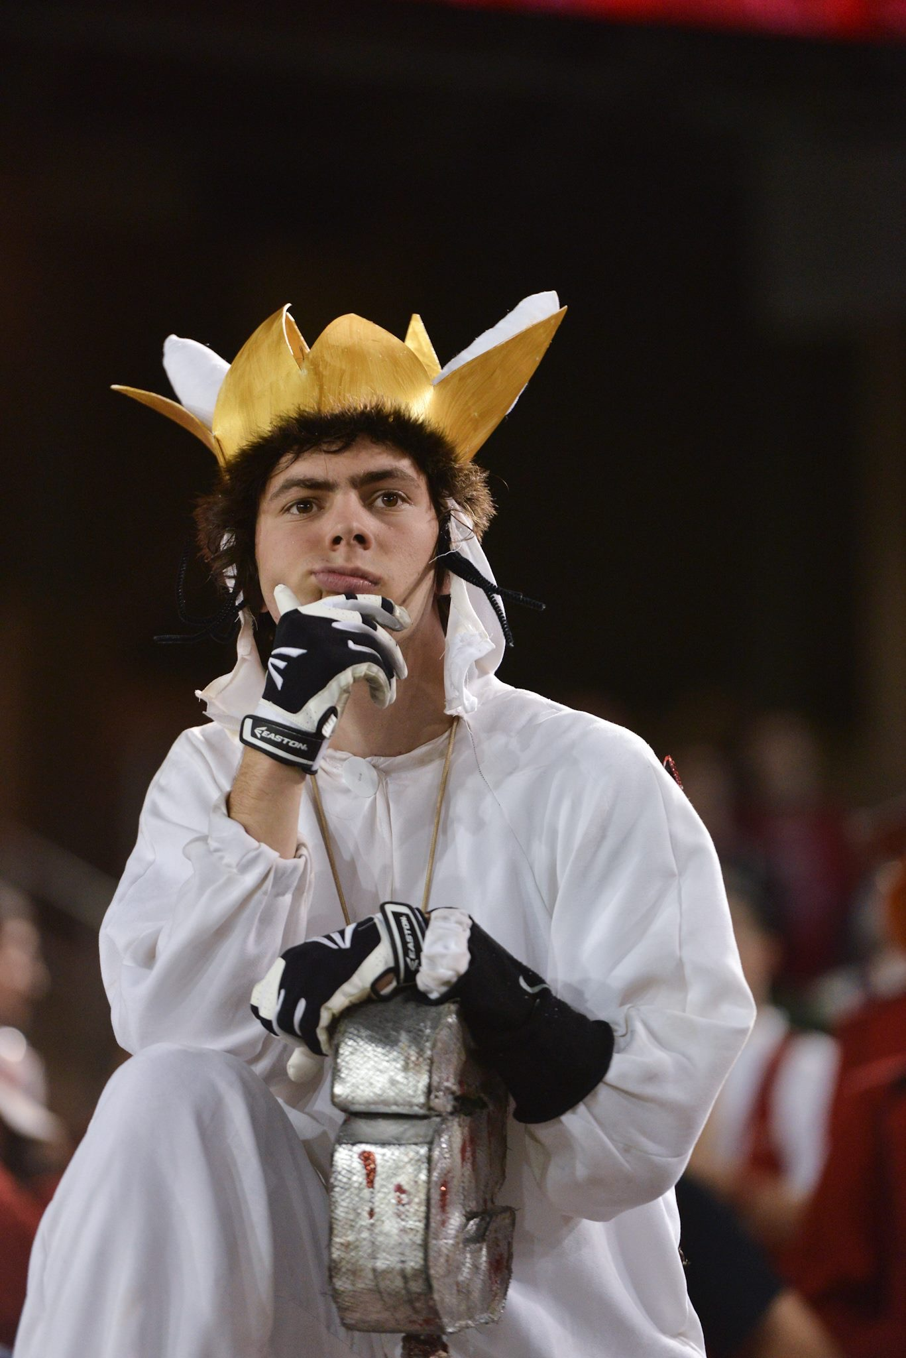
Santos’ methodology
New style “inverse classroom” user
My roommate - open communication
Current student
“How do you feel about your Stanford education?”
“How do you feel about your relationship with education and tech?”

Slide 5
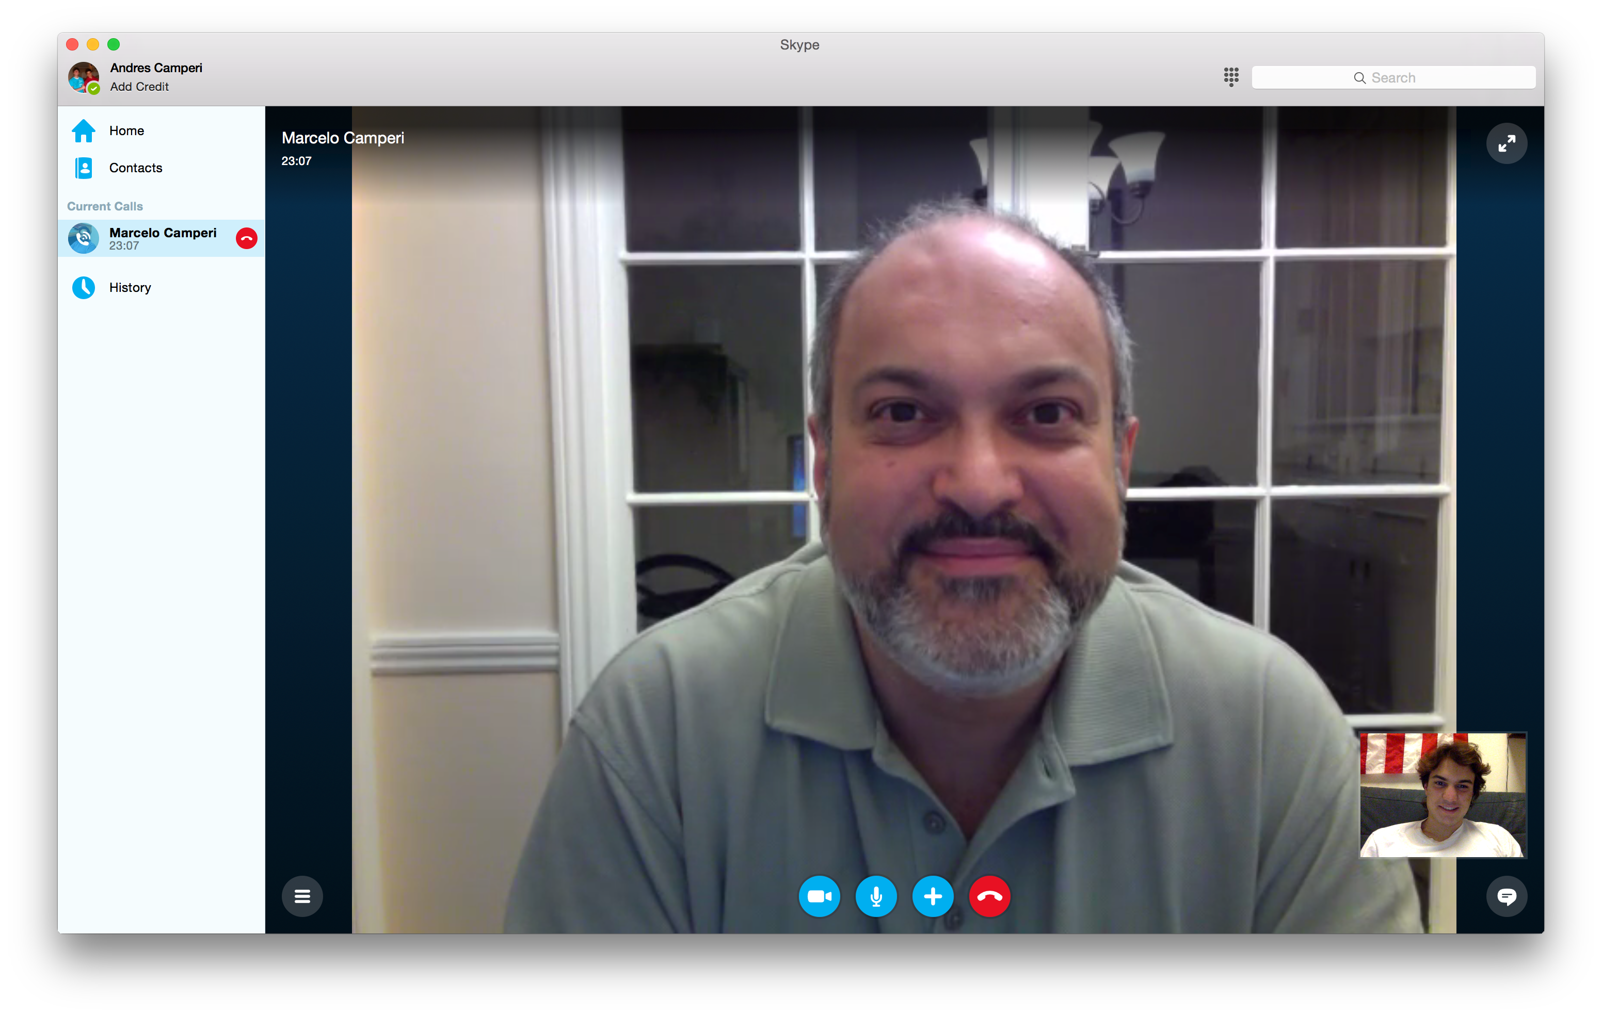
Andrés’ methodology
Dean of the College of Arts and Sciences at the University of San Francisco
PhD in quantum theoretical physics from Boston University
My dad
Discussed his experience as a student and professor before moving on to administration of a University

Slide 6
Do
Think
Education is
changing
There is not enough
face to face
interaction
Laid down
Demonstrated workflow
The system is
problematic
Sighing
Laughing to cope
Technology more
pervasive
Rubbing eyes
Looking excited
Easier format through
which to participate
in the discussion
Looking dejected
Class participation
needs to increase
Trying to remember
Reflection
Frustrated
Expectant
“Teaching isn’t the same
as it was 20 years ago”
“I don’t care”
“That was frustrating”
Enthusiastic
Complacent
“No one ever used the forum”
Annoyed
Upset
“I want real-time interaction”
“It’s exciting!”
Excited
Good (sometimes)
If we use it right
technology can be a huge asset”
Say
Feel

Slide 7
Minmin’s interview results
“I never went into the forum to read the posts.I type slowly so it’d take me 3x time to interact with SCPD students thru online forum than doing the 90 mins class.” - Tom
“It’s frustrating that I could not participate in the discussions. I was just watching the video…. There were times when I have comments I would have made but I just could not make them.” - Shannon
“Nobody ever used the forum.” - Shannon, Nate, John
“I’ve been in classes where online forums were active, but it’s only an OK substitute. The downside is that it requires a lot of additional reading - I have to go thru a lot of posts to find what’s interesting and important” - John

Slide 8
Santos’ interview results
“To me, there is no reason to sit down in the same room as a lecturer, because now there are so many new ways to get a question answered”
“I’m up for tenure soon, I have to focus on my research and I won’t be able to give you guys much attention”
Class time better spent interacting, discussing
Overall - Didn’t like educational experience here

Slide 9
Andrés’ interview results
“Teaching isn’t the same as it was 20 years ago when I started”
“They’re spending so much time on their smartphones anyways I want to put that to good use”
Technology is advancing at a rapid pace, and we need to capitalize on that to increase classroom participation
Interactivity is key: we need to foster increased interaction between the students and professor

Slide 10
Do
Think
Education is
changing
There is not enough
face to face
interaction
Laid down
Demonstrated workflow
The system is
problematic
Sighing
Laughing to cope
Technology more
pervasive
Rubbing eyes
Looking excited
Easier format through
which to participate
in the discussion
Looking dejected
Class participation
needs to increase
Trying to remember
Reflection
Frustrated
Expectant
“Teaching isn’t the same
as it was 20 years ago”
“I don’t care”
“That was frustrating”
Enthusiastic
Complacent
“No one ever used the forum”
Annoyed
Upset
“I want real-time interaction”
“It’s exciting!”
Excited
Good (sometimes)
“If we use it right
technology can be a huge asset”
Say
Feel

Slide 11
Do
Think
Education is
changing
There is not enough
face to face
interaction
Laid down
Demonstrated workflow
The system is
problematic
Sighing
Laughing to cope
Technology more
pervasive
Rubbing eyes
Looking excited
Easier format through
which to participate
in the discussion
Looking dejected
Class participation
needs to increase
Trying to remember
Reflection
Frustrated
Expectant
“Teaching isn’t the same
as it was 20 years ago”
“I don’t care”
“That was frustrating”
Enthusiastic
Complacent
“No one ever used the forum”
Annoyed
Upset
“I want real-time interaction”
“It’s exciting!”
Excited
Good (sometimes)
“If we use it right
technology can be a huge asset”
Say
Feel

Slide 12
Points of View
It would be a game changer if…
we could help students participate more in class
professors interacted more with students in person and through the internet

