Slide 1
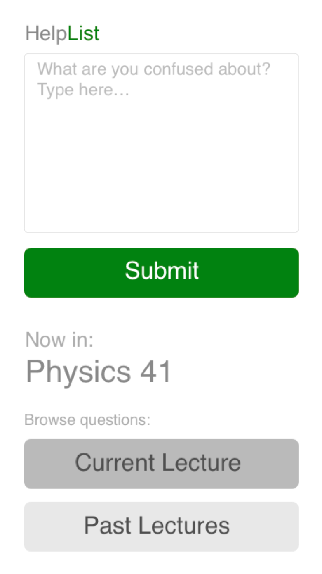
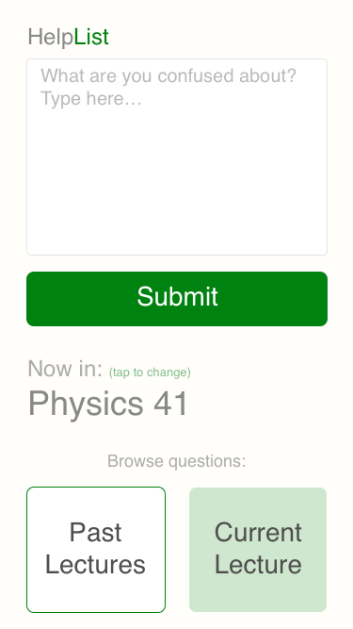
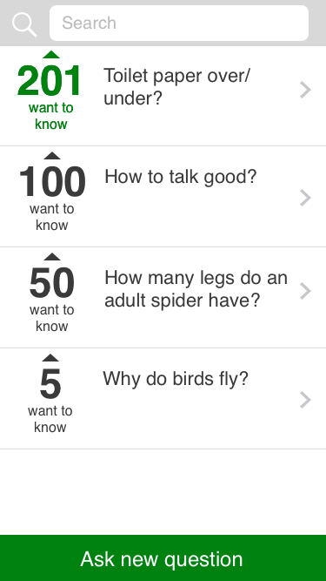
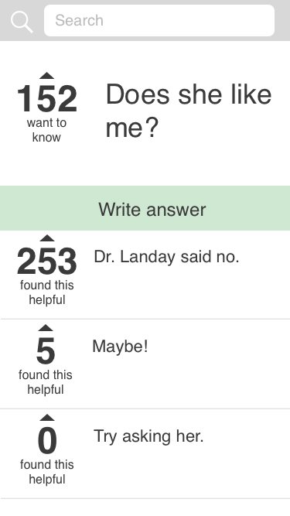
HelpList
Anonymous Asking, Ranking & Answering Questions in College Lectures
Andrés Camperi Santos Hernandez Minmin Hou
Our solution:
Anonymous platform to ask and answer questions
Rank questions based on relevance
Get questions answered on the spot
Easily search through old questions
anyone else have a similar question?
I don’t want to sound dumb….
Design Iterations
Design Process:
Needfinding interviews
Concept sketches
Low-fi prototype to work out task flows
Medium-fi prototype to refine flows and define user interface
Concept sketch
Low-Fi paper prototype
Medium-Fi prototype
Ask Questions
Browse Questions
Answer Questions
Browse Lectures
Find us at: http://hci.stanford.edu/courses/cs147/2015/au/projects/learning/helplist

