Slide 1
LiME
Low Income & Minorities in Education

Slide 2
Value Proposition: Making dreams accessible
Problem/Solution Overview: Institutional racism and classism present unique barriers to low-income and minority students. We propose a partial solution that introduces them to different career paths, provides them with information about academic opportunities, and allows them to uplift other students by sharing those opportunities with their peers .

Slide 3
simple task: take a profession quiz
No Change
Medium Task: Find an opportunity
No Change
Complex Task: Add an opportunity for others
New emphasis on peer sharing

Slide 4
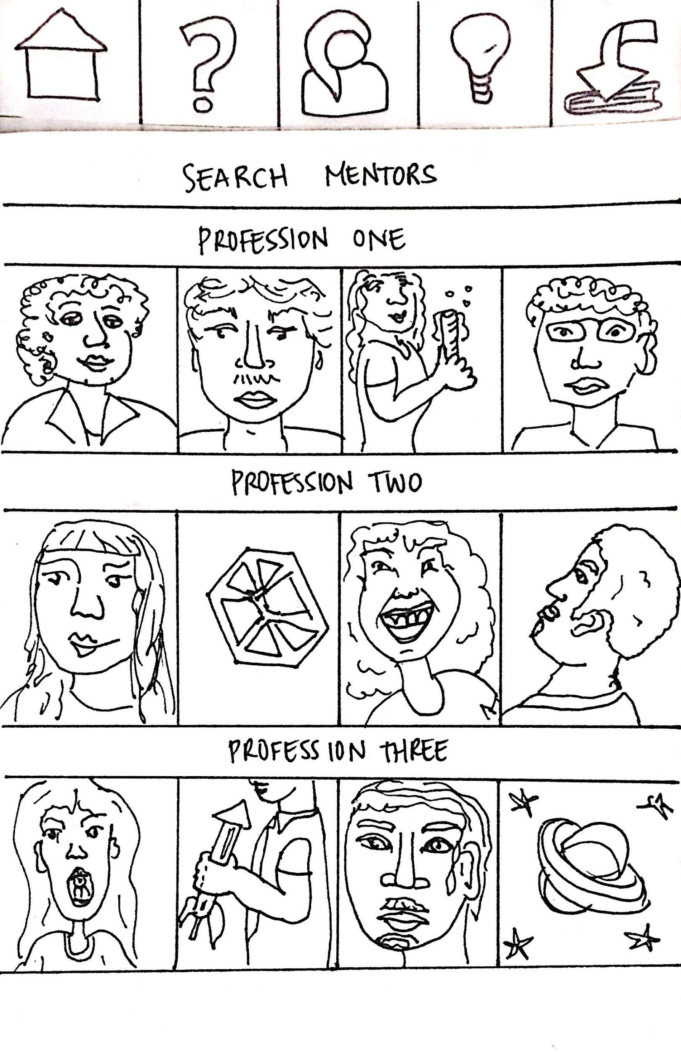
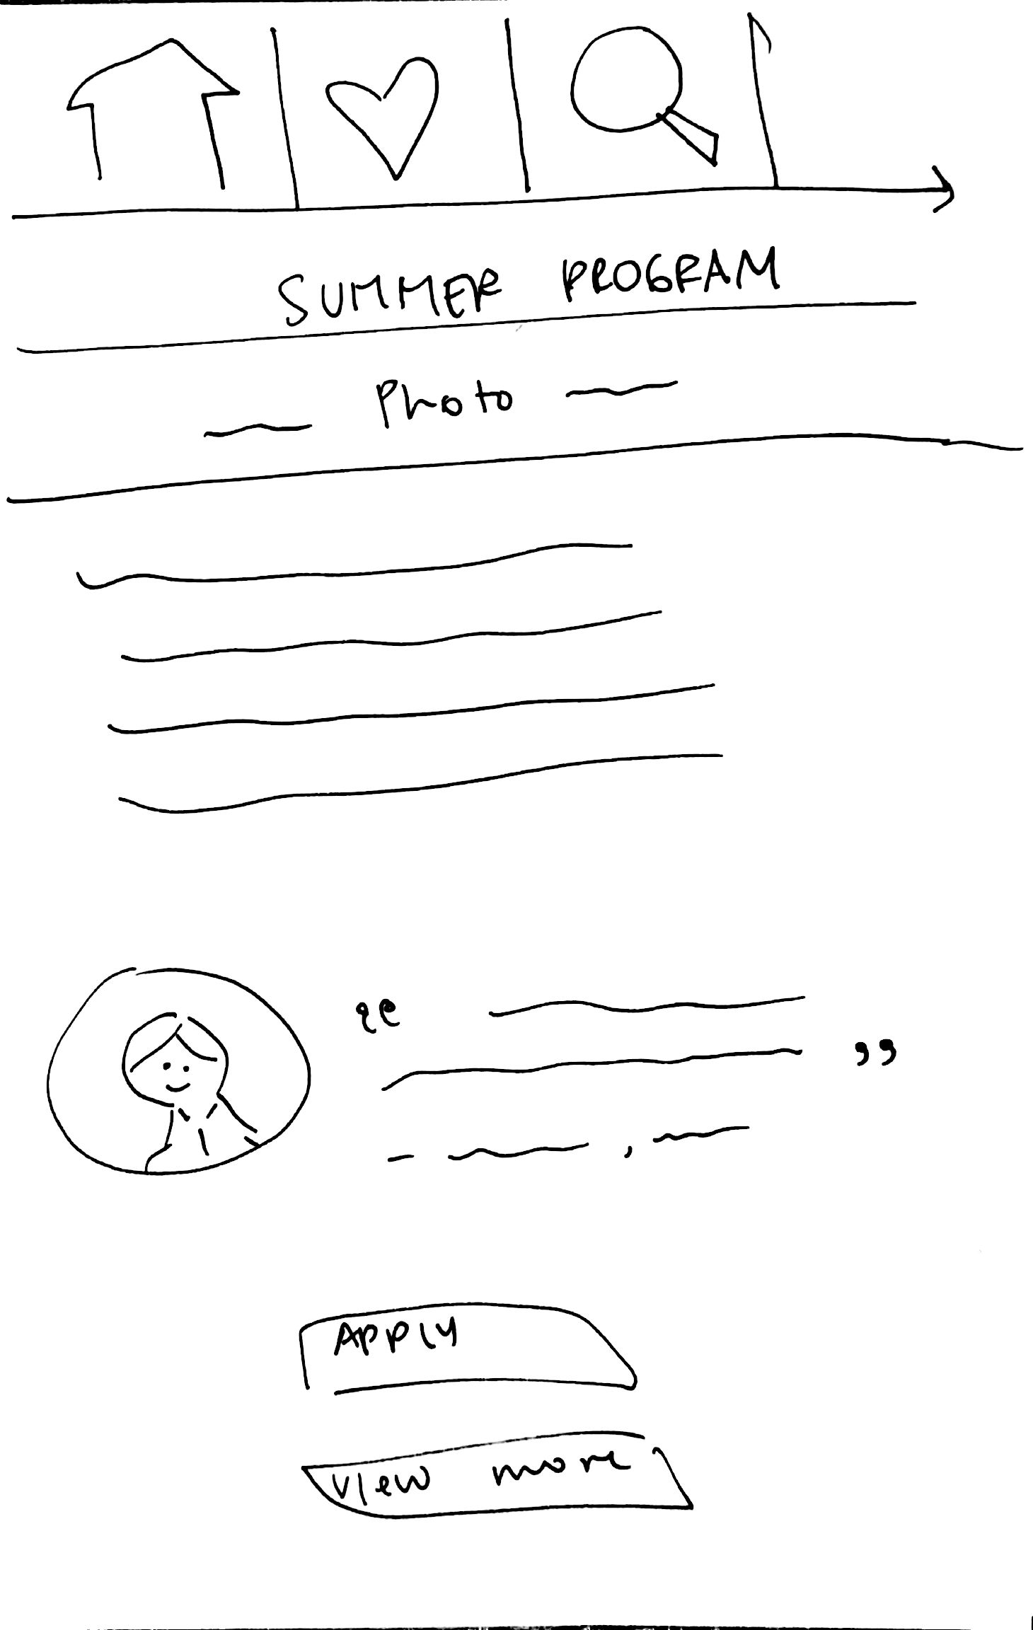
Major Design Change #1: Focus on peer experiences rather than mentors
Notes:
we got feedback that the mentors would feel distant
we got feedback that summer programs were the most important part and when we asked, “what would you want to know about the summer programs?”
we got a response that students wanted to hear about how the program went for other students

Slide 5
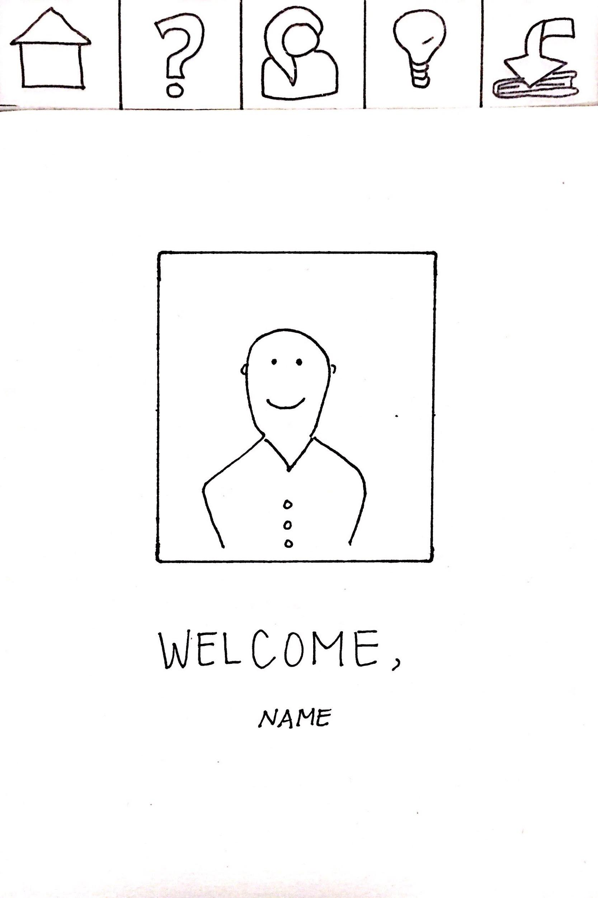
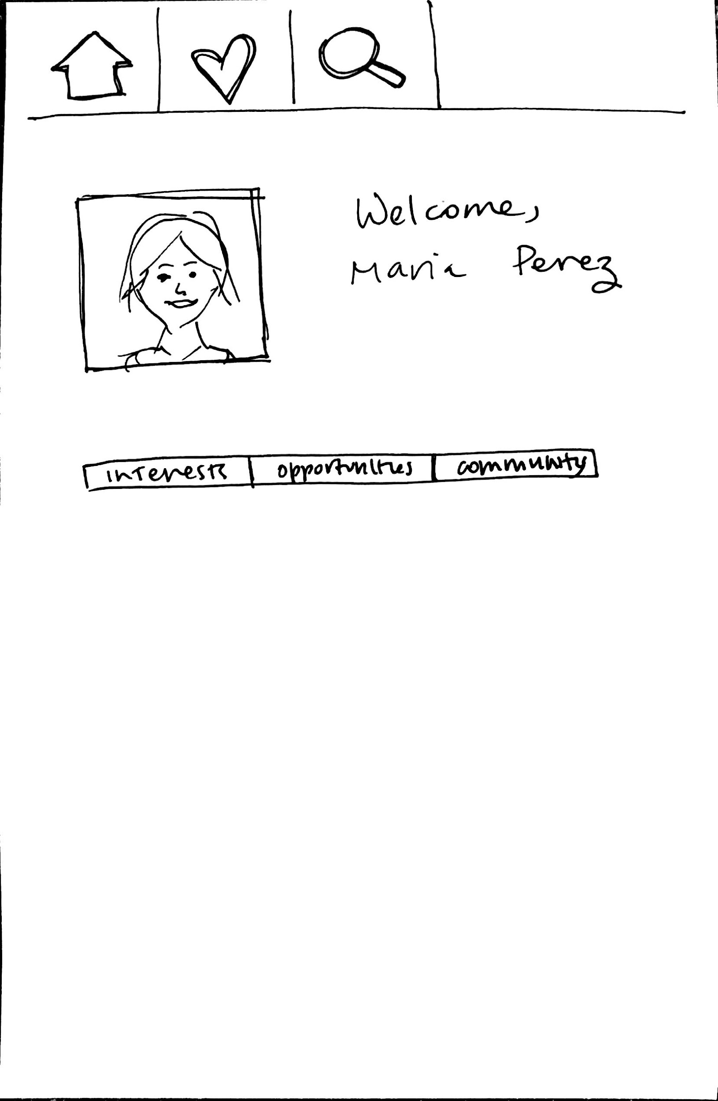
Major Design Change #2: More self-explanatory icons
Notes:
We got feedback that our icons were confusing - simple as that
After thinking about icon ideas, we realized it might be best to use icons that already exist and mean things to people
HEART: my interests, things you find that might have a connection
MAGNIFYING GLASS: search opportunities

Slide 6
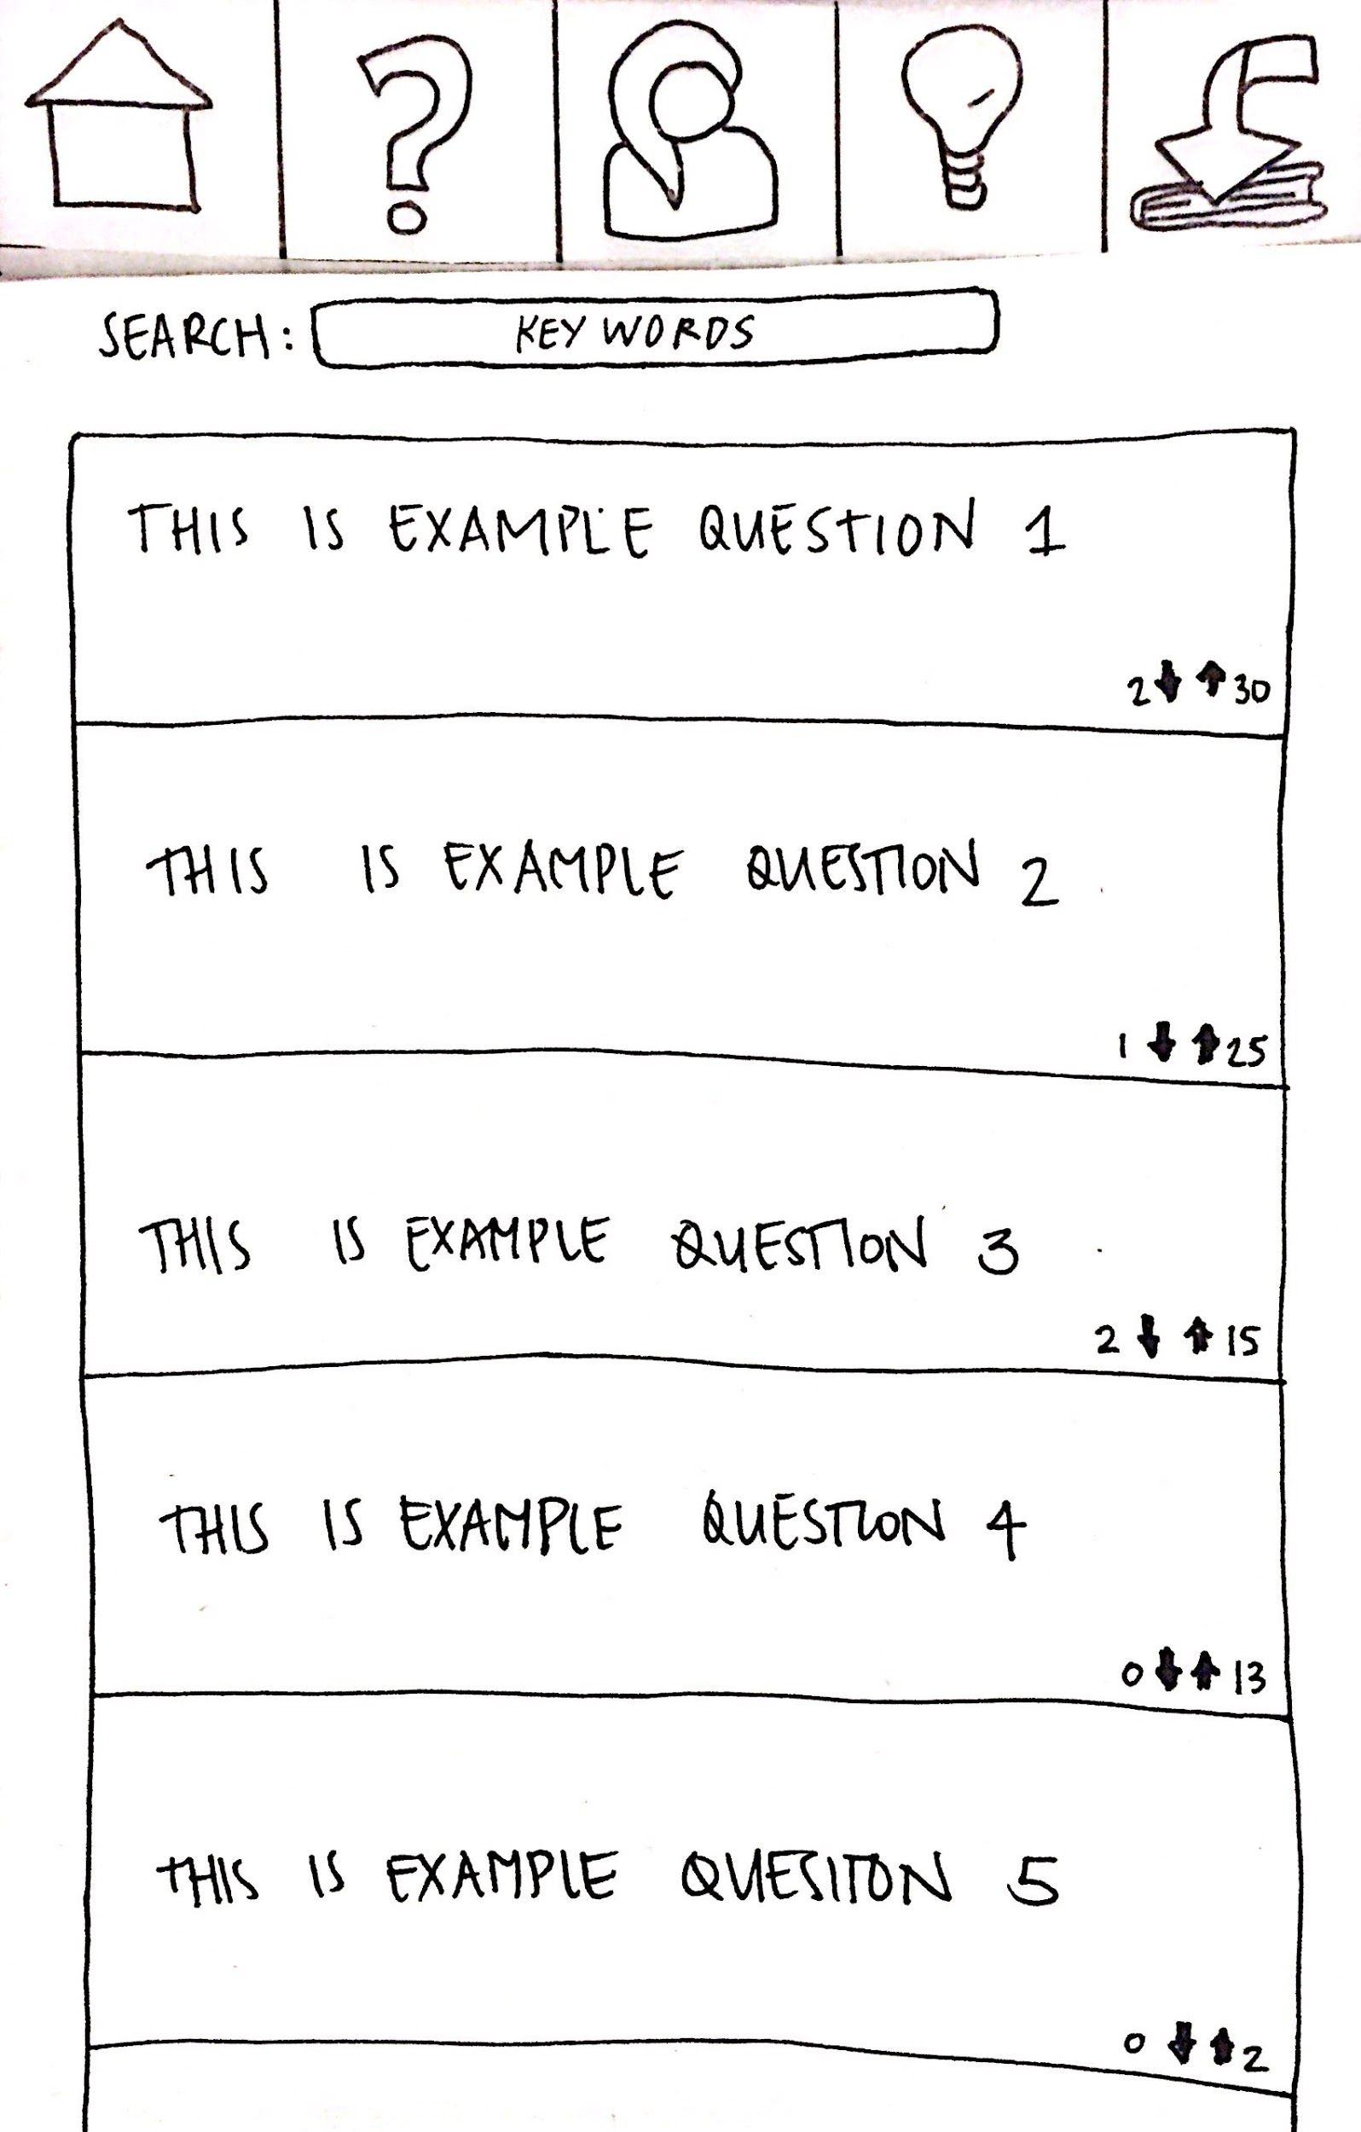
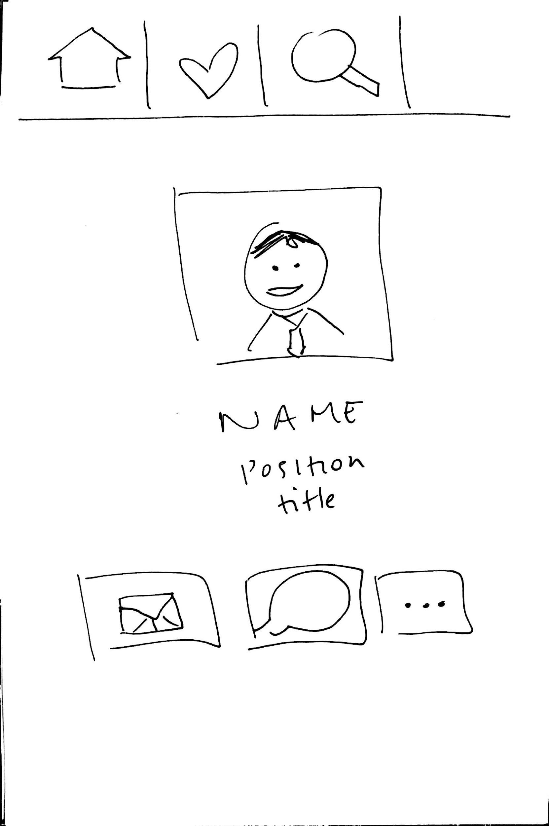
Major Design Change #3: emailing people versus asking questions
Notes:
more of a connection
mentors said that they were worried that it would be a lot of work or that they might get so many questions at once,
and this offers a more intimate connection
users wanted to connect with peers
mentors will come with the summer program

Slide 7
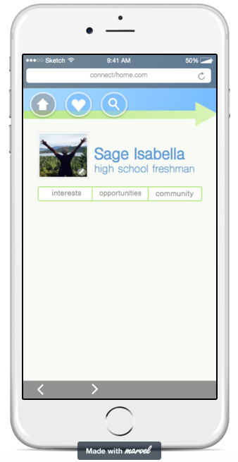
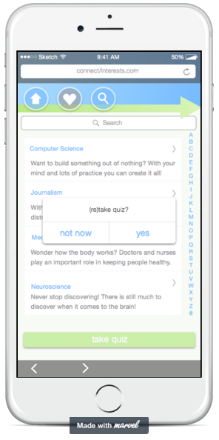
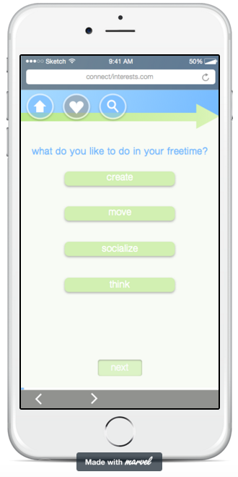
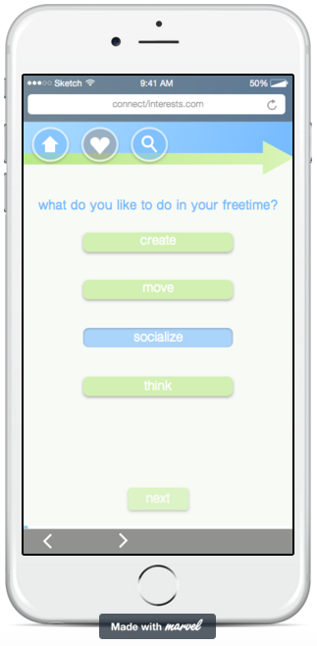
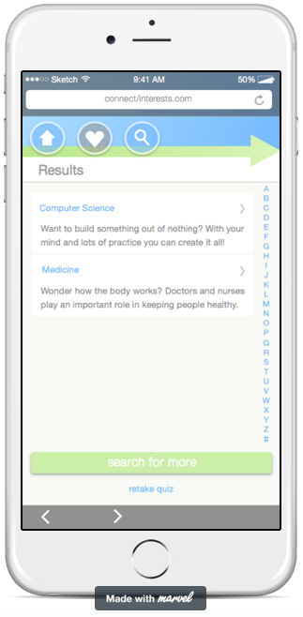
Simple task: take a profession quiz

Slide 8
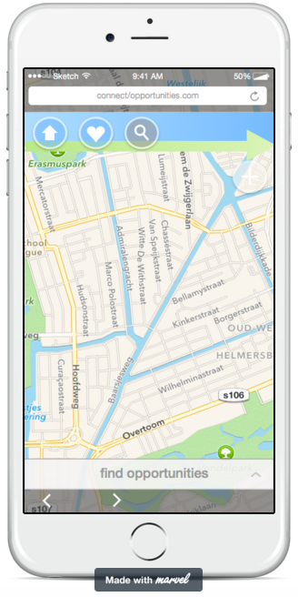
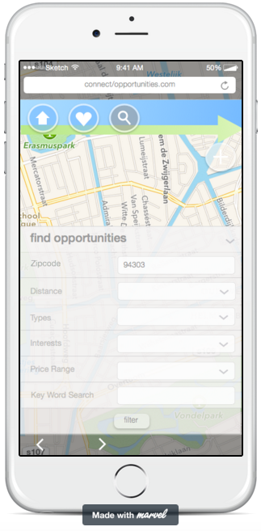
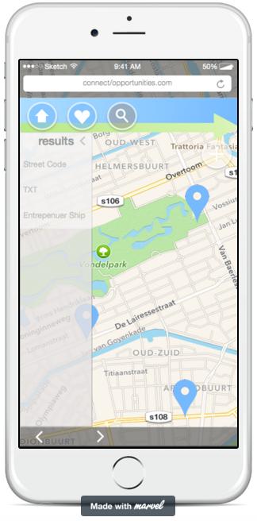
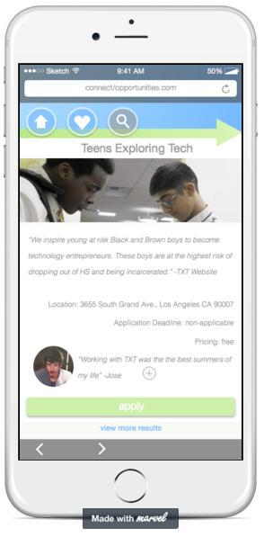
medium task: find an opportunity

Slide 9
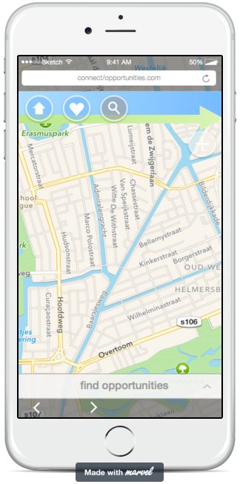
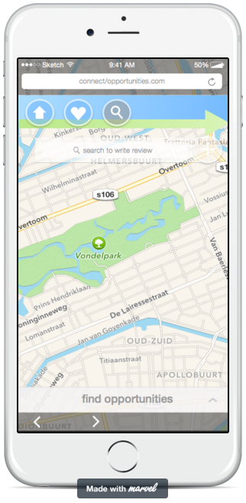
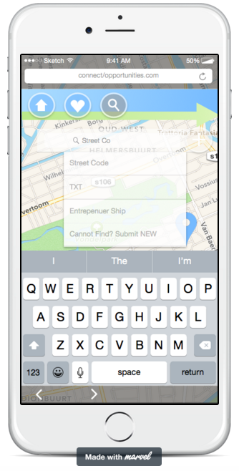
complex task: add an opportunity for others (Part One)

Slide 10
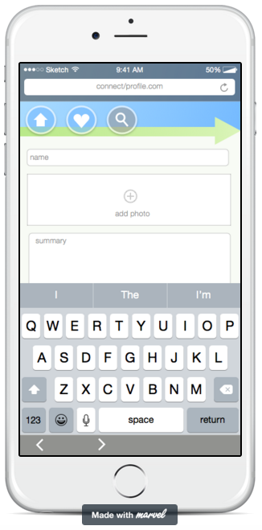
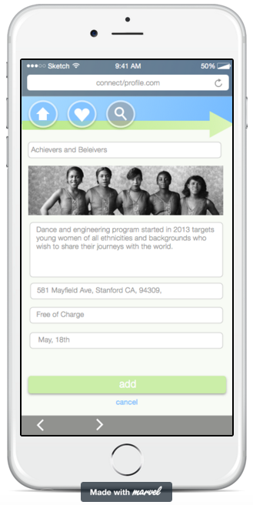
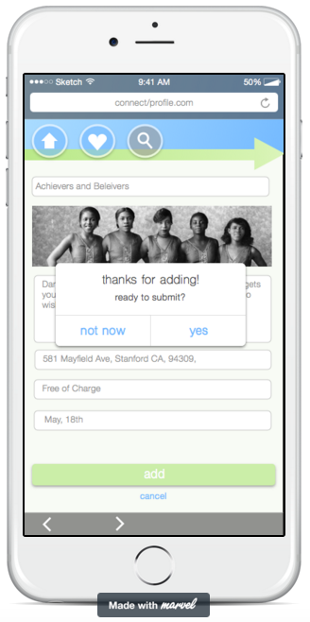
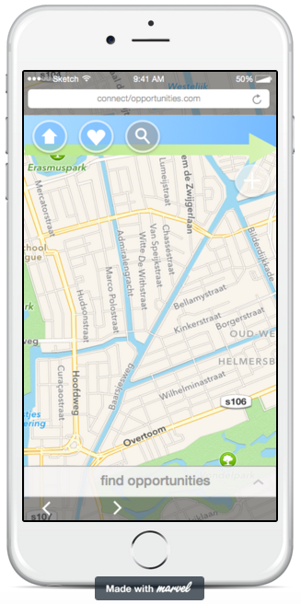
complex task: add an opportunity for others (Part Two)

Slide 11
complex task: add an opportunity for others (Part Two)

Slide 12
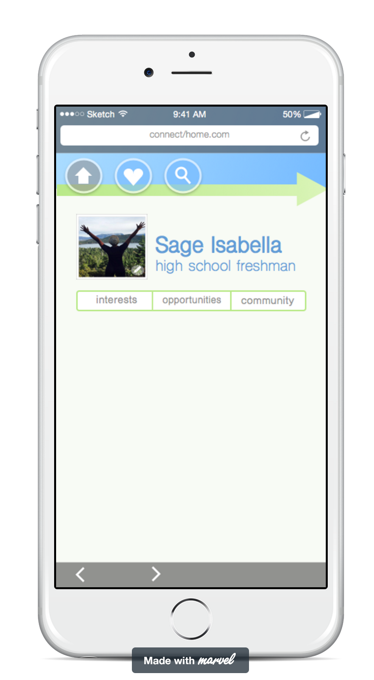
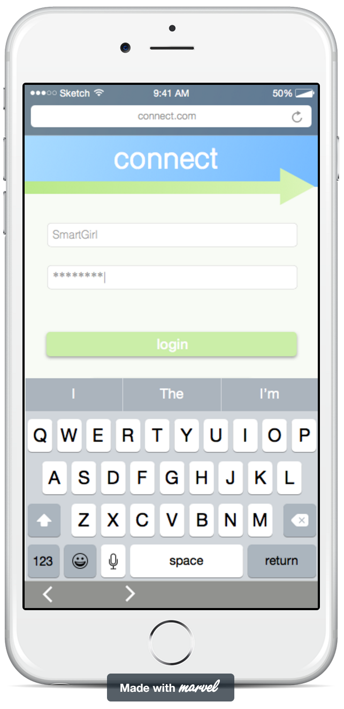
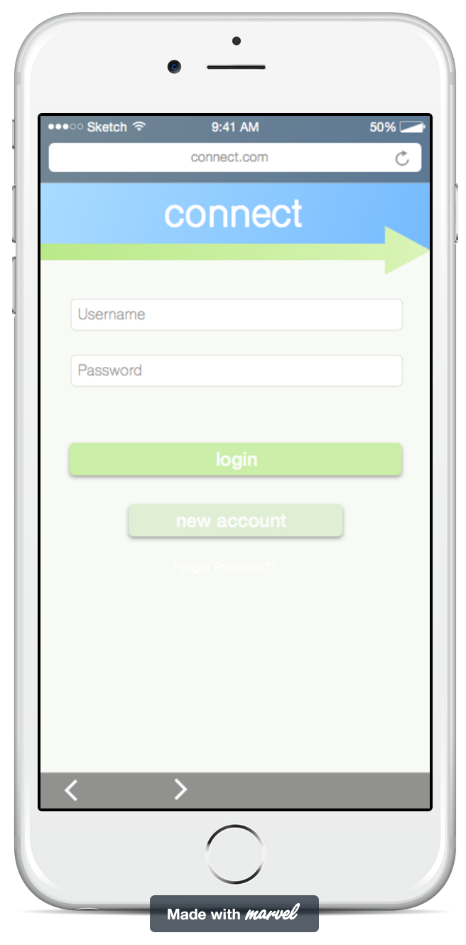
review on marvel sketch
positives
easy to use
UI Kit
Plugin
negatives
mirror app costs $4.99

Slide 13
Limitations/Trade Offs (what was left out and why)
No full profession quiz - we anticipate outsourcing that
No actual database - that’s for later
No real users - obvious reasons
No moderation process for summer programs - that’s functionality for us, not for users

Slide 14
Wizard of Oz Techniques / Hard-Coded Features
Everyone gets the same quiz results
Everyone gets the same list of opportunities after filtering
Uniform username/password
can’t customize new opportunities

