Slide 1
LiME
Low Income & Minorities in Education

Slide 2
Overview
Team mission statement
Selected Interface & Rationale
Low-fi prototype structure
3 tasks & task flows shown carrying out each task w/ low-fi
Experimental method
Experimental results
Suggested UI changes
Summary of talk

Slide 3
Team mission statement
Making stem accessible FOR LOW INCOME AND/OR MINORITY HIGH-SCHOOLERS

Slide 4
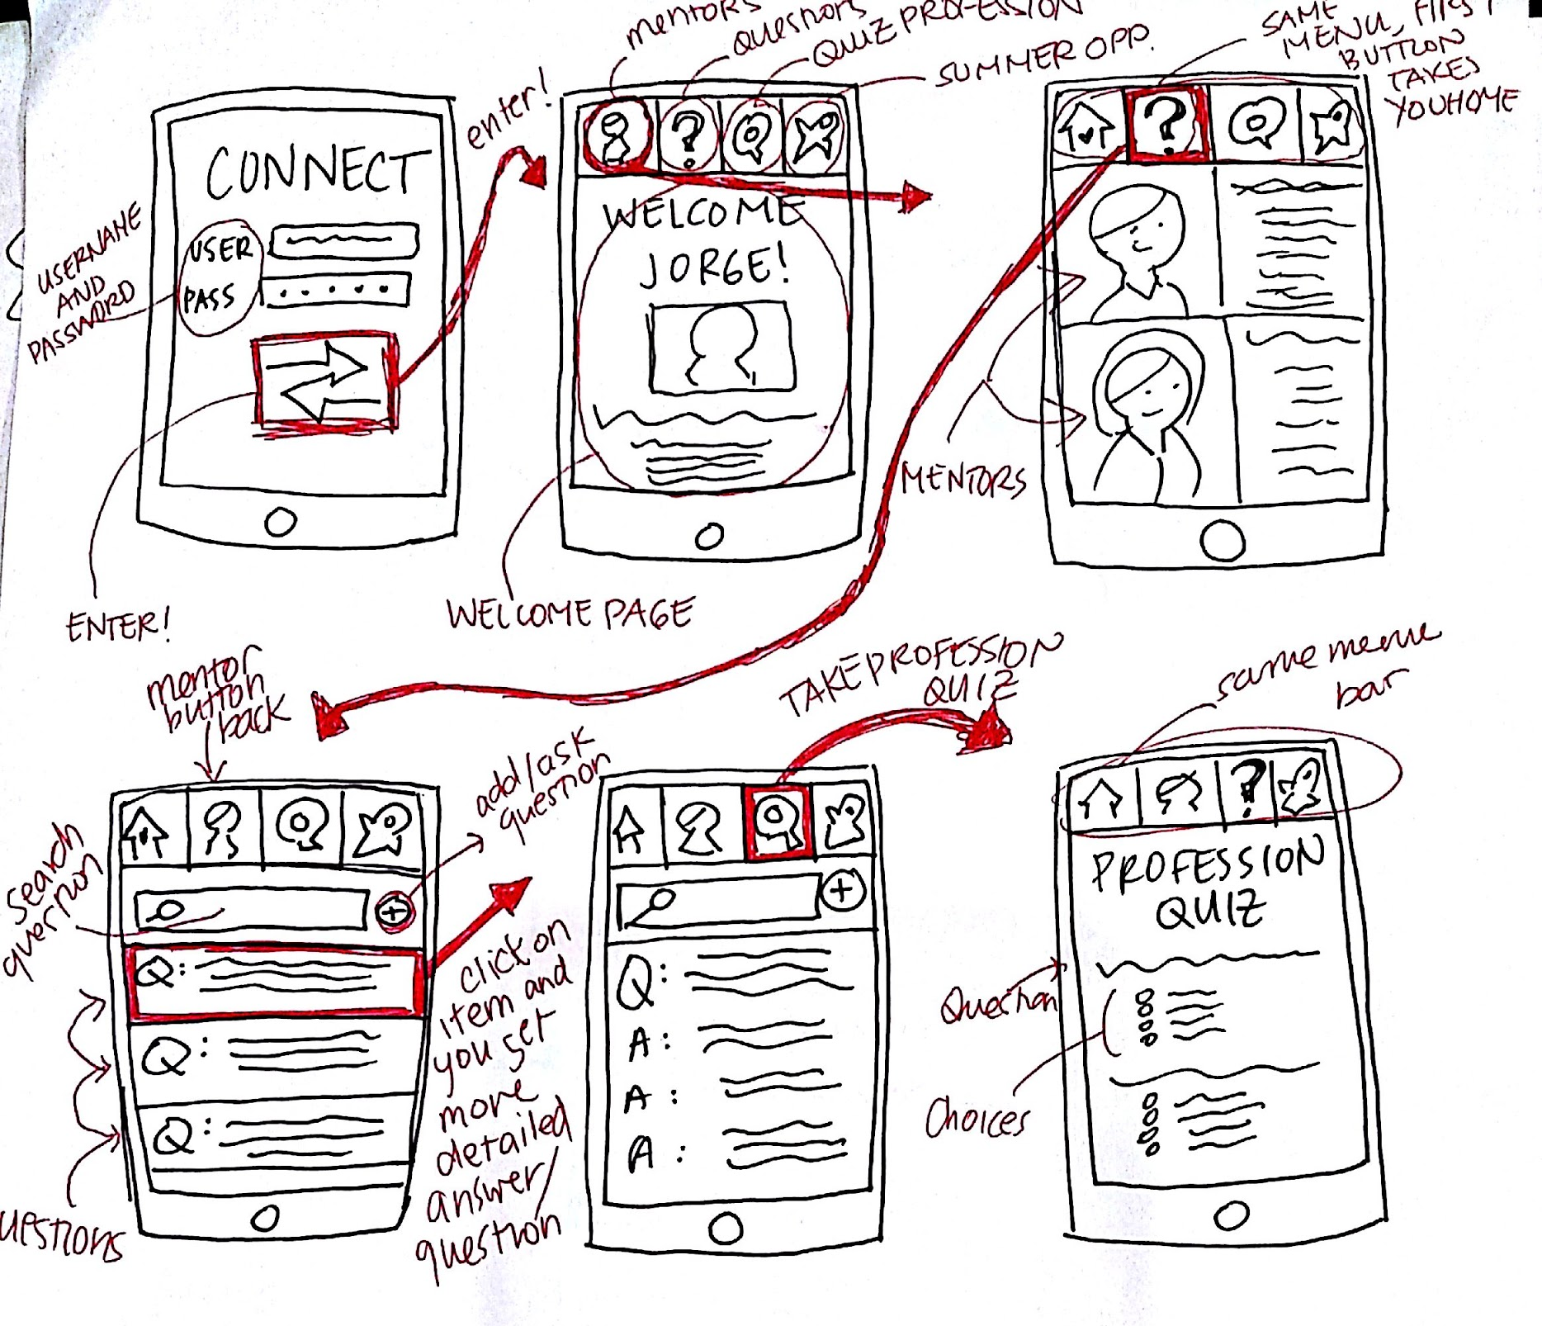
Selected interface and rationale
Mobile/web app
Rationale:
easy and accessible for target demographic;
familiarity with computers and mobile devices
Notes:
We picked the mobile web app because it will be easier for our target demographic (low income and minority high school students) to get access to computers and smartphones than more expensive, rare technologies like Apple watches or virtual reality equipment. They also have a level of familiarity with computers/tablets/smartphones that will make using the app feel more comfortable.

Slide 5
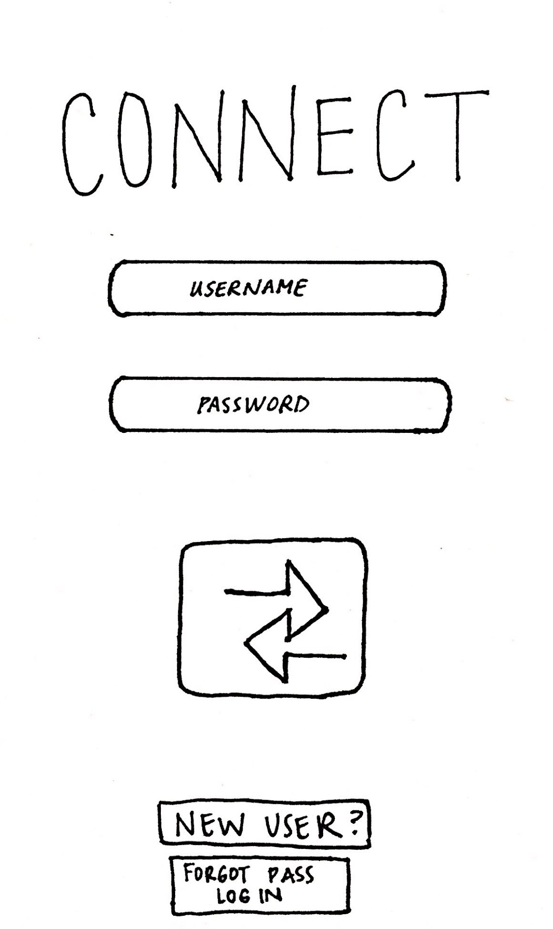
TASK #1 - Discover suitable careers
1) Students discover which careers might suit them through automatic recommendations from career quizzes.
Notes:
a)GO TO Home PAGE
b) Click on light bulb
c) take the profession quiz
D) Results are displayed

Slide 6
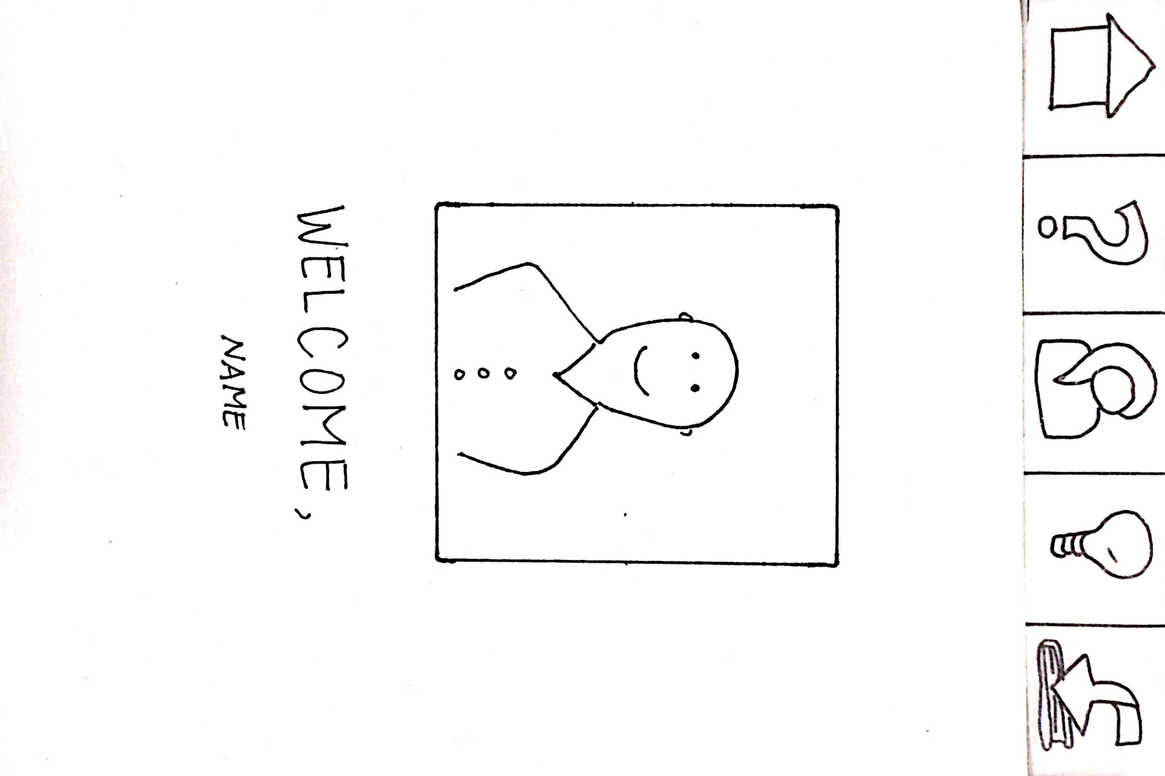
TASK #1 - Discover suitable careers
1) Students discover which careers might suit them through automatic recommendations from career quizzes.

Slide 7
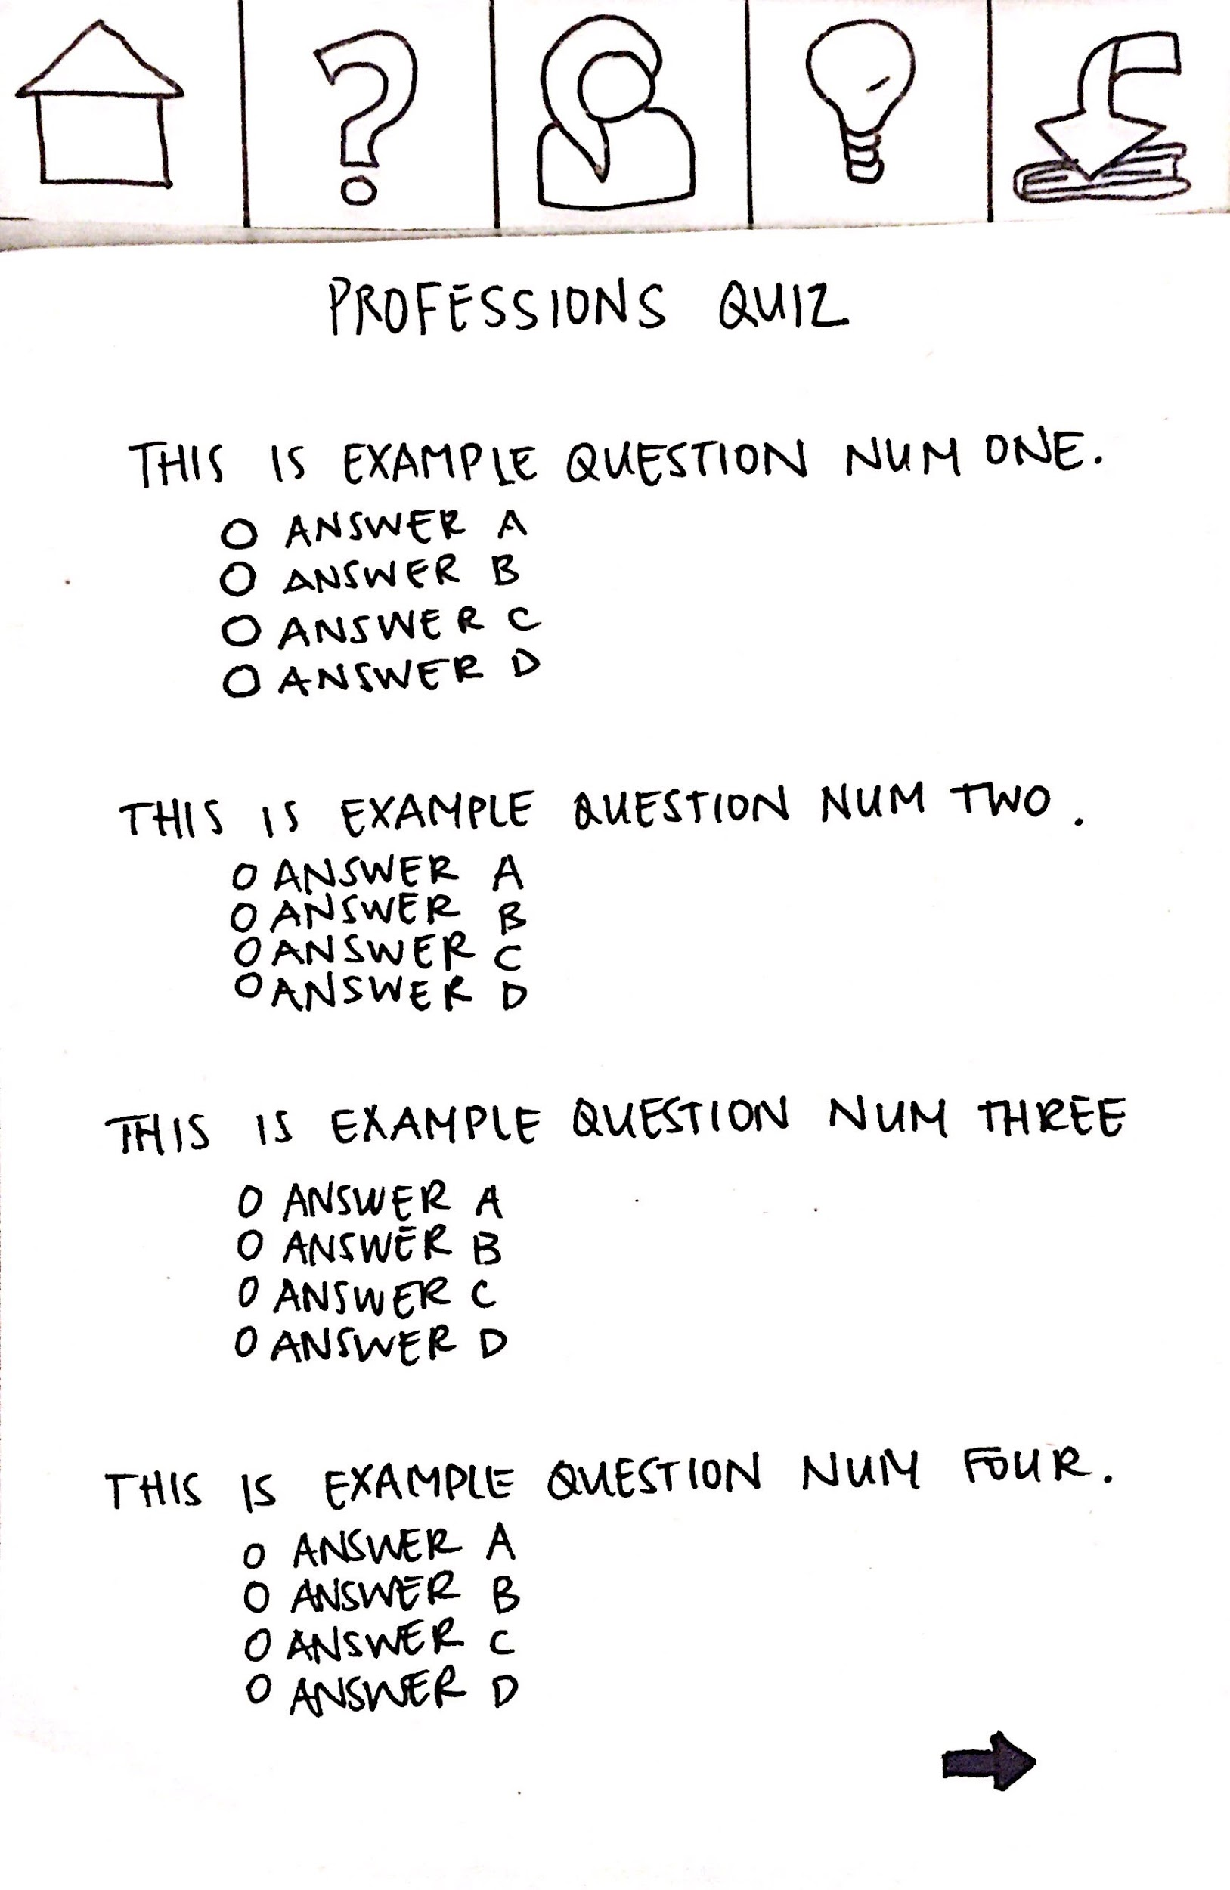
TASK #1 - Discover suitable careers
1) Students discover which careers might suit them through automatic recommendations from career quizzes.

Slide 8
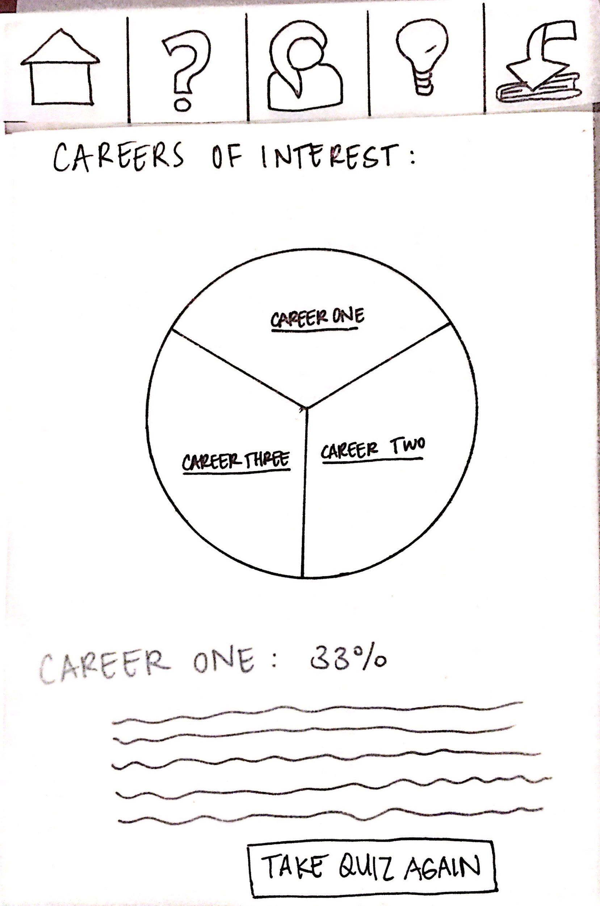
TASK #1 - Discover suitable careers
1) Students discover which careers might suit them through automatic recommendations from career quizzes.

Slide 9
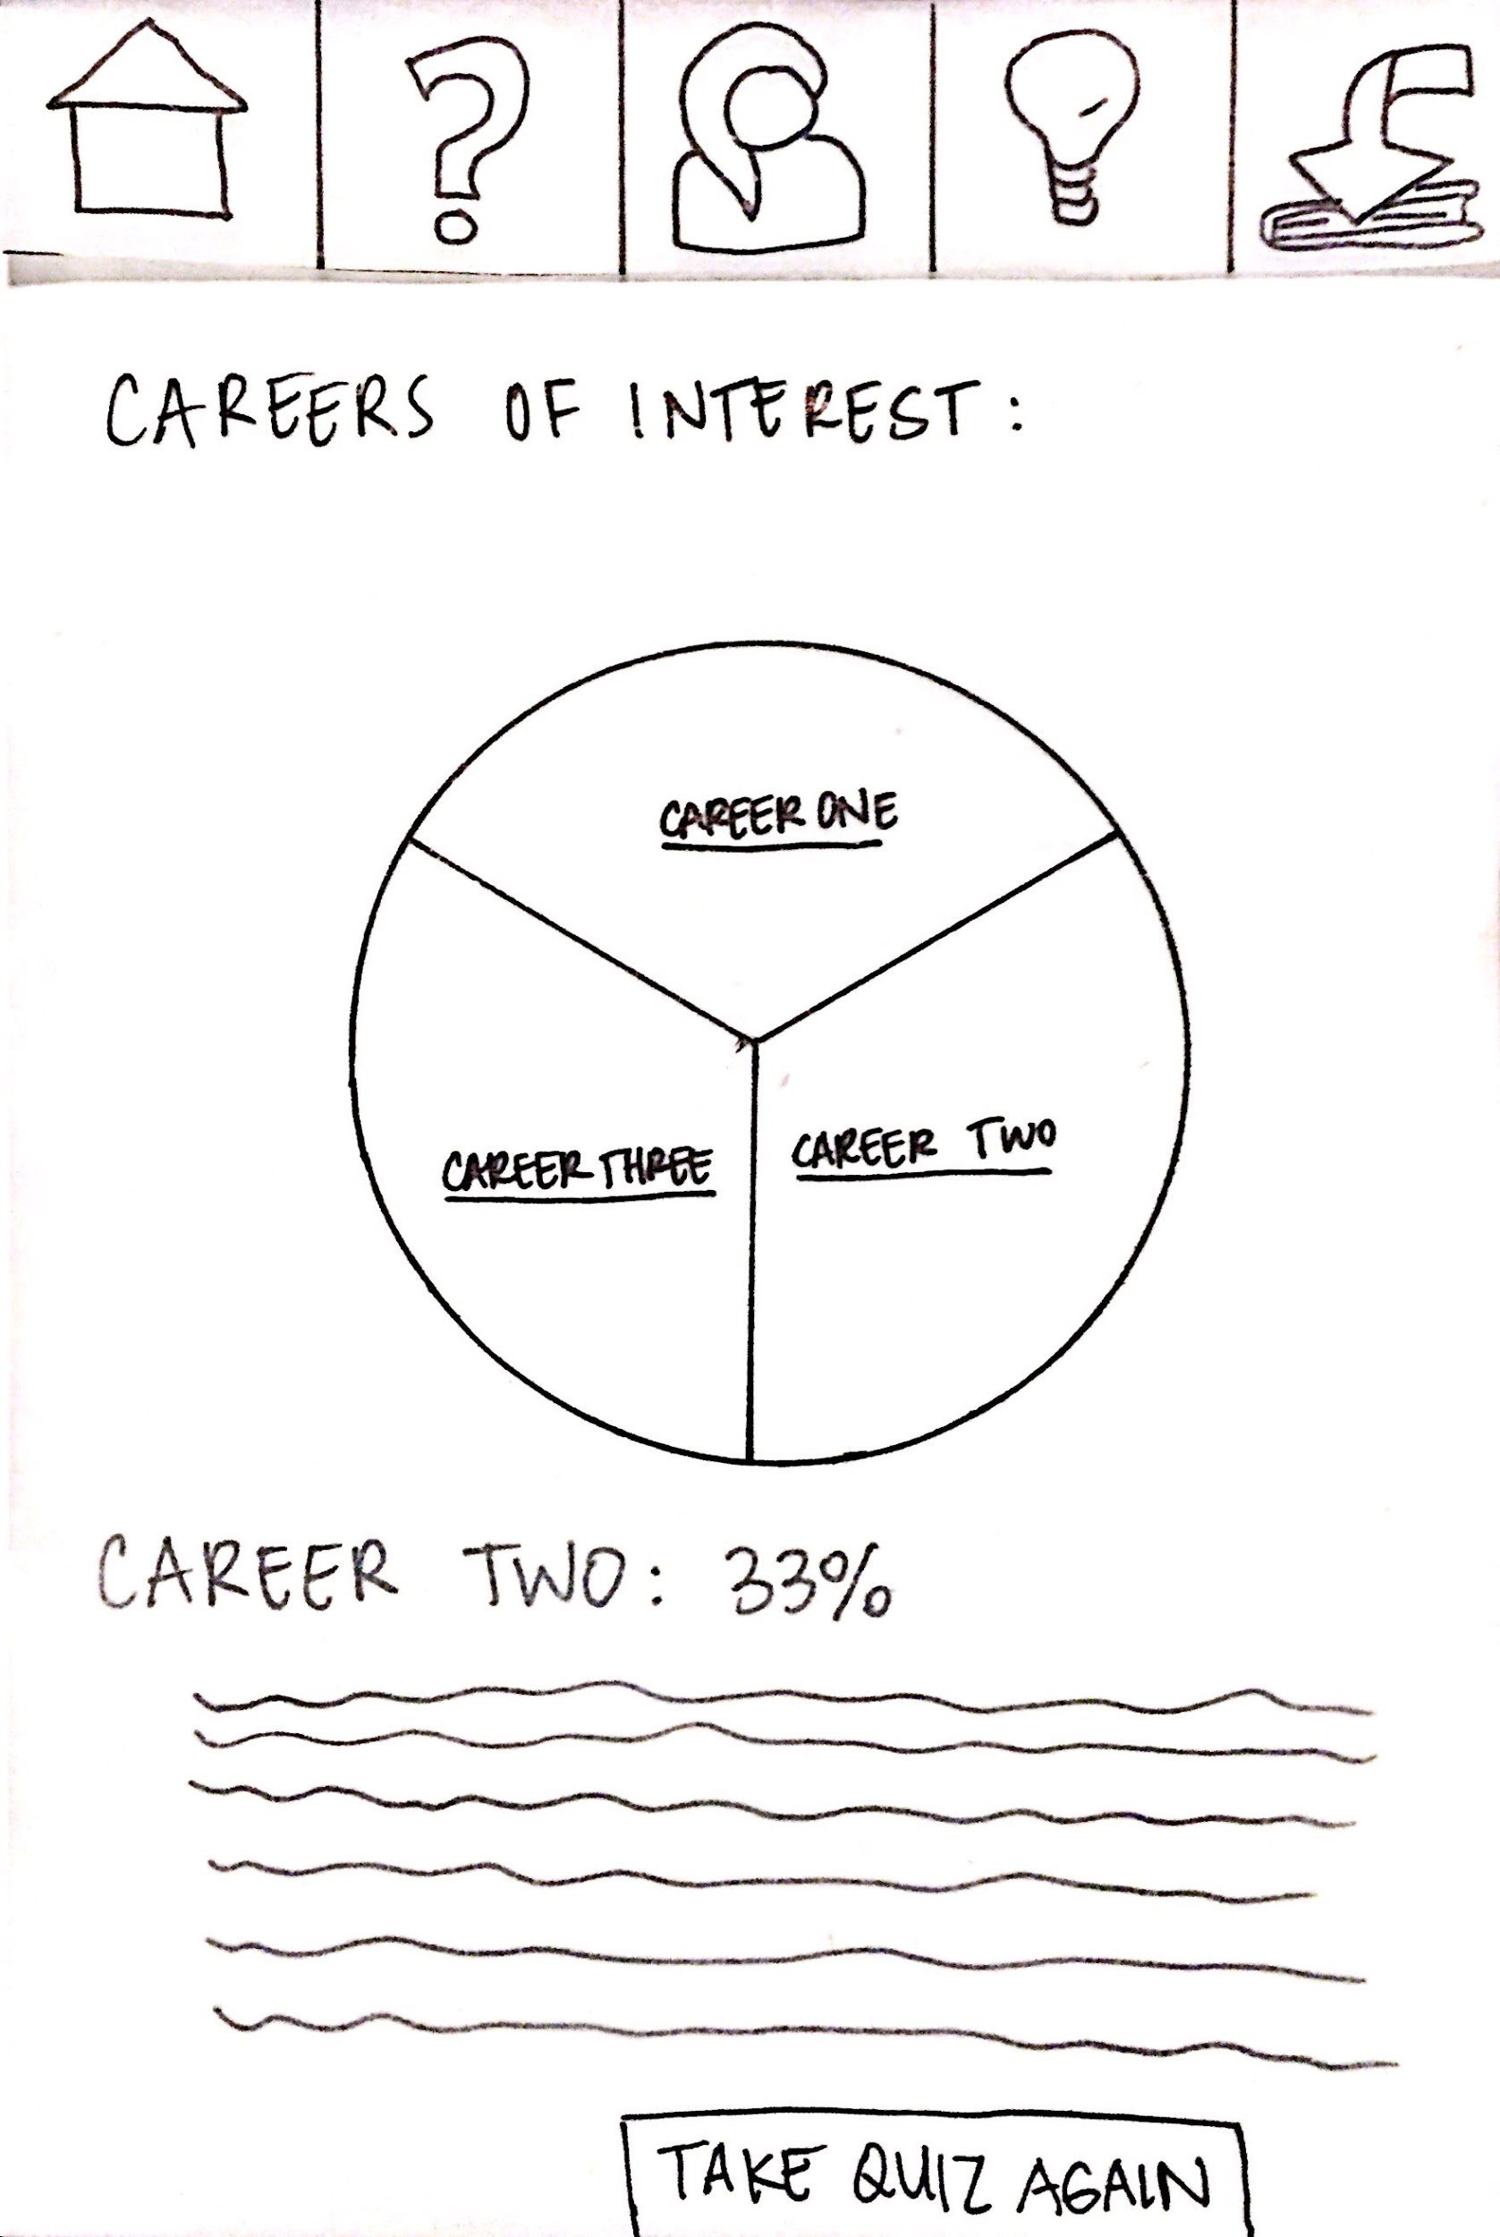
TASK #1 - Discover suitable careers
1) Students discover which careers might suit them through automatic recommendations from career quizzes.

Slide 10
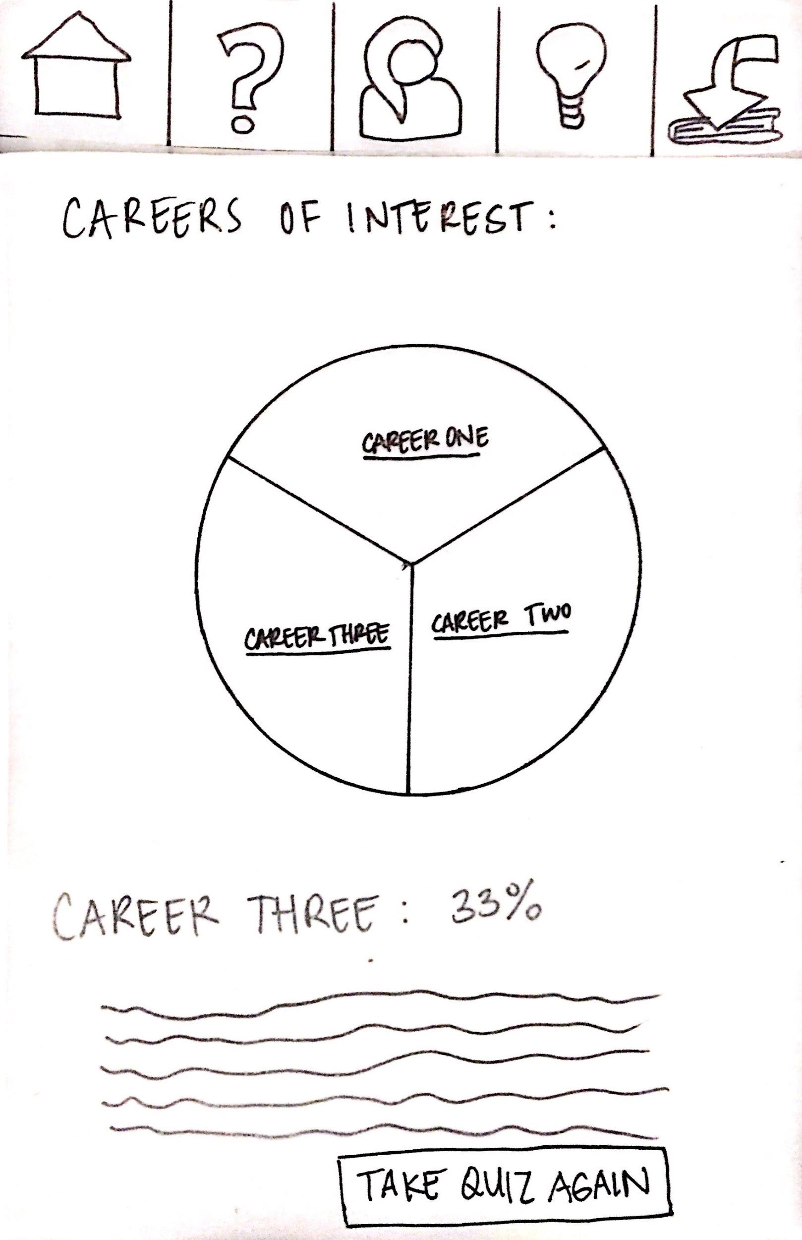
TASK #1 - Discover suitable careers
1) Students discover which careers might suit them through automatic recommendations from career quizzes.

Slide 11
Task #2 - Connect to mentors
2) Students connect with mentors whom they can relate to (with common values and/or background) in the desired career field.
Notes:
A) START AT HOME PAGE
b) Click on person icon
c) Review current mentors
D) If wants to add mentor, click on add Mentor Button
E) Browse mentors and click on one to add

Slide 12
Task #2 - Connect to mentors
2) Students connect with mentors whom they can relate to (with common values and/or background) in the desired career field.
Notes:
A) START AT HOME PAGE
b) Click on person icon
c) Review current mentors
D) If wants to add mentor, click on add Mentor Button
E) Browse mentors and click on one to add

Slide 13
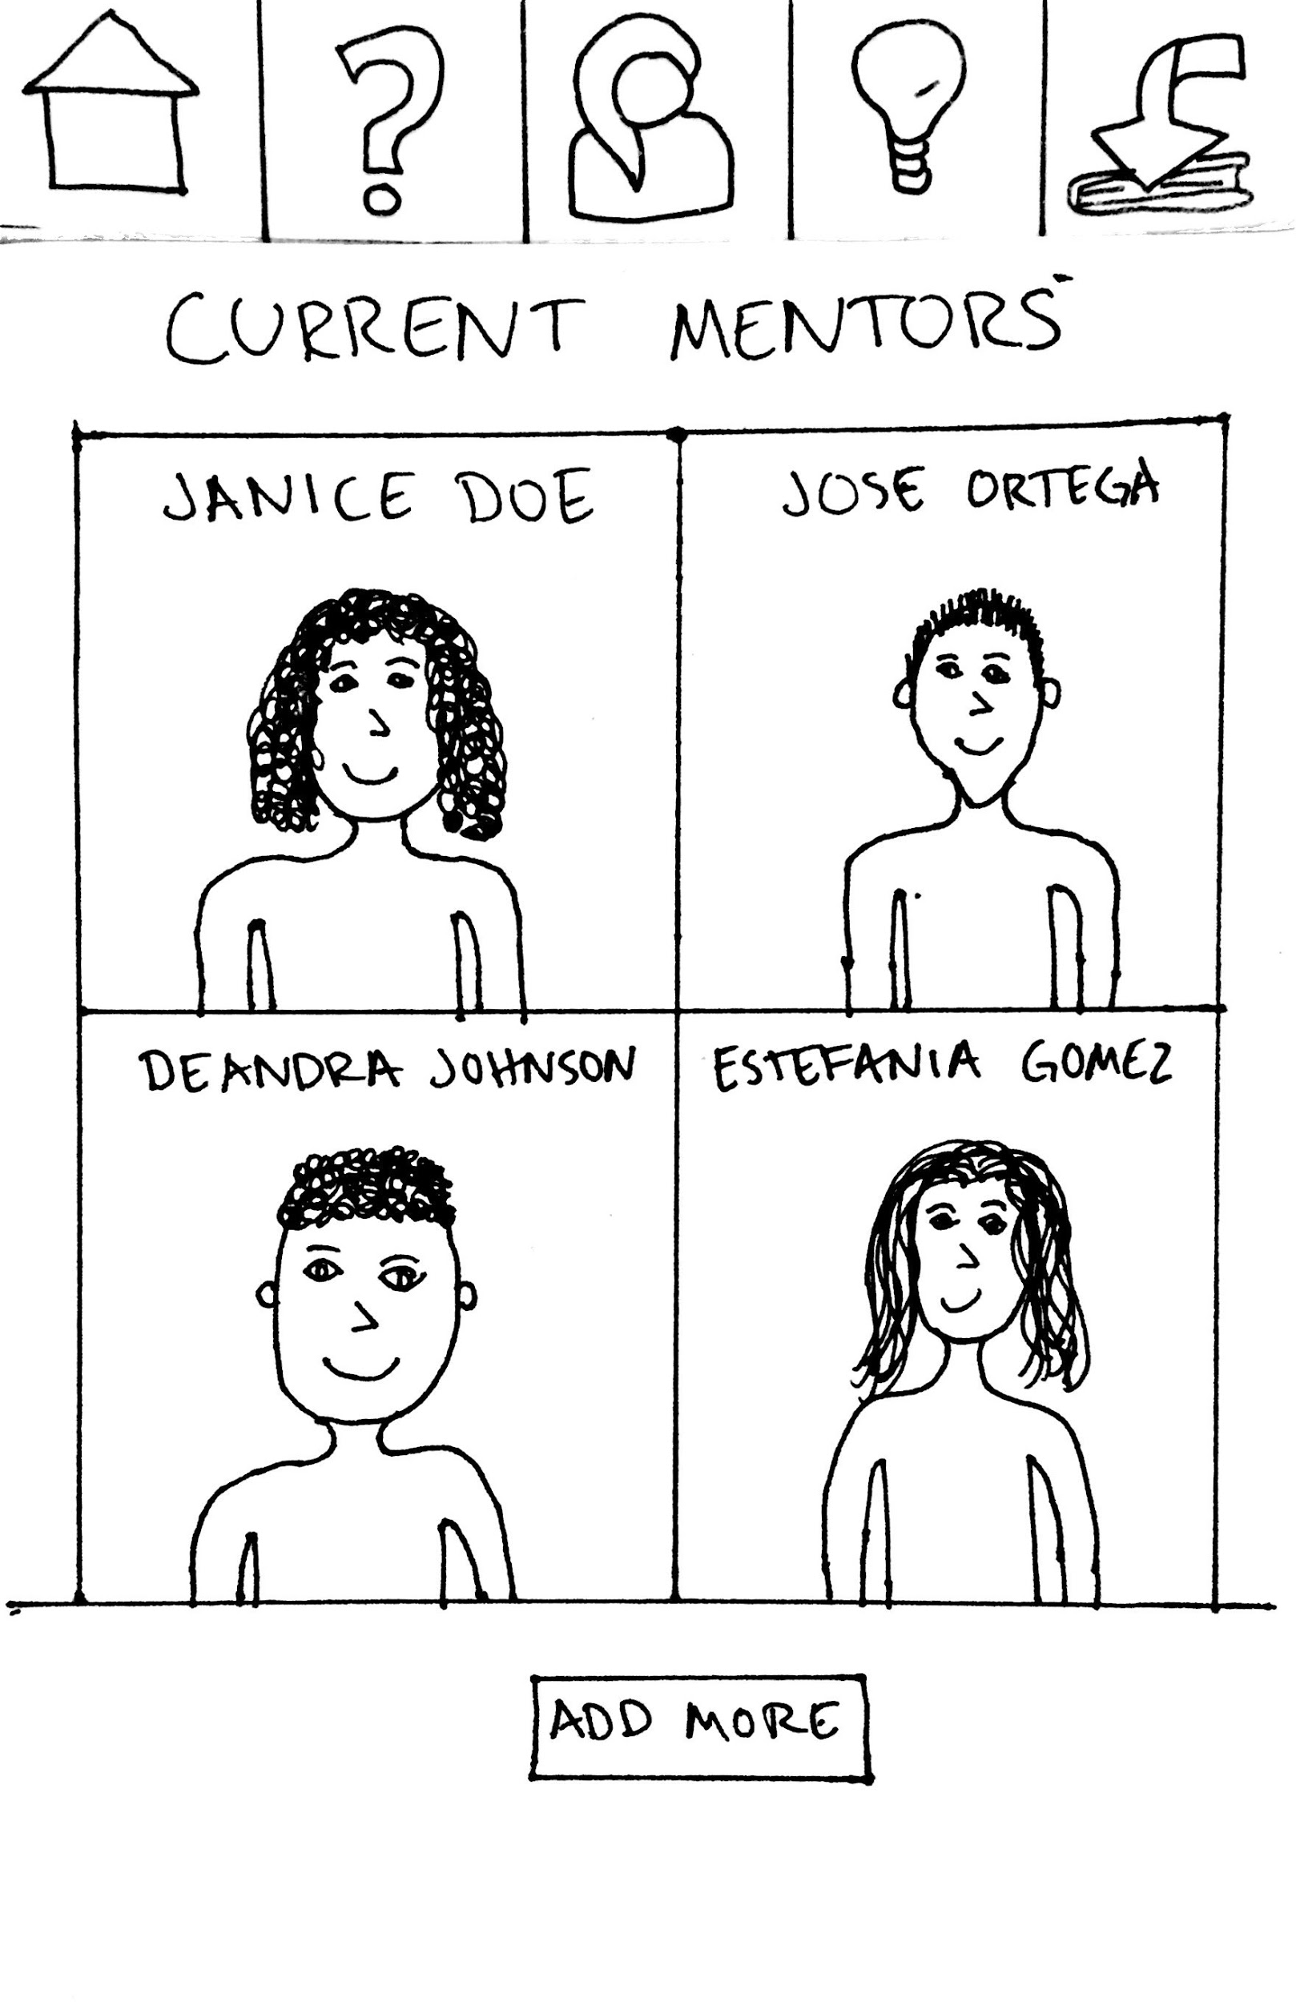
Task #2 - Connect to mentors
2) Students connect with mentors whom they can relate to (with common values and/or background) in the desired career field.
Notes:
A) START AT HOME PAGE
b) Click on person icon
c) Review current mentors
D) If wants to add mentor, click on add Mentor Button
E) Browse mentors and click on one to add

Slide 14
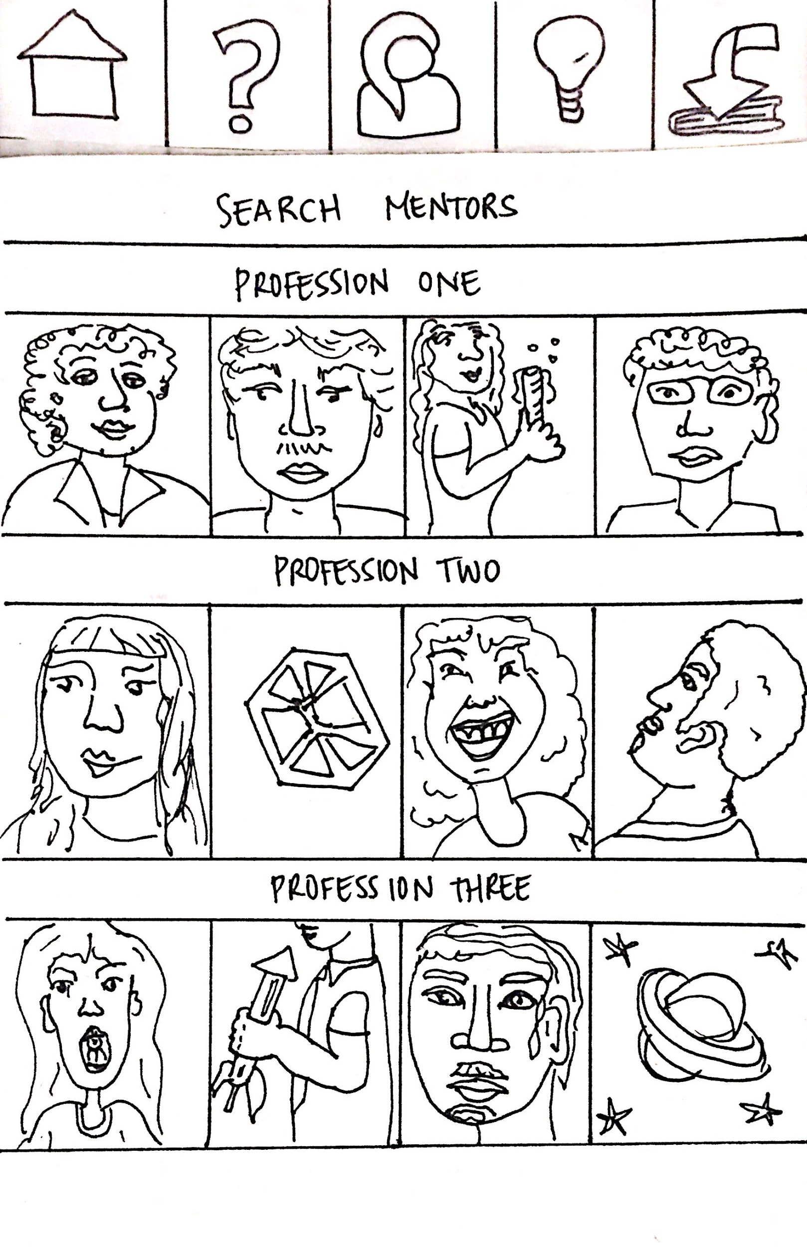
Task #2 - Connect to mentors
2) Students connect with mentors whom they can relate to (with common values and/or background) in the desired career field.
Notes:
A) START AT HOME PAGE
b) Click on person icon
c) Review current mentors
D) If wants to add mentor, click on add Mentor Button
E) Browse mentors and click on one to add

Slide 15
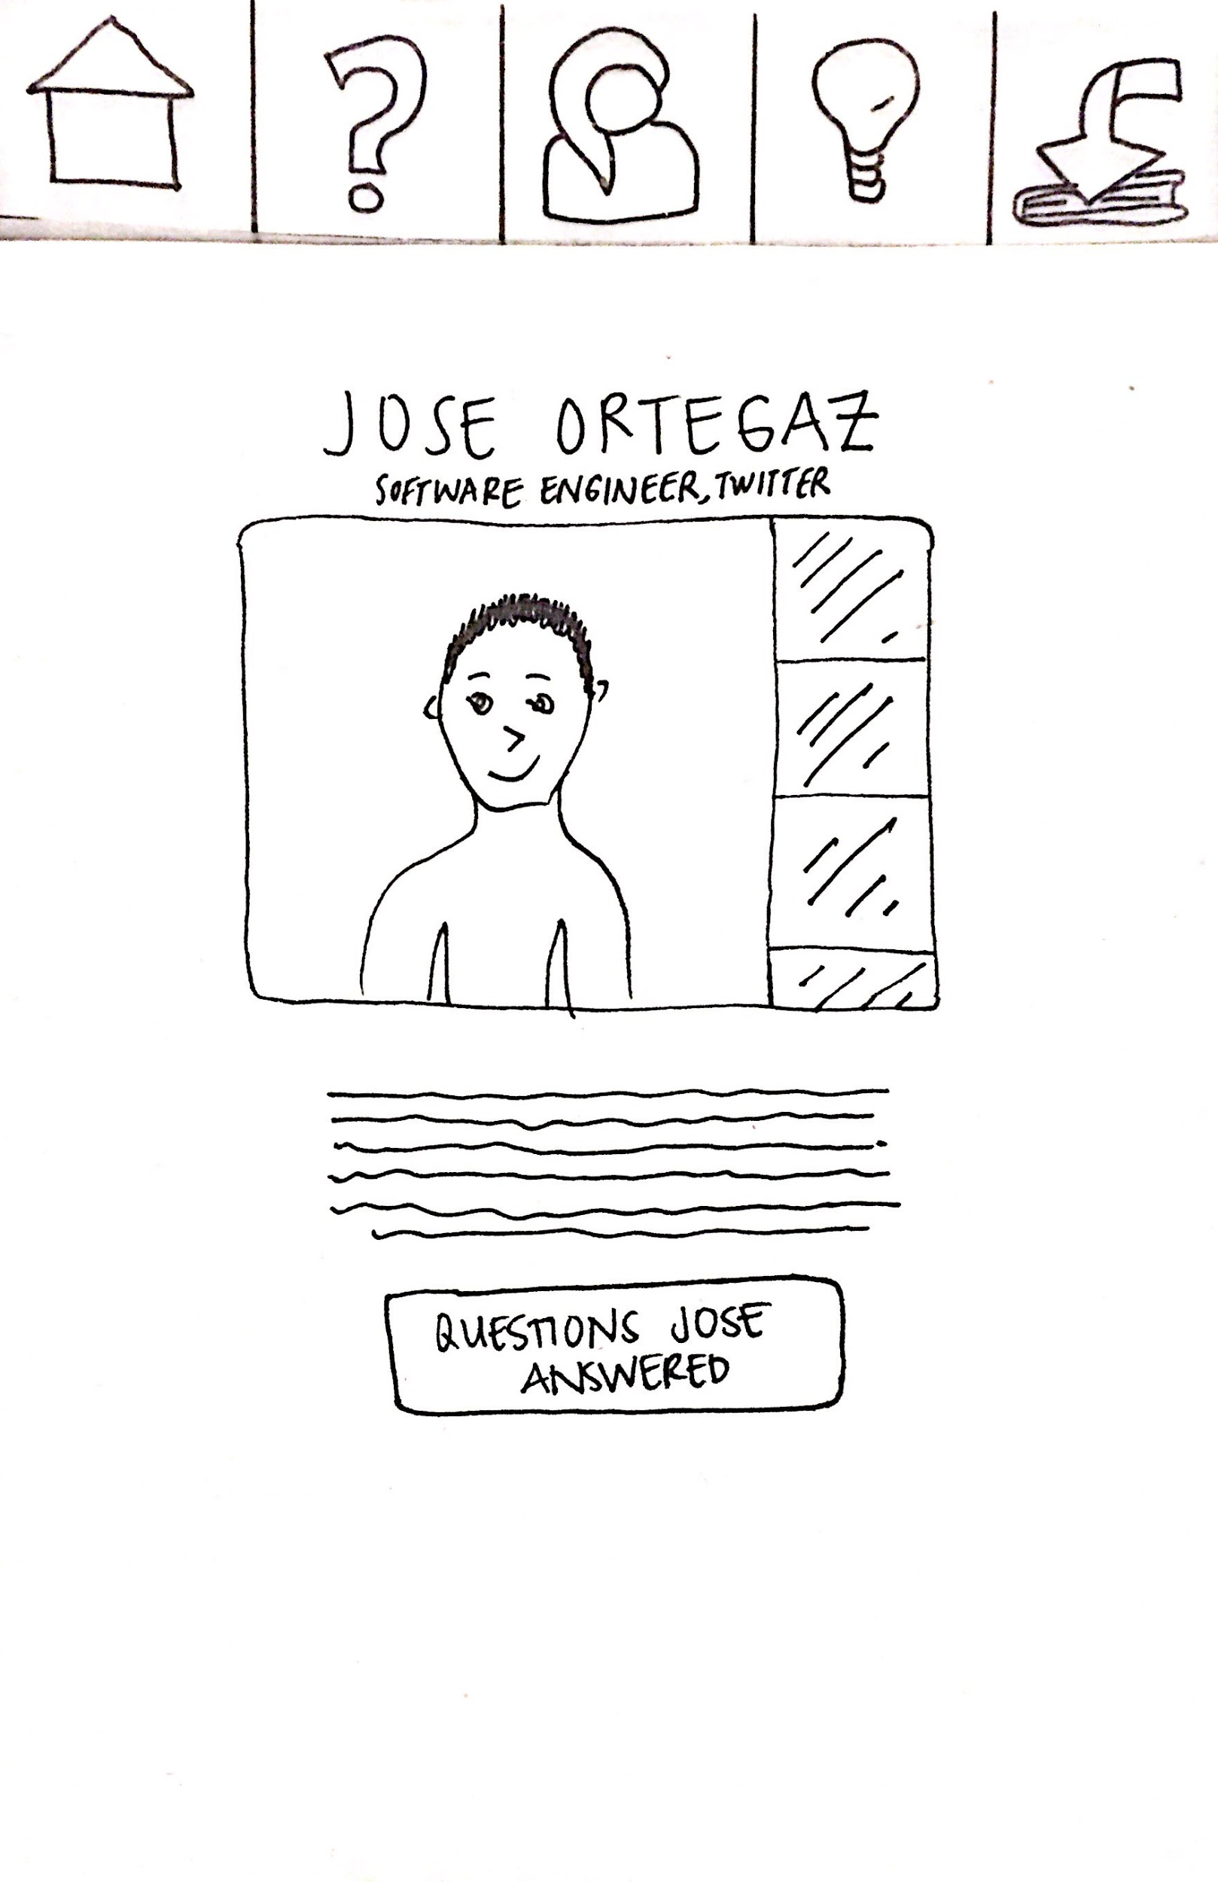
Task #2 - Connect to mentors
2) Students connect with mentors whom they can relate to (with common values and/or background) in the desired career field.
Notes:
A) START AT HOME PAGE
b) Click on person icon
c) Review current mentors
D) If wants to add mentor, click on add Mentor Button
E) Browse mentors and click on one to add

Slide 16
Task #3- Discover summer program opportunities
3) Students discover summer internship opportunities in the career field they are interested in.
Notes:
A) START AT HOME PAGE
b) Click on person icon
c)
D)
E)

Slide 17
Task #3- Discover summer program opportunities
3) Students discover summer internship opportunities in the career field they are interested in.
Notes:
A) START AT HOME PAGE
b) Click on person icon
c) Review current mentors
D) If wants to add mentor, click on add Mentor Button
E) Browse mentors and click on one to add

Slide 18
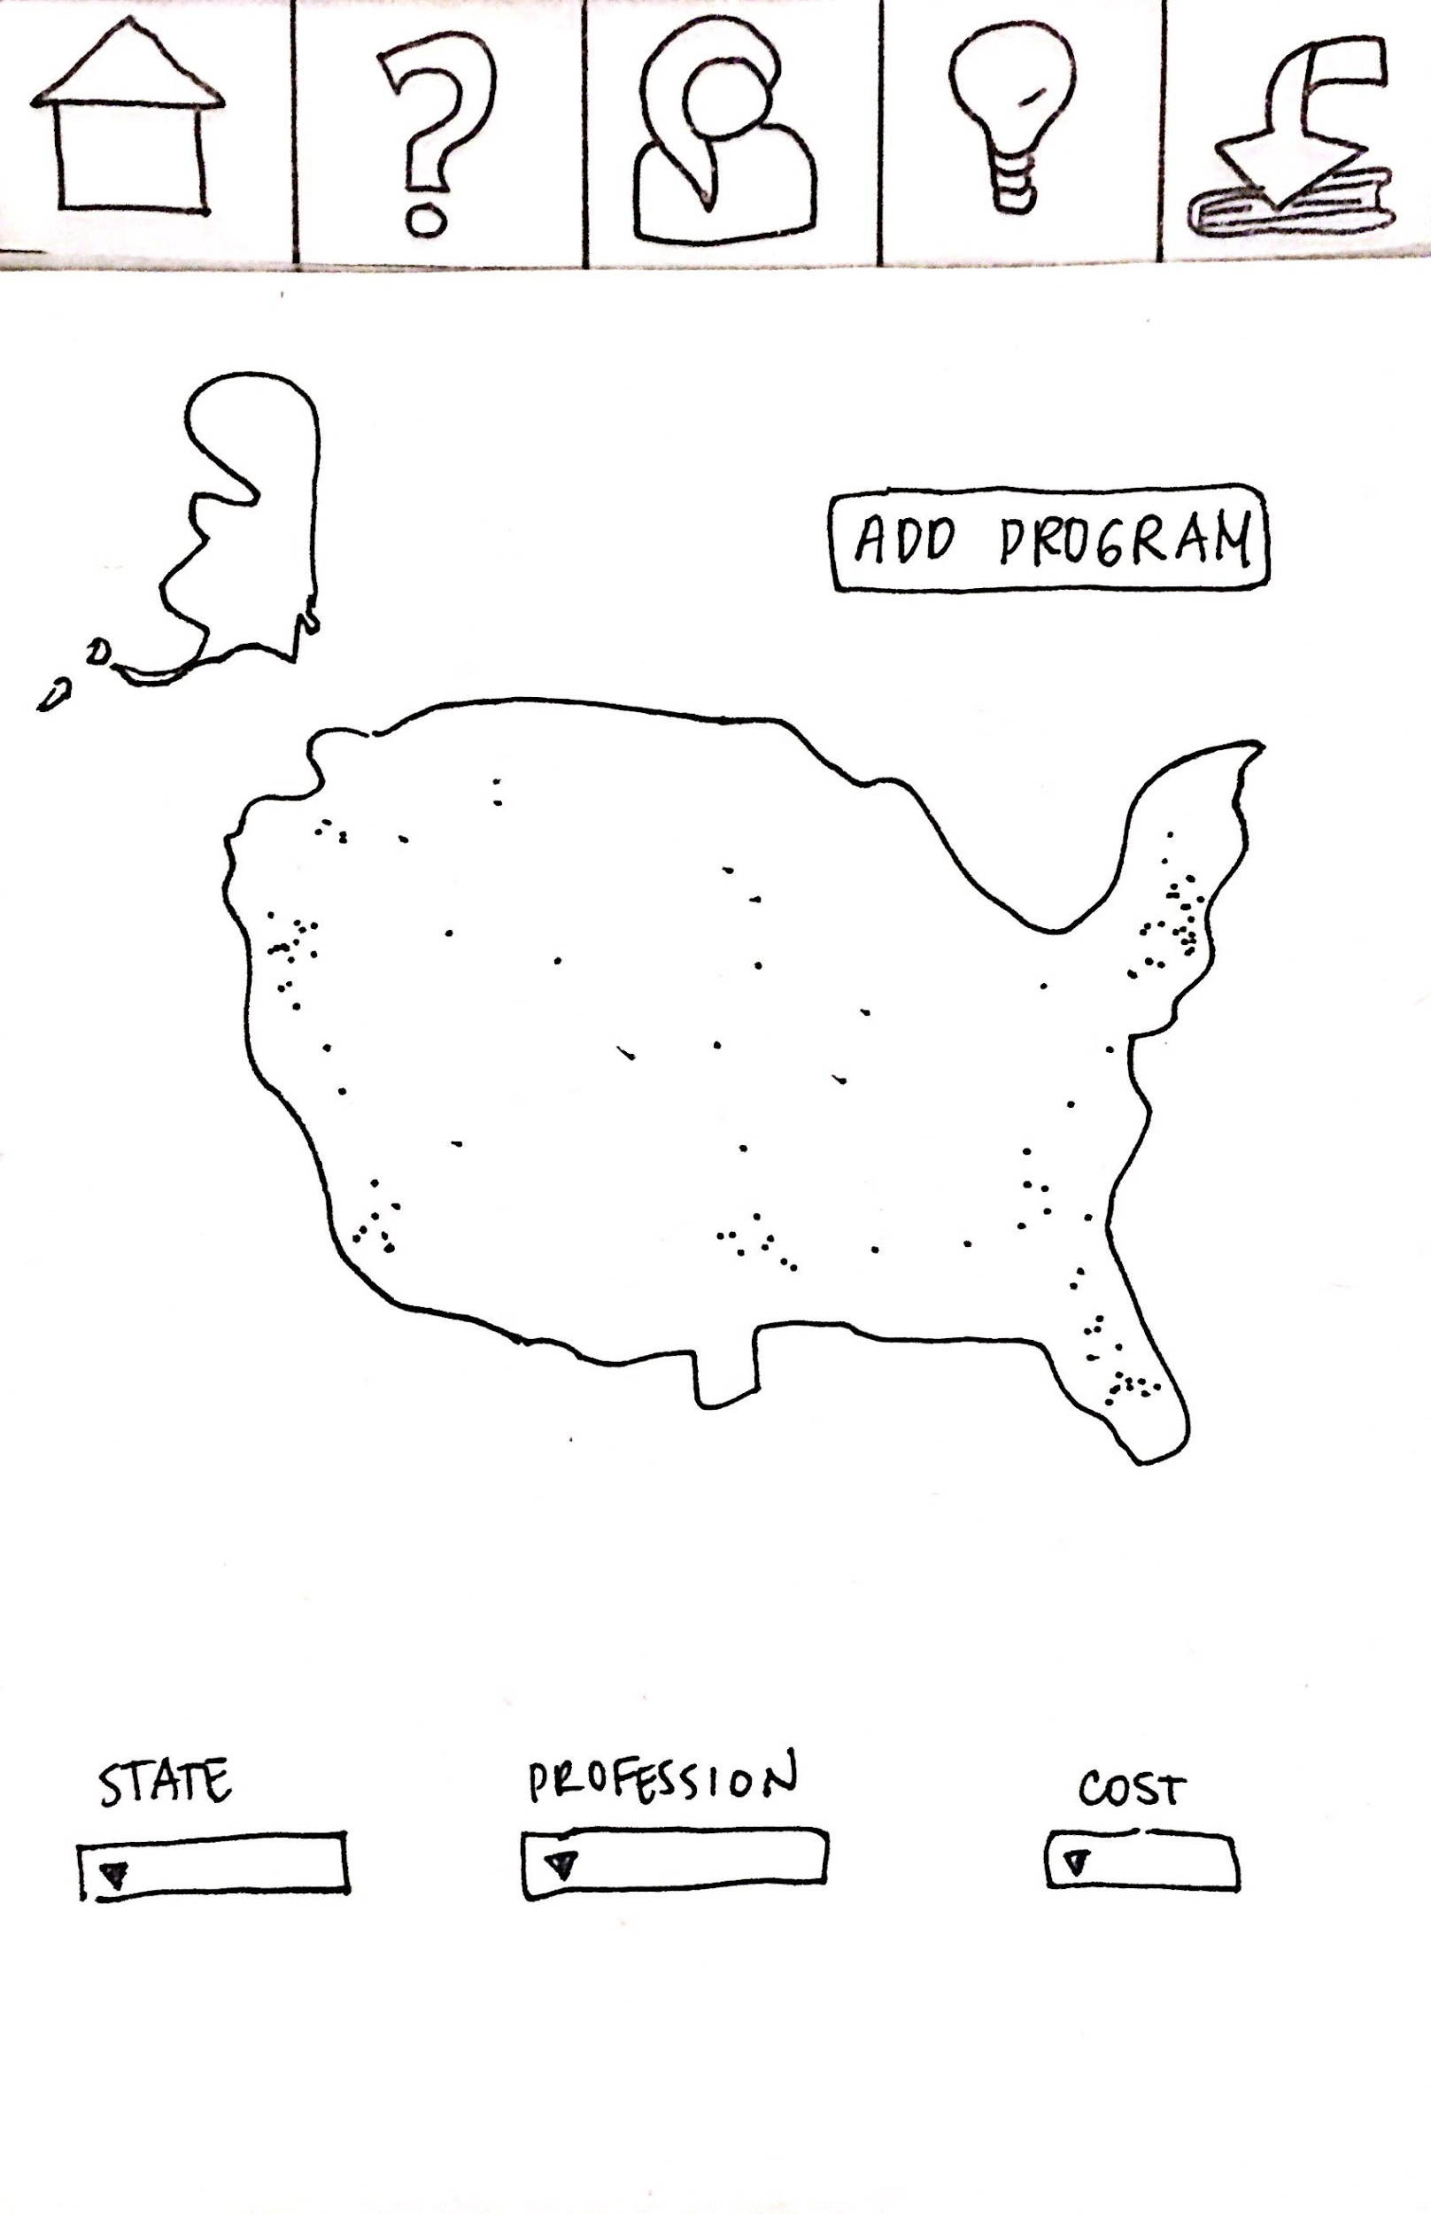
Task #3- Discover summer program opportunities
3) Students discover summer internship opportunities in the career field they are interested in.
Notes:
A) START AT HOME PAGE
b) Click on person icon
c) Review current mentors
D) If wants to add mentor, click on add Mentor Button
E) Browse mentors and click on one to add

Slide 19
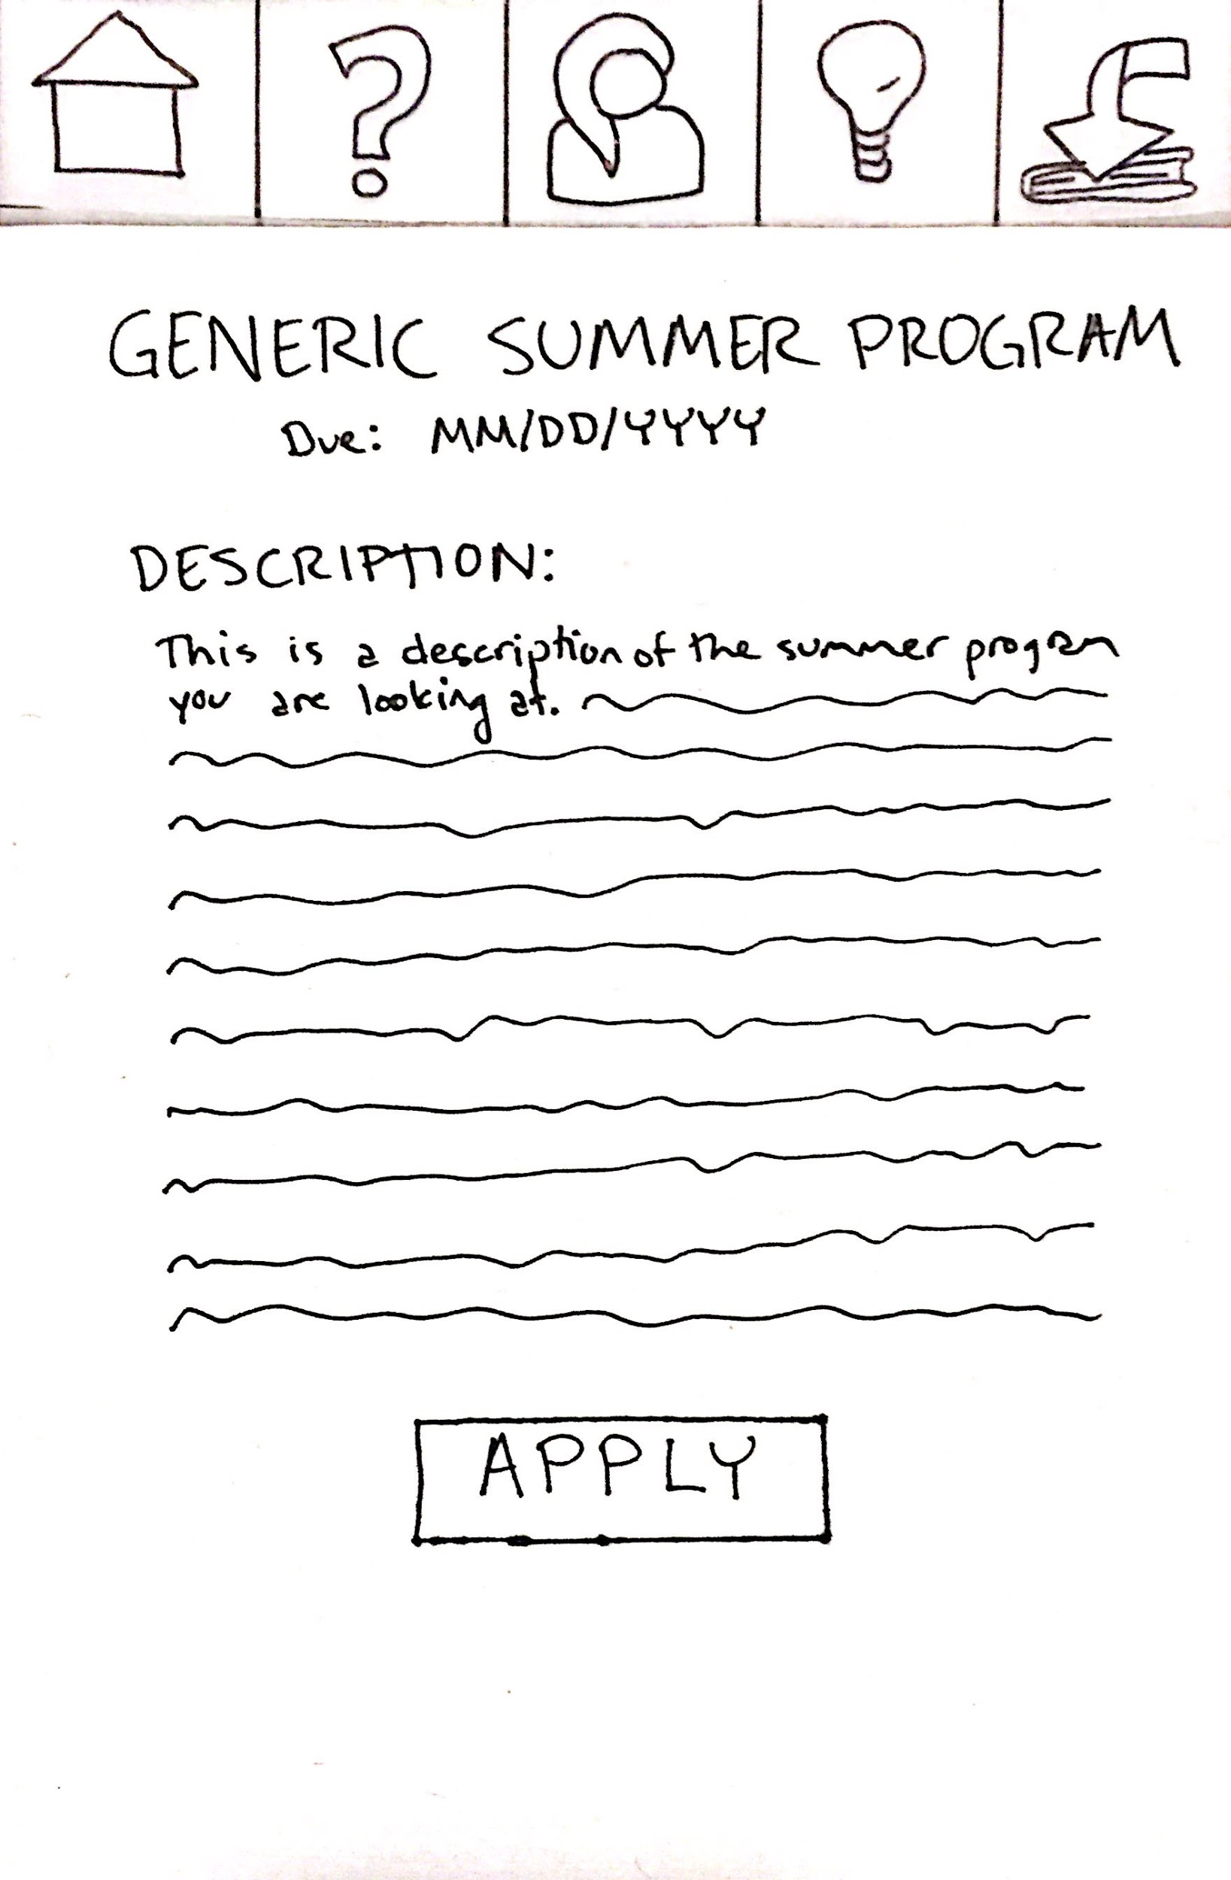
Task #3- Discover summer program opportunities
3) Students discover summer internship opportunities in the career field they are interested in.
Notes:
A) START AT HOME PAGE
b) Click on person icon
c) Review current mentors
D) If wants to add mentor, click on add Mentor Button
E) Browse mentors and click on one to add

Slide 20
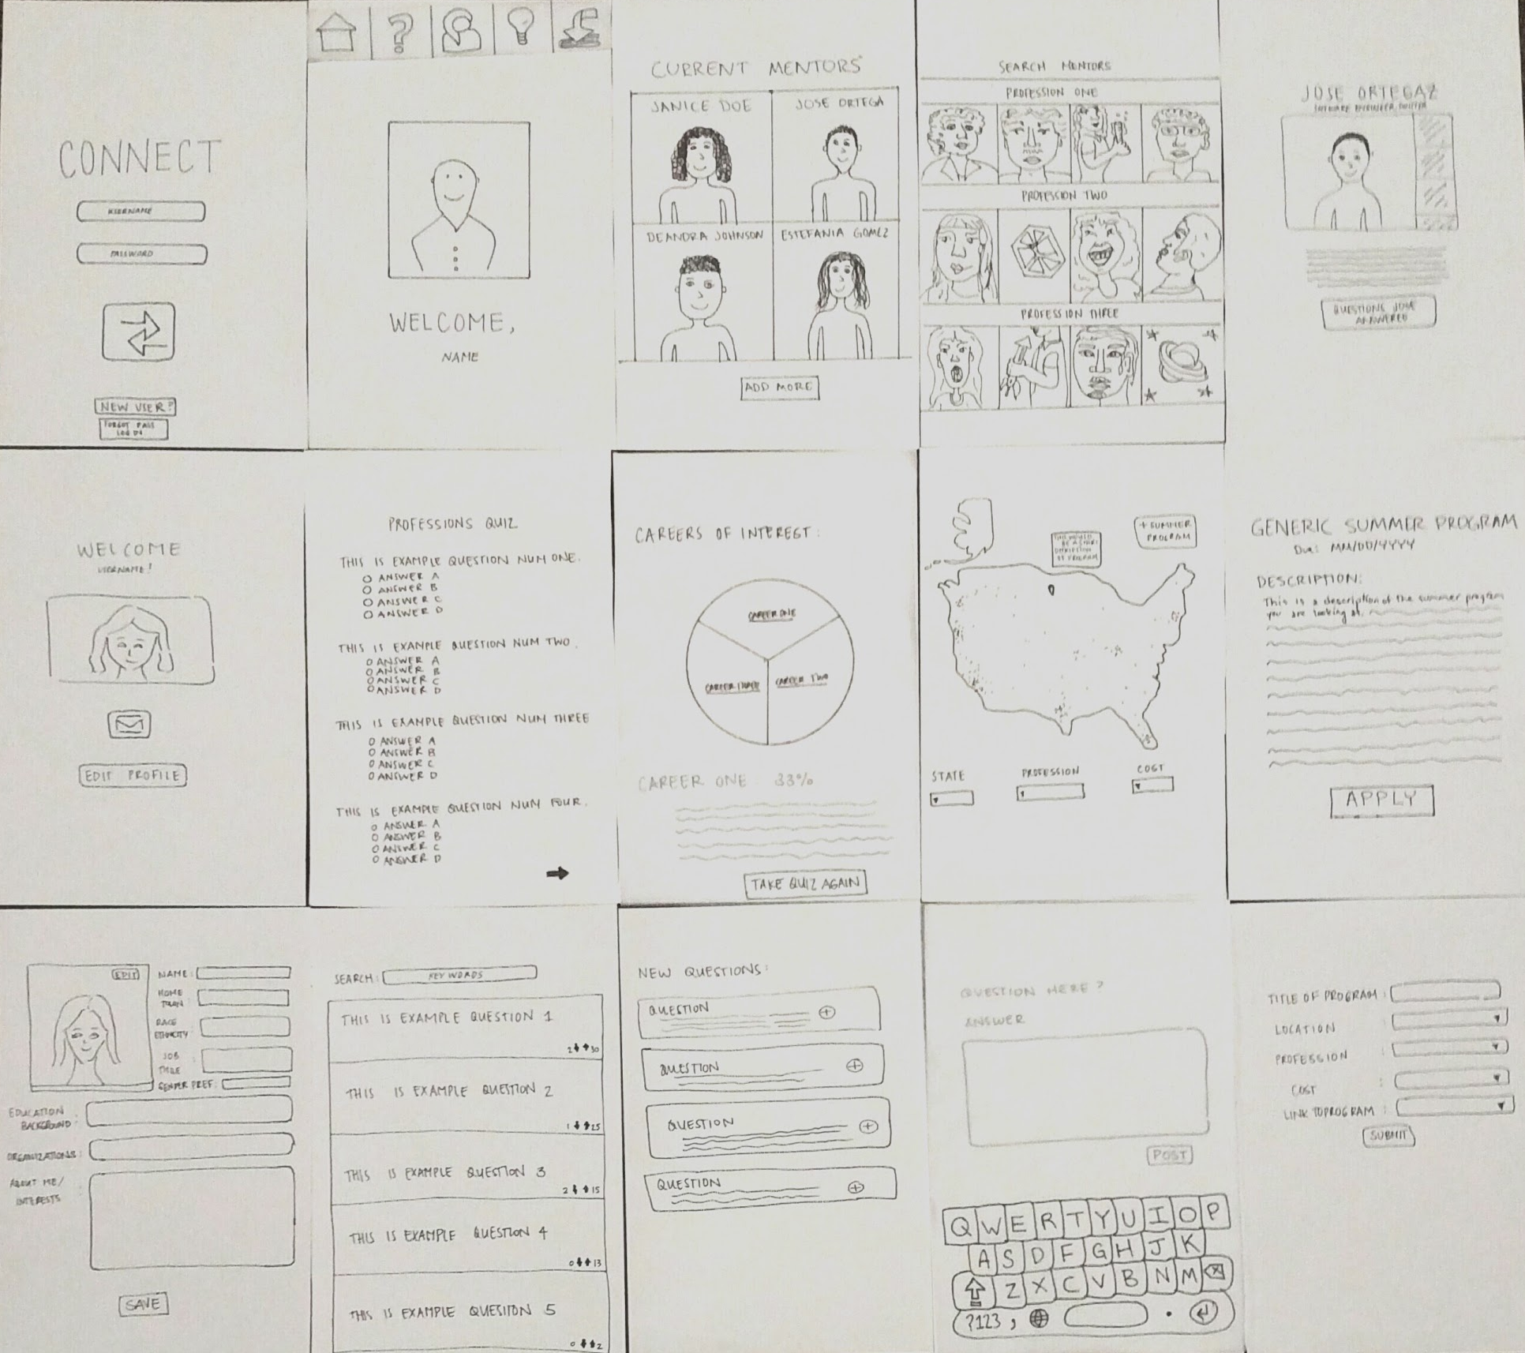
Lo-fi prototype structure

Slide 22
Experimental method
interviewed five users in quiet & diverse environments
separate tasks and task flows for different users
procedure :
facilitator intro
user monologue
simulate computer
note taking
test measures
number of errors
ease of use

Slide 23
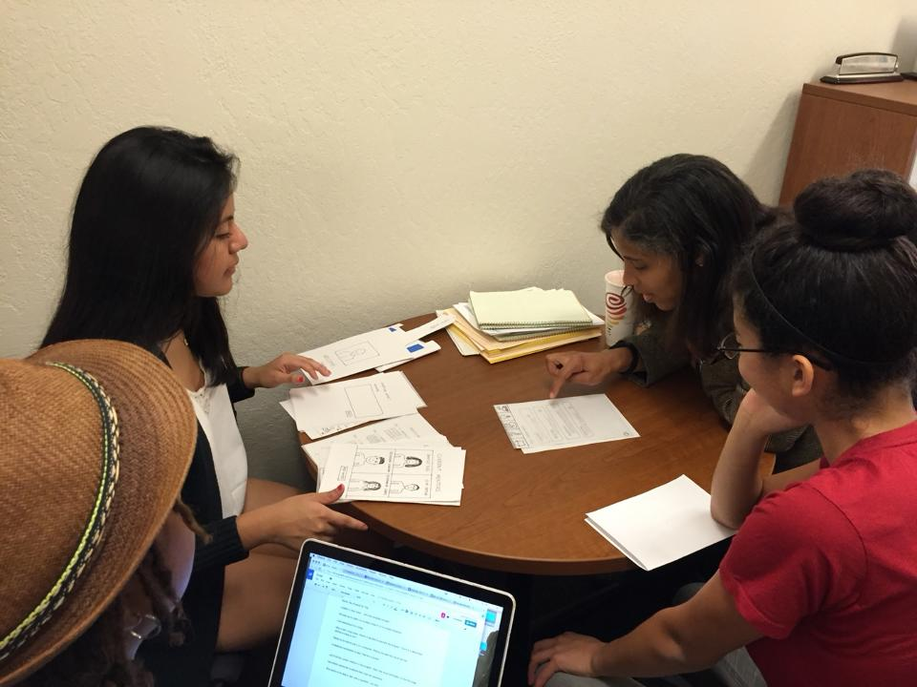
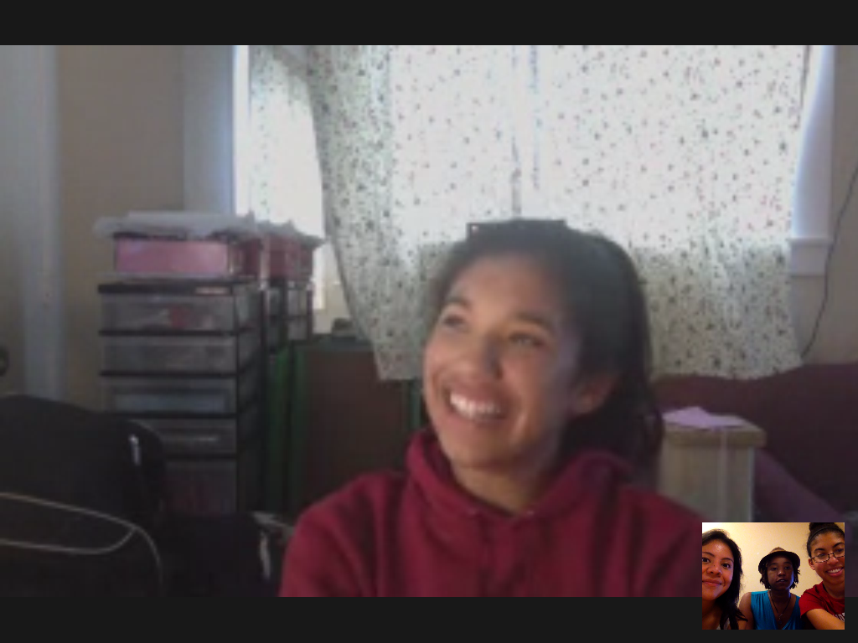
Experimental results #1 - SMART USERS
Participant one and participant two found the app intuitive and easy to use
they made only one error

Slide 24
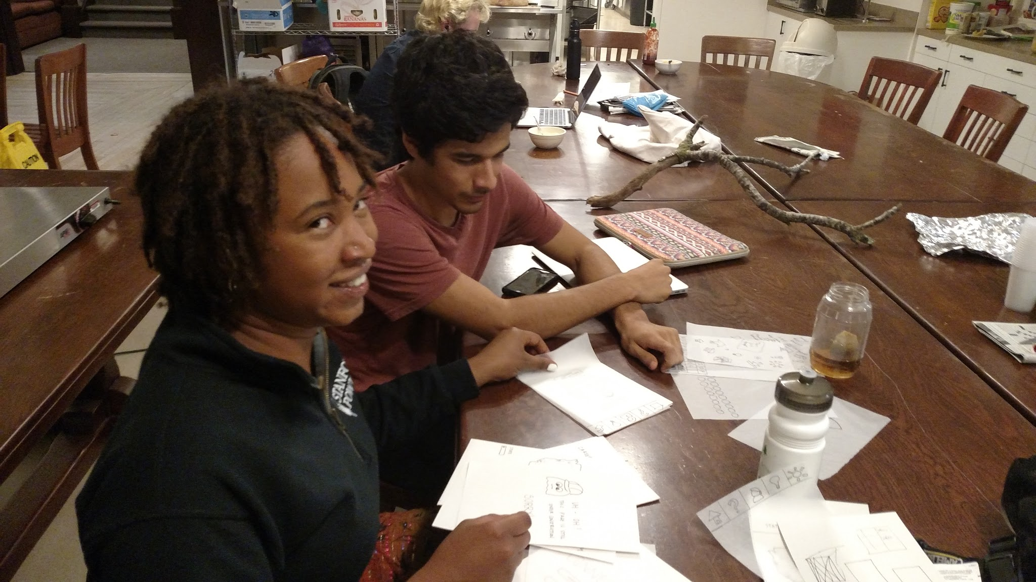
Experimental results #2 - USERS WITH DIFFICULTIES
Participant THREE and participant FOUR found the application confusing and had major difficulties in using it
4 errors each

Slide 25
Suggested UI changes
have different buttons/functionality for Mentors vs Mentees (e.g., don’t let mentors access the ‘Take quiz’ view)
CHANGE the icons that are not intuitive
search mentors by name
ADD map zoom functionality
giving mentors the ability to edit their answers to questions after posting them

Slide 26
Summary of talk
chose Mobile web app (FAMILIAR AND ACCESSIBLE TO TARGET DEMOGRAPHIC)
TESTED 3 tasks with 4 users
contradictory FEEDBACK FROM USERS -
some found app intuitive
some found it confusing
suggestions to change ui elements and add functionality

