Slide 1
LiME
Low Income Minorities in Education
Notes:
Notes:
Pictures from Jasmine’s Mom and Sister
Pictures of Testing
Add in new interview bullets
Whether or Not Assumptions Were Valid

Slide 2
Value Proposition, Problem/Solution Overview
value proposition: Making stem accessible!
Problem/solution overview: there are unique barriers that prevent low-income minority students from having easy access to stem fields. We propose a solution that introduces them to different career paths, connects them with mentors from similar backgrounds, and provides them with information summer opportunities.

Slide 3
Three Tasks
Students discover which careers might suit them through automatic recommendations from career quizzes.
Students connect with mentors whom they can relate to (with common values and/or background) in the desired career field.
Students discover project/internship opportunities in the career field they are interested in.

Slide 4
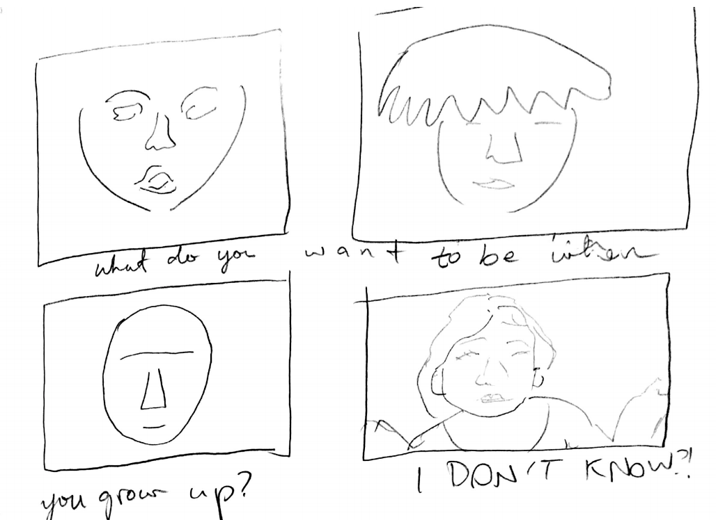
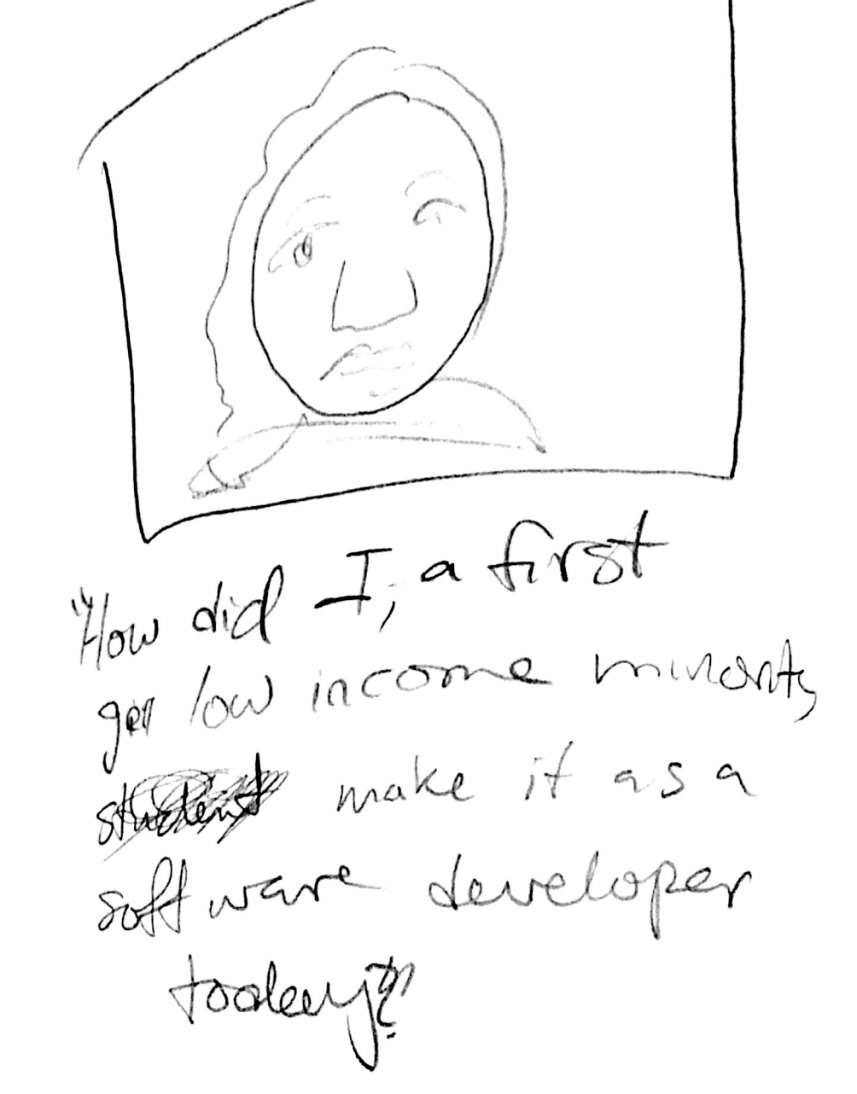
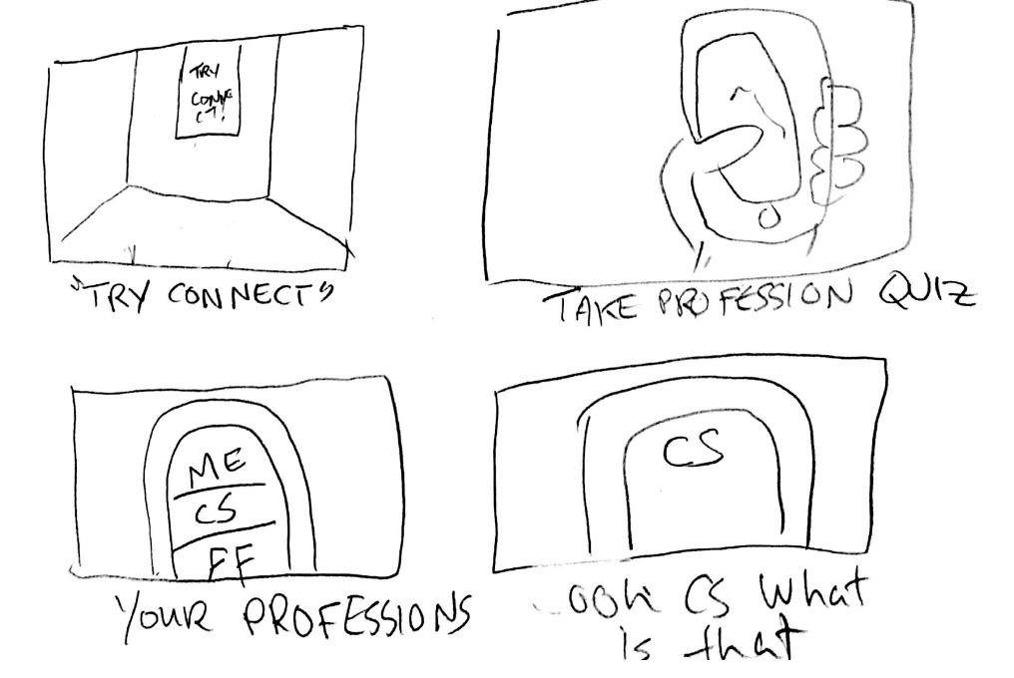
Video Storyboard

Slide 5
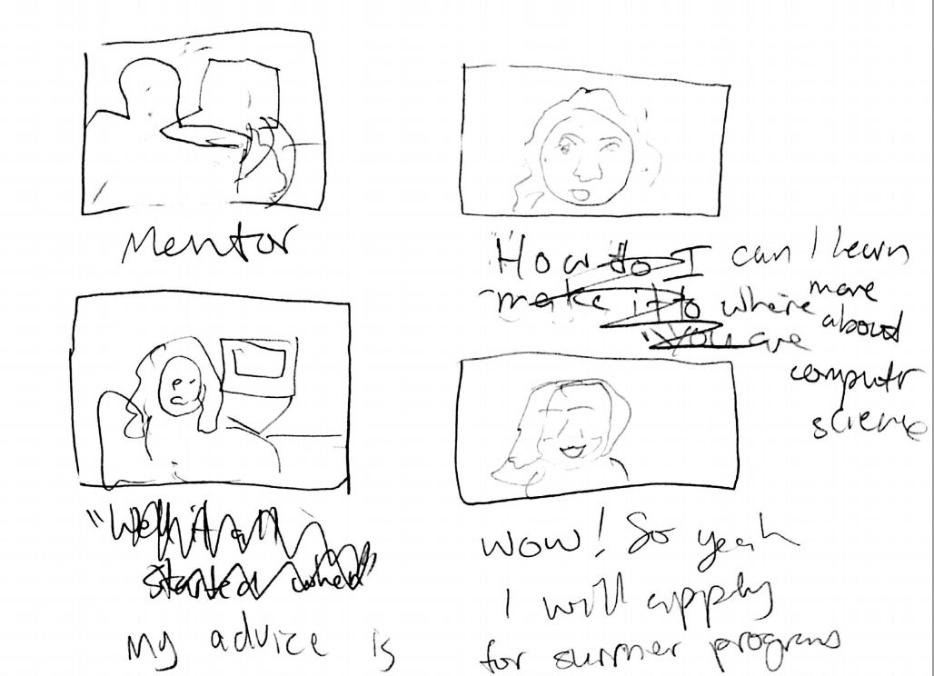
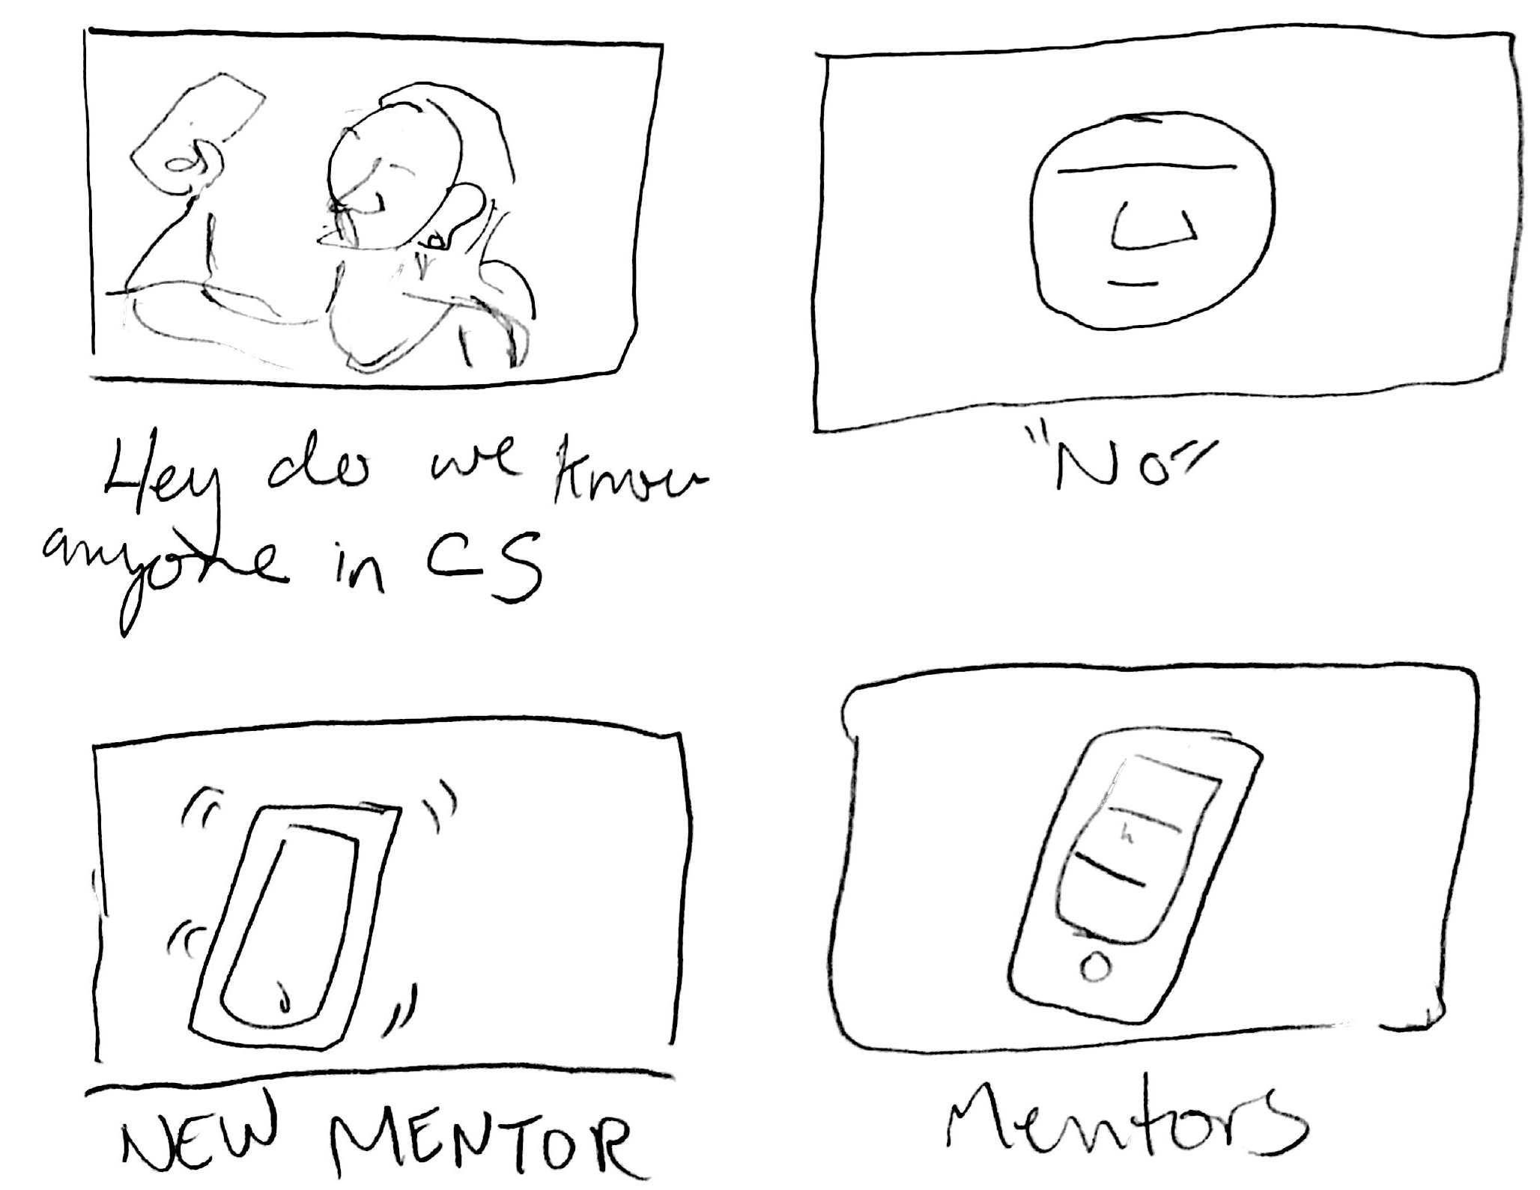
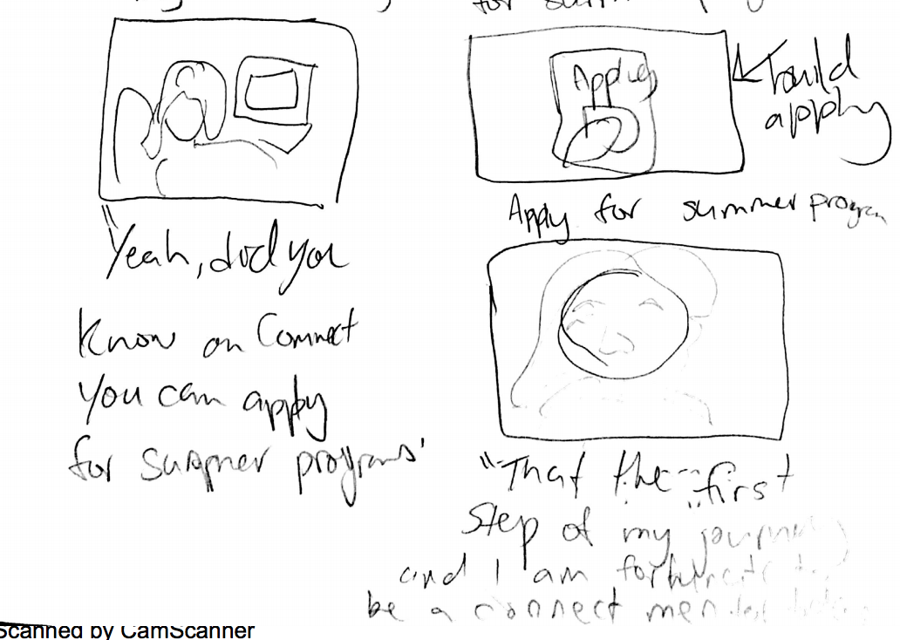

Slide 7
APPENDIX
Video: https://drive.google.com/a/stanford.edu/file/d/0Bxlk3B-IVP84amNPZG9tVF9NbTA/view?usp=sharing

