Slide 1
LIME
Low Income Minorities in Education
Notes:
Notes:
Small Sample
Support Teachers and Students than Help (Teachers already have a lot on their plate)
Emphasize diversity of interviews not individual

Slide 2
About Us
and
Our Project

Slide 3
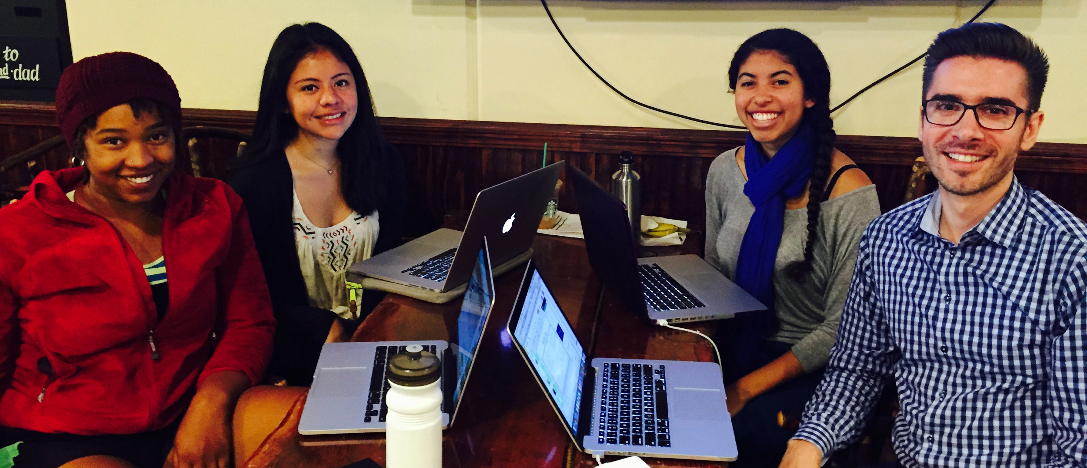
Sage, Betsy, Jasmine, Cristian
How to expose low-income minority students to STEM education

Slide 4
Needfinding Methodology
Notes:
1 - 2.5 -1.5 -3 -1

Slide 5
WHO and Why?
High school students
Pre-K teacher
Street Code Leaders
Notes:
Low income black Male Junior Female Sophomore
Diverse and not diverse schools
2nd Most diverse private high school in US
Almost all the teachers are white 36% white
98% Latino 100% free lunch
An enrichment program for low-income minority students.
Although not huge sample offers diverse perspectives

Slide 6
How and Where?
Street Code information session
Reaching out to a black high school junior attending The Bay School in the Precidia
Phoning César Chavez Elementary School Teacher
Google Hangout with high school sophomore at Saint Mary’s College High School
Notes:
During interviews we took detailed notes in a shared drive and went over each others notes to see if there were any gems missed

Slide 7
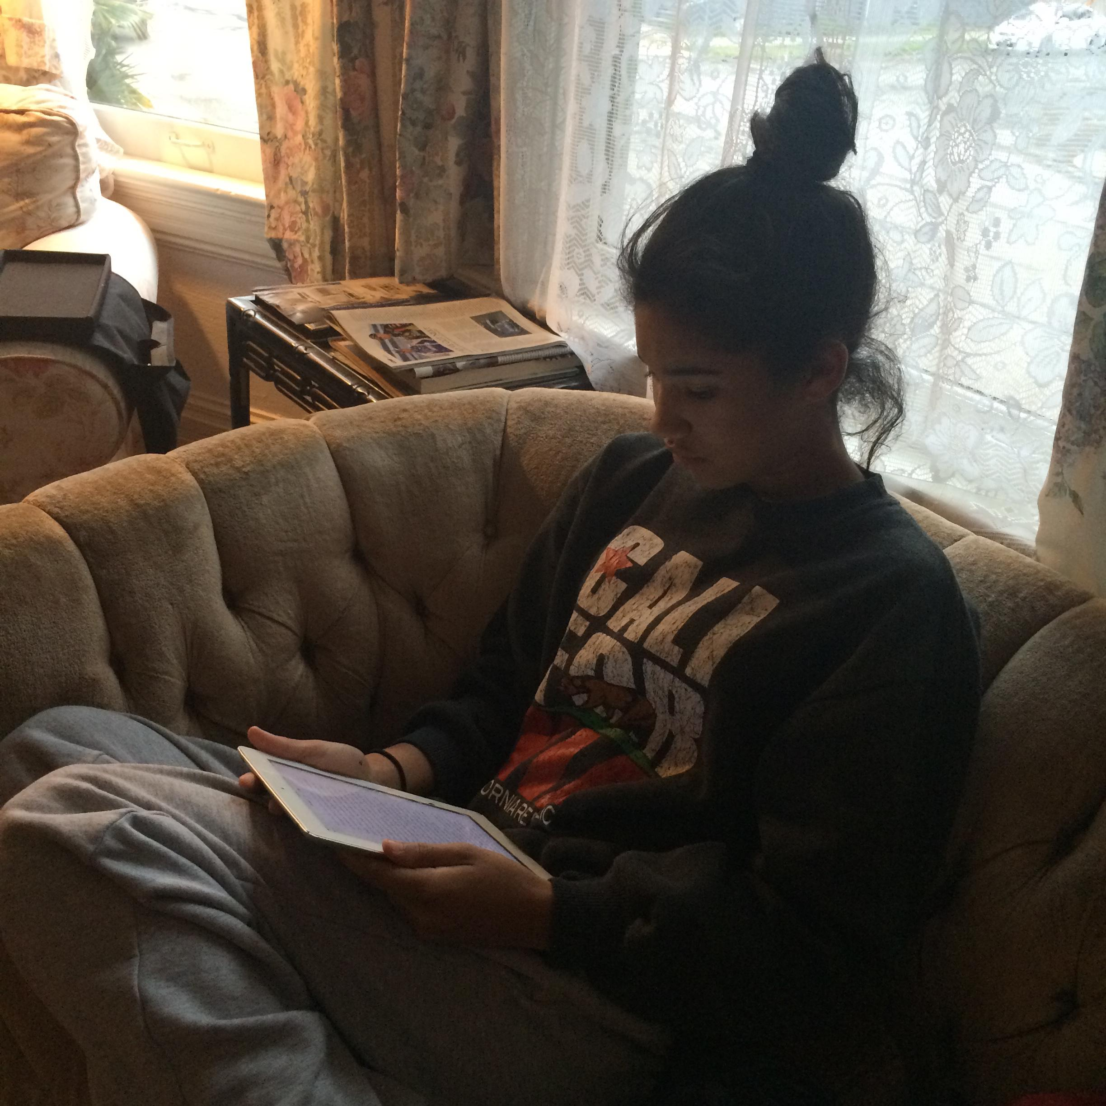
What?
Process of being in school
Impact of technology on classroom
Needs of minority low-income students
What is the benefit of enrichment programs
Are students’ needs being met in STEM classes/programs

Slide 8
Interview Results

Slide 9
“Popular things are sports, art, and drama, but not so much technology.”
K photo

Slide 10
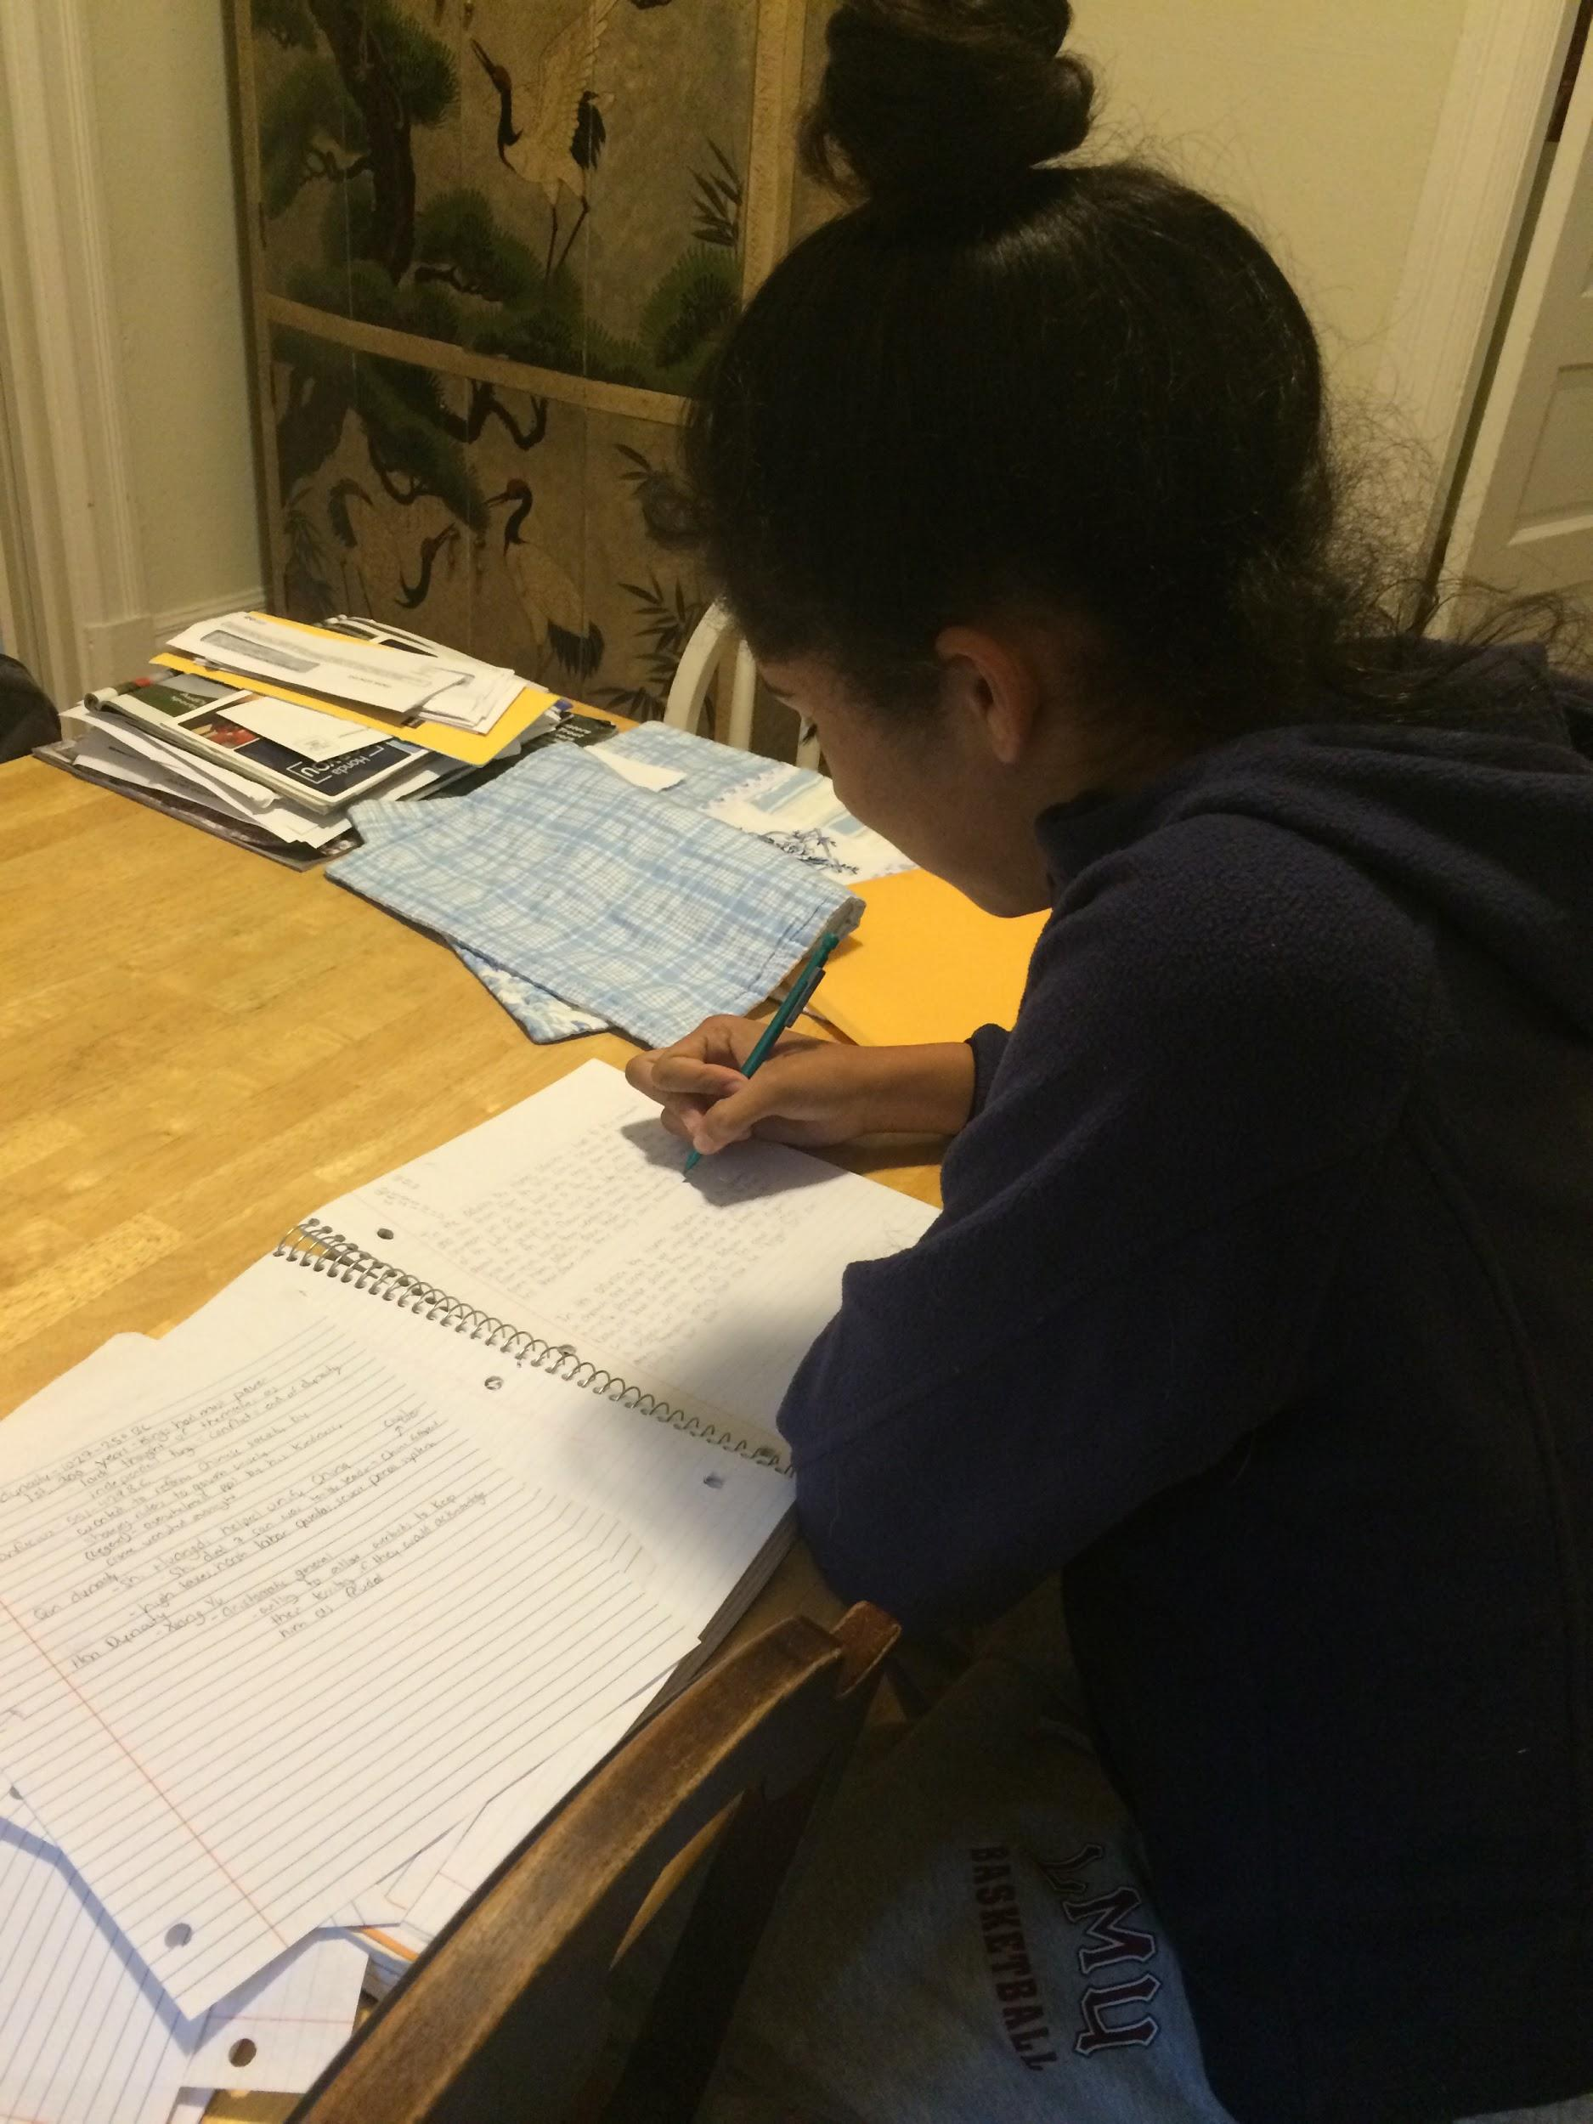
“I like science when I understand what’s going on.”

Slide 11
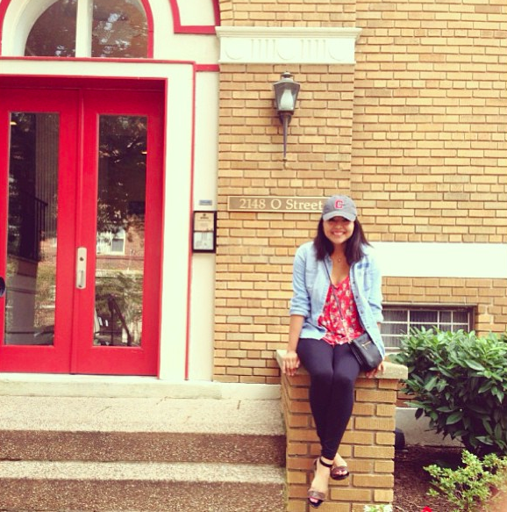
“Teachers need to know how to use tech. If teachers don’t know, then students won’t know.”

Slide 12
“The best way to keep kids with different levels of proficiency motivated is to have well prepared lectures.”

Slide 13
Analysis

Slide 14
Analysis
EdTech may enhance education but also increase social divide
Students excited by STEM if they understand
Students sometimes distracted while working in groups and/or with mobile devices
Combat distraction with tailored curriculum
Students are not familiar with STEM careers

Slide 15
Empathy Map - student
Say: “I like science when I understand it” -C “Gender is a bigger obstacle than race or class” -C “I hate online classes” - C “No one pays attention in class because they’re on their iPads” - C “Engineering is not advertised as a source of income” -K | Think: Minorities are less interested in STEM -C You work harder in a class you understand -C Engineering classes should be mandatory and applicable -K STEM subjects underemphasized in US-K Engineering is a “new” field -K
Do: C lit up with joy when talking about subjects she understood When studying: C more on her phone than actually studying C’s iPad is old so she spends a lot of time troubleshooting it K responded quickly about being interviewed | Feel: C- Happy when with friends in class C- Intimidated when she doesn’t understand something in class K is disappointed by the lack of diversity at his private school K thankful teacher in Malaysia inspired him to code K- enthusiastic about learning about his career options in STEM

Slide 16
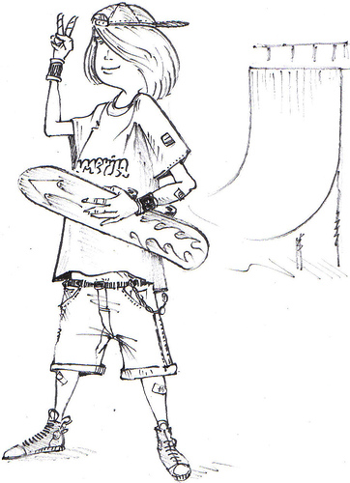
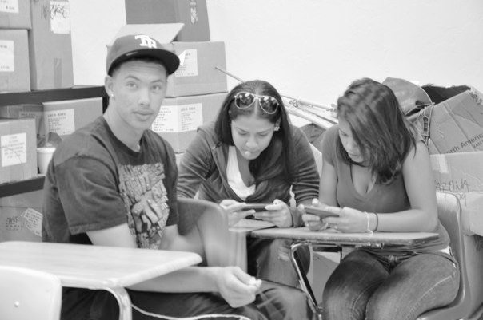
Say
Think
Do
Feel
Notes:
Say:
Engineering is not as popular as gaming, sports, art science can be cool when it is understood. Online classes are lame. Gaming is popular.
Gender is a bigger issue than race or class
No required engineering classes like in Malaysia
Think: Minorities are not as involved in STEM due to lack of exposure
Do: Works harder when a subject seems approachable
Codes in free time
Feel: Embarrassment that underrepresented minorities are less interested in STEM. K misses some elements of his Malaysian education. K is unsure of all of his career options in the U.S.

Slide 17
Empathy Map - Teacher
Say: “iPads encourage little wait time, but in the classroom they won’t get everything immediately” - L “Tech brings more info into the classroom” - L “Tech widens the social gap” - L “Kids work well by themselves but get distracted in a group” - M | Think: have high faculty to kids ratio! - M kids focus with good content - M teachers need to know how to use tech - L ed tech is for rich students - L Tech can enhance classrooms but also widens the gap between those who have/don’t have - L
Do: Insisted on integrating tech with classroom’s curriculum - Lesley Talked more about Lumosity than other ed tech products - L Prepared curriculum designed for different levels of coding proficiency - M | Feel: enthusiasm to help kids through Streetcode - M excitement about Lumosity because of the mind games - L nervous about the gap tech creates - L

Slide 18
say
think
do
feel
Notes:
Say: Technology has impacted student patience. Students work well alone and get distracted in groups.
Think: Teachers are crucial in integrating technology into classrooms. Some classrooms don’t have that so ed tech widens the gap between those have/don’t have.
Do: A lot of discussion about knowing how each classroom functions and individualized learning.
Feel: Enthusiasm and excitement about working with students. Nervous about the inclusion of ed tech.

Slide 19
needs
Insights
Kids need to focus in class
Students need to be able to understand materials
Students need to know their career options
Engineering is not seen as “cool”
Web classes are not enjoyable
Technology is distracting and useful
Technology can further increase the social divide
Students only get interested in STEM once exposed

Slide 20
Summary

Slide 21
A Multifaceted Problem
One Solution Cannot Fix Everything

Slide 22
APPENDIX
Detailed Empathy Maps

