Slide 1
Medium-Fi
Prototype
clicked
Gordon D. Michael K. Jake M. Krister J.

Slide 2
Mission Statement:

Slide 3
Mission Statement:
“Never Leave Class Confused.”

Slide 4
Problem/Solution Overview:
Problem:
Solution:

Slide 5
Problem/Solution Overview:
Problem:
Public Embarrassment ->
Students’ fear to admit that they don’t understand
Solution:

Slide 6
Problem/Solution Overview:
Problem:
Public Embarrassment ->
Students’ fear to admit that they don’t understand
Solution:
Temporary Anonymity

Slide 7
Problem/Solution Overview:
Problem:
Public Embarrassment ->
Students’ fear to admit that they don’t understand
Solution:
Temporary Anonymity
(Teacher can know who you are after class)

Slide 8
Task Overview:
Simple:
Moderate:
Complex:

Slide 9
Task Overview:
Simple: Students need to alert their teacher when they are confused in class.
Moderate:
Complex:

Slide 10
Task Overview:
Simple: Students need to alert their teacher when they are confused in class.
Moderate: Teachers need to effectively read the classroom to determine student understanding during a lecture.
Complex:

Slide 11
Task Overview:
Simple: Students need to alert their teacher when they are confused in class.
Moderate: Teachers need to effectively read the classroom to determine student understanding during a lecture.
Complex: Teachers need to update their next lesson after class based on what happened during class that day.

Slide 12
Low-fi Prototype Edit #1
More intuitive “All Clear” screen, prompting teacher to begin teaching.

Slide 13
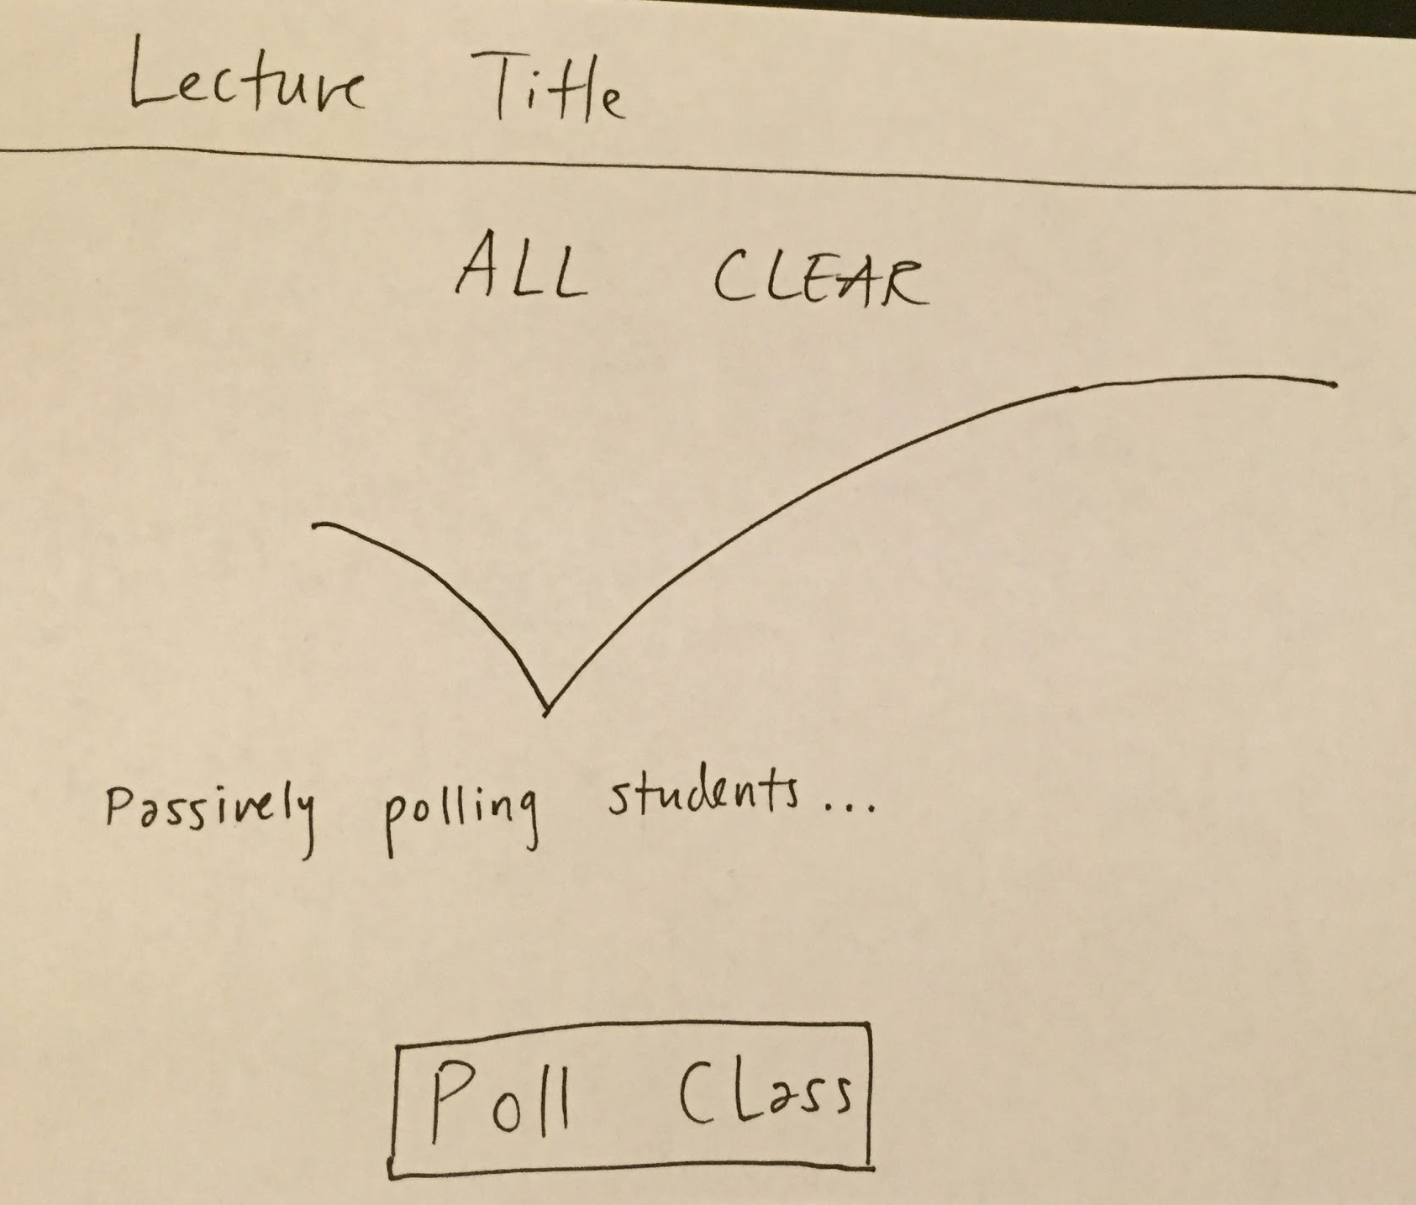
Low-fi Prototype Edit #1
More intuitive “All Clear” screen, prompting teacher to begin teaching.

Slide 14
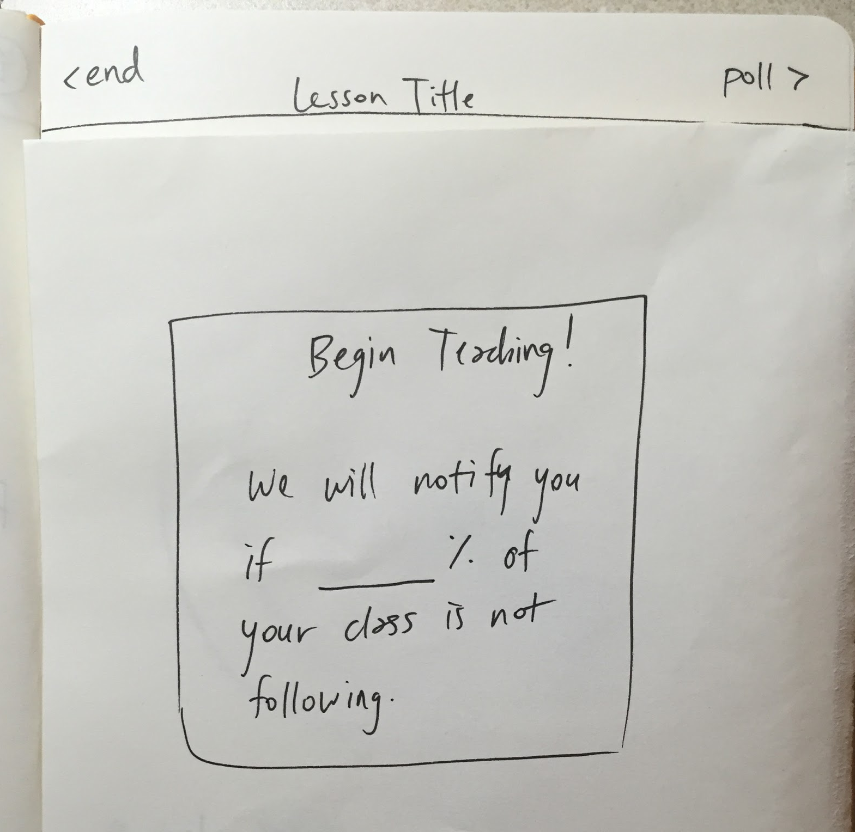
Low-fi Prototype Edit #1
More intuitive “All Clear” screen, prompting teacher to begin teaching.

Slide 15
Low-fi Prototype Edit #1
More intuitive “All Clear” screen, prompting teacher to begin teaching.

Slide 16
Low-fi Prototype Edit #1
More intuitive “All Clear” screen, prompting teacher to begin teaching.

Slide 17
Low-fi Prototype Edit #1
More intuitive “All Clear” screen, prompting teacher to begin teaching.

Slide 18
Low-fi Prototype Edit #2
Login Screen so as to identify students in teacher’s after-class summary.

Slide 19
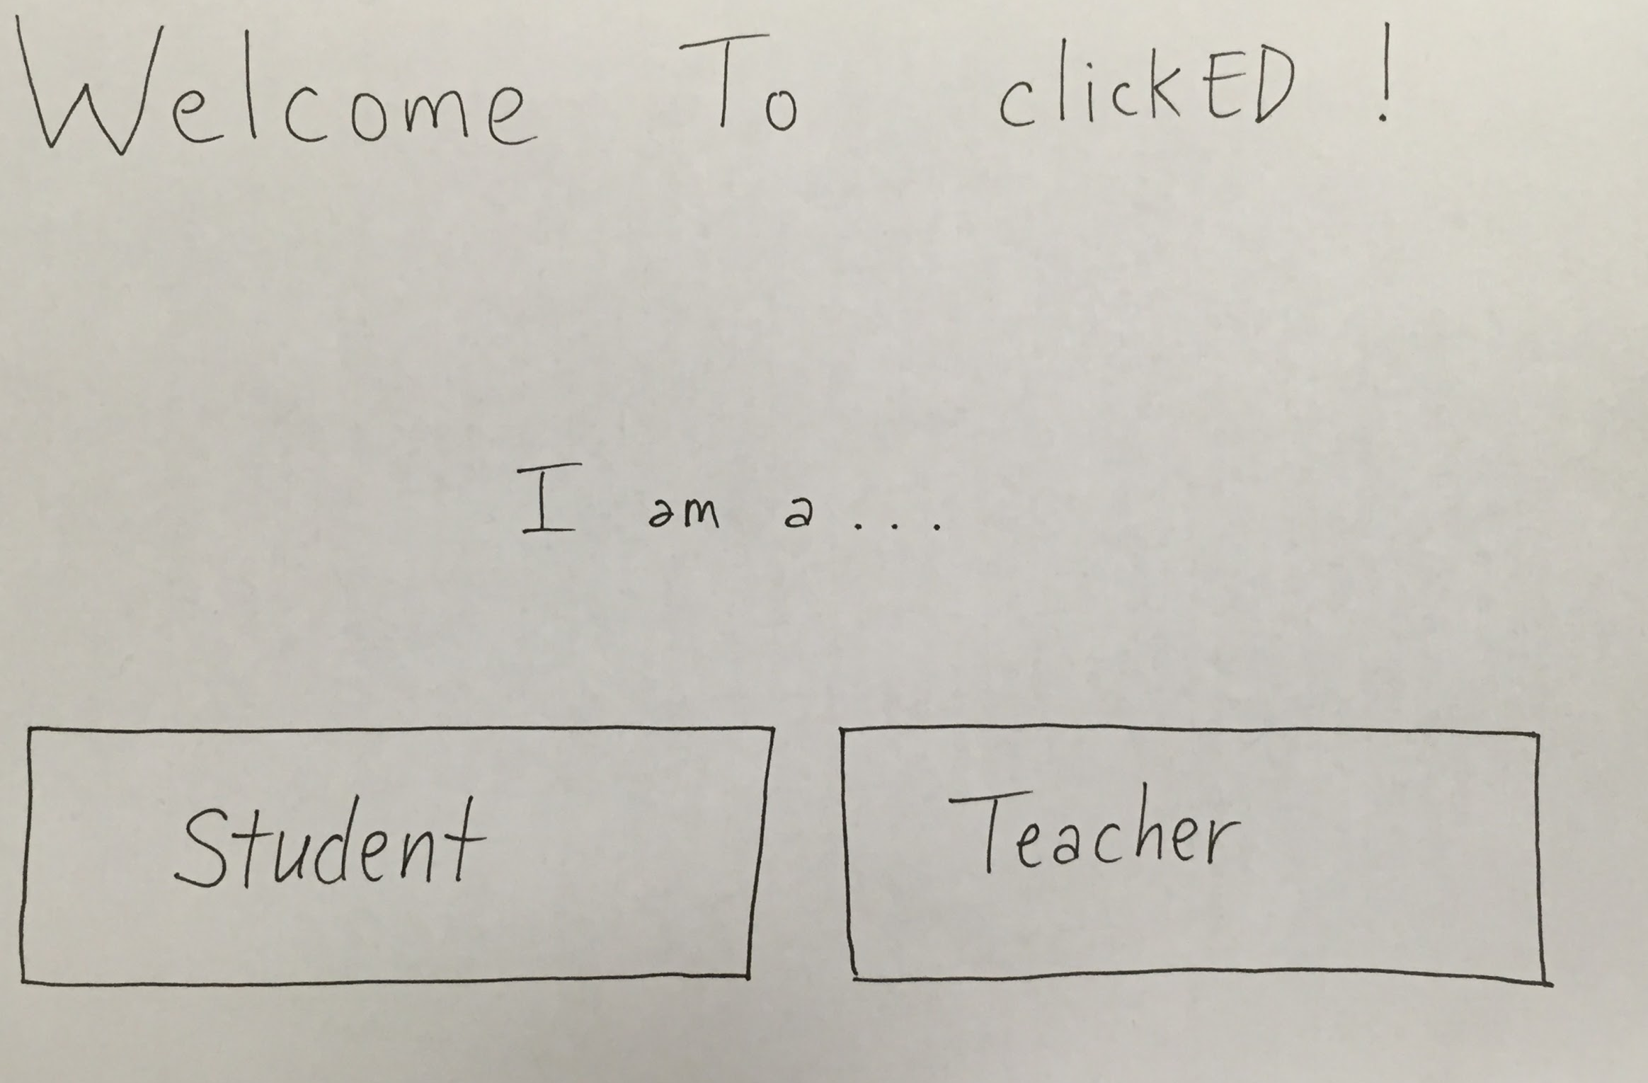
Low-fi Prototype Edit #2
Login Screen so as to identify students in teacher’s after-class summary.

Slide 20
Low-fi Prototype Edit #2
Login Screen so as to identify students in teacher’s after-class summary.

Slide 21
Low-fi Prototype Edit #2
Login Screen so as to identify students in teacher’s after-class summary.

Slide 22
Low-fi Prototype Edit #3
More specific feedback than just “I don’t understand.”

Slide 23
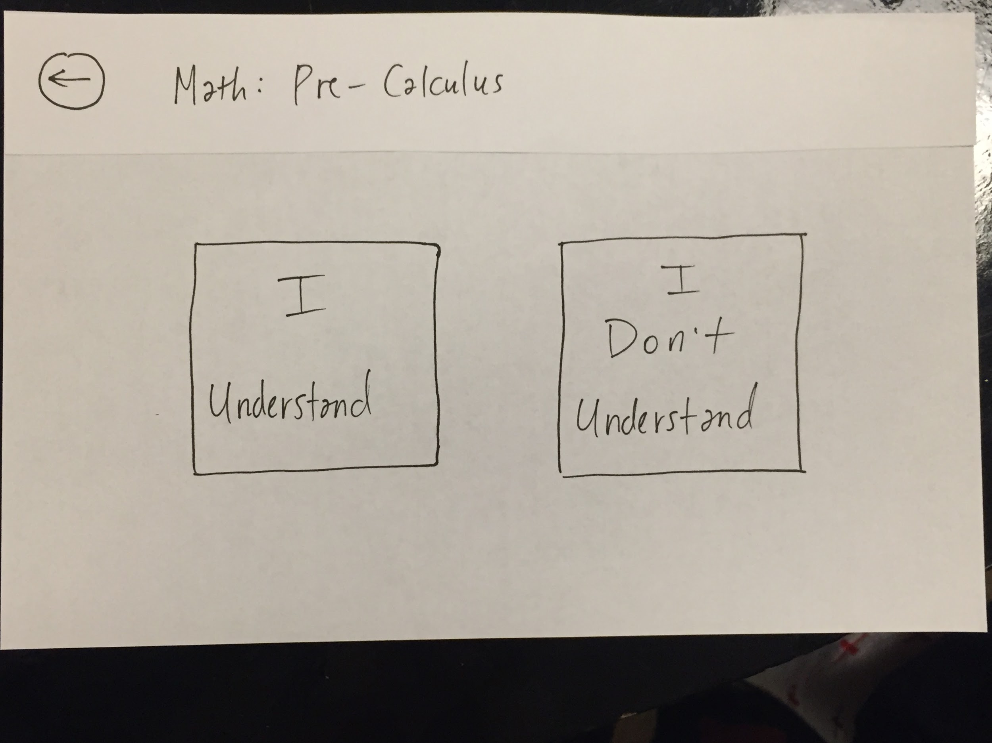
Low-fi Prototype Edit #3
More specific feedback than just “I don’t understand.”

Slide 24
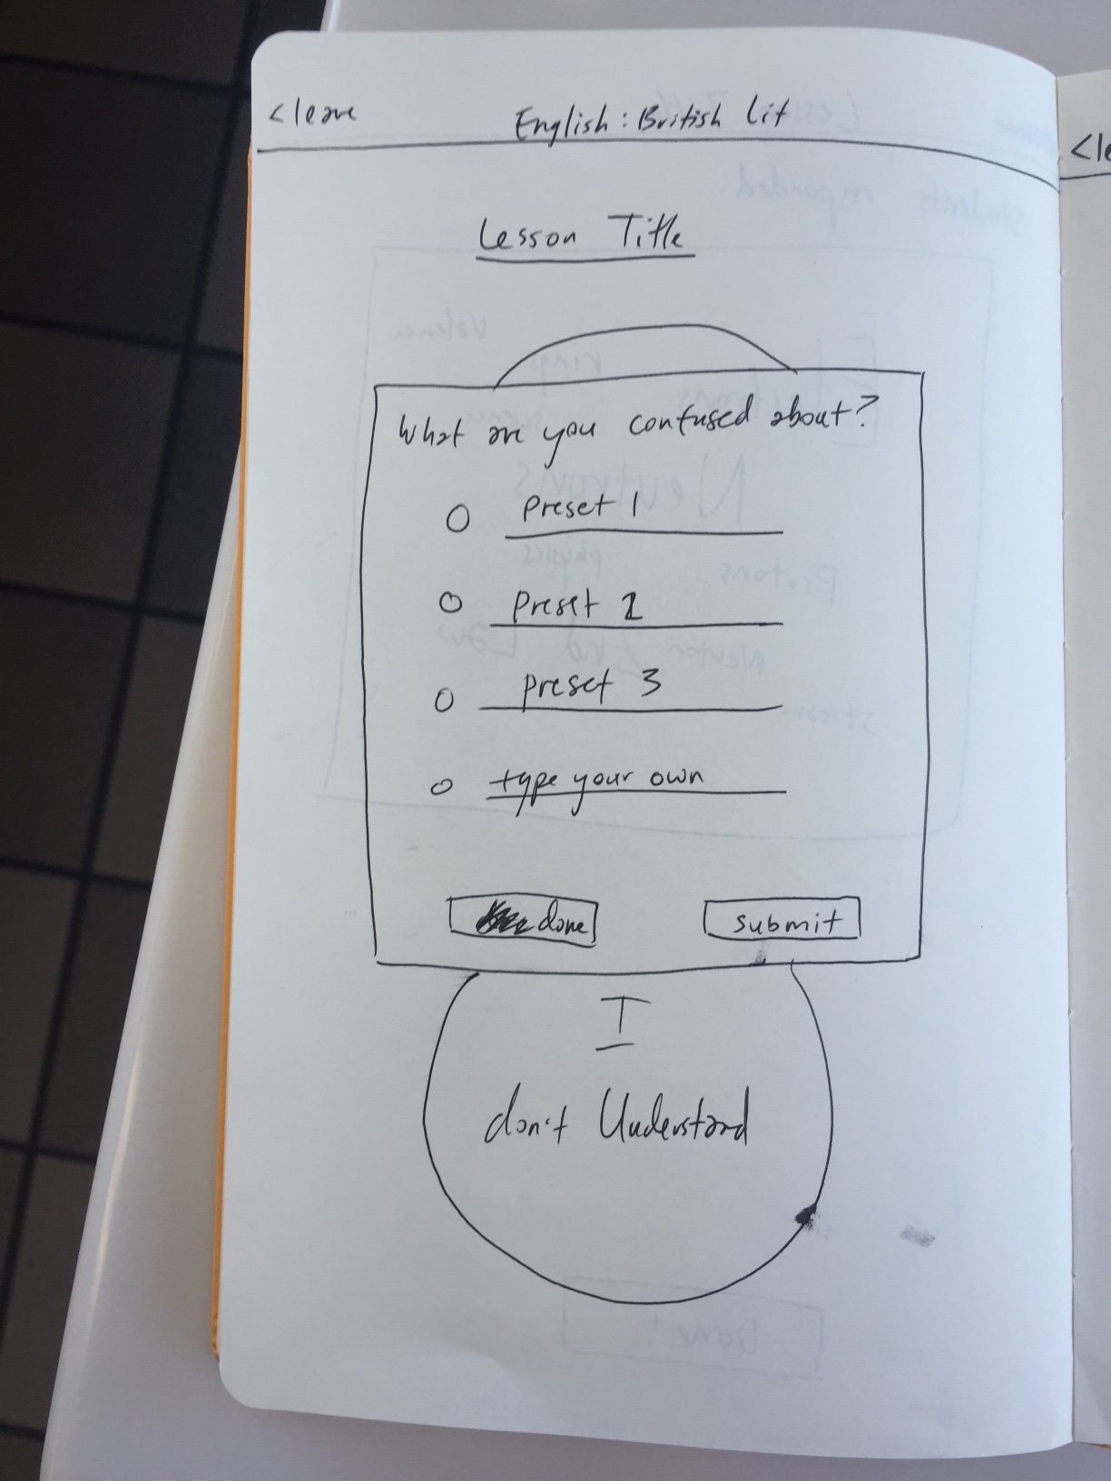
Low-fi Prototype Edit #3
More specific feedback than just “I don’t understand.”

Slide 25
Low-fi Prototype Edit #3
More specific feedback than just “I don’t understand.”

Slide 27
Low-fi Prototype Edit #3
More specific feedback than just “I don’t understand.”

Slide 28
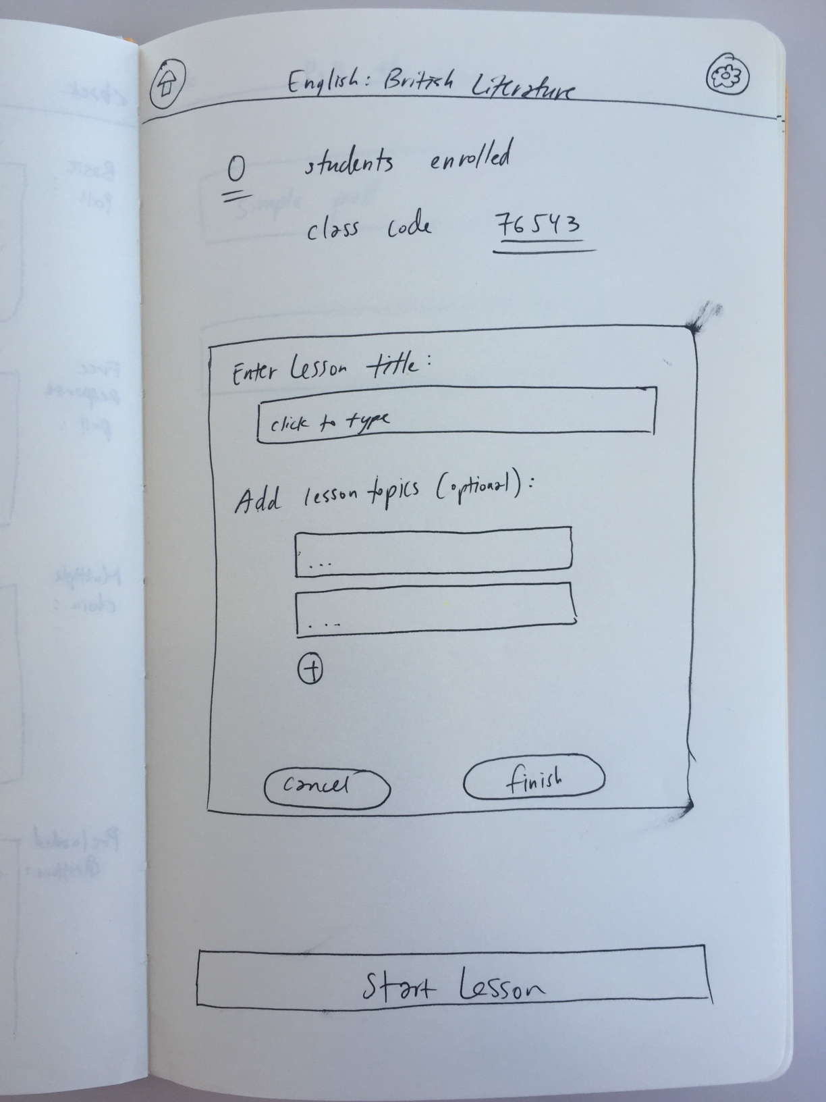
Low-fi Prototype Edit #3
More specific feedback than just “I don’t understand.”

Slide 29
Low-fi Prototype Edit #3
More specific feedback than just “I don’t understand.”

Slide 31
Low-fi Prototype Edit #3
More specific feedback than just “I don’t understand.”

Slide 32
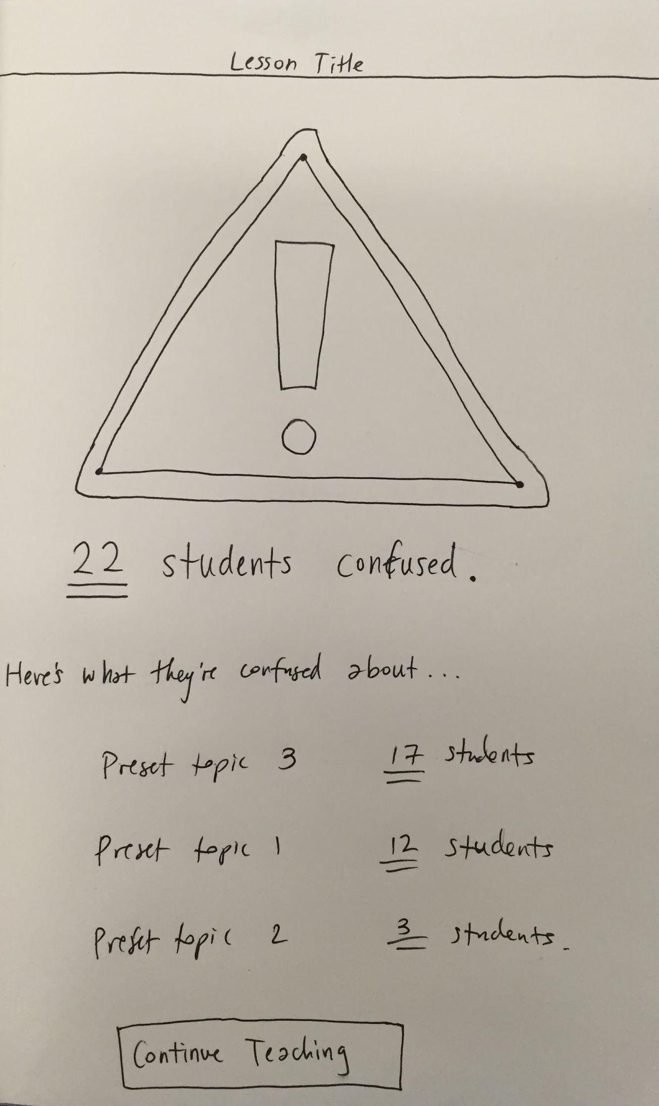
Low-fi Prototype Edit #3
More specific feedback than just “I don’t understand.”

Slide 33
Low-fi Prototype Edit #3
More specific feedback than just “I don’t understand.”

Slide 35
Low-fi Prototype Edit #3
More specific feedback than just “I don’t understand.”

Slide 36
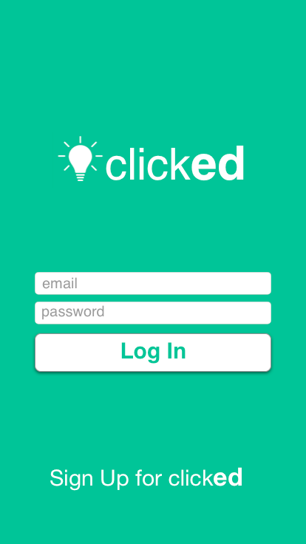
Task 1 Storyboard

Slide 37
Task 1 Storyboard

Slide 38
Task 1 Storyboard

Slide 39
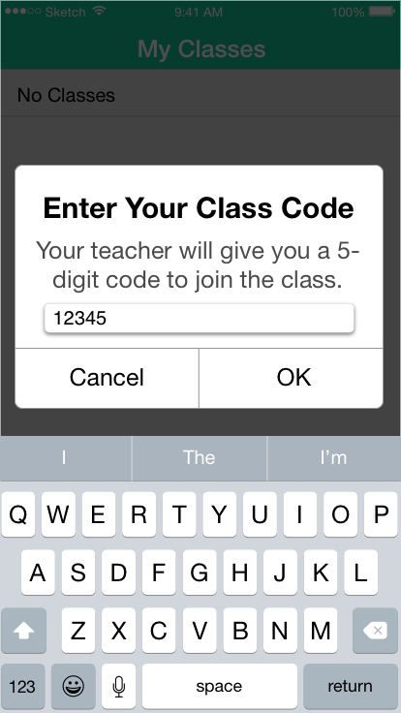
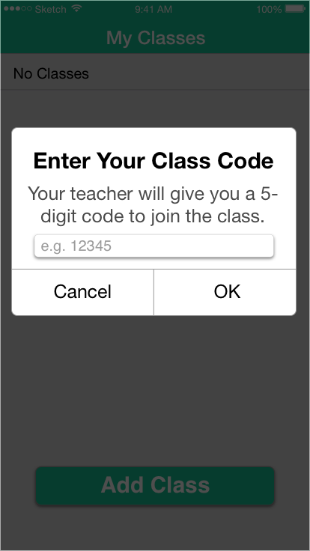
Task 1 Storyboard

Slide 40
Task 1 Storyboard

Slide 41
Task 1 Storyboard

Slide 42
Task 1 Storyboard

Slide 43
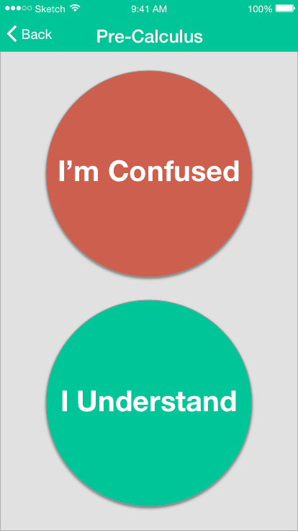
Task 1 Storyboard

Slide 44
Task 1 Storyboard

Slide 45
Task 1 Storyboard

Slide 46
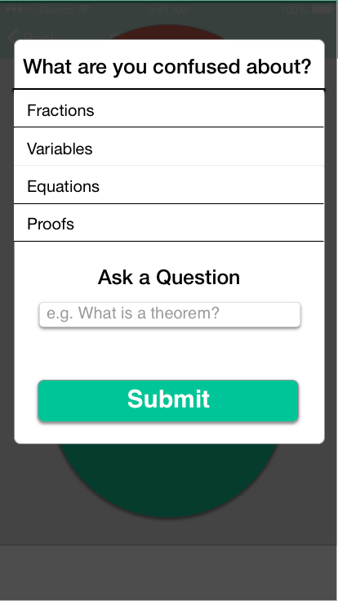
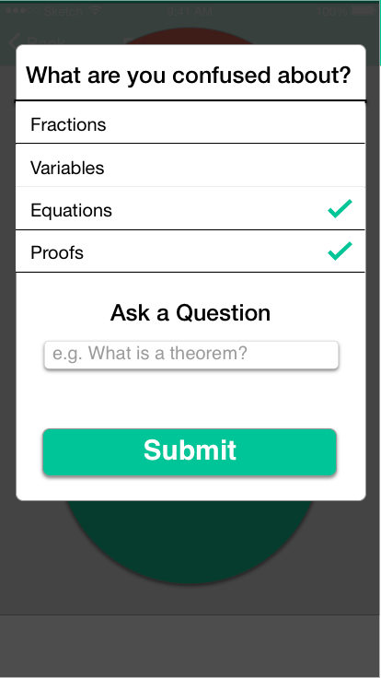
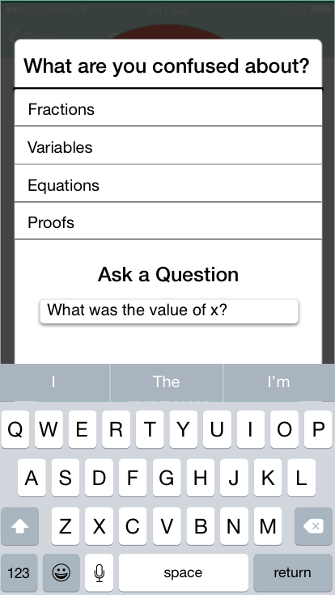
Task 1 Storyboard

Slide 47
Task 1 Storyboard

Slide 48
Task 1 Storyboard

Slide 49
Task 1 Storyboard

Slide 50
Task 1 Storyboard

Slide 51
Task 2 Storyboard

Slide 52
Task 2 Storyboard

Slide 53
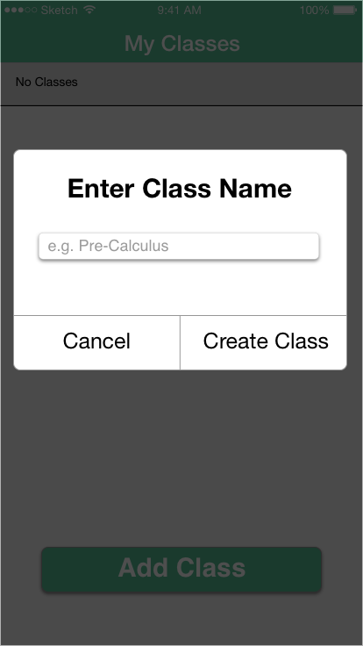
Task 2 Storyboard

Slide 54
Task 2 Storyboard

Slide 55
Task 2 Storyboard

Slide 56
Task 2 Storyboard

Slide 57
Task 2 Storyboard

Slide 58
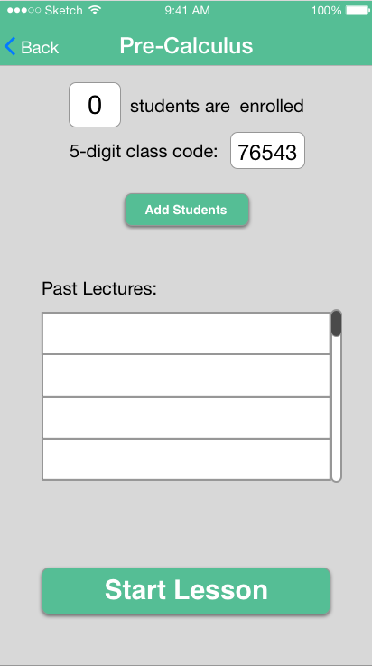
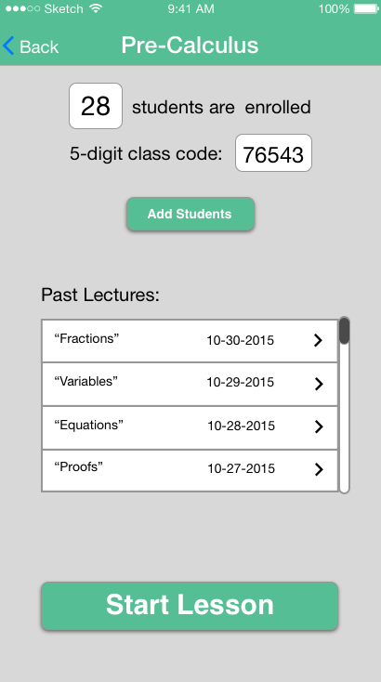
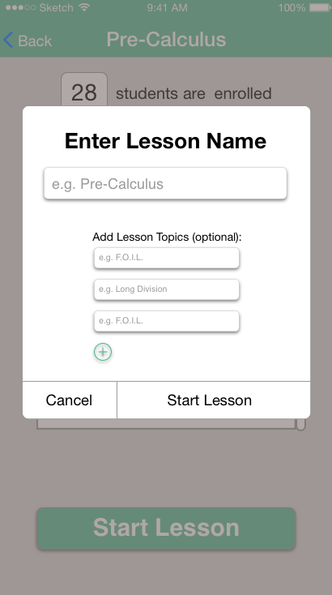
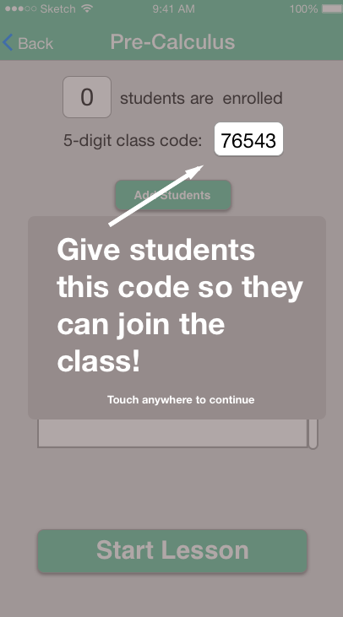
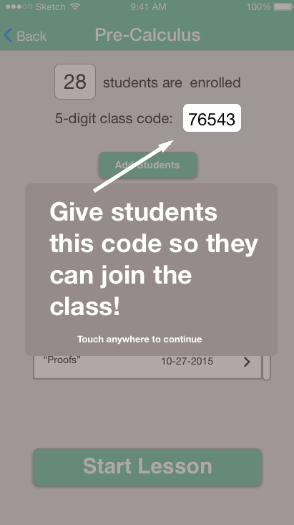
Task 2 Storyboard

Slide 59
Task 2 Storyboard

Slide 60
Task 2 Storyboard

Slide 61
Task 2 Storyboard

Slide 62
Task 2 Storyboard

Slide 63
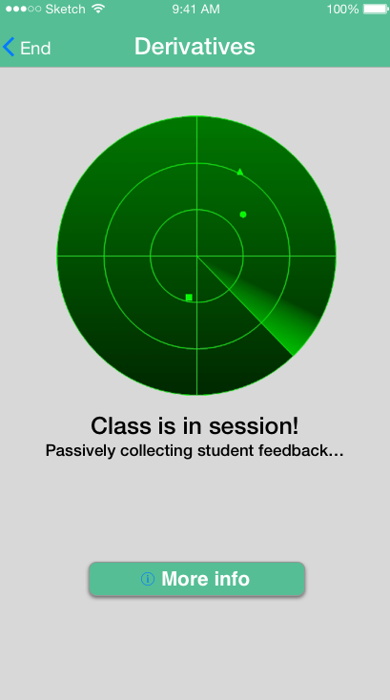
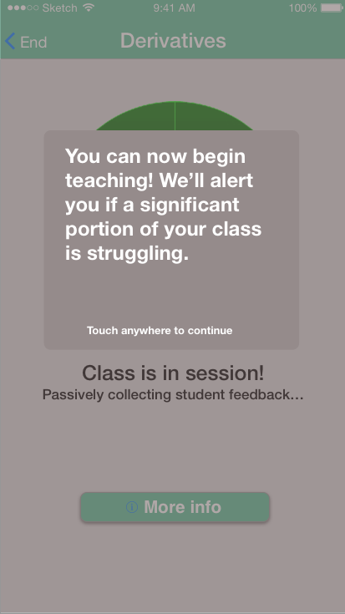
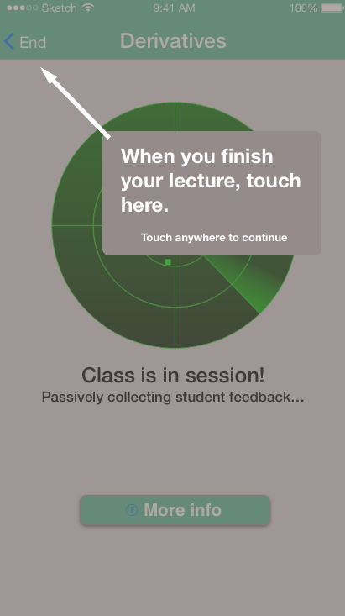
Task 2 Storyboard

Slide 64
Task 2 Storyboard

Slide 65
Task 2 Storyboard

Slide 66
Task 2 Storyboard

Slide 67
Task 2 Storyboard
Wizard of Oz technique!

Slide 68
Task 2 Storyboard
Wizard of Oz technique!
After 5 seconds, a timer prompts Marvel to transition to the “Threshold Exceeded - 28 students confused” screen

Slide 69
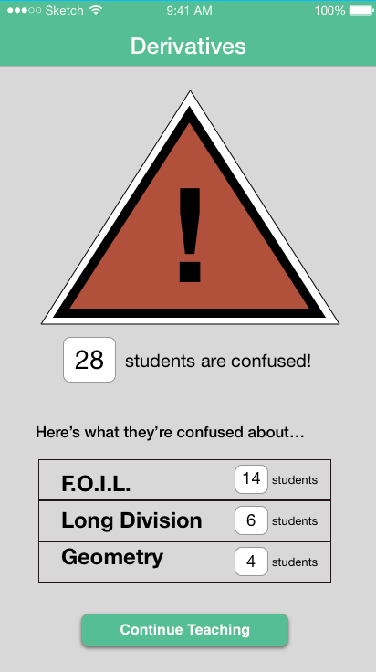
Task 2 Storyboard

Slide 70
Task 2 Storyboard

Slide 71
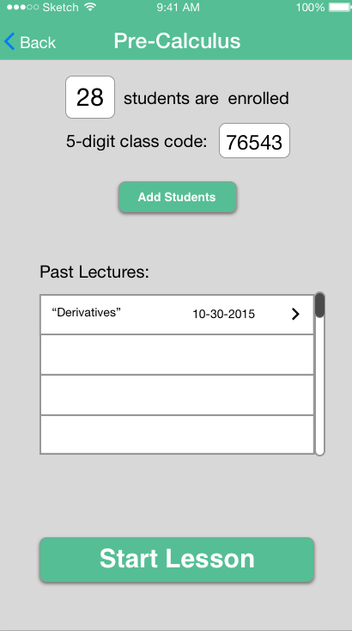
Task 3 Storyboard

Slide 72
Task 3 Storyboard

Slide 73
Task 3 Storyboard

Slide 74
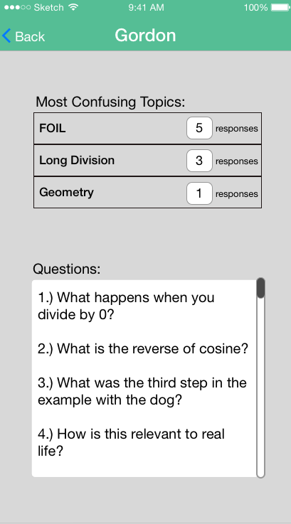
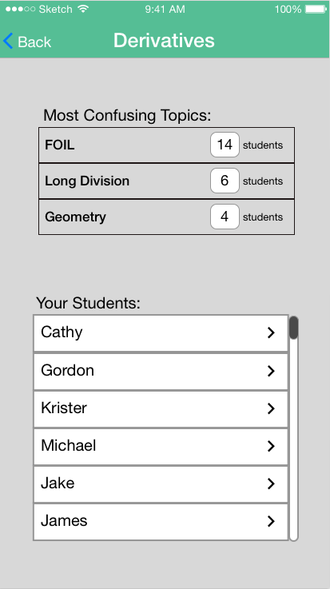
Task 3 Storyboard

Slide 75
Task 3 Storyboard

Slide 76
Task 3 Storyboard

Slide 77
Task 3 Storyboard

Slide 78
Prototyping Tools
Sketch

Slide 79
Prototyping Tools
Marvel

Slide 80
Prototyping Tools
+
Sketch
Marvel

