Slide 1
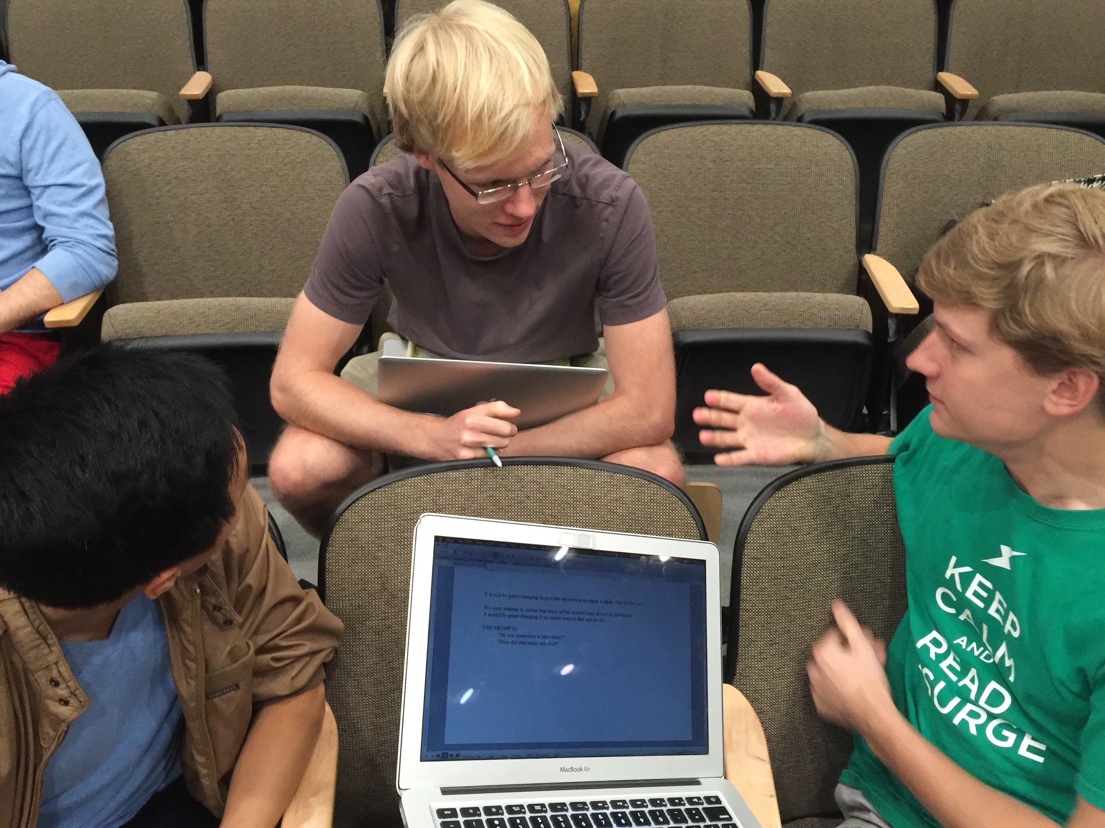
Experience Prototypes
Click Education

Slide 2
Problem Domain
Education
↓
K-12
↓
High School

Slide 3
Initial POV
We met: honors high school students
We were amazed to find that: their success did not stem from any interest in learning but rather from their ability to “play” school well
It would be game changing if: we could instill legitimate intellectual curiosity in these students

Slide 4
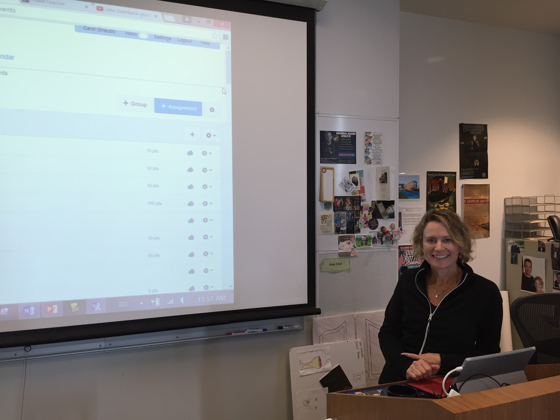
Who we interviewed:
Four additional high school students and teachers
What we found out:
“The iPad has the potential to cultivate connection, but it currently does the opposite.”
Students currently don’t have a means to give feedback to teachers
Students are frustrated when they have too many tests and papers scheduled for the same day

Slide 5
Problem Domain
Education
↓
K-12
↓
High School
↓
Improving Student - Teacher Interaction

Slide 6
POV #1
POV #2
HMW #1
HMW #2
HMW #3
Solution #1
Solution #2
Solution #3

Slide 7
POV #1
We met: Mrs. Woodward, a teacher who constantly updated her lectures to make them more relevant and engaging.
We were amazed to find that: Mrs. Woodward chose to sacrifice teaching time to engage her students because she considered student attention to be the most important factor in her students’ learning.
It would be game-changing we: could give teachers immediate feedback on how engaging they were being.

Slide 8
POV #2
We met: Elizabeth, a student who was incredibly frustrated about having too many tests and papers due on the same day
We were amazed to find that: even though a tool exists to help teachers plan around student conflicts, the tool added so much time to the scheduling process that teachers didn’t actually use it
It would be game-changing if: we could shift this burden from teachers and onto students who have the most at stake

Slide 9
HMW #1: How might we turn negative feedback on lectures into positive feedback?
HMW #2: How might we push the students to be the ones who are making the class engaging?
HMW #3: How might we give students a voice in scheduling exams and large assignments?

Slide 10
Solution #1: Read students’ minds every time the students think something is going well in class
Solution #2: Peer Instruction app that pairs up students who understand with those who don’t
Solution #3: Heat-map of what days the students have the most exams/assignments scheduled

Slide 11
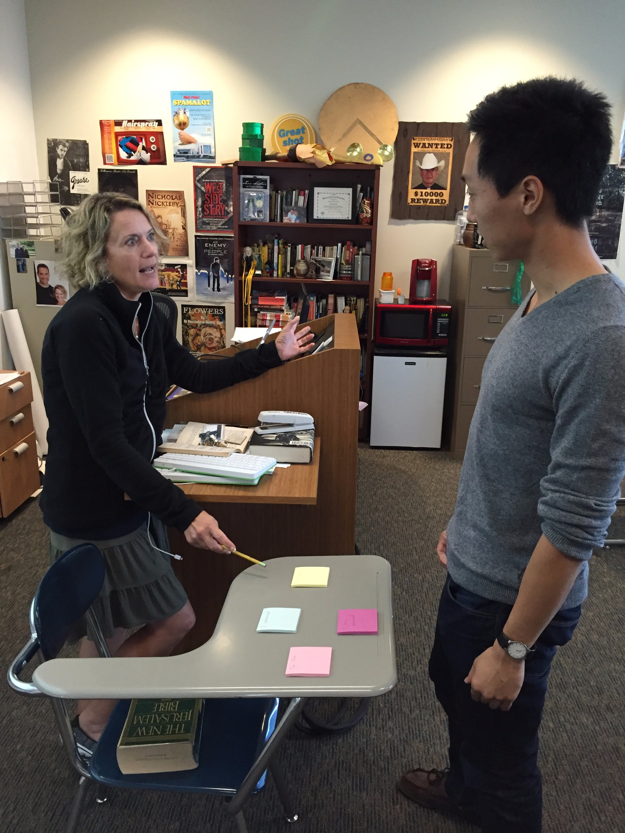
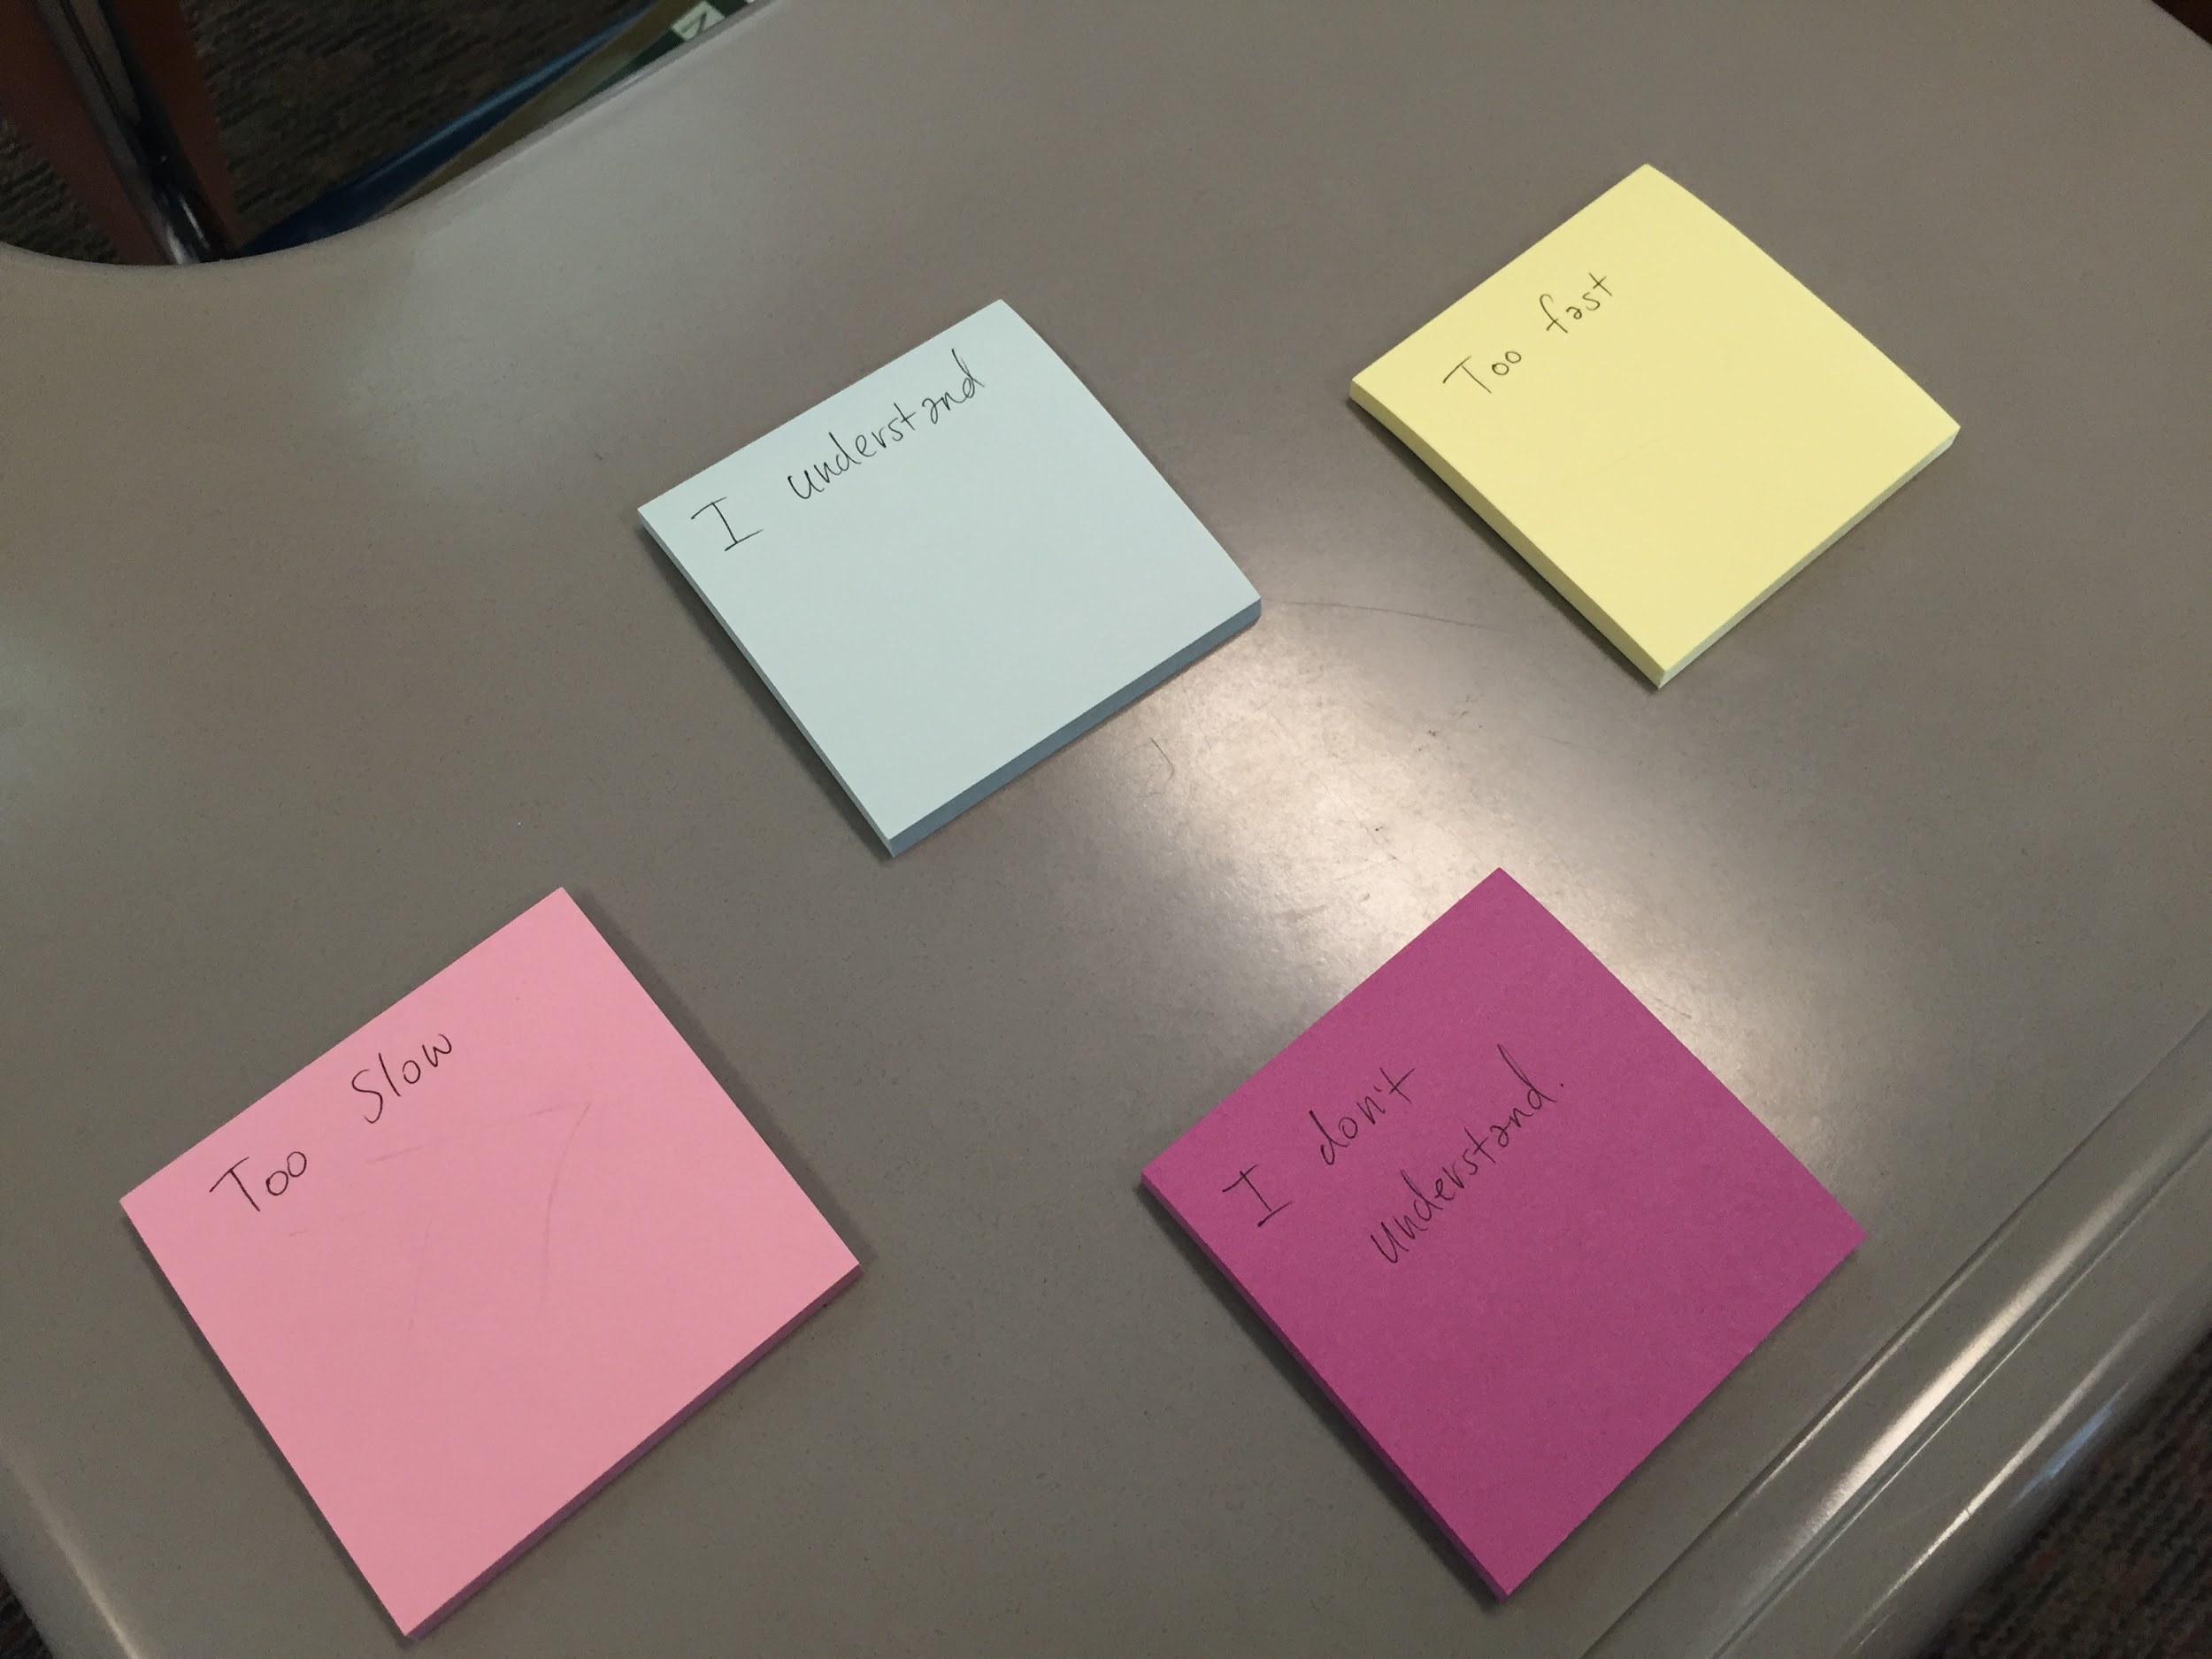
Prototype #1

Slide 12
Results
Things that worked:
The scenario gave the teacher an accurate representation of what it would be like to receive feedback in real time
Things that didn’t work:
The teacher found the feedback during the lecture to be distracting
Because it was one teacher to one student, we were not able to simulate demand from multiple students

Slide 13
Results
Surprises:
Despite indicating that she wanted feedback, she was visibly discouraged by the “Too fast” and “I’m confused” notes
New learnings:
She wouldn’t stop the lecture if just one student was confused, but if there were three or more she would
Although she didn’t want all the notifications mid-lecture, she definitely wanted the data to consult after class

Slide 14
Validity
Initial Assumption:
Even though our original assumption was shown to be incorrect, the teacher indicated that the data used in a slightly different context would be incredibly helpful
New Assumptions:
That students would actually be comfortable providing feedback or indicating that they don’t understand
And that students and teachers would not be distracted

Slide 15
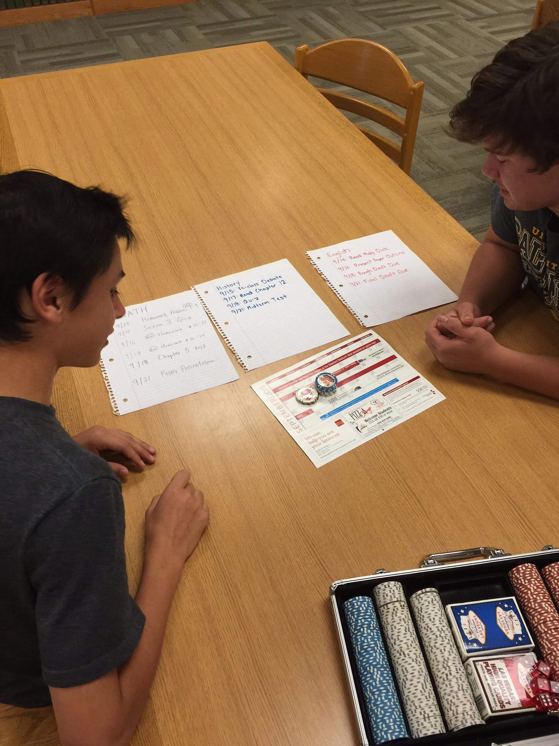
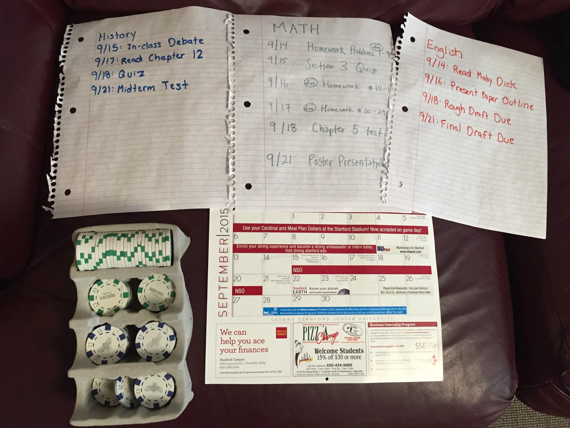
Prototype #2

Slide 16
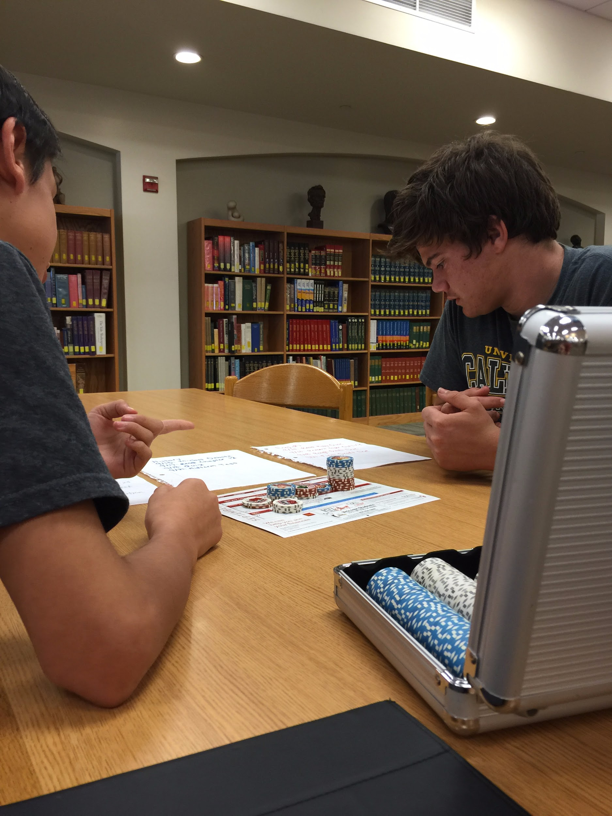
Results
Things that worked:
The 3D stacks did a great job of making the visual impact we wanted
Things that didn’t work:
Students thought that there needed to be more variability in point values for different assignments

Slide 17
Results
Surprises:
Students did not plan more than one day ahead
Students felt uncomfortable asking for extensions or to reschedule tests when they had conflicts
New learnings:
Students were frustrated with their parents nagging them about what they had to do for homework

Slide 18
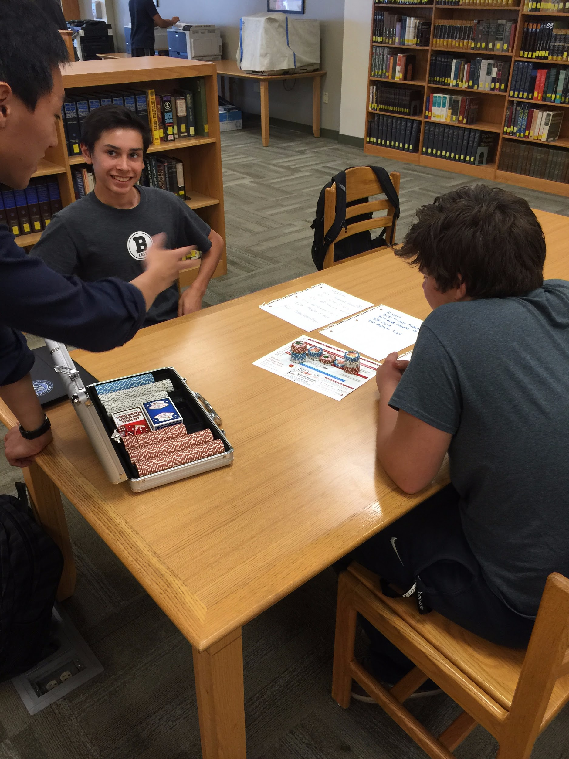
Validity
Initial Assumption:
We confirmed that the physical representation of work made the students more aware
New Assumption:
That students would be willing to put in the work themselves to fill this out

Slide 19
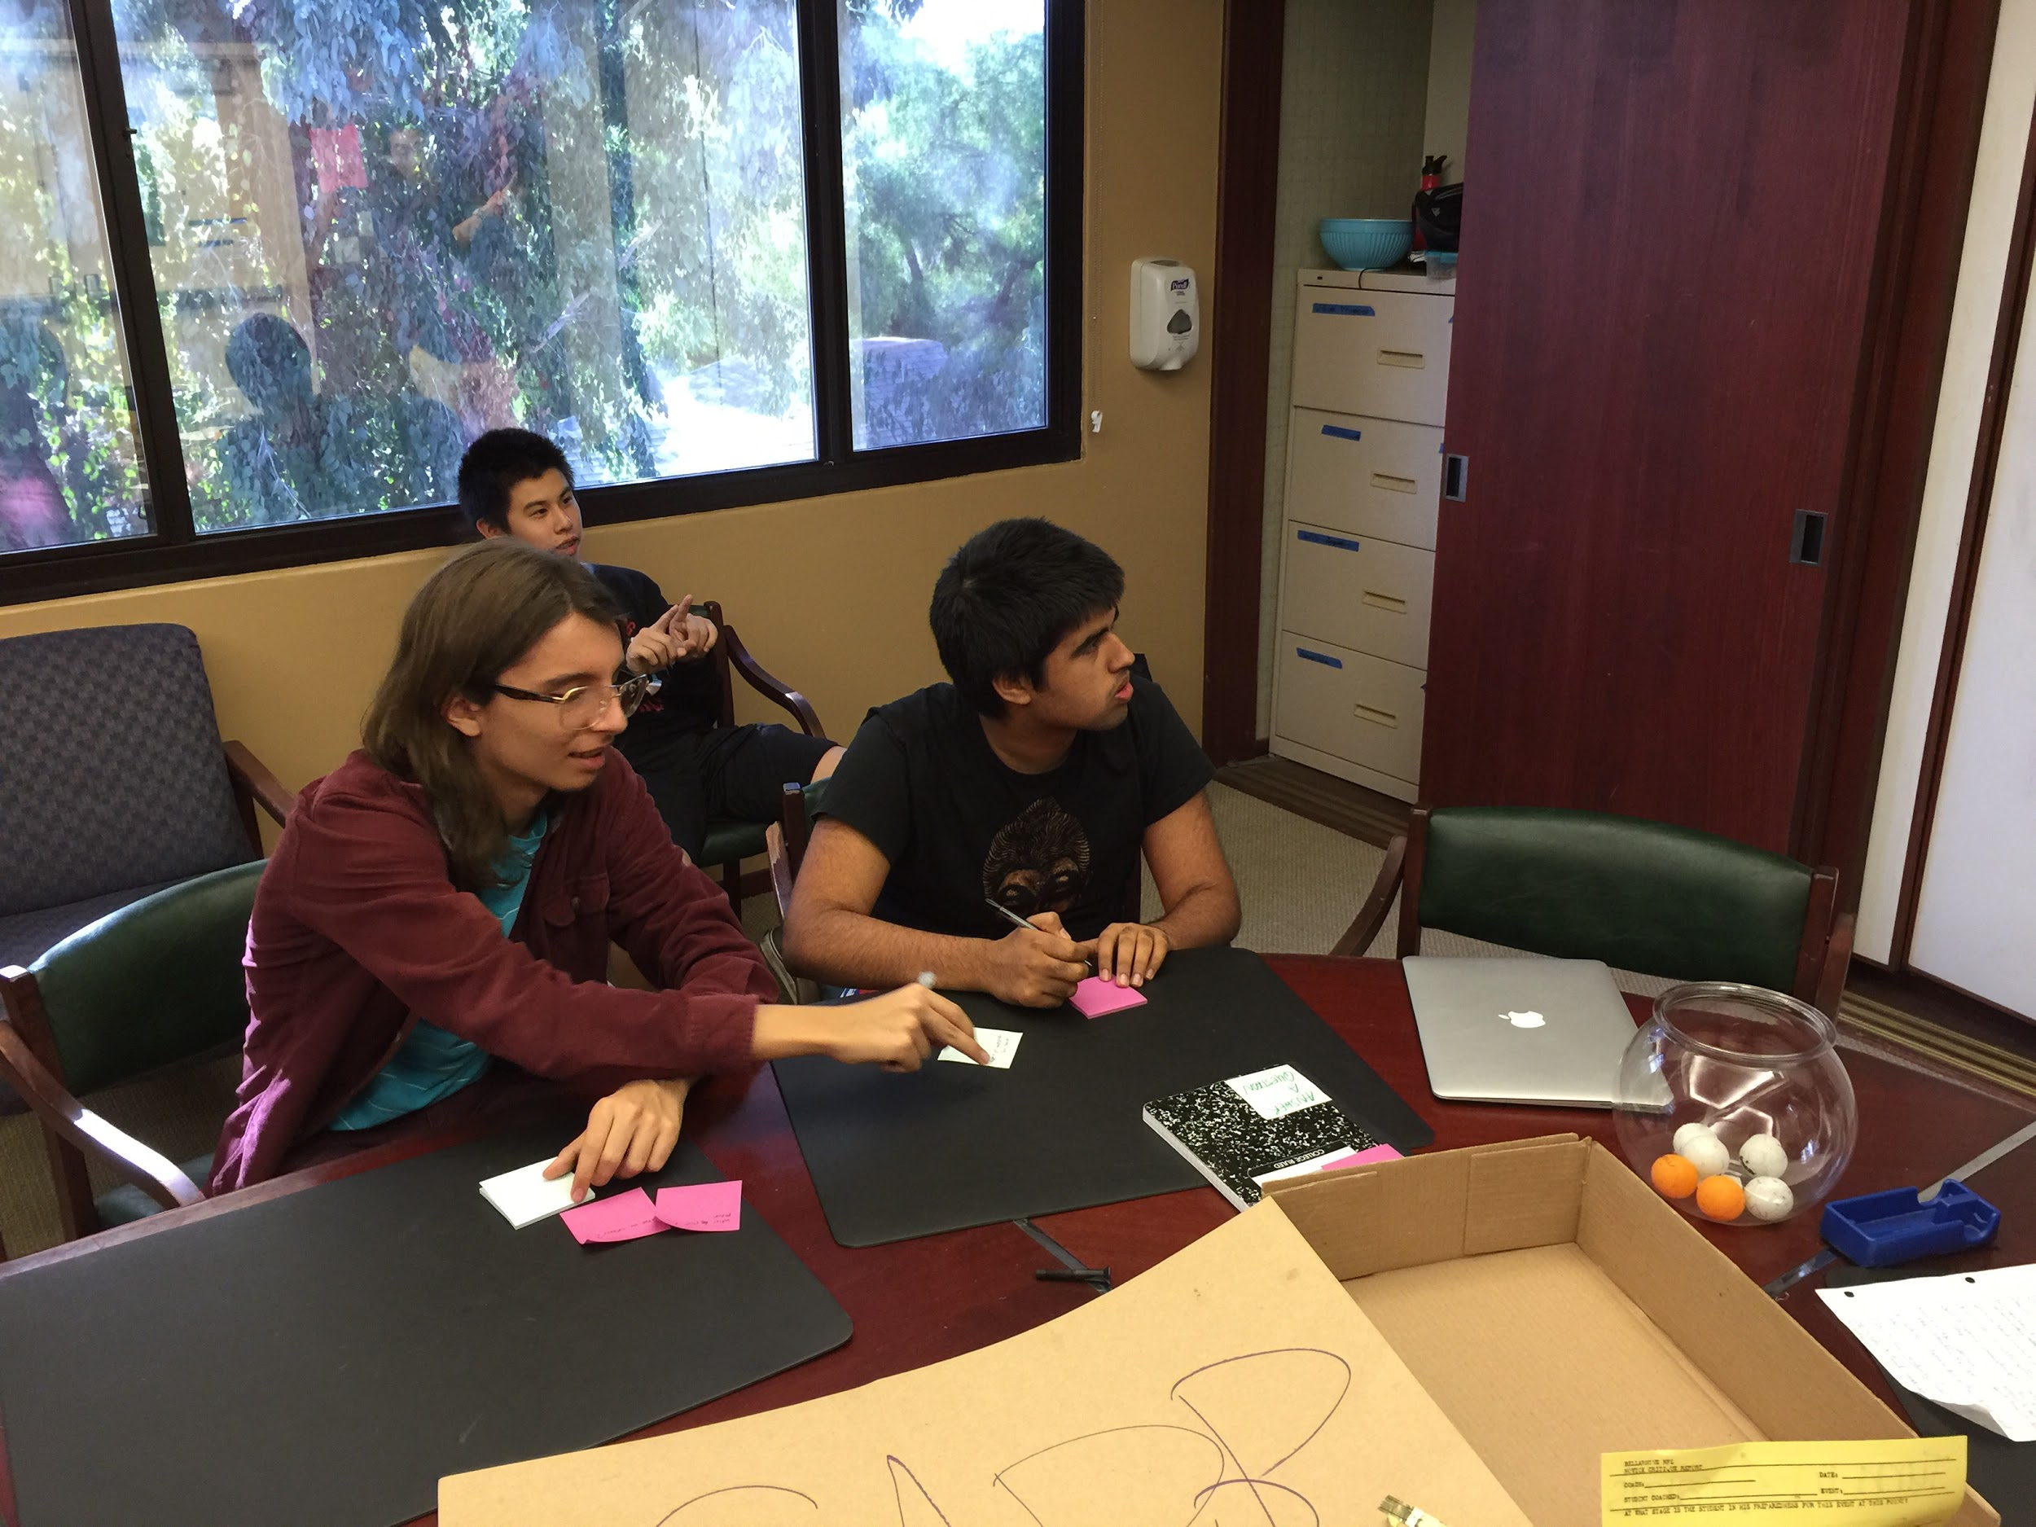
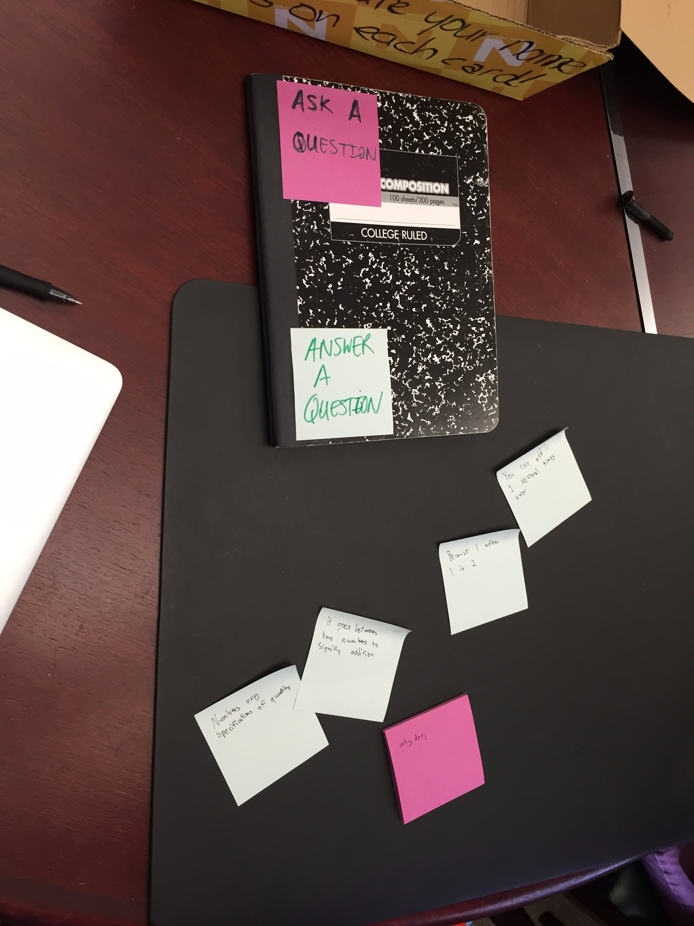
Prototype #3

Slide 20
Results
Things that worked:
The process wasn’t distracting to the third-party participant
Despite the awkward group size, the ping pong balls effectively conveyed the random pairing
Things that didn’t work:
Both the “asker” and the “answerer” were distracted while writing out their questions and answers

Slide 21
Results
Surprises:
Even though the students confirmed that people ask each other questions during class, the current method wasn’t distracting
New learnings:
We had assumed that anonymity would be prefered, but the students thought that the responses would be better if the “answerer” could receive recognition

Slide 22
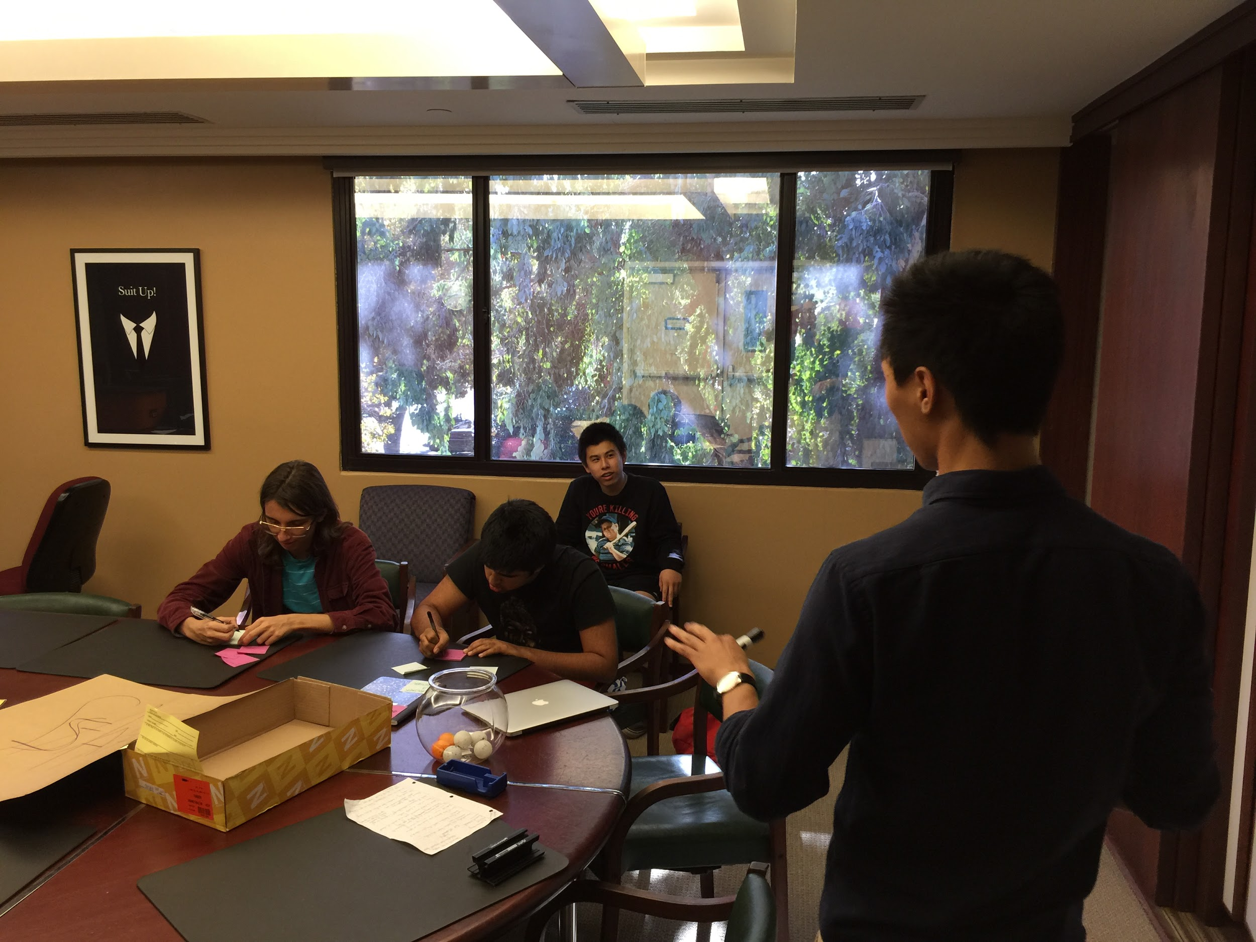

Slide 23
Validity
Initial Assumption:
Our solution turned out to be more distracting than the status quo because the act of reading and writing the questions and answers took too much time and attention
New Assumption:
Any in-class pairing or additional inter-student communication would be too distracting

Slide 24
clickED
Instant Student Feedback

