Slide 1
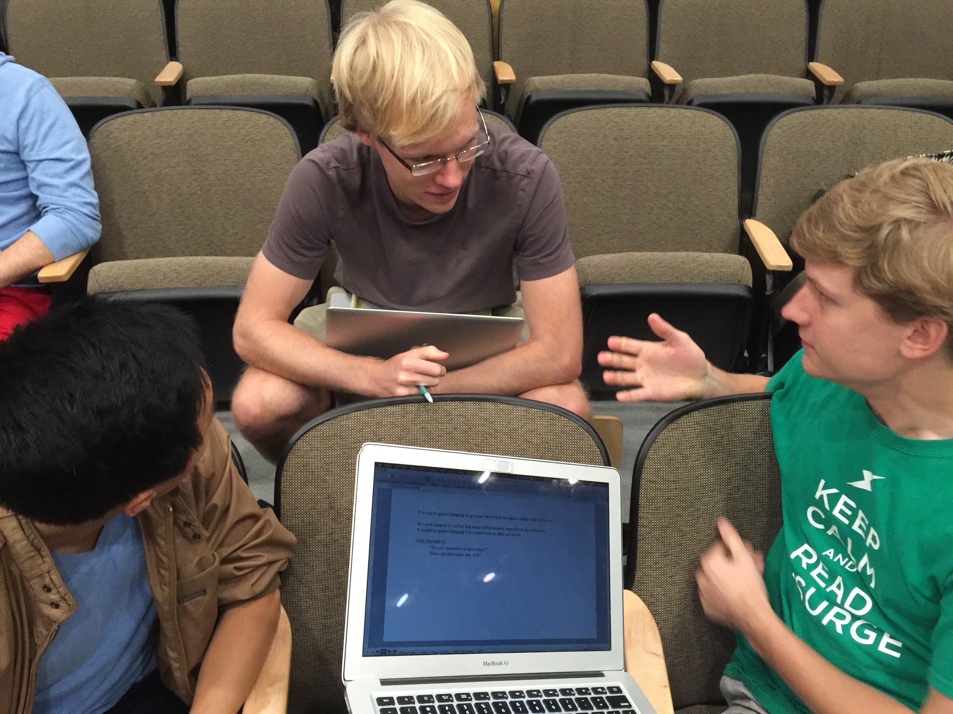
Needfinding
Michael Kim, Gordon Dean,
Jake McKinnon, Krister Johnson

Slide 2
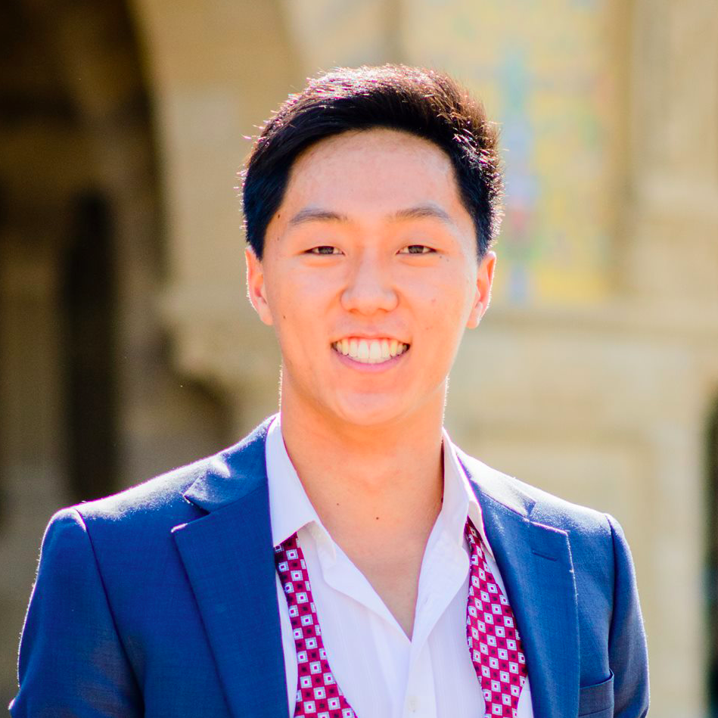
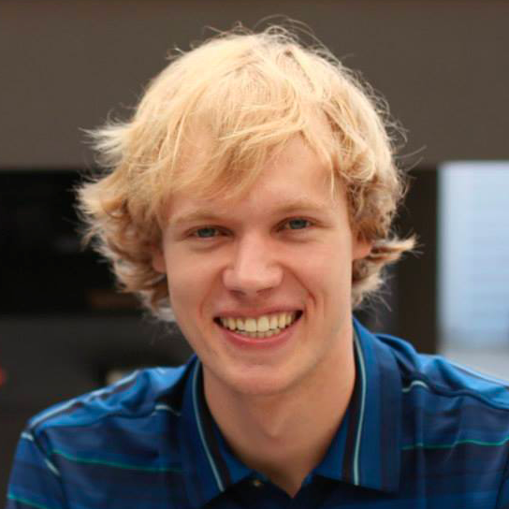
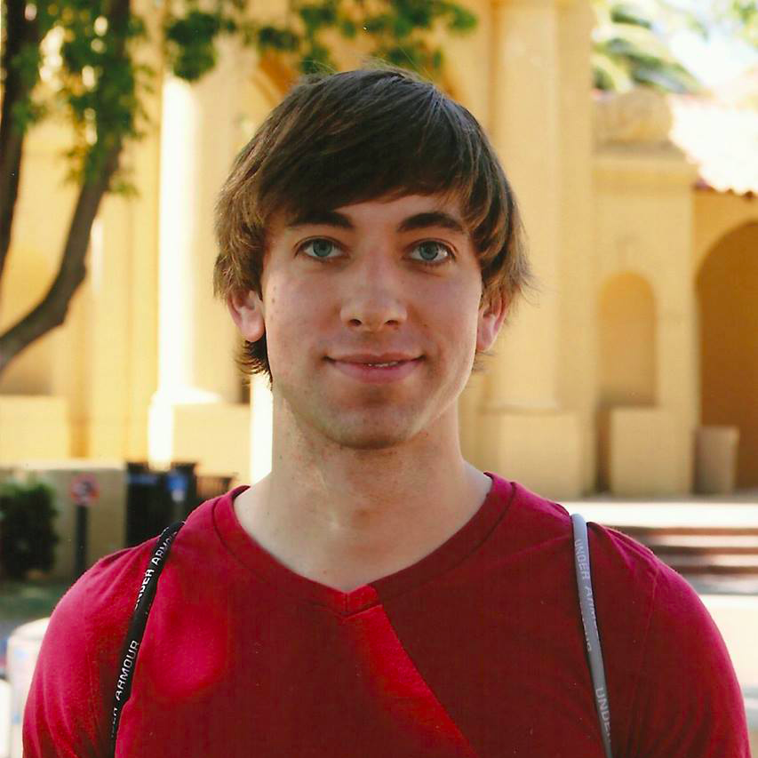
Introduction
Studio Theme:
Learning / Education
Our Problem Domain:
Education
↓
K-12
↓
High School
Michael Kim
Gordon Dean
Jake McKinnon
Krister Johnson
Notes:
We chose to focus on high school to maximize the resources we had available to us and because high schoolers are most likely to have access to smartphones or iPads, which is the platform we intend to build our product upon. Finally, we felt that high schoolers spend more time on academics outside the classroom so we wanted to consider that as well.

Slide 3
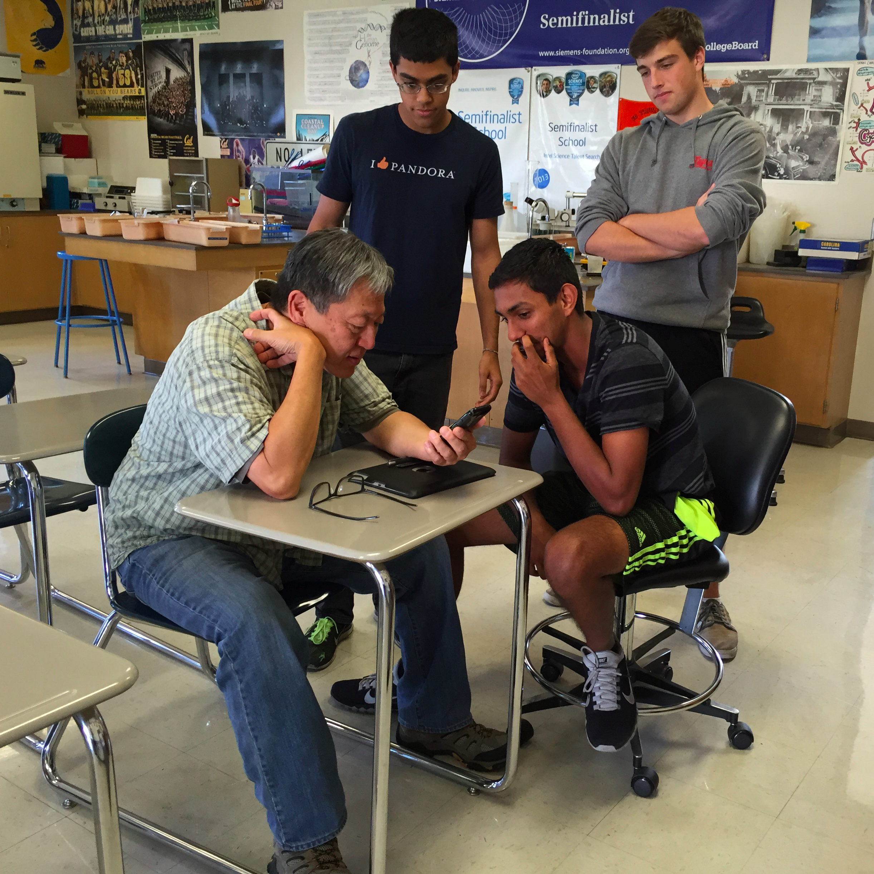
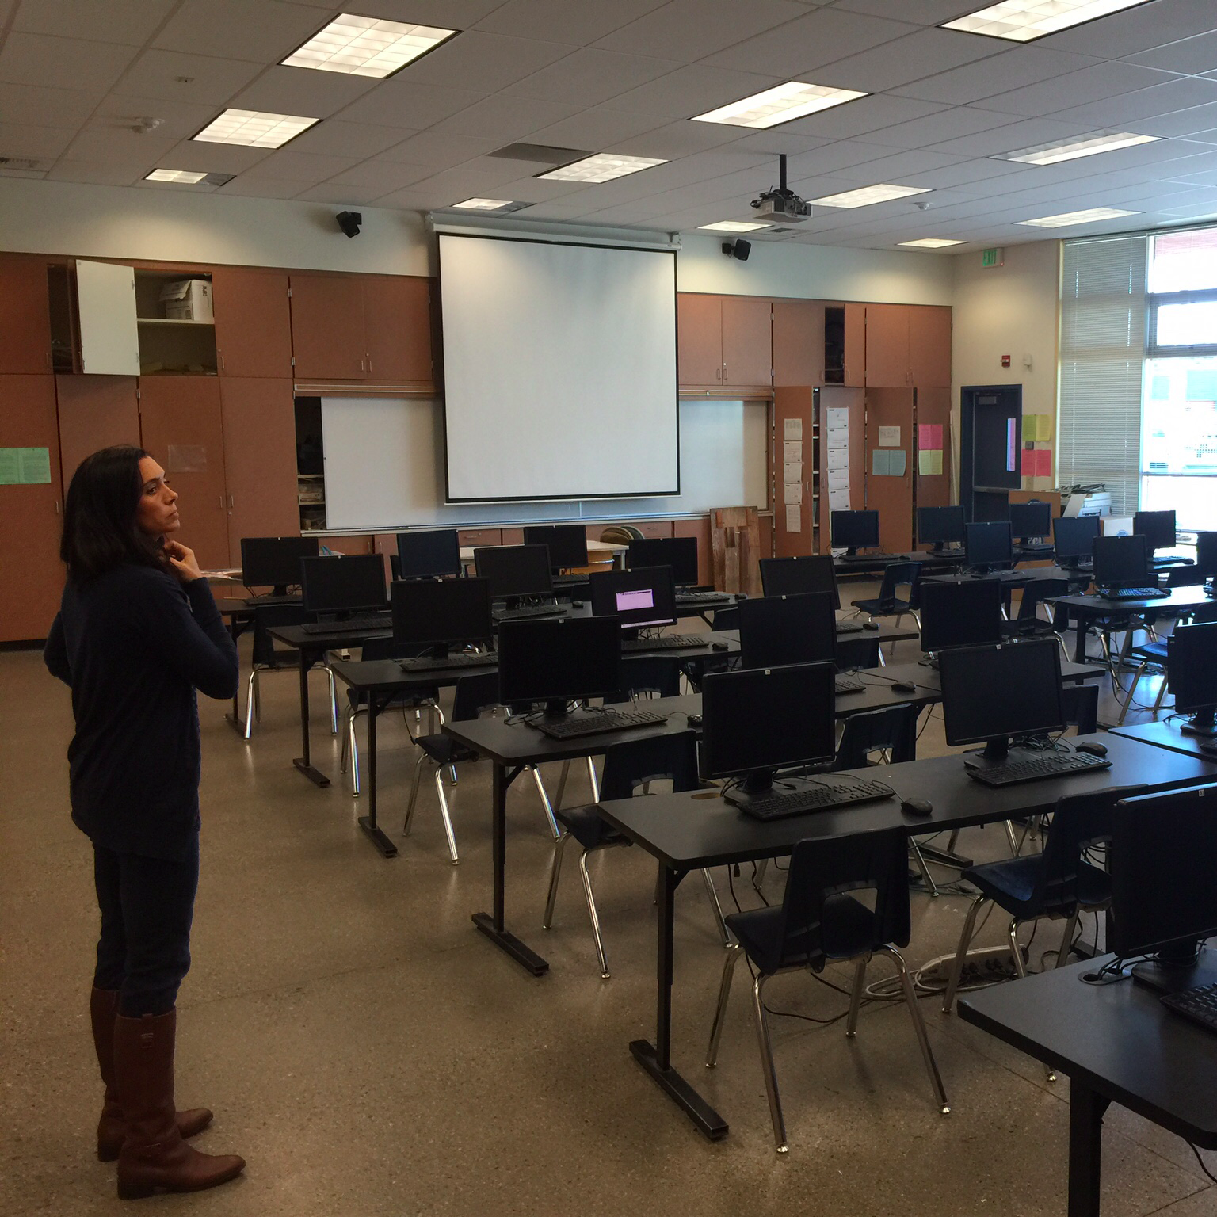
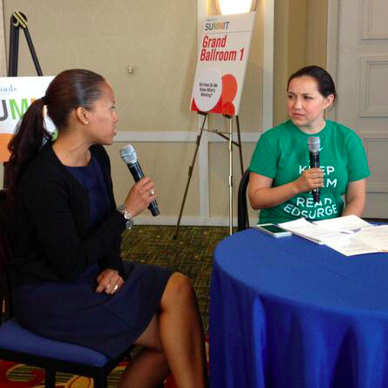
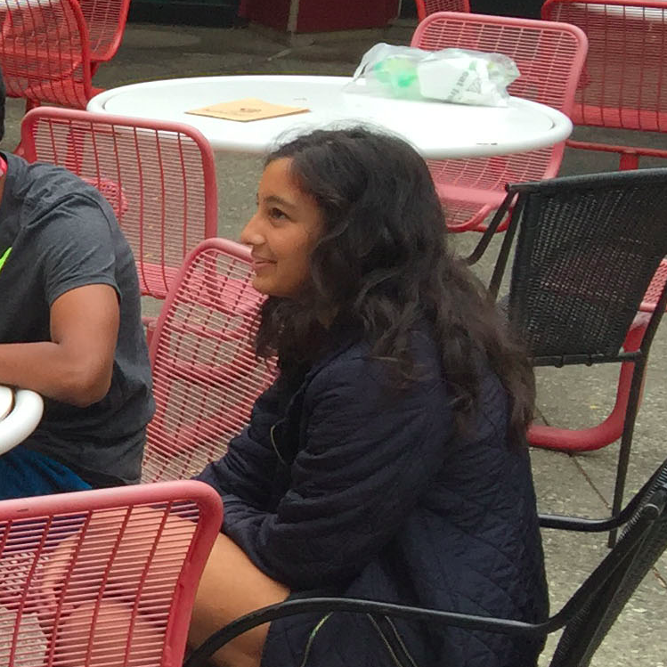
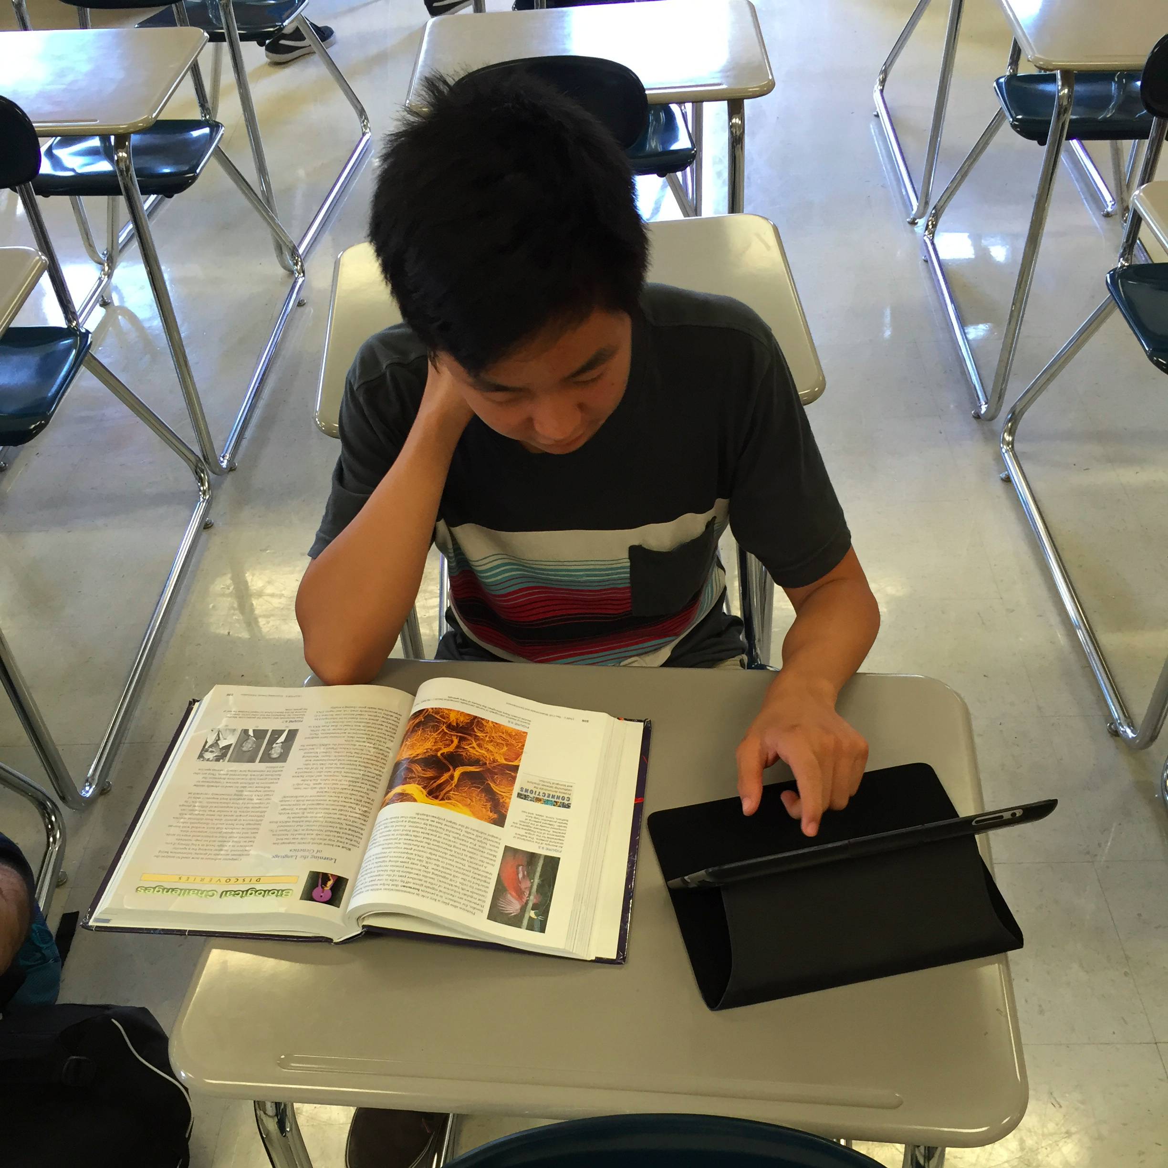
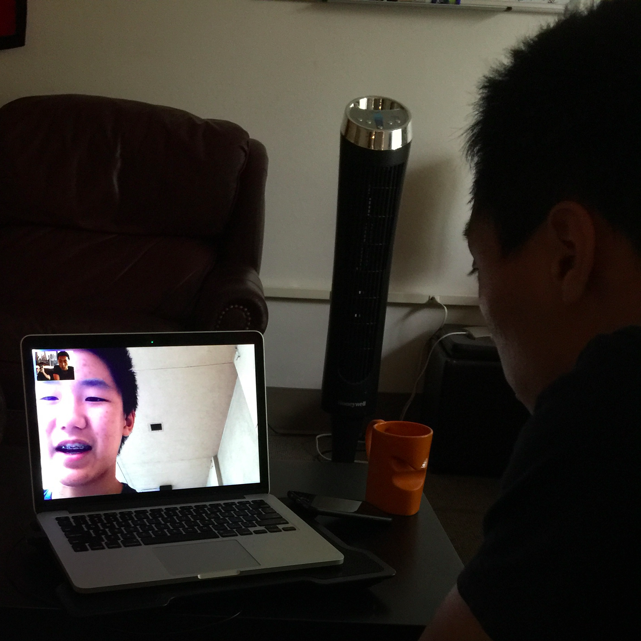
We Interviewed...
Teachers
Industry Experts
Tutors
K-12 Students
Notes:
With a total of 6 interviews, we collected information from a diverse group of stakeholders in high school education: namely teachers, experts in the ed-tech field, tutors, and two high school students. The interviews ranged from 20 minutes to an hour in length, and were conducted in person, 2 via Skype, and over the phone.

Slide 4
Needfinding Methodology - Teachers
Interview #1 - Mr. Wong
Interview #2 - Mrs. Woodward
Notes:
We were able to interview two local educators, Mr. Wong at Bellarmine College Prep and Mrs. Woodward at Buchser Academy in Santa Clara. They represent “Extreme” users because Mr. Wong led the integration of iPads into Bellarmine’s classrooms and Mrs. Woodward teaches at a school that lacks the resources to really engage with technology.

Slide 5
Needfinding Methodology - Industry Experts
Interview #3 - Mrs. Quattrocchi
Notes:
We were able to interview Gordon’s colleague Christina Quattrochi, who is a former 9th grade math teacher and current Director of Research and Development at EdSurge. She is a leading expert on the needs of current K-12 teachers, as well as different school models.

Slide 6
Needfinding Methodology - Students
Interview #4 - Daniel
Interview #5 - Tim
Notes:
Our two students are my siblings, a freshmen and a sophomore at Bellarmine. Though they are my siblings, they have near opposite personalities (being 1 year apart can do that to siblings) and very different study habits (Tim is an athlete). They both have iPads through Bellarmine’s iPad program, so we were able to ask them about their experiences with technology inside the classroom and at home while doing homework. We asked open ended questions like “Tell us about a time you liked working on an assignment” and “Why is _____ your favorite class?” Both had good comments to make on their teachers’ teaching styles.

Slide 7
Needfinding Methodology - Tutors
Interview #6 - Indira
Notes:
We were able to strike a middle ground between student and teacher by interviewing Indira, who is a Stanford student with extensive experience tutoring students younger than her. As a student herself, we felt that her view on teaching could be very different from that of the teachers.

Slide 8
Results - Teachers
“The iPad is the next calculator.”
Interview #1 and #2 - Mr. Wong and Mrs. Woodward
Notes:
Mr. Wong mentioned that technology allows him to remain connected to the greater science community, which gives him a greater passion for the material he teaches.
He also wanted to teach his students about having a positive/mature internet presence, as well as use new technologies like NearPod to have a more intimate learning experience.
Mrs. Woodward had recently changed schools to one with even fewer resources, so she was able to directly compare what she was able to do with laptops and without them. She shared that her classroom had a significant proportion of ELL and Special Needs students, but because she didn’t have any support, she couldn’t provide them the individualized attention they needed to really excel.

Slide 9
Results - Industry Experts
“If we don’t start properly displaying student data, it will never actually influence teaching practices.”
Interview #3 - Mrs. Quattrocchi
Notes:
Mrs. Quattrocchi reflected on her time as a teacher, remembering how her 9th graders really struggled with the transition into high school both socially, as well as with their organizational skills. In her current role, she finds that student data, the key element of blended learning, is not currently presented in a way that can actually influence teaching practices.

Slide 10
Results - Students
“There’s over a hundred questions available per day, but I only do the ones that I’m assigned.”
Interview #4 and #5 - Daniel and Tim
Notes:
Interesting points:
-Tim and Daniel had very different experiences and opinions about the same note taking app.
-Both mentioned teaching as a great way to learn. Daniel teaches himself the material to study for a test, and Tim really enjoyed teaching his peers in his history class.
-Unfortunately, Tim said that he always needs both his laptop and his computer to do his homework, which defeats the main purpose of the iPads.

Slide 11
Results - Tutors
“I feel like there’s some sort of obligation to help people who just happen to have less access to stuff than you have.”
Interview #6 - Indira
Notes:
It was important to Indira that she not charge her students any money for her services. This was important to her for two reasons:
(1) She wanted to raise awareness are to people who don’t yet know about these subjects
She wanted to bring these subjects to people who went to schools that couldn’t afford these subjects
In other words, she wouldn’t tutor any old person at Stanford – she’s not just trading some of her time for a paycheck. She emphasized that she only tutors when it increases accessibility, when she’s sharing a subject with people who would not otherwise get it.

Slide 12
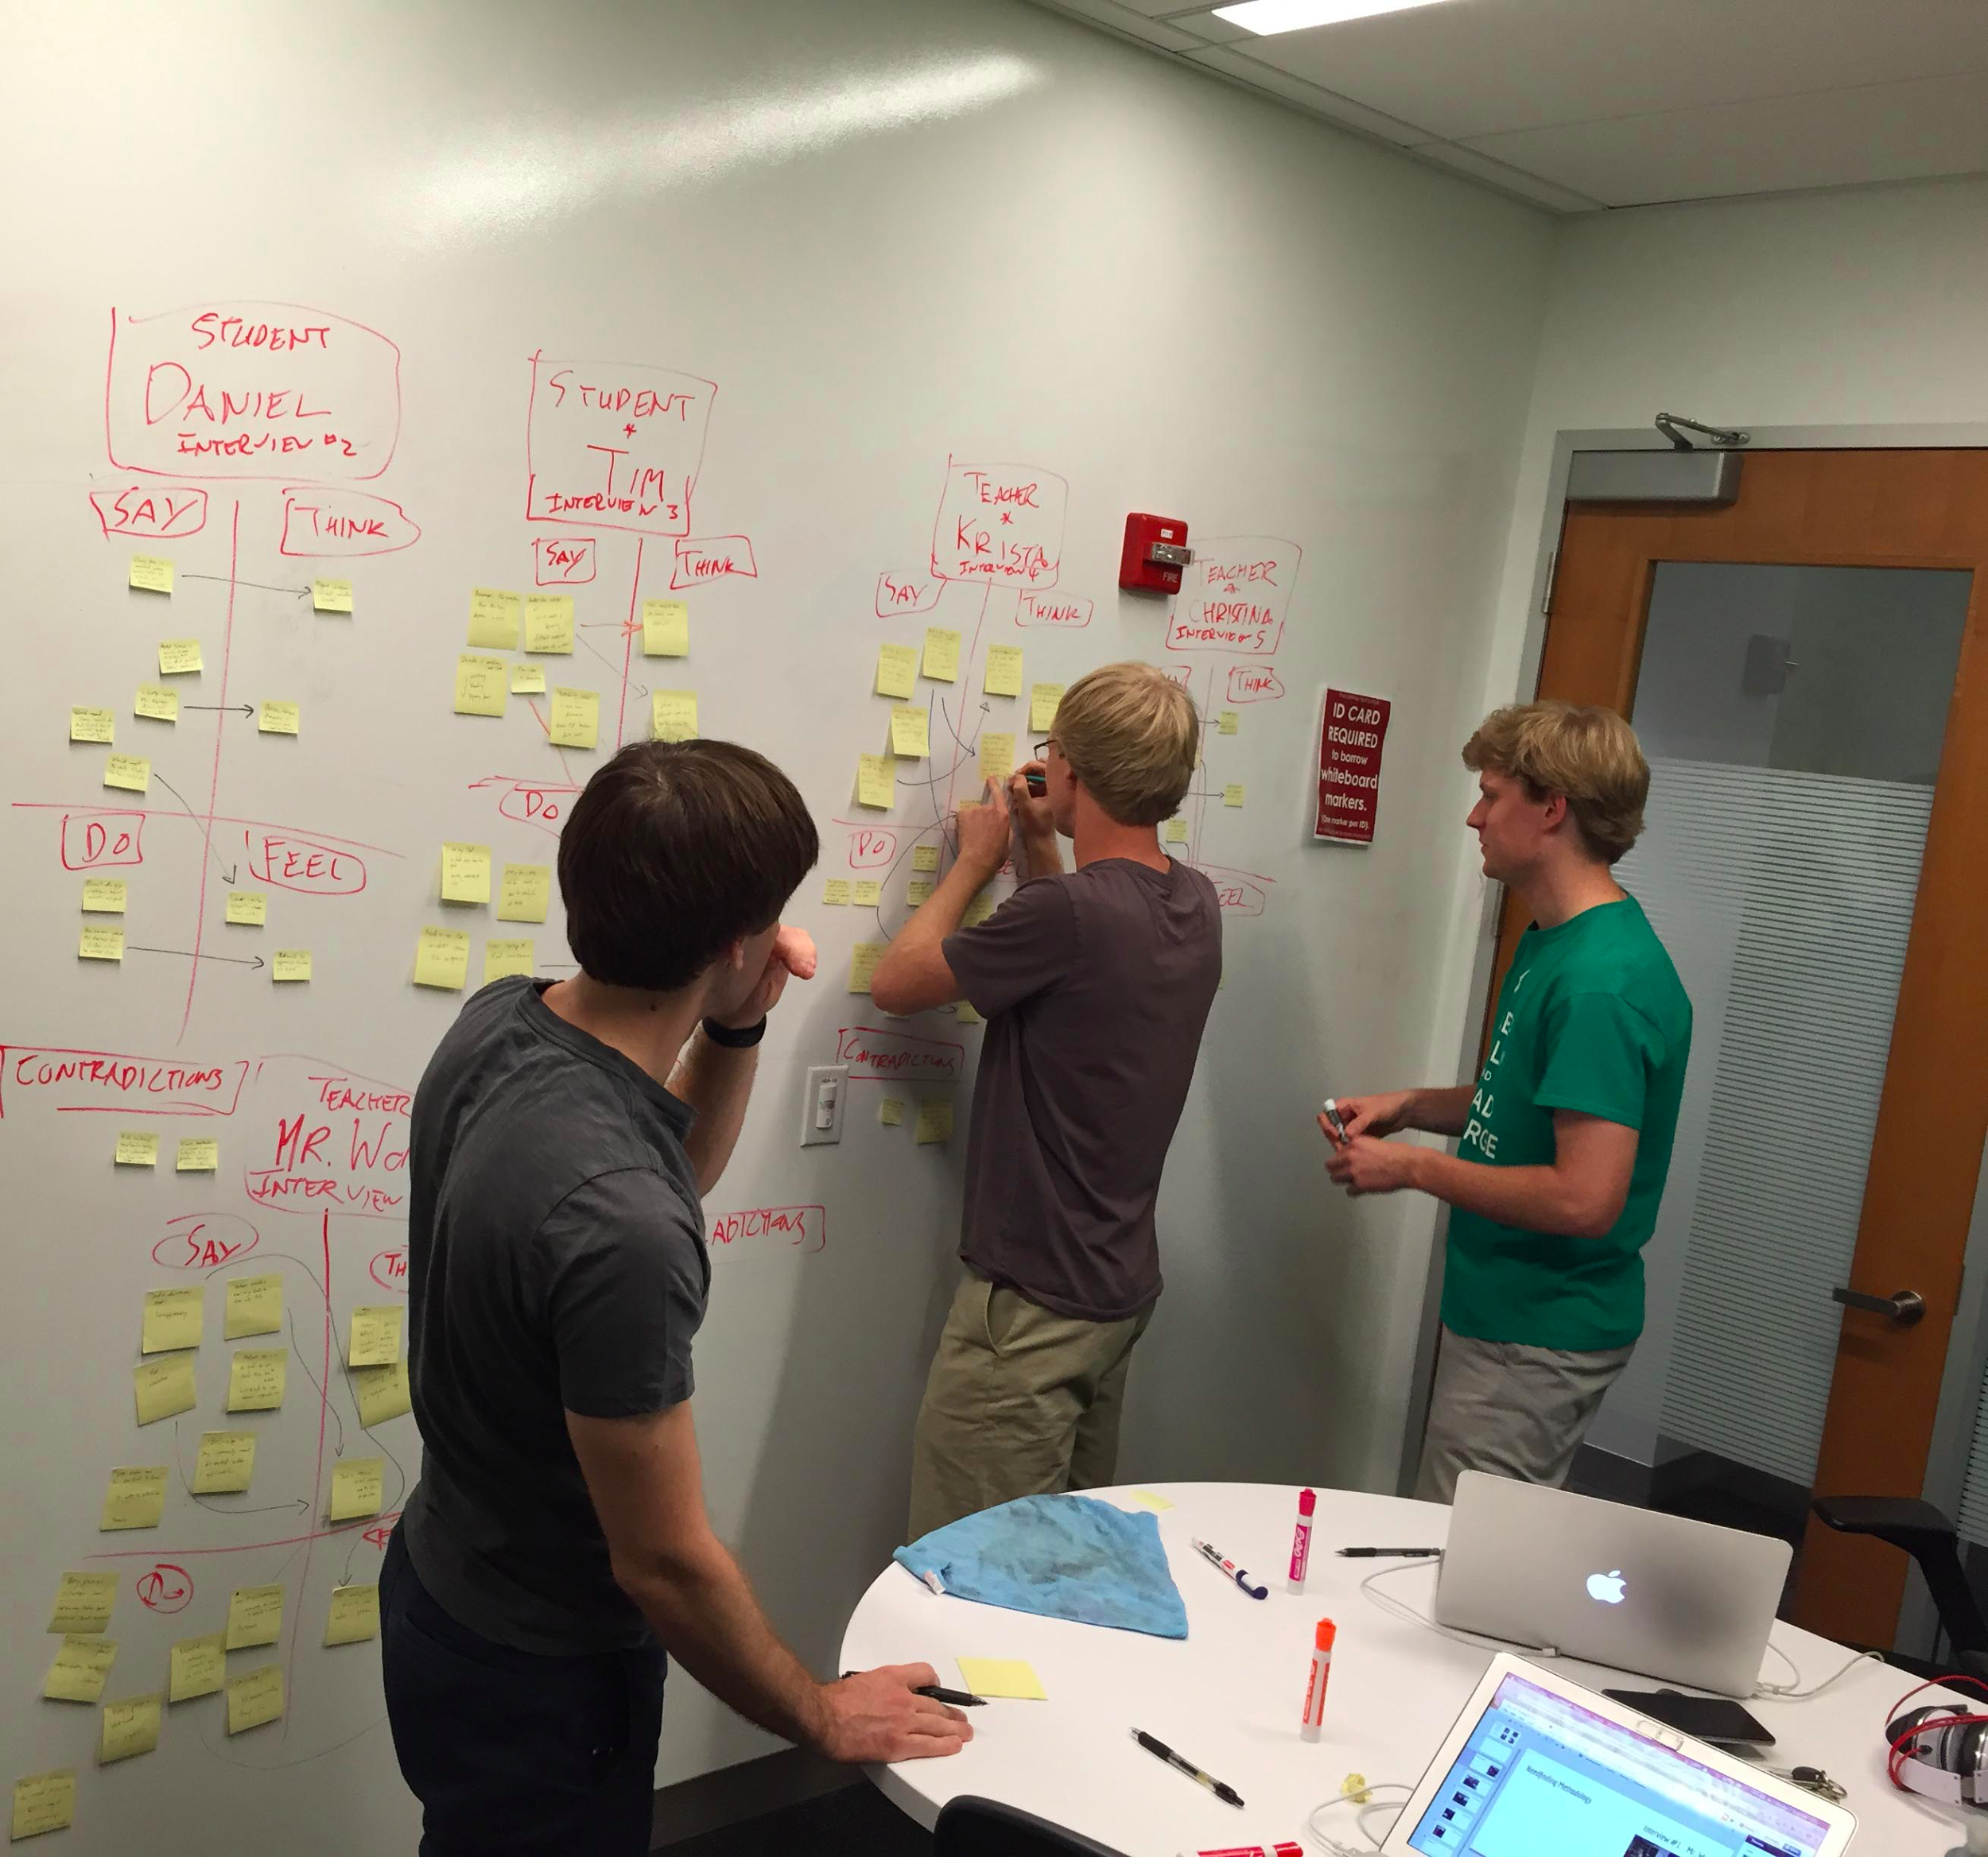
Analysis
It was surprising that teachers would send the best students out of the classroom to explore more on their own.
Notes:
The traditional model is that the best students are the ones who are always in class and always participating, but in this case, it made more sense to send them to the computer lab so they could explore on their own. Teachers feel the responsibility to take care of the children who are struggling/falling behind.

Slide 13
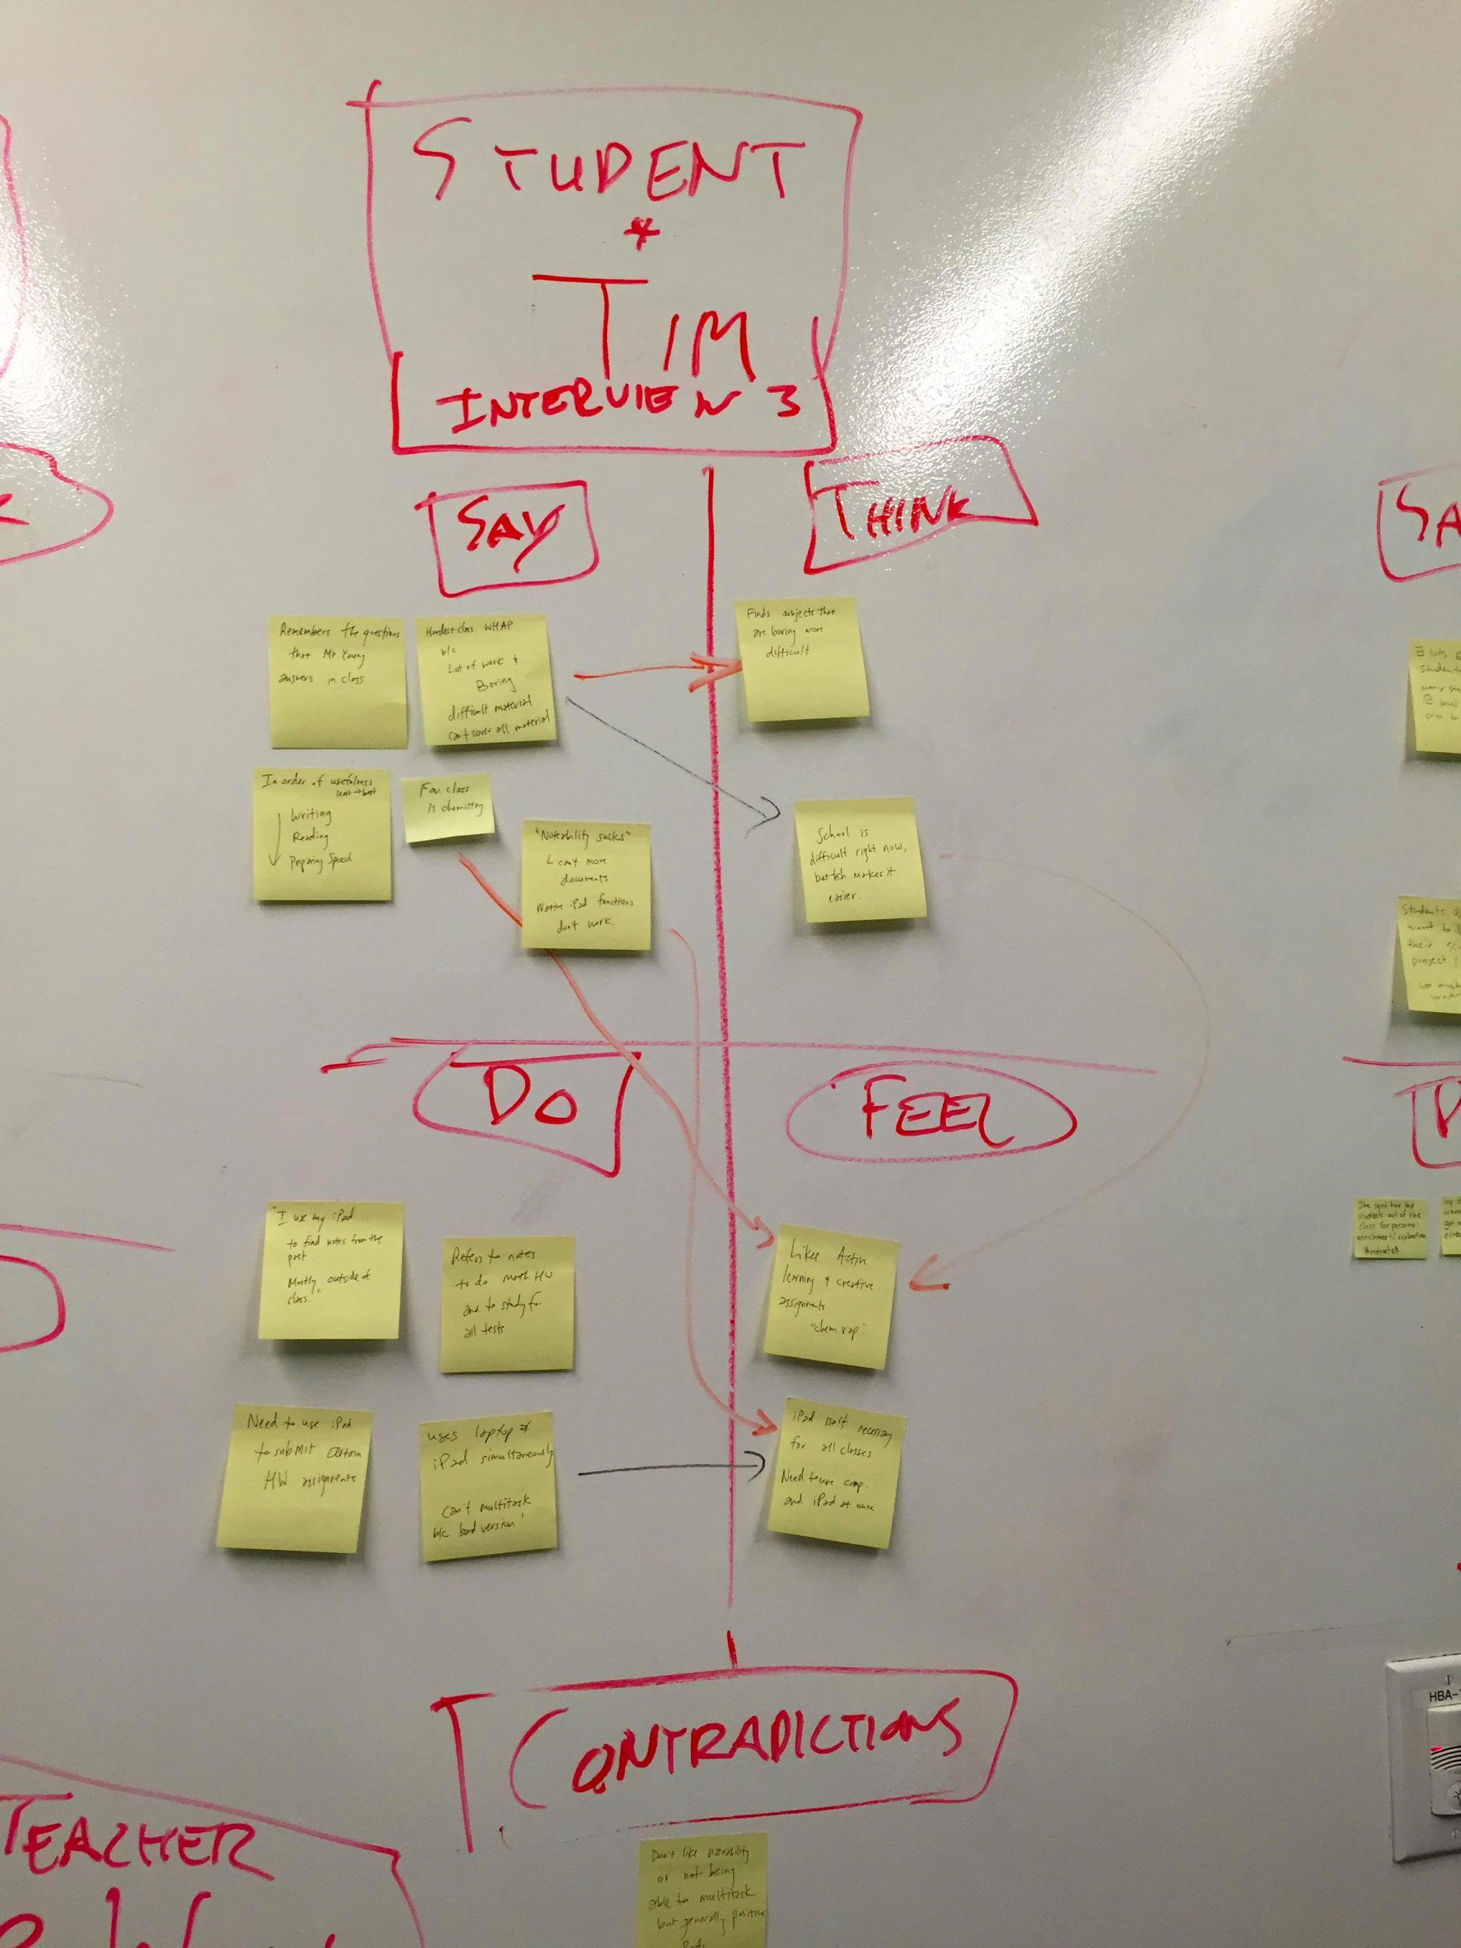
Analysis
The iPad has the potential to increase accountability and participation in class.
Notes:
In the past, distractions would happen anyway, but the difference is that now there are easier ways to tell if someone is spacing out or not paying attention. Also, though there is no hard scientific evidence yet, most educators believe that using the ipads to interact with students in class has increased input from students who are more shy and quiet. Because a student no longer needs to hold up his/her hand and be put on the spot, he/she can ask questions more freely. Mr. Wong: if you are a good teacher, they won’t be distracted and doing other things.

Slide 14
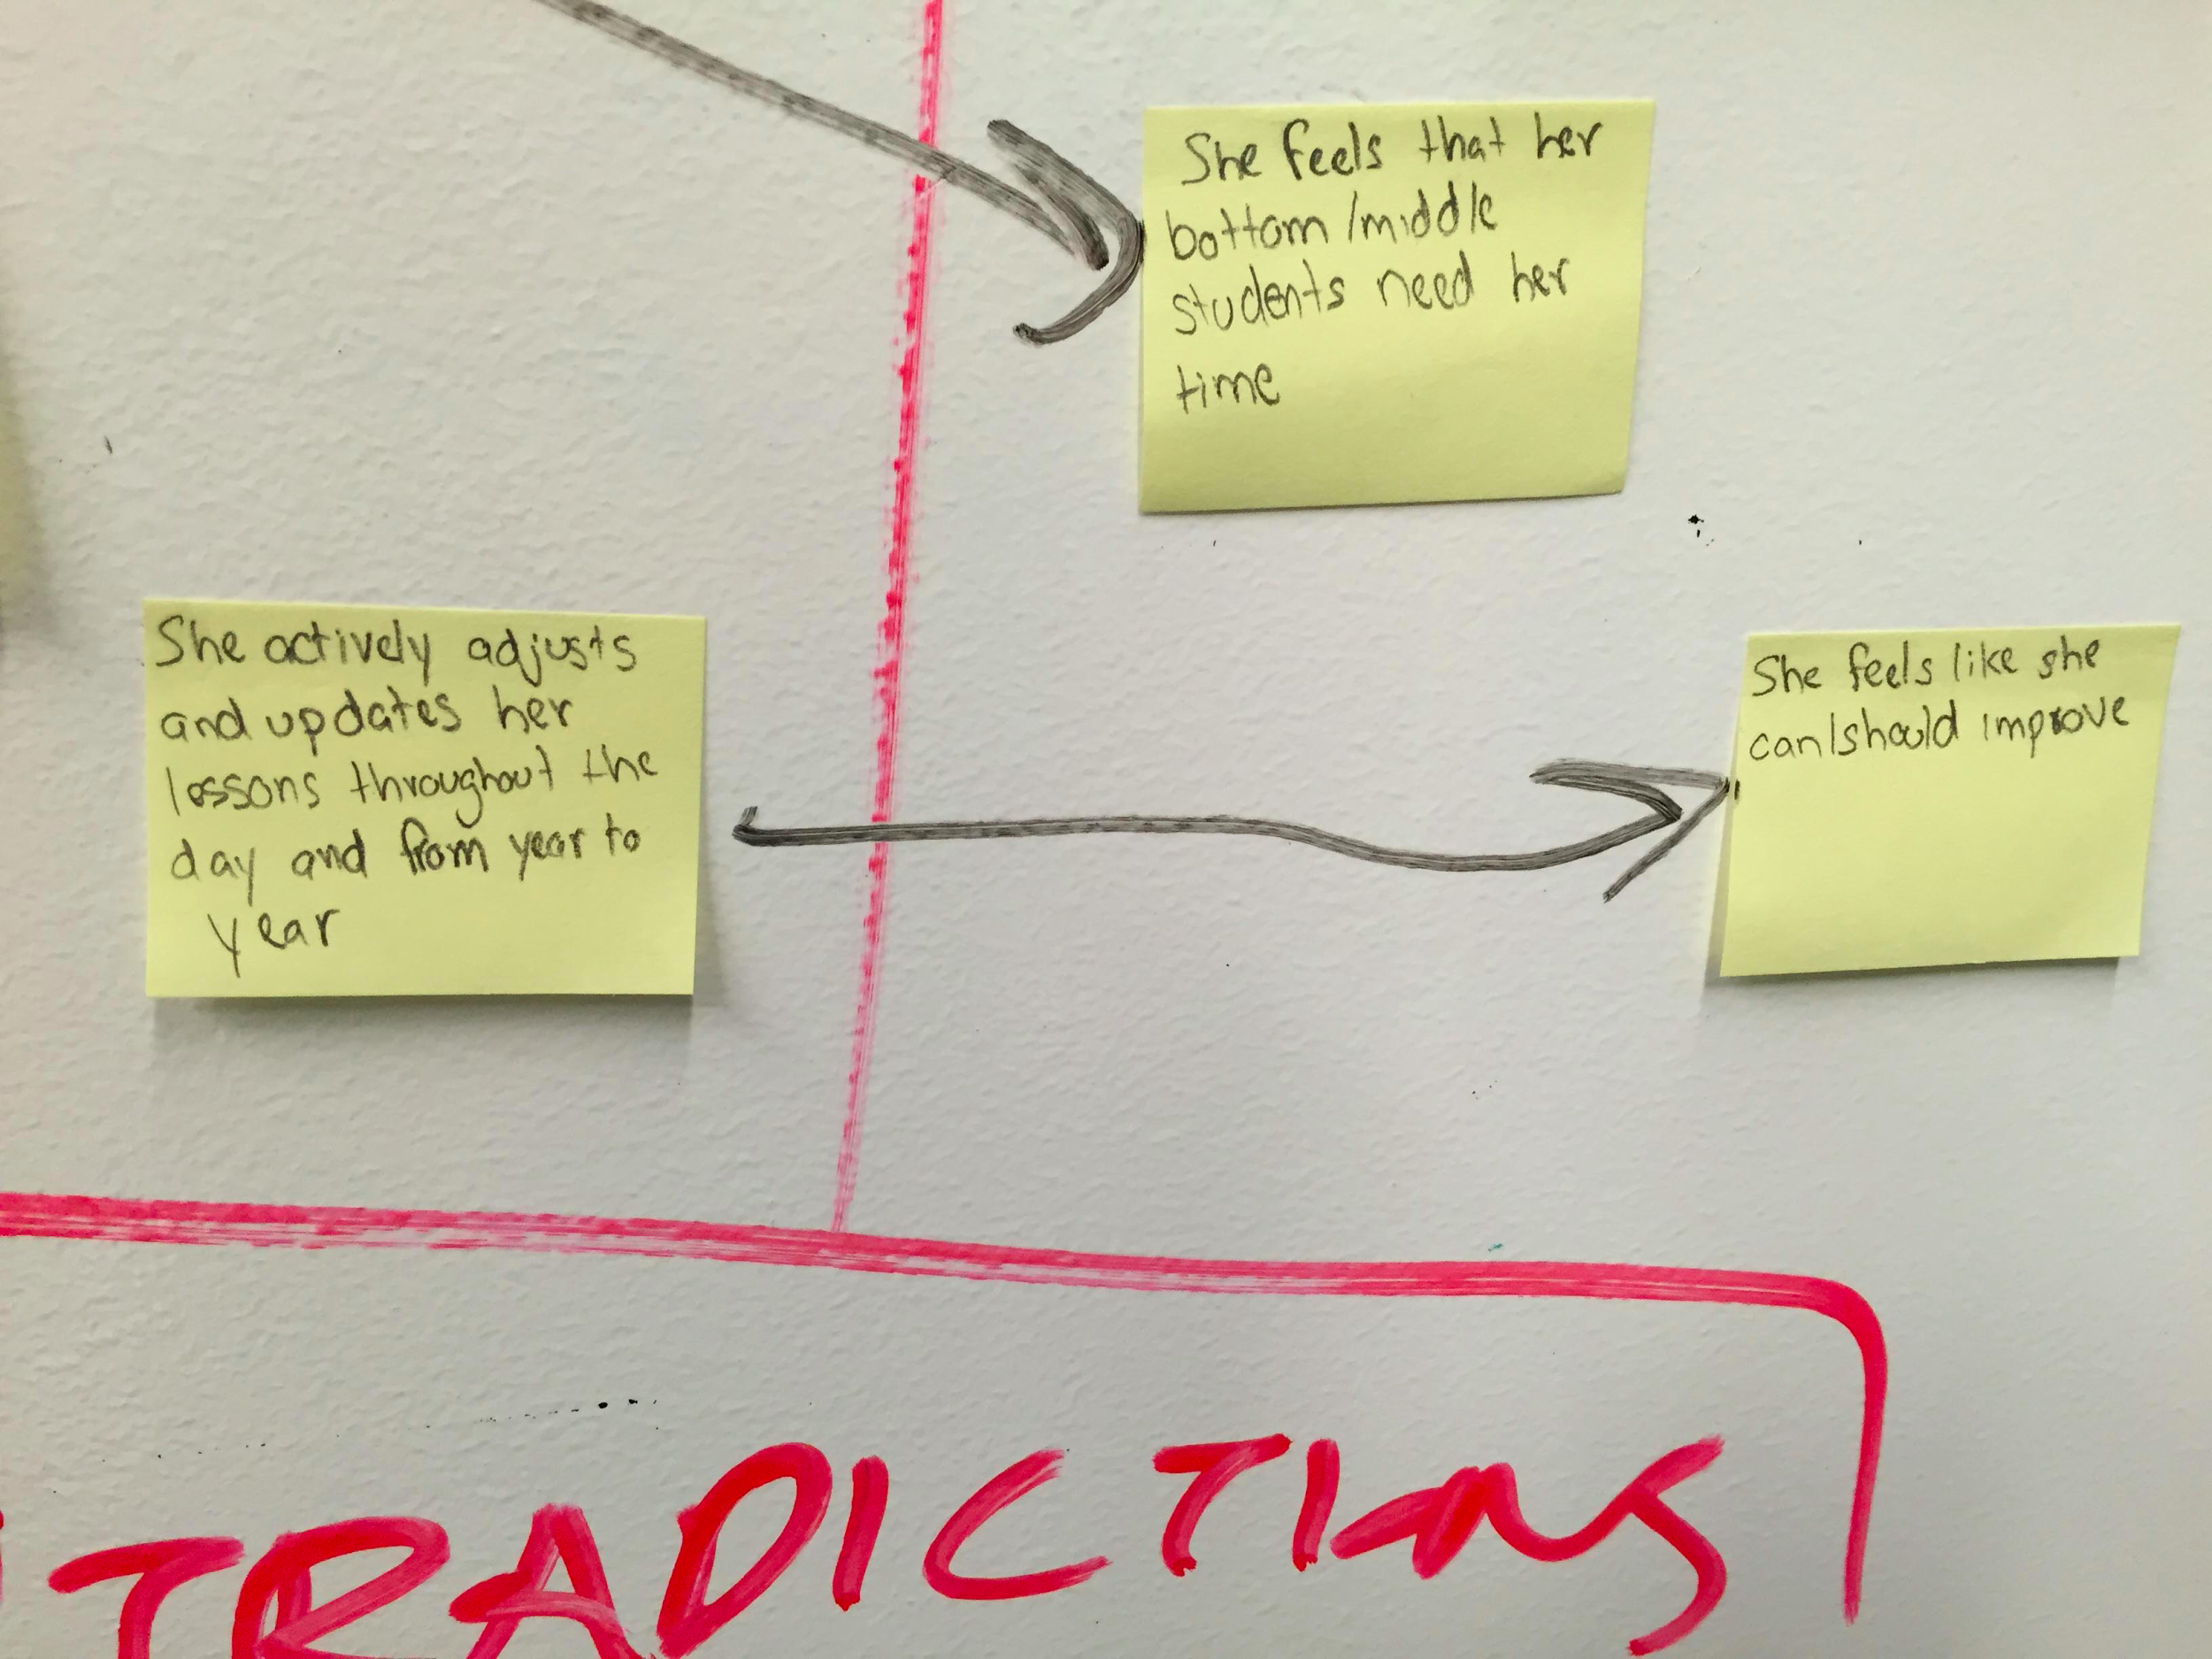
Analysis
Students found unexpected and quirky assignments to be the most enjoyable.
Notes:
A rap about chemistry or teaching the class about a vocabulary term. These assignments stray from the traditional model of taking notes, writing an essay, or filling out a worksheet. And they seem to stick in their minds better. Blogs, Twitter accounts, and other tech-related fun assignments are good too.

Slide 15
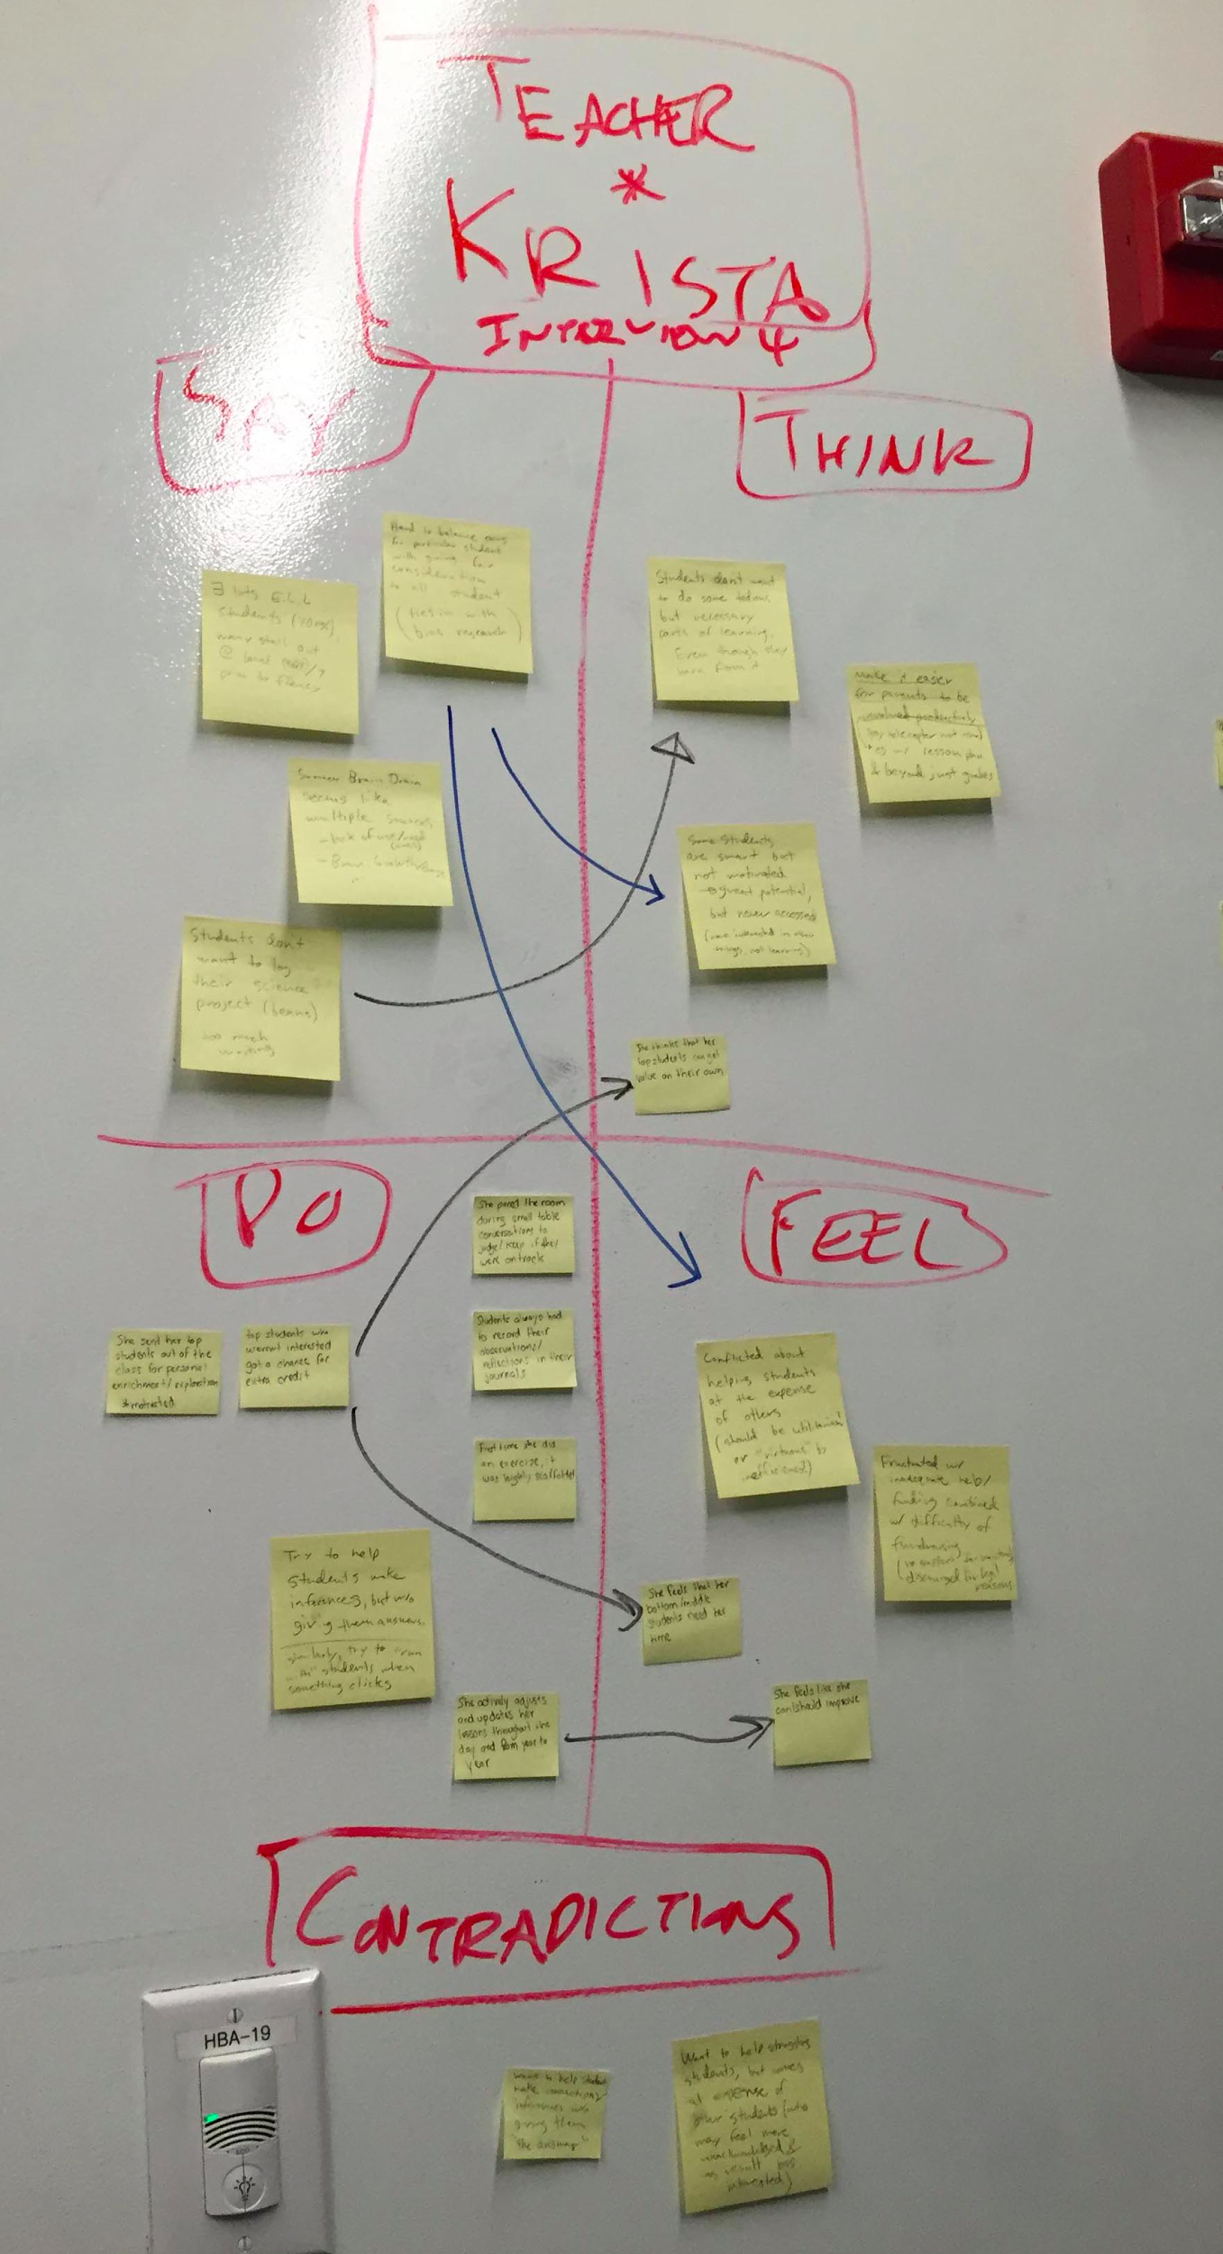
Analysis
The physical mobility of iPads or laptops can create more dynamic classrooms.
Notes:
For Mr. Wong, students would take pictures on their devices during a lab. For Mrs. Woodward, she couldn’t even do a lab with computers because the only screens available are at the computer lab - where they obviously can’t do science experiments. Mr. Wong sits his students in a circle!iphn

Slide 16
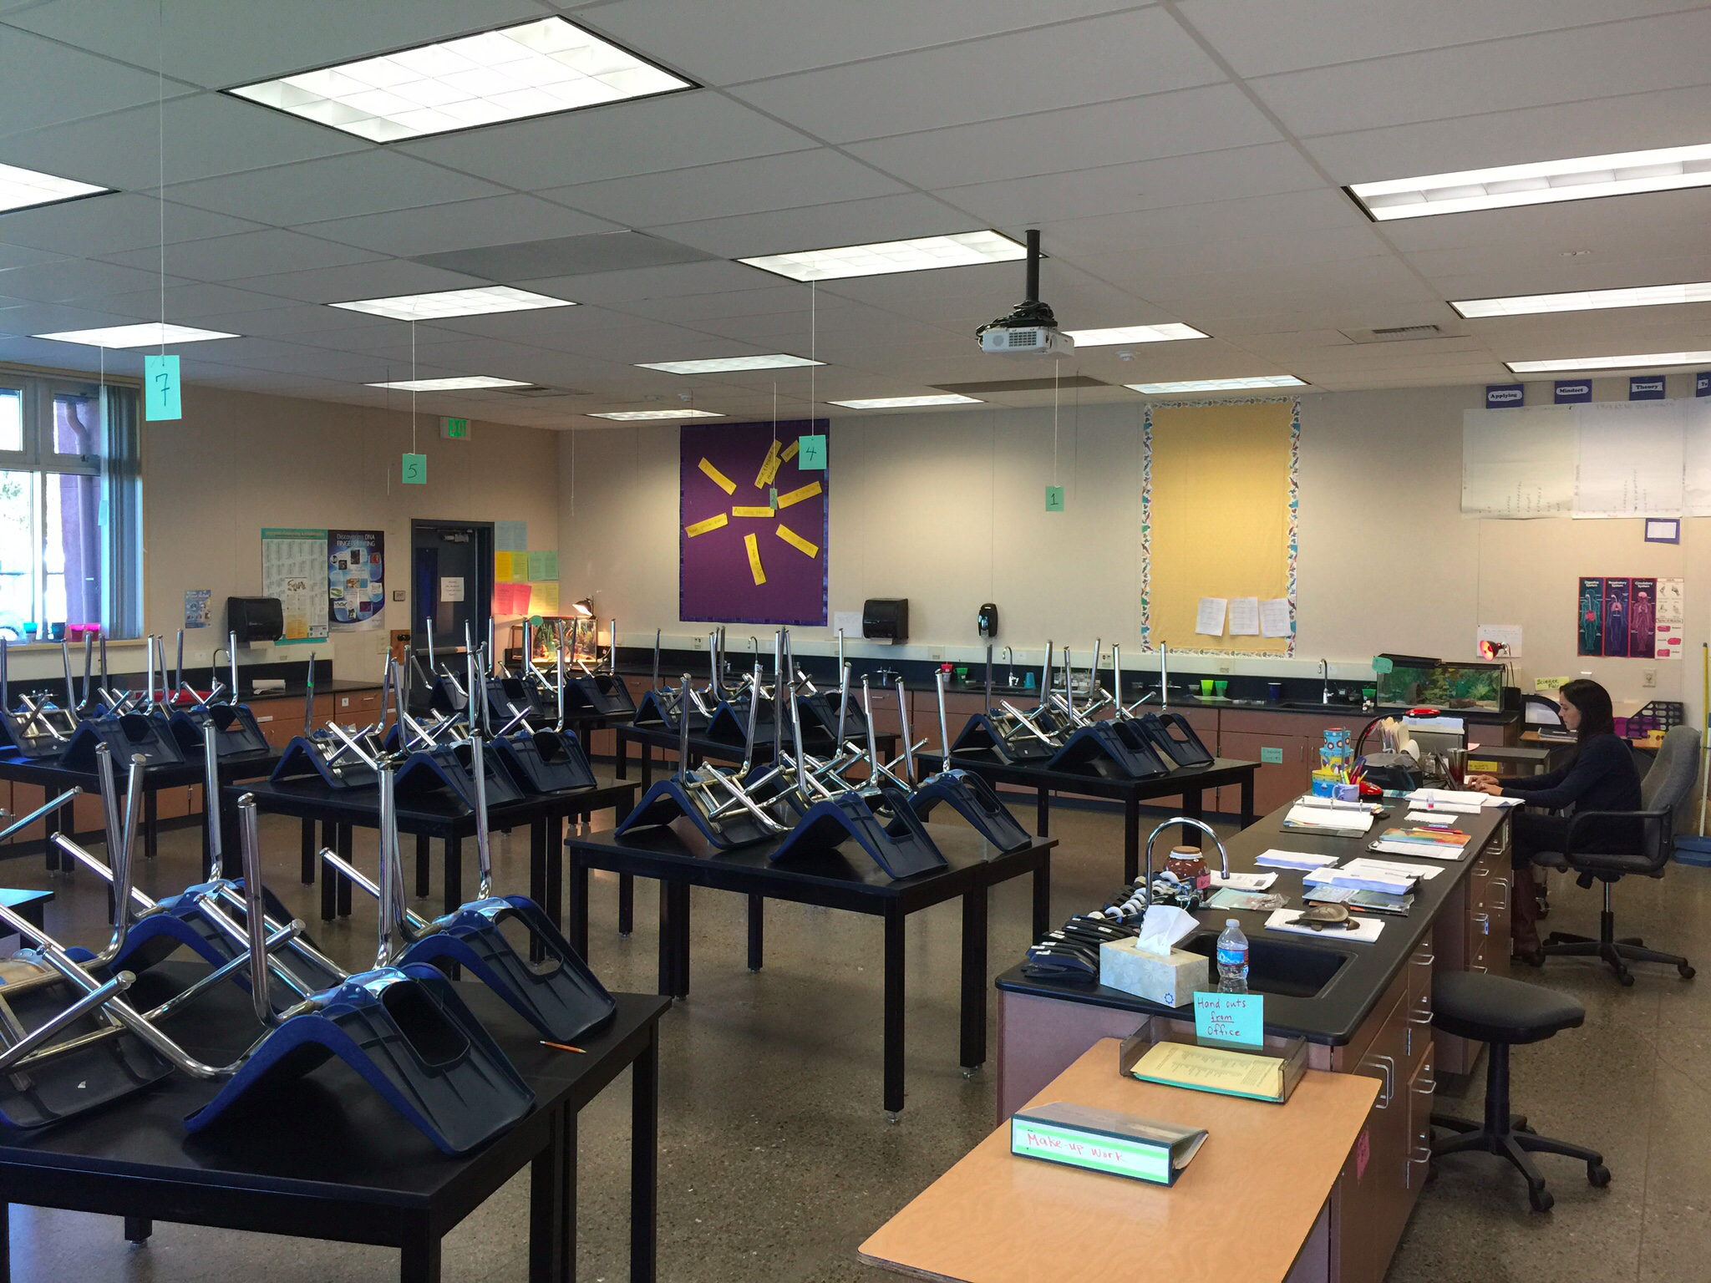
Summary
Teachers = attention
Industry Experts = data interpretation
Students = connectivity
Tutors = spread passion

