Slide 1
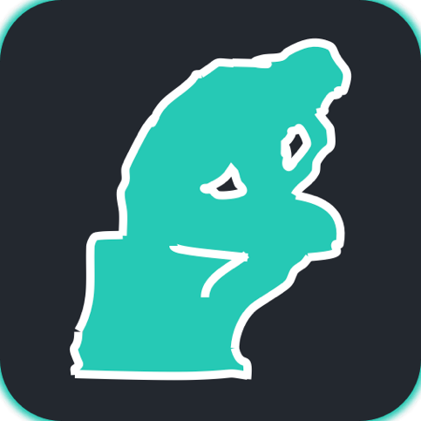
CanTour
bespoke museum tours

