Slide 1
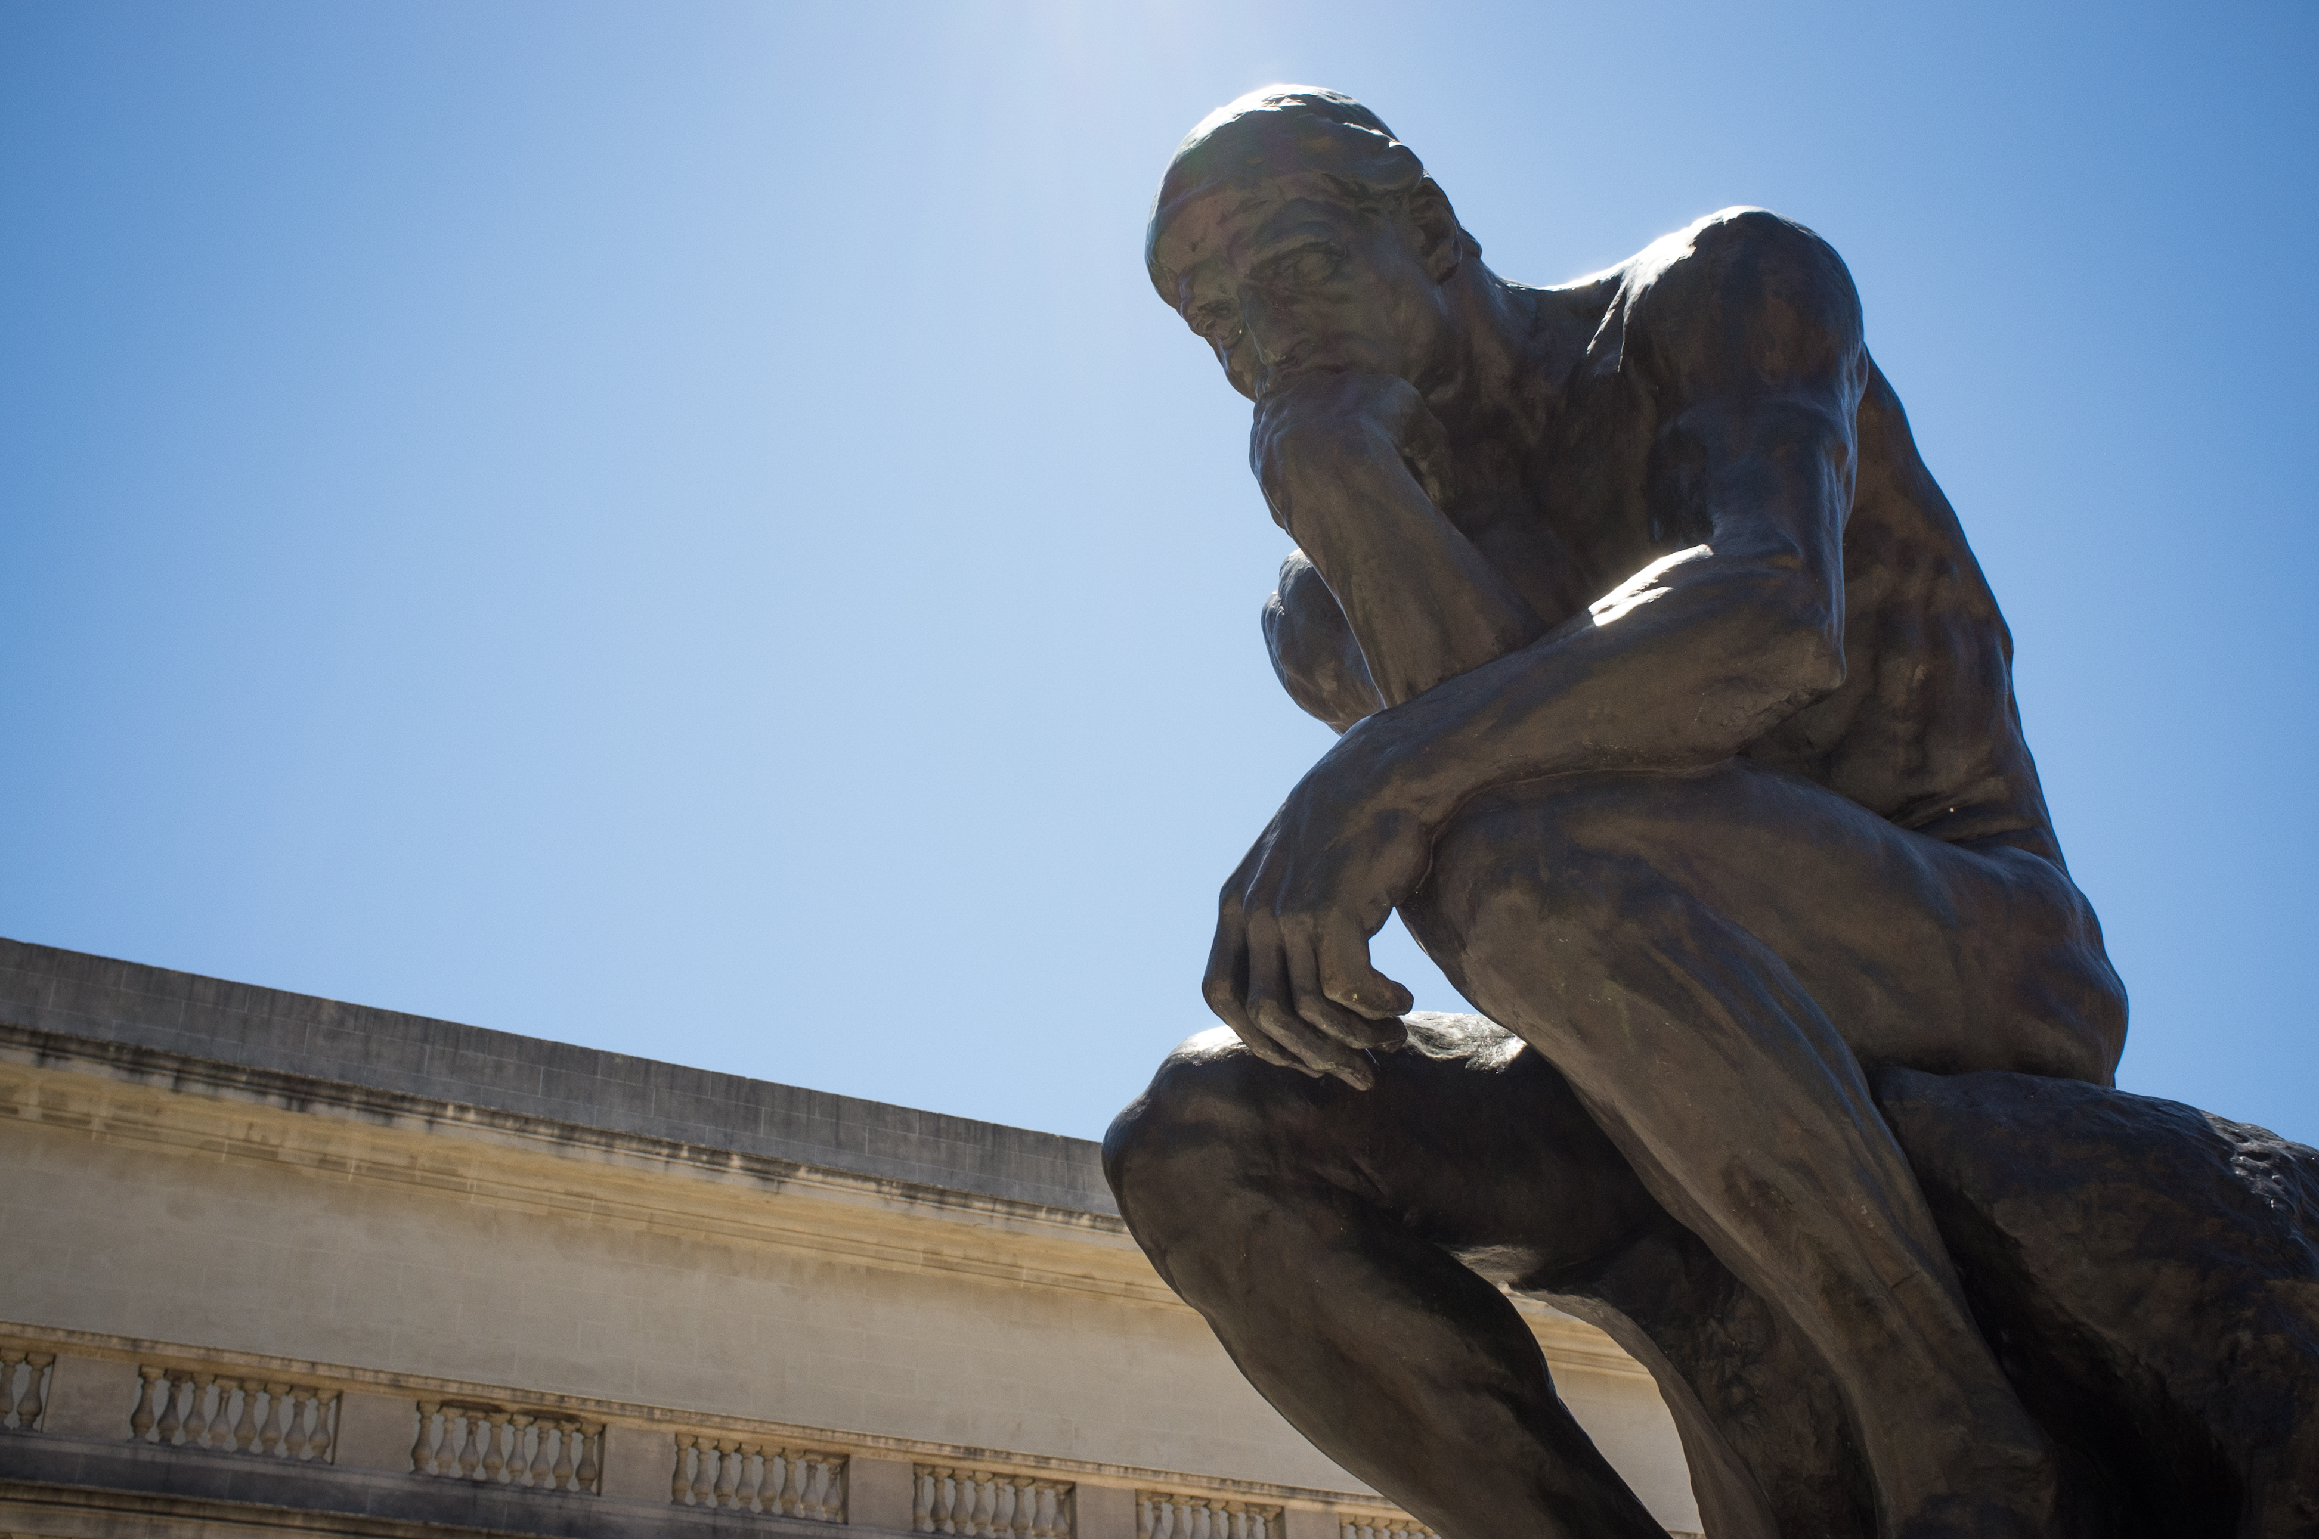
CanTour
Personalize your cantor experience

Slide 2
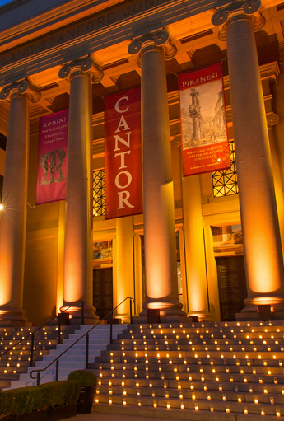
Problem & Solution
Visitors experience museum fatigue and overwhelming options
CanTour proposes to personalize and curate your museum experience at the Cantor Arts Center

Slide 3
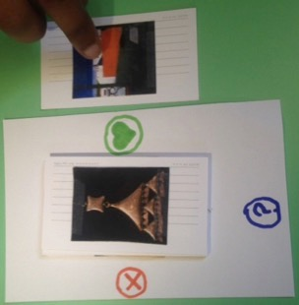
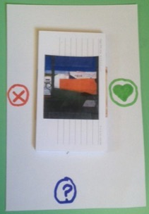
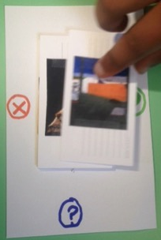
task 1: art preferences quiz
(Medium)
  Directions
  Info Button
  Tap Action

Slide 4
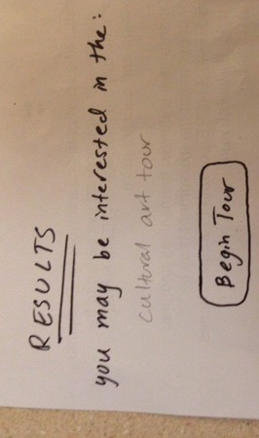
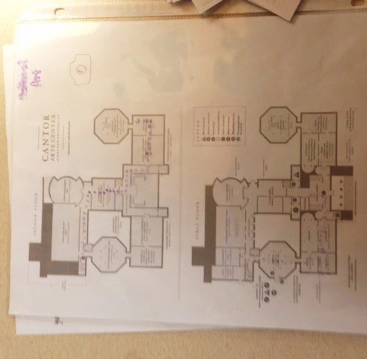
task 2: MUSEUM NAVIGATION
(Hard)
  Tour Results
  Navigation Zoom

Slide 5
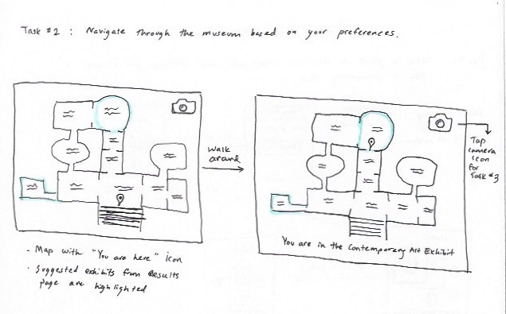
task 3:seek further information
(simple)
  Tappable Points of Interest
i

Slide 6
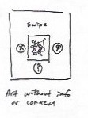
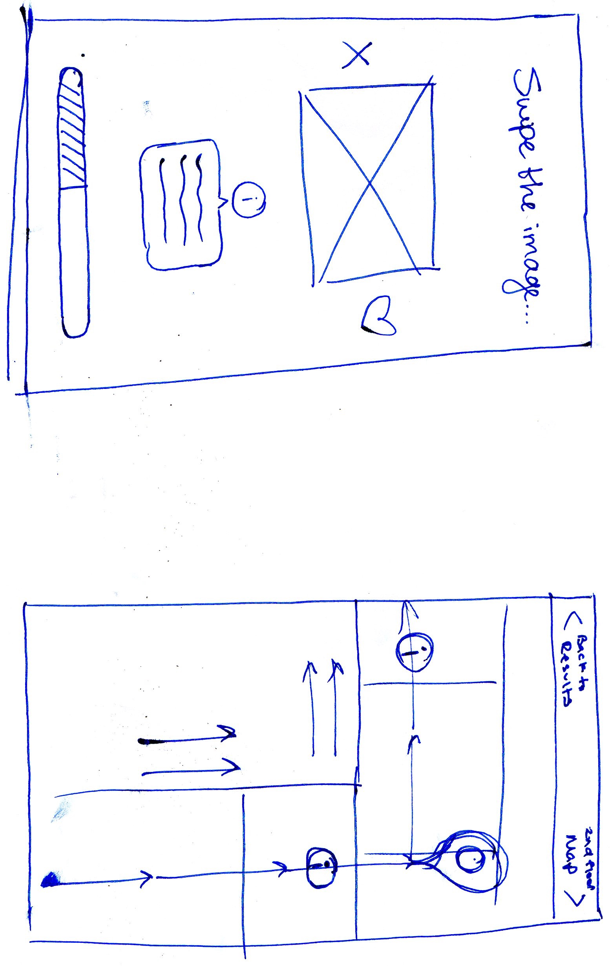
Major Design change 1

Slide 7
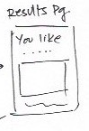
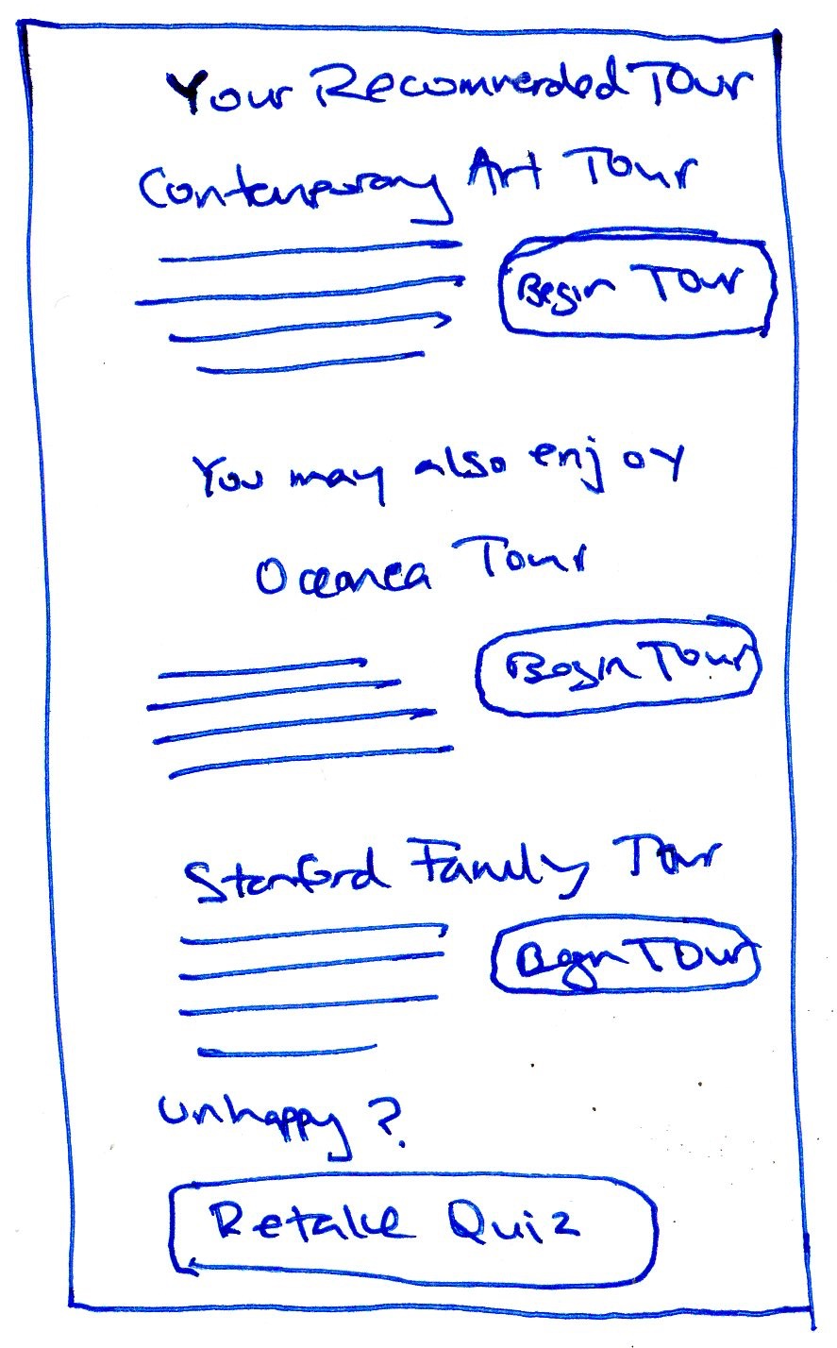
Major Design change 2

Slide 8
Major Design change 3

Slide 9
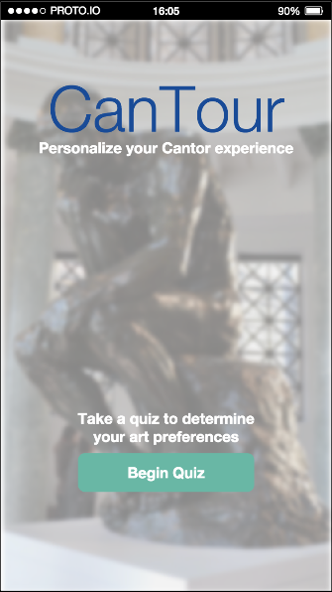
Prototype task flows

Slide 10
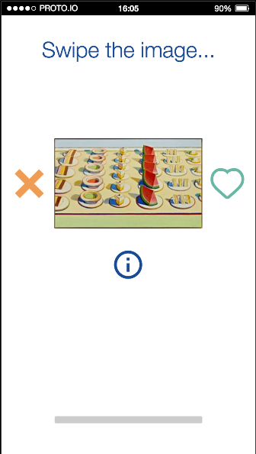
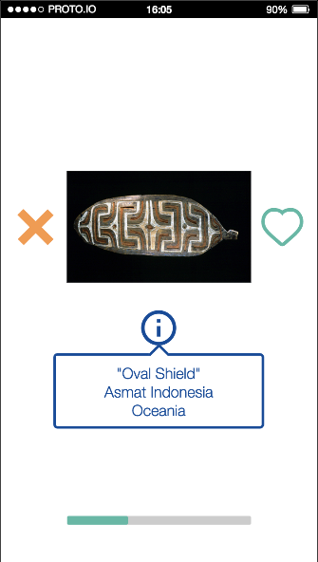
Art Preferences Quiz
“Swipe to Discover Your Preferences”

Slide 11
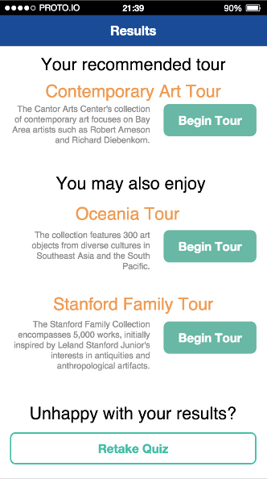
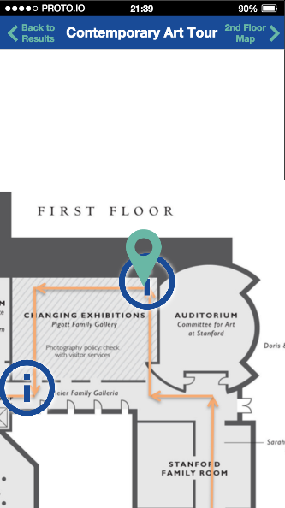
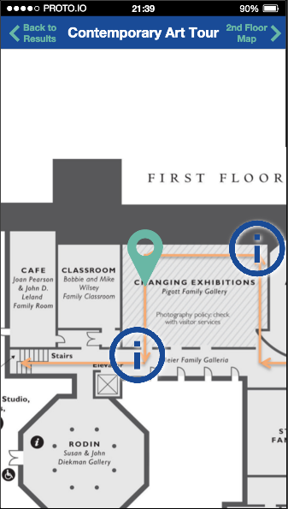
Museum navigation
“Follow a Curated Tour”

Slide 12
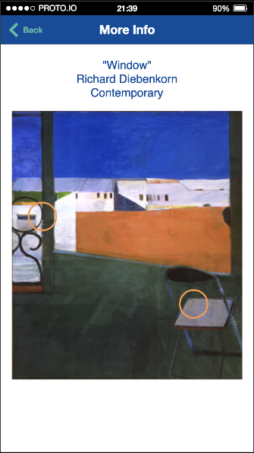
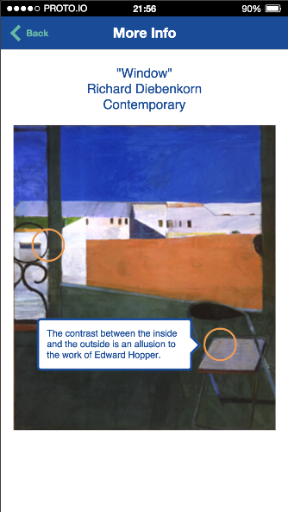
seek further information
“Tap to Learn More”

Slide 13


Prototype overview

Slide 14
Prototype overview
Mimicked user actions fairly accurately
Phone features could not be used
Limited backend database, just to convey UI

Slide 15
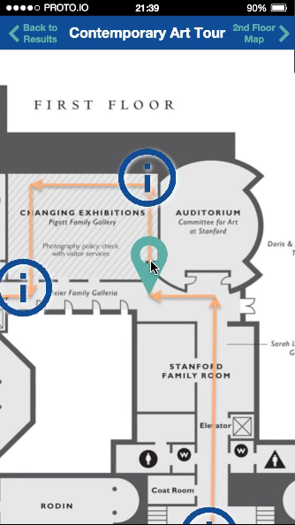
wizard of oz techniques
Quiz Results - limited set of pictures and no backend processing
Tour Routes - one finalized option behind the scenes
GPS Tracking - animated map (see video)

Slide 16
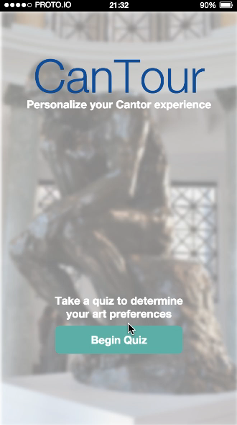
Hard coded results

Slide 17
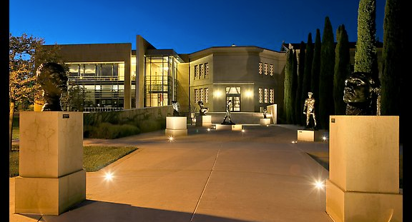
Questions?

