Slide 1
Assignment #4
Maya Balakrishnan, Tara Balakrishnan, Alex Chang, Shubha Raghvendra
10/16/15
Notes:
Thank you all for coming.
Before I start, I just wanted to thank everyone who has answered my questions, passed on their knowledge, and helped me get to where I am today.
I’ll start off sharing some of my work from B239 before going into some depth on a specific project with B222.

Slide 2
Assignment 4 | Value Proposition, Problem/Solution Overview
Value Proposition: Personalize your Cantor experience
Problem/Solution Overview: The Cantor Arts Center, among other museums, lacks self-guided tour options. Visitors often seem disengaged from the art they see, or are overwhelmed by the volume of art to see. CanTour uses a quiz interface to personalize the experience of the Cantor visitor, and allows users to learn more about the paintings they choose to see.
12/4/2015 | Page | Maya Balakrishnan, Tara Balakrishnan, Alex Chang, Shubha Raghvendra
Rev. 20130815
Apple Confidential - Strictly Need to Know
12/4/2015 | Page Ryan Brooks• Input Devices - Apple Confidential

Slide 3
Assignment 4 | Three Tasks
Take a quiz to discover what art and exhibits you would like or potentially like. (complex)
Navigate through the museum based on your preferences. (simple)
Learn more about art that is directly in front of you. (moderate)
12/4/2015 | Page | Maya Balakrishnan, Tara Balakrishnan, Alex Chang, Shubha Raghvendra
Rev. 20130815
Apple Confidential - Strictly Need to Know
12/4/2015 | Page Ryan Brooks• Input Devices - Apple Confidential

Slide 4
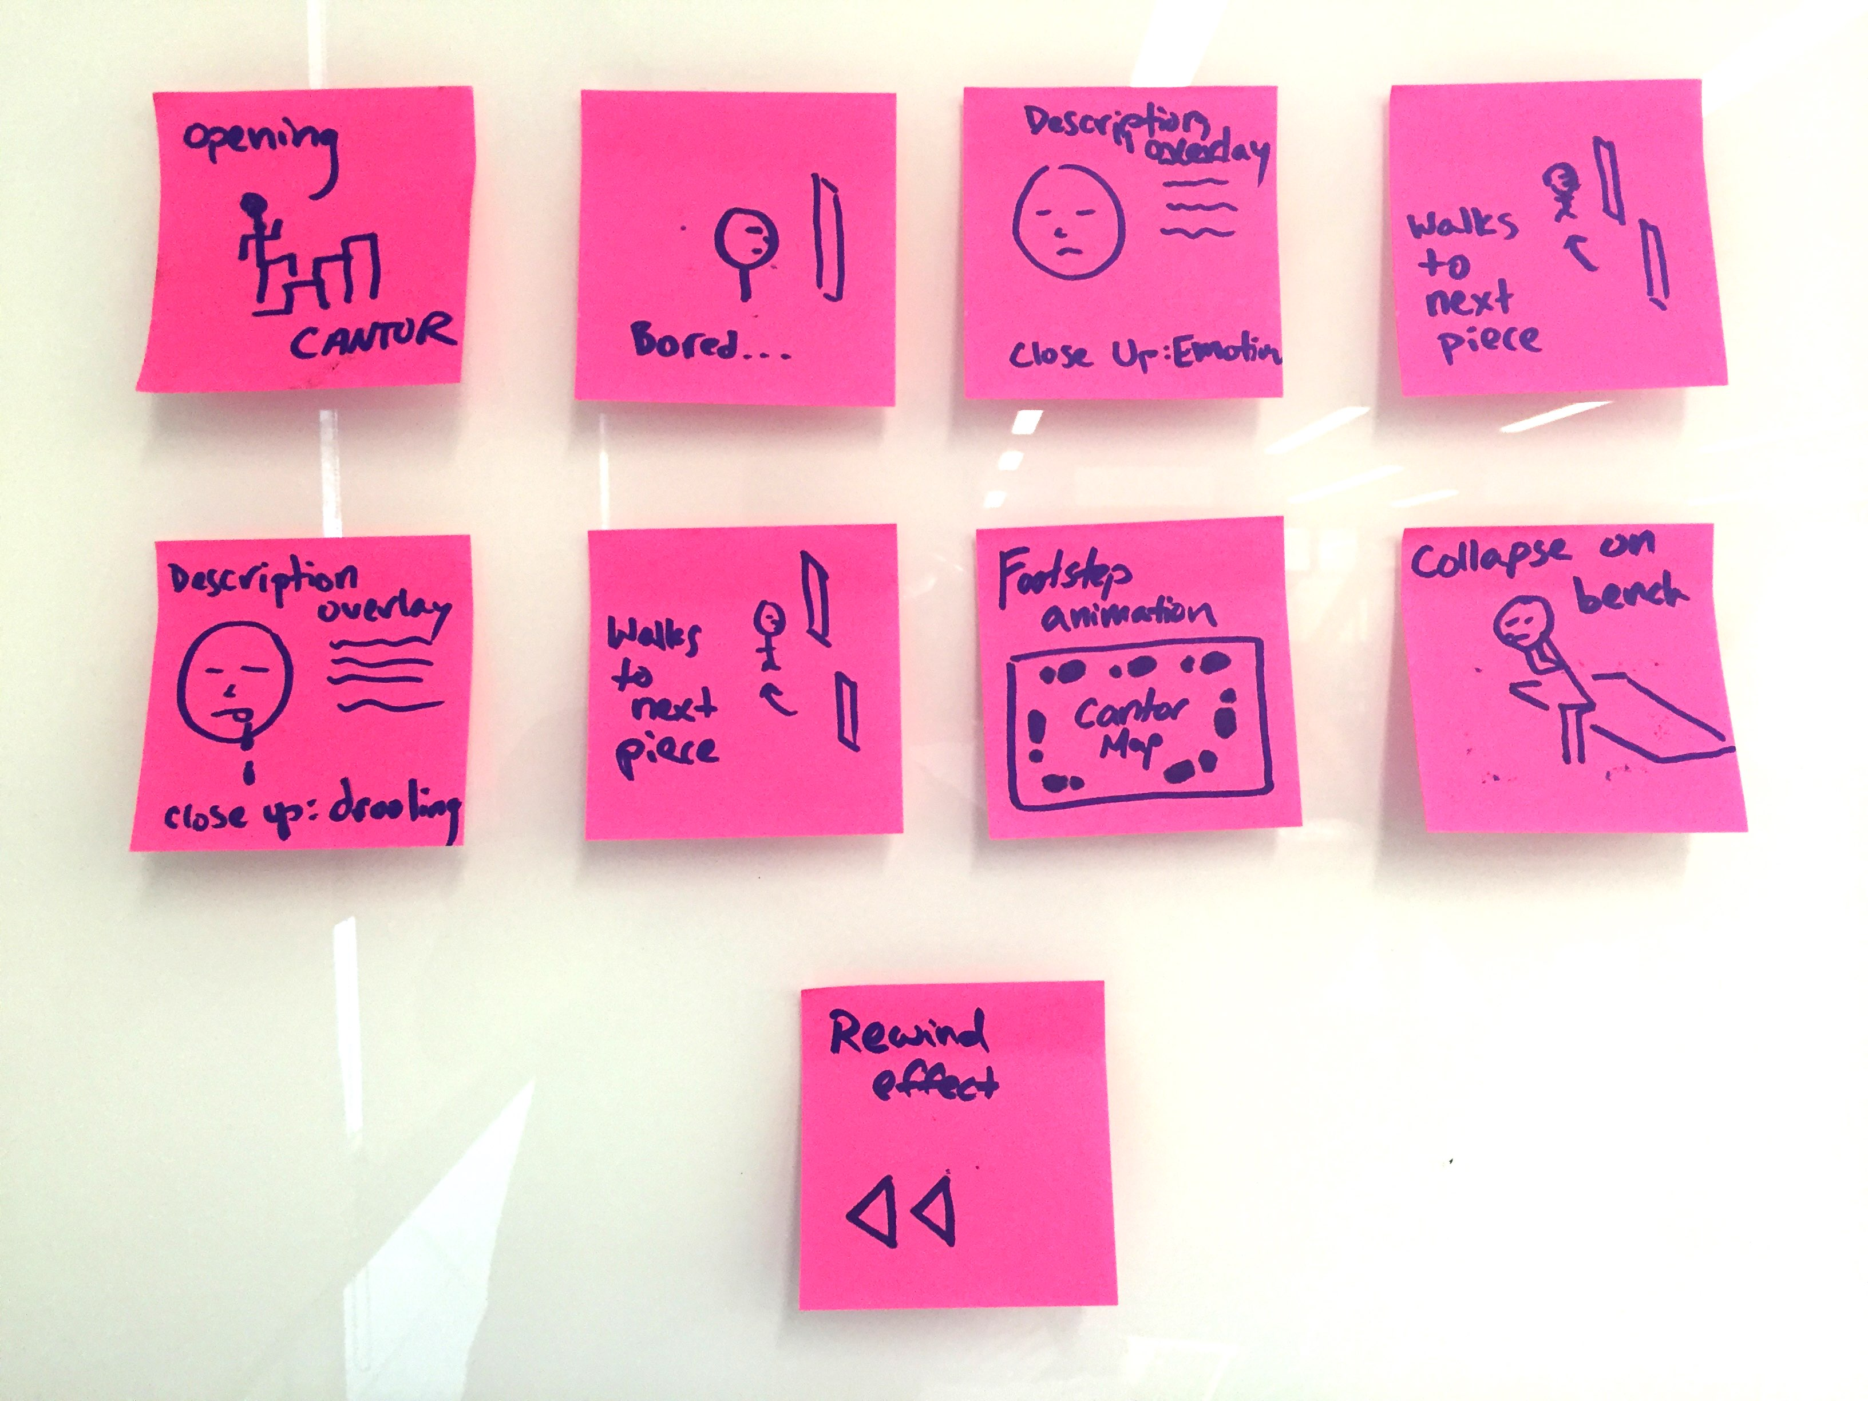
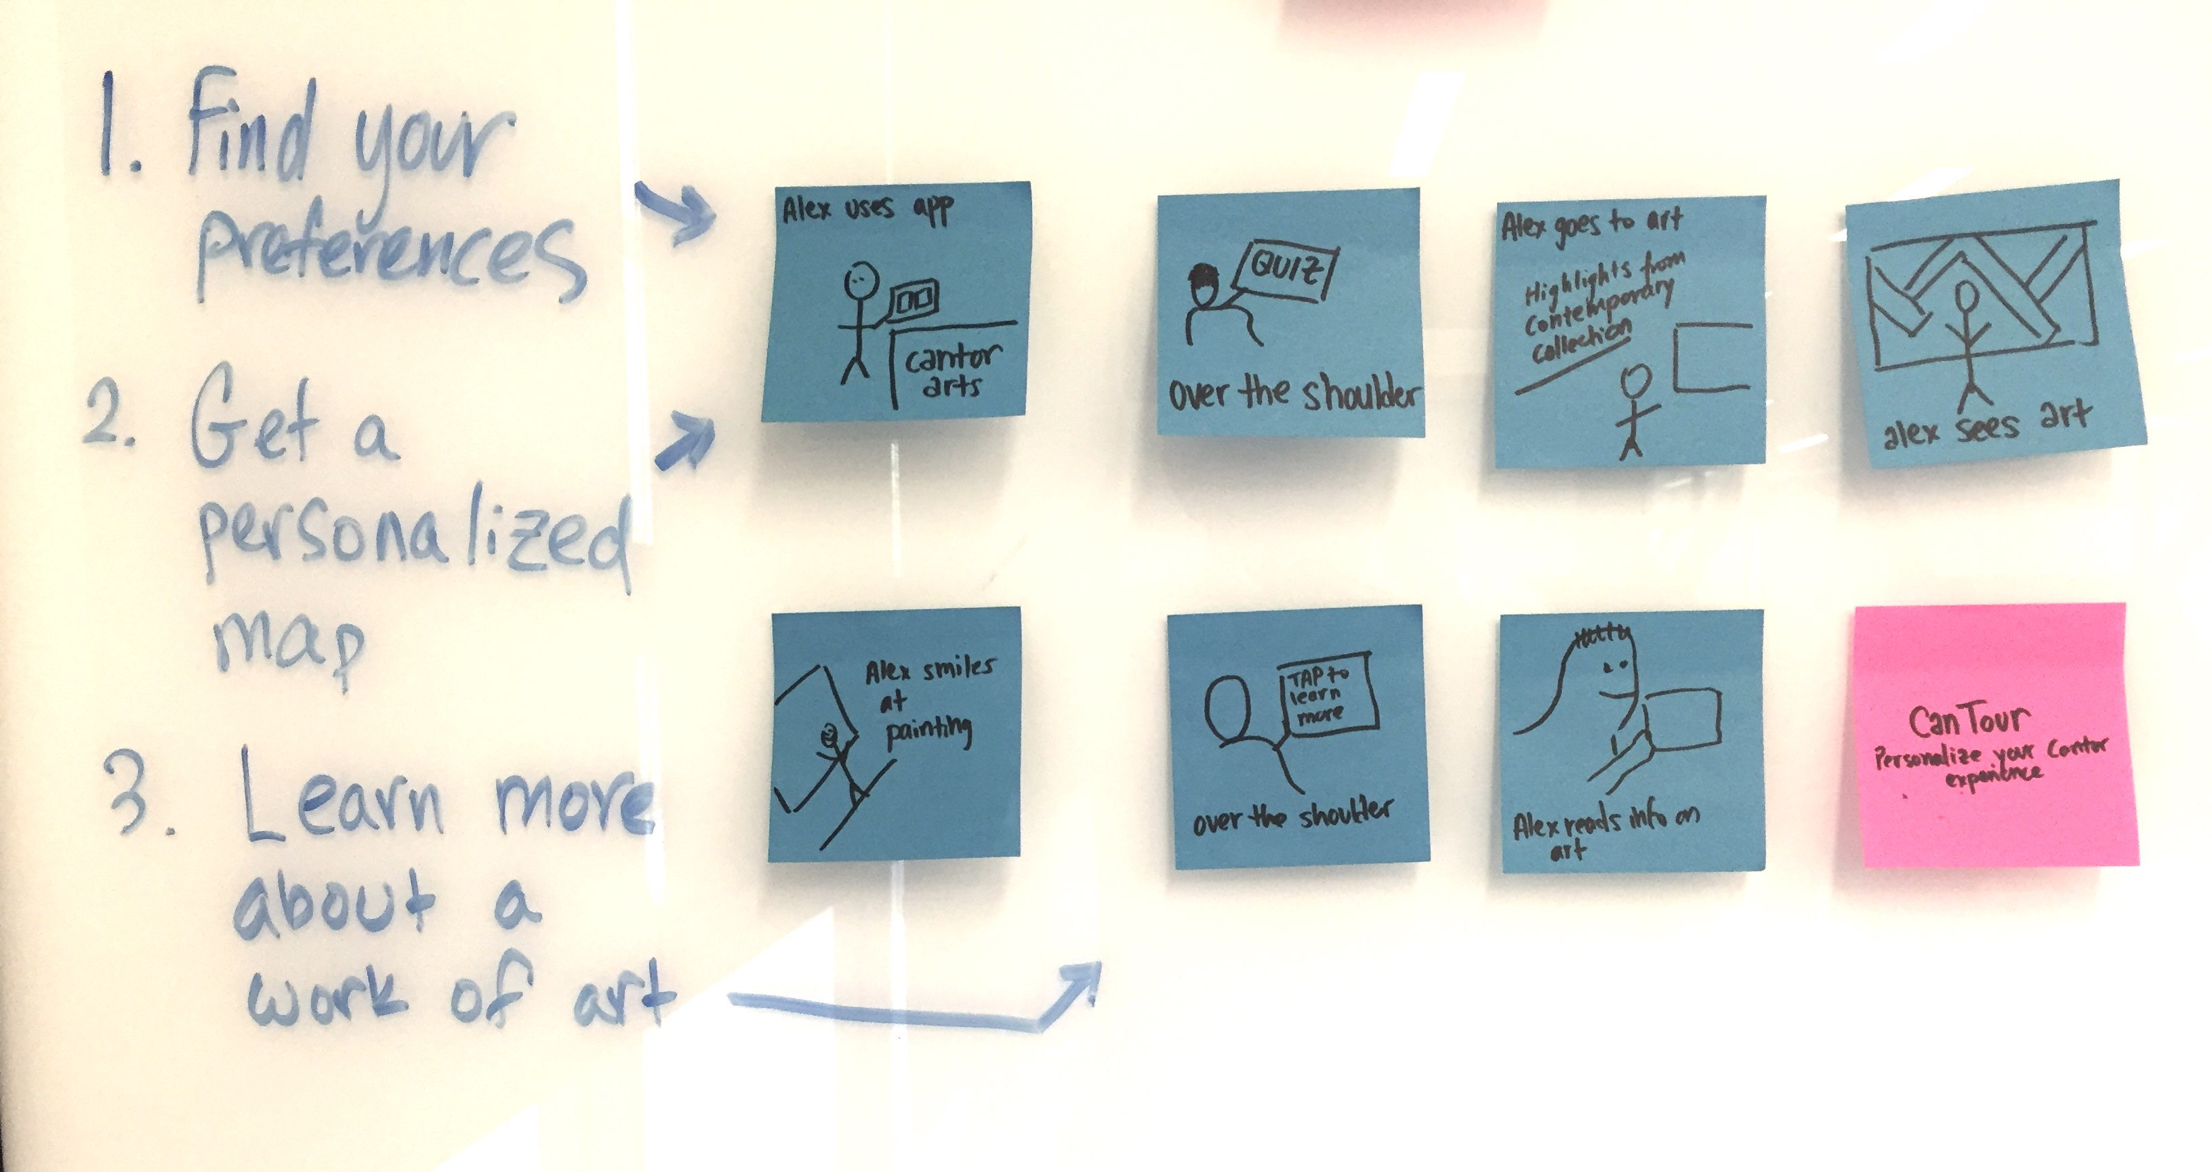
Assignment 4 | Video Storyboards
Video Link: www.youtube.com/watch?v=_2Osni4cE9w
12/4/2015 | Page | Maya Balakrishnan, Tara Balakrishnan, Alex Chang, Shubha Raghvendra
Rev. 20130815
Apple Confidential - Strictly Need to Know
12/4/2015 | Page Ryan Brooks• Input Devices - Apple Confidential

