Slide 1
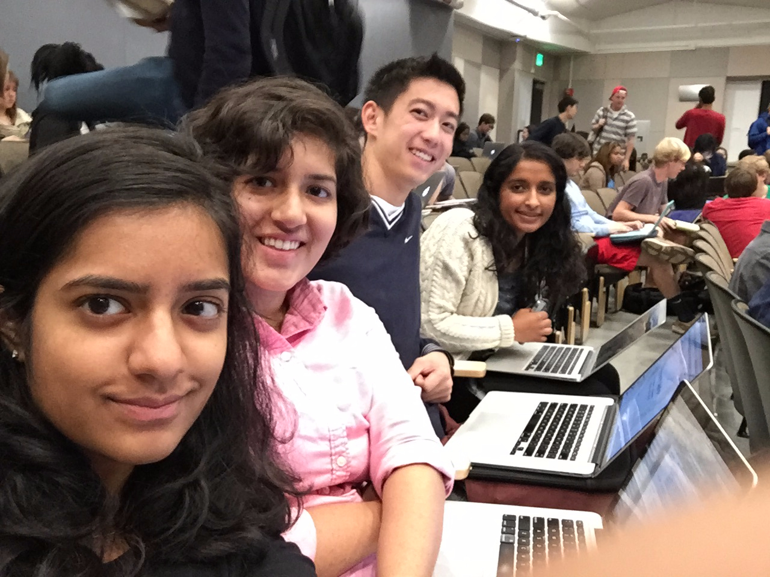
Assignment #1: Needfinding
Maya Balakrishnan, Tara Balakrishnan, Alex Chang, Shubha Raghvendra

Slide 2
Intro | Problem Domain
How parents learn about their children
Notes:
Started with communication between parents and children, how parents learn about their kids’ lives

Slide 3
Methodology | Participants
Parents
Children
Notes:
Families with teenager to college aged kids
Felt like this was the age range of kids with the most potential points of contention
Younger kids, communication is more straightforward, little pushback from kids
Children in their late 20s and beyond are generally more independent, therefore the parent-child communication is fundamentally different from our intended demographics
Within these families, wanted to look at both sides
Parents
Children
In person interviews at Town & country, near Paly
Skype conversations between college kids and their parents

Slide 4
Methodology | Questions
Parents:
-What do you want to learn about your kids and their lives?
-Tell me about the last time you learned something new about your child.
Children:
-What conversations are difficult to have with your parents?
-Tell me about a time your parents didn’t understand you.
Ask both:
-Why, why, why?
Notes:
Some of the starting questions
Parents
General open-ended prompts: What they wanted to learn about your kids and their lives?
Prompt specific story: Tell me about the last time you learned something new about your child
Children
General: What conversations are difficult to have with your parents?
Specific story: Tell me about a time your parents didn’t understand you.
For all users, tried to dive into reasoning behind their statements or actions, repeatedly asking why

Slide 5
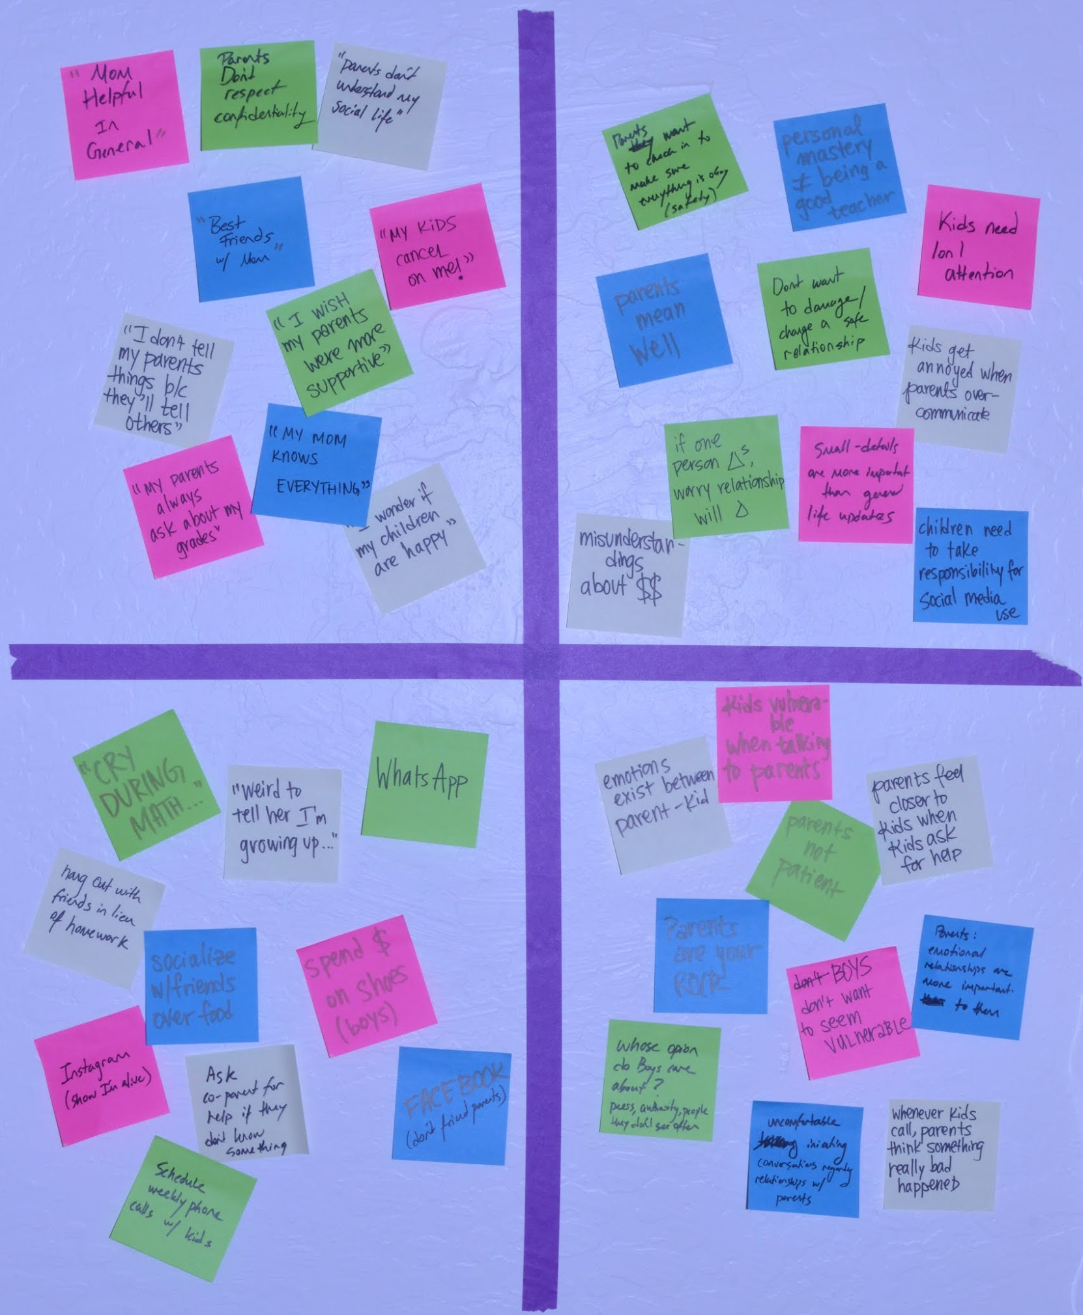
Results & Analysis | Empathy Map
SAY
THINK
DO
FEEL
Notes:
After our interviews, we unpacked our notes and recordings into empathy maps,
to help us uncover unexpected insights and needs about our users
At this pt, we want to highlight the key insights we gleaned from our interviewees.

Slide 6
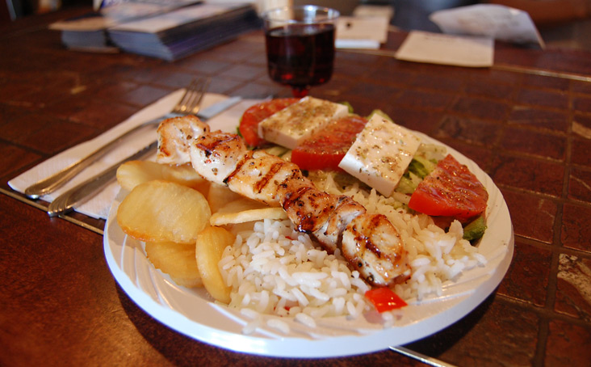
Results & Analysis | Jamshid & Malathi
“These days, it’s so easy to go to a restaurant, take a picture of your meal, and share it on WhatsApp.”
SAY
DO
THINK
FEEL
Notes:
we had a couple conversations with parents, including Jamshid and Malathi
quote SAY
despite how easy it is, it’s not habitual for his children to share such a detailed perspective on their daily lives
Often times the only communication that children DO initiate with their parents is when they require help.
conclusion: what college kid ultimately wants from long distance parent/child relationship is support, advice in times of need
result: The parent then sees an incomplete picture of the child’s life - composed primarily of “critical moments.”
when parent receives call from child, parents automatically THINK that something is wrong
conclusion: parents want something else in this long distance relationship...
Safety becomes a primary concern -
the parent prefers regular updates or small details
these small details enable parents to FEEL comforted in knowing child is happy / safe…

Slide 7
Results & Analysis | George & Roman
“I don’t tell my parents things because they will tell other family members.”
SAY
DO
THINK
FEEL
Notes:
Let’s shift gears to our interviews with children
George & Roman, high schoolers
quote SAY, DO
Teenage boys THINK their image, reputation is more important than sharing things about their lives with parents or getting advice
want to be in control of it
They don’t want to seem vulnerable, and they FEEL that showing emotions is a sign of vulnerability
in retrospect, we wish we had clarified which family members he was referring to, as this affects our insights significantly
question: to aunts/uncles/grandparents/authority figures?
to cousins/siblings/peers/same generation?
to people who are not as familiar with, don’t want isolated instances to skew their image of him

Slide 8
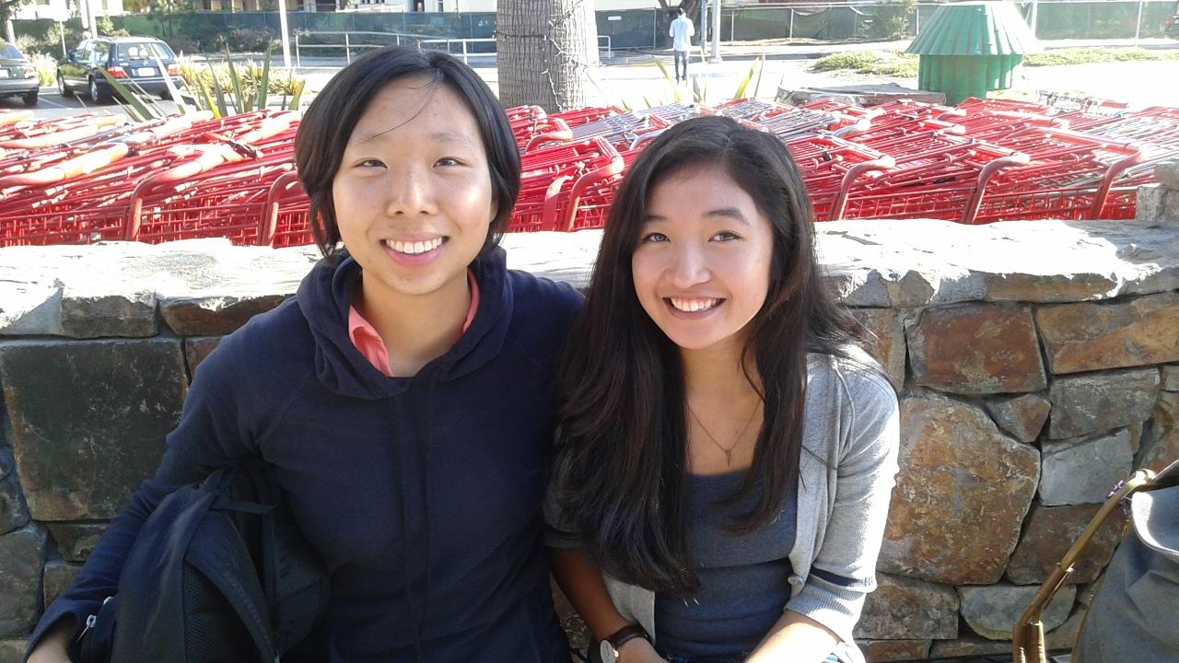
Results & Analysis | Nicole & Leila
“Best friends”
“Weird to tell her I’m grown up”
SAY
DO
THINK
FEEL
Notes:
Leila has close relationship with single, young mom
they are best friends
DO regularly have healthy conversations
BUT more difficult to talk with mom about relationships / significant others
in particular, SAYs “weird to tell her i’m grown up”
one conclusion we drew was Leila THINKs mom is worried or unreceptive to child growing up
therefore, certain conversations she doesn’t want to bring up, avoid any negative reactions
unpack more...
kids FEELs parents are your rock, one relationship you never want to have in question, particularly in this tight 2-person family
perhaps Leila worries about changing this relationship by growing up, or at least having different types of conversations

Slide 9
Results & Analysis | Nicole & Leila
“Sometimes, I would cry when learning math. My mom wasn’t the most patient. But in general she was very helpful.”
SAY
DO
THINK
FEEL
Notes:
conversation moved to how their moms would help them with their schoolwork
nicole’s mom was engineer, BUT
quote SAY/DO
...contradictory
one hand, she FEELs she is disappointing her mom
at the same time, kids need 1-on-1 attention, something her mom is willing to commit more of than a teacher
this is ultimately why she THINKs mom is very helpful
unpack another level…
emotions exist when parent is teaching child, but those emotions don’t exist in an ideal learning environment between teacher-student
however, still important to harvest deeper sense of investment between parent-child versus teacher-student

Slide 10
Summary
Insights / Needs:
Parent-child communication
Parent-child teaching
Next steps:
Focus domain, choose need
Solution space
Notes:
Because we started with a relatively broad problem domain and went into interviews with an open mind,
we gathered a wide scope of insights and potential needs
Next step, focus in on a more specific problem domain, demographic, and eventually, a specific need
before expanding our horizons once again as we enter the solution space

Slide 11
Appendix
Interview Notes & Empathy Maps: https://docs.google.com/document/d/13ylROaHROnegtYzMv7MQ-iOvS13xLZeGXdbSDjVx8lQ/edit?usp=sharing
Initial Idea Brainstorm: https://docs.google.com/document/d/1MMedW3v24WMMpAnNSgiLzLUZW8lPkOYFhxz5jbVOM2I/edit?usp=sharing

