Slide 1
Need-Finding
FOCUS
Ian Lewis, Gavin Mai
Chang Young Park, Haiyin Wang

Slide 2
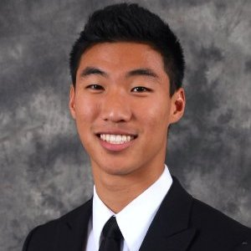
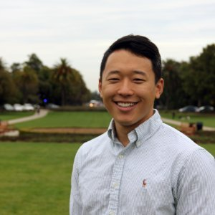
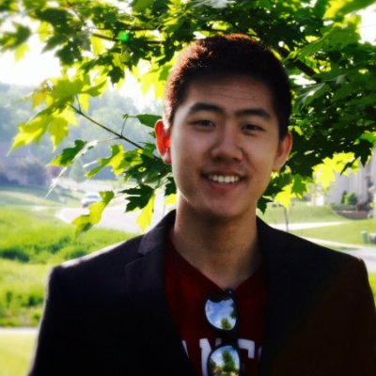

Slide 3
Who?
Bennett Lewis
James Chang
Alton Sun
Jasmine Kyi

Slide 4
Why?
EXTREME USERS!
People who are under a lot of stress
People who need to FOCUS
High school students
Industry professionals

Slide 5
How?
Connections
Friends
Mentors
Family

Slide 6
Where?
Phone interviews
Skype interviews
In-person interviews

Slide 7
What?
Productivity
Procrastination
Focus
Distractions
Aids

Slide 8
Assumptions
Everyone procrastinates
Different preferences when it comes to working & being productive
Common procrastination patterns

Slide 11
Results - Jasmine
“I typically block facebook, youtube, or any website I watch videos on”
“I make a list and I have a certain time I have to do everything”
“I procrastinate by physically getting away from my work”
“It’s like contracts, it’s more real that way. You’re making a deal to finish it”

Slide 13
Results - Alton
“This world of Supernormal stimuli”
“Procrastination is willingly welcoming the death of 99.9% of dreams”
“Diminishing marginal utility from pursuing a focused project”
“A lack of Instant gratification”

Slide 14
Results - James
“I need to turn off everything that can distract me”
“The environment in which I work is crucial for my productivity”
“I tend to procrastinate on harder tasks”
“I use sticky notes and place them right next to my light switch to constantly remind myself of the tasks I need to finish”

Slide 16
Results - Bennett
“Assignments seem more enjoyable when their steps to completion are planned out for me”
“Due dates help me focus”
“I feel like starting a task is the hardest part”

Slide 17
Analysis – Surprises & Contradictions
Instant Gratification – positive reinforcement
Guidance – timed / planned deliverables
Constant reminders
Pressure / stress helps!
Accountability
Environment

Slide 18
Empathy Map - SAY
Block
List
Physically getting away
Making a deal
Supernormal stimuli
Diminishing marginal utility
Instant gratification
Turn off everything
Environment
Harder tasks
Constantly remind myself
Steps to completion are planned out
Due dates
Starting a task is the hardest

Slide 19
Empathy Map - DO
FB/Youtube Blockers
Making lists
Using a scheduler
Planning
Physically getting away
Timeblocking
Google Calendar
Sticky notes
Scheduling ahead
Constant reminders
Automating tasks
Starting early

Slide 20
Empathy Map - THINK
Need Pressure
Hard to start
Instant gratification through smaller/easier tasks
Public pressure helps
Accountability
Procrastination is a negative feedback loop
My focus decays exponentially
The more I visualize my task, the better I focus
Focus is saying NO
Tangible representation of tasks help me connect to my tasks

Slide 21
Empathy Map - FEEL
Stress about larger tasks
Constantly seeking short term happiness
Potentially feeling lonely when working
Feeling overwhelmed
Feeling unmotivated
Boredom
Satisfaction
Responsibility

Slide 22
Summary
Instant gratification
Timeblocking
Lists
Schedulers
Constant reminders
Breaking down tasks into smaller parts
Accountability

