Slide 1
Assignment 2 - POVs and Experience Prototyping
Irene Hsu, Ke Xu, Jessica Zhang
Focus: Productivity in transitioning stages of education
Notes:
What happens to people’s focus on their tasks when they transition through stages of their career and education

Slide 2
Initial POV: We met Brian...
We were amazed to realize . . .
he needed public deadlines with wide audiences (such as his birthday, holidays, the end of the school year, breaks, etc.) to get his personal projects done.
It would be game changing for . . .
people to have more opportunities to showcase their work.
Notes:
Brian, a senior at Emory who created an organic chemistry and graphic design textbook

Slide 3
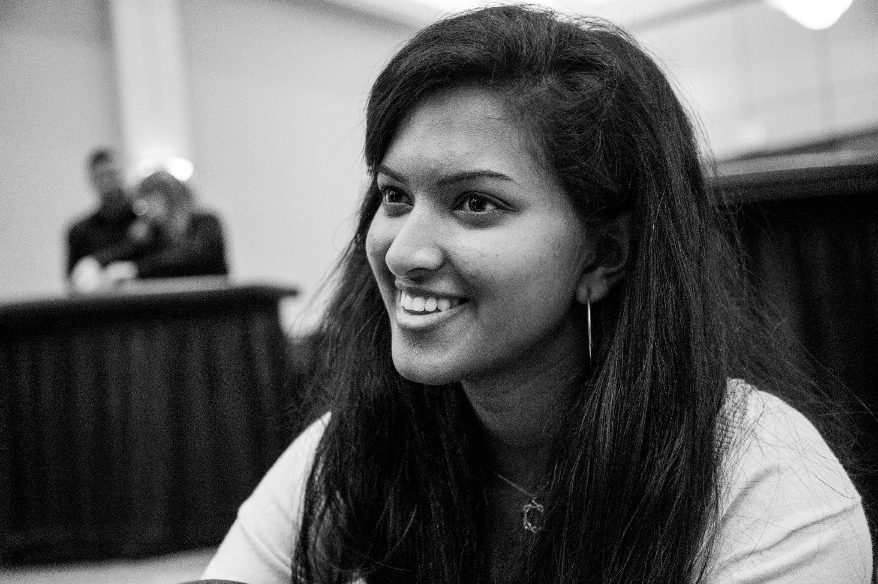
Additional Interviews: Somya Khare
-undeclared freshman at Stanford
-tracks productivity on GCal after she completes tasks
-distracted by uncertainty about long-term goals
Notes:
interviewed her because she recently transitioned from high school to college
tracks productivity on google calendar after she completes the tasks
visual representation of her productivity works well (said she was “obsessed with the color blocking”)
helps her to balance her life
contradictions: focused, but often distracted by what her peers were doign
one of the biggest distractions: uncertainty about long-term goals, compounded by her feeling that her peers all knew their four-year plans

Slide 4

Additional Interviews: Matthew Willis
-first-year grad student
-uses a whiteboard to prioritize tasks
-has trouble with long-term tasks without a clear objective
-has trouble prioritizing tasks without a visual reminder
Notes:
first-year grad student
interviewed him because he recently went from undergrad to grad
also needs a visual reminder
now uses a whiteboard, needs to cross off tasks
helps for short-term tasks
has a lot of problems with long-term tasks such as making decisions, researching plans, writing, etc.
usually has to break them down on his whiteboard
after moving, hasn’t been able to get a whiteboard
still productive, but not prioritizing tasks right

Slide 5
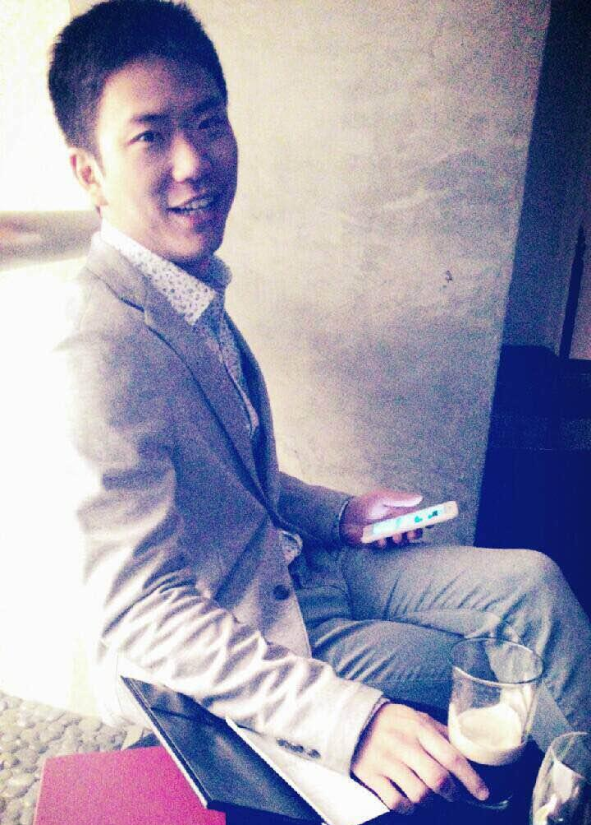
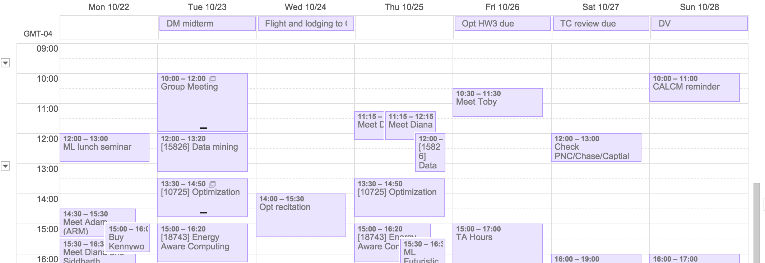
Additional Interviews: Daniel Chen
-first year at Google as a software engineer, previously a PhD student at Carnegie Mellon
-“After work, I’m exhausted. It’s hard to focus on anything that’s not related to my promotion.”
Notes:
-interviewed him because he graduated from his phd program last year and is now working in the techn industry
-previously highly focused on his research
-focus has continued into his career
-but finds it hard to focus on his own projects now (was planning to expand more on his thesis)
“after work, i’m exhausted. it’s hard to focus on anythign that’s not related to my promotion, or my career”

Slide 6
Revised POVs: We met Somya...
we were amazed to realize that she is helpless about her long-term plans even though she tracks her short-term accomplishments well on Google Calendar.
It would be game-changing for her to be able to draw a connection between her short-term tasks and long-term goals.

Slide 7
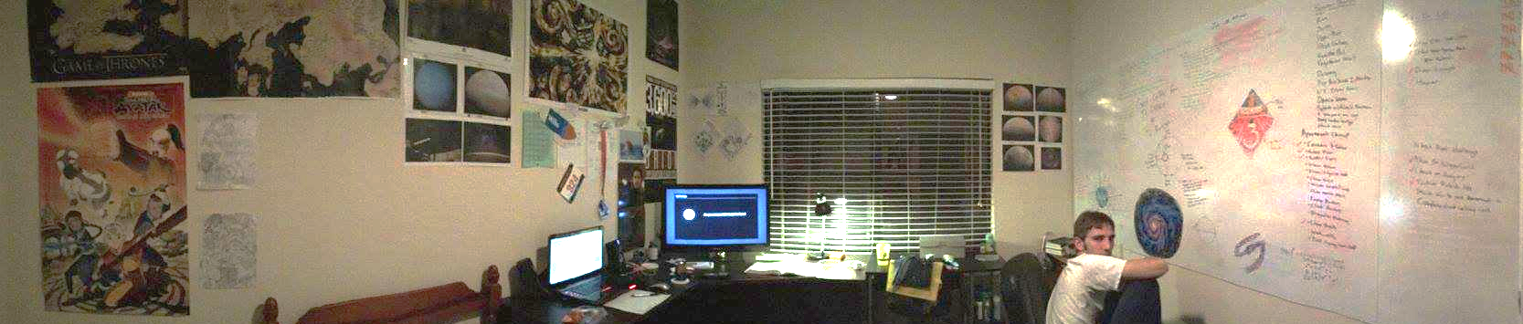
Revised POVs: We met Matthew...
and we were surprised to find that he has trouble keeping track of his priorities without his whiteboard.
It would be game changing for him to prioritize without the physical reminder.
Notes:
-again, going back to how his productivity tool is not portable and readily available

Slide 8
Revised POVs: We met Daniel...
and we were amazed to realize how he had trouble focusing on both his career and personal research after work, even though both are related.
It would be game changing to keep him motivated even after work.

Slide 9
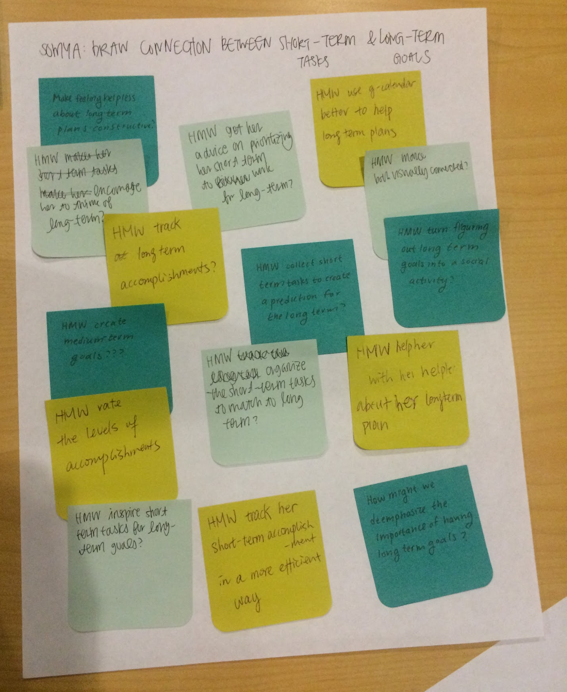
How might we . . .
organize short-term tasks to reflect or match long-term goals?
(inspired by Somya’s helplessness about long-term goals, uncertainty about what the right short-term goals are)

Slide 10
How might we . . .
turn figuring out long term goals into a social activity?
(inspired by Somya’s self-consciousness about not knowing her long-term goals, and her belief that her peers are sure of themselves)

Slide 11
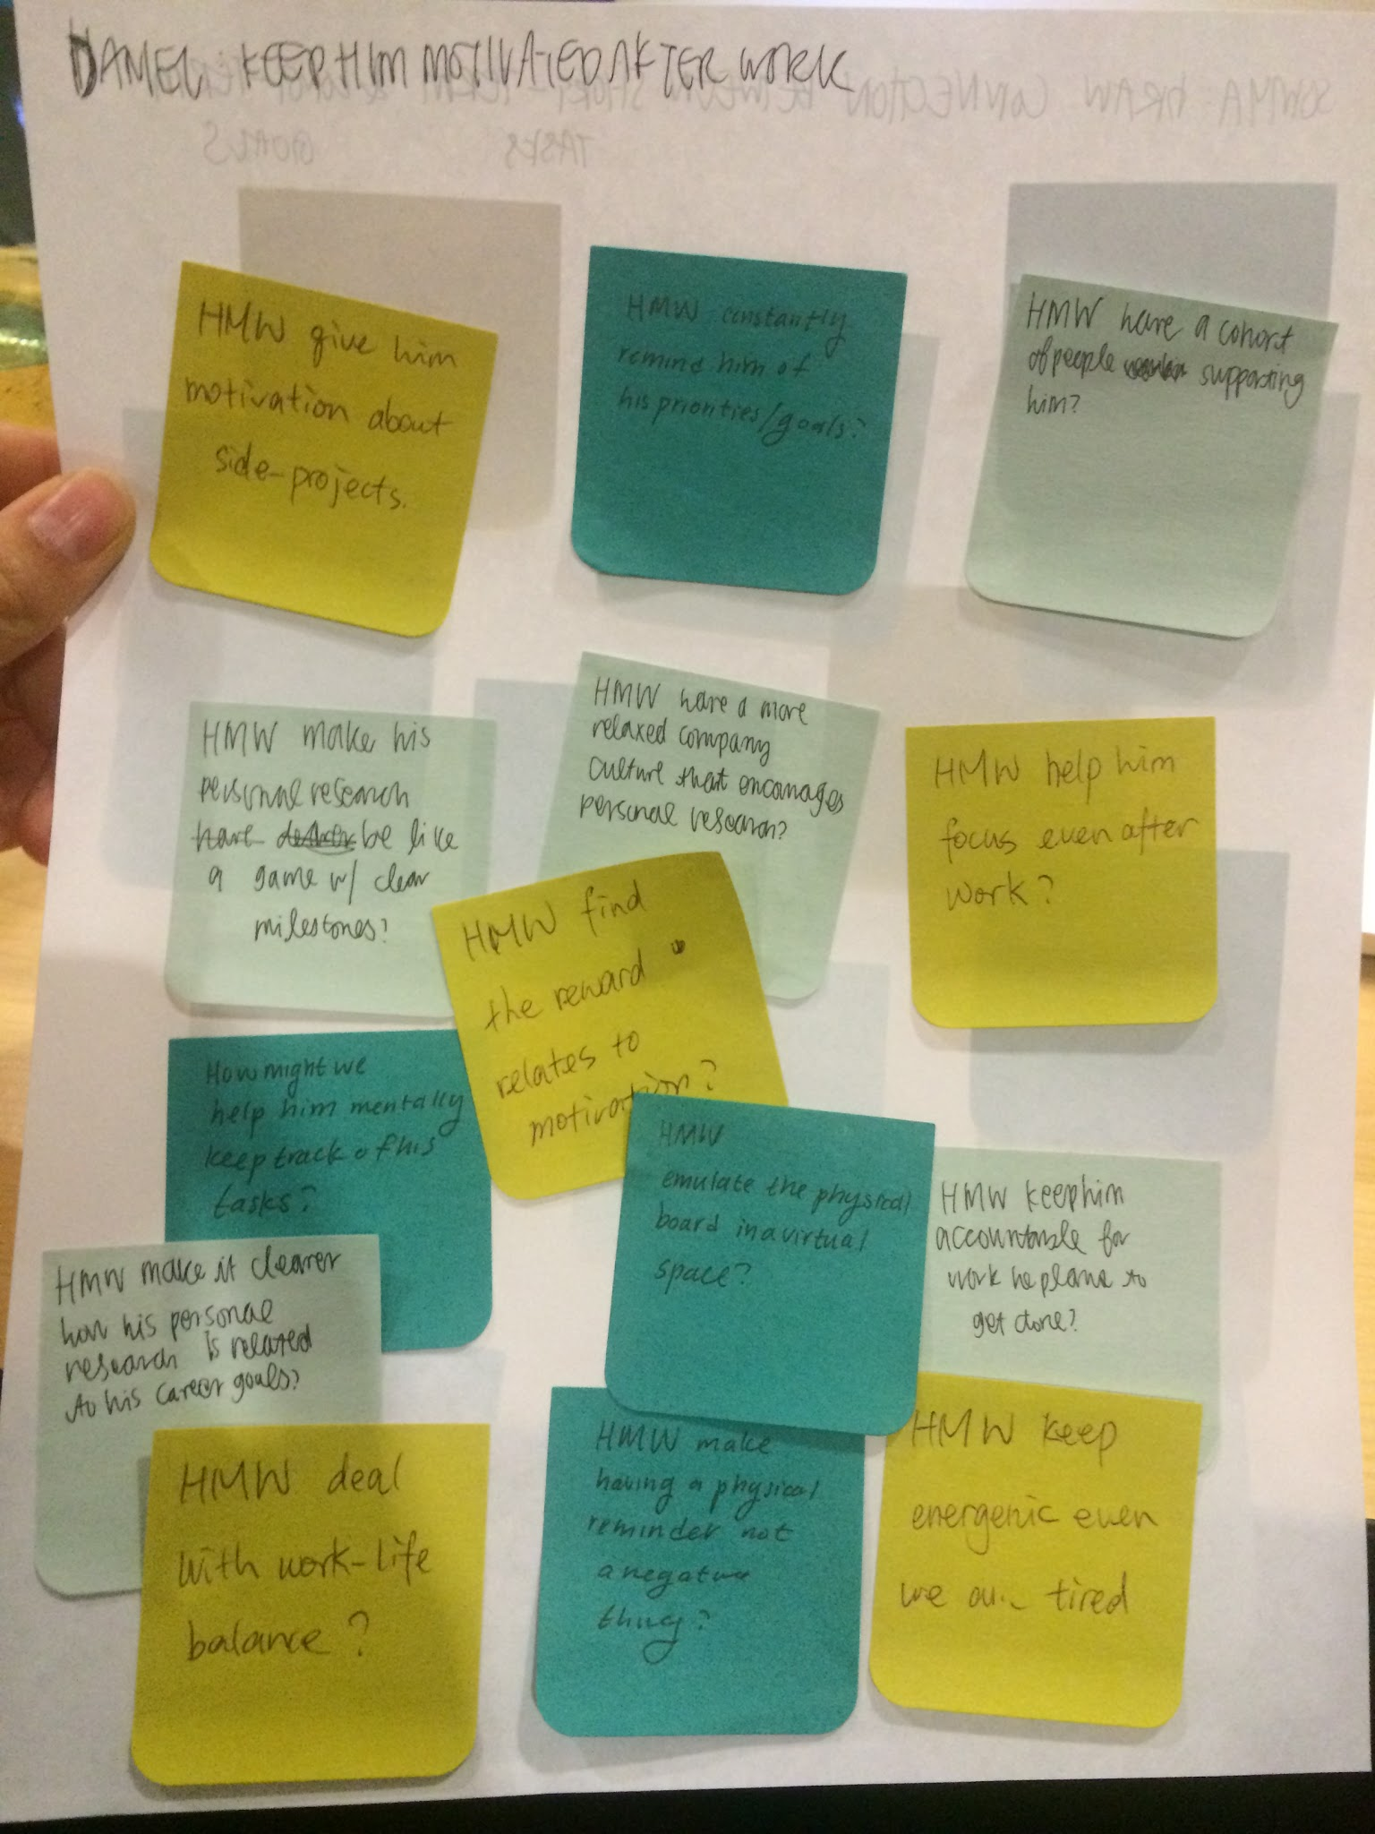
How might we . . .
have a company culture that encourages work on personal projects?
(inspired by Daniel’s inability to focus on his side research project while working on his career)

Slide 12
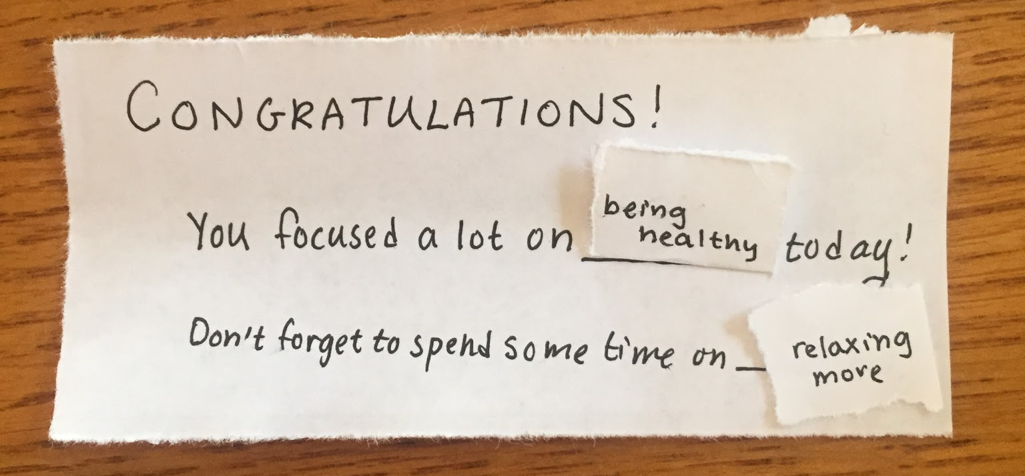
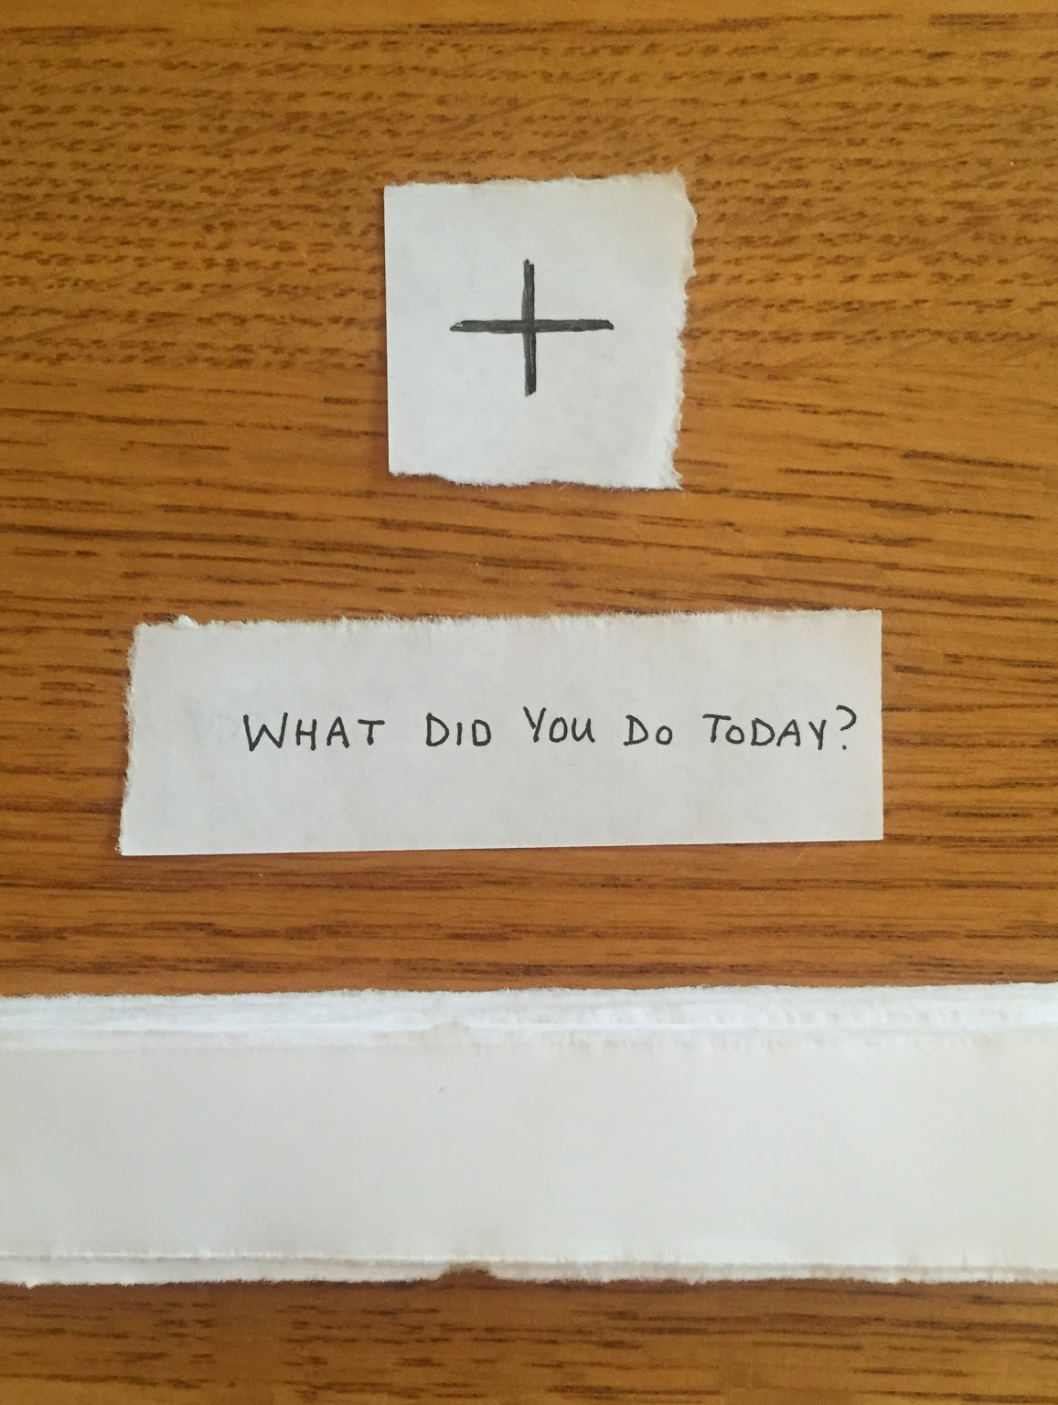
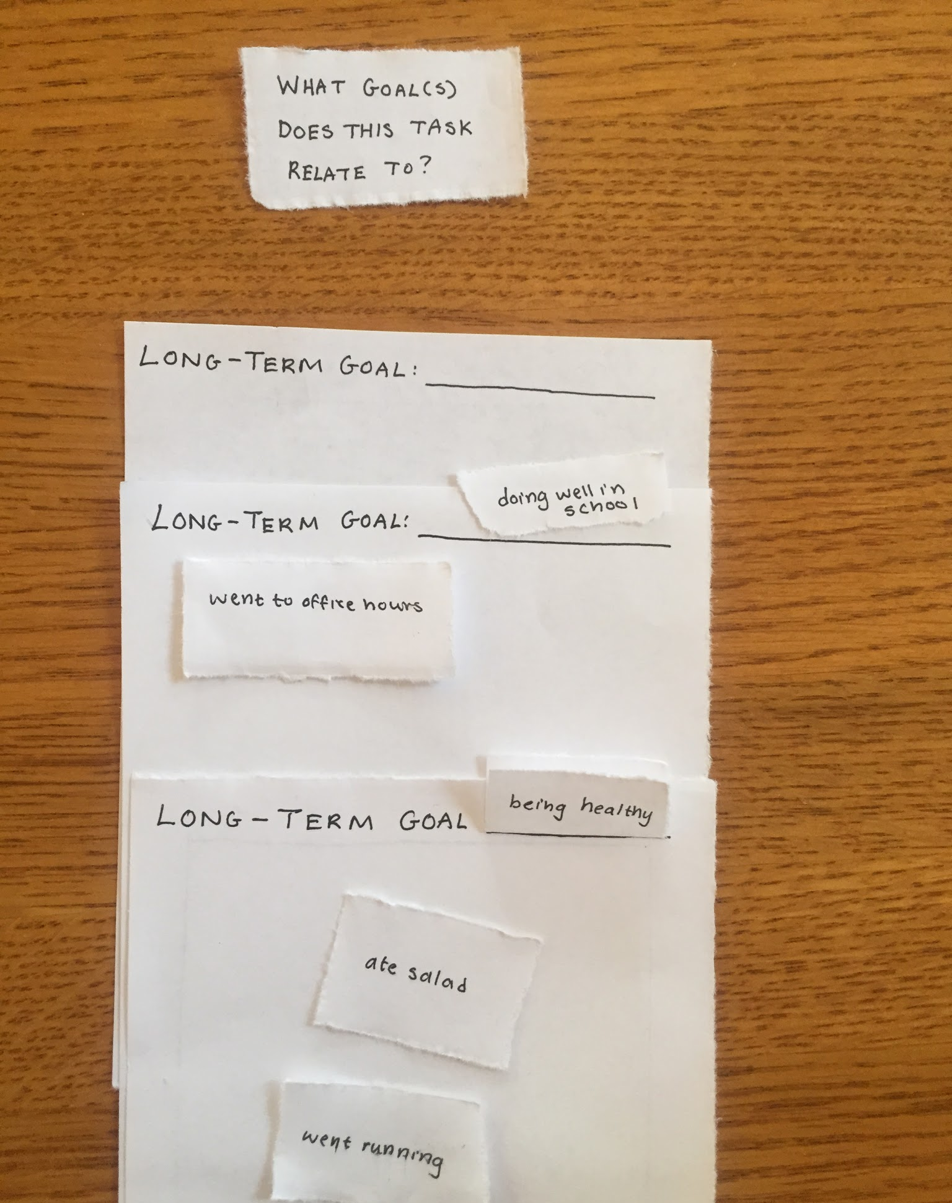
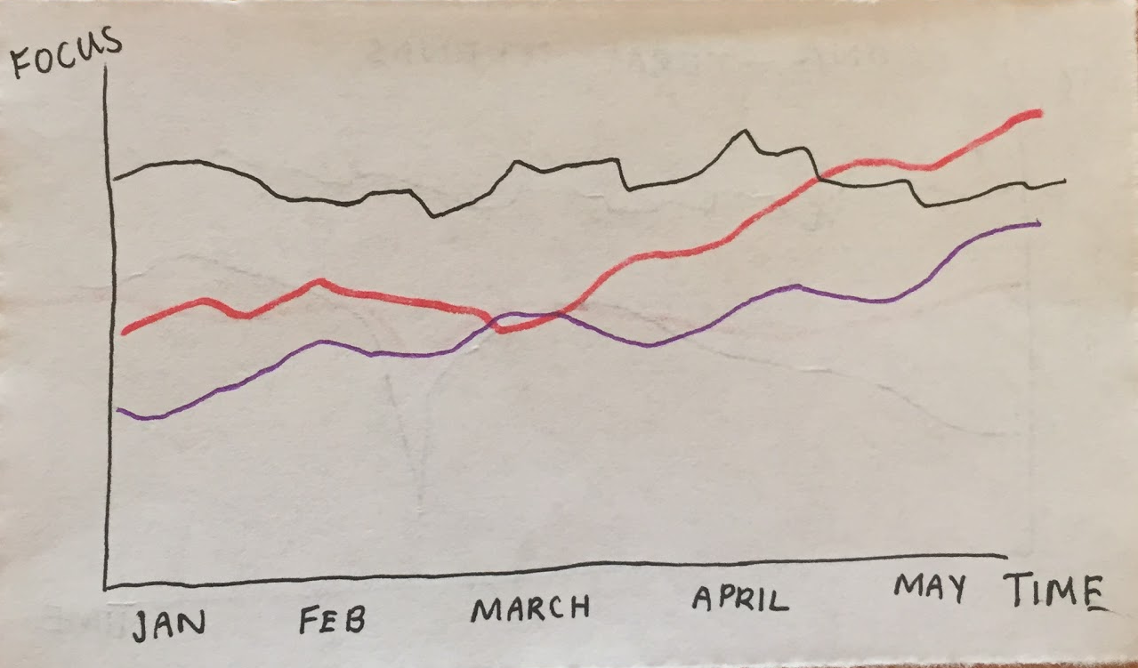
Experience Prototype 1:
Connecting short-term tasks & long-term goals
-slips of paper to track short-term goals
-panels of paper categorizing long-term goals
-summary slips analyzing the day’s results and displaying trends
Notes:
Connecting short-term tasks to long-term goals

Slide 13
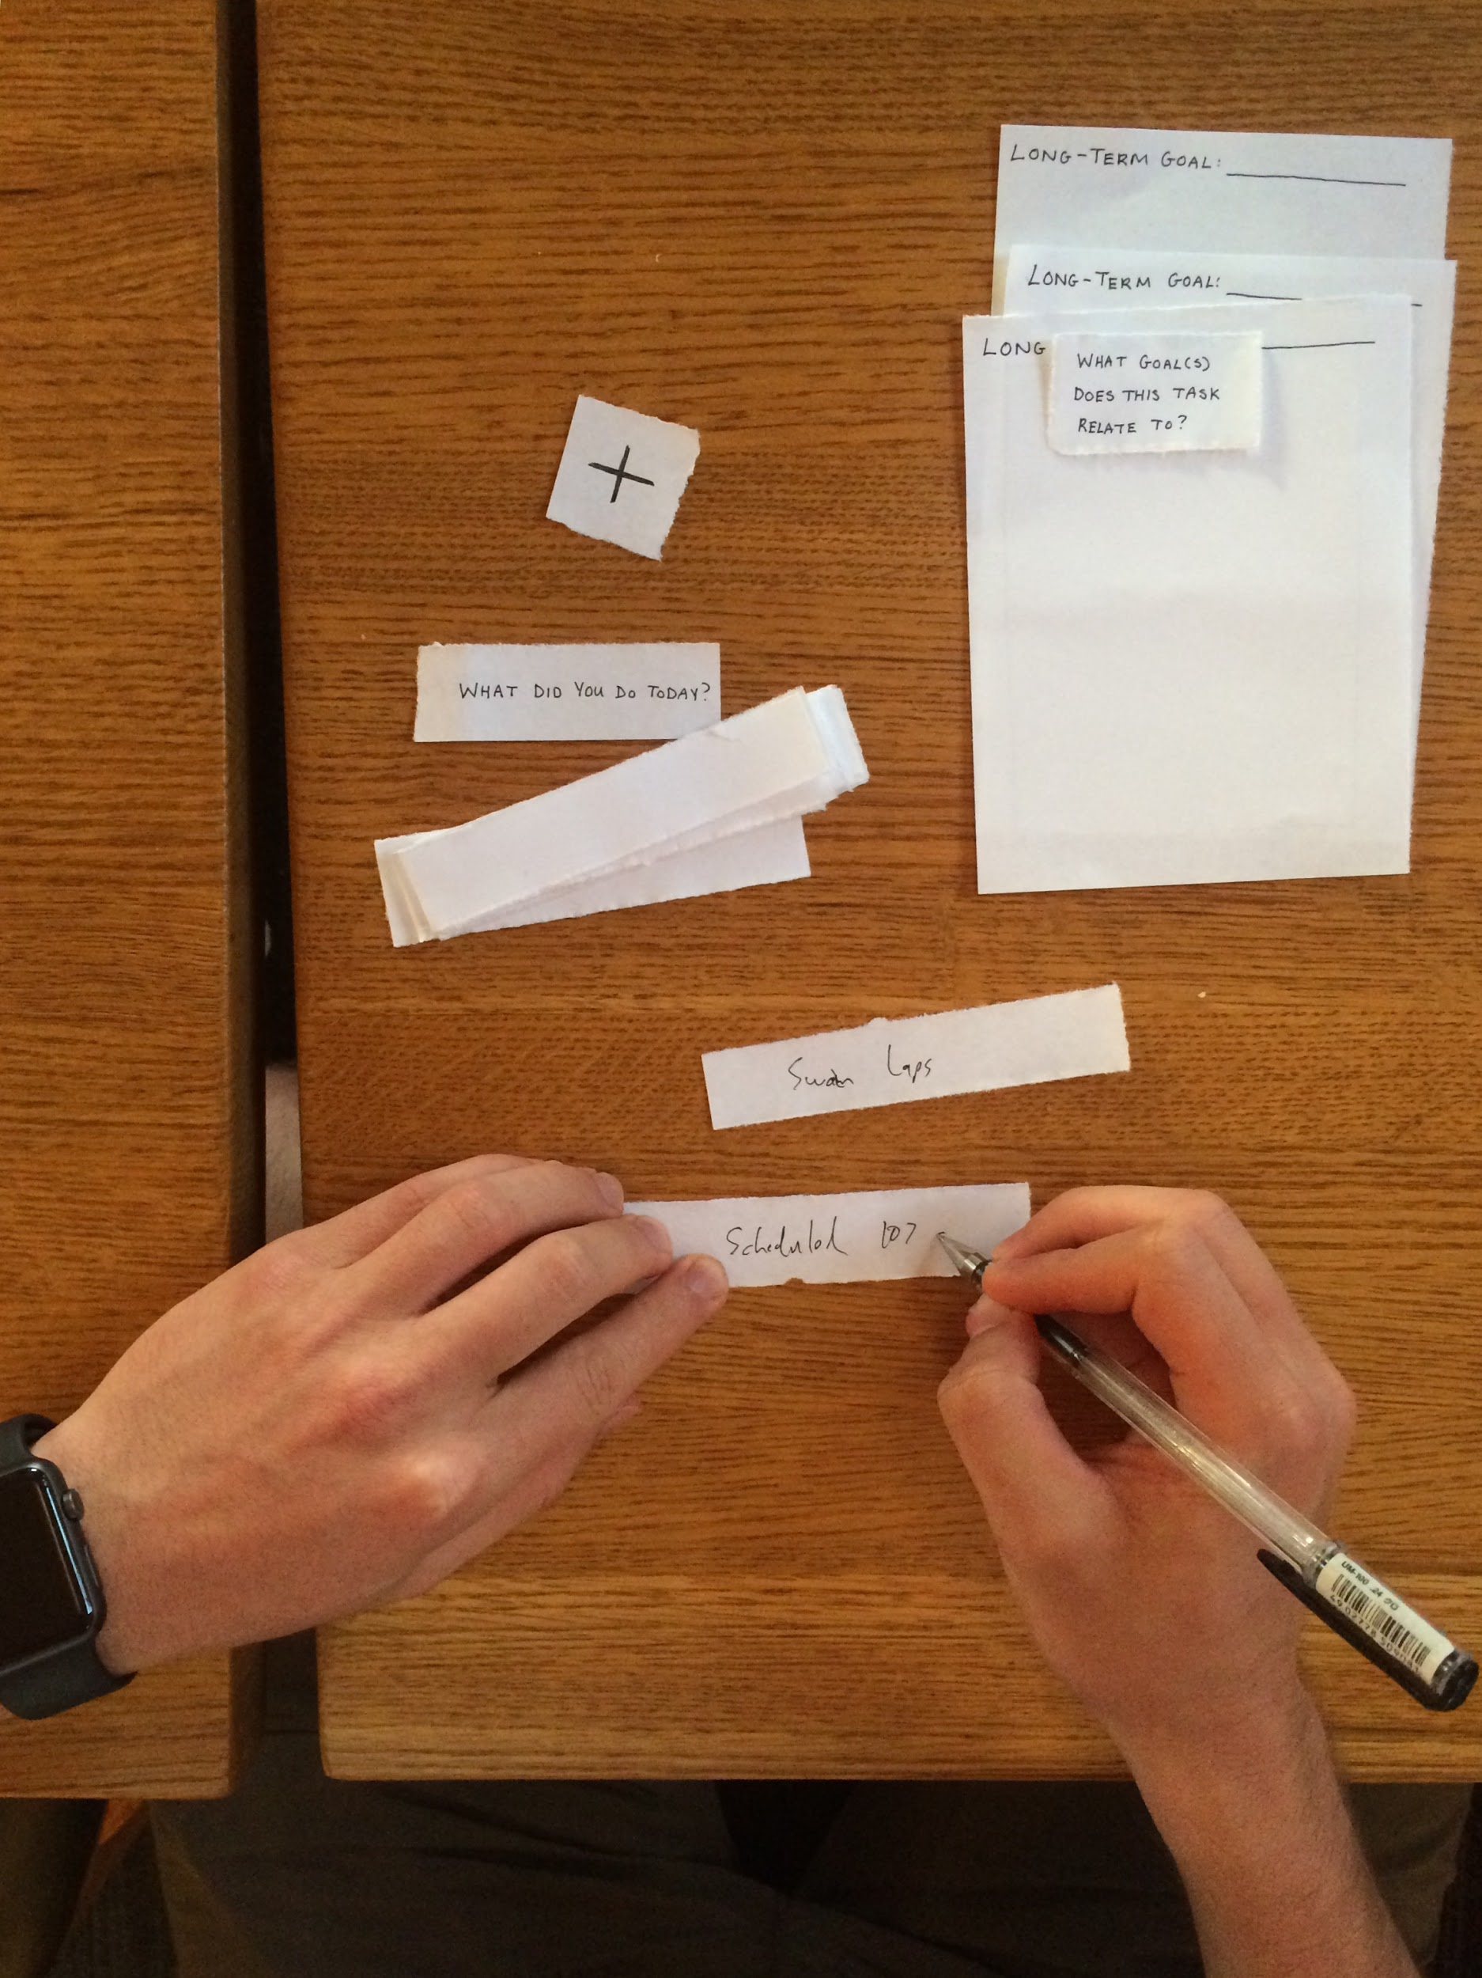
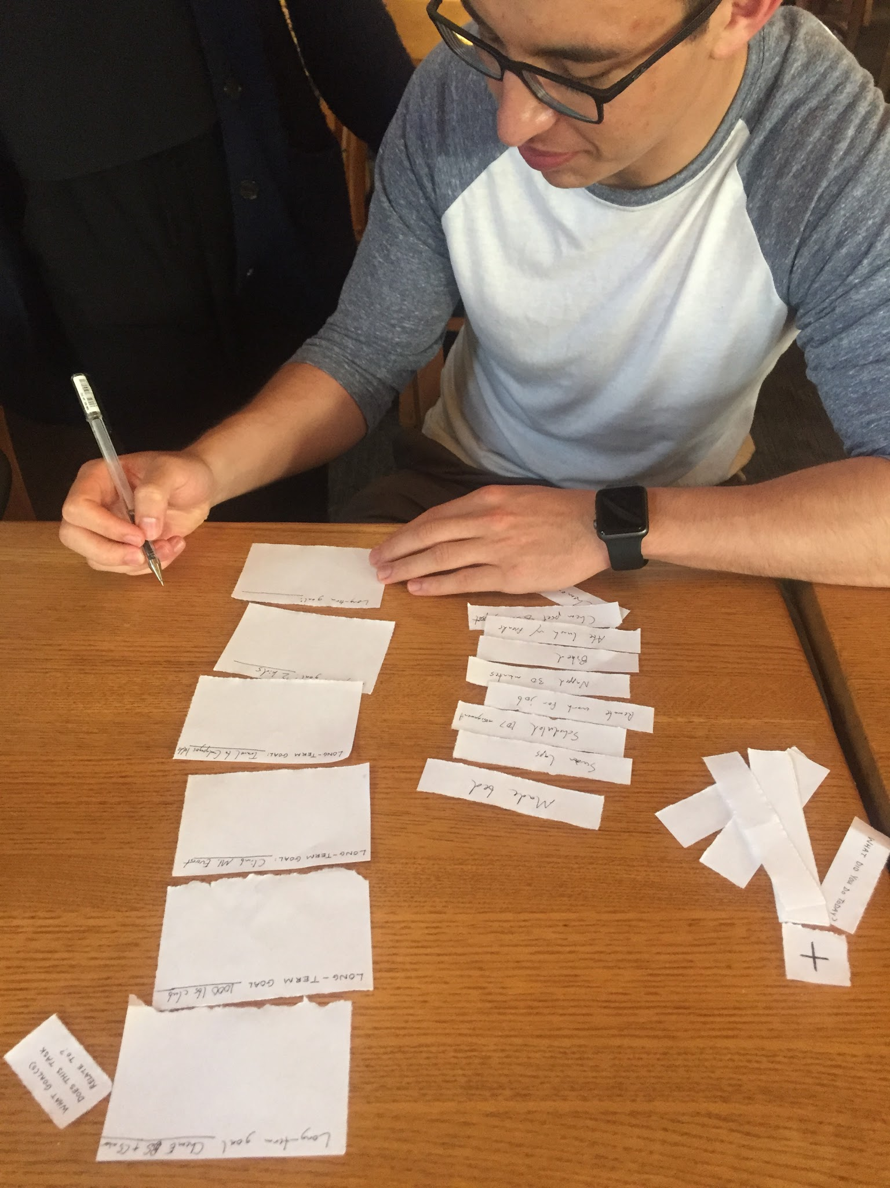
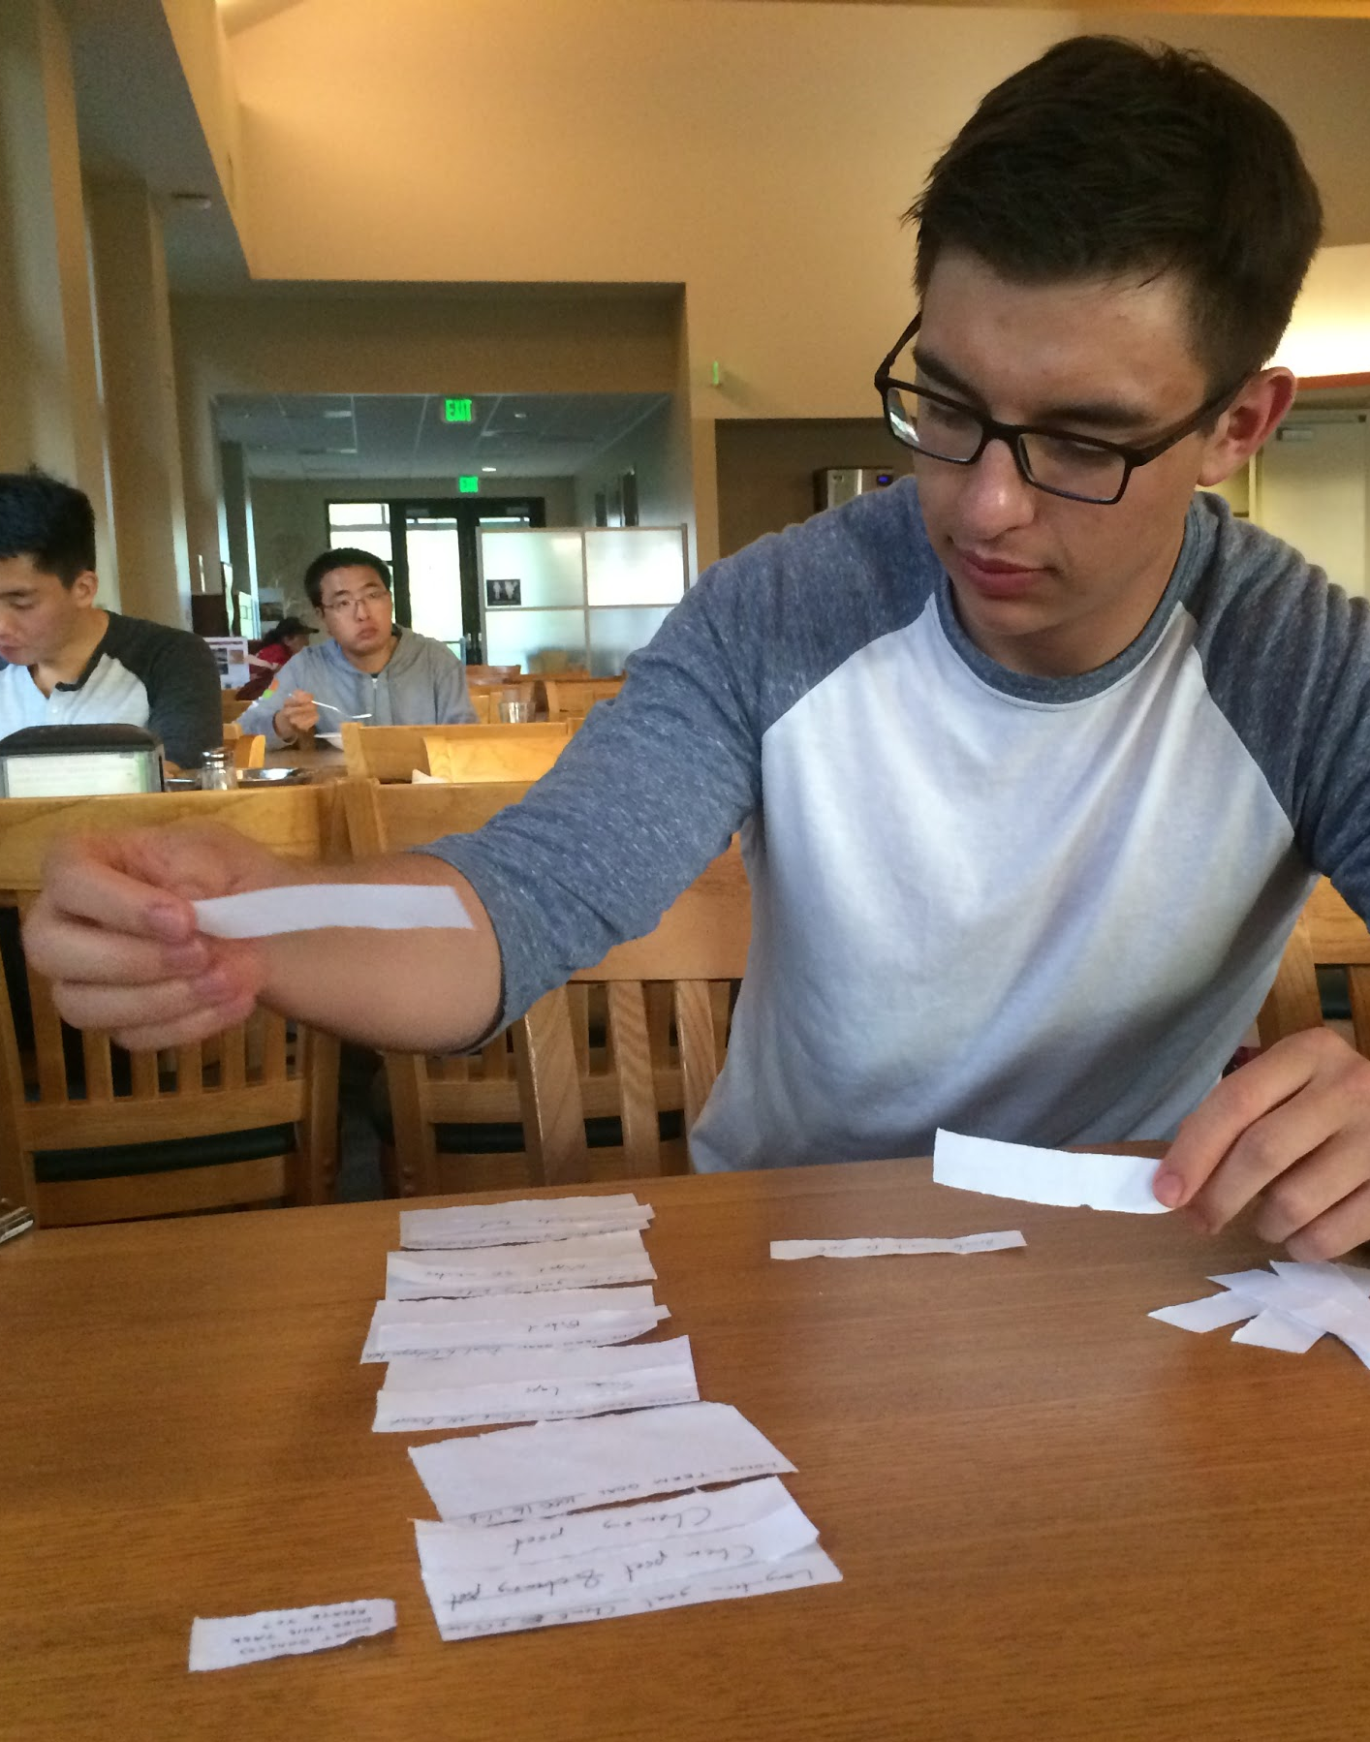
Experience Prototype 1:
Testing
-write tasks accomplished onto slips of paper
-place into panels with long-term goals
-receive summary report

Slide 14
Experience Prototype 1:
Results
What worked:
-straightforward interaction
-categorizing short-term into long-term
What didn’t work:
-took extra effort to remember day
-needed help choosing long-term goals
Surprises:
-bucket lists and long-term goals are not the same things!
New learnings:
-user would like structure choosing/categorizing long-term goals

Slide 15
Experience Prototype 1:
Validity
Assumptions we had:
-people care about how their short-term tasks factor into their long-term goals
-people like to visualize their progress
-people are willing to log their tasks every day
New assumptions:
-users would prefer for their tasks to be automatically logged or compiled based on an already written account
Notes:
-user was curious to see how the tasks added up and which long-term goals he ended up focusing on more unconsciously
-user was excited to see progress of his tasks
-user wasn’t sure if he’d be willing to log his tasks, said it would be unnecessary and would prefer a program to parse through diary entries

Slide 16
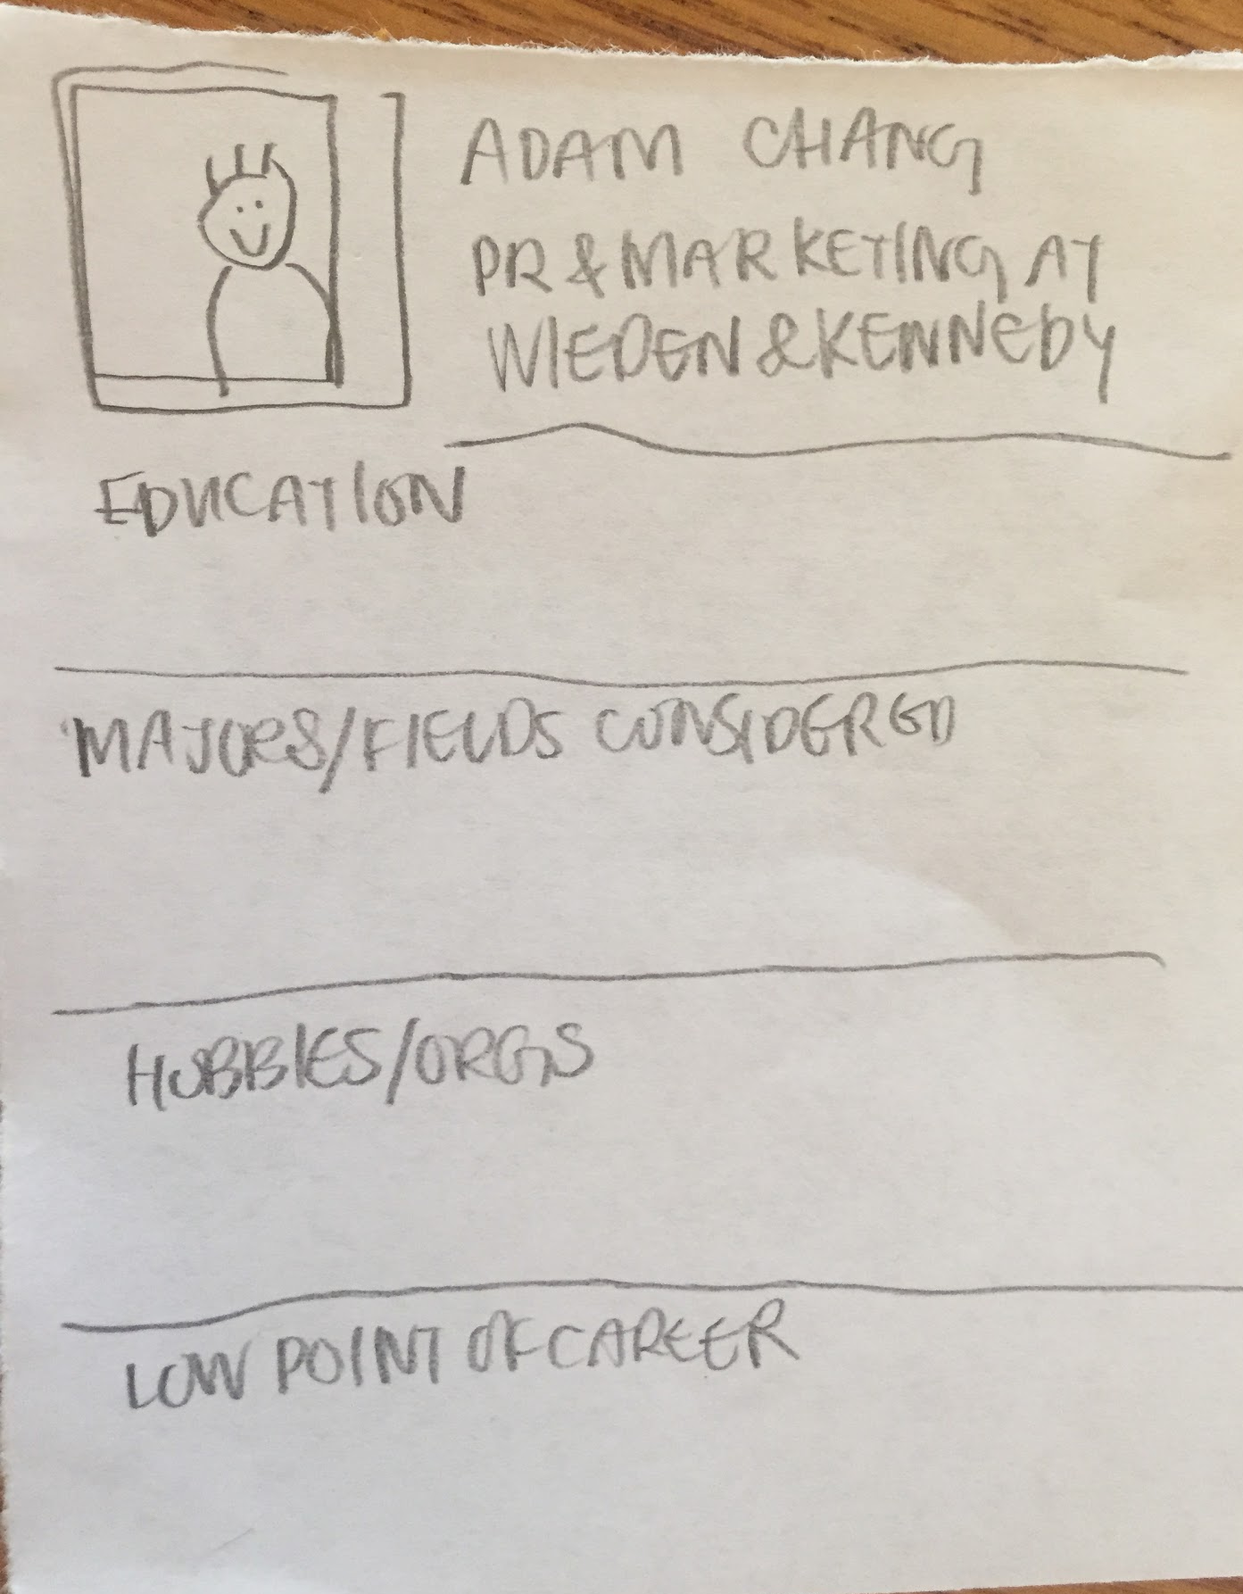
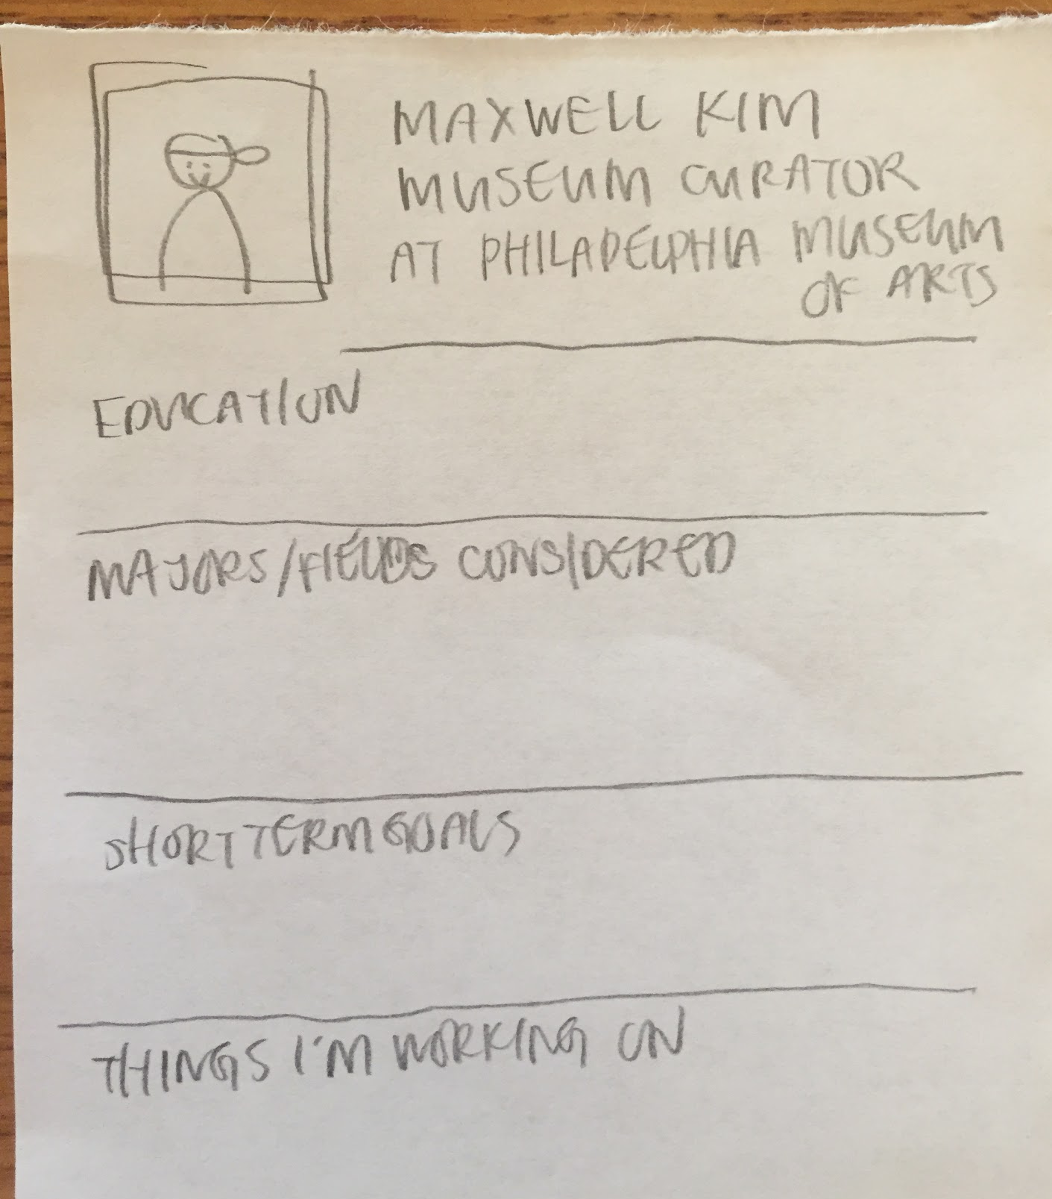
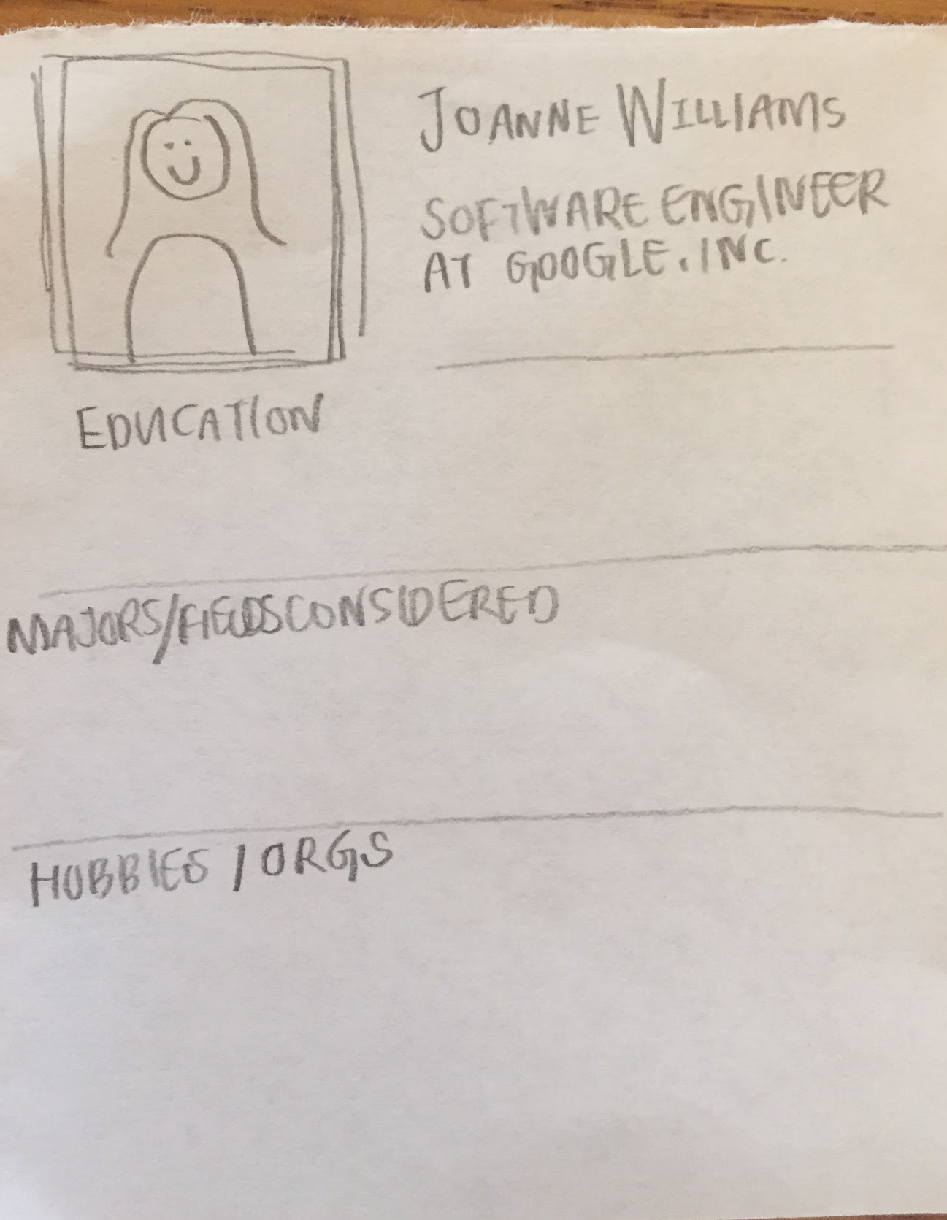
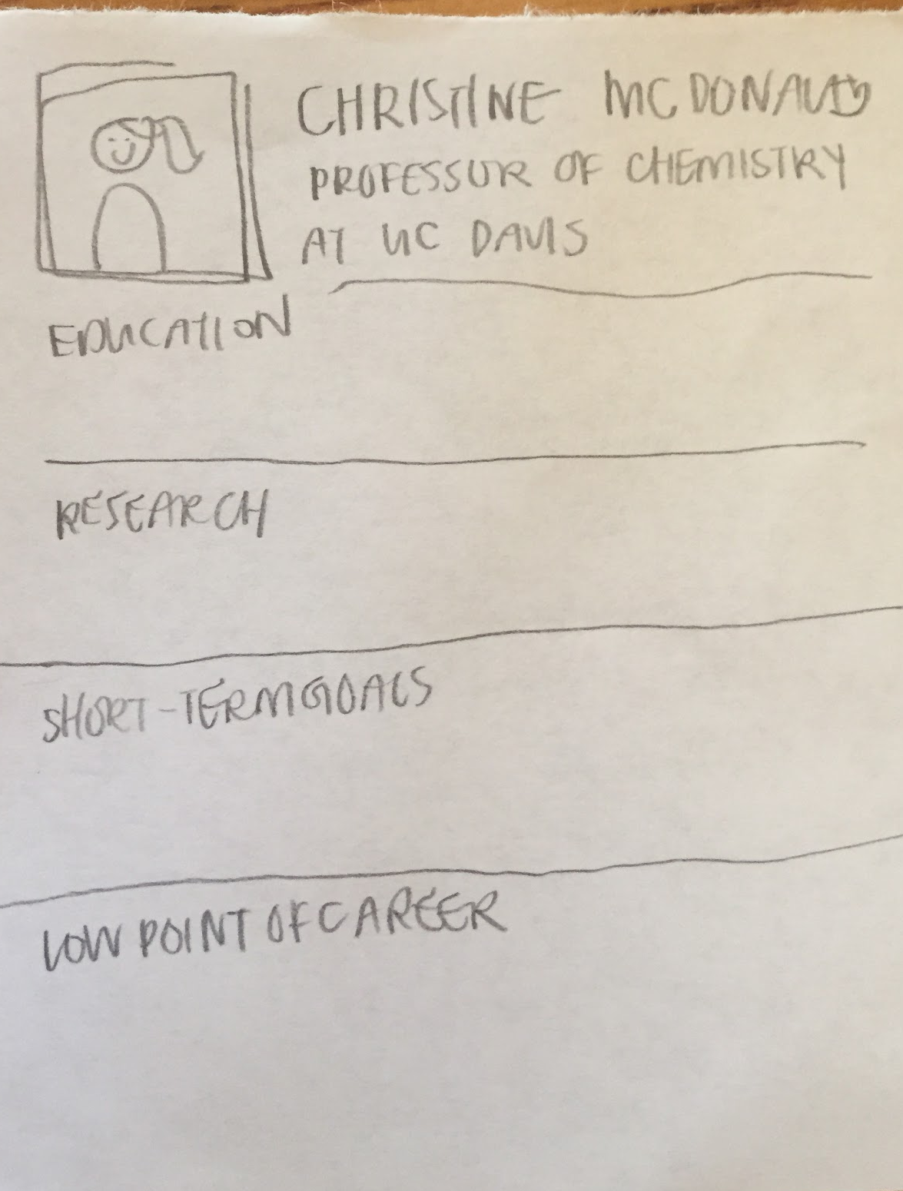
Experience Prototype 2:
Mentorship for developing long-term goals
-profile cards of professionals from different fields
-info on professional background, trajectory of career
-familiarity: LinkedIn + Tinder
Notes:
-contains more personal info

Slide 17
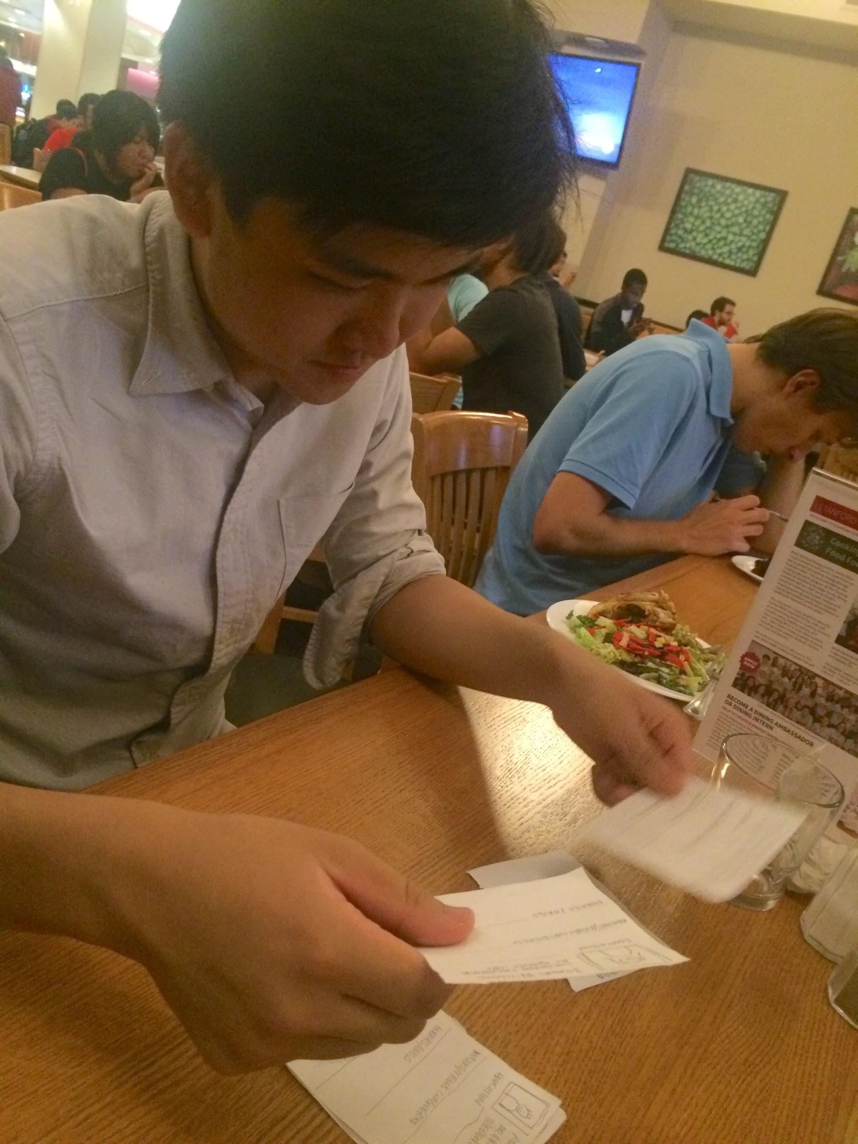
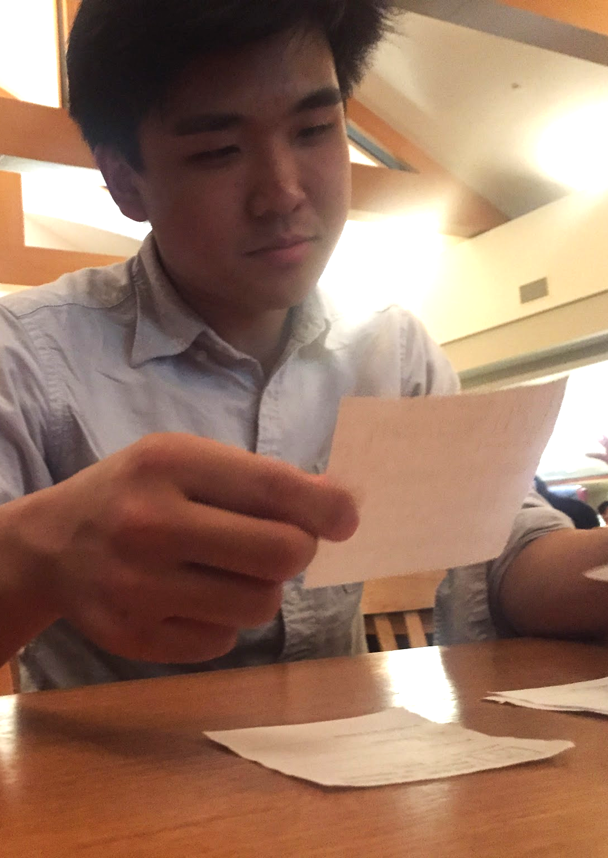
Experience Prototype 2:
Testing
-flip through cards to “find a match”
-simulation of connecting with professional to chat

Slide 18
Experience Prototype 2:
Results
What worked:
-having personal and relatable career information, such as the “low-point in one’s career”
What didn’t work:
-relatable career information struck user as not particularly useful
Surprises:
-process felt impersonal; user said he felt it was like “browsing”
New learnings:
-relatable information and useful information may not be the same thing

Slide 19
Experience Prototype 2:
Validity
Assumptions we had:
-students would like mentorship
-people would be more comfortable with advice from those they related to
-people would like to mentor students
New assumptions:
-people who are more unsure about their careers would be more interested in career trajectories
Notes:
-user was interested in receiving mentorship, and had previously looked through people’s linkedin accounts to understand what peopel did during their careers
-user didn’t care too much about relating to mentor because he cared more about the action items and resume experiences more
-user speculated that not enough mentors would be interested in answering mentees’ questions; he himself said he wasn’t at a point of his life to be able to give advice
-new assumption based on the fact that user was more confident about his career

Slide 20
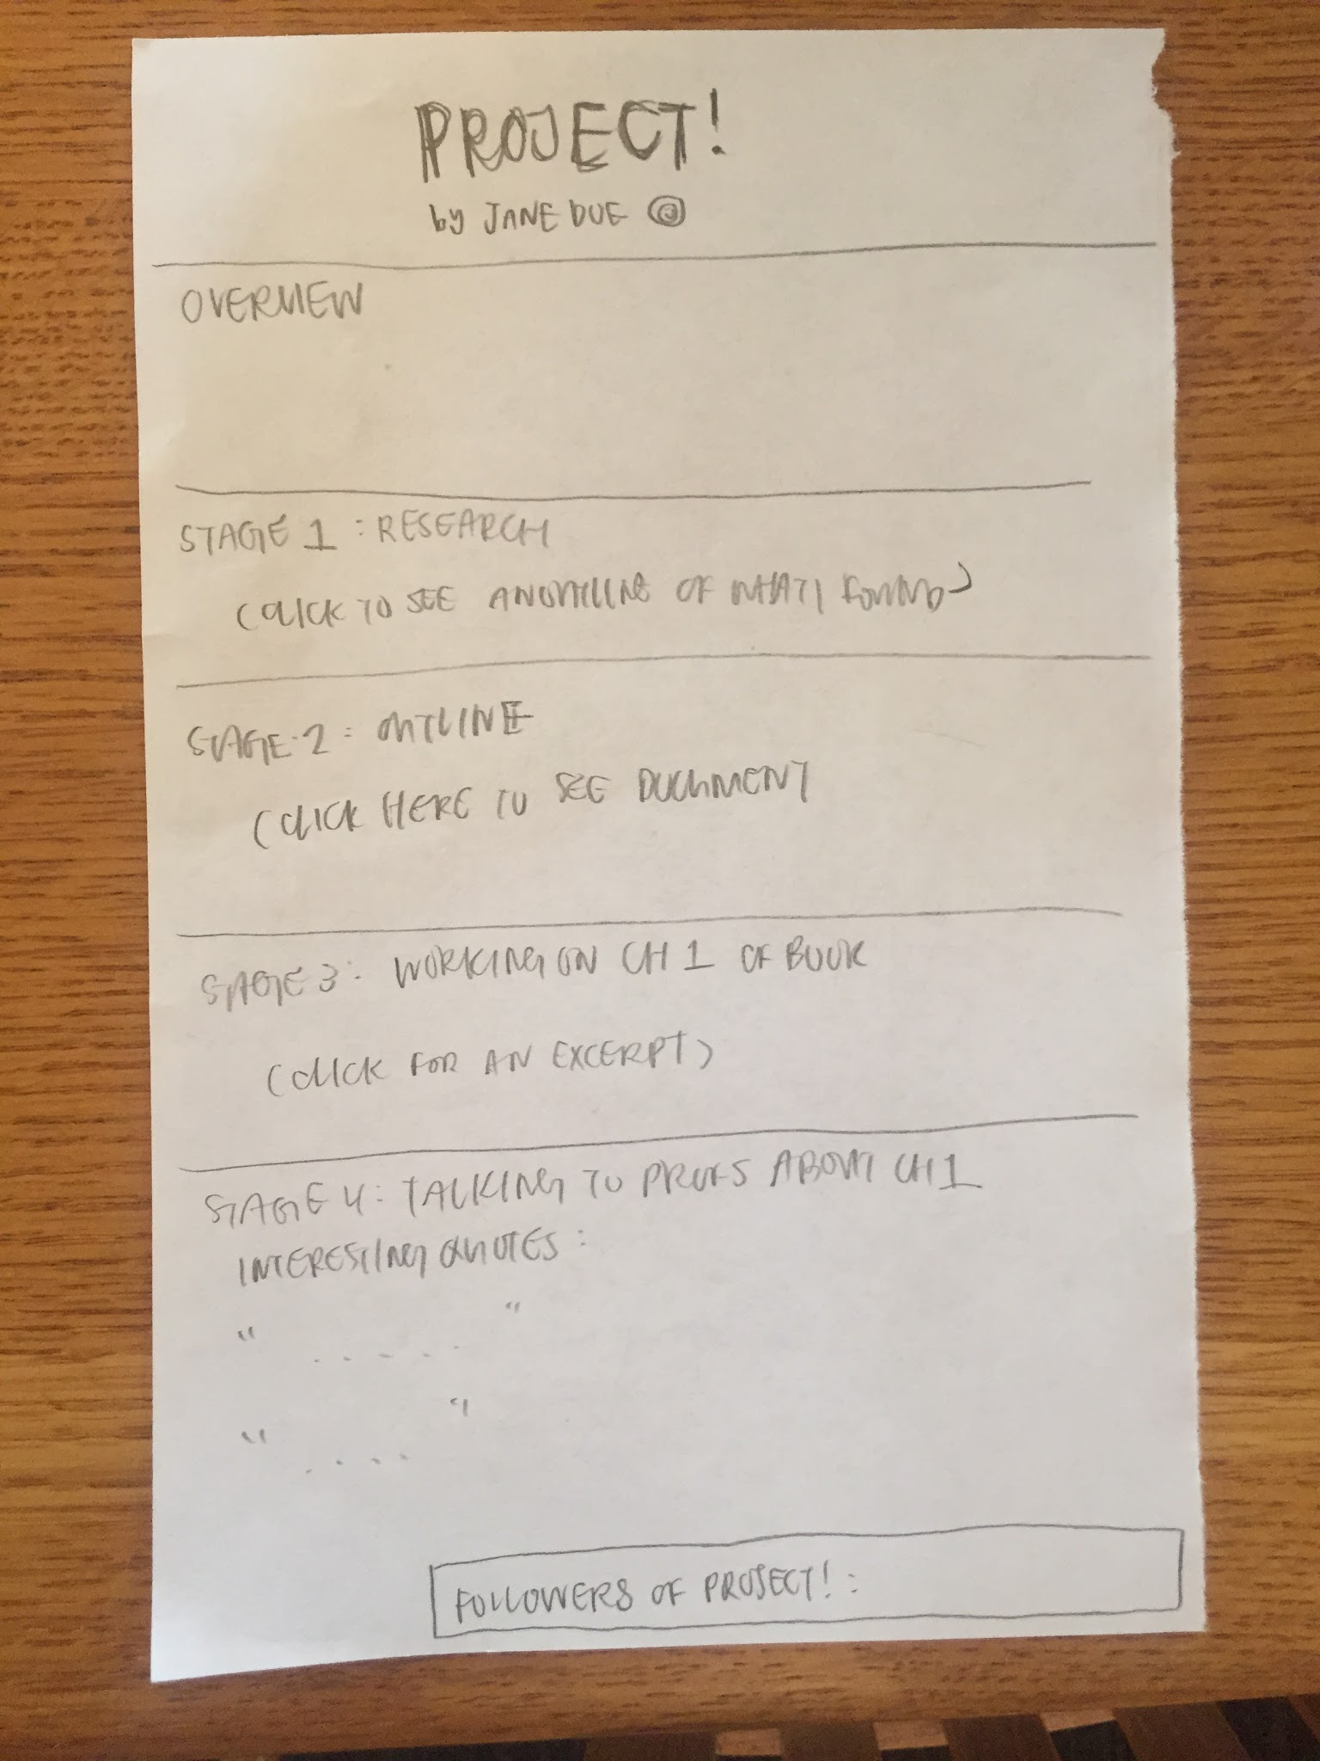
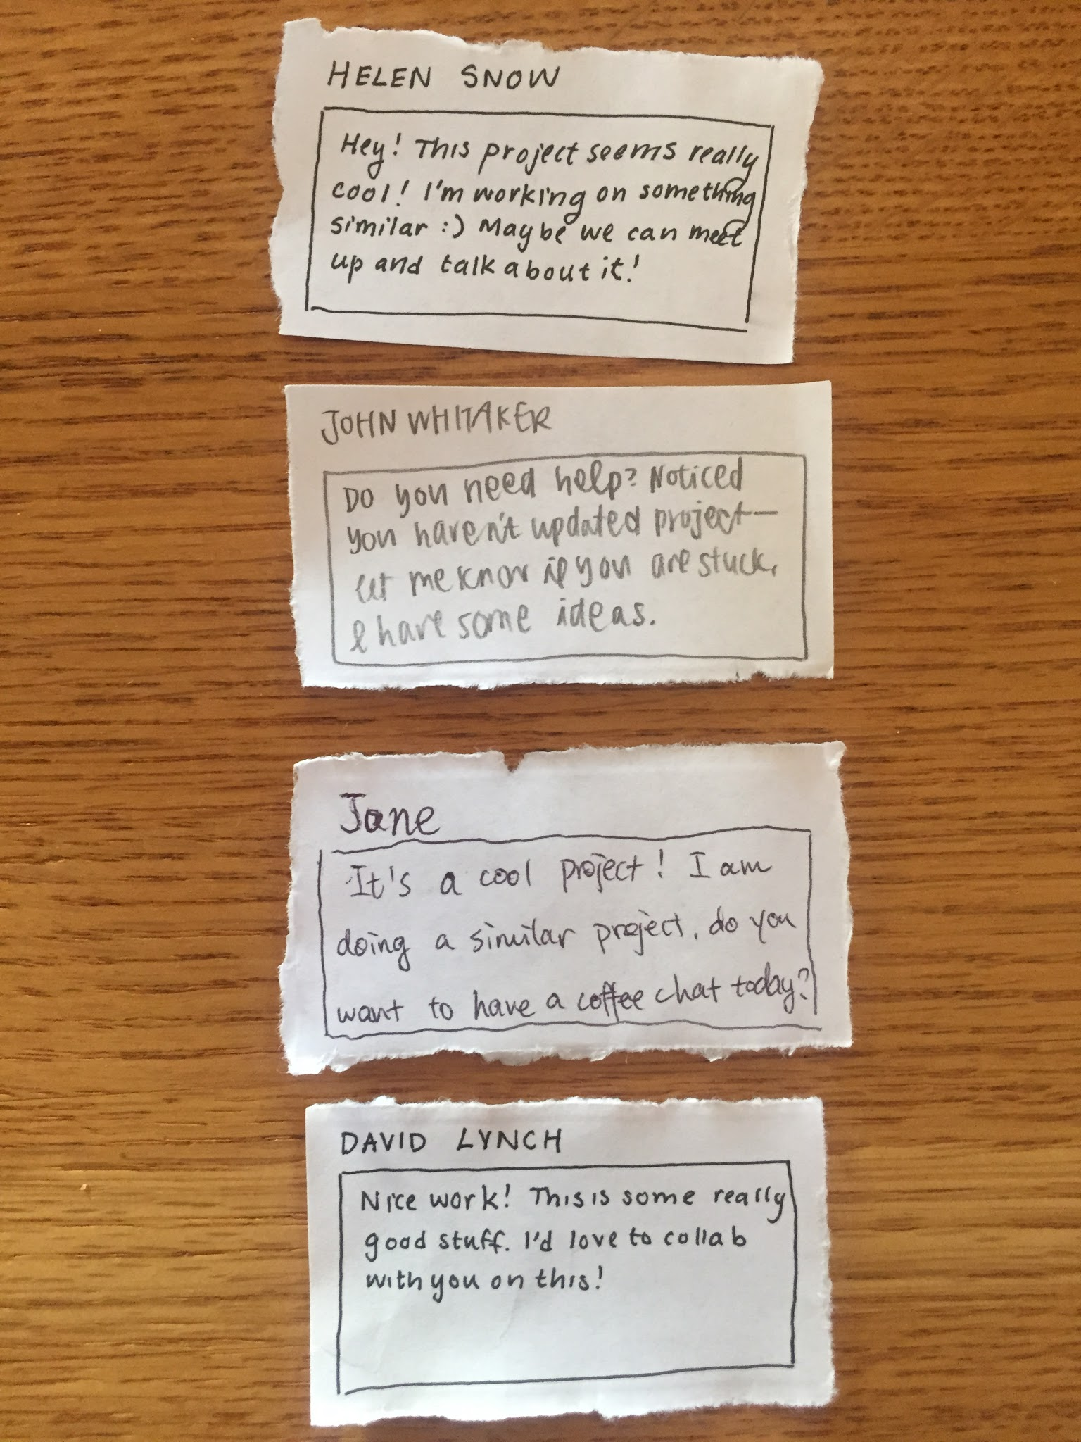
Experience Prototype 3:
Culture of supporting personal projects
-sheet of paper simulates project page
-project page lists points of progress
-at the bottom: tallies followers of project
-post-its contain filler comments
Notes:
-sheet of paper simulates project page
-project page lists points of progress
-at the bottom: tallies followers of project
-post-its contain filler comments
things like “this project seems really cool, working on something similar, maybe we can meet up
noticed you haven’t updated project in a few days, i have some ideas if you’re stuck
this is good work! hope to collab with you sometime

Slide 21
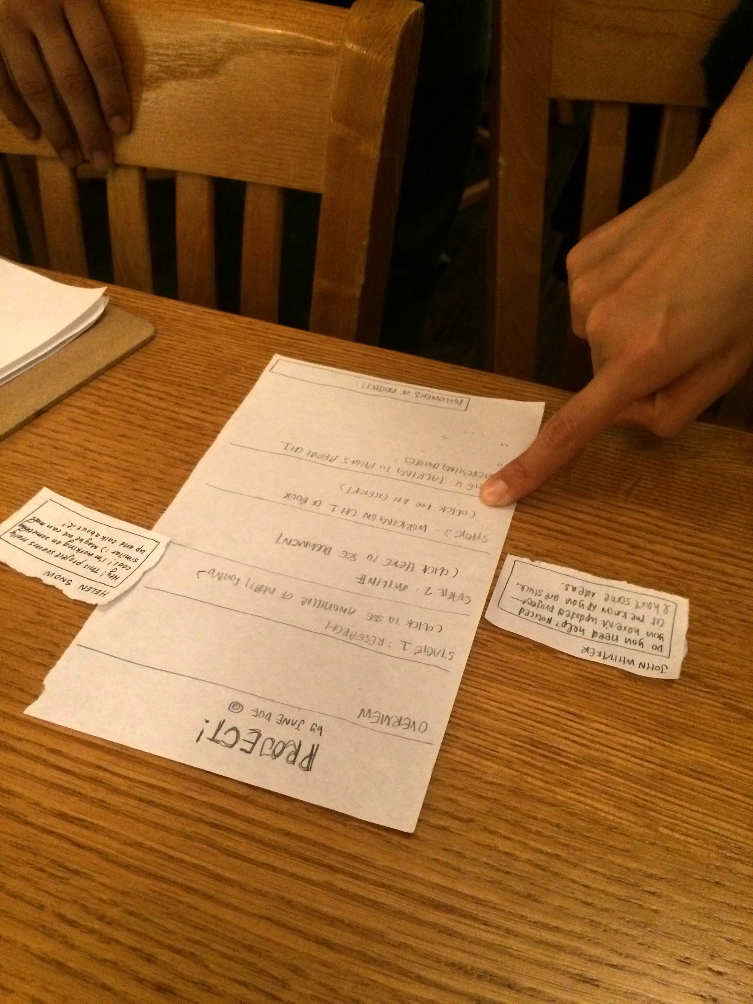
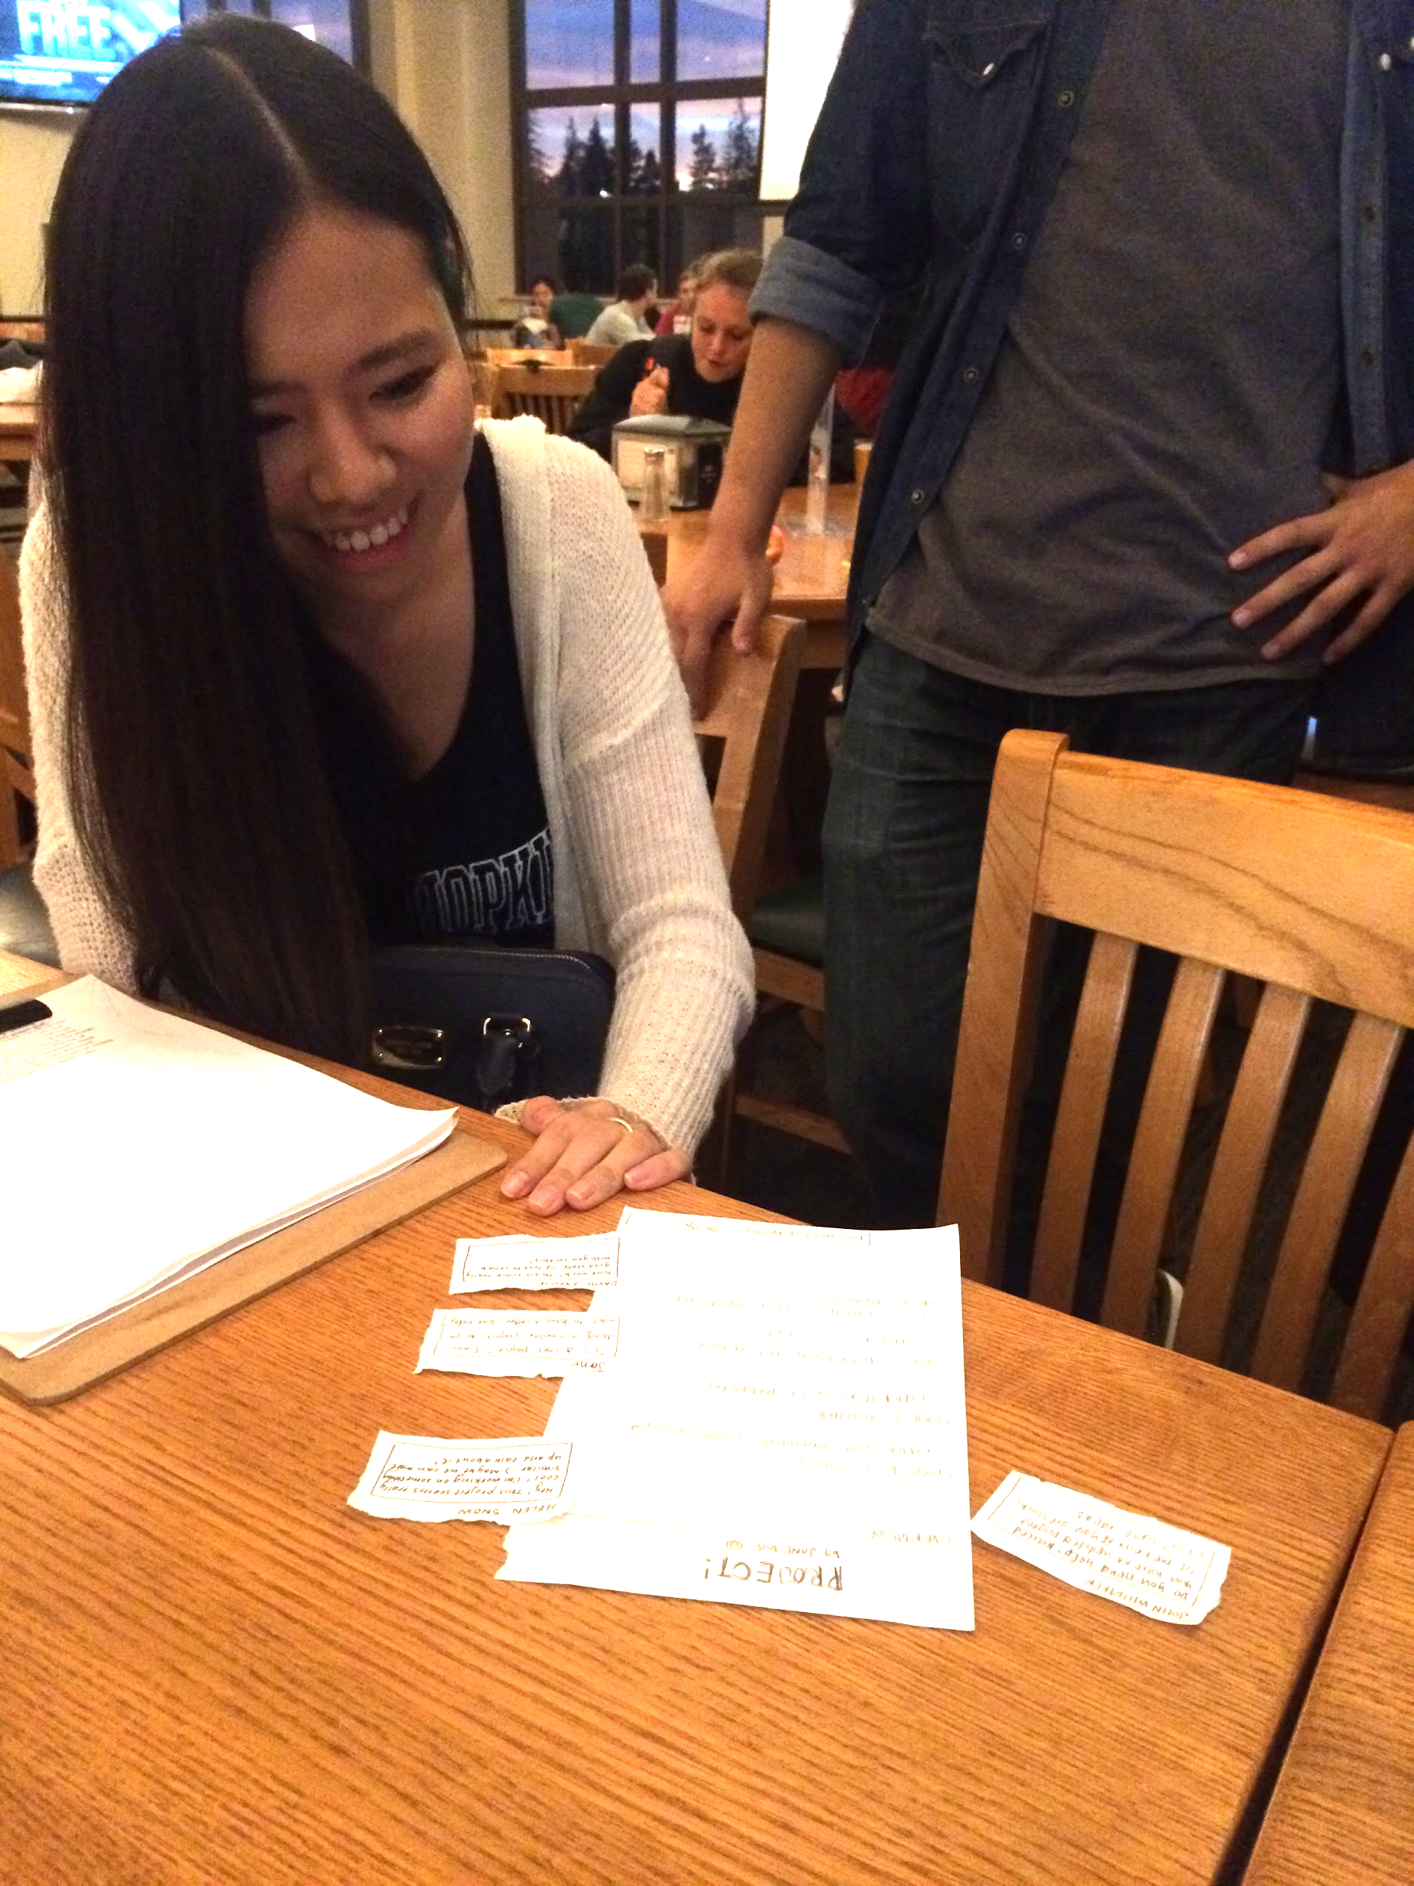
Experience Prototype 3:
Testing
-fill out project page of progress
-simulation of receiving followers (tally marks go up)
-simulation of receiving comments
-receive trend report on number of followers

Slide 22
Experience Prototype 3:
Results
What worked:
-followers were motivating
-exciting to find collaborators in comments
What didn’t work:
-confidentiality issues might prevent users from sharing projects
Surprises:
-user unsure of how much information about project should be shared
New learnings:
-people are sensitive about what they are working on

Slide 23
Experience Prototype 3:
Validity
Assumptions we had:
-people are motivated to work on projects by an audience
-people would support and follow other people’s projects
-people want to share their projects
New assumptions:
-privacy settings may allow people to feel more comfortable sharing their projects
-students may be more comfortable sharing than professionals
Notes:
-people are motivated to work on projects by an audience
interested ot see who follows them, get advice
-people would support and follow others’ projects
seek out collaborators, partners, etc.
-people want to share their projects--may not be true, due to confidentiality
may not want to share work that depends on publication, or innovative work that may lead to lucrative outcomes
dilemma: if you share the interesting parts of your work, the final outcome may be less exciting because it has already been seen, but if you don’t share, you may not have as many followers

