Slide 1
Assignment 1 - Needfinding
Irene Hsu, Ke Xu, Jessica Zhang
Focus: Distractions & Longterm Productivity

Slide 2
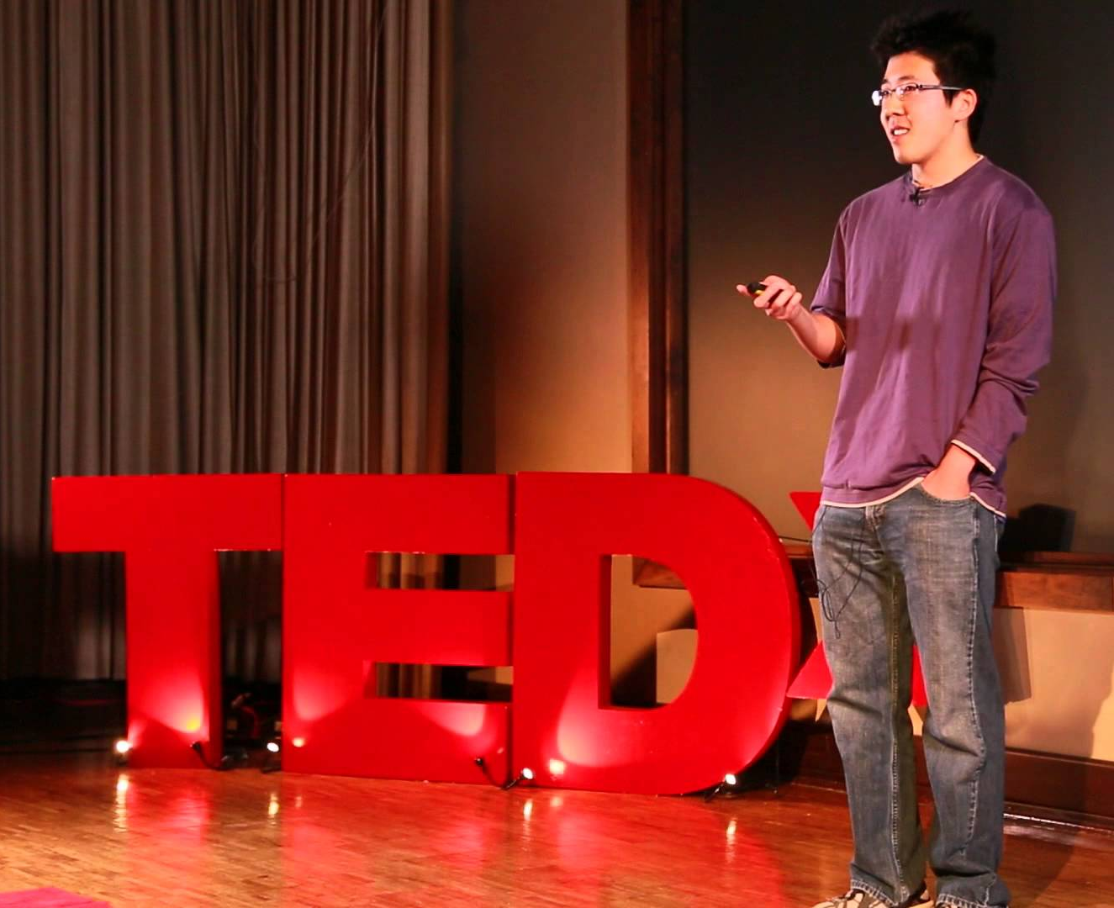
Our Participants:
Brian Zhao Cognitive Neuroscience Senior at Emory
Amelia Hardy Computer Science Sophomore at Stanford
Liang Koh Risk Analyst at Bank of the West

Slide 3
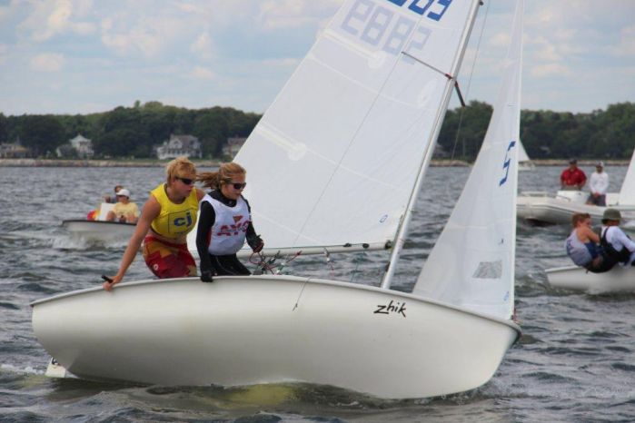
Why they were chosen
-Brian completed & kickstarted a graphic design & organic chemistry on his own time during the school year
-Liang was formerly in academia teaching and doing research, then switched to industry work
-Amelia is a former varsity athlete for the Stanford sailing team

Slide 4
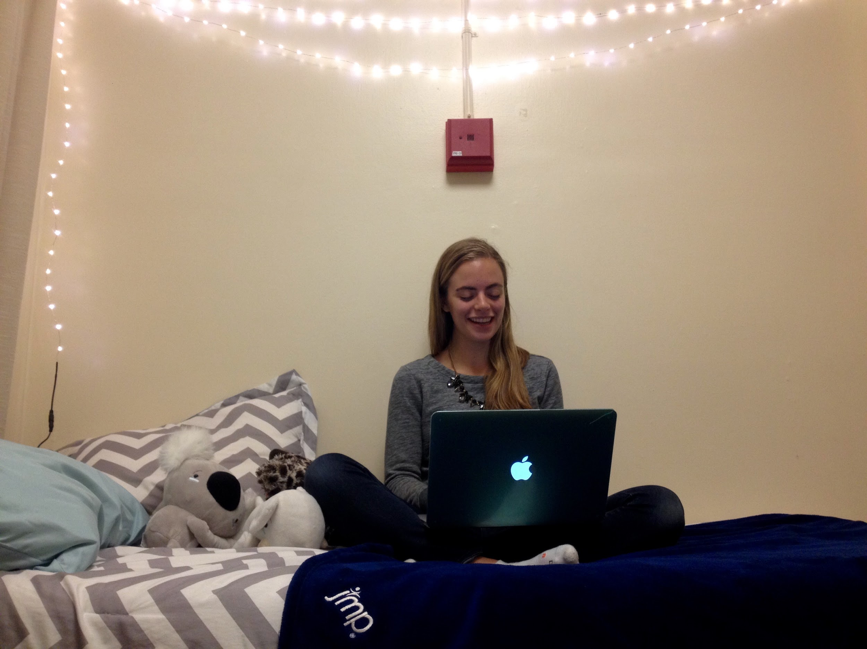
Where they were interviewed

Slide 5
What We Asked
-long term vs short term goals
-maintaining focus
-routines to develop focus
-managing/eliminating distractions
Notes:
How do you keep in mind the long term while still working on short term tasks?
How do you focus on tasks with longer timeframes?
What are some rituals you engage with to sit down and focus on a task?
How do you clear your mind?
What has been bothering/distracting you lately?

Slide 6
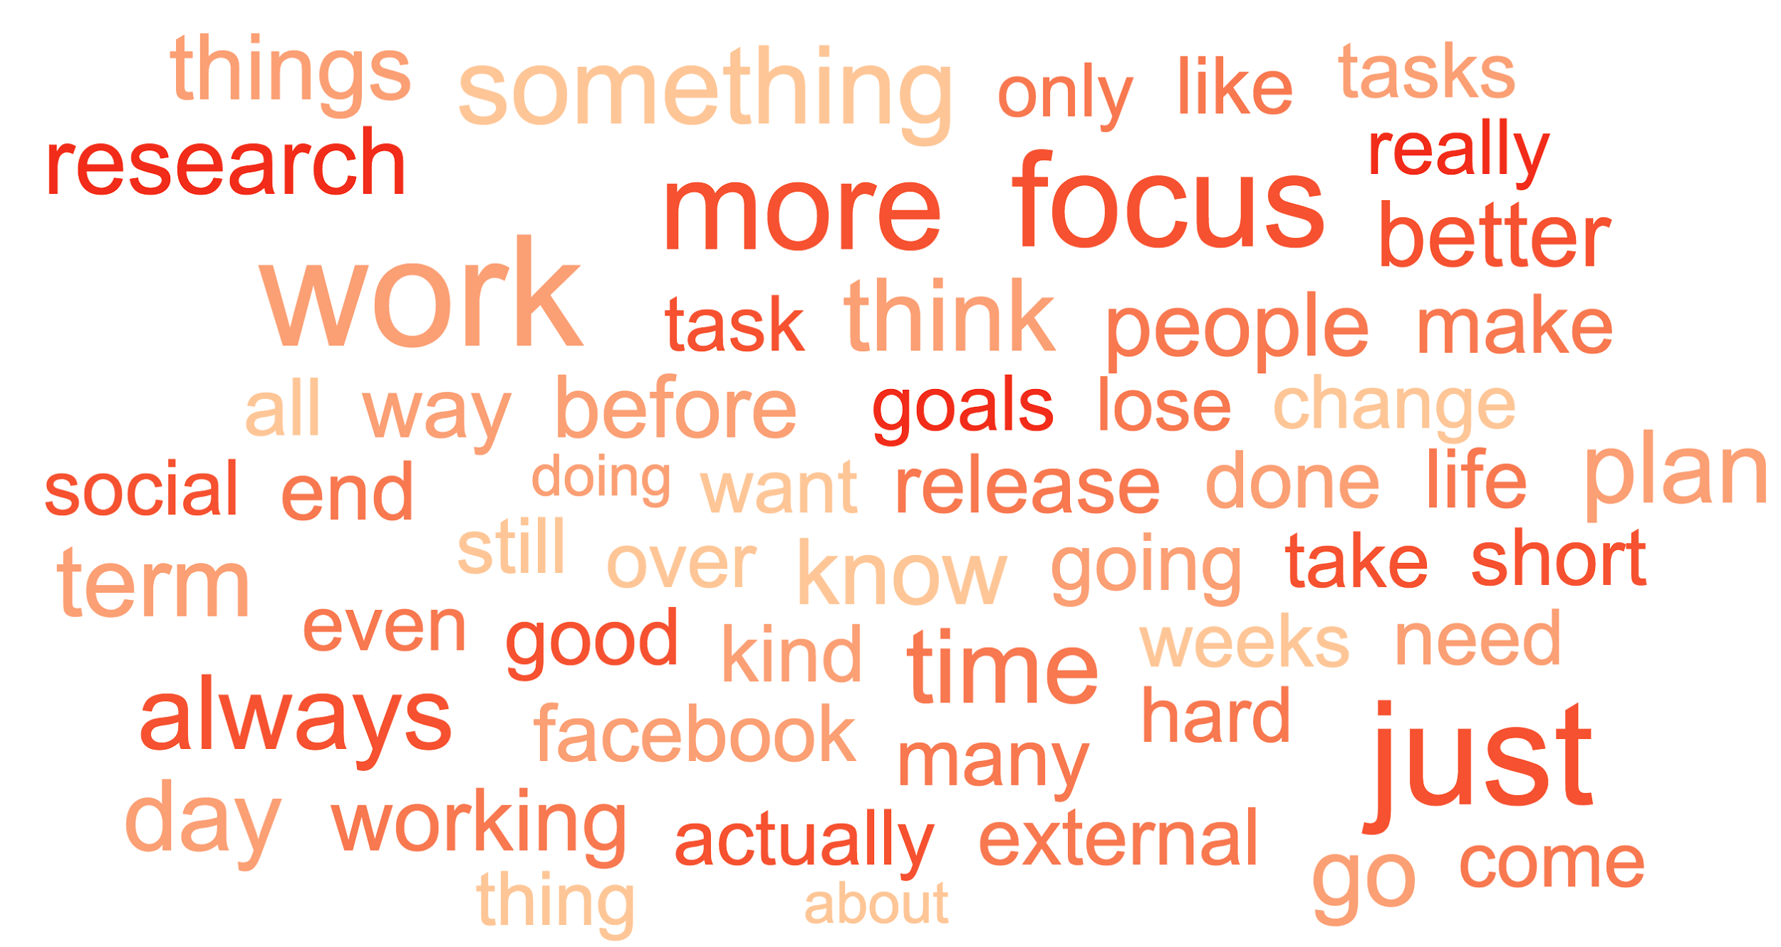
Interview Results:
Notes:
work, planning, social, external facebook, release, done
centered around productivity

Slide 7
Quotes:
“It just gets done”
“You always come back [from breaks] better”
“Anything can be resolved with proper planning”
“The only thing that motivates me to commit to something is deadlines”
“If I lose focus, something goes wrong. So I have to maintain complete focus”
“I only do short term tasks if they contribute to my long term goals. If they don’t, then I just don’t do them.”

Slide 8
Surprises
-no routines or rituals
-internal motivation
-very confident and positive
-believed that focus was something you had and was hard to develop
-believed that those who plan don’t have problems with focus

Slide 9
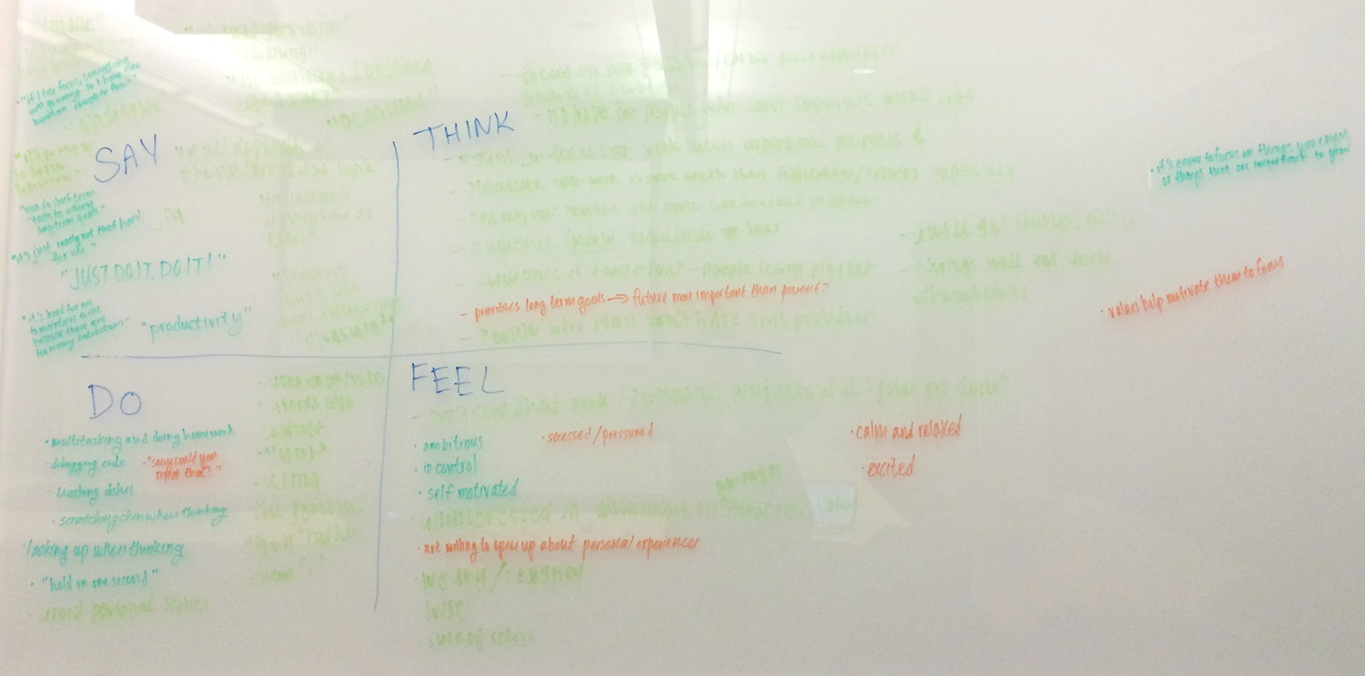
Empathy Map

Slide 10
Empathy Map
Say - “it just gets done” - “just do it. do it” - “you always come back better” - “everything can be resolved with proper planning”
Do -avoiding eye contact -saying “um” -using the general “you” -multitasking -asking for questions to be repeated
Think -need people to see their work -focus is hard to develop -reminded to focus by thinking of things important to them
Feel -stressed -weary -confident -ambitious

Slide 11
Insights
-confident of their own focus
-planning solves everything
-short term tasks are steps to long term goals
-motivated by putting their work out there for people to see
-setting deadlines or mandatory events helps improve productivity
-acknowledging/accepting distractions makes people more productive

Slide 12
Needs
-plan and create visible deadlines or events
-develop self-confidence for long-term goals
-know when multitasking is appropriate
-know when they are unfocused

Slide 13
Questions moving forward
-How can people tell when they’re focused versus and when they’re not?
-How do people find the urgency to be focused?
-What kinds of external pressures can we apply on ourselves to find our focus?
-How do people find the energy/focus to work on personal projects?
Notes:
(events, deadlines, audience etc)

Slide 14
Summary
-everyone positive/confident about their ability to focus
-rely on both internal and external motivation
-identifying and eliminating distractions
-answers centered primarily around productivity

