Slide 1
docket
“Bringing ideas to life” Assignment 8: Midway Hi-fi
Irene Hsu, Ke Xu, Jessica Zhang

Slide 2
Problem
For people from all walks of life, the bustle of everyday leaves little time and energy for personal side projects.

Slide 3
Solution
docket is a public platform that documents project-related ideas throughout the day and allows users to support one another’s projects for inspiration and motivation. Through documentation and social interaction, docket aims to build momentum for personal projects.

Slide 4
Overview of Talk
-Heuristic Evaluation Results & Design Revisions
General
Task 1, 2, 3
-Implementation
Tools
Completed & Ongoing
Wizard-of-Oz & Hard-coded Data
-Demonstration

Slide 5
HE Results & Design Revisions
General
-misleading icons/sections [H2-2 Aesthetic] [H2-8 Match]
“Explore” & “Following” icons: misleading
“Projects” → “My Projects”
-better metaphors [H2-8 Match]
“Stages” → “Sections”
“Quicknotes” → “Notes”
-unaddressed: branding [H2-6 Recognition]
Notes:
most were aesthetic & minimalistic design & matches between the system and the real world
-misleading icons & sections on our navigation sidebar
explore: house icon; originally the default page that hte app would open up to → will change to compass icon
following: person icon, which evaluators said was misleading because our platform follows projects, not users → willc hange to something more intuitive to docket
renaming Projects to My Projects to clarify that this links to personal projects
-also got the feedback to improve our metaphor usage
some changes: renaming project stages to project sections; renaming quicknotes to simply “notes”
-one important suggestion we didn’t take: including the branding, listed as recognition & recall
we won’t have the logo on the page to save space; after looking at similar apps, most don’t have brandign on the page. we believe that when opening the app, the icon and launching page are branding enough

Slide 6
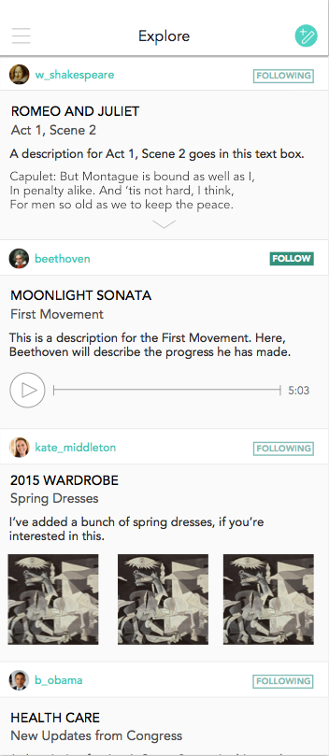
HE Results & Design Revisions
Task 1: Follow Inspiring Projects
-feed: visually overwhelming
[H2-2 Aesthetic]
confusing sectioning of project updates
black text on white background
-unaddressed: subscribing to other users
Notes:
suggestions for our first task to follow inspiring projects: mainly aesthetic & minimalistic design issues
originally an all white background
-confusing sectioning of project updates; evaluators said might be difficult to tell from project update to project update
-especially for a text-y page, black text on white background made it hard to read content
solution--> make the user bars white and gray out the content background, both to give the illusion that the background is nested under the header and also to improve readability

Slide 7
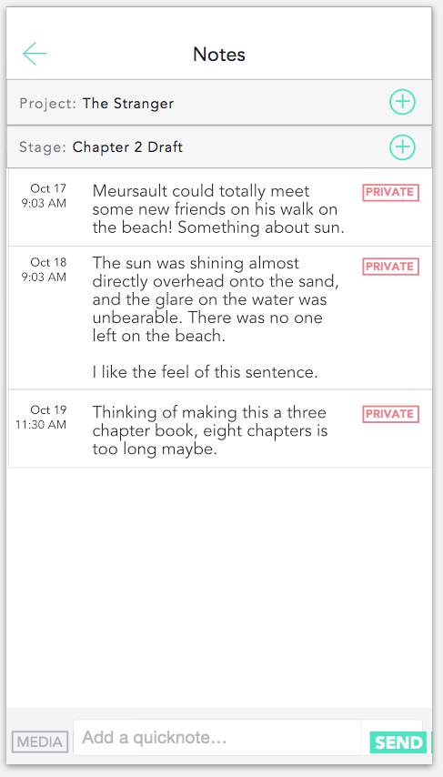
HE Results & Design Revisions
Task 2: Add a Public Note
-issues w/ managing notes [H2-3 Control] [H2-1 Visibility]
organizing into stages, deleting
showing status of note
(public, private, stage, etc.)
→ redesign into message format
select stages from another window
add delete features (slide out)
Notes:
Suggestions for task 2 had to do with control & freedom, and visibility of system status
originally there were issues with managing the notes
for instance, our evaluators said it wasn’t clear how to add to specific stages, how to delete messages and how to make sure a note was published
we’ve redesigned into a format reminiscent of a messaging page
select stages on this bar, which opens to antoher window
add delete feature which will slide out
message will first be gray, then turn white when publsihed

Slide 8
HE Results & Design Revisions
Task 3: Look through project page
-visual design [H2-8 Aesthetic]
cluttered notes
black text on white background → off-gray
-related:
-add project list page [H2-7 Flexibility]
-add “complete” feature [H2-7 Flexibility]
Notes:
Suggestions for task 3, looking over the project page, ranged from Aesthetic & minimalistic design to Felxibility and Freedom
-some things mentioned included having a cluttered project page by being able to open all the sections and see all the notes; we didn’t address because we thought that users might want to have the freedom to see all the notes laid out
-also again, black text on white background was an issue, so we changed it to off-gray
-we will be adding an intermediary project list page which we will then link to a project page, related to flexibility and freedom
-as well as add a complete feature on our project page

Slide 9
Implementation: Tools
-iOS
on-the-go momentum
-XCode (Swift)
collaborate
resource to learn
Notes:
Again, same concept but more specific task

Slide 10
Implementation: Completed
Task 3: Look through project page
-project page
clickable
hard-coded content
-”My Projects”
Notes:
: intermediary page listing projects

Slide 11
Implementation: Ongoing
-Task 1: Follow Inspiring Projects
create feed
-Task 2: Add a Public Note
create page
link to update with project page
Notes:
Again, same concept but more specific task

Slide 12
Implementation: Wizard-of-Oz
-none
Notes:
Again, same concept but more specific task

Slide 13
Implementation: Hard-coded Data
-preloaded user
-feed pre-loaded with project updates
-pre-loaded notes
can add project section
can add notes
-pre-loaded project sections & updates
Notes:
Again, same concept but more specific task

Slide 14
Implementation: Questions
-Is it possible to use two platforms to implement the app and merge them together? (Meteor & swift)
Notes:
Again, same concept but more specific task

Slide 15
Demonstration
Task 3: Look through project
Notes:
Again, same concept but more specific task

Slide 16
Summary
-completed: Task 3 is completed!
-uncompleted: Task 1 & 2
-design changes
metaphors & labels
text on background
organized “Notes”
Notes:
Again, same concept but more specific task

