Slide 1
B Sharp: Lo-Fi Prototype
Jamison, Marilyn, Nathalia, Thu

Slide 2
Overview & Mission
Integrate mindfulness practices into rehearsal routines to help musicians stress less and focus more
Notes:
In a career path that demands perfection, a musician can sometimes be her worst inner critic, letting perfection impede her growth. Mindfulness practices that are known to increase self-awareness and help individuals develop a sense of perspective to life’s challenges, allowing them to weather the ups and downs more easily. The goal of “B-Sharp” is to integrate such practices into a musician’s regular rehearsal routine, helping musicians stress less about perceived failure and help them focus on learning about themselves and their craft.

Slide 3
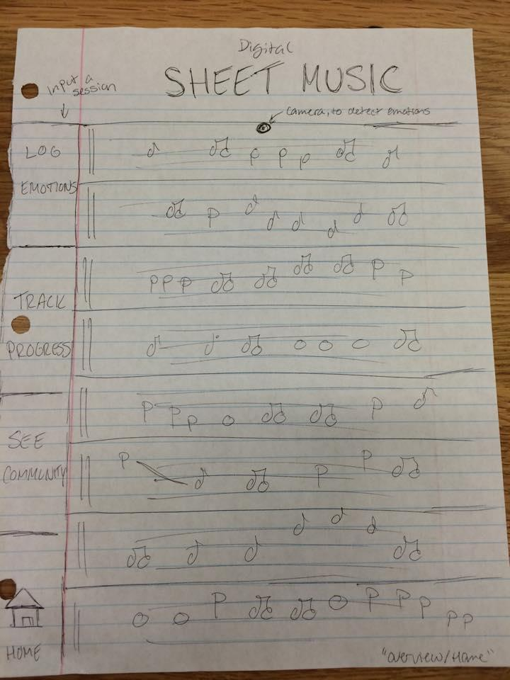
Selected Interface: Digital Sheet Music
Notes:
Rationale:
Intuitive, built into musicians’ routine (always have sheet music with them)
Accordion design fits with current uses (familiar)
Allows for greater visual screen impact, feedback and design

Slide 4
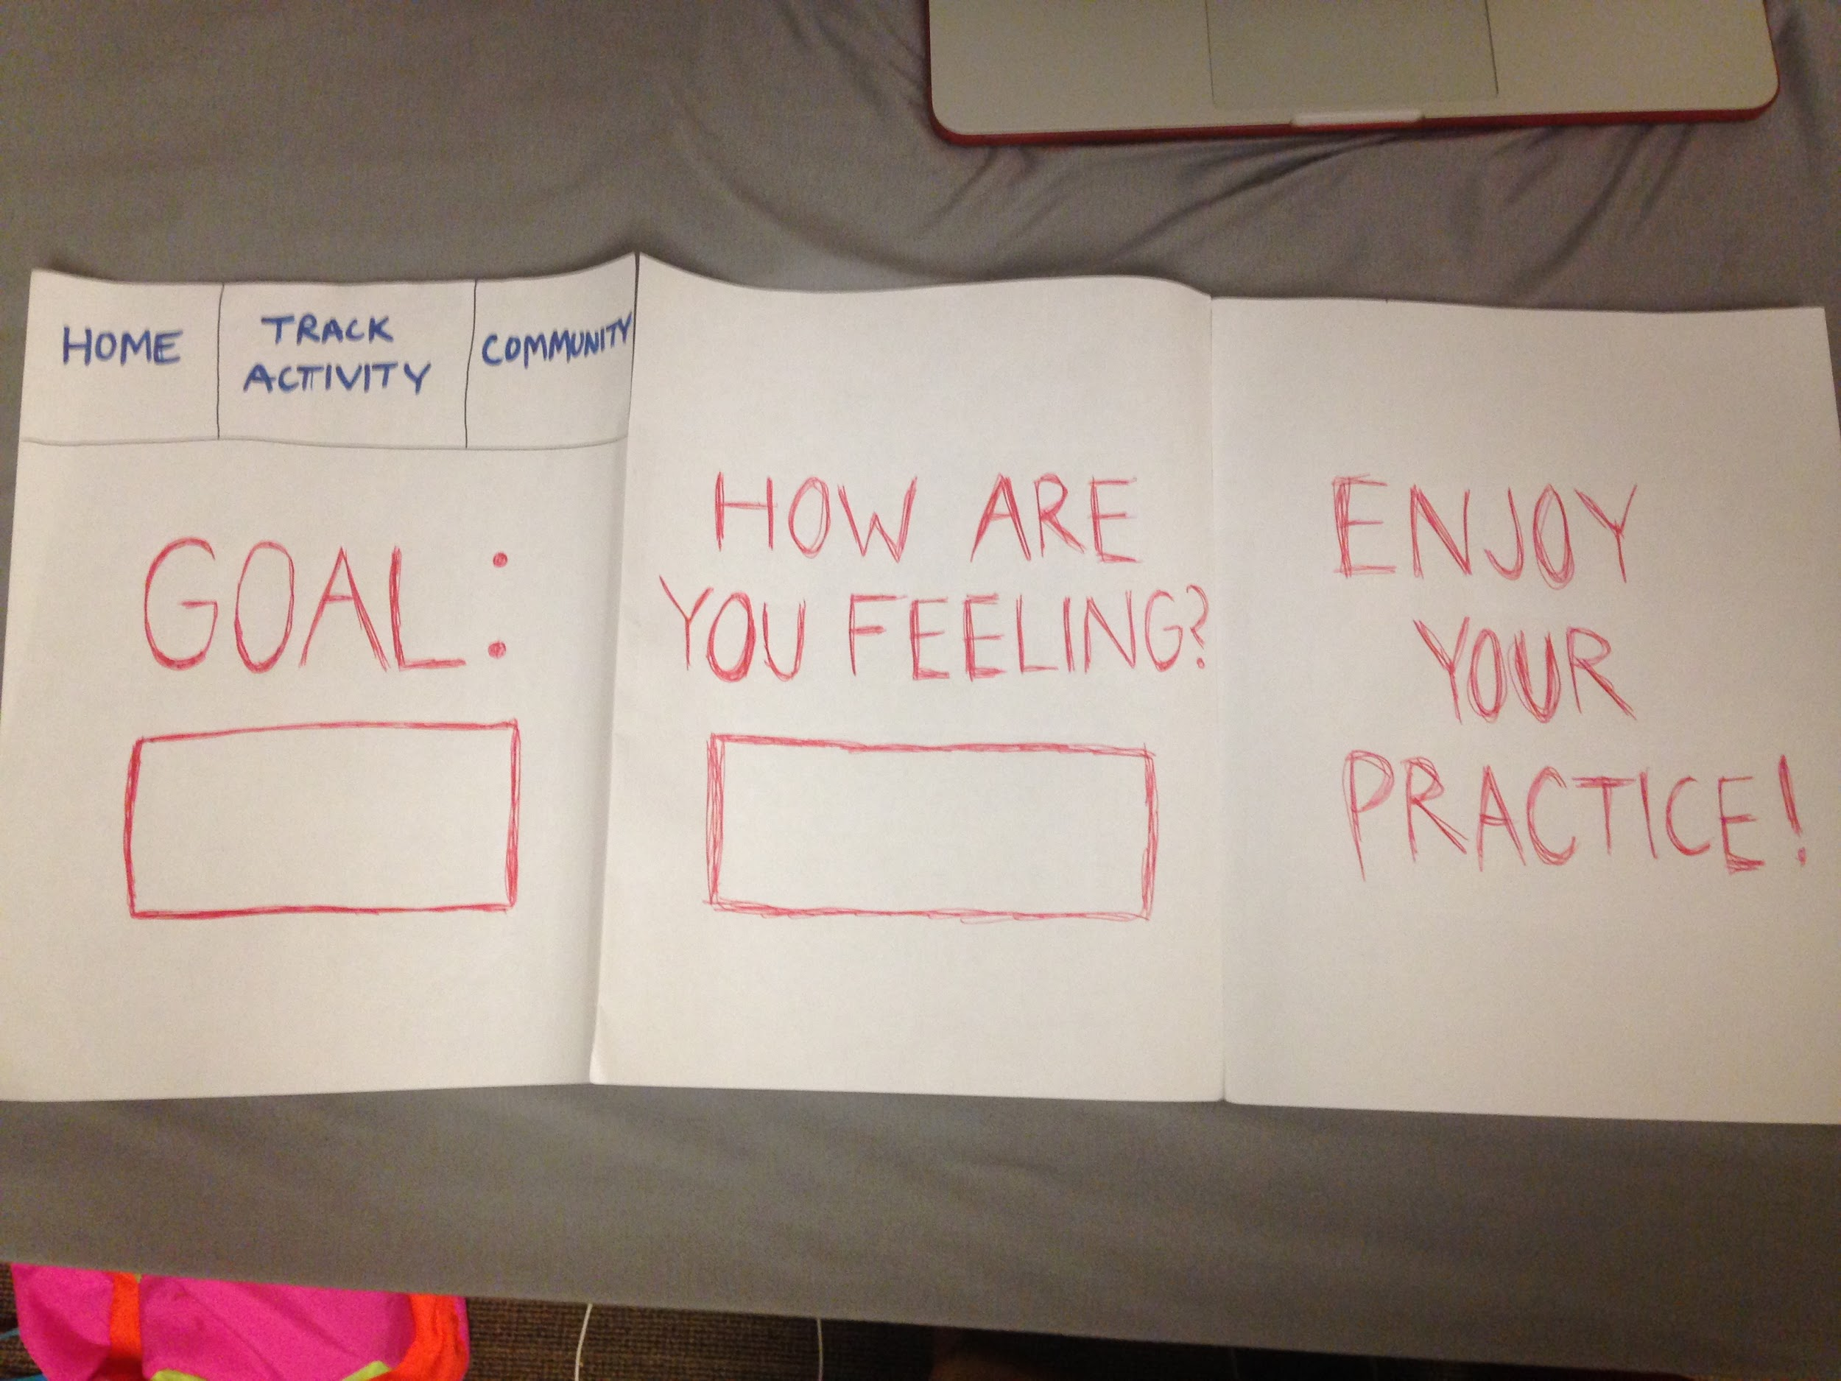
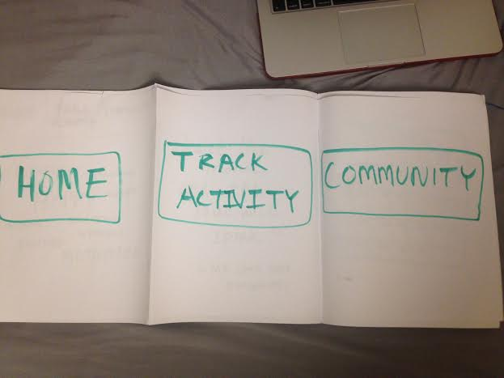
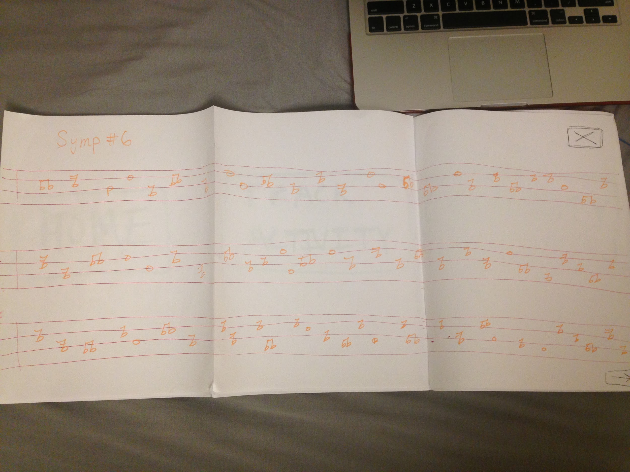
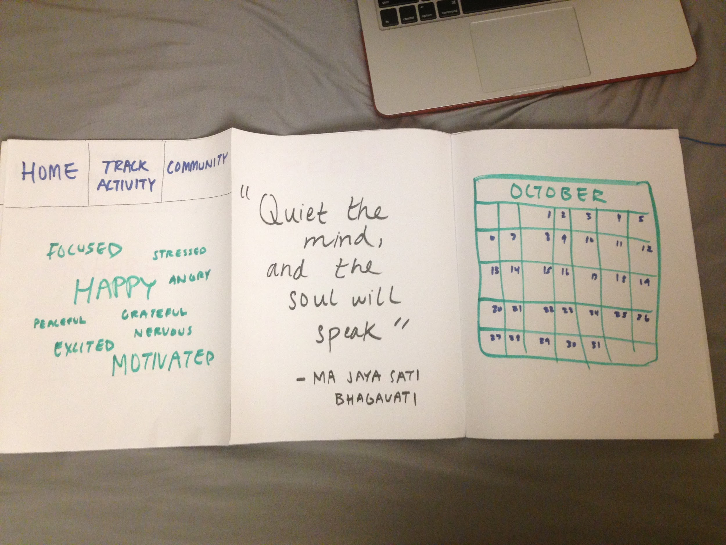
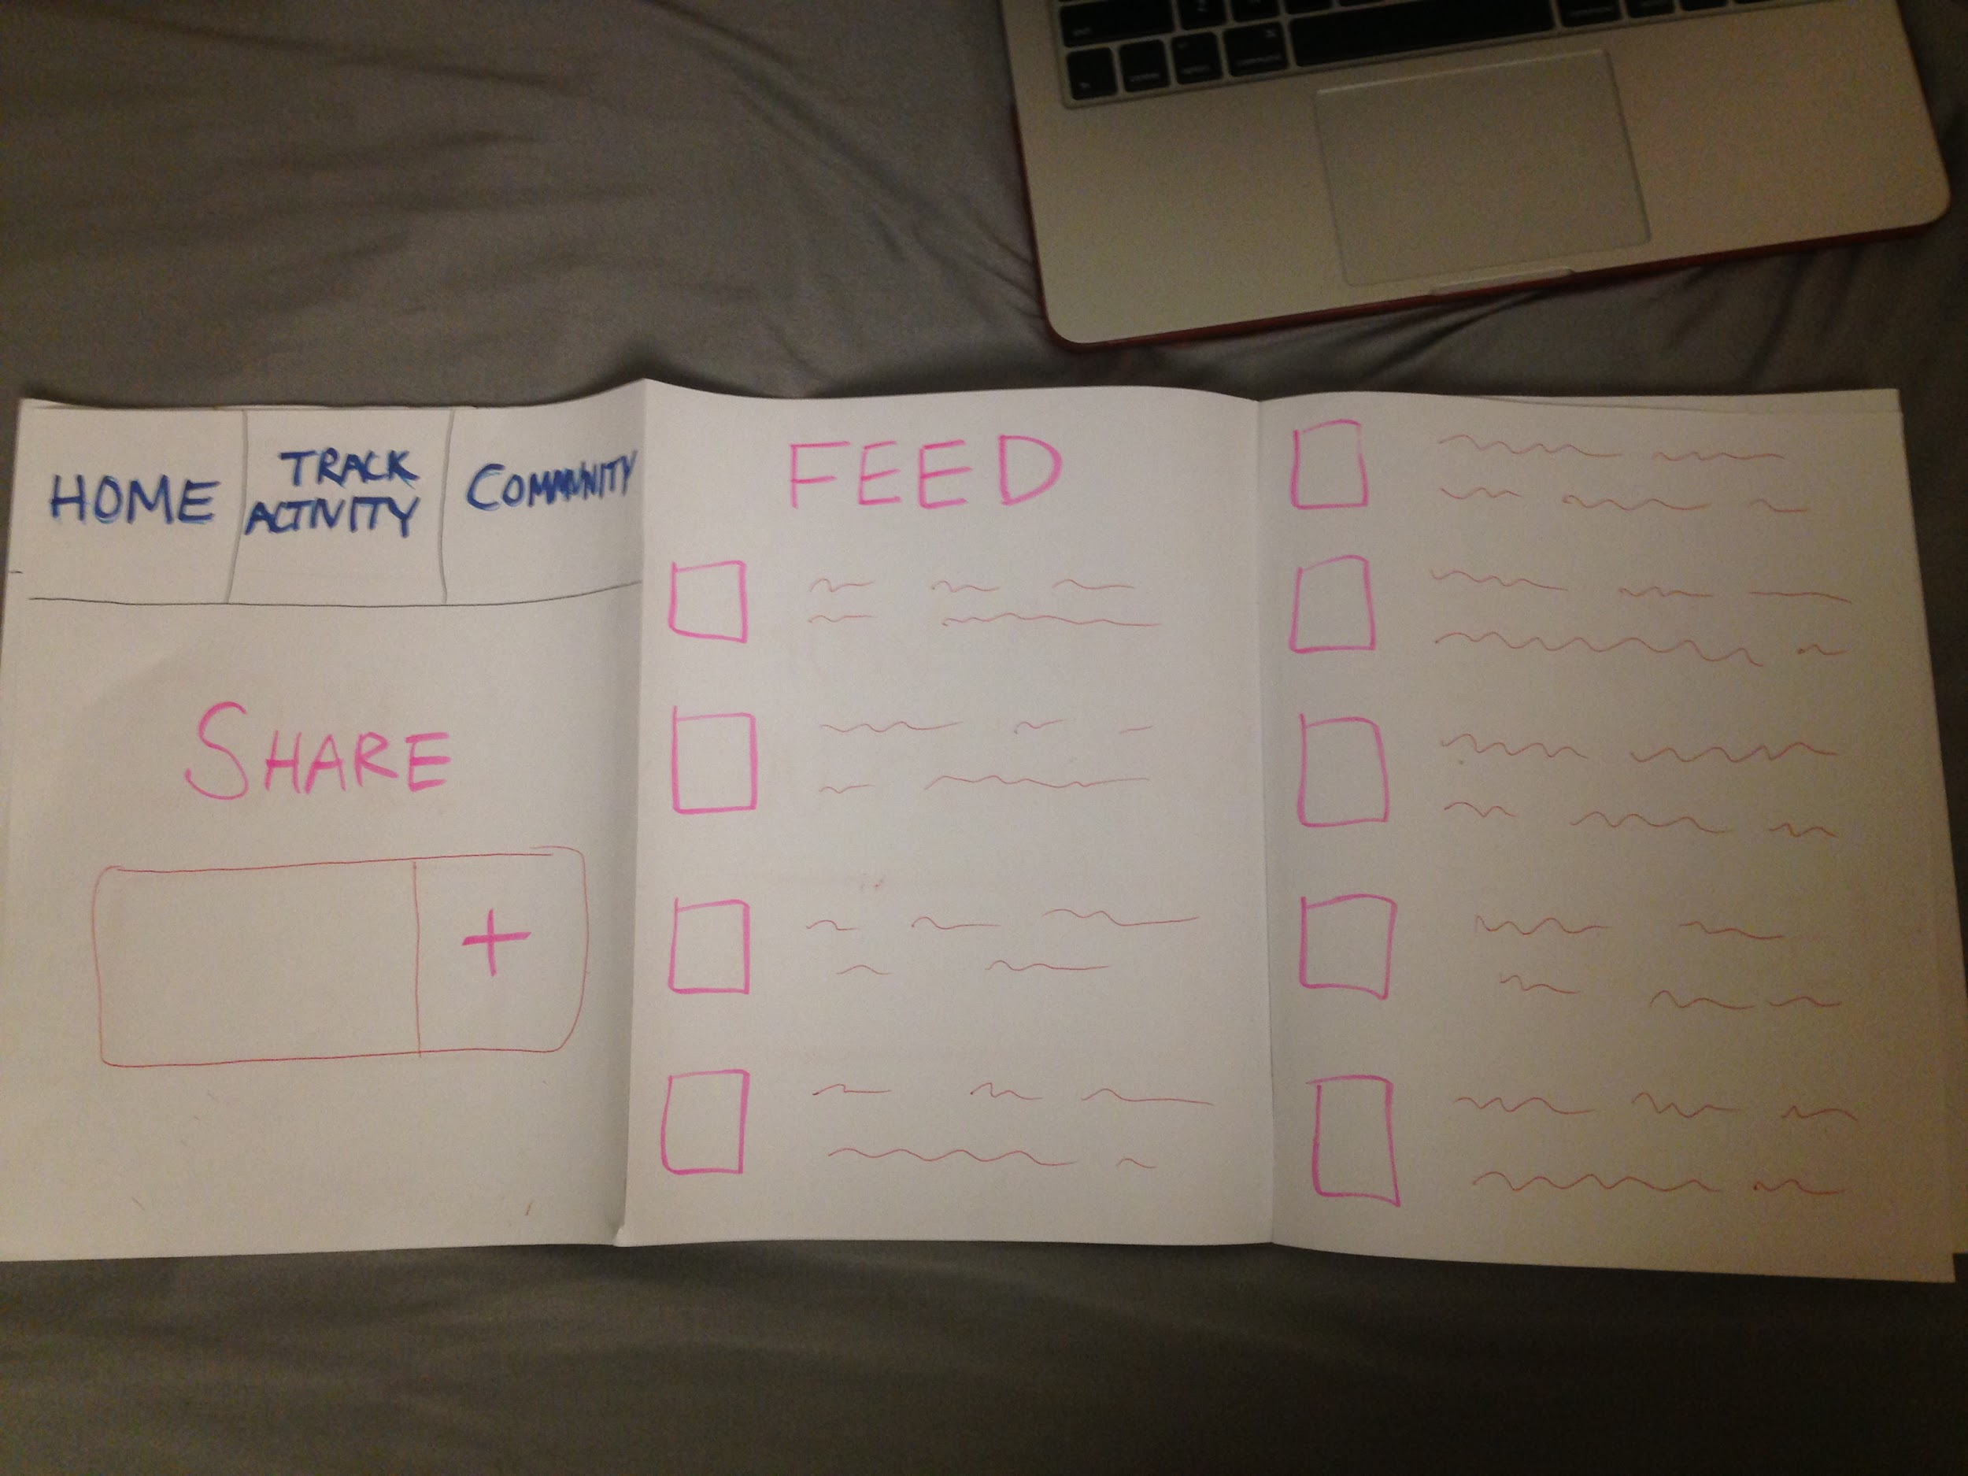
Low-Fi Prototype

Slide 5
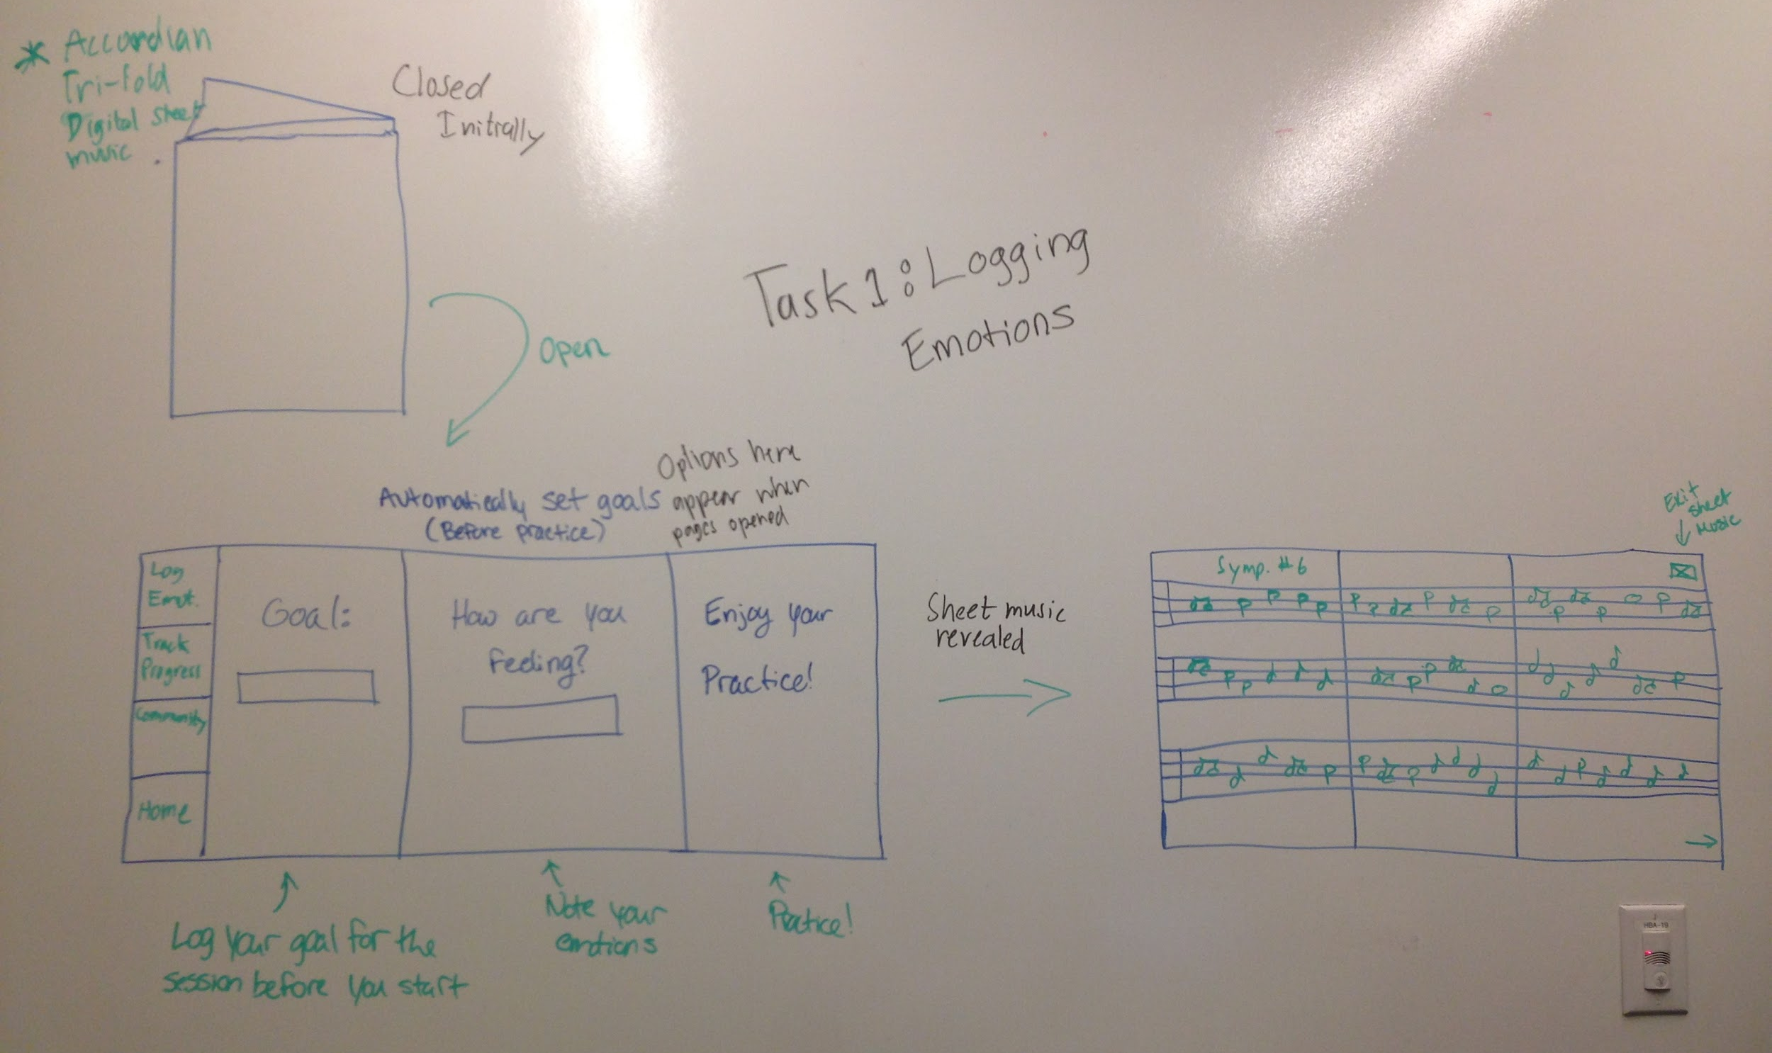
Task 1: Log Goal and Emotions
Notes:
Tasks: [give a brief walkthrough]
Log emotions
Track progress
Share + Engage with community

Slide 6
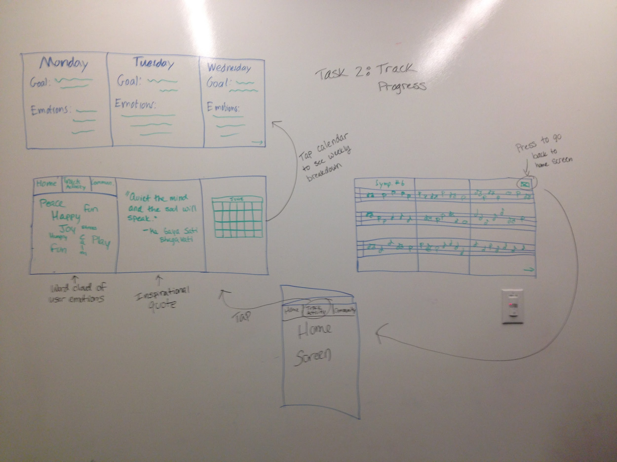
Task 2: Track Progress
Notes:
Tasks: [give a brief walkthough]
Log emotions
Track progress
Share + Engage with community

Slide 7
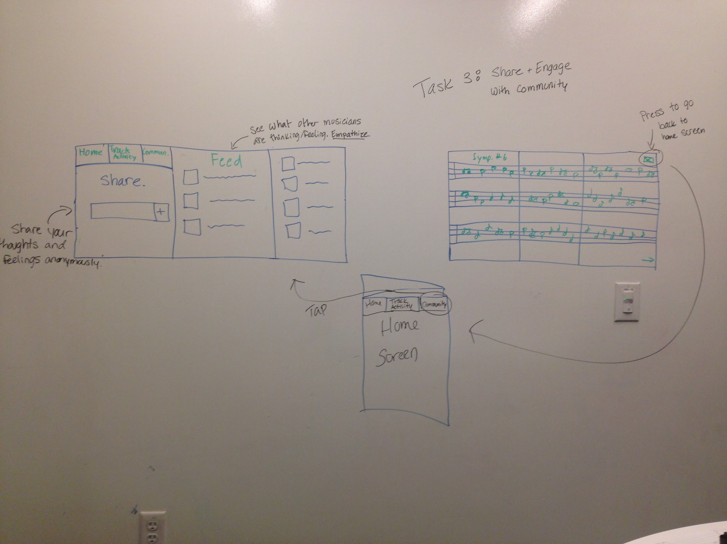
Task 3: Share and Engage
with Community
Notes:
Tasks: [give a brief walkthough]
Log emotions
Track progress
Share + Engage with community

Slide 8
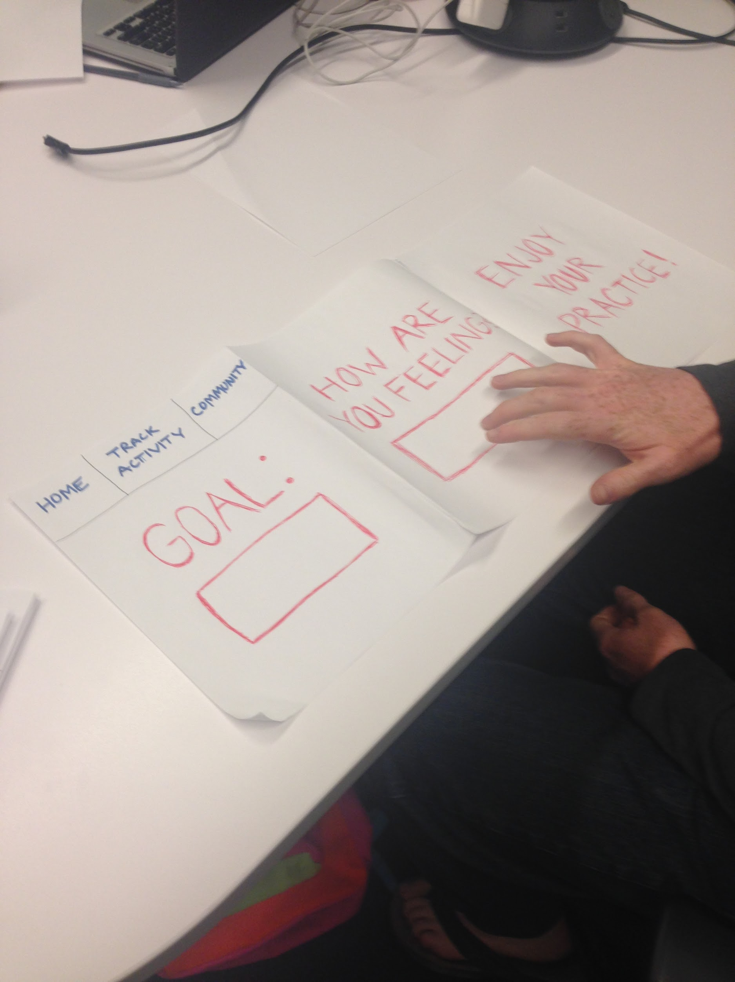
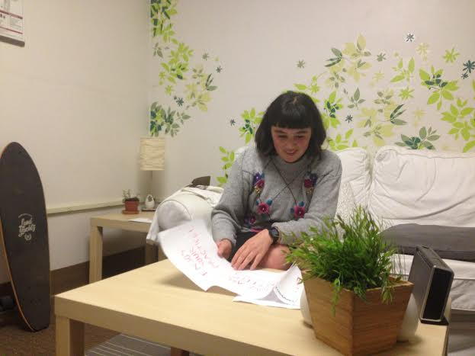
Experimental Method
Notes:
Testers: Musicians!
Used a script to give them three goals to accomplish, gave them paper prototype, observed what they tried to do

Slide 9
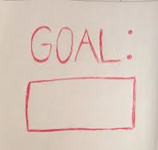
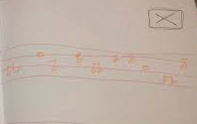
Experimental Results: Issues
Trouble navigating UI to accomplish Task 2
Inconsistent menu bar
Confusion about goal setting
VS.
Notes:
Users were confused by naming Task #2 “View Aggregated Stats.” We did not provide a descriptive enough UI or set of instructions to smoothly guide a user out of viewing sheet music in rehearsal and into a period of analysis and reflection with our dashboard views on emotional shifts over time.
The lack of a consistent menu bar across all screens confused users and made it difficult for them to know how to get out of the “Sheet Music” view in the UI.
There was confusion over what sort of goal should be documented in the first task. Some participants felt that this goal needed to be directly tied to having control over or changing their current emotional state during the practice period, rather than setting a goal and intention as a musician for the rehearsal period.

Slide 10
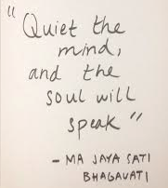
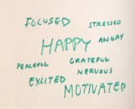
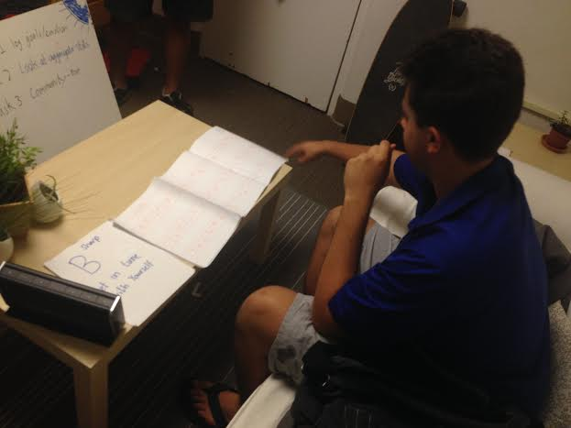
Experimental Results: Positive Feedback
Value proposition
Accordian-style sheet music interface
Quote and word cloud feature
Notes:
The app’s value proposition. Several participants not only saw its utility in building mindfulness, but as a way to develop a routine and recognize abnormalities that they could address as a means to improve their effectiveness in rehearsing for their respective ensembles.
The app’s appeal: our user group was decidedly more casual than the pre-professional or professional musicians we spoke to initially, yet they still saw a use for the app in their current musical pursuits. Furthermore, participants with little to no prior exposure to mindfulness concepts still understood and expressed interest in the application, with validated an assumption that such an application could hold appeal to those who had never tried such practices before.
The “orchestral”, accordion-style sheet music interface felt familiar and beloved to musicians who are accustomed to using physical sheet music and enjoy having something more tangible to work with.
Both the quote and word cloud features included in our dashboard view were well-liked by all participants, who offered suggestions for how to enrich these features.

Slide 11
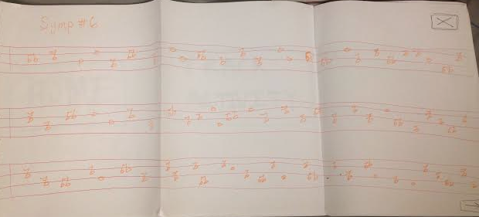
Suggested UI Changes
Clarify selecting calendar option
Sort feed by instrument
Add menu to sheet music
Notes:
Calendar: Daven: “Thought choosing a date meant you were selecting a date to add notes to as opposed seeing that day’s goals and emotions”. Confused.
Community: Unclear ‘boxes’ next to feed items. Desire to sort feed by musician type/instrument.
Sheet music: confused about getting to other features- add menu

Slide 12
Summary
Testing validated interface choice
Users recognized benefit of integrating mindfulness into rehearsal
Some qualities of interface found confusing
Going forward: address issues, test with broader user group, and further develop key features

