Slide 1

Crowd Power
Online Marketplace
Addison, Joanne, Katherine, SunMi

Slide 2
ADDISON
JOANNE
KATHERINE
SUNMI

Slide 3
INITIAL POV
We met Lorena. We were amazed to realize that Facebook was her go-to website for things like event tickets or hard-to-get items. It would be game-changing to facilitate buying & selling of items through Facebook.

Slide 4




Needfinding: Who we talked to
Bayian, electrical engineering student at Stanford
Miji, mother of three kids
In person
Video call

Slide 5
Needfinding: Why these two?
Bayian, electrical engineering student at Stanford
Student perspective, exploring how people use social media in relation to online marketplaces
Miji, mother of three kids
From a different age group, hearing experiences about extensive use of larger marketplaces like Amazon

Slide 6
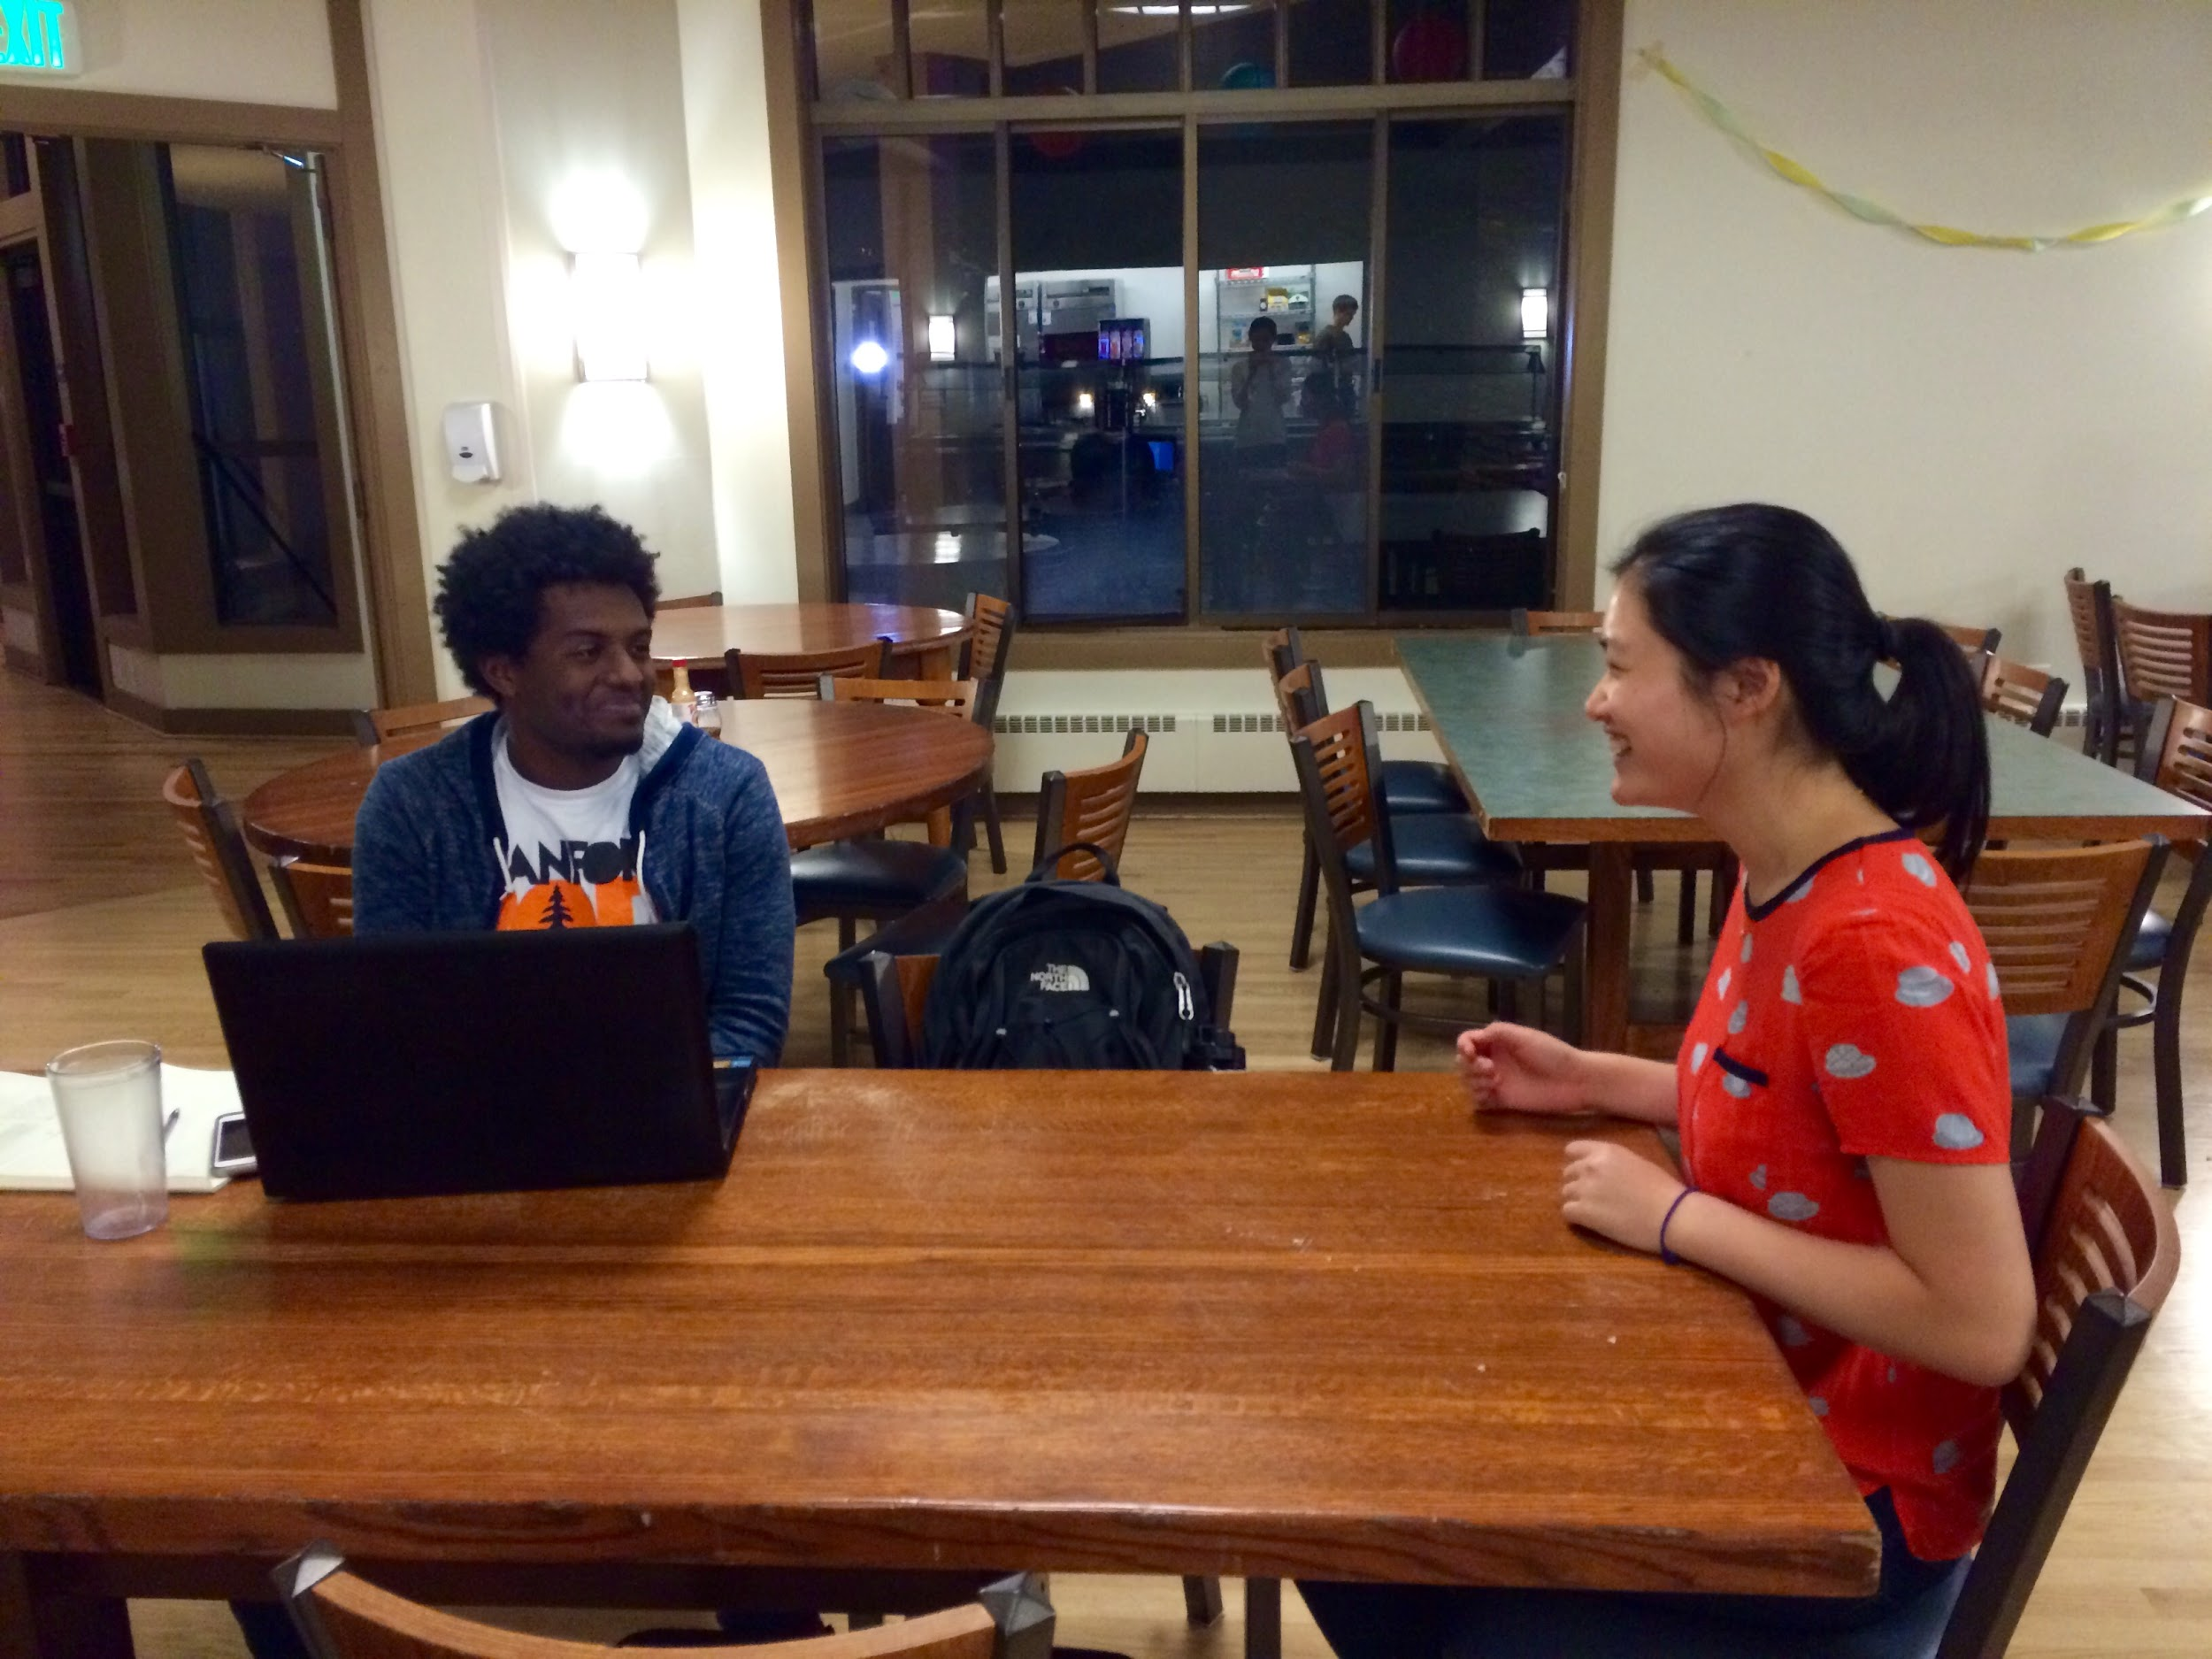
Talking with Bayian

Slide 7

WE HEARD STORIES!

Slide 8
BAYIAN
bought soccer cleats that didn’t arrive for half a year – the importance of reviews and good customer service
MIJI
had a seller on Amazon contact her after she submitted a low rating and try to artificially boost their ratings – the need for more honest, unbiased ratings

Slide 9
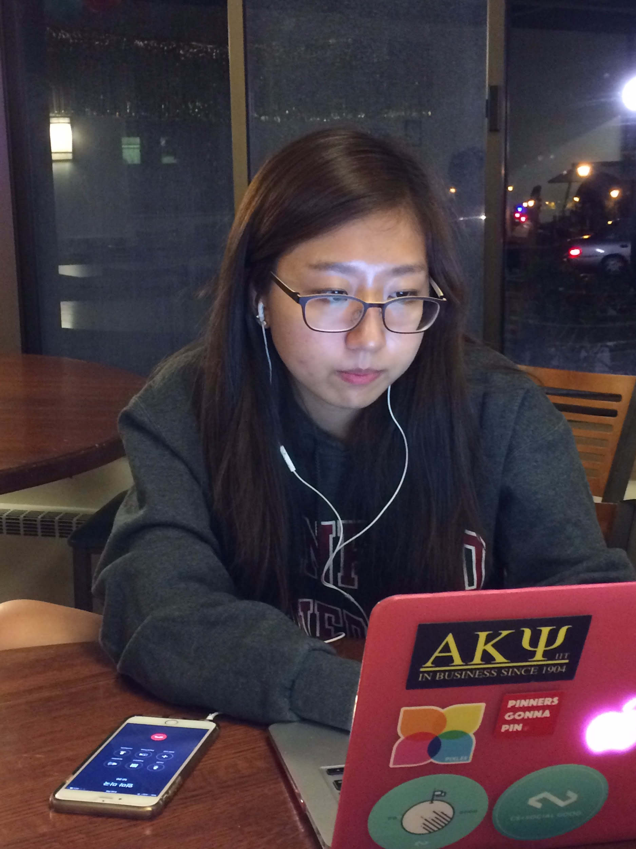
Talking with Miji

Slide 10

WHAT WE LEARNED

Slide 11
What we learned
While reviews are important and increase trust, some reviews are artificially generated
The platform should offer some kind of guarantee – even if not in the form of traditional customer service, the product should move from the seller to the buyer quickly

Slide 12
REVISED POVS

Slide 13
We met Miji.
We were amazed to realize how far people and 3rd party sellers were willing to go to keep their ratings up.
It would be game-changing to design a new rating system that reflects the quality of products/sellers accurately.

Slide 14
We met Lorena.
We were amazed to realize that Facebook was her go-to website for things like event tickets or hard-to-get items.
It would be game-changing to leverage people’s social networks to facilitate buying & selling of items without frustration.

Slide 15
We met Bayian.
We were amazed to realize that he deemed secure arrival of items as one of the most important aspects of online marketplaces.
It would be game-changing for an online marketplace to offer the advantages of crowdsourcing while guaranteeing reliable shipping and delivery of orders.

Slide 16
HOW-MIGHT-WE’S

Slide 17
How might we provide users with a way to sell and purchase time-sensitive products?

Slide 18
How might we help the users so that they can write high quality reviews and put each review in a certain context?

Slide 19
How might we improve the user experience of obtaining purchases?

Slide 20
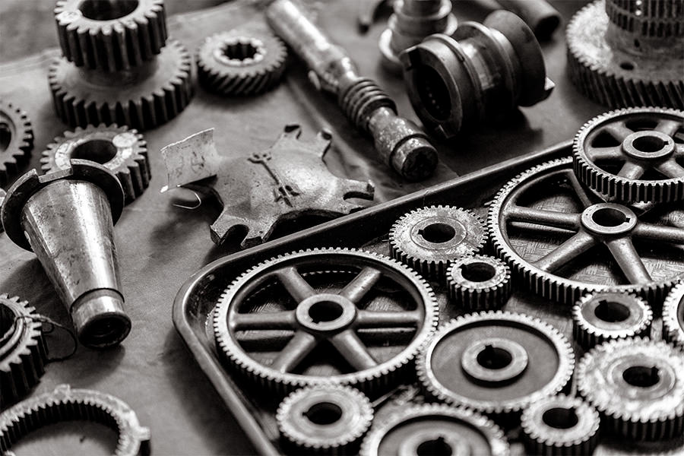
BRAINSTORM SOLUTIONS!

Slide 21
Solution #1: Ticket Market
A platform devoted to buying and selling time-sensitive tickets for shows, concerts, and festivals

Slide 22
Solution #2: Five Favorites
A platform where users can share their five favorite products each month and see trending items

Slide 23
Solution #3: Yard Sale
A location-based buying and selling platform where users can only see products that are within a certain proximity

Slide 24

EXPERIENCE PROTOTYPES

Slide 25
TESTING METHODS
After making paper prototypes, we created scripts to put the testers into an environment where they would be using our product prototypes
So instead of telling our testers, “Imagine this situation…” we started by creating an actual scenario

Slide 26
Script example: Jeff as a ticket seller
SunMi: “Hey, isn’t Beyond Wonderland this Friday, which is in two days? How are you going to finish your heap allocator due Saturday?”
Jeff: “I know right, I don’t know if I can go anymore… I’m so bummed.”
SunMi: “What are you going to do with the ticket then? Are you planning on selling it?”
Jeff: “Yeah, that would be ideal.”
SunMi: “But how? It’s in two days.”
… [continued]

Slide 27



APPROPRIATENESS OF PARTICIPANTS
JEFF
SARAH
CINDY
Diverse backgrounds in terms of education and usage of online marketplaces
Participants are extreme users or non-users
People who use different marketplaces (ex: Amazon, Etsy)

Slide 28
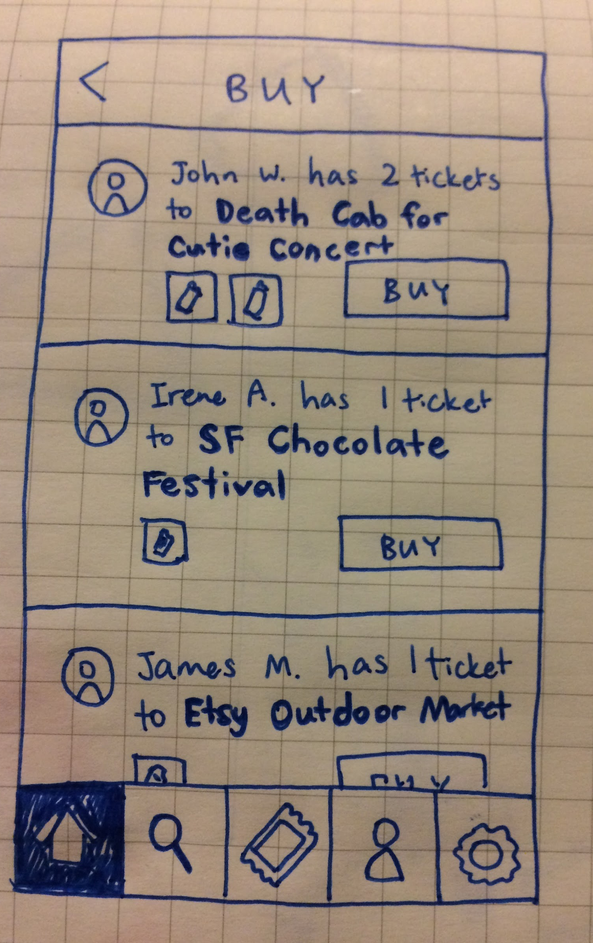
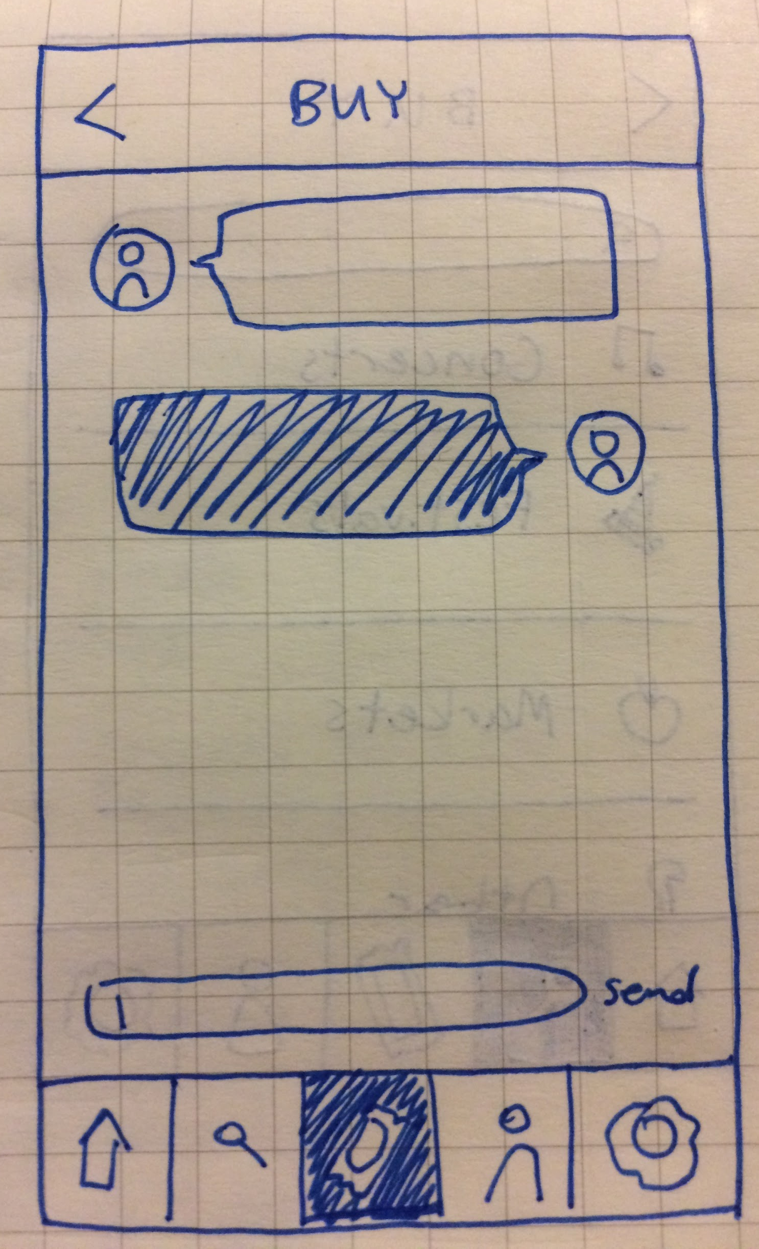
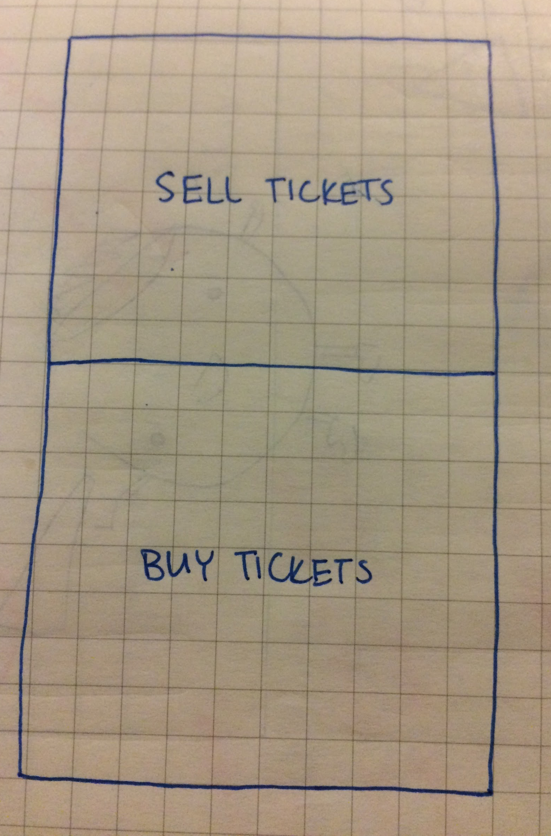
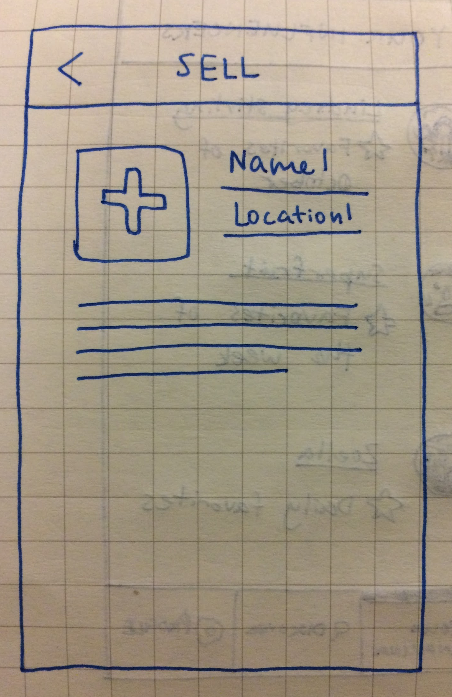
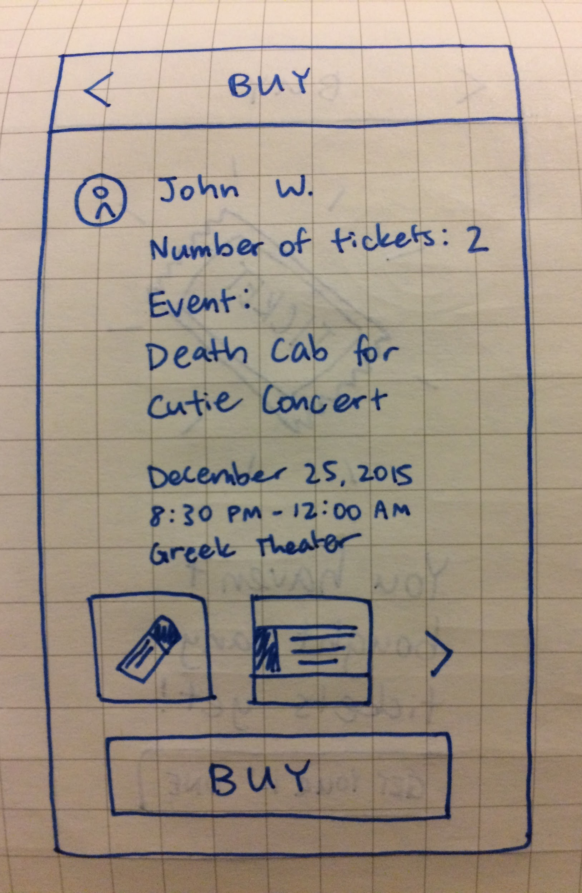
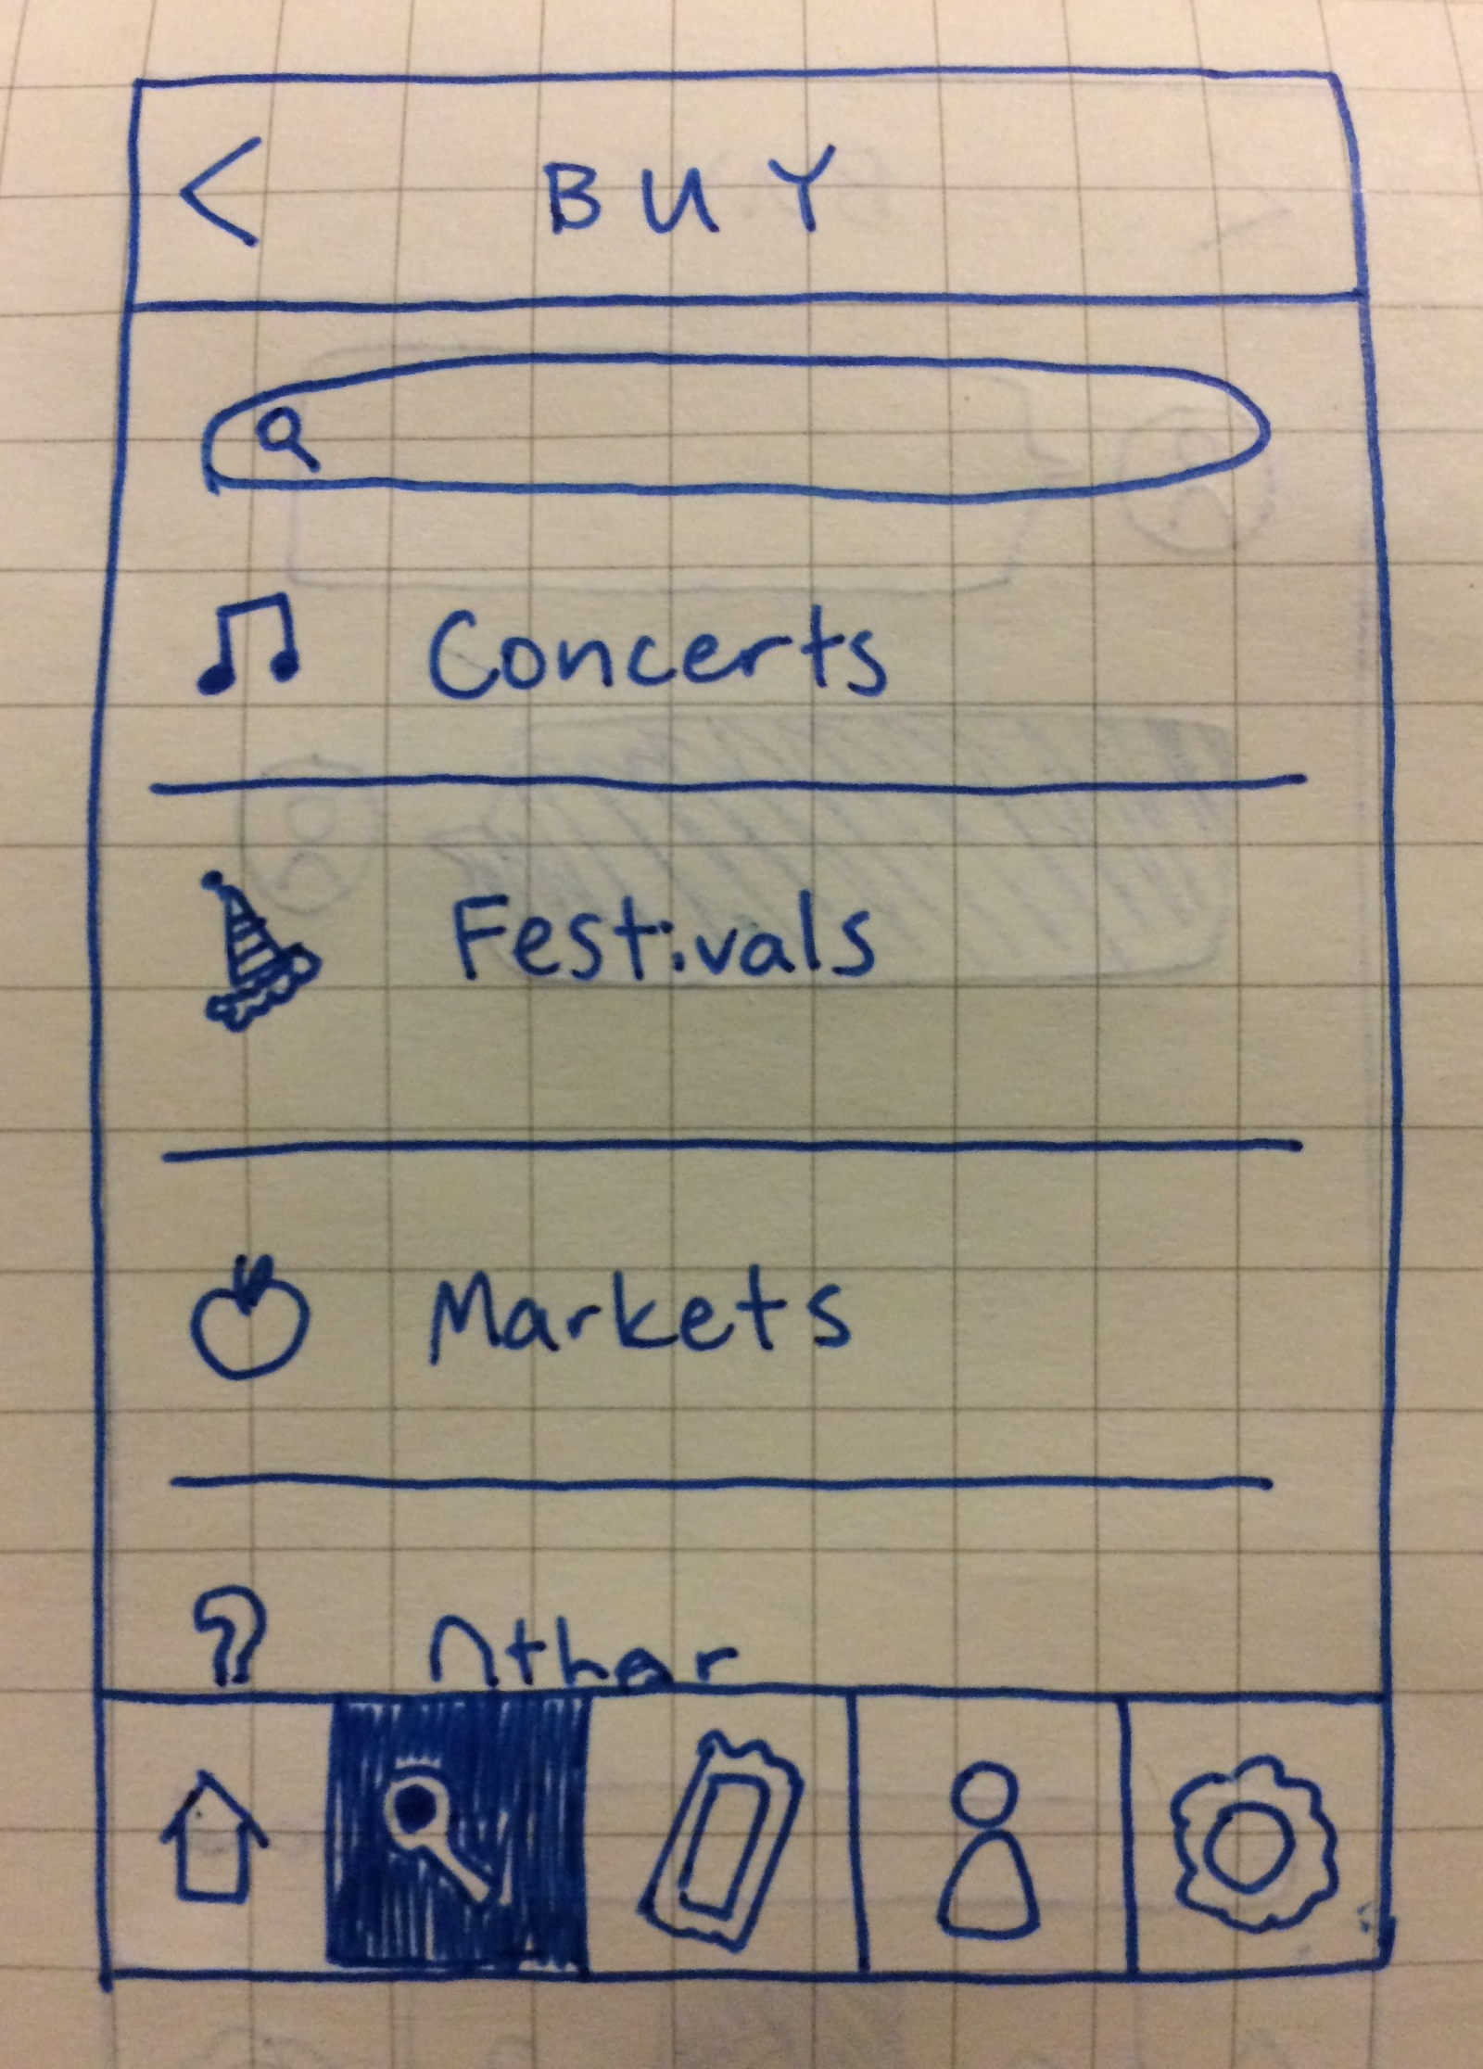
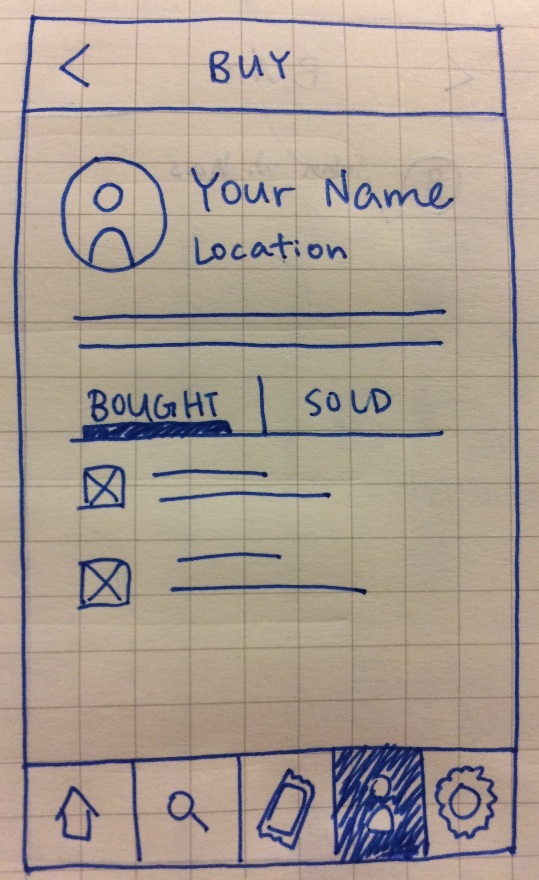
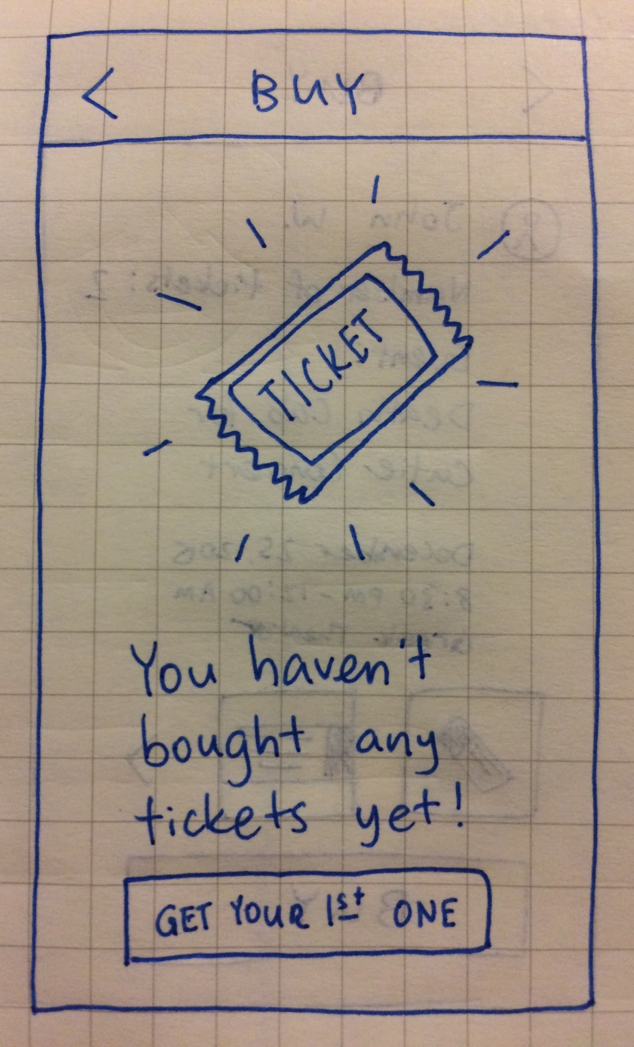
PROTOTYPE #1
HMW from Lorena’s POV:
How might we provide users with a way to sell and purchase time-sensitive products?

Slide 29
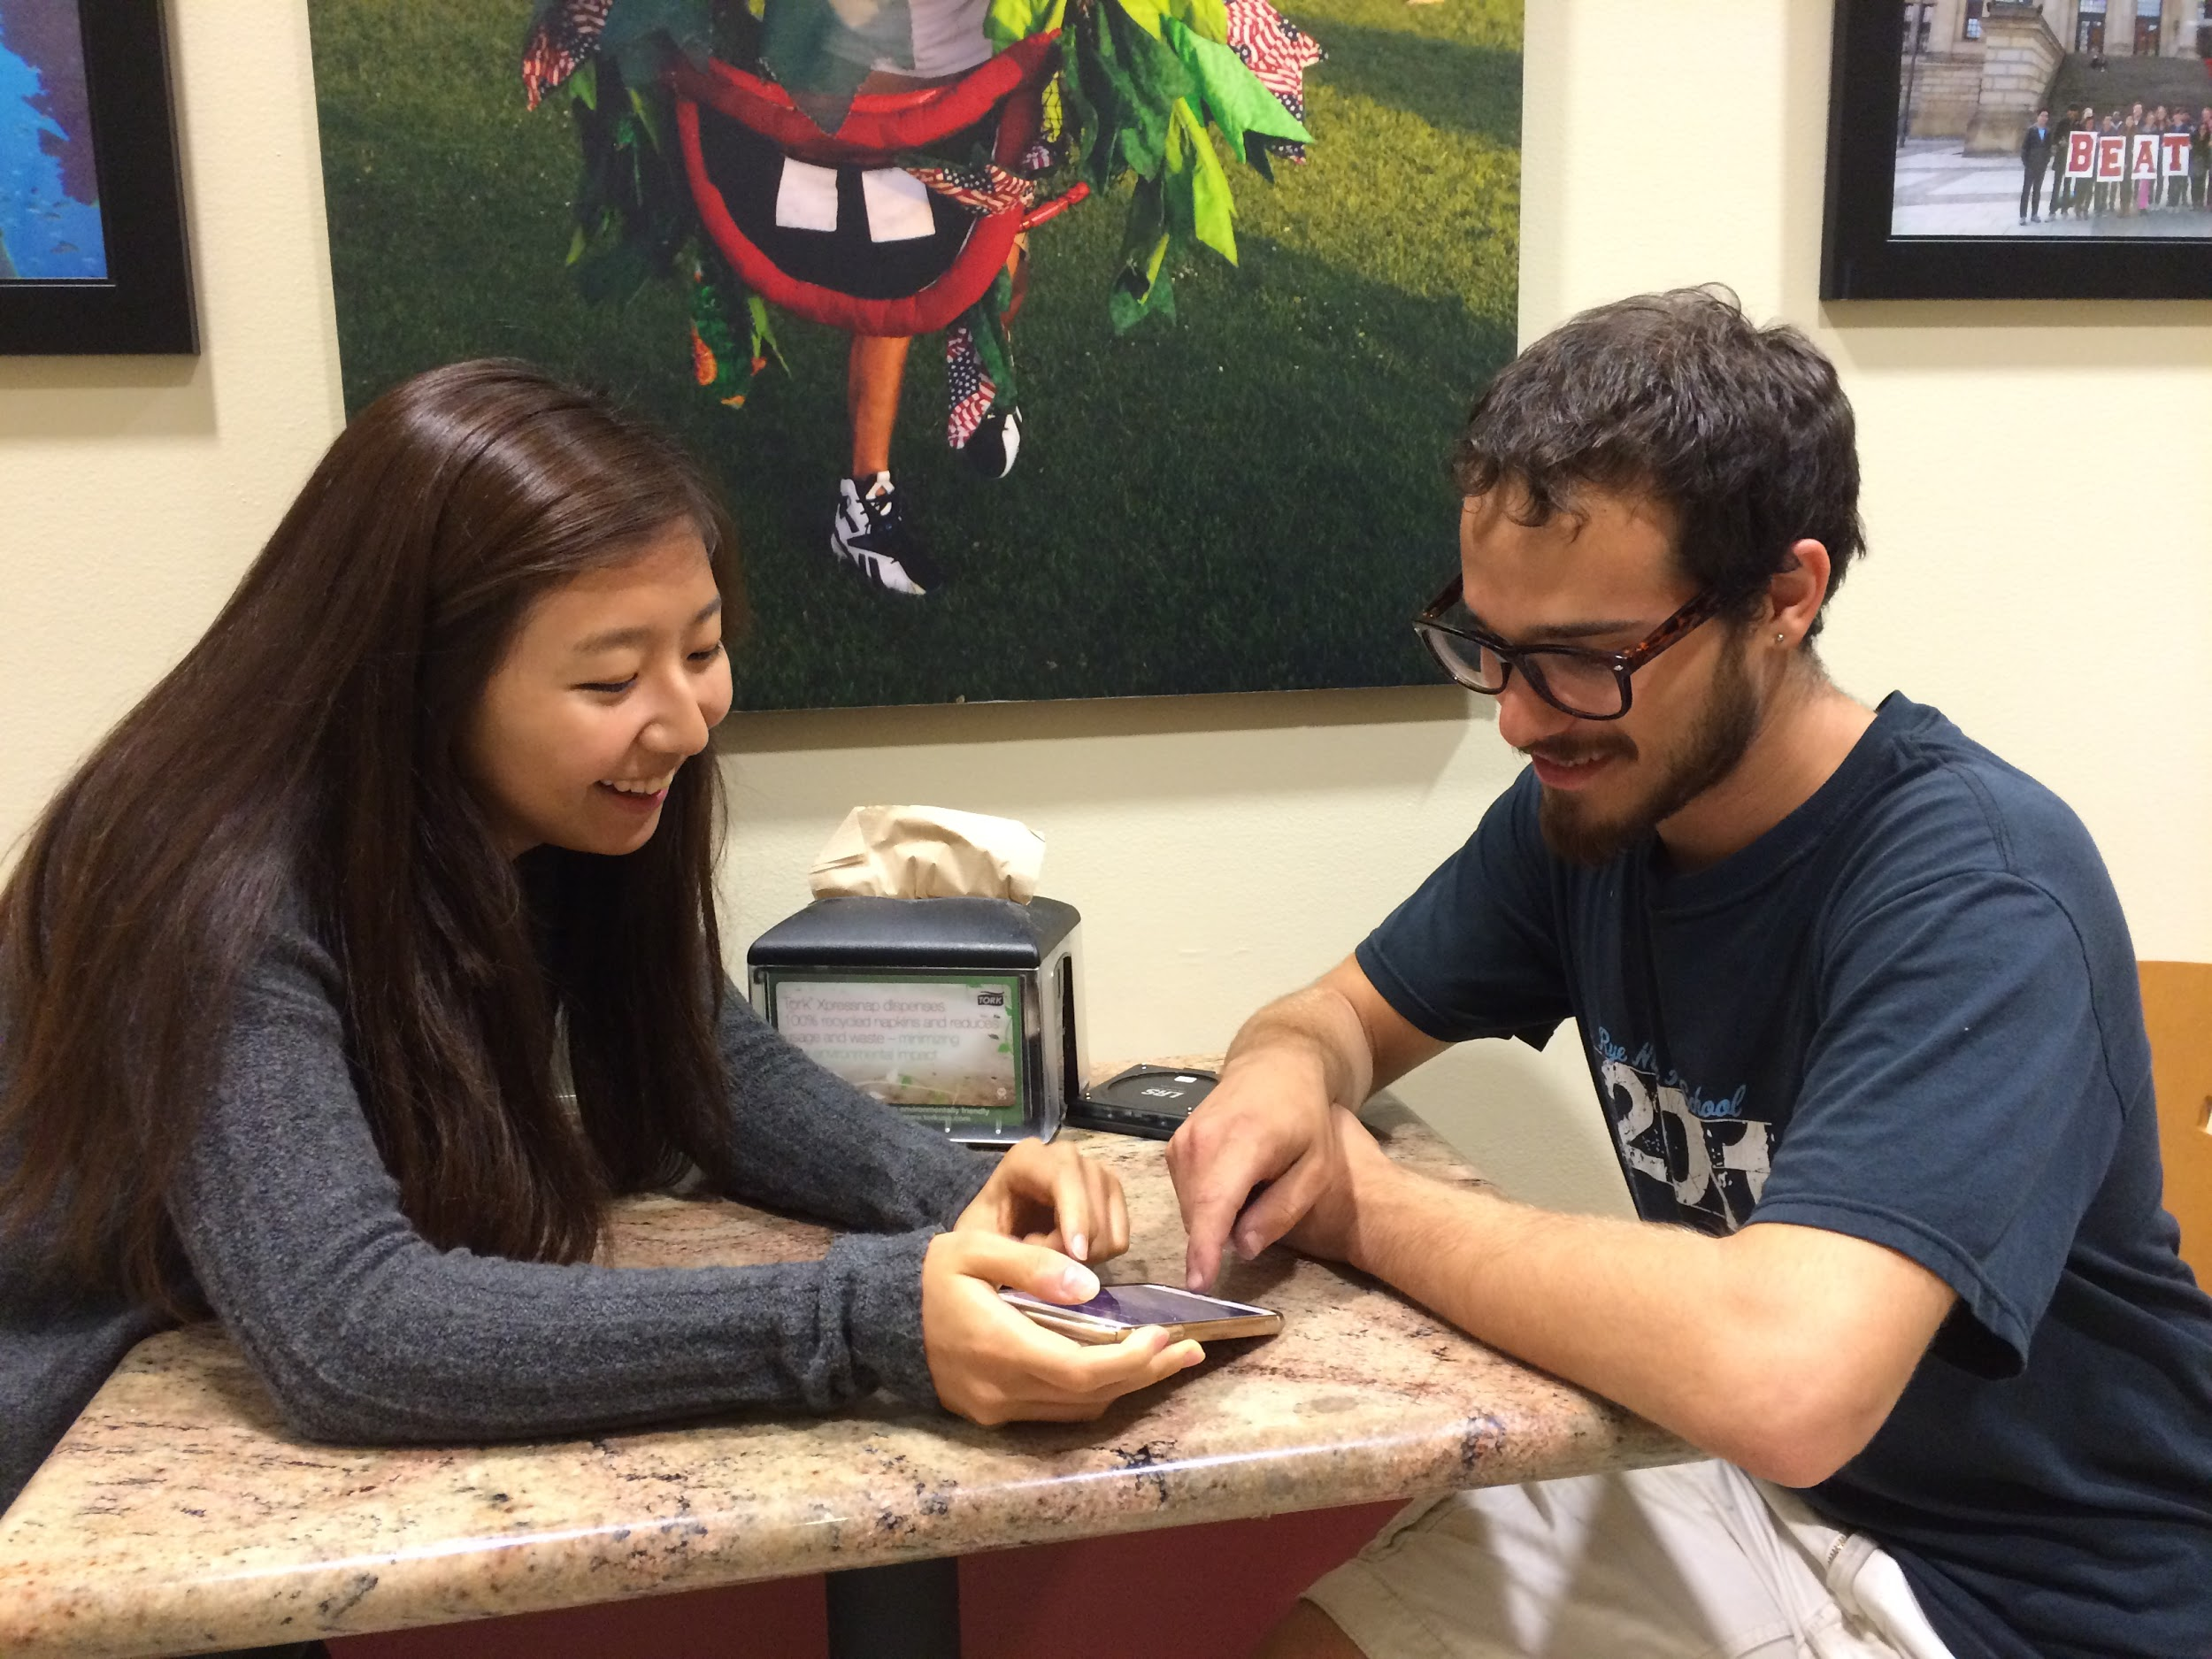
Testing with Jeff

Slide 30
PROTOTYPE #1: Ticket Market
Appropriate for solution #1: A platform devoted to buying and selling time-sensitive tickets for shows, concerts, and festivals
Innovation: Our tester mentioned that he used social media to buy last-minute tickets – Ticket Market addresses frustration with finding the right events

Slide 31
PROTOTYPE #1
THINGS THAT WORKED
People already post this kind of content – but they are sending out mass emails and posting in Facebook groups where it could get lost

Slide 32

“I would use this… sometimes it’s awkward to post on Facebook or email asking about extra tickets”
-Jeff

Slide 33
PROTOTYPE #1
THINGS THAT DIDN’T WORK
More brainstorming around ticket validation is needed
Ensure that people will be reached out to within a trusted network – don’t want it to turn into a Craigslist-like community

Slide 34
PROTOTYPE #1
SURPRISES
Being able to sort by time-sensitive event (examples: concerts, festivals) is a huge plus – “On social media, I can’t find the events I want to go to. Everything is up to chance.”

Slide 35
PROTOTYPE #1
NEW LEARNINGS
Having a way to more easily enter the ticket information would be a plus
Sorting is good, but search would be even more helpful – for example, finding an extra ticket for “Taylor Swift concert”

Slide 36
PROTOTYPE #1
VALIDITY
Assumption that people want a different platform for time-sensitive items was valid.
Using Facebook to buy or sell tickets is frustrating
New Assumption: People will trust the platform enough to buy/sell tickets from strangers

Slide 37
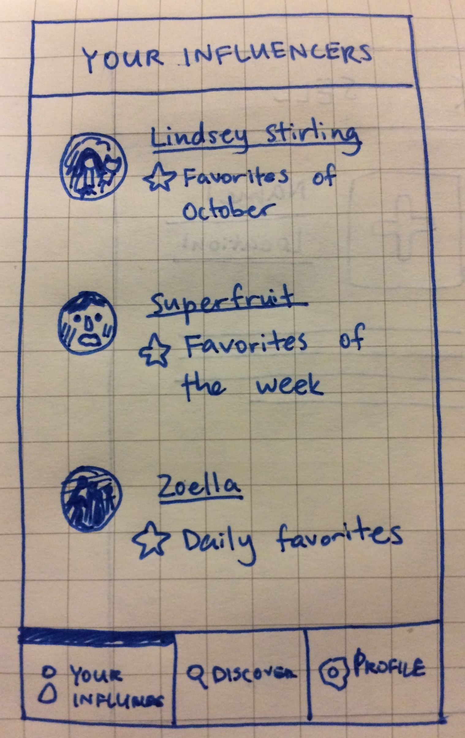
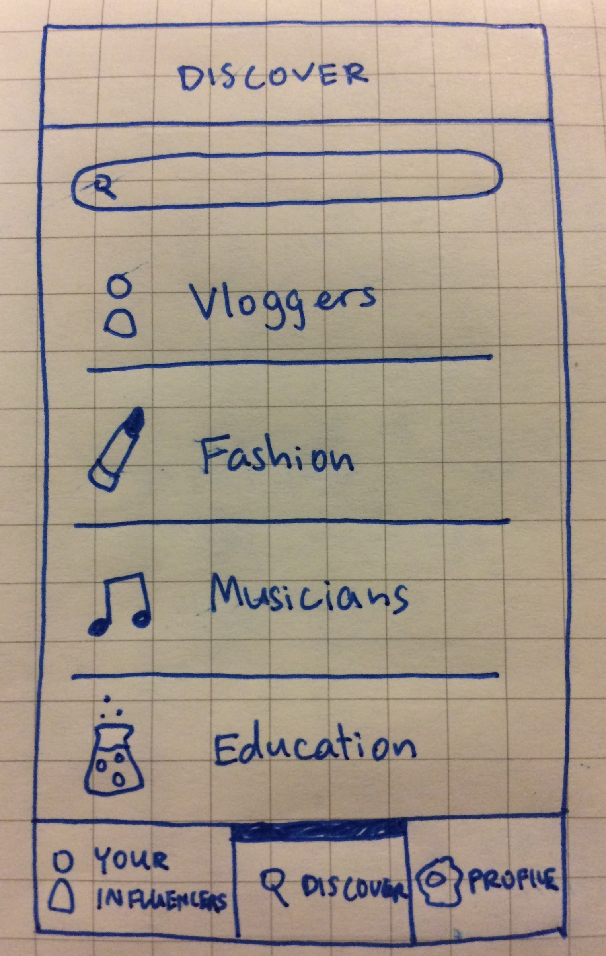
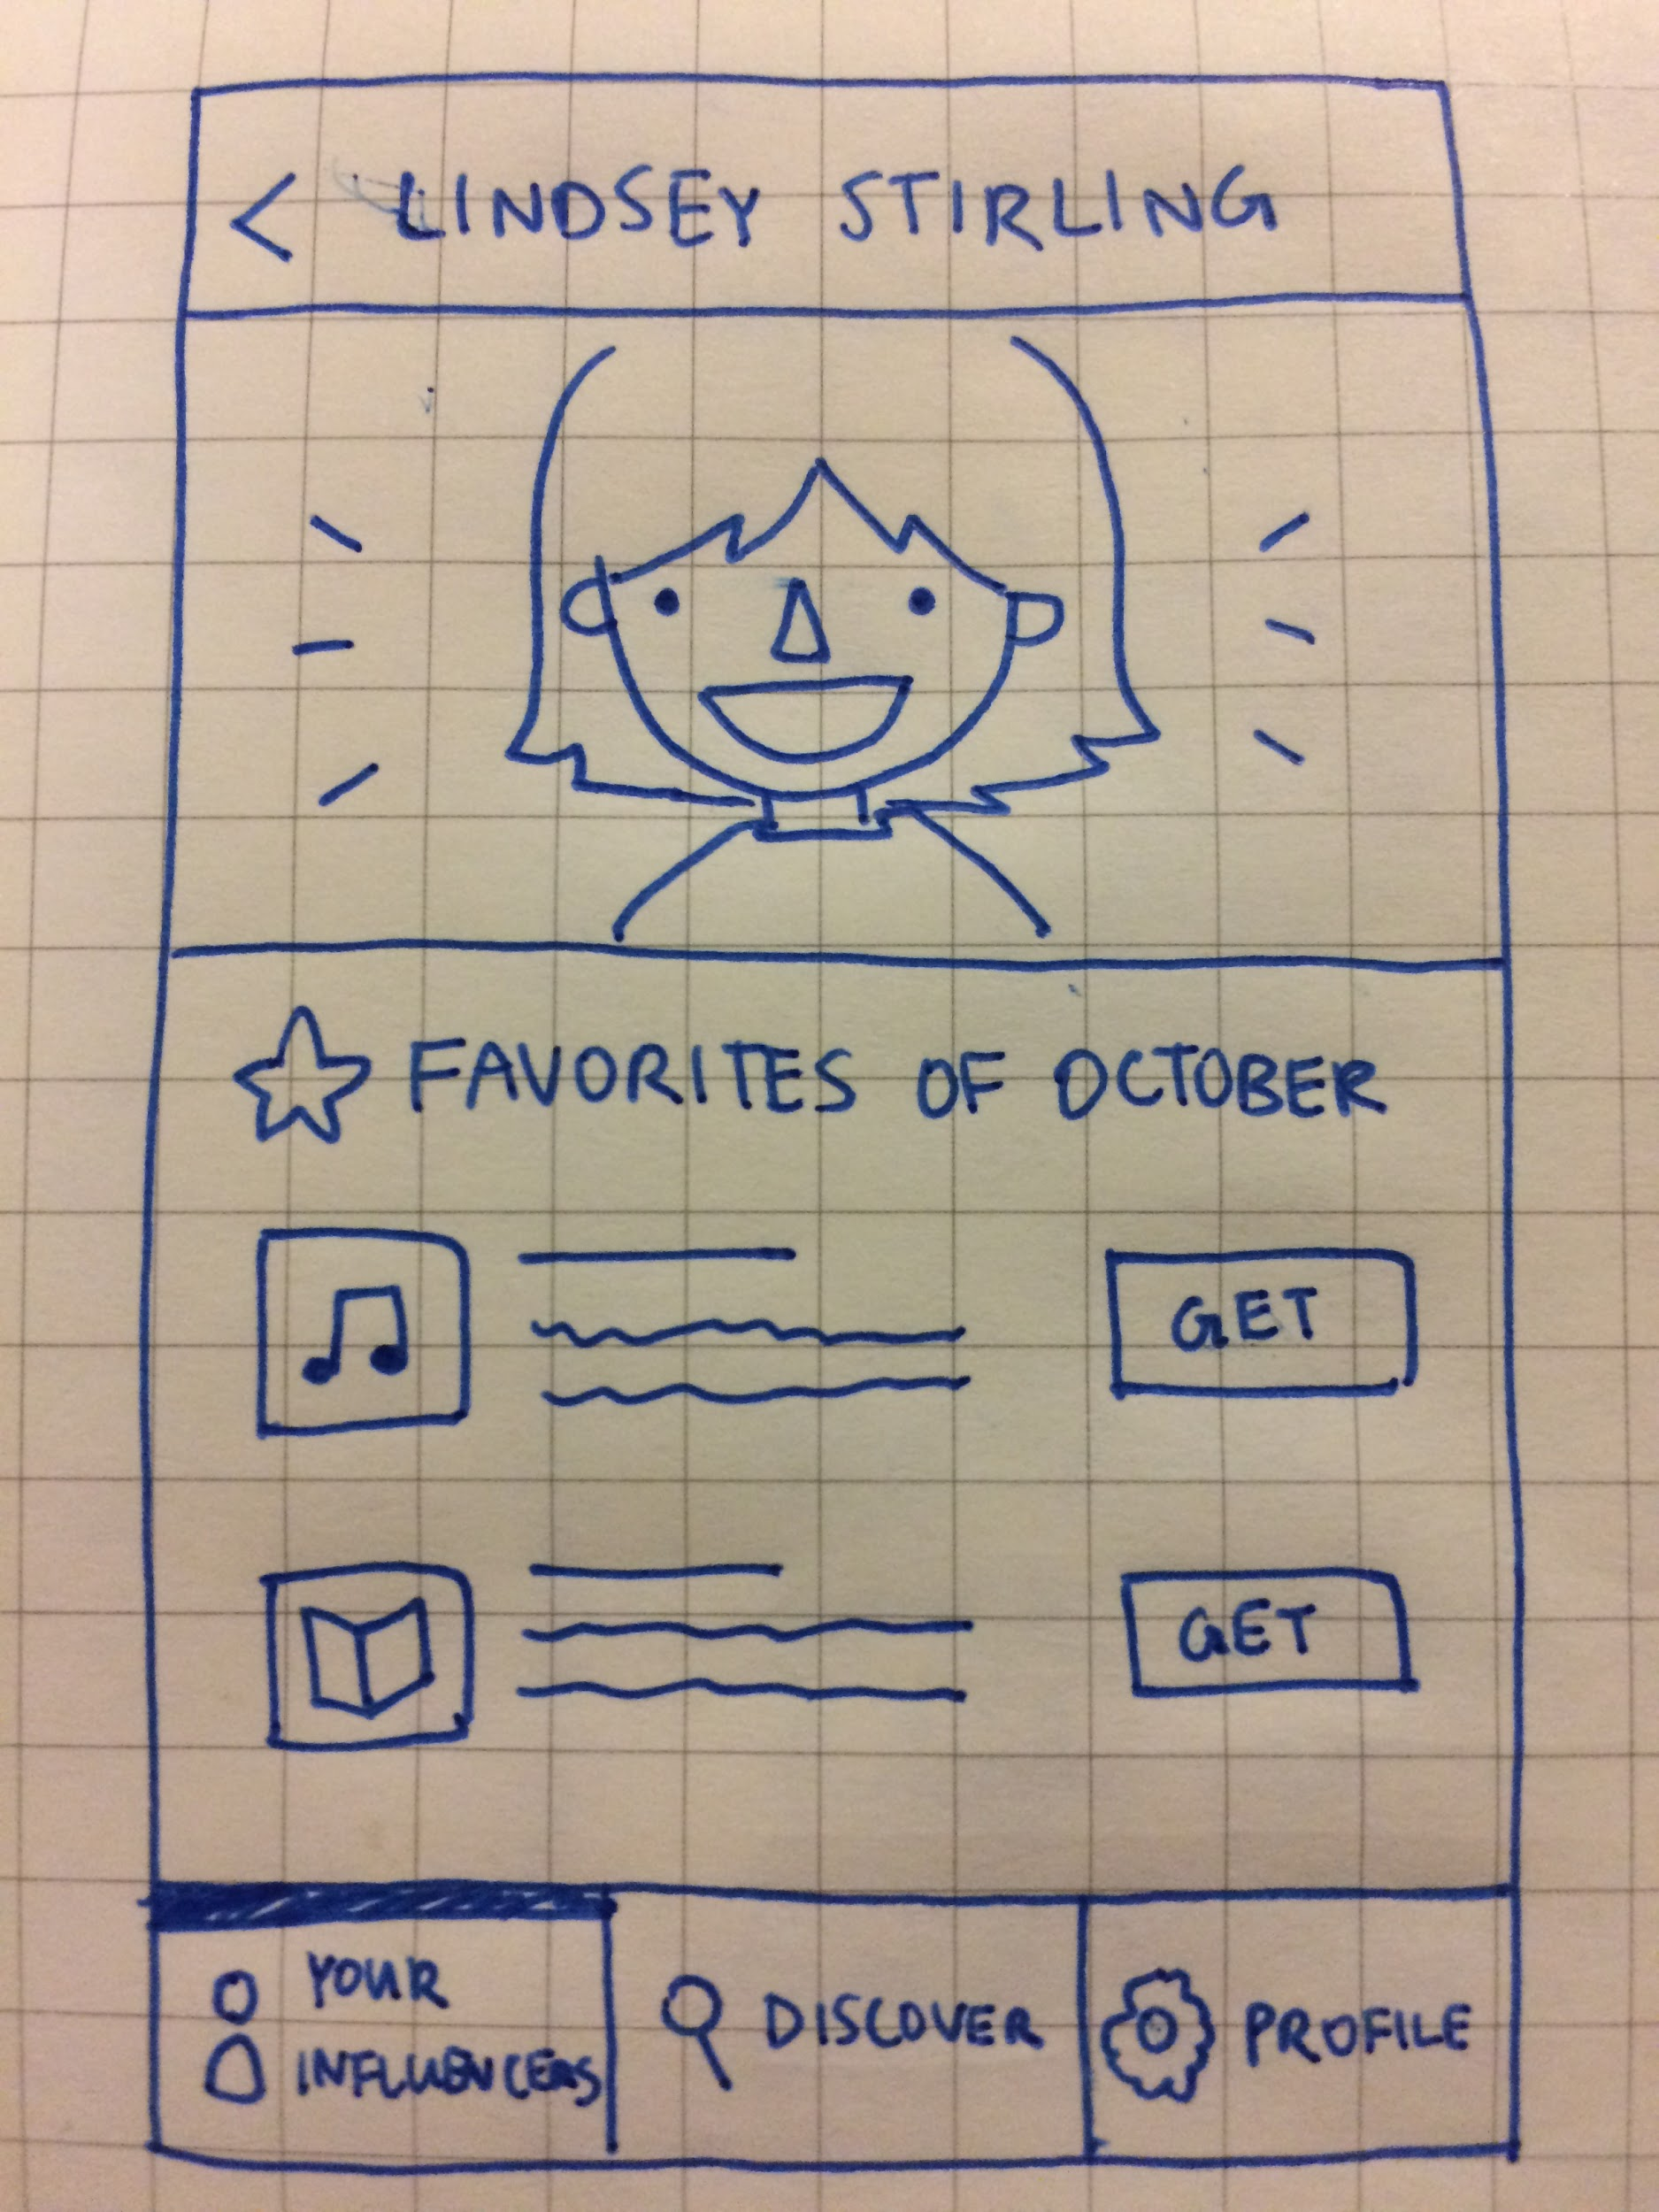
PROTOTYPE #2
HMW from Miji’s POV:
How might we help the users so that they can write high quality reviews and put each review in a certain context?

Slide 38
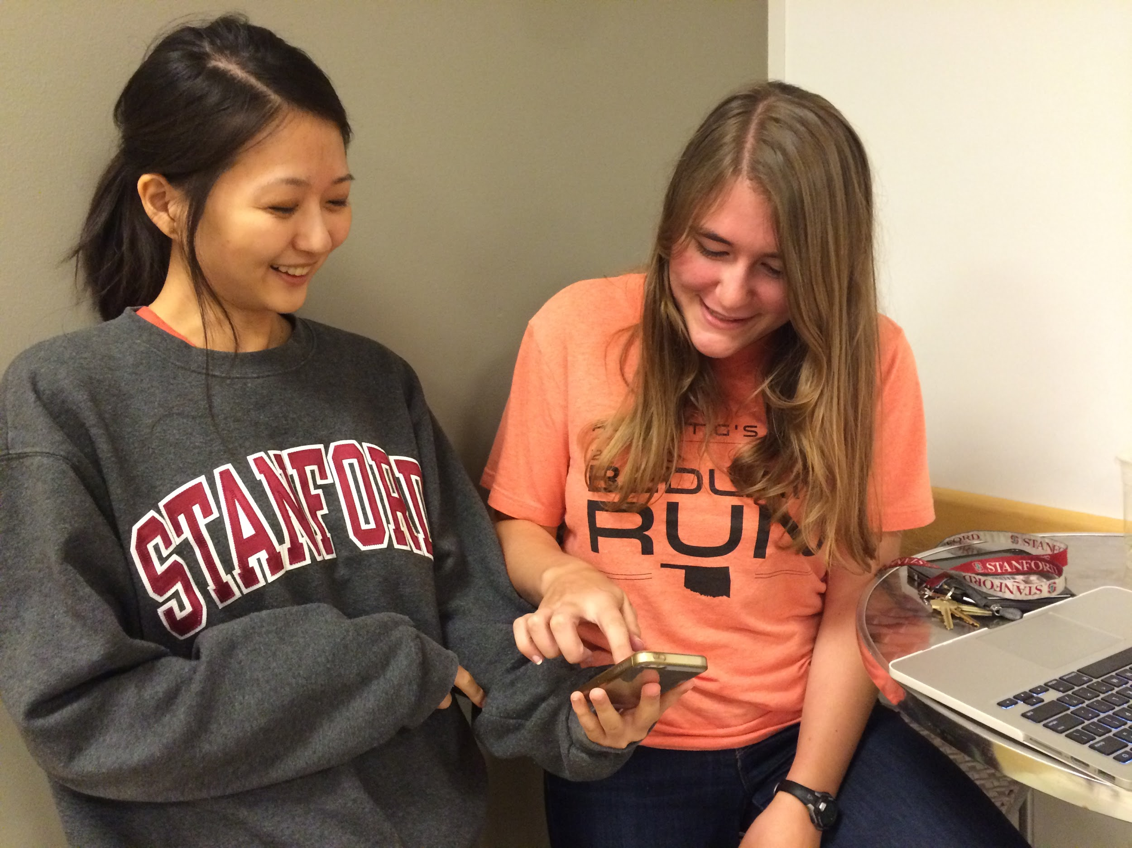
Testing with Sarah

Slide 39
PROTOTYPE #2: Five Favorites
Appropriate for solution #2: A platform where users can share their five favorite products each month and see trending items
Innovation: Our need finding helped us understand that reviews and recommendations were key to building trust – Five Favorites addresses the need for trustworthy recommendations

Slide 40
PROTOTYPE #2
THINGS THAT WORKED
Interested in knowing what the trending or the latest “it” items are
Wouldn’t mind sharing her favorites with strangers

Slide 41
PROTOTYPE #2
THINGS THAT DIDN’T WORK
People need to rate a lot of things for platform to be effective
Not everyone cares about other people’s recommendations

Slide 42
PROTOTYPE #2
SURPRISES
While she doesn’t really care about other people’s recommendations, if she by chance finds someone she really likes, she would follow the person and trust that the person will post great reviews

Slide 43
PROTOTYPE #2
NEW LEARNINGS
This could be a platform useful as a trend but not necessary as a necessity

Slide 44
PROTOTYPE #2
VALIDITY
Assumed people want to hear what other people’s favorites are, she thought it was “stupid”.
New Assumption: people are just looking for affordable, good products. They don’t need someone to tell them.

Slide 45
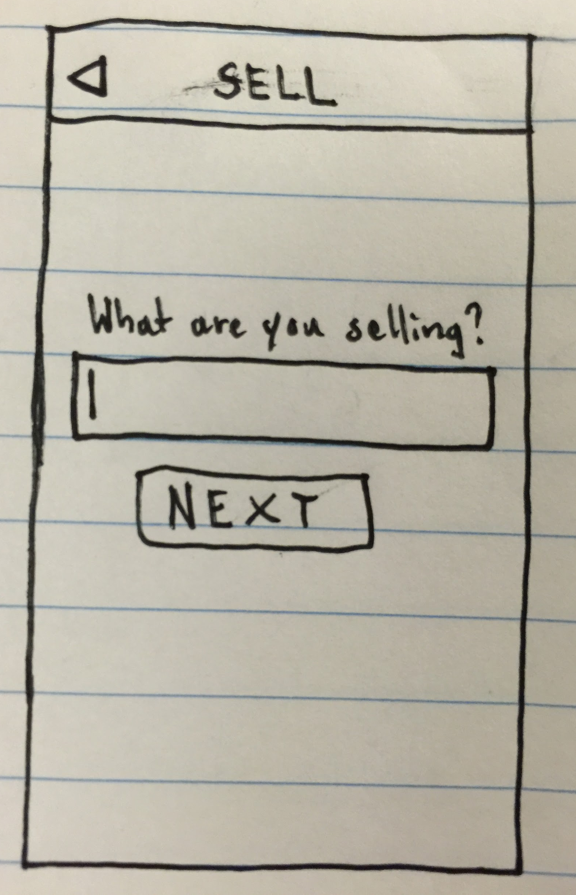
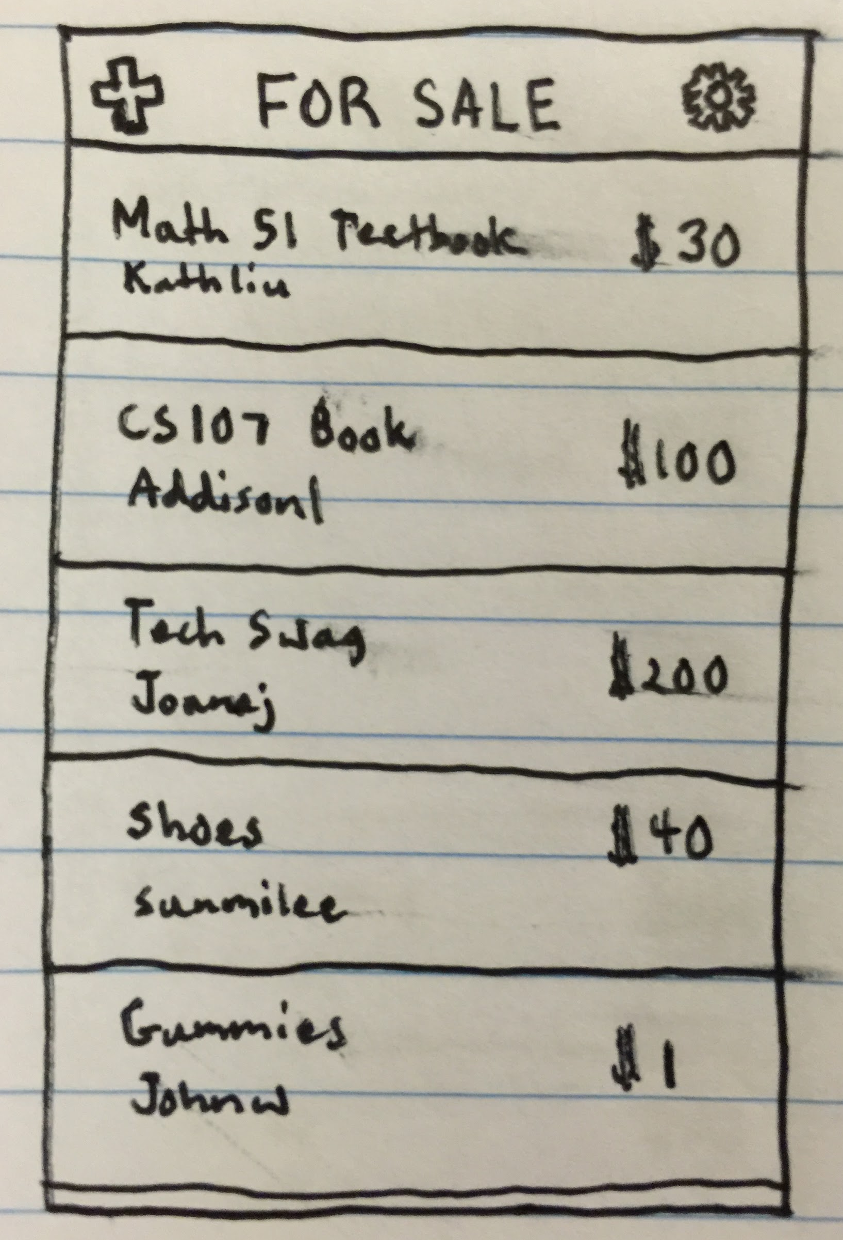
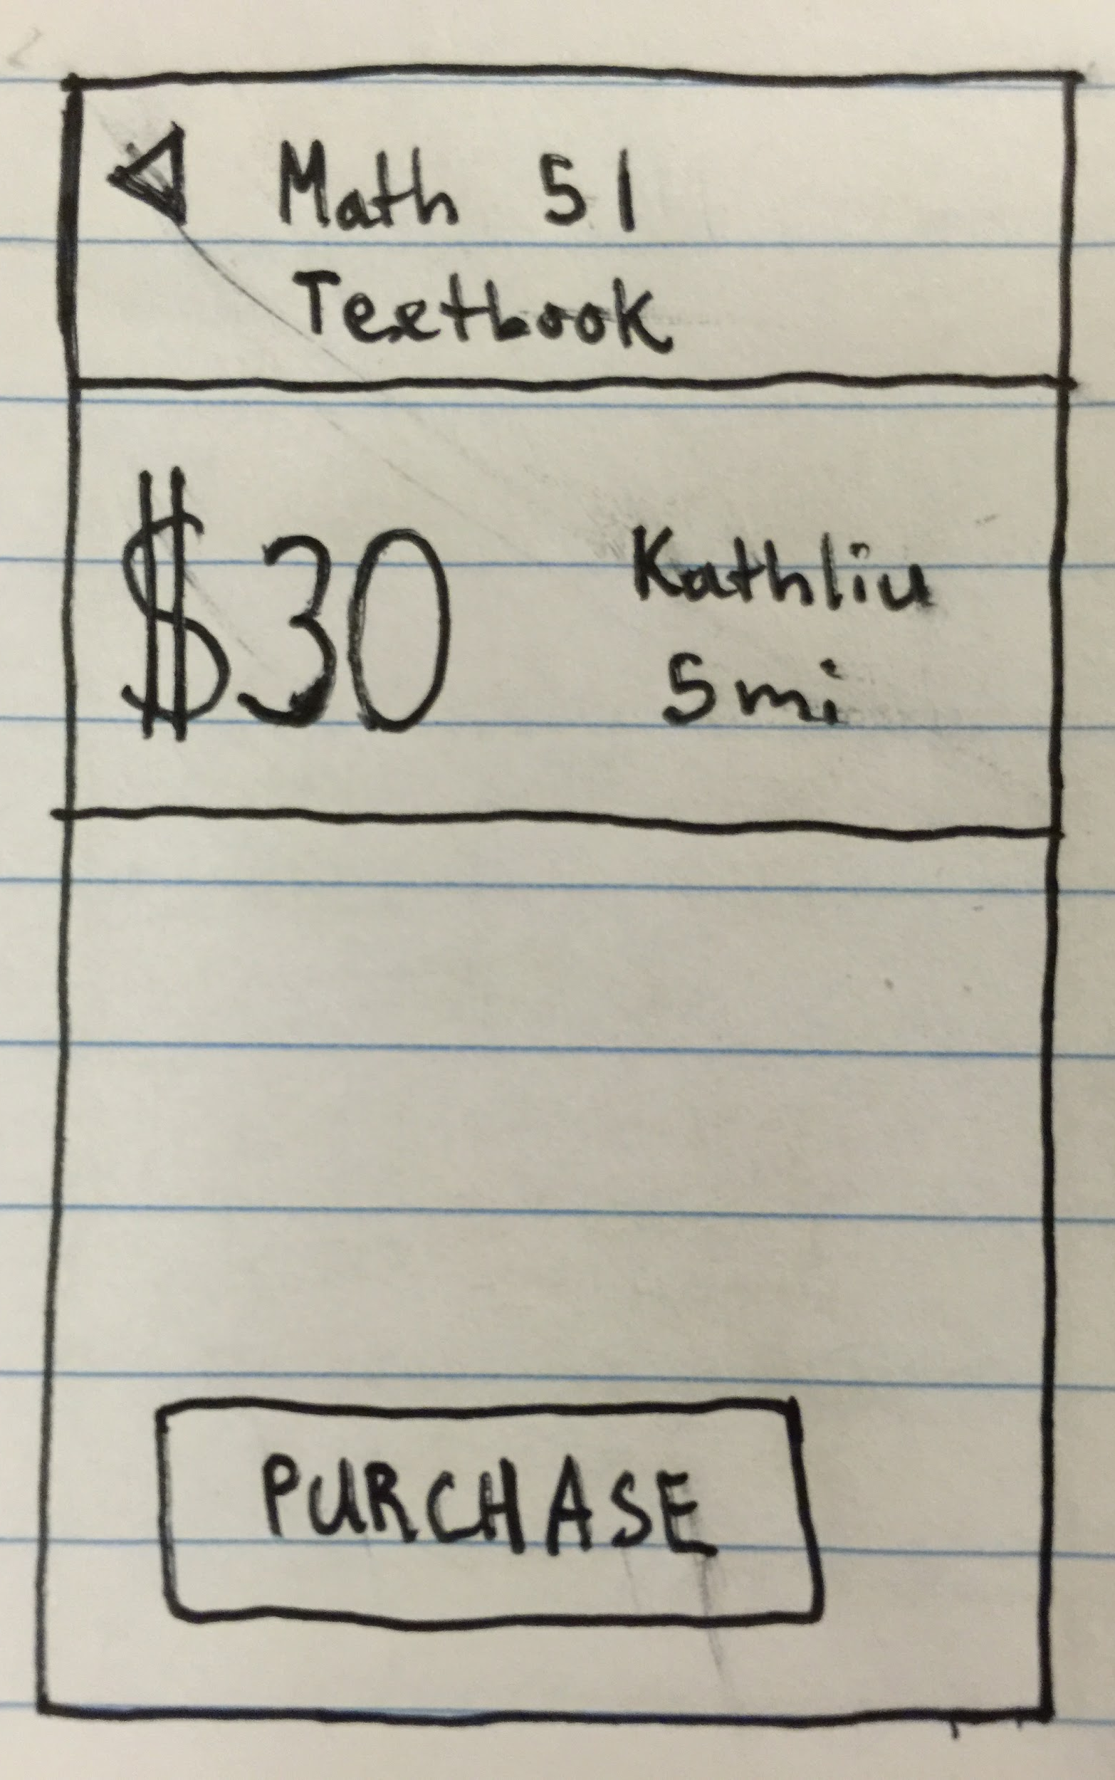
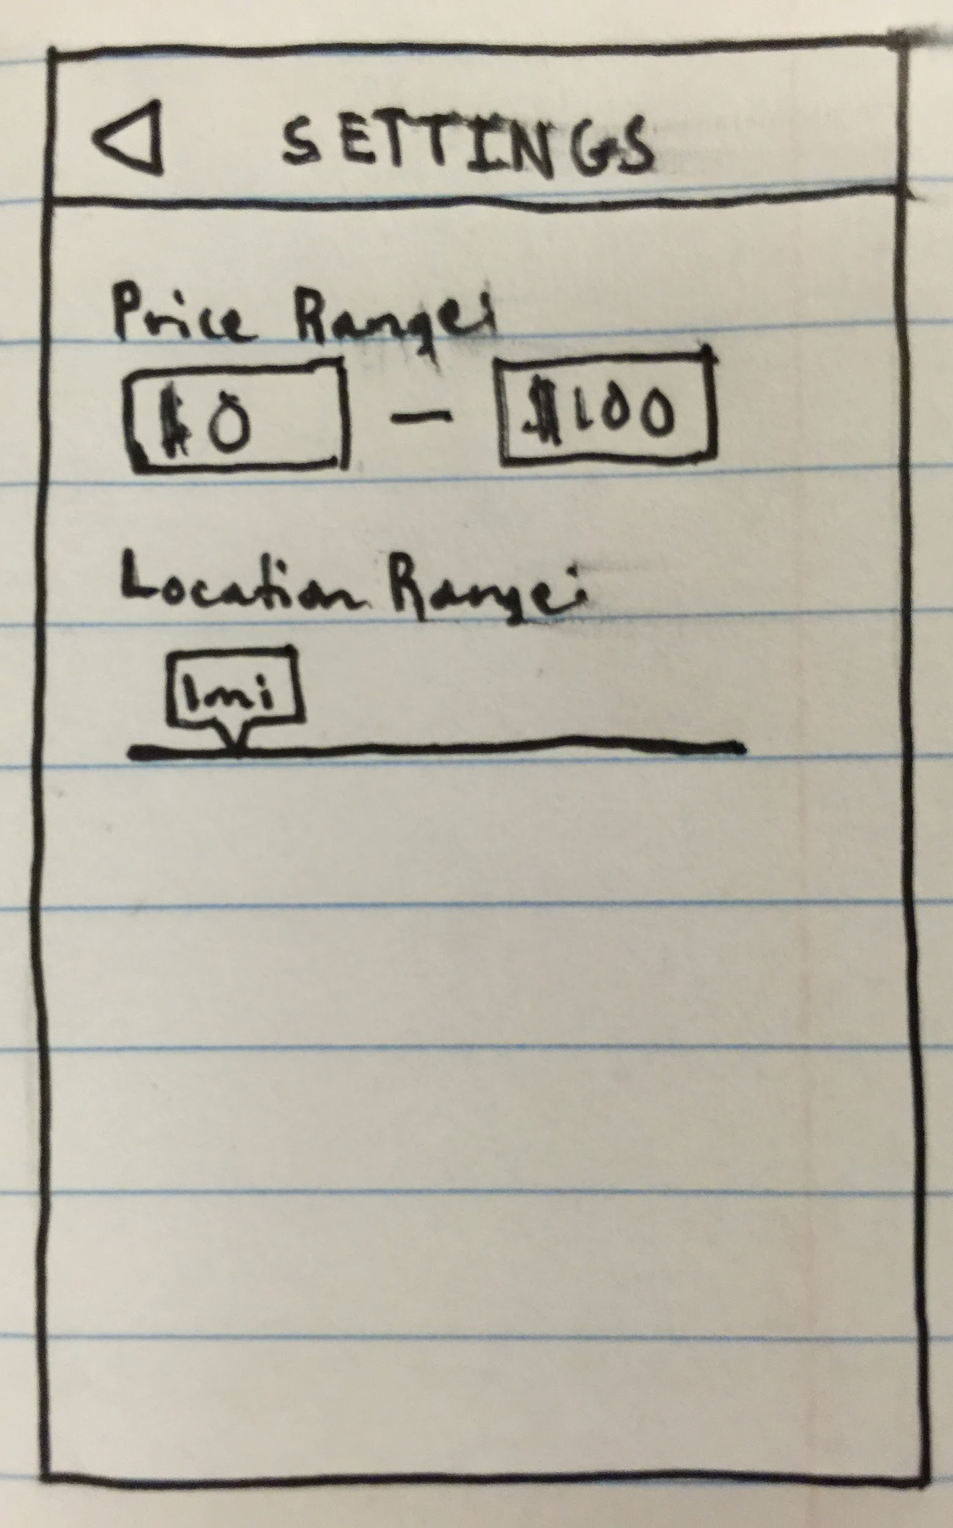
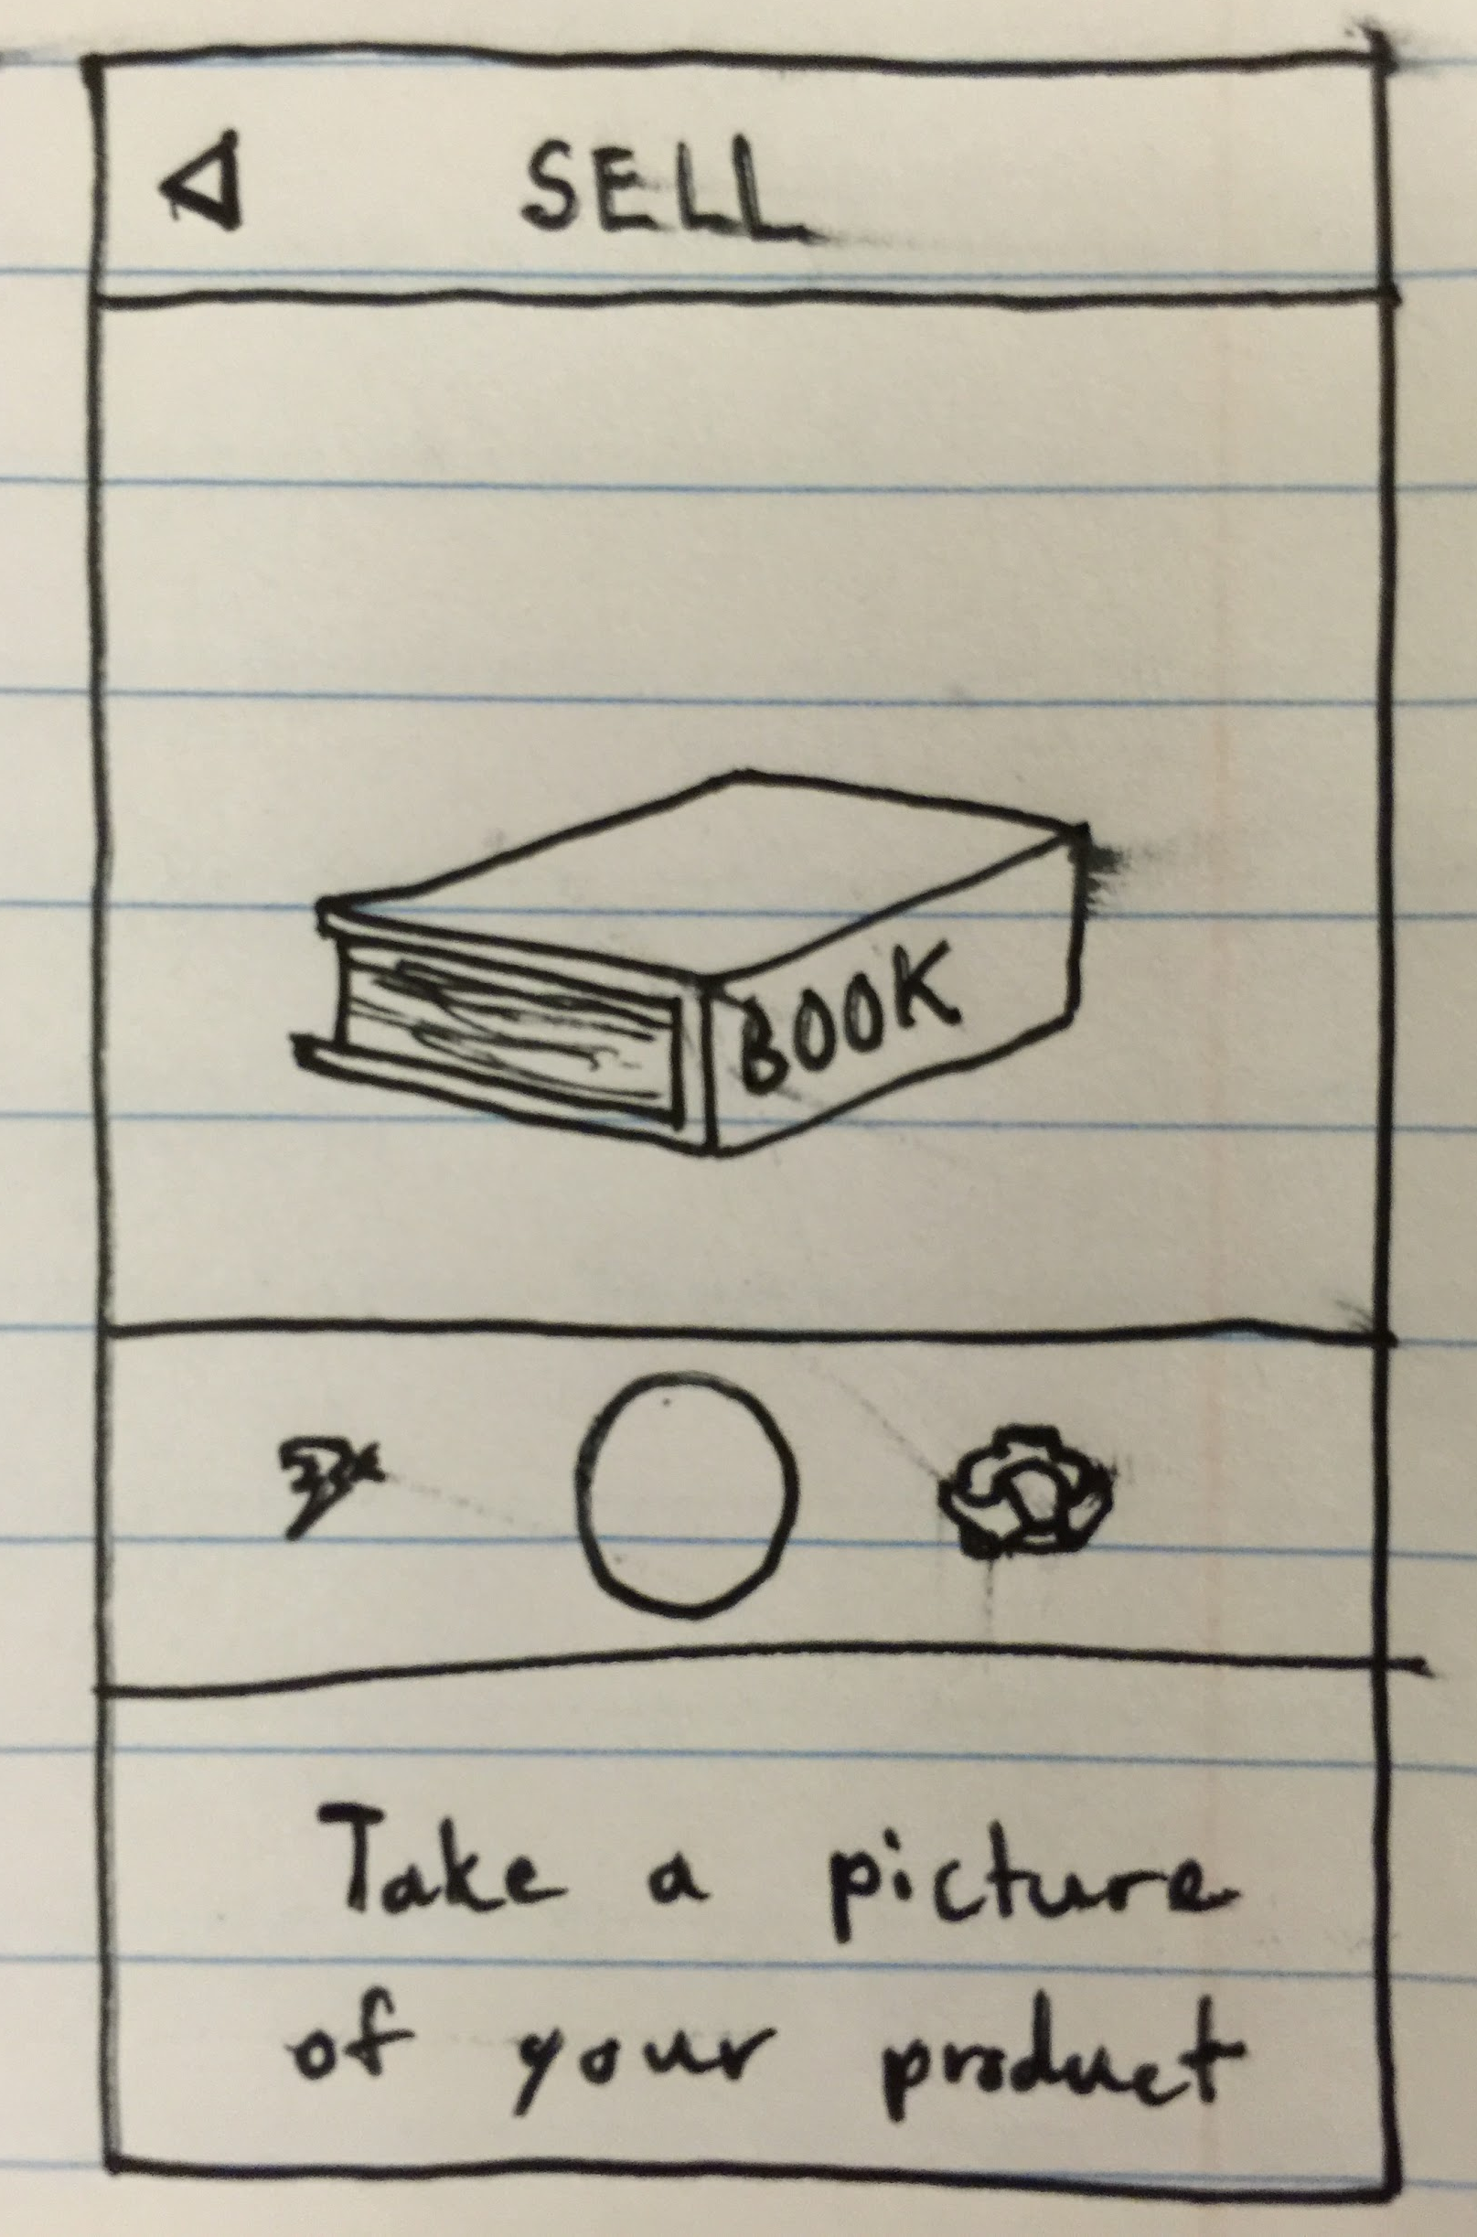
PROTOTYPE #3
HMW from Bayian’s POV:
How might we improve the user experience of obtaining purchases?

Slide 46
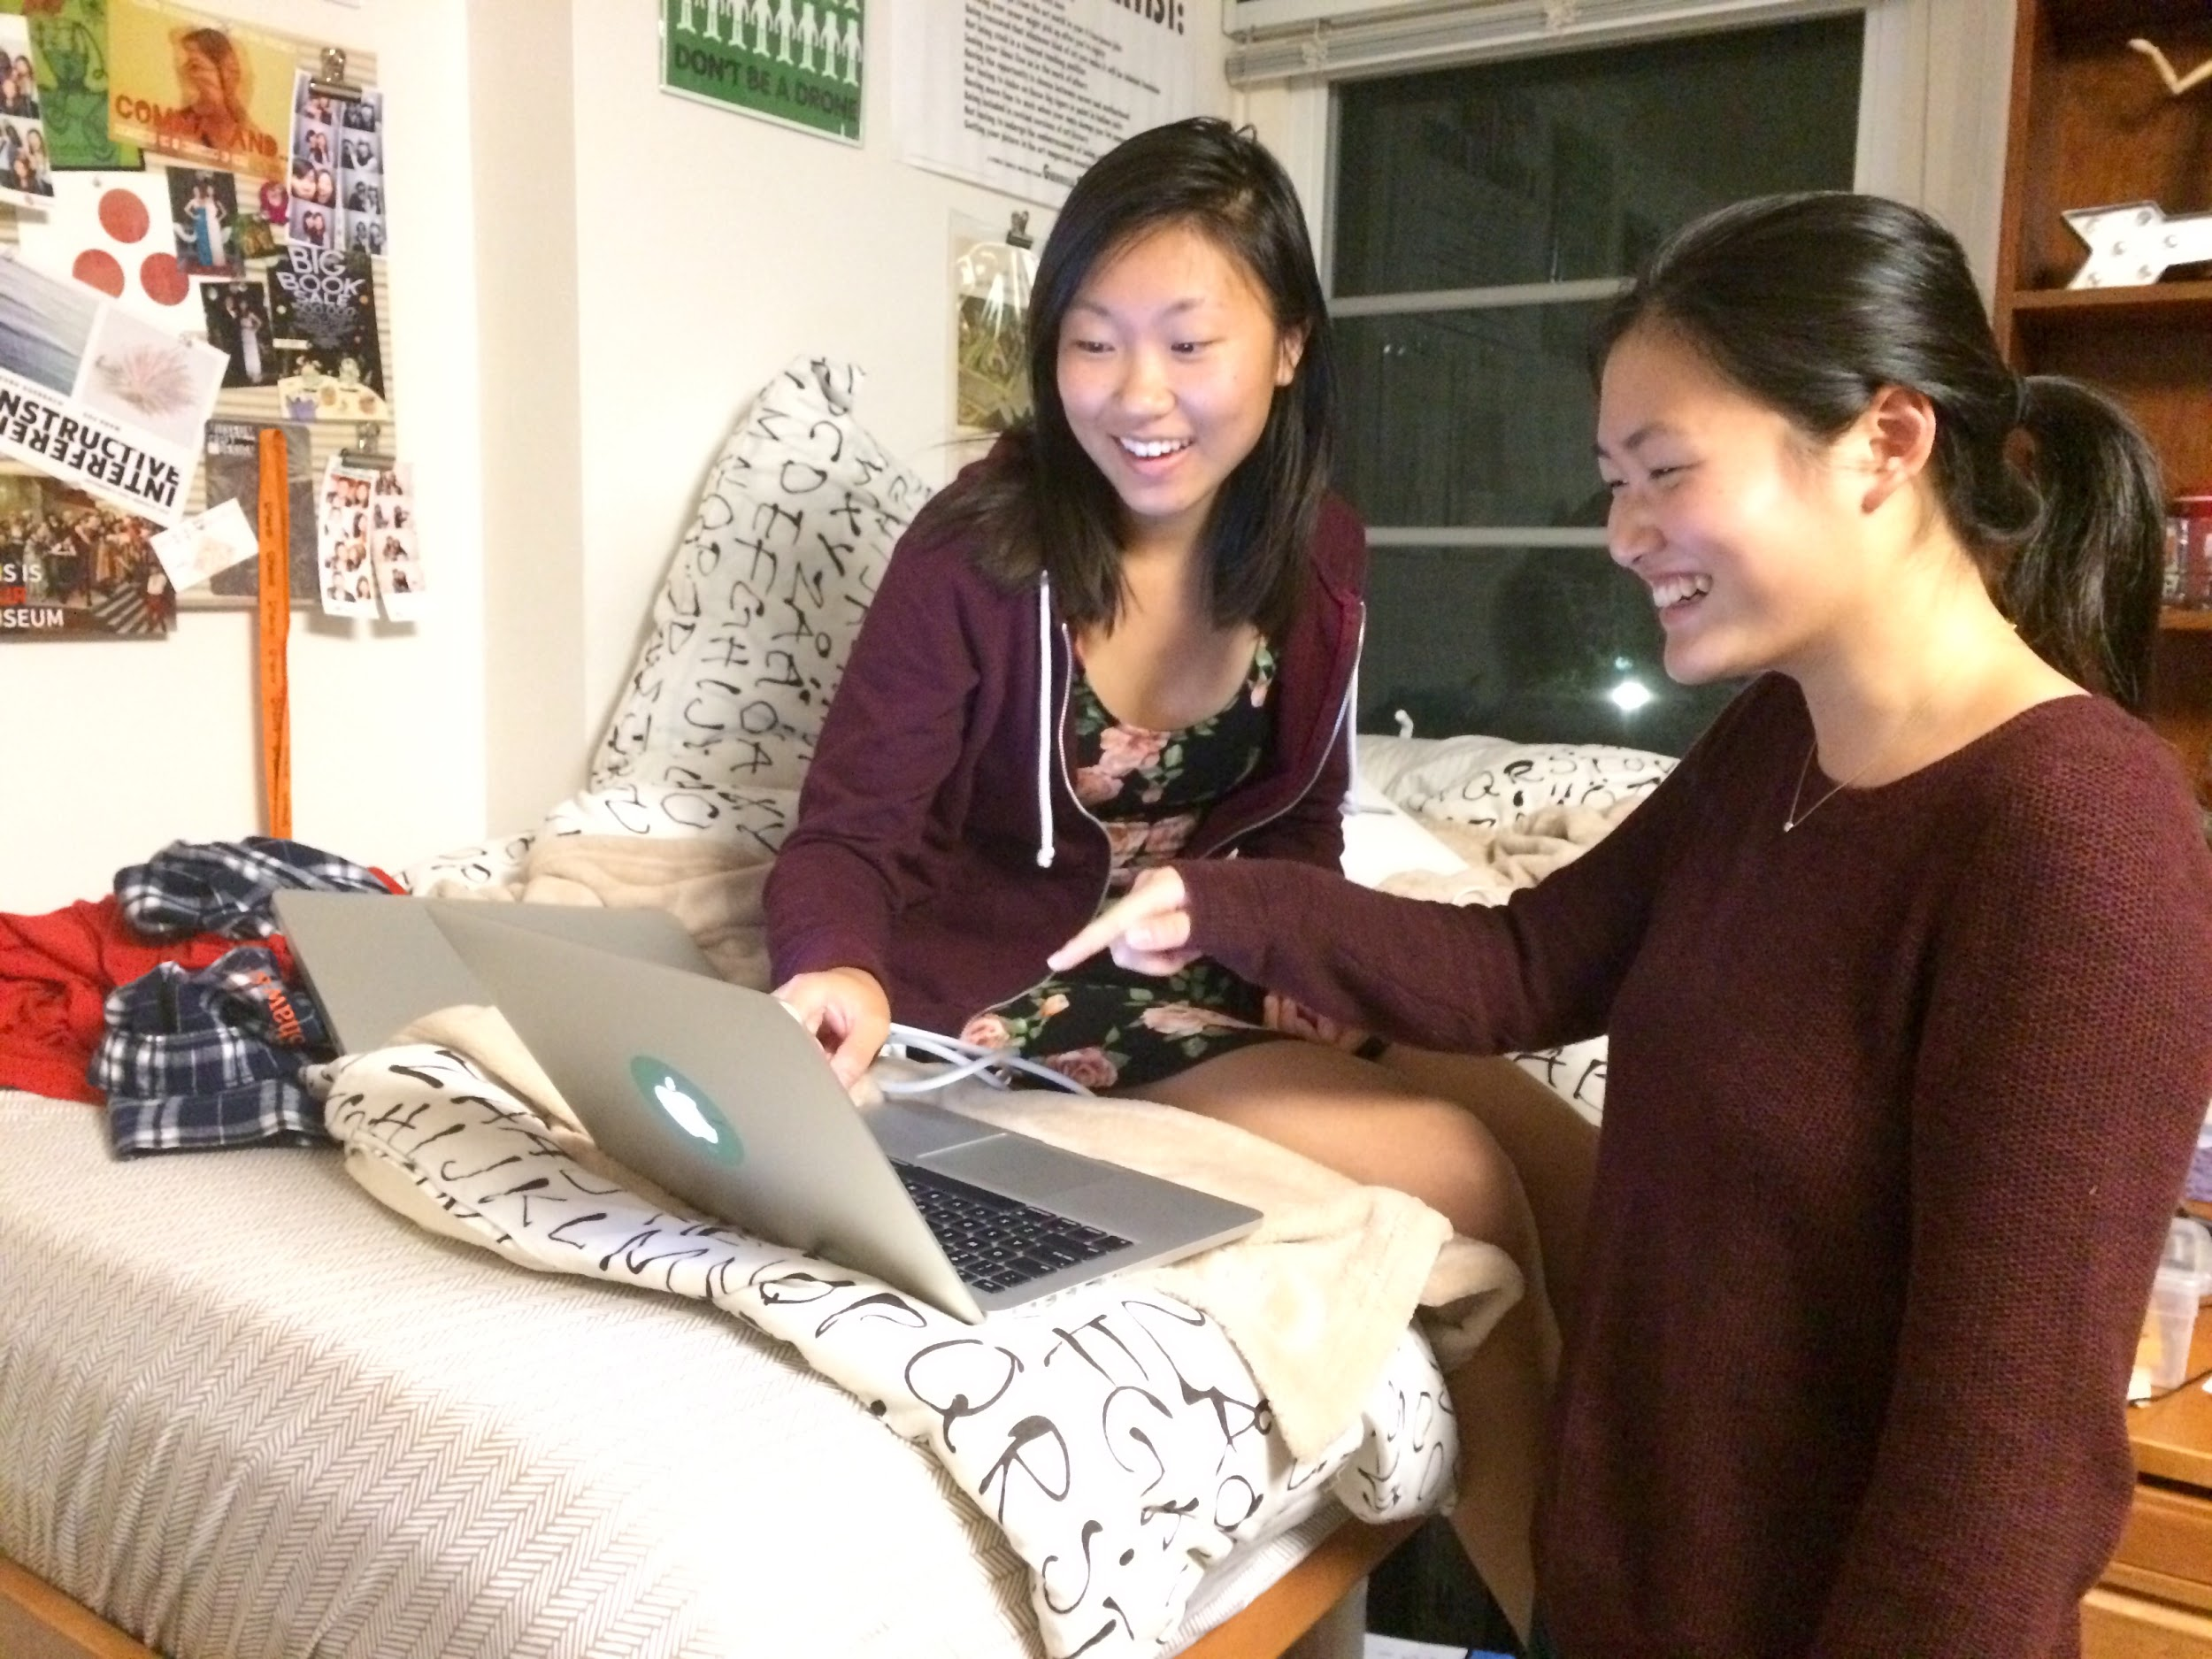
Testing with Cindy

Slide 47
PROTOTYPE #3: Yard Sale
Appropriate for solution #3: A location-based buying and selling platform where users can only see products that are within a certain proximity
Innovation: We found that our interviewees were looking for a platform where they could exchange items with people close to them – Yard Sale addresses the desire to buy and sell items quickly

Slide 48
PROTOTYPE #3
THINGS THAT WORKED
Could be a better Craigslist
Might be useful for students who want to sell on campus

Slide 49
“I guess it could be helpful, but I don’t think I would use it after college”
-Cindy

Slide 50
PROTOTYPE #3
THINGS THAT DIDN’T WORK
Maybe useful in college but not afterwards
Location matters less to seller than to buyer

Slide 51
PROTOTYPE #3
SURPRISES
Over 10 miles, especially for college students, is equivalent to 100 miles or more

Slide 52
PROTOTYPE #3
NEW LEARNINGS
While it could be useful to some, this is not a necessary service
There are too many platforms – the market is saturated

Slide 53
PROTOTYPE #3
VALIDITY
Assumed that people want to buy and pick up things locally. Found this is only convenient for sellers.
New Assumption: this could be more useful if somehow buyers and sellers could find it equally convenient

Slide 54
So… which prototype seemed to best address the needs we found?
TICKET MARKET
(we plan to do further digging!)

