Slide 1
Crowd Power
Online Marketplace
Addison, Joanne, Katherine, SunMi

Slide 2
ADDISON
JOANNE
KATHERINE
SUNMI

Slide 3
METHODOLOGY

Slide 4



Methodology: Who we talked to
Daniel, startup employee
Matt, intern at enterprise corporation
Lorena, student at Stanford
In person
Video call
In person

Slide 5
Methodology: Why these three?
Daniel, startup employee
Made an online platform for selling clothes (Closetloop) – expert
Matt, intern at large enterprise corporation
In the target age group – non-user
Lorena, student at Stanford
In the target age group – avid user

Slide 6
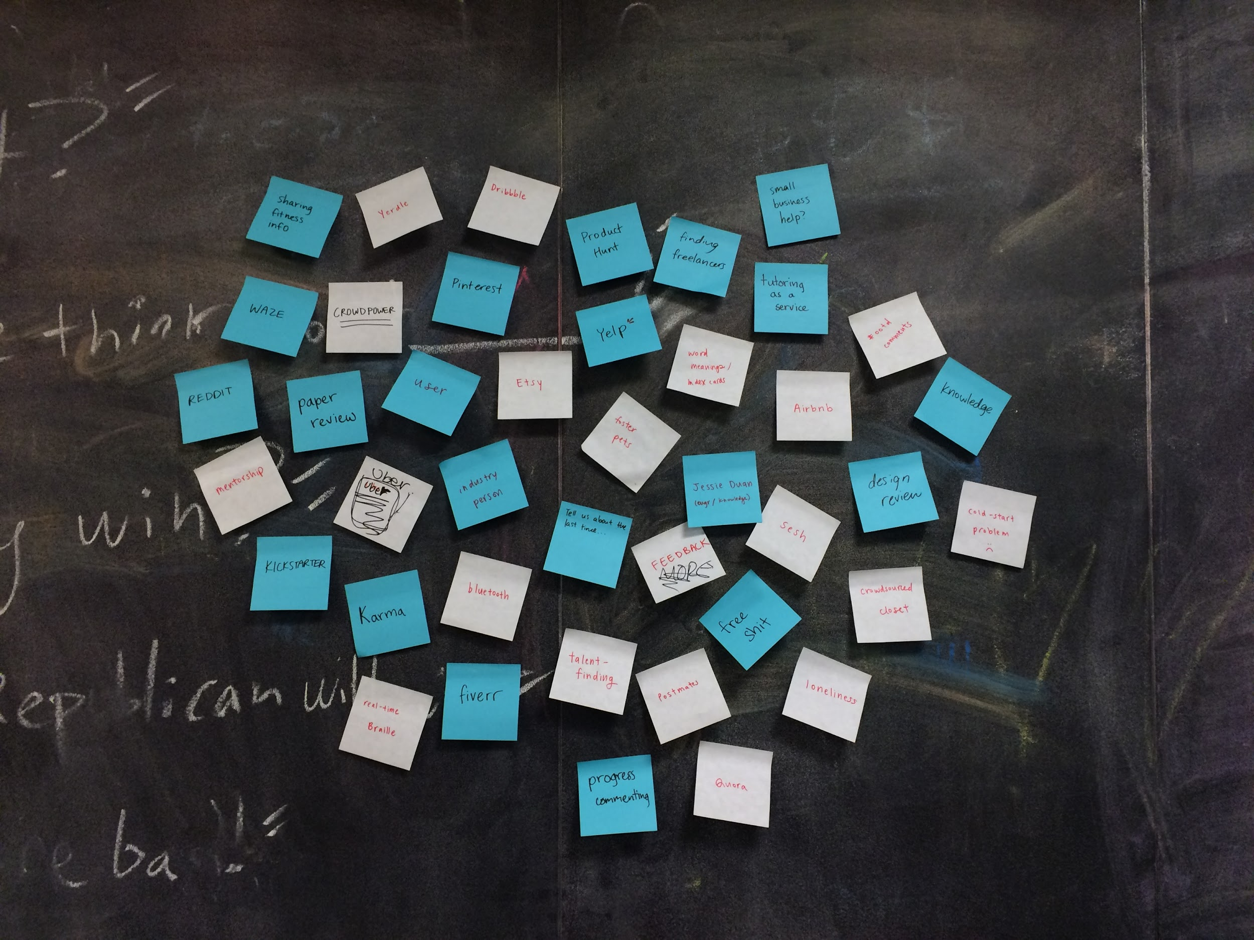
Picture of planning process

Slide 7
Methodology: What did we ask?
Are you an avid user of crowdsourced products?
What’s the last time you bought/sold something online? Explain what it was. Was it time-sensitive?
What do you typically look for in online marketplaces?
What are some online marketplaces you use?
What sites do you usually use to purchase items?

Slide 8
Methodology: What did we ask?
Ask the expert:
  What was the hardest part of building your product?
  Are there unique challenges on the engineering or security and liability sides?
  What are some problems only crowdsourcing can address?

Slide 9
If you have something to sell, what do you do?

Slide 10
INTERVIEW RESULTS

Slide 11
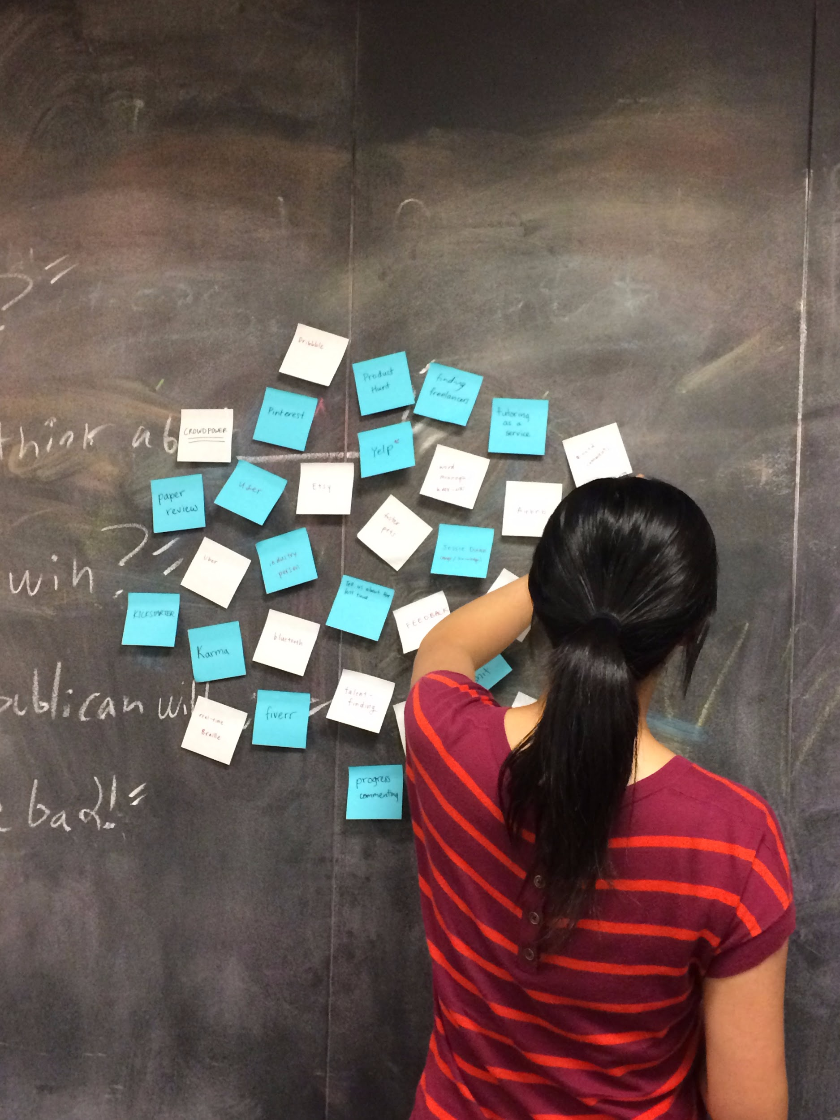
Or picture of notebook
Picture of someone

Slide 12
“I always look for mutual friends if I’m buying online from someone”
-Matt

Slide 13
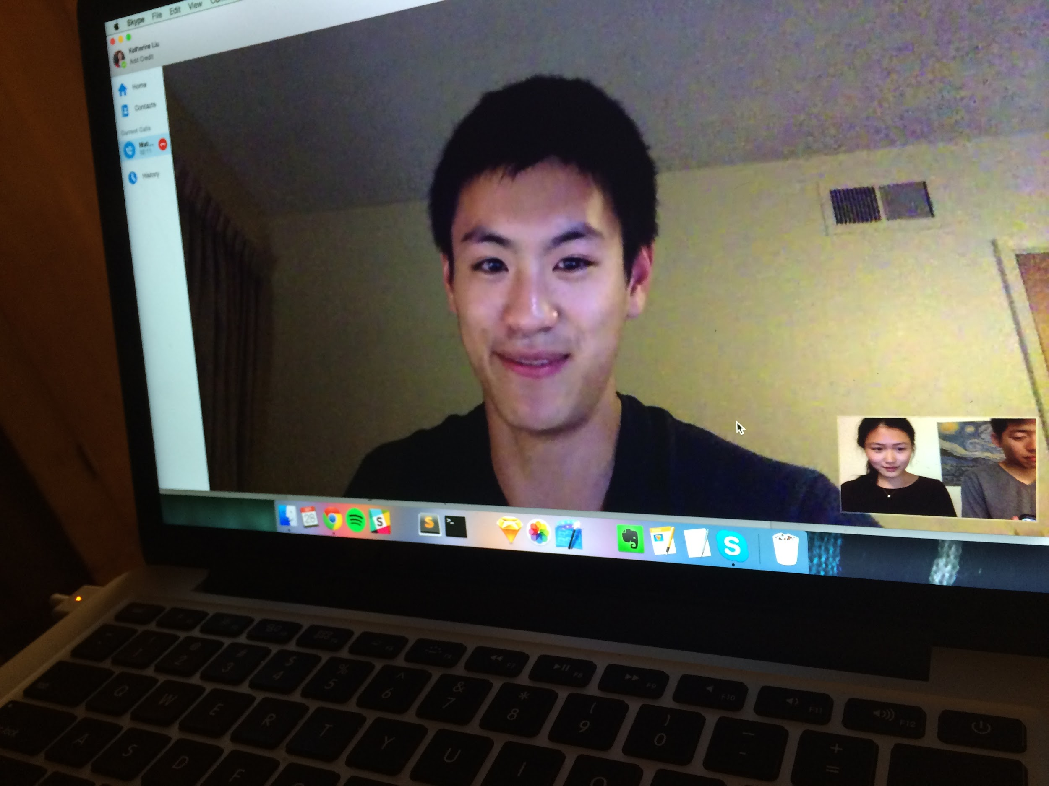
Matt

Slide 14
The topic of trusting friends’ recommendations came up again and again

Slide 15
“I don’t like ULoop because it’s ugly”
-Lorena

Slide 16
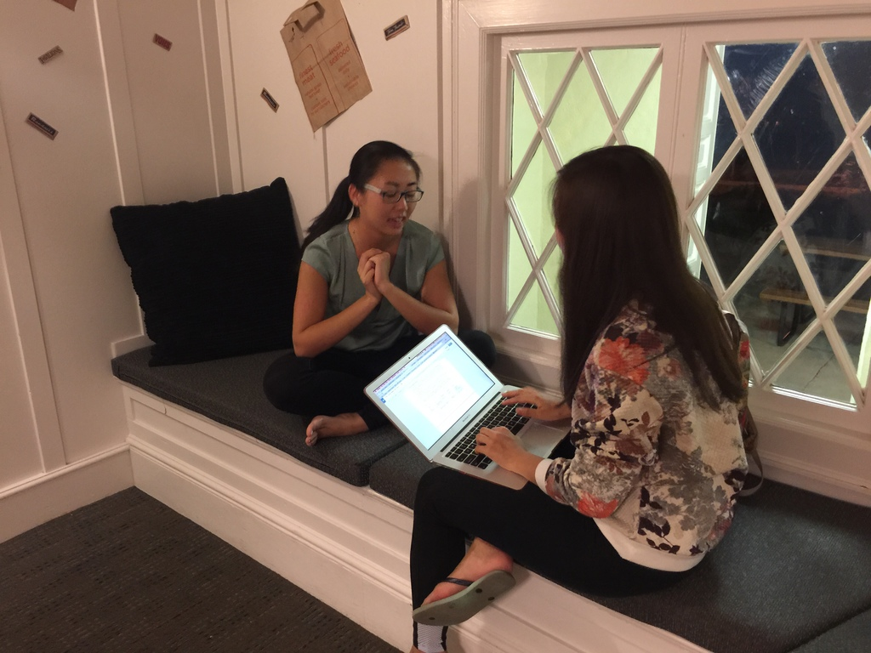
Lorena

Slide 17
Visual appearance of interface seems to matter to users – for example, Craigslist vs. Etsy

Slide 18
“Facebook is a really familiar platform, so it’s just more convenient”
-Daniel

Slide 19
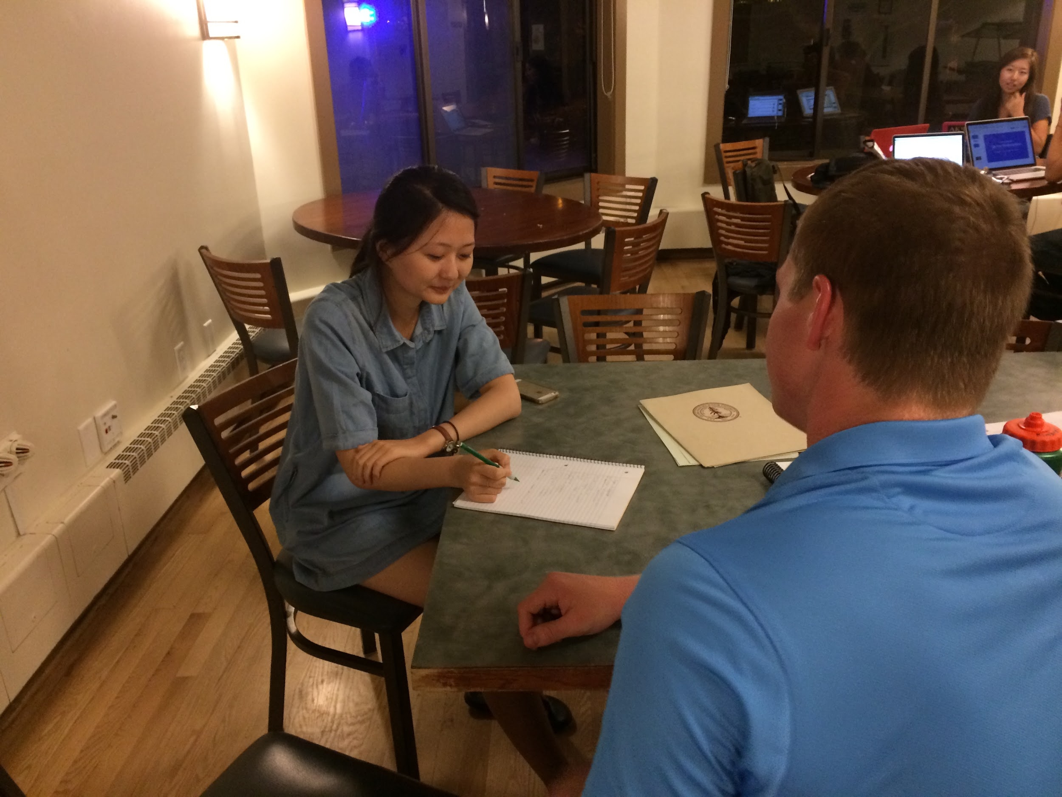
Daniel

Slide 20
Multiple interviewees mentioned using social networks to buy items online

Slide 21
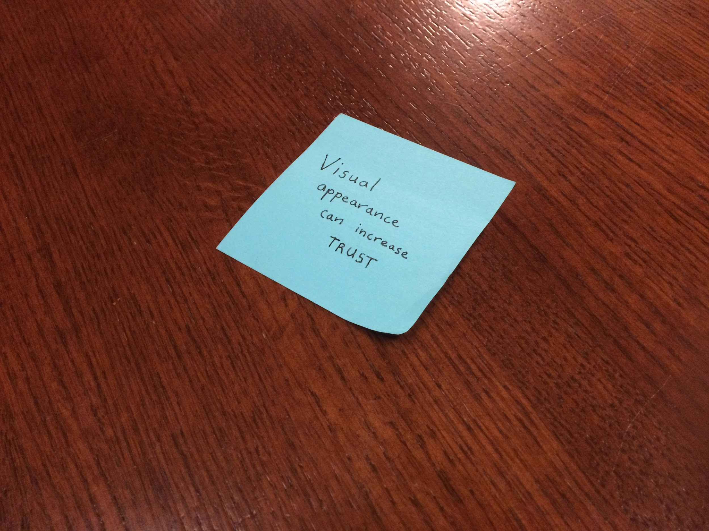
Picture of post-it with a surprise???

Slide 22
Friends are the #1 trusted source
Visual appearance can increase trust
Social networks can facilitate online shopping

Slide 23
ANALYSIS

Slide 24
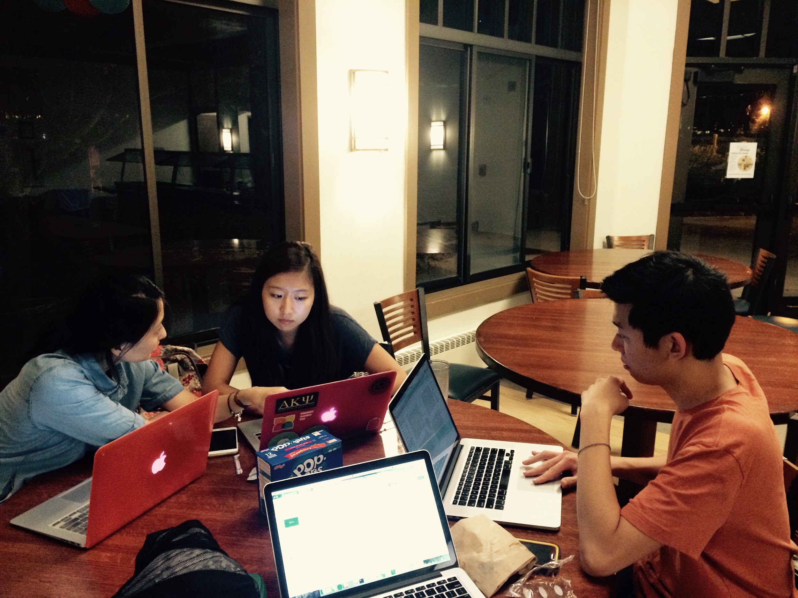

Slide 25
INFERENCES
Social networks are used extensively as marketplaces
People want to be safe when buying or selling online
The visual appearance of a site influences the amount of trust a user has.

Slide 26
QUESTIONS
Is there an effective way to integrate friends into an online marketplace?
Are social media transactions the best way to buy and sell among friends?
What kind of visual design helps users start to trust a product?

Slide 27
CONCLUSIONS
People are looking for a secure way to buy and sell.
A new online marketplace needs to establish itself as trustworthy.
A more professional UI will help users feel safer.

Slide 28

“It’s really hard to do anything on a website when its userbase is too small.”
“I always look for mutual friends if I’m buying online from another person.”
“It’s a hassle to go through social media to buy things.”
“Picture focused platforms seem to be really effective. Like Instagram.”
“Quality control is so essential for crowdsourced products”
Why are they asking me these questions?
How do I get my purchase?
Is this site/marketplace reliable?
How do I keep a safe, spam-free market?
What’s the highest price I can set without losing my potential buyer?
I need to sell this off really soon!
Resorting to the web first
Searching for the lowest price
Urgency leads to compromise when it comes to selling items
Trusting images more than text
Relying on their pre-existing social network
Security is really important - needing to know exactly who they are meeting online
Annoyance due to difficulty in searching for items on Facebook
Distrust in certain items in non-mainstream online marketplace
Appreciation for niche markets when talking about Etsy
Worry about being taken advantage of or information being stolen
Delight coming with getting an item that the user really wanted, especially when there is a premium on it

Slide 29
“I mainly look for textbooks and housing online.”
“I don’t like ULoop because it’s ugly.”
“I find it hard to sell things that have more personal significance on the traditional online marketplaces”
“There are concert tickets that people may not want to buy online”
“Price inflation is a problem”
Why are these people charging so much for this product? Not worth it.
Has this been sold already?
Wow this stuff is actually really crappy.
It’s so hard to write reviews through my mobile app!
Even when an information isn’t on Facebook, people still post a link to it on Facebook to advertise it
On Facebook, transaction takes place through statuses and university “buy & sell” groups
Judging the sketchiness of a website by its user interface
Relating more to people in their age group
Frustration when user makes a mistake in ordering items (“accidentally”, “want geolocate functionality”)
More trust in people in their age group when talking about ULoop (“both buyers and sellers are students!”, excited tone)
Indifference toward getting the best deal or getting unique items
Excitement in realizing that there is high demand for a product one listed
Confused because there are so many options

Slide 30
NEED
A balance of usability and safety

Slide 31
NEED
Ability to purchase/sell things quickly

Slide 32
INSIGHT
People using social networks to buy and sell face frustration and annoyance trying to find the right items – ”It’s a hassle.”

Slide 33


Slide 34
INSIGHT
Users of online marketplaces trust images more than text – “Picture focused platforms seem to be really effective.”

Slide 35
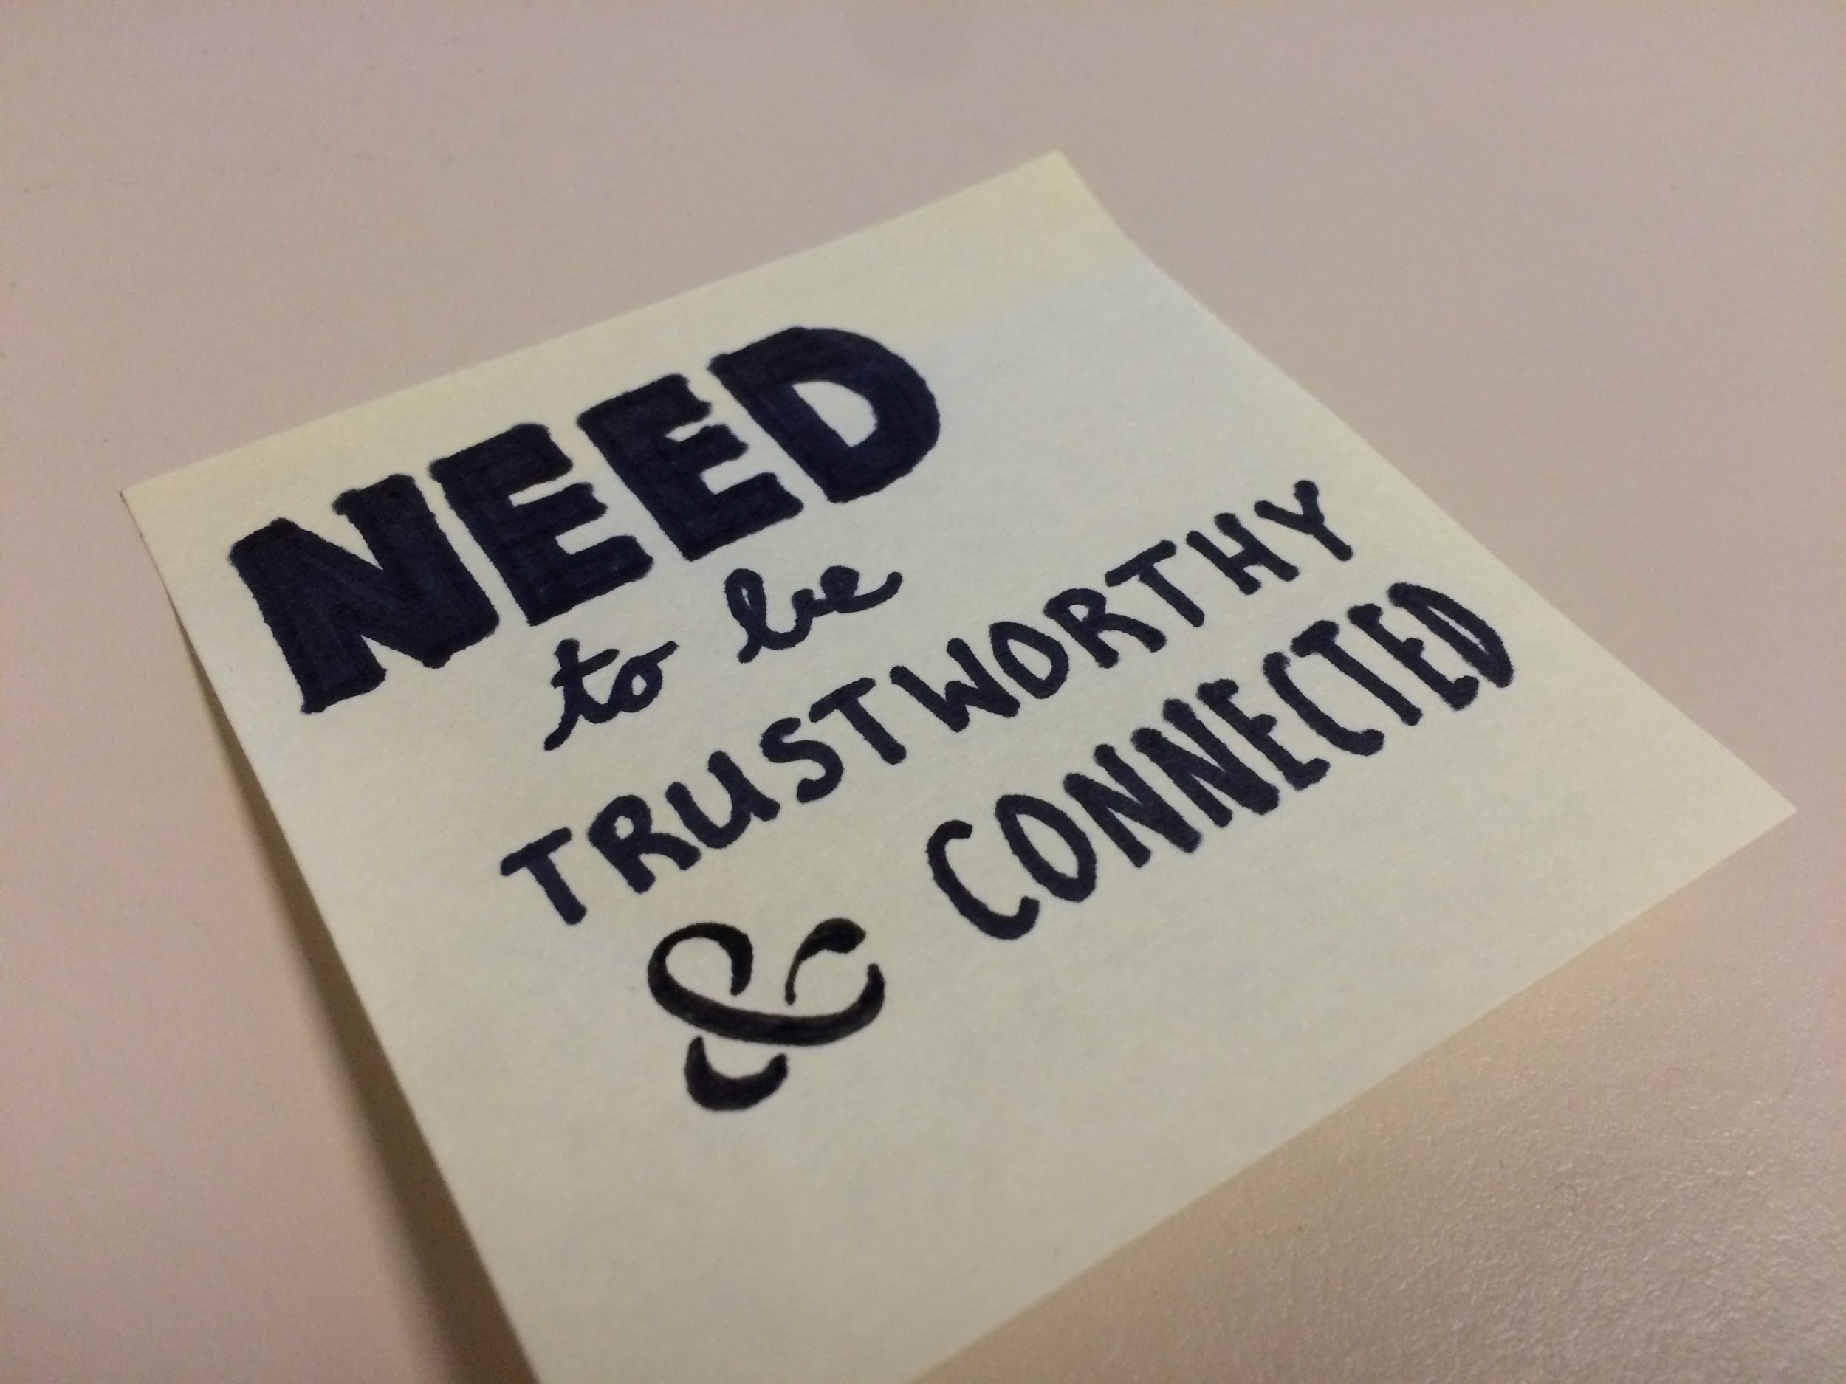

Slide 36

CONTRADICTION?

Slide 37
CONTRADICTION?
Social media is a popular way to buy and sell items in a network, but multiple interviewees complained that this was a “hassle” and that they couldn’t find the items they wanted.

Slide 38
SUMMARY
A professional visual identity that incorporates images along with text increases the feelings of trust and security
Having mutual friends as common users increases trustworthiness
Familiarity can be more powerful than features or even ease of use
Notes:
Telling stories -
Text heavy slides

Slide 39
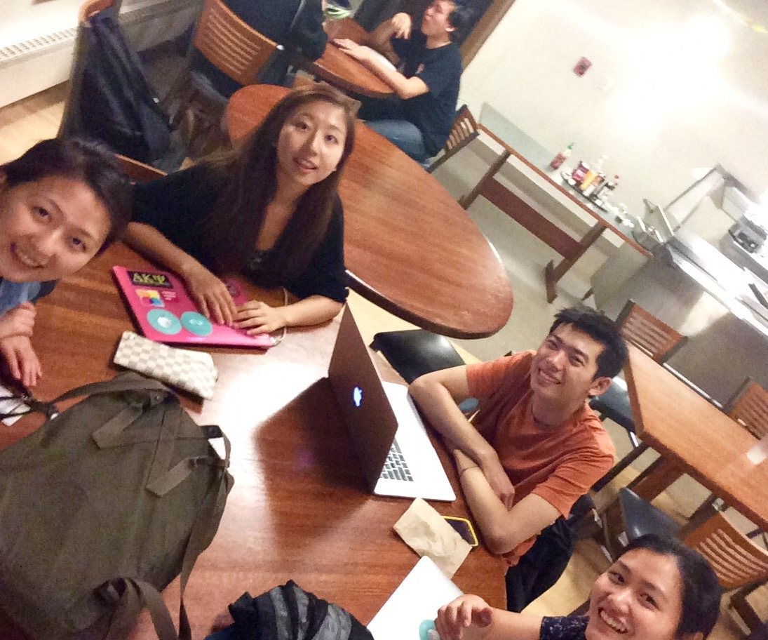
Taken with a selfie stick!

