Slide 1
MEDIUM-FI PROTOTYPING
Addison, Joanne, Katherine, SunMi

Slide 2
but first… an important announcement

Slide 3
Picks
Spiel

Slide 4
PROBLEM-SOLUTION OVERVIEW
People are searching for a better way to learn about the lifestyles of the people they like, admire, and respect.
Spiel helps users tell stories about their favorite discoveries. It provides a simpler, more elegant, and more personal platform that allows people to discover new interests through people-centric product recommendations and be inspired by the lifestyles of people they admire.

Slide 5
MISSION • VALUE PROPOSITION
Connect to people by sharing stories through your favorite discoveries

Slide 6
Tasks
Learn about the lifestyles of people you admire.*
MEDIUM
Inspire others with your new finds and stories.*
COMPLEX
Share interesting spiels with your other social networks.
SIMPLE
*changed from low-fi

Slide 7
MAJOR DESIGN CHANGES

Slide 8
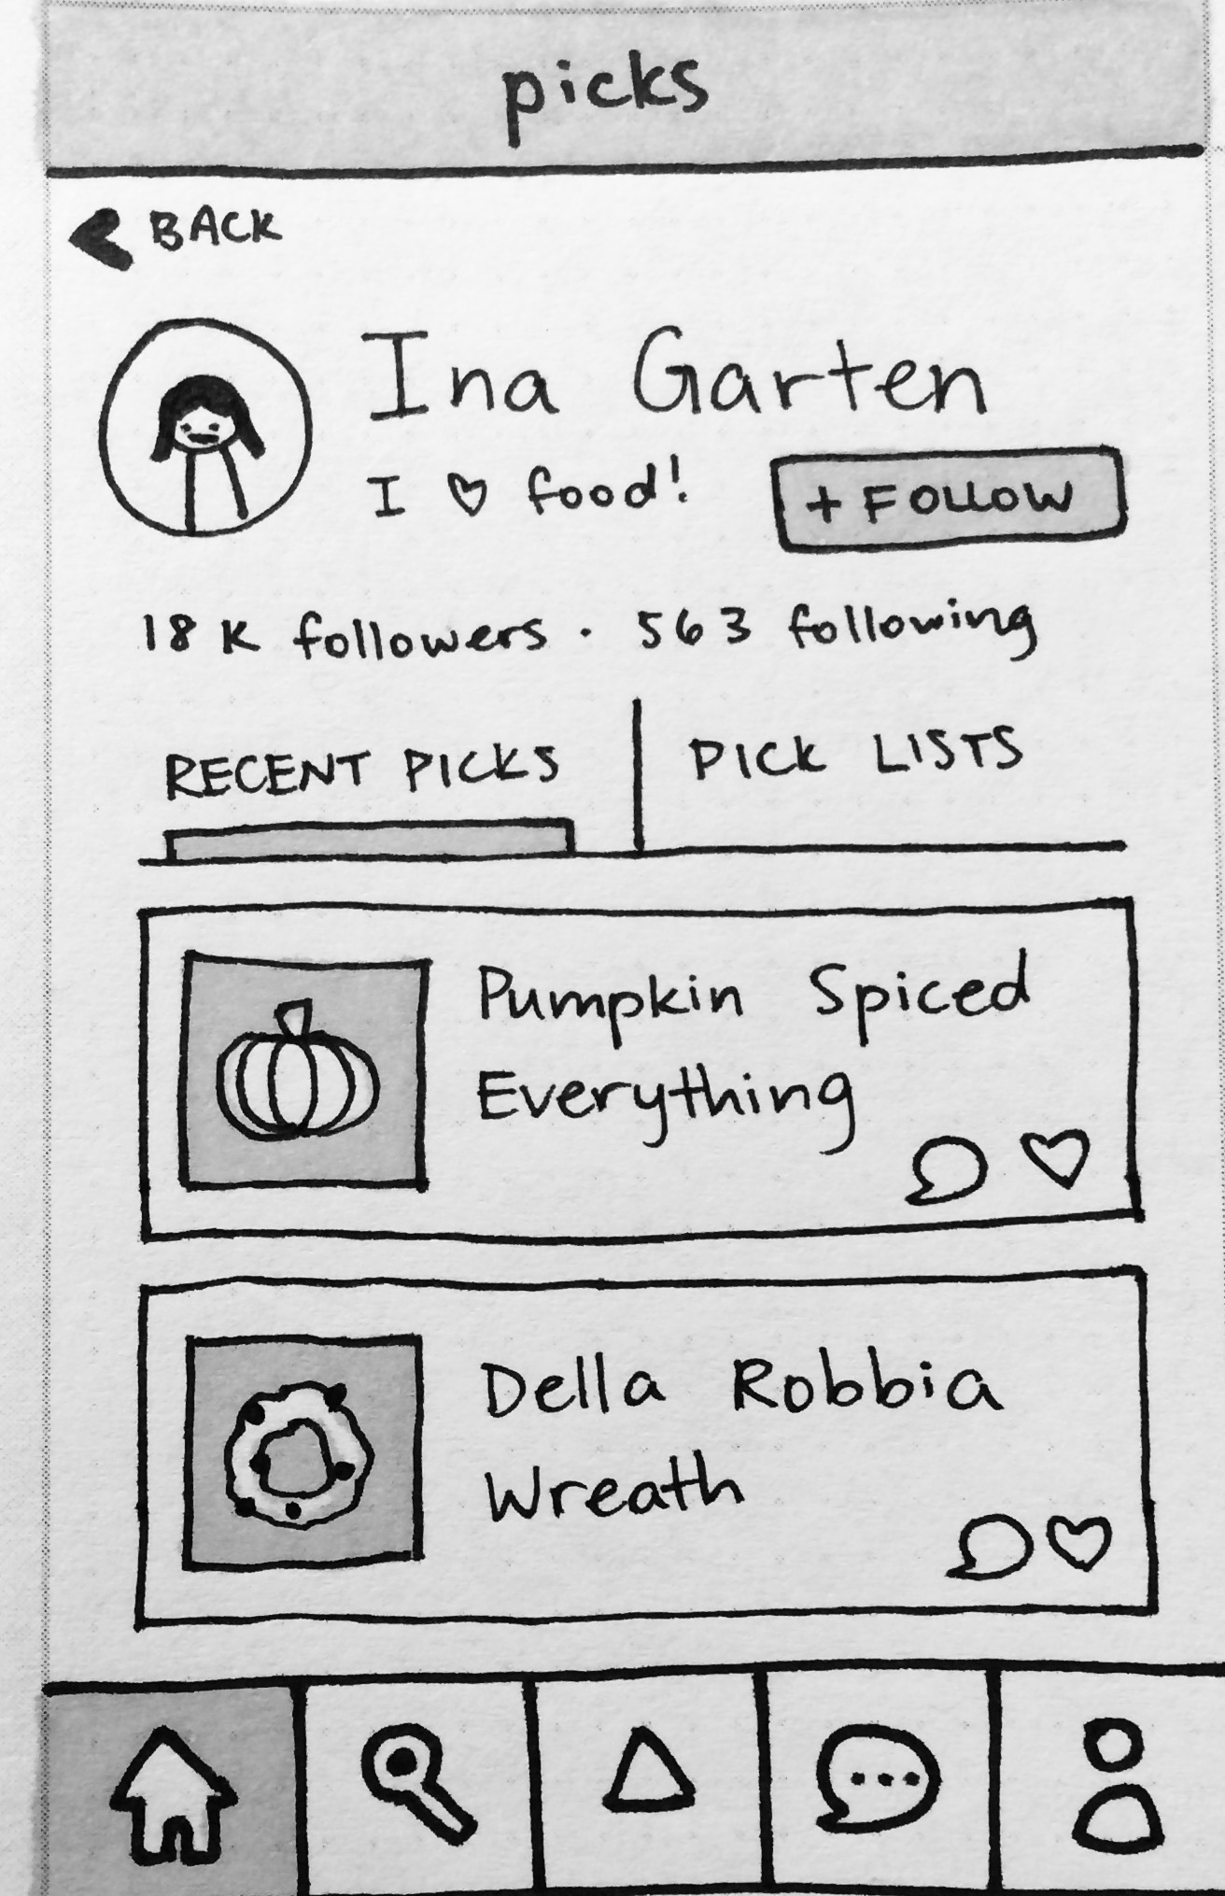
When viewing other people’s profiles...
How do we reduce confusion about “pick lists” and offer a way to scan by monthly basis (feature suggested by our tests)?
Just “recent picks” doesn’t help discover more about a profile in a new or useful way – it’s just an information dump
Original sketch of profile screen

Slide 9
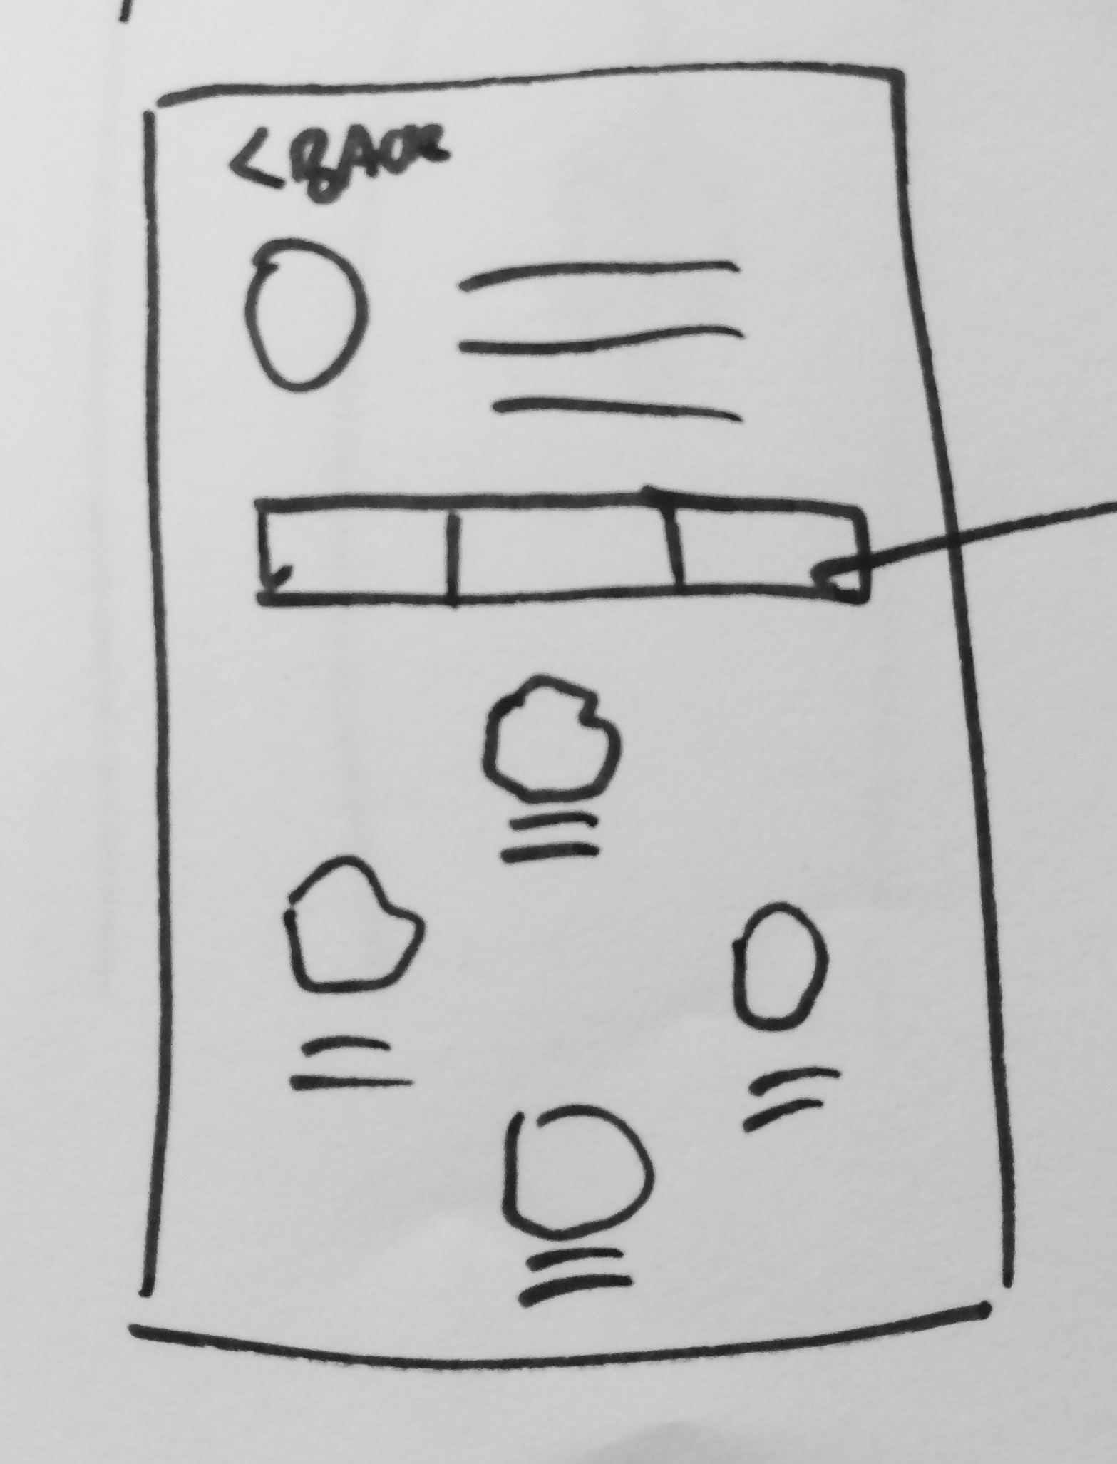
When viewing other people’s profiles...
Discover by month
Existing print and video models
Categories are useful

Slide 10
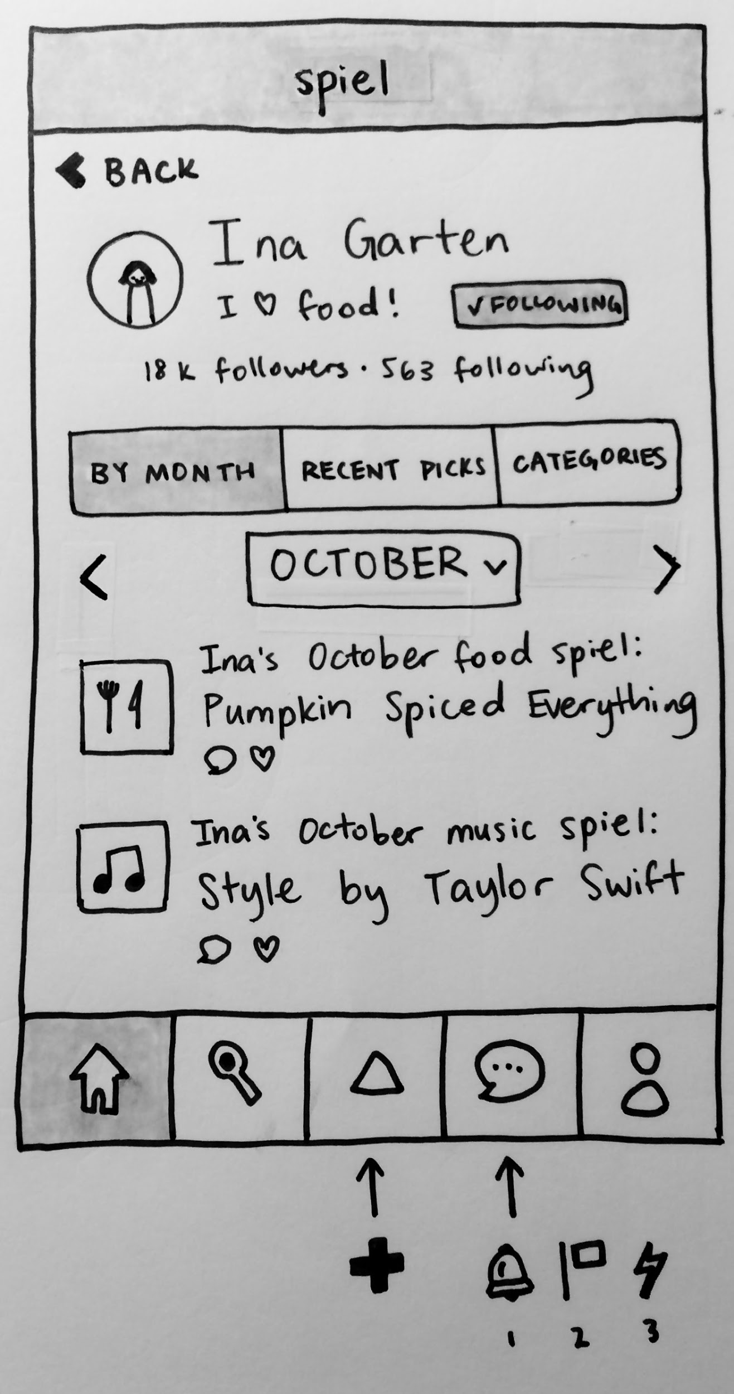
When viewing other people’s profiles...

Slide 11
When viewing other people’s profiles...

Slide 12
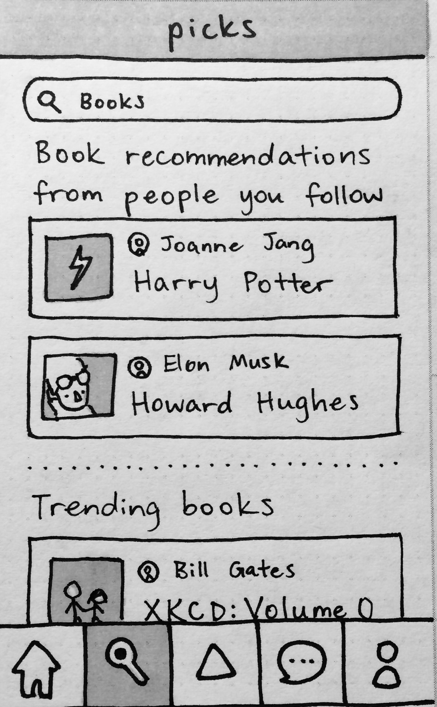
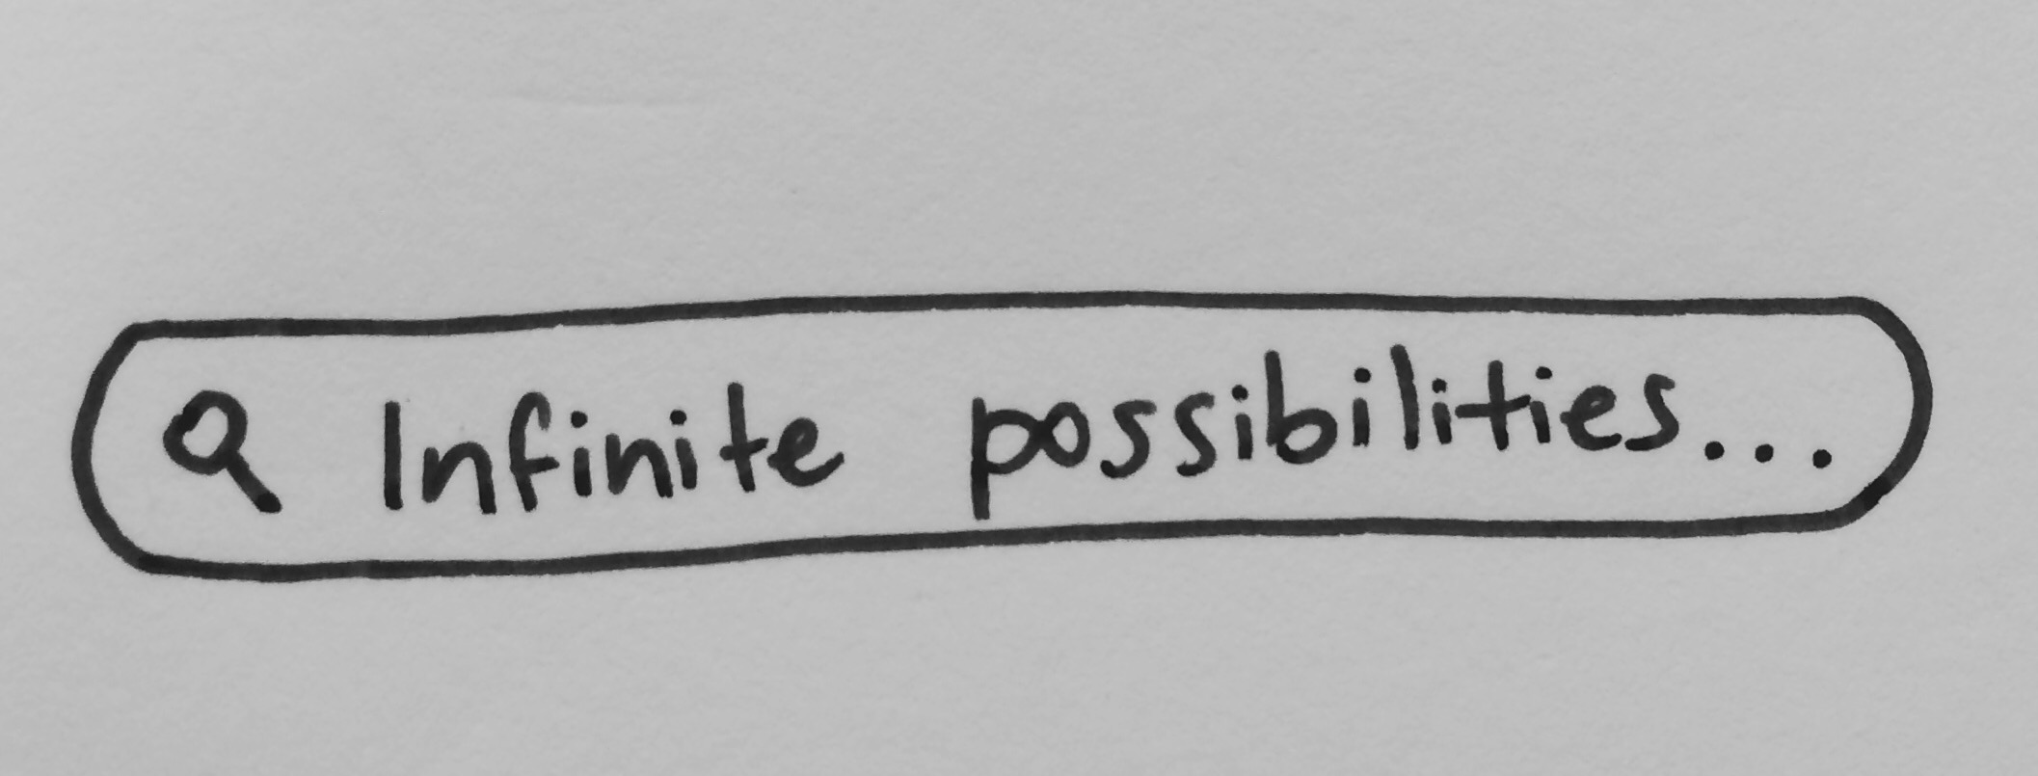
2. Can users search for anything they want?

Slide 13
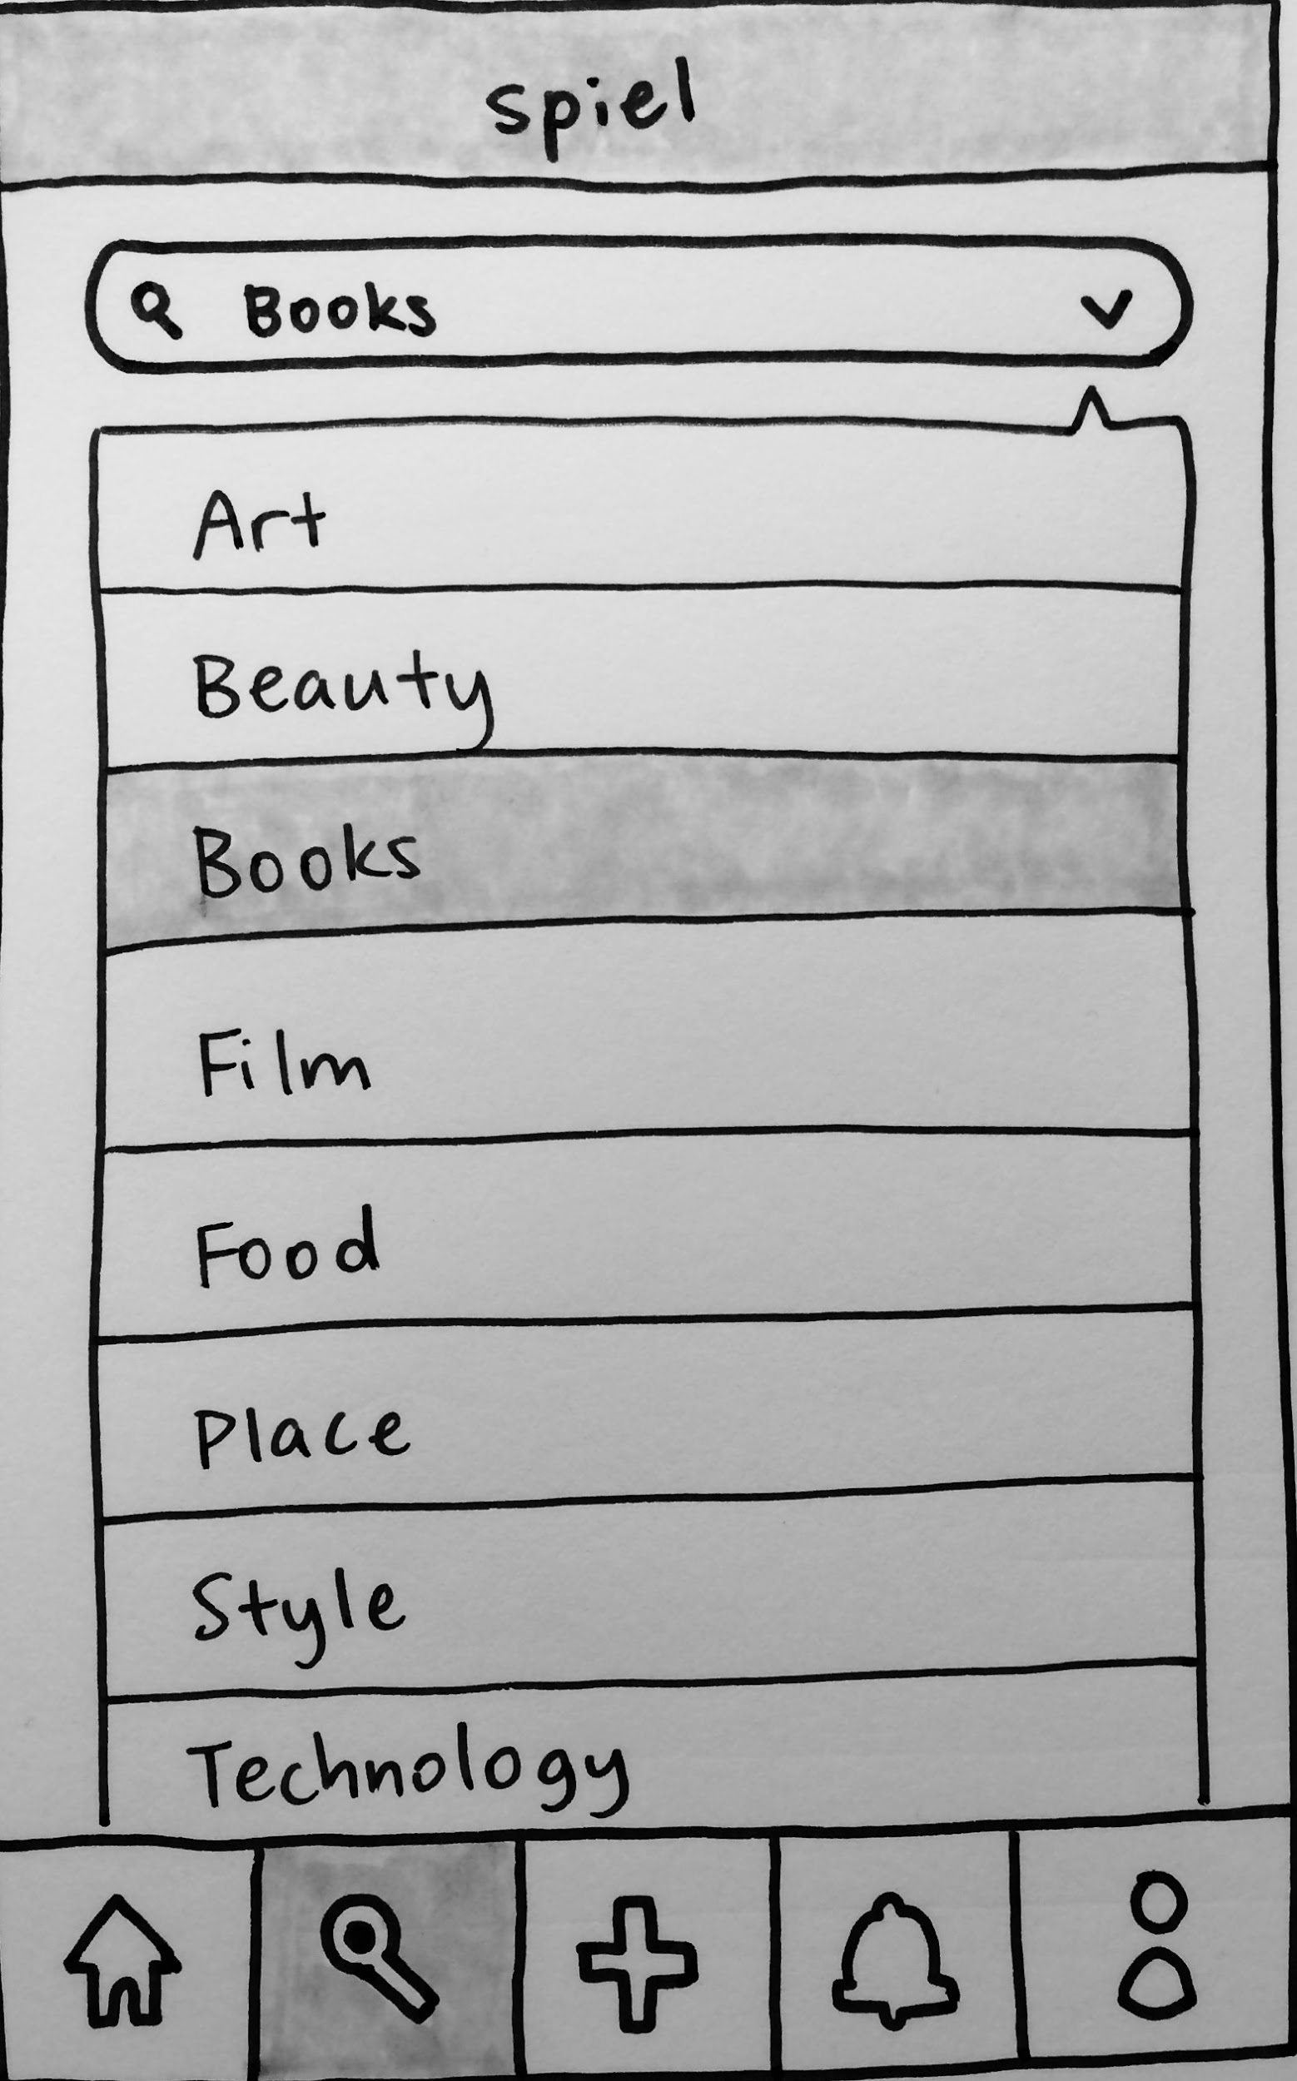
2. Can users search for anything they want?

Slide 14
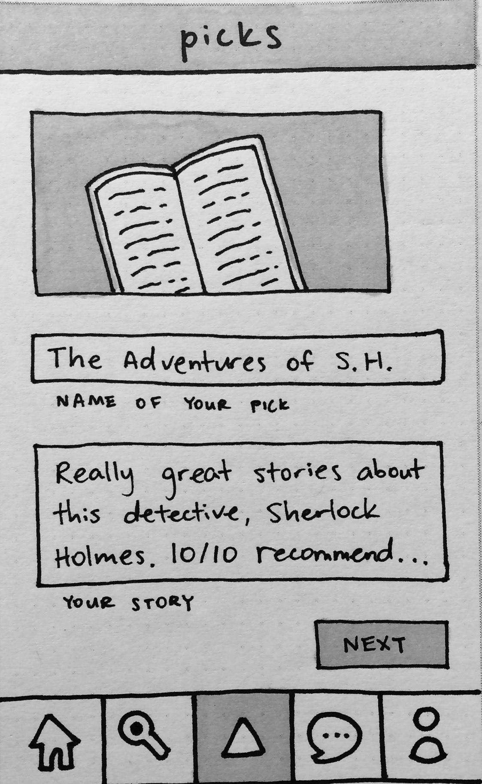
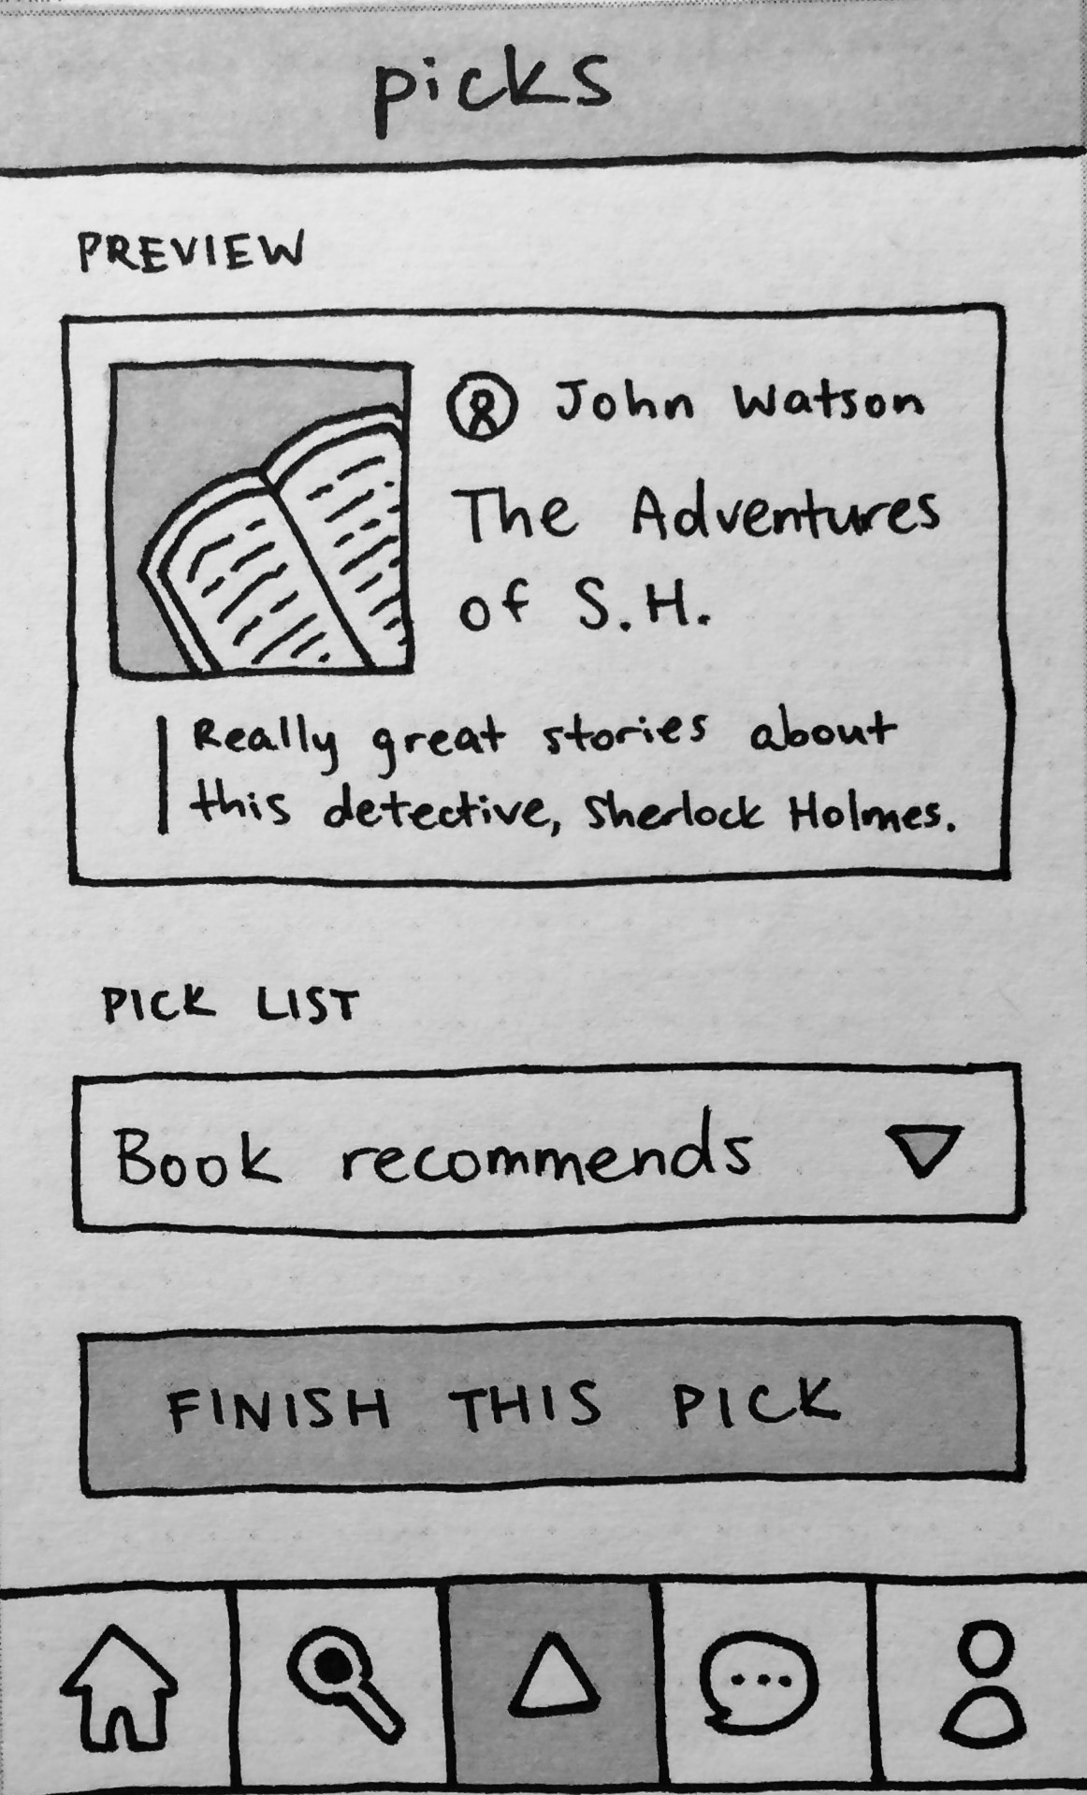
3. Does the mental model of categories change?

Slide 15
3. Does the mental model of categories change?
Move to front of posting process

Slide 16
PROTOTYPING TASK FLOWS

Slide 17
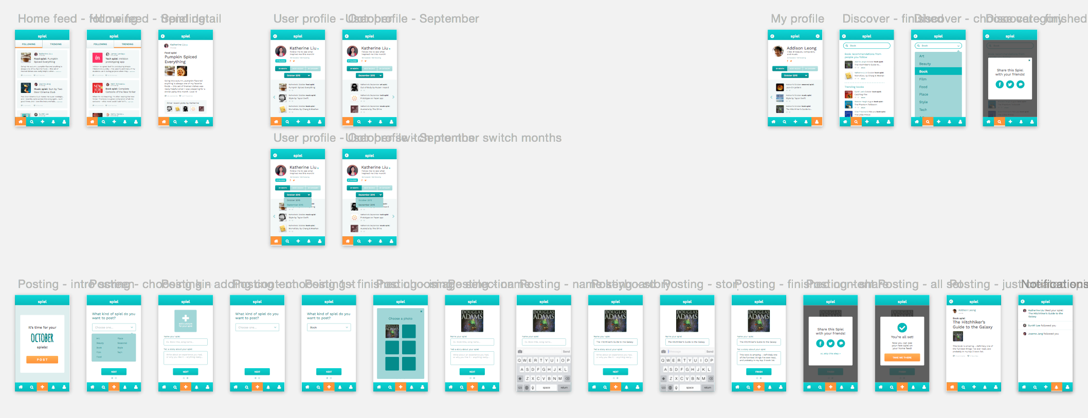
What the Sketch file looked like…

Slide 18
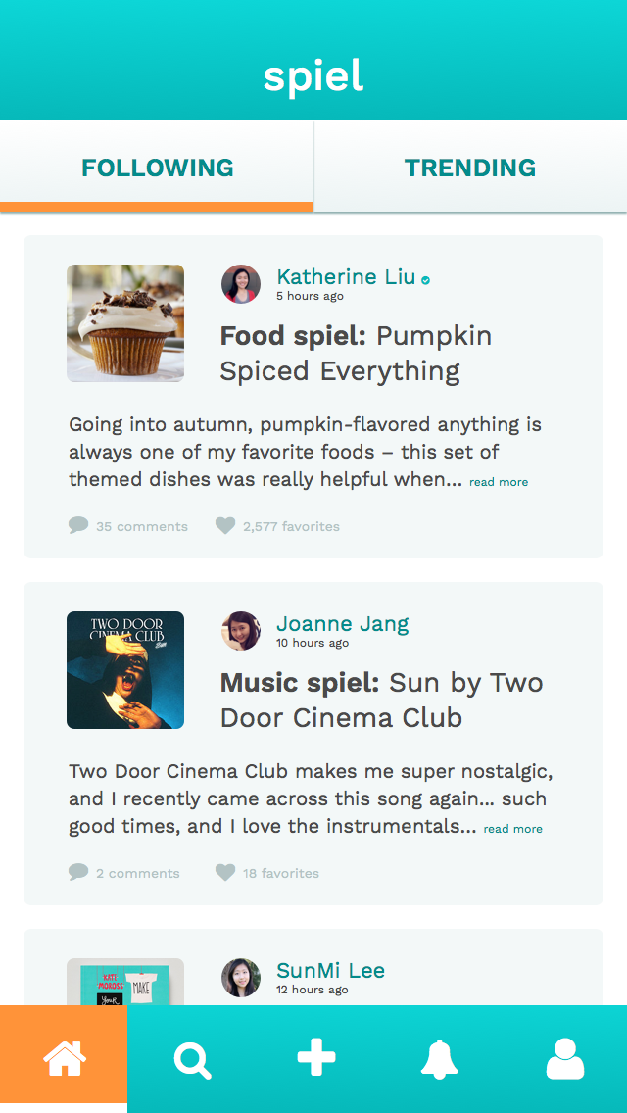
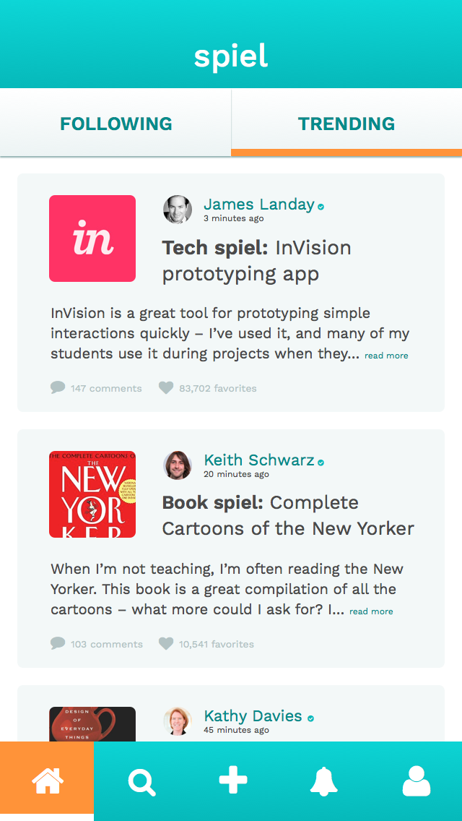
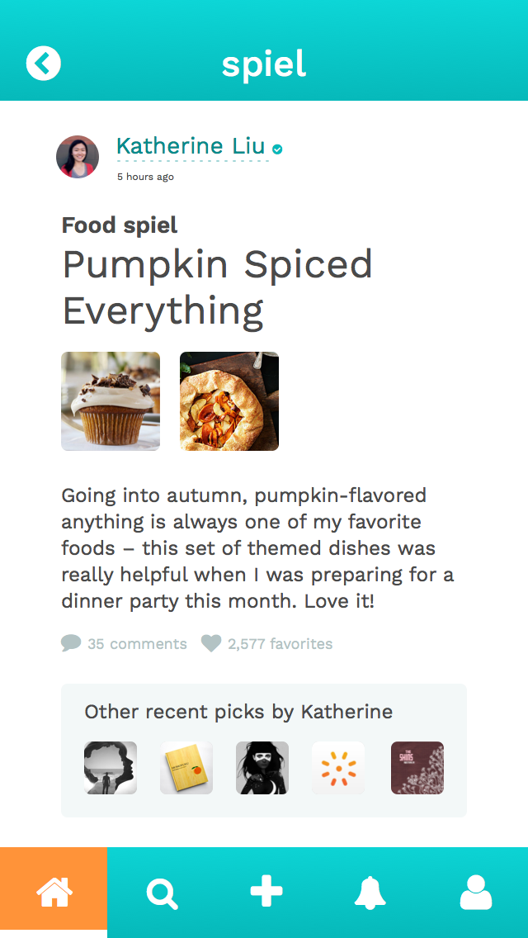
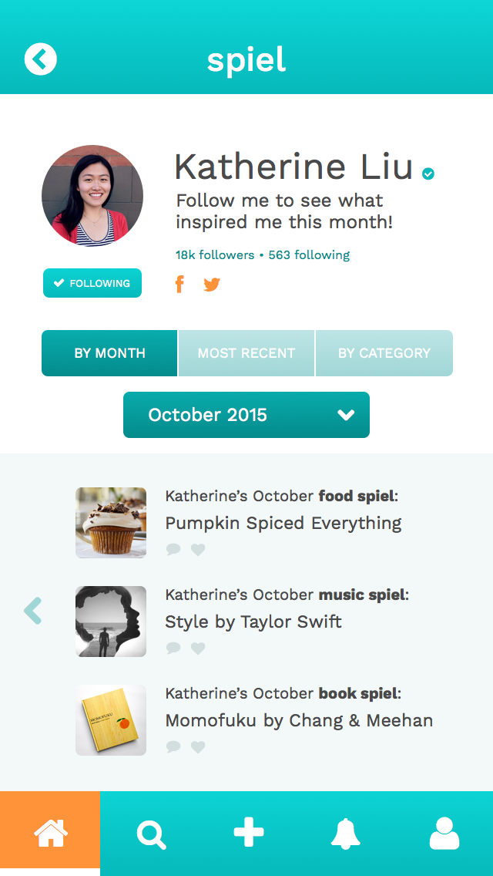
1. Learn about the lifestyles of people you admire.

Slide 19
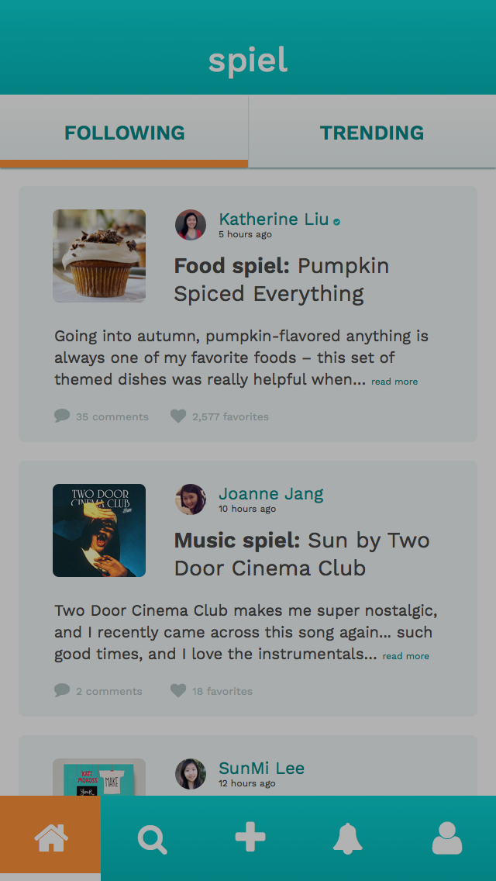
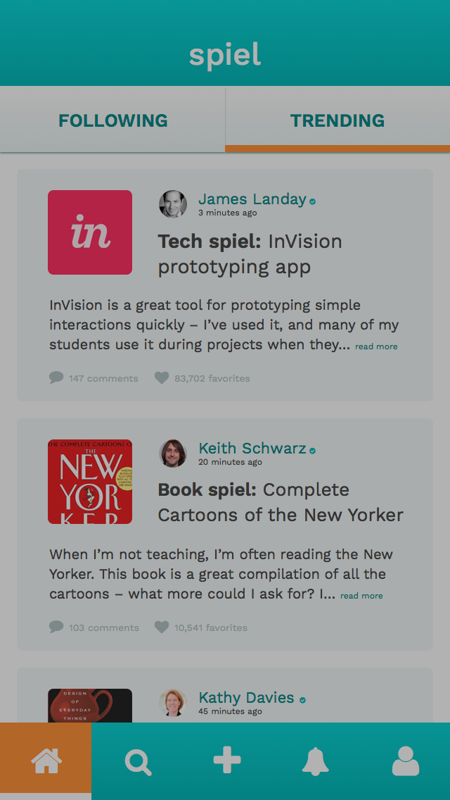
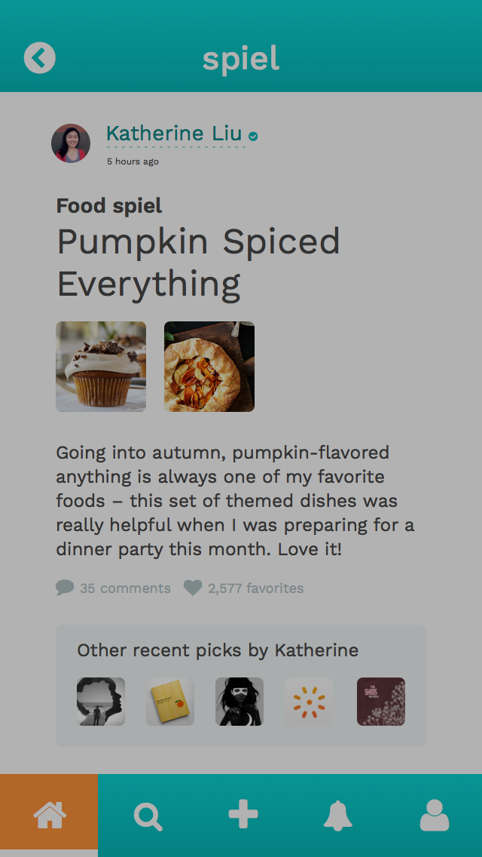
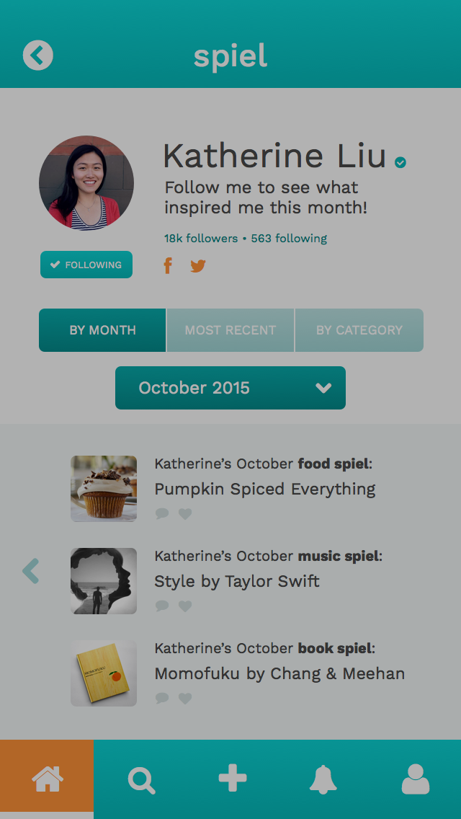
1. Learn about the lifestyles of people you admire.
Home feed - following
Home feed - trending
Spiel detail
User profile

Slide 20
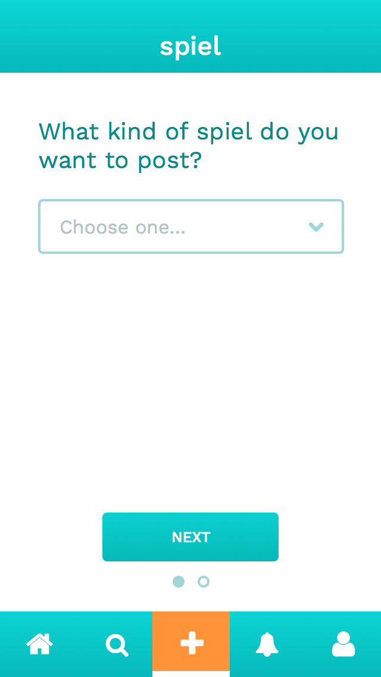
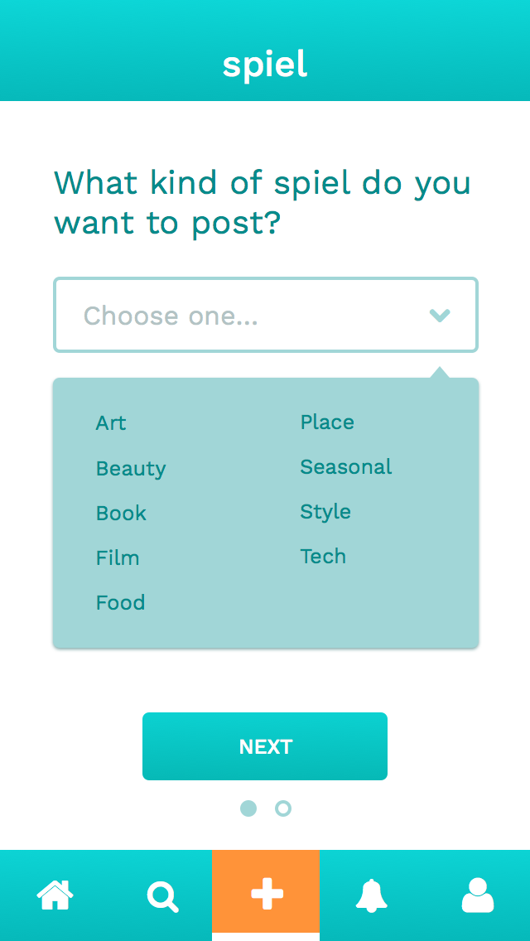
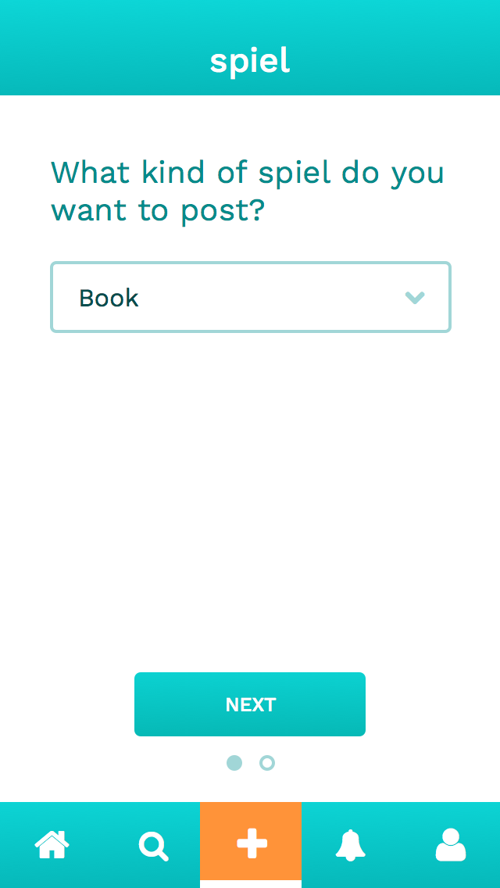
2. Inspire others with your new finds and stories.

Slide 21
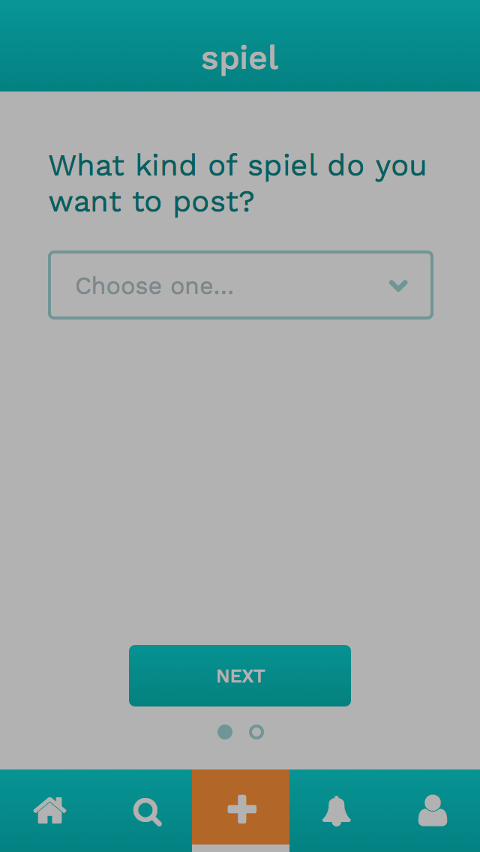
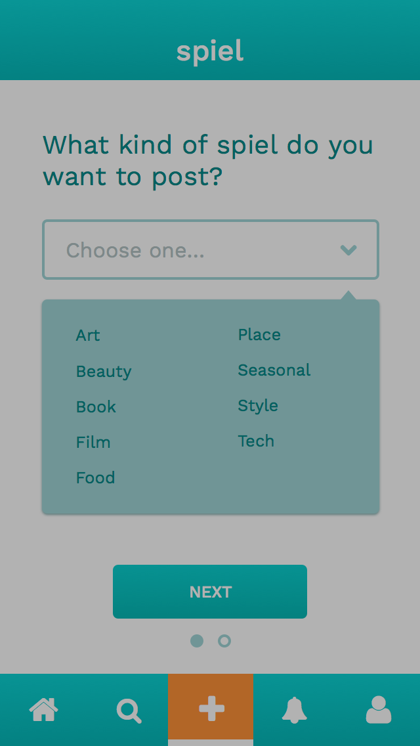
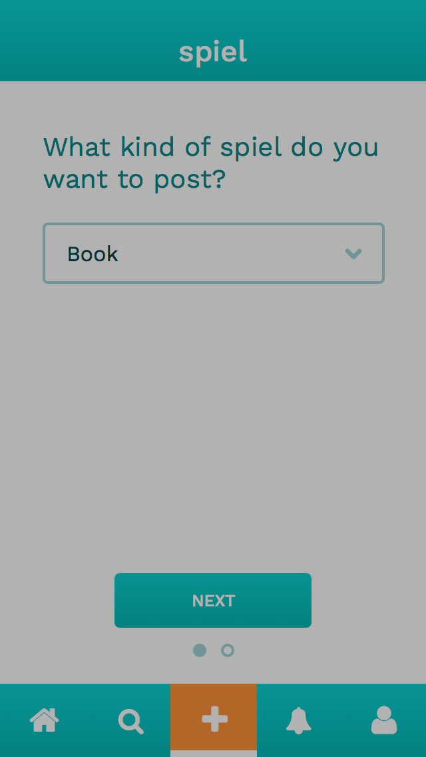
2. Inspire others with your new finds and stories.
Clicked on add icon
Choose category
Proceed to next screen

Slide 22
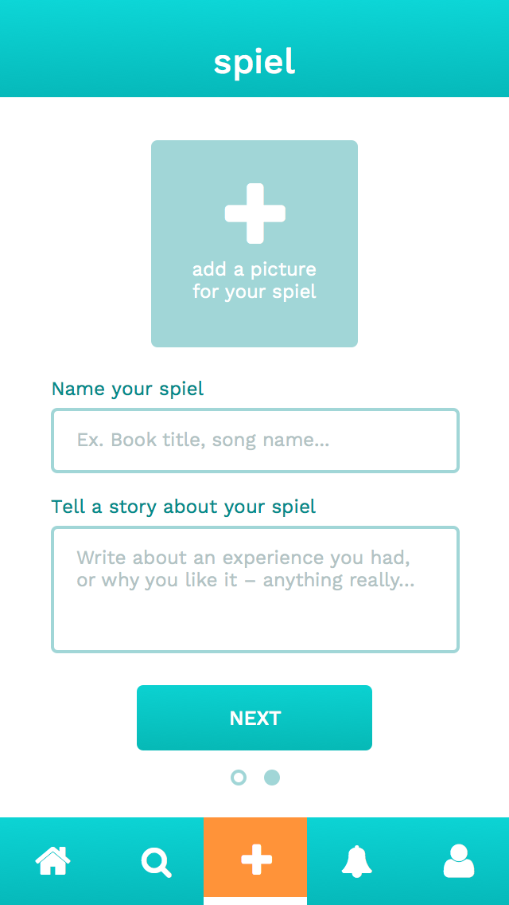
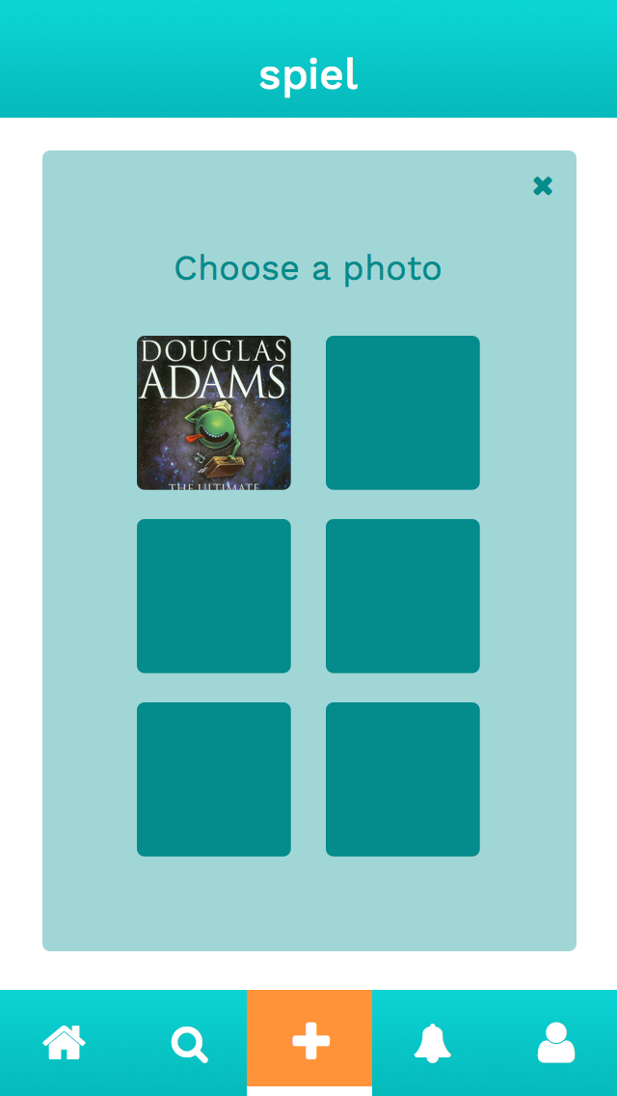
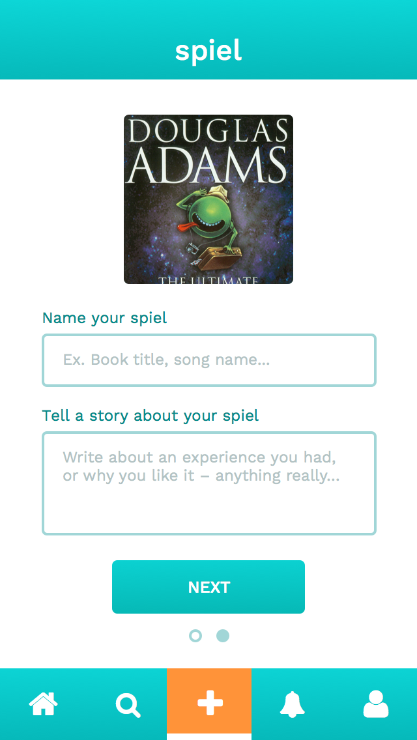
2. Inspire others with your new finds and stories.

Slide 23
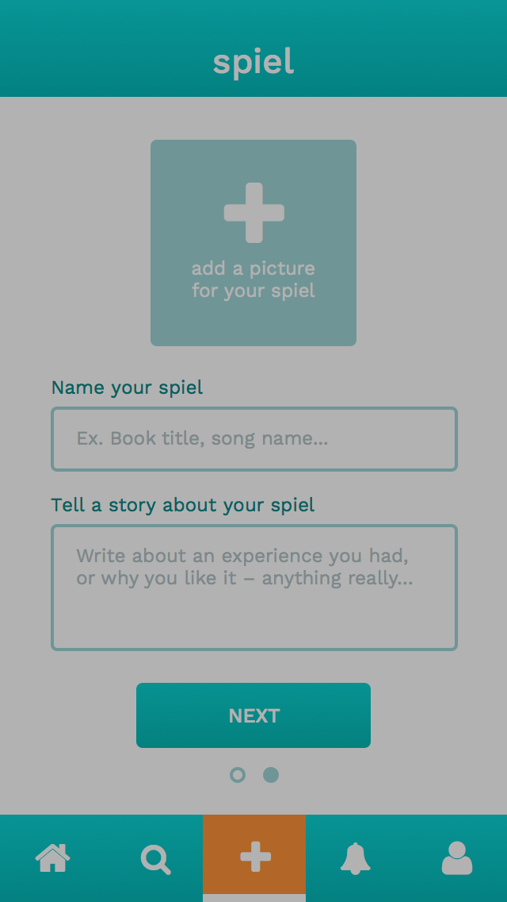
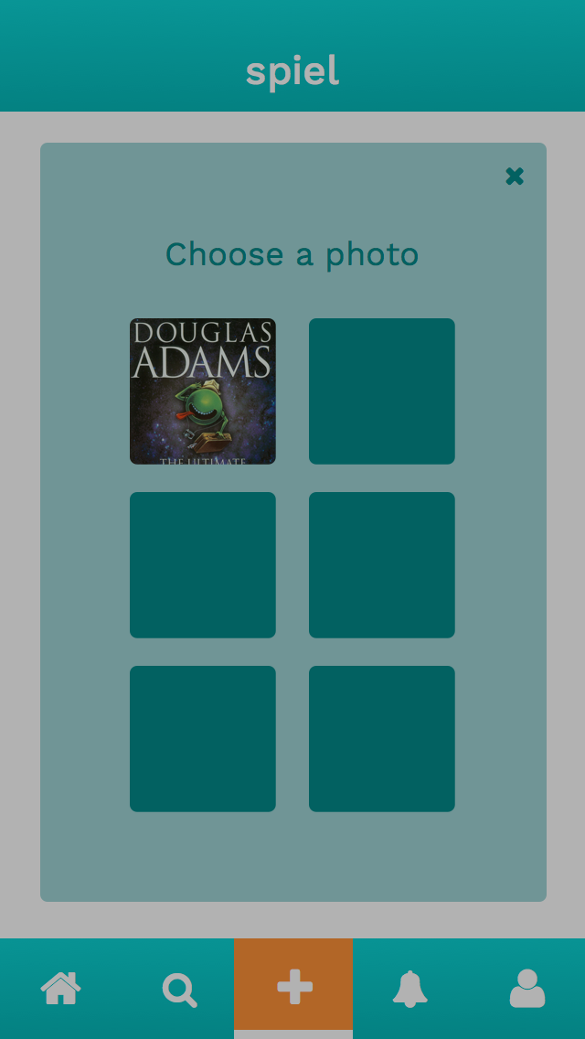
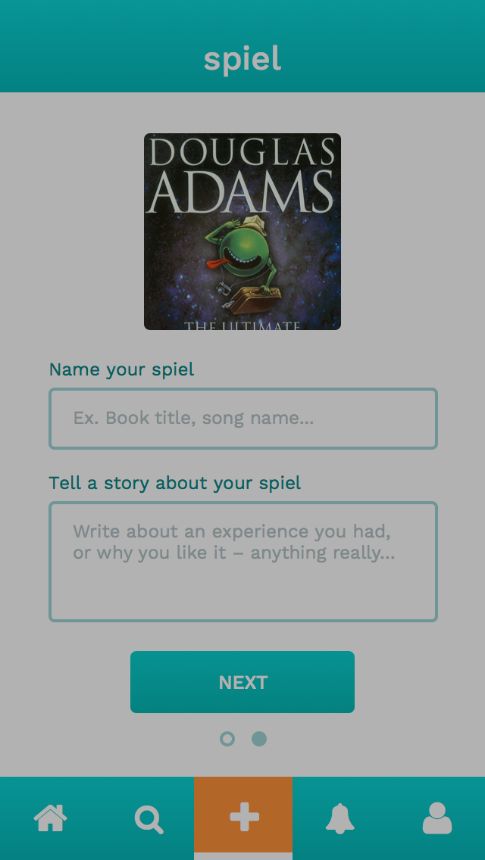
2. Inspire others with your new finds and stories.
Click add picture
Choose a picture
Add name of spiel

Slide 24
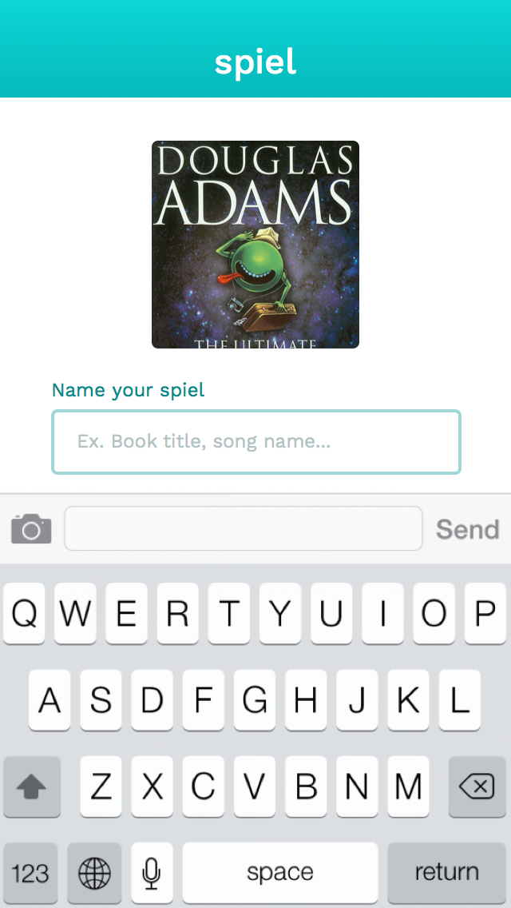
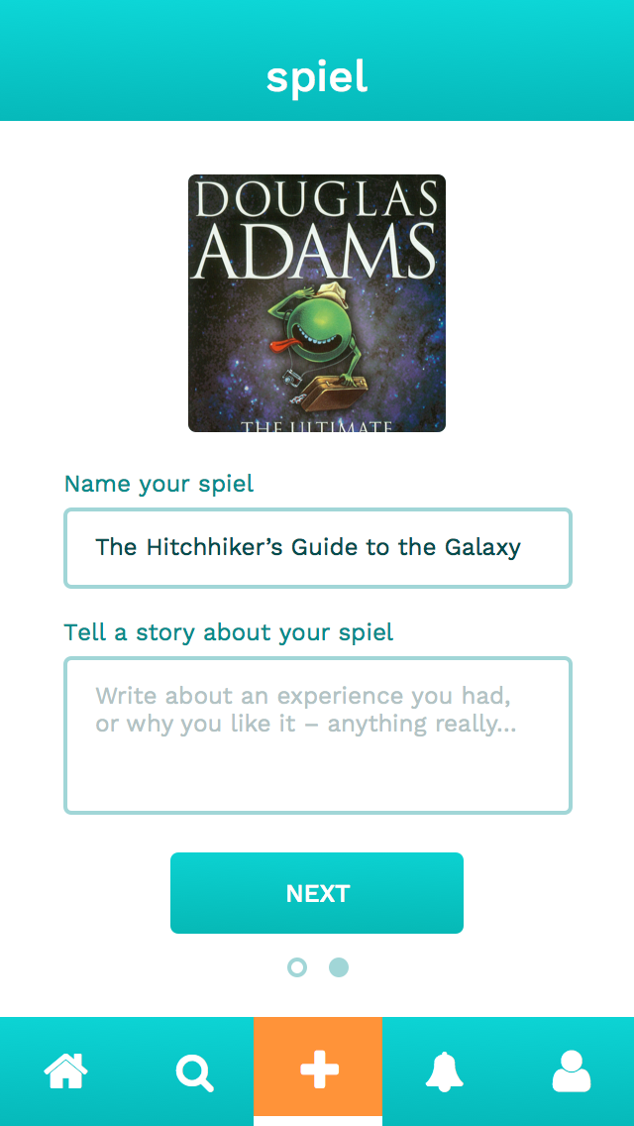
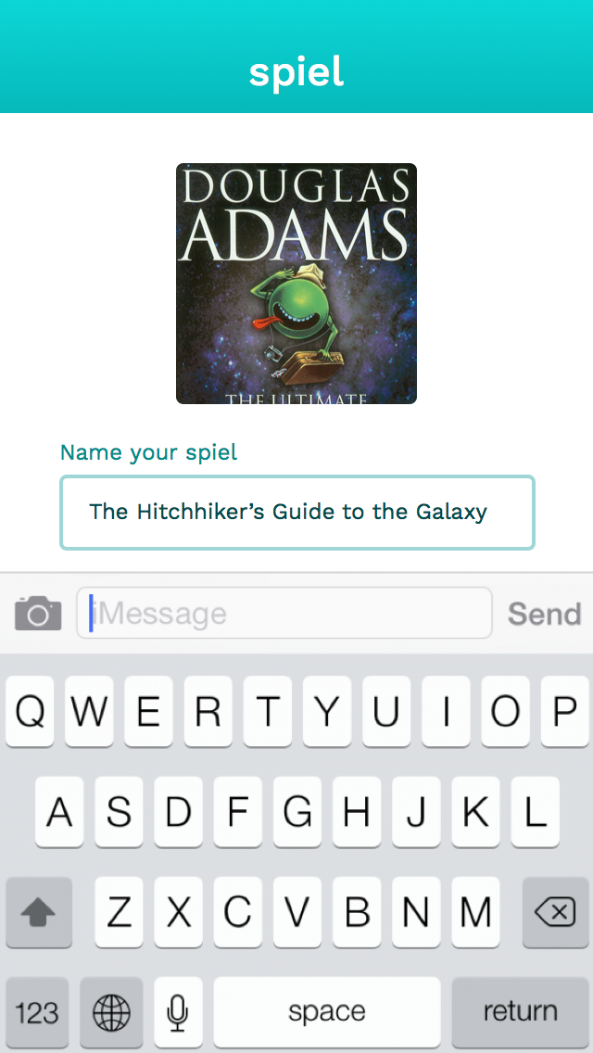
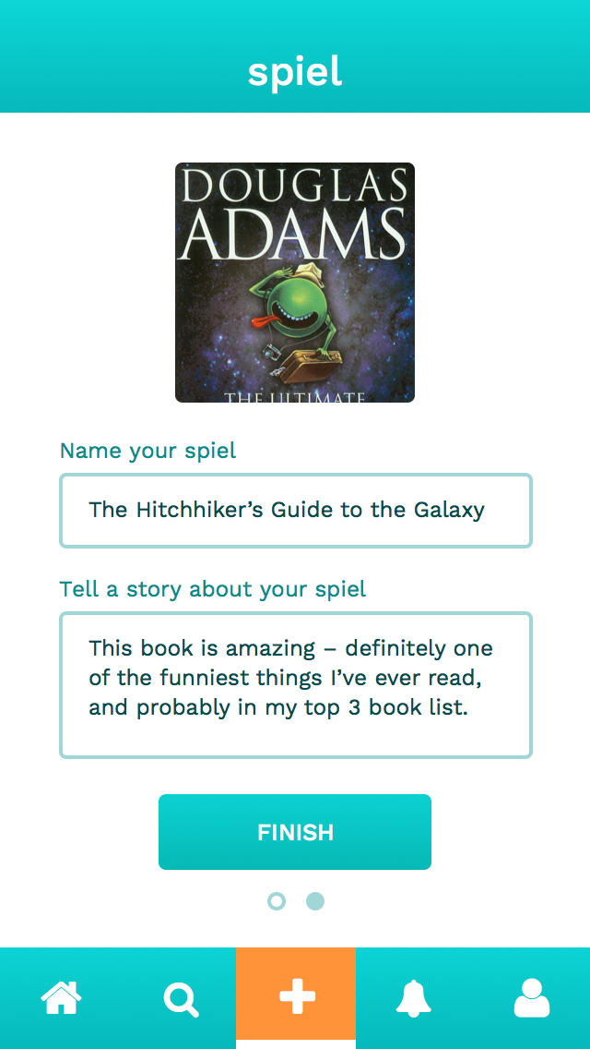
2. Inspire others with your new finds and stories.

Slide 25
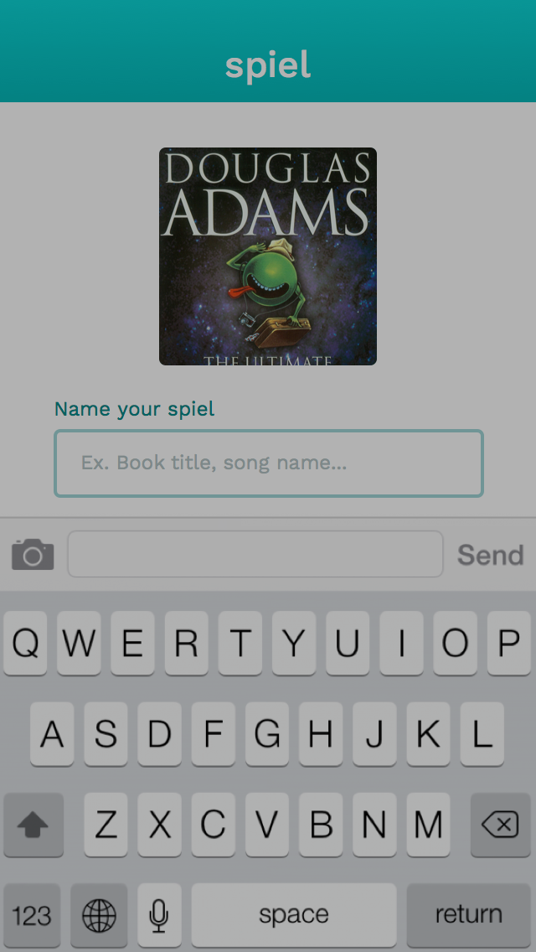
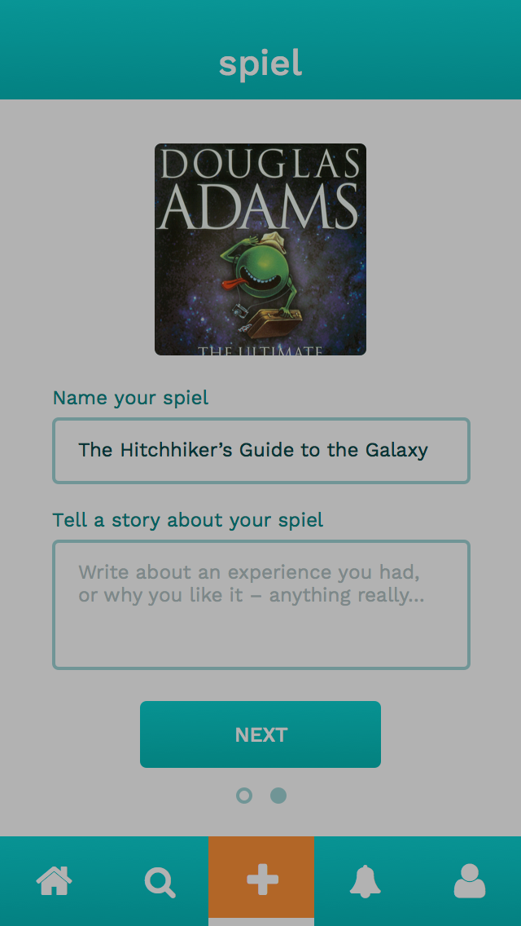
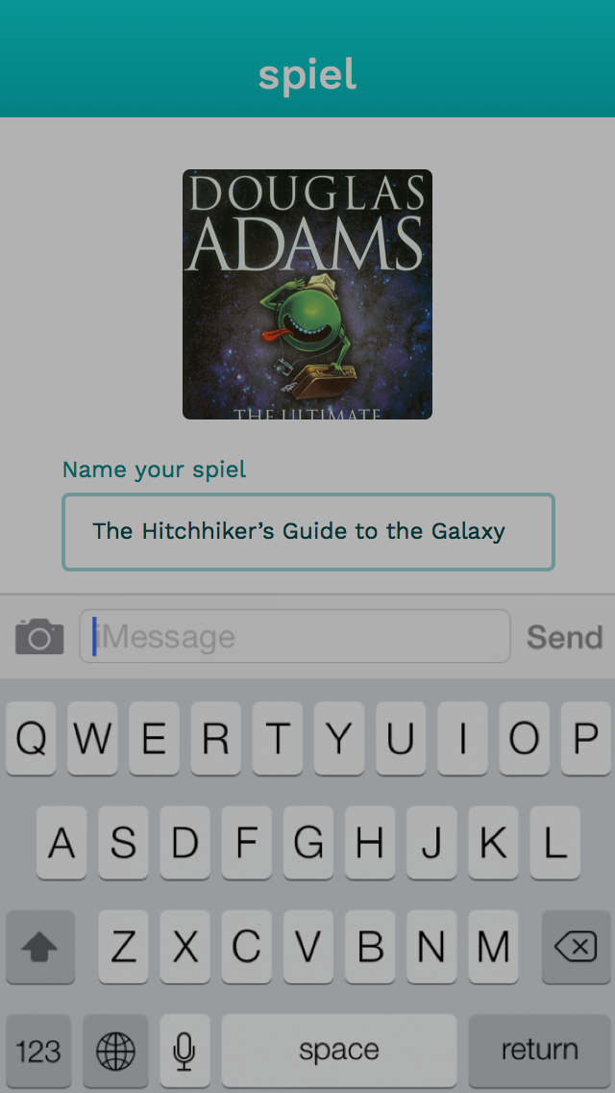
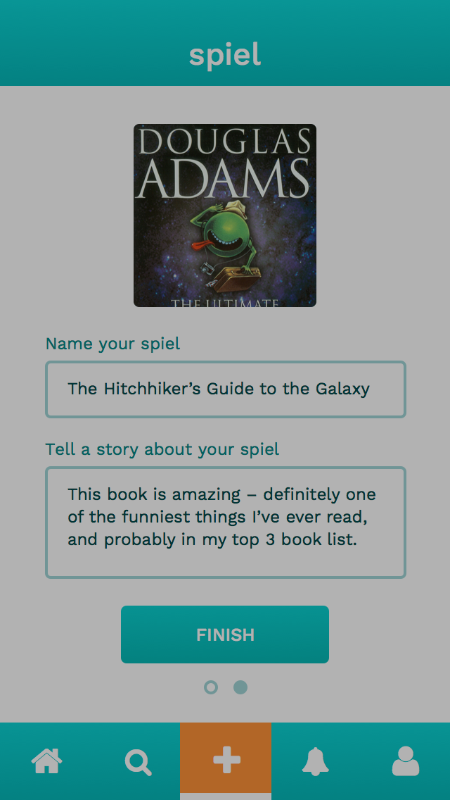
2. Inspire others with your new finds and stories.
Keyboard appears
Add story about spiel
Keyboard appears
Proceed to next screen

Slide 26
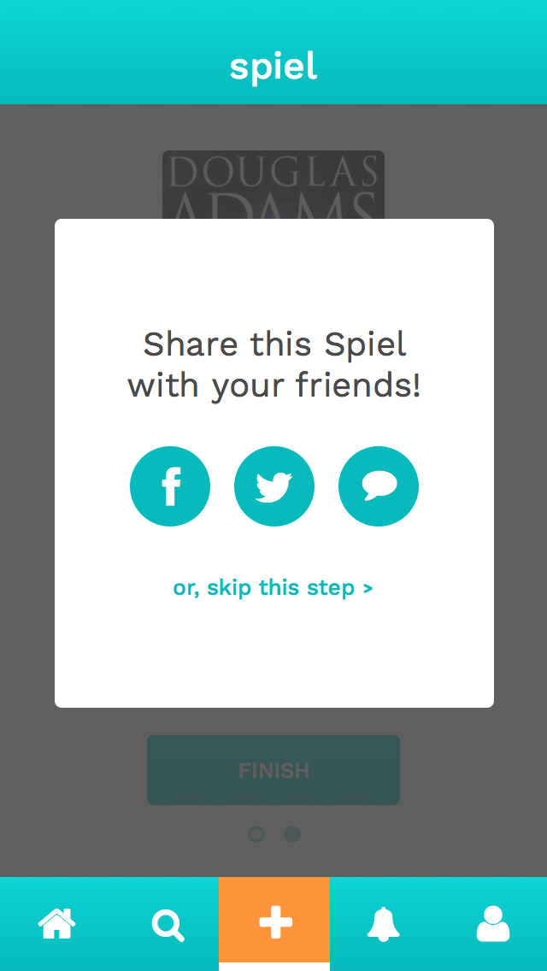
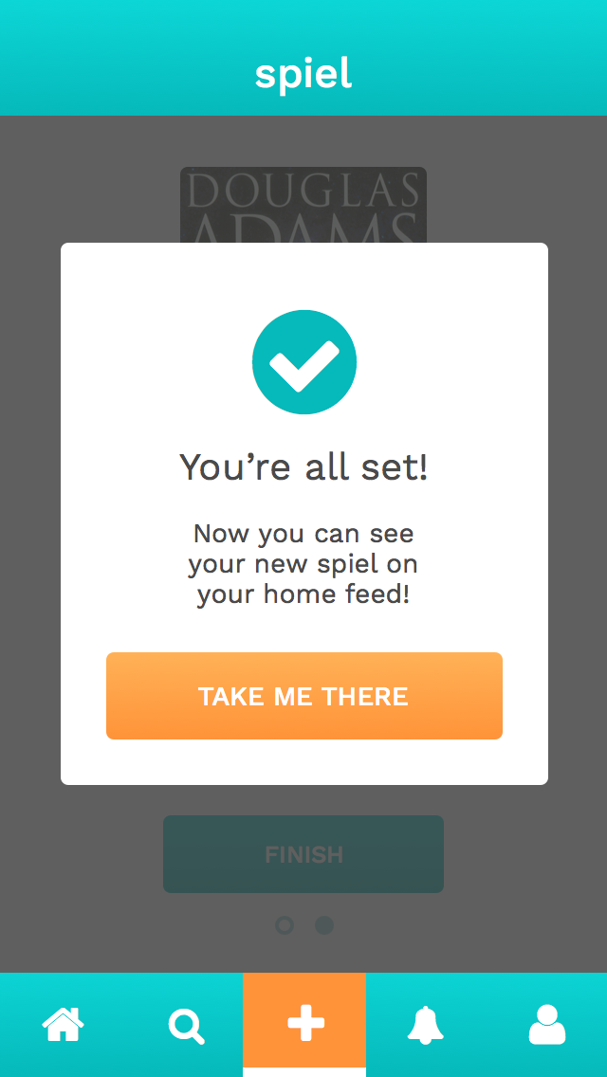
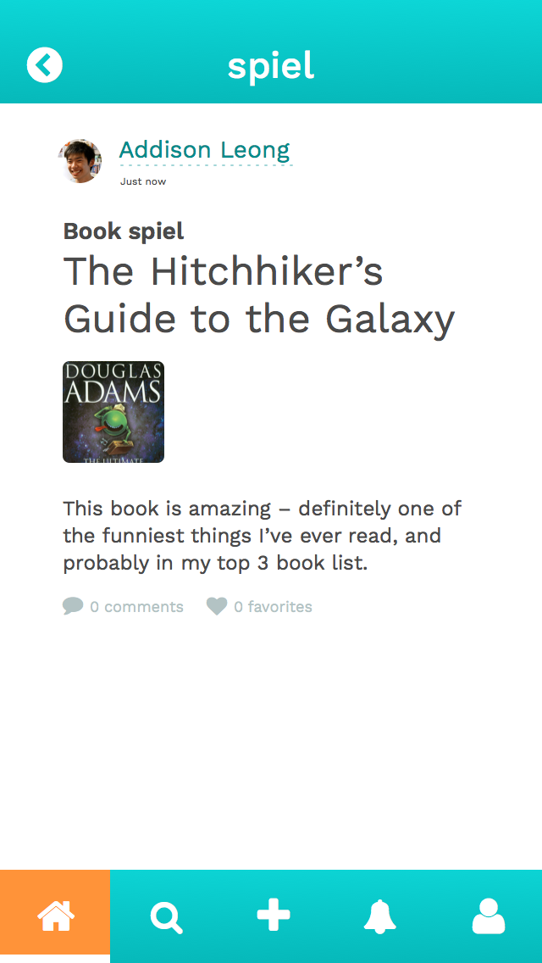
2. Inspire others with your new finds and stories.

Slide 27
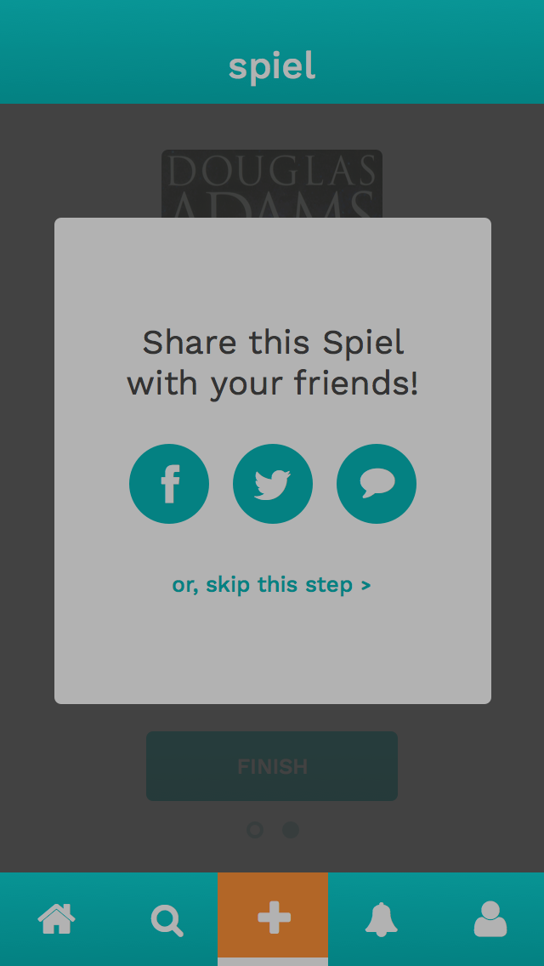
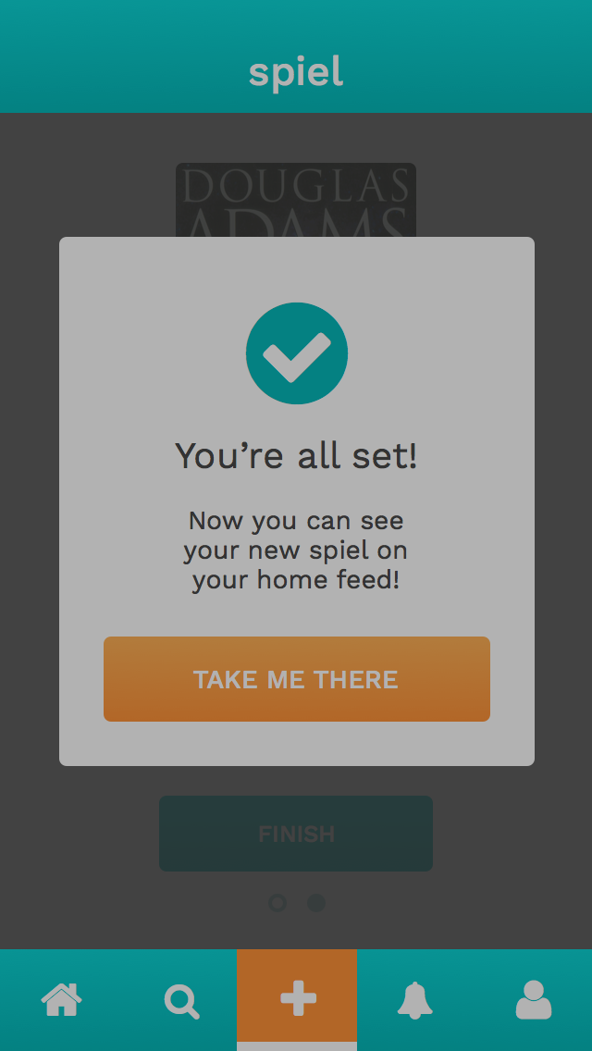
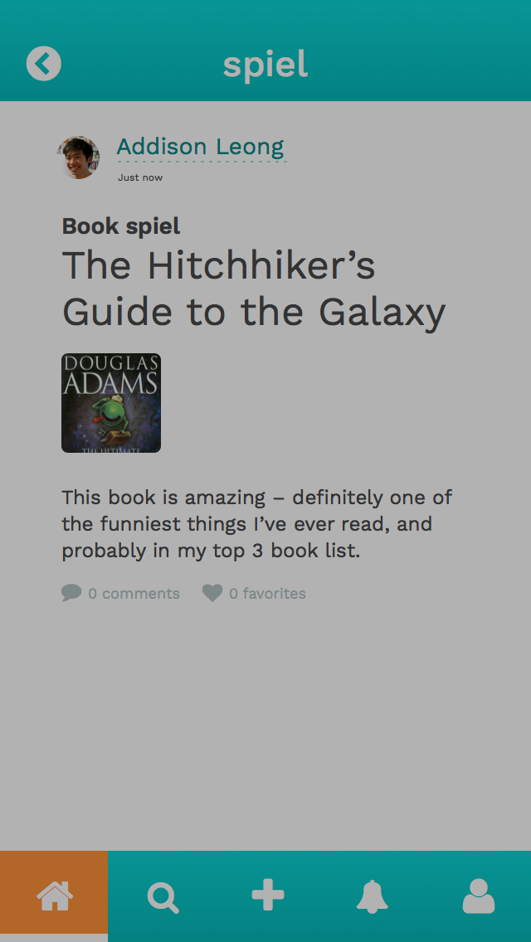
2. Inspire others with your new finds and stories.
Share with networks
Finished confirmation
See new spiel detail in feed

Slide 28
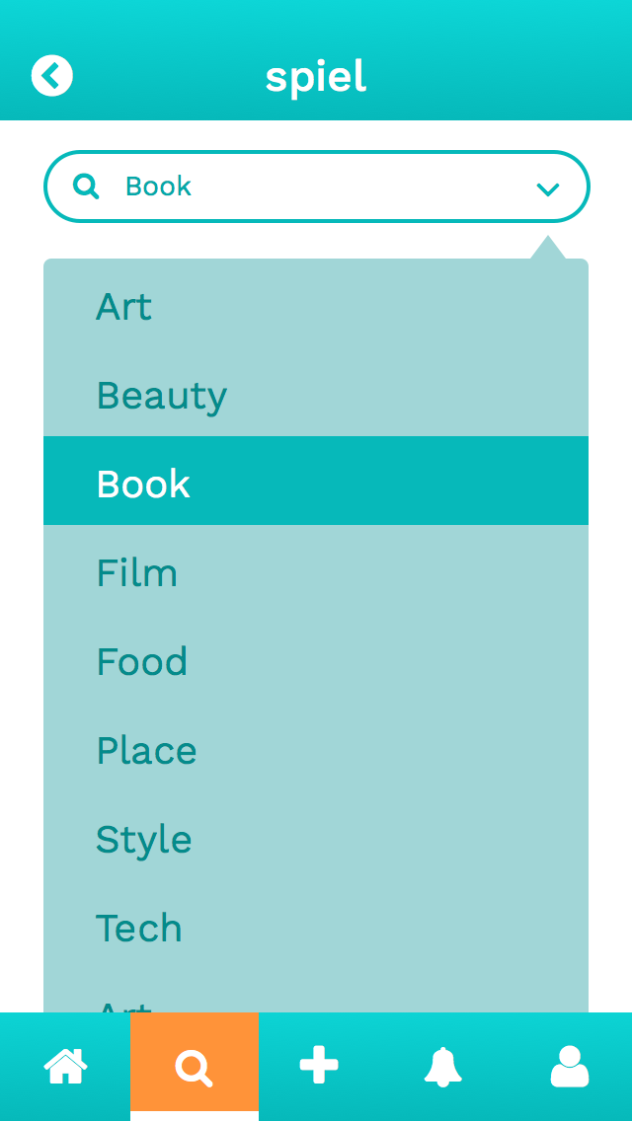
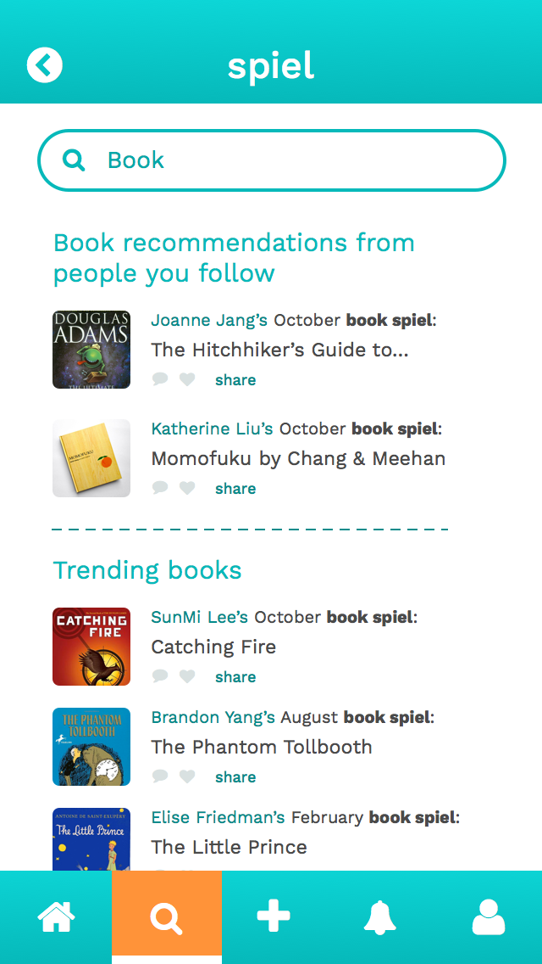
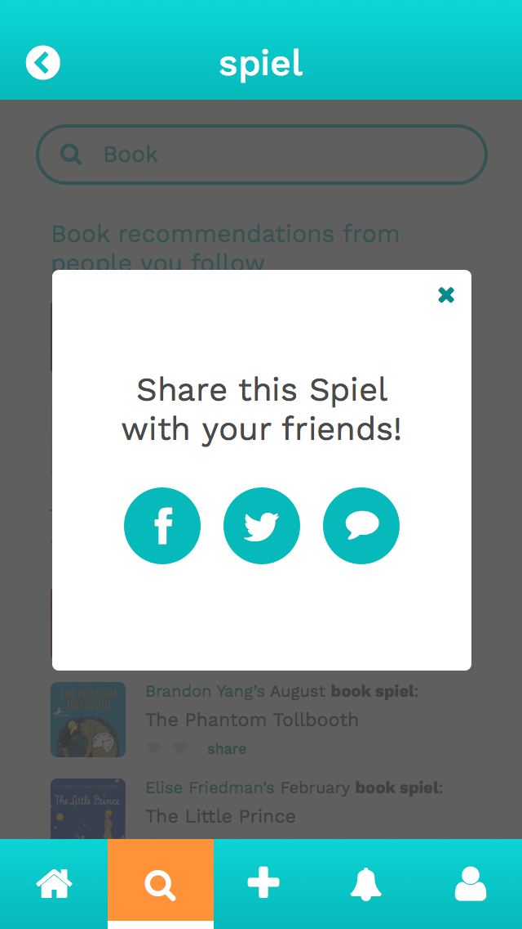
3. Share interesting spiels with your other social networks.

Slide 29
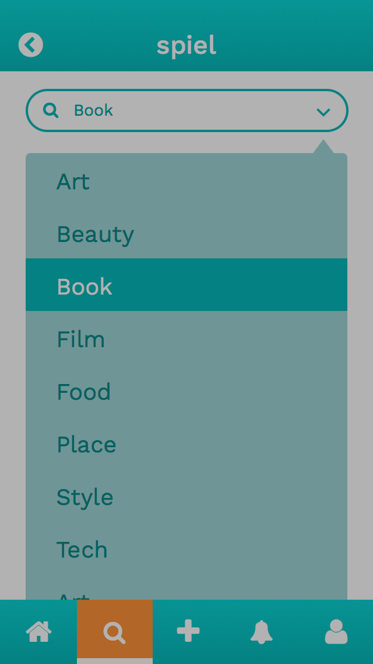
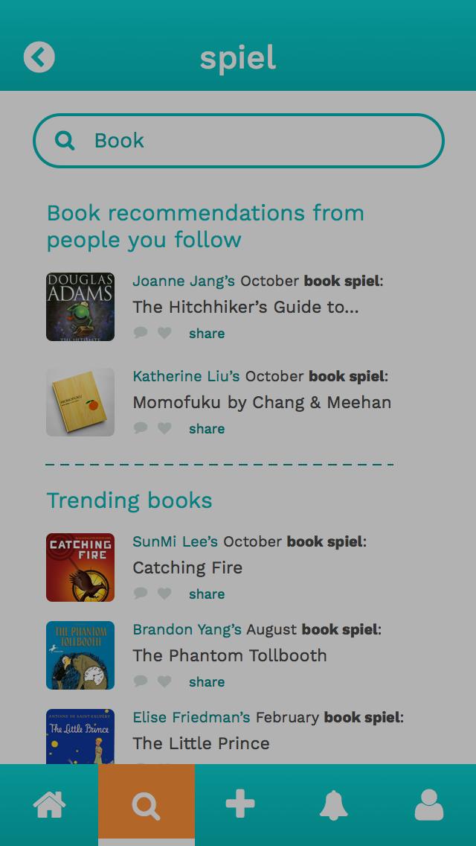
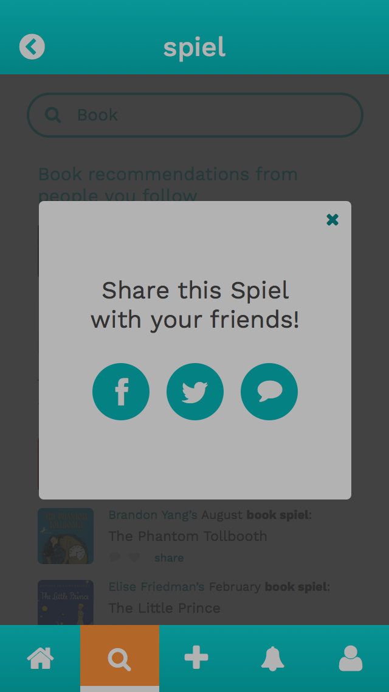
3. Share interesting spiels with your other social networks.
Select category in Discover
Click to share a spiel
Share with other networks

Slide 30
PROTOTYPING TOOLS

Slide 31
Sketch
InVision

Slide 32
Process
Revisions of sketches based on feedback from last week! (pen and paper)
Designing medium-fi in grayscale for hierarchy (Sketch)
Adding color and making revisions (Sketch)
Adding interaction (InVision)

Slide 33
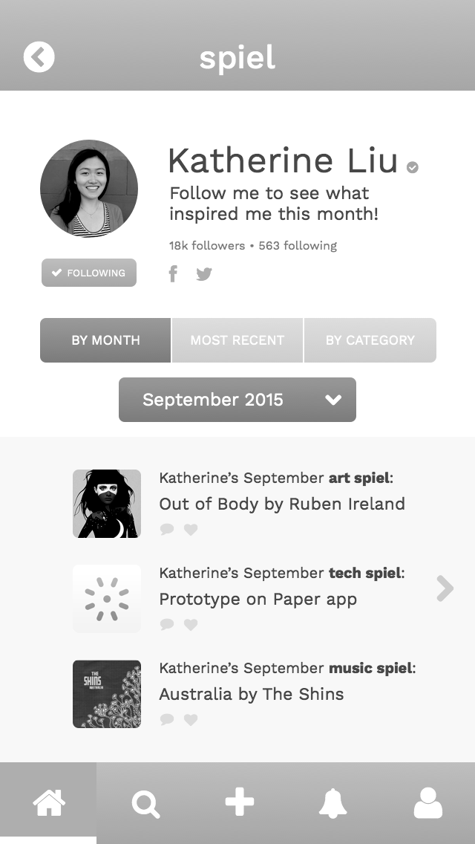
Sketch
HELPED
Quick to learn, WYSIWYG building
Integrated with InVision
Symbols and styles
DID NOT HELP
Not collaborative – worked on separate documents

Slide 34
InVision
HELPED
Helpful features like applying a hotspot template to all screens
Easy import to an iPhone background
DID NOT HELP
Did not account for top bar in prototype
Hard to keep track of which screen are linked

Slide 35
LIMITATIONS & TRADEOFFS

Slide 36
LIMITATIONS & TRADEOFFS
Left out certain app features
User settings
Only view-by-month, toggle is static

Slide 37
LIMITATIONS & TRADEOFFS
Looks like a real app, but limited by tools
No scrolling

Slide 38
HAND-CODED FEATURES

Slide 39
HAND-CODED FEATURES
Users cannot create a post freely, we have preset information in place
Text information, photos, and search terms were autofilled and pre-defined

Slide 40
Find our website, prototype (with additional screens!) at
stanford.io/1XD6DVX

