Slide 1
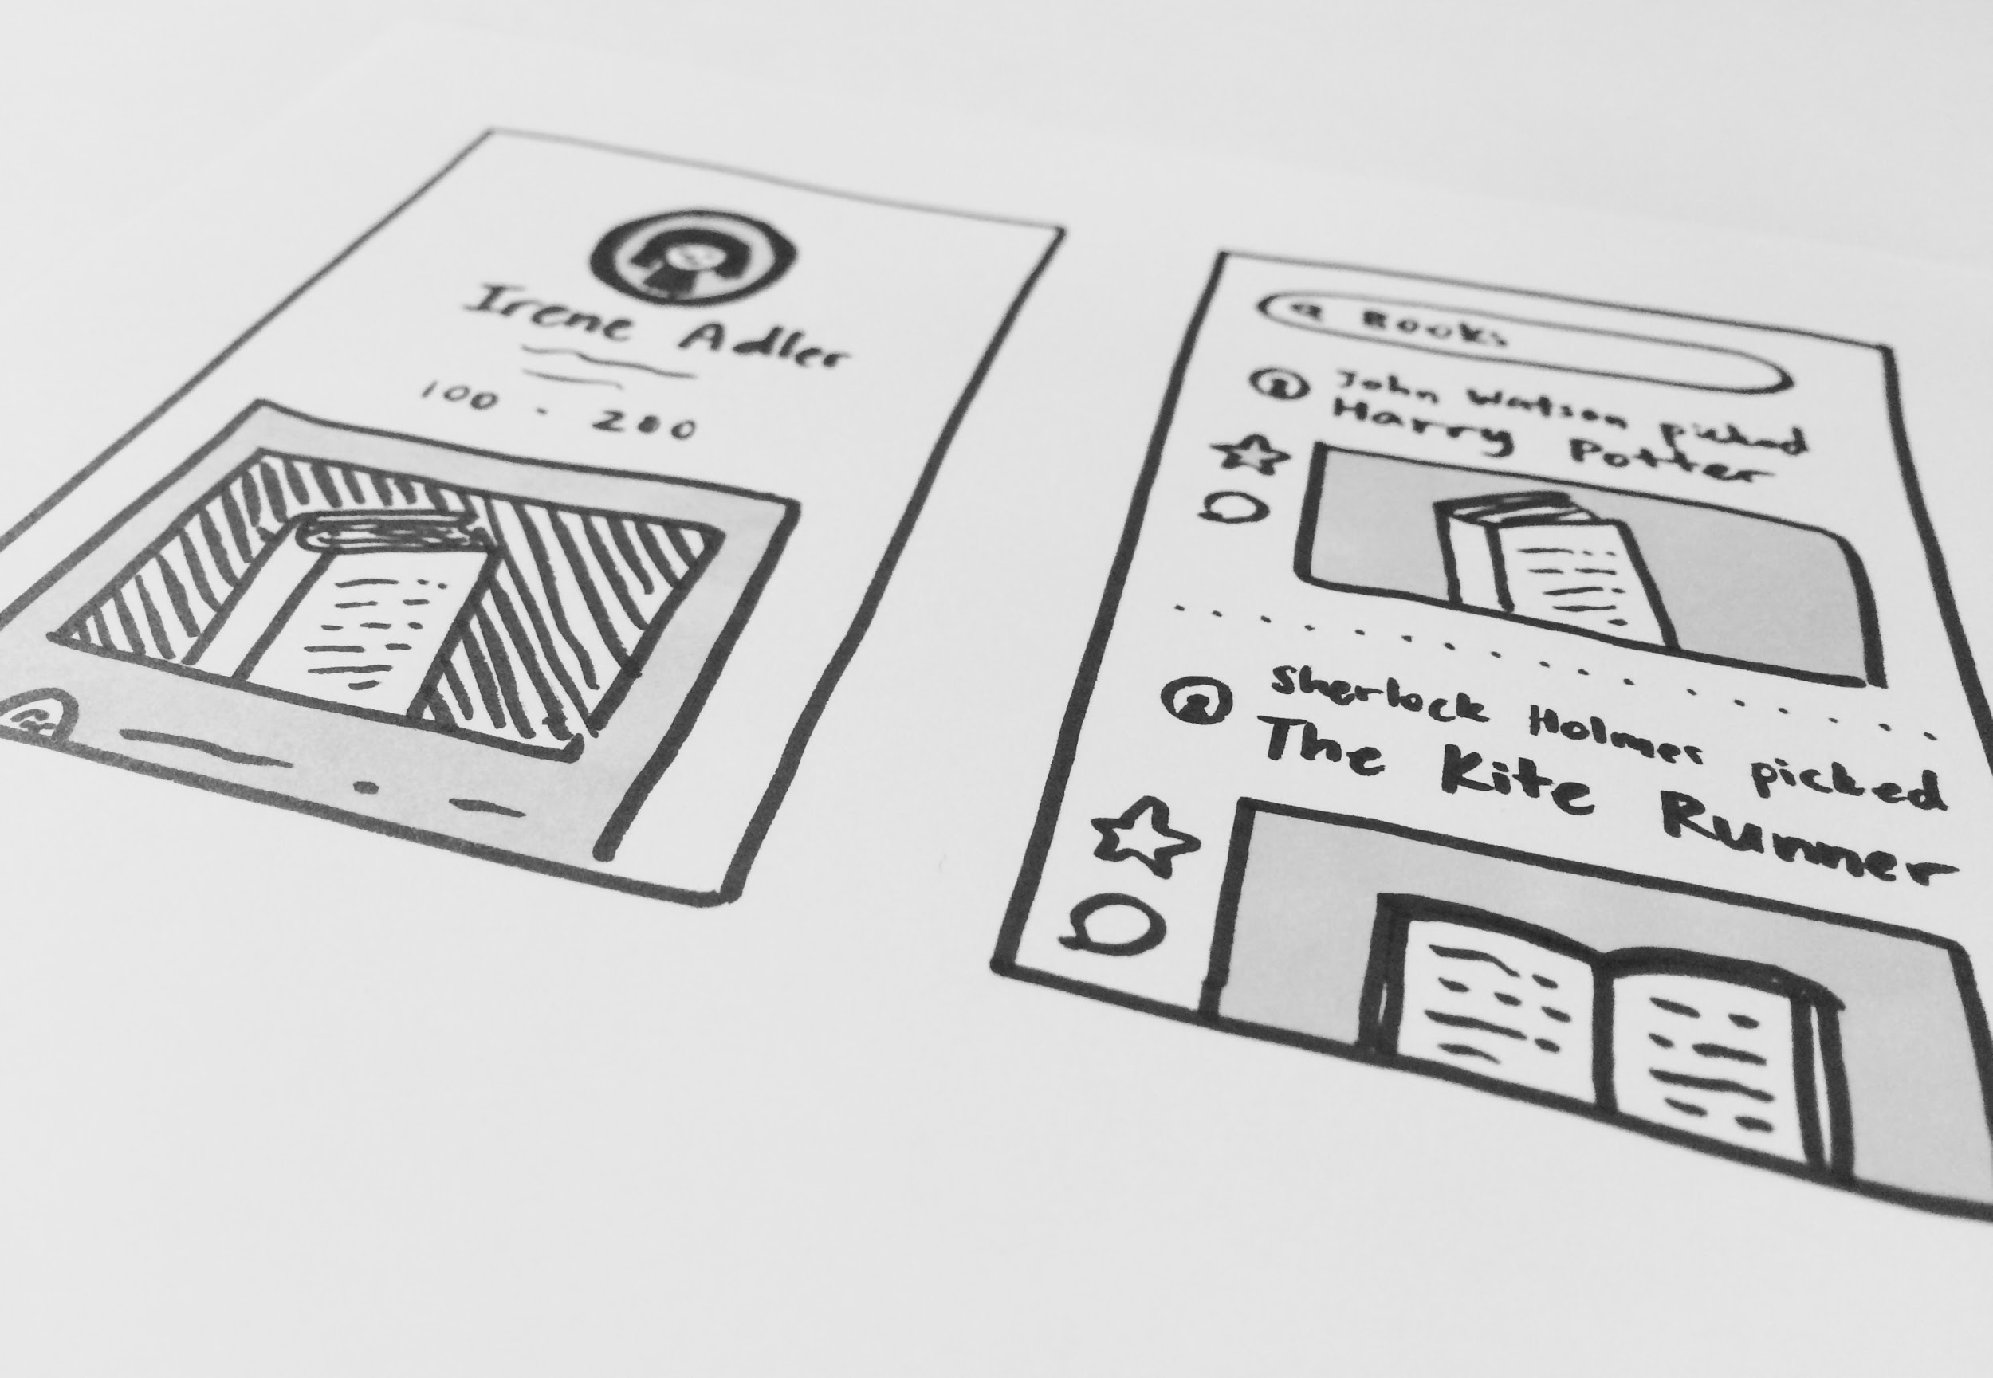
LOW-FI PROTOTYPING
Addison • Joanne • Katherine • SunMi

Slide 2
OVERVIEW
Problem/Solution
Value Proposition
Prototyping Process
Task Flows for the Low-Fi Prototype
Experimental Method
Results
UI + Feature Changes

Slide 3
PROBLEM-SOLUTION
People are searching for a better way to learn about the lifestyles of the people they like, admire, and respect.
Picks tells a person’s life story through nouns. It provides a simpler, more elegant, and more personal platform that allows people to discover new interests through people-centric product recommendations and be inspired by the lifestyles of people they admire.

Slide 4
MISSION • VALUE PROPOSITION
A discovery network guided by person-to-person connections that tells a person’s life story through nouns

Slide 5
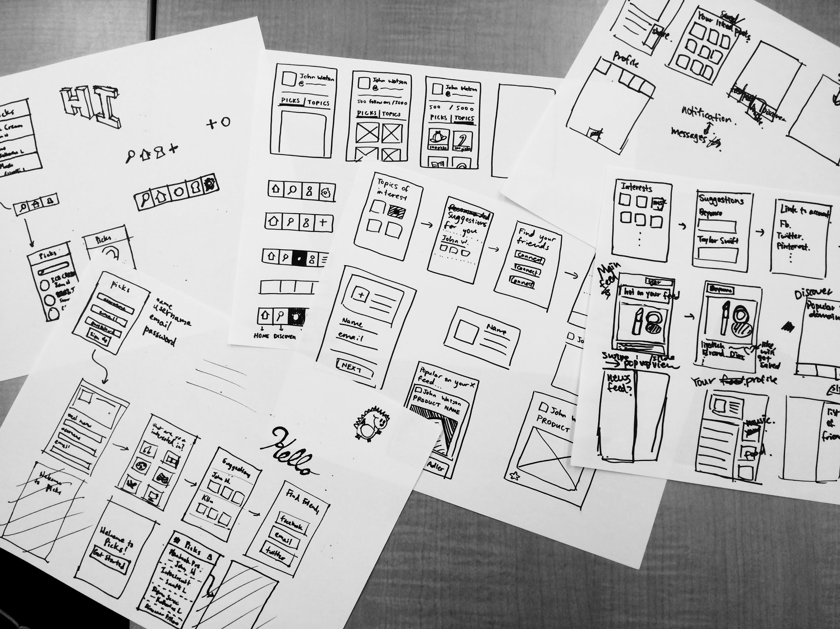
CONCEPT SKETCHES (3)

Slide 6
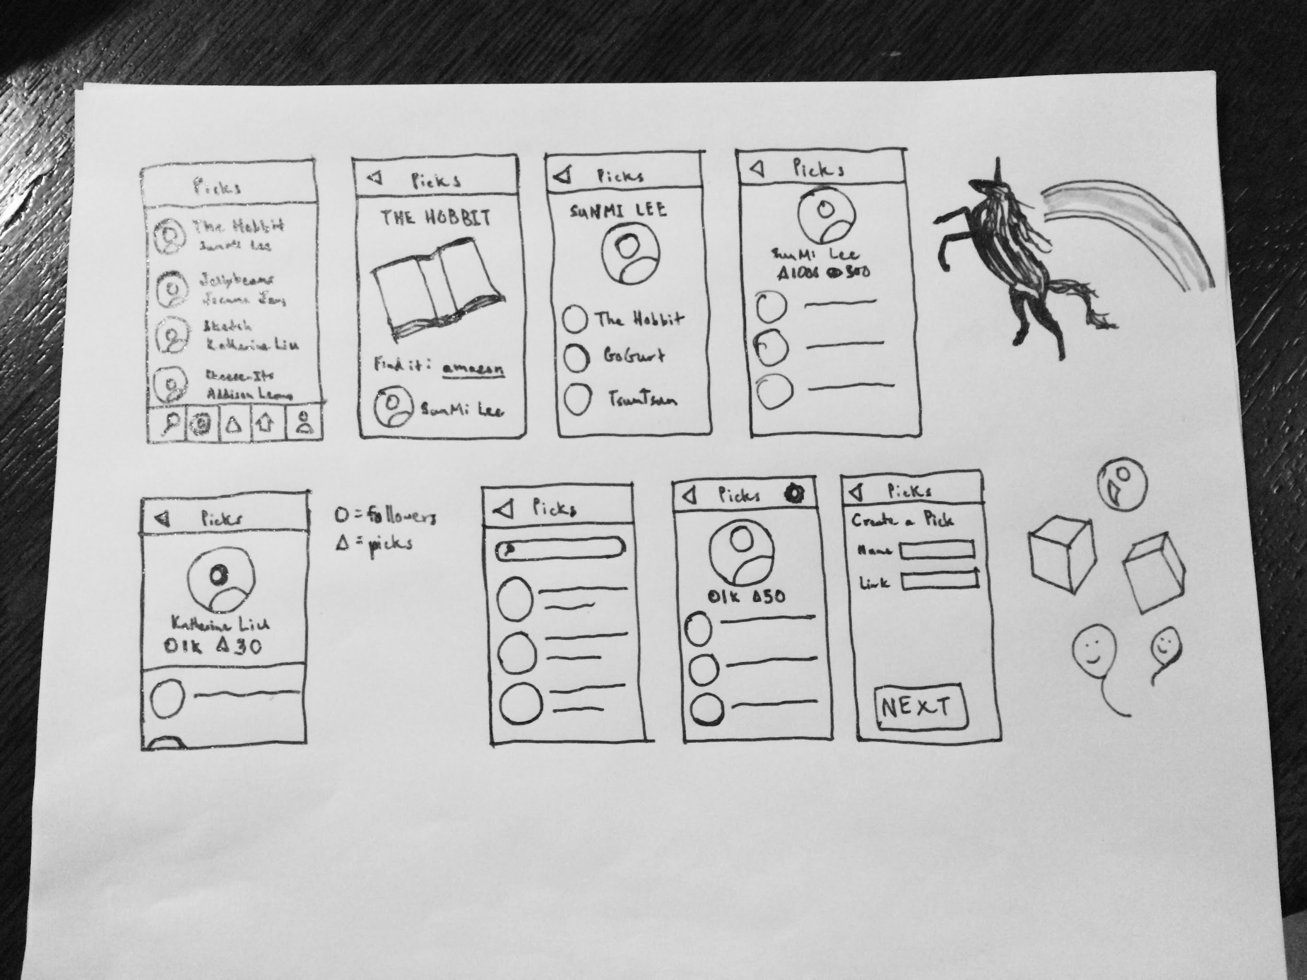

Slide 7
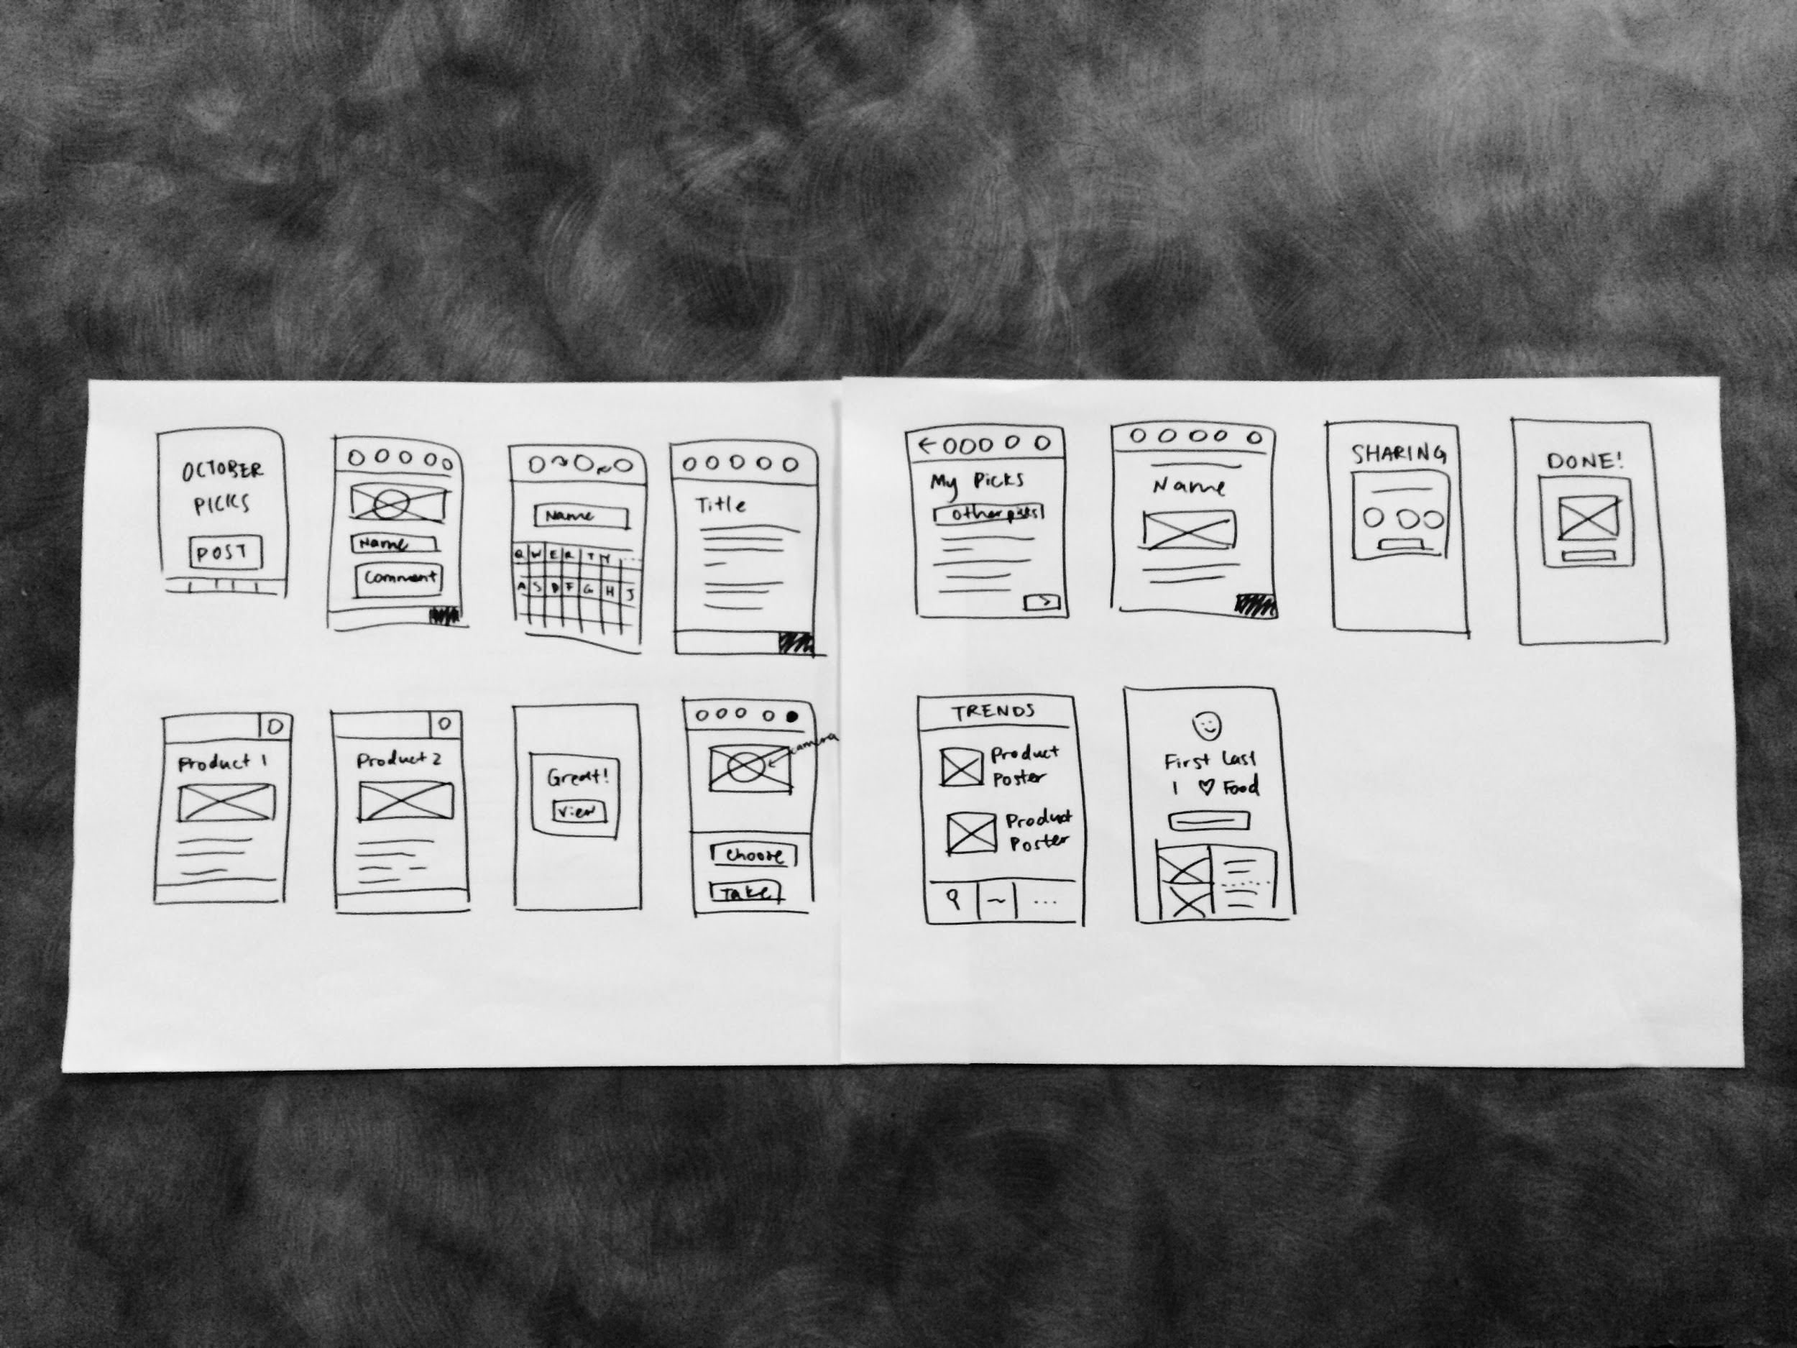

Slide 8
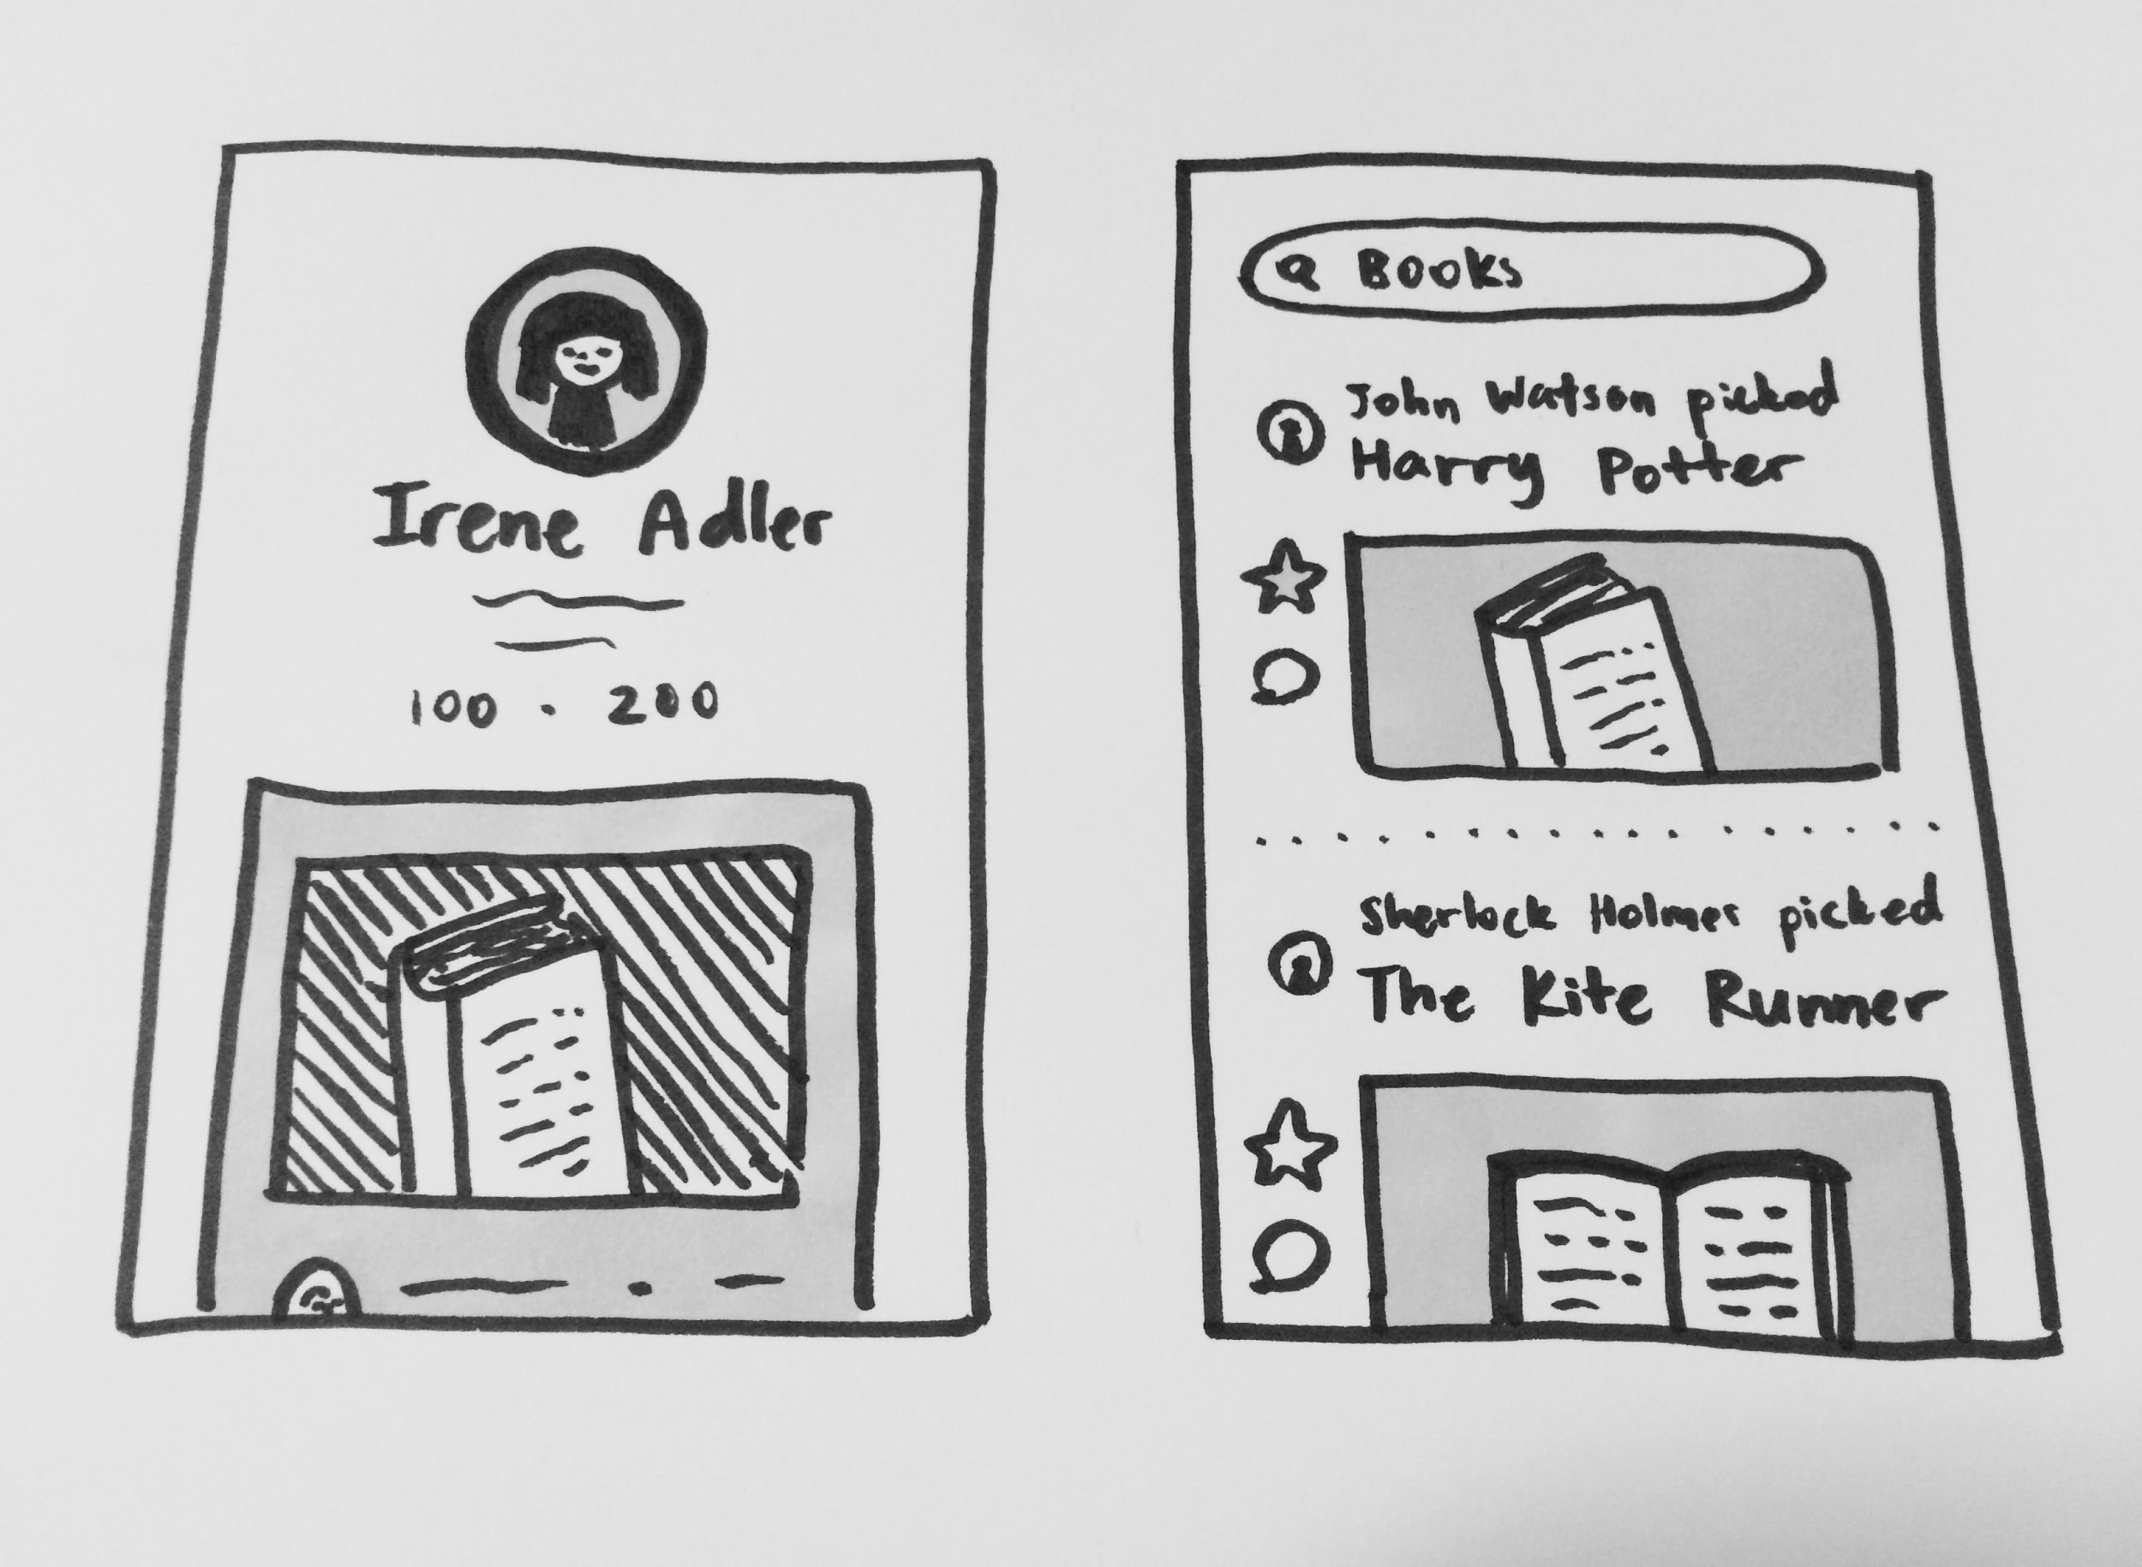
UI SKETCHES
(2)

Slide 9
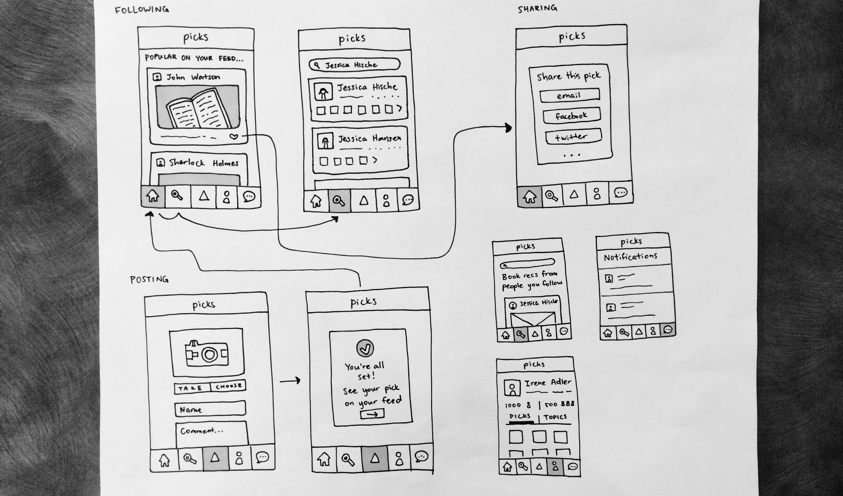

Slide 10
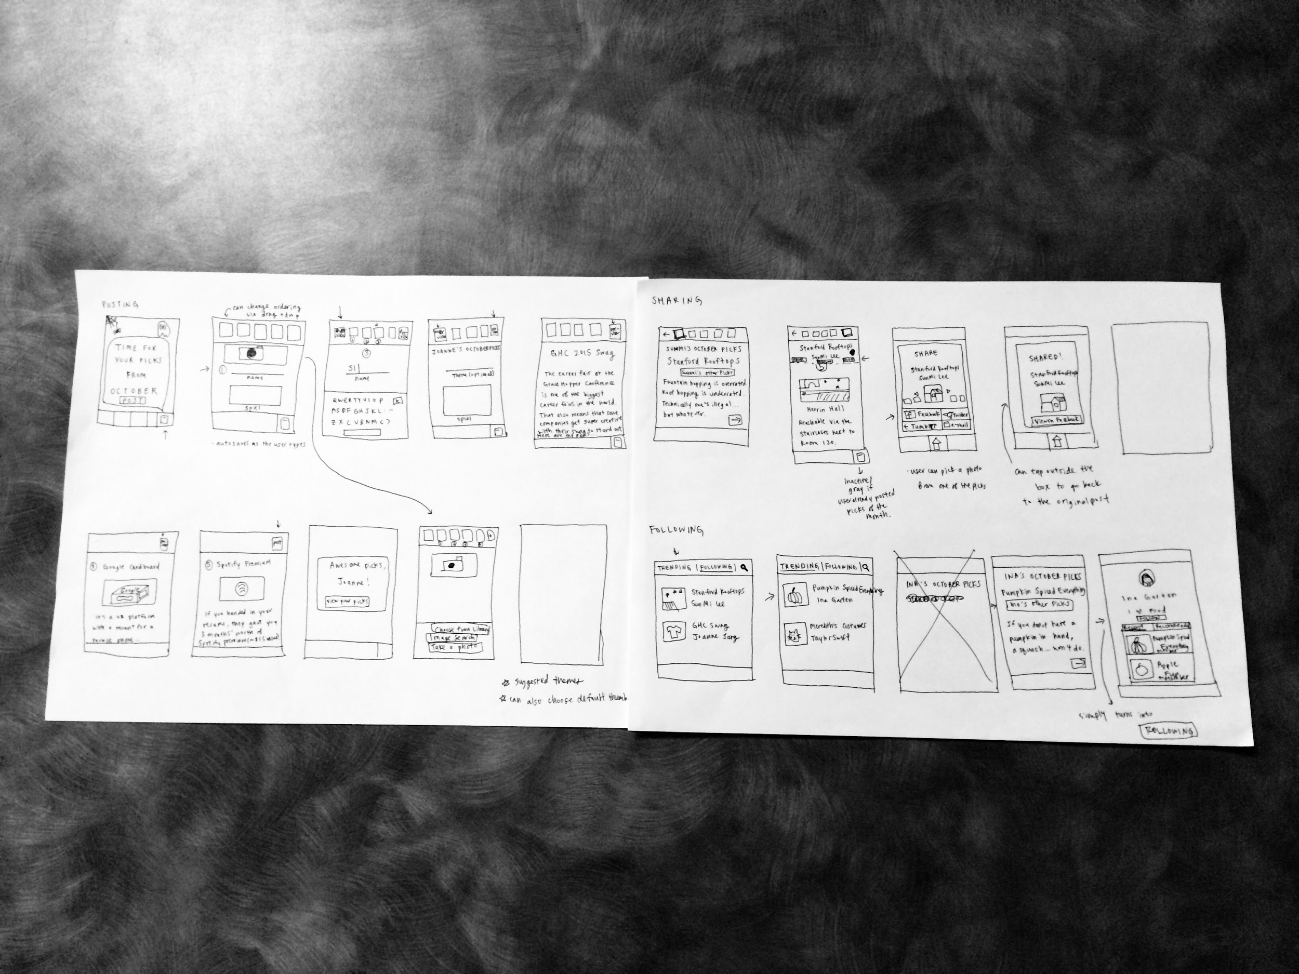

Slide 11
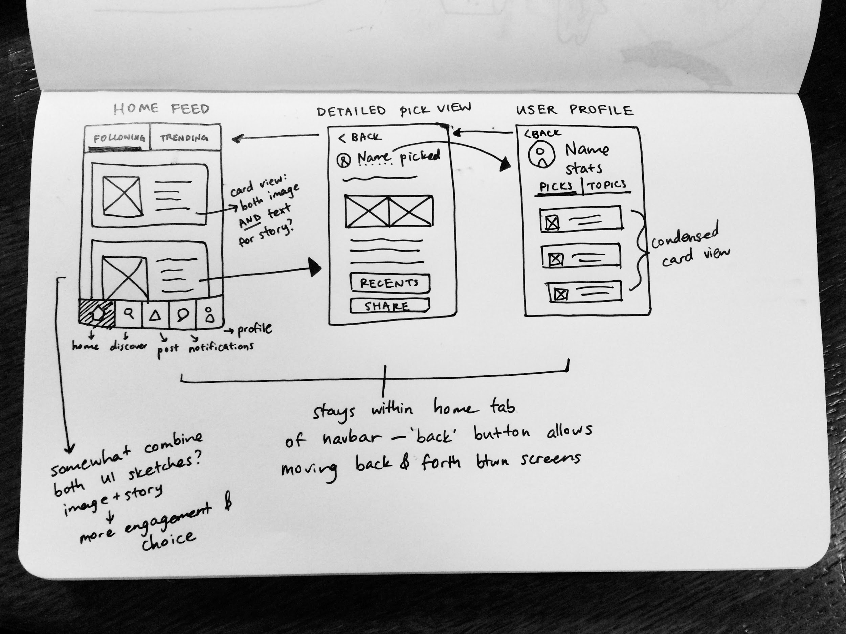
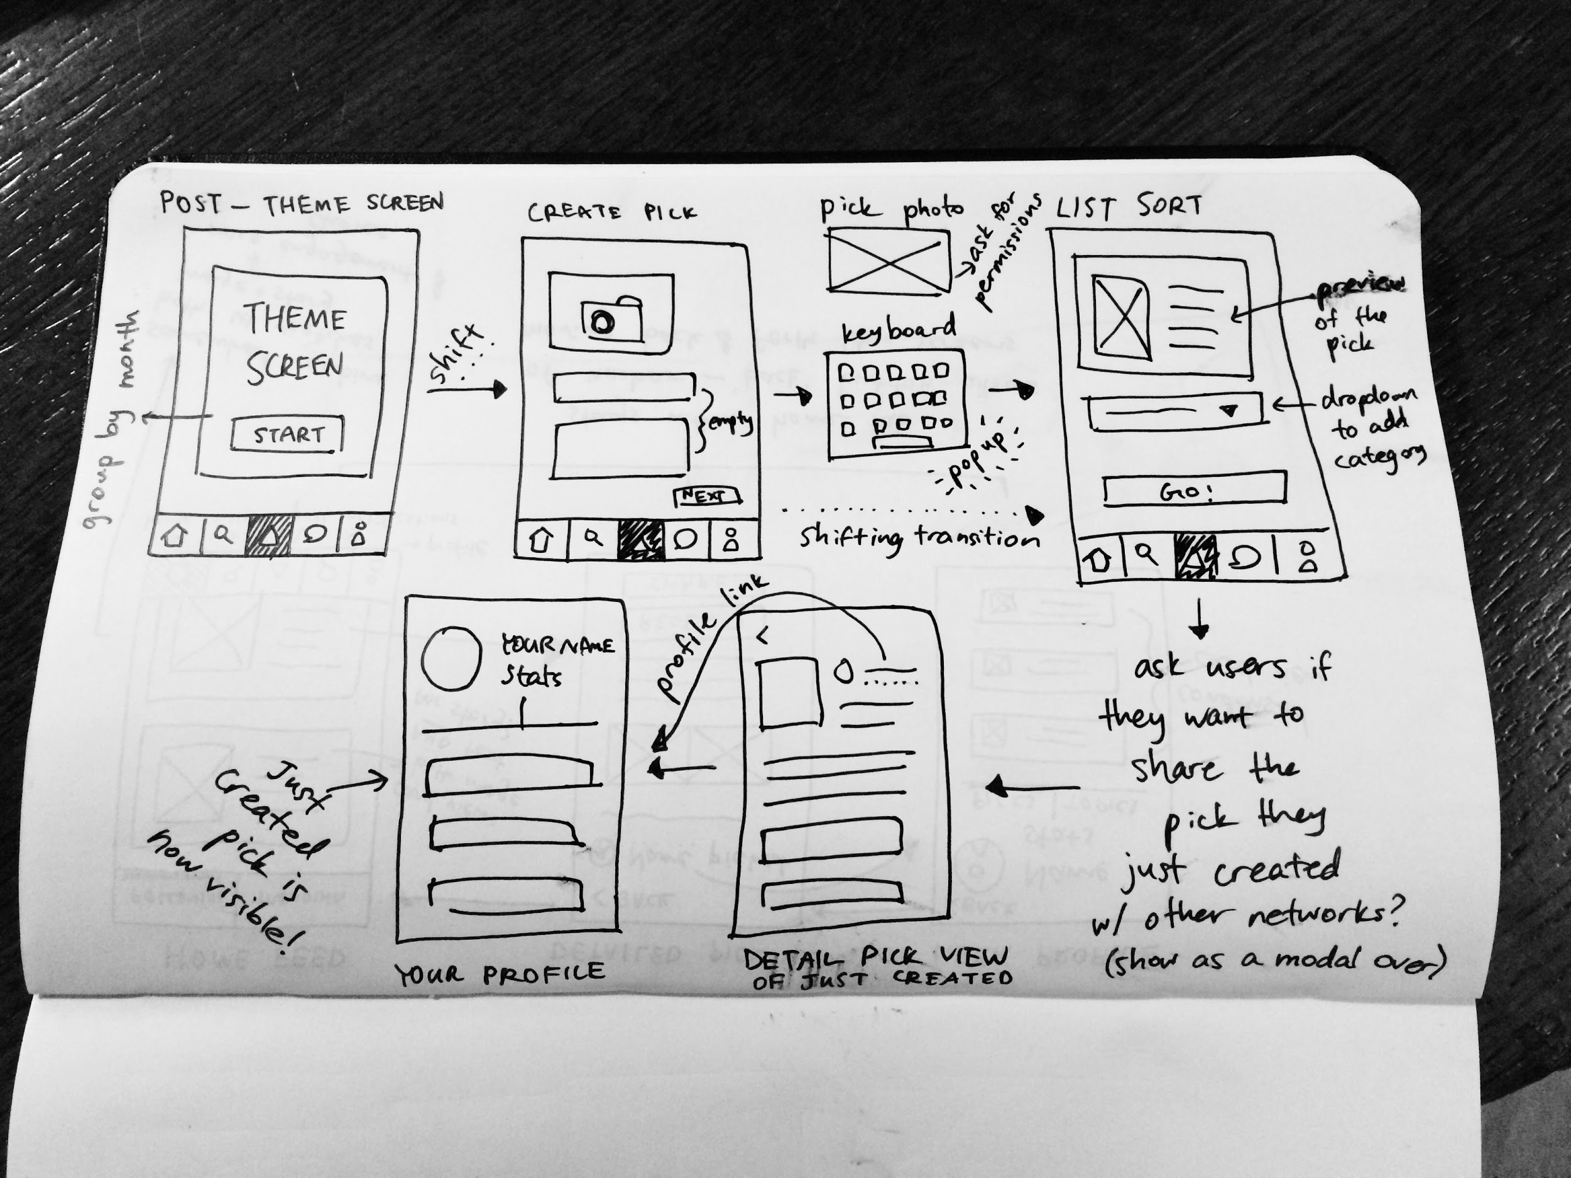
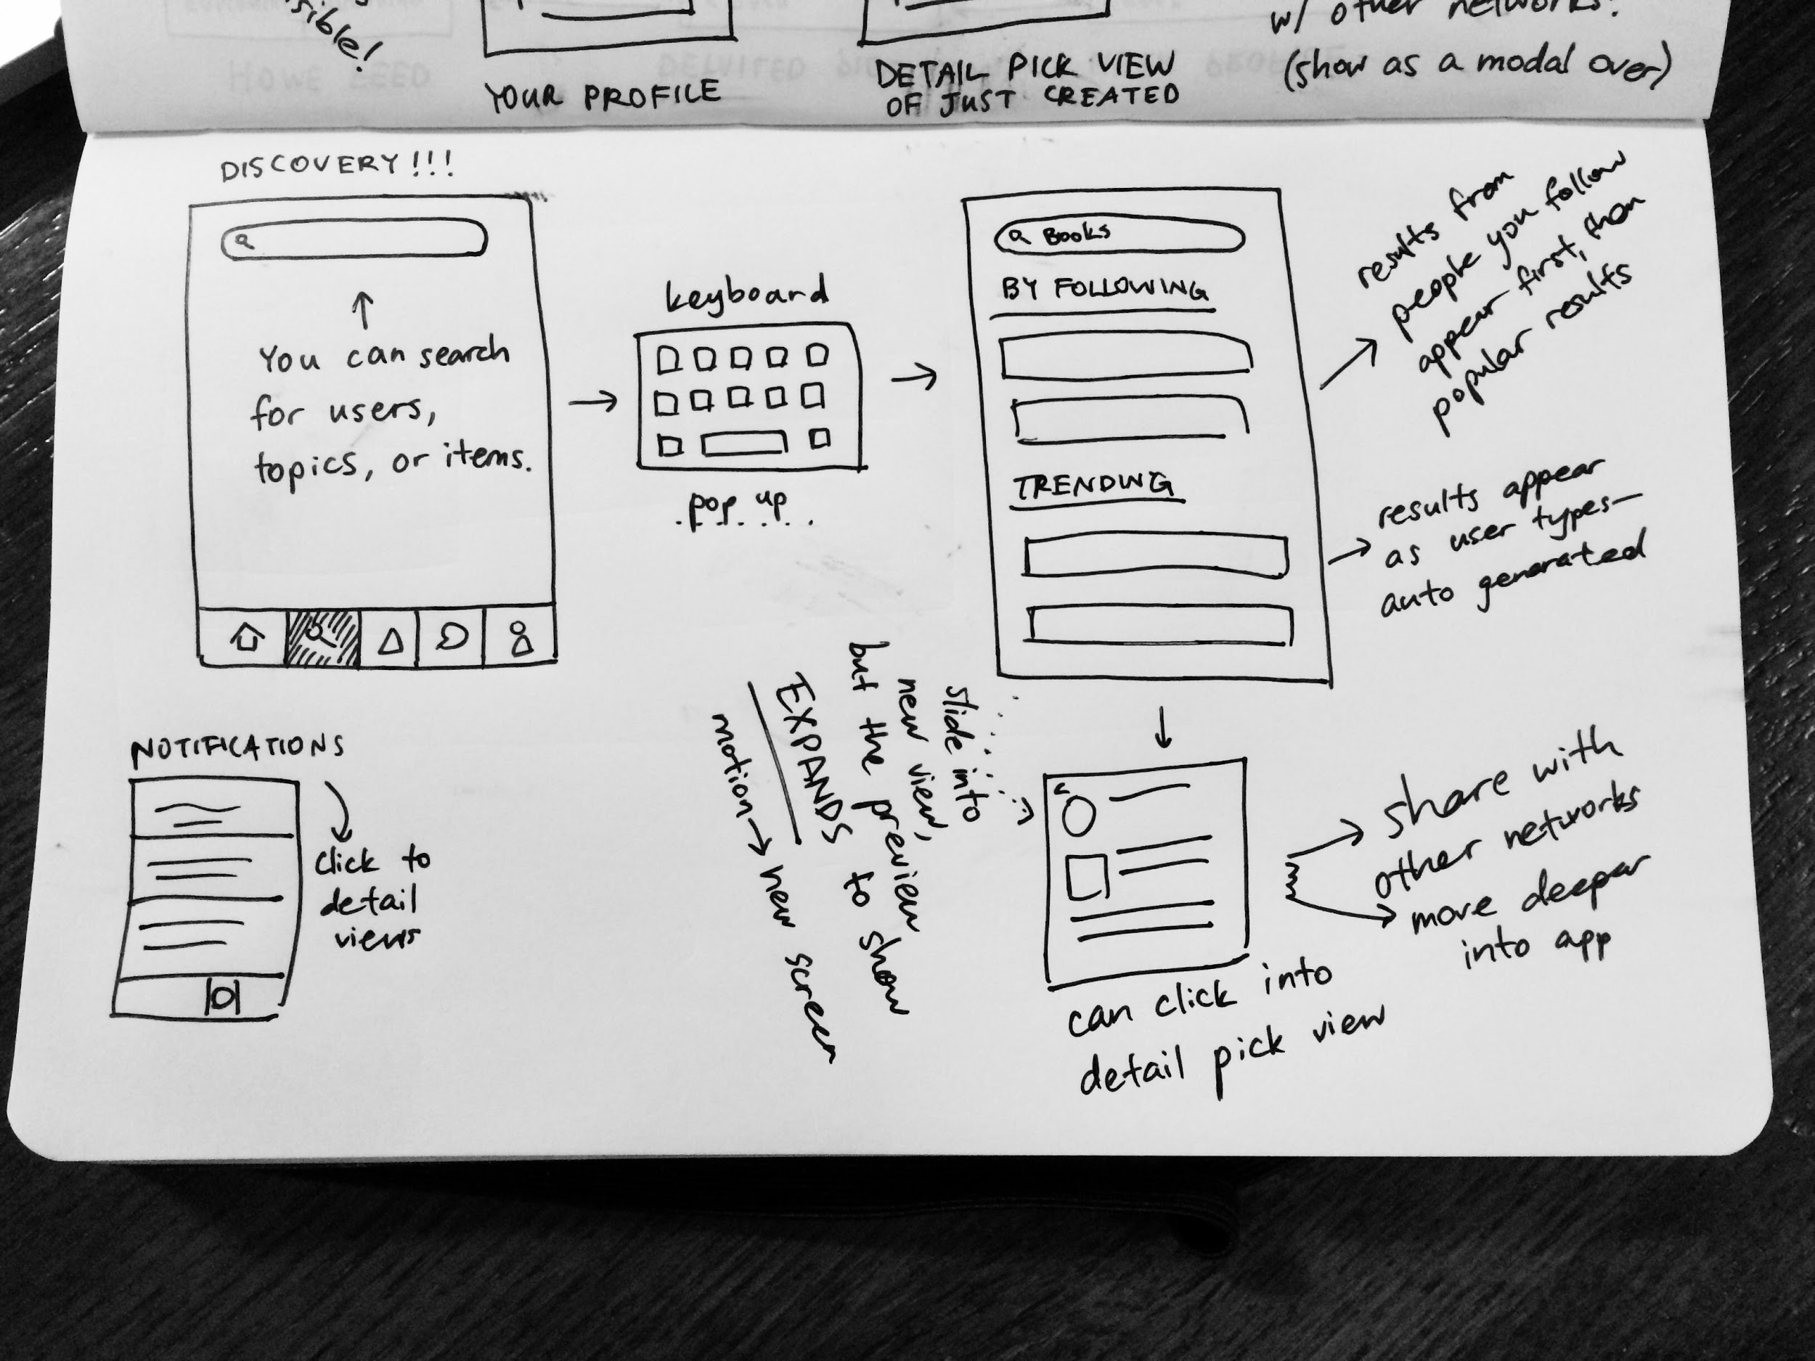
SELECTED INTERFACE

Slide 12
RATIONALE
More product-focused
More intuitive interface than the second sketch
Encourages users to post one pick at a time
More mobile-friendly
Second sketch asked for picks in the form of collection of picks by theme
Ended up incorporating the story component of the second sketch

Slide 13
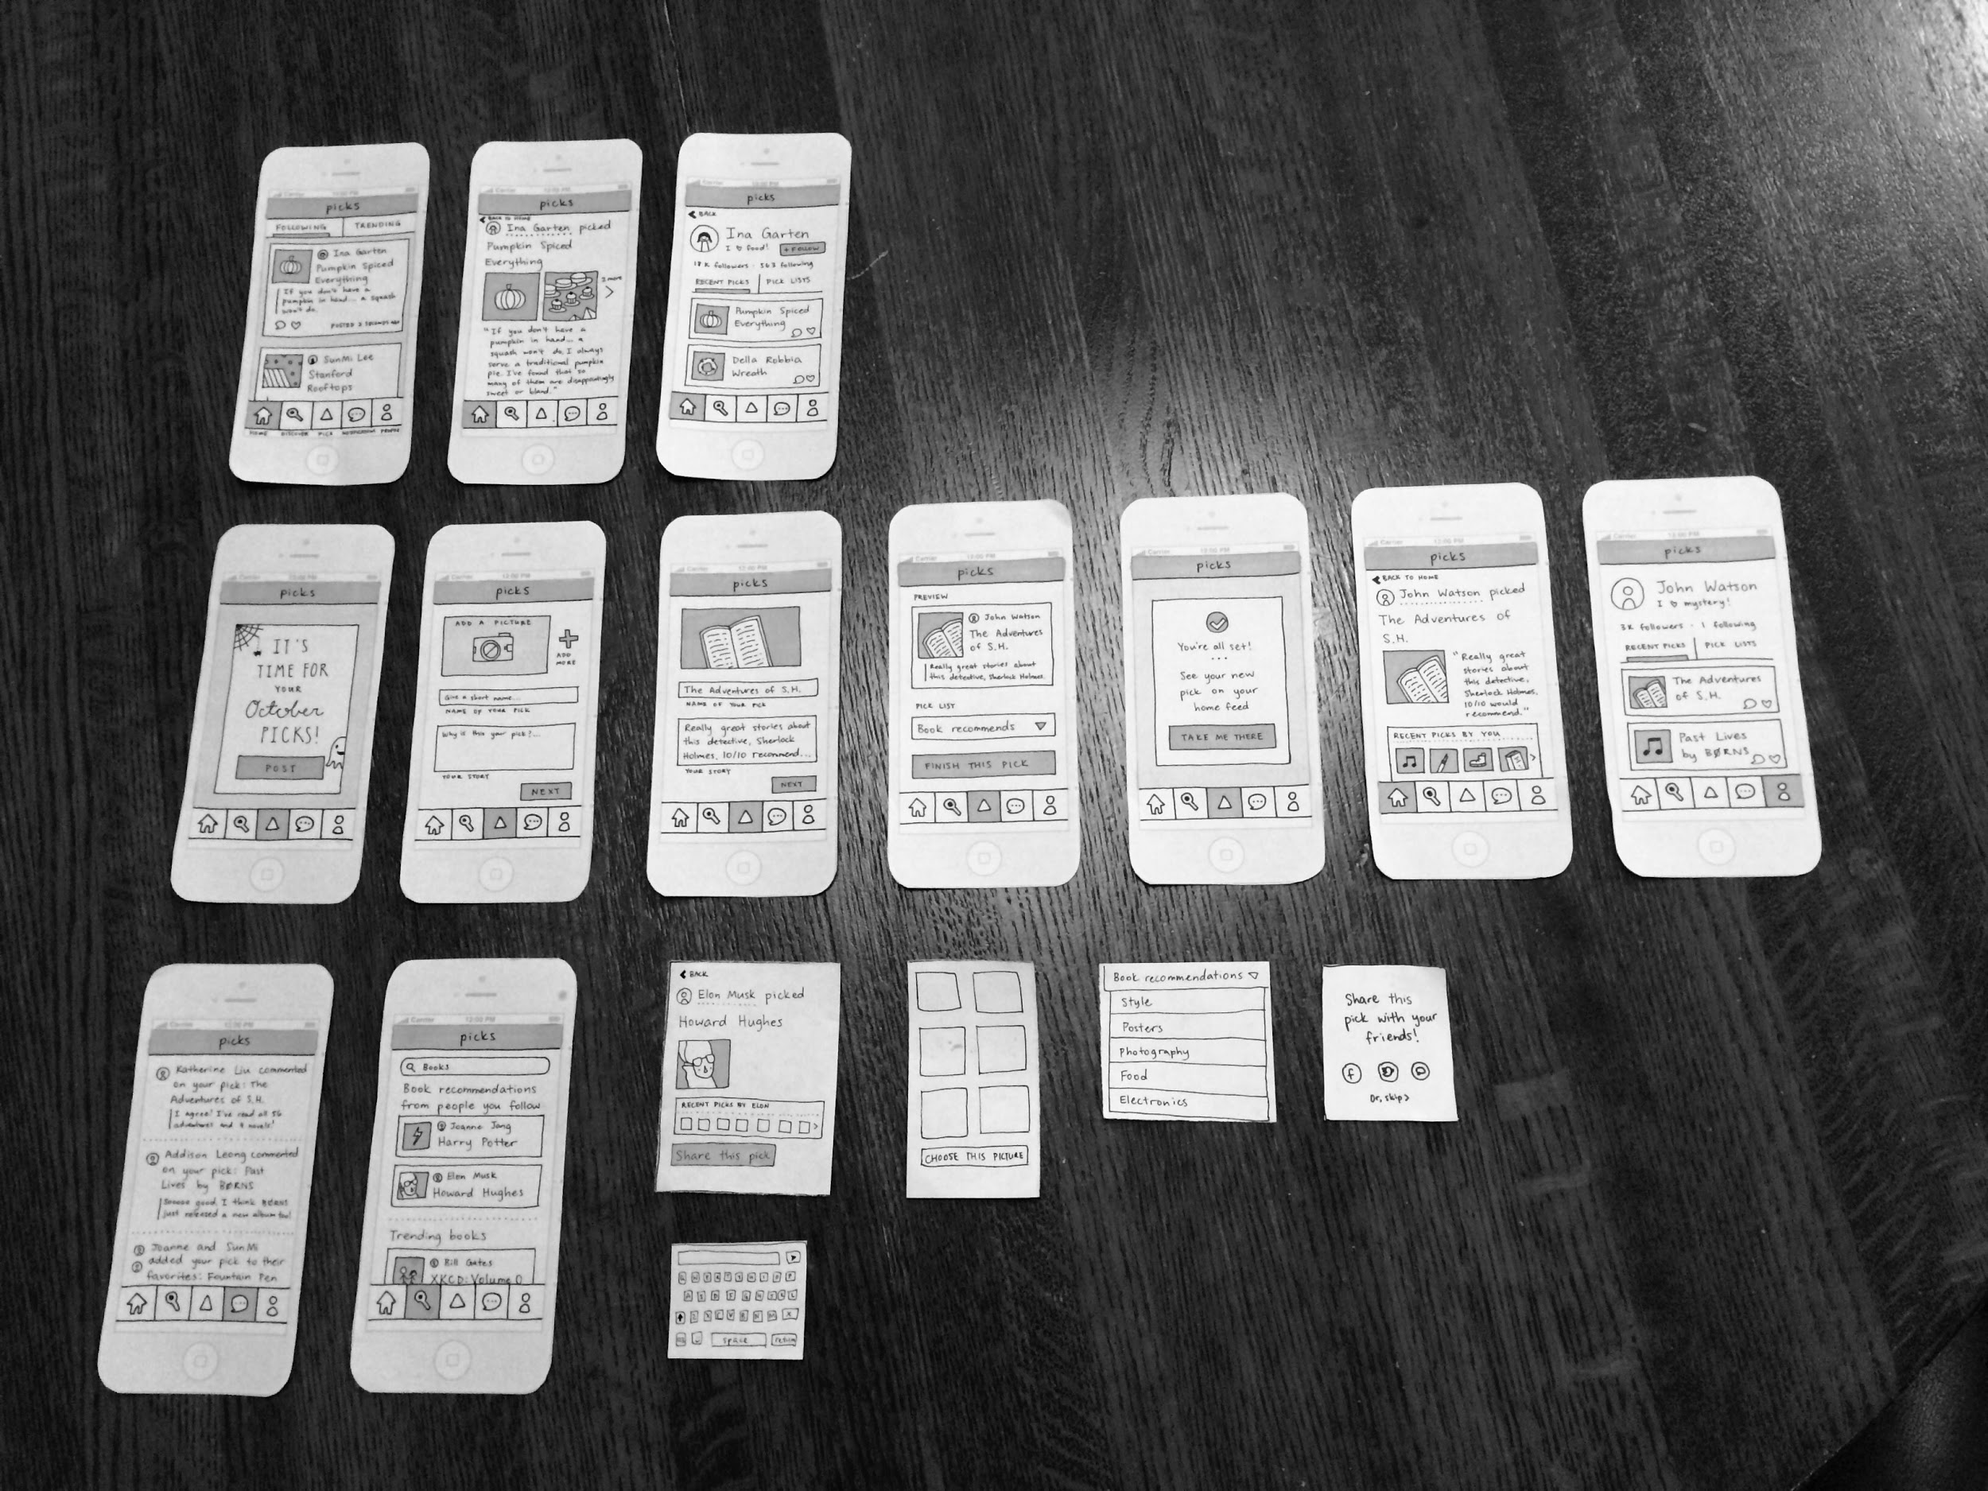
LOW-FI PROTOTYPE

Slide 14
PROTOTYPE STRUCTURE
Flows for each of our three tasks
All screens could be reached through interactions from other screens
Base screen with supporting pop ups (keyboard, choosing a picture, sharing, etc.)
Tried PoP (Prototype on Paper) at first
Participants expected functions like scrolling
Felt we would get better feedback with just paper

Slide 15
TASK FLOW

Slide 16
TASK 1: Discovery + Following

Slide 17
TASK 2: Posting

Slide 18
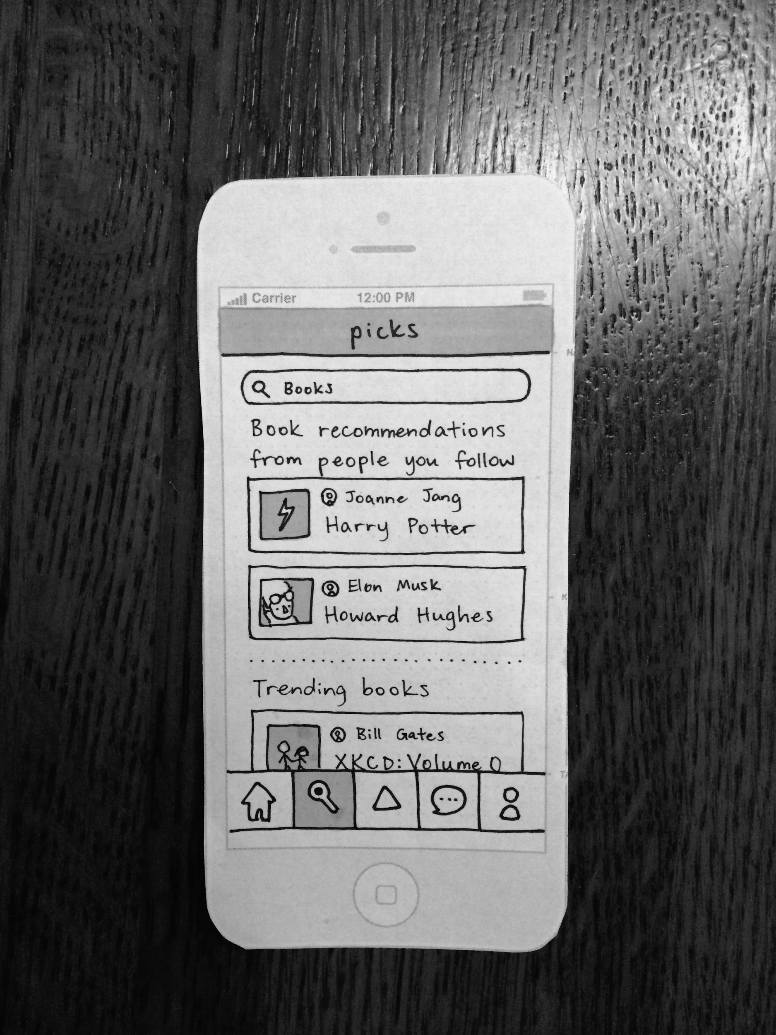
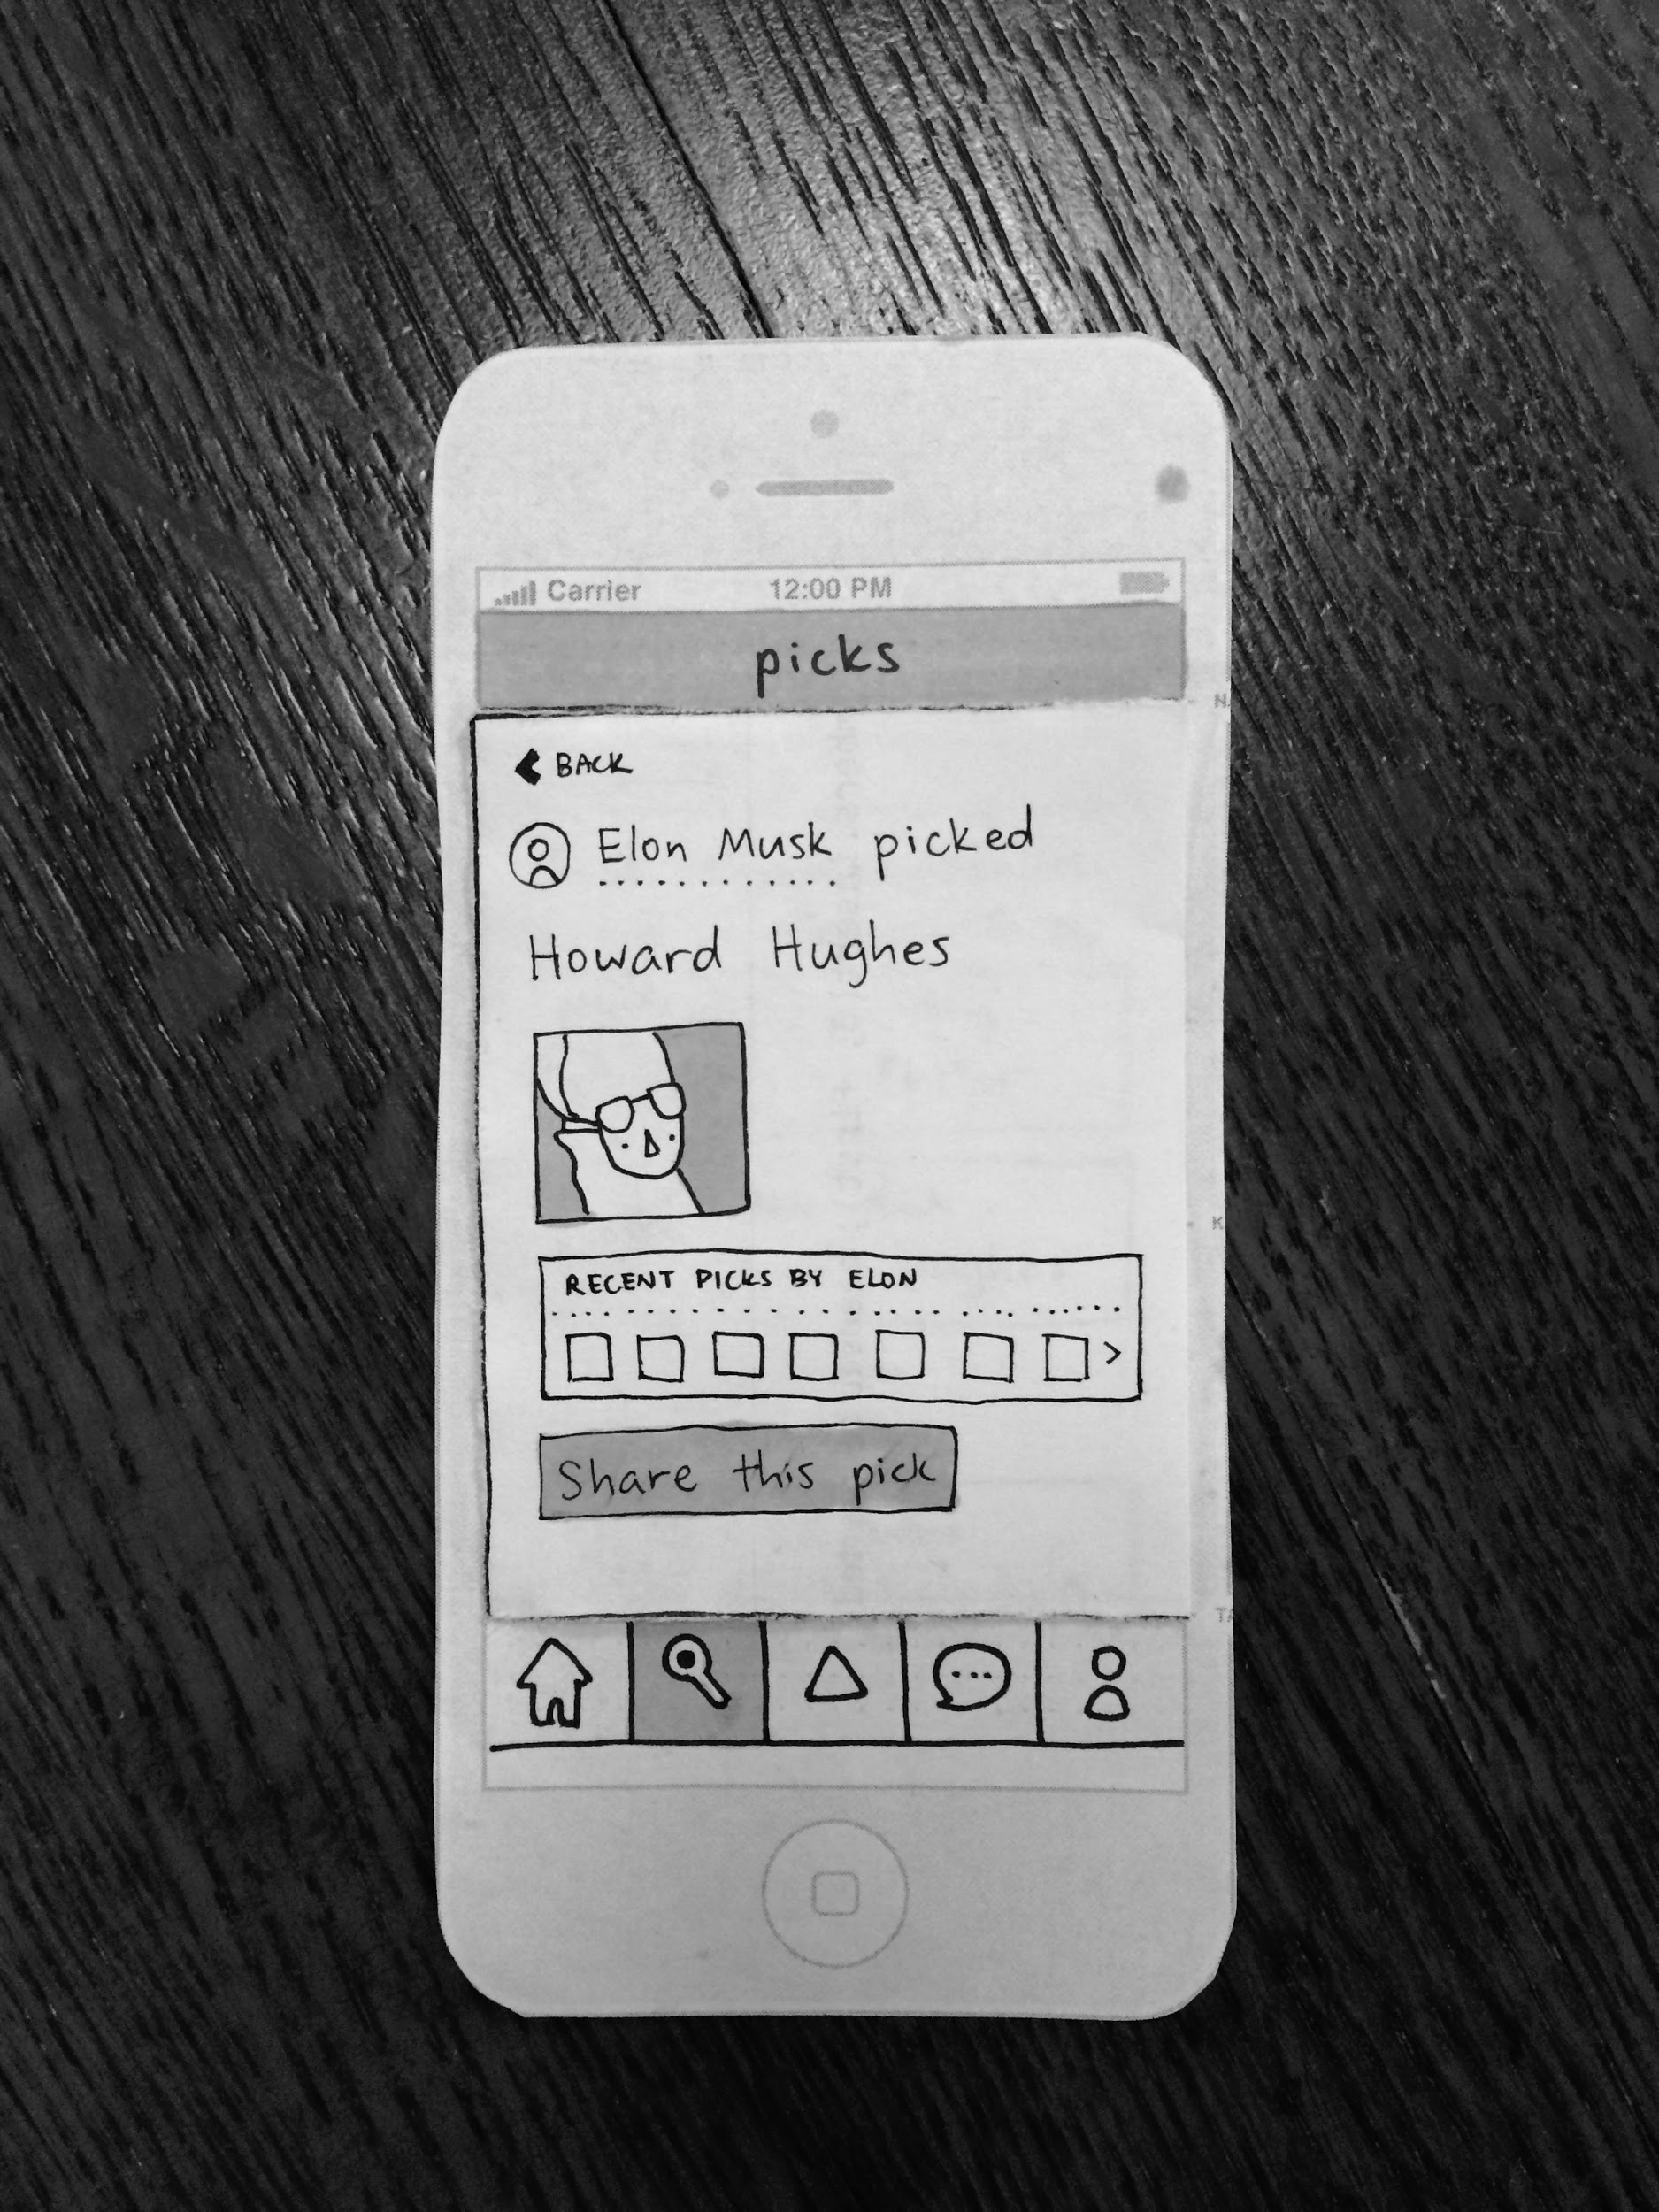
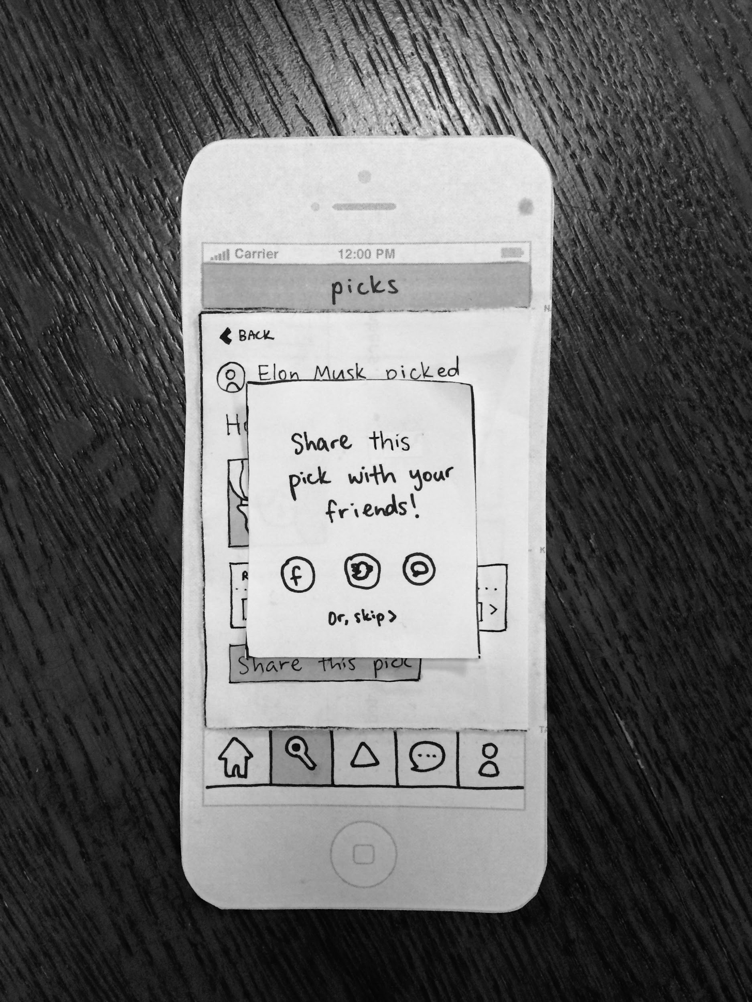
TASK 3: Sharing

Slide 19
EXPERIMENTAL METHOD
Participants
Random selection
Already using mobile
Location
On campus
Method
SunMi, Coordinator + Interviewer
Katherine, Screen Manager / Computer
Joanne, Note Taker
Addison, Photographer

Slide 20
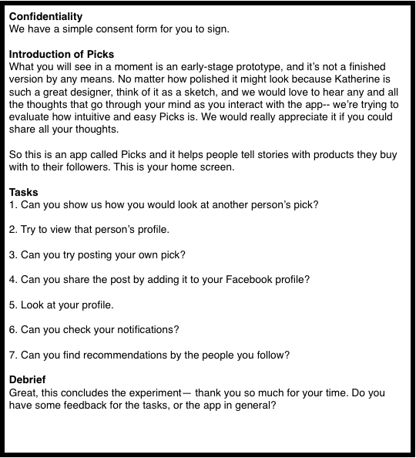
Script
Introduction and consent form
Primer
Task questions and observation
Debrief and additional comments

Slide 21
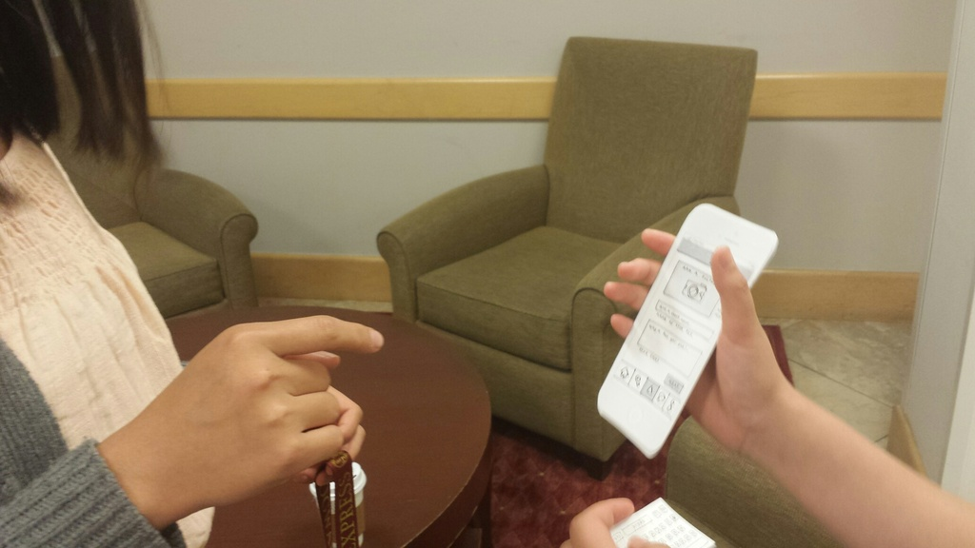
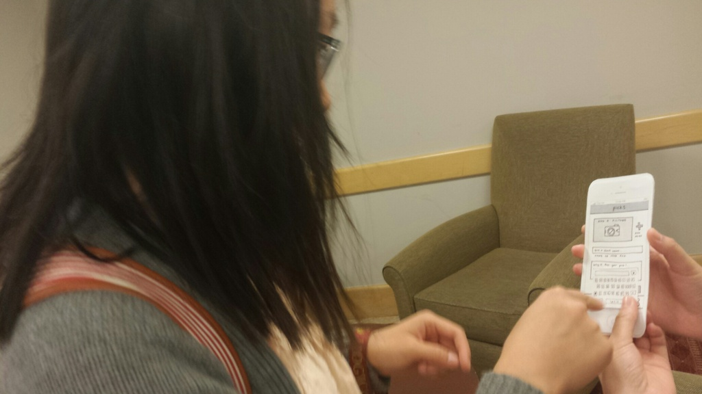
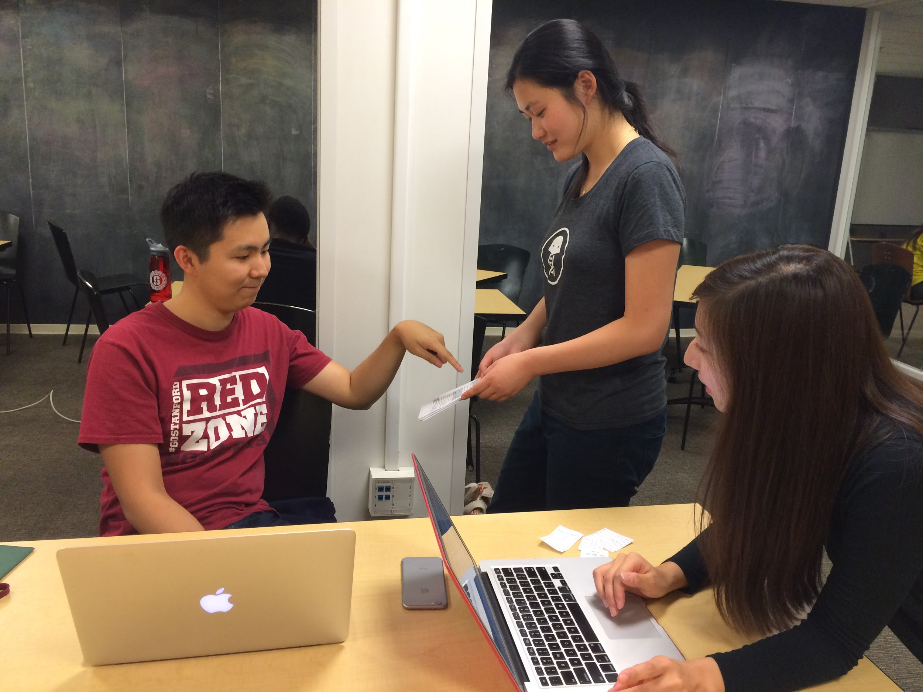
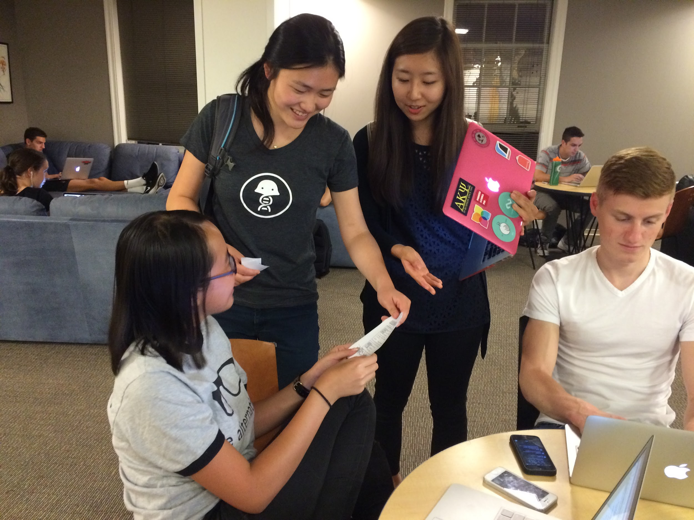
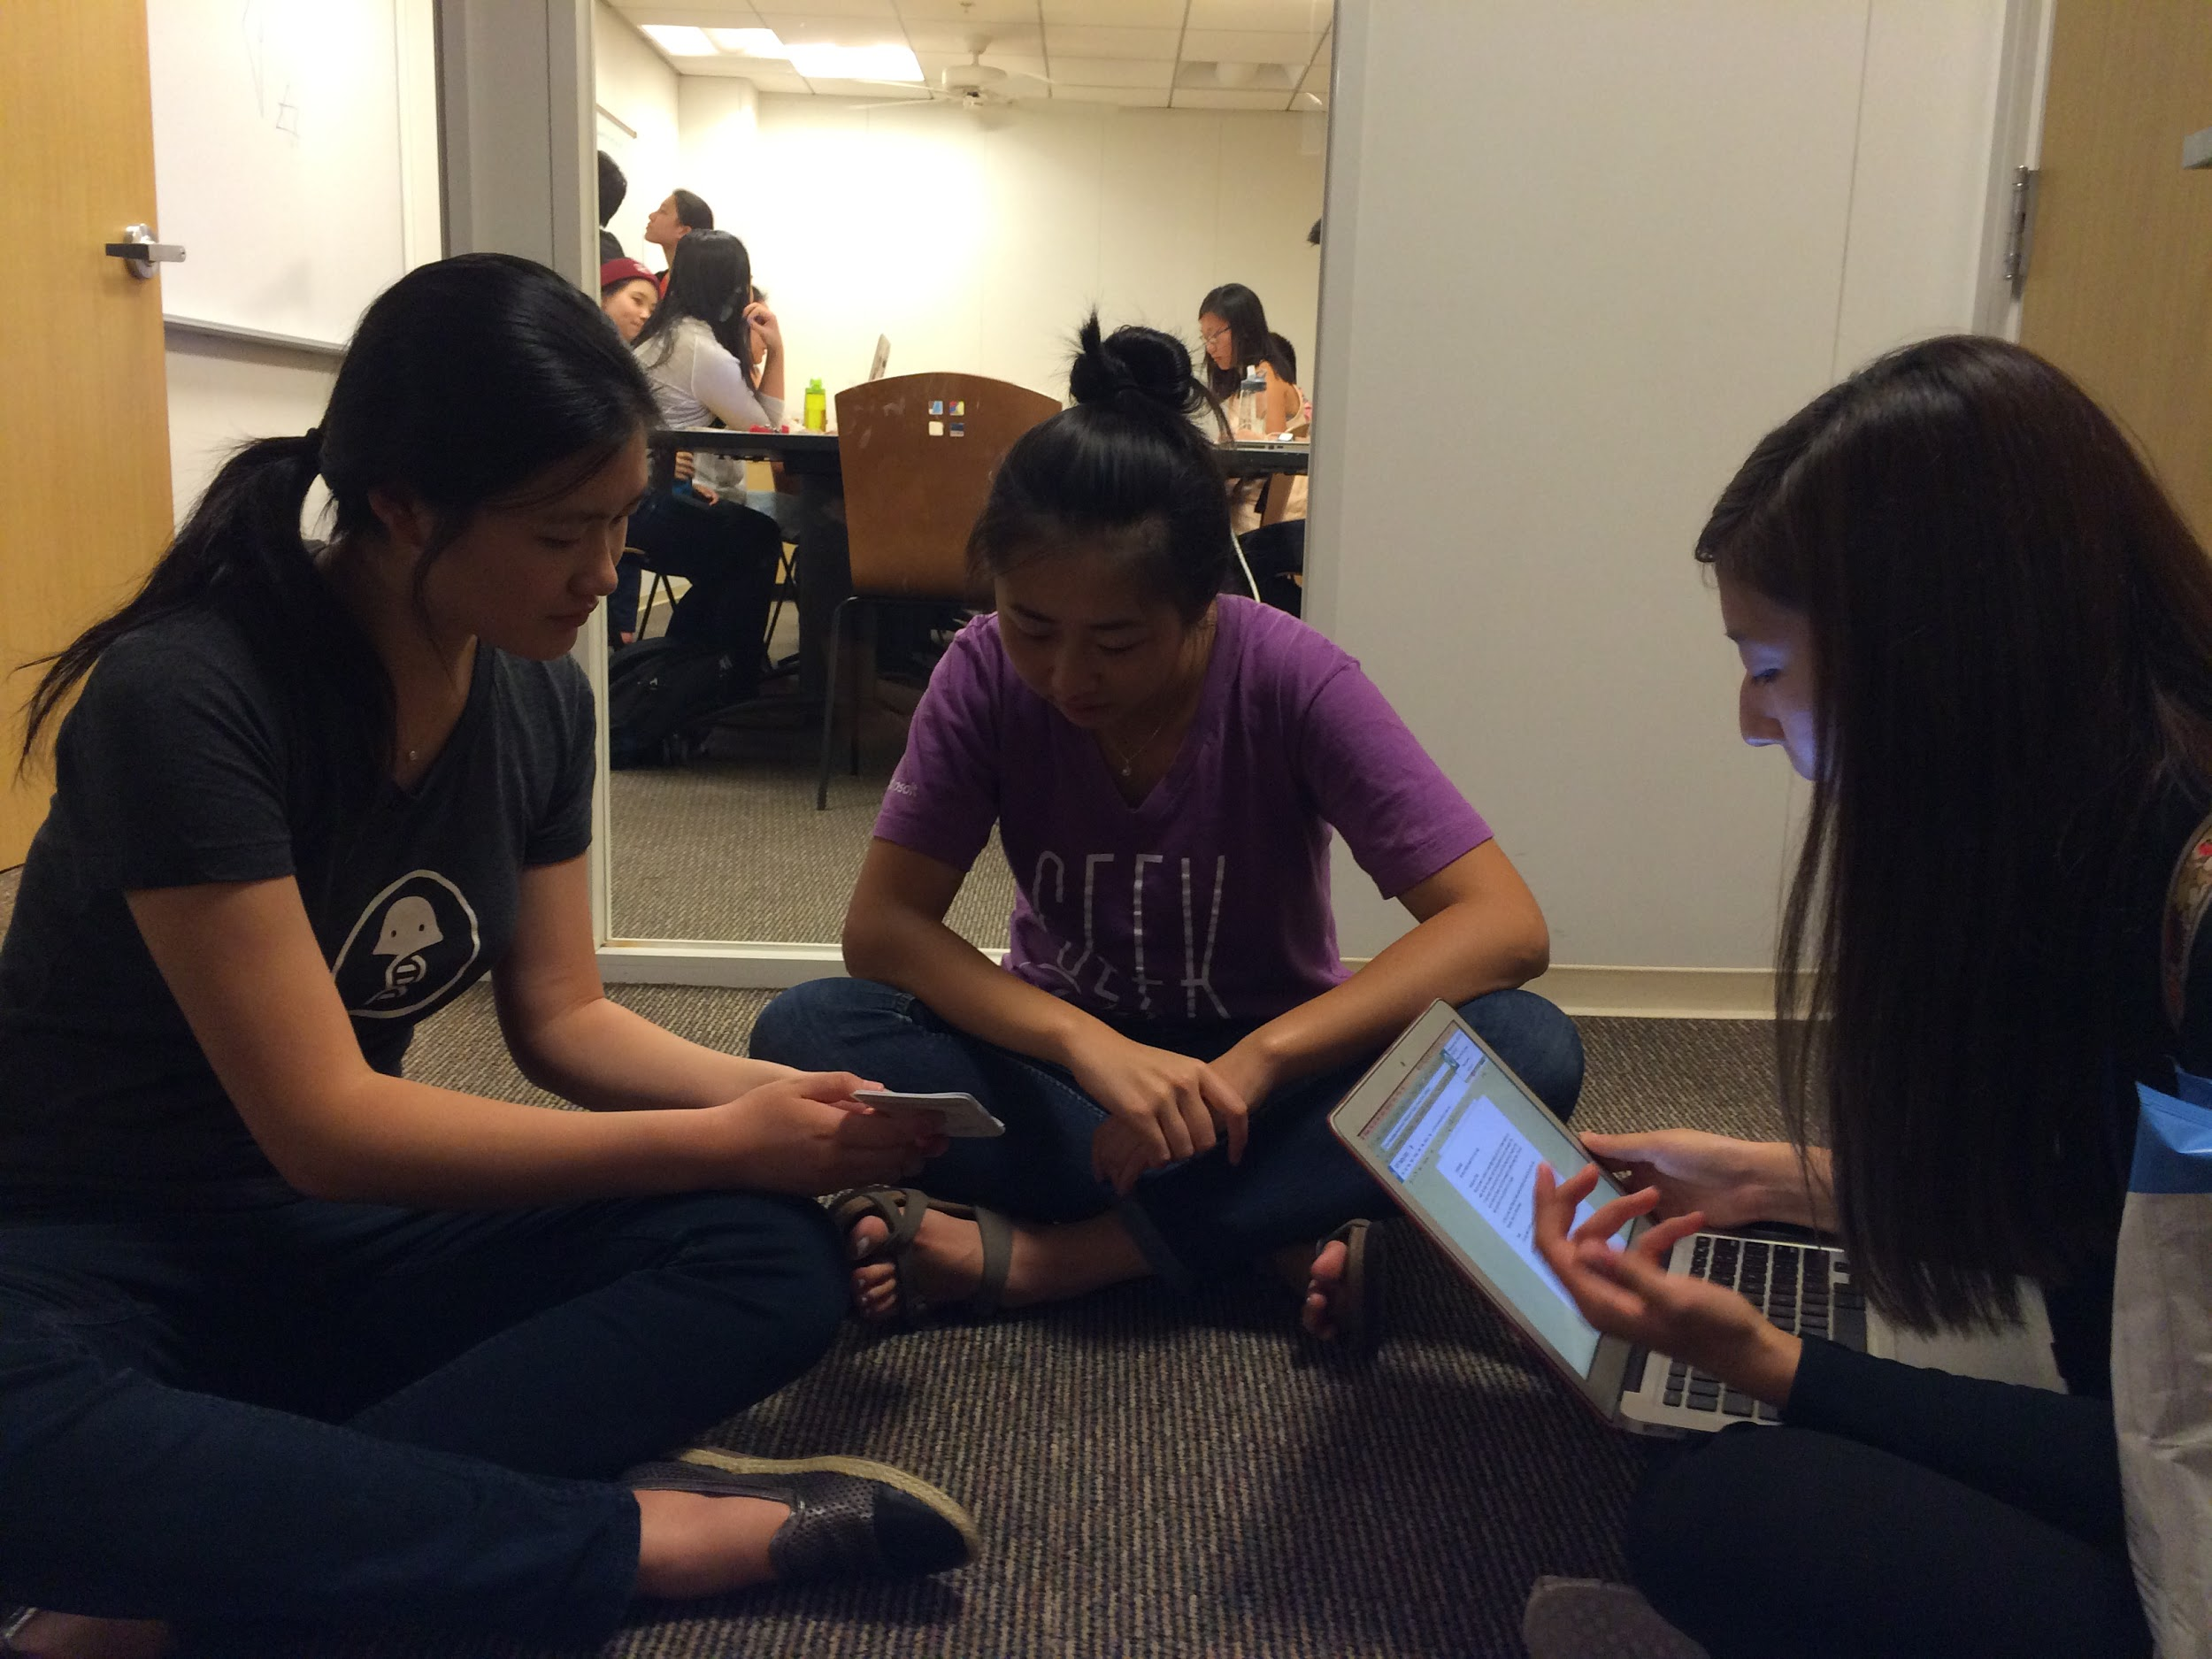

Slide 22
TESTER 1
“Feels very Pinteresty”
Confused because it initially feels like Pinterest, but the workflow is different
Didn’t know where to press to post
Confusion between home feed and search screen
“This looks just like the last screen!”
Score: 2 - minor usability problem

Slide 23
TESTER 2
Went through the app very quickly
Wanted to see previous picks as well (September picks rather than just October)
Couldn’t find the notifications button
Tried going to the user profile and looking for notifications button rather than looking at lower menu bar
Score: 2 - minor usability problems

Slide 24
TESTER 3
Also finished most tasks very easily
Mentioned some small, specific buttons while working through the tasks
Wanted to see the “pick list” (which we didn’t have)
Tried to select multiple photos for a single post
Notifications button looked like messaging button
Score: 2 - minor usability problem

Slide 25
TESTER 4
Fully narrated his thoughts while going through
Took a while to figure out how to post
“There’s a triangle I’m tempted to pick on. But I’m going to go back to user screen first”
Wanted each post to highlight more elements
Who shared the pick
Who was commenting on each pick
Score: 2 - Minor usability problems

Slide 26
RESULTS
Users were confused by icons (triangle, notifications)
Some users gravitated to the feed instead of other parts of the app
Didn’t account for uses some users wanted (taking photos)
“Very Pinteresty”

Slide 27
UI + FEATURE CHANGES
New icons that better display meaning
UI and experience differentiation from Pinterest
Experiments with new features:
Monthly posting limits
User profiles that group picks based on month
Being able to select multiple pictures per post

Slide 28
SUMMARY
2 = minor usability problem – confusion about icons and home feed vs. search feed
Differentiate from Pinterest
Insights about wishes and needs:
Categorize picks as features by month

Slide 29
QUESTIONS || FEEDBACK

