Slide 1
Concept Video
Dartis Willis
Cristian Lara
Neven Wang-Tomic

Slide 2
Value Proposition and Overview
“Never miss out”
Finding reliable information about events is incredibly difficult. By enabling people to make informed decisions about events through user-driven data, we can improve the event-going experience as a whole.

Slide 3
Three Tasks
Simple: Find upcoming events in your area.
Medium: Share information (photos, comments, etc) about events while at them.
Complex: Decide whether or not to go to an event.

Slide 4
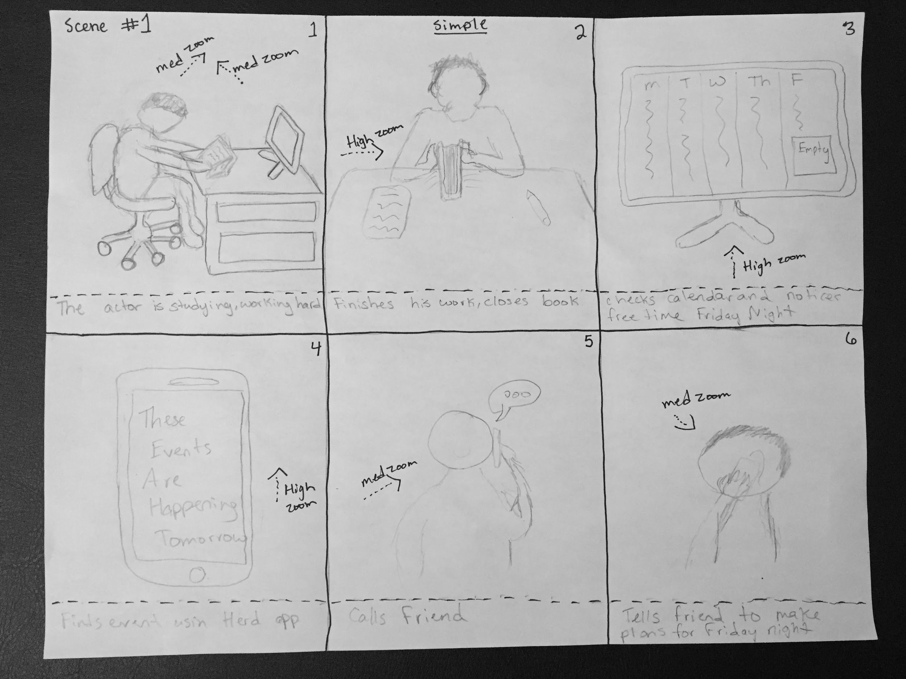
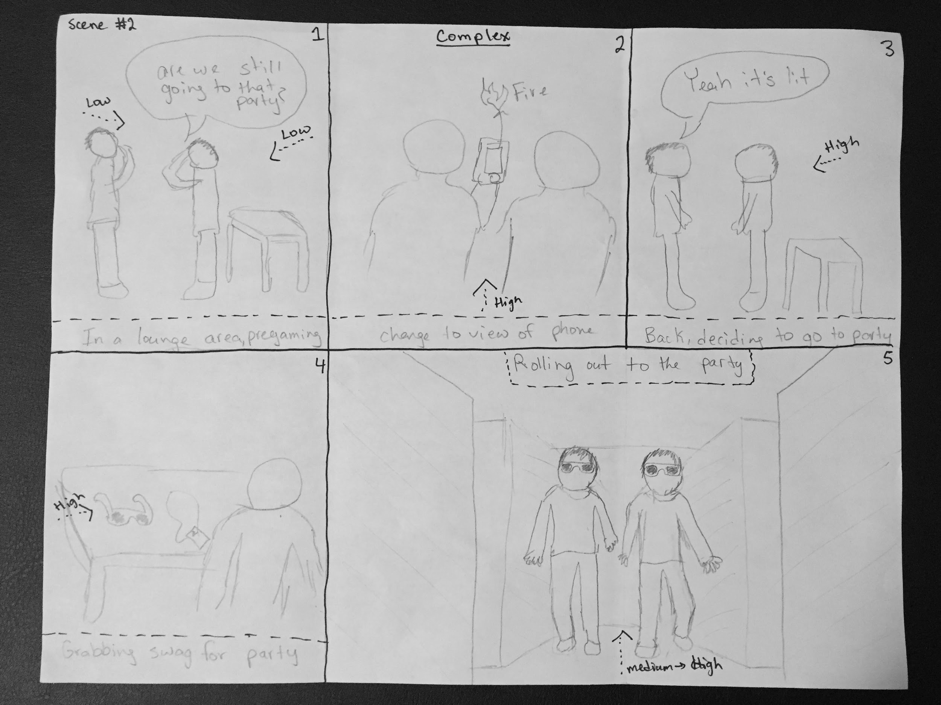
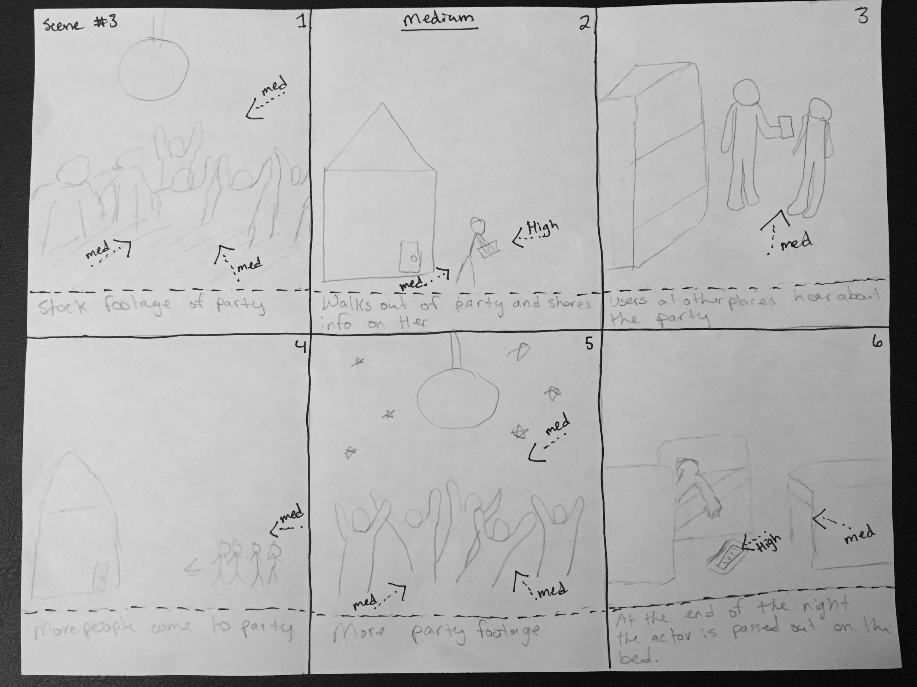
Storyboard
https://www.youtube.com/watch?v=1_6CTiQ-FnY

