Slide 1
Low-fi Prototyping & Pilot Usability Testing
Cody Sugarman, Elizabeth Davis, Alona King

Slide 2
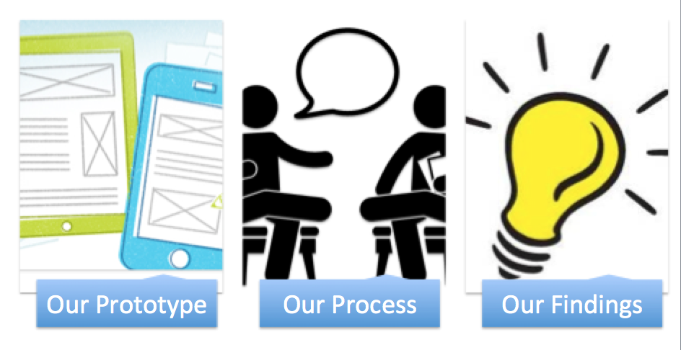
We will cover...

Slide 3
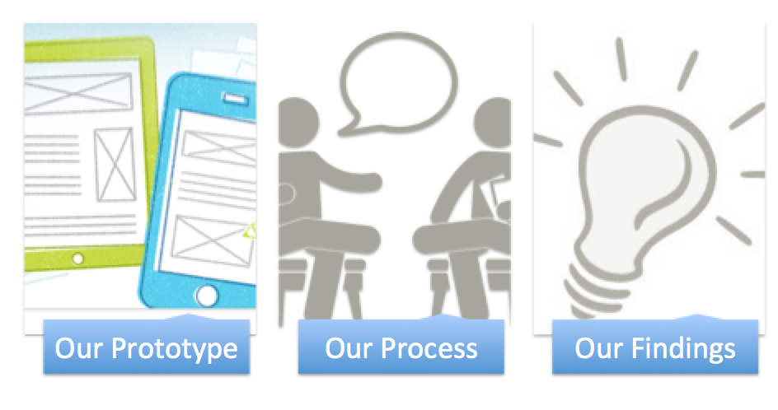

Slide 4
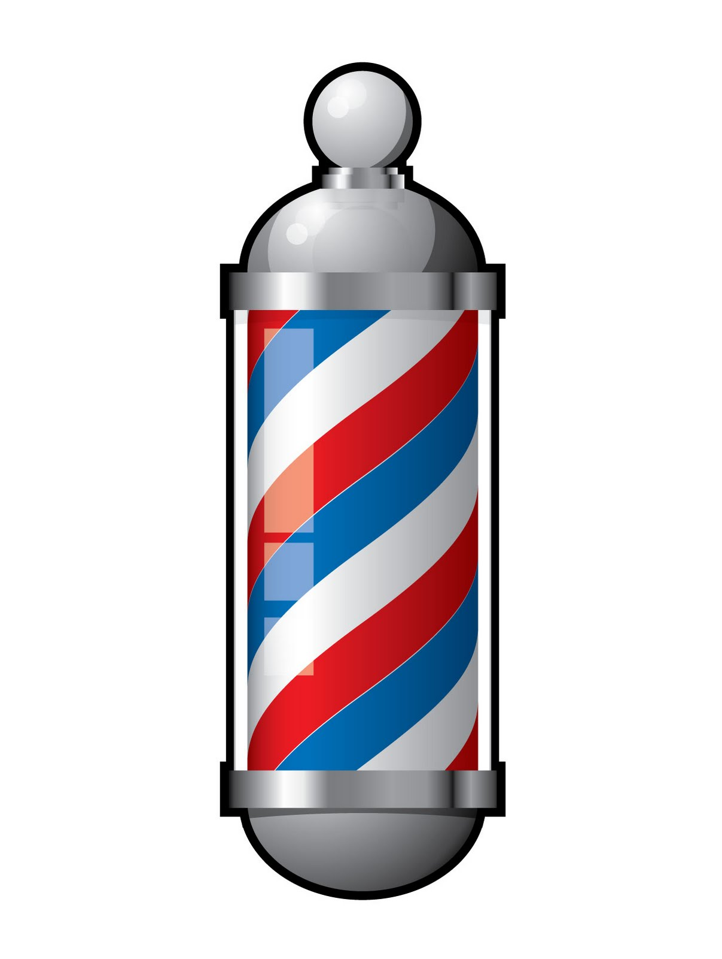
Fleek.
“Enabling black men and women to discover and share local, high-quality hair care content”

Slide 5
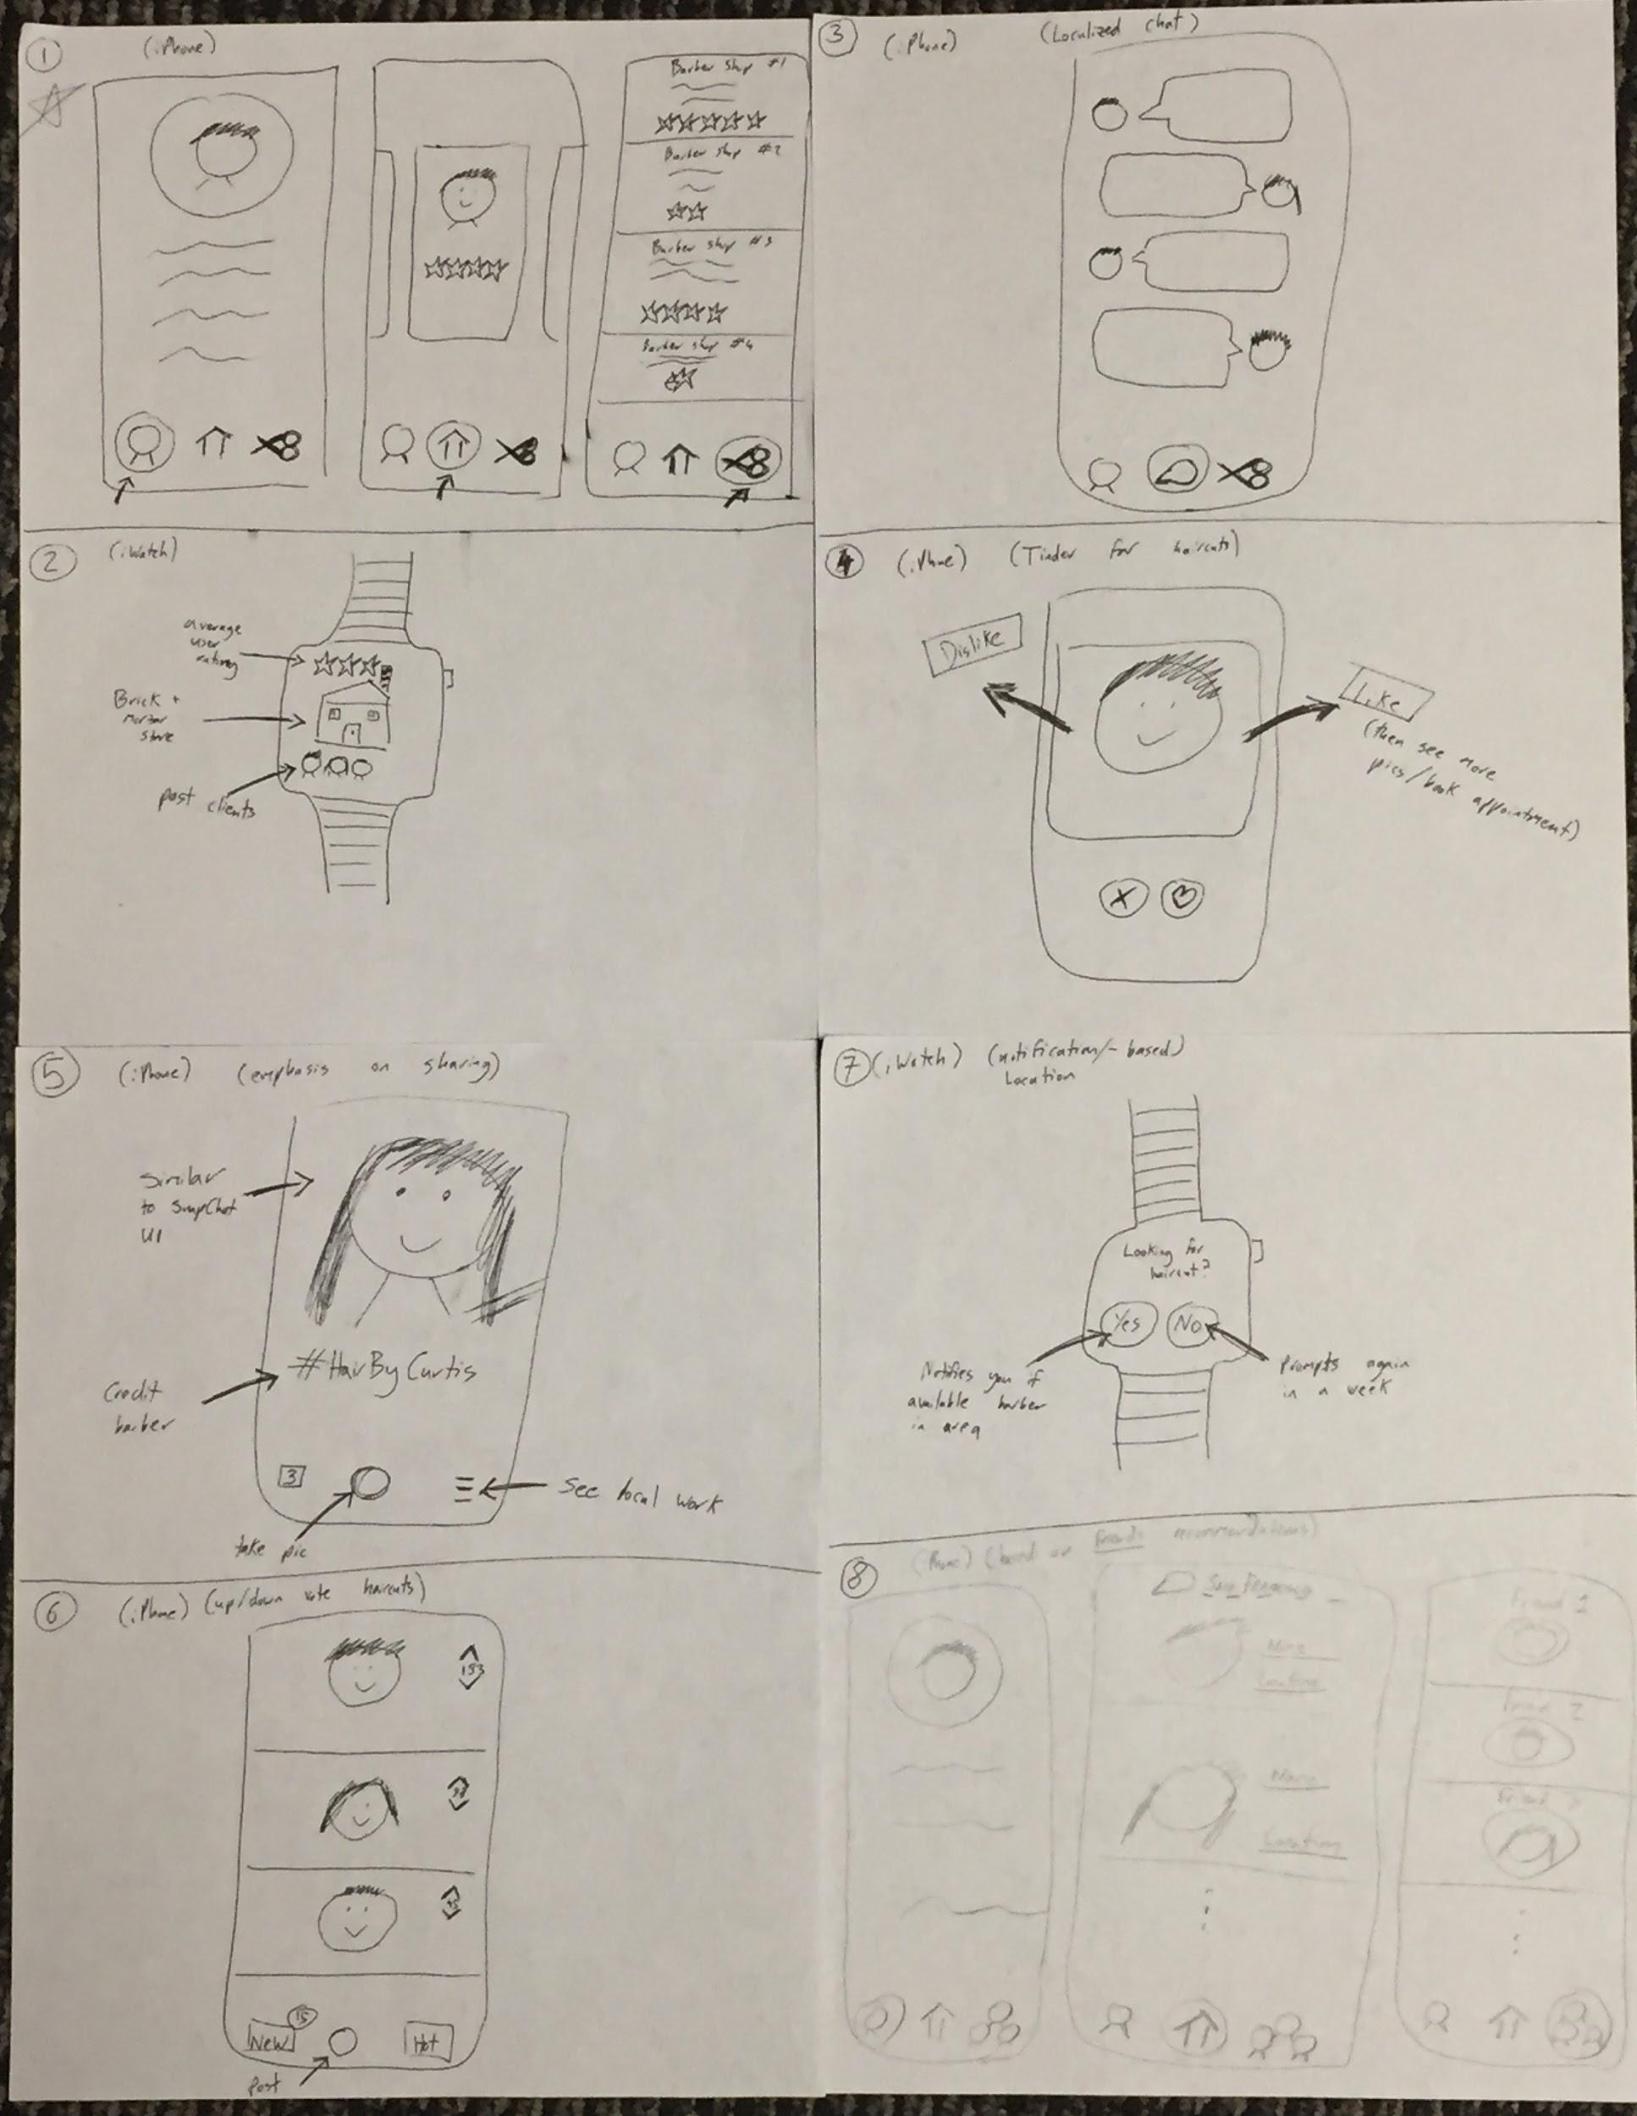
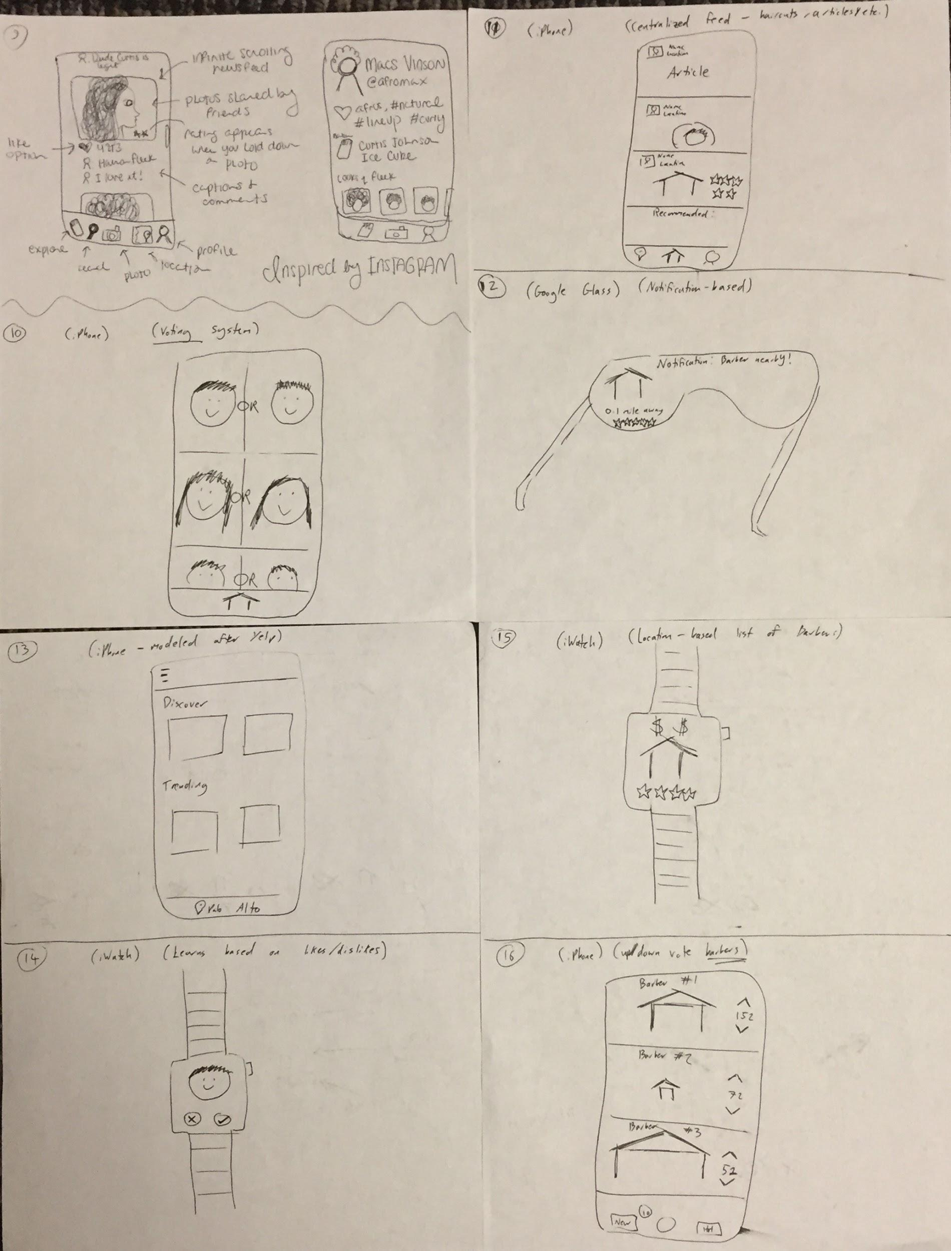
Selected Interface

Slide 6
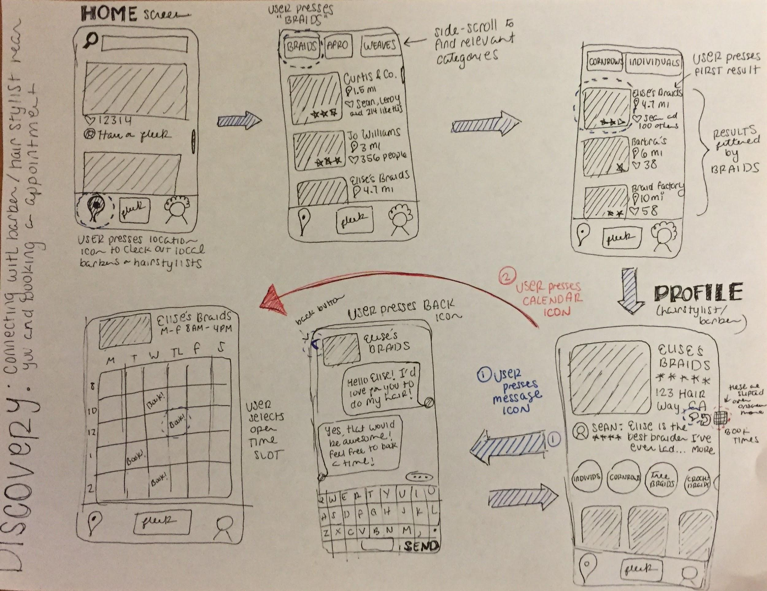
DISCOVER

Slide 7
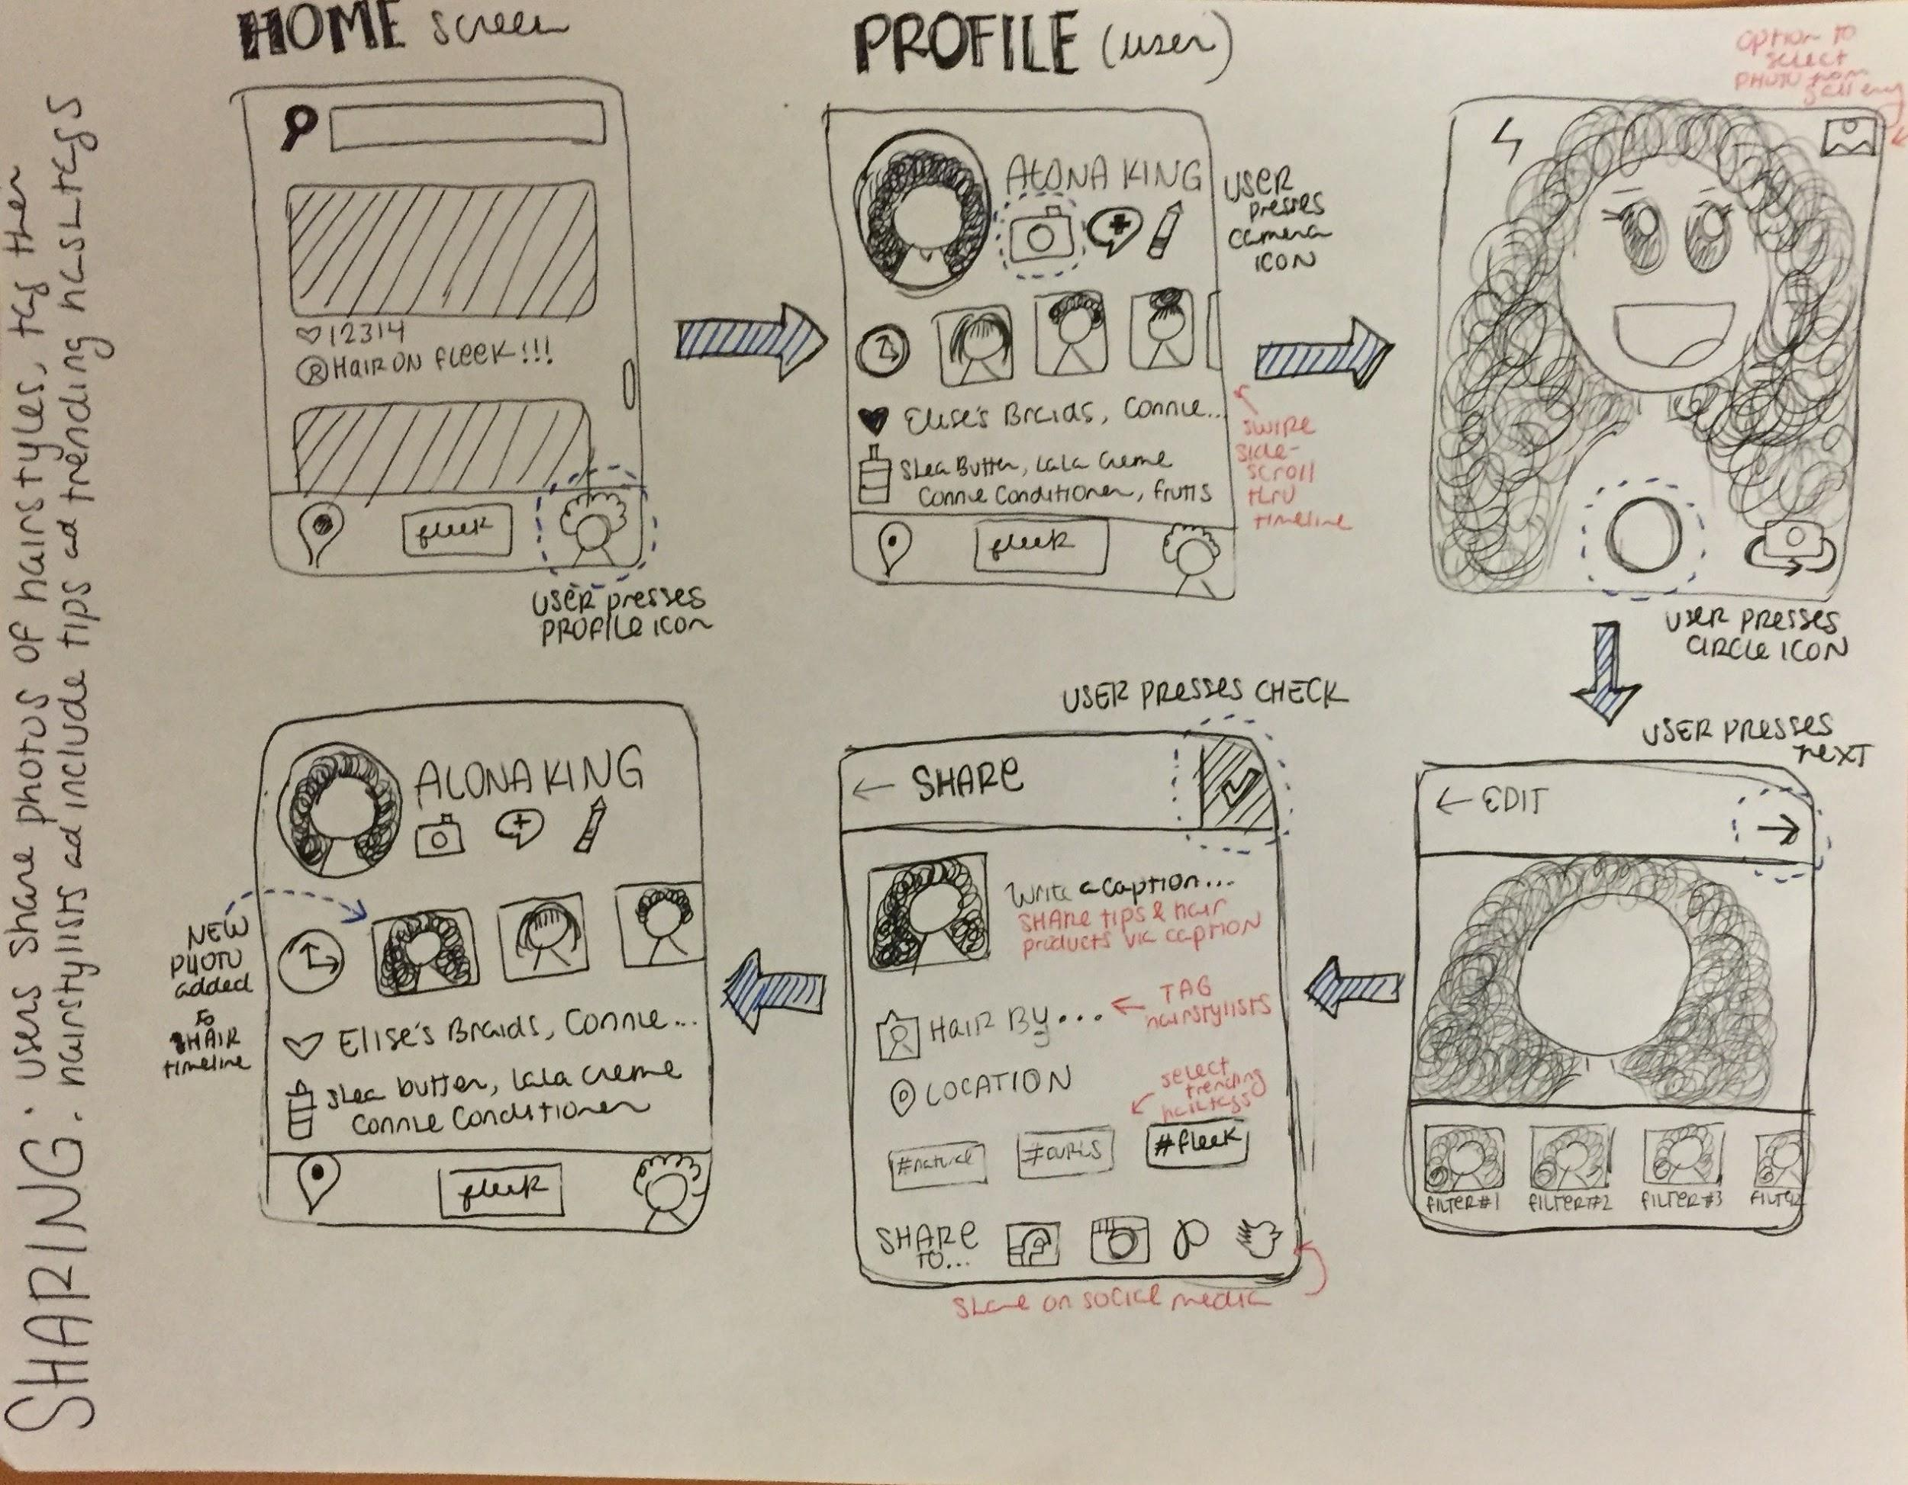
SHARE

Slide 8
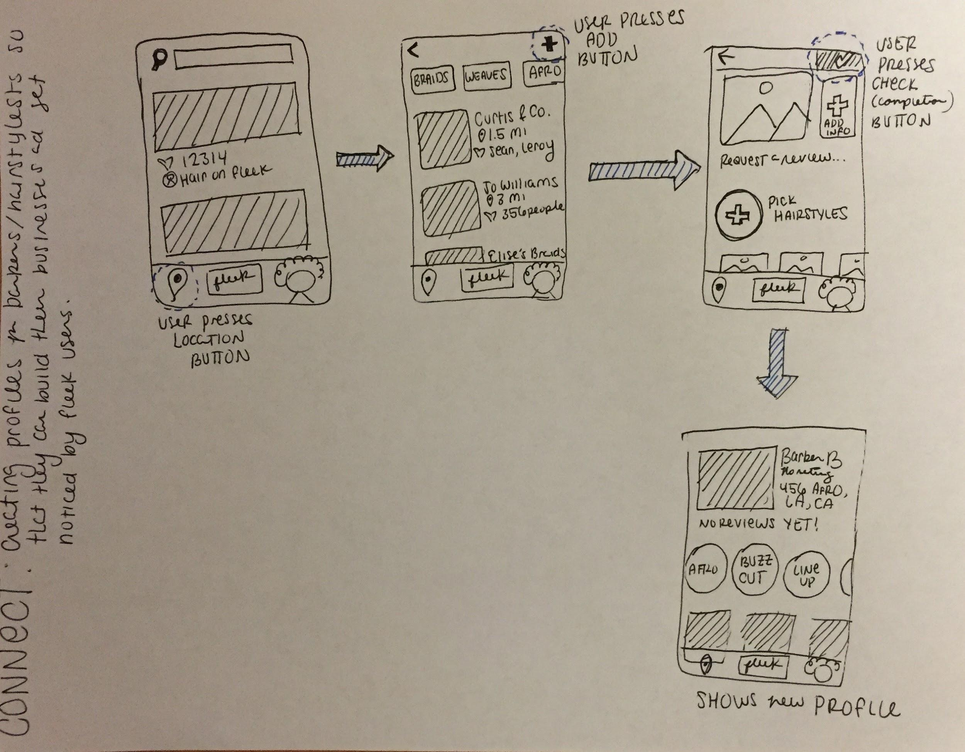
CONNECT

Slide 9
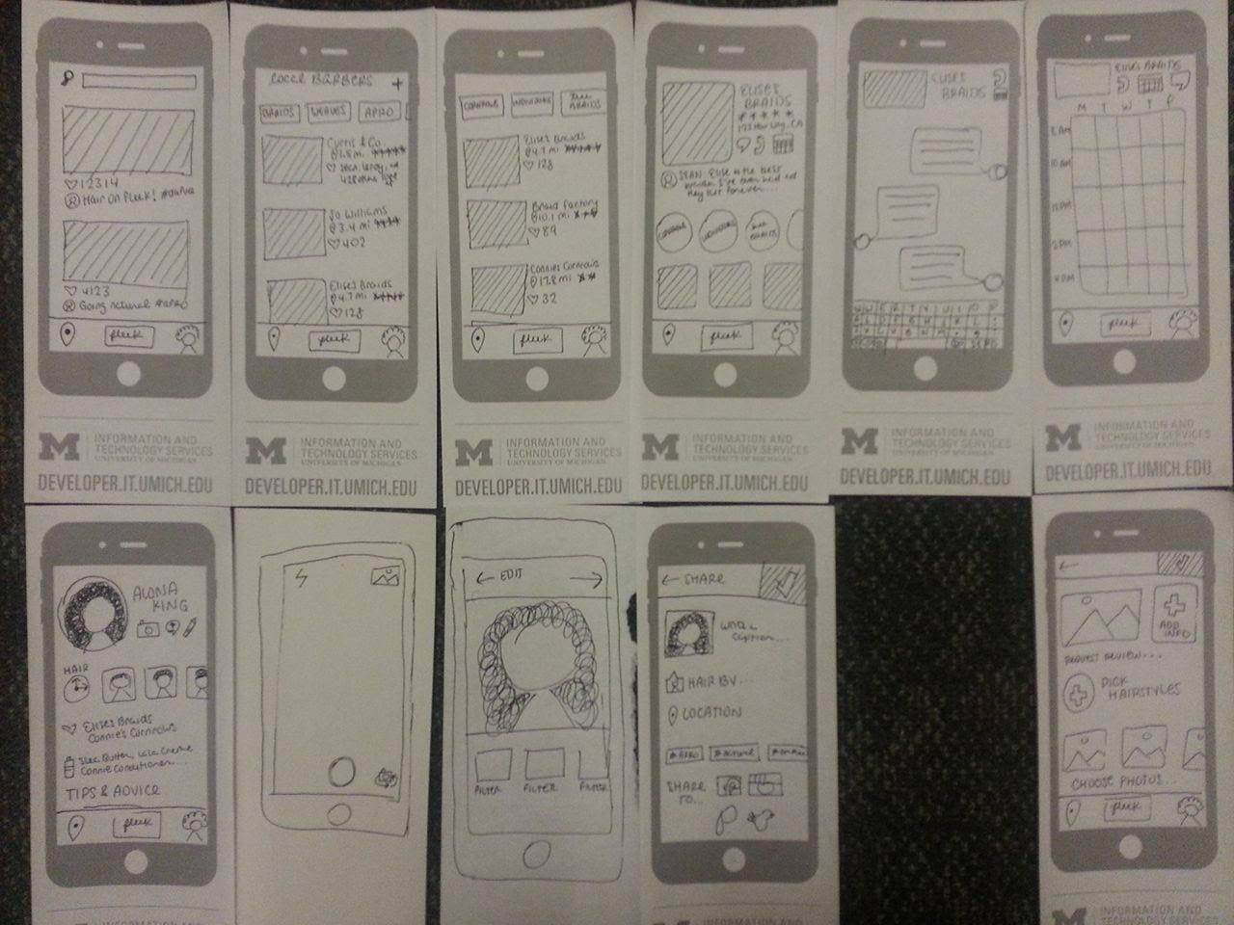
Low-fi Prototype

Slide 10
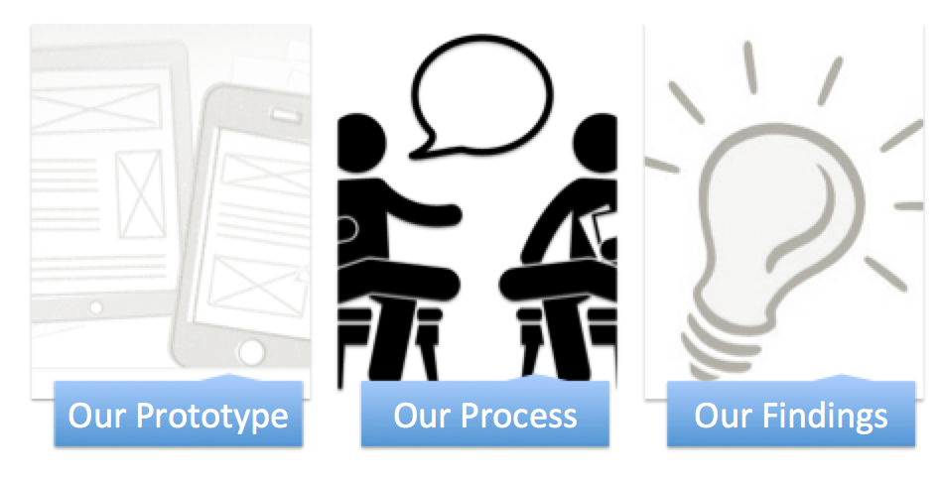

Slide 11
Experimental Method

Slide 12
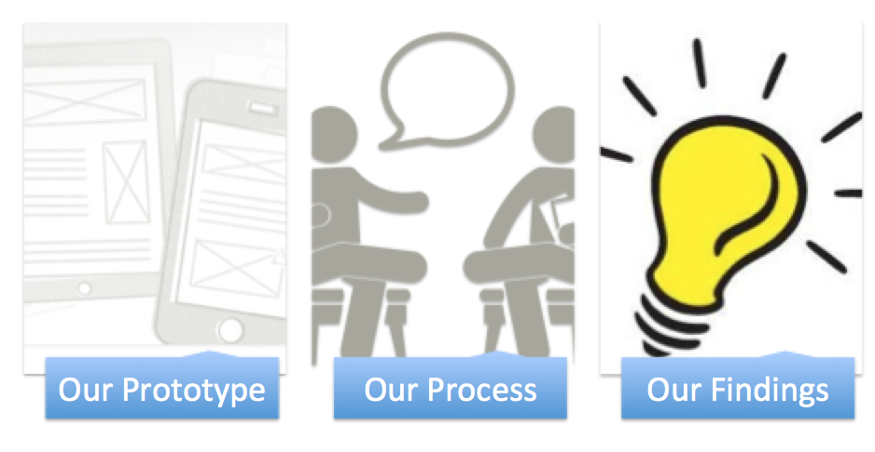

Slide 13
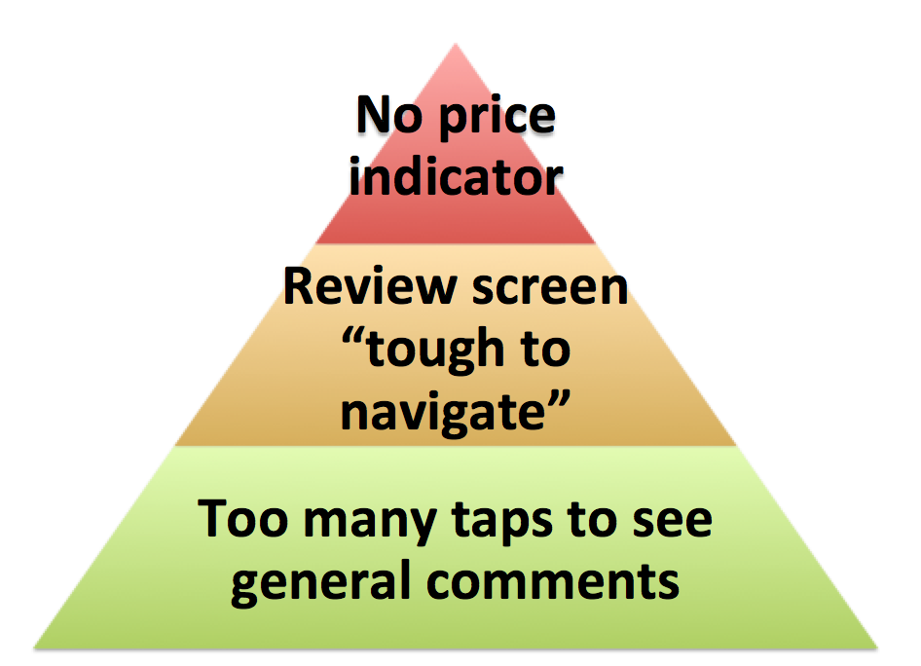
DISCOVER Findings

Slide 14
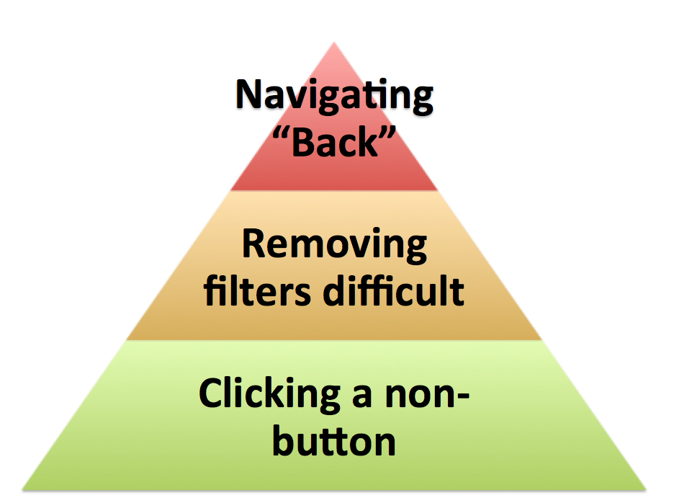
SHARE Findings

Slide 15
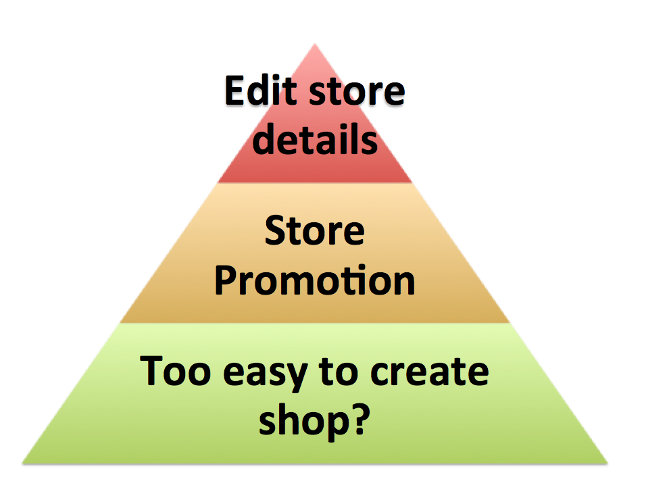
CONNECT Findings

Slide 16
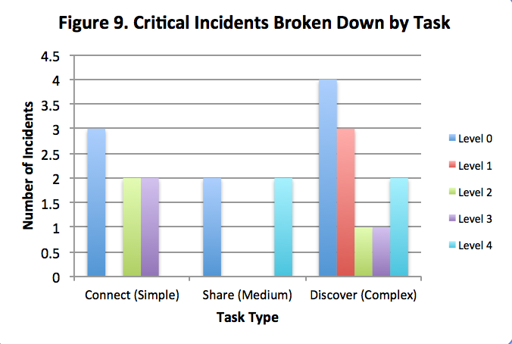
Summary of Findings:

Slide 17
We have covered...

Slide 18
Thank You!
Any Questions?

