Slide 1
Needfinding
Cody Sugarman, Elizabeth Davis, Alona King
Notes:
Introduce team - I’m Cody Sugarman, Junior majoring in CS with a focus in HCI...

Slide 2
Crowd Power
Notes:
Three very different directions with our interviews as it relates to crowd power...

Slide 3
Our Process
Notes:
Touched on previously but in all of our interviews we really tried to start with broad, surface level questions and gradually get to more sophisticated topics with our subjects through stories so we could break down the critical questions of Why they do the things they do

Slide 4
Notes:
I interviewed based on the interesting new job opportunities from the shared economy that have clearly attracted an incredibly vast and diverse workforce. Talk about an Uber driver, Mike, I chatted with during (and slight after) a drive into Palo Alto.

Slide 5
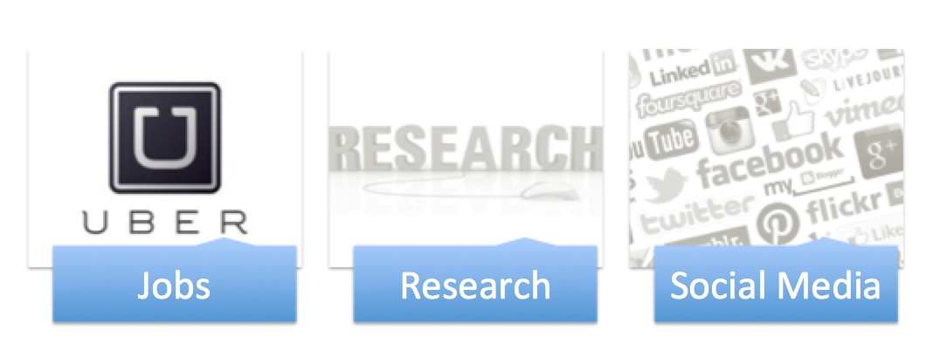
Notes:
I interviewed based on the interesting new job opportunities from the shared economy that have clearly attracted an incredibly vast and diverse workforce. Talk about an Uber driver, Mike, I chatted with during (and slight after) a drive into Palo Alto.

Slide 6
“...At uber you don’t get fired you get ‘Account Disabled’…”
Notes:
Lack of human connection

Slide 7
Insights
VS

Slide 8
Notes:
I interviewed based on the interesting new job opportunities from the shared economy that have clearly attracted an incredibly vast and diverse workforce. Talk about an Uber driver, Mike, I chatted with during (and slight after) a drive into Palo Alto.

Slide 9
“4.3 stars on Yelp doesn’t mean the guy’s gonna get my fade right every time...”
Notes:
I interviewed based on the interesting new job opportunities from the shared economy that have clearly attracted an incredibly vast and diverse workforce. Talk about an Uber driver, Mike, I chatted with during (and slight after) a drive into Palo Alto.

Slide 10
Insights
>

Slide 11
Notes:
I interviewed based on the interesting new job opportunities from the shared economy that have clearly attracted an incredibly vast and diverse workforce. Talk about an Uber driver, Mike, I chatted with during (and slight after) a drive into Palo Alto.

Slide 12
“...I definitely spend too much time thinking about captions, lighting, filters… but so does everyone else!”
Notes:
Lani also went in another direction with her interview and decided to survey some Palo Alto locals about their relationship with social media. She started by asking broad questions about platform preferences (i.e. are you a snapchat guy or an instagram guy?) and then attempted to delve into the psychology behind using one platform over another and why the platform of choice was so addicting to them.

Slide 13
Insights

Slide 15
Questions?

