Slide 1
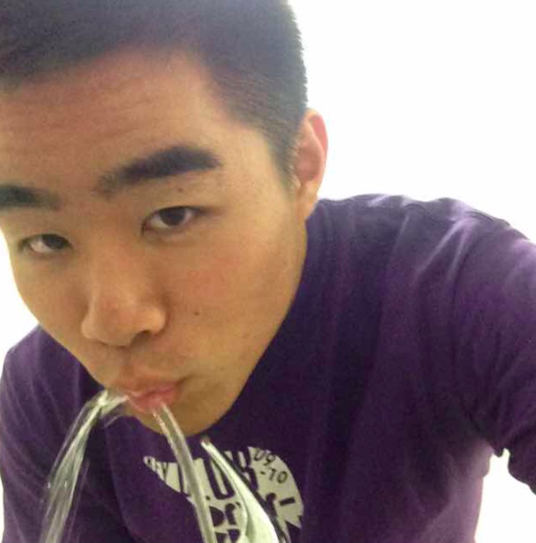
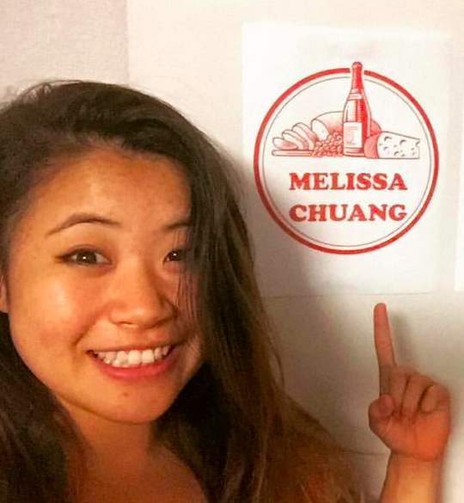
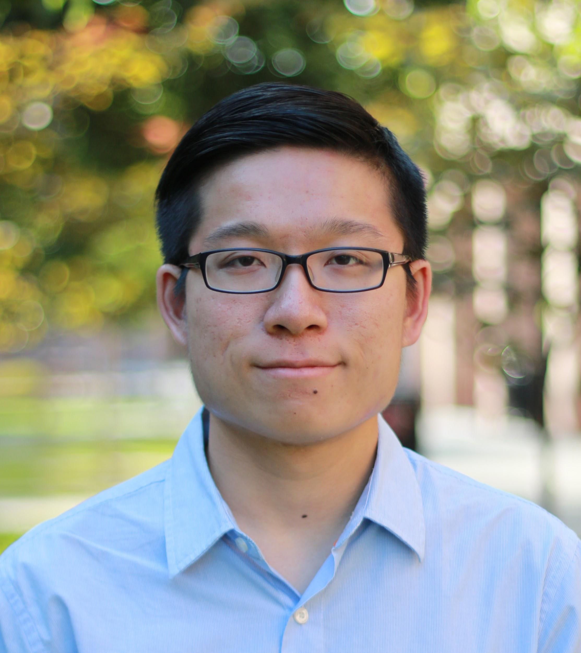
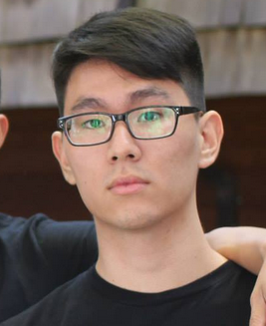
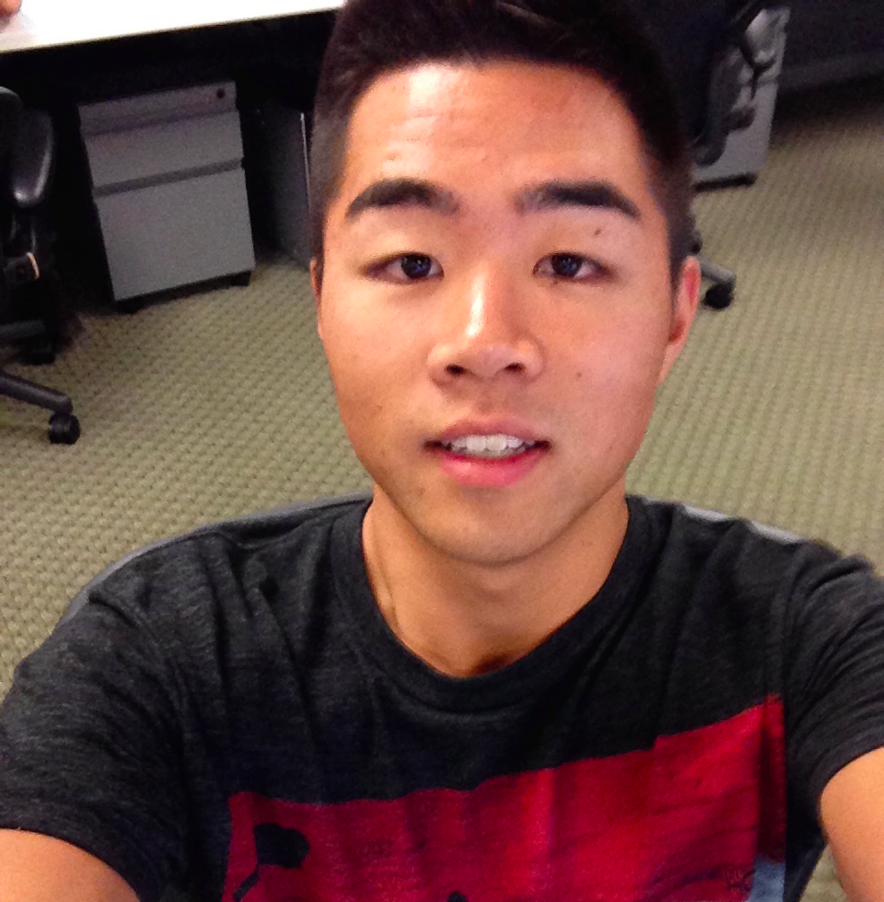
Chapter by Loco Power
Week 5: Low-Fidelity Prototypes
Dan, Melissa, Irving, & David

Slide 2
1. Overview
2.Value proposition
3. Selected Interface & Rationale
4.Low-fi prototype structure
5.Three tasks In low-fi
6. Methods
7. results/Discussions/Changes
Notes:
Overview of the presentation

Slide 3
Overview

Slide 4
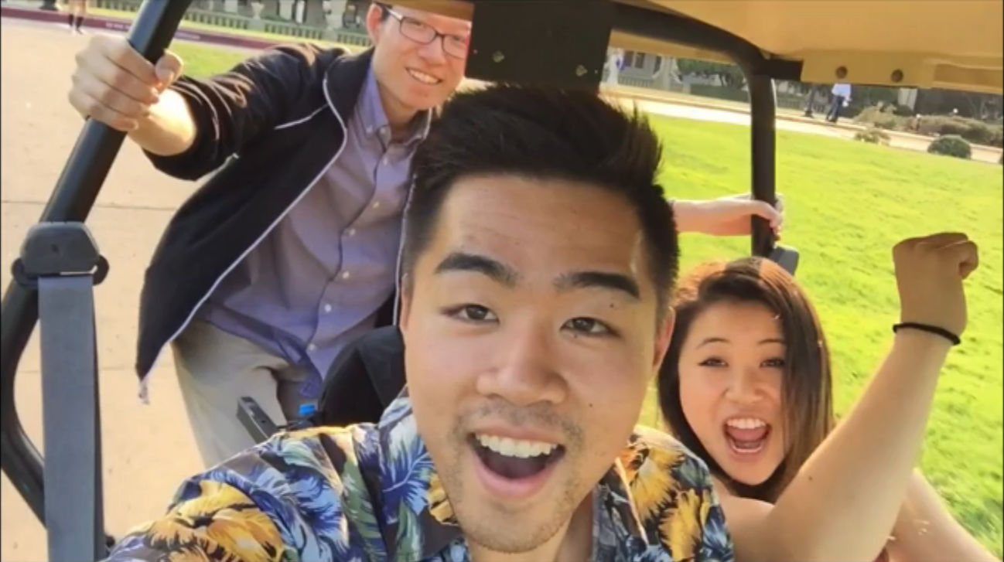
Chapter
Notes:
Mission Statement:
Finding exciting and memorable things to do in a new settings is hard, and it's even harder to document all the meaningful interactions you have on a consistent basis.
Whether you are a tourist in a foreign country or a local in your nearby town, Chapter allows you to experience new exciting activities to do and scrapbook those memories for later.

Slide 5
2. Value Proposition

Slide 6
Discover locally curated activities for a location and document personal memories.

Slide 7
3. Selected Interface & Rationale

Slide 8
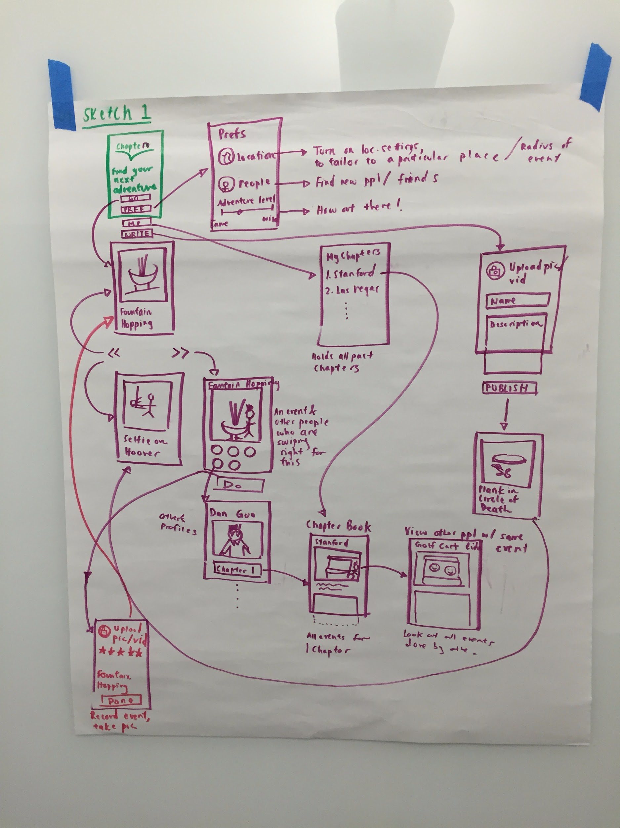
Swipe to do / decline events.
Map of activity and others keen.
Forms to record and share activities.
Notes:
Key features for each activity...
1) Is on a separate screen, and swiping will take you to new screens. (Tinder-like UI)
2) Has a map associated with it to provide information about its location.
3) Has a list of other people who are also keen on doing the activity (i.e., people who have swiped right for the activity)
Rationale: 1) Natural flow of swiping facilitated the process of navigating the app.
2) The other UI Sketch (design #2) was location-centric, and did not have the aspect of the app controlling the destiny of the user. It instead allowed users to choose what event to do next.

Slide 9
4.Low-fi prototype structure

Slide 10
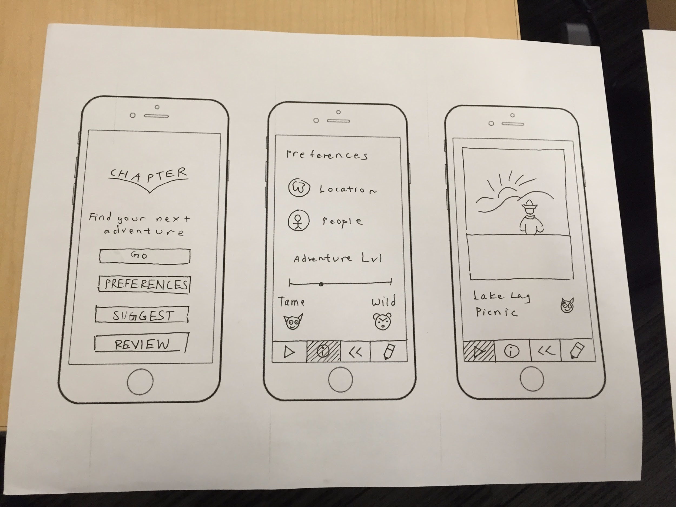
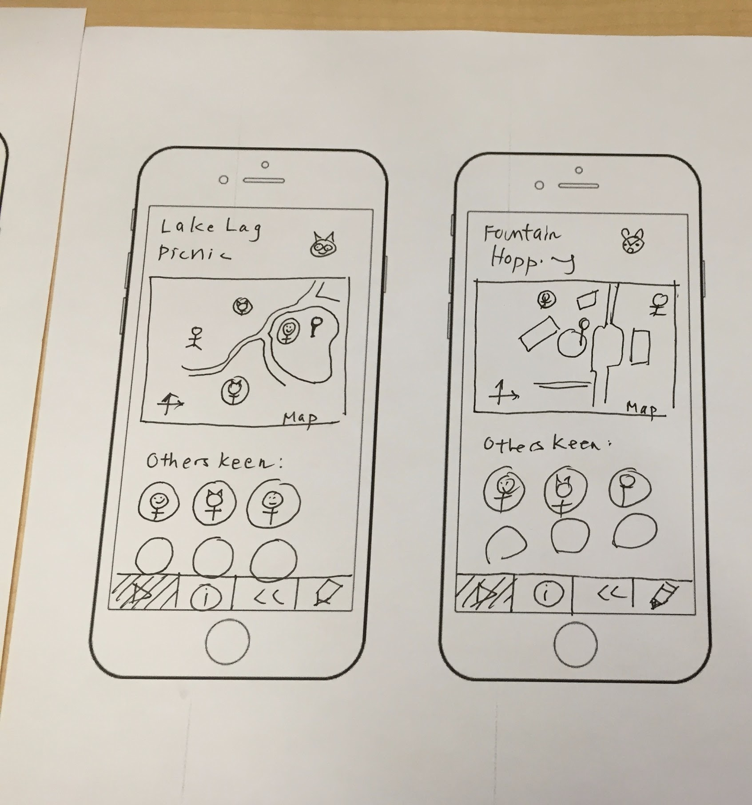
Home
Prefs
Activity
Activity Info
Swipe Right

Slide 11
Features
Record
Suggest
Review
Review Detail

Slide 12
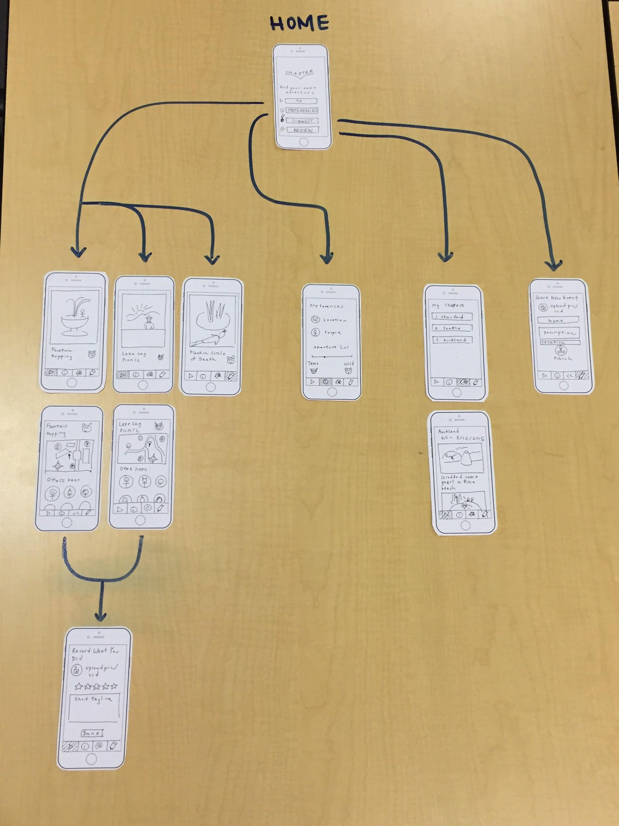
Notes:
General flow of our prototype
1) First section: activities to do
2) Second section: preferences
3) Third section: reviewing chapters
4) Fourth section: suggest new activities

Slide 13
5.Three tasks In low-fi

Slide 14
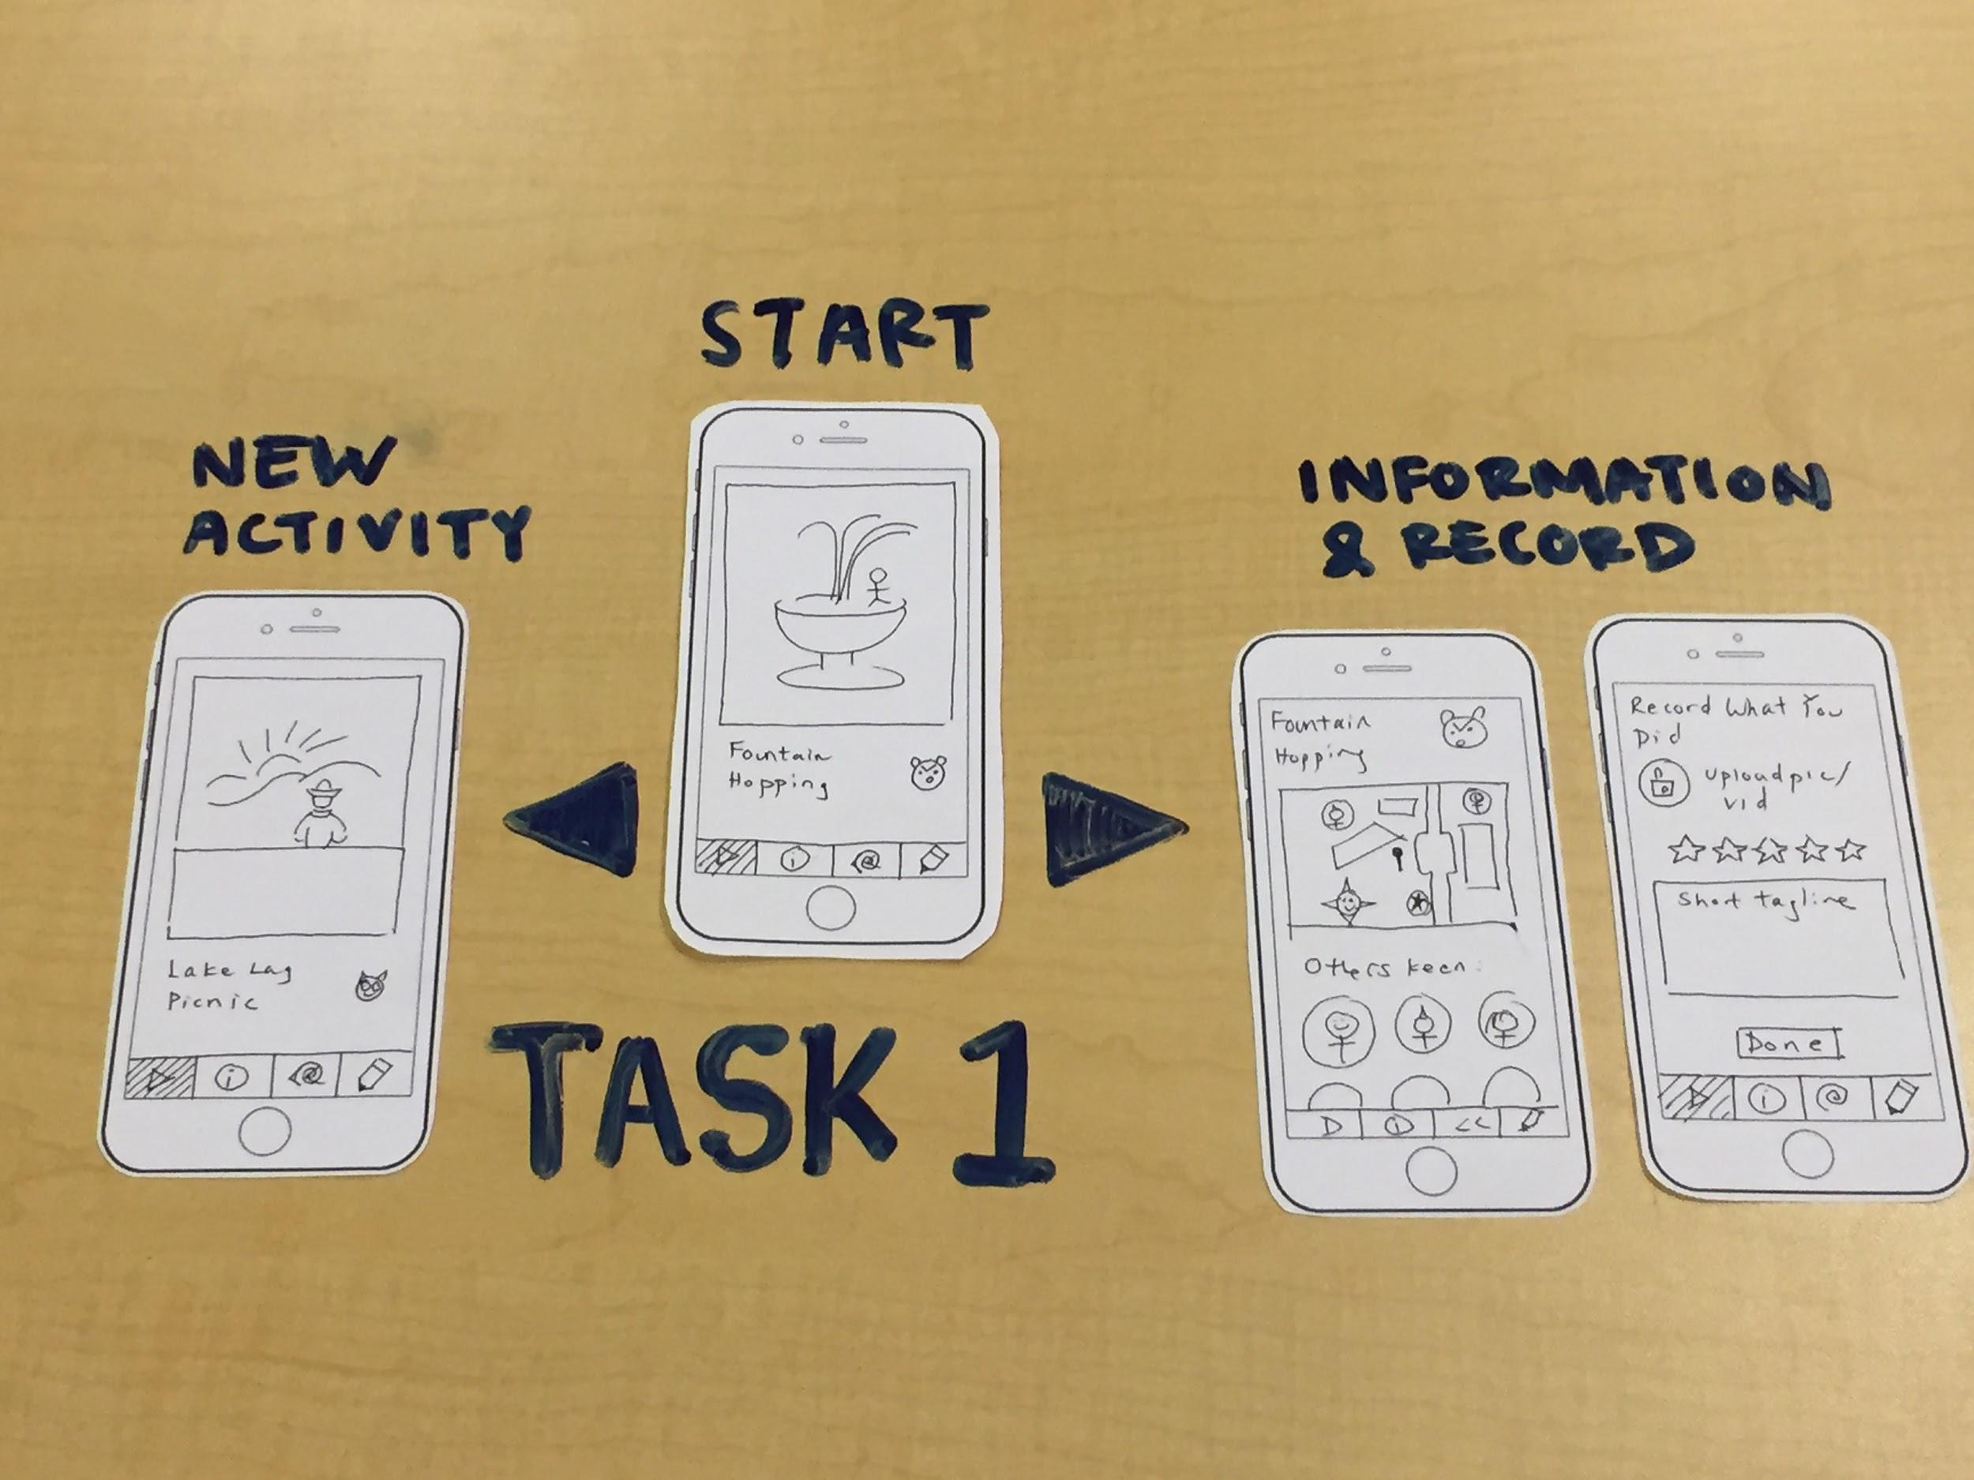
Task #1
As a newcomer, finding interesting activities to do at a location (i.e., Stanford).

Slide 15
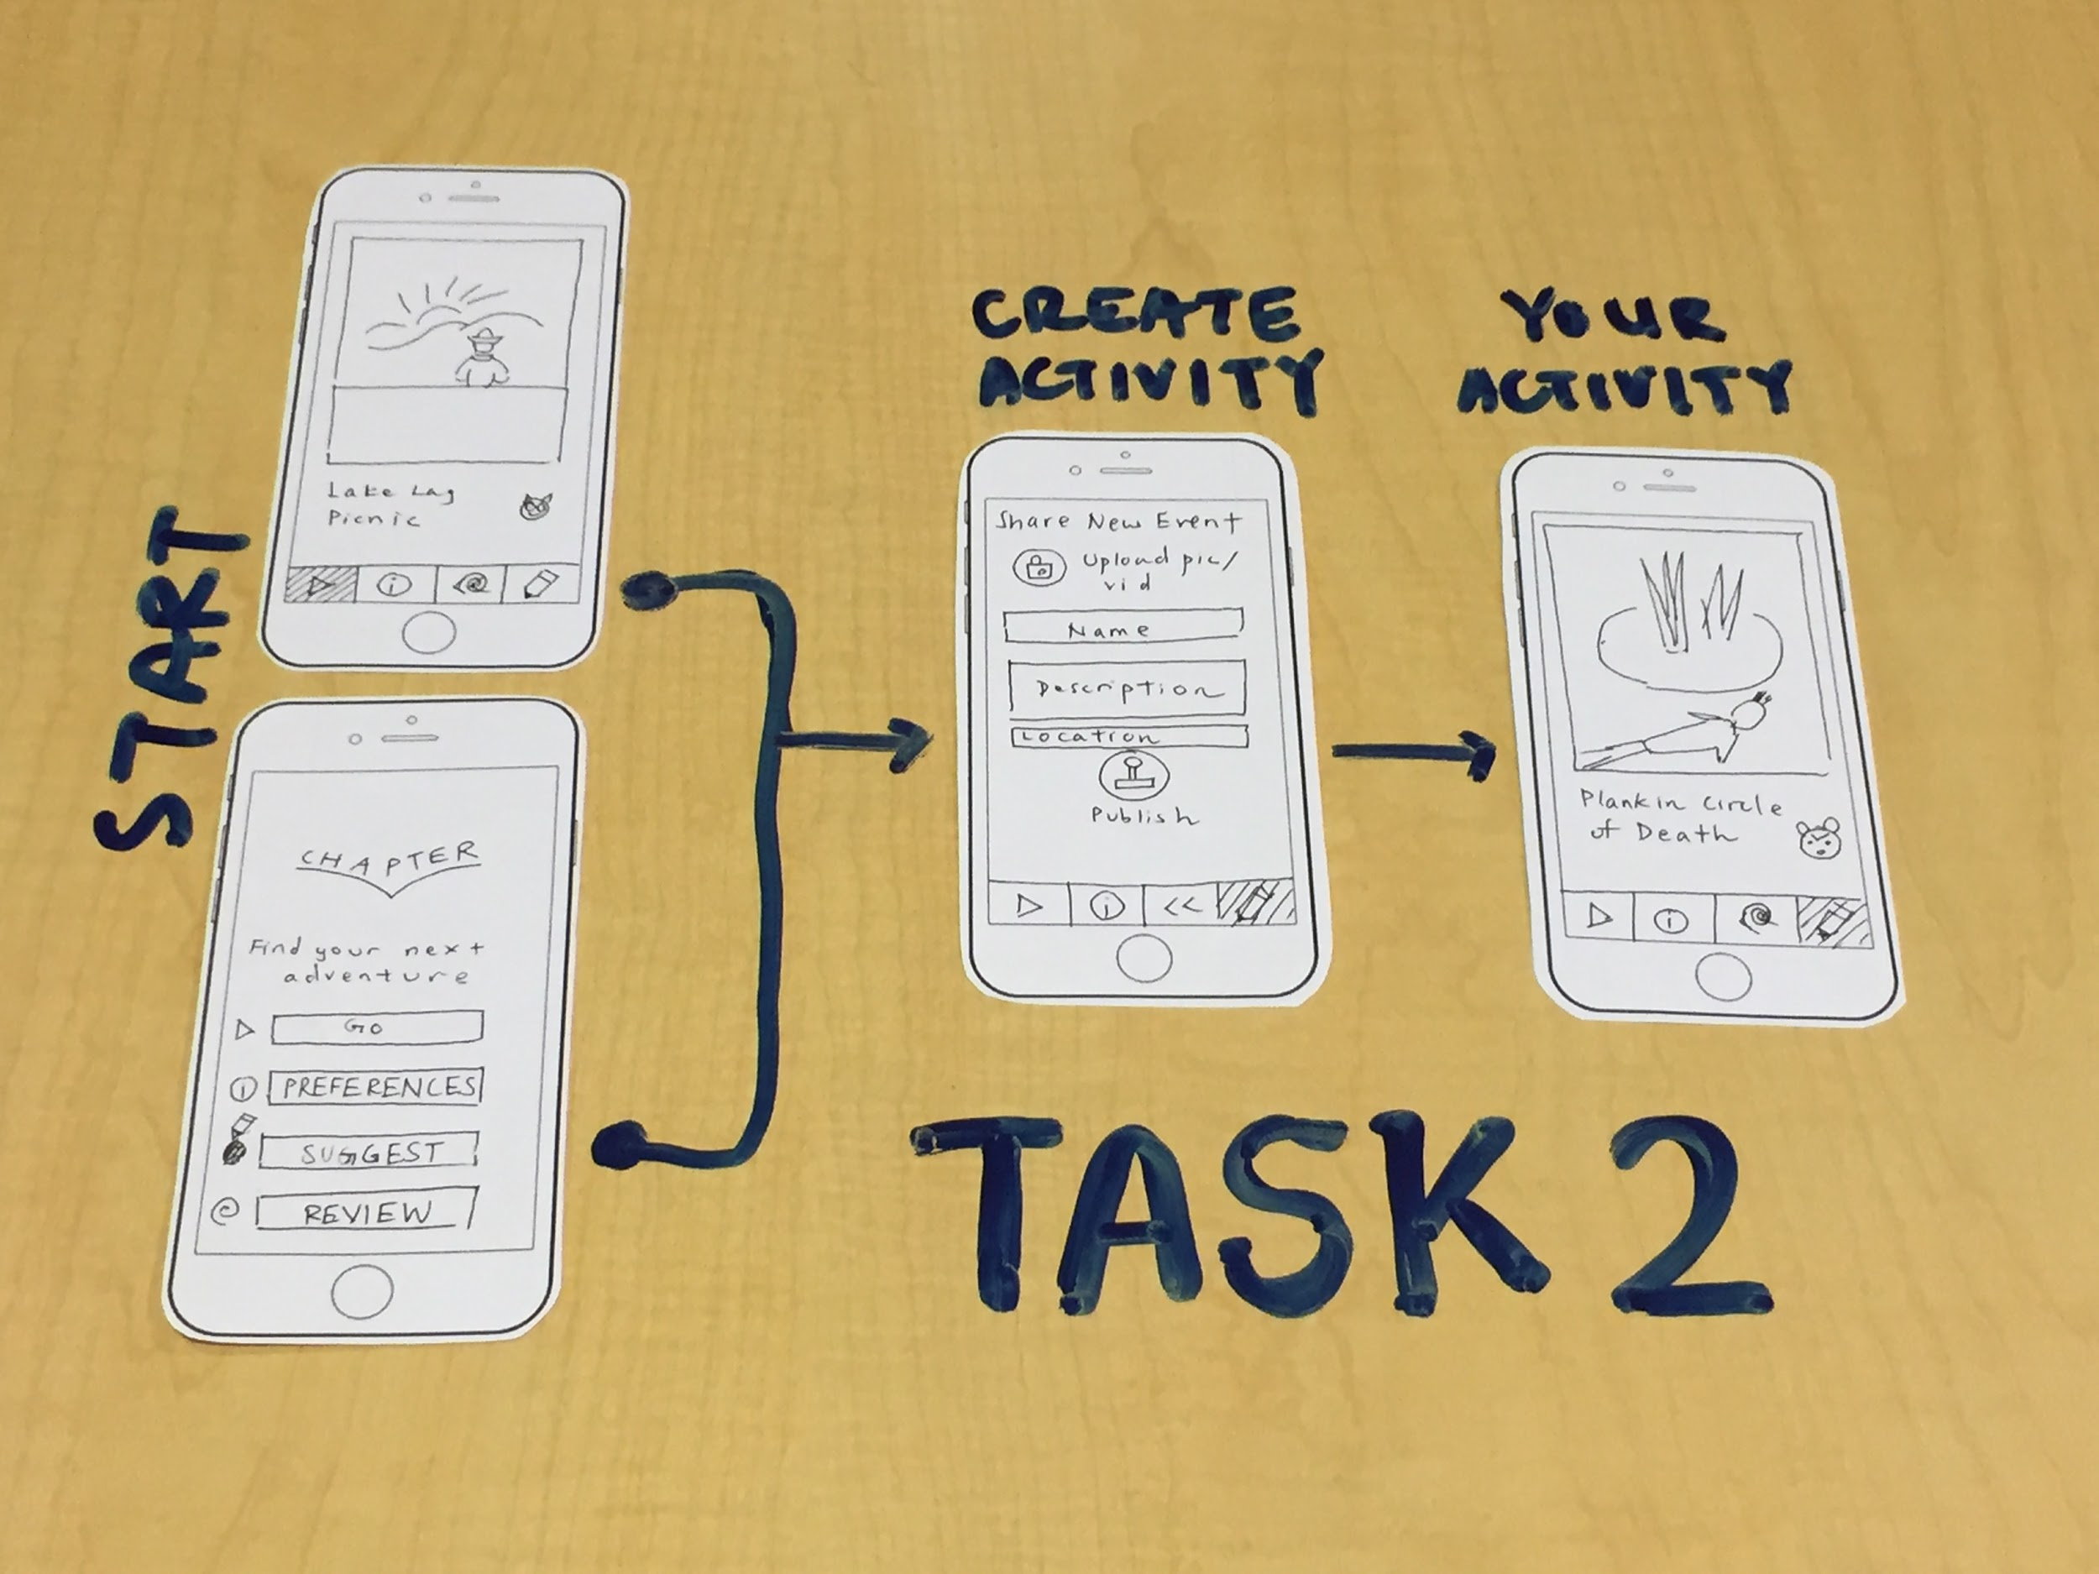
Task #2
As a local, suggesting interesting activities to do or places to go at a location.

Slide 16
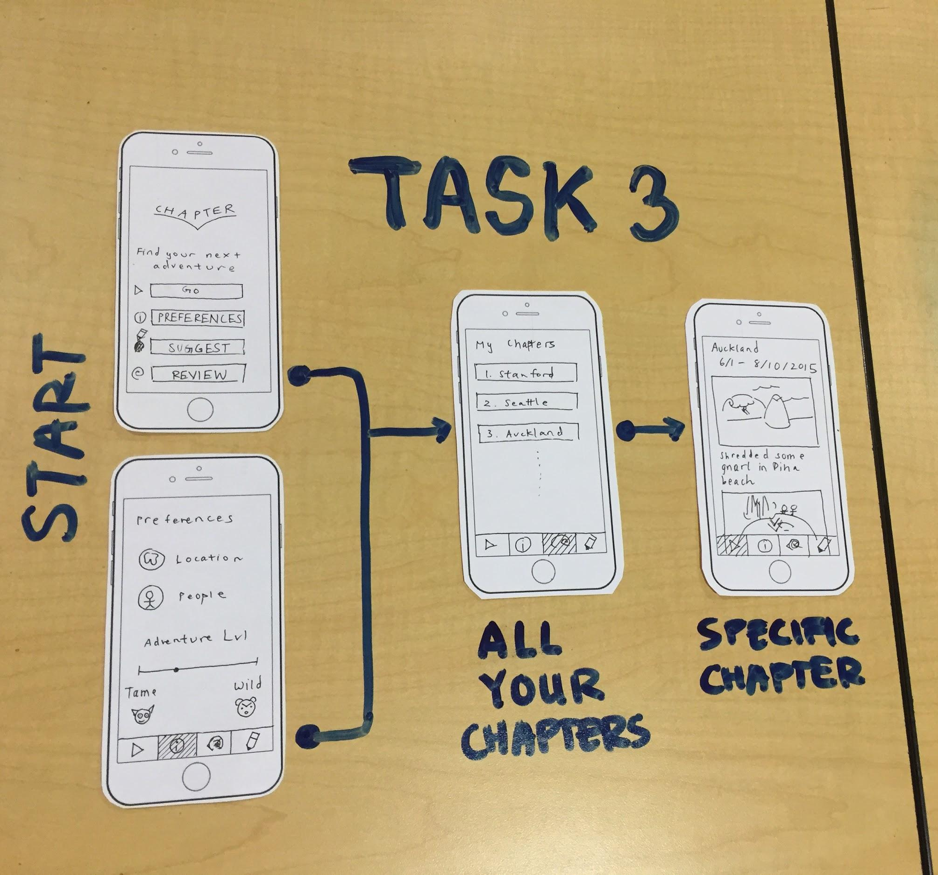
Task #3
Creating a story of memories when in a new place.

Slide 17
6. Experimental Method

Slide 18
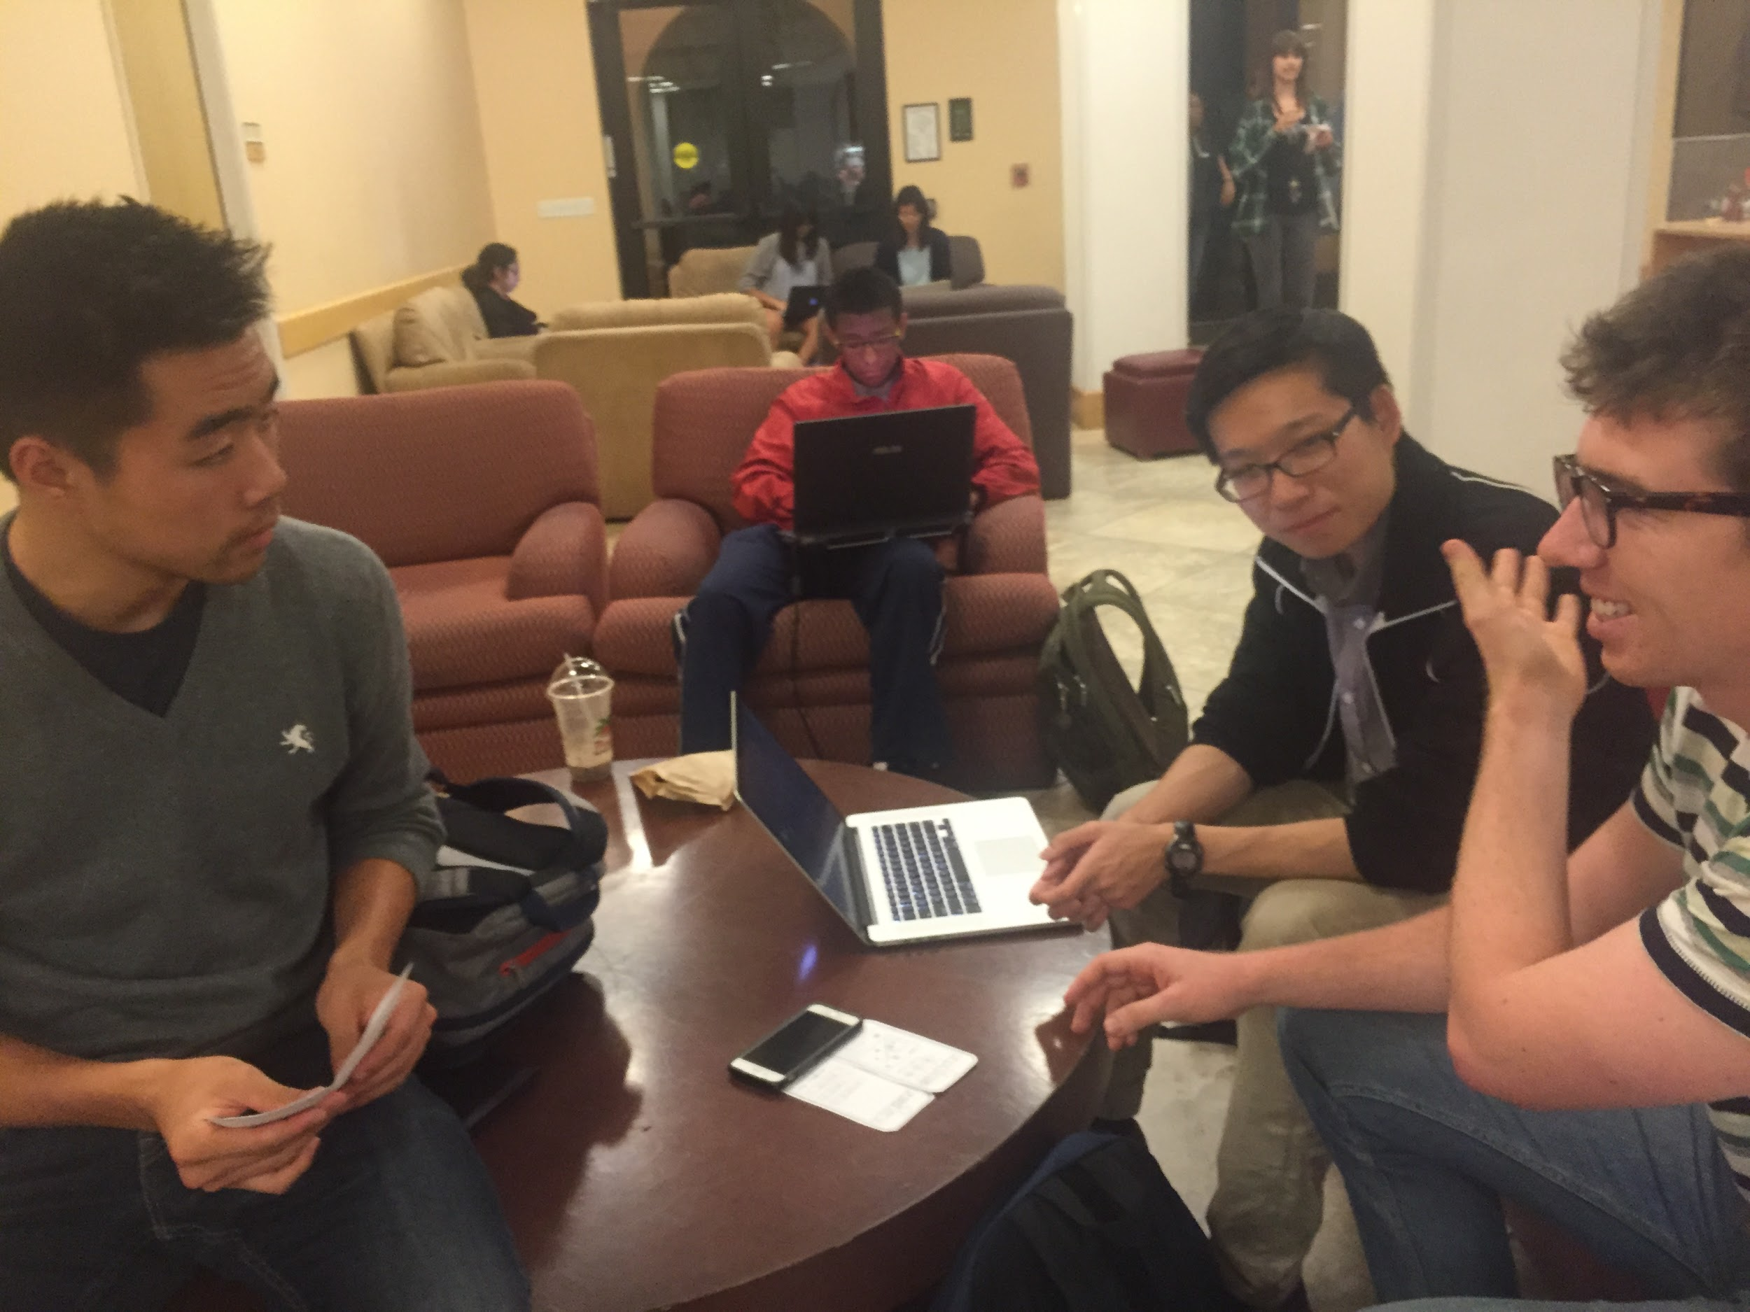
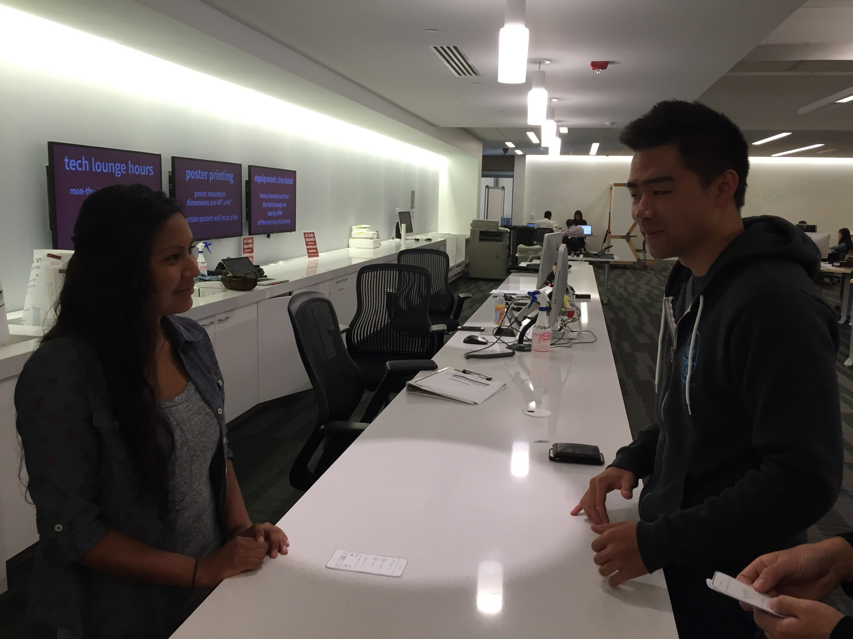
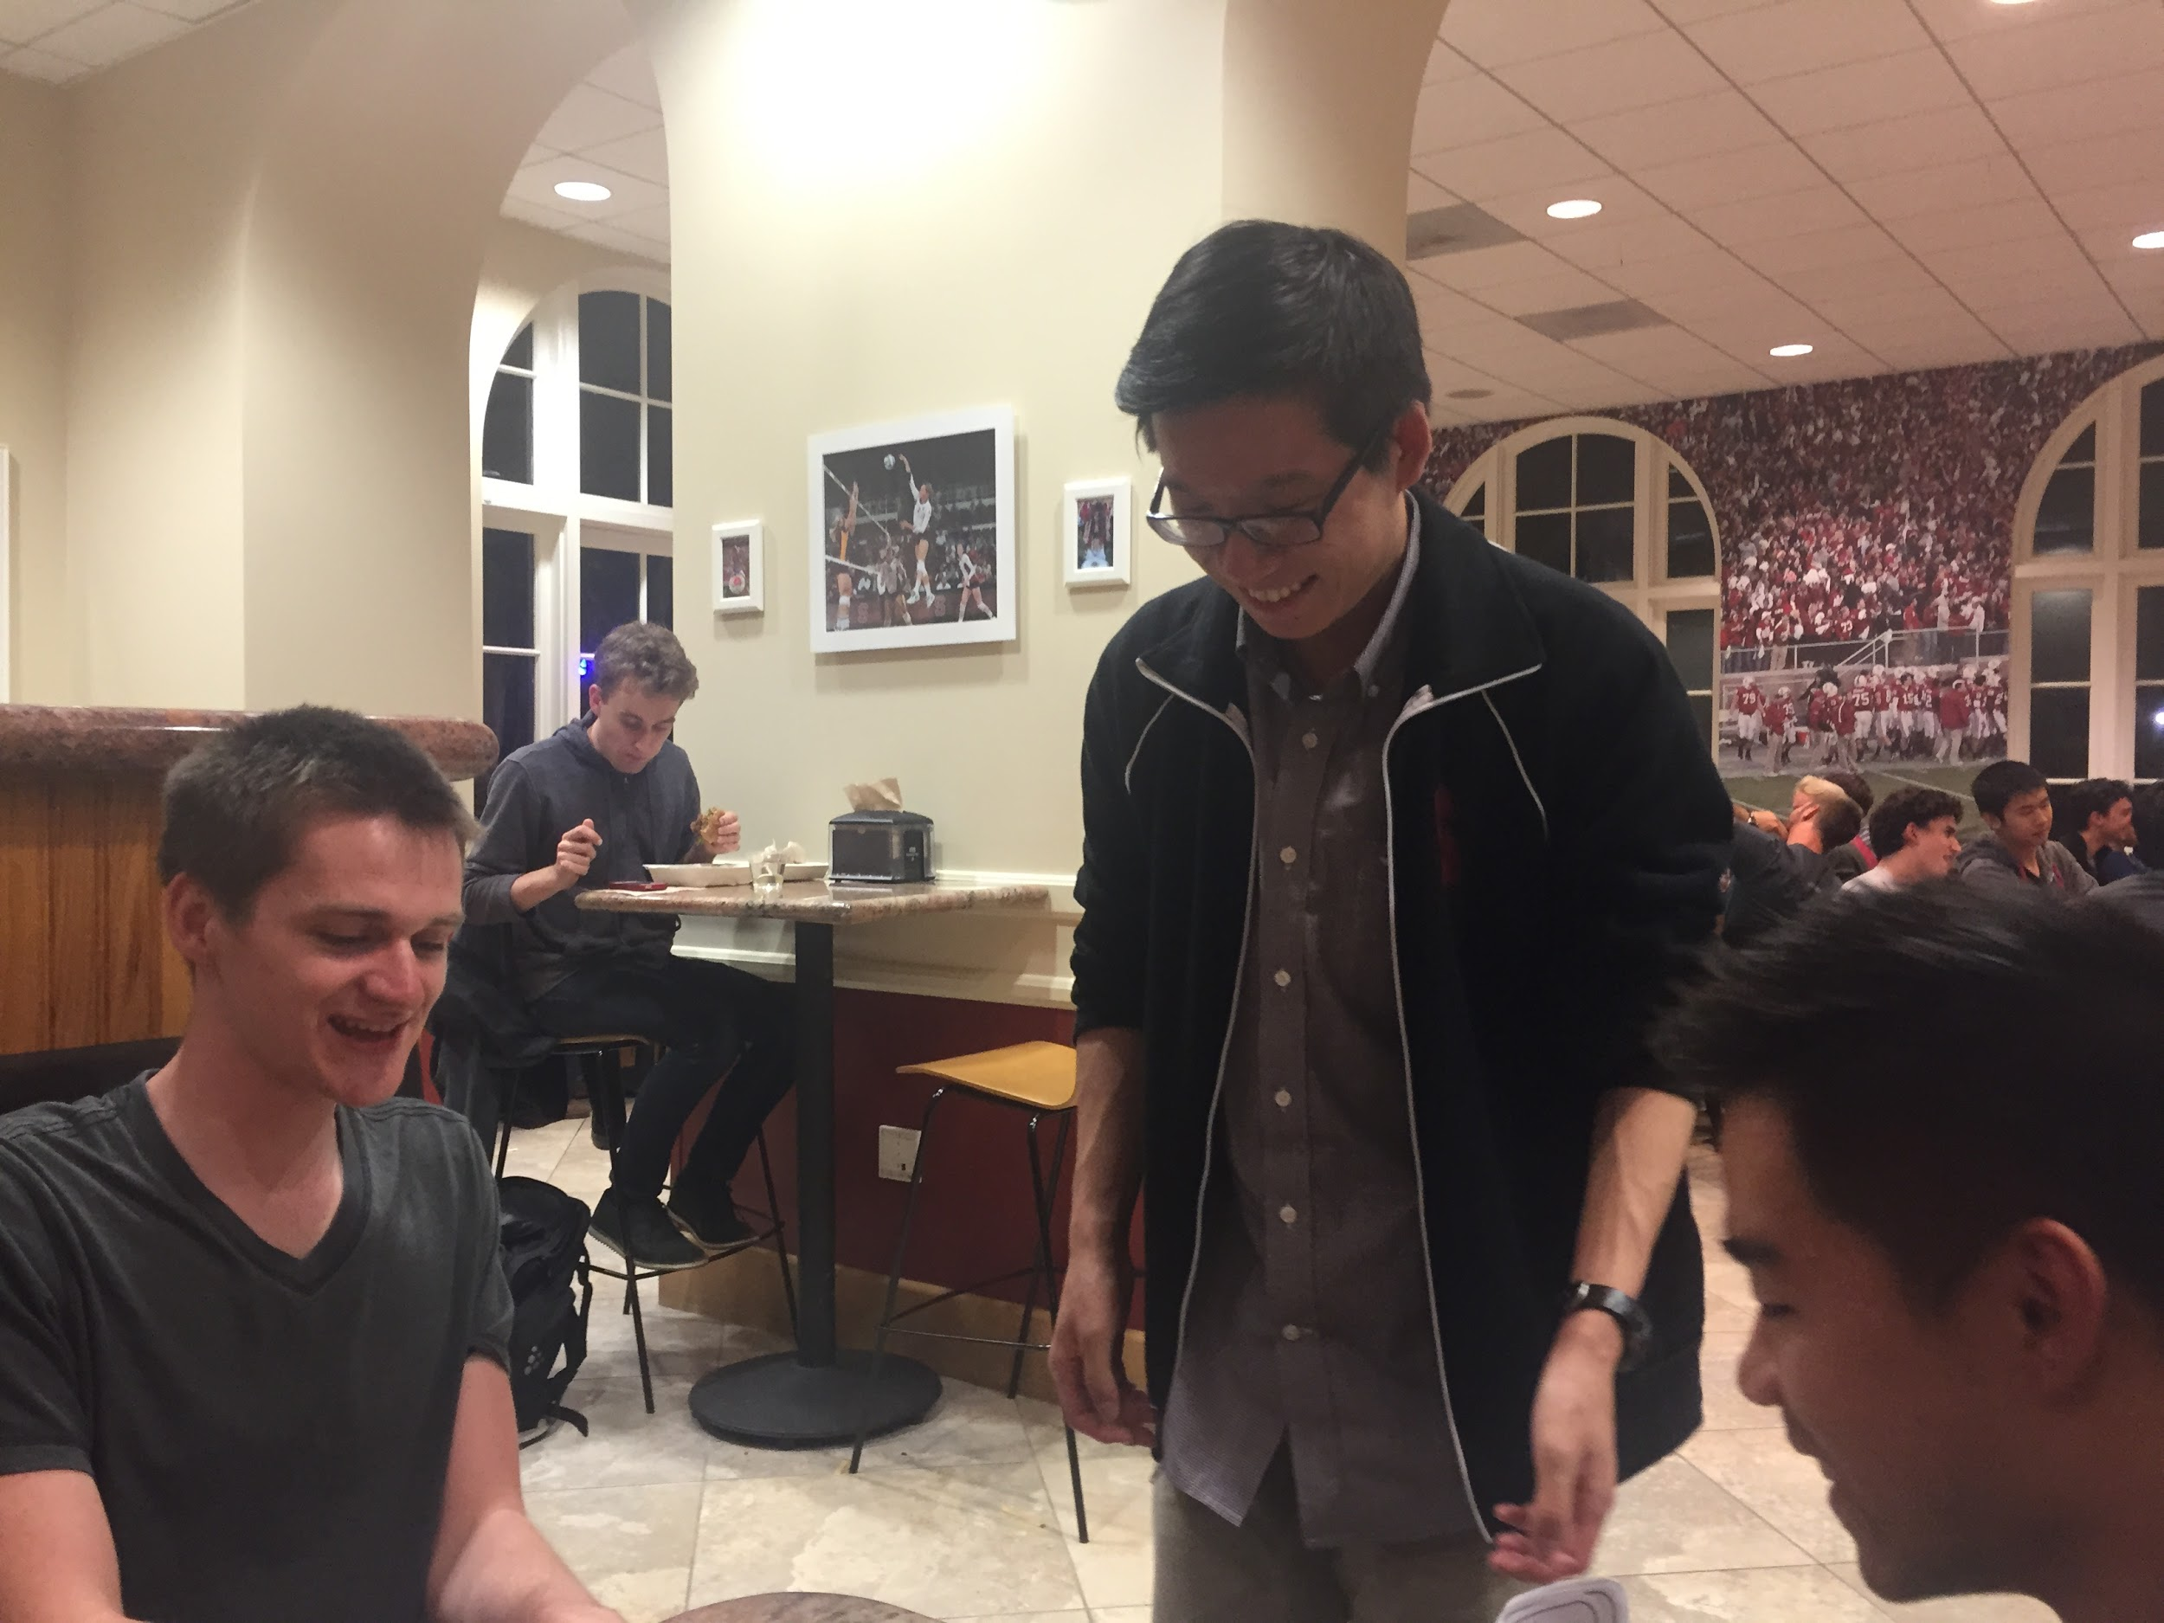
Experimental Method
Demo app
Set the scene for each task
Assess performance using test measures
Iterate
Notes:
1) Set the scene as a tourist in a new place,....
2) An a local, ….
3) As an experienced user, relive some Chapters….
We used the following test measures:
1) The user’s first reactions to the app
2) How many times they made incorrect assumptions about a particular button (or UI component) or feature
3) How many functionality-related questions were asked

Slide 19
7. results/Discussions/Changes

Slide 20
Study #1
Notes:
Freshman working at the Tech Desk; Wanted a user who did not have much exposure / experience using mobile apps in general
Ex: esp. some of the more popular ones, such as Tinder, Snapchat, etc.

Slide 21
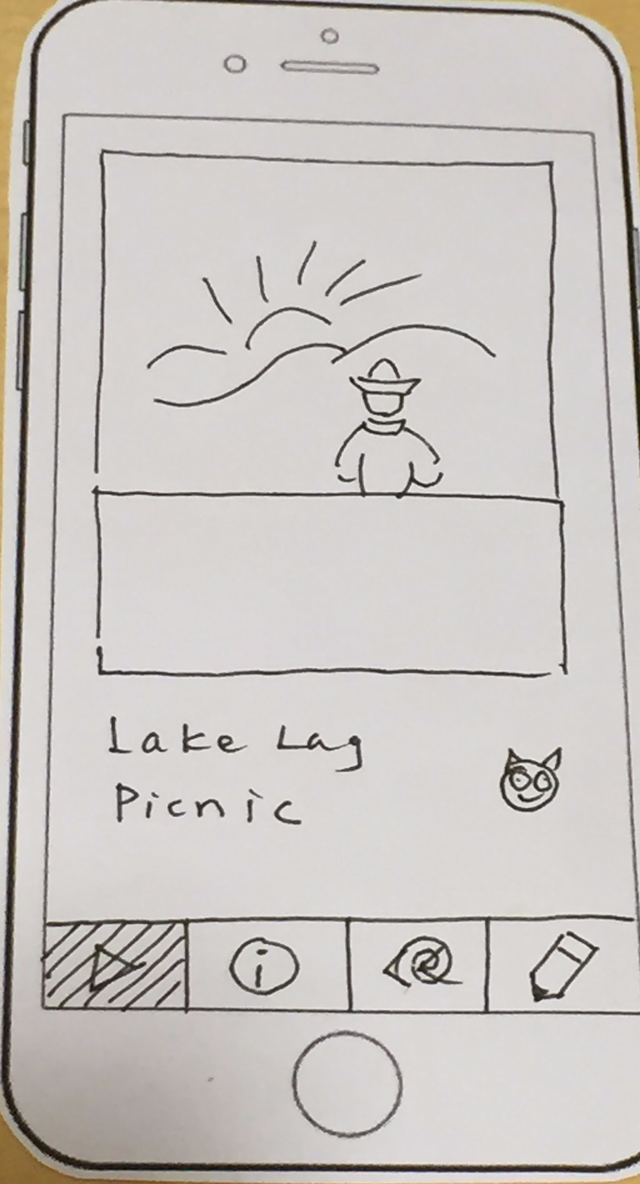
Results/Discussion
Changes
Navigation Issues
Button Icon changes
<<
<<
Notes:
Event swiping navigation confusion
Button for reviewing chapters

Slide 22
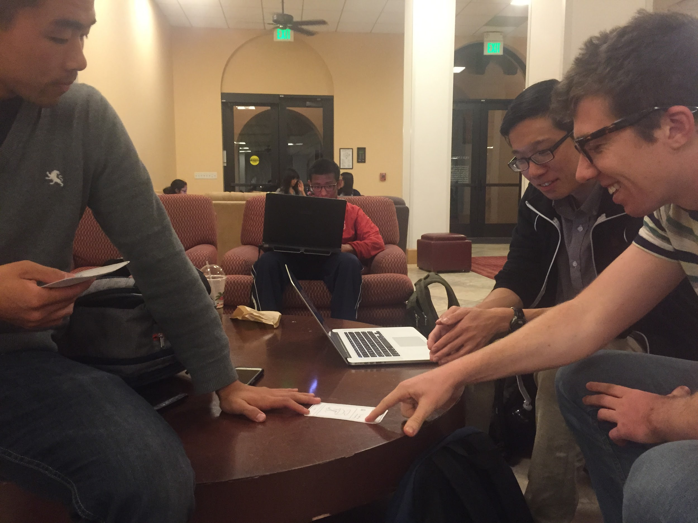
Study #2
Notes:
Senior; physics major, math minor. Wanted someone who was a self-proclaimed techie to see how quickly he could understand and appreciate the app.

Slide 23
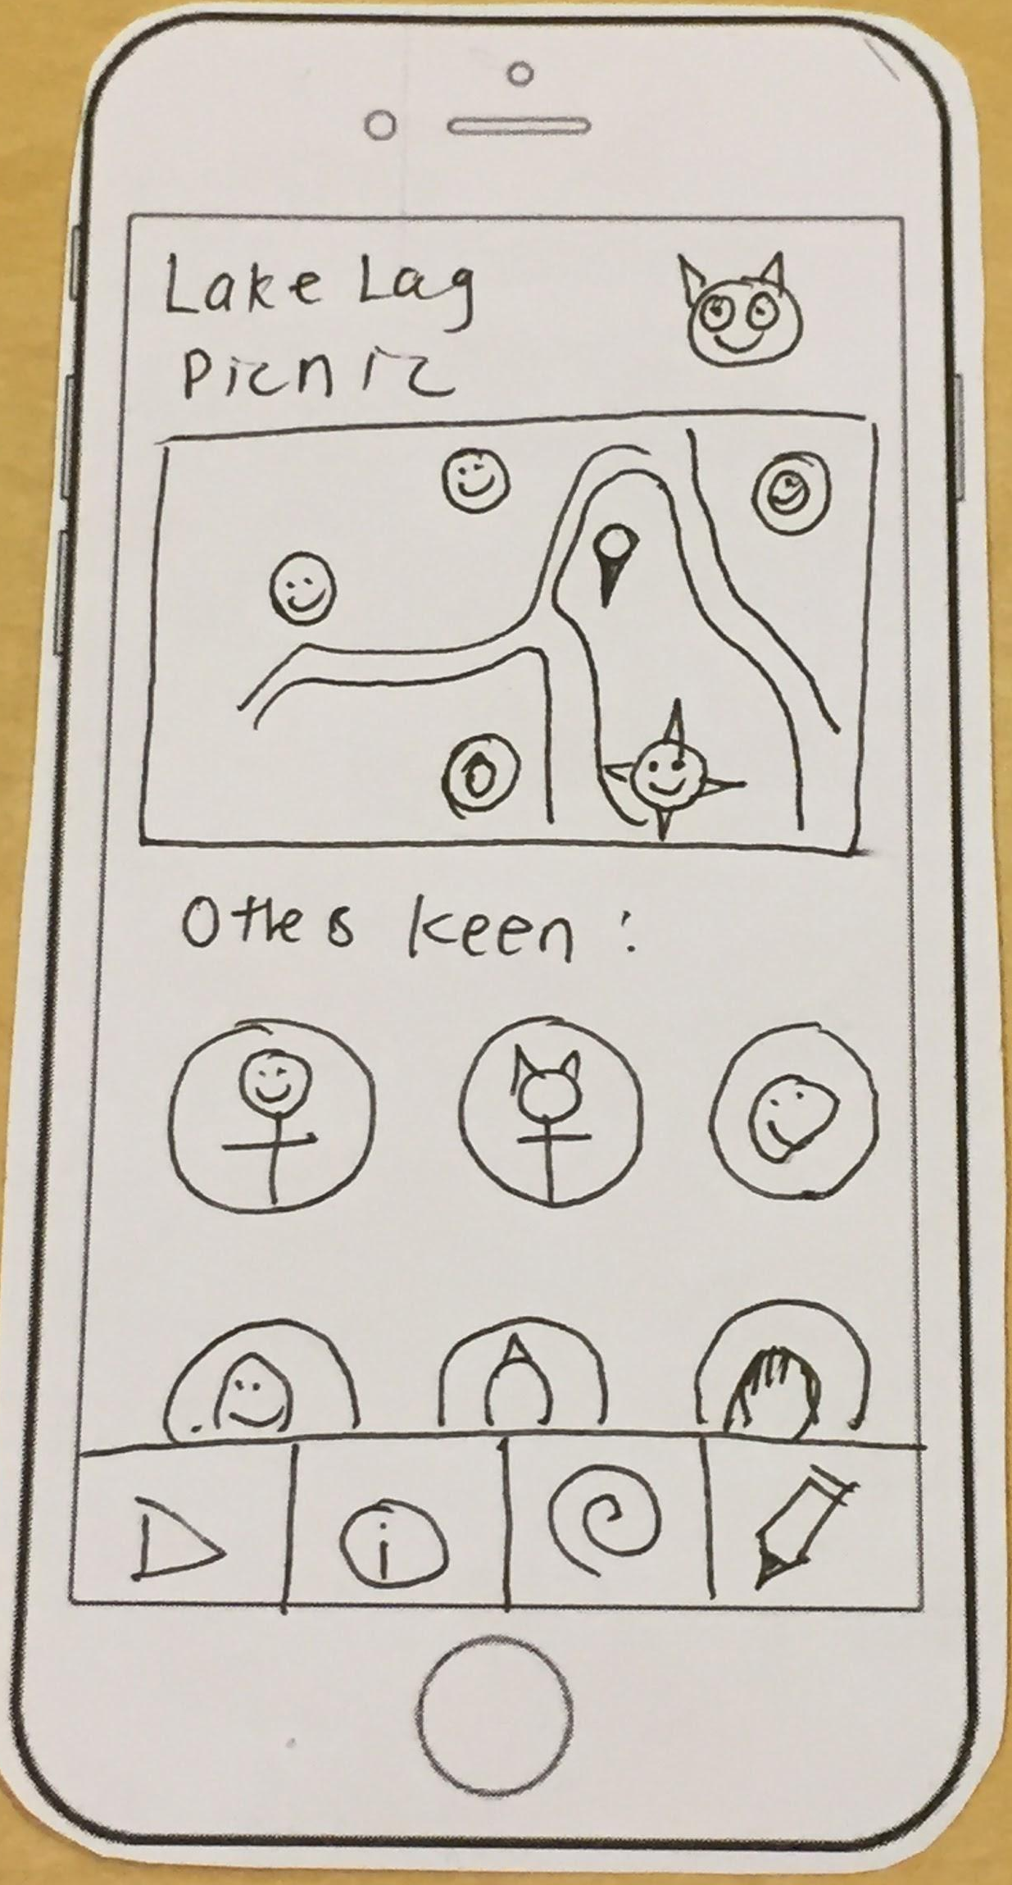
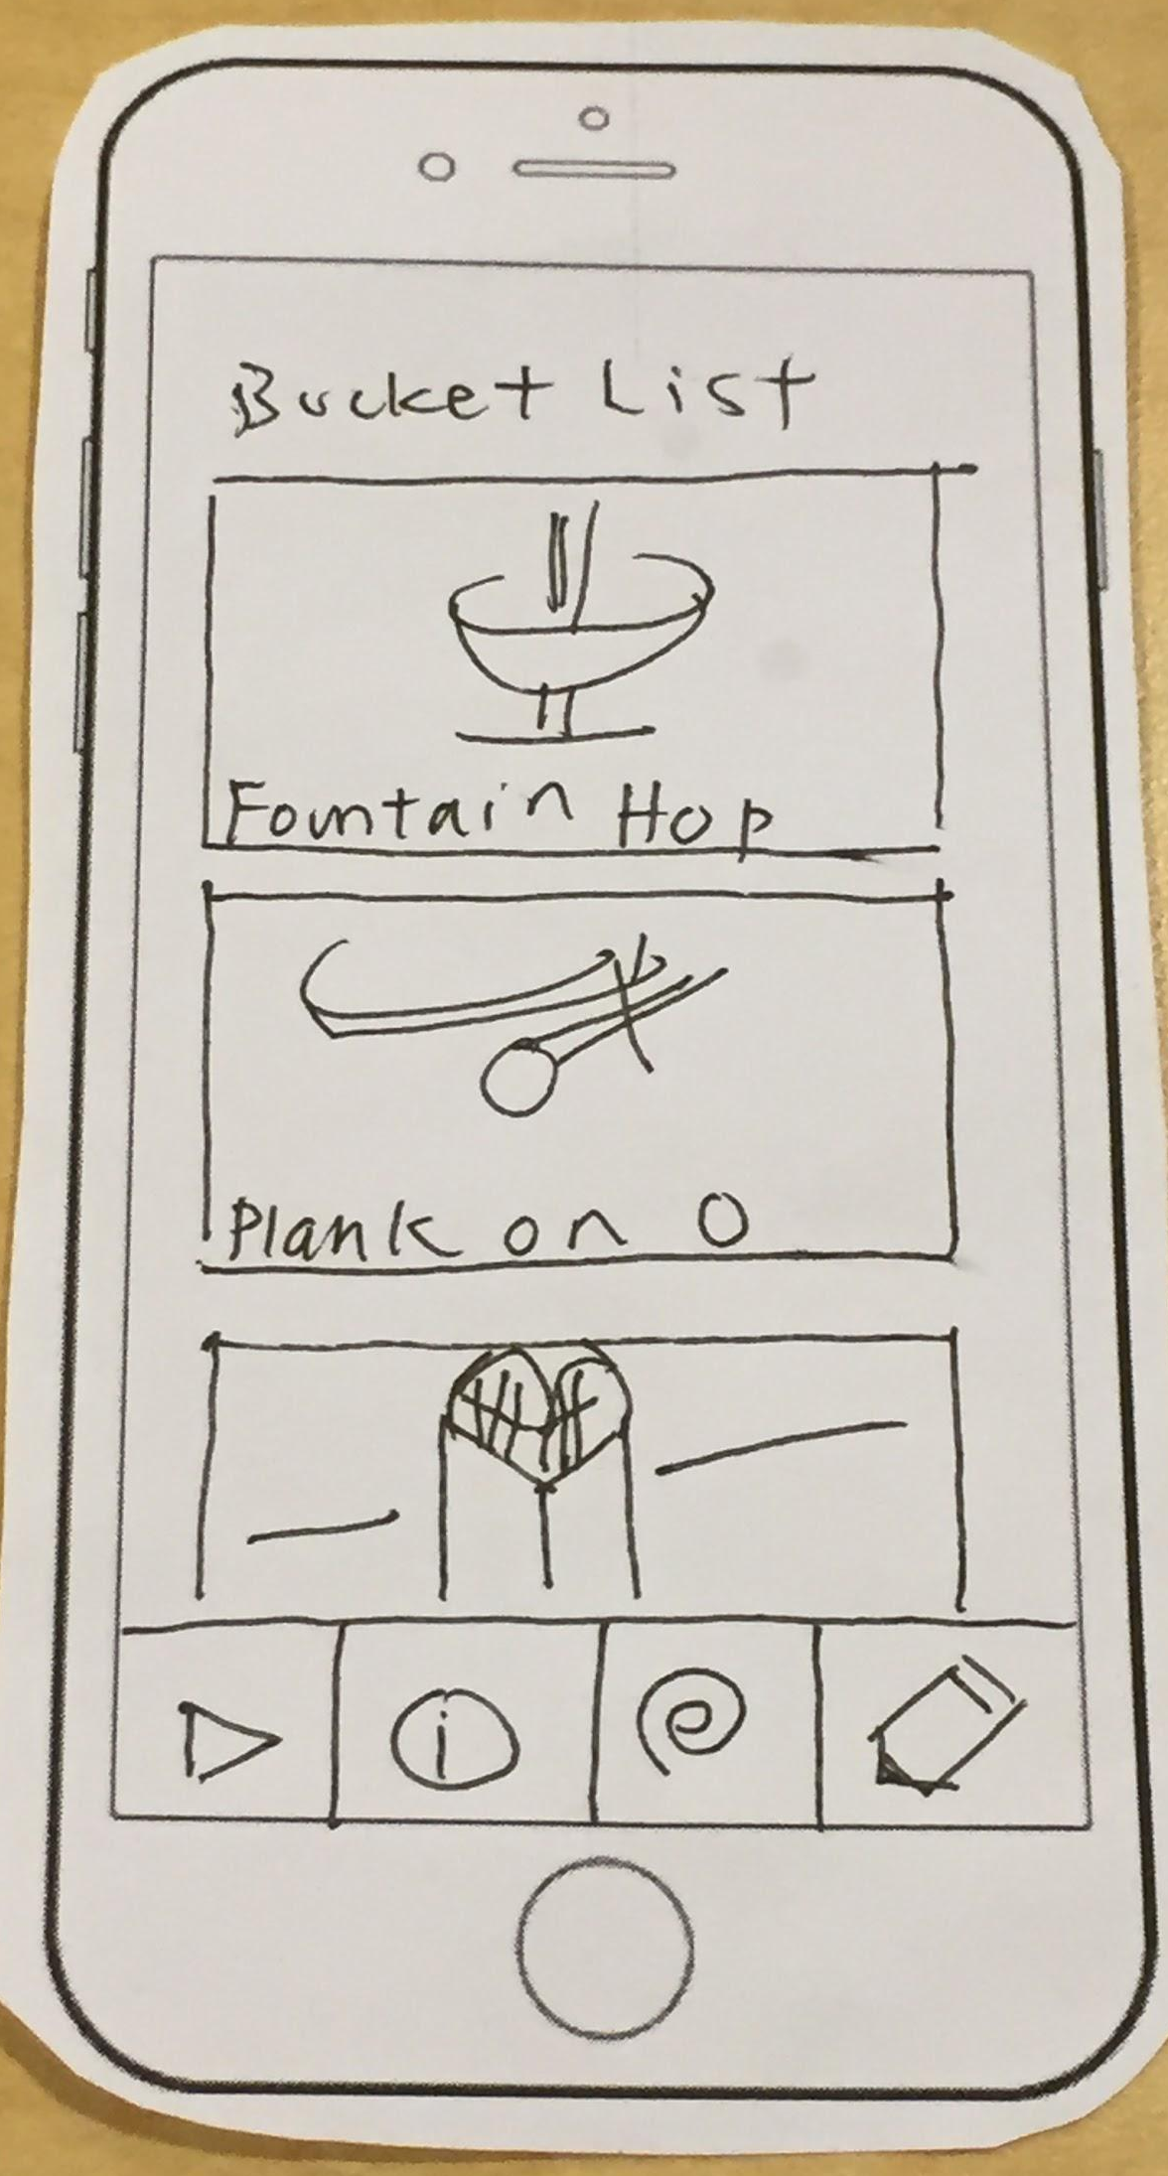
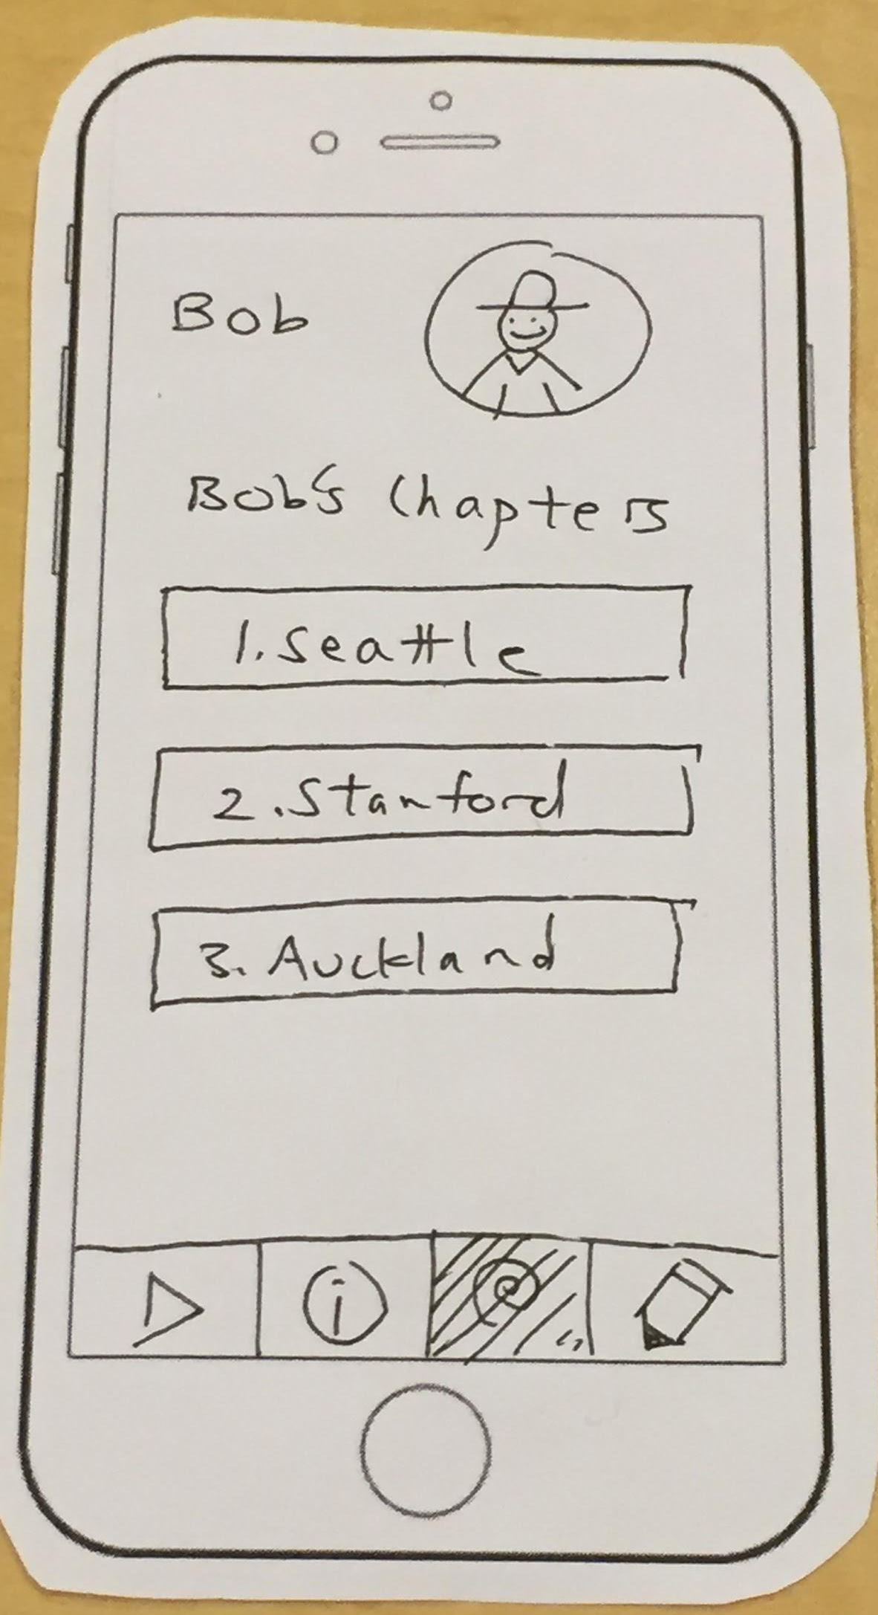
Results/Discussion
Changes
Lowly Rated Activities
Scrolling Down
Saving Activities
Viewing Other User Profiles
Notes:
Lowly Rated Activities
Delete activities with many low ratings
Scrolling Down
More intuitive
Saving Activities
View activities later
Viewing Other User Profiles
Social networking aspect

Slide 24
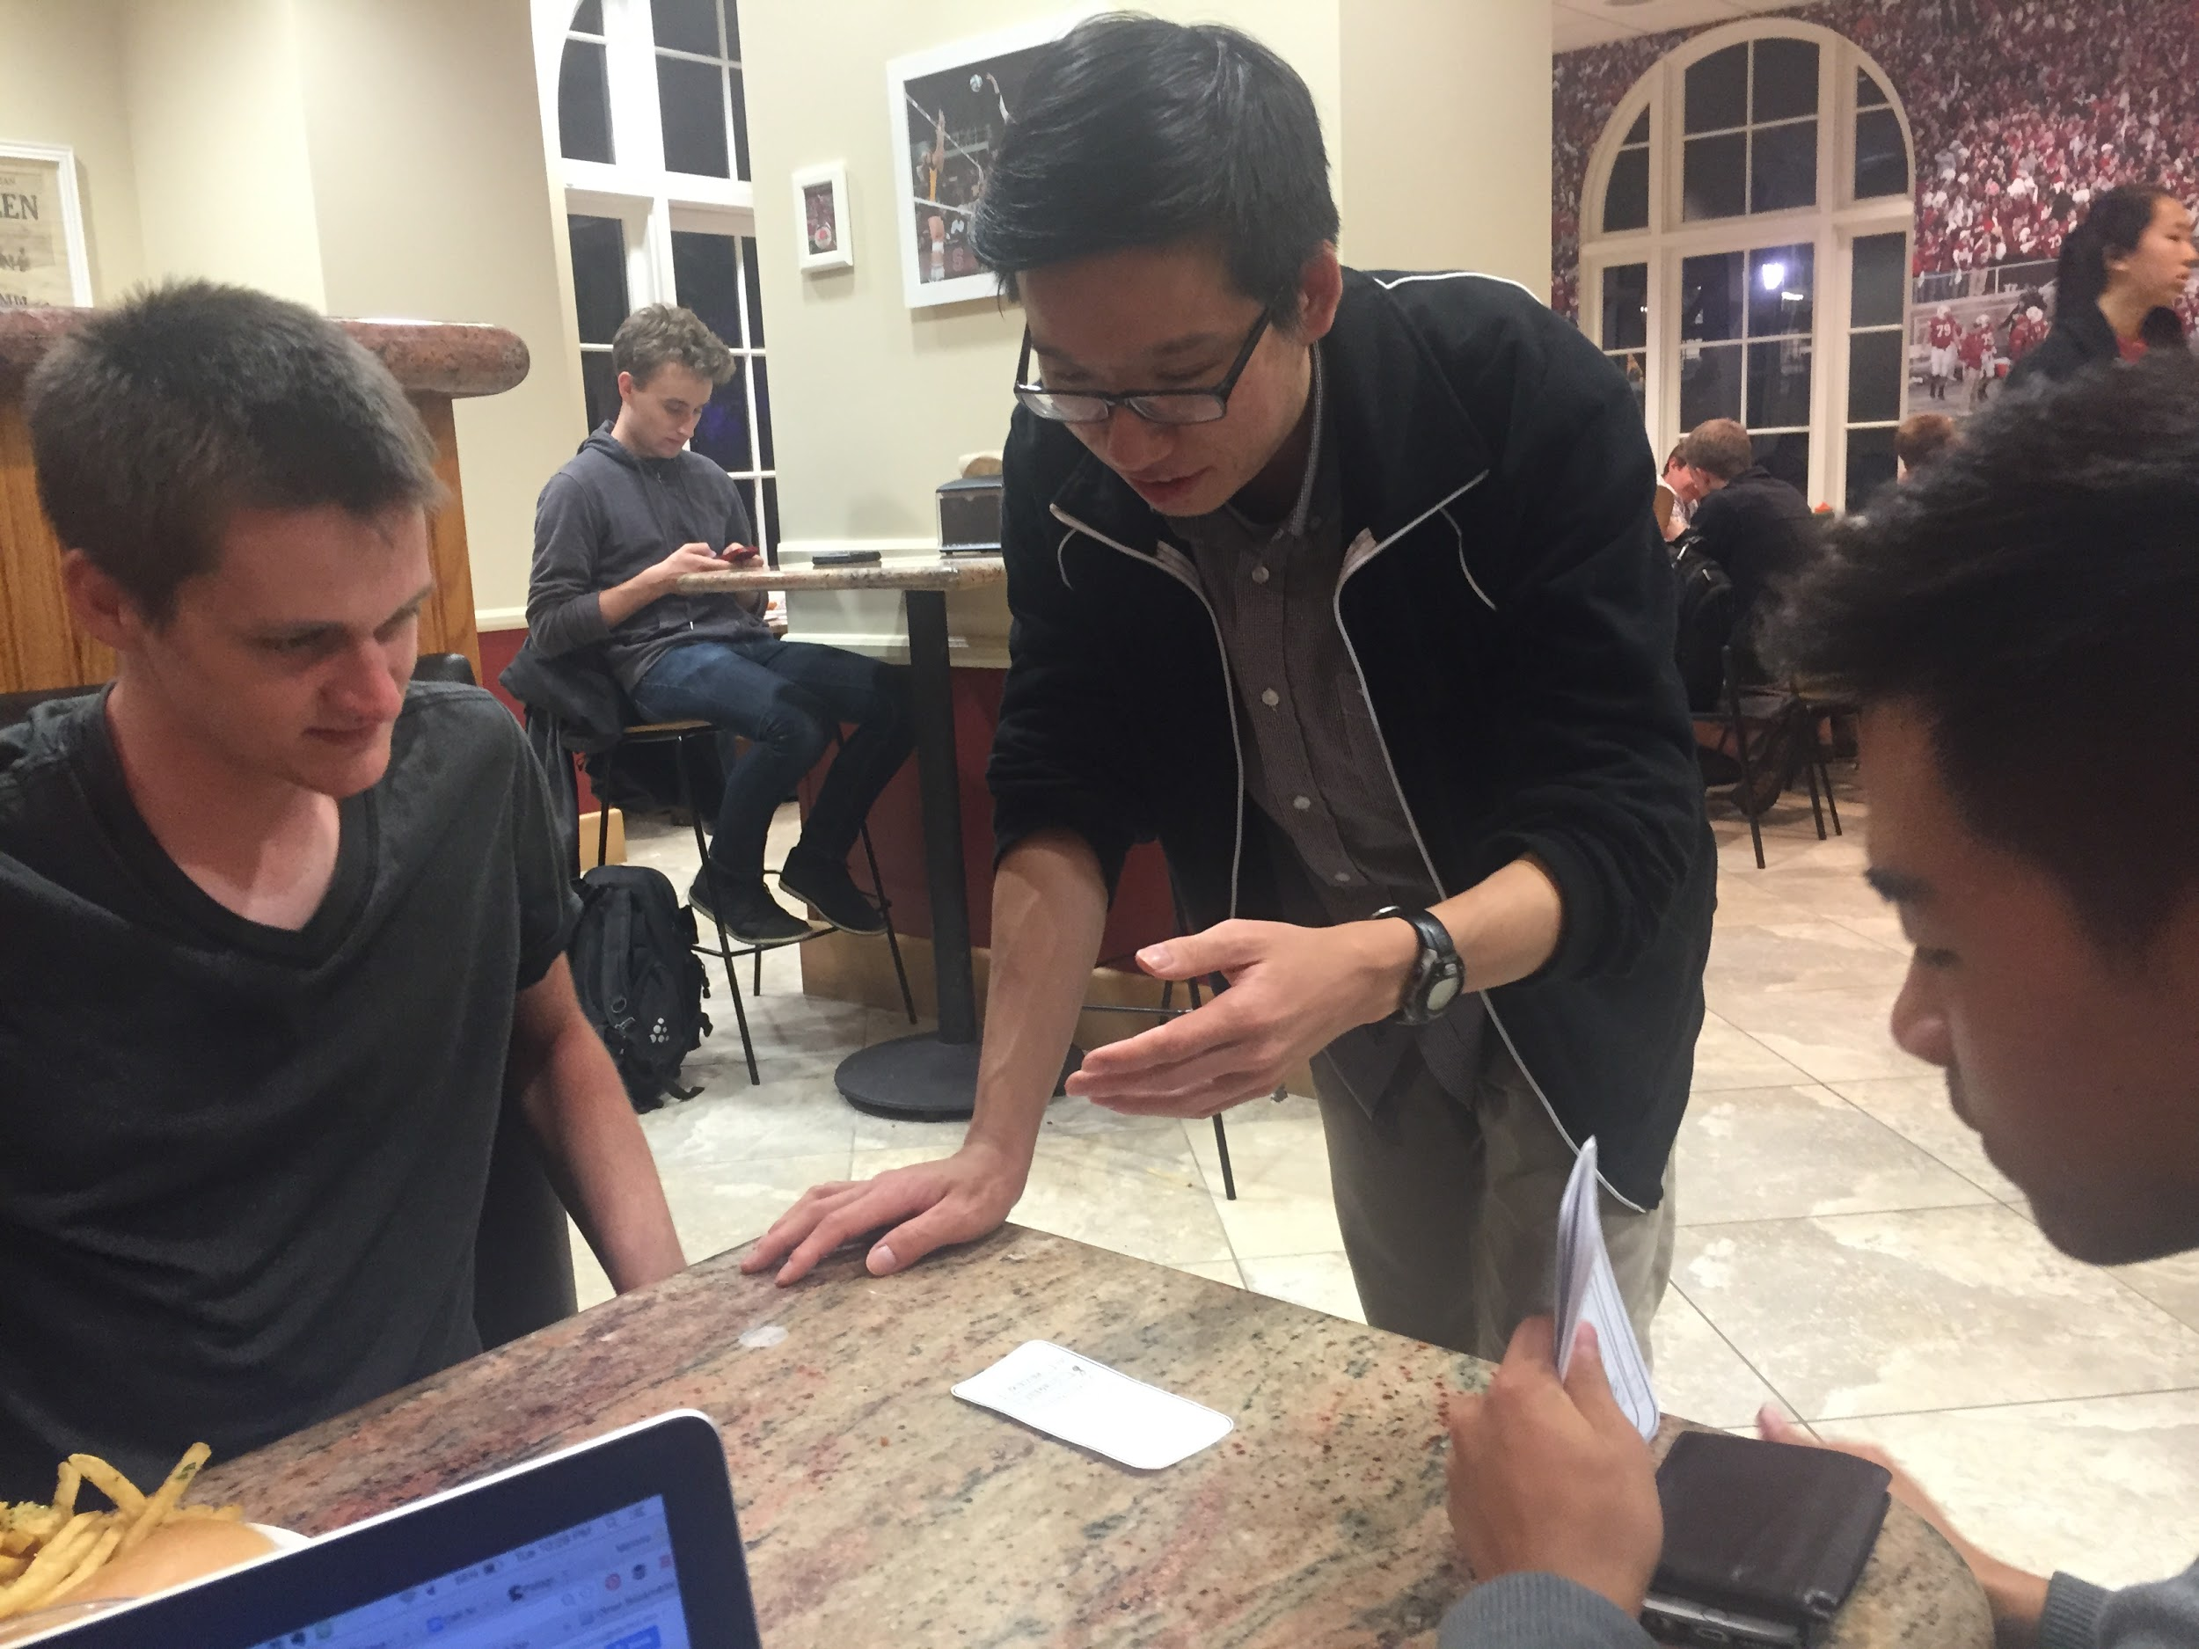
Study #3
Notes:
Design major
Wanted someone with a design background to give a more critical approach to the User Interface and Experience

Slide 25
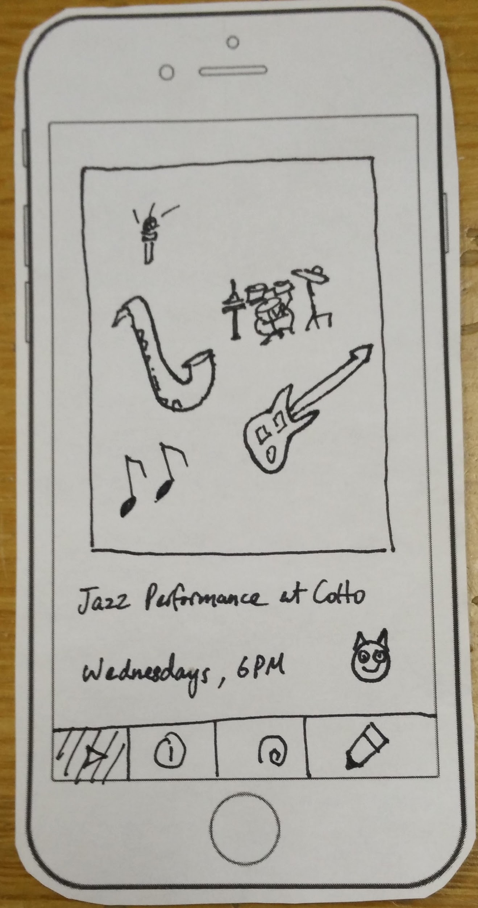
Results/Discussion
Changes
Is it intuitive?
Directions
Scheduling Activities
Distinguishable
Notes:
Intuition
Meaningful Icons: making icons more intuitive in general (i.e., What does the pencil icon do? Is it for writing a post?)
Wording of the app (Share vs suggest) (Event vs activity)
Directions
Map to show location: dynamically updated based on your current location
Scheduling Activities
Filter one-time activities and recurring activities, Time and Date
Distinguishable
From the perspective of a tourist, there are 2 main functions of the app → doing the activity and reviewing it

Slide 26
Thanks!

Slide 27
Sketches & Storyboards

Slide 28
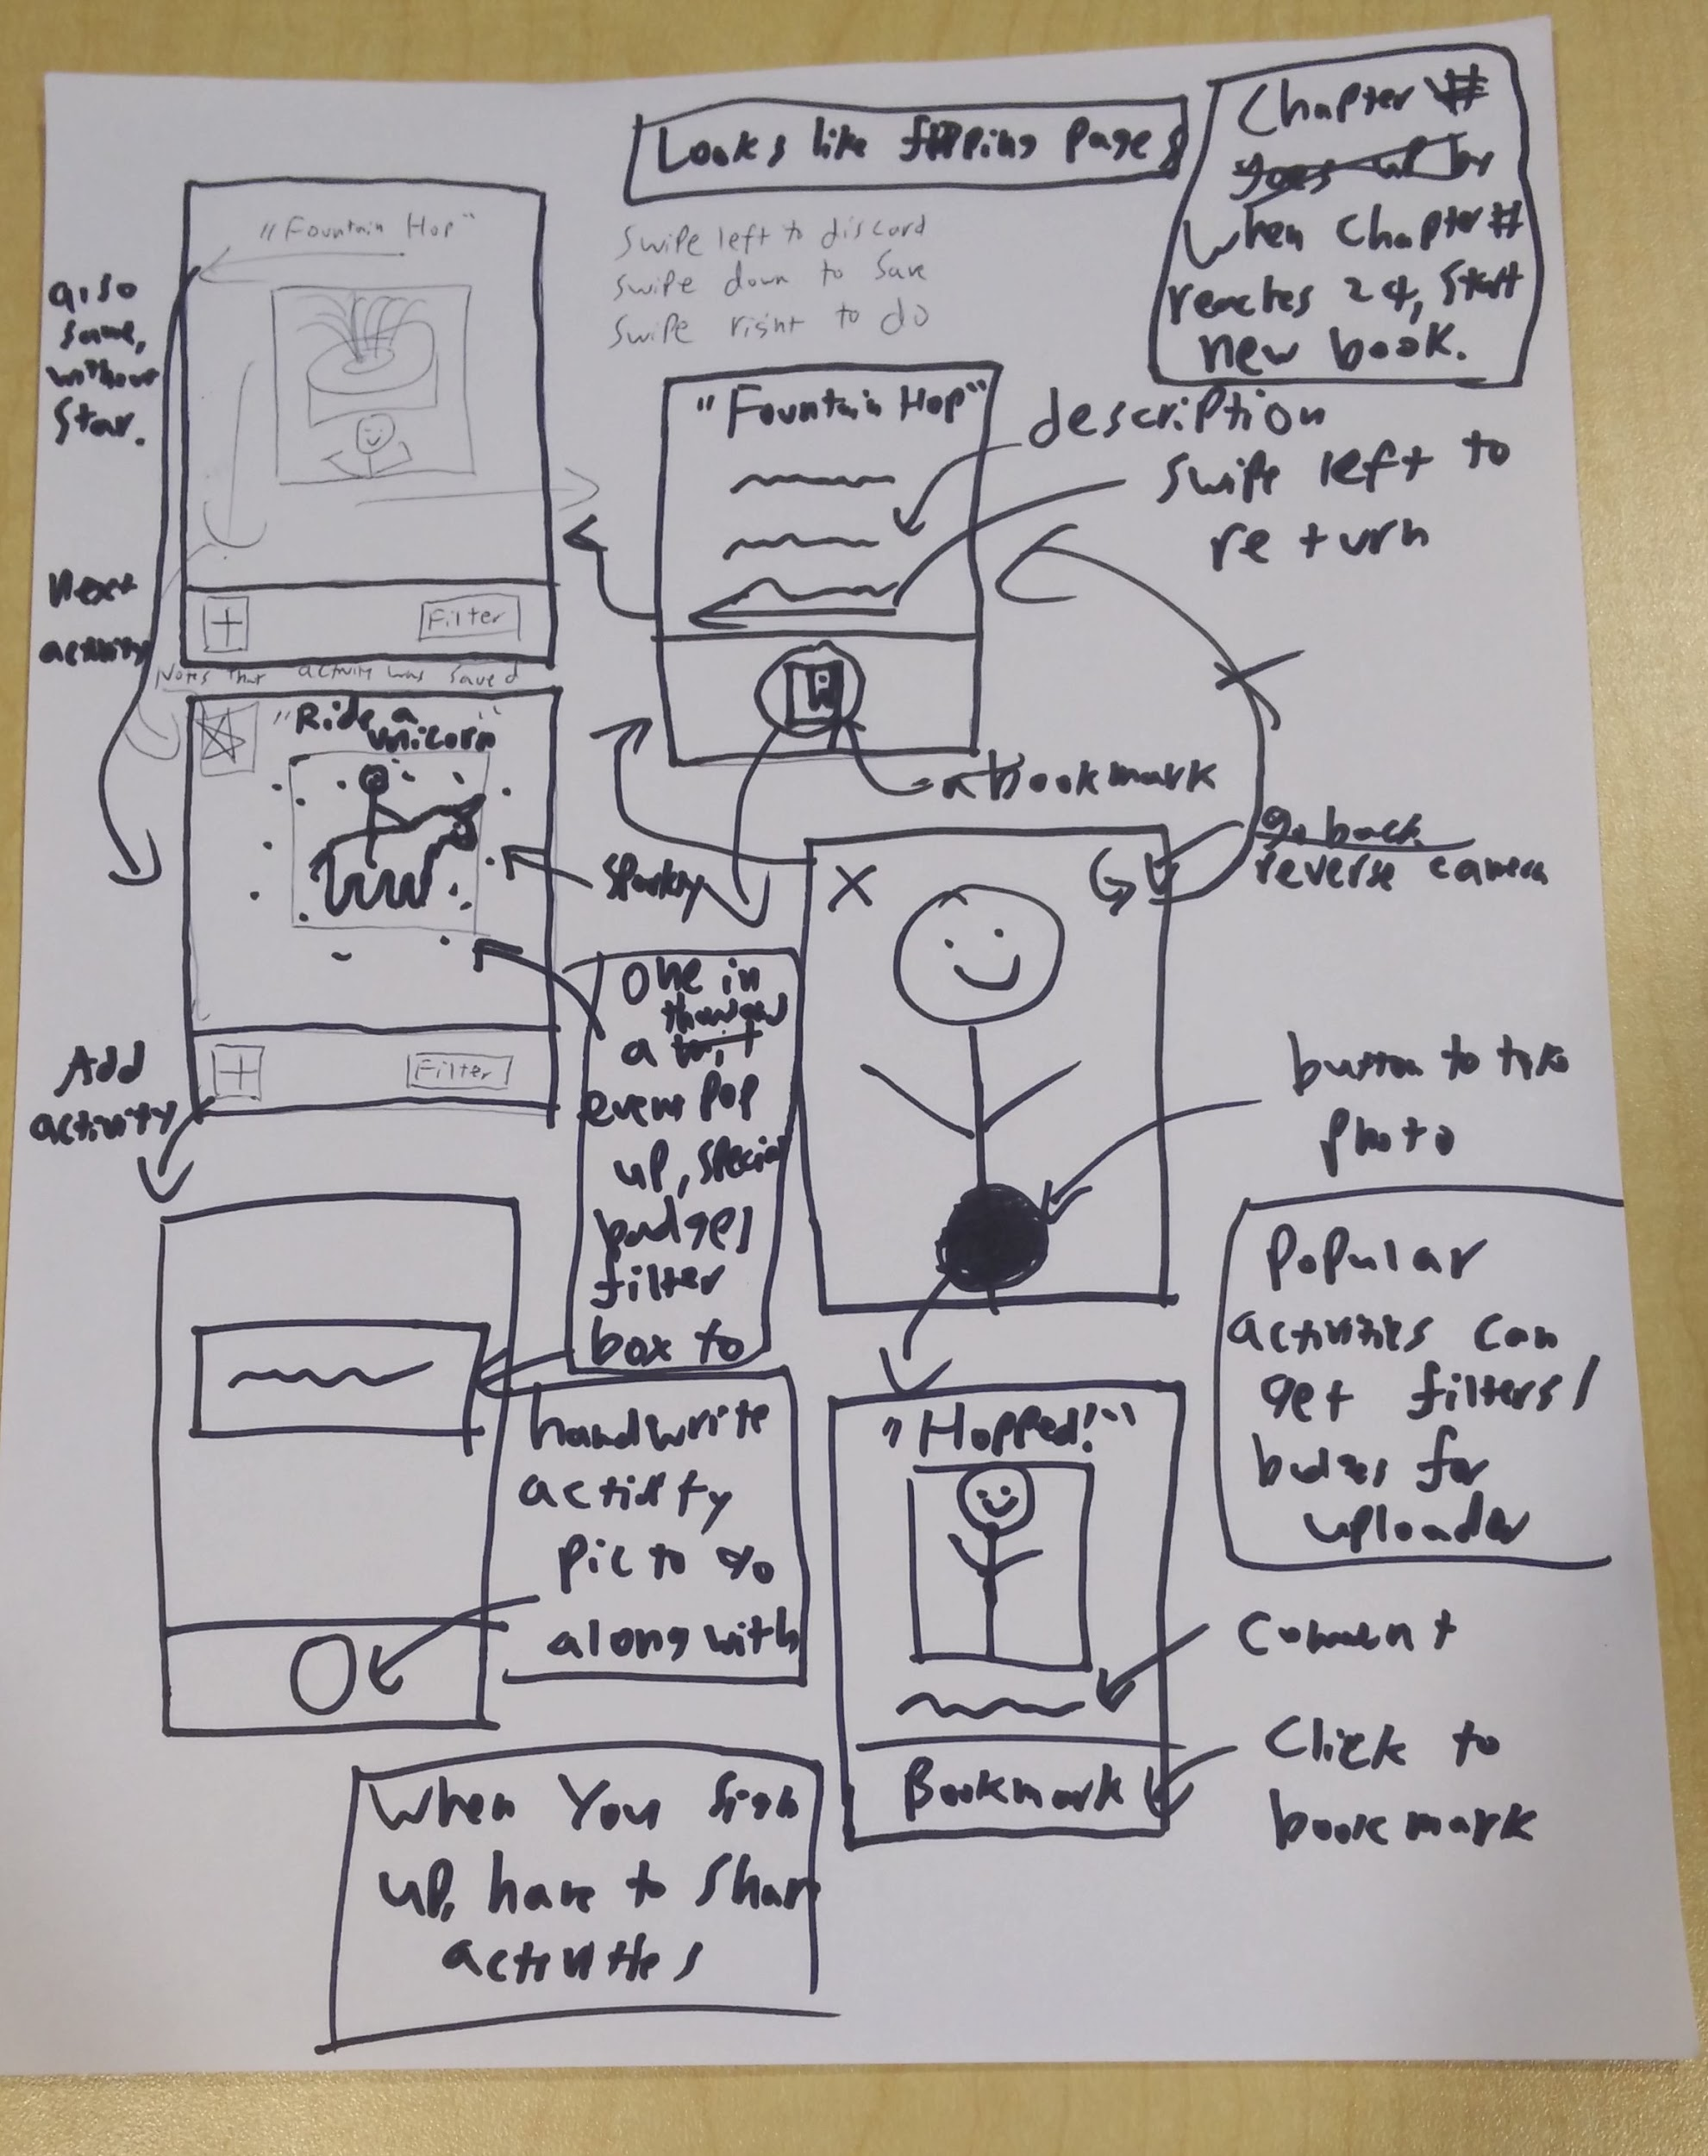
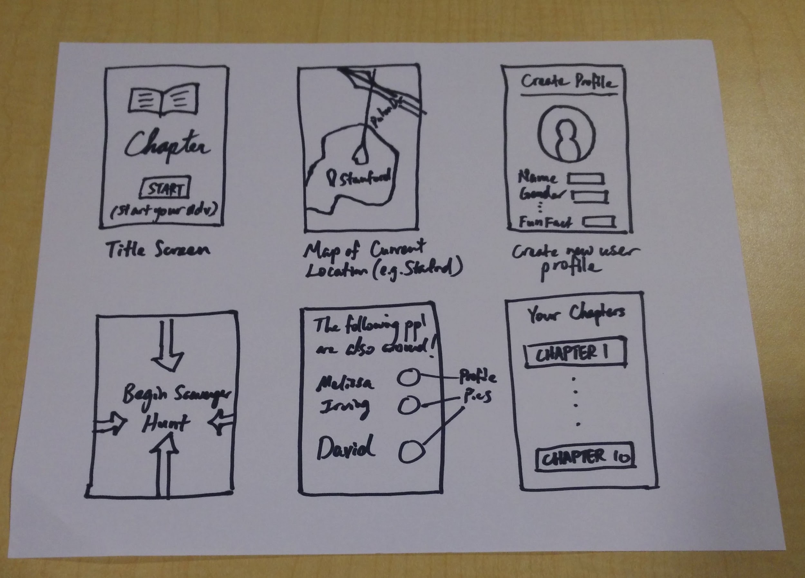
SKETCHES
“Maps”
Visually showing user location and other users around
“Ride a Unicorn”
Incentivizing users to engage with the app in order to get special filter/events

Slide 29
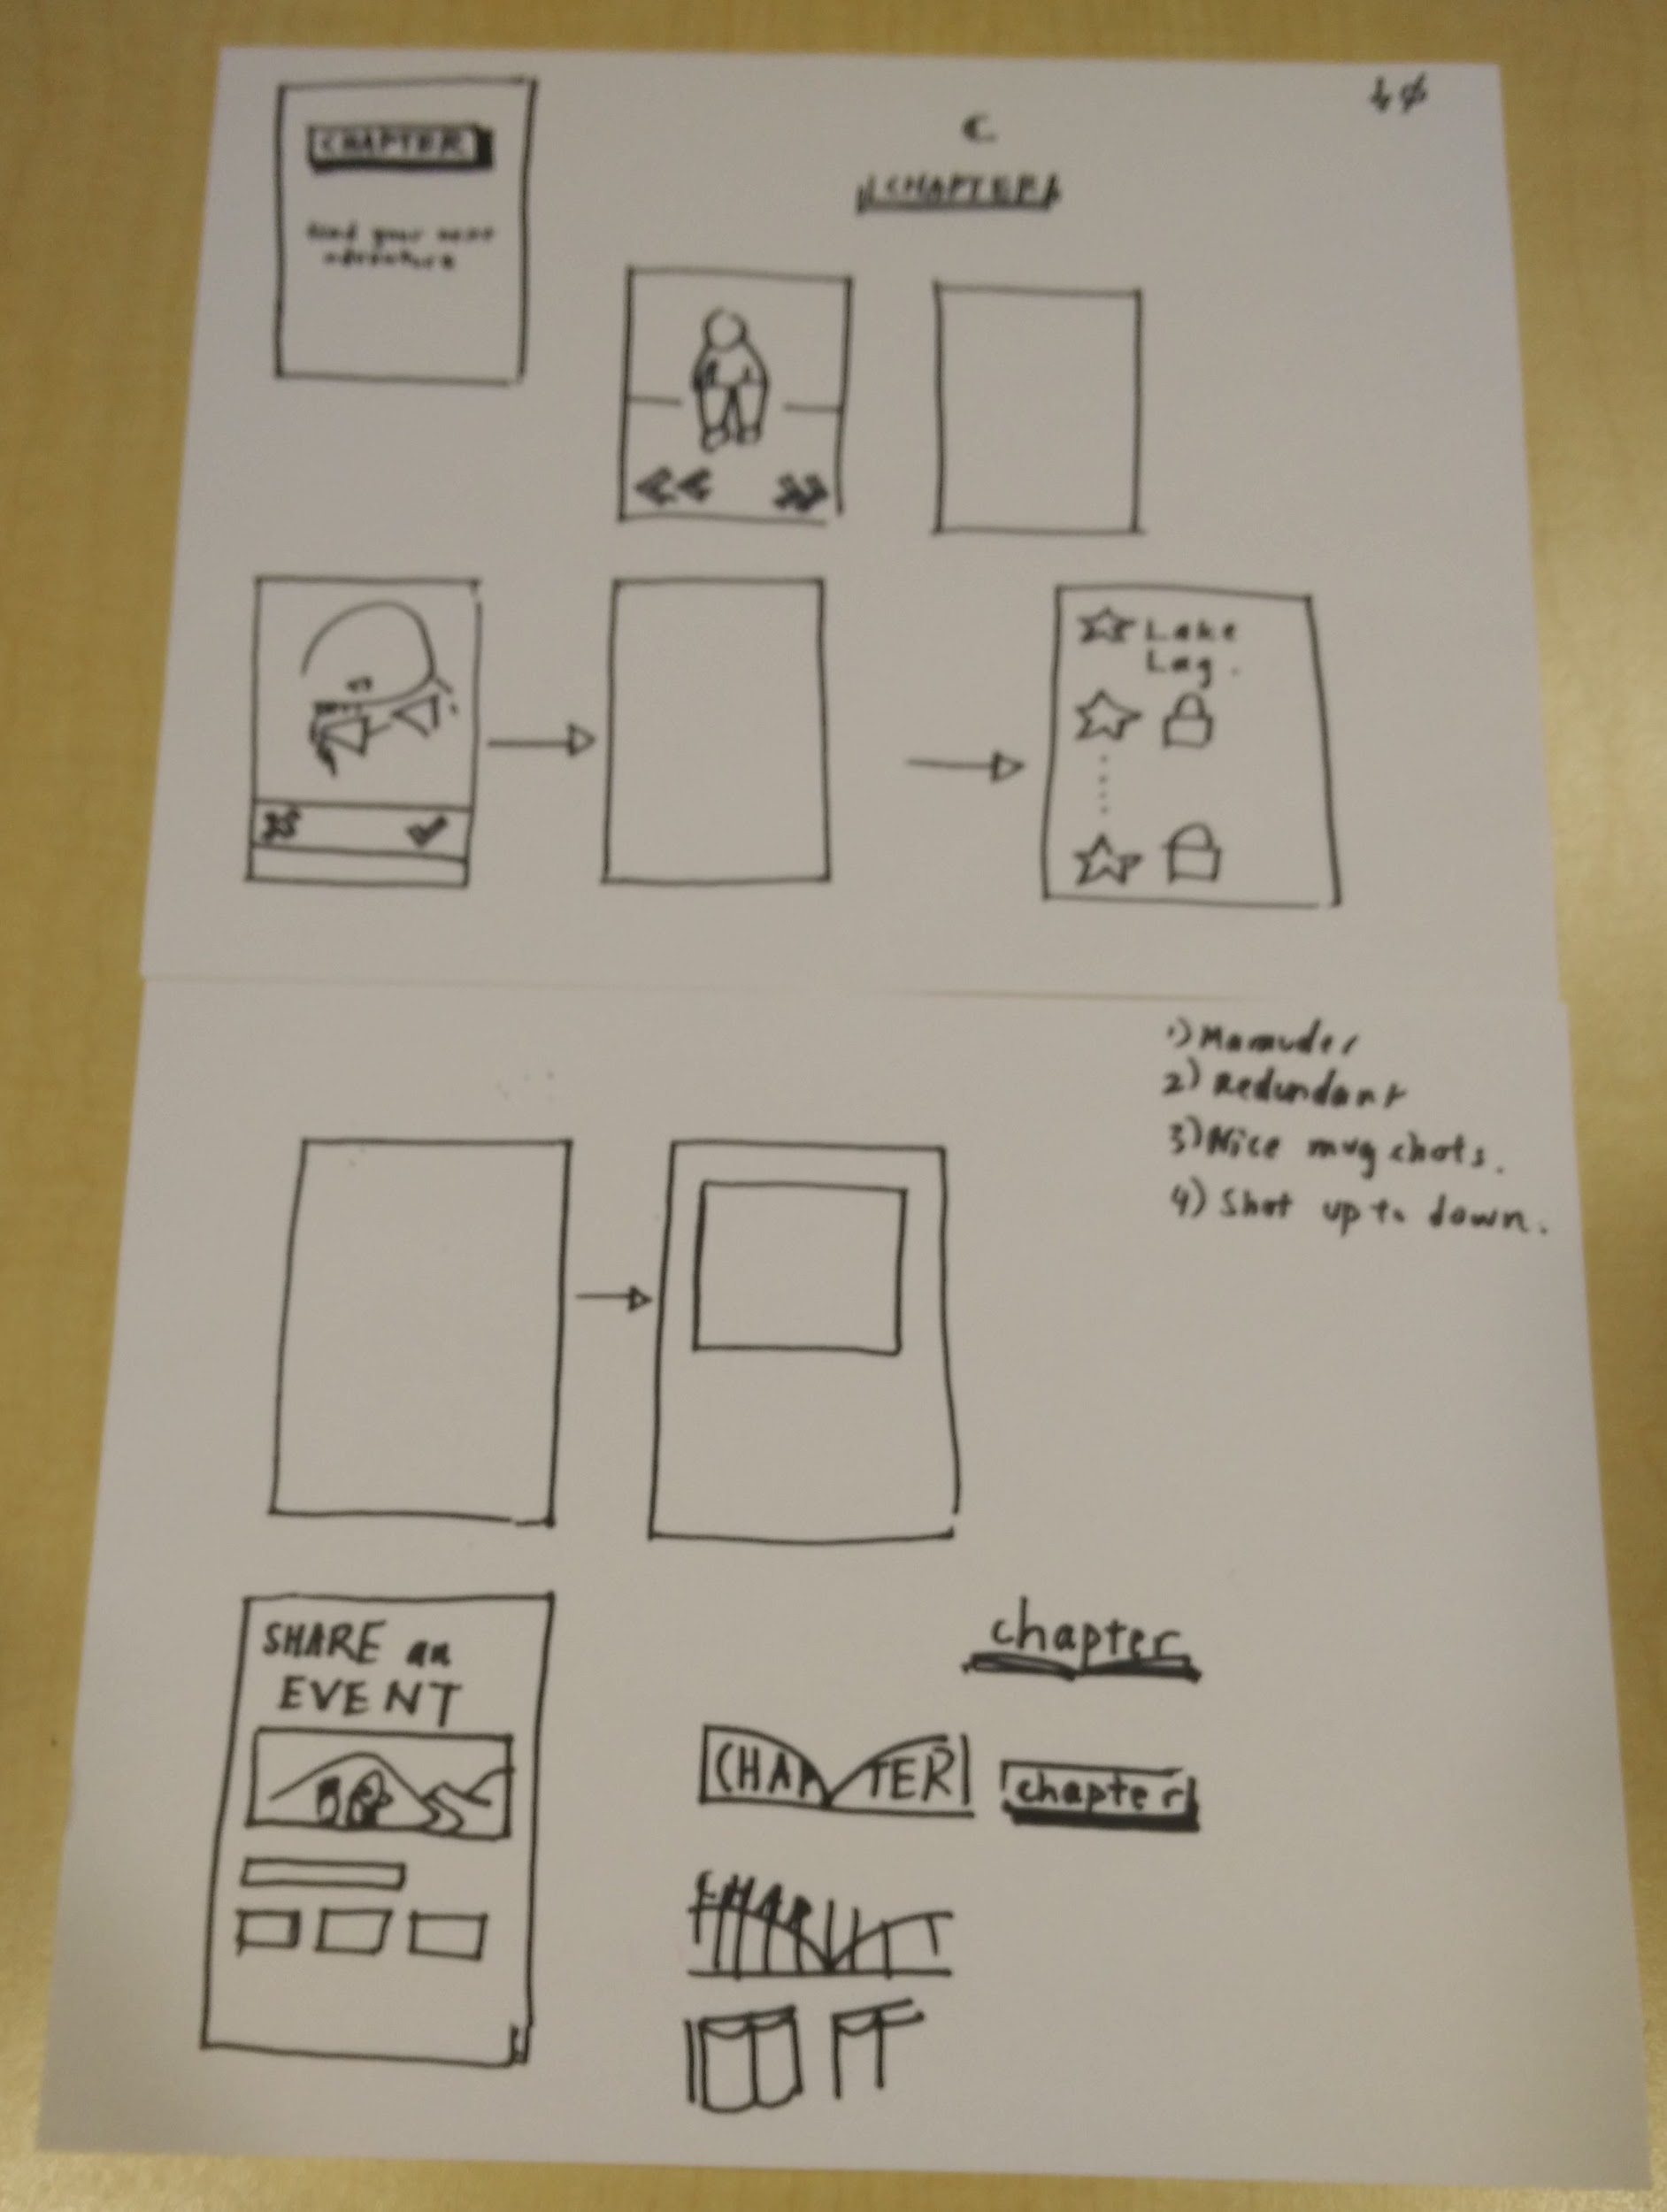
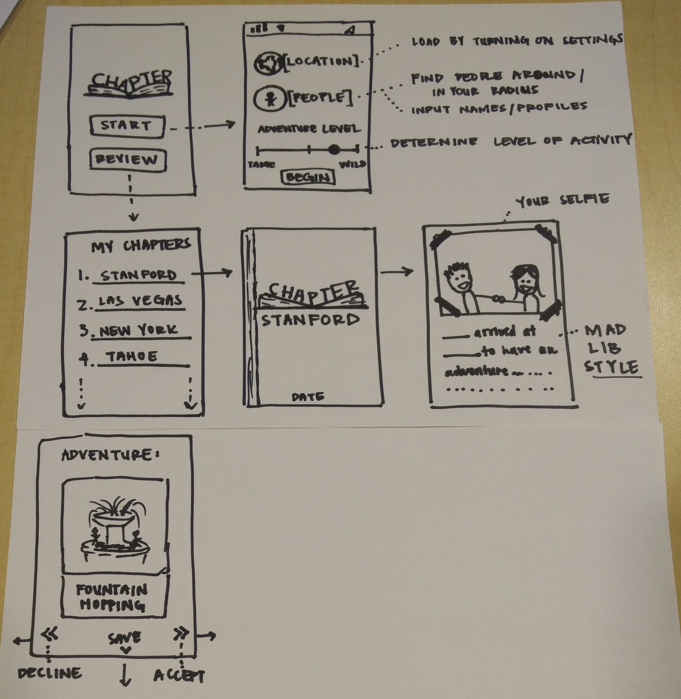
SKETCHES
“Swiping”
Action-based tracking for user’s next steps
“Preferences”
Filtering events based on the settings set by the user.

Slide 30
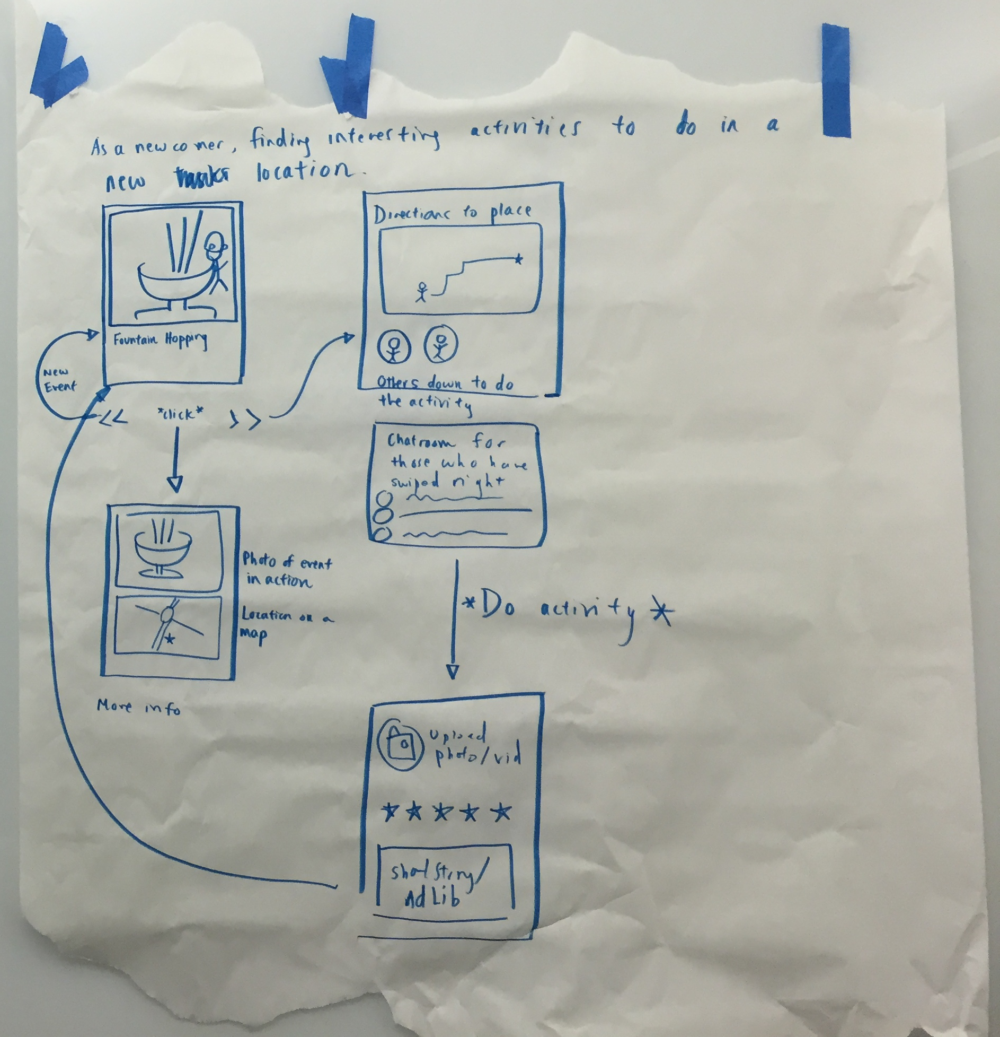
Storyboard #1
Task #1:
As a newcomer, finding interesting activities to do at a location (i.e., Stanford).

Slide 31
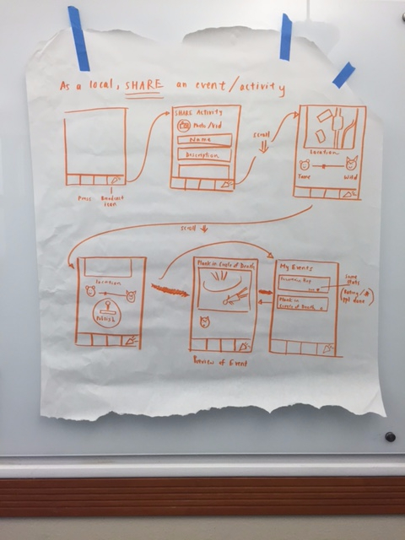
Storyboard #2
Task #2:
As a local, suggesting interesting activities to do or places to go at a location.

Slide 32
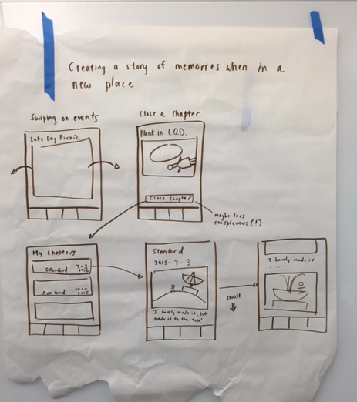
Storyboard #3
Task #3:
Creating a story of memories when in a new place.

