Slide 1
Crowd Power -> Location
Week 1: Needfinding
Dan, David, Irving, & Melissa
Notes:
Hi, my name is David, and I’ll be presenting on behalf of my team. Our domain of interest was location, and how we can use crowd power to enable easier decision-making in both new and familiar locations.

Slide 2
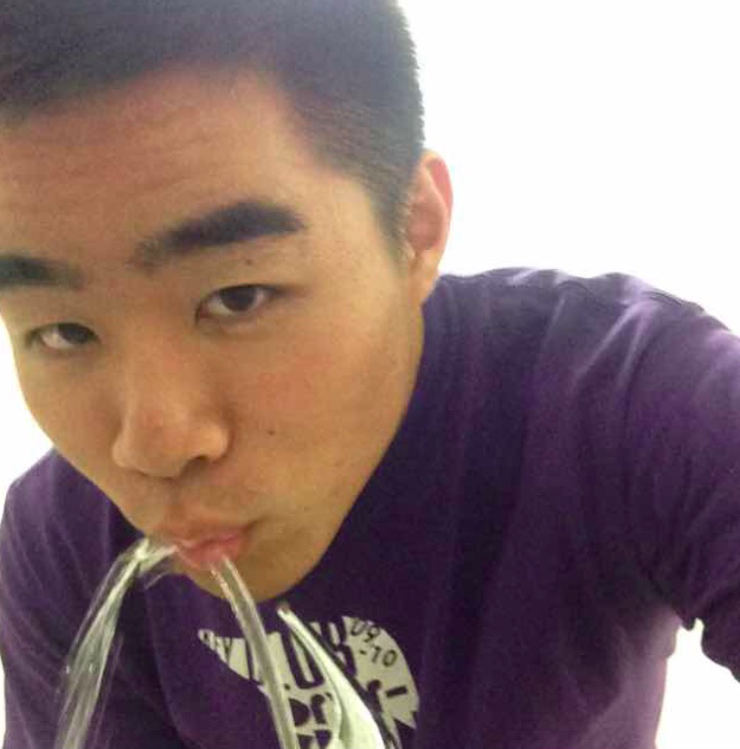
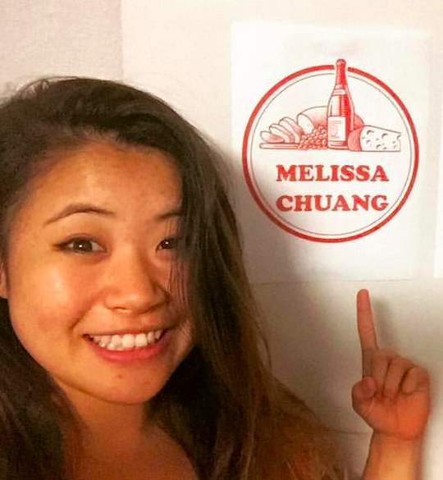
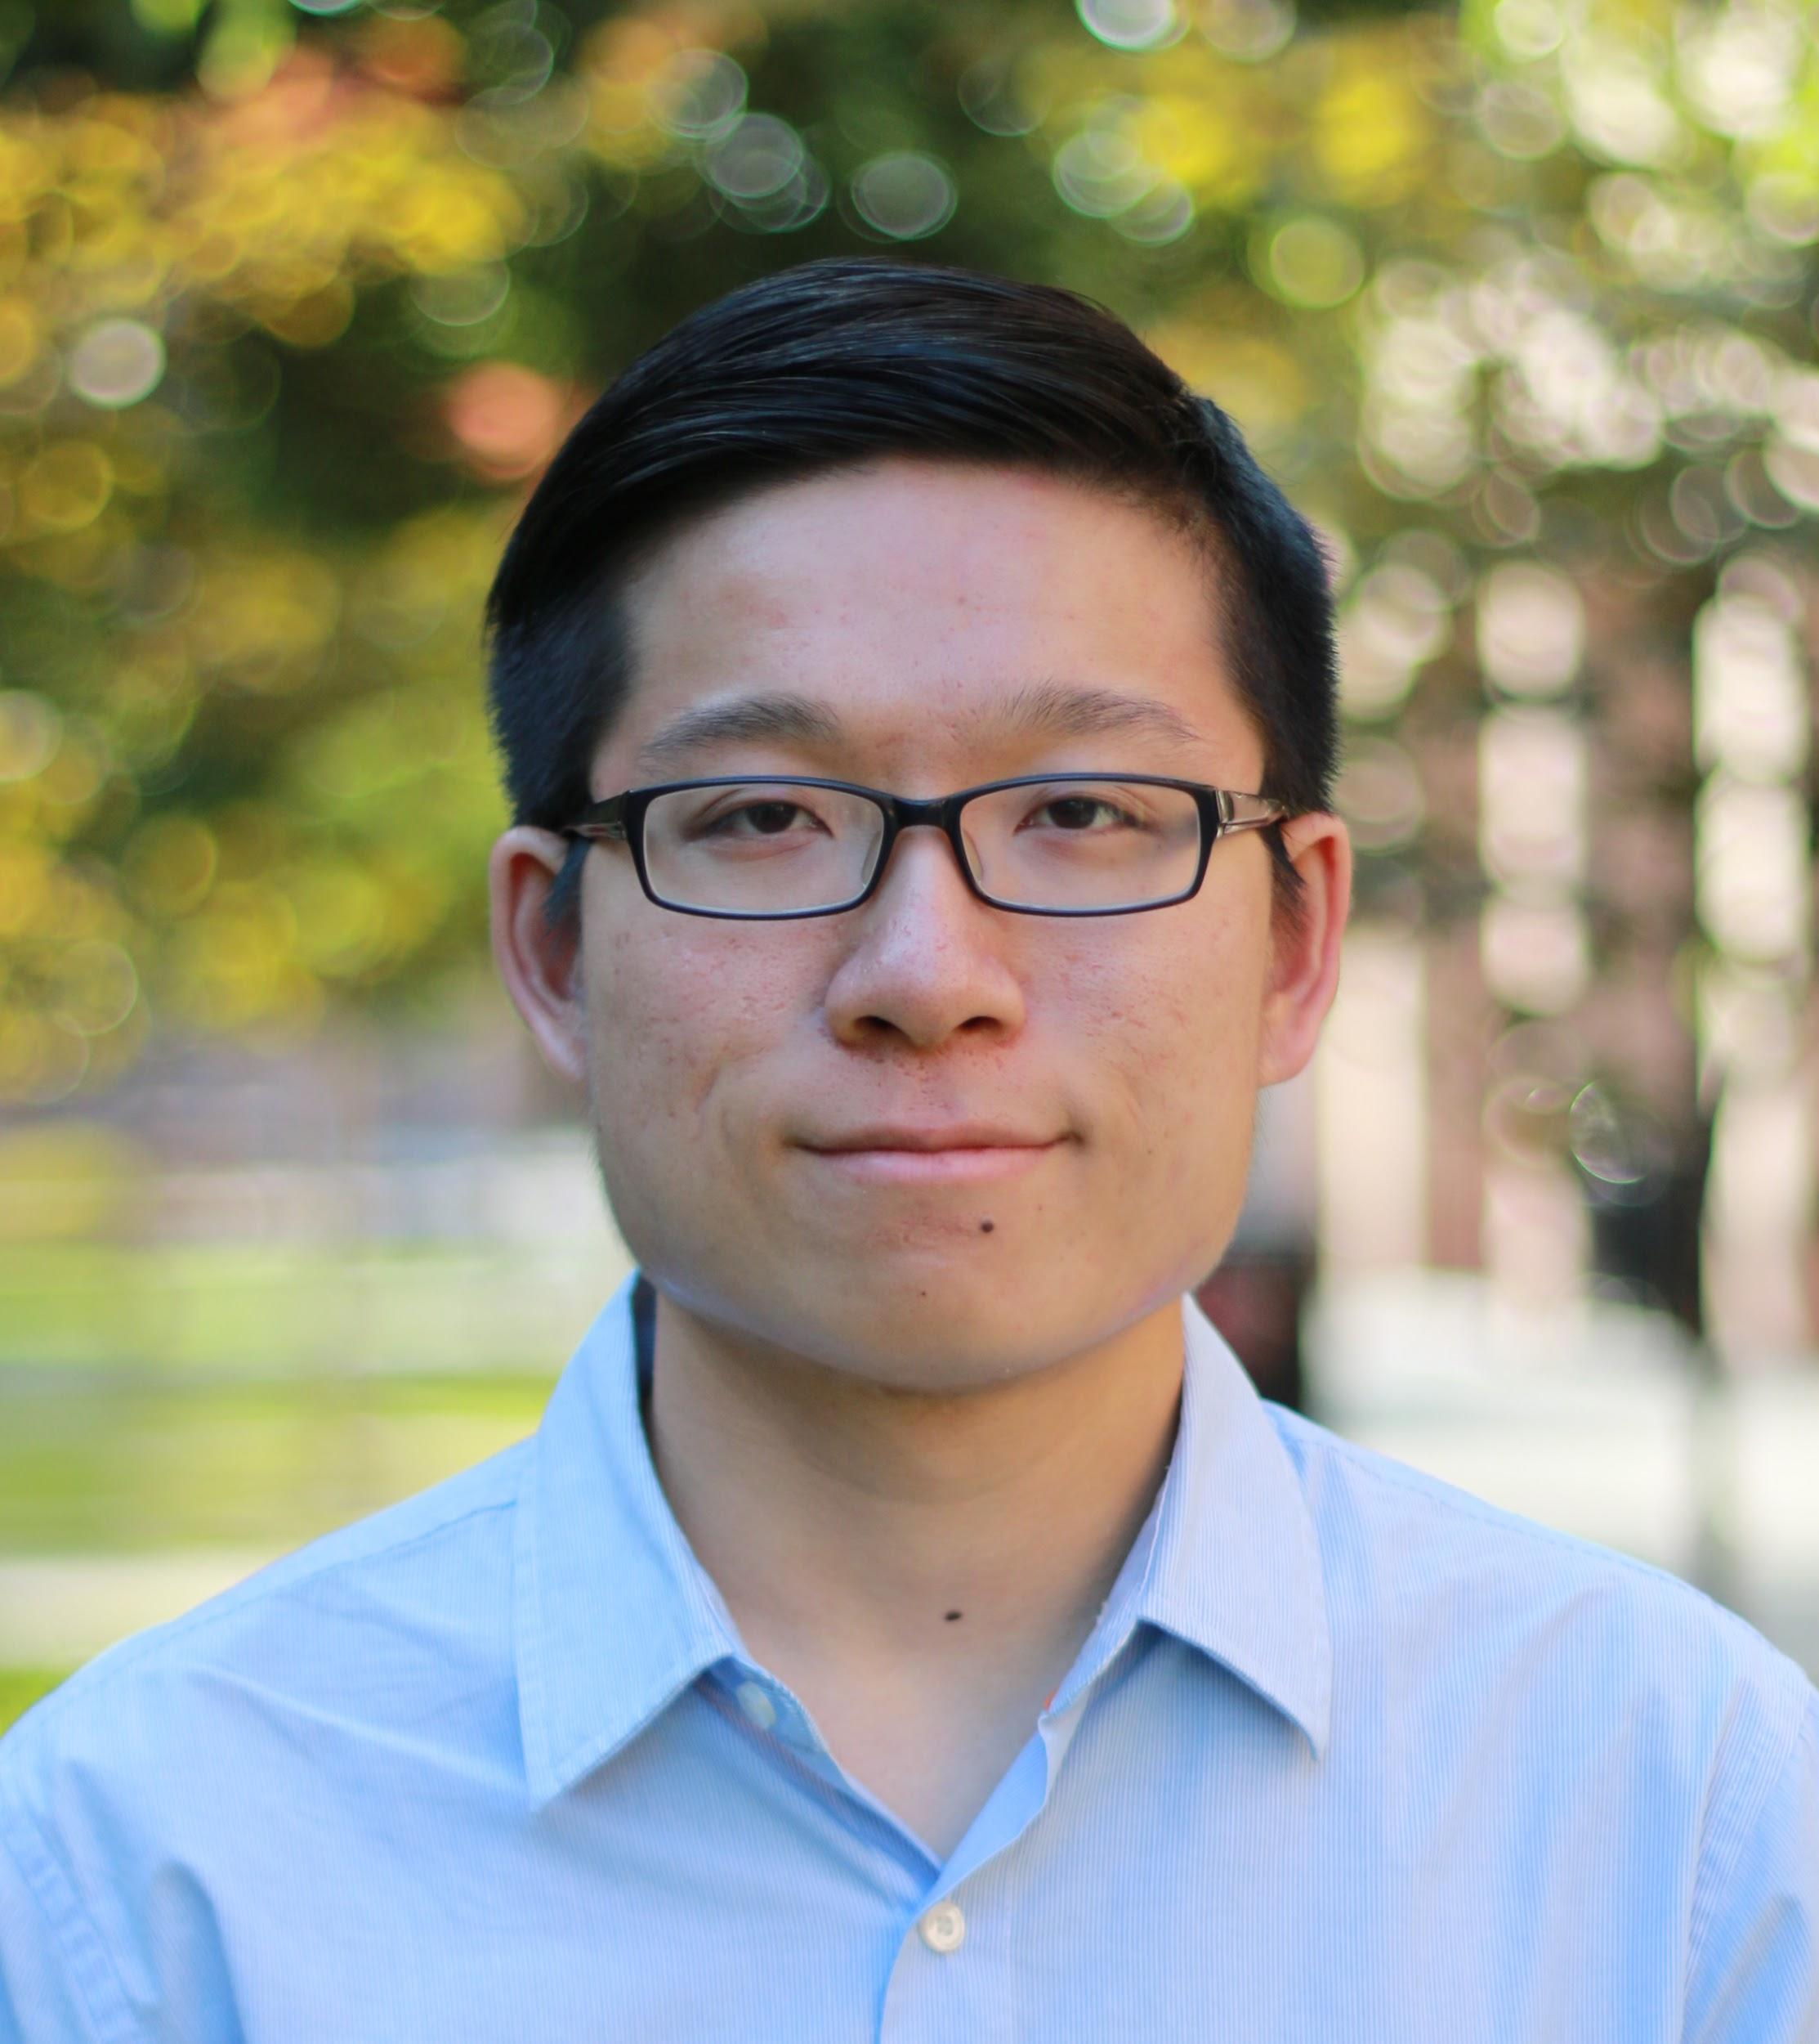
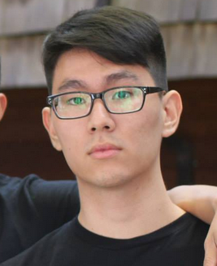
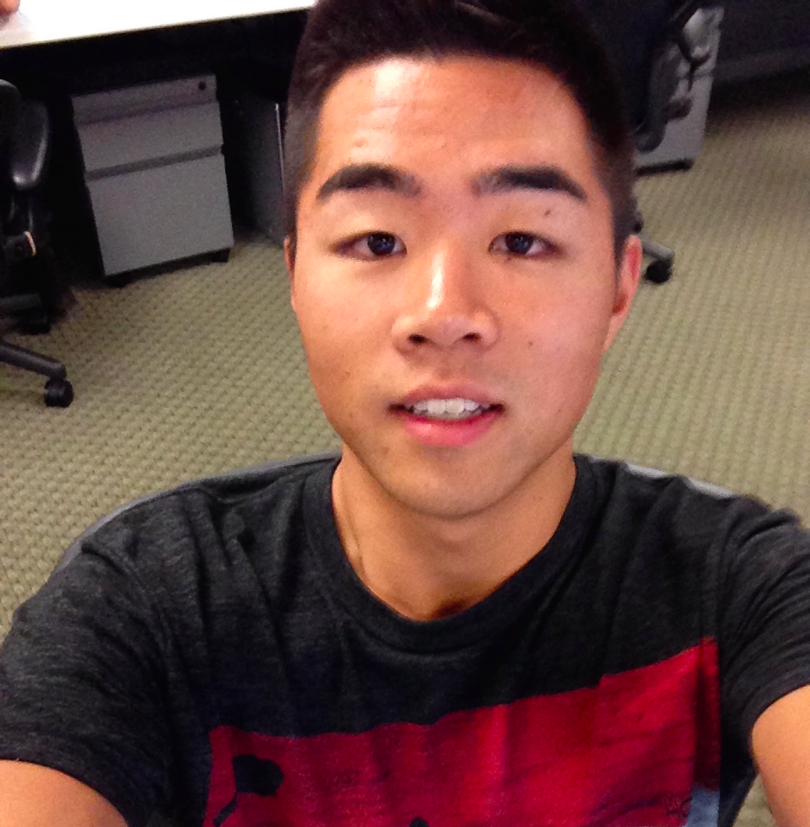
Hey y’all!

Slide 3
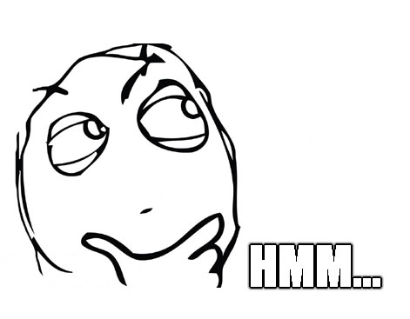
Notes:
I’m sure everyone’s been the same situations before. You’re in a new place, You’re trying to think of things to do. What do I want to eat? What do I want to do? Do I even have friends to do these things with? And eventually in the end, you’re just super frustrated.

Slide 4
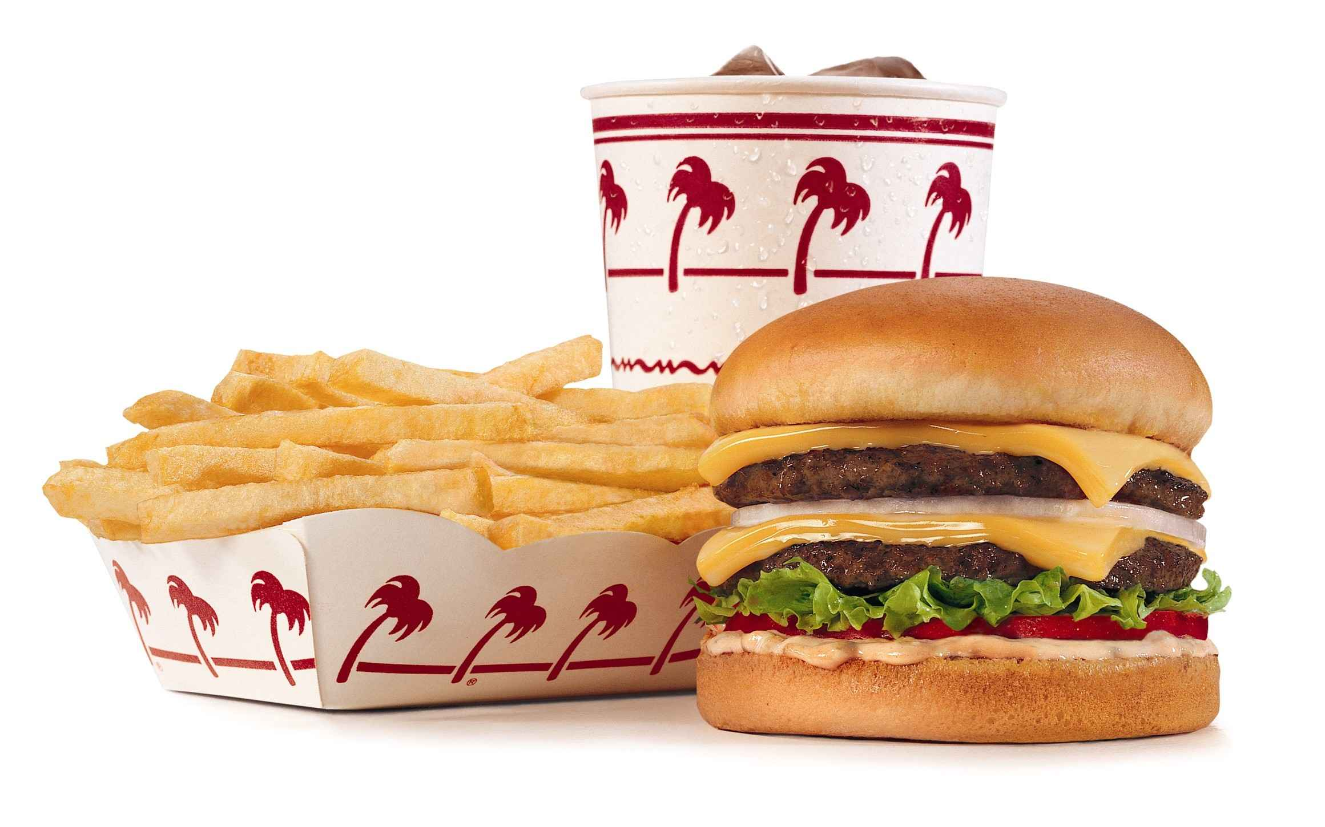
Notes:
Audience participation - who has used Yelp? Yelp -> food, restaurants, etc. What other locational-based info do we need/want?
https://buywithheather.files.wordpress.com/2015/01/yelp.png

Slide 5
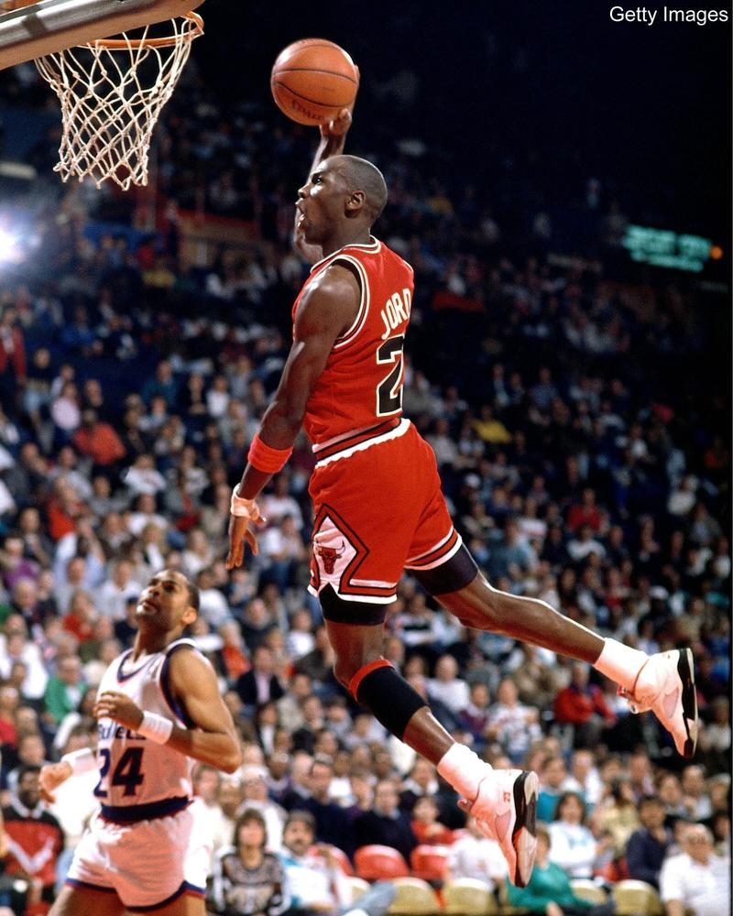
Notes:
Audience participation - who has used Yelp? Yelp -> food, restaurants, etc. What other locational-based info do we need/want?
https://buywithheather.files.wordpress.com/2015/01/yelp.png

Slide 6
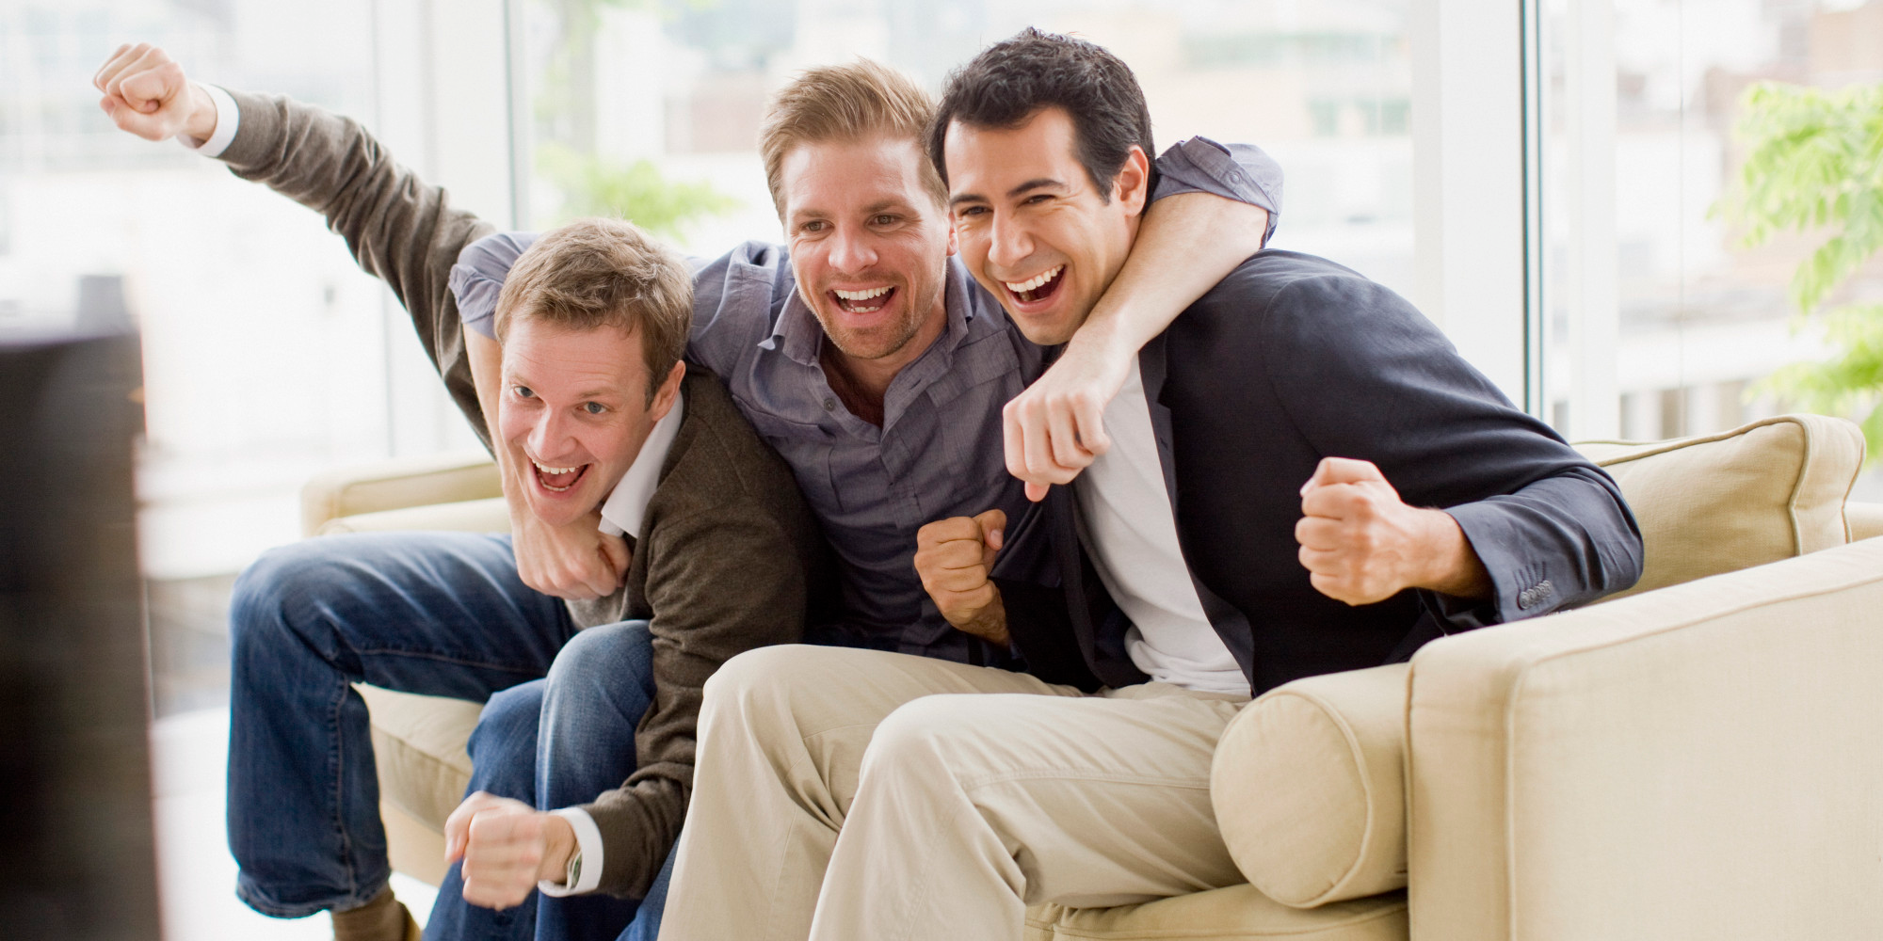
Notes:
Audience participation - who has used Yelp? Yelp -> food, restaurants, other stuff. What other locational-based info do we need/want?
https://buywithheather.files.wordpress.com/2015/01/yelp.png

Slide 7
Notes:
Audience participation - who has used Yelp? Yelp -> food, restaurants, etc. What other locational-based info do we need/want?
https://buywithheather.files.wordpress.com/2015/01/yelp.png

Slide 8
What location-based
services do we need?
Notes:
That was the basis of our domain of interests - what location - based services do people need? In addition, how can we use crowd power to fuel this service?

Slide 9
Interview
Analysis
Result
Notes:
This presentation will be divided into three parts. First, we will go through the interviews we conducted. Second, we will analyze the interviews by breaking each one down into the four empathy map categories. Finally, we will summarize the inferences and insights we gained.

Slide 10
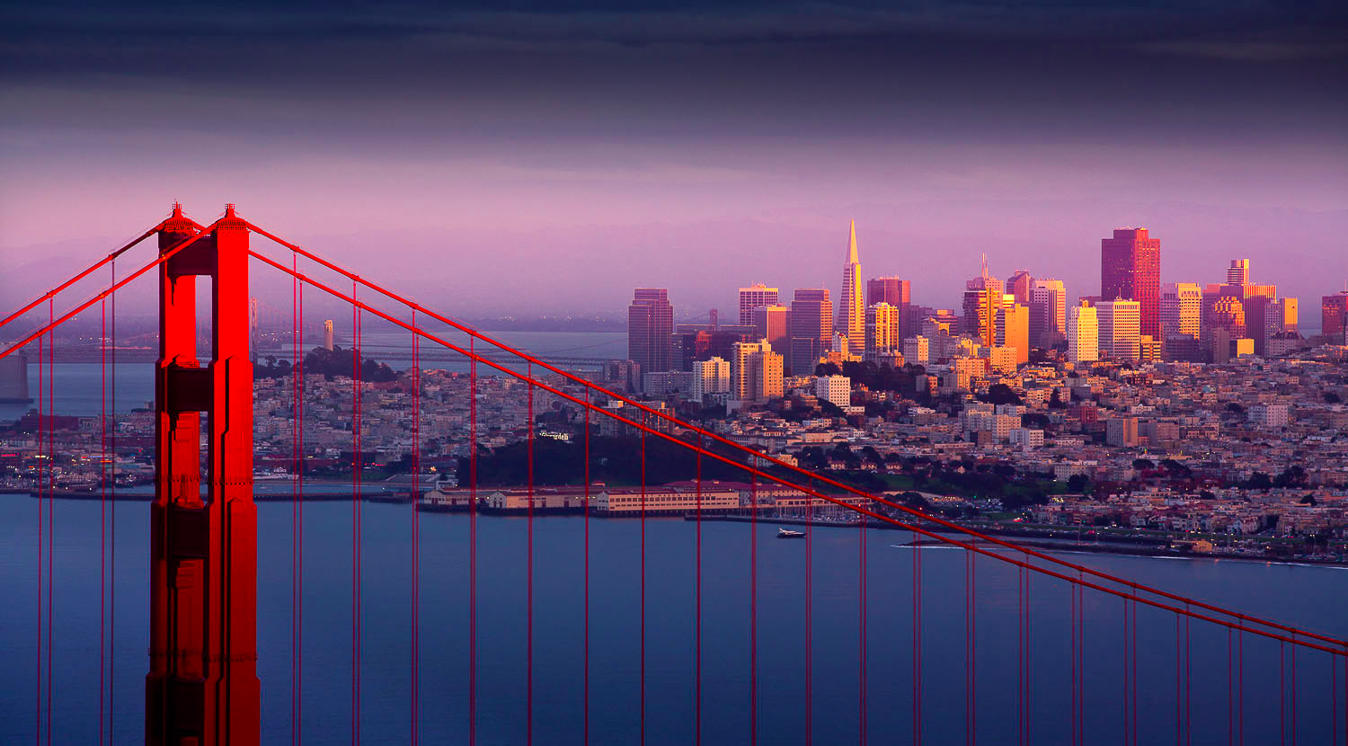
Sample Questions
Notes:
“Tell us about a time when you were in a new location.”...What was your favorite activity? How did you learn about it?
“What’s your experience touring places in general?”...What did you wish to know from the people around you?
“What services/apps do you use for a location?”...How did you feel using those products?

Slide 11
Ryan - Tourist
Diana - Stanford Student
Herman - Tourist
Christie - Stanford Student

Slide 12
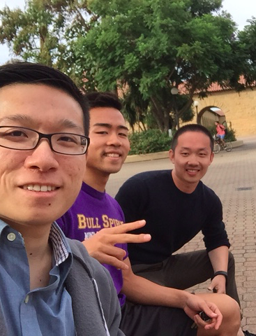
Say/DO
Rui (Ryan) Guo
“First time I go to SF, I go to ... but I want to try something new the next time.”
“There’s logistics and scheduling conflicts that make meeting people for a short trip hard.”
Notes:
Ryan: Forecast analyst at Belk (company in Charlotte, NC); graduated with a Master’s degree in Supply Chain Management from Ohio State University. Originally from Beijing, China, Ryan was visiting/touring the Bay Area with his parents, who had come from China to see him. Ryan stopped by Stanford to visit a friend of his who studies here.
Contradiction: He mentions conflicts of scheduling, as a tension to meeting new people short term. At the same time, he feels content visiting areas alone.

Slide 13
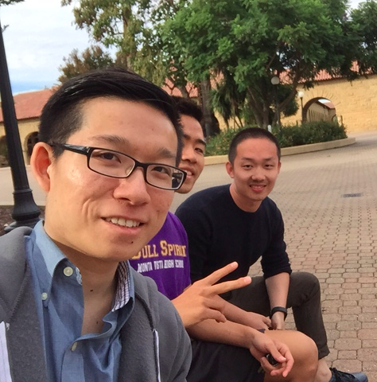
Rui (Ryan) Guo
Think/Feel
Curious about where locals go for fun.
Excited to meet people, but frustrated by inconvenience.
Trusts the platform of WeChat that many Chinese people are on.

Slide 14
Diana: Say/Do
Findings
Spontaneity - Traveled with no itinerary, reservations, or place to stay.
Major tourist attractions were always really crowded.
Found places by word of mouth and asking locals.
Meet new people - “It would be cool if the app had a filtering system”
“Parking in a city like SF is expensive and dangerous”
Notes:
Contradictions: She was very straightforward in living one step at a time and playing by ear.

Slide 15
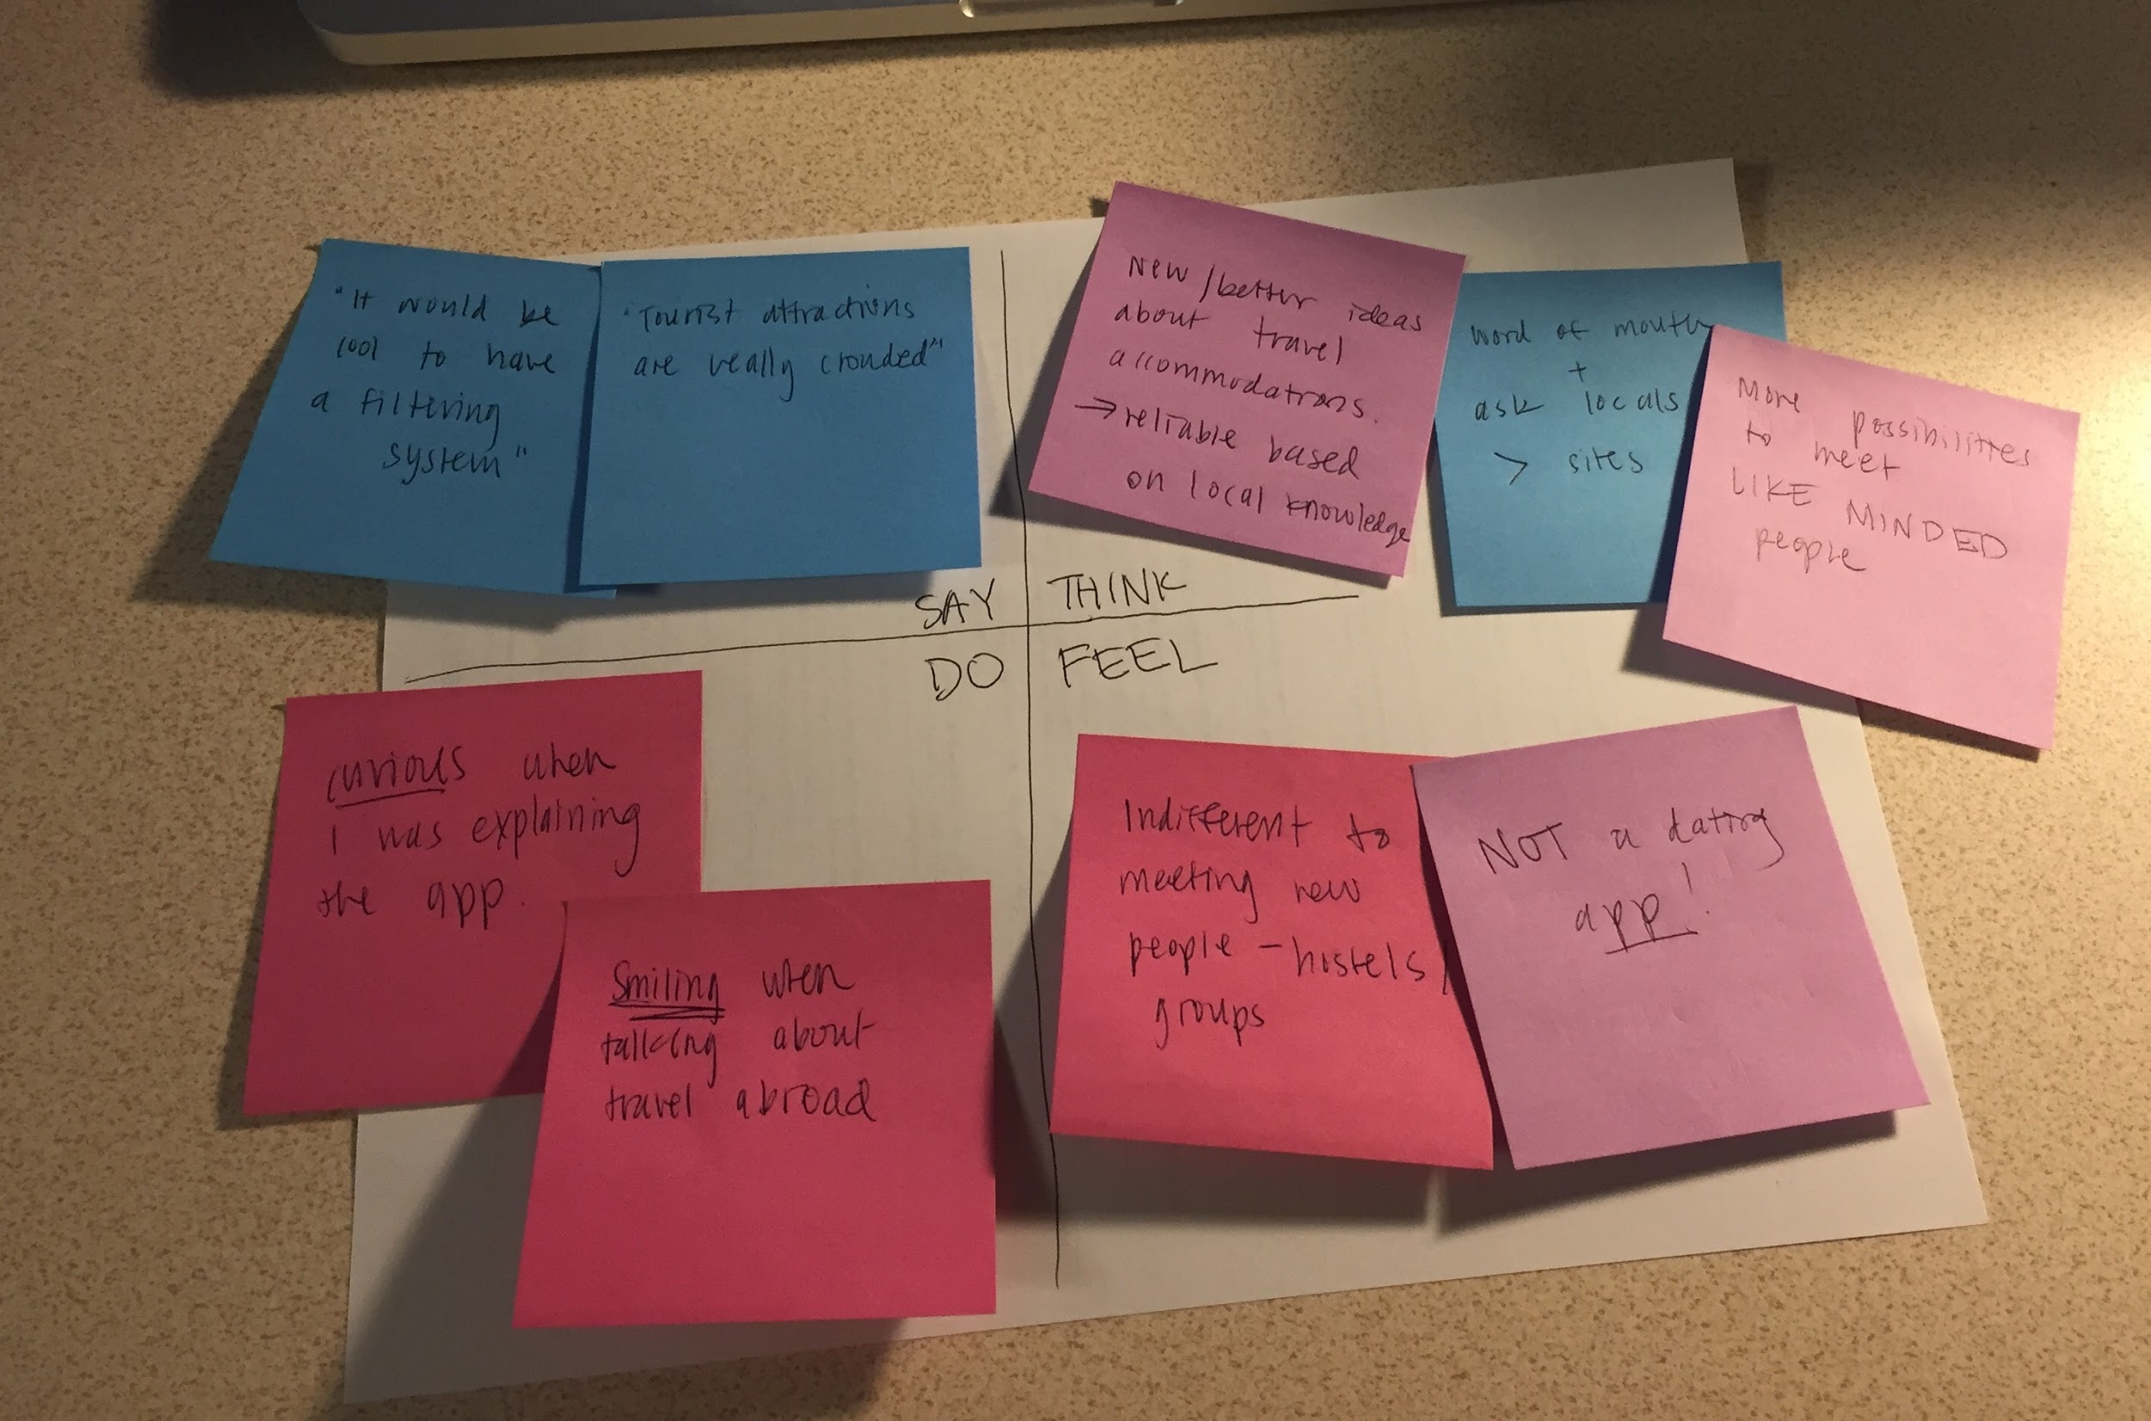
Diana: Think/Feel
I want to find places to stay last minute.
Add filter for preferences & compatibility: I don’t want to get stuck spending the day with someone who has completely different interests.

Slide 16
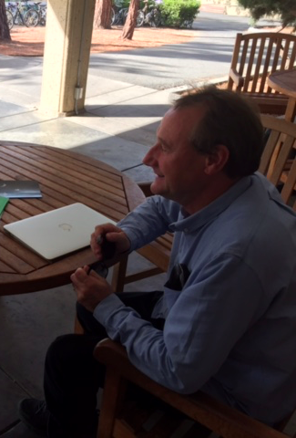
Herman
Say/Do
“I don’t like large groups, I like to be on my own”
“I find the people here very friendly, much more willing to help than those in Germany”
“If I’m bored, I’ll first walk around myself, then look for friends”
Notes:
Herman: an advisor of a student group that had won a competition for young entrepreneurs in Germany. The award for winning first prize in the competition was a tour of Silicon Valley. He wanted to see Stanford, the startups in the Valley, and San Francisco.
Contradictions: He came to Stanford to see a friend. He was sitting on a bench instead of looking around.

Slide 17
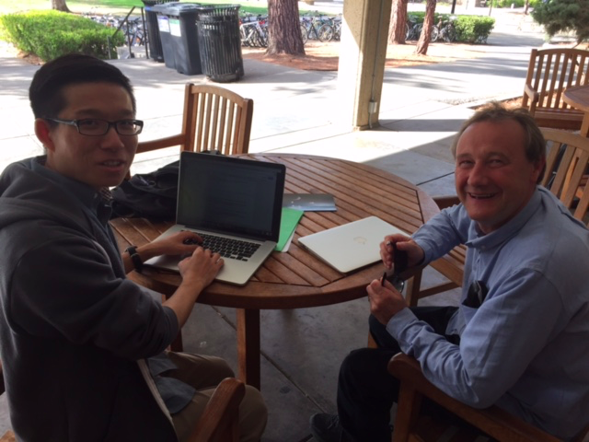
Herman
Think/Feel
Wants spontaneity, but direction during travel.
Wants better coordination with friends in a new area.
Wishes the hospitality here is in Germany.
Keen on atypical tourist attractions.

Slide 18
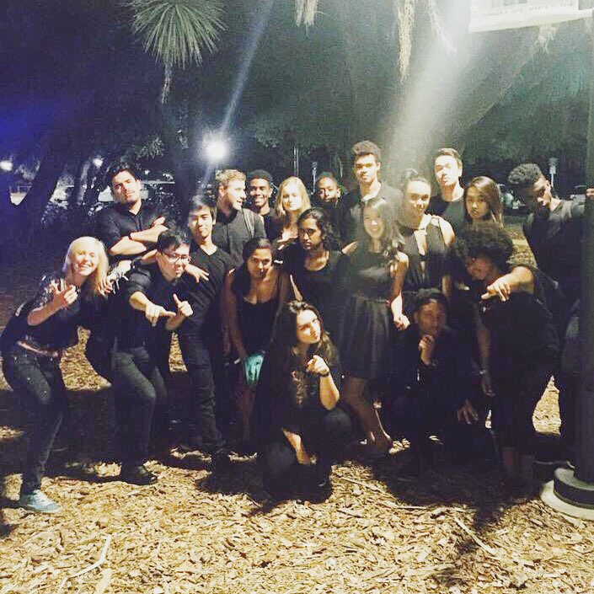
Christie: Say/Do
People Centric - “I remember at NSO when my friends from East Campus came all the way over to Lagunita”
“I need social media in my life”
Loves shopping in new locations
Notes:
Contradiction, really loves shopping, talked a lot about shopping but was sad when she mentioned that her friends were gone to school while she was still in summer.

Slide 19
Christie: Think/Feel
People make the location memorable.
Wants more enjoyable way to shop, not necessarily faster.
Really likes singing, joined A Capella to be with people of same interests.
Always wants to be connected with friends through social media.

Slide 20
Needs / Insights
Want to find people with common interests easily
Keen on finding the local favorites
Wants the process to be spontaneous and adventurous
Wants to be with fun, likeable people
Keep connected with current friends

Slide 21
Questions
How can we make accessible local knowledge of a place?
How can people feel comfortable about meeting new people in an unfamiliar place?
Are people innately willing to find friends?

Slide 22
Thanks!

Slide 23
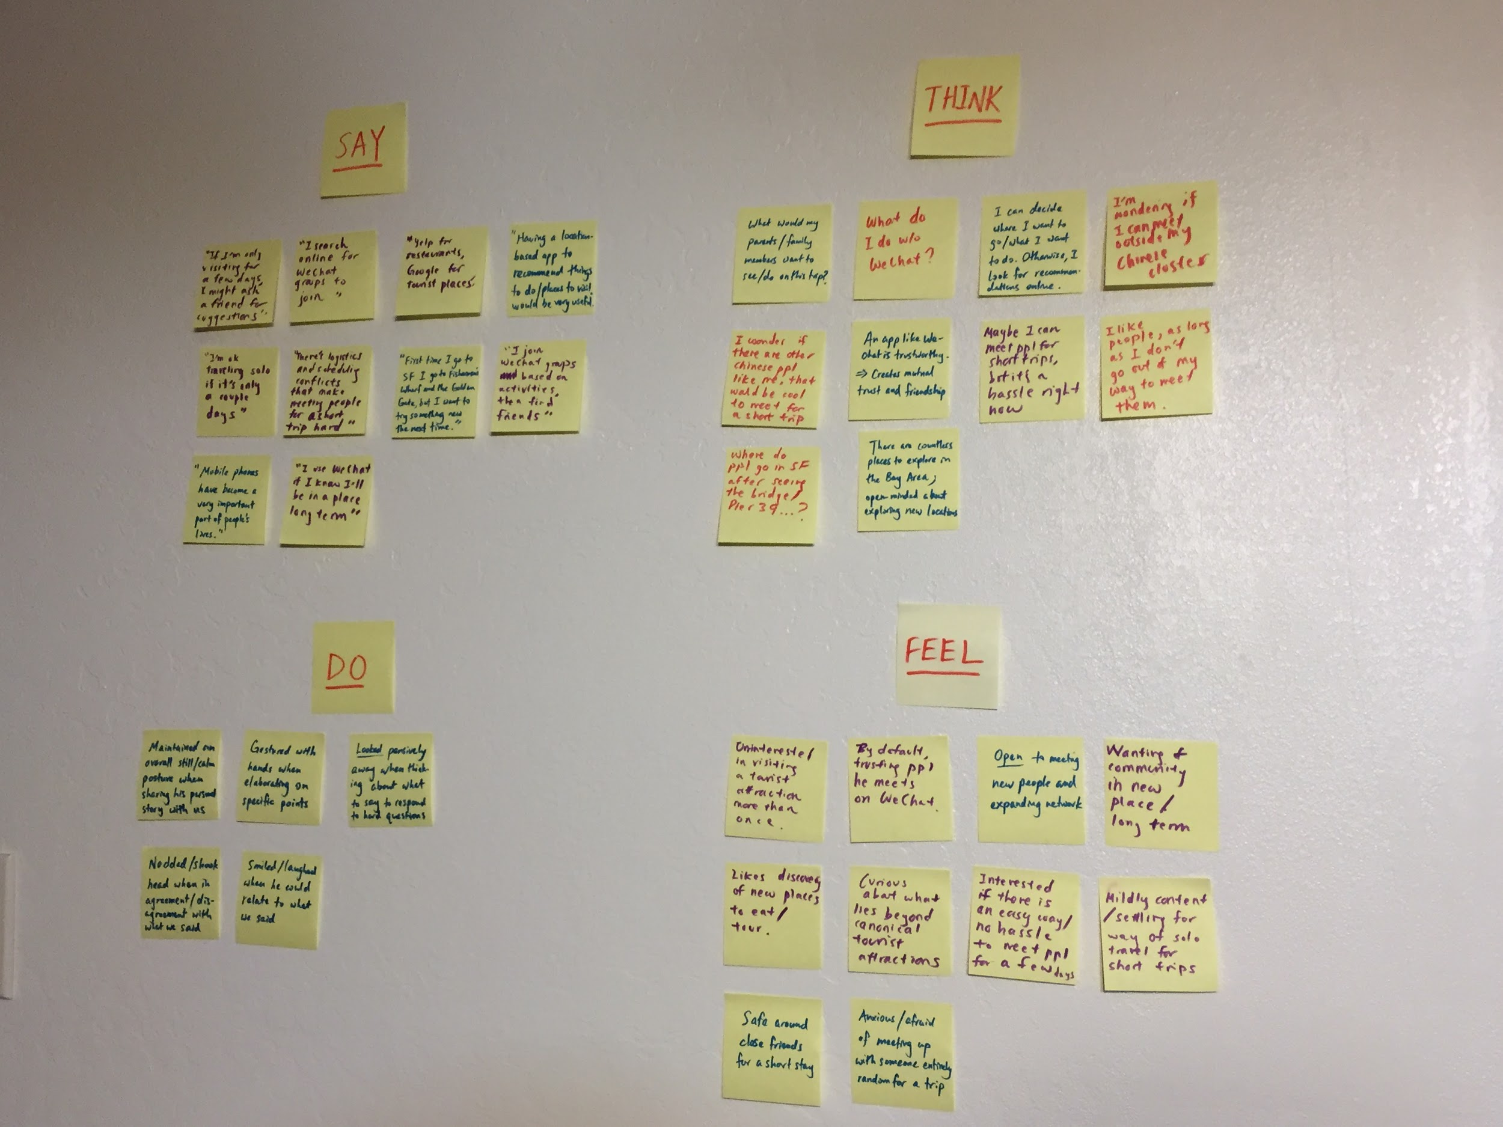
Appendix

Slide 24
