Slide 1
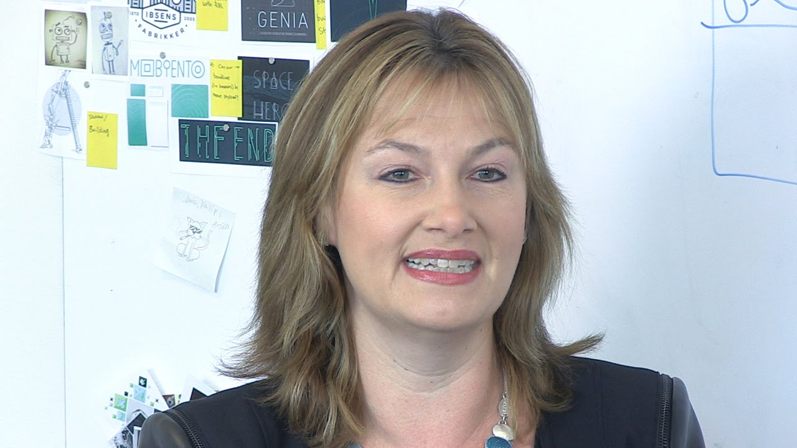
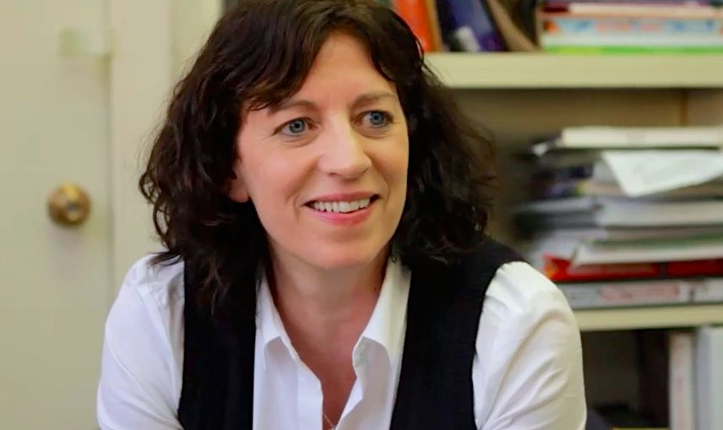
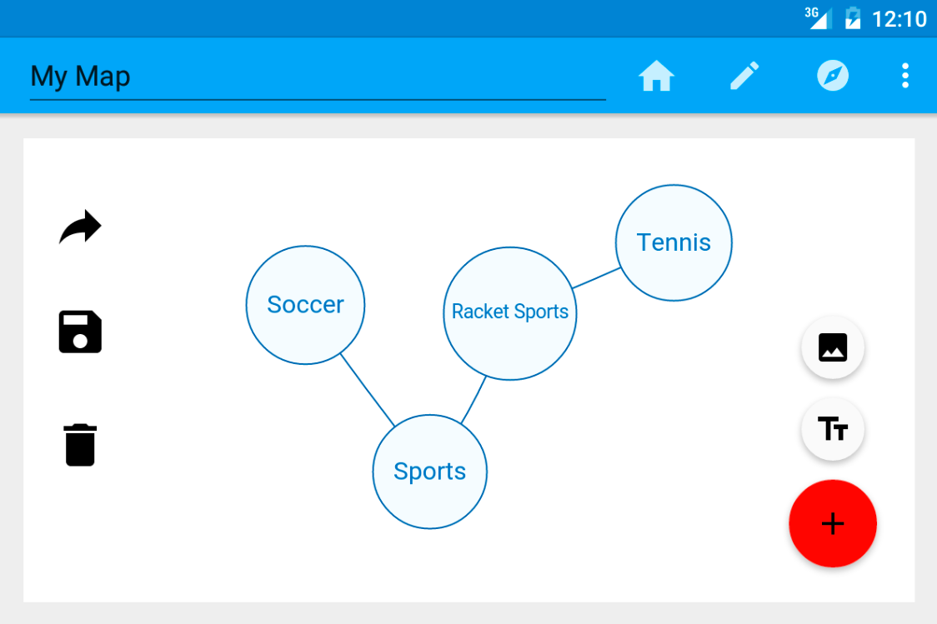
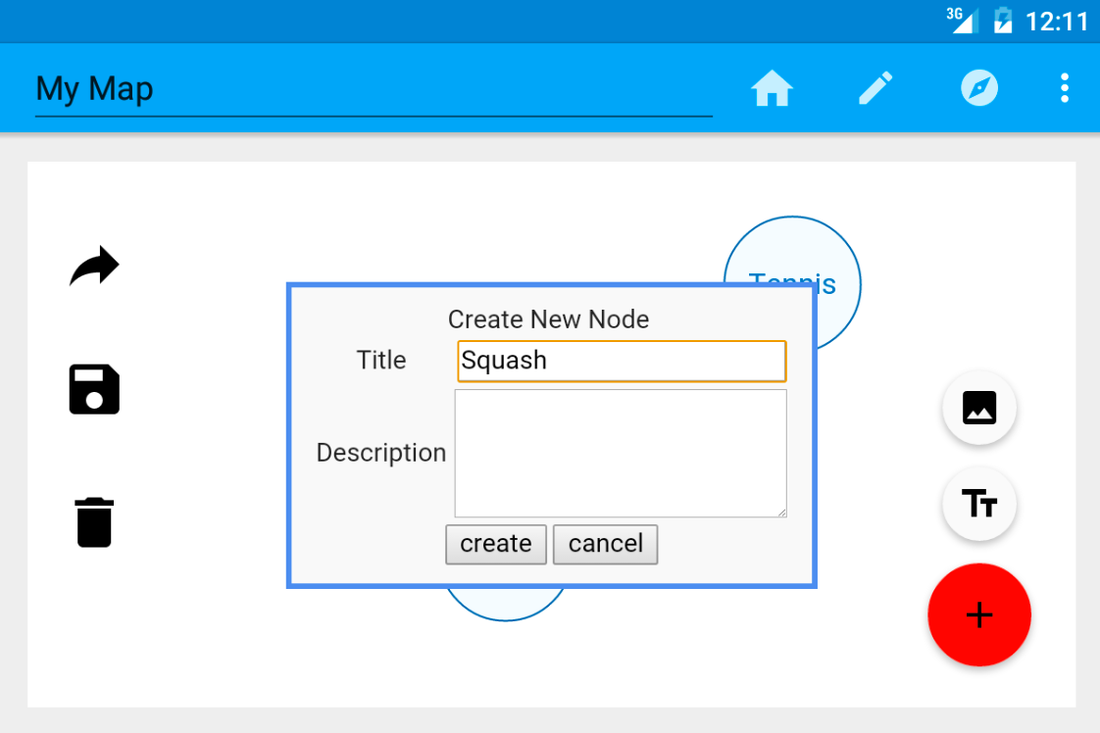
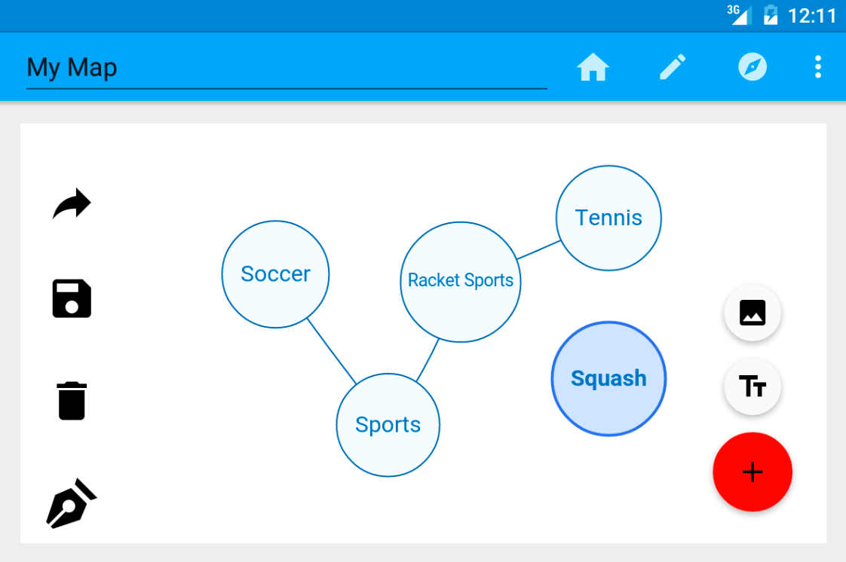
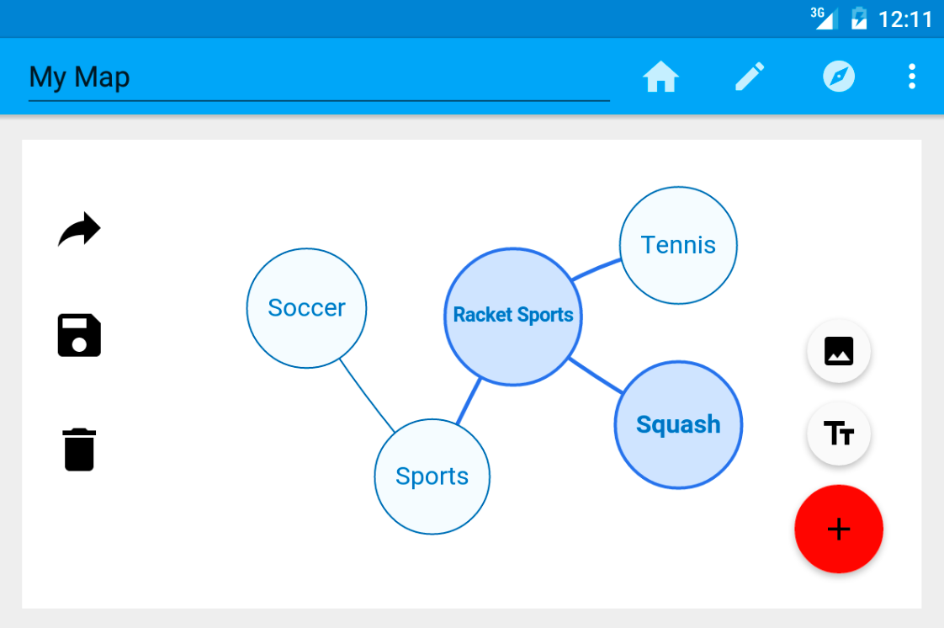
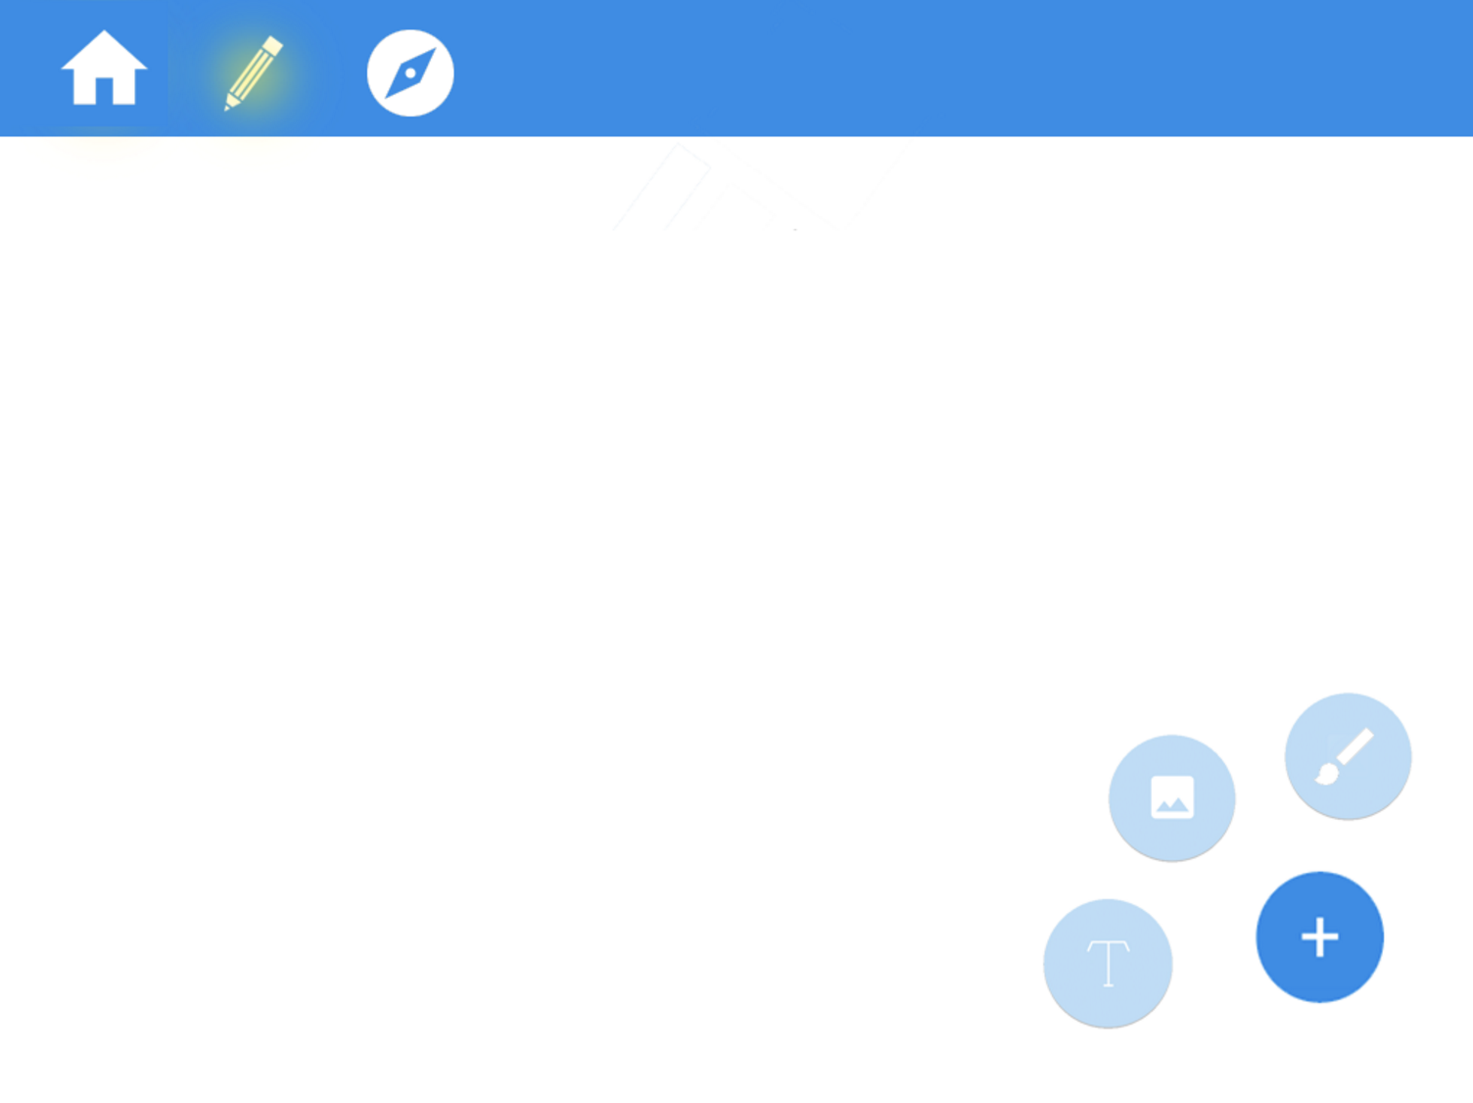
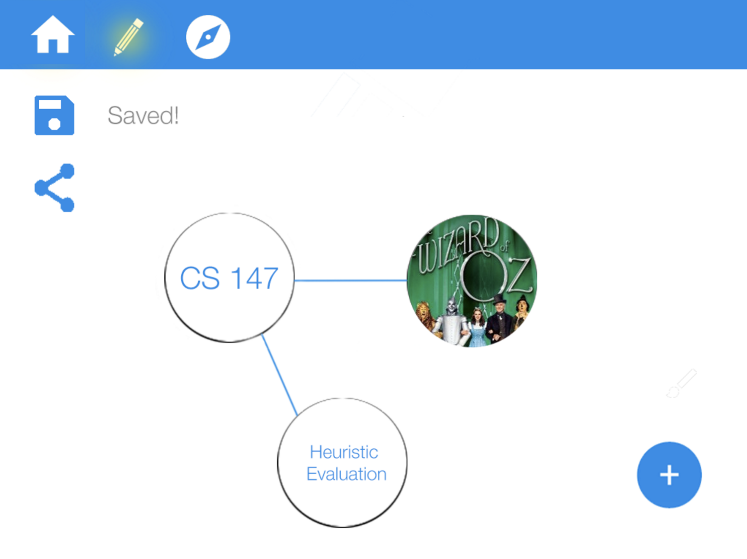
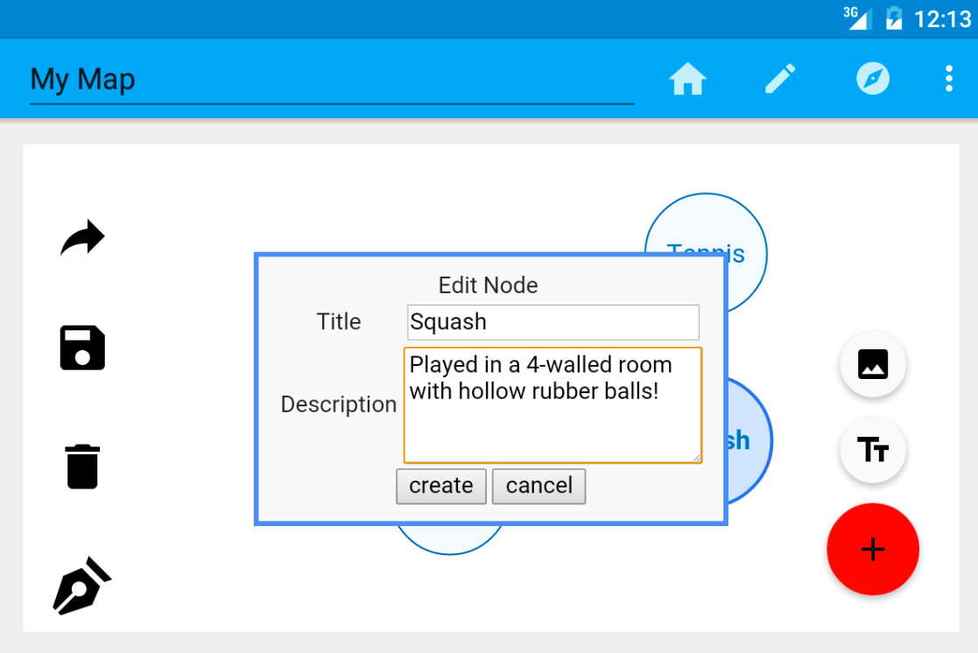
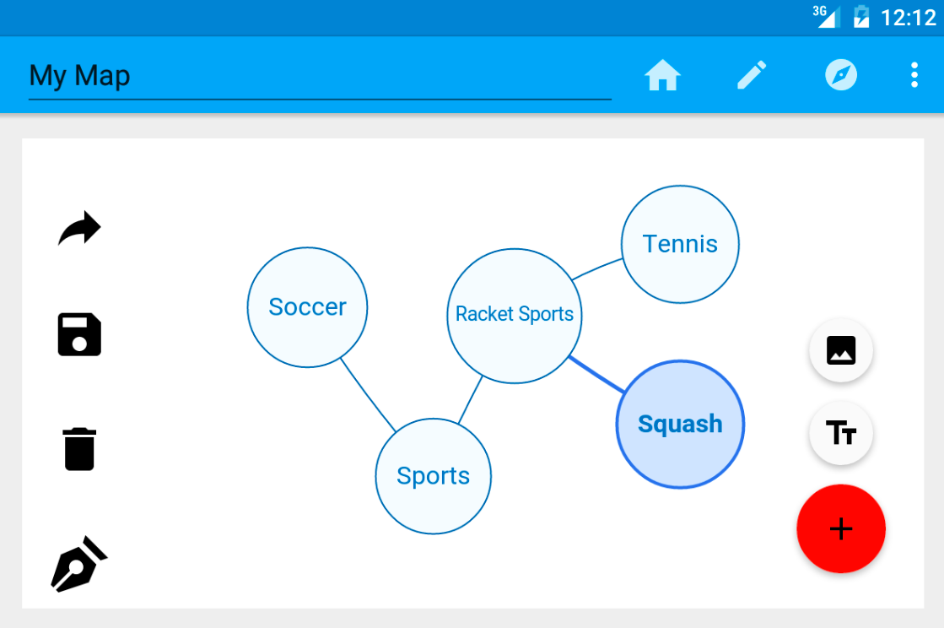
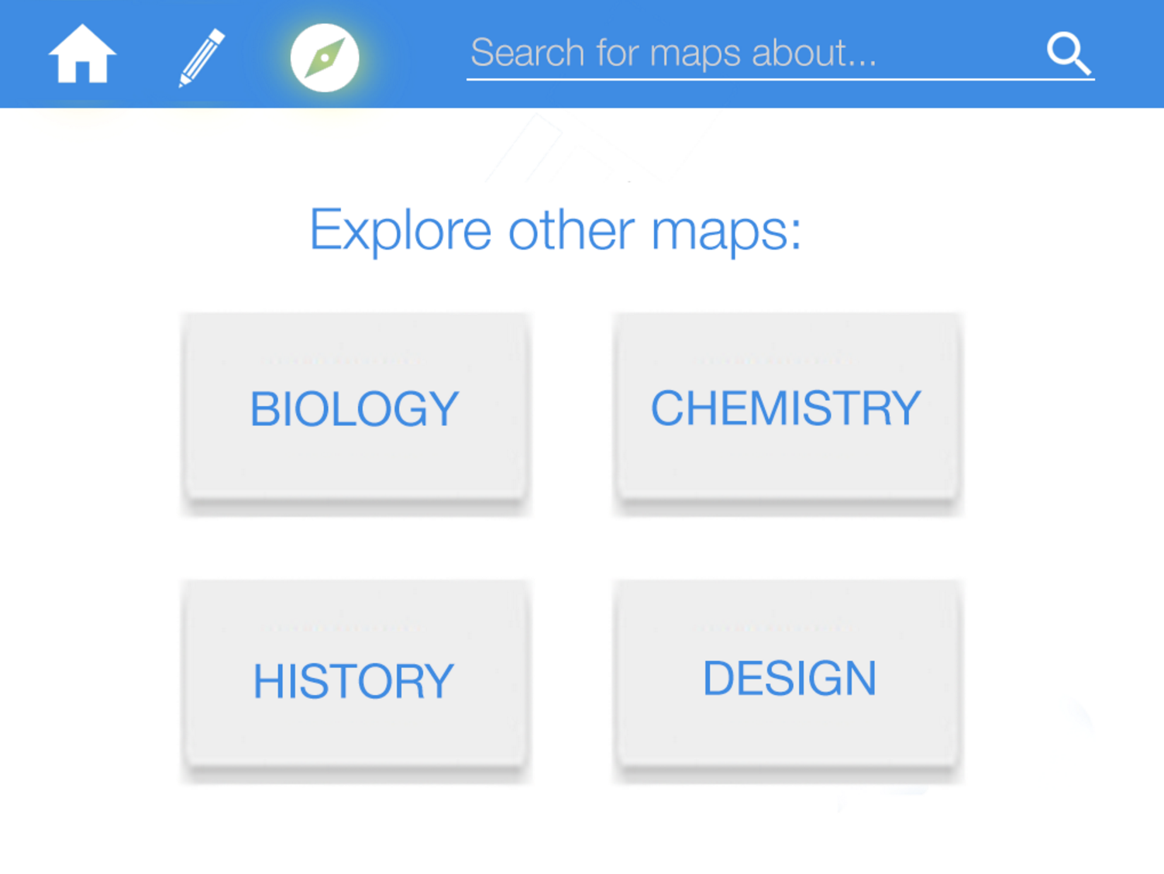
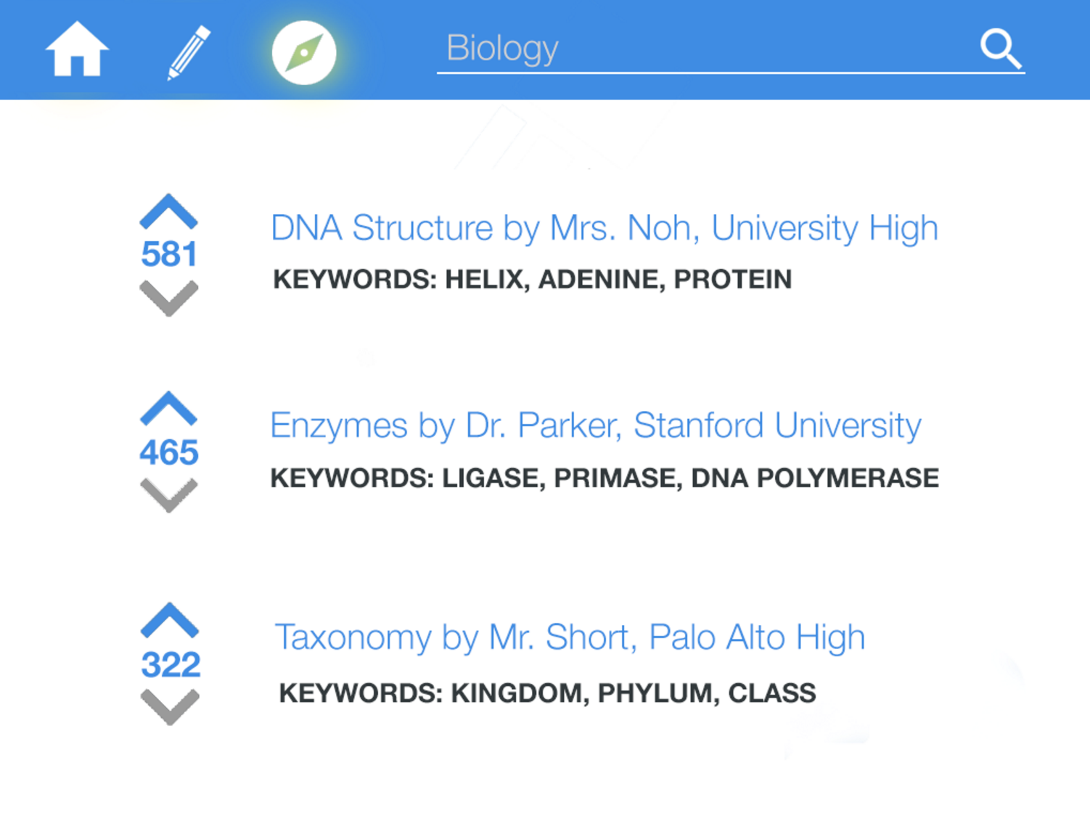
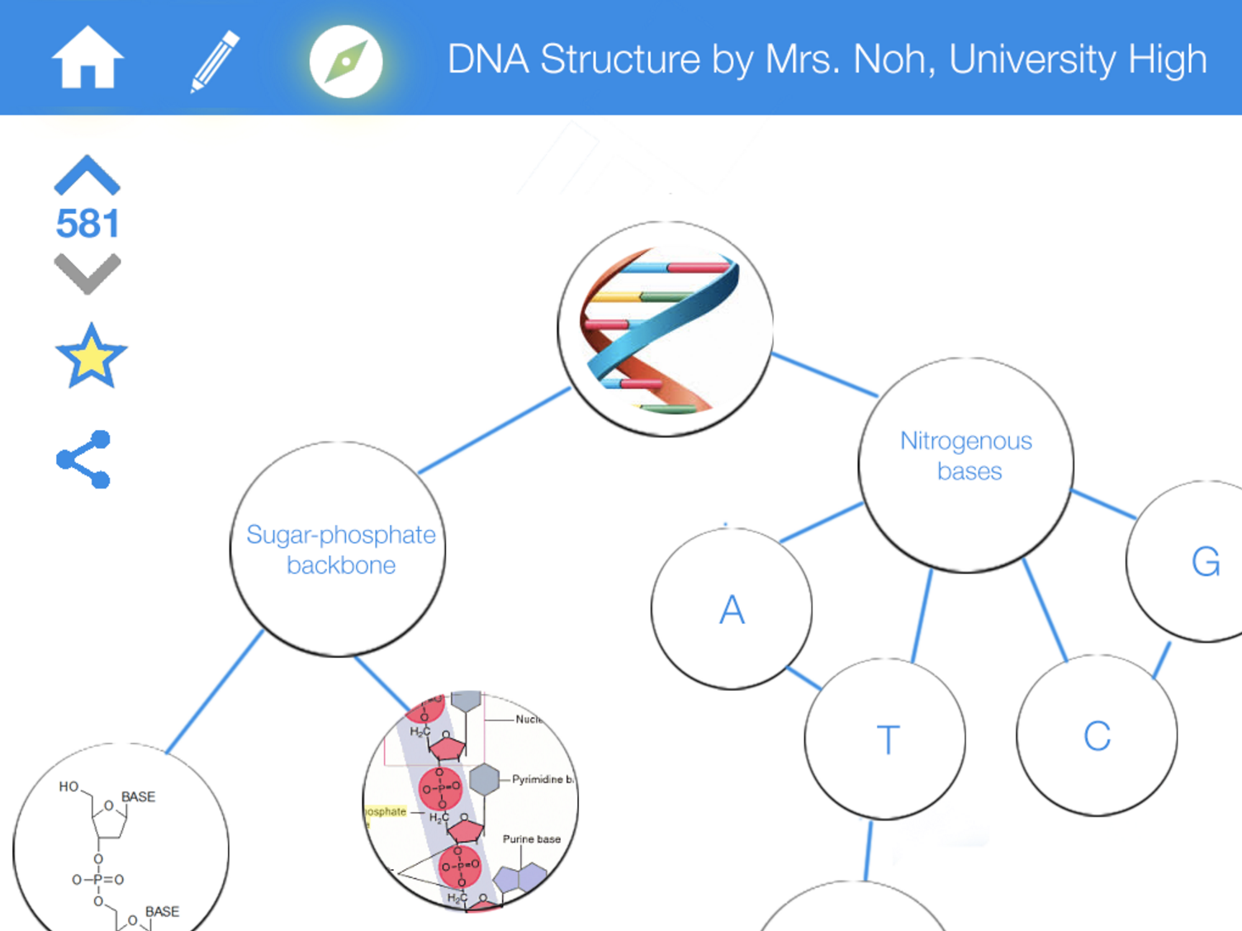
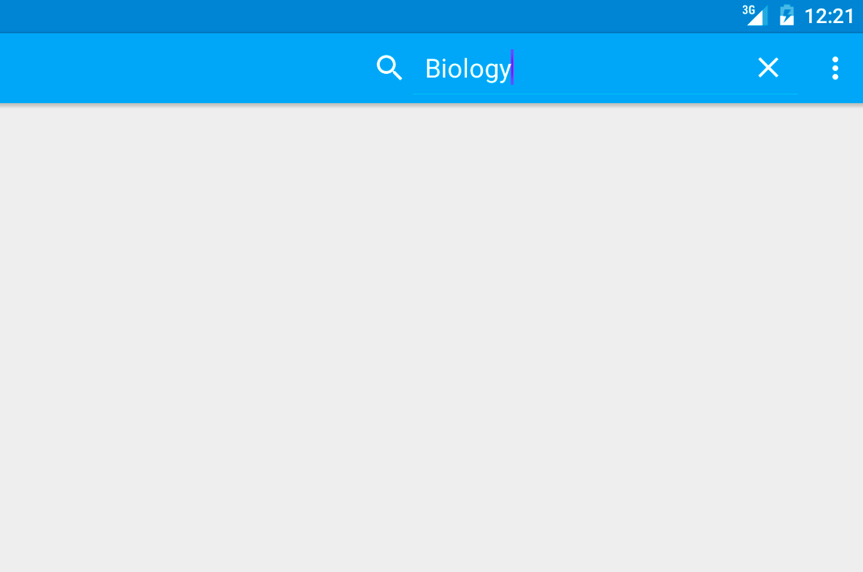
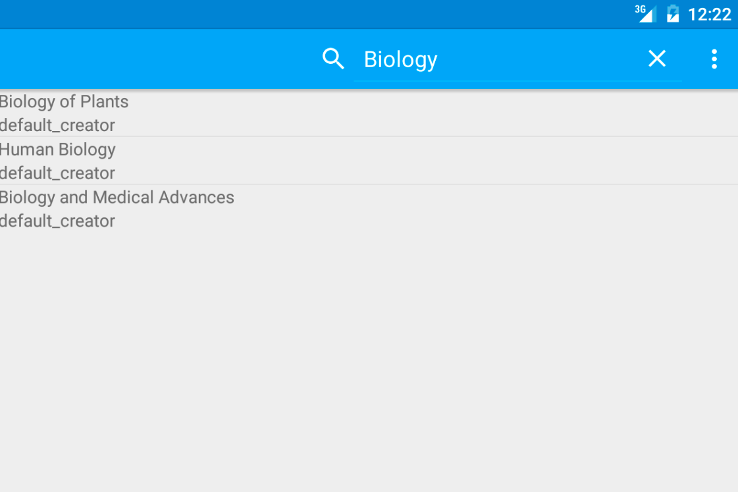
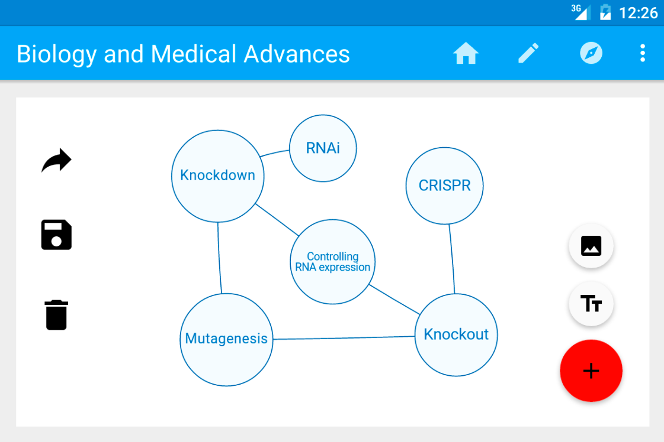
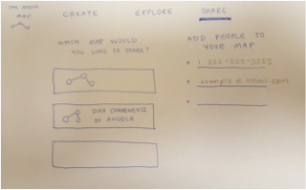
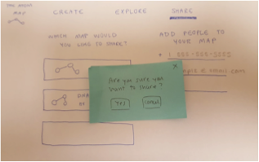
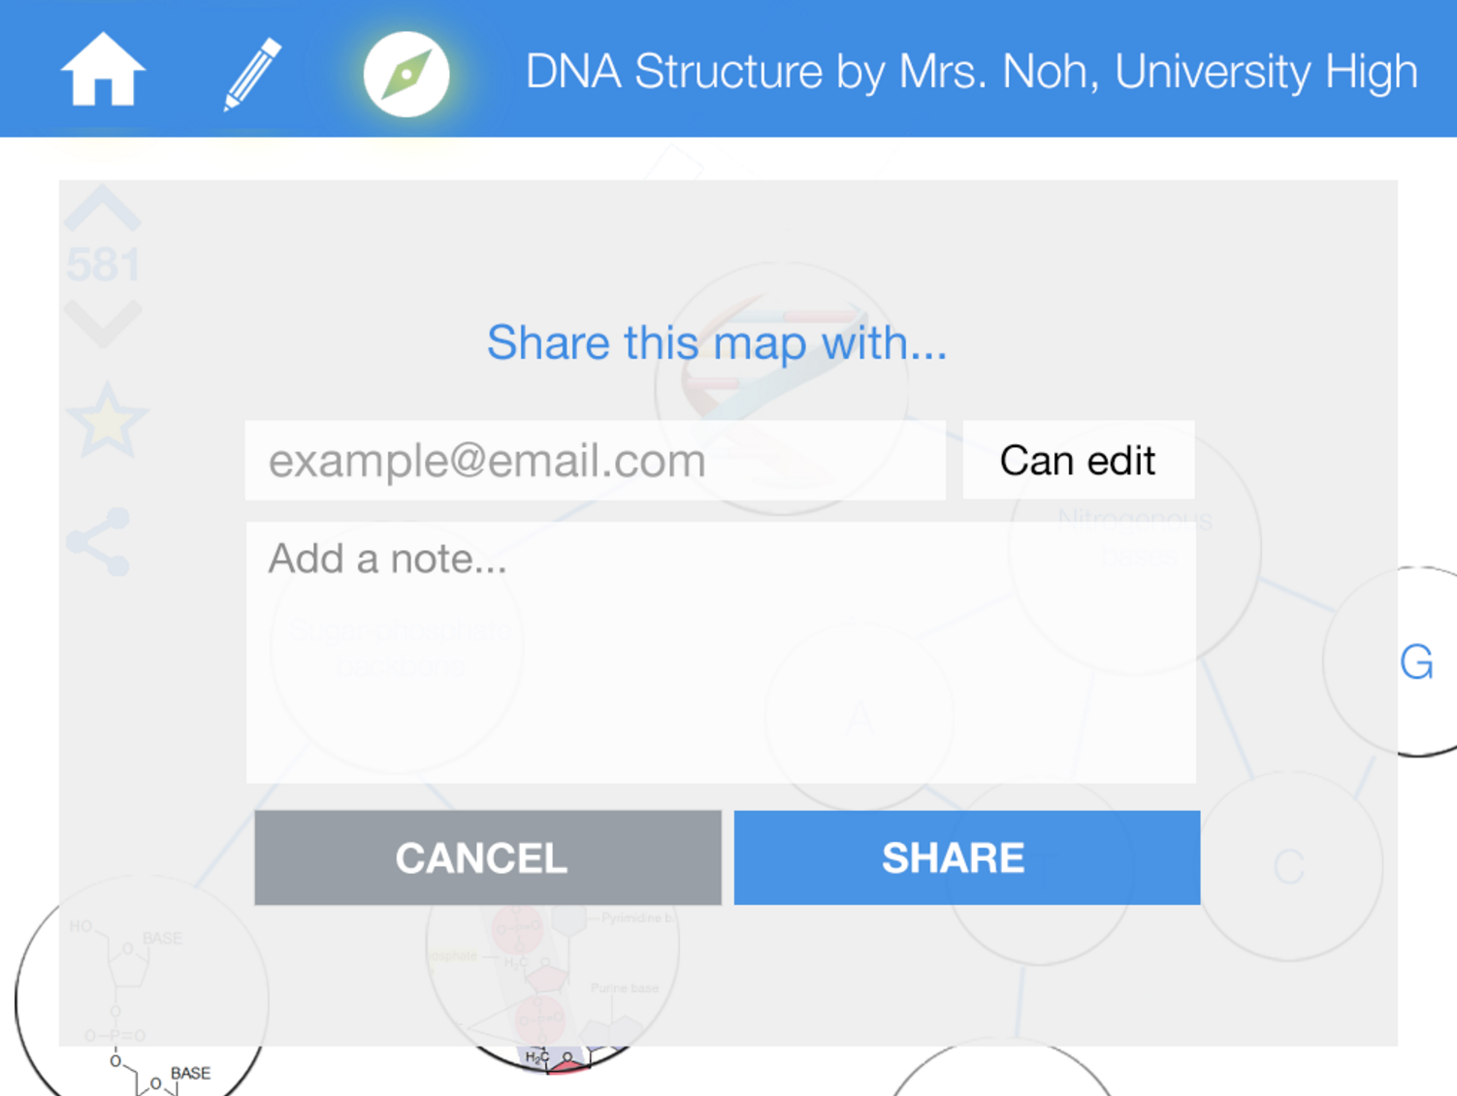
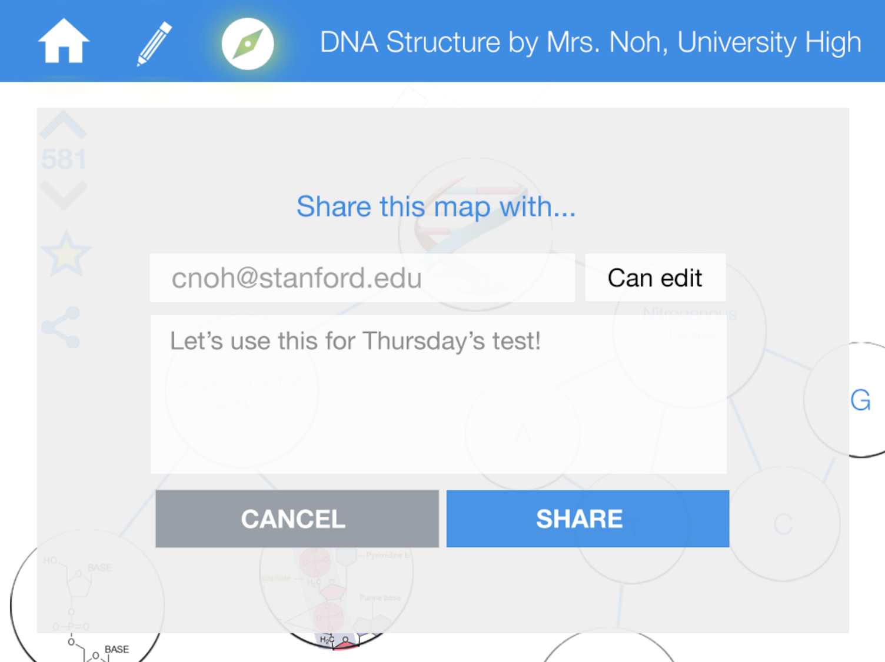
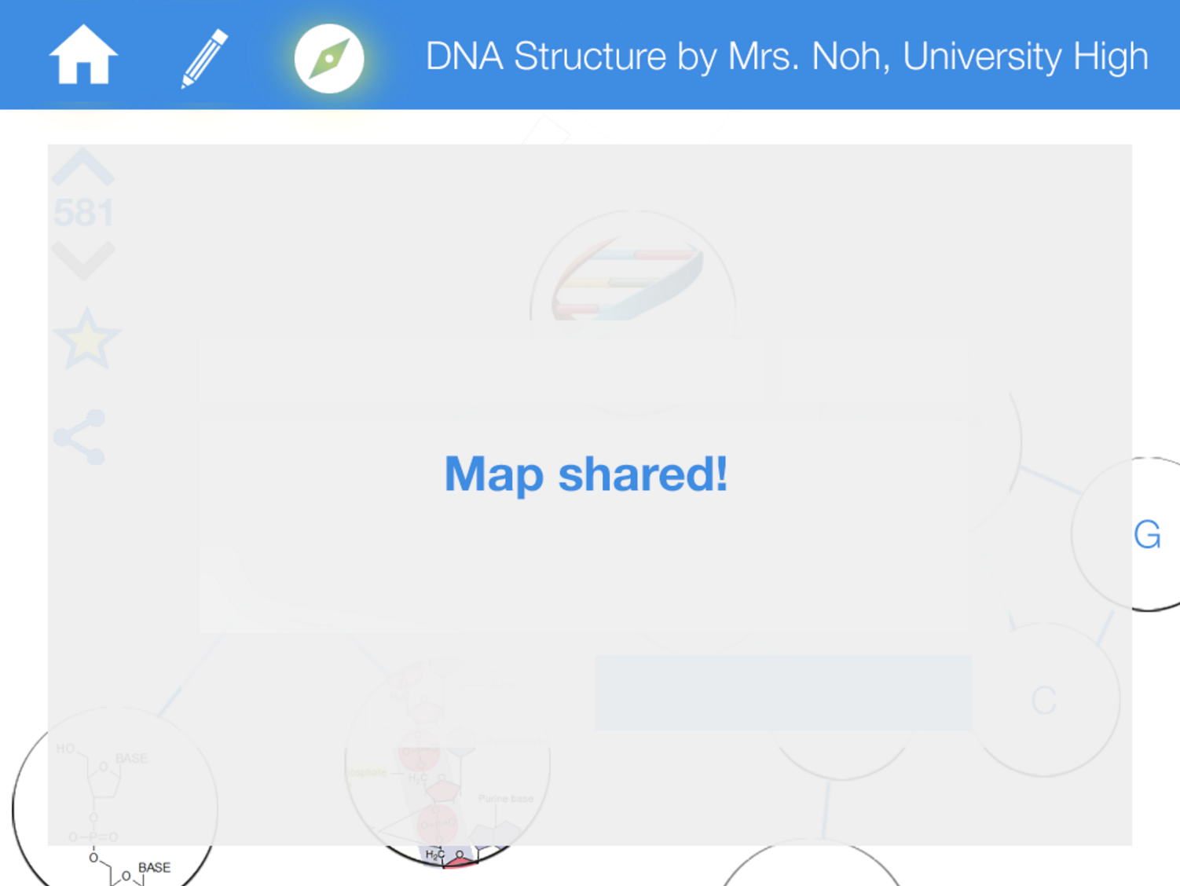
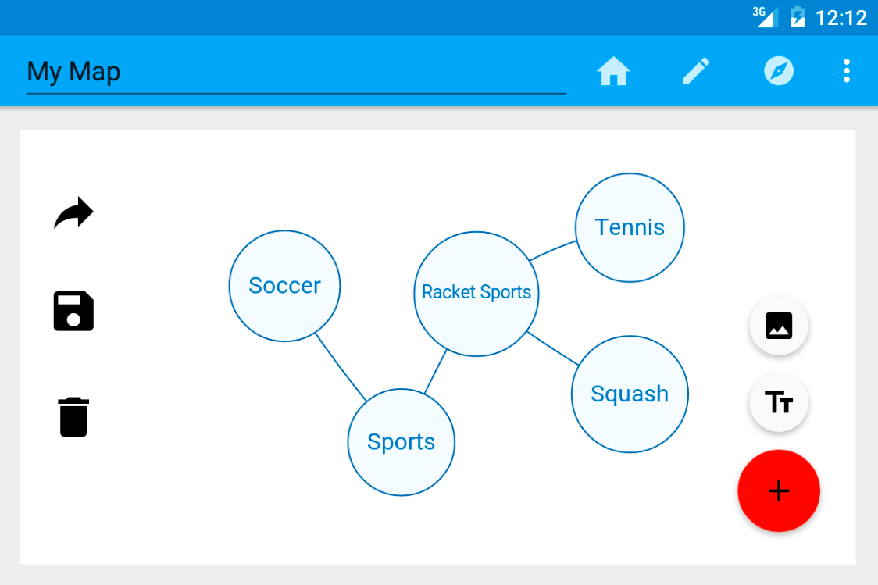
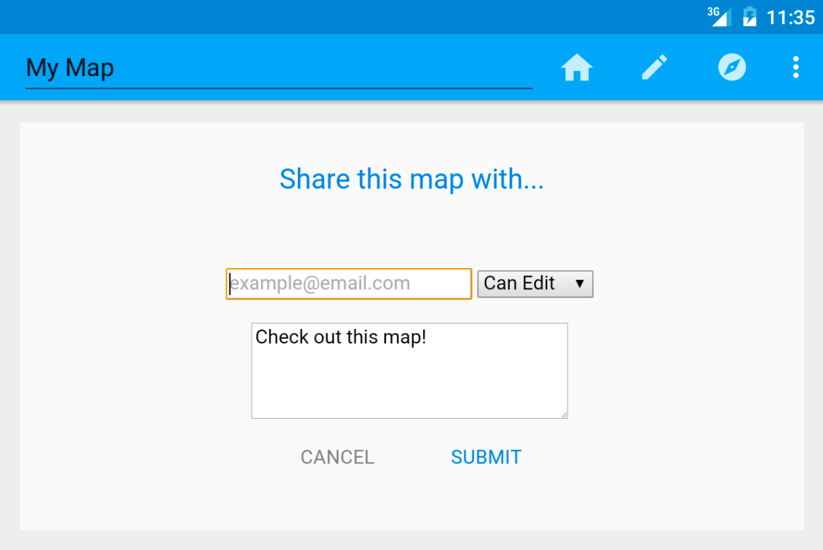
covalence
a visual, mobile workspace for concept maps
Connect your world.
TED
LI
COURTNEY
NOH
LOGAN
SHORT
EMMA
TOWNLEY-SMITH
Problem
“
Needfinding
Learning happens everywhere: MOOCs, pdfs, handwritten notes, ppts, textbooks, etc… no way to organize learning across mediums
Think of [the concepts in a class] as pods...the point of a class is to show how they are connected.
Features
“When writing my notes, I create a spatial relationship!... literally doing SOMETHING that makes you interact with it to a certain degree.
1
create concept maps
explore others’ maps
collaborate and share easily
2
Solution: covalence
George Fei
Student & Splash Teacher
Petra Dierkes-Thrun
Professor of Comparative Literature
flexible, interactive learning resources that help teachers see how students are understanding material
help students take their natural learning patterns online, together
Interactive, fun, simple concept maps that facilitate studying through creation & collaboration
3
Jo Boaler
Professor of Math Education
Jennifer Short
Middle School Chinese Teacher
Glenn ‘Max’ McGee
Superintendent of PAUSD
Carol Giraudo
High School English Teacher
DESIGN ITERATION
Final Product
Paper Prototyping
Med-Fi Prototype
1
1
2
2
3
3
Team Covalence | CS147 | Autumn 2015
http://hci.stanford.edu/courses/cs147/2015/au/projects/creation/covalence

