Slide 1
C H O R E O L A B
Creative conversations through dance

Slide 2
DISCOVER
CREATE
CONTRIBUTE

Slide 3
Design Changes
+
music configuration
+
sharing settings
+
notifications

Slide 4
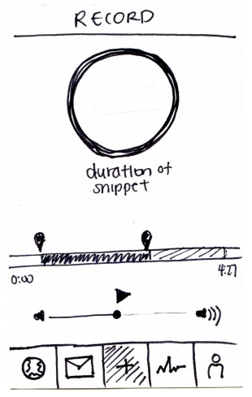
MUSIC CONFIGURATION
INSTRUCTIONS
On boarding step by step instructions
MUSIC SOURCE
Clarity in types of sources
EDITING INTERFACE
Sliding mechanisms

Slide 5
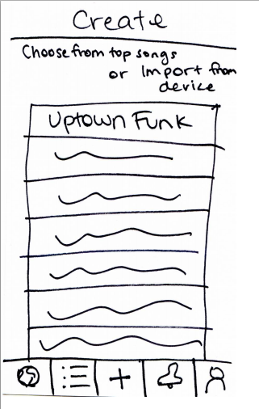
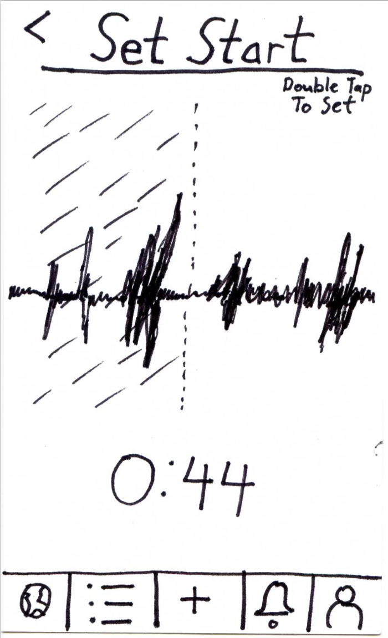
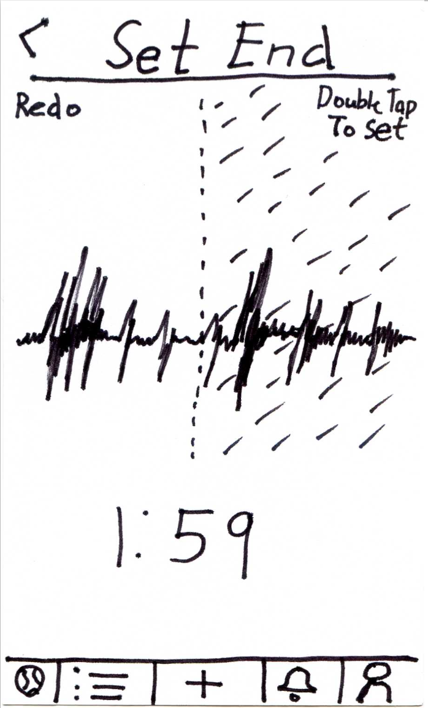
MUSIC CONFIGURATION
music source
EDITING INTERFACE

Slide 6
MUSIC CONFIGURATION
instructions

Slide 7
MUSIC CONFIGURATION
editing interface
EDITING INTERFACE

Slide 8
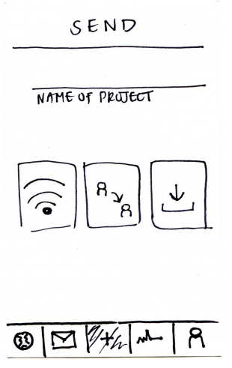
SHARING
SETTINGS
TEXT LABELS
Labels to accompany icons
GRANULARITY
Specifying multiple people to send direct requests
Limiting types of potential collaborators

Slide 9
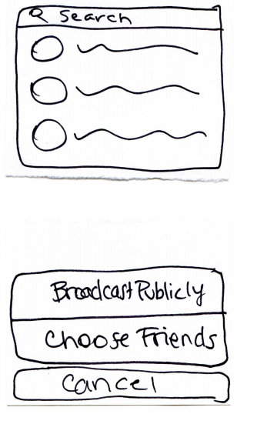
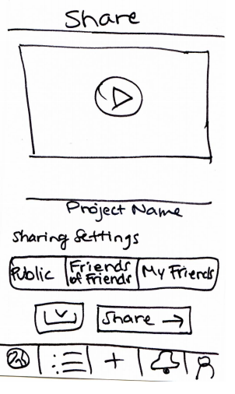
SHARING SETTINGS
text labels

Slide 10
SHARING SETTINGS
granularity

Slide 11
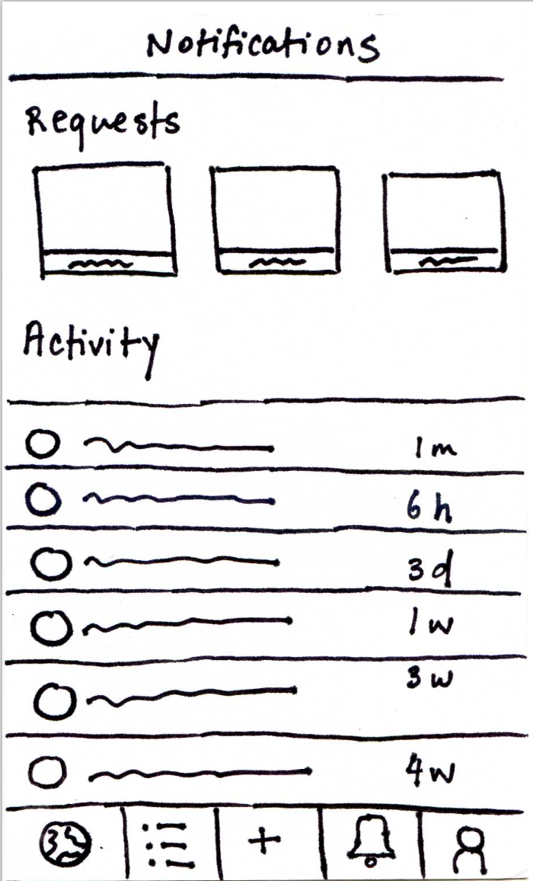
NOTIFICATIONS

Slide 12
Discover and watch an interesting video

Slide 13
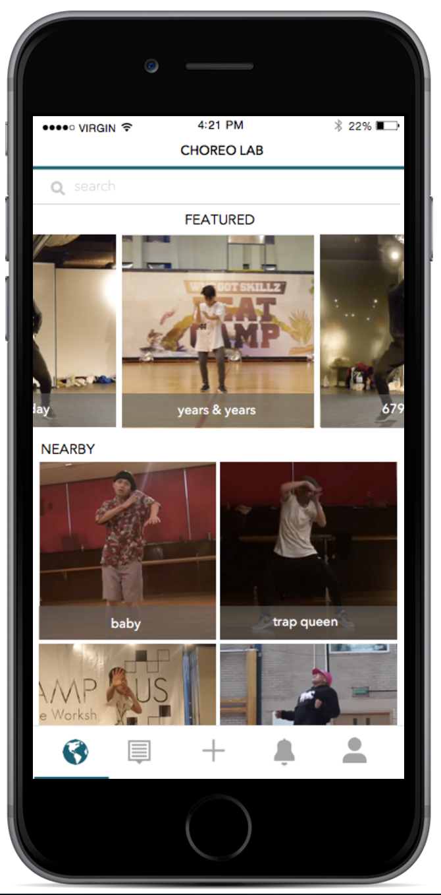
Discover

Slide 14
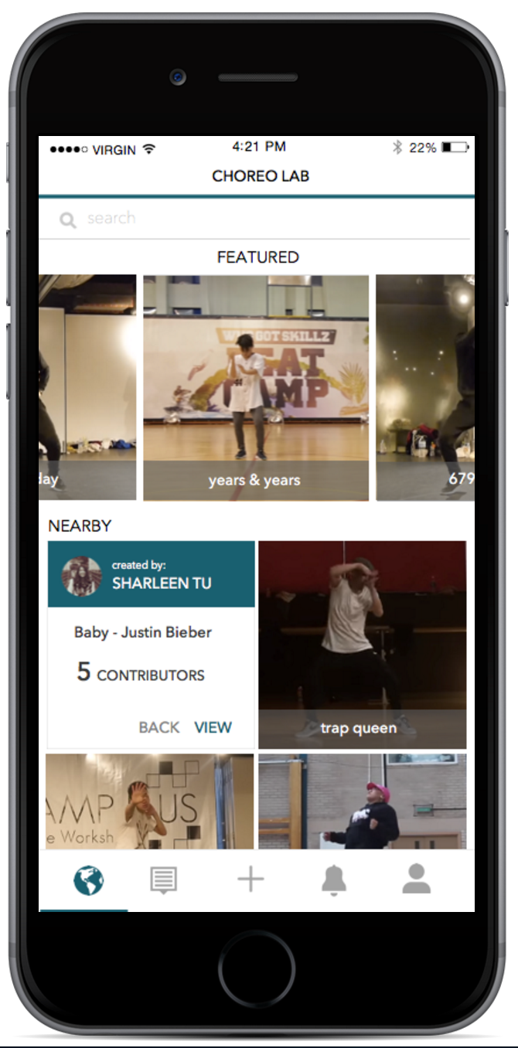
Discover

Slide 15
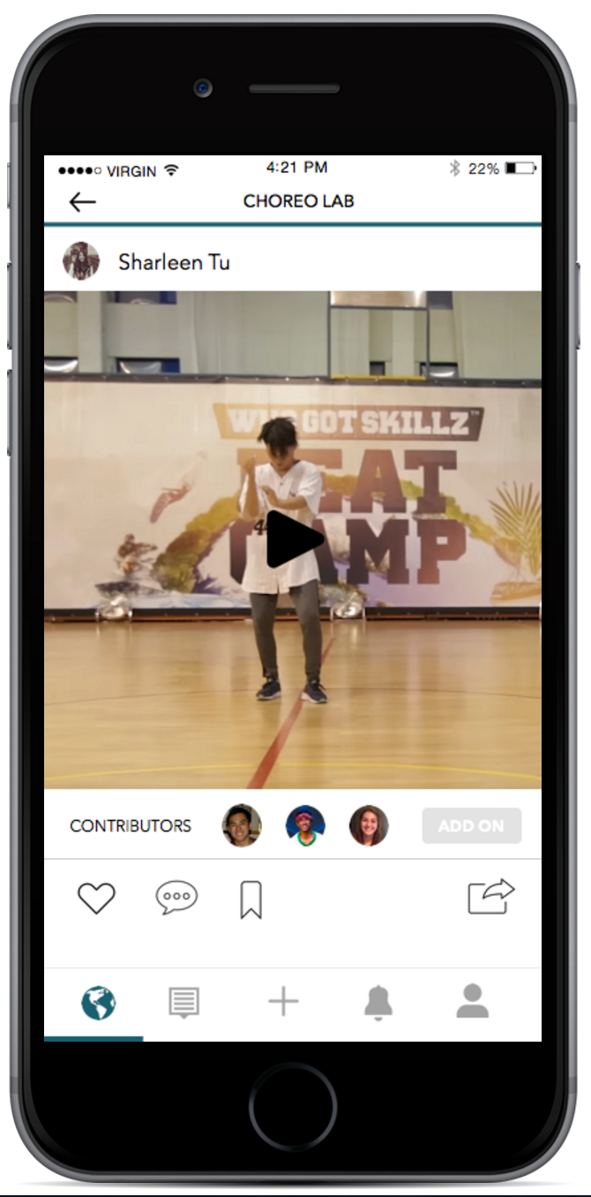
Discover

Slide 16
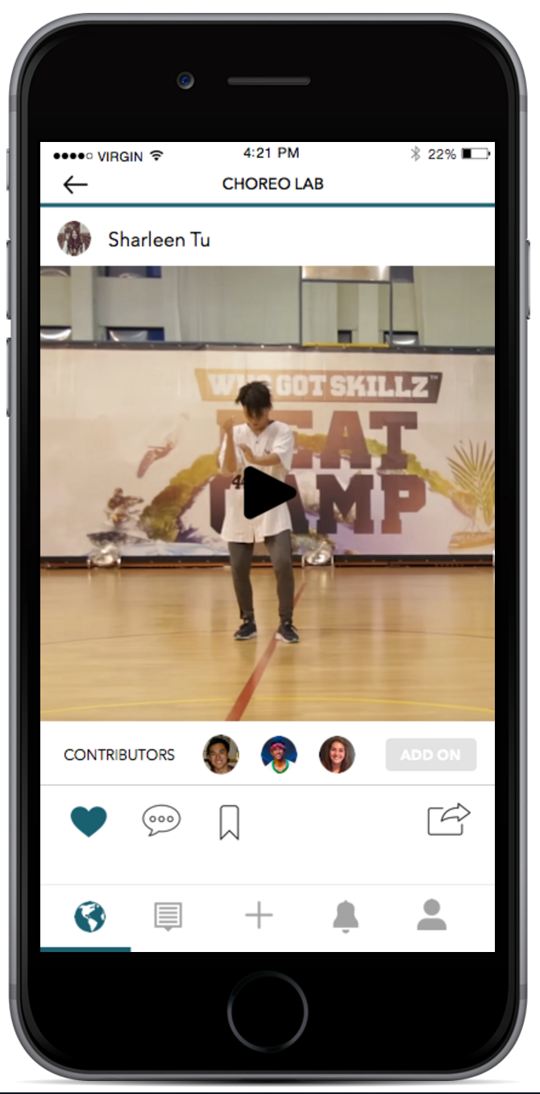
Discover

Slide 17
Create a new choreography project

Slide 18
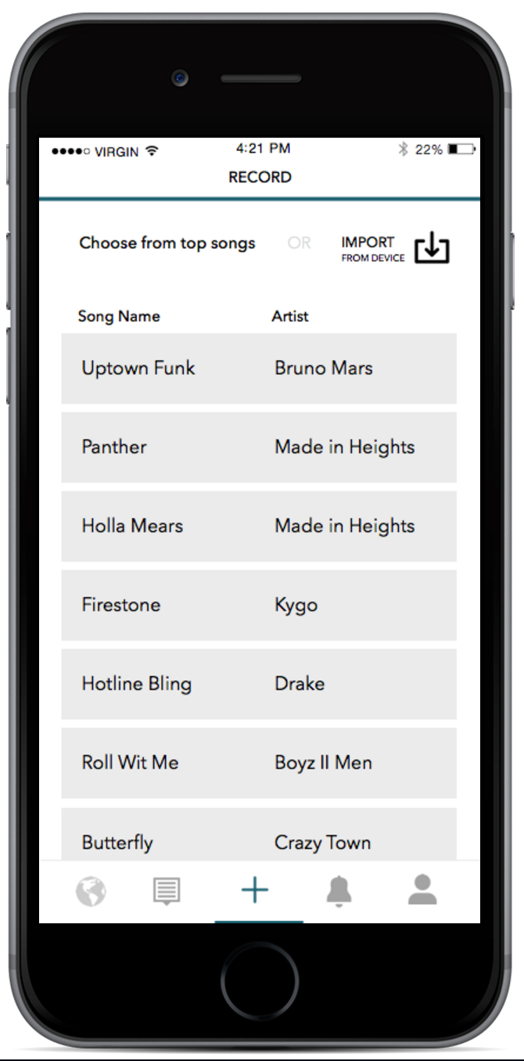
Create

Slide 19
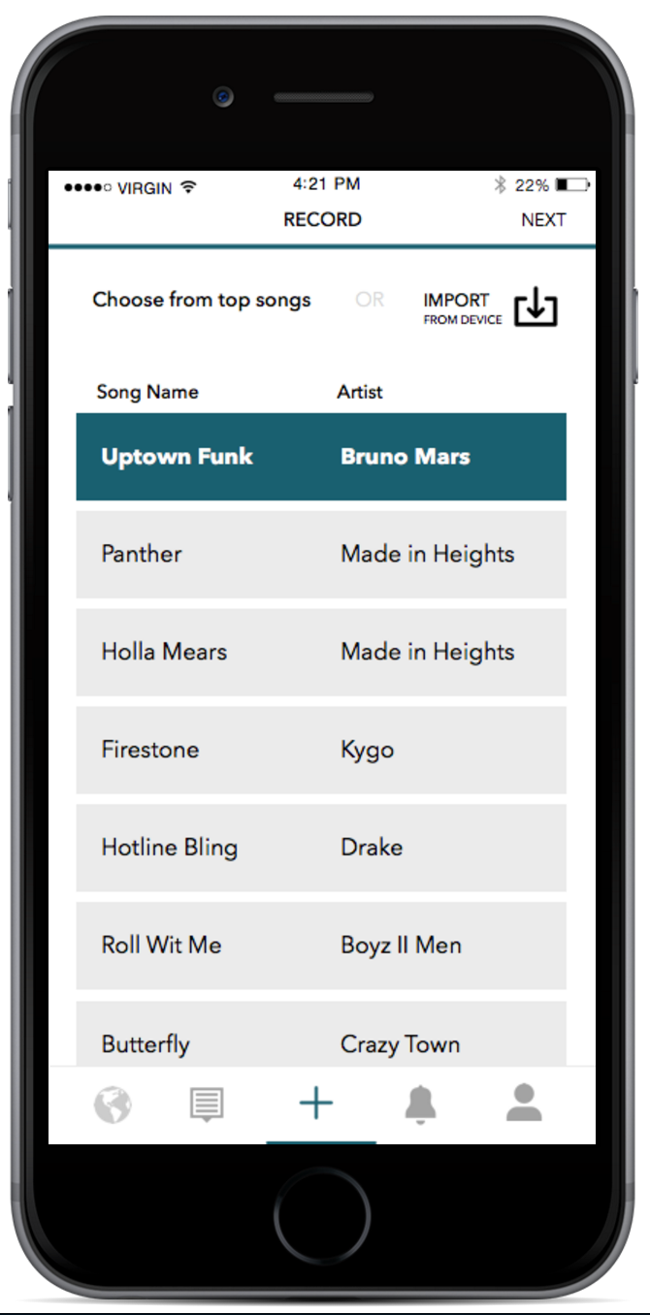
Create

Slide 20
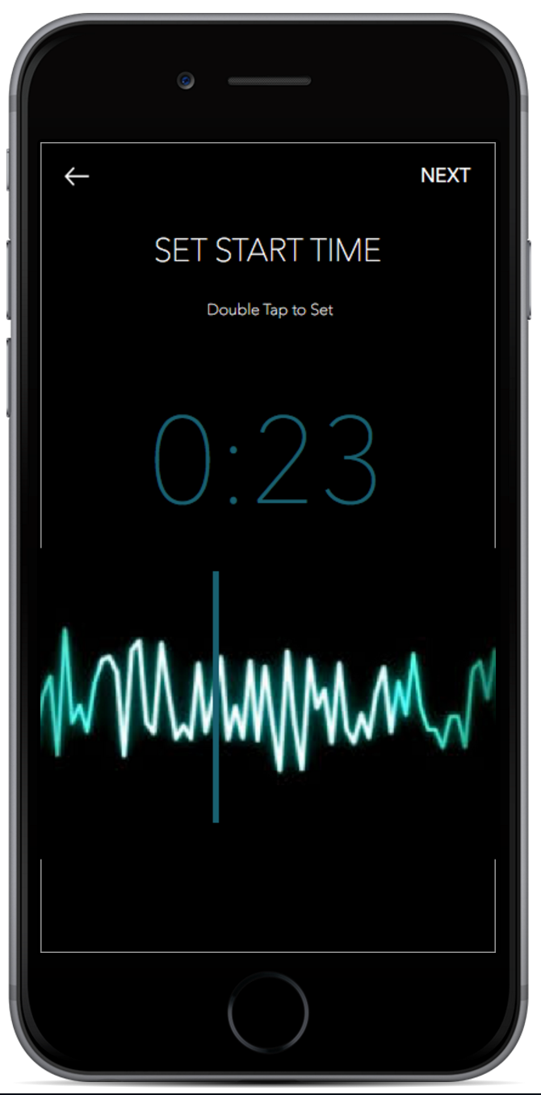
Create

Slide 21
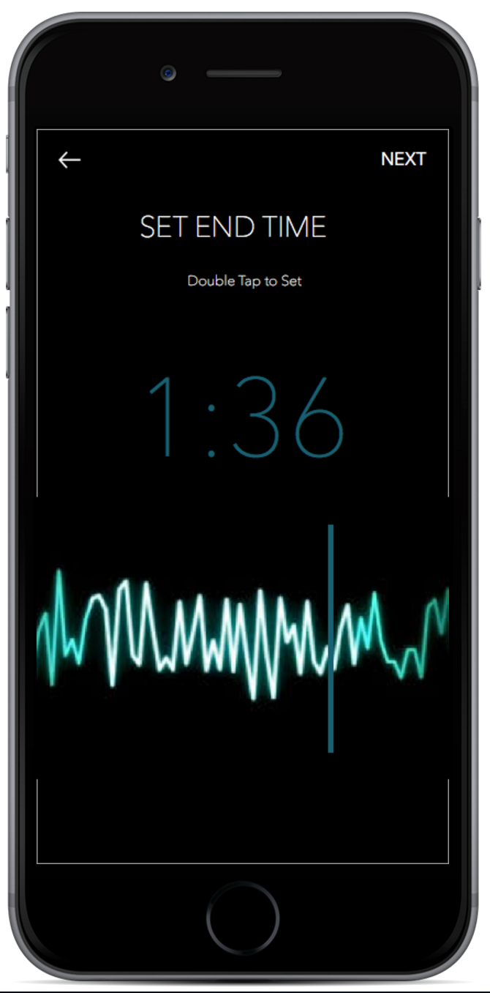
Create

Slide 22
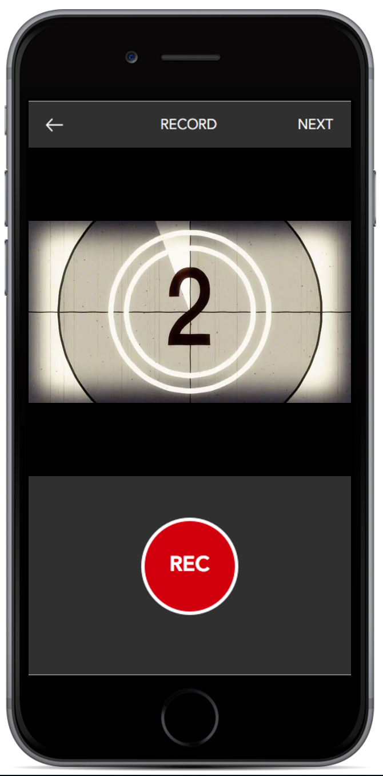
Create

Slide 23
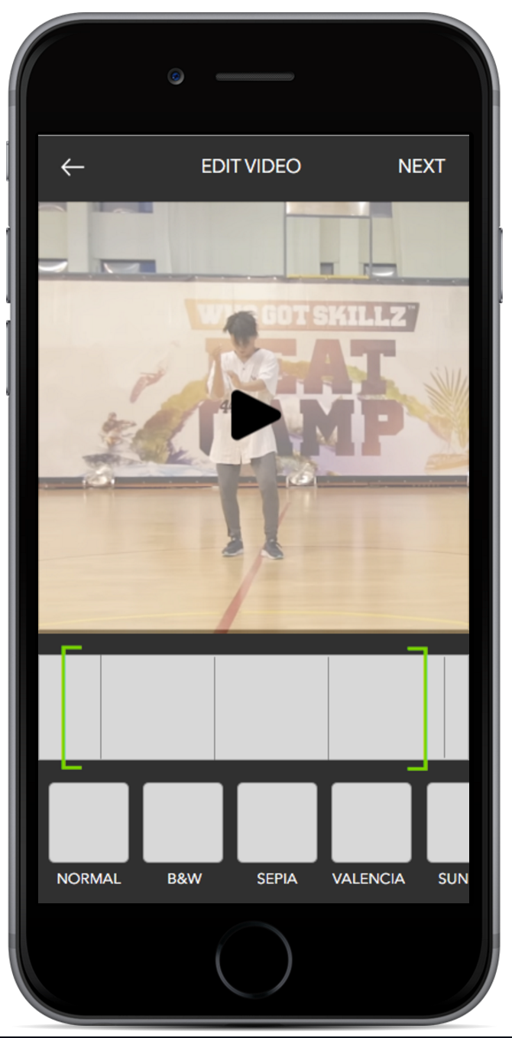
Create

Slide 24
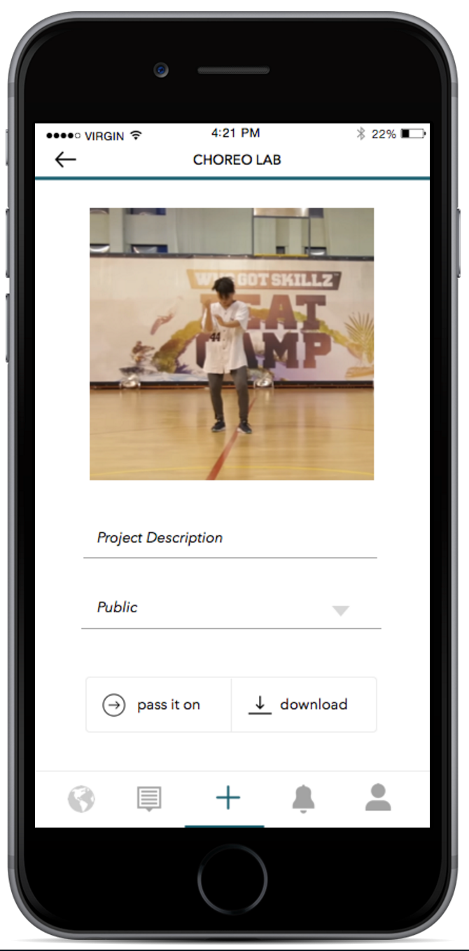
Create

Slide 25
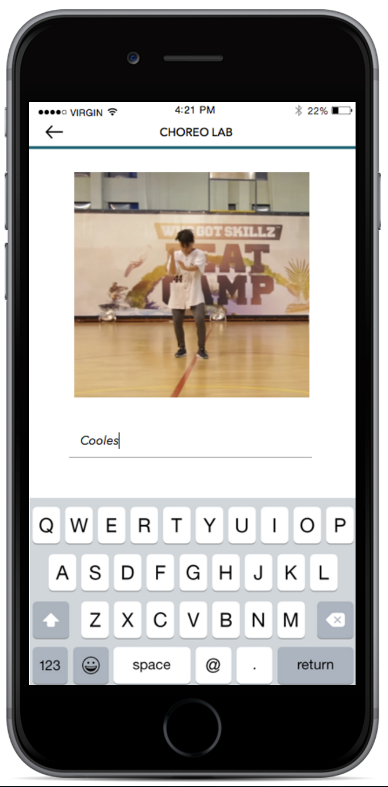
Create

Slide 26
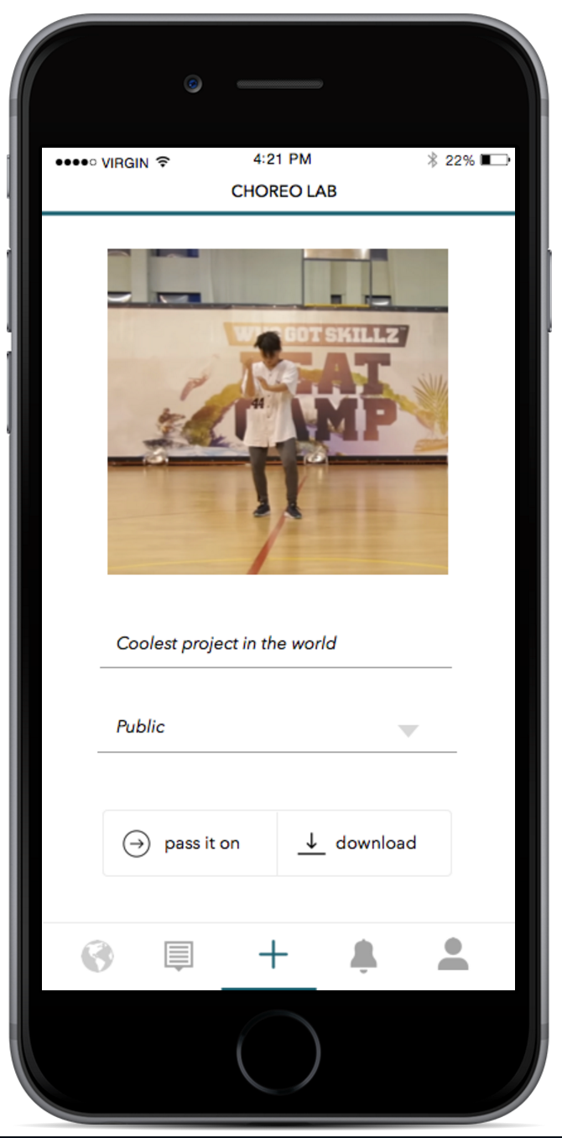
Create

Slide 27
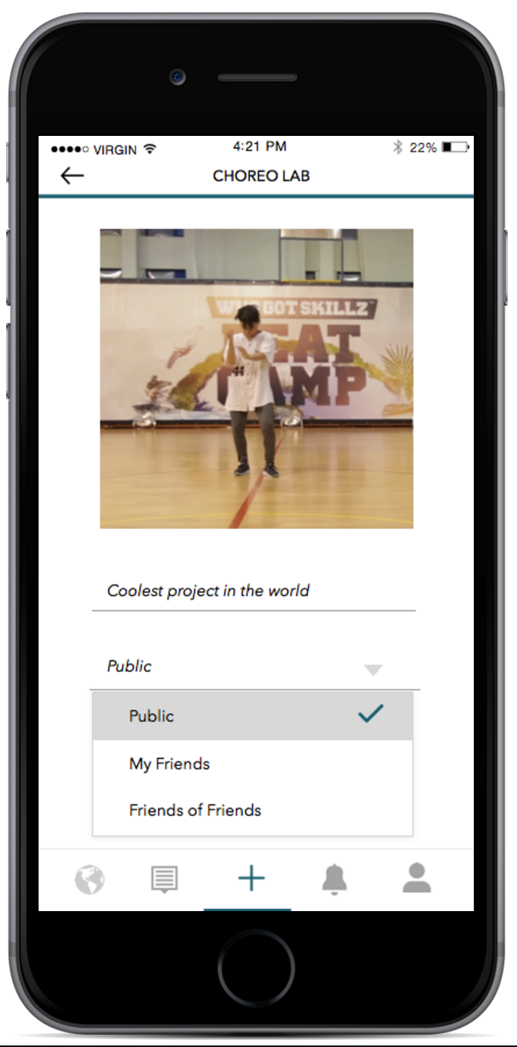
Create

Slide 28
Create

Slide 29
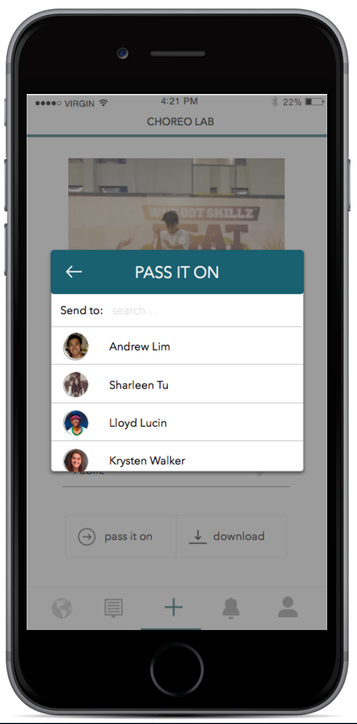
Create

Slide 30
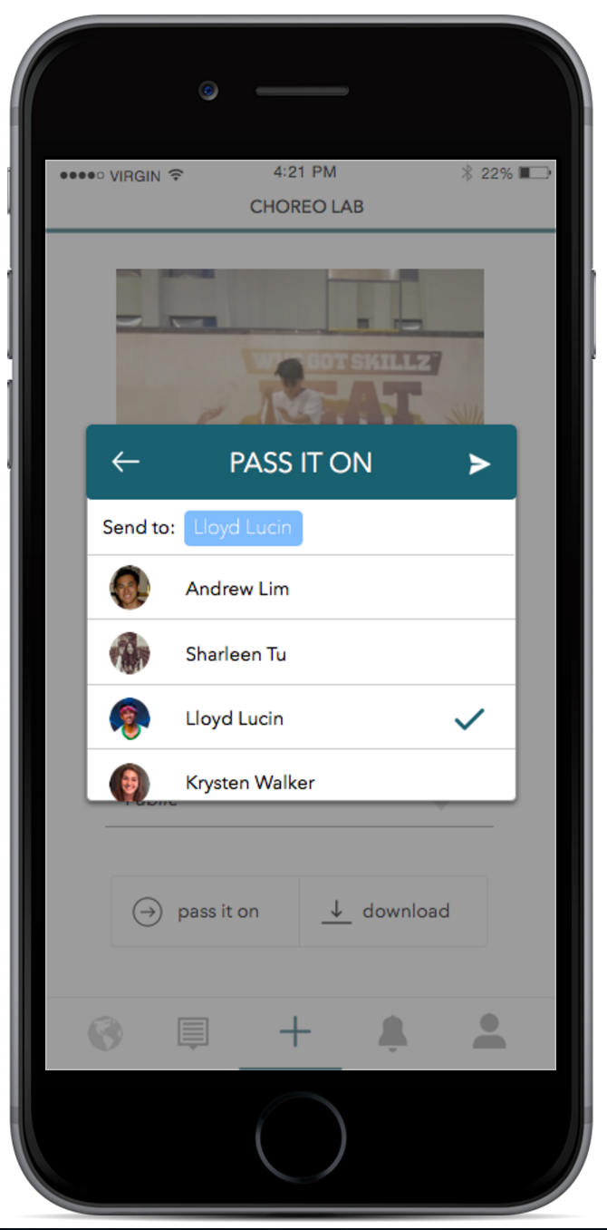
Create

Slide 31
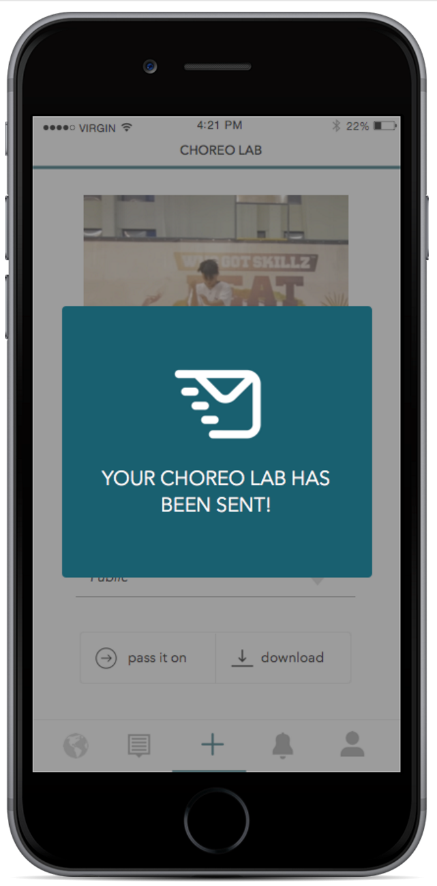
Create

Slide 32
Contribute choreography to an
existing project

Slide 33
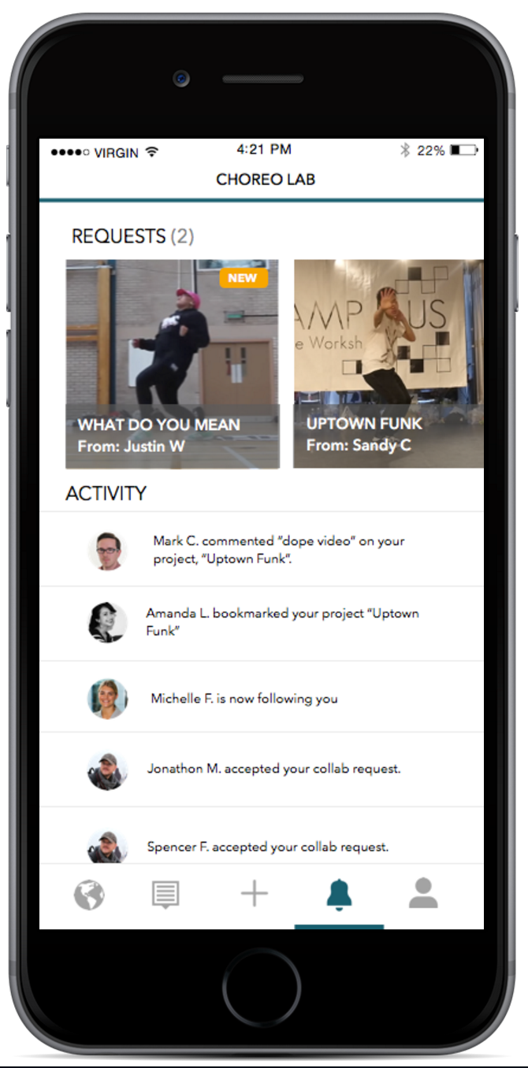
Contribute

Slide 34
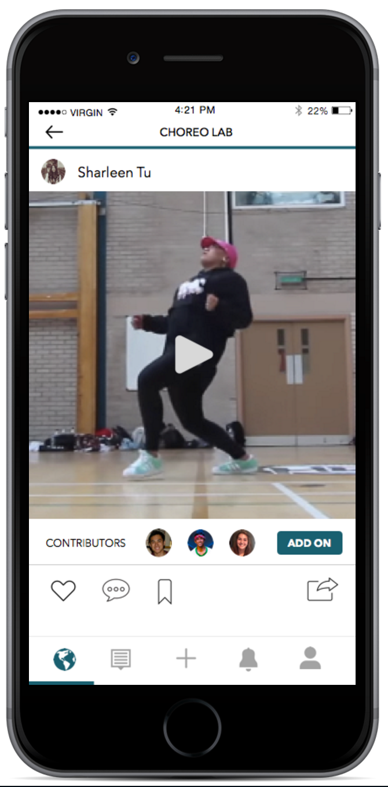
Contribute

Slide 35
Contribute

Slide 36
Contribute

Slide 37
Contribute

Slide 38
Contribute

Slide 39
Contribute

Slide 40
Contribute

Slide 41
Contribute

Slide 42
Prototyping Tools
+
sketch
+
marvel

Slide 43
SKETCH
PROS
CONS
Accurate mobile artboards
“Symbols” to templatize artboards
Grid/ruler/alignment
No interactive components
Complicated export process

Slide 44
MARVEL
PROS
CONS
Copying common hotspots across views
No support for conditional flows
Minimal video support
Previewing on device

Slide 45
Limitations and Tradeoffs
+
multimedia support
+
dynamic input
+
microinteractions
+
content variety

Slide 46
Wizard of Oz and Hard-coding
+
recording
+
post editing
+
final compilation video

Slide 48
Team Website:
http://web.stanford.edu/class/cs147/projects/creation/EnhancingDancing/
Medium-Fi Prototype:
https://marvelapp.com/11icj87

