Slide 1
C H O R E O L A B
Different dancers create together

Slide 2
CHOREOGRAPHY PROCESS

Slide 3
CHOREOLAB PROCESS

Slide 4
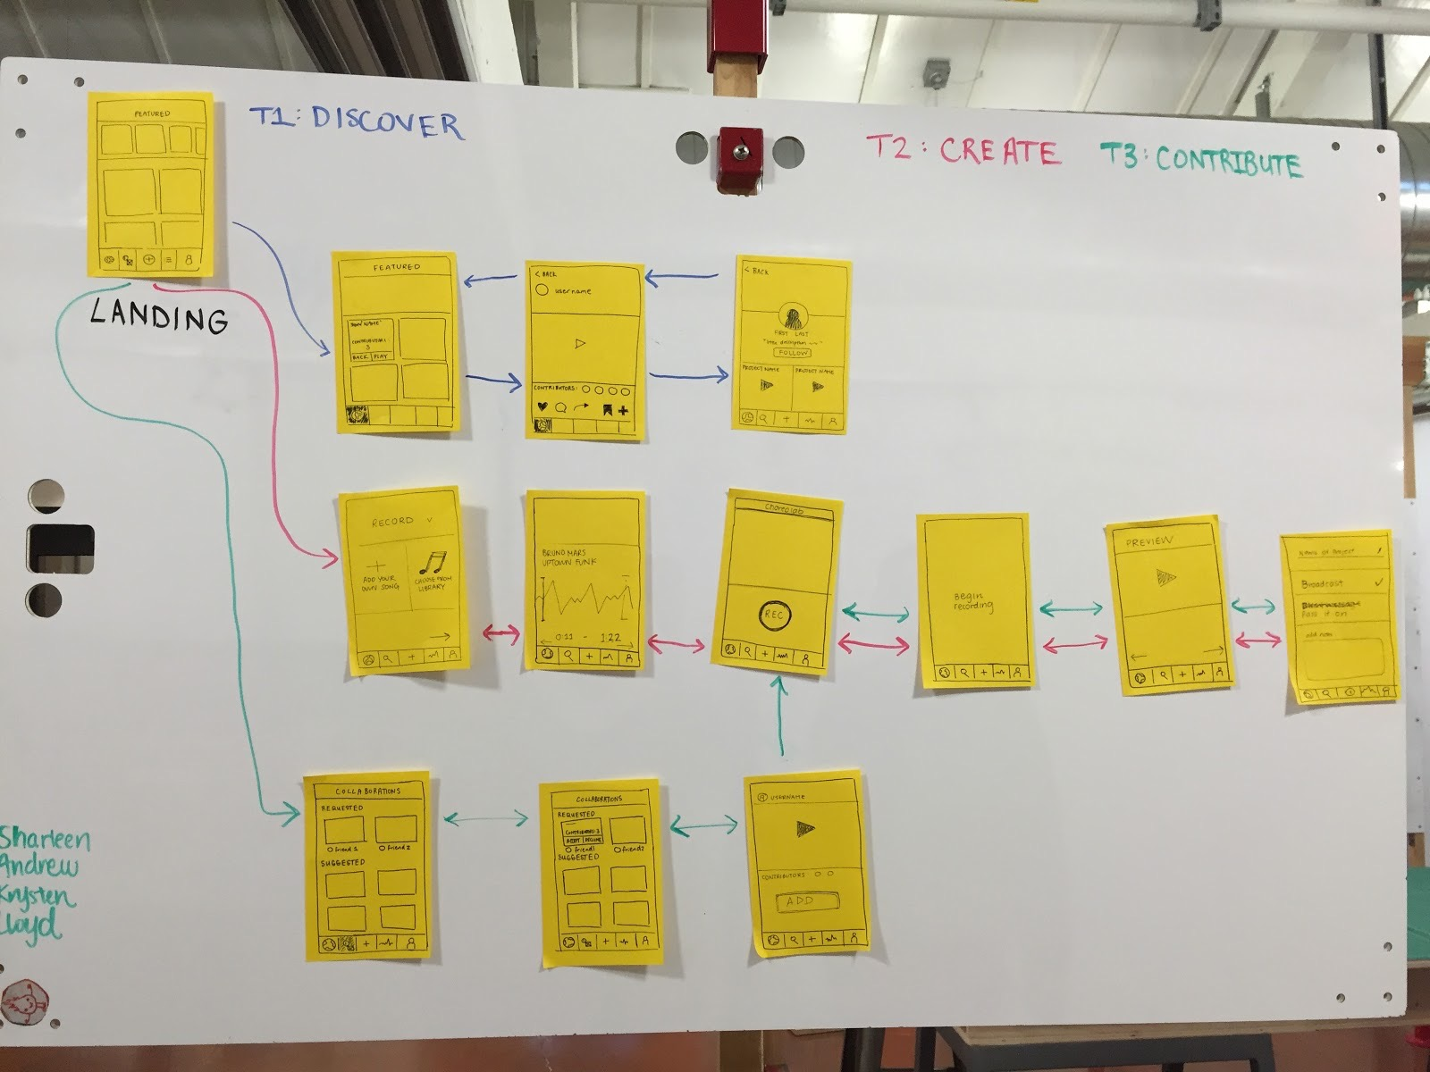
STORYBOARD

Slide 5
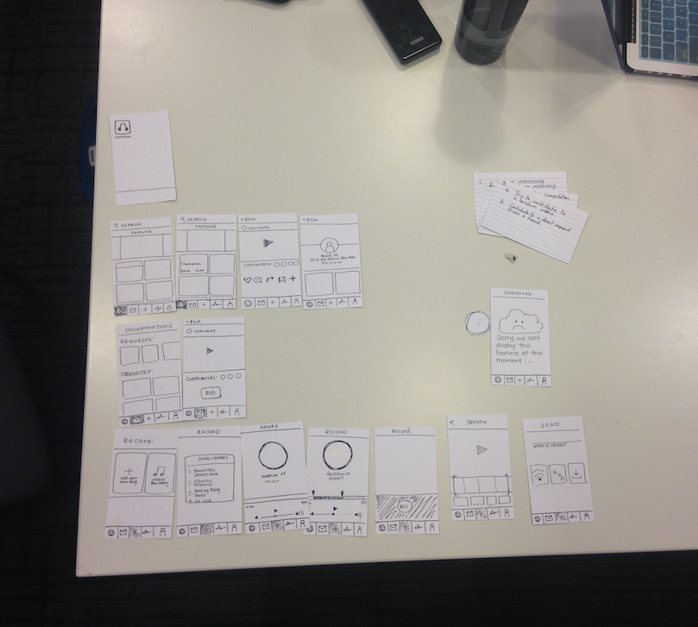
LO-FI PROTOTYPES
LAUNCH
DISCOVER
TASKS
CONTRIBUTE
ERROR PAGE
RECORD

Slide 6
Discover and watch an interesting video

Slide 7
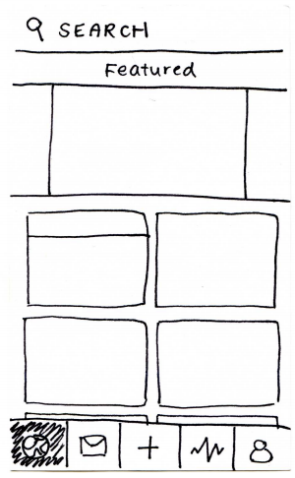
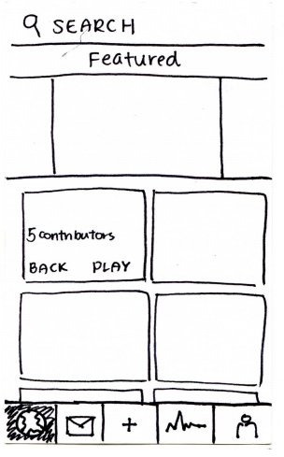
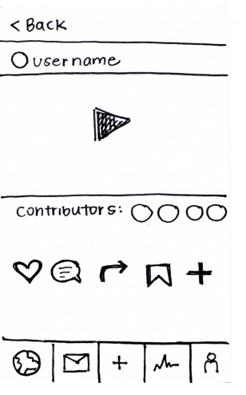

Slide 8
Create a new choreography project

Slide 9
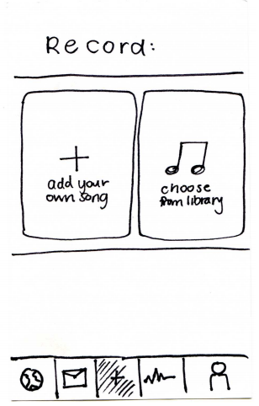
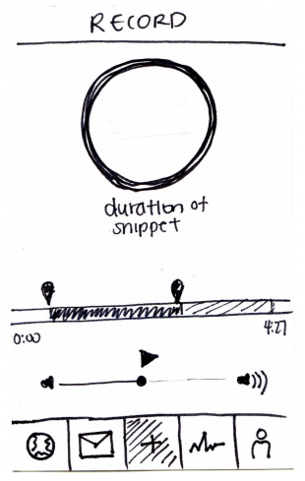
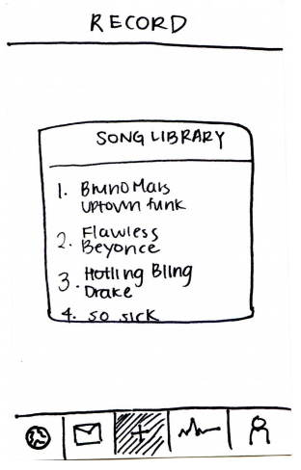
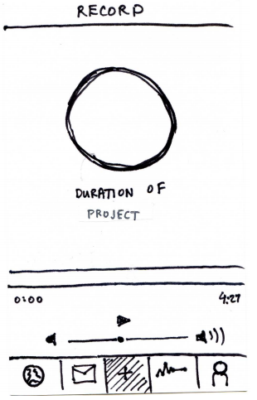
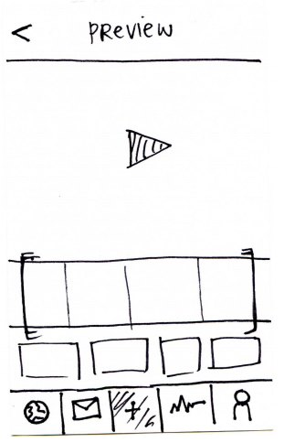
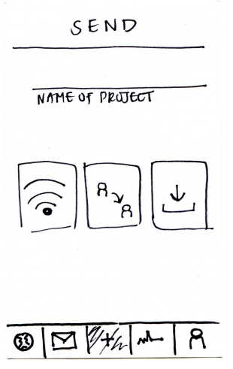
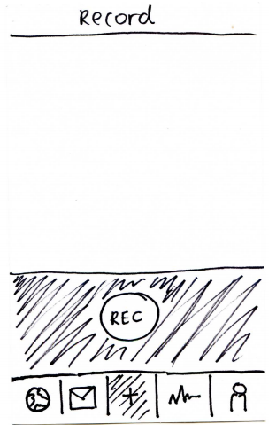

Slide 10
Contribute choreography to an
existing project

Slide 11
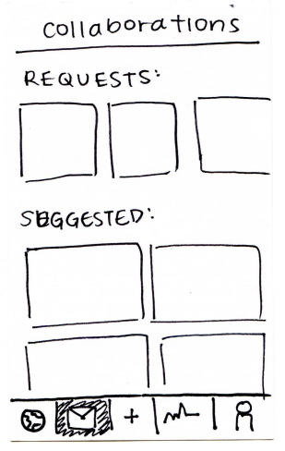
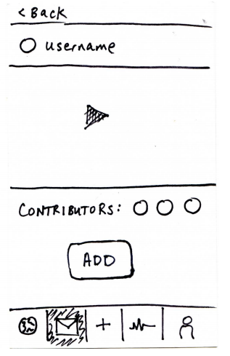

Slide 12
EXPERIMENTAL METHOD
computer
observer
facilitator
observer

Slide 13
OUR RESULTS

Slide 14
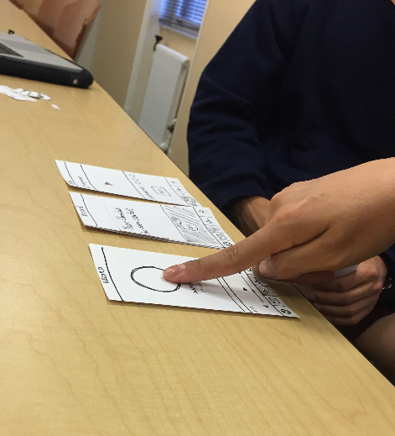
OUR RESULTS
DISCOVER
Familiar interface and easy to understand
What are the different categorizations?
How do I know if a project is complete?

Slide 15
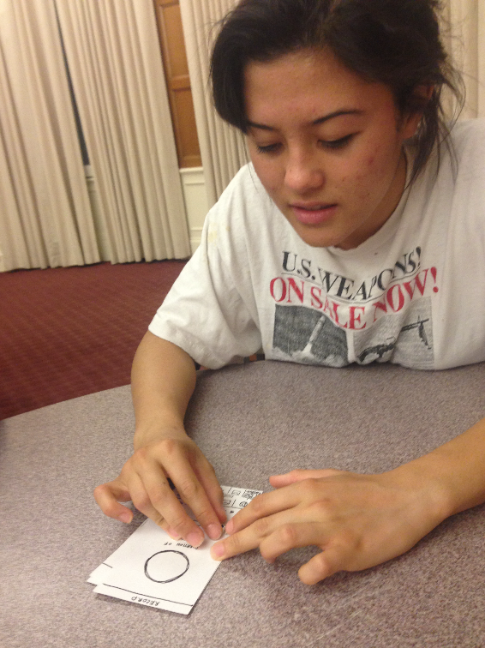
OUR RESULTS
CREATE
Is the music library referring to my own library or the app’s library?
What are these sliders?
What is this wifi button?

Slide 16
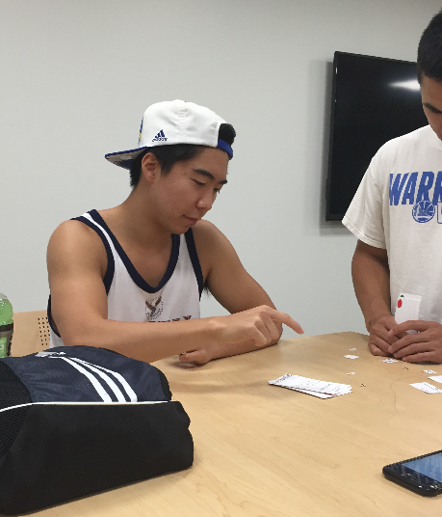
OUR RESULTS
CONTRIBUTE
What if I don’t want a 5 year old contributing to my video?
Who am I sending it to when I am done?

Slide 17
SUGGESTED UI CHANGES
+
landing page
+
music configuration
+
sharing settings

Slide 18
LANDING
PAGE
ORGANIZATION
Featured based on popularity and suggestions
SEGMENTATION
Group by genres
Recent activity of friends
DESCRIPTIONS
Show name of project

Slide 19
CREATION
SET UP
INSTRUCTIONS
On boarding step by step instructions
MUSIC SOURCE
Clarity in types of sources
EDITING INTERFACE
Sliding mechanisms

Slide 20
SHARING
SETTINGS
TEXT LABELS
Labels to accompany icons
GRANULARITY
Specifying multiple people to send direct requests
Limiting types of potential collaborators

