Slide 1
VALUE PROPOSITION
“Different Dancers Create Together”

Slide 2
PROBLEM OVERVIEW
The art of choreography is one driven by spontaneous moments of inspiration that are unified into a single performance piece; dancers, however, often encounter challenges maintaining motivation throughout this creative process and unifying disparate sequences of movements. The initial spark of creativity is often not enough to drive a dancer to a finished, performance-ready piece that he or she feels is sufficient in both quality and length. Unable to maintain this creative energy, dancers often abandon ideas without fully exploring the potential for those ideas to be refined into inspiring pieces of movements.

Slide 3
SOLUTION OVERVIEW
ChoreoLab facilitates the creative process by providing a novel, fun, and collaborative outlet where the short choreography contributions of individual dancers are eventually unified into a final compilation video.
Inspired to dance, individuals may either create their own projects if they are compelled to dance to a particular song or contribute to the compilation sequences of existing projects. Upon creating or contributing to an existing project, individuals may pass on the compilation to a friend or broadcast it to a wider audience.
ChoreoLab provides a means of creating a single piece that creates a flow of continuity among a global network of dancers of different styles and backgrounds. Due to the short nature of individual contributions, dancers can provide and draw inspiration from other collaborators in a short amount of time and with little effort - ultimately contributing a piece of self-expression to a larger project.

Slide 4
TASKS #1
Complex Task: Creating a collaborative choreography project
Dan is a 28-year old photographer, considering pursuing dance as a full-time profession. Creating is his passion, and he feels that choreography enables a more tangible, physical mode of self-expression, especially when compared to photography. Establishing one’s reputation in the dance community is difficult, and he would like an outlet to broadcast his interpretations of music and see how others’ respond or react differently. At the moment, Dan’s photography work does not afford him the necessary bandwidth to create full-length choreography routines; he does not have time to deeply analyze a song and refine and iterate choreography. He currently has a short segment of Bruno Mars’s “Uptown Funk” stuck in his head and is visualizing choreography. He would like to capture this burst of inspiration, exercise his creativity, and share his idea in a more organic, short-form manner.

Slide 5
TASKS #2
Moderate Task: Contributing choreography “shorts” to others’ existing projects
Ashley is a 25-year old architect, who has recently relocated to New York City. She has had extensive contemporary dance training in the past. Moving to a new city, however, has displaced her from her prior dance community. To maintain her connection with this community, Ashley would like to remotely collaborate and contribute ideas for their upcoming performance routines. In the past, she has not taken on the role of lead choreographer but after seeing the initial inspiration for a piece, is willing to contribute her ideas for short sequences of movements that can be incorporated into the larger routine. She really misses working with Dan and is hoping to collaborate with him in the future.

Slide 6
TASKS #3
Simple Task : Discovering projects and watching compilation videos
Andre is a teenager whose affinity for watching dance has developed into a desire to start dancing. He would like to dance more but does not have the time or confidence to enroll in workshops or formal classes. He often watches online dance videos for both inspiration and entertainment; he is not yet comfortable dancing in front of others but appreciates those who share their work and provide visual guides that he can attempt to copy while dancing in private. Having not yet developed a particular dance style, Andre would like to watch videos of various dancers who practice different styles.

Slide 7
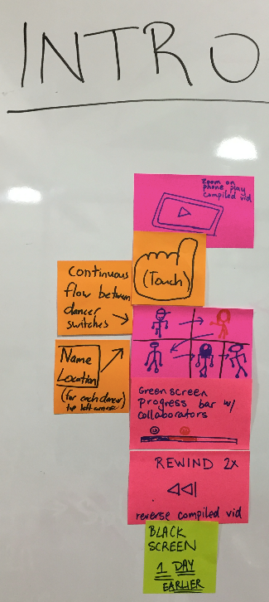
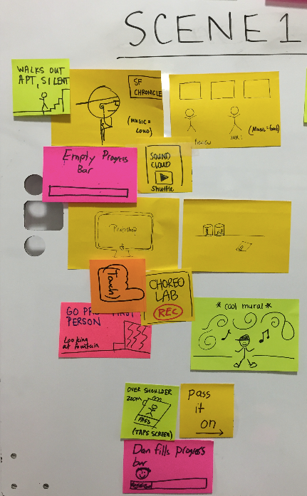
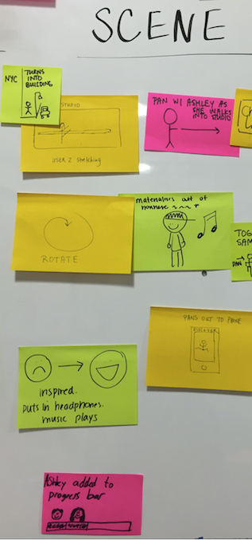
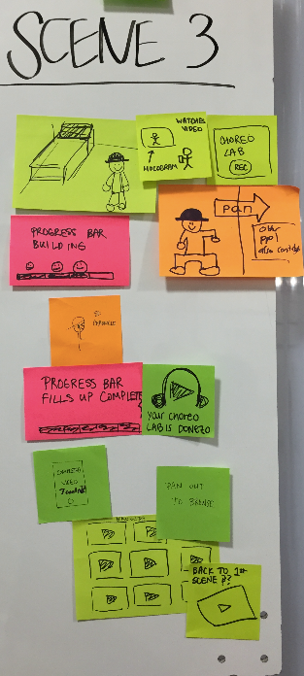
VIDEO STORYBOARDS

Slide 8
CONCEPT VIDEO
https://youtu.be/AI6Ed-wWzXc

