Slide 1
Enhancing
Dancing

Slide 2
TEAM
andrew lim
lloyd lucin
sharleen tu
krysten walker
computer science
computer science
computer science
sts

Slide 3
PROBLEM DOMAIN
dancers
hip hop dancers
choreographers of all levels and genres

Slide 4
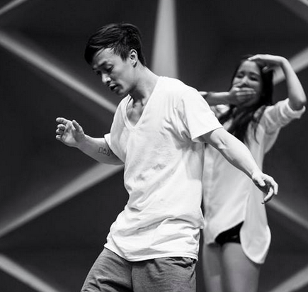
INITIAL POV
We met Andy.
We were amazed to realize that dancers don’t necessarily welcome feedback until they feel the piece is “performance-ready”.
It would be game-changing to allow dancers to feel comfortable giving and receiving feedback throughout the creative process.

Slide 5
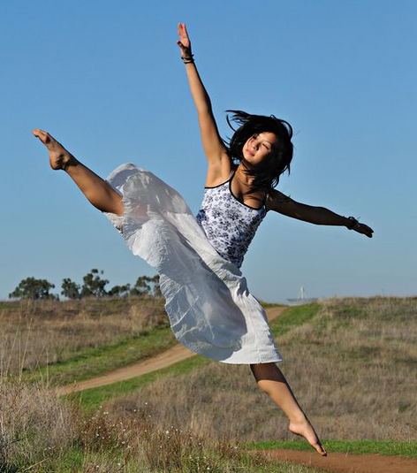
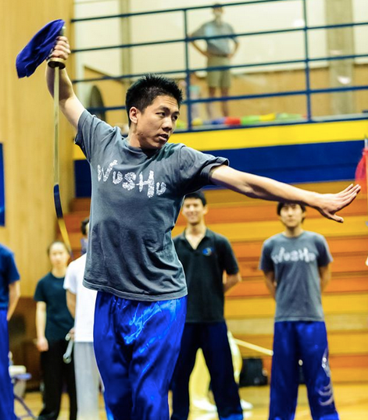
ADDITIONAL NEEDFINDING
Mindy Phung
Mel Hsieh
Mina Han
Doris Z.

Slide 6
INSIGHTS
Musicality
Important for all levels of dancers
Feedback
Mechanical Movement Feedback vs Creative Feedback
Creation
Inspiration & Creativity is spontaneous

Slide 7
POV #1
We met Mel.
We were amazed to understand the intricacy of musicality in relation to self expression and creativity
It would be game changing to allow dancers to expand their musicality by examining the musical interpretations of their peers.

Slide 8
HMW #1
How might we help dancers visualize the auditory subtleties of music?

Slide 9
POV #2
We met Tad.
We were amazed to realize that he creates choreography in non-chronological chunks whenever inspiration hits him.
It would be game changing to provide dancers with a means of exploring the relationships between discrete, even disparate sequences of movements to create a unified piece.

Slide 10
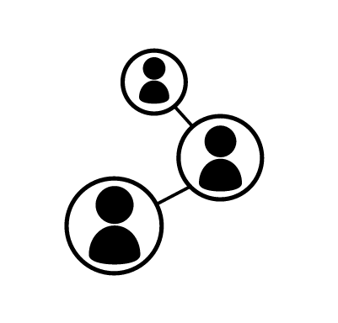
HMW #2
How might we encourage more collaboration in the predominantly individual choreography process?

Slide 11
POV #3
We met Andy.
We were amazed to realize that unlike many other creative genres, dancers do not often seek feedback until a piece is “performance ready.”
It would be game changing to allow dancers to reframe pieces of choreography as dynamic works in progress and establish a new feedback cycle that integrates more effectively with the different stages of the creative process.

Slide 12
HMW #3
How might we reframe all pieces of dance as “works in progress” to facilitate more open feedback?

Slide 13
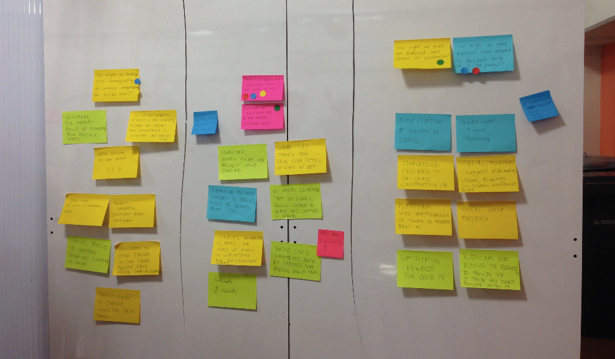
EXPERIENCE PROTOTYPES
HMW#1
HMW#2
HMW#3

Slide 14
TAP2CLAP

Slide 15
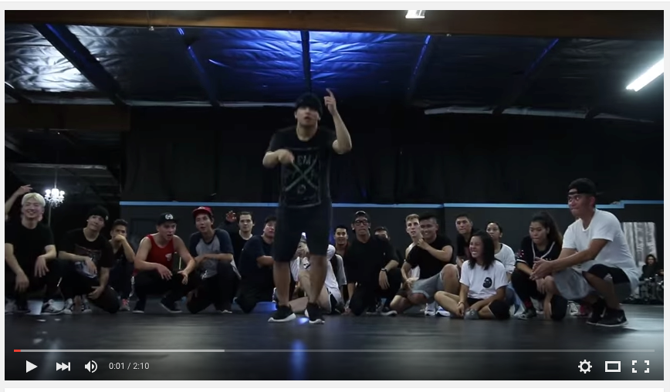
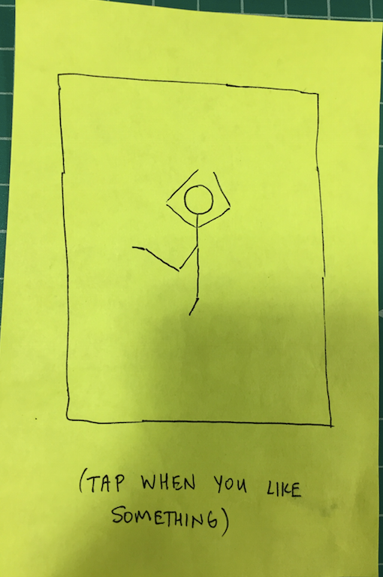
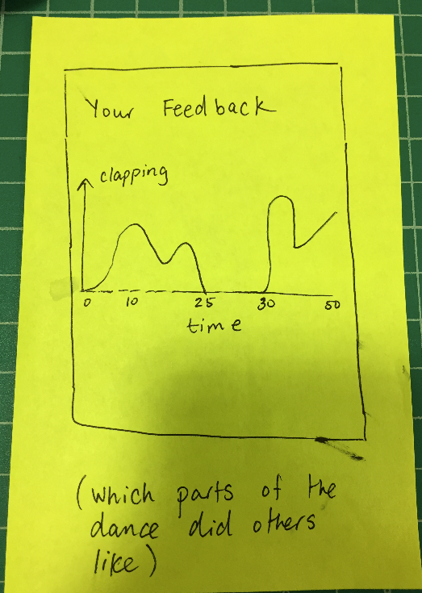
HOW IT WORKS
Viewer
Watches videos and gives applause
Dancer
Uploads video and receives data

Slide 16
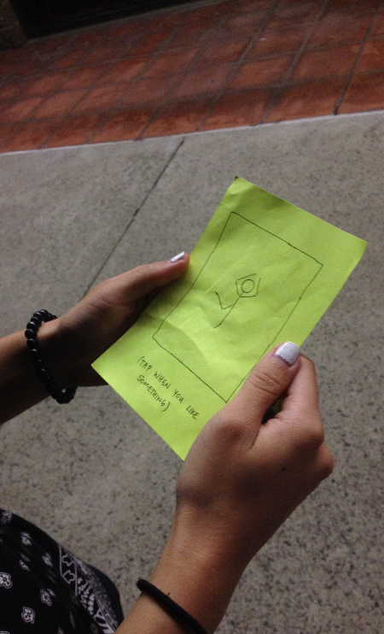
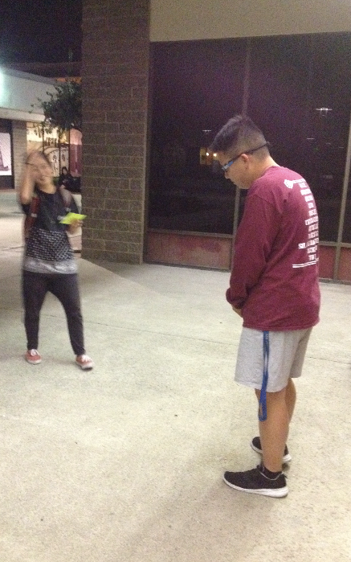
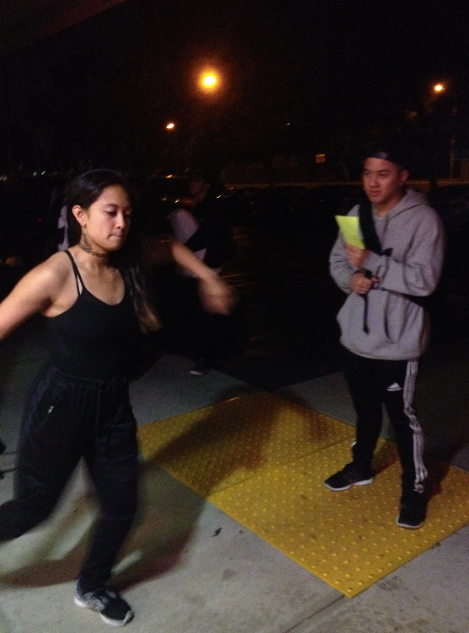
HOW WE TESTED

Slide 17
OUR RESULTS
things that worked
things that did not work
concept was clear to grasp
enthusiasm tied to timestamps was cool
content would be catered to audience appeal
lack of clapping could be perceived negatively
surprises
new learnings
user preferred to be a passive audience member
looking at histogram would be more discouraging than helpful
simple concept makes for surprisingly complex insights
an interesting idea but doesn’t solve an inherent problem

Slide 18
OUR RESULTS
Dancers will be comfortable uploading videos and having other people watch.
Viewers will find it natural to tap or swipe the screen to “applaud.”
Dancer will get value out of seeing the results
things that worked
concept was clear to grasp
things that did not work
content would be catered to audience appeal
surprises
looking at histogram would be more discouraging than helpful
new learnings
an interesting idea but doesn’t solve an inherent problem

Slide 19
BOOTS AND CATS

Slide 20
HOW IT WORKS
Beginning Dancer
Choreographs to song
Intermediate Dancer
Browses different interpretations of song
Feedback Providers
Browses uploaded videos and provides feedback

Slide 21
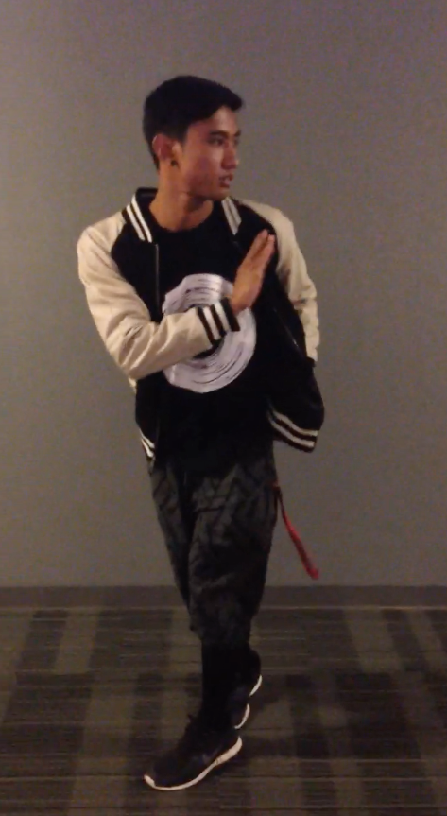
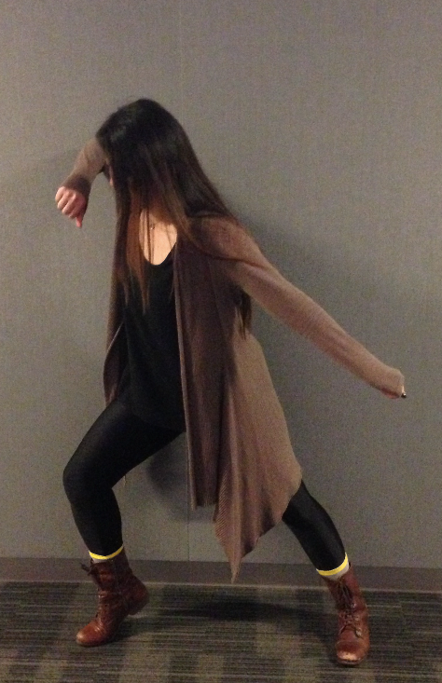
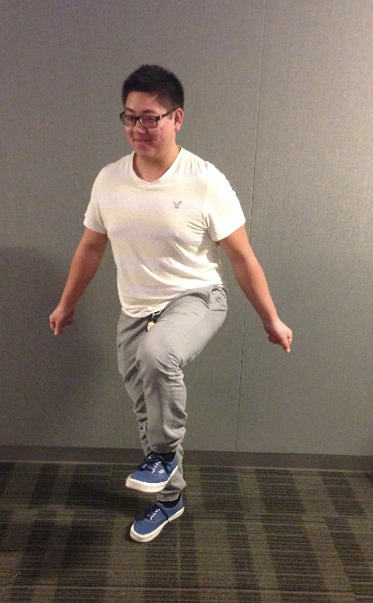
HOW WE TESTED

Slide 22
OUR RESULTS
things that worked
things that did not work
useful to see how different people interpreted music
dedicated space to show your abilities
purpose of idea was not clear because of the complexities
youtube serves the same purpose
surprises
new learnings
musicality difficulty isn’t categorized by song, but by interpretation
dancers are hesitant about validity of comments
practicing musicality for the sake of it has little appeal
too many roles in the experience led to too much confusion

Slide 23
OUR RESULTS
Dancers want to work on musicality
Dancers can improve their musicality by listening to music and choreographing frequently
Dancers can provide useful feedback about musicality
things that worked
useful to see how people interpreted music differently
things that did not work
concept was too complex
surprises
dancers were skeptical about feedback
new learnings
practicing musicality itself is not appealing

Slide 24
CHOREO LAB

Slide 25
HOW IT WORKS
Starter
Picks a snippet of song, choreographs up to 2 8 counts and passes it on
Contributor
Either receive a request or actively chooses to contribute to a project
Passive Browser
Browses cool projects

Slide 26
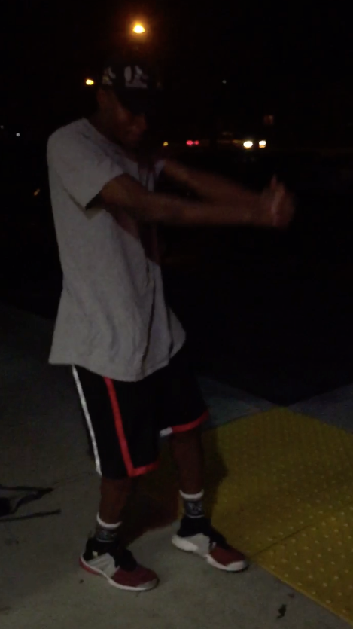
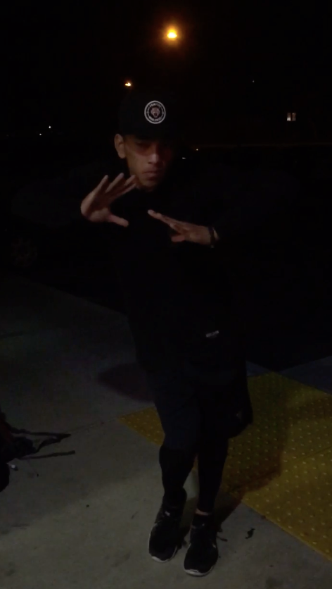
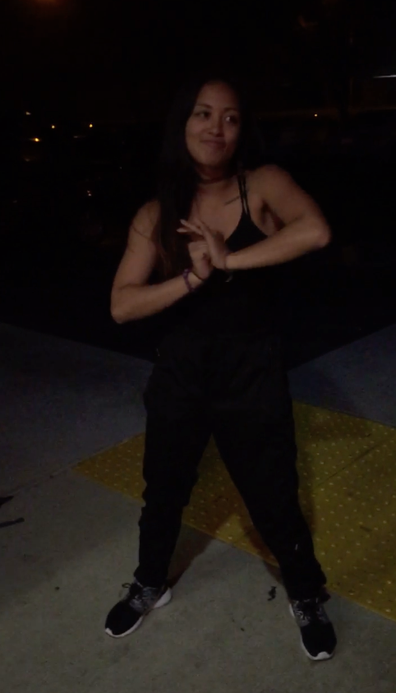
HOW WE TESTED

Slide 27
OUR RESULTS
things that worked
things that did not work
users liked the collaborative nature
interesting to see all the different interpretations put together
imposing restrictions on choreography length
some could develop attachment to their choreography
surprises
new learnings
dancers would be okay with sending the choreography to strangers
all users were genuinely excited about both creating and seeing other’s results
collaborating with other dancers is an exciting space that is hard to do
community is important

Slide 28
OUR RESULTS
Dancers will contribute to choreography that included other people’s different interpretations of the song
Dancers like creating fun choreography in a collaborative manner
Dancers like choreographing small sections of songs
things that worked
collaborative nature
things that did not work
restrictions on time/music
surprises
genuine excitement
new learnings
collaboration and community are important

Slide 29
CONCLUSION

