Slide 1
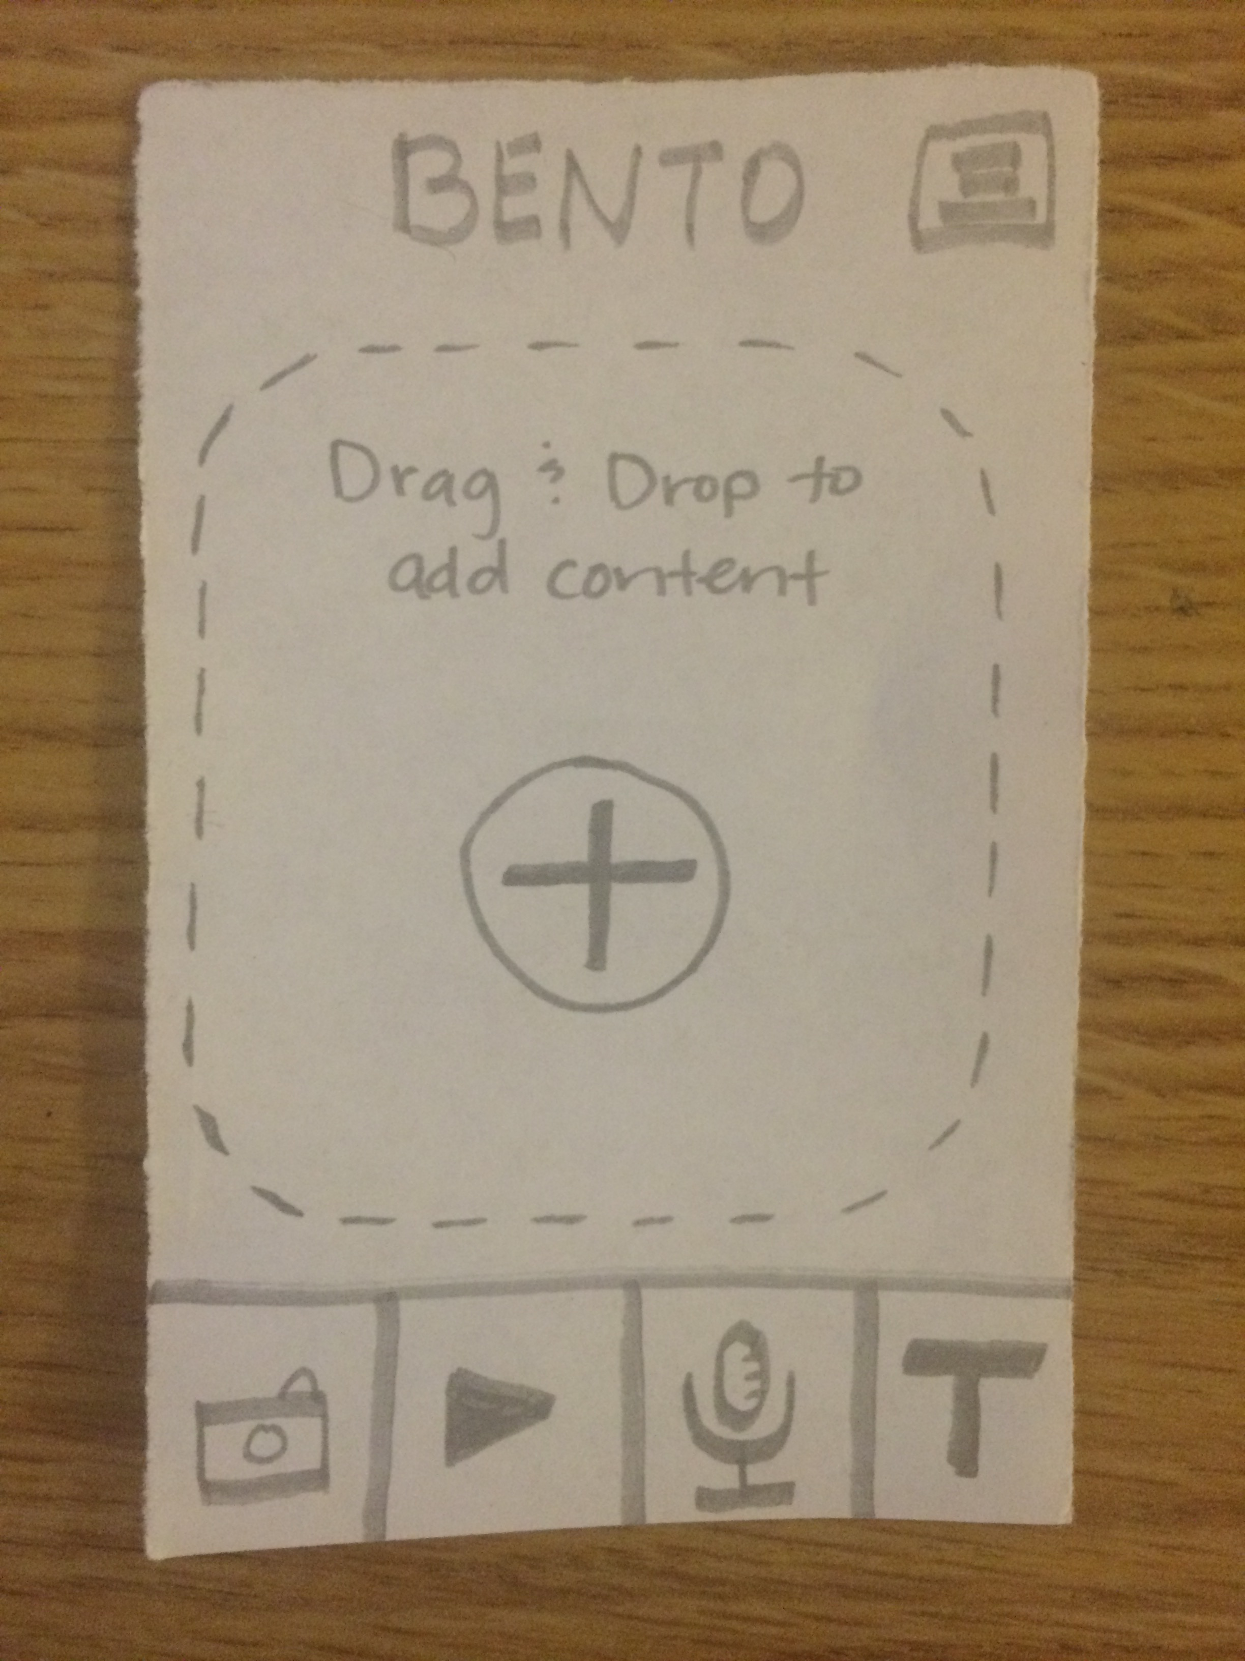
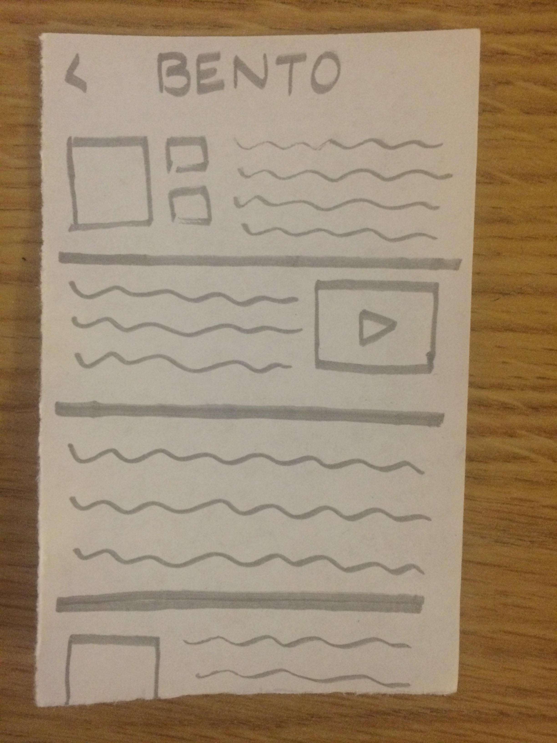
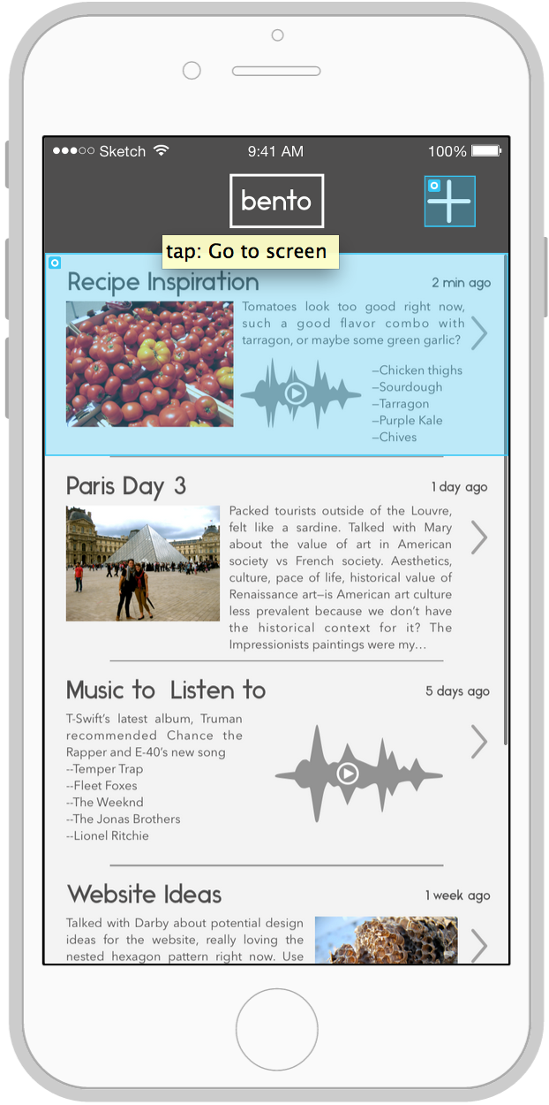
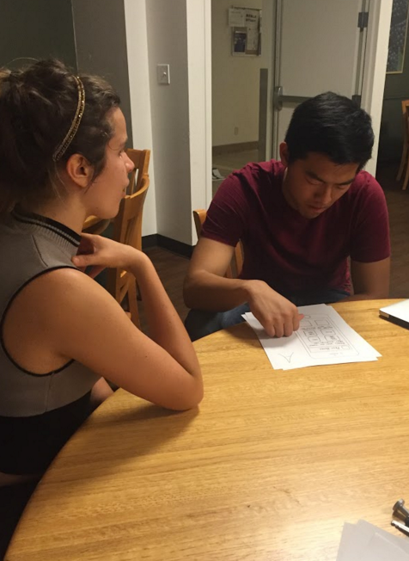
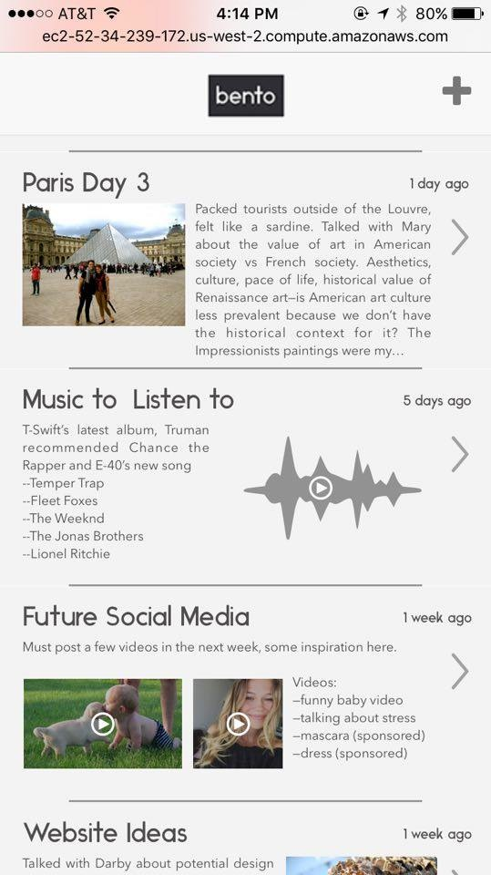
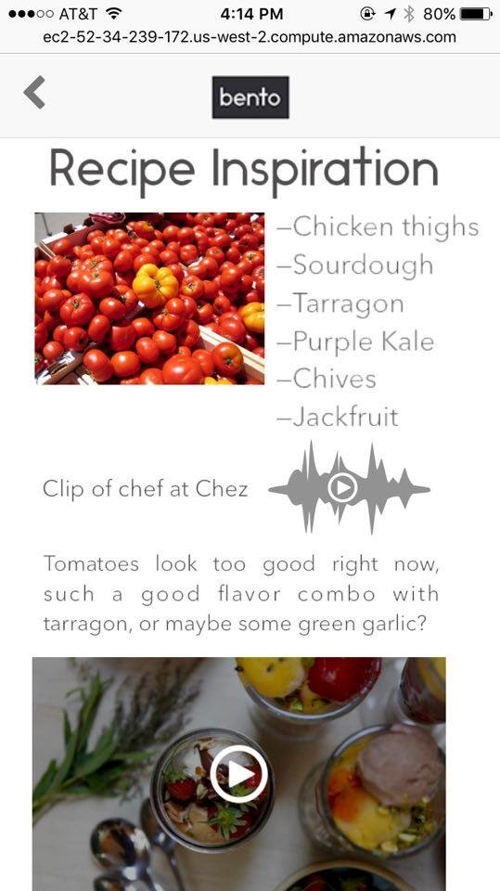
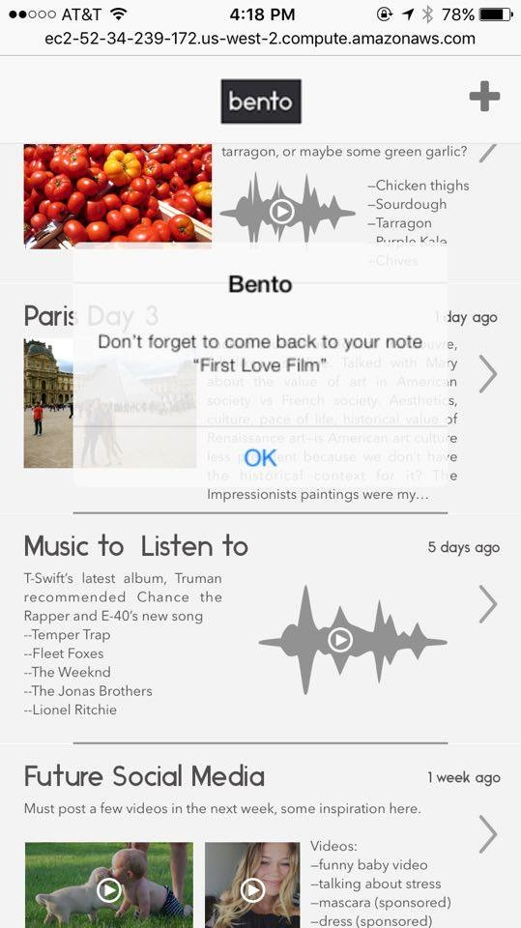
bento
hci.stanford.edu/courses/cs147/2015/au/projects/creation/bento
hold onto your inspiration
overview
problem: creative inspiration is scarce. when we forget about things in the world or moments that inspire us, we’re frustrated and our creative process is hindered
“it would be game-changing if designers could seamlessly bring inspiration from the real world home with them in an authentic way.”
“the most important thing about creative ideas is remembering a few key context points about where they came from.”
design process
low fi: paper
med fi: proto.io
add content
view old logs
add content
view old logs
prototype
test
solution
be inspired
log the moment
get reminded
screenshot of creation page
screenshot of inspiration log
screenshot of reminder sent

