Slide 1
10 Lines
Low-fi Prototype
by: Team Art Attack!
Selina Her
Nyasha Smith
Ben-Han Sung
Sarah Wymer
10/23/2015

Slide 2
Current Trajectory
Go Mobile
Improve Flow

Slide 3
Mission Statement:
To facilitate artistic creation through collaboration, on-the-go.

Slide 4
Why Mobile?
Portable
No tablet?
No problem.
Can’t predict
inspiration

Slide 5
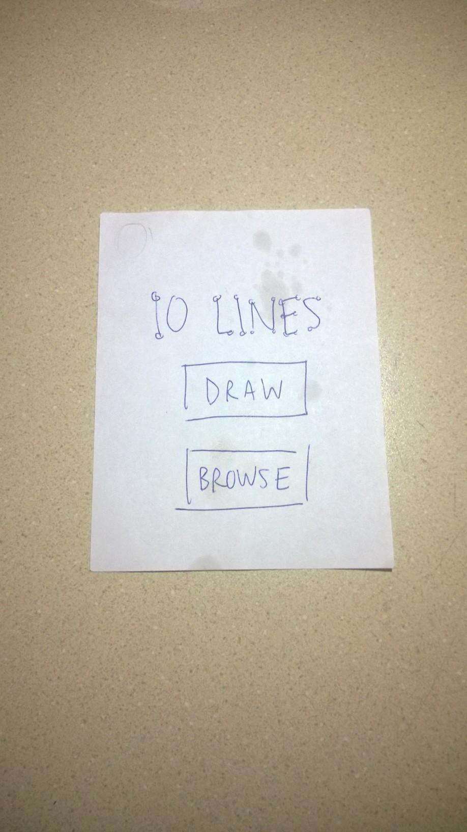
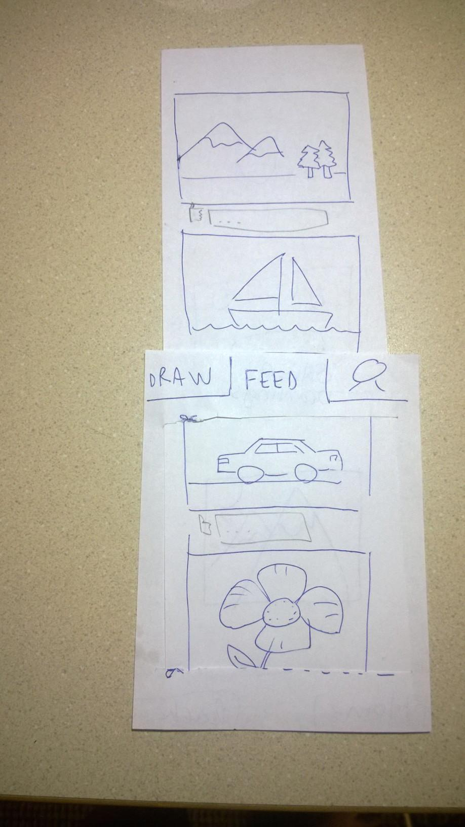
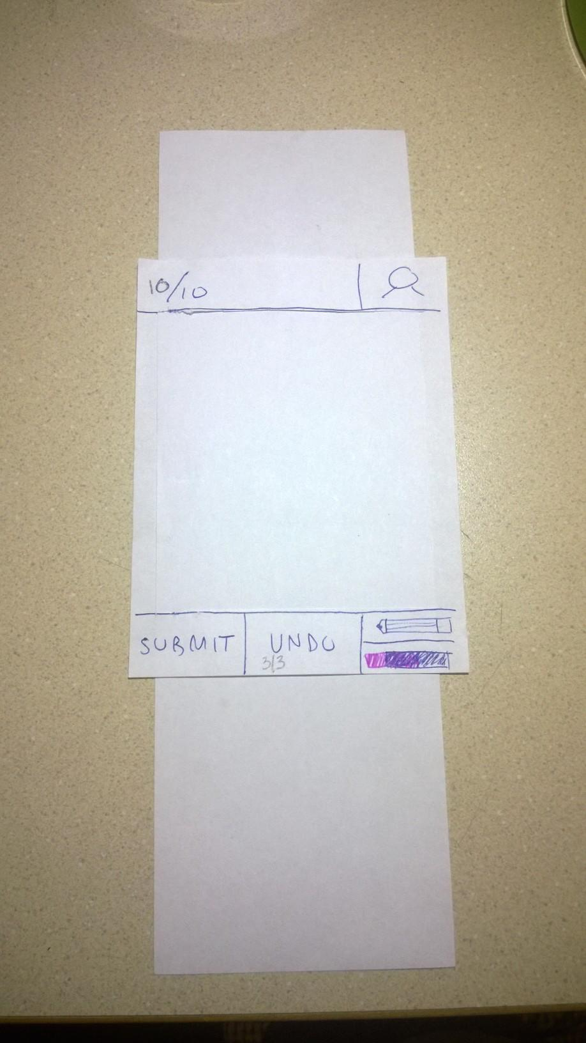
Low-Fi Prototype Structure
Sheets of paper roughly phone screen sized
Slots in screens for scroll function
Replaceable blank screens for real art

Slide 6
3 Tasks
Look at other people’s art (for fun or inspiration)
Draw pictures with another person without being in the same place
Start visual dialogue with creative community about a current event
Task Flows

Slide 7
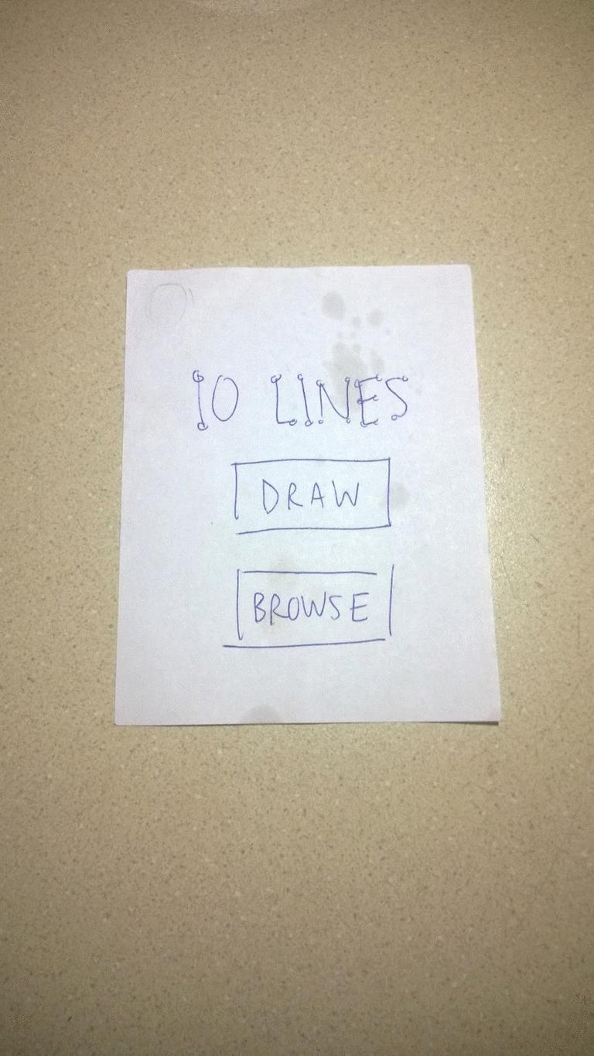
3 Tasks
Look at other people’s art (for fun or inspiration)
Draw pictures with another person without being in the same place
Start visual dialogue with creative community about a current event
Task Flows
“Browse through
other people’s art
and add a comment to
a picture you like.”

Slide 8
3 Tasks
Look at other people’s art (for fun or inspiration)
Draw pictures with another person without being in the same place
Start visual dialogue with creative community about a current event
Task Flows
“Draw a picture with your friend Alice who is far away.”

Slide 9
3 Tasks
Look at other people’s art (for fun or inspiration)
Draw pictures with another person without being in the same place
Start visual dialogue with creative community about a current event
Task Flows
“Draw art with a current event theme with other anonymous public users.”

Slide 10
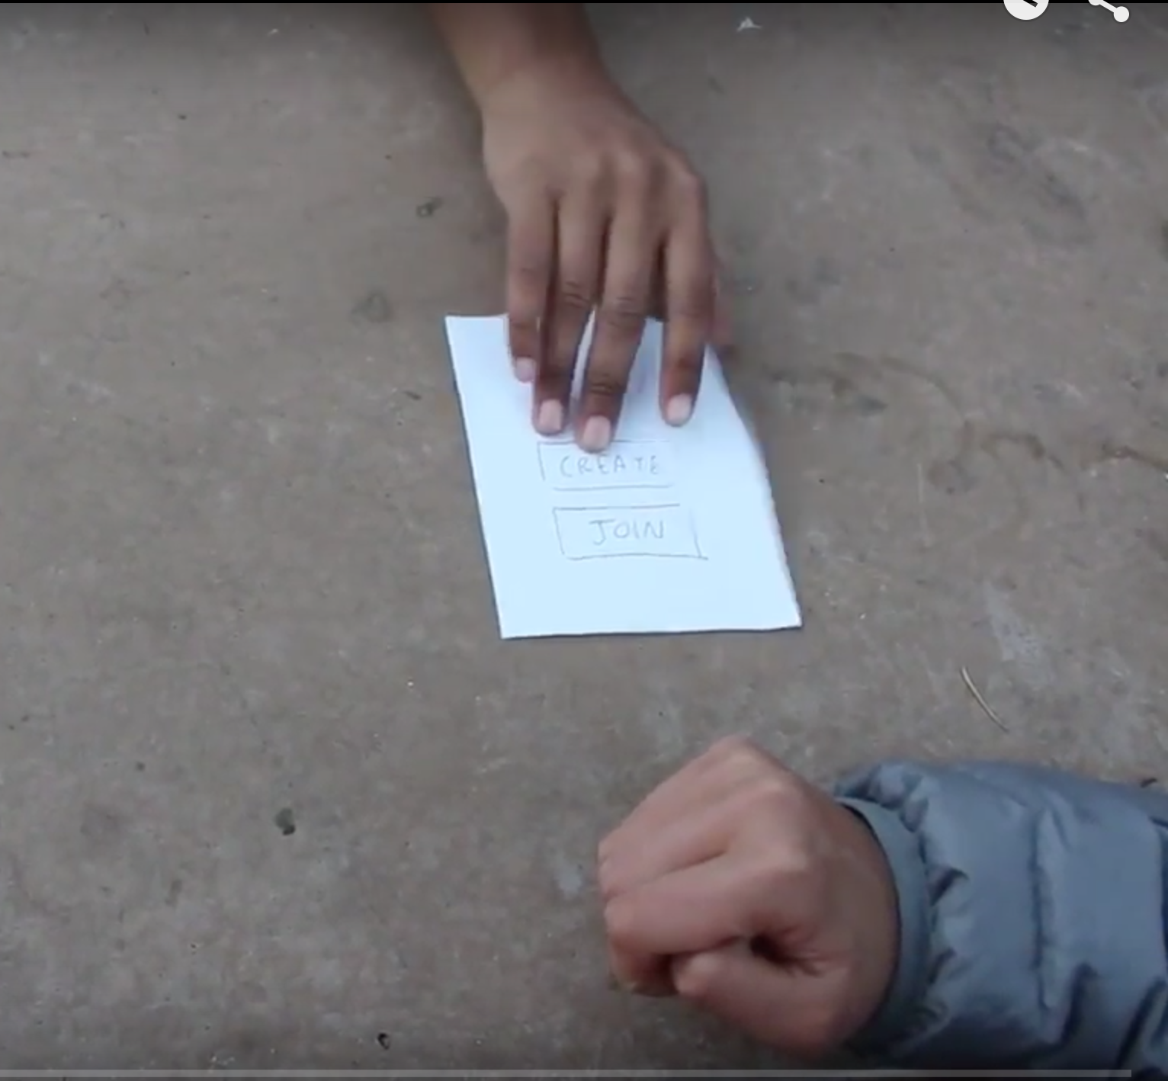
Testing Method
Demo the system.
“This is how you scroll”
Prompt user with task.
“Draw a picture with
your friend Alice who
is far away.”
Observe process.

Slide 11
Critical Incidents & Results
Quotes
Draw anything without judgment
It’s like a game that never ends
Didn’t I just do that?
What do I press? (join group)
(Couldn’t glean rules of the game)
Not sure what this is (profile)
What if I want to create alone?
Results
Interactivity was fluid overall
Task completion: 45 seconds

Slide 12
Looking Toward the Future
Refine sketchbook metaphor
typefaces, gestures, etc.
Unify
language
‘create’ vs.
‘draw’
Relieve never-ending feel
change screen flows

Slide 13
To summarize...
Mobile makes sense.
Our biggest challenge moving forward:
Screen Flows.

