Slide 1
10 Lines
Brought to you by: Team Art Attack!
Selina Her
Nyasha Smith
Ben-Han Sung
Sarah Wymer
10/16/2015

Slide 2
Value Proposition:
Get on the Same PAge. Literally.
Notes:
To recap a bit, our app idea is to build a collaborative art platform that lets people draw together. Each person gets to draw 10 lines, and they take turns drawing 1 line at a time.

Slide 3
Problem: Creative Paralysis
noun
Caused by perfectionism and self-doubt
Artist’s block, writer’s block
Symptoms: lots of circular thoughts, little to no output
Notes:
Also known as artists’ block, writers’ block.
Sometimes even the most creative people will get stuck. For example, they might be seeking perfectionism - they might be afraid to output something mediocre, because people will judge them for that. So then they scrap too many good ideas.

Slide 4
Solution: 10 Lines
Collaborative art-making platform that brings minds together
Challenges users to communicate and express themselves - only 10 lines per person
Removes the pressure to demonstrate individual excellence
Constraints fuel creativity by forcing users to think outside the box and adapt to the previous player’s response
Discussion: So, how does our art platform solve this problem?
First, we would like to mention that our platform is collaborative. This removes the pressure to demonstrate individual excellence because collective authorship means collective responsibility for whatever happens. If you end up a great picture, then you get some of the credit - and that’s great! If you end up with a bad picture, it’s not your fault - someone else might have messed it up.
We also think that the constraints of drawing one line at a time will force people to think outside the box. They have to cede creative control to other players after every line and they have to figure out how to adapt to what the other players do.

Slide 5
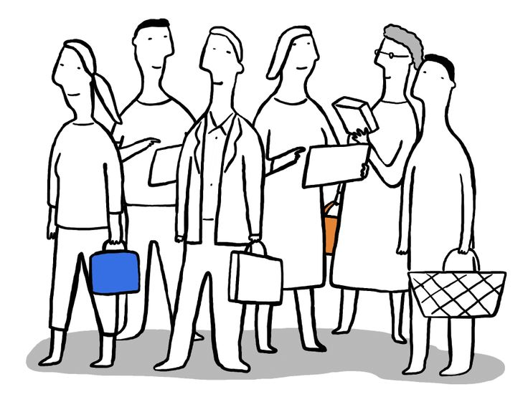
THREE TASKS

Slide 6
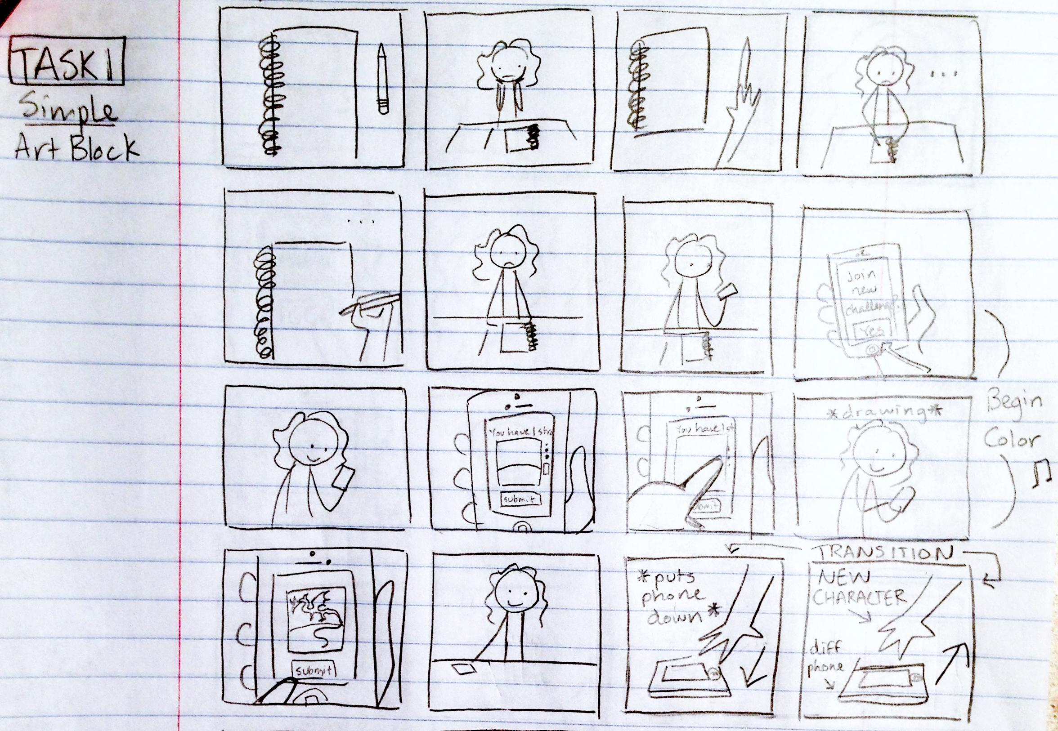
Simple: Artist’s BLock
Discussion: Our first task is to stimulate creativity by giving artists/players something to work with. Even the most creative people will get stuck. For example, they might be seeking perfectionism - they might be afraid to output something mediocre, because people will judge them for that. So then they scrap too many good ideas and have trouble figuring out where to start.
Storyboard: Meet Nyasha, who needs to draw a fantasy scene for her creative storytelling class. This being an uncommon activity for her, she has no idea where to begin. Cut between blank sketchbook and pensive Nyasha to emphasize artists’ block. With 10 Lines, she enlists the help of other players/artists who can start the picture first and give her something to build on.

Slide 7
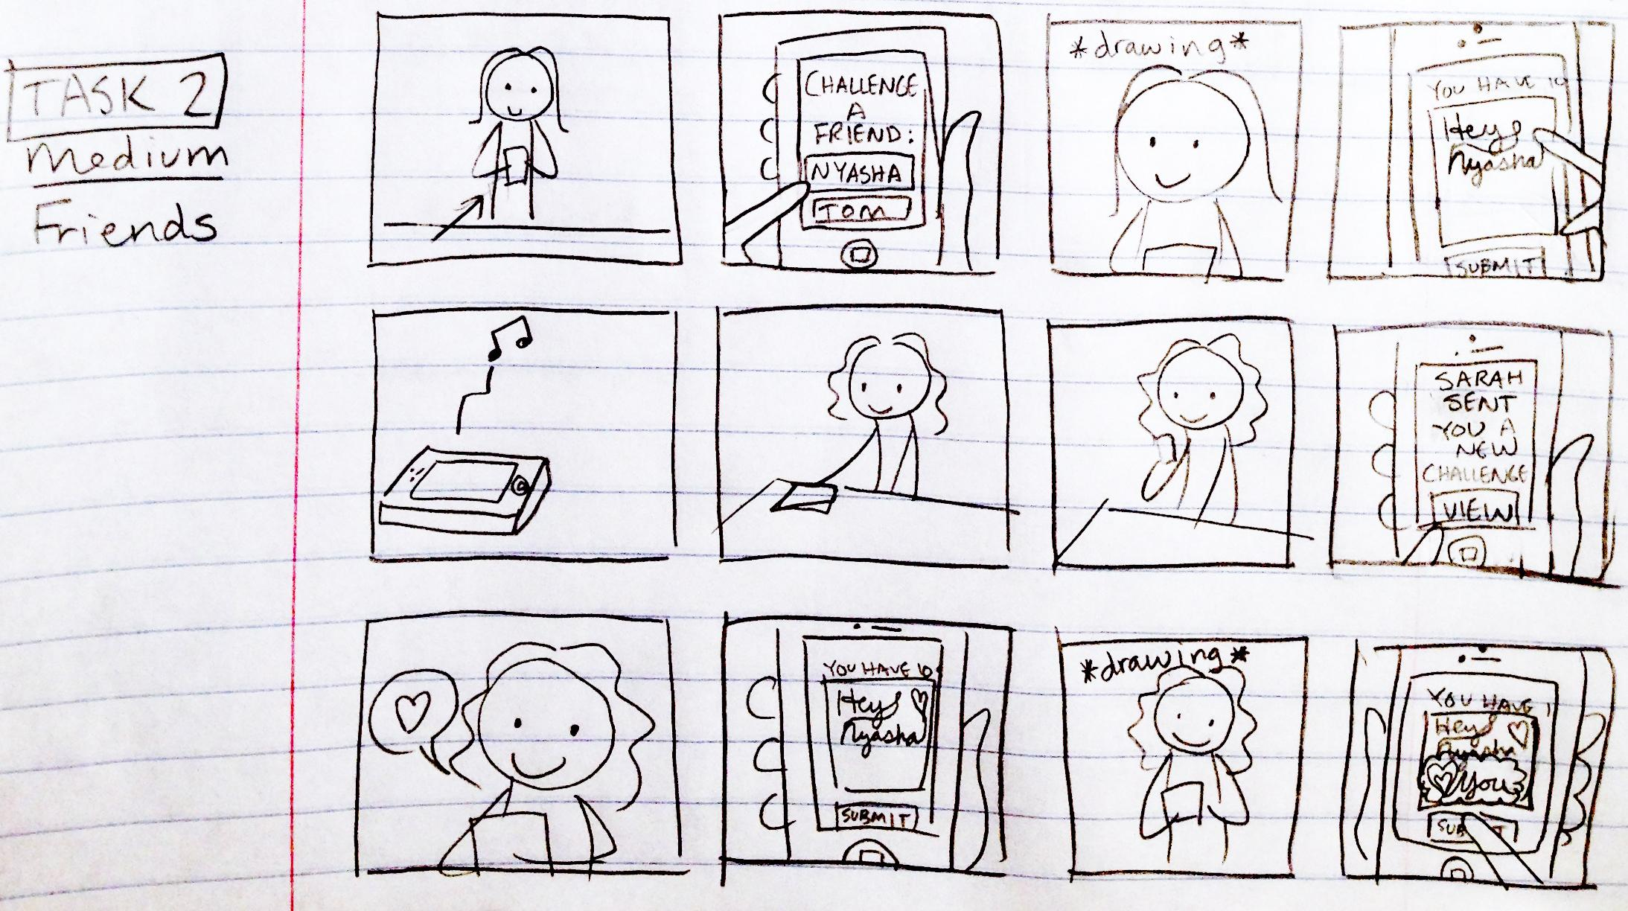
Medium: Cross Country Collaboration
Discussion: Our second usage scenario is to connect far-away friends and allow them to still have fun together. By the power of the internet, our app will allow people to draw with each other no matter where they are. For example, consider grandparents who want to connect with the grandkids. They won’t be able to be there to read a bedtime story, but drawing together would be a pretty fun alternative that can overcome age and (perhaps) language barriers. Furthermore, turn-taking does not have to occur in real time (even though it can!), so that collaborative drawings can proceed at the pace that participants want.
Storyboard (grandparent idea not possible because we couldn’t get actors): Meet Sarah from New York, who wants to say hi to her friend Nyasha on the opposite coast in a casual and non-disruptive way, since Nyasha’s pretty busy. Sarah sends Nyasha an art challenge that she starts off and can be continued by Nyasha at her leisure. Nyasha is happy to hear from Sarah and takes a few seconds out of her day to draw a reply.

Slide 8
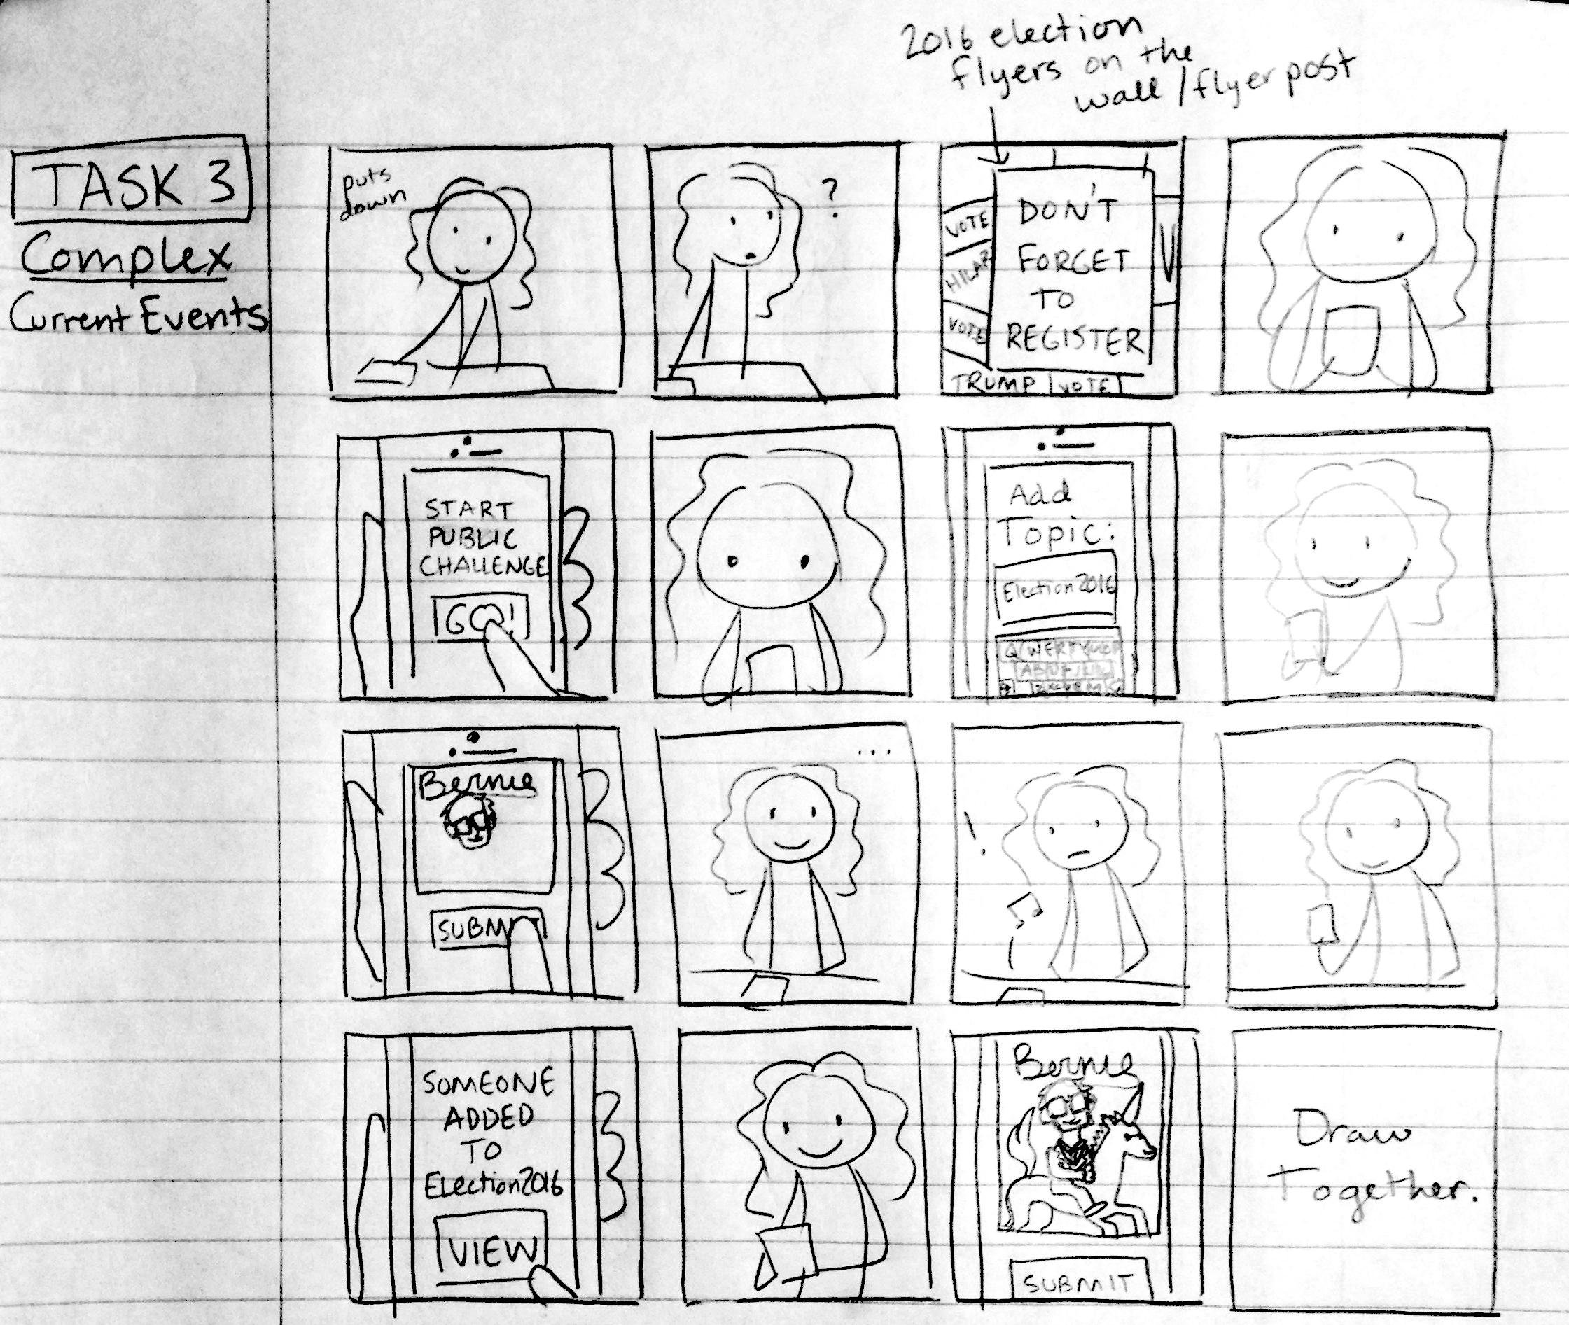
Complex: Current Events Commentary
Discussion: Finally, collaborative art can allow people to comment on current events using visual language. We can curate drawings and display them in a public feed so that other people can see it, comment on it, and maybe even add to it. We can also challenge people to submit art under a particular theme, or work on a big picture together. It would be like political cartoons, except that the pictures would show the collaborative wit of the public rather than a single artist.
Storyboard: Nyasha sees a Bernie Sanders poster and wonders what other students think of his campaign. She opens up our app and submits a challenge idea to start a visual discussion. She starts the picture off with a picture of Bernie’s head and waits to see what others will add. Sarah gets a notification about her friend Nyasha’s challenge and decides to participate. Cut back to Nyasha, who sees that a unicorn has popped up under Bernie. Is Sarah saying Bernie’s presidential campaign is unrealistic?
Notes:
Finally, we imagine that collaborative art might also be used as a current events commentary. We could curate drawings and display them in a public feed so that other people can see it, comment on it, and maybe even add to it.
We can also challenge people to submit art under a particular theme, or work on a big picture together.
So this storyboard tries to capture what this kind of large-scale interaction might look like.

Slide 9
THE VIDEO: https://youtu.be/Ef6ZEqsGTSE

