Slide 1
POV’s and Experience Prototypes
Team: Art Attack!
Nyasha Smith, Sarah Wymer, Selina Her, Ben-han Sung

Slide 2
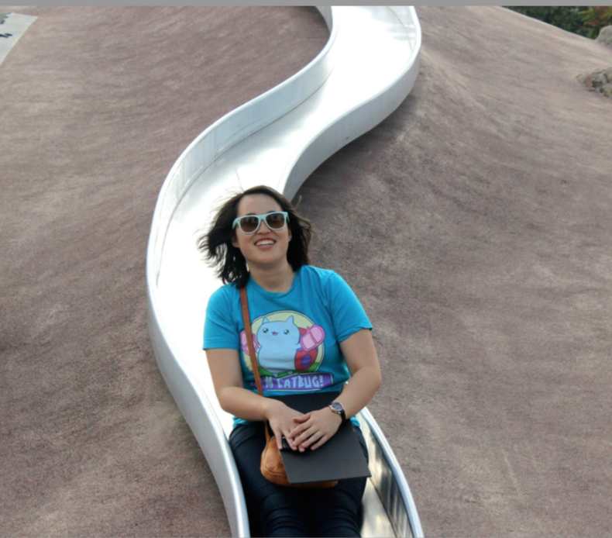
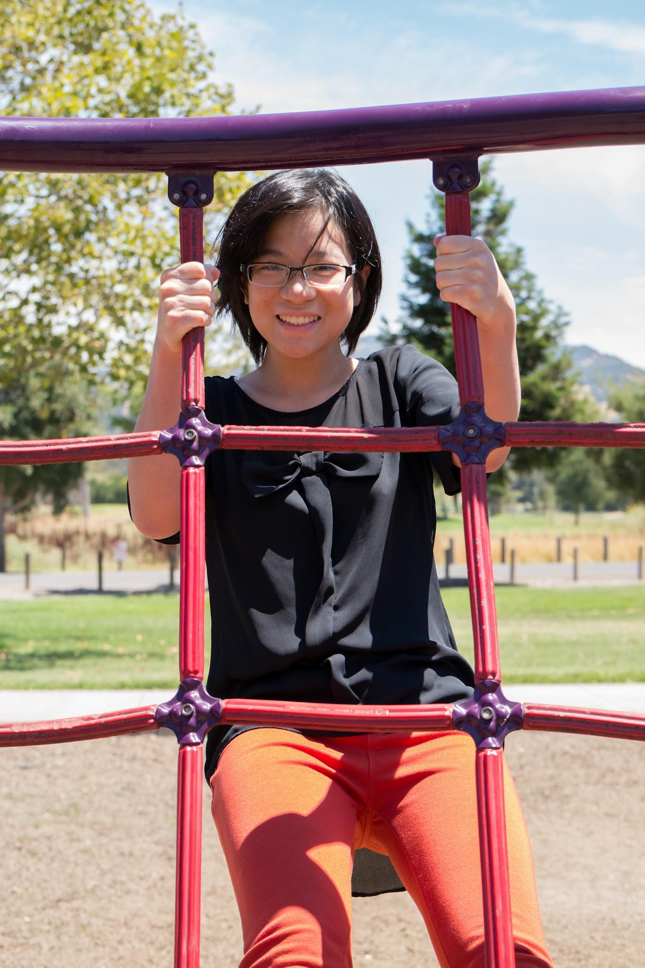
Additional Interviews
Ben-Zhen
Digital art student at the Academy of Art
Joyce
Design Student
California College of Art

Slide 3
Point Of View’s
We met Ben-zhen, a digital art student at the Academy of Art.
We were amazed to realize that she lacked confidence without an impressive portfolio.
It would be game-changing to help her realize that there are other ways to prove herself.
We met Joyce
We were amazed to realize she has trouble finding compatible clients
We think it would be game changing to help her find the right clients for her
We met Emile..
We were amazed to realize that he relies primarily on his network for clients
We think it would be game changing to help him reach outside of his network

Slide 4
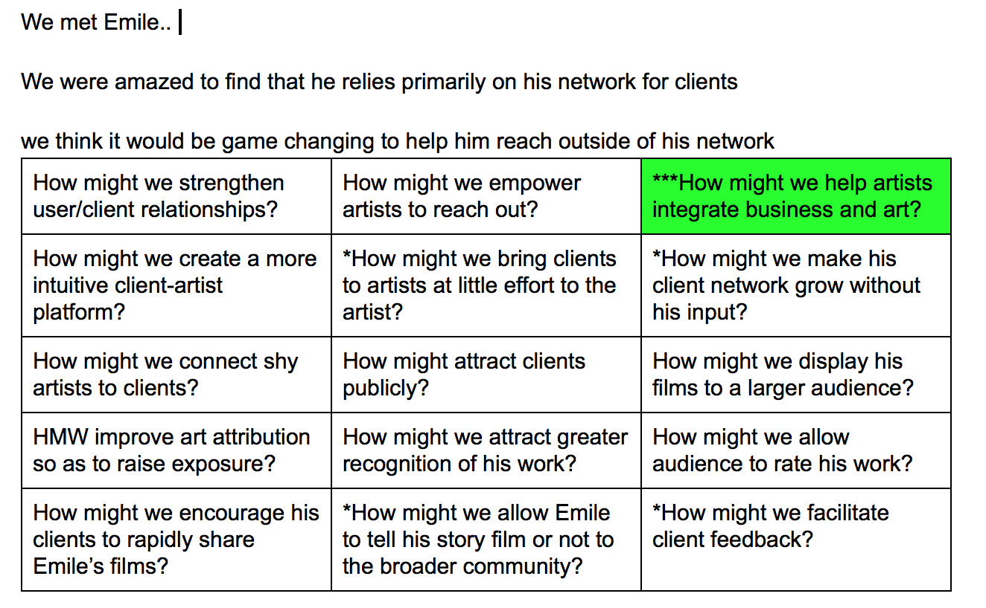
How might We?

Slide 5
Top Three HMW’s
HMW help artists integrate business and art?
HMW implement real-time skill demonstrations?
HMW encourage artists to create spontaneously?

Slide 6
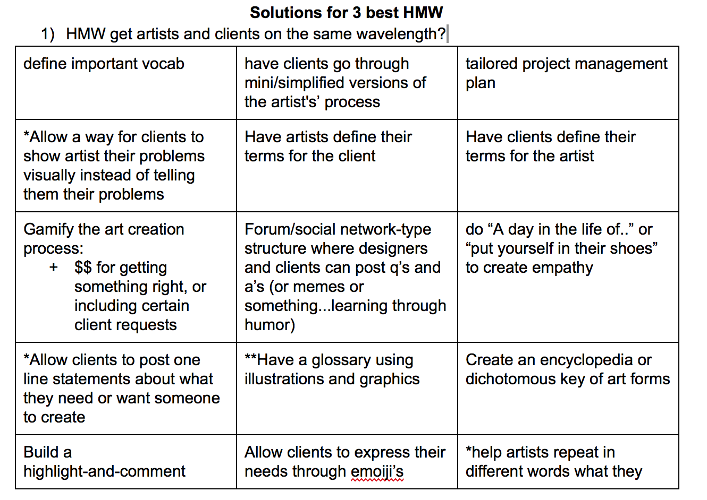
Solutions

Slide 7
Top 3 Solutions
Create 30-second art pieces based on the a daily theme and showcase the most popular submissions.
Art commission platform. Client: I want to make X and I’ll give you $$ to get it done.
Collaborative picture making, where everyone adds 10 strokes per turn to one drawing.

Slide 8
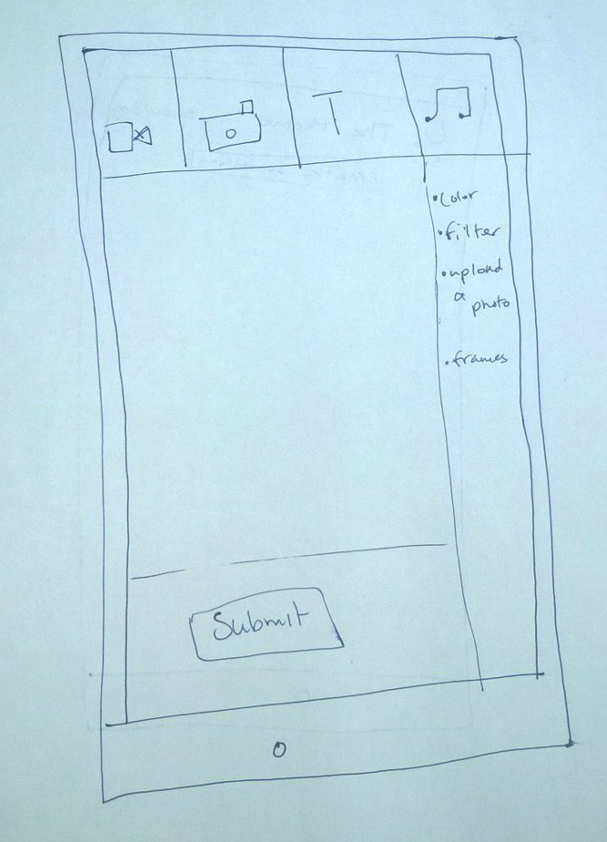
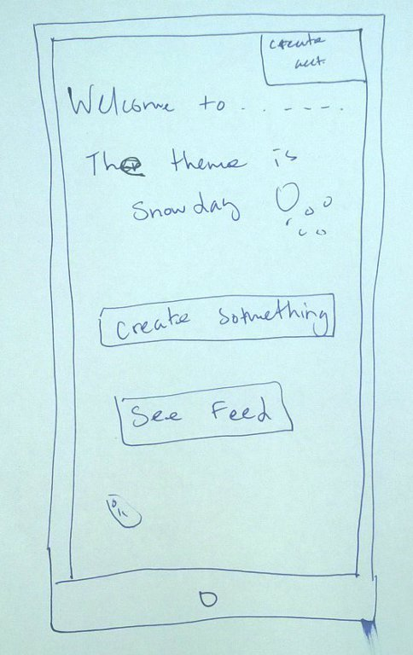
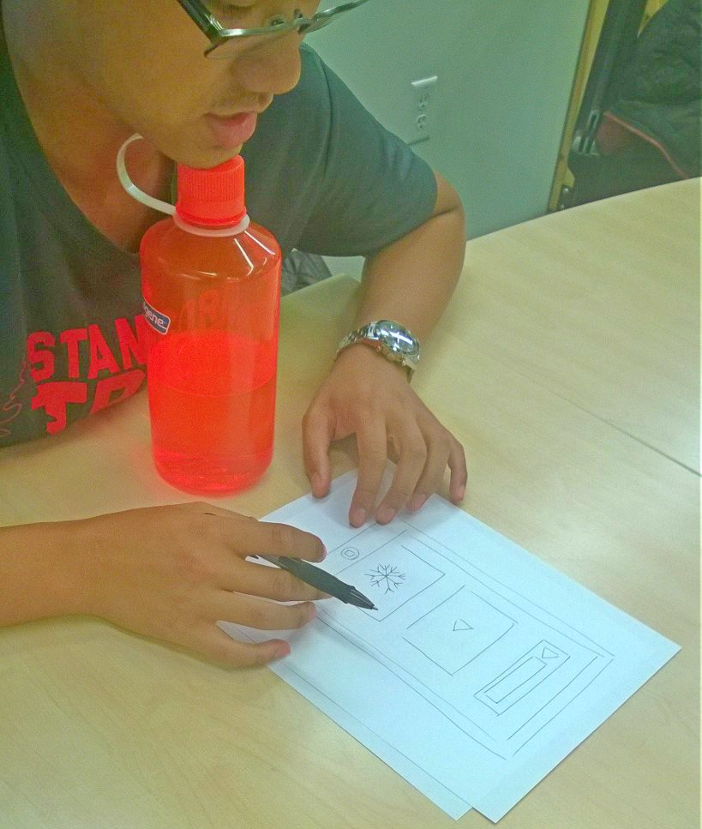
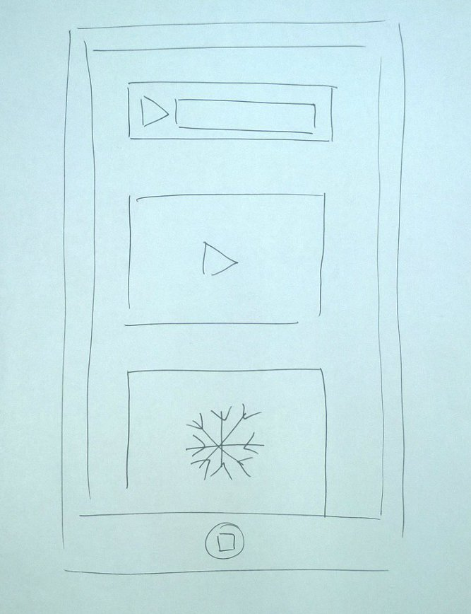
Prototype 1: Art Prompts

Slide 9
Feedback Prototype 1
“Oh, This is really cool”
Aftering seeing the feed asked “What do I do?”
Editors display should change depending on the upload content

Slide 10
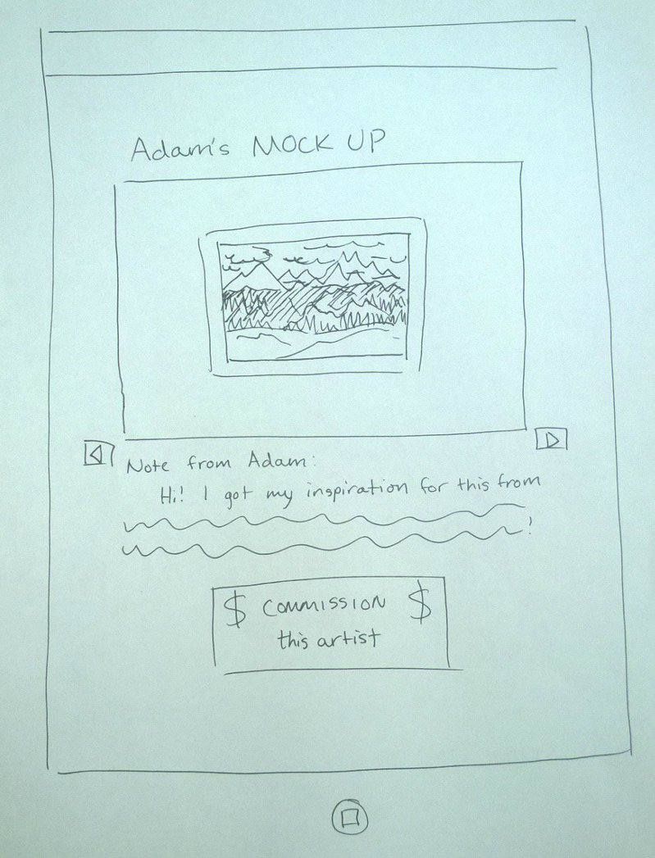
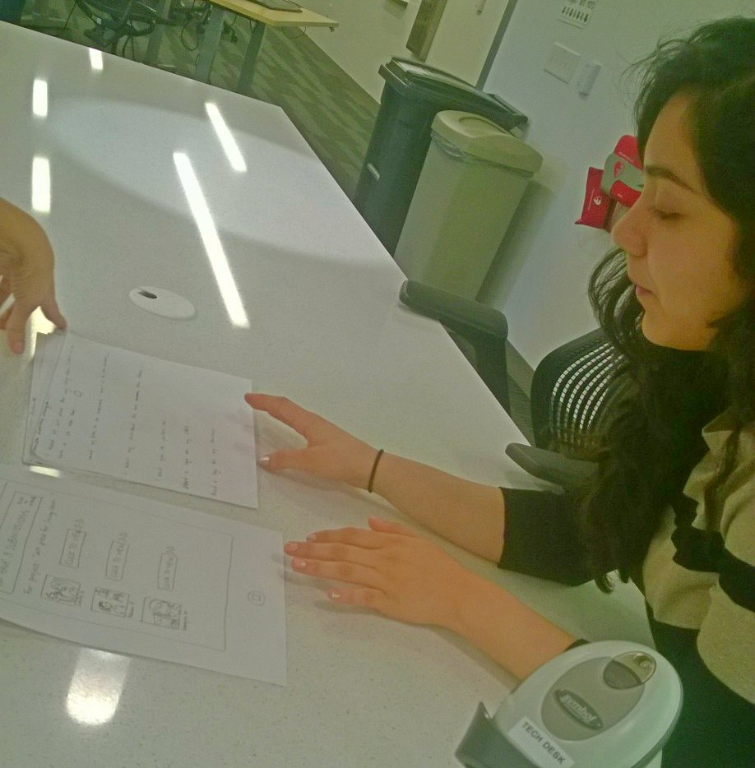
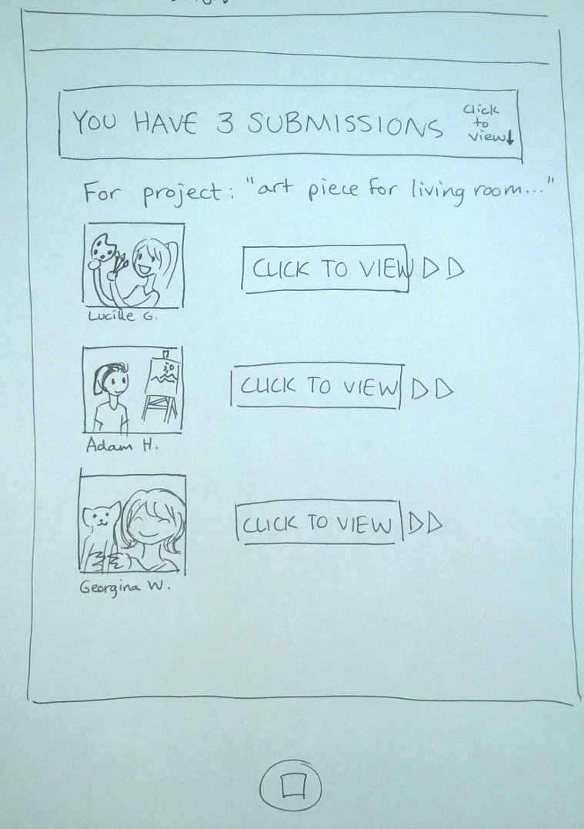
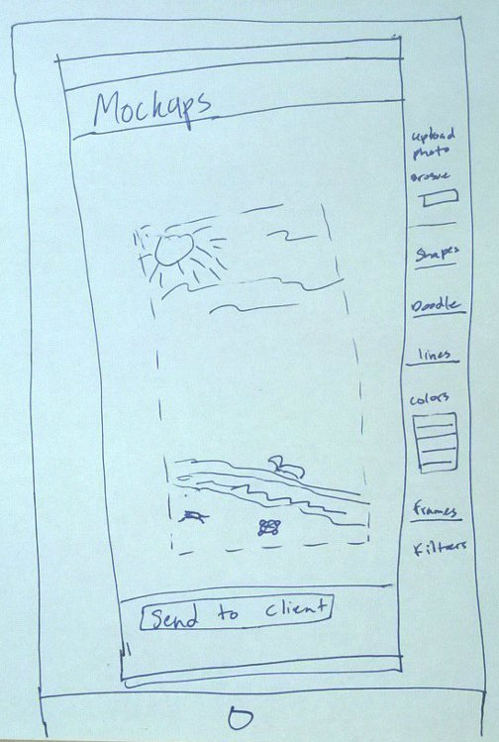
Prototype 2: Commissioning

Slide 11
Feedback Experience Prototype 2
For artist: Have clients tag their requests so they can be filtered by type (painting? digital art? ceramic? etc)
For client: Change it so the client can see all of their artist mock-ups at once and compare in the same window

Slide 12
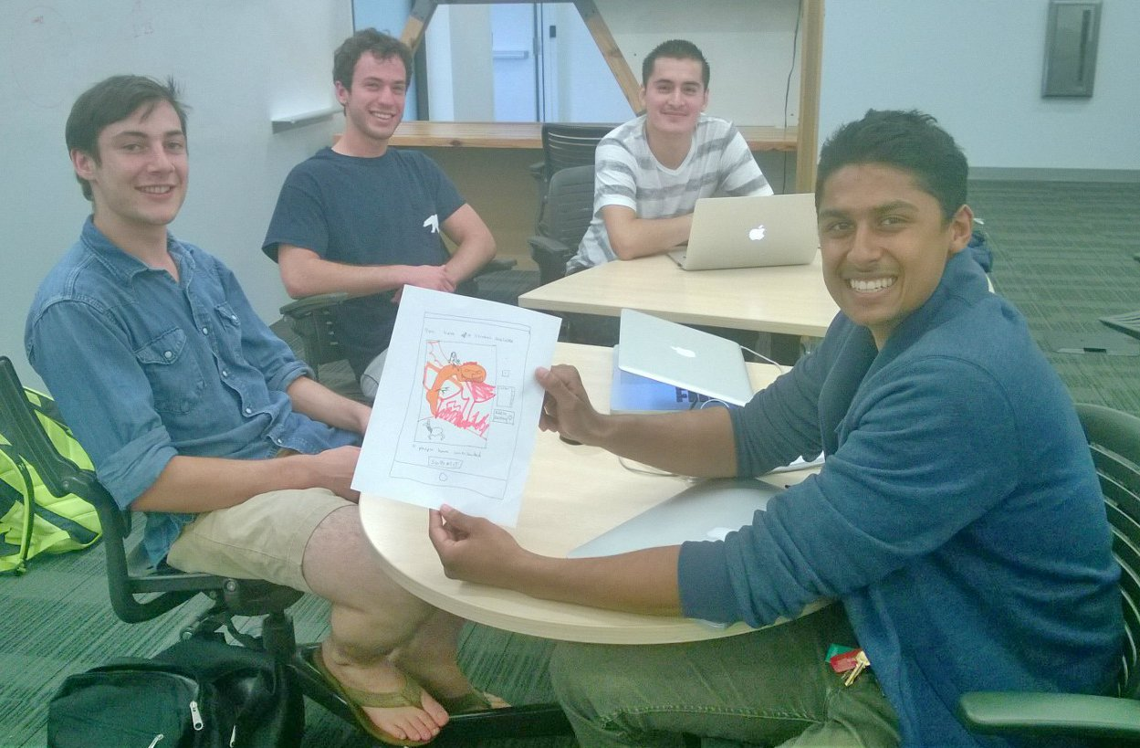
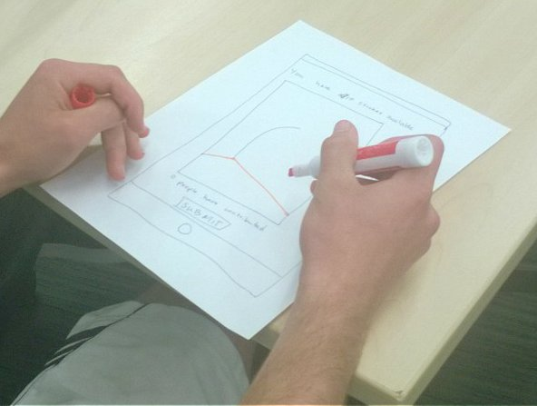
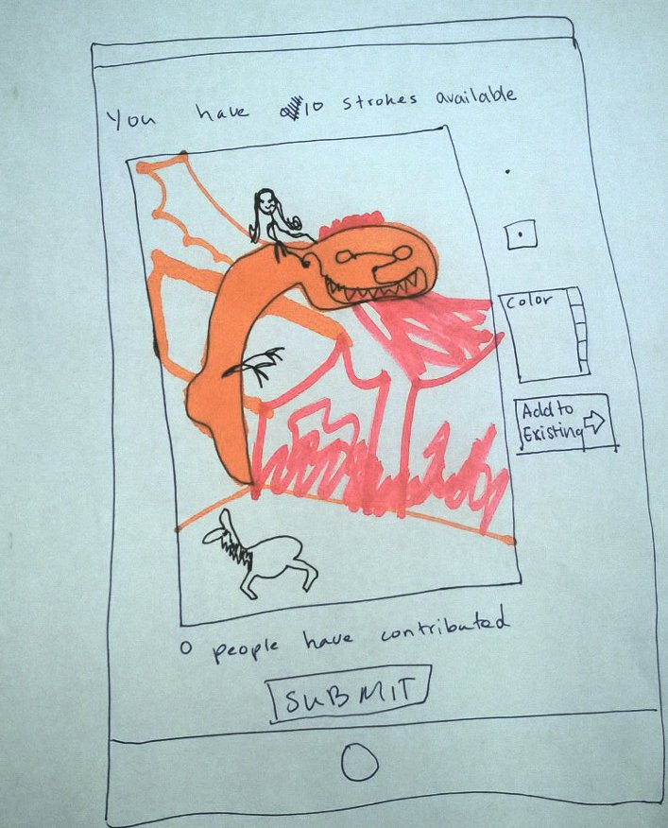
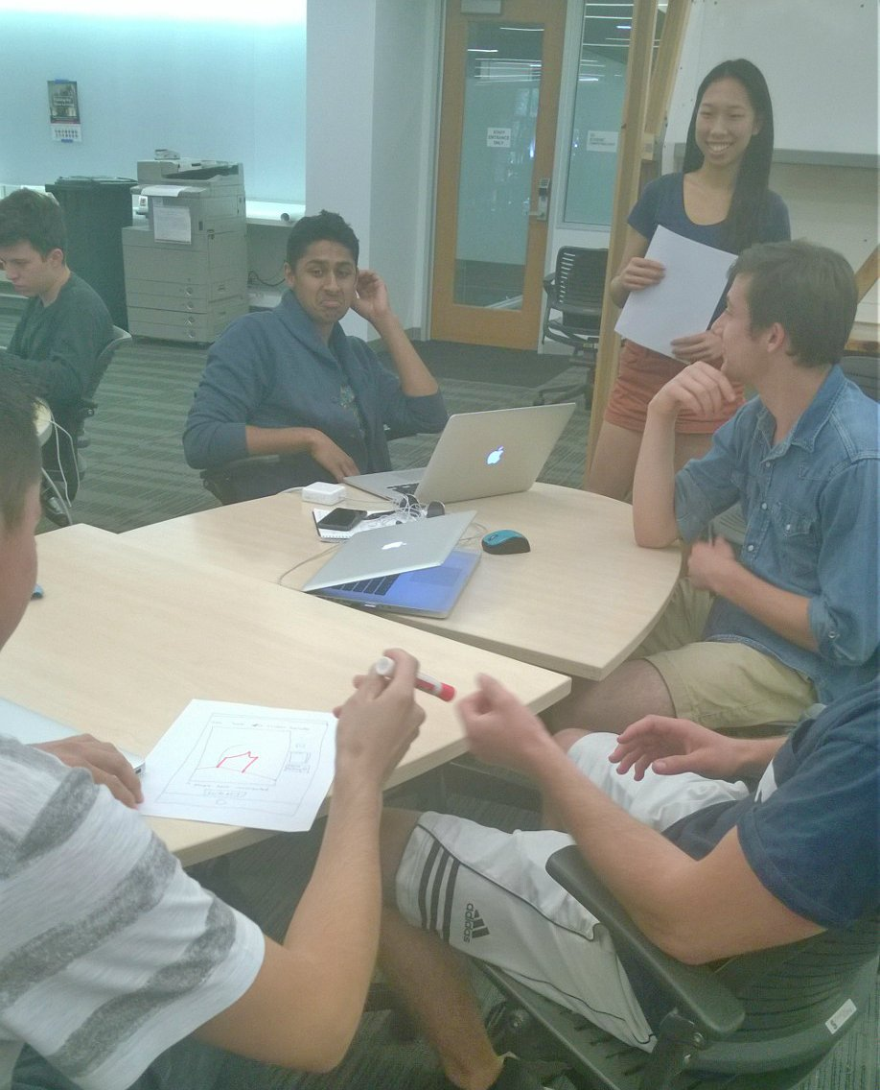
Prototype 3: 10 Lines

Slide 13
Feedback Experience Prototype 3
Had starting context (“There’s a CS career fair today”), but didn’t know what they were making collectively at first
Started to see their drawing developing into something
“This is really fun”
We should add a chat feature
“This is going to be in a class presentation, I’ll keep it not perverted then”
Need to censor

Slide 14
Conclusion
10 Lines?
A game where you can be an artist without being judged :)

Slide 15
Questions & Feedback
?

