Slide 1
Creation Studio: Branding
Selina Her • Nyasha Smith • Ben-Han Sung • Sarah Wymer

Slide 2
Problem Domain: Brand Creation
What is a brand? Is it important?
How do artists differentiate themselves?
How do artists establish themselves?
And more...

Slide 3

Needfinding: Joyce
  Who
    Product Design student at CCA, Oakland
  Why
    No established brand
  Where
    Facetime
  What
    Branding education
    Applied situations

Slide 4


Needfinding: Jane
  Who
    Branding agency employee
    1185 Design
  Why
    Knowledge of branding
process
  Where
    Philz Coffee, Palo Alto
  What
    What do clients want?

Slide 5


Needfinding: Emile
  Who
    Owner of Dogpatch Films, SF
  Why
    Established professional
  Where
    Phone
  What
    Worries about working in this field?

Slide 6


Needfinding: Nadine
  Who
    Independent photographer
  Why
    Professional
  Where
    Cafe Venetia, Palo Alto
  What
    What was your first break?

Slide 7
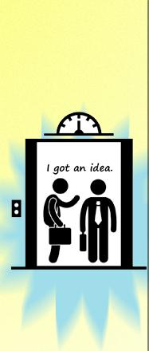
Results: Joyce
  Shaky elevator pitch
  Distance yourself from your work
  Contradiction between words + actions
    Avoided “show me” questions
  “My job as a design is to visually communicate. It’s up to the other person whether I’m someone they would want to hire.”

Slide 8
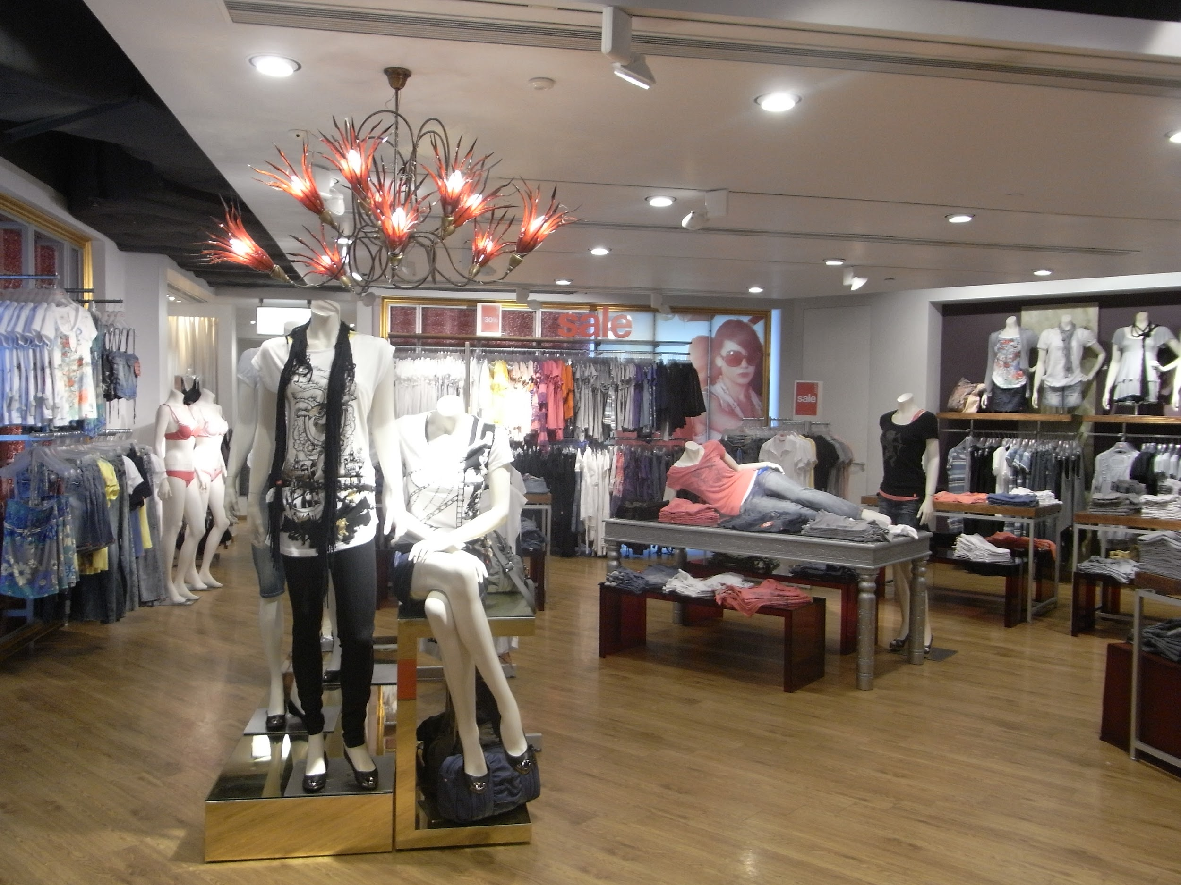
Results: Jane
  Why clients hire agencies
  Anecdote: clothing store
    “They couldn’t decide on a direction. Bad branding is inconsistency”
  Potential targets, not just current
  “I was hired because I emailed her and they had a spot open.”

Slide 9

Results: Emile
  Only online presence is website
  Mostly employed word-of-mouth networking
  Prioritizes content over audience

Slide 10

Results: Nadine
  Emphasized good customer experience over visual artistry
  Fear of technology?
    “I have a blog section that’s been ‘coming soon’ for a while...I’m not part of the digital generation”
  Marketing is hard
    “How do you put a price on your work?”
Notes:
Interesting tidbit: She has a perfect 5-star Yelp review.
“I’m a designer, editor, accountant...I spend the least amount of my time with my camera”
“I have a blog section that’s been ‘coming soon’ for a while...I’m not part of the digital generation”
“How do you put a price on your work?”

Slide 11
Empathy Map: Say
“Focus on creating content over audience development”
“It’s intimidating trying to convince people to invest in you. If someone doesn’t like you it’s a blow to your ego.”
“It’s up to the other person whether I’m someone they would want to hire.”
“You have to network.”
“Branding is about projecting into the future, not staying with your current demographic.”
“My goal as artist is to learn and grow.”

Slide 12
Empathy Map: Say (cont.)
“I spend the least amount of time with my camera.”
“[My blog] has been ‘coming soon’ for a while now.”
“Separating the personal from the business was pretty difficult for me.”
“Maybe ‘photographer’ isn’t the right word. I feel like I’m a editor, designer, accountant, all of those things.”
“I’m not part of the digital generation.”

Slide 13
Empathy Map: Do
Joyce avoided answering directly when asked to pitch herself.
Joyce appeared embarrassed when acknowledging the lack of personal branding.
Joyce seemed eager to discuss “textbook knowledge” but shied away from experience and practical knowledge.
Emile declined to discuss himself, making distinction between company identity from personal identity.
Jane emphasized being ready in addition to being lucky

Slide 14
Empathy Map: Do (cont.)
Nadine seemed a bit uncertain about the meaning of branding. She gave three definitions before settling on “user experience.”
Nadine gave a helpless shrug when discussing the need to earn $$$
Nadine got emotional about her work (i.e. tearing up when talking about a photo of a dying 3 year old).
Nadine talked with her hands a lot.
Nadine kept throwing her long scarf over her shoulder.

Slide 15
Empathy Map: Think
Branding is something an artist should have.
My work will speak for itself.
Company and personal identity are very different, separate entities.
I am where I am due to luck.
Branding is a difficult task that takes more than one person to do well
You have to know yourself in order to project a consistent persona.
Presenting inconsistent personalities is bad branding
Good relationships with customers will lead to good word of mouth and more business.
Notes:
“Corporations use a branding agency because they don’t have in-house power [to do a good job] and want the whole package. An agency team can also bring in a fresh perspective on a company’s work, as an outsider.”

Slide 16
Empathy Map: Think (cont.)
Intimacy leads to better understanding, better future work opportunities.
Branding is not just about your art; it includes the practical side and business aspects.
Notes:
“Corporations use a branding agency because they don’t have in-house power [to do a good job] and want the whole package. An agency team can also bring in a fresh perspective on a company’s work, as an outsider.”

Slide 17
Empathy Map: Feel
Stressed and powerless during the job hunt
  Need to feel validated / accepted
  Defensive + Blame-Shifting
    “If you don’t get the job it's because you're not a good match."
Afraid of not showing your best - of being judged for a mediocre performance or work
Intimidated by the success of others

Slide 18
Empathy Map: Feel (cont.)
Afraid of new technologies, since current process is working out
  Change is undesirable unless the current status quo is bad
Apathetic about making a real effort at publicity and self-promotion
  Rely too much on word of mouth (only online presence is a stale website)
Frustrated at business things and other practical matters that get in the way of art

Slide 19

Common Needs
Be less passive about self promotion
Feel more in control over success/job hunt
Better express their thoughts to others
Effectively deal with business + practical sides of their work
Notes:
Do we want to reduce these two like two or three points, which we can back up with quotes?

Slide 20

Insights
Theory + application disconnect
Non-transitive creative skills
Mutually exclusive personal/business identities
Belief that work speaks for the artist
Difficulty of judging work value; leaving judgment to others

Slide 21
moving forward...

Slide 22
How might we…
encourage artists to confidently take an active role in self-promotion?
Notes:
Artists seem to feel like success is mostly the result of luck, which makes them apathetic or frozen about branding and publicity even though they acknowledge its importance.

