Slide 1


Slide 2



MISSION & VALUE
PROTOTYPE & TASK FLOW
EXPERIMENT

Slide 3
Time Well Spent.
Phocus helps individuals and groups spend their times without the distraction of electronic devices.
We achieve this through a platform where people share their focusing successes and failures.

Slide 4
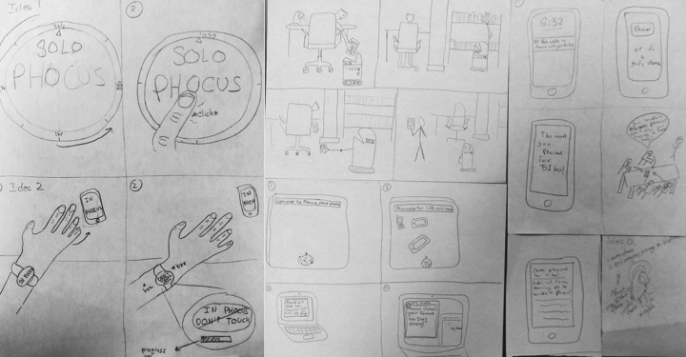
Sketches!

Slide 5
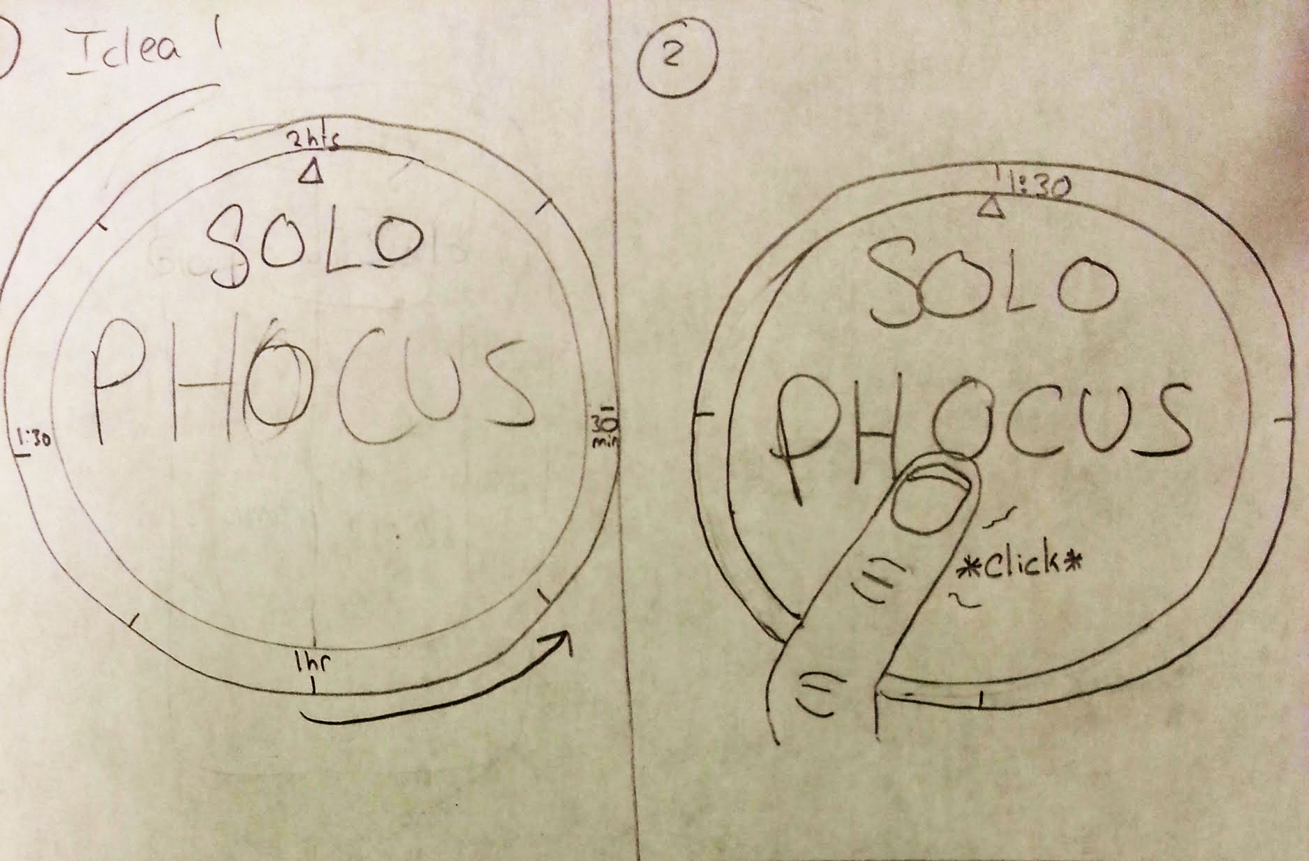

Sketches!
Notes:
the Phocus Button would serve as a combination of egg timer and the Easy button that would be synced to the user’s phone. It would allow individuals to set a Phocus time and start their session at the same time in a visually appealing way.

Slide 6
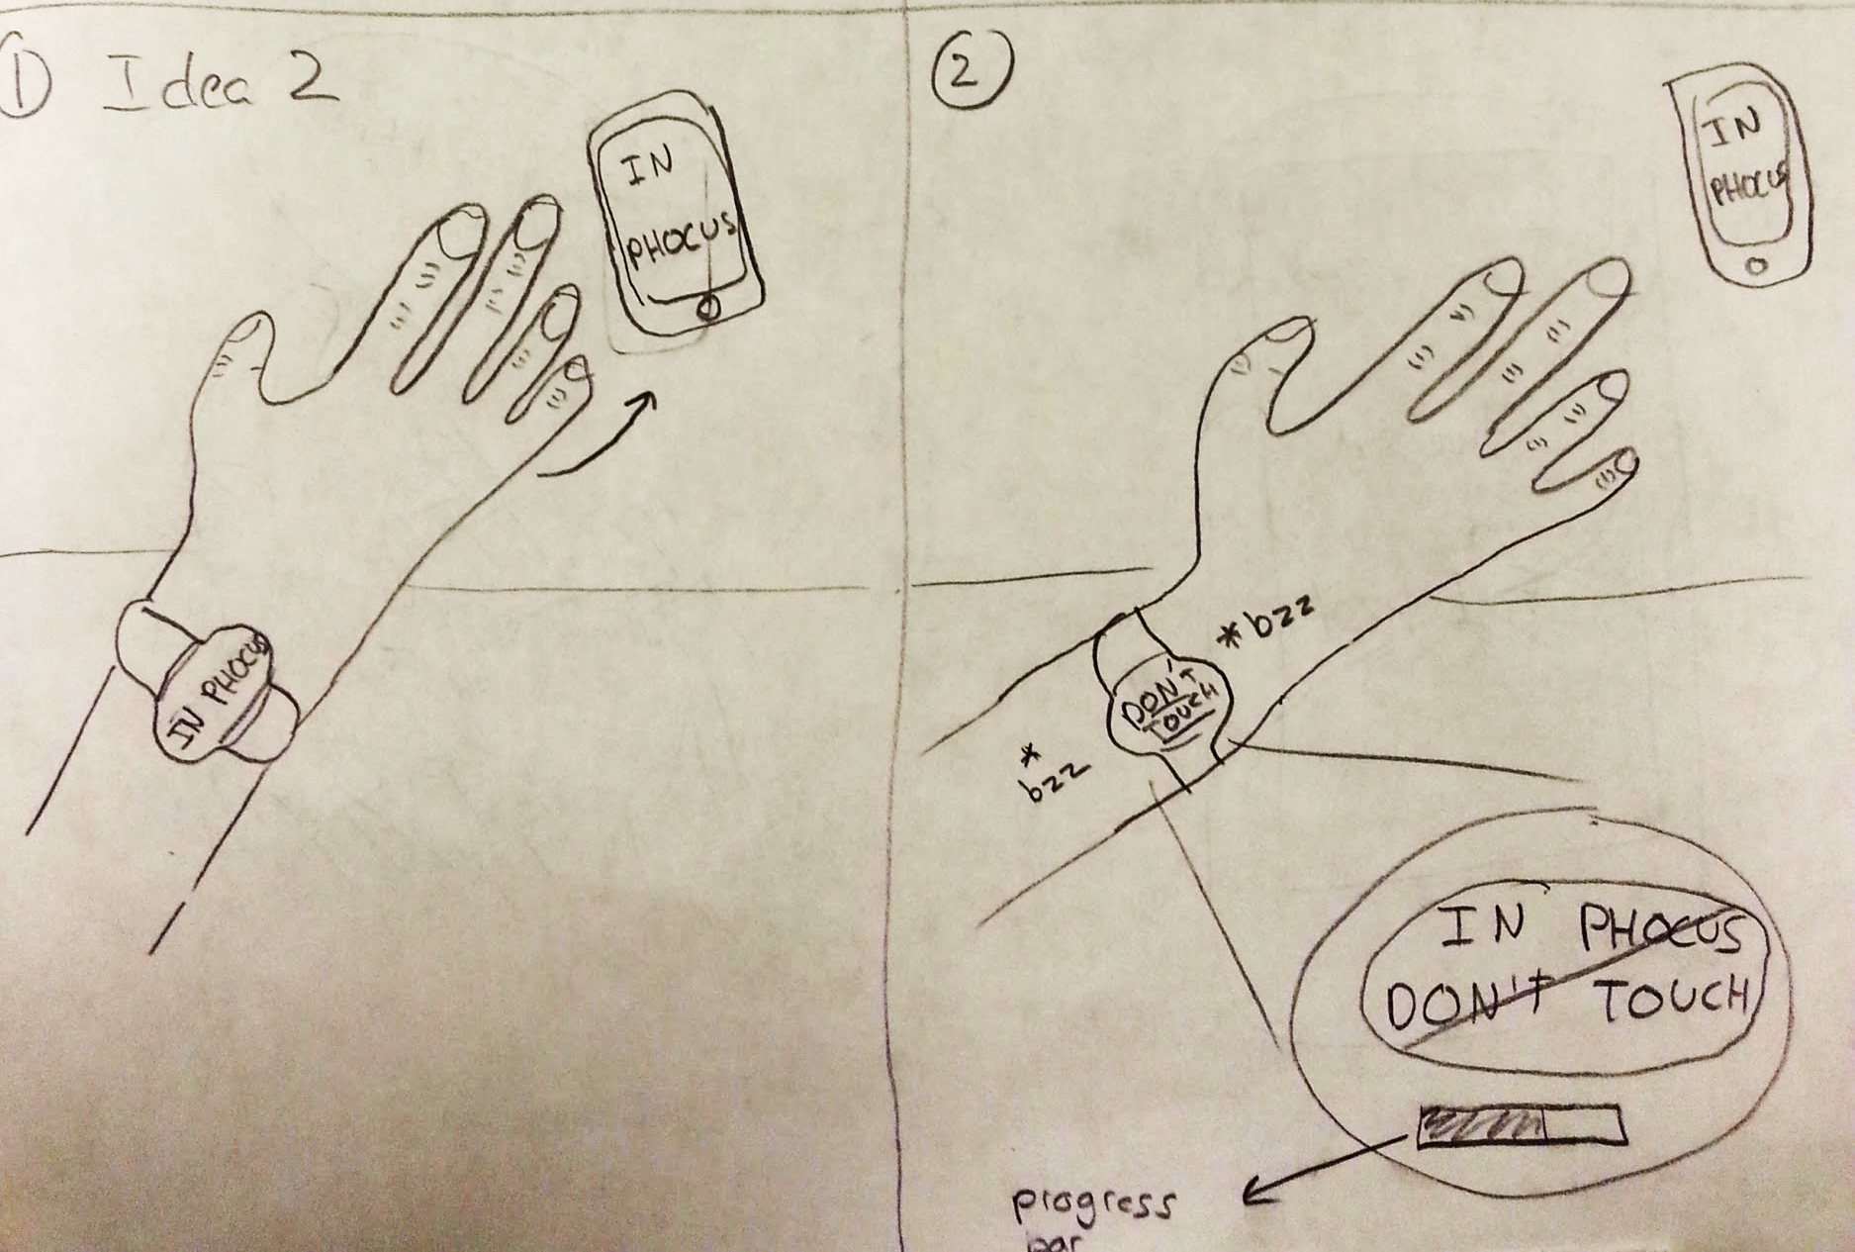

Sketches!
Notes:
Phocus Watch would have a button in the middle of its screen. If the user clicks it, a focus session will be created and the phone will be muted. If the Phocus Watch approaches the phone any time during the focus session, the Watch will vibrate on the user’s wrist and warn the user not to use the phone.

Slide 7
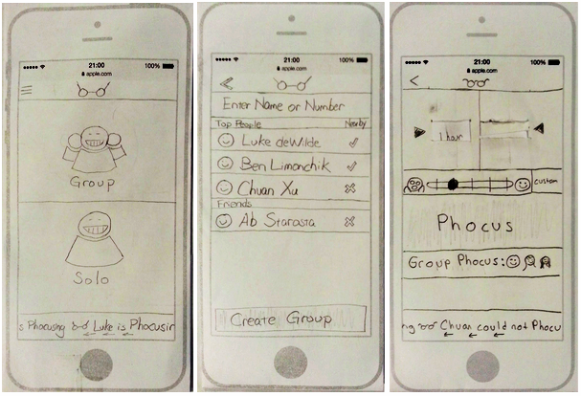
Selected Interface
Adoption

Slide 8
Selected Interface
Adoption
Ease of Use

Slide 9
Selected Interface
Adoption
Ease of Use
Social
Notes:
We were very excited for the originality and simplicity of the Phocus Watch and the Phocus Button. However, given that both the Watch and the Button had very few functions beyond making users focus, user adoption may be problematic. A mobile app, in contrast, is easier to adopt.
Secondly, we believe that the Phocus App is easier to use. For the Watch and the Button, the user has to set up the hardware by connecting it with the phone. Making this connection takes time and knowledge that the Phocus App does not require.
Thirdly, the Phocus mobile app enables users to take pictures and videos of other who have failed to focus. The Watch and the Button do not have such functionalities. Since socialization is a critical component of our product concept, we believe the Phocus app is a better medium.

Slide 11
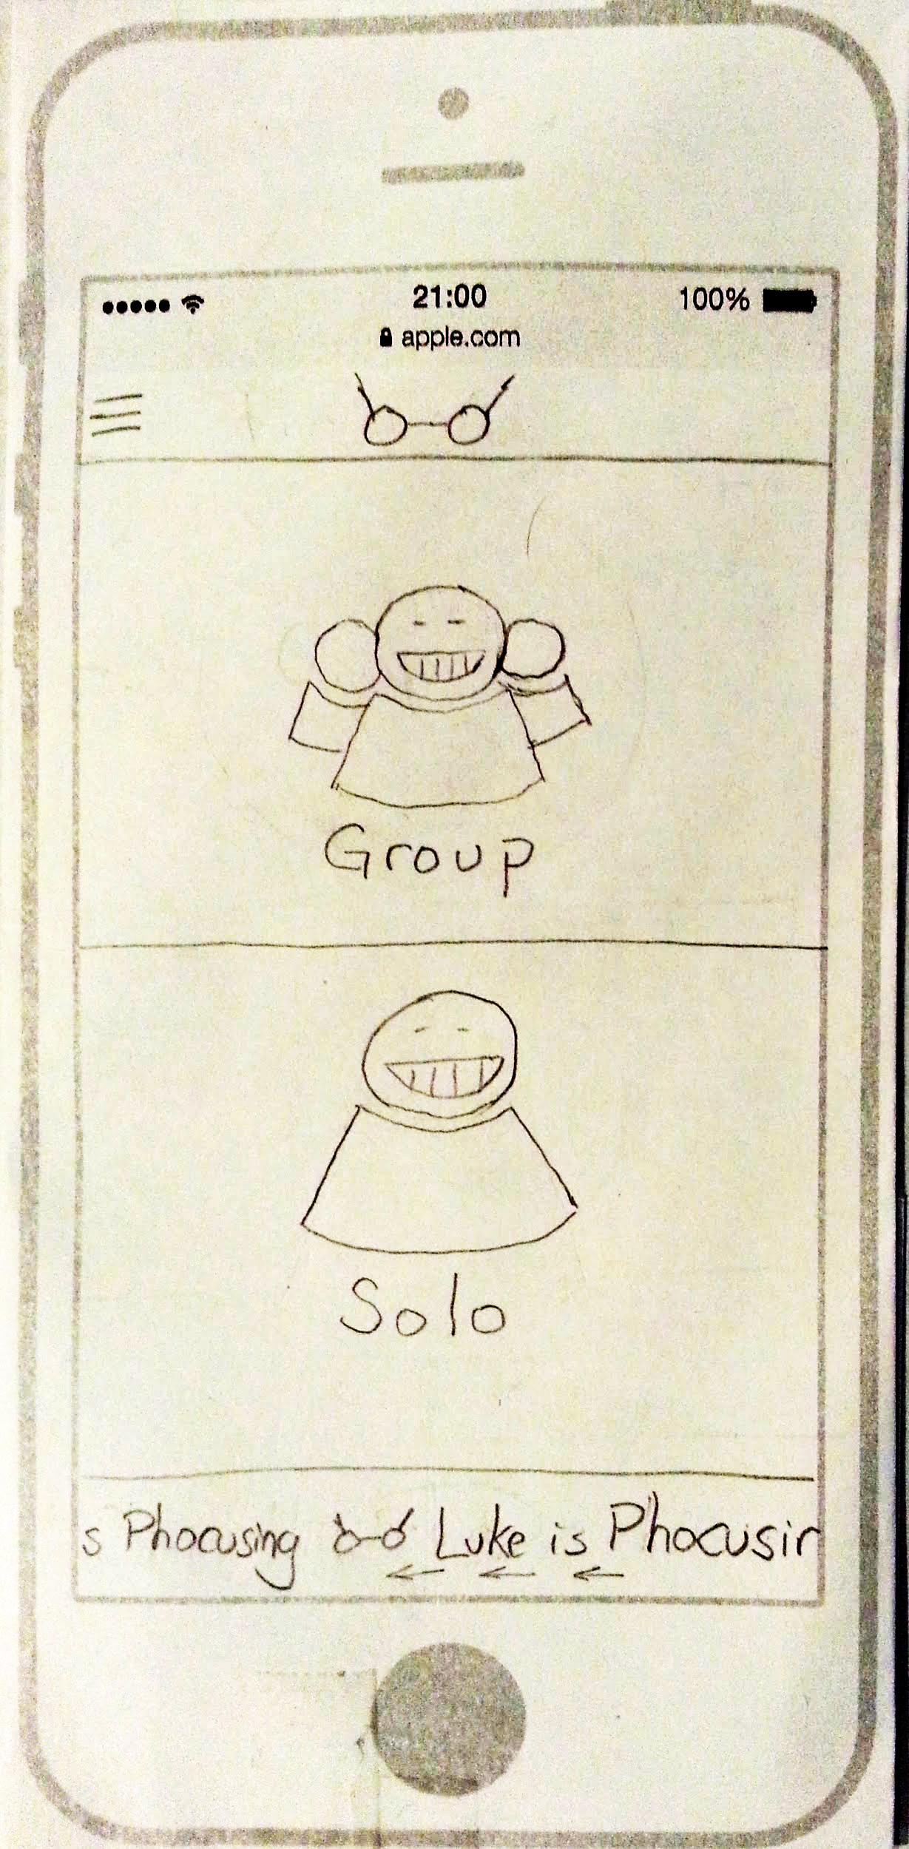
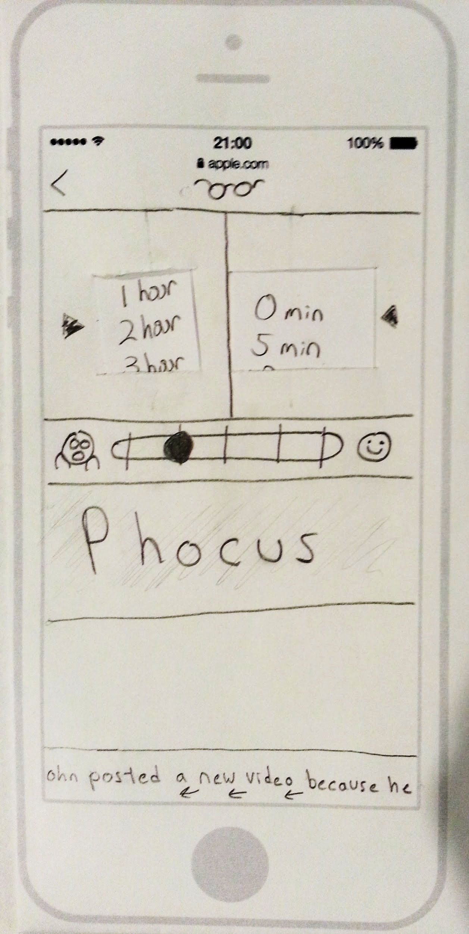
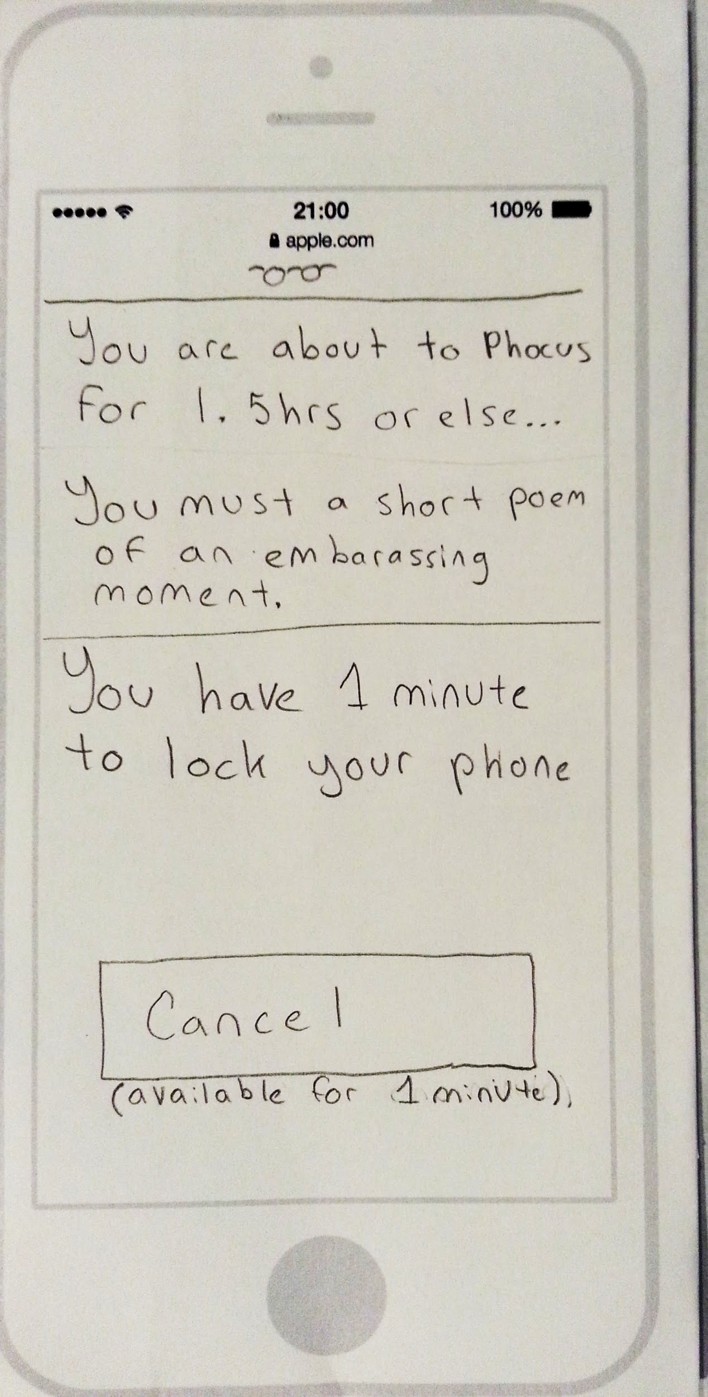
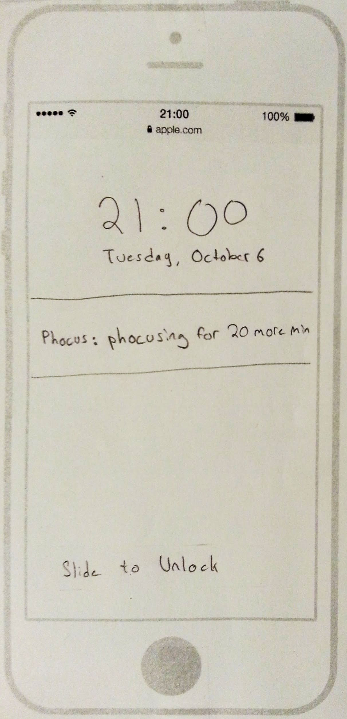
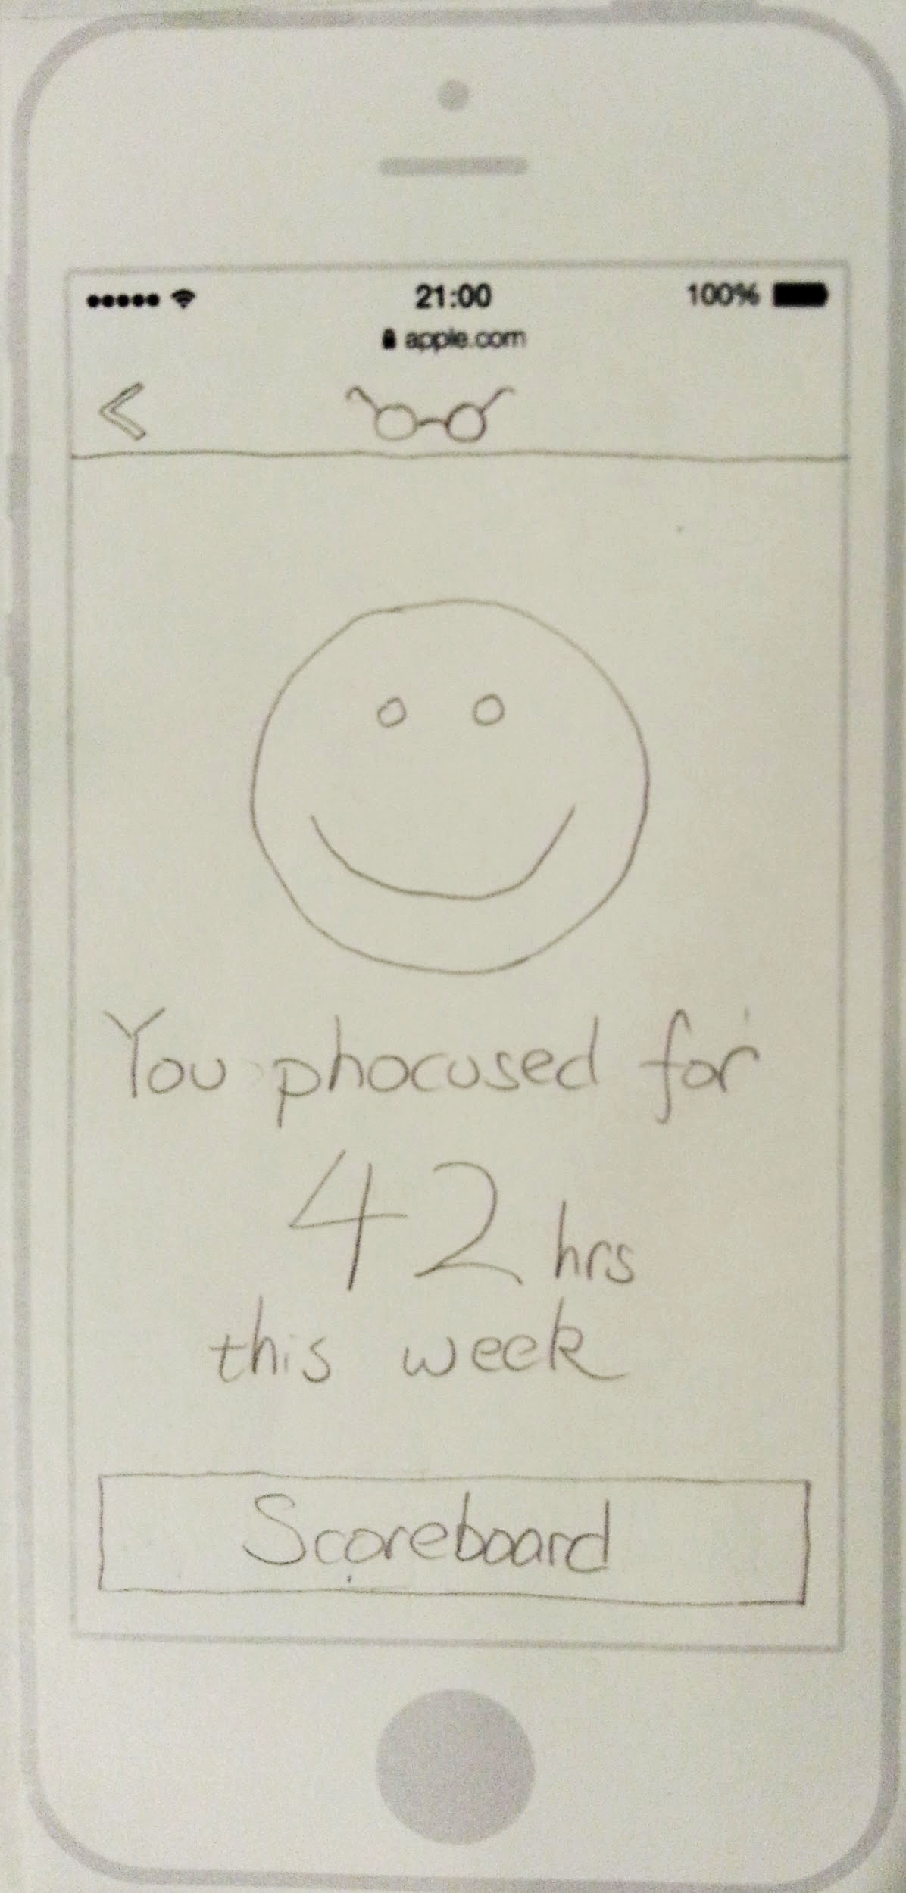
Task 1 & Task Flow
An individual wants to focus on his or her work

Slide 12
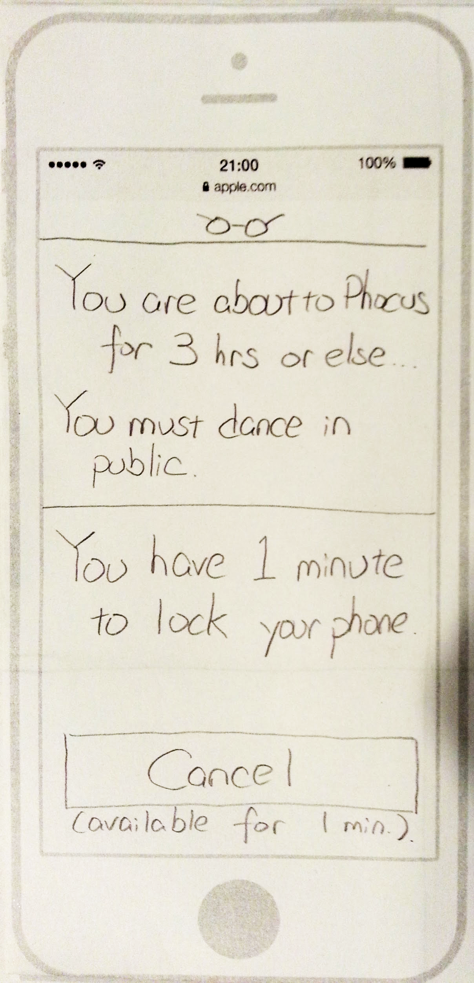
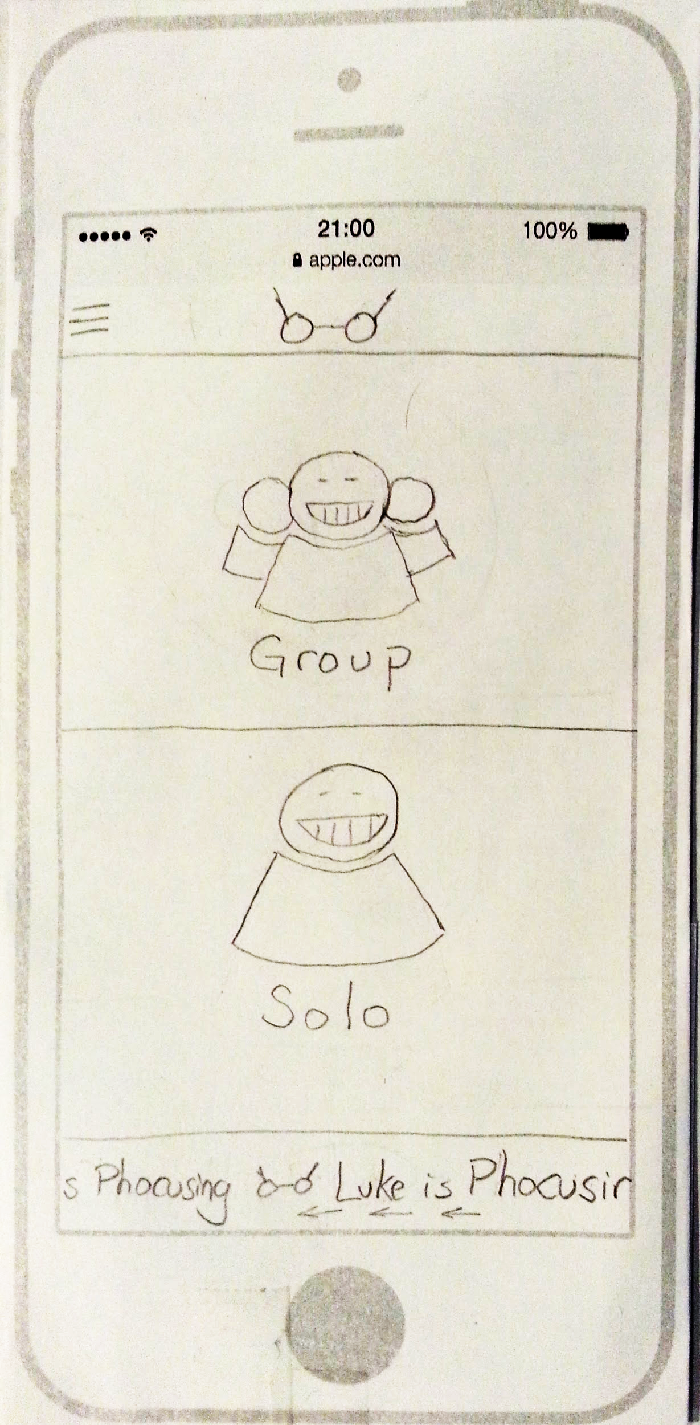
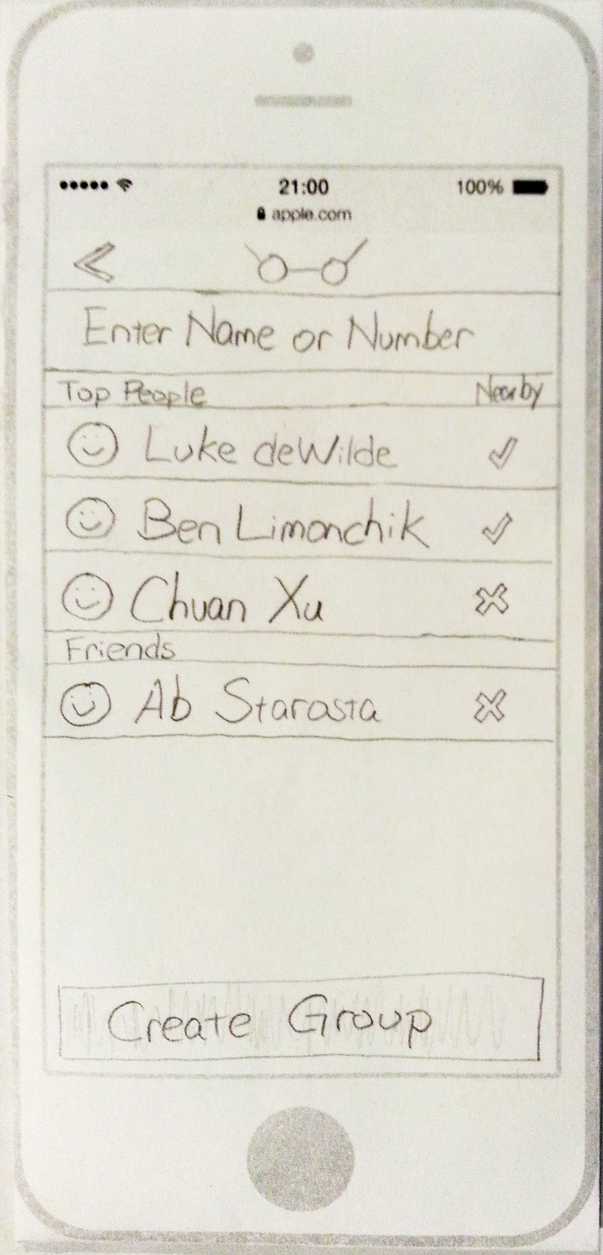
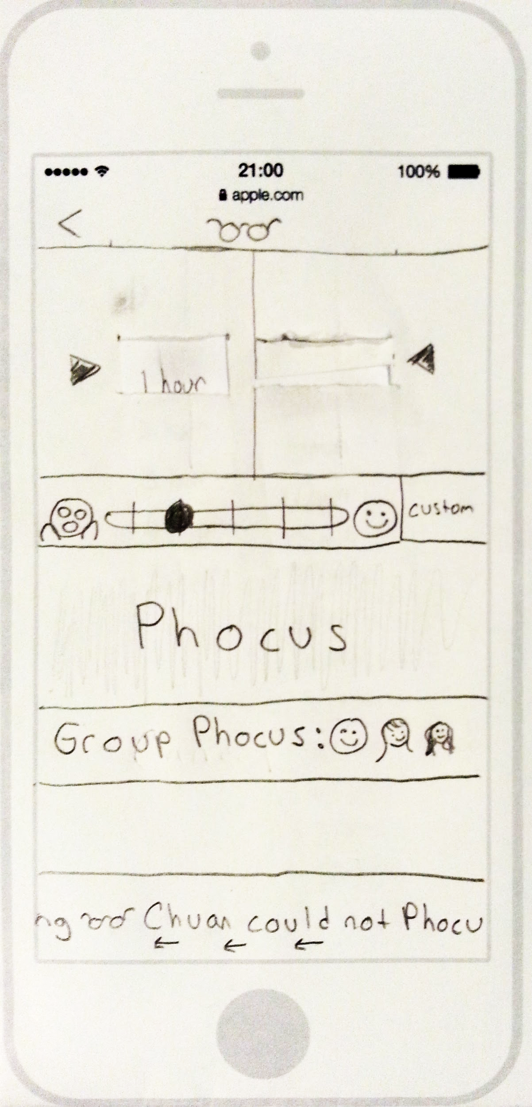
Task 2 & Task Flow
An individual wants a group to put away their phones and focus

Slide 13
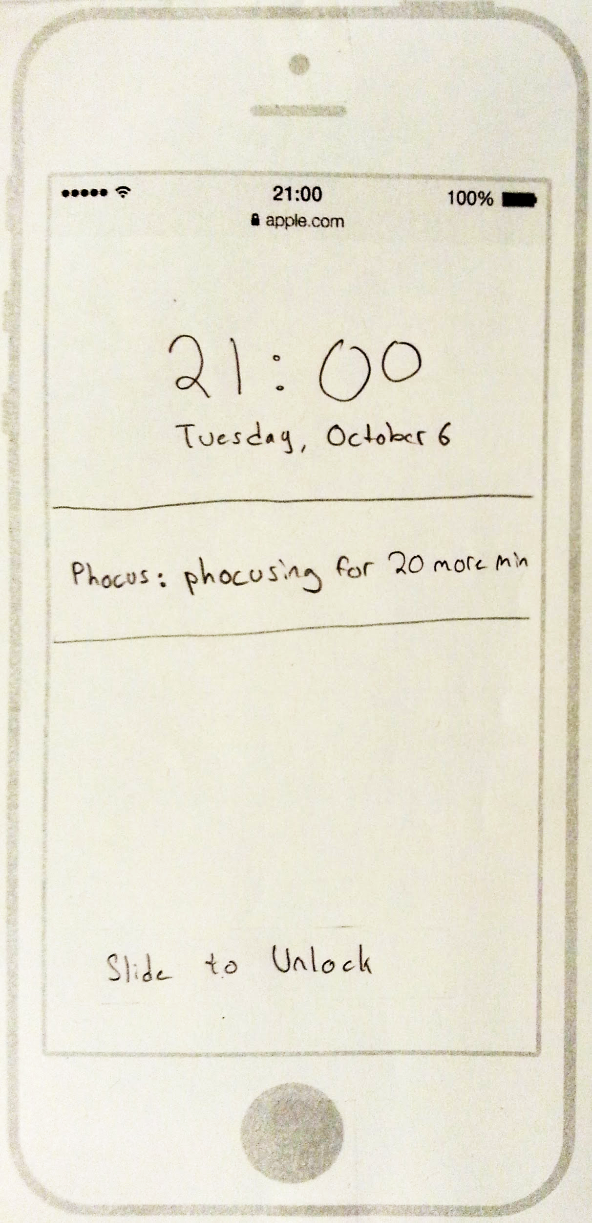
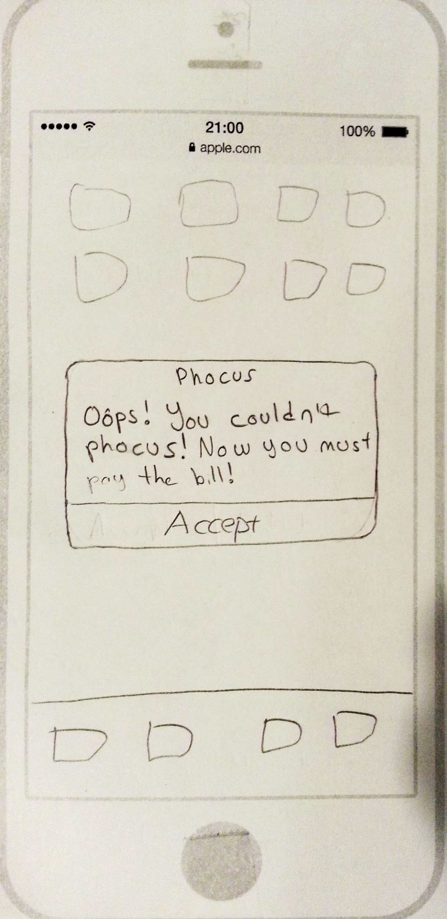
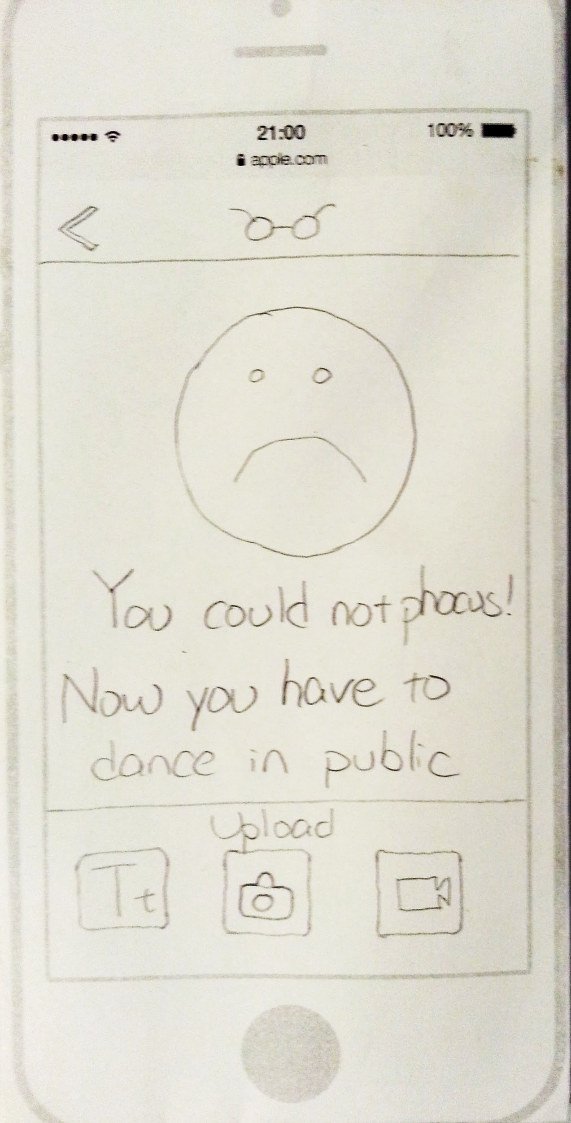
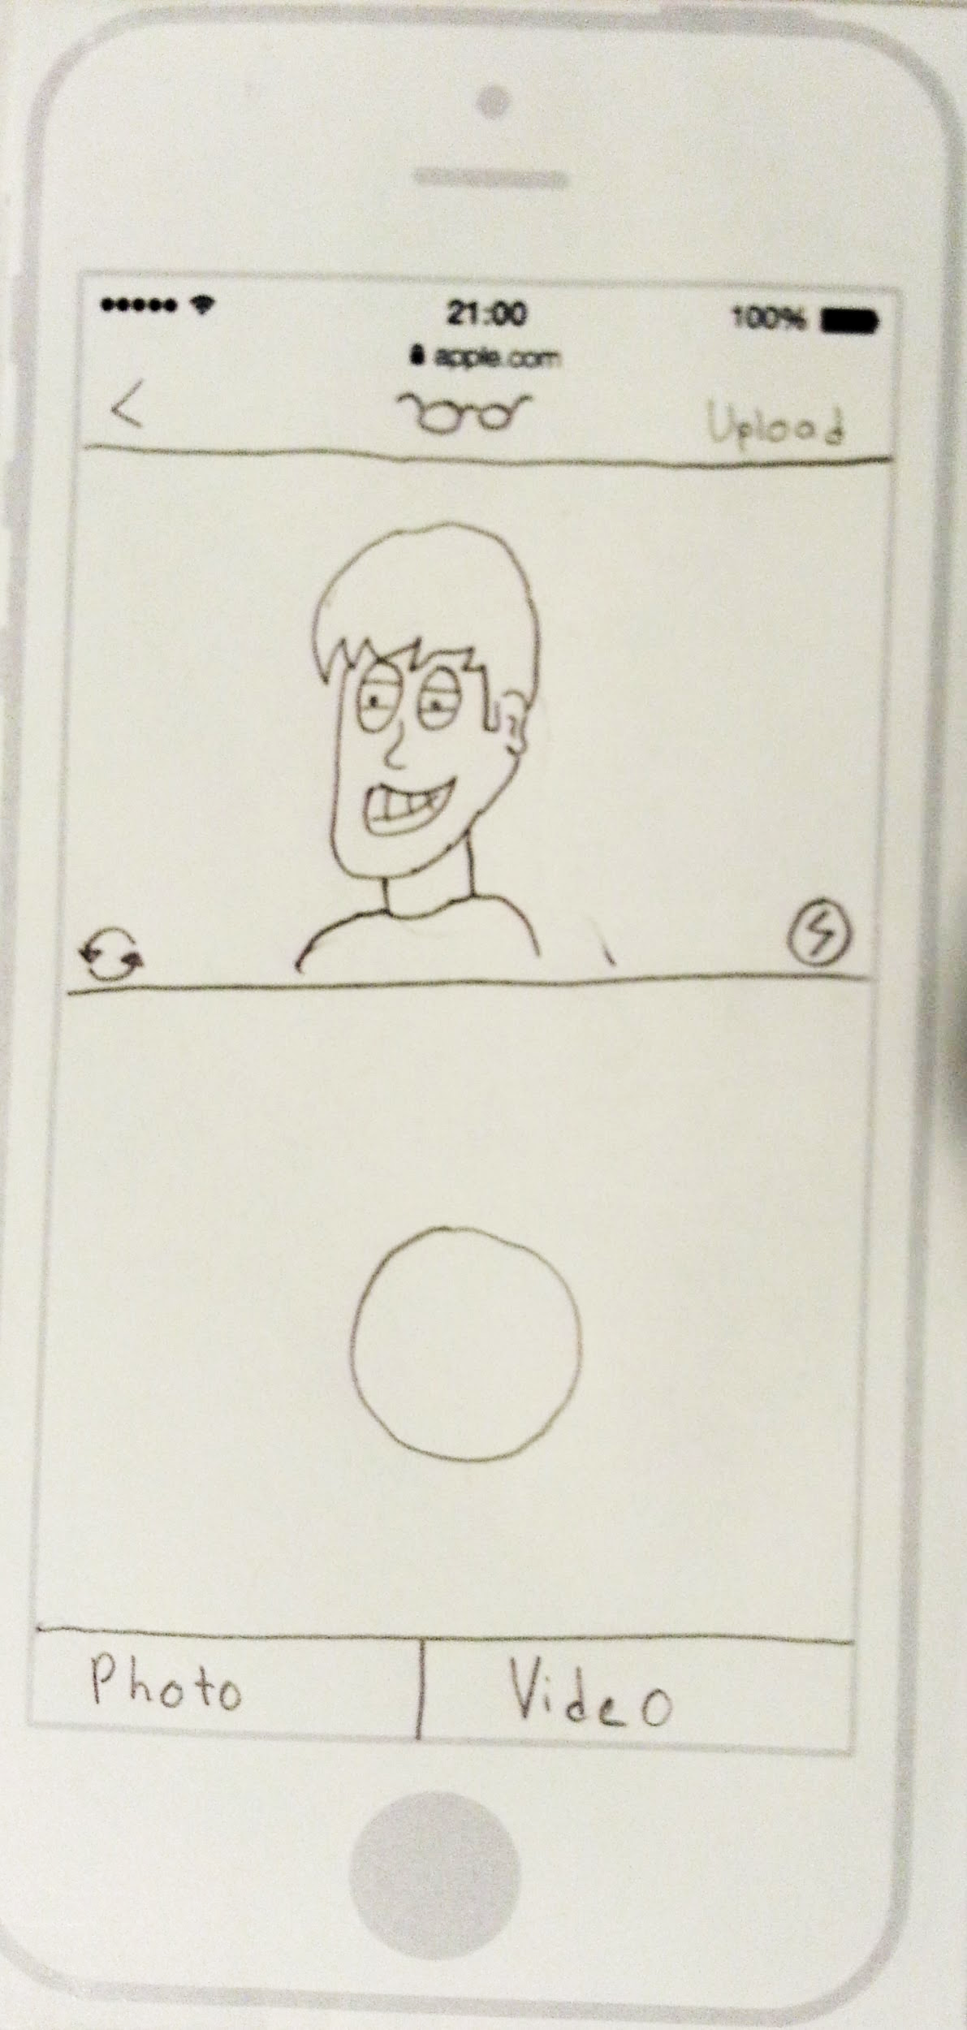
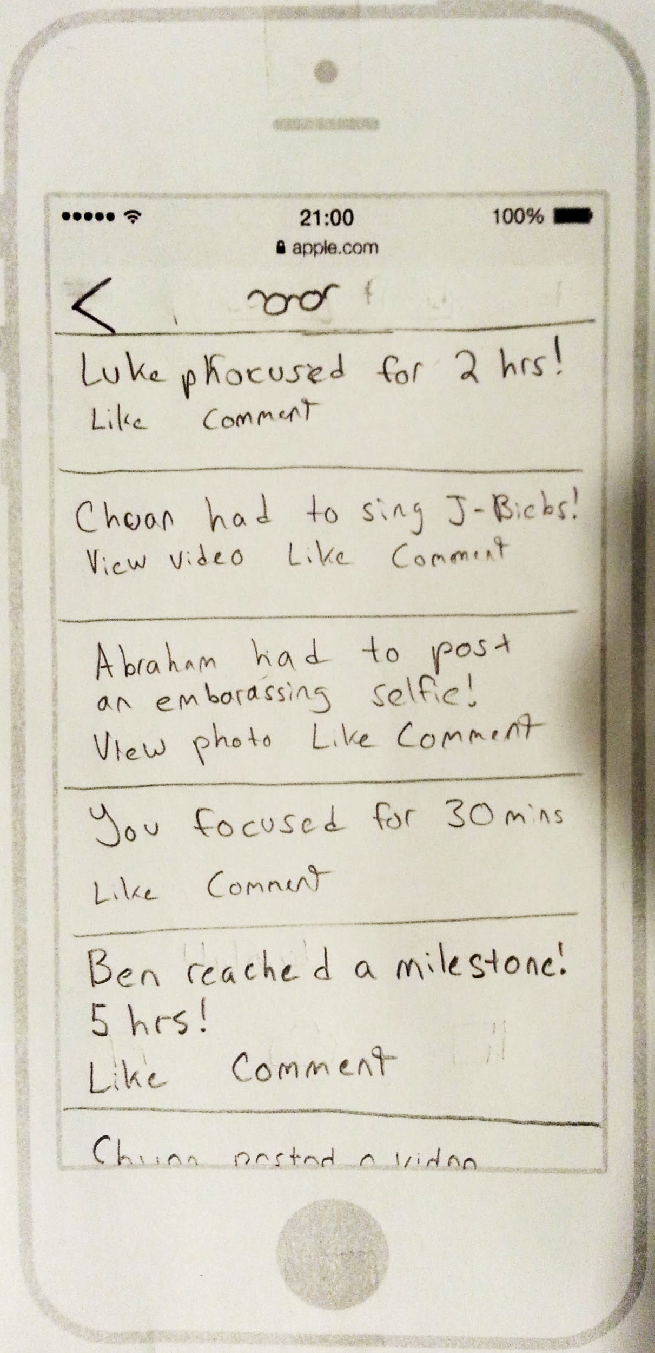
Task 3 & Task Flow
An individual fails to focus and must rise to the “dare” challenge

Slide 14
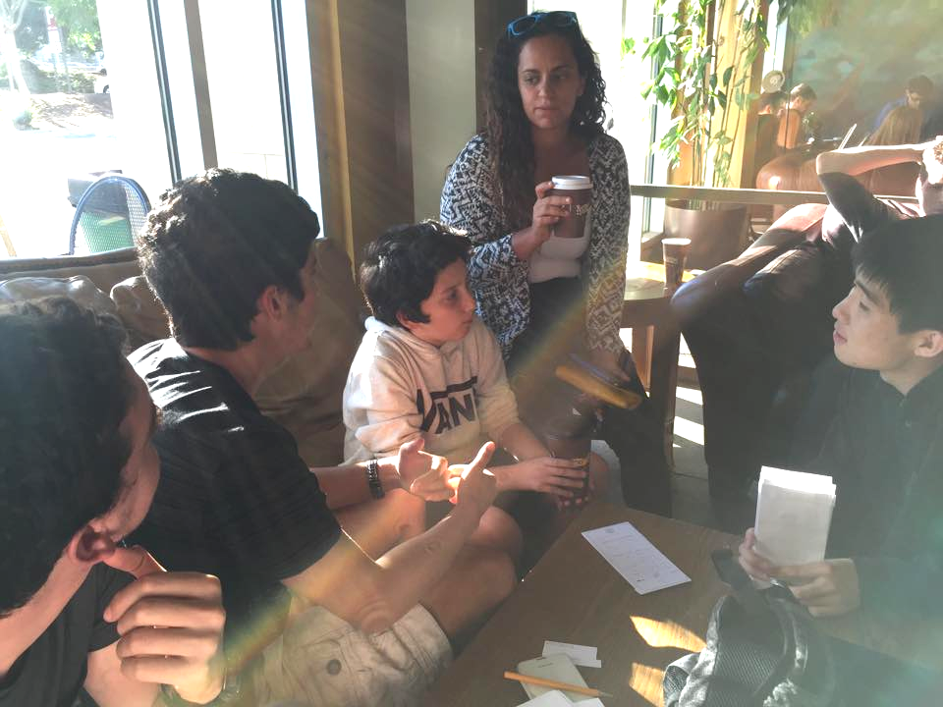
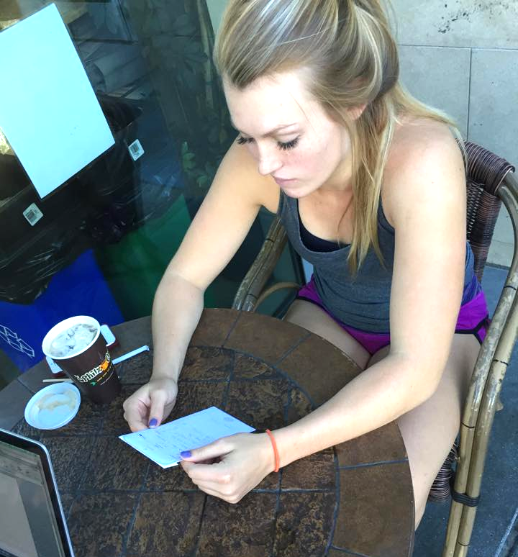
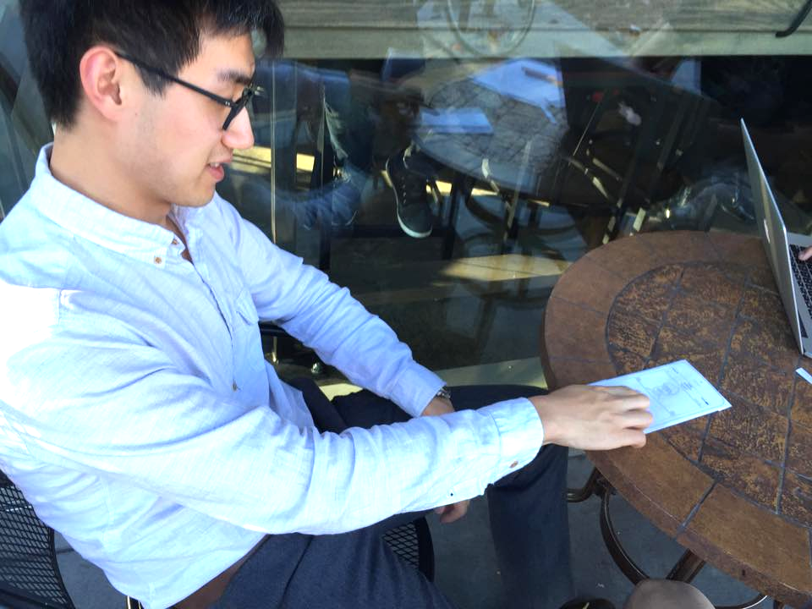
Methods
3 Interviews at Philz Coffee

Slide 15

Let the user decide.
Observe and listen.

Slide 16

Where did users get confused?
What did the users find cool?
How did users operate differently?
… …

Slide 17

We look for expressions:
Happy, Surprise, Confusion, Frustration, Curiosity...

Slide 18
Results
Generally Intuitive
Love the concept

Slide 19
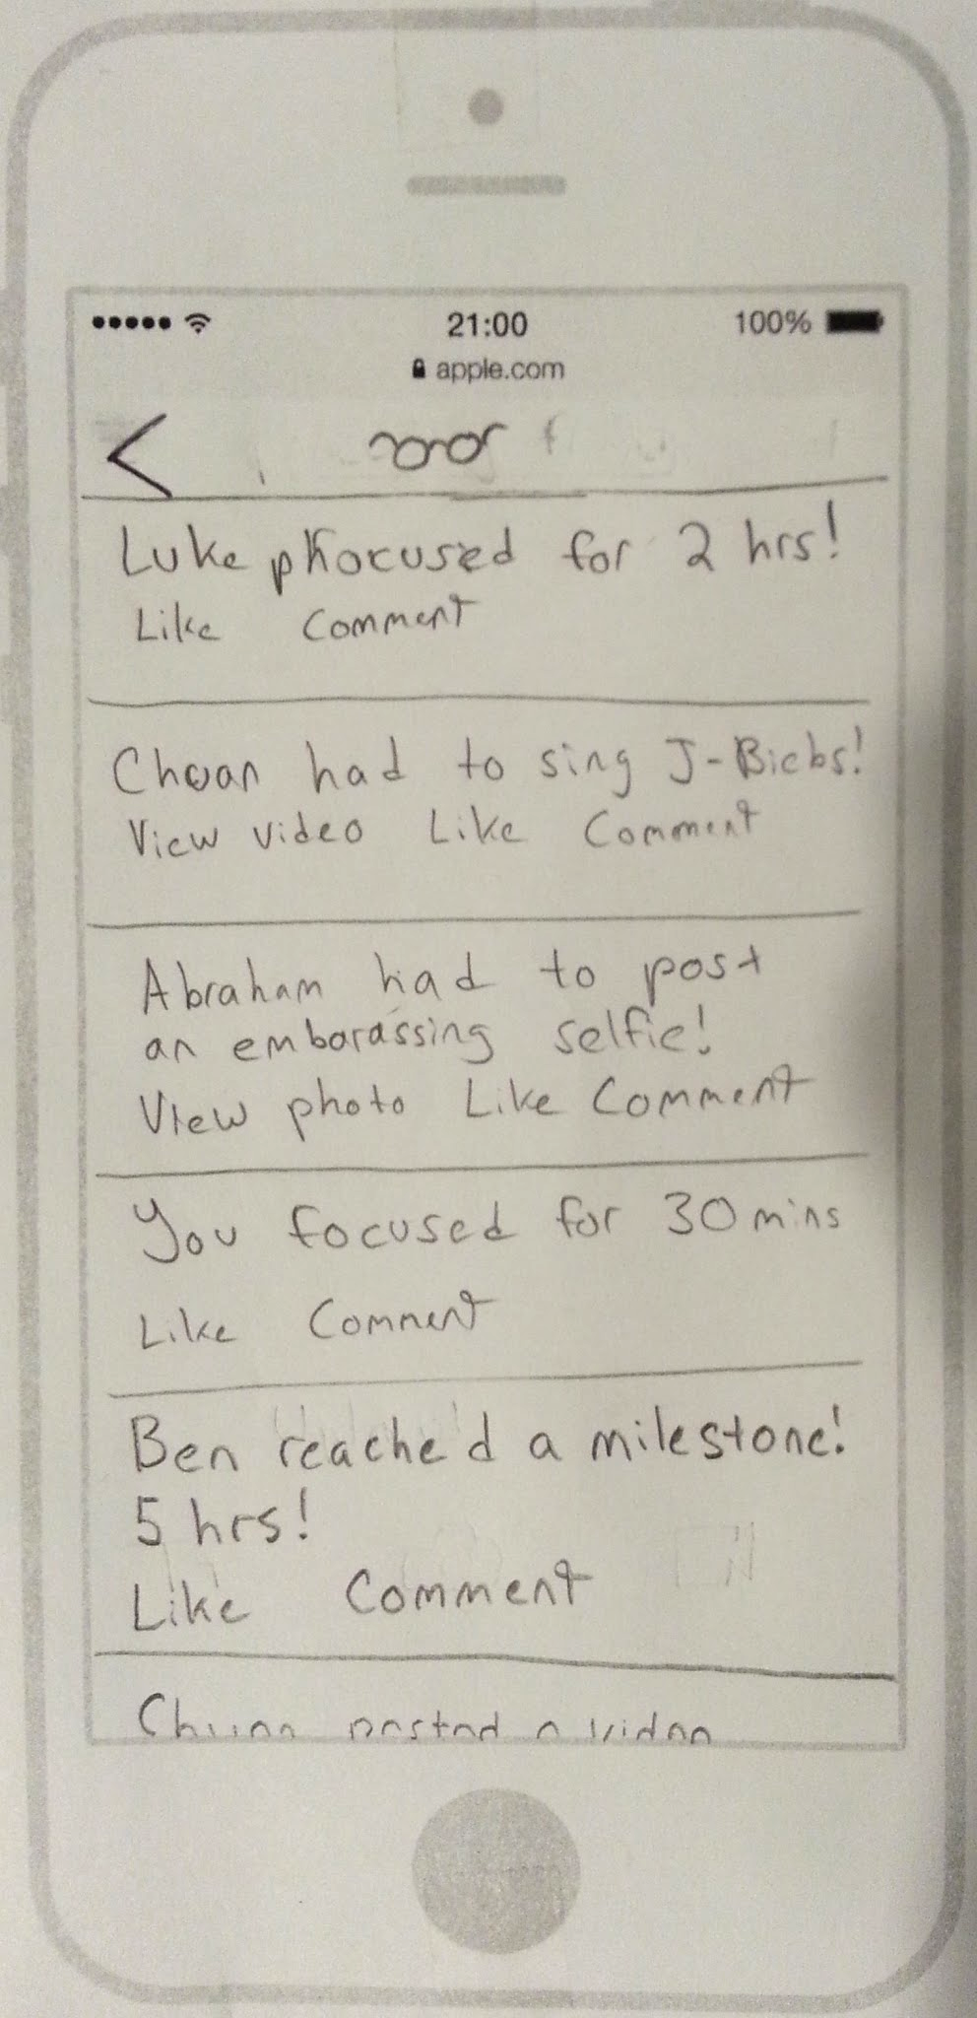
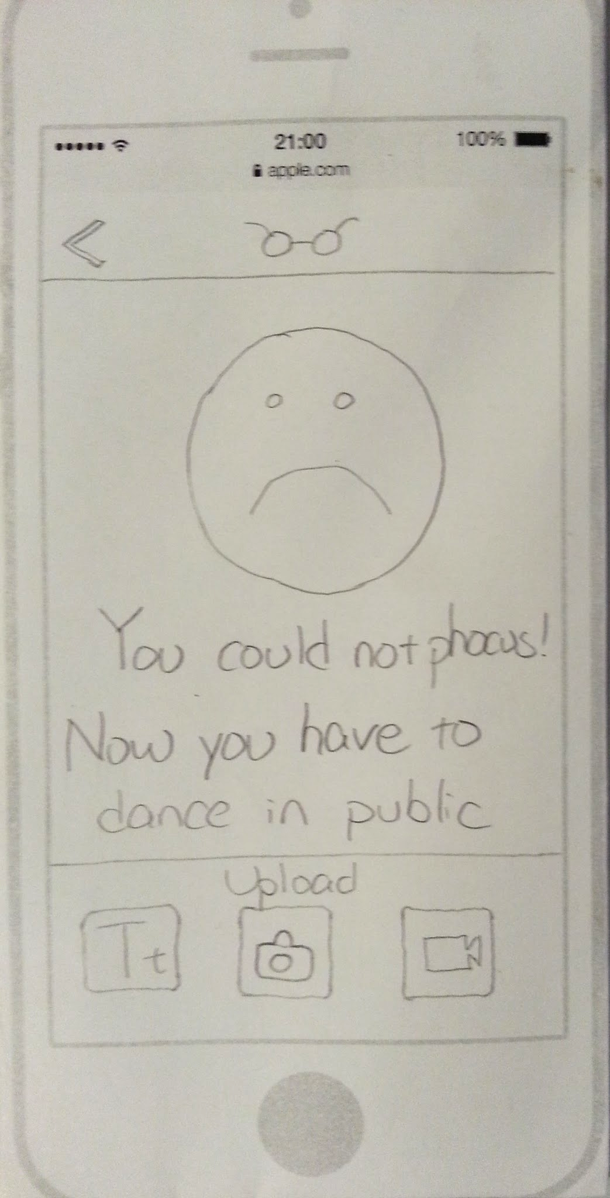
Most Popular Features

Slide 20
Results
Participant 1: I might cop-out if I fail to focus...

Slide 21
Results
Participant 1: I might cop-out if I fail to focus...
Participant 2: I might not want to do the challenge because it is not personalized

Slide 22
Results
Participant 1: I might cop-out if I fail to focus...
Participant 2: I might not want to do the challenge because it is not personalized
Participant 2/3 confused by the Phocus Settings Screen

Slide 23
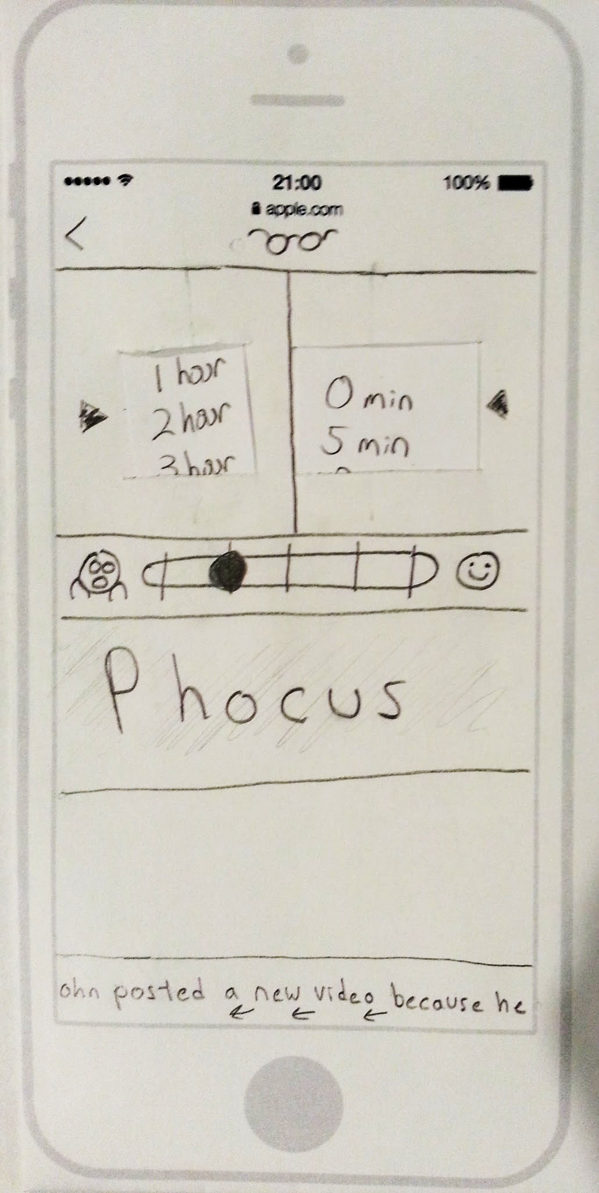
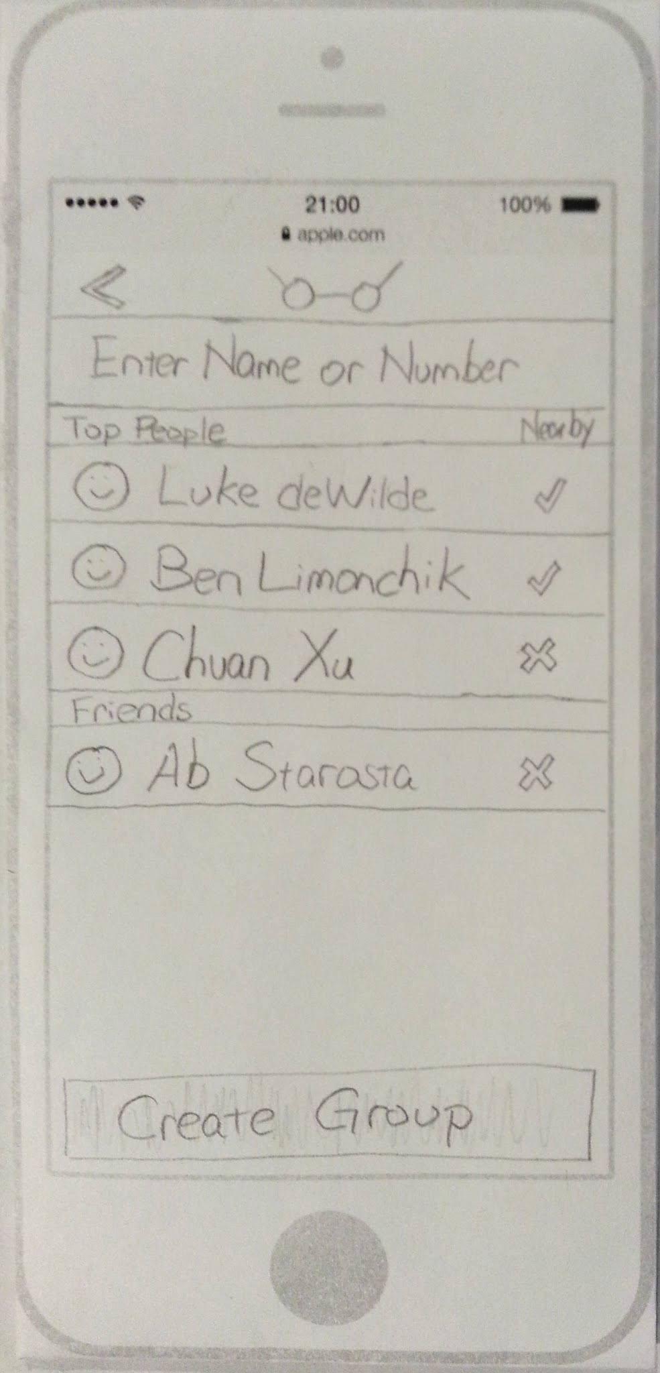
Most Confusing Screens

Slide 24
Next Step
For solo sessions, record the challenge before starting to phocus

Slide 25
Next Step
For solo sessions, record the challenge before starting to phocus
Let users suggest punishments to their friends to add a more personal component

Slide 26
Next Step
For solo sessions, record the challenge before starting to phocus
Let users suggest punishments to their friends to add a more personal component
Add colors!

Slide 27
Switch flow and re-make Phocus Settings Screen

Slide 29
Our low-fi prototype interviews confirmed our confidence in the Phocus App idea

Slide 30
Our low-fi prototype interviews confirmed our confidence in the Phocus App idea and inspired us to make three key design changes.

