Slide 1
Phocus Concept Video
Team LaserPhocus

Slide 2
Phocus - Time Well Spent.
Technology can ruin our most important moments. Phocus enables groups and individuals to be present in the moment instead of distracted by electronic devices. It achieves this by allowing people to join focus sessions and publicize their focusing endeavors.

Slide 3
Tasks
Simple: John, who is working hard, wants to concentrate without the distraction of his mobile device.
Medium: John, who is with a group of people, wants everyone to stop being distracted by their devices and focus on the conversation.
Complex: John, who has failed to focus and used his mobile device, needs to publicize his “dare” challenge to his friends.

Slide 4
Scene 1

Slide 5
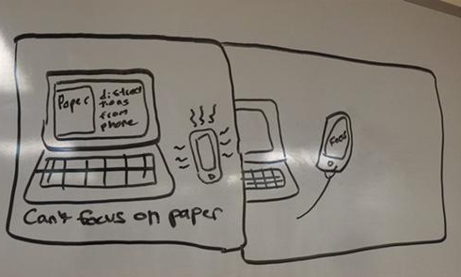
Scene 2 - Simple Task

Slide 6
Scene 3 - Medium Task

Slide 7
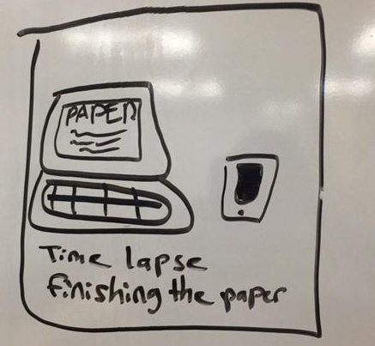
Scene 4

Slide 8
Scene 5 - Complex Task

Slide 9
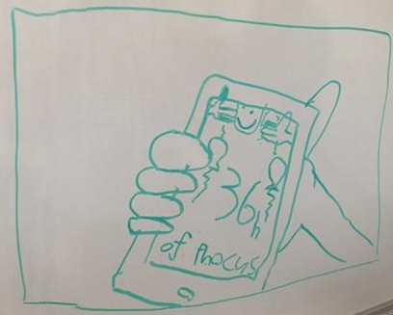
Scene 6

Slide 10
Phocus Concept Video

