Slide 1
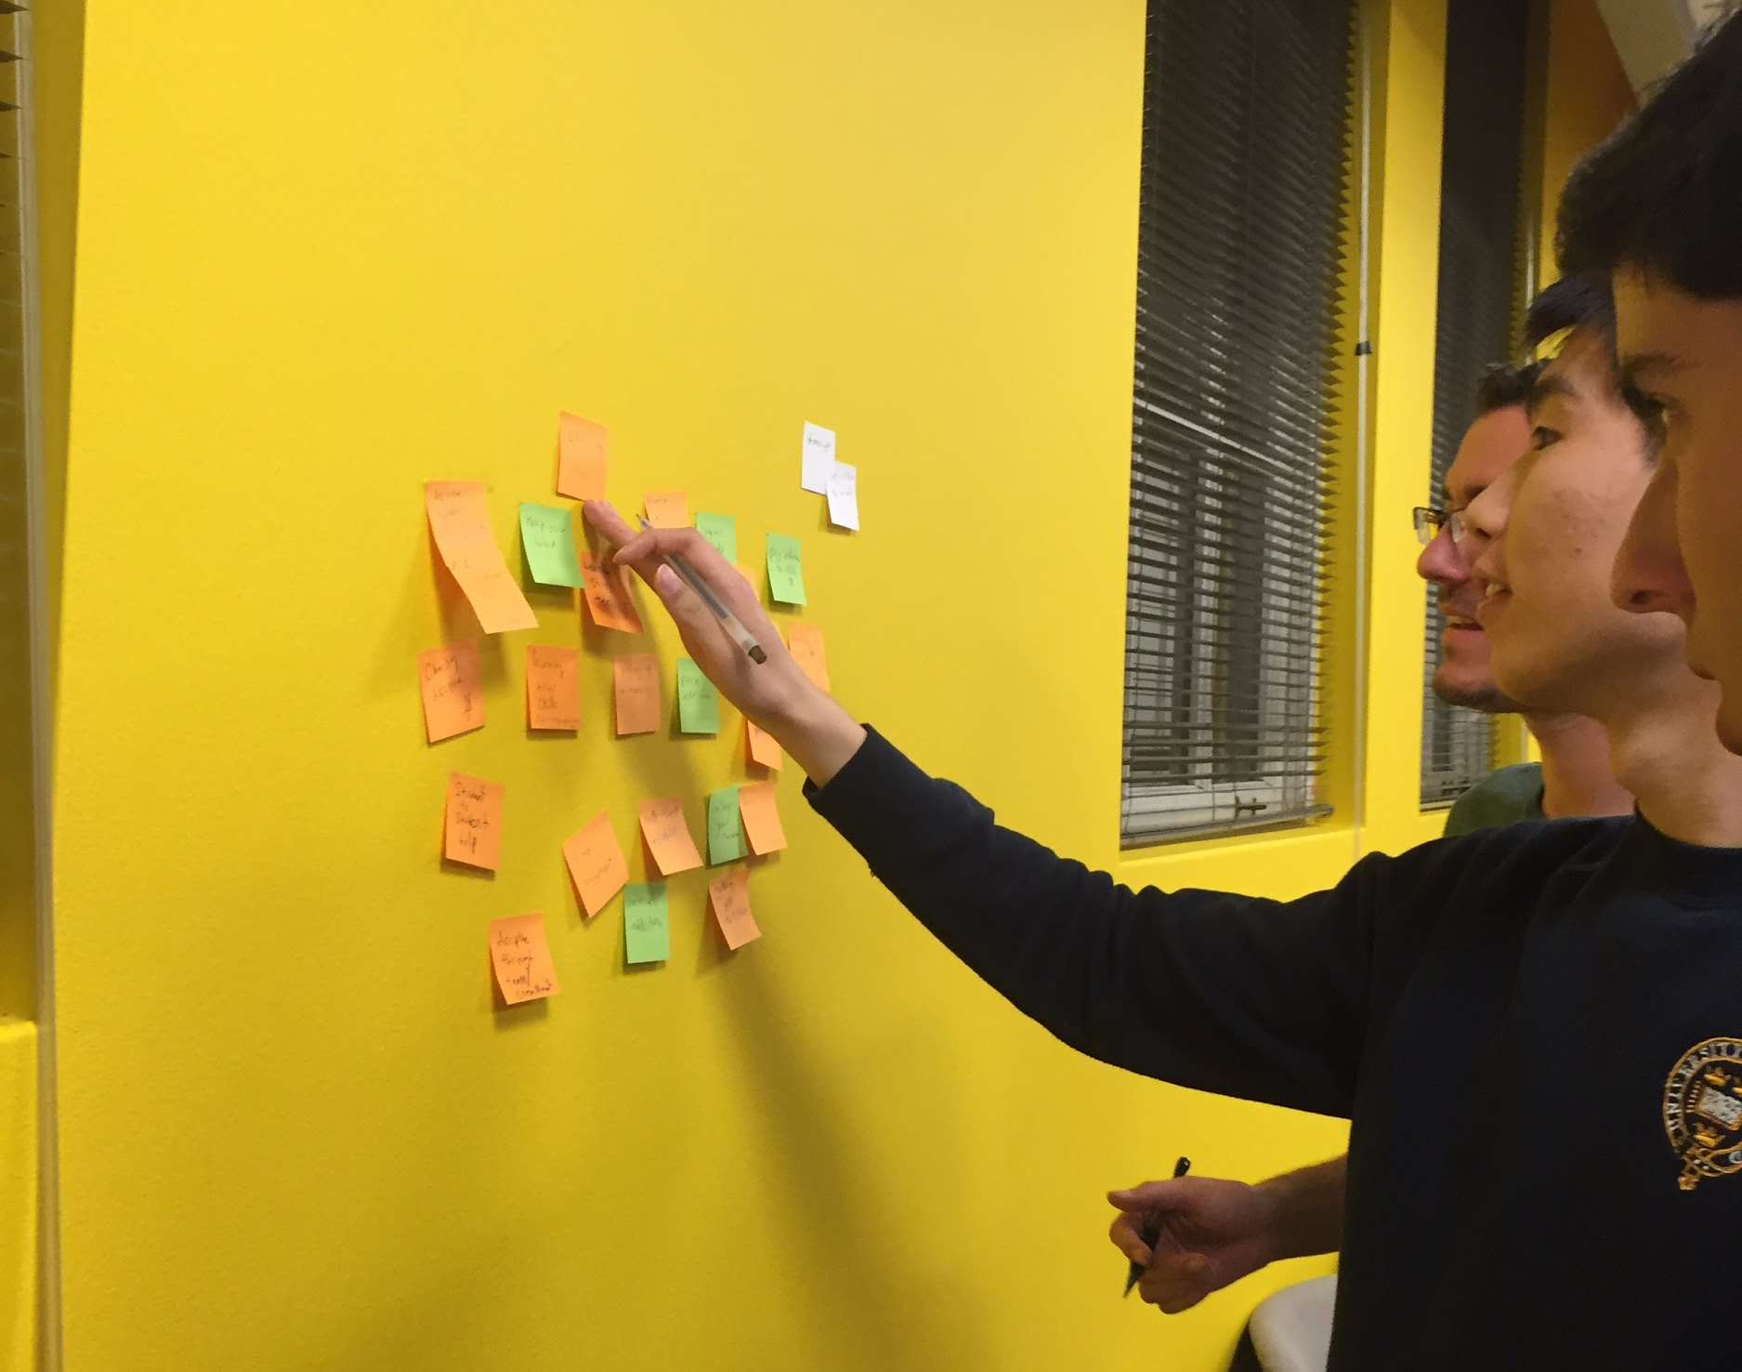
Self-Improvement
Jane’s Studio | Behavioral Change
Luke, Chuan, Ben, and Abraham aka Team Laser Phocus

Slide 2
We met Jarreau the assistant director of the Office of Alcohol Policy and Education.
We were amazed to realize that people’s self-control collapses due to stress, fear, anxiety, and boredom.
It would be game-changing to help people identify binge-triggering emotions such as stress, anxiety, fear, and boredom.
Initial POV

Slide 3
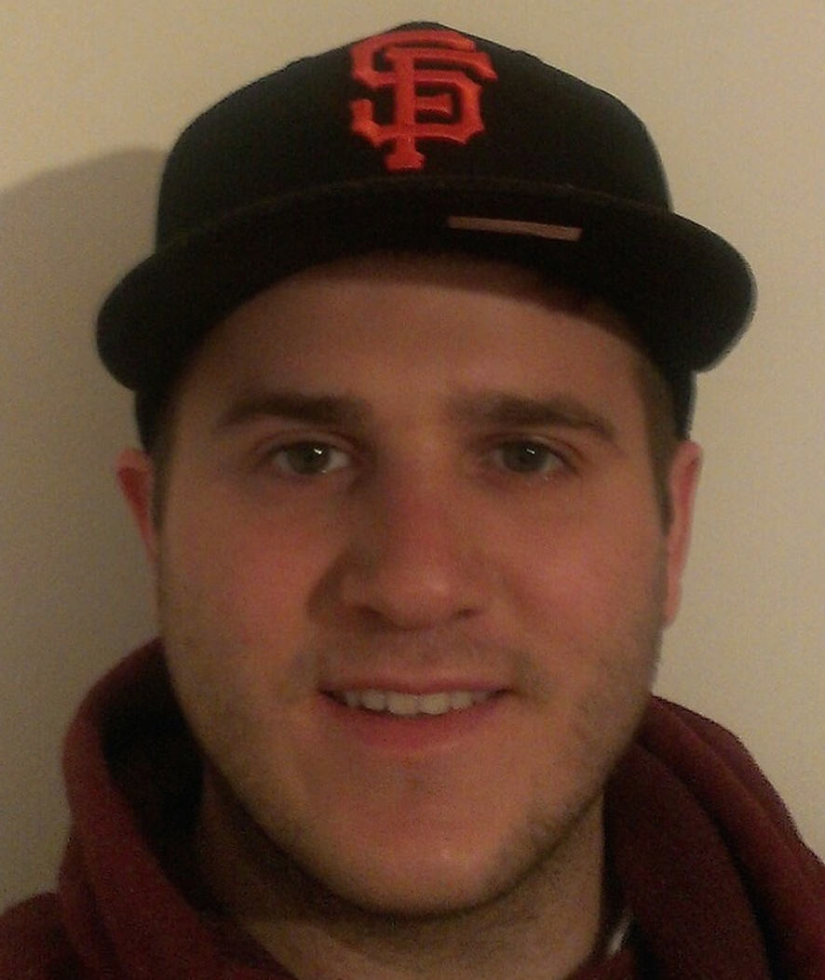
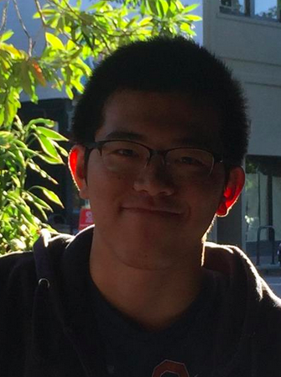
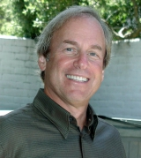
Diego S.: Stanford Senior
Koki Y.: Stanford Junior
Yotam C.: College student
Ian G.: Psych Dept Chair
Our Interviewees

Slide 4
INT 1
We met: Diego a Stanford senior, who was an Adderall addict until 3 months ago.

Slide 5
INT 1
Did: He spoke much slower when talking about his Adderall withdrawals
Said: “I felt I was alone fighting this addiction; I was helpless.”
Felt: Happy to explain how Adderall “pressed the pedal for him”
Thought: the best way to fight an addiction is with discipline and being open with his family

Slide 6
INT 2
We met Professor Gotlib, the Chair of the Psych Dept and expert in addiction.

Slide 7
INT 2
Did: Looked to the floor while thinking about the research
Said: “The mechanism triggering binging is extremely complex, but it is clear that self-esteem plays a critical role.”
Felt: Cautious about the new developments in the field
Thought: It would be difficult to identify the main trigger of binging

Slide 8
POVs, HMWs,
and Prototypes

Slide 9
POV 1
We met Professor Gotlib, the Chair of the Psych Dept.

Slide 10
POV 1
We met: Professor Gotlib, the Chair of the Psychology Department.
We were amazed to realize: that increased self-esteem helps to prevent binging habits.

Slide 11
POV 1
We met: Professor Gotlib, the Chair of the Psychology Department.
We were amazed to realize: that increased self-esteem helps to prevent binging habits.
It would be game changing to increase students’ self-esteem so that they can achieve moderation.

Slide 12
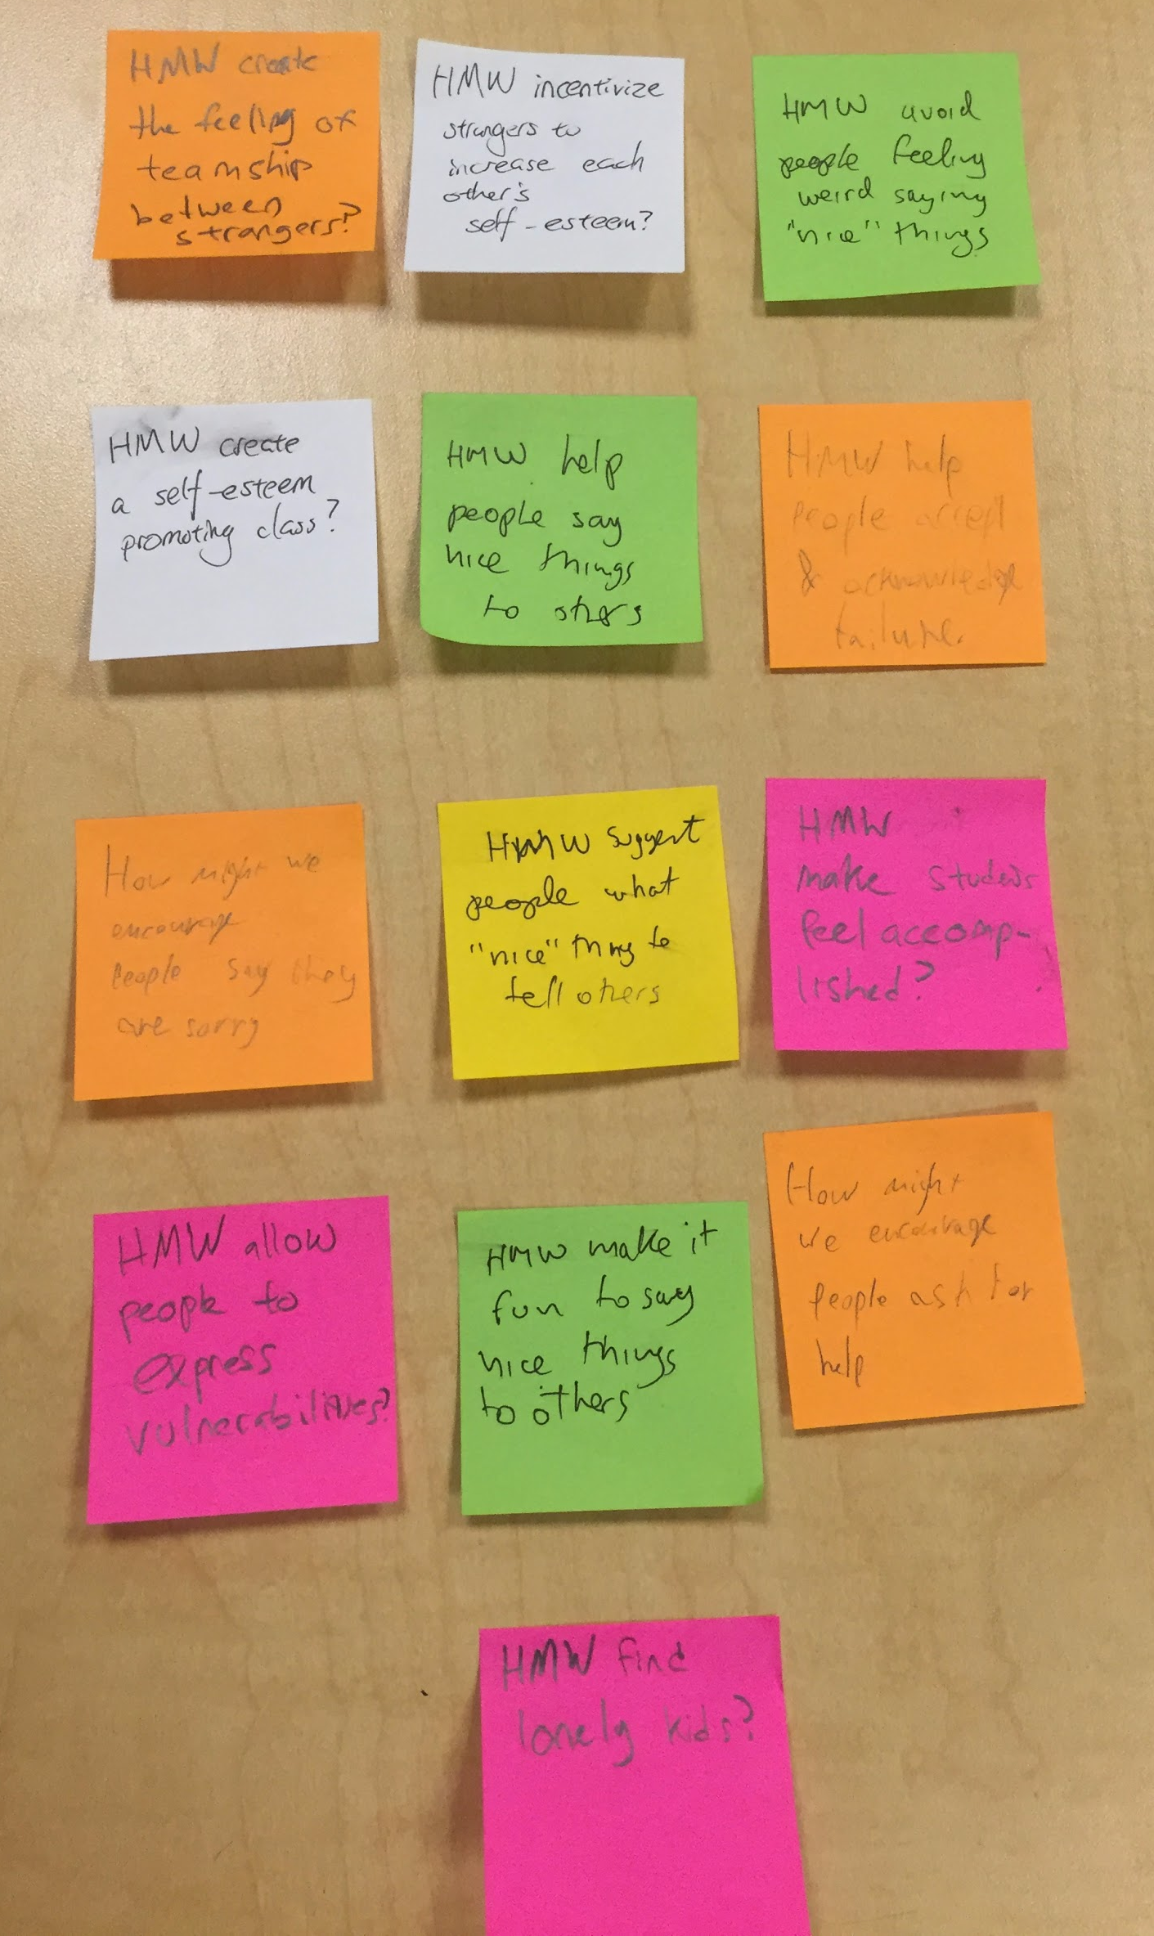
It would be game changing to increase students’ self-esteem so they can achieve moderation.
HMW
HMW make it fun to convey positive energy to each other?

Slide 13
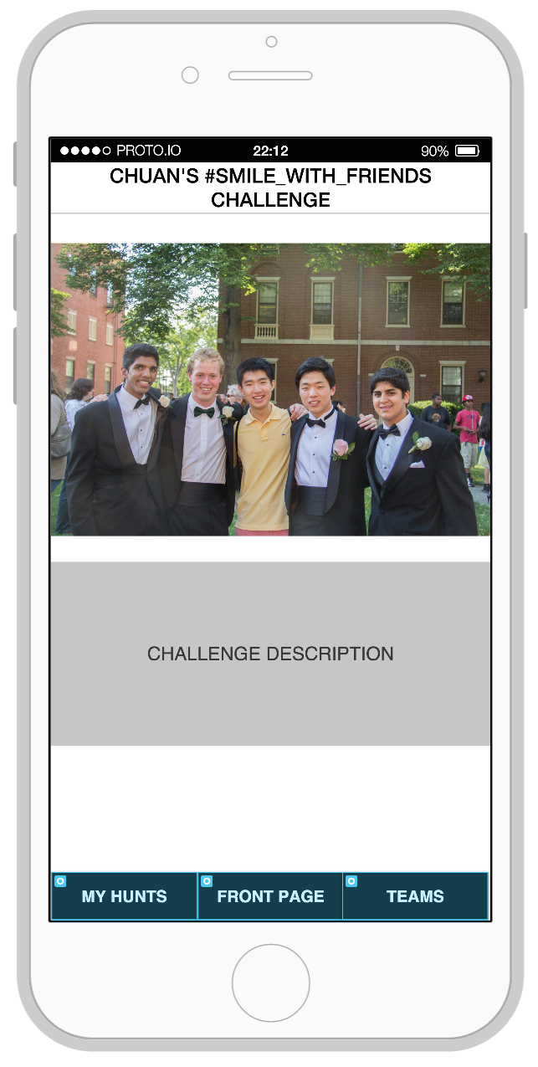
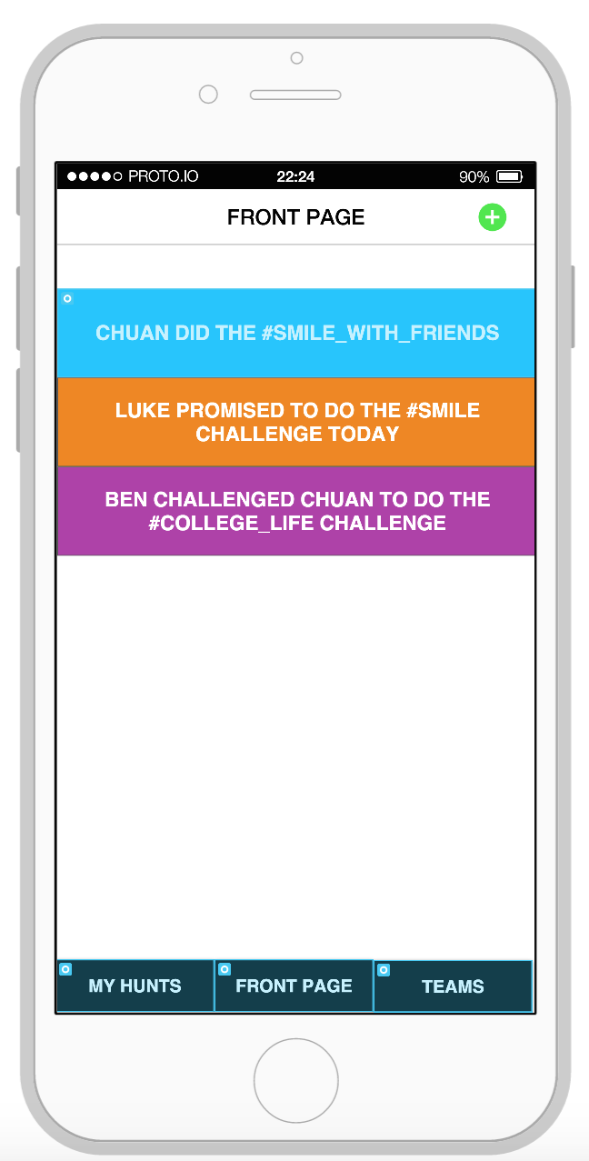
Kindness Hunt
Motivates people to do nice things by incorporating the fun factor of scavenger hunts

Slide 14
Kindness Hunt
Motivates people to do nice things by incorporating the fun factor of scavenger hunts
Created using an iPhone template and tested with Edric in Lathrop library

Slide 15
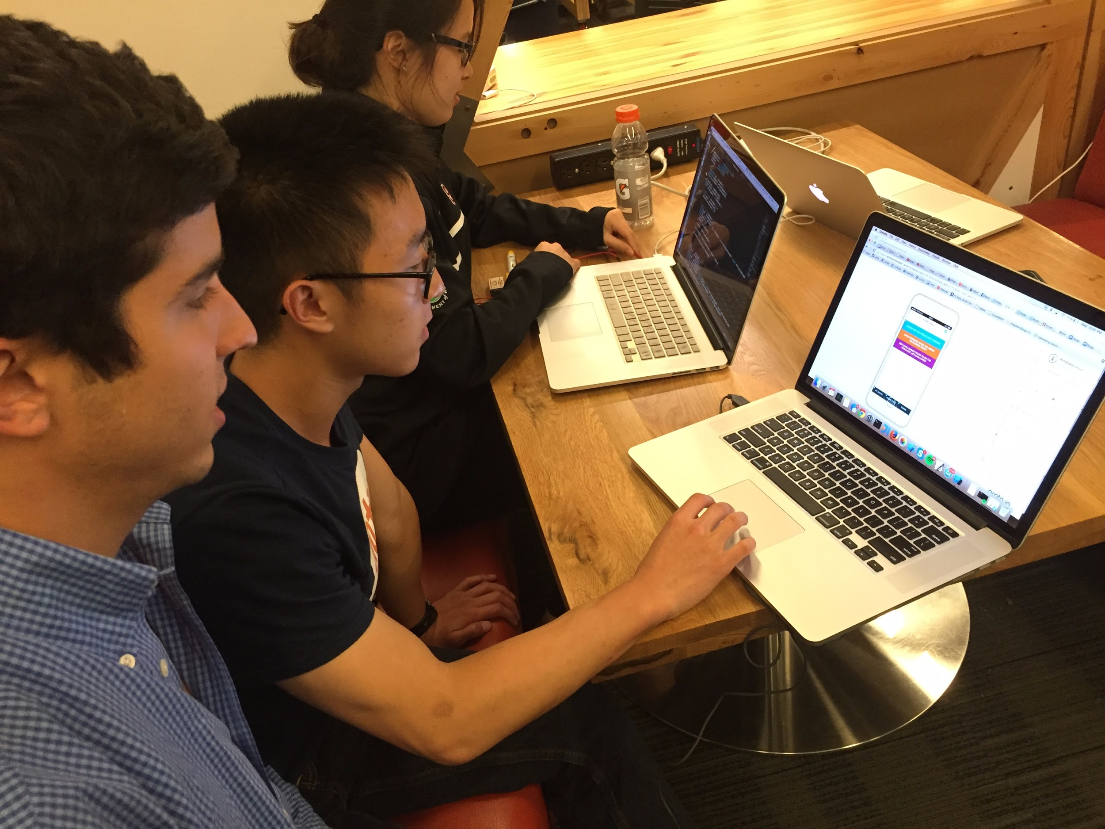
Kindness Hunt
What worked
app’s goal of motivating people to do nice things
Tested by Edrick

Slide 16
Kindness Hunt
What worked
app’s goal of motivating people to do nice things
What didn’t work
The app’s layout wasn’t intuitive enough
Tested by Edrick

Slide 17
Kindness Hunt
What worked
app’s goal of motivating people to do nice things
Surprised
users could feel uncomfortable posting pictures of themselves doing nice things
What didn’t work
The app’s layout wasn’t intuitive enough
Tested by Edrick

Slide 18
Kindness Hunt
What worked
app’s goal of motivating people to do nice things
Surprised
users could feel uncomfortable posting pictures of themselves doing nice things
What didn’t work
The app’s layout wasn’t intuitive enough
Learnings
positive feedback on the app’s vision
users need to feel comfortable posting their pictures doing nice things in the Kindness Hunt space
Tested by Edrick

Slide 19
Kindness Hunt
Valid assumption: people want to perform acts of kindness

Slide 20
Kindness Hunt
Valid assumption: people want to perform acts of kindness
Edrick said he enjoyed being motivated to create happiness for others

Slide 21
Kindness Hunt
Valid assumption: people want to perform acts of kindness
Edrick said he enjoyed being motivated to create happiness for others
New assumption: people will feel comfortable posting pictures of their kind acts only if it is for a fun motive or for a social activity.

Slide 22
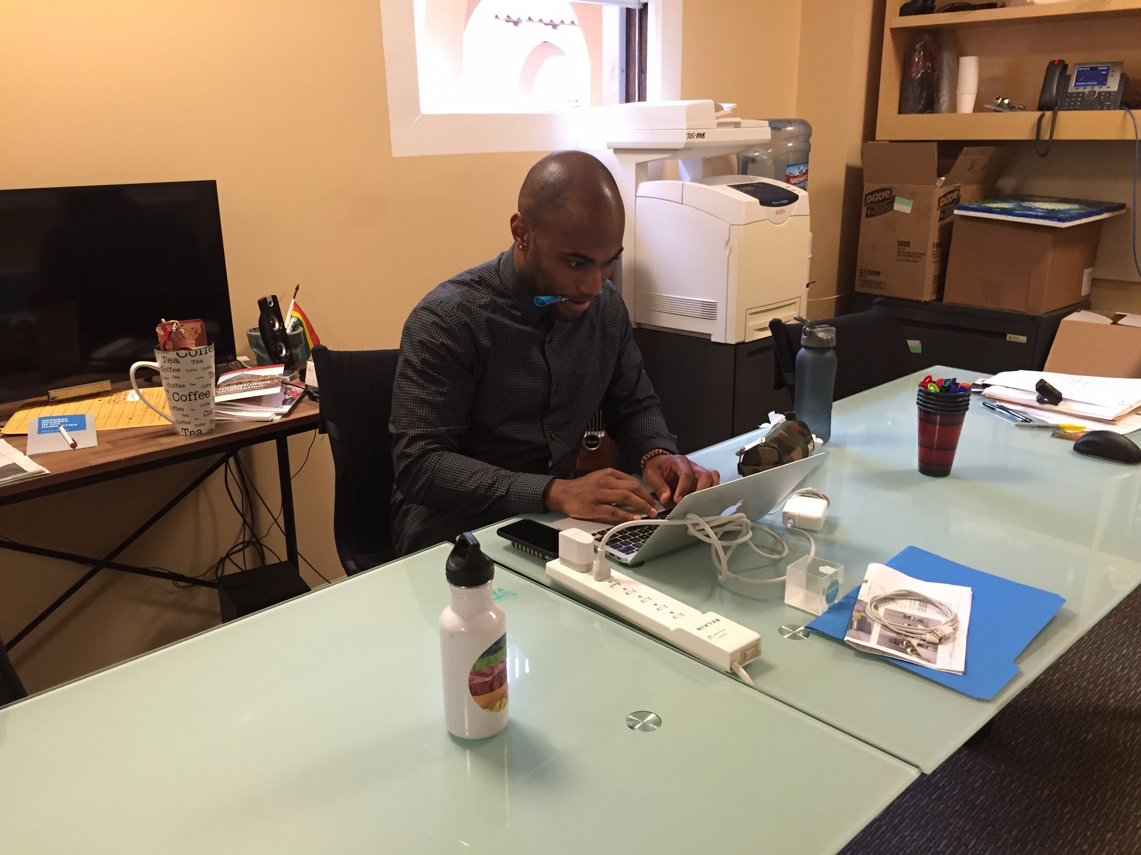
POV 2
We met Jarreau, the assistant director of the Office of Alcohol Policy and Education, who helps students develop healthier plans around their drinking.

Slide 23
POV 2
We met Jarreau the assistant director of the Office of Alcohol Policy and Education, who helps students develop healthier plans around their drinking.
We were amazed to realize when a person wants to achieve a goal, they are more likely to be successful if they join a social circle with others who have similar goals.

Slide 24
POV 2
We met Jarreau, the assistant director of the Office of Alcohol Policy and Education, who helps students develop healthier plans around their drinking.
We were amazed to realize when a person wants to achieve a goal, they are more likely to be successful if they join a social circle with others who have similar goals.
It would be game changing to facilitate people meeting others who have similar goals.

Slide 25
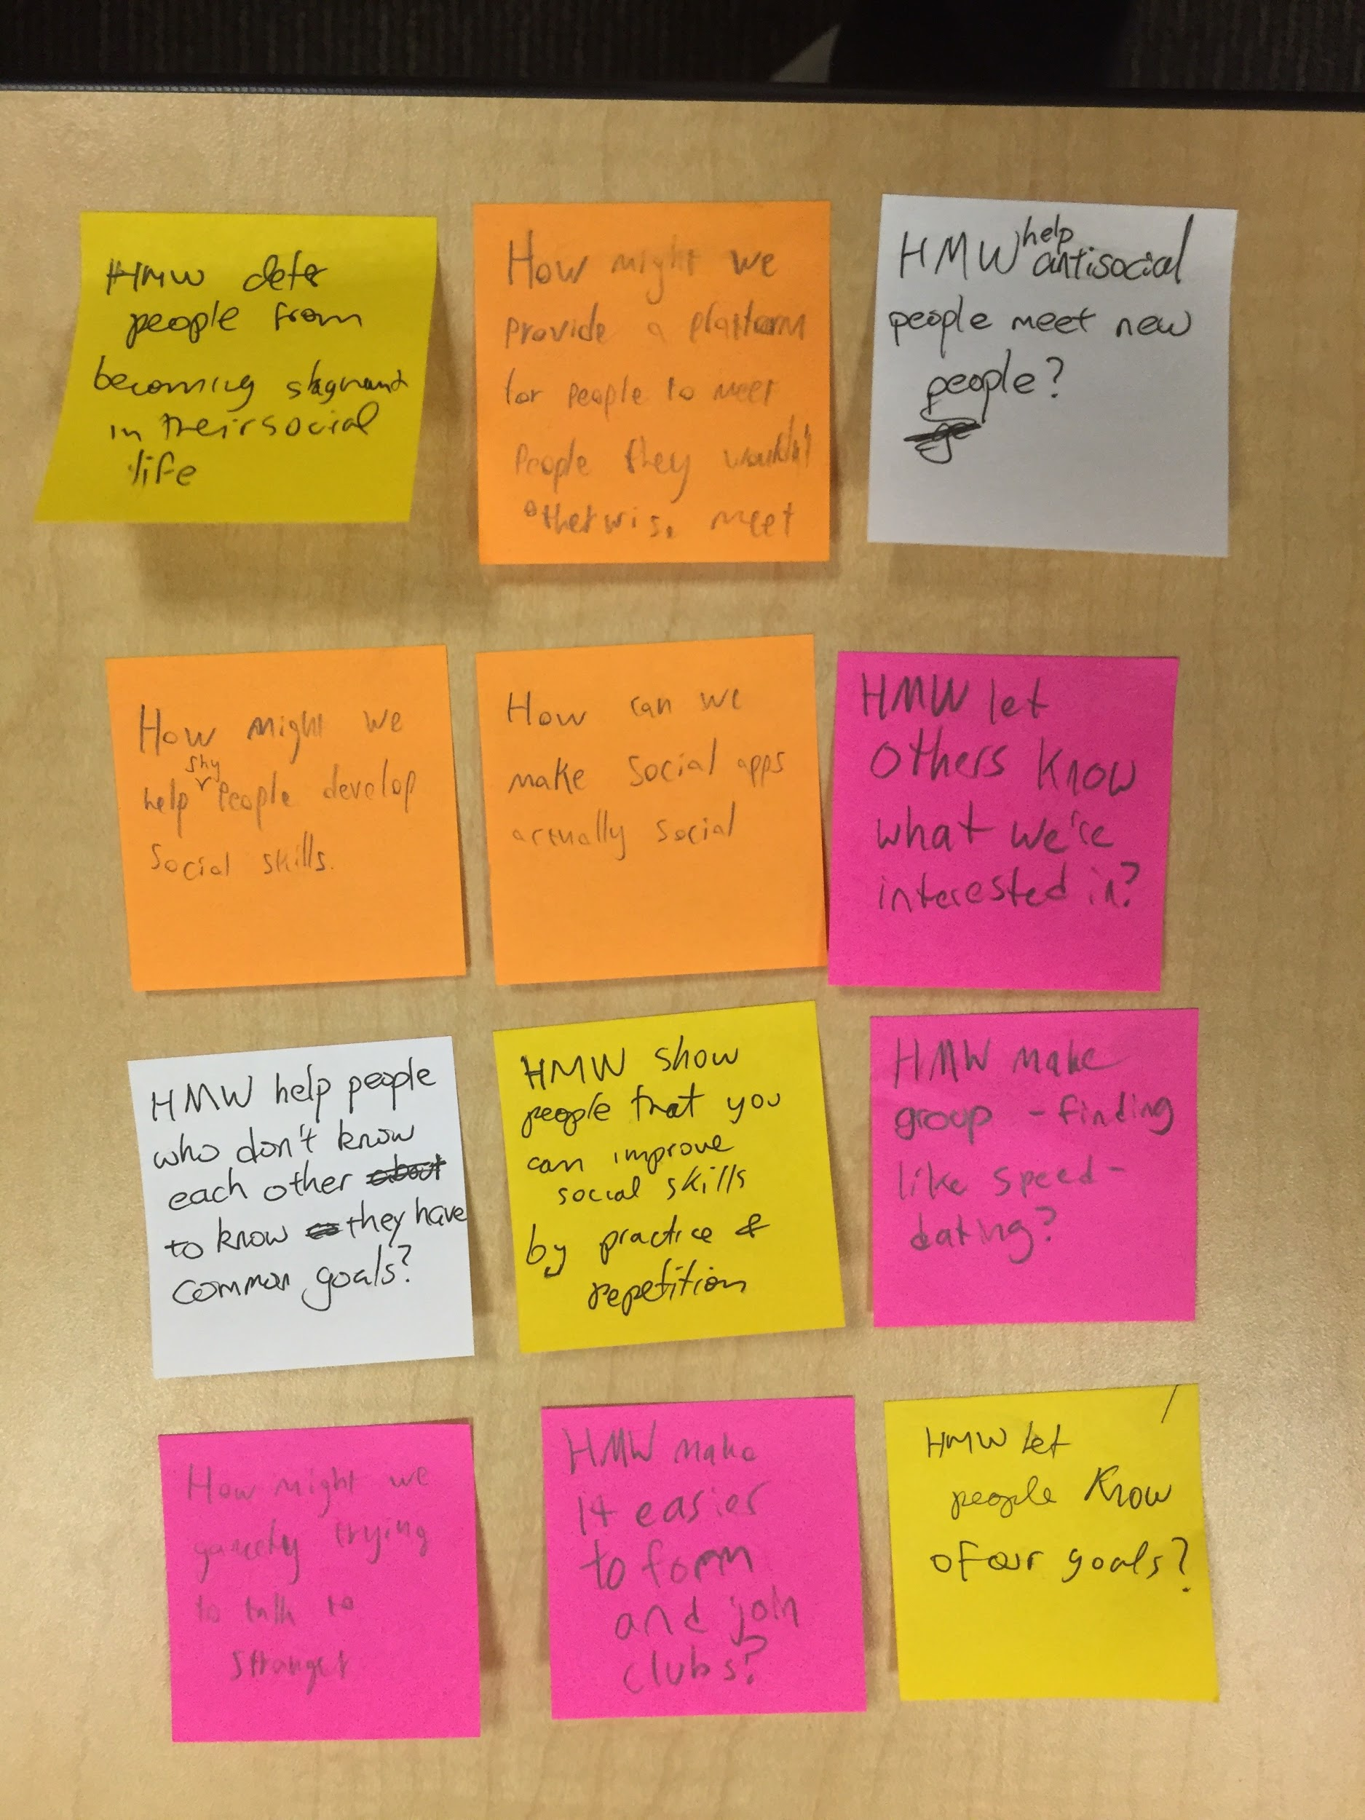
It would be game changing to facilitate people meeting others who have similar goals.
HMW 2
HMW let other people know our individual goals?

Slide 26
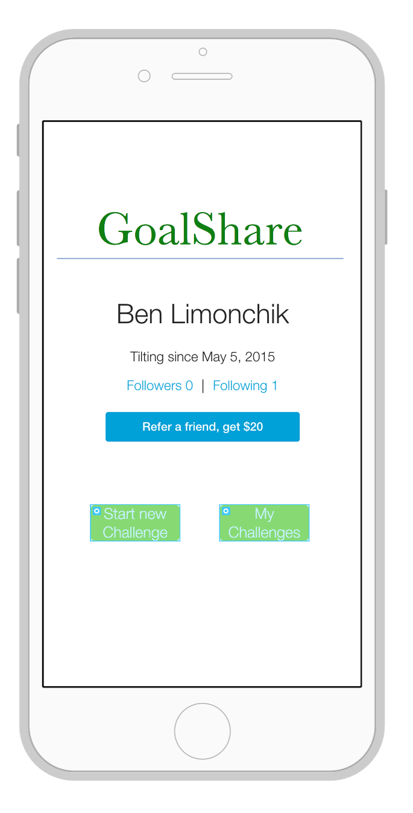
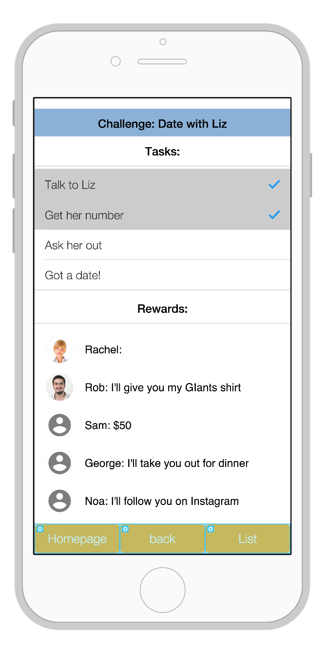
GoalShare
An App where users can post challenges to friends and reward them for completion
Notes:
About the user experience:
The app can be used to post challenges to friends or to take upon yourself new challenges
When a new challenge is created one lists the tasks required to complete the challenge and then posts the challenge to his friends
A friend who gets a challenge invite has to accept it and specify what reward would he/she give to the person who is trying to complete the challenge.
Interesting insights: One of our testing users said that Privacy would be a big issue for him. While we assumed that one could look up all the challenges his friends are working on, the user said he would like the ability to choose whether the challenge is private/open for all friends to review. Similar to events on Facebook.

Slide 27
GoalShare
An App where users can post challenges to friends and reward them for completion
Created with Proto and tested with students in Lathrop and Tressider
Notes:
About the user experience:
The app can be used to post challenges to friends or to take upon yourself new challenges
When a new challenge is created one lists the tasks required to complete the challenge and then posts the challenge to his friends
A friend who gets a challenge invite has to accept it and specify what reward would he/she give to the person who is trying to complete the challenge.
Interesting insights: One of our testing users said that Privacy would be a big issue for him. While we assumed that one could look up all the challenges his friends are working on, the user said he would like the ability to choose whether the challenge is private/open for all friends to review. Similar to events on Facebook.

Slide 28
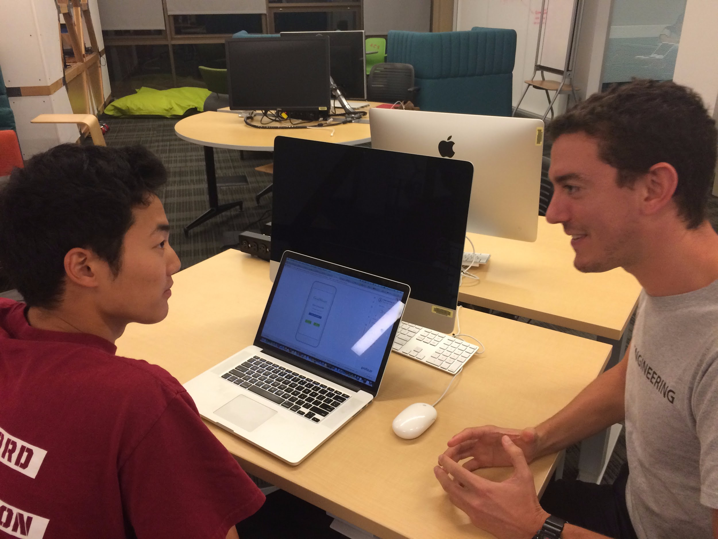
GoalShare
What worked:
Liked the interface to follow challenges and rewards
Tested by Edwin and Sam

Slide 29
GoalShare
What worked:
Liked the interface to follow challenges and rewards
What didn’t:
The list of challenges given and delegated is not intuitive
Tested by Edwin and Sam

Slide 30
GoalShare
What worked:
Liked the interface to follow challenges and rewards
What didn’t:
The list of challenges given and delegated is not intuitive
Surprises:
Suggested Privacy setting
Tested by Edwin and Sam

Slide 31
GoalShare
What worked:
Liked the interface to follow challenges and rewards
What didn’t:
The list of challenges given and delegated is not intuitive
Surprises:
Suggested Privacy setting
New Learnings:
Add the ability to click on friends to see their profile
Tested by Edwin and Sam

Slide 32
GoalShare
Valid assumption: people are more likely to develop skills when rewarded by friends
Test users were thrilled

Slide 33
GoalShare
Valid assumption: people are more likely to develop skills when rewarded by friends
Test users were thrilled
New assumption: Social and experience rewards are more valuable than monetary ones

Slide 34
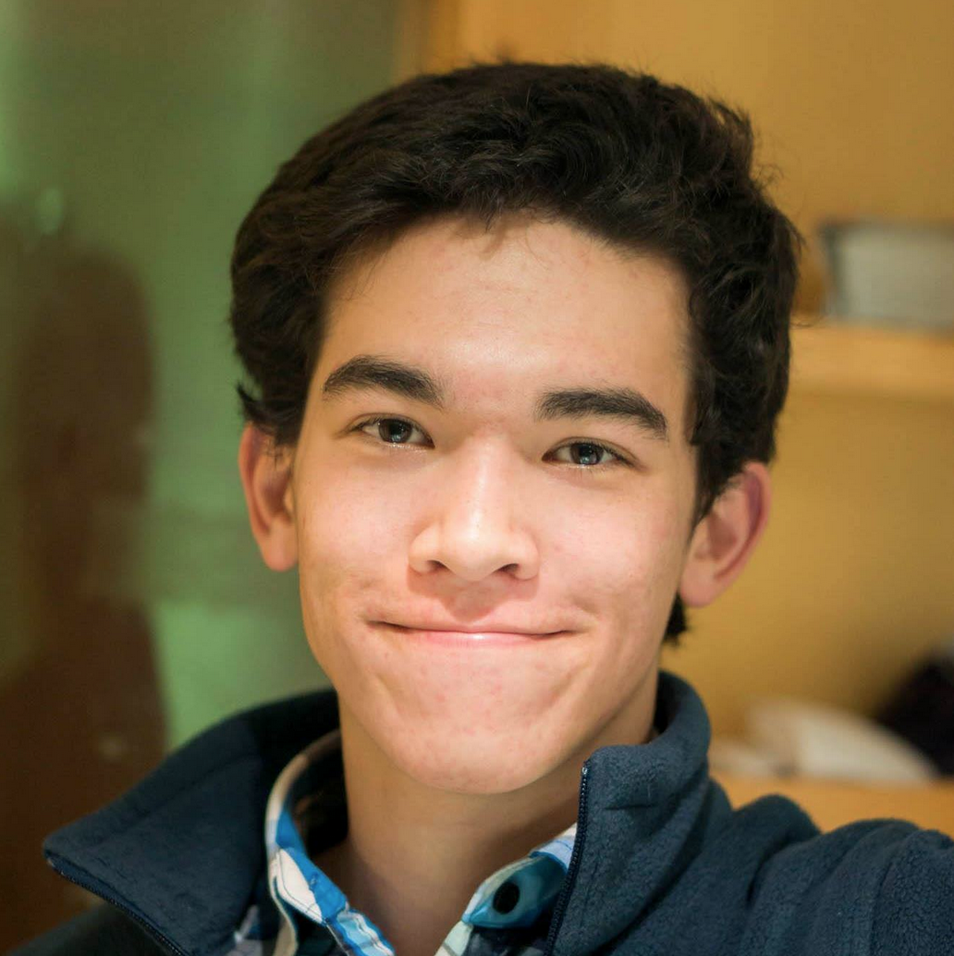
POV 3
We met John, who is a recent college grad working at a car dealership, who indulges in reading comic books.

Slide 35
POV 3
We met John, who is a recent college grad working at a car dealership, who indulges in reading online comic books.
We were amazed to realize he could not get off the screen despite the knowledge that his binge-reading was affecting his sleep and his work.

Slide 36
POV 3
We met John, who is a recent college grad working at a car dealership, who indulges in reading comic books.
We were amazed to realize he could not get off the screen despite the knowledge that his binge-reading was affecting his sleep and his work.
It would be game changing to help people like John escape technology.

Slide 37
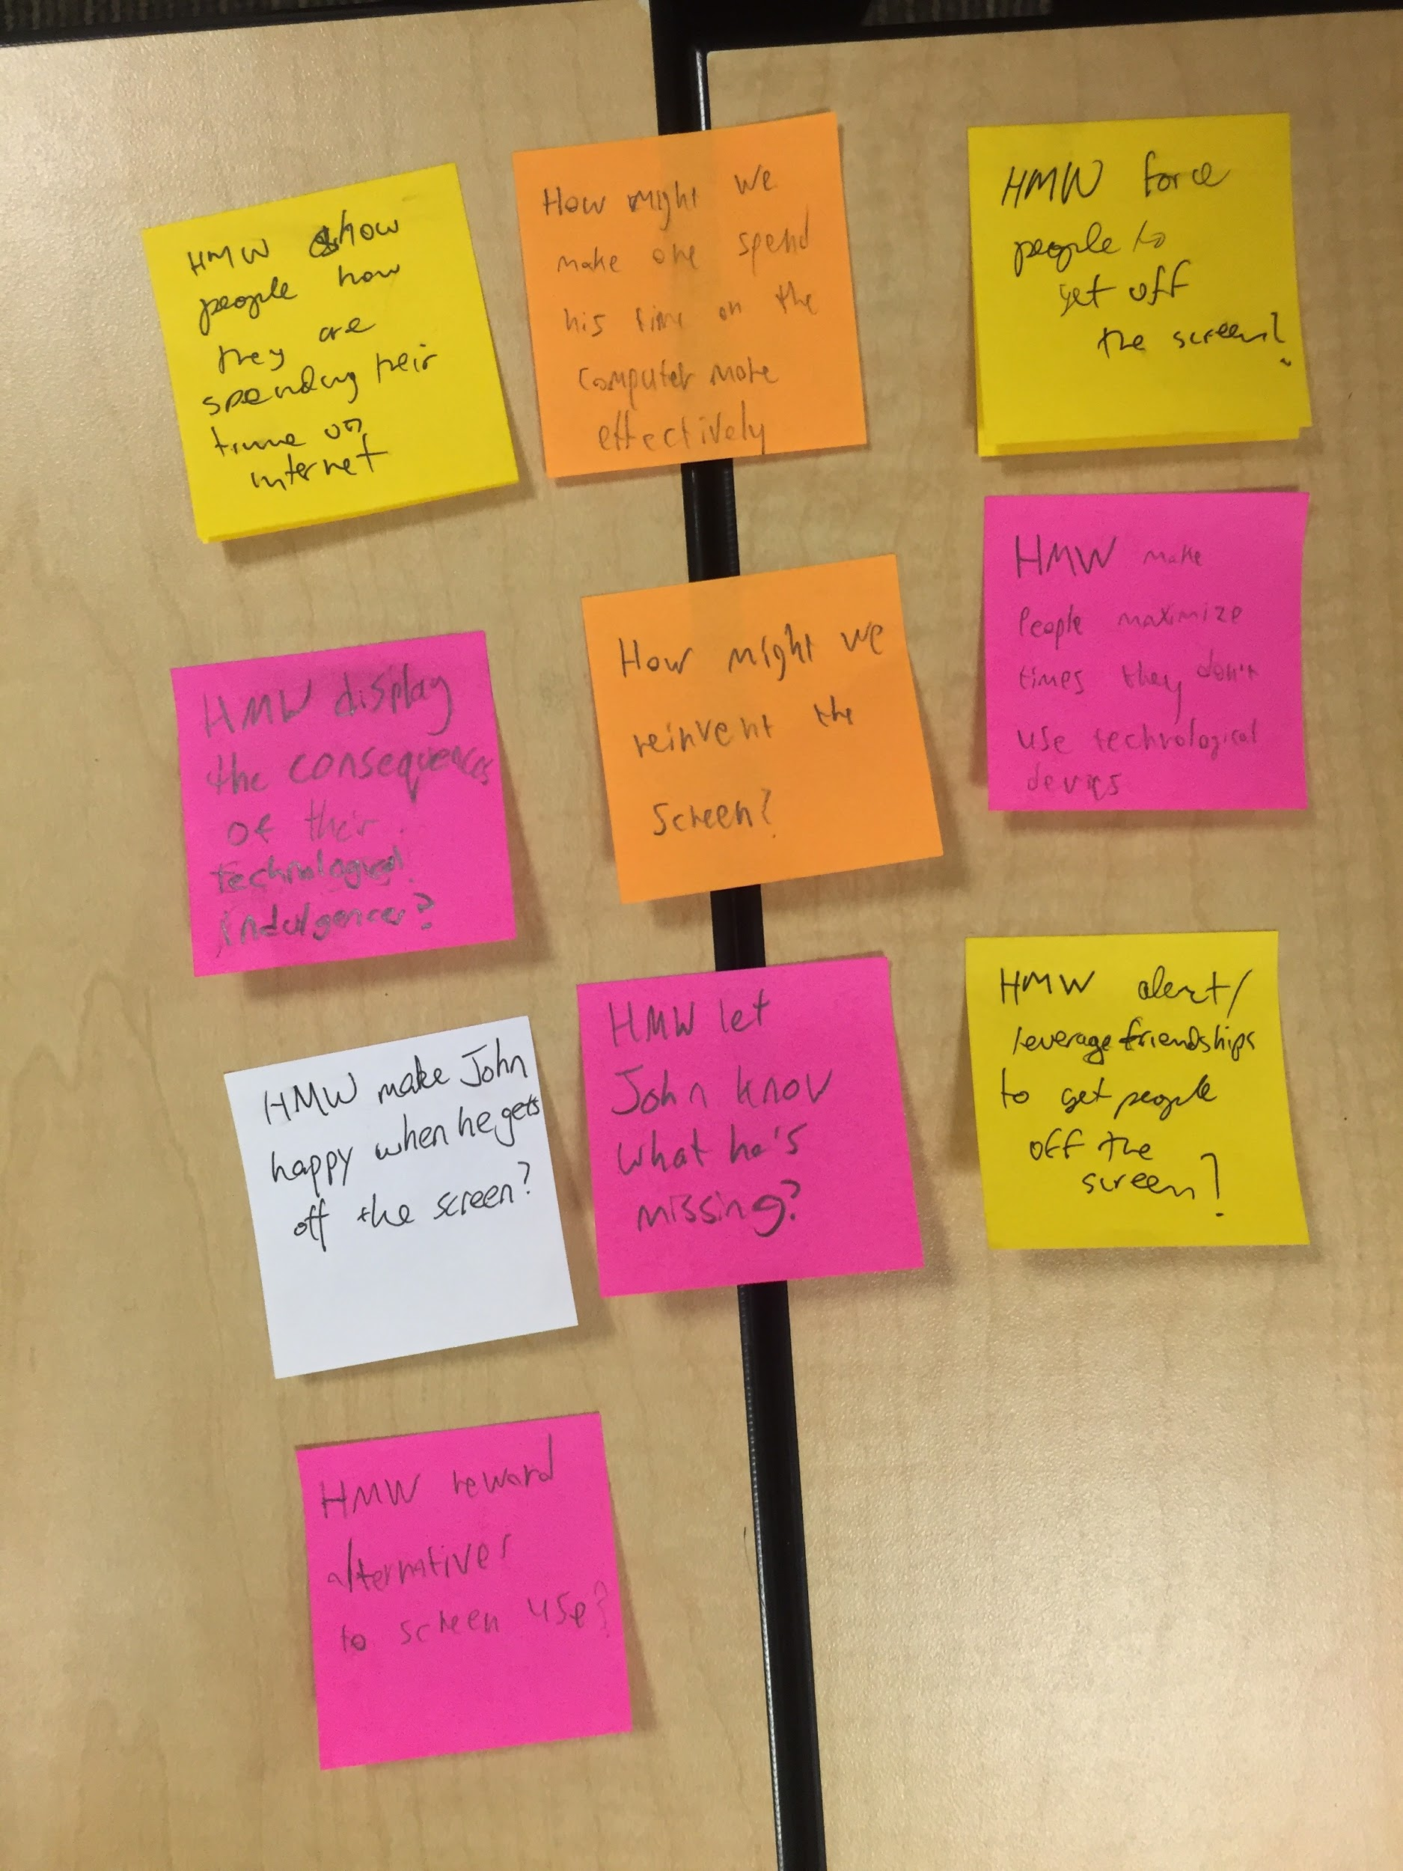
It would be game changing to help people like John escape technology.
HMW 3
HMW display the consequences of John’s technological indulgences?

Slide 38
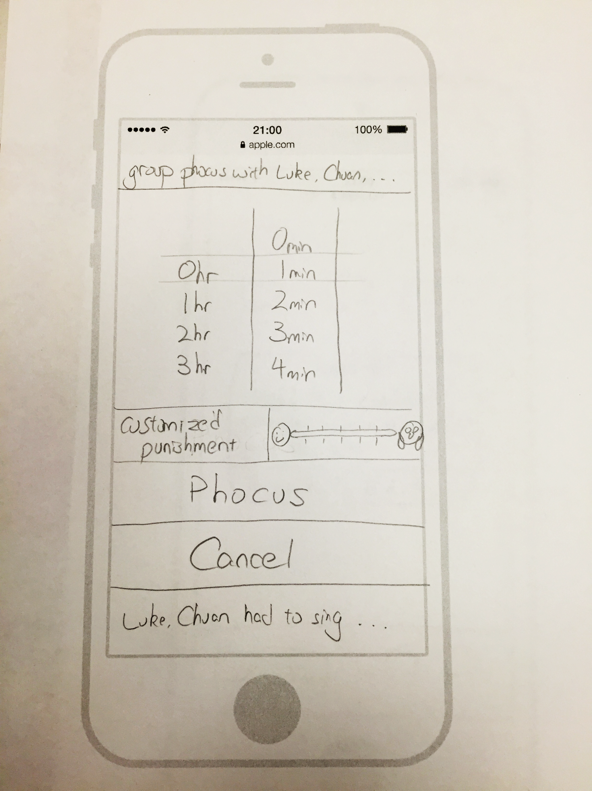
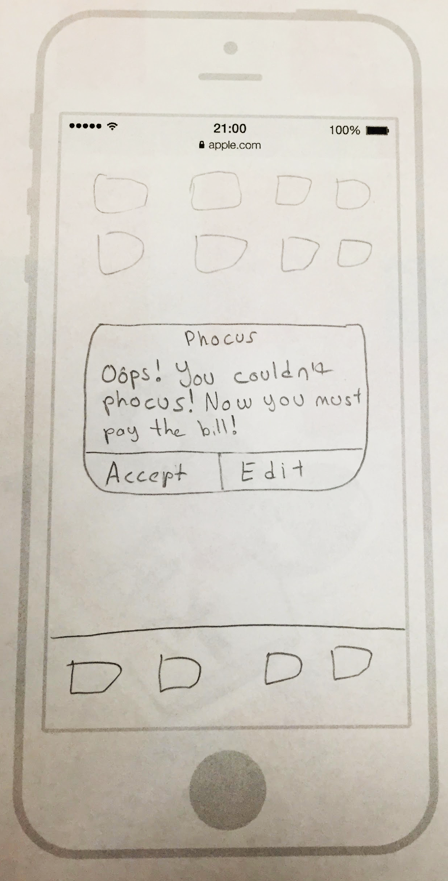
Phocus
Social game that leverages pride to encourage people not to check their phones with others or by themselves.

Slide 39
Phocus
Social game that leverages pride to encourage people not to check their phones with others or by themselves.
Created using an iPhone template and tested with students at Axe & Palm.

Slide 40
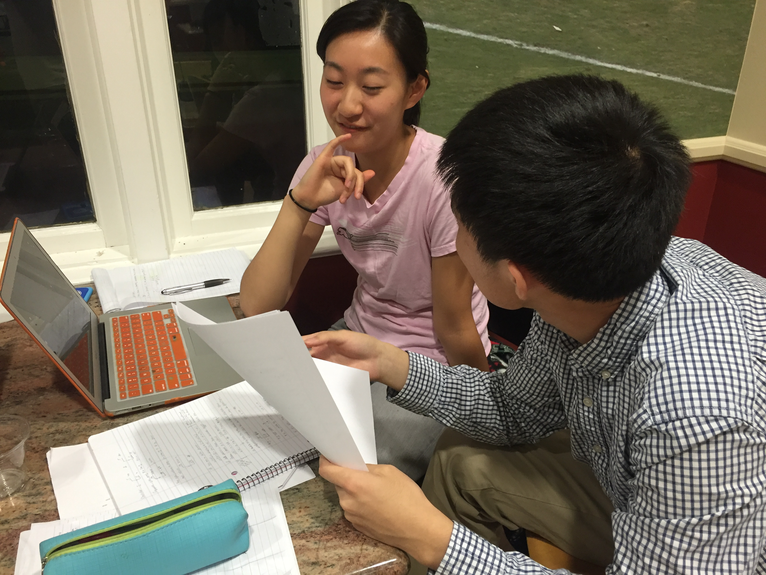
Phocus
What worked:
Positive feedback for both solo and group modes
Social portion would be great with lots of traction
Tested by Weiwei, Ryan, and Katherine

Slide 41
Phocus
What worked:
Positive feedback for both solo and group modes
Social portion would be great with lots of traction
What didn’t:
Ryan wouldn’t use solo mode, Weiwei wouldn’t use group mode
Social is bad without lots of users
Tested by Weiwei, Ryan, and Katherine

Slide 42
Phocus
What worked:
Positive feedback for both solo and group modes
Social portion would be great with lots of traction
What didn’t:
Ryan wouldn’t use solo mode, Weiwei wouldn’t use group mode
Social is bad without lots of users
Surprises:
Different people liked different modes
Tested by Weiwei, Ryan, and Katherine

Slide 43
Phocus
What worked:
Positive feedback for both solo and group modes
Social portion would be great with lots of traction
What didn’t:
Ryan wouldn’t use solo mode, Weiwei wouldn’t use group mode
Social is bad without lots of users
Surprises:
Some users would only use one mode
New learnings:
Re-design “social” aspect
Tested by Weiwei, Ryan, and Katherine

Slide 44
Phocus
Valid assumption: people would use an pride-based system to motivate them to focus on real life

Slide 45
Phocus
Valid assumption: people would use an pride-based system to motivate them to focus on real life
Both testing groups confirmed they would use Phocus in different scenarios

Slide 46
Phocus
Valid assumption: people would use an pride-based system to motivate them to focus on real life
Both testing groups confirmed they would use Phocus in different scenarios
New assumption: the ‘power users’ will have extroverted personalities

Slide 47
Why Phocus?
Smartphone distraction is a pain point - benefits everyone

Slide 48
Why Phocus?
Smartphone distraction is a pain point - benefits everyone
Solves a real problem

Slide 49
Why Phocus?
Smartphone distraction is a pain point - benefits everyone
Solves a real problem
Simple, but not easy

Slide 50
Why Phocus?
Smartphone distraction is a pain point - benefits everyone
Solves a real problem
Simple, but not easy
Fun!

Slide 51
Thank You!

