Slide 1
POVs, HMWs, and EPs
CS147 Presentation 2
Autumn 2015

Slide 2
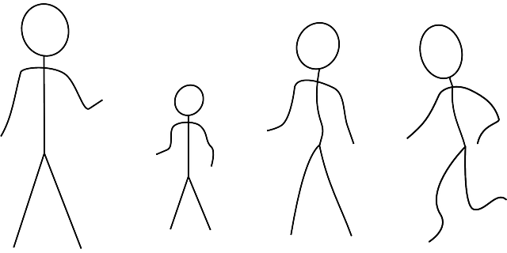
Introduction
Tanner Gilligan
Domain: Changing behaviors related to travel
Dennis Ellis
Amanda McNary
Rhea Dookeran

Slide 3
Initial POV
Who: New Traveler
Needs: Information

Slide 4
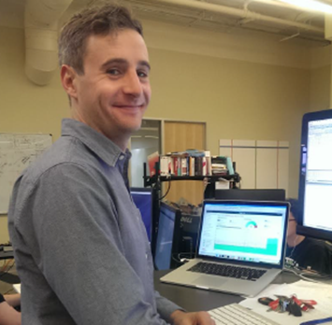
Initial POV
Who: New Traveler, Business Travelers
Needs: Information, Connectivity

Slide 5
Needfinding Interviewees
We interviewed 5 people
Leisure traveler

Slide 6
Needfinding Interviewees
We interviewed 5 people
Leisure traveler
Group travel planner

Slide 7
Needfinding Interviewees
We interviewed 5 people
Leisure traveler
Group travel planner
Infrequent family/friend traveler

Slide 8
Needfinding Interviewees
We interviewed 5 people
Leisure traveler
Group travel planner
Infrequent family/friend traveler
2 Business travelers

Slide 9
Needfinding Interviewees
We interviewed 5 people
Leisure traveler
Group travel planner
Infrequent family/friend traveler
2 Business travelers
Family (upcoming)

Slide 10
Needfinding Results
Needs
Authentic experience
Centralized information source
Streamlined group planning
Spontaneity
Easier Reimbursement
Reliability in foreign countries

Slide 11
POV 1 – Group Trip Planner
Who: Jason, 27 year old who voluntarily plans group trips
Need: a way to collaborate with others on trip plans
Insight: It would be game changing if we could provide a platform for groups to collaborate on trips and pay their bill

Slide 12
POV 2 – Infrequent/New Traveler
Who: Abraham, a dual citizen of the US and Venezuela
Need: Access to travel information when internet is unavailable.
Who: Katie, a new traveler
Need: Access to consolidated information about airports and airlines
Insight: It would be game changing if we could provide information directed at new/infrequent flyers, possibly in an offline manner

Slide 13
POV 3 – Business Traveler
Who: Ben, frequent business traveler and father
Need: Way to make trips more efficient and stay connected with family
Who: Jonathan, frequent business traveler
Need: Wants to optimize his trips, as well as be able to meet up with people
Insight: It would be game changing if we could help make trips more compact/efficient, reducing time spent traveling, as well as staying connected others

Slide 14
Top HMW 1
How might we enable users to collaborate on a trip more efficiently?
- Group trip planner

Slide 15
Top HMW 2
How might we consolidate information for (typically new) travelers that is currently fragmented across platforms?
- New/infrequent traveler

Slide 16
Top HMW 3
How might we help travelers feel fully satisfied that they got the most out of their trip?
– Business Traveler

Slide 17
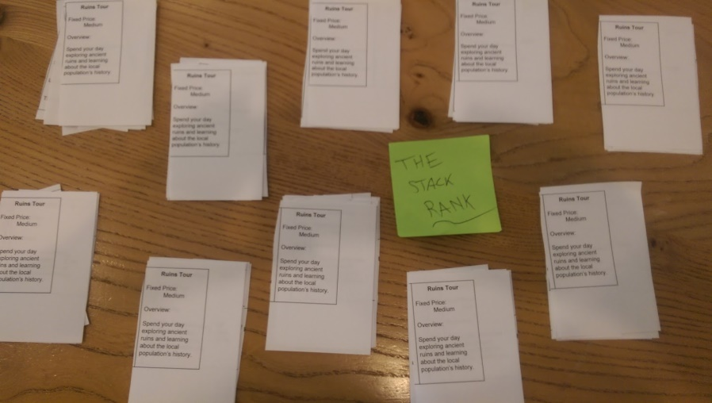
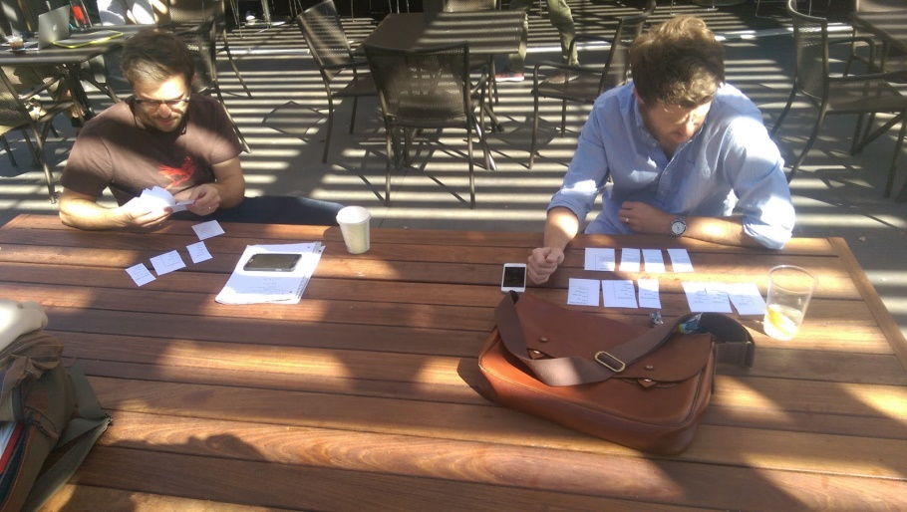
Collaborative Planning Tool
Description:
- Allow group to work together on travel plans
- Tested by having group rank activities, then recommend activities to planner
Worked:
- Planner gets group preferences
- Reduces bias of friends’ opinions
Didn’t:
- Grouping of activities being ranked
Surprises:
- Ranking activities builds excitement for trip
Learnings:
- Activities should be broken up into categories
Assumptions:
- Traveling in a group
- Users want to voice their opinions

Slide 18
Collaborative Planning Tool
Description:
- Allow group to work together on travel plans
- Tested by having group rank activities, then recommend activities to planner
Worked:
- Planner gets group preferences
- Reduces bias of friends’ opinions
Didn’t:
- Grouping of activities being ranked
Surprises:
- Ranking activities builds excitement for trip
Learnings:
- Activities should be broken up into categories
Assumptions:
- Traveling in a group
- Users want to voice their opinions

Slide 19
Collaborative Planning Tool
Description:
- Allow group to work together on travel plans
- Tested by having group rank activities, then recommend activities to planner
Worked:
- Planner gets group preferences
- Reduces bias of friends’ opinions
Didn’t:
- Grouping of activities being ranked
Surprises:
- Ranking activities builds excitement for trip
Learnings:
- Activities should be broken up into categories
Assumptions:
- Traveling in a group
- Users want to voice their opinions

Slide 20
Collaborative Planning Tool
Description:
- Allow group to work together on travel plans
- Tested by having group rank activities, then recommend activities to planner
Worked:
- Planner gets group preferences
- Reduces bias of friends’ opinions
Didn’t:
- Grouping of activities being ranked
Surprises:
- Ranking activities builds excitement for trip
Learnings:
- Activities should be broken up into categories
Assumptions:
- Traveling in a group
- Users want to voice their opinions

Slide 21
Collaborative Planning Tool
Description:
- Allow group to work together on travel plans
- Tested by having group rank activities, then recommend activities to planner
Worked:
- Planner gets group preferences
- Reduces bias of friends’ opinions
Didn’t:
- Grouping of activities being ranked
Surprises:
- Ranking activities builds excitement for trip
Learnings:
- Activities should be broken up into categories
Assumptions:
- Traveling in a group
- Users want to voice their opinions

Slide 22
Collaborative Planning Tool
Description:
- Allow group to work together on travel plans
- Tested by having group rank activities, then recommend activities to planner
Worked:
- Planner gets group preferences
- Reduces bias of friends’ opinions
Didn’t:
- Grouping of activities being ranked
Surprises:
- Ranking activities builds excitement for trip
Learnings:
- Activities should be broken up into categories
Assumptions:
- Traveling in a group
- Users want to voice their opinions

Slide 23
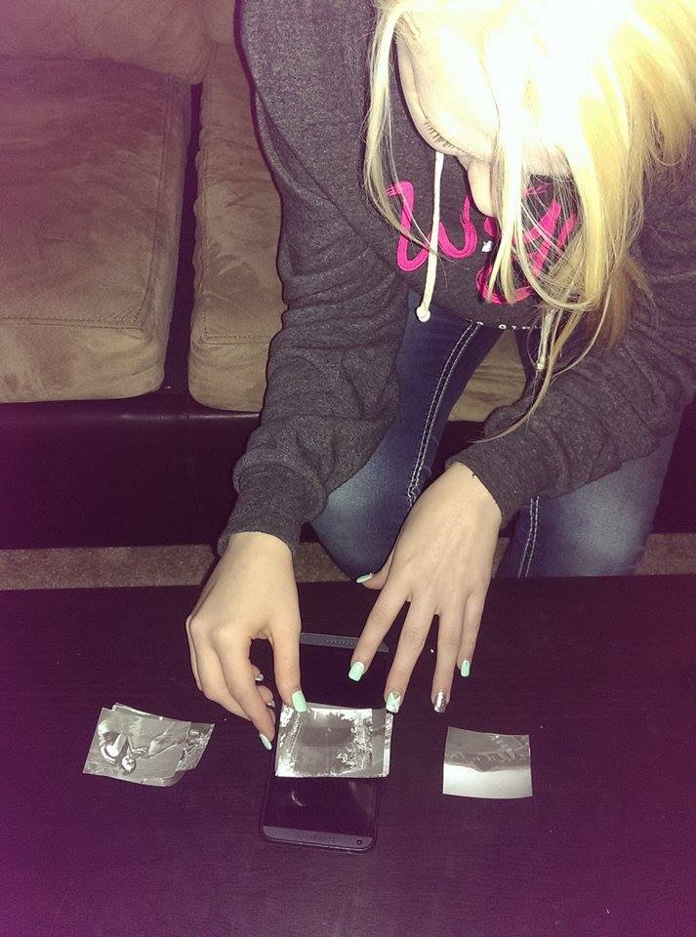
Tinder Travel App
Description:
- Selecting activities Tinder-style
- Tested using cut out pictures and moving them left or right
Worked:
- Swiping motion
- Unknown outcome
Didn’t:
- Can’t rank items
Surprises:
- Activities were preferential to site-seeing
Learnings:
- Swiping and seeing travel ideas is a fun activity
Assumptions:
- Leisure traveler
- Doesn‘t want 100% control

Slide 24
Tinder Travel App
Description:
- Selecting activities Tinder-style
- Tested using cut out pictures and moving them left or right
Worked:
- Swiping motion
- Unknown outcome
Didn’t:
- Can’t rank items
Surprises:
- Activities were preferential to site-seeing
Learnings:
- Swiping and seeing travel ideas is a fun activity
Assumptions:
- Leisure traveler
- Doesn‘t want 100% control

Slide 25
Tinder Travel App
Description:
- Selecting activities Tinder-style
- Tested using cut out pictures and moving them left or right
Worked:
- Swiping motion
- Unknown outcome
Didn’t:
- Can’t rank items
Surprises:
- Activities were preferential to site-seeing
Learnings:
- Swiping and seeing travel ideas is a fun activity
Assumptions:
- Leisure traveler
- Doesn‘t want 100% control

Slide 26
Tinder Travel App
Description:
- Selecting activities Tinder-style
- Tested using cut out pictures and moving them left or right
Worked:
- Swiping motion
- Unknown outcome
Didn’t:
- Can’t rank items
Surprises:
- Activities were preferential to site-seeing
Learnings:
- Swiping and seeing travel ideas is a fun activity
Assumptions:
- Leisure traveler
- Doesn‘t want 100% control

Slide 27
Tinder Travel App
Description:
- Selecting activities Tinder-style
- Tested using cut out pictures and moving them left or right
Worked:
- Swiping motion
- Unknown outcome
Didn’t:
- Can’t rank items
Surprises:
- Activities were preferential to site-seeing
Learnings:
- Swiping and seeing travel ideas is a fun activity
Assumptions:
- Leisure traveler
- Doesn‘t want 100% control

Slide 28
Tinder Travel App
Description:
- Selecting activities Tinder-style
- Tested using cut out pictures and moving them left or right
Worked:
- Swiping motion
- Unknown outcome
Didn’t:
- Can’t rank items
Surprises:
- Activities were preferential to site-seeing
Learnings:
- Swiping and seeing travel ideas is a fun activity
Assumptions:
- Leisure traveler
- Doesn‘t want 100% control

Slide 29
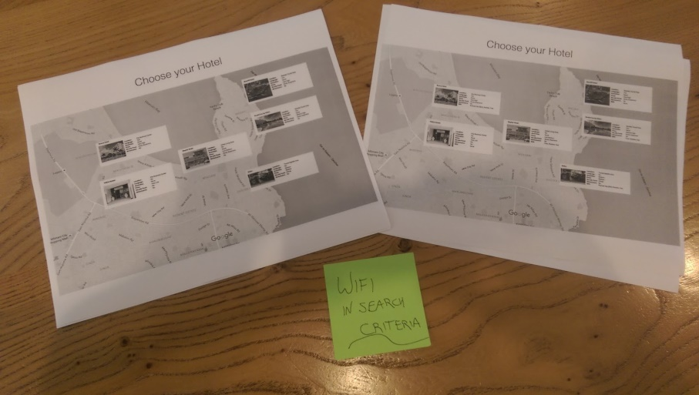
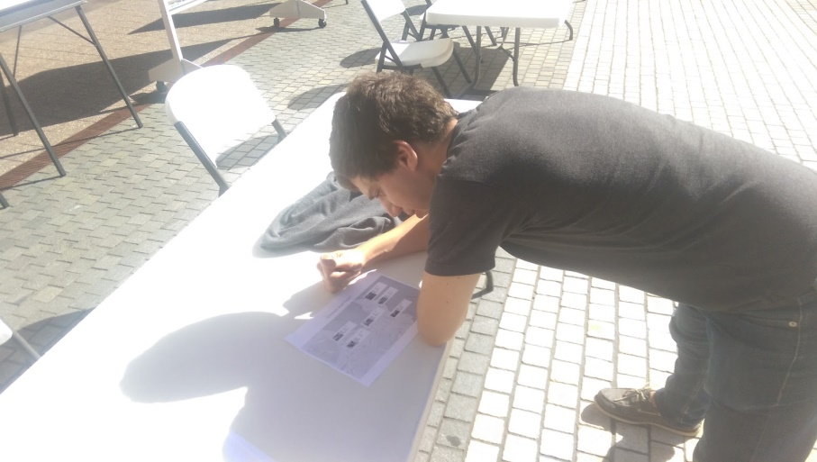
WiFi-Informed Booking
Description:
- Provide location WiFi data to user
- Tested by comparing hotel selections without WiFi data vs with
Worked:
- Maps are a good medium to present data
Didn’t:
- Business travelers suggested a mobile tether
Surprises:
- Ranking activities builds excitement for trip
Learnings:
- Less applicable to business travelers
Assumptions:
- User plan their own travel
- People will change their lodging based on internet

Slide 30
WiFi-Informed Booking
Description:
- Provide location WiFi data to user
- Tested by comparing hotel selections without WiFi data vs with
Worked:
- Maps are a good medium to present data
Didn’t:
- Business travelers suggested a mobile tether
Surprises:
- Ranking activities builds excitement for trip
Learnings:
- Less applicable to business travelers
Assumptions:
- User plan their own travel
- People will change their lodging based on internet

Slide 31
WiFi-Informed Booking
Description:
- Provide location WiFi data to user
- Tested by comparing hotel selections without WiFi data vs with
Worked:
- Maps are a good medium to present data
Didn’t:
- Business travelers suggested a mobile tether
Surprises:
- Ranking activities builds excitement for trip
Learnings:
- Less applicable to business travelers
Assumptions:
- User plan their own travel
- People will change their lodging based on internet

Slide 32
WiFi-Informed Booking
Description:
- Provide location WiFi data to user
- Tested by comparing hotel selections without WiFi data vs with
Worked:
- Maps are a good medium to present data
Didn’t:
- Business travelers suggested a mobile tether
Surprises:
- Ranking activities builds excitement for trip
Learnings:
- Less applicable to business travelers
Assumptions:
- User plan their own travel
- People will change their lodging based on internet

Slide 33
WiFi-Informed Booking
Description:
- Provide location WiFi data to user
- Tested by comparing hotel selections without WiFi data vs with
Worked:
- Maps are a good medium to present data
Didn’t:
- Business travelers suggested a mobile tether
Surprises:
- Ranking activities builds excitement for trip
Learnings:
- Less applicable to business travelers
Assumptions:
- User plan their own travel
- People will change their lodging based on internet

Slide 34
WiFi-Informed Booking
Description:
- Provide location WiFi data to user
- Tested by comparing hotel selections without WiFi data vs with
Worked:
- Maps are a good medium to present data
Didn’t:
- Business travelers suggested a mobile tether
Surprises:
- Ranking activities builds excitement for trip
Learnings:
- Less applicable to business travelers
Assumptions:
- User plan their own travel
- People will change their lodging based on internet

