Slide 1
Needfinding
Gabriella Brignardello | Brian Higgins
Nate Lohn | John Morgan
October 1, 2015

Slide 2
Road Map
1
2
3
brainstorm
expert interviews
end-user survey & interviews
4
5
6
empathy map
initial conclusions
next steps → narrowed domain focus

Slide 3
Road Map
1
brainstorm

Slide 4
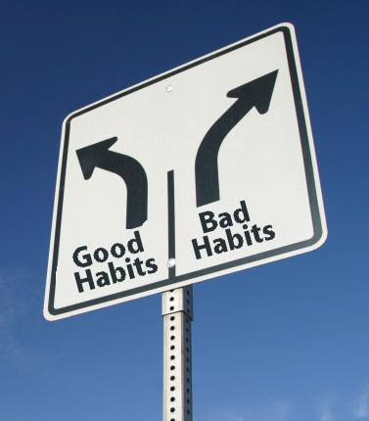
Problem Domain
Theme: Behavioral change
Focus: Building up & breaking down
HABITS

Slide 5
Initial Questions
> technology in daily habits?
> little effort, but changes behavior?
> fostering awareness rather than correction?
> user accountability & consistent engagement?
Notes:
How does technology currently play a role in people’s daily habits?
How can a technological tool require little effort from the user, but change their behavior?
How can a technological tool effectively make people aware of what they are doing (rather than what they should be doing)?
What about user accountability and consistency in engagement?

Slide 6
Road Map
1
2
brainstorm
expert interviews

Slide 7
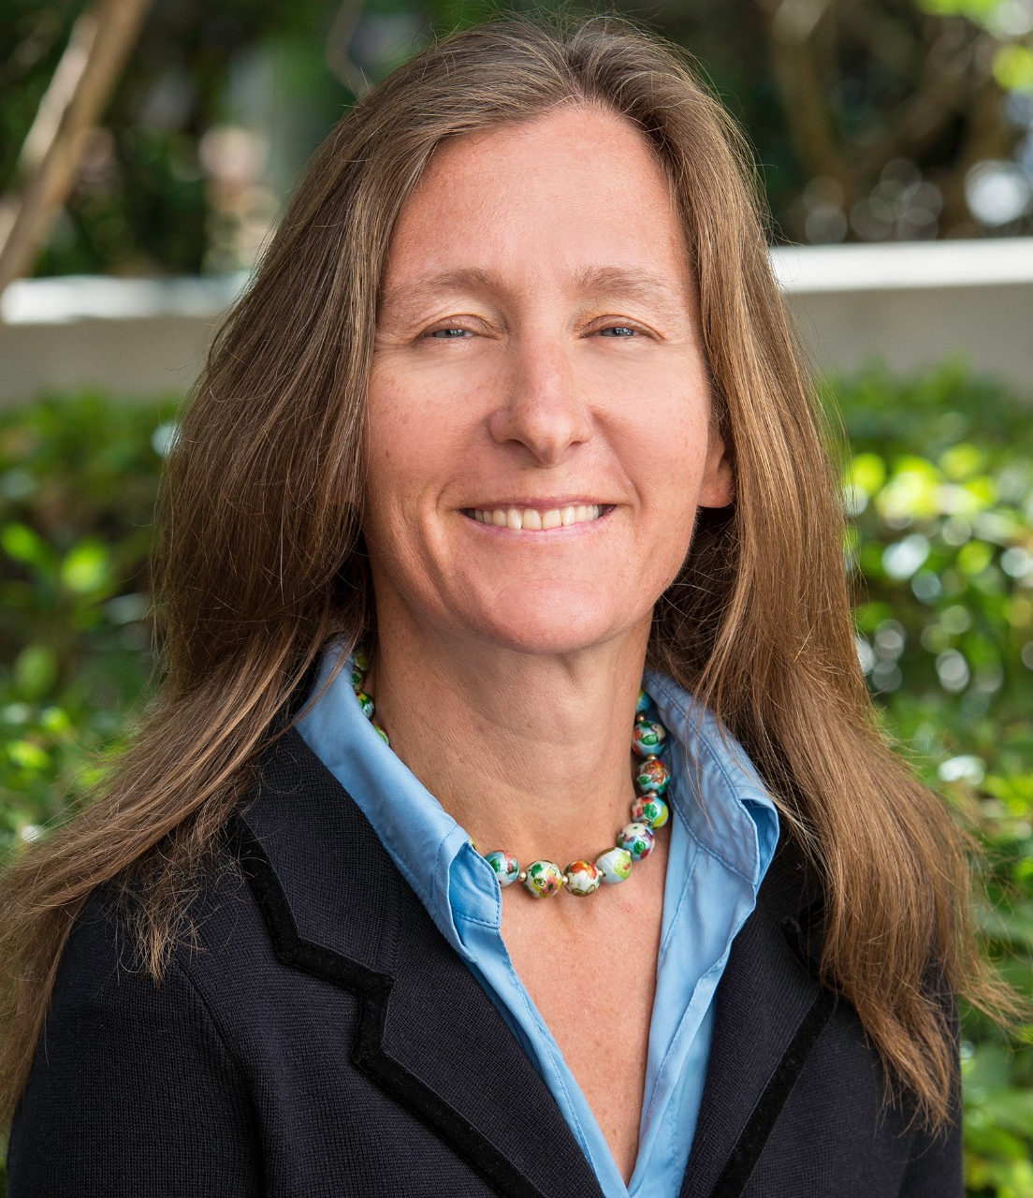
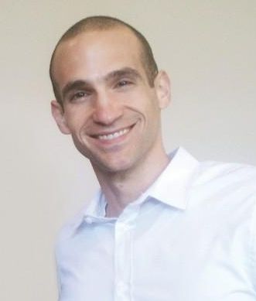
Expert Interviews
Dr. BJ Fogg
Founder, Stanford Persuasive Tech Lab
(Interview: 9/28)
Dr. Anna Lembke
Program, Director Stanford Addiction Medicine Program
(Interview: 9/28)
Nir Eyal
Author, Hooked
(Interview: TBD)

Slide 8
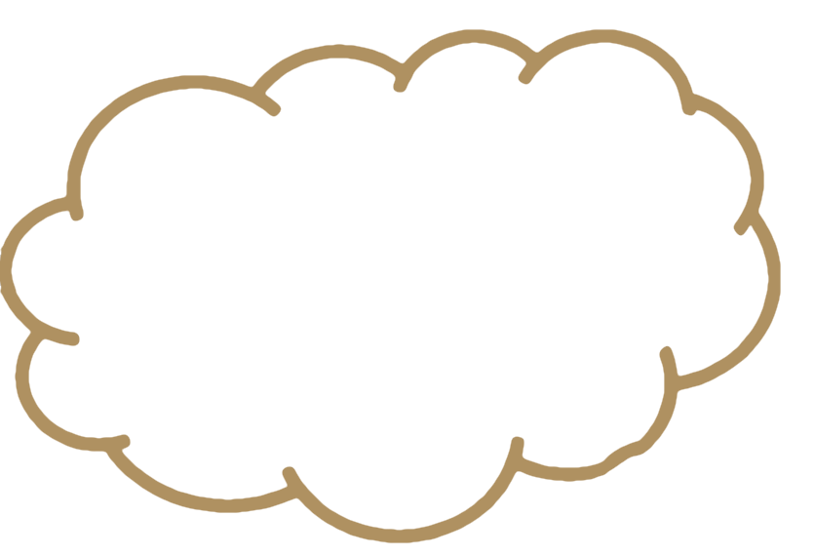
Expert Results
“Think about habits at three levels: aspirations, target outcome, and specific behaviors" -BJ Fogg
“Replacement or channelling addiction into something else is much better” -Anne Lembke
“Self help groups create communal values”
-Anne Lembke
“Technology overcomplicates things… you need to keep it simple”
-BJ Fogg
“Help people do what they already want to do… help them feel successful" -BJ Fogg
“Just the anticipation of a reward releases dopamine” -Anne Lembke
“Tiny habits create bigger habits" -BJ Fogg

Slide 9
Expert Results
“Think about habits at three levels: aspirations, target outcome, and specific behaviors" -BJ Fogg
“Replacement or channelling addiction into something else is much better” -Anne Lembke
“Self help groups create communal values”
-Anne Lembke
“Technology overcomplicates things… you need to keep it simple”
-BJ Fogg
“Help people do what they already want to do… help them feel successful" -BJ Fogg
“Just the anticipation of a reward releases dopamine” -Anne Lembke
“Tiny habits create bigger habits" -BJ Fogg

Slide 10
Road Map
1
2
3
brainstorm
expert interviews
end-user survey & interviews

Slide 11
End-User Survey & Interviews
Survey:
> 23 responses (still in the field)
> 3 Freshmen, 4 Sophomores,
4 Juniors, 10 Seniors, 2 Co-terms
Interviews:
> 4 interviews
> 2 Freshmen, 1 Sophomore,
1 Senior

Slide 12
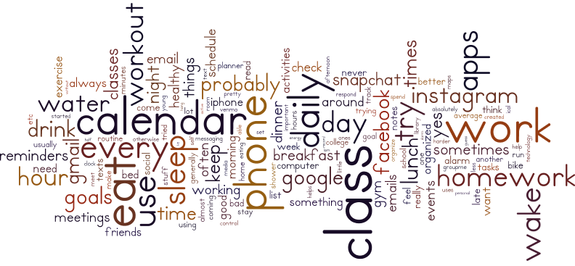
End-User Results

Slide 13
Road Map
1
2
3
brainstorm
expert interviews
end-user survey & interviews
4
empathy map

Slide 14
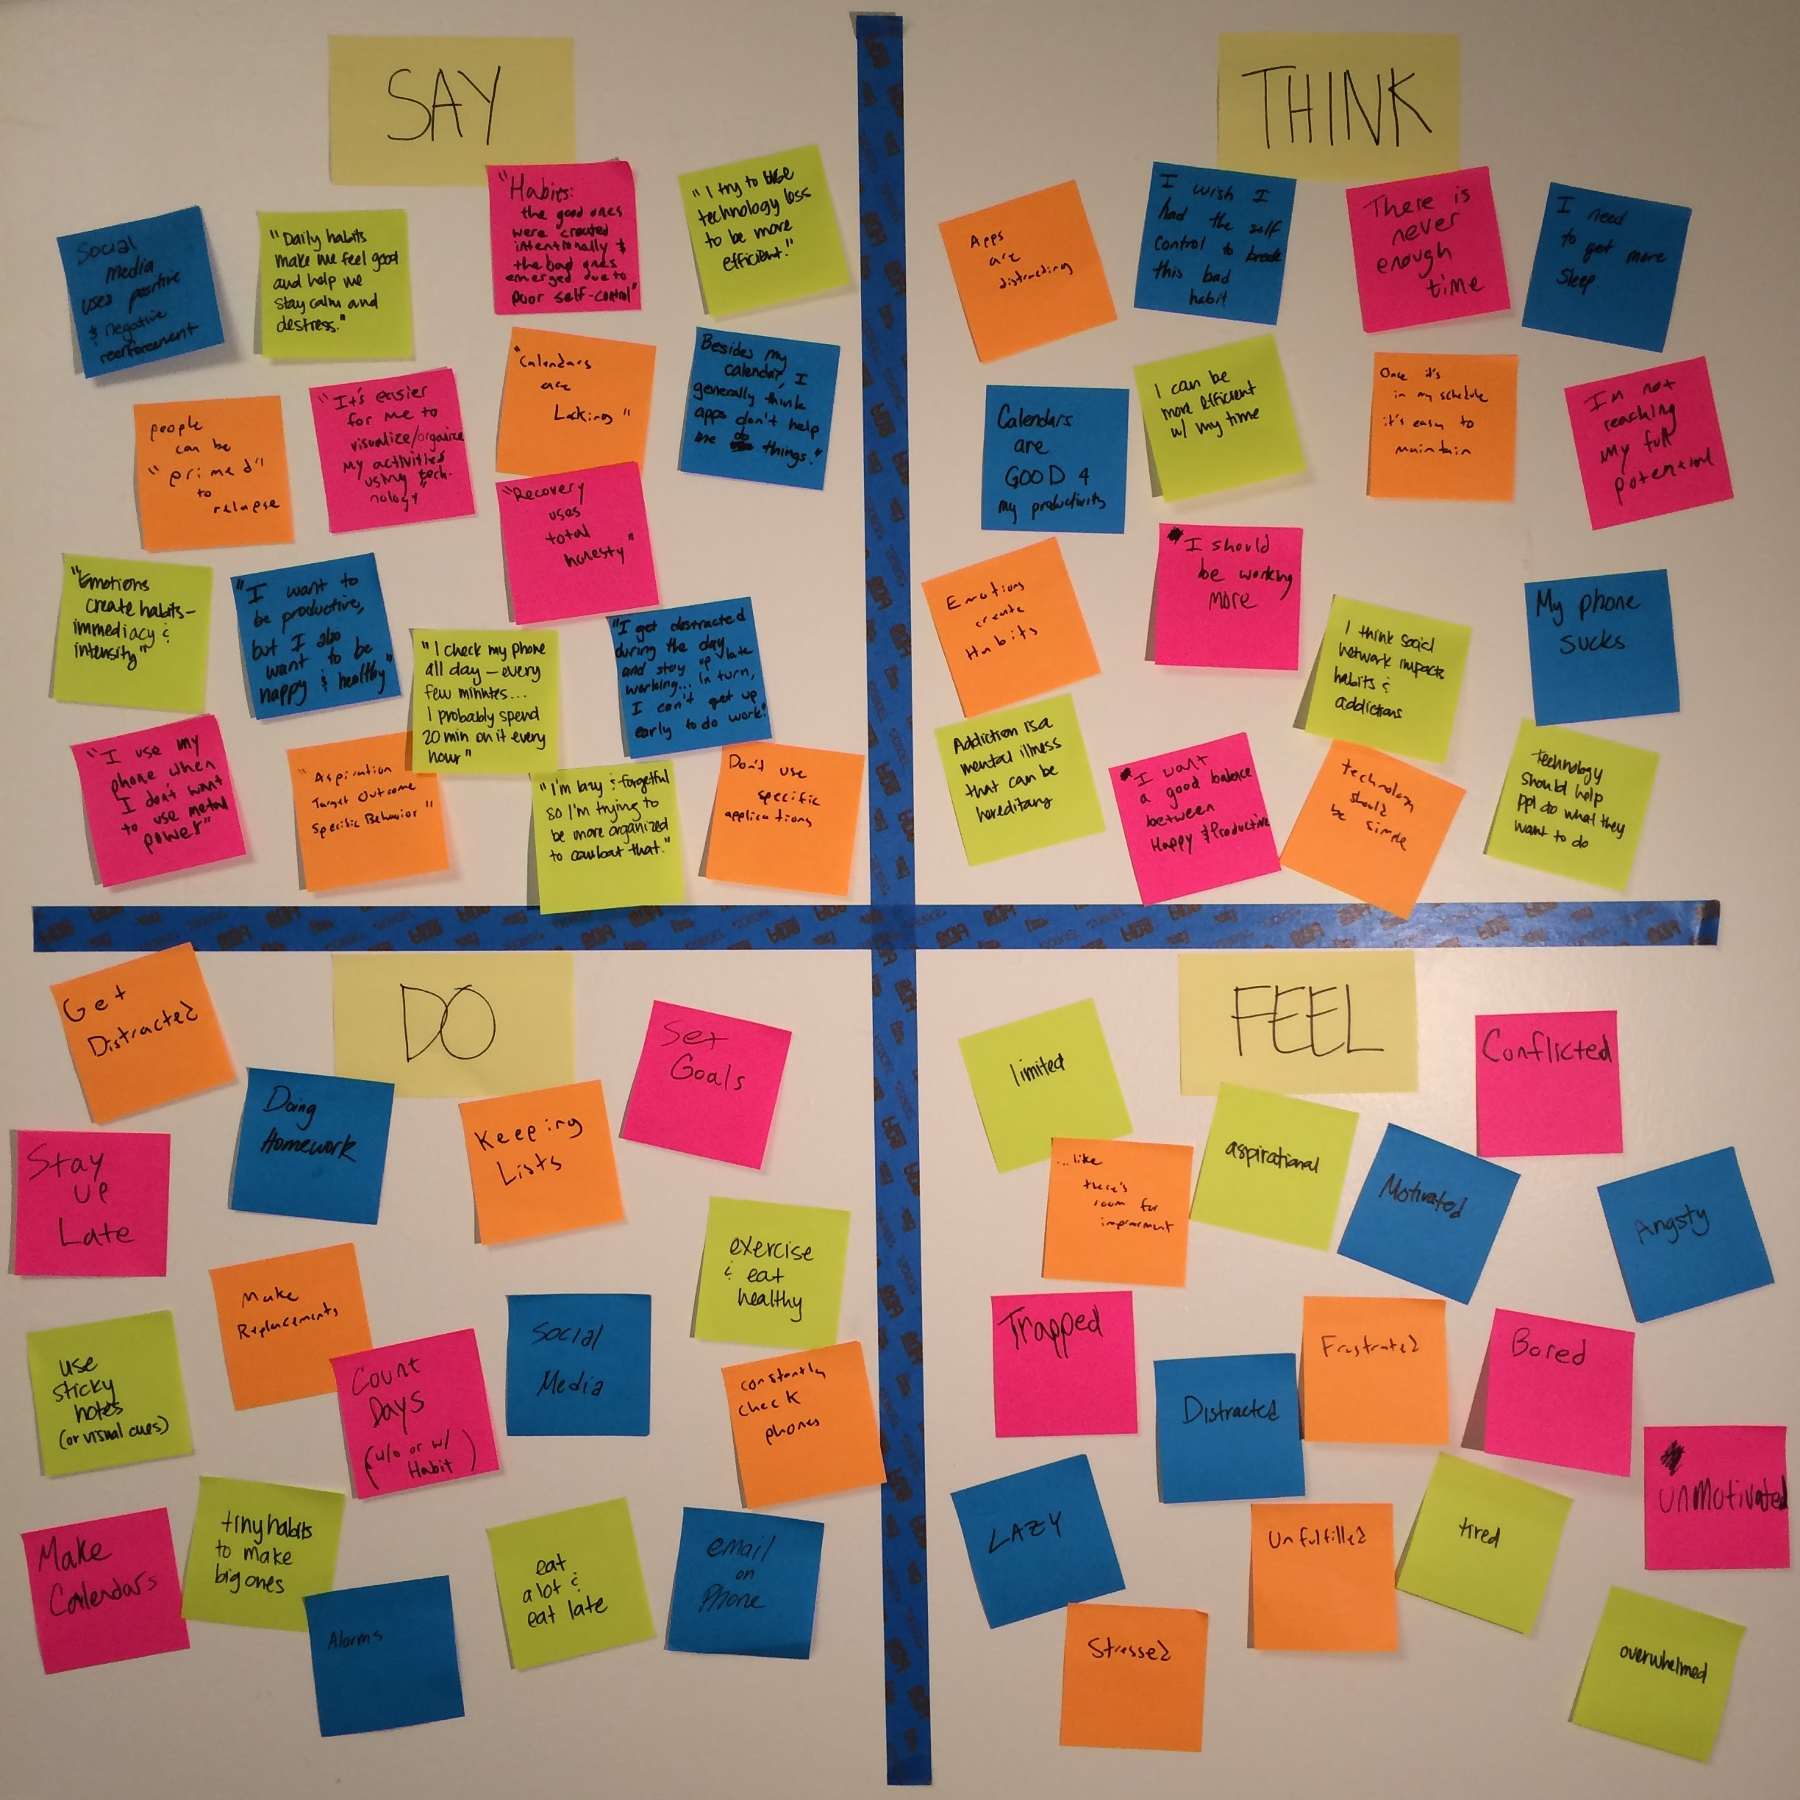
Empathy Map
Observations or “Needs”
> Constant engagement w/ phone
> Lists, calendars, alarms, & notes
> Lifestyle goals & changes
Inferences or “Insights”
> Technological harm > good
> Unfulfilled, limited, & conflicted
> Room for improvement

Slide 15
Road Map
1
2
3
brainstorm
expert interviews
end-user survey & interviews
4
5
empathy map
initial conclusions

Slide 16
Initial Conclusions
> tiny habits → bigger ones
> technology needs simplicity
> only essential apps are preferred
> other apps create distraction or aren’t effective
> breaking habits w/ technology needs work
Notes:
Habits are built up step by step - tiny habits make bigger ones
Breaking bad habits (addictions) with technology has not been successful or even tackled yet as its a very complex problem
People only used essential apps, or apps that are really good at a specific tasks.
Consistently heard stories about people trying niche apps, and finding them distracting or not very helpful.
In specific cases, we see people using apps well and to their advantage. But those cases were usually because they had a very specific need and use case.
General productivity apps are not generally helpful other than calendars.
Phones are distracting. Often by trying to use an app to break a bad habit, it leads to inefficiency because your phone is already out. (you text or use other apps because your phone is already out)
Effective apps use both positive and negative reinforcement techniques (Facebook example is what Fogg used)
> how can technology effectively break down habits/addictions?
> how can current niche apps be improved?
> how do you avoid distracting users rather than helping them?

Slide 17
Road Map
1
2
3
brainstorm
expert interviews
end-user survey & interviews
4
5
6
empathy map
initial conclusions
next steps → narrowed domain focus

Slide 18
Next Steps
identify
point of view
& potential end-users
narrow
needfinding & focus of problem domain
brainstorm potential solutions for prototyping

Slide 19
Recap
1
2
3
brainstorm
expert interviews
end-user survey & interviews
4
5
6
empathy map
initial conclusions
next steps → narrowed domain focus

Slide 20
Questions?

