Slide 1
Conceptual Models &
Interface Metaphors
November 3, 2015
Notes:
took 10 minute team break at 12:55 (1 hour, 20 minutes in – move break earlier)
need 5 more minutes overall (started 5 min late & skipped consistency -- had a good conversation on metaphor… but need more images

Slide 2

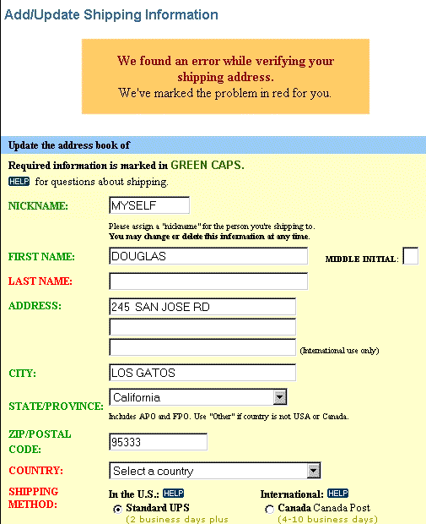
Hall of Fame or Shame?
Design based on a top retailer’s site

Slide 3

Hall of Shame!
Design based on a top retailer’s site
Color deficiency
  can’t distinguish between red & green
In study, user could not get by this screen!
How to fix?
  redundant cues

Slide 4
Hall of Fame or Shame?
M-Pesa mobile payments
Common in Africa
http://africanbusinessmagazine.com/wordpress/wp-content/uploads/2014/07/mobile-payment.png
http://blog.unibulmerchantservices.com/m-pesa-by-the-numbers/
Notes:
64% of Nigerians do not have a bank account
Over 80% have a mobile phone

Slide 5

Hall of Fame!
M-Pesa mobile payments
Common in Africa
Simple UI, but brings banking services to the unbanked!
http://africanbusinessmagazine.com/wordpress/wp-content/uploads/2014/07/mobile-payment.png
http://blog.unibulmerchantservices.com/m-pesa-by-the-numbers/
Notes:
64% of Nigerians do not have a bank account
Over 80% have a mobile phone

Slide 6
Conceptual Models &
Interface Metaphors
November 3, 2015
Notes:
1:07 with no time spent on metaphor/consistency slides

Slide 7
Outline
Review Heuristic Evaluation
Design of Everyday Things
Conceptual models
Team break
Interface metaphors
UI consistency

Slide 8
Review Heuristic Evaluation
Usability method that relies on who?
  experts
Ask evaluators to see if UI complies with heuristics
  note where it doesn’t, say why, & suggest fix
Combine the findings from 3 to 5 evaluators ?
  different evaluators find different problems
  adding more won’t be worth the cost
Cheaper or more expensive than user testing ?
  cheaper than user testing (time/cost)
False positives ?
  HE may find problems that users may never encounter
Alternate with user testing

Slide 9
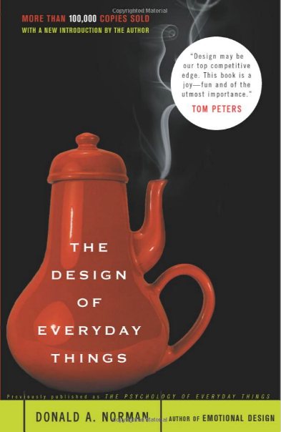
Design of Everyday Things
By Don Norman (UCSD, Apple, HP, NN Group, NU, UCSD)
Design of everyday objects illustrates problems faced by designers of systems
Explains conceptual models
  doors, washing machines, digital watches, telephones, ...
Resulting design guides
→ Highly recommended

Slide 10
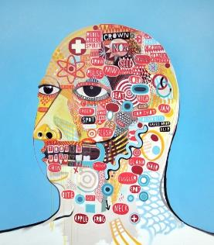
Conceptual Model?
    Mental representation of how an artifact works & how interface controls affect it
People may have preconceived
models that are hard to change
  (4 + 5) vs. (4 5 +)
  dragging to trash?
    deletes file but ejects disk
Interface must communicate model
  visually (& possibly physically or using sound)
  shouldn’t need online help & documentation
David Shillinglaw
Notes:
Also sometimes called a “Mental Model”

Slide 11
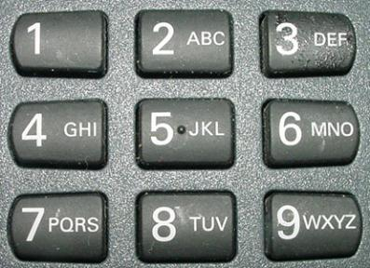

Affordances as Perceptual Clues
Well-designed objects have affordances
  clues to their operation
  often visual, but not always (e.g., speech)
What affordances do you see here?
Notes:
In DOET, affordances are visual. But affordances are more than that. Affordances can be physical or audio

Slide 12
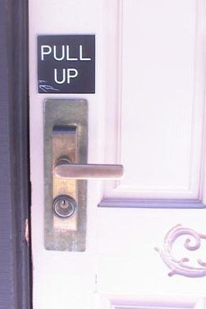
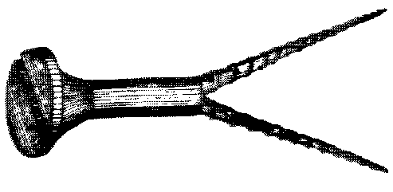
Affordances as Perceptual Clues
Poorly-designed objects
  no clues or misleading clues
French artist Jacques Carelman
Crazy design for a screw punch!
Notes:
misleading

Slide 13
Refrigerator
freezer
fresh food
Problem: freezer too cold, but fresh food just right

Slide 14
Refrigerator Controls
Normal Settings C and 5
Colder Fresh Food C and 6-7
Coldest Fresh Food B and 8-9
Colder Freezer D and 7-8
Warmer Fresh Food C and 4-1
OFF (both) 0
A B C D E
7 6 5 4 3
What is your conceptual model?
Spend 30 sec. drawing a diagram showing your model (where the cooling units are & how controlled)
Share with your neighbor
Notes:
Take 30 seconds to draw it & then share with your neighbor

Slide 15
A Common Conceptual Model
A B C D E
cooling
unit
7 6 5 4 3
cooling
unit
independent controls

Slide 16
Actual Conceptual Model
A B C D E
cooling
unit
7 6 5 4 3
Can you fix the problem?
Possible solutions
  make controls map to customer’s model
  make controls map to actual system

Slide 17
Design Model & Customer Model
Design Model
Customer Model
System Image
Customers get model from experience & usage
  through system image
What if the two models don’t match?

Slide 18
Conceptual Model Mismatch
Mismatch between designer’s & customer’s conceptual models leads to…
  slow performance
  errors
  frustration
  ...

Slide 19
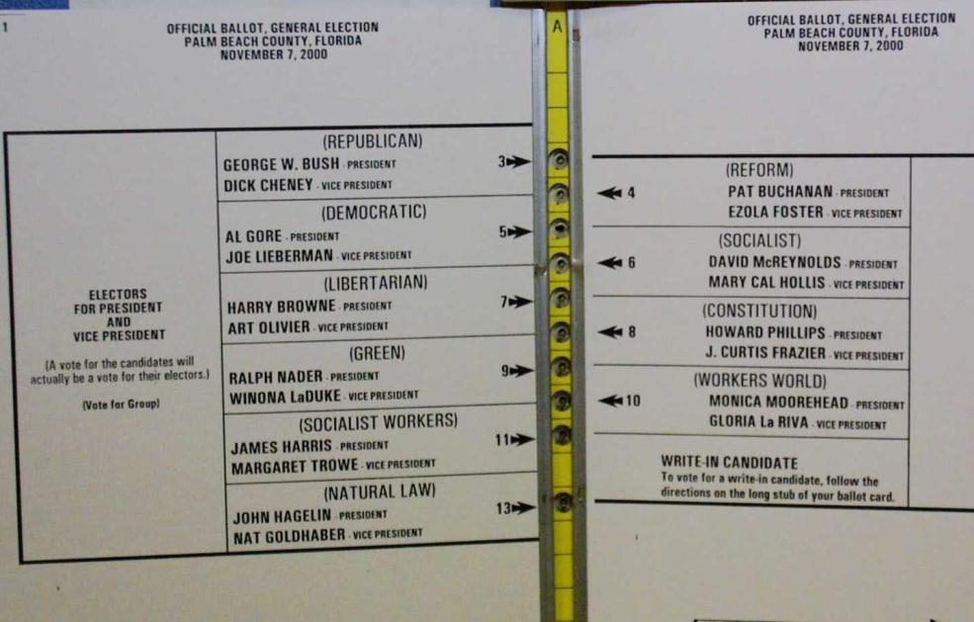
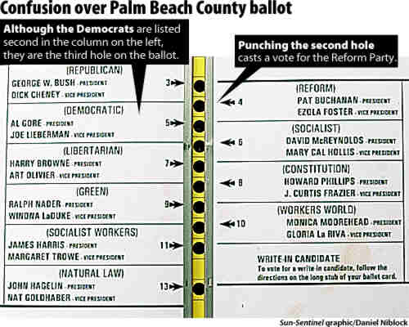
Notorious Example
Notes:
2000 Presidential Election. Palm Beach Florida

Slide 20
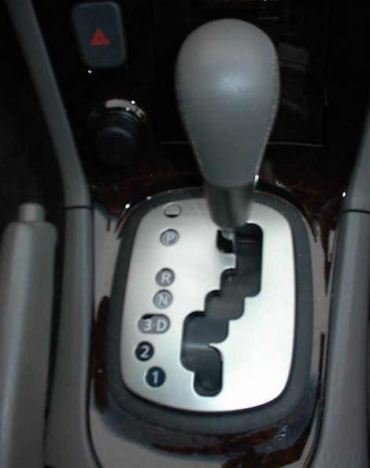
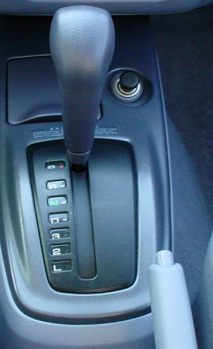
Car Automatic Shifter
Notes:
Image at left seems obvious, but many first time users of this design don’t notice the difference between “3 and D” and in fact put the car in third gear when they mean to put it in Drive.
The more standard gear shift distinguishes these more directly.
On the other hand, the newer design has a more PHYSICAL feedback

Slide 21
Design Guides
Provide good conceptual model
  customer wants to understand how controls affect object
Make things visible
  if object has function, interface should show it
Map interface controls to customer’s model
  infix vs. postfix calculator – whose model is that?
Provide feedback
  what you see is what you get! (WYSIWYG)

Slide 22
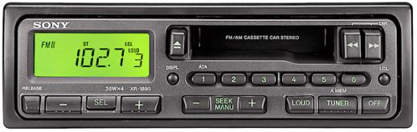
Make Things Visible
Refrigerator (?)
  make the A..E dial something about percentage of cooling between the two compartments?
Controls available on watch w/ 3 buttons?
  too many and they are not visible!
Compare to controls on simple car radio
  #controls = #functions
  controls are labeled (?) and grouped together
  tradeoffs of the “glass UI” (e.g., Tesla)?

Slide 23
Map Interface Controls to Customer’s Model
Which is better for car dashboard speaker front / back control?
Control should mirror real-world
Dashboard
1
2

Slide 24
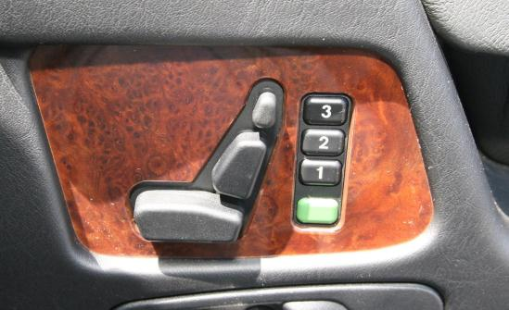
Map Interface Controls to Customer’s Model
Which is better for car dashboard speaker front / back control?
Control should mirror real-world
Mercedes Benz Seat Control

Slide 25
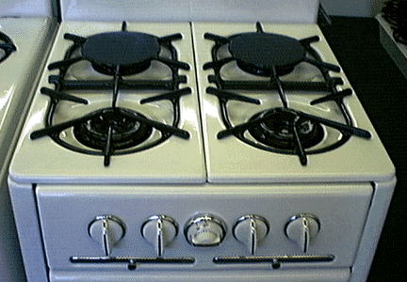
Map Interface Controls to Customer’s Model
Problem?
Which knob controls which burner?

Slide 26
Map Interface Controls to Customer’s Model
Possible fixes?

Slide 27
Administriva
Louis is running an iOS workshop this week/weekend (Thur/Friday/Sat/Sun)
  please respond to poll on Piazza so he knows which slot to run it in
Hi-Fi Prototype Assignment posted Thur
  final prototype due 12/3
  mid-way milestone is due on 11/19– just before Thanksgiving
  key deliverables (final)
    redesigned UI based on HE report & CA feedback
    native prototype sufficient to carry out usability test w/ target users completing your three tasks (unlike medium-fi)
      mobile web implementations need pre-approval from the teaching staff
    look & feel of final application on target platform with good visual design
    all of underlying functionality does not have to work
    report (cumulative)
  key deliverables (mid-way)
    at least 1 of 3 tasks should work (you will demo)
    9-minute presentation describing how you got to the new design & current implementation status

Slide 28
Team break
Notes:
broke at 12:55 (1 hour, 20 minutes in – move break earlier)

Slide 29
Metaphor
Definition ?
  “The transference of the relation between
  one set of objects to another set for the
  purpose of brief explanation.”
Lakoff & Johnson, Metaphors We Live By
  “...the way we think, what we experience, and what we do every day is very much a matter of metaphor.”
  in our language & thinking – “argument is war”
    … he attacked every weak point
    … criticisms right on target
    … if you use that strategy
We can use metaphor in interface design to
leverage existing conceptual models

Slide 30
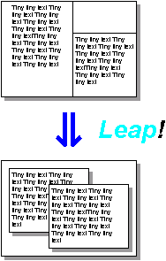
Desktop Metaphor
Suggests a conceptual model
  not really an attempt to simulate a real desktop
  a way to explain why some windows seemed blocked
  leverages existing knowledge about files, folders & trash
Notes:
The first image is the windows as invented by Engelbart
When you push a metaphor TOO far is when it gets interesting

Slide 31
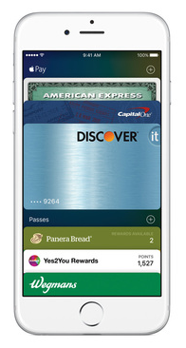
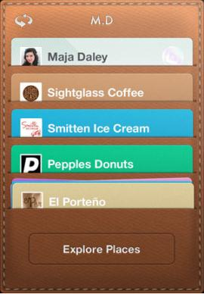
Example Metaphors
Global metaphors
  personal assistant, wallet, clothing,
  pens, cards, telephone, eyeglasses
Data & function
  rolodex, to-do list, calendar,
  applications documents, find, assist
Collections
  drawers, files, books,
  newspapers, photo albums
Square Card Case

Slide 32
How to Use Metaphor
Develop interface metaphor tied to
conceptual model
Communicate that metaphor to the user
Provide high-level task-oriented operations, not low-level implementation commands
Notes:
32
Develop interface metaphor or conceptual model
Communicate that metaphor to the user
Provide high-level task-oriented operations not low-level implementation commands

Slide 33
Metaphor for Metaphor’s Sake
If it doesn’t help, why have it?
Skeuomorphism: “making items resemble their real-world counterparts” or “a physical ornament or design on an object made to resemble another material or technique”
Argument against: takes up too much space & leads to inconsistent look
Argument for: helps people learn
Notes:
33
Pushback on use of metaphor
Skeuomorphism is the design concept of making items represented resemble their real-world counterparts. Skeuomorphism is commonly used in many design fields, including user interface (UI) and Web design, architecture, ceramics and interior design.
The shutter-click sound emitted by most camera phones when taking a picture is an auditory skeuomorph: it does not come from a mechanical shutter, which camera phones lack, but from a sound file in the phone's operating system.

Slide 34
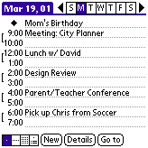
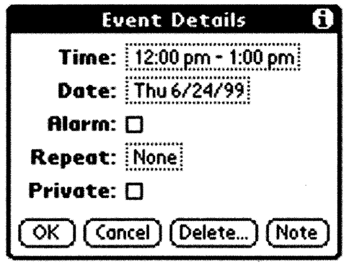
Is Consistent Always Better?
NO
Palm PDA example: should “new appointment” & “delete appointment” be in the same place?
New (add) is common, but delete is not
Notes:
Consistency of having add/delete together always, vs. making it faster for common task

Slide 35
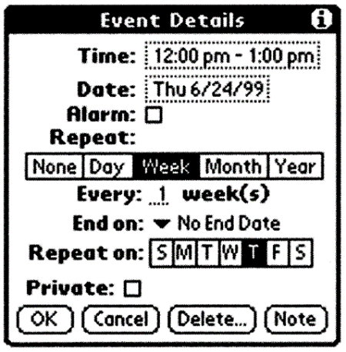

Is Consistent Always Better?
NO
Early Palm design
(like desktop version)
Streamlined design
Notes:
Consistency with desktop (early design) vs. making it better for mobile

Slide 36
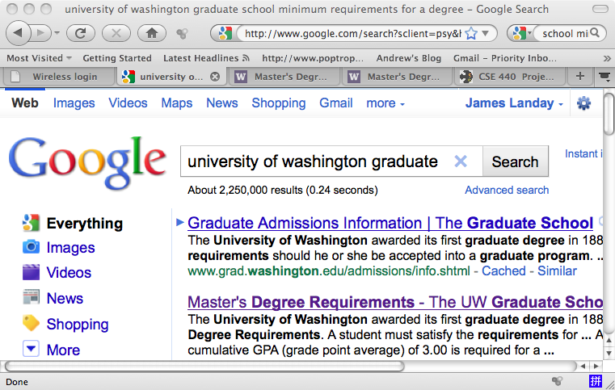
Is Consistent Always Better?
NO
Firefox 3 Back/Forward Buttons

Slide 37
Ways of Being Consistent
Interfaces should be consistent in a
meaningful way
  e.g., ubiquitous use of same keys for cut/copy/paste
Types of consistency
  consistent internally
    e.g., same terminology and layout throughout app
  consistent with other apps
    ex. works like MS Word, uses keyboard conventions
    design patterns (across many apps)
  consistent with physical world

Slide 38
Summary
Conceptual models ?
  mental representation of how the object works & how interface controls effect it
Design model should equal customer’s model ?
  mismatches lead to errors
  use customer’s likely conceptual model to design
Design guides ?
  make things visible
  map interface controls to
  customer’s model
  provide feedback
Design Model
Customer Model
System Image

Slide 39
Further Reading
Design of Everyday Things, Donald Norman
Design as Practiced, Donald Norman
  Talks about failure to make changes to Macintosh
  http://www.jnd.org/dn.mss/Design_as_Practiced.html
Computing the Case Against User Interface Consistency, Jonathan Grudin
  Talks about why interfaces should not always be consistent
  http://citeseerx.ist.psu.edu/viewdoc/download?doi=10.1.1.90.6480&rep=rep1&type=pdf

Slide 40
Next Time
User Testing
Readings
  none
Group HE assignment in this week’s studio
  have your individual assignment with you & easily accesible electronically
Next team assignment
  High-fidelity Prototype
    fix HE issues brought up by your evaluators
    implement application on native platform (unless permission from us to do otherwise)
    backends & other pieces can be faked as necessary

