Slide 1
Heuristic Evaluation
October 29, 2015
Notes:
[75 minutes – was Shooting for 60 minutes including 25 minute exercise – gave 15 minutes to do exercise and discussed for 10 minutes] – cut a little more
Lecture ended at 12:45, giving them 35 minutes for team work (shooting for 45-50 minutes)
Today I’m going to tell you about a useful technique in the evaluation of the DESIGN of software products…

Slide 2

Hall of Fame or Shame?
LG F7100
courtesy of Genevieve Bell, Intel
Notes:
Qiblah phone
UAE, Saudia Arabia, North Africa, India Malaysia

Slide 3

Hall of Fame!
LG F7100
courtesy of Genevieve Bell, Intel
Good
  targeted at Muslim audience
  need to pray 5x/day pointing
  towards Mecca
Notes:
Mecca Phone

Slide 4
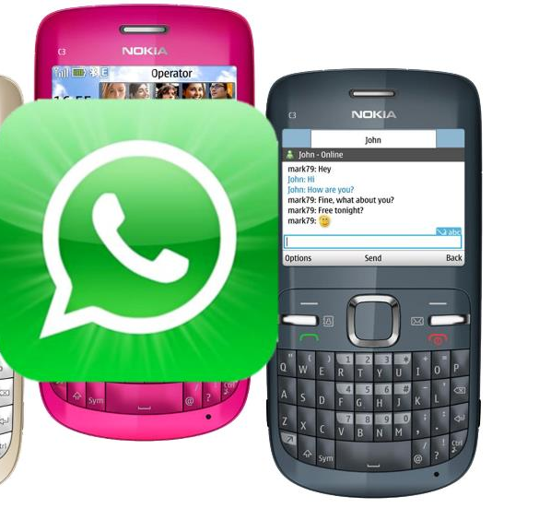
Hall of Fame or Shame?
WhatsApp
mobile messaging
Notes:
Works on some non-smart phones… allowed it to really take off in the developing world

Slide 5
Hall of Fame!
WhatsApp
mobile messaging
Good
  do not have to pay expensive SMS
  can contact people on other phones
  works on “feature” phones → led to rapid take-off in developing world

Slide 6
Heuristic Evaluation
October 29, 2015
Notes:
Today I’m going to tell you about a useful technique in the evaluation of the DESIGN of software products…

Slide 7
Outline
Visual Design Review
Wizard of Oz
Heuristic Evaluation Overview
The Heuristics
Exercise
Team Break

Slide 8
Visual Design Review
Start with context
  what is the nature of the information?
  what is the most important?
Avoid clutter, focus on the essence of your tasks – CUT!
Design first in?
  grayscale to focus on hierarchy
  use proximity & size to indicate importance
Small changes help us see
  key differences (e.g., small multiples)
Use color properly – not for
  ordering!
Only use 1-2 colors at a time, unless absolutely necessary

Slide 9
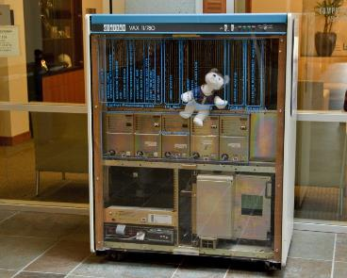
Wizard of Oz Technique
Faking the interaction. Comes from?
  the film “The Wizard of OZ”
    “the man behind the curtain”
Long tradition in computer industry
  e.g., prototype of a PC w/ a DEC VAX behind the curtain
Notes:
1) "wizard of oz" is when you use a person or some other way to fake an interaction that has not been implemented yet. An early example of this in computing was when designing a speech-based UI, to use a human to do the recognition and even output to simulate a functioning system before it is built. Similar things have been done for handwriting recognition. Today, you could imagine that if your application needed working location-sensing features that weren't accurate enough yet or maybe even some more complicated machine learning feature that didn't exist yet, you could have a person (not the end-user) select it from a menu and have that impact the experience of a user testing your application. To the end-user it would appear as if your application worked as designed.

Slide 10
Wizard of Oz Technique
Faking the interaction. Comes from?
  the film “The Wizard of OZ”
    “the man behind the curtain”
Long tradition in computer industry
  e.g., prototype of a PC w/ a DEC VAX behind the curtain
Much more important for hard to implement features
  speech & handwriting recognition
Notes:
2) "hard-coded features" are similar. Often, you might have an application that needs to require on a large data set (1000s of products, 100s of friends in a social network, 1000s of places with review information, etc.). None of this data may be impossible to get in practice, but for testing your user interface you may want to just "hard-code" some of this data in your app to give the flavor of how it will work (e.g., all the places are on the Stanford campus or you type in 30 products, or you simulate the friends in the social network, but all your users see the SAME list of friends) to allow you to test it or demo it.

Slide 11
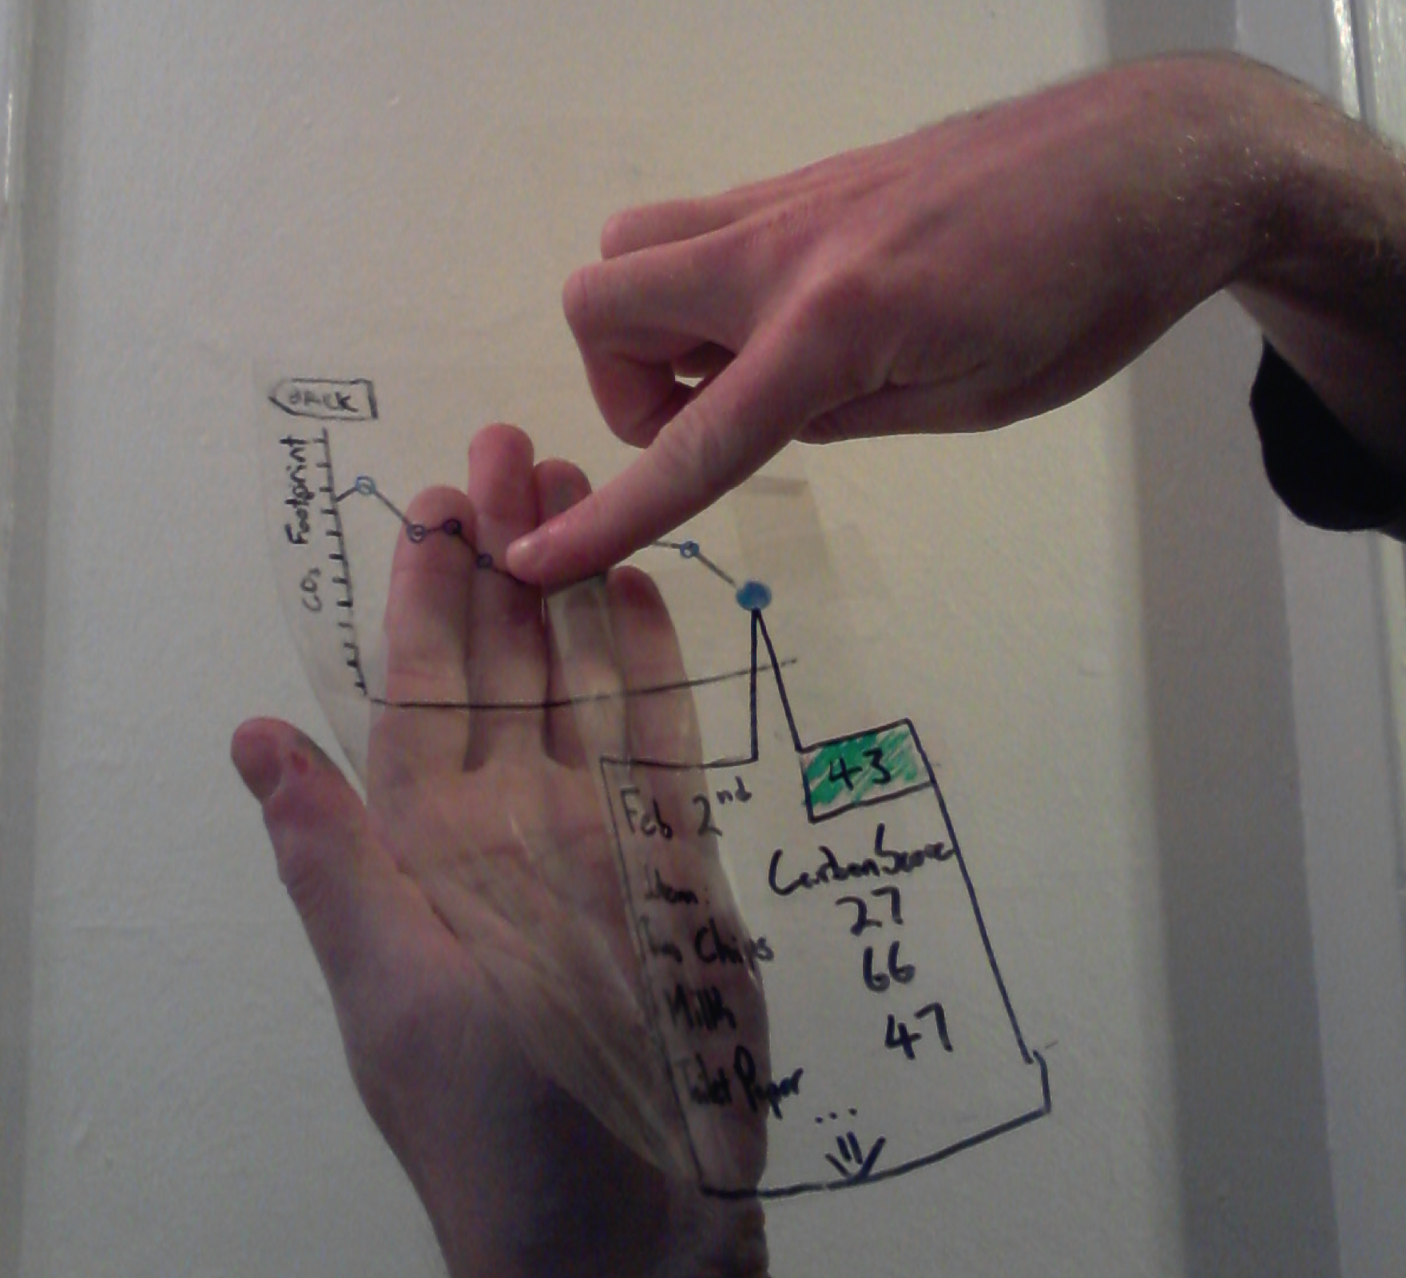
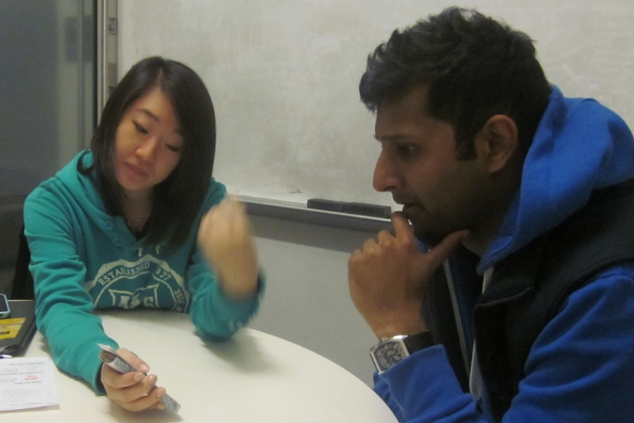
Evaluation
About figuring out how to improve design
Issues with lo-fi tests?
Notes:
Ask and THEN NEXT SLIDE

Slide 12
Evaluation
About figuring out how to improve design
Issues with lo-fi tests?
Not realistic
  visuals & performance
Not on actual interface
  can’t test alone
Need participants
  can be hard to find repeatedly
Notes:
Issues with lo-fi:
Not realistic
Not on actual interface
Need participants

Slide 13
Heuristic Evaluation
Developed by Jakob Nielsen
Helps find usability problems in a UI design
Small set (3-5) of evaluators examine UI
  independently check for compliance with usability principles (“heuristics”)
  evaluators only communicate afterwards
    findings are then aggregated
  use violations to redesign/fix problems
Can perform on working UI or on sketches

Slide 14
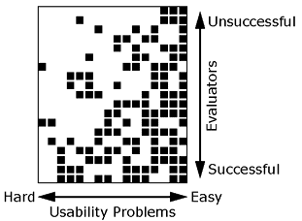
Why Multiple Evaluators?
Every evaluator doesn’t find every problem
Good evaluators find both easy & hard ones
Notes:
Meaning?
Need multiple evaluators because:
Every evaluator doesn’t find every problem
Good evaluators find both easy & hard ones

Slide 15
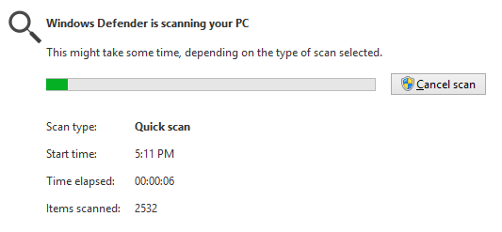
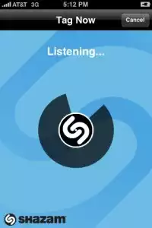

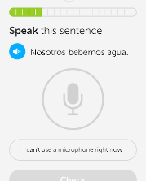
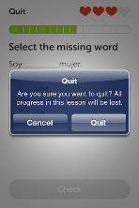
Heuristics
H2-1: Visibility of system status
H2-2: Match between system & real world
H2-3: User control & freedom
Notes:
DuoLingo – no way when practicing to ask to “test out” like in other parts of the UI. Need to quit & go select the function. (courtesy Armando Mota)

Slide 16
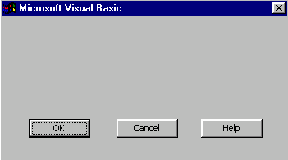
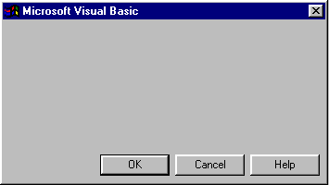
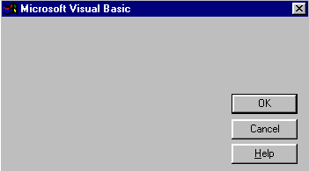
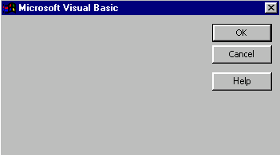
Heuristics (cont.)
H2-4: Consistency & standards
H2-5: Error prevention
H2-6: Recognition rather than recall
H2-7: Flexibility and efficiency of use
H2-8: Aesthetic & minimalist design
H2-9: Help users recognize, diagnose, & recover from errors
Notes:
These are all from the same UI… what’s the problem? Why? (-> consistency)

Slide 17
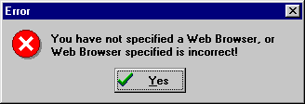
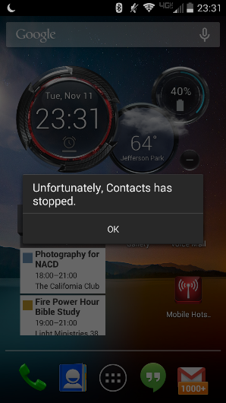
Heuristics (cont.)
bad
Notes:
Galaxy S4 message

Slide 18
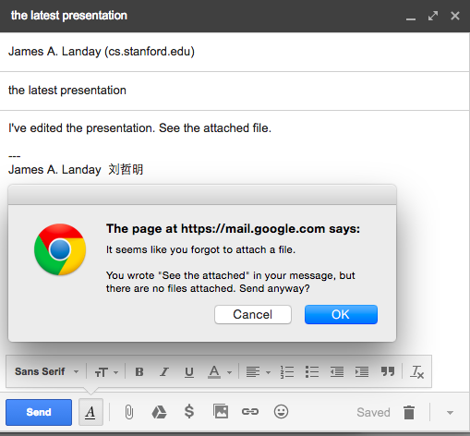
Heuristics (cont.)
good

Slide 19
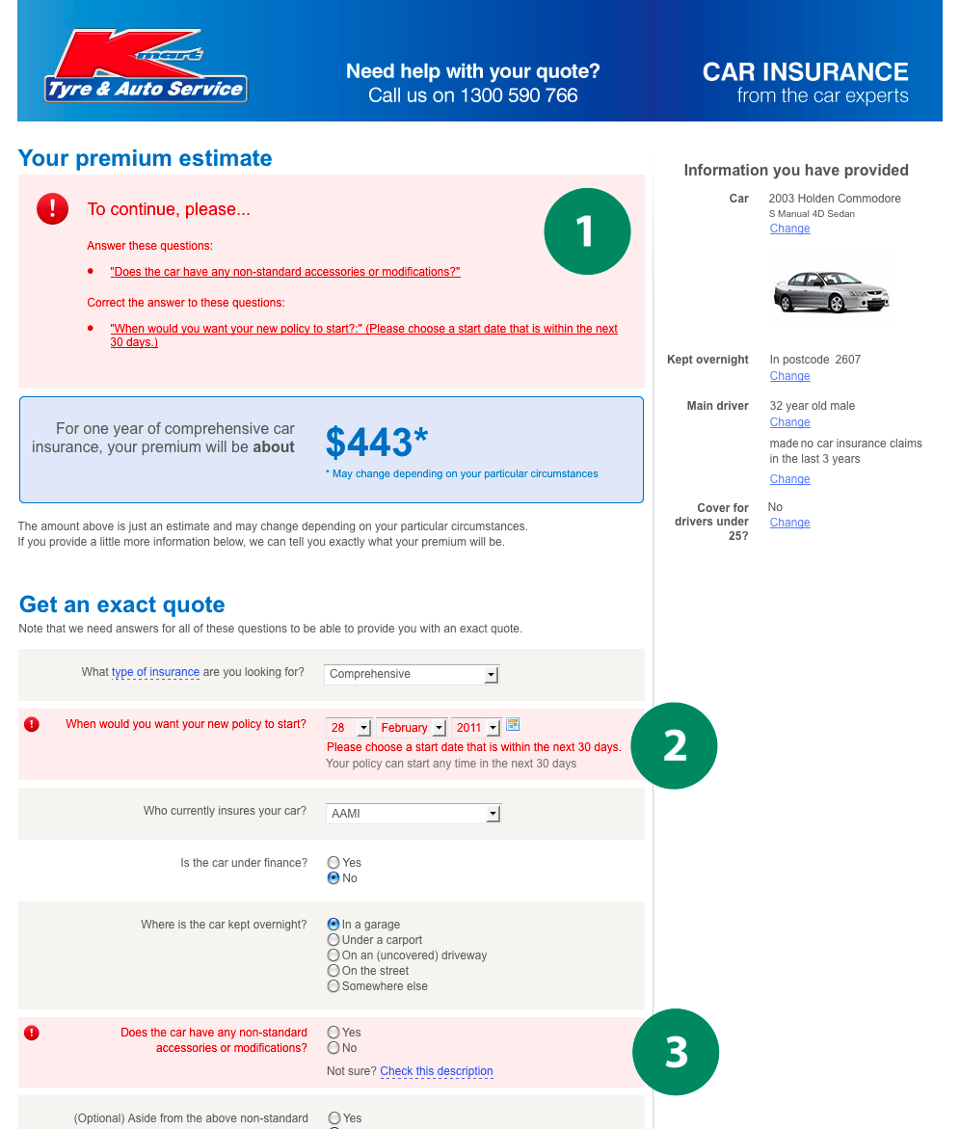
Good Error Messages
Clearly indicate what
has gone wrong
Human readable
Polite
Describe the problem
Explain how to fix it
Highly noticeable

Slide 20
Heuristic Violation Examples
[H1-3 Minimize the users’ memory load]
Can’t copy info from one window to another
  fix: allow copying
[H2-4 Consistency and Standards]
Typography uses different fonts in 3 dialog boxes
  slows users down
  probably wouldn’t be found by user testing
  fix: pick a single format for entire interface

Slide 21
Severity Ratings
0 - don’t agree that this is a usability problem
1 - cosmetic problem
2 - minor usability problem
3 - major usability problem; important to fix
4 - usability catastrophe; imperative to fix

Slide 22
Severity Ratings Example
1. [H1-4 Consistency] [Severity 3]
The interface used the string “Save” on the first screen for saving the user’s settings, but used the string “Store” on the second screen. Users may be confused by this different terminology for the same function.

Slide 23
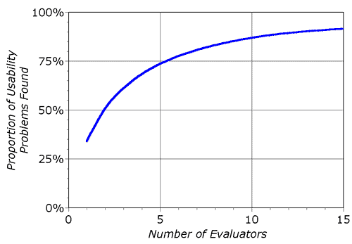
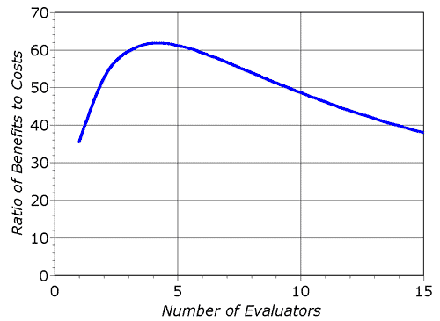
Decreasing Returns
problems found
benefits / cost
* Caveat: graphs for a specific example

Slide 24
Heuristic Evaluatoin Summary
Have evaluators go through the UI twice
Ask them to see if it complies with heuristics
  note where it doesn’t & say why
Combine the findings from 3 to 5 evaluators
Have evaluators independently rate severity
Alternate with user testing

Slide 25
e x e r c i s e

Slide 26
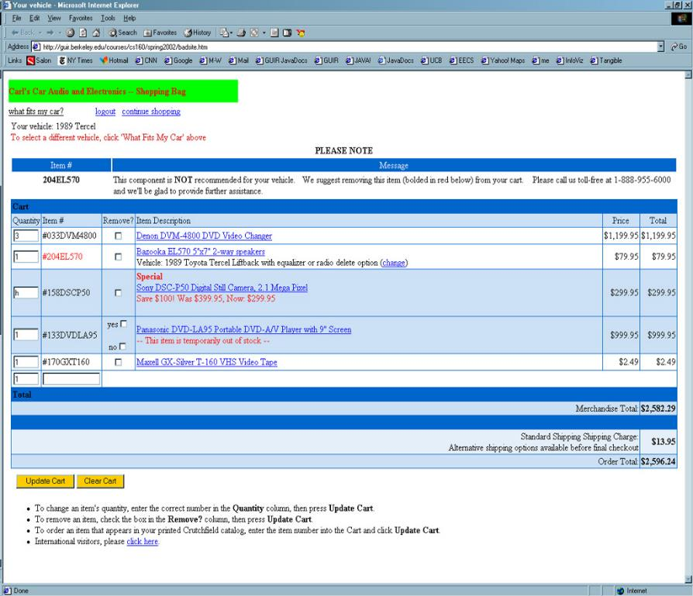
e x e r c i s e
Notes:
Let’s take 15 minutes

Slide 27
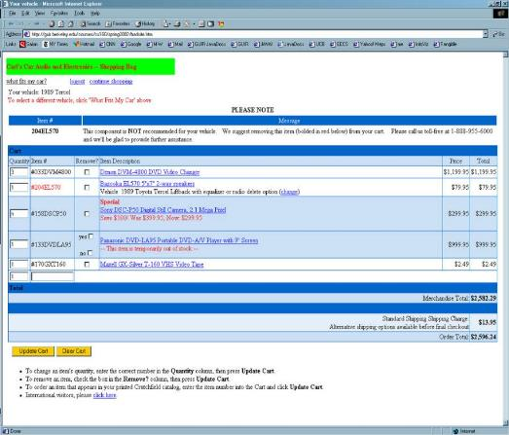
http://hci.stanford.edu/courses/cs147/2015/
au/assignments/simple-heuristic-evaluation.pdf
Find 12-15 Heuristic Violations
Turn in on Coursework after we discuss
Notes:
Let’s take 15 minutes

Slide 28
Problems Found
H2-4 Consistency
remove column, 4th item is different w/ checkboxes. [150]
H2-9 Error prevention
non-numeric data in the quantity. Do not allow. [125]
H2-2 Match between system & real world
vehicle selection link not language I’d expect [100]
H2-1 Visibility of System Status
unclear which item to remove based on error message (“red/bold”). [150]
Notes:
Collect and discuss problems for 10 minutes

Slide 29
Further Reading
Heuristic Evaluation
Books
  Usability Engineering, by Nielsen, 1994
Web site
  http://www.nngroup.com/articles/

Slide 30
Next Time
Lecture
  Conceptual Models & Interface Metaphors
Read
  “The Psychology of Everyday Things” (Ch. 1), from The Design of Everyday Things by Donald Norman
Studio
  Medium-fi Prototype Presentations
  Break early

Slide 31
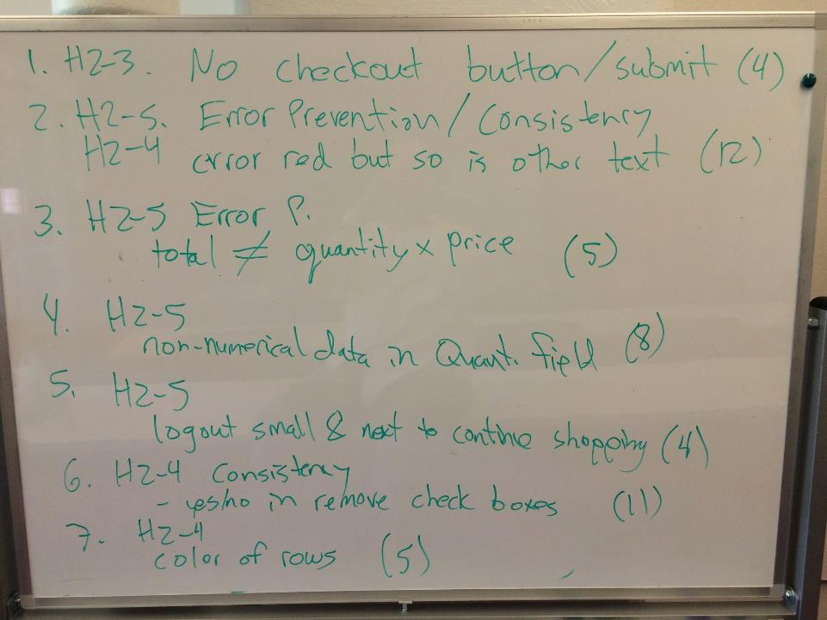
Notes:
Cornell class results with number having found that problem in parenthesis

Slide 32
