Slide 1
Design Exploration Through Sketching & Experience Prototyping
This work is licensed under the Creative Commons Attribution-
Noncommercial-Share Alike 3.0 Unported License. To view a copy of
this license, visit http://creativecommons.org/licenses/by-nc-sa/3.0/
October 6, 2015
* slides marked Buxton are courtesy of Bill Buxton, from his talk “Why I Love the iPod, iPhone, Wii and Google”, remix uk, 18-19 Sept. 2008, Brighton
Notes:
51 minutes until the team break (at 12:20)
Finished at 1:16 (4 minutes early)
Perfect on time. Maybe MORE info on how to create experience prototypes (example).
Also move some of the Experience Prototype content to the previous lecture on Ideation so that is has been seen before that assignment is given out.

Slide 2
Hall of Fame or Shame?
THINQ Smart Fridge
By LG
Notes:
Samsung Smart Fridge (THINQ UI)

Slide 3
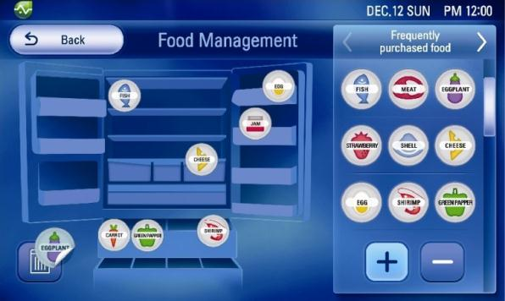
Hall of Fame or Shame?
THINQ Smart Fridge
By LG
Notes:
Samsung Smart Fridge (THINQ UI)

Slide 4
Hall of Shame!
Forget about UI specifics
Who wants this????
Notes:
Samsung Smart Fridge (THINQ UI)

Slide 5
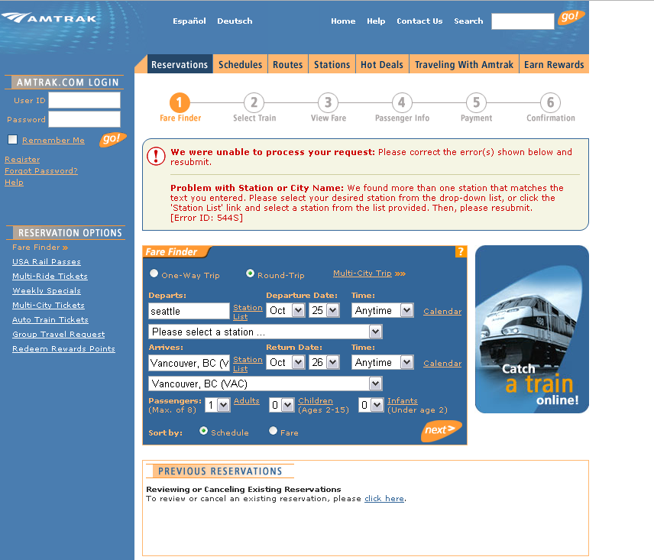
Interface Hall of Shame or Fame?
Amtrak Web Site (US trains)

Slide 6
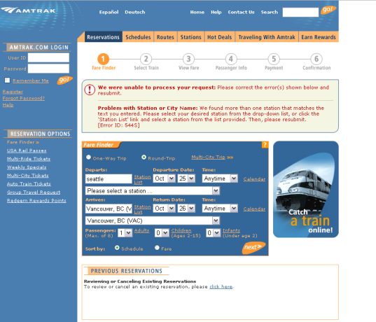
Interface Hall of Fame/Shame!
Amtrak Web Site (US trains)
Good
tells you what’s wrong
gets your attention
Bad
doesn’t label where to fix issues
tells you that you made an error, because you didn’t know their codes

Slide 7
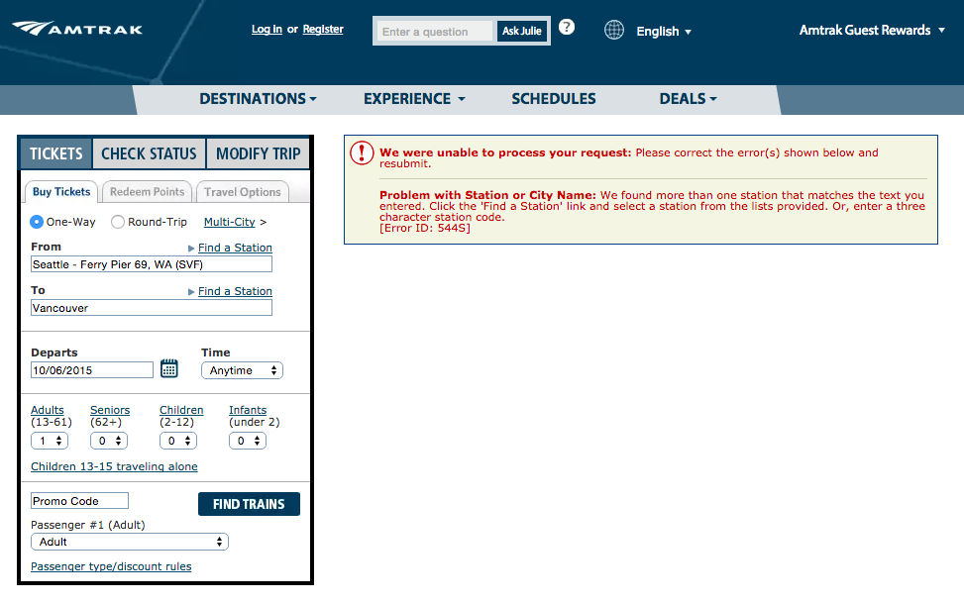
Interface Hall of Fame/Shame!
Amtrak Web Site (US trains)
New Version is marginally better

Slide 8
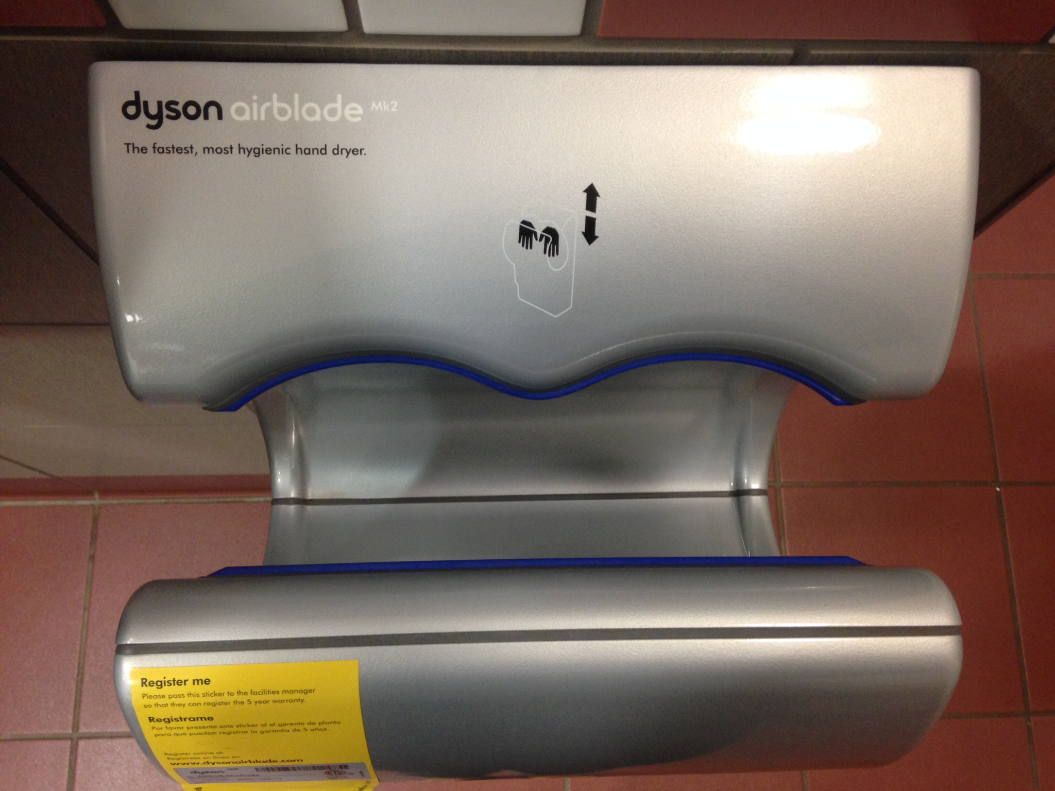
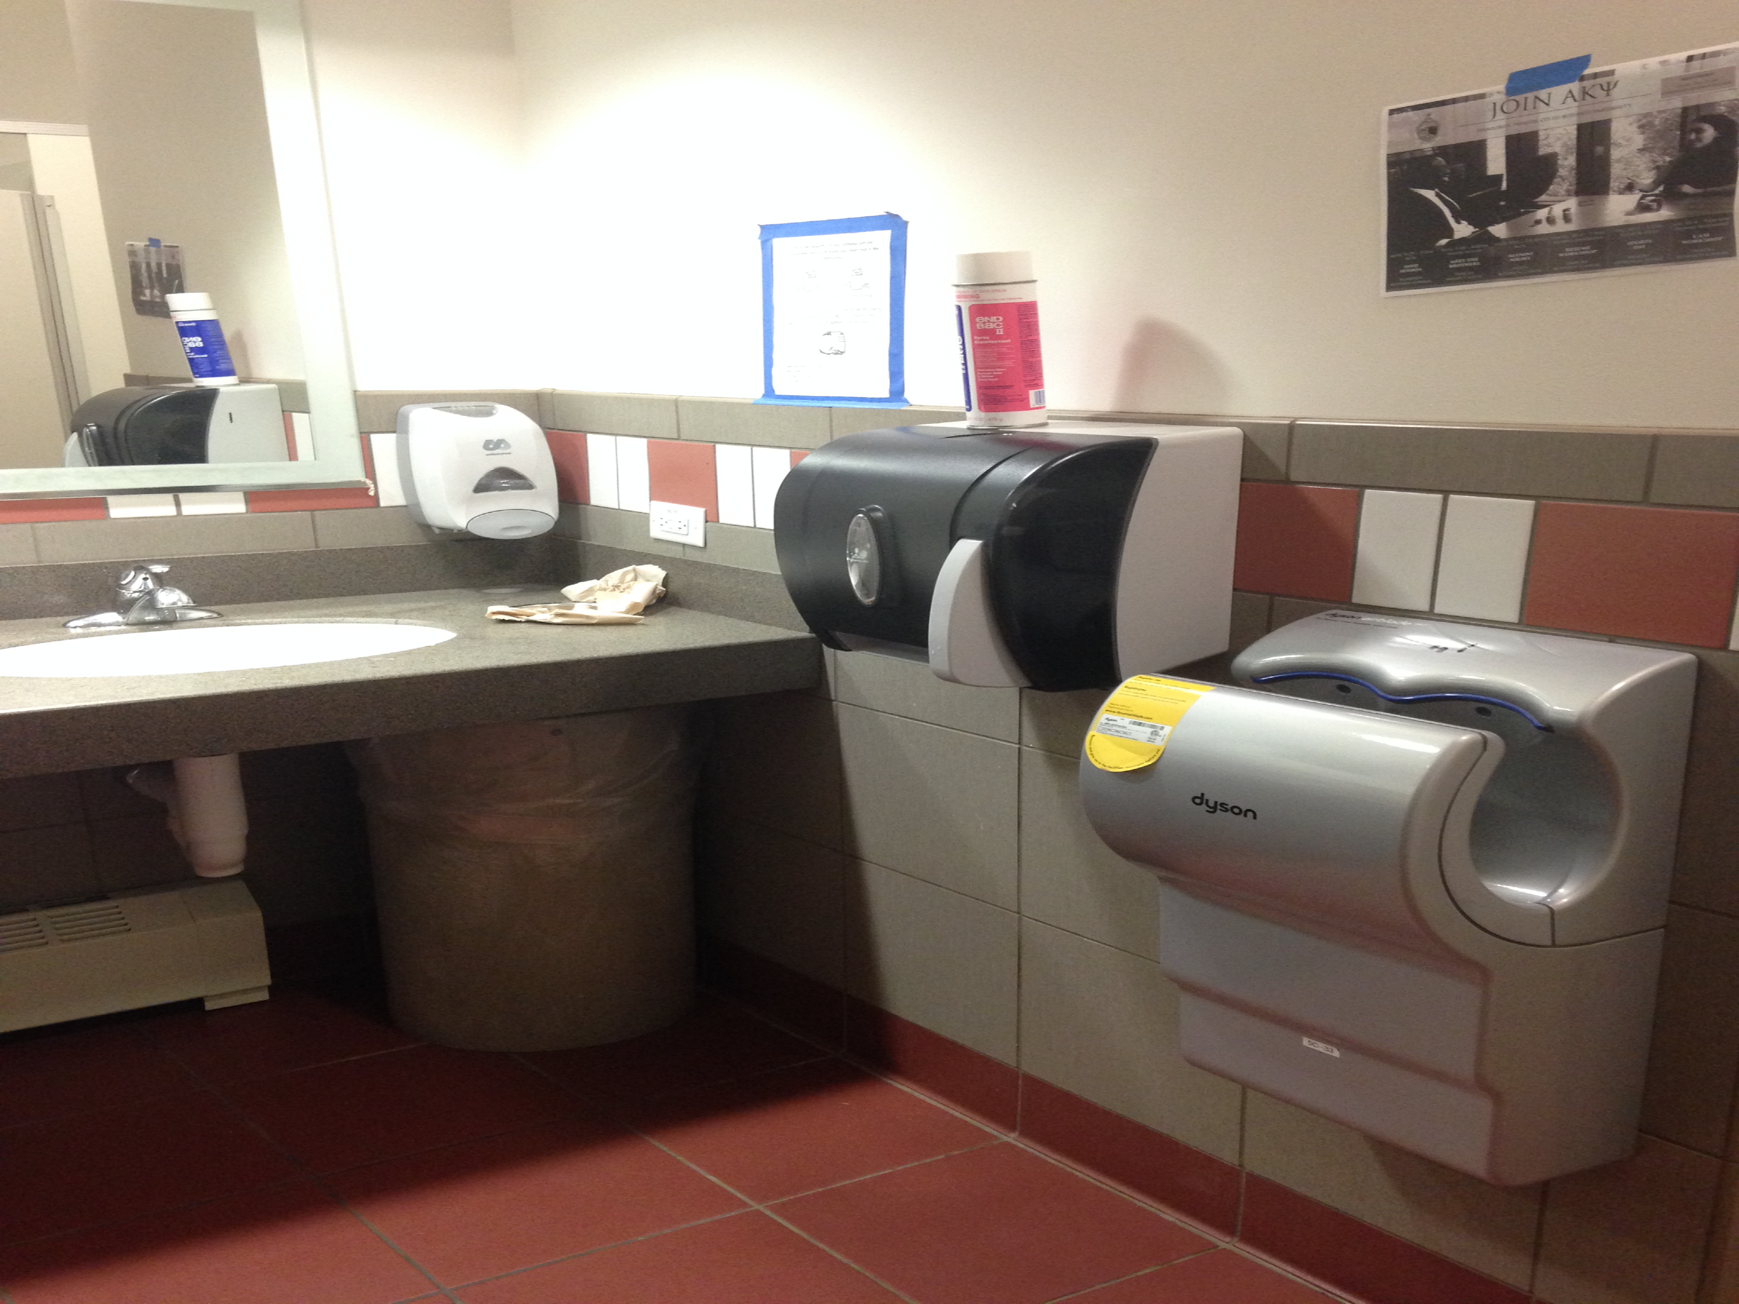
Interface Hall of Fame or Shame?
Dyson AirBlade hand dryer
example courtesy of Maya I.

Slide 9
Interface Hall of Fame!
Good
shape indicates function
so simple that instructions fit in 1 image
fun!
Bad
dripping water?
too much noise
still takes too long
Dyson AirBlade hand dryer
example courtesy of Maya I.

Slide 10
Design Exploration Through Sketching & Experience Prototyping
This work is licensed under the Creative Commons Attribution-
Noncommercial-Share Alike 3.0 Unported License. To view a copy of
this license, visit http://creativecommons.org/licenses/by-nc-sa/3.0/
October 6, 2015
* slides marked Buxton are courtesy of Bill Buxton, from his talk “Why I Love the iPod, iPhone, Wii and Google”, remix uk, 18-19 Sept. 2008, Brighton
Notes:
45 minutes

Slide 11
Outline
Sketching to explore user experiences
Team Break
Experience prototyping

Slide 12
Design Process: Discovery
Assess Needs
understand client’s expectations
determine scope of project
characteristics of customers & tasks
evaluate existing practices & products
Discovery
Design Exploration
Design Refinement
Production

Slide 13
Design Process: Exploration
Expand Design Space
brainstorming
sketching
storyboarding
prototyping
Discovery
Design Exploration
Design Refinement
Production
Notes:
Expand design space:
brainstorming, sketching, storyboarding, prototyping

Slide 14
Iteration
At every stage!
Design
Prototype
Evaluate
Sketch
Paper
Video
Tool
Program
Gut
Crit
Expert Eval Lo-fi Test
User Study

Slide 15
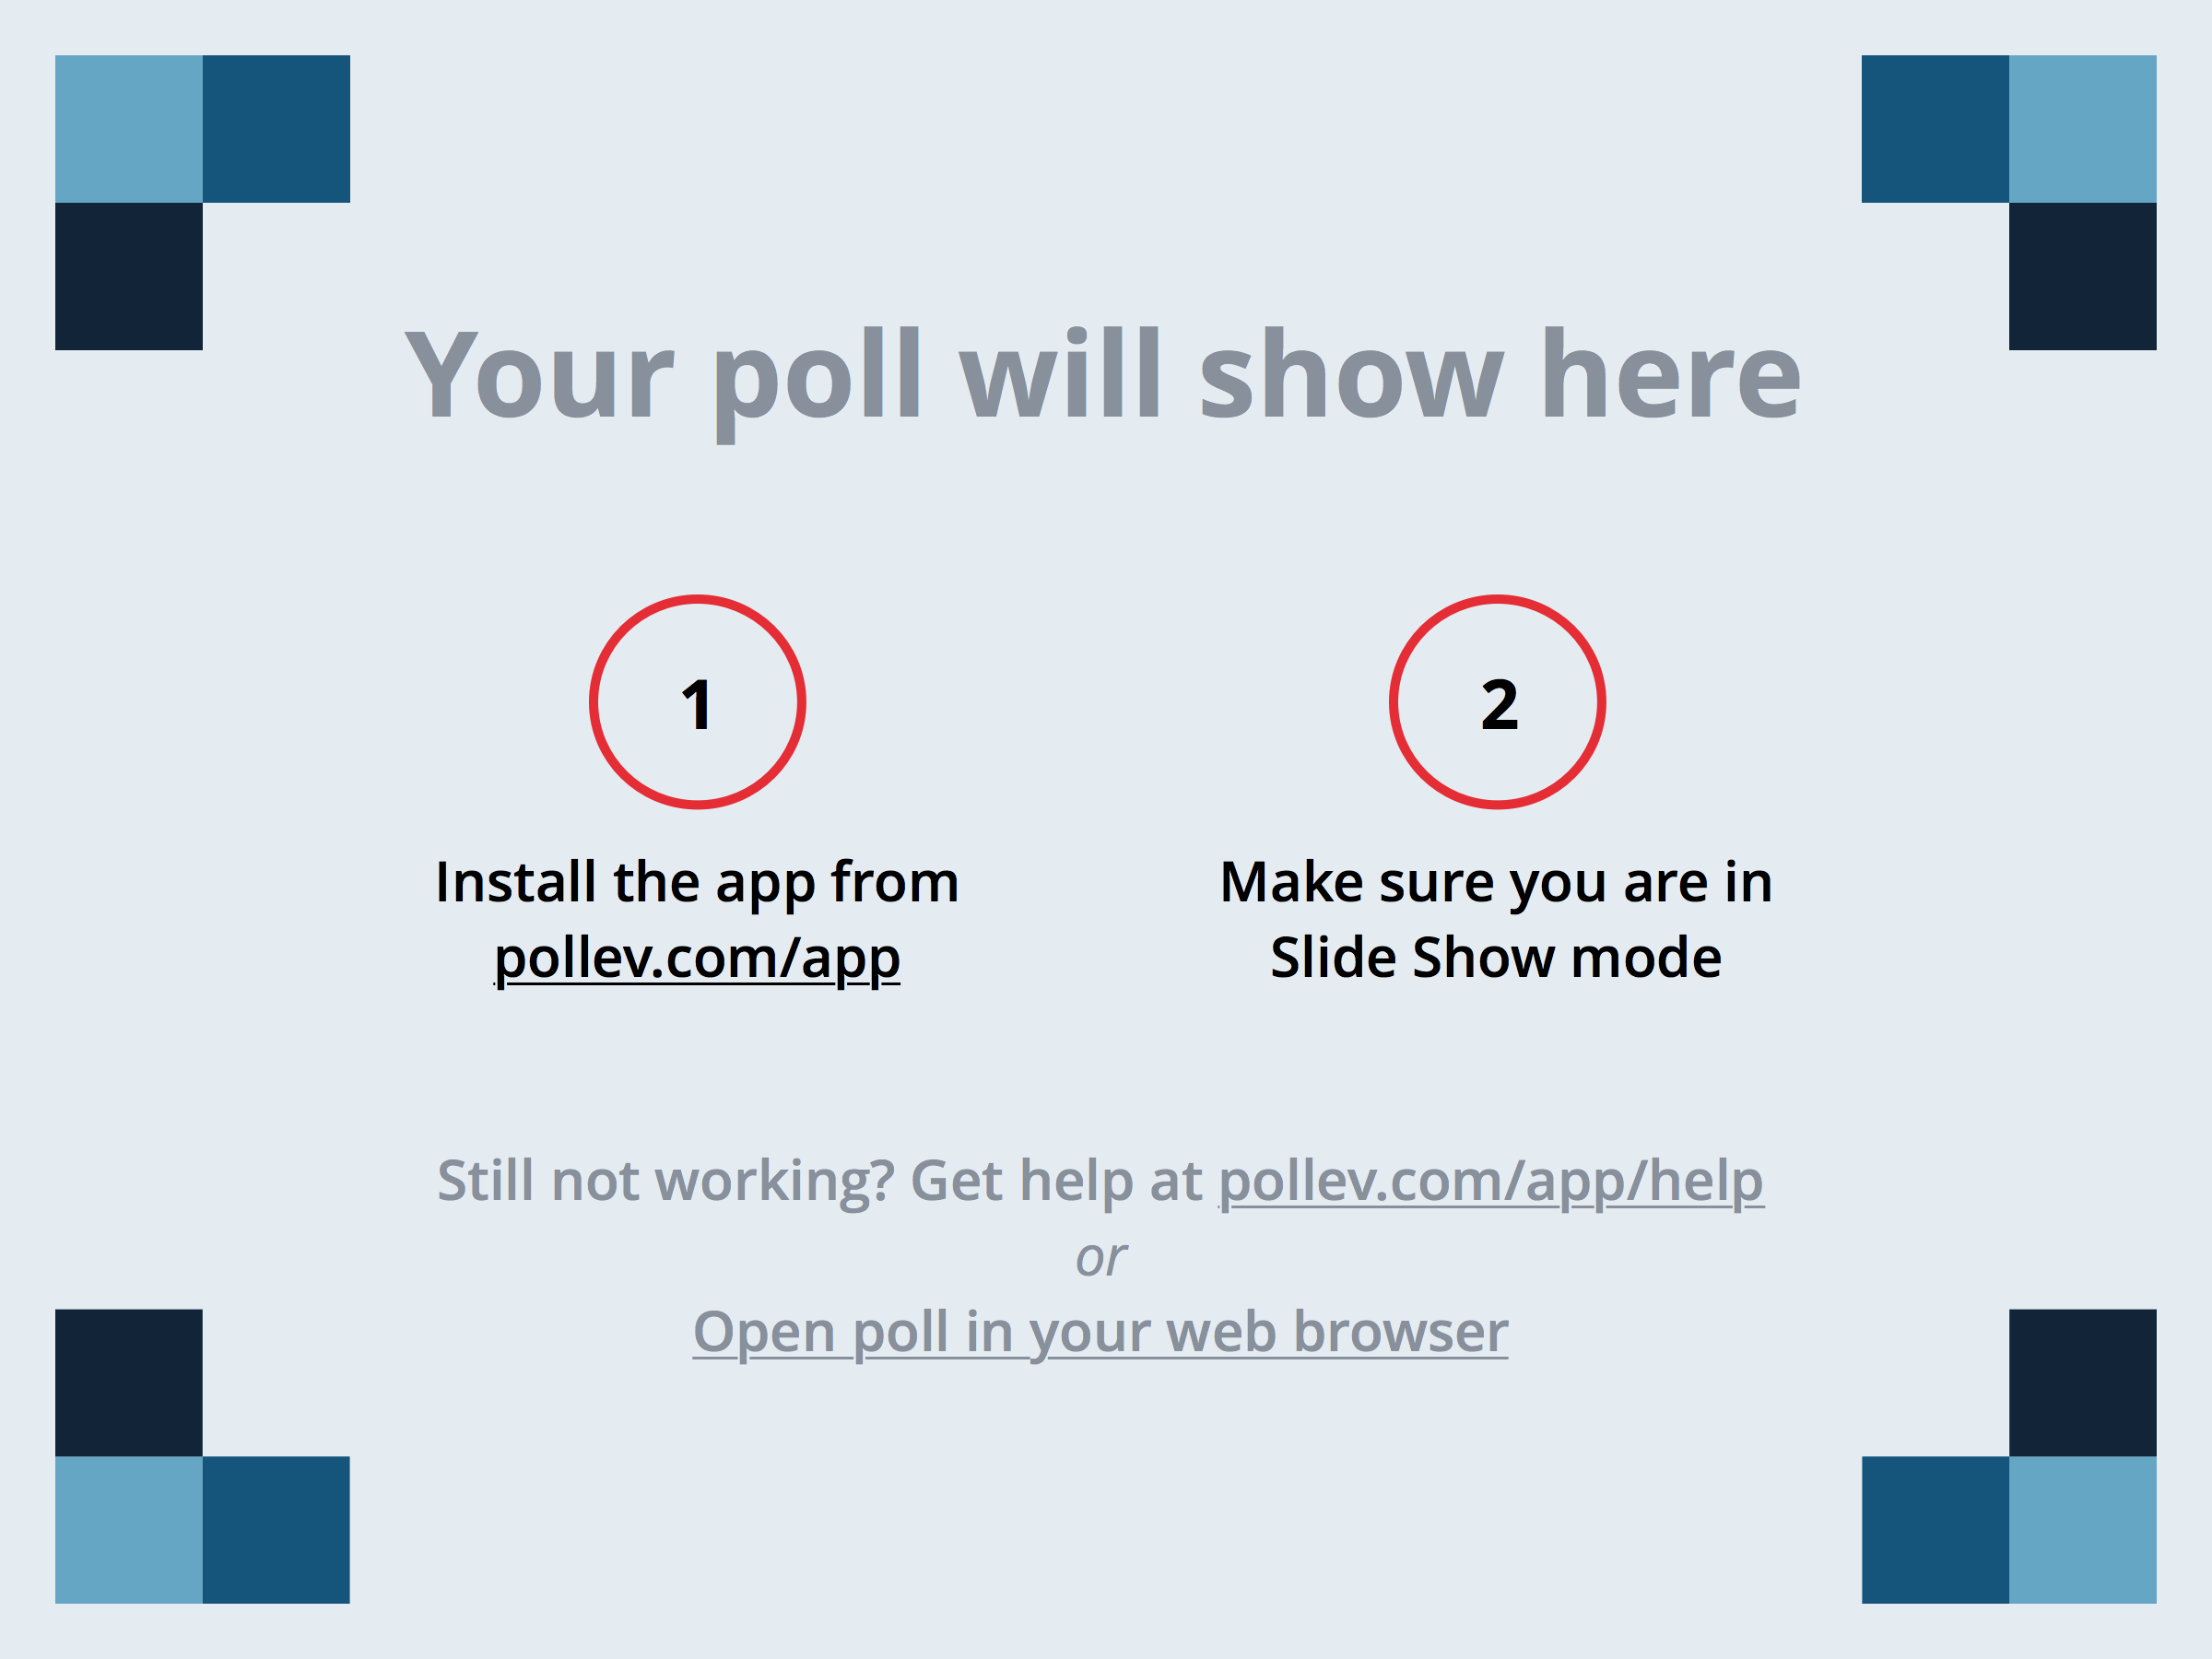
Notes:
Which group in the ceramics class described in the Buxton reading produced the highest quality pots? https://www.polleverywhere.com/multiple_choice_polls/gDPJfIClD6BWh52

Slide 16
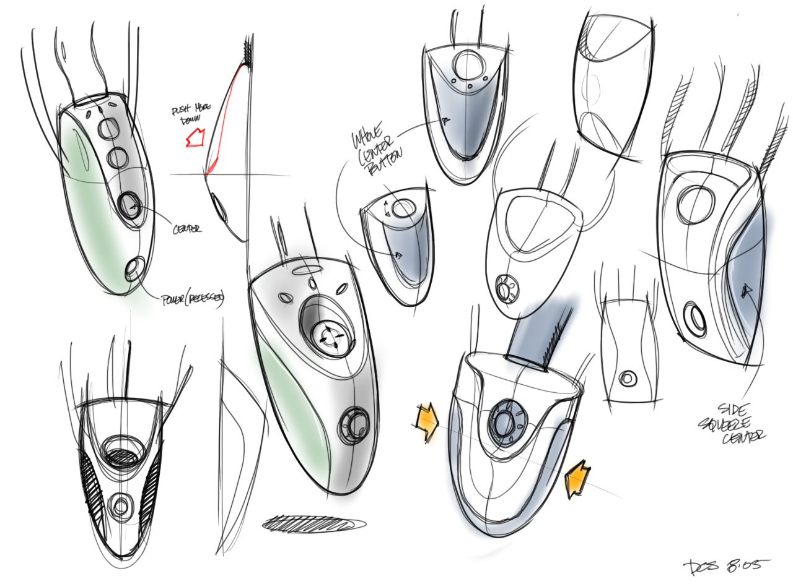
Sketching: A Quintessential Activity of Design
* Courtesy Bill Buxton
Notes:
Design and Innovation comes from sweat. From trying many ideas. Sketching them. Building prototypes.

Slide 17
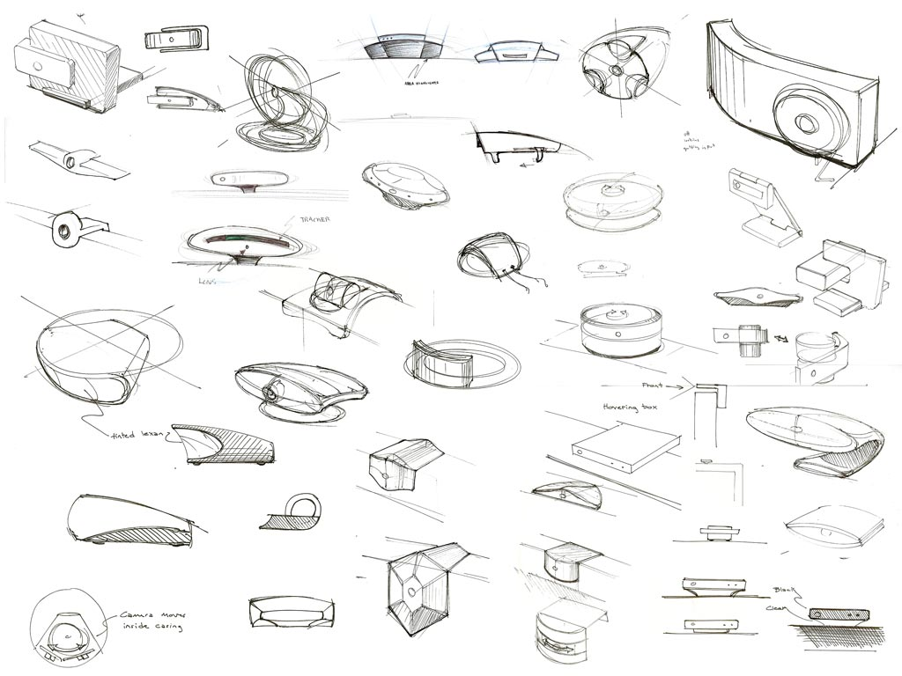
Kicker Studio, www.kickerstudio.com
Notes:
Trying literally dozens and dozens of ideas.

Slide 18
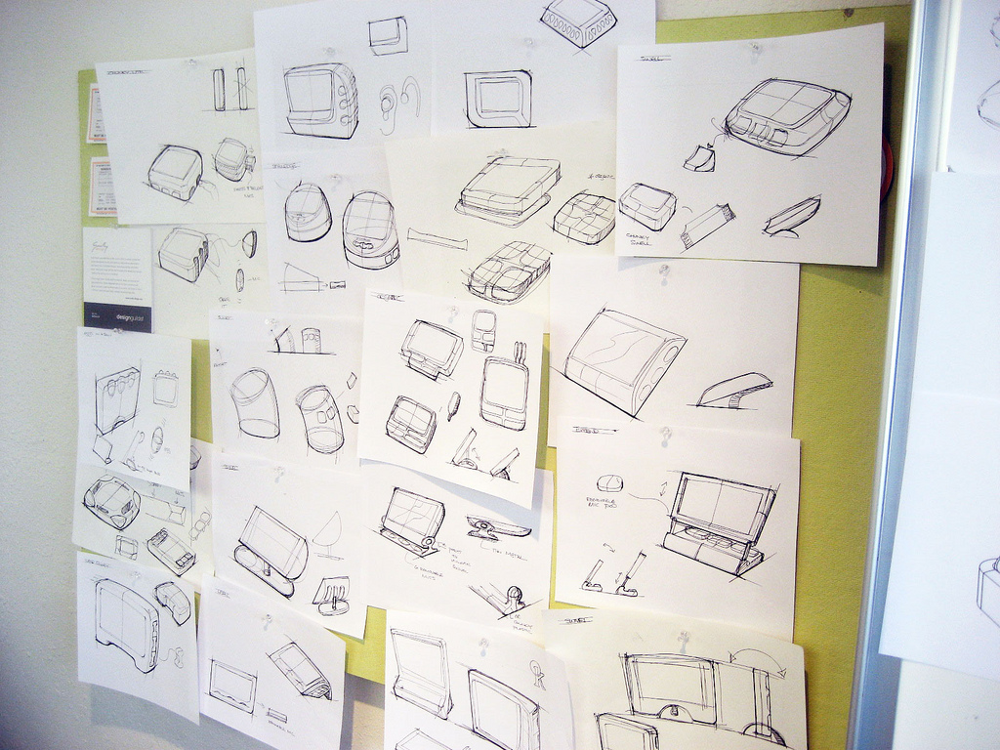
Kicker Studio, www.kickerstudio.com
Notes:
Trying them out with people and observing what occurs.

Slide 19
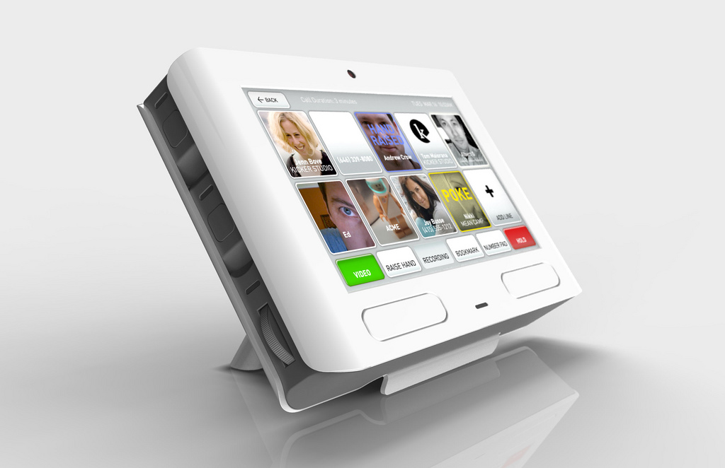
Kicker Studio, www.kickerstudio.com
Notes:
Until you find ideas/products/services that evoke an emotional response with your customers. Ideas that give new experiences that people value. The differences of opinion are on how you might get to this point.

Slide 20
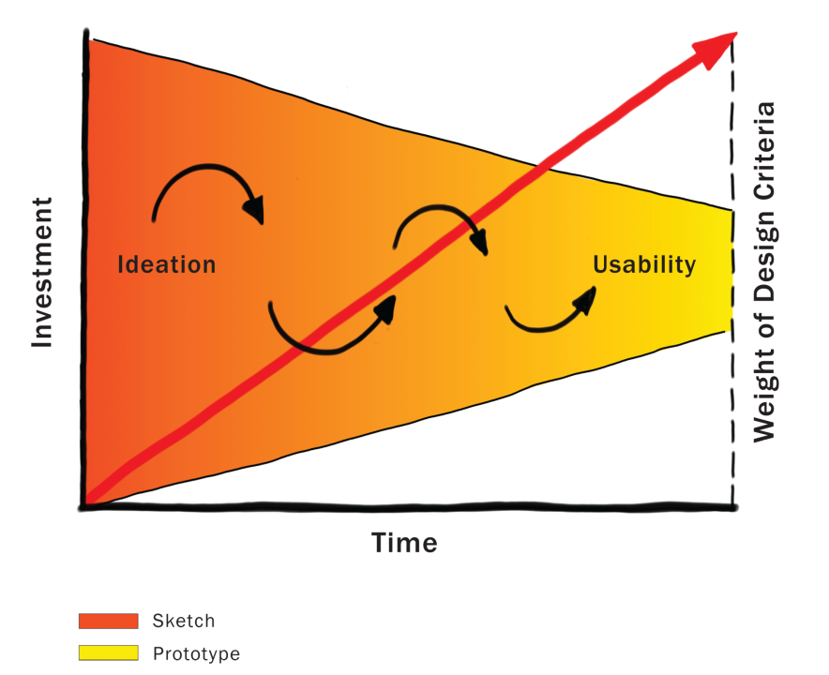
Courtesy Bill Buxton
Notes:
Because investment is low in the early stages, this is the one time in the product pipeline when one can afford to play, explore, learn, and really try and gain a deep understanding of the undertaking.
This is where YOUR TEAM WILL be for most of this quarter!!!!

Slide 21
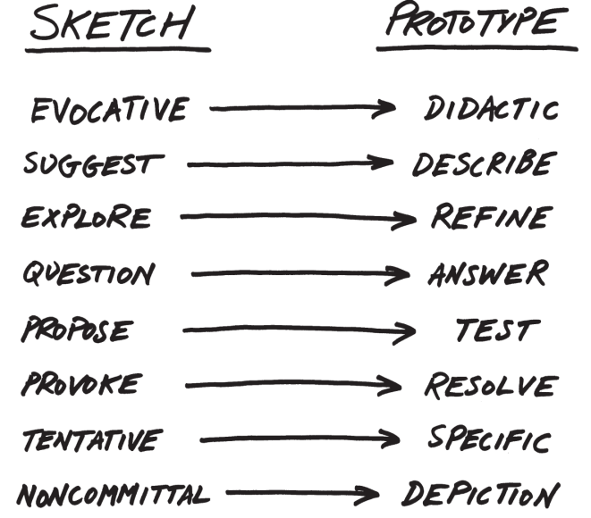
From Sketch to Prototype
Difference in intent rather than in form
Courtesy Bill Buxton
Notes:
This is a continuum, not an either/or proposition
The difference between the two is as much a contrast of purpose, or intent, as it is a contrast in form

Slide 22
The Anatomy of “Sketching”
Quick / Timely
Inexpensive / Disposable
Plentiful
Clear vocabulary. You know that it is a sketch (lines extend through endpoints, …)
No higher resolution than required to communicate the intended purpose/concept
Resolution doesn’t suggest a degree of refinement of concept that exceeds actual state
Ambiguous
Courtesy Bill Buxton

Slide 23
If you want to get the most out of a sketch, you need to leave big enough holes.
There has to be enough room for the imagination.
Courtesy Bill Buxton
Notes:
Ambiguity in sketches is VERY important

Slide 24
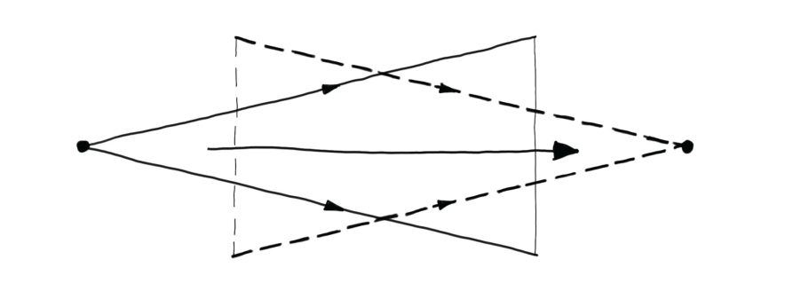
Design as Choice
Elaboration (“Flare”)
Reduction (“Focus”)
Courtesy Bill Buxton
Laseau (1980)
Notes:
Choice where there are two key places for creativity:
the creativity that you bring to enumerating meaningfully distinct options from which to choose
the creativity that you bring to defining the criteria, or heuristics, according to which you make your choices
Design is both GENERATIVE and REDUCTIVE

Slide 25
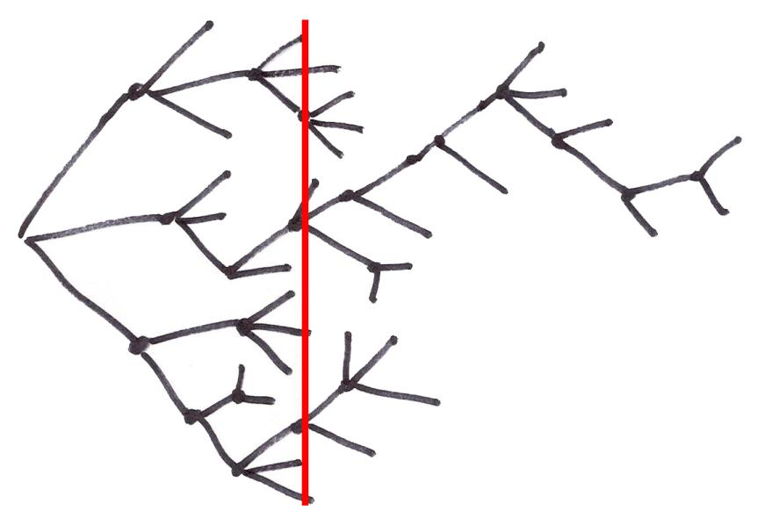
Exploration of Alternatives
… a designer that pitched three ideas would probably be fired. I’d say 5 is an entry point for an early formal review (distilled from 100’s). … if you are pushing one you will be found out, and also fired. … it is about open mindedness, humility, discovery, and learning. If you aren’t authentically dedicated to that approach you are just doing it wrong!
Alistair Hamilton
VP Design
Symbol Technologies
Courtesy Bill Buxton
Notes:
Design is NOT a straight path
We must generate and discard much more than we keep
All of these representations of the design process converge.
Some of the ideas thrown out may be your’s! – you need to learn to embrace this [ADVANCE]

Slide 26
Exploration of Alternatives
People on a design team must be as happy to be wrong as right. If their ideas hold up under strong (but fair) criticism, then great, they can proceed with confidence. If their ideas are rejected with good rationale, then they have learned something.
…
There are no dumb questions. There are no ideas too crazy to consider. Get it on the table, even if you are playing around. It may lead to something.
Bill Buxton
Sketching User Experiences
pg. 147-149
Courtesy Bill Buxton
Notes:
bringing “design rationale” or reasoning for decisions is the key to making this work well
diverse teams help make this work better & that is why we are creating such teams in this class

Slide 27
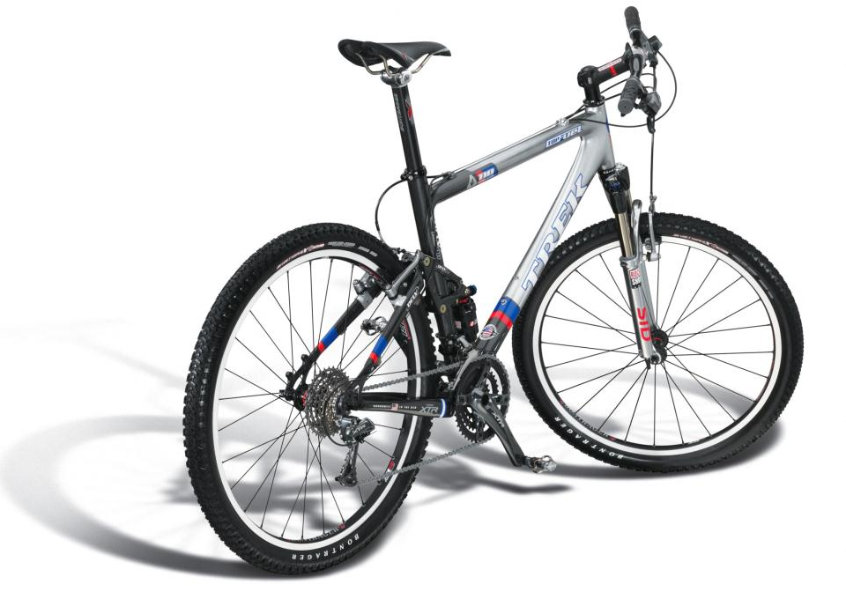
Design
What does the customer want to buy?
Courtesy Bill Buxton
Notes:
This clearly shows the DESIGN of the bike…
But what the bike owner buys is this [ADVANCE]

Slide 28
Experience Design
“The experience of even simple artifacts does not exist in a vacuum but, rather, in dynamic relationship with other people, places, and objects” – Buchenau & Suri 2000
Courtesy Bill Buxton
Notes:
The EXPERIENCE of using the bike. The aspiration (and hopefully the reality) of the experience
Experience depends on the bike, your equipment, the weather, the terrain, your skill, your current state of mind, etc.

Slide 29
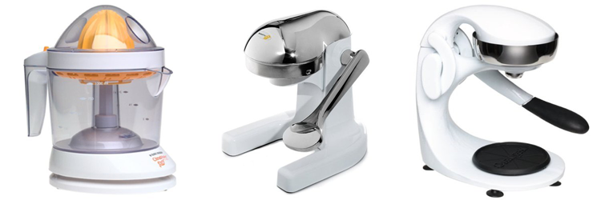
Experience vs. Interface Design
CitrusMate Plus Mighty OJ Manual Juicer OrangeX Manual Juicer
Notes:
He loved his first juicer every morning… complained he didn’t have it at the cabin
Then got the gift of the second for his cabin. Quiet!!! Loved the experience and now no longer liked the original!
Complained… then got a gift of the 3rd for home… Same interface as the second…
but DIFFERENT experience. Easy at end of pulling down lever.
USER EXPERIENCE!

Slide 30
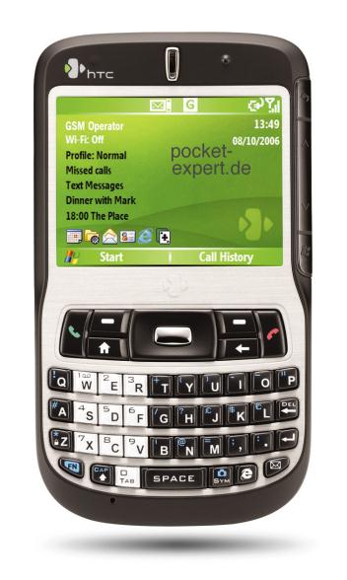
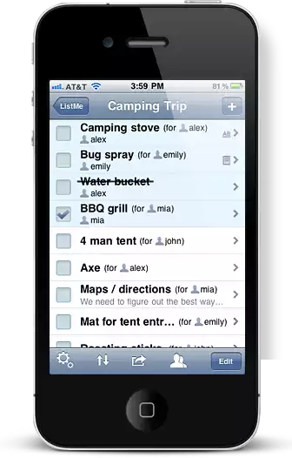
Experience Design
Draw my phone
Draw my phone’s interface
Draw the experience of using my phone
Which is the true object of design?
http://www.listmeapp.com/
Courtesy Bill Buxton

Slide 31
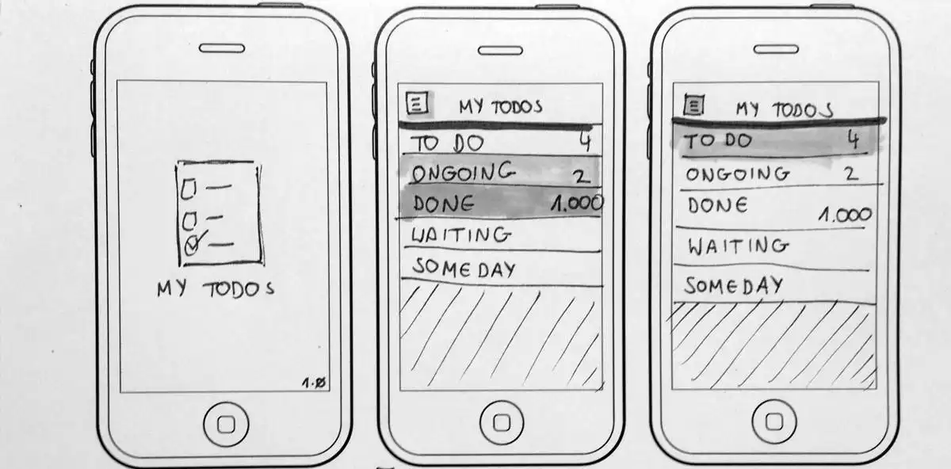
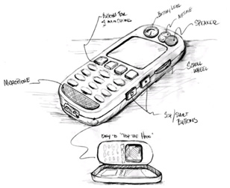
Minimal Detail
Include only what is required to render the intended purpose or concept
http://www.smashingmagazine.com/2013/06/sketching-for-better-mobile-experiences/
Notes:
Abstract it

Slide 32
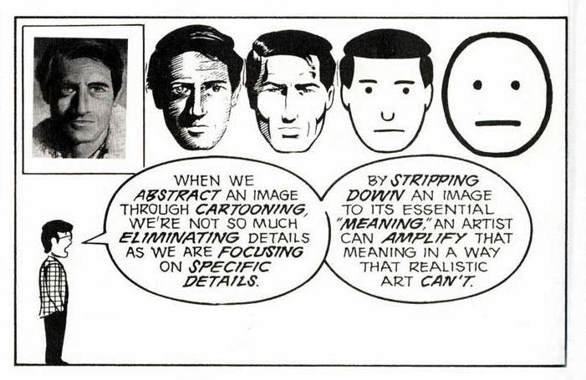
Scott McCloud’s Understanding Comics
People think focusing is about saying “yes.” But…
“Focusing is about saying no.” – Steve Jobs
Notes:
Scott McCloud’s Understanding Comics

Slide 33
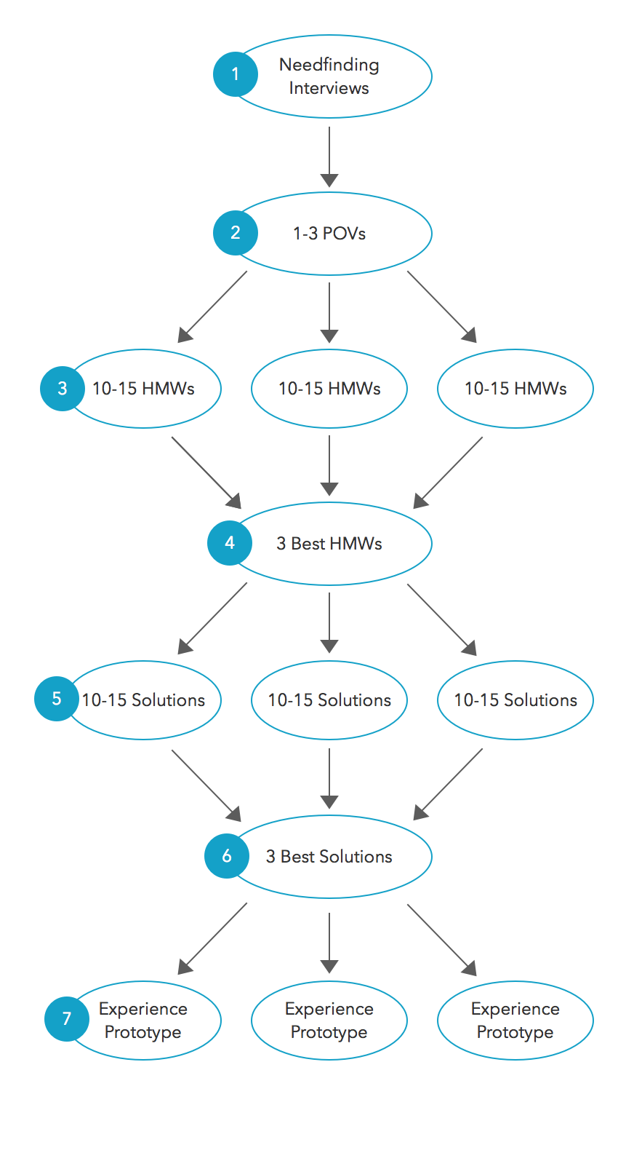
Strive for diversity of solutions

Slide 34
Team Break
Reflect on last week’s assignment (5-10 min)
what did you like about your team work?
what do you wish could be improved?
This weeks assignment (20 min)
what will it take to get finished?
what remains to be done? plan it!
can you address the critique from your TA in what you are doing for this week?

Slide 35
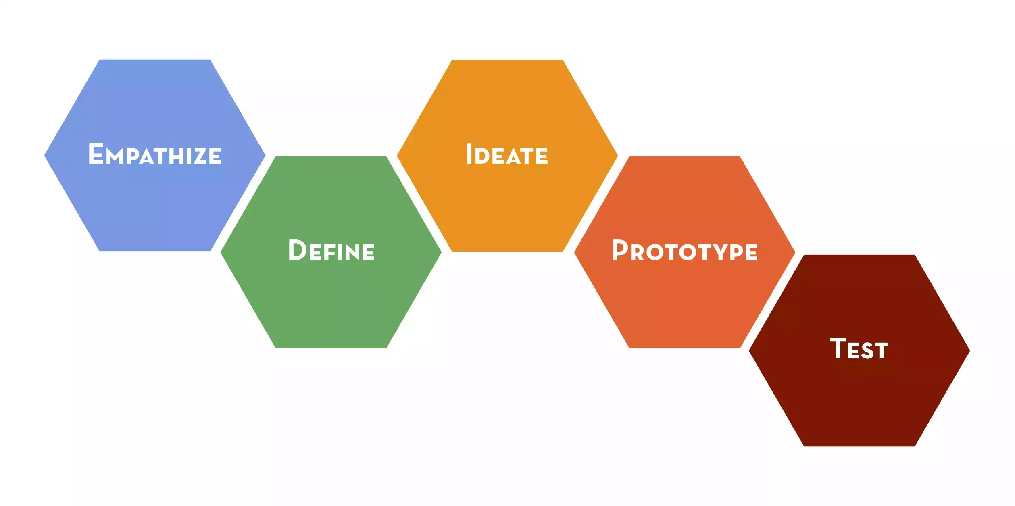
Design Thinking

Slide 36
Design Thinking

Slide 37
to think
prototype
to learn

Slide 38
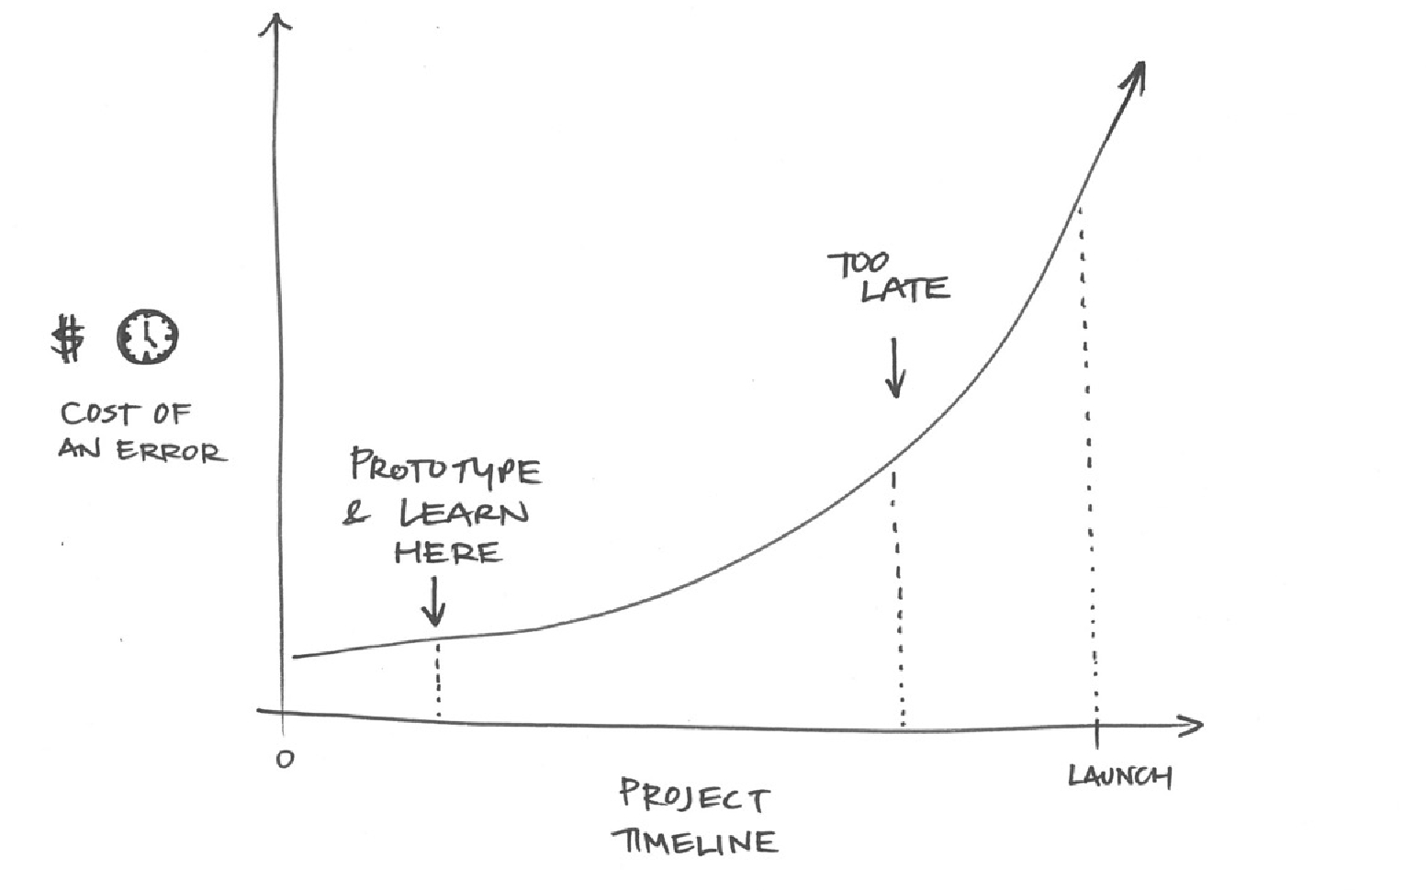
TRY THE MARSHMALLOW
TEST YOUR ASSUMPTIONS
From a resources and project management point of view: Prototyping reduces risk! Early failures are much cheaper (time and $) than late failures!
Notes:
From a resources and project management point of view: Prototyping reduces risk! Early failures are much cheaper (time and $) than late failures!

Slide 39
You can use an eraser on the drafting table or a sledgehammer on the construction site.
Frank Lloyd Wright

Slide 40
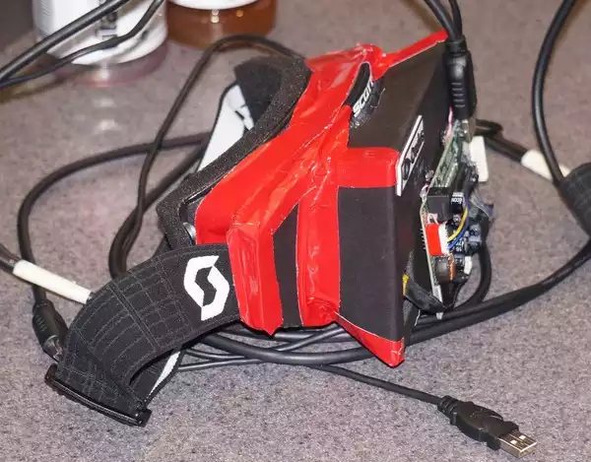
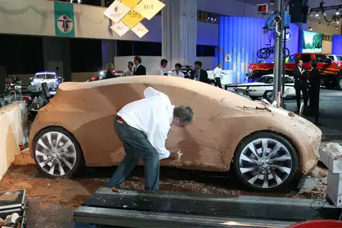
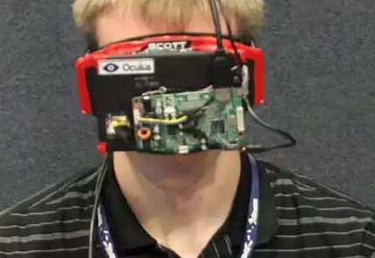
Types of Prototypes
looks like
works like

Slide 41
Notes:
You can also prototype what something INTERACTS like. We also call these EXPERIENCE prototypes. In these, we test how users interact with our ideas– what they think and how they feel during that experience.
This is a picture of a team testing a new fast food counter concept. They are actually letting the users experience the process the team has developed.
Don’t just tell users about an idea that you have—a prototype is an opportunity for you to create an experience for your user.
You get to observe how the user acts, and also ask them about the experience they had.
Let the user react to something they are doing, rather than just intellectually judging something you describe.

Slide 42
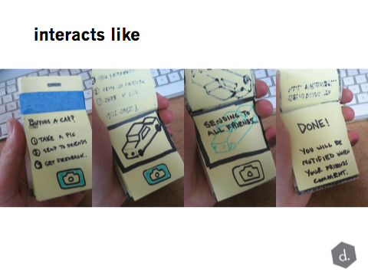
Interacts Like = Experience Prototype
Notes:
This is another experience prototype – an early concept to explore buying a car with a smartphone. Notice that even though this is low-res, it is still developed. It is not just something that looks like an iPhone – it takes a shot at a possible sequence that the user can actually try out. The idea in testing this isn’t whether the user likes it or not – instead by going through the process (with some realism) it can bring up issues you hadn’t thought of, or feelings from the user, or stark memories of stories . . .

Slide 43
Famous Experience Prototype
Notes:
Jeff Hawkins carried around a block of wood like this in his pocket & pulled it out when meeting people and used a pen to act like he was adding things to his device
This led to the The PalmPilot

Slide 44
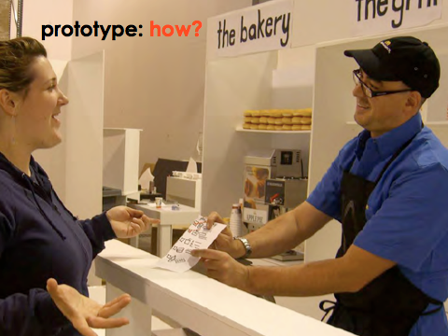
Notes:
So how can we get from all the ideas we generated in our brainstorm to making a prototype that helps us learn from users

Slide 45
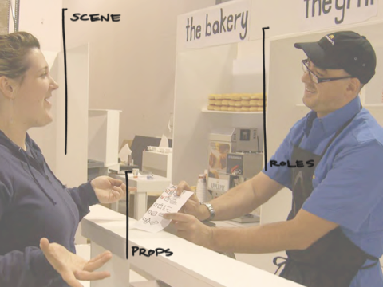
Notes:
We need to think about the various components of the experience prototype. Think about it like a developing a play.
You’ve got the props – i.e. the physical objects. These could be the things you are actually testing (the prototype itself) – or they could be objects in the larger prototype.
Then, you have the scene or scenario surrounding the objects – you’re not just giving things to people in a vacuum. You are helping people imagine and experience the possible situation they are in.
And finally, you may have roles that you play within the prototype – you become part of the prototype.

Slide 46
what new information do you
have about the
user’s need?
Test
what new information do you
have about how your
solution addresses
the need?

Slide 47
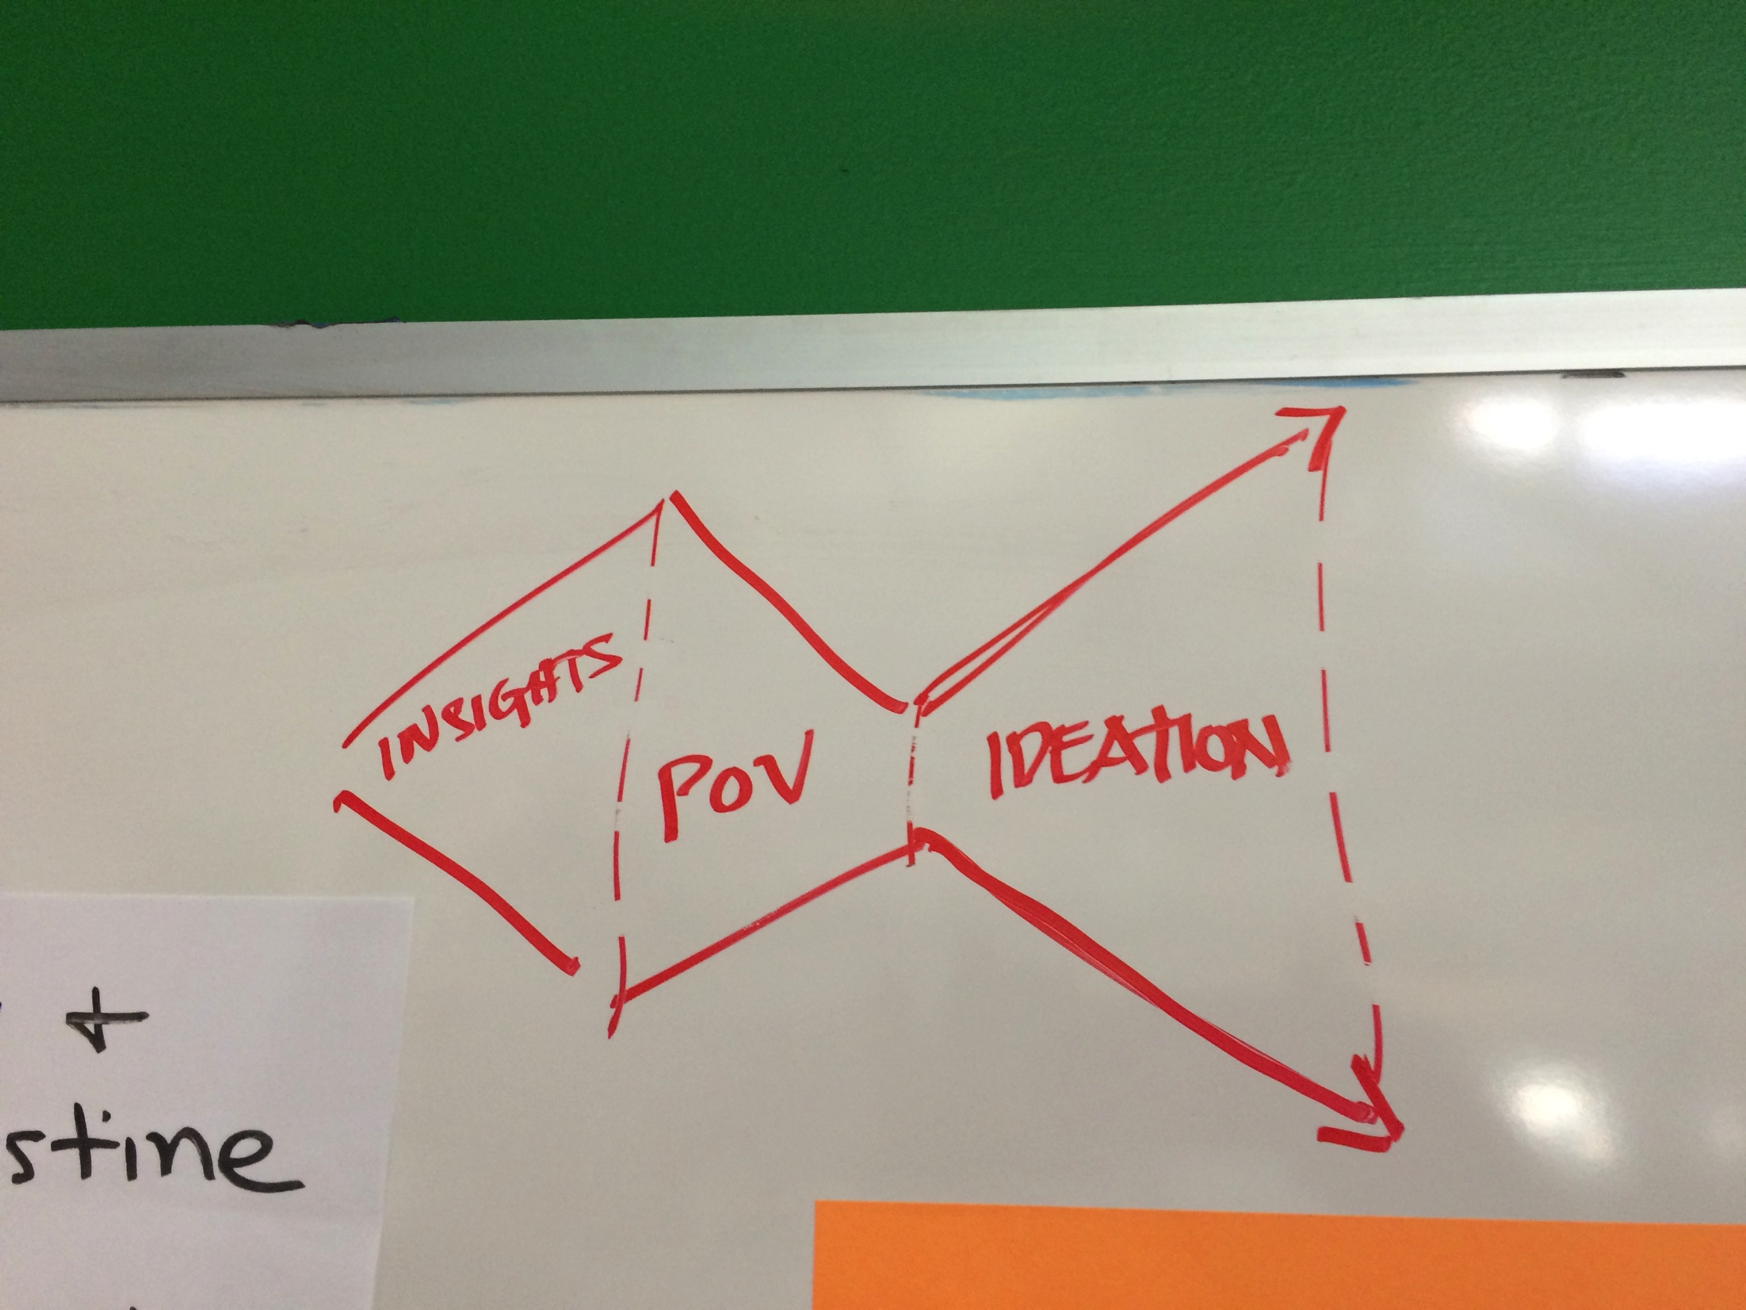
Notes:
Let me give you an example that I worked on with my team.
Now that you have a refined point of view, we can continue with ideation

Slide 48
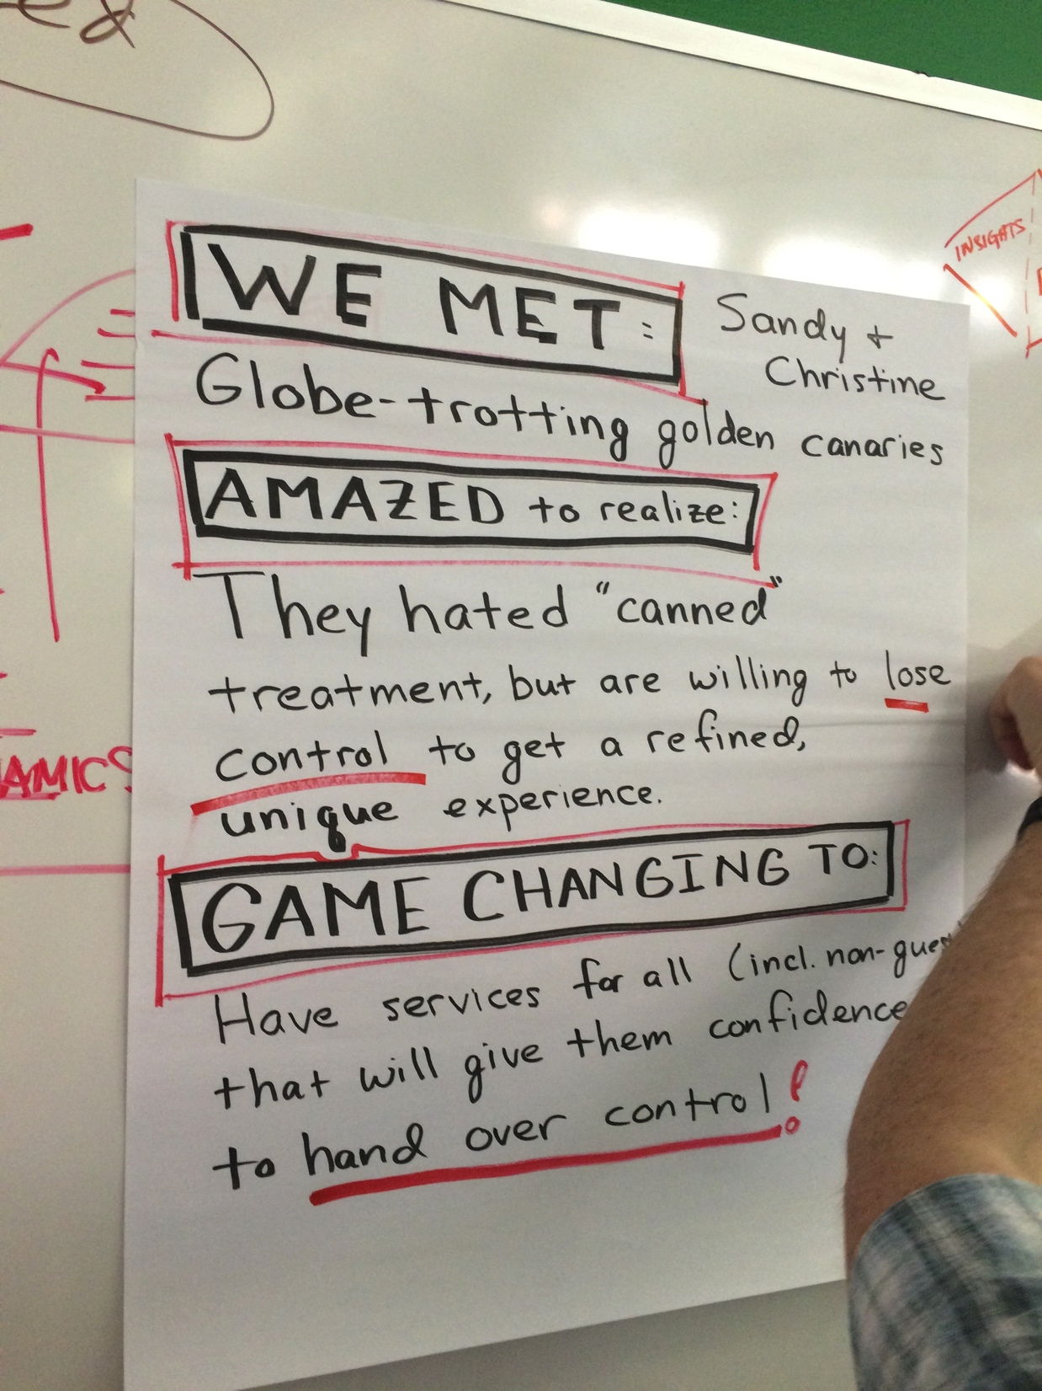
Notes:
I worked on a team over Spring Break at the d.School that was exploring how to improve the customer experience outside of the hotel for Hyatt Hotels
We interviewed a number of people in downtown San Francisco around the Hyatt (mainly in Union Square).
We met two interesting older ladies who gave us a lot of insight in to the travel experience.
This led to the following Point of View (POV)

Slide 49
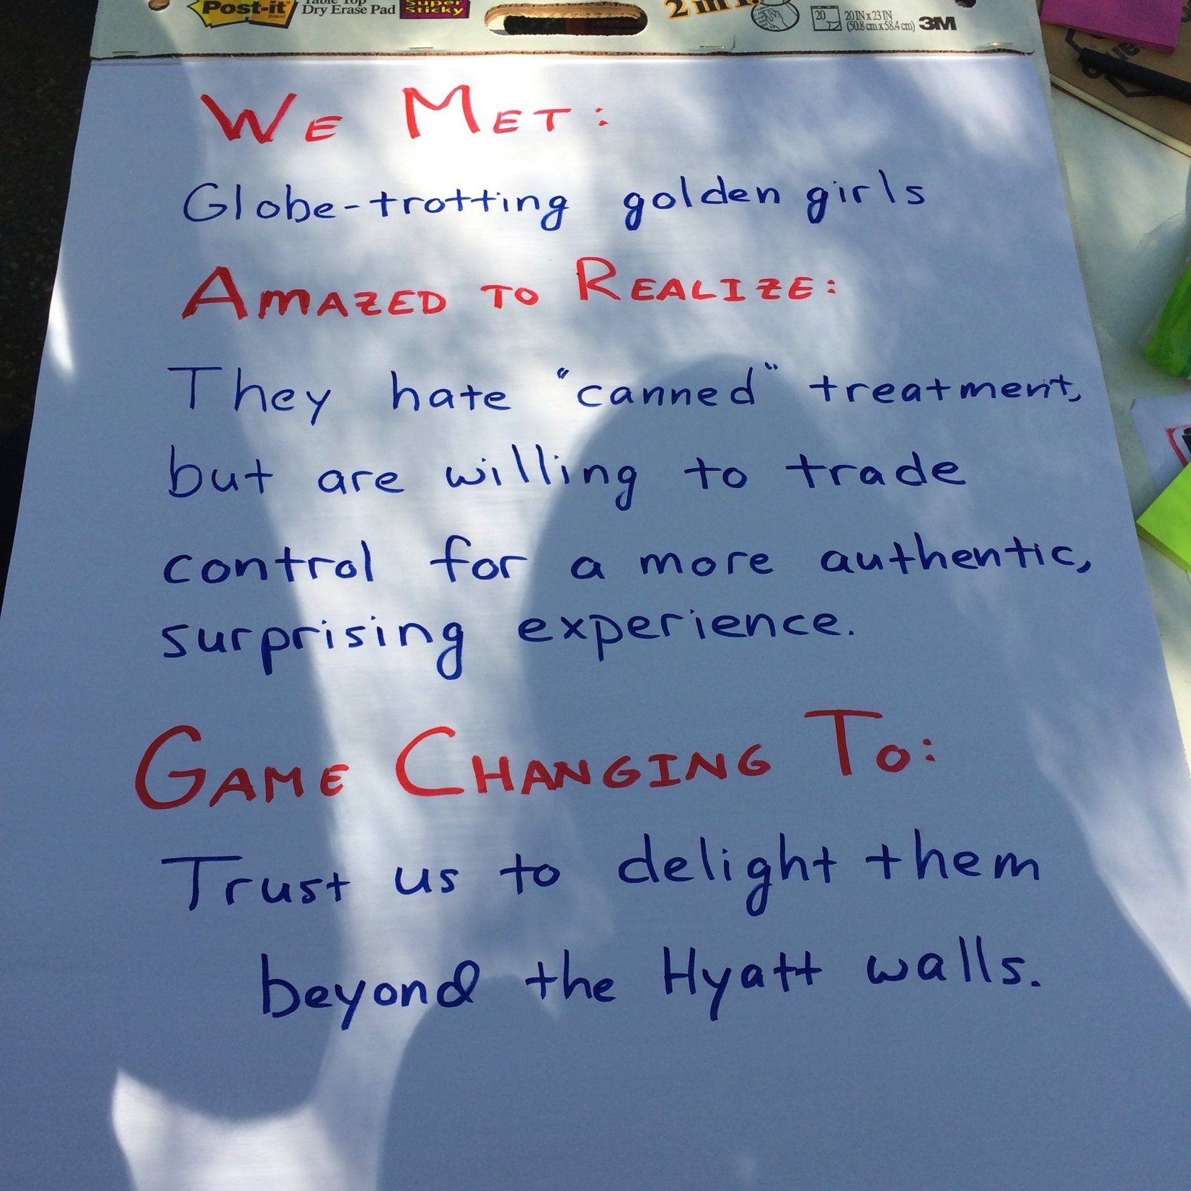
Notes:
After sitting on it overnight we revised a bit to make the last bit “Game Changing To:” more general.
Your teams are at the point of needing to create such opportunity statements.

Slide 50
Notes:
We used this to then brainstorm on some possible opportunities (4-6).
“How might we statements”

Slide 51
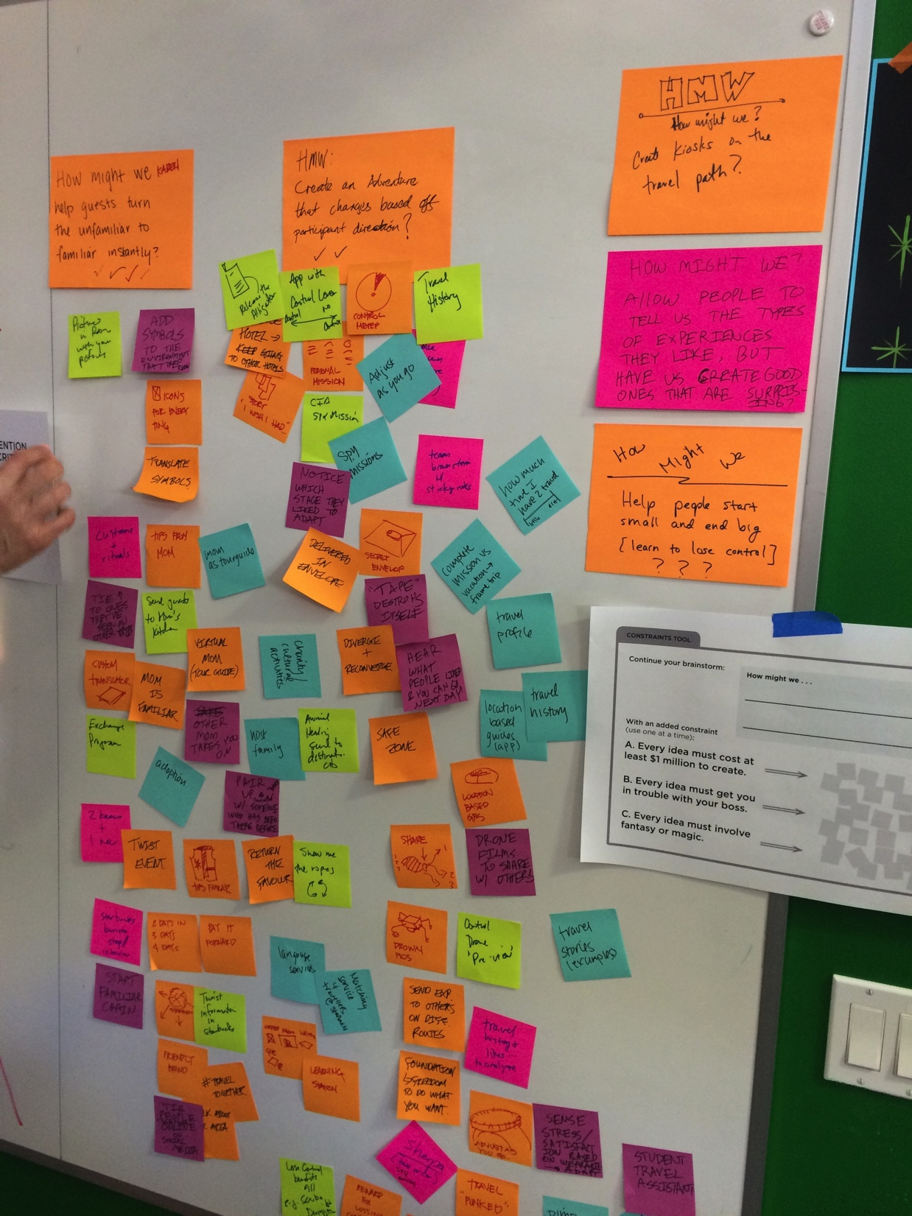
Notes:
Here are 5 of them

Slide 52
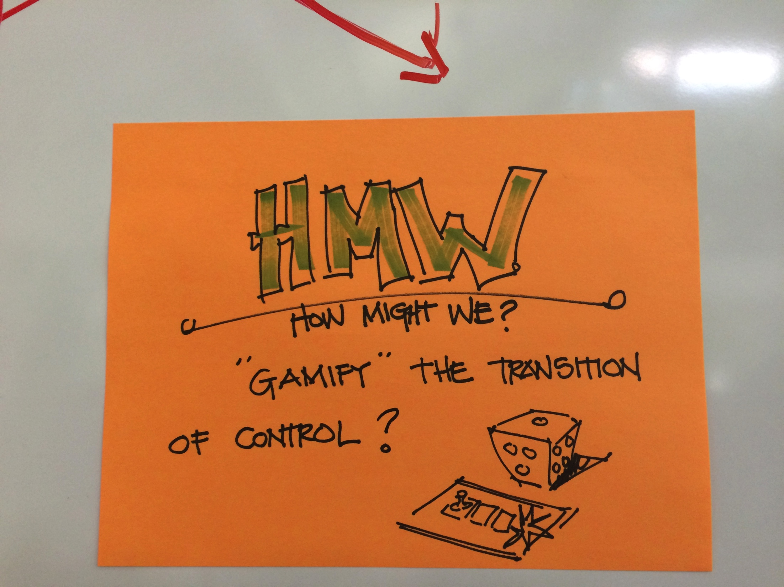
Notes:
Here is the 6th that we decided to push on further

Slide 53
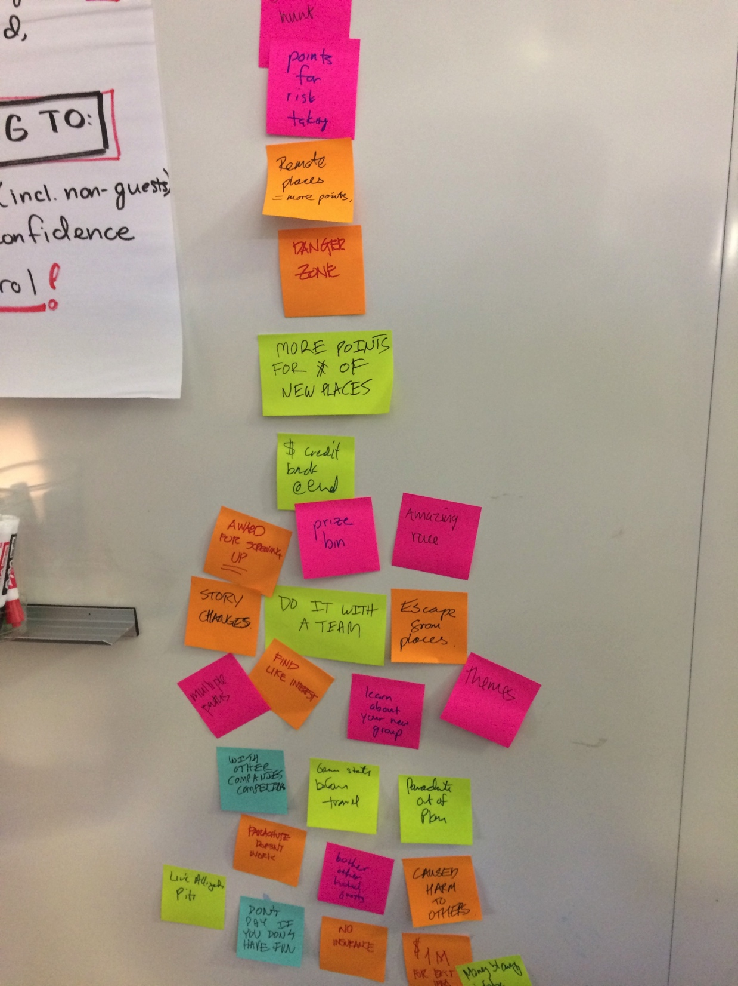
Notes:
We brainstormed on how we might do this

Slide 54
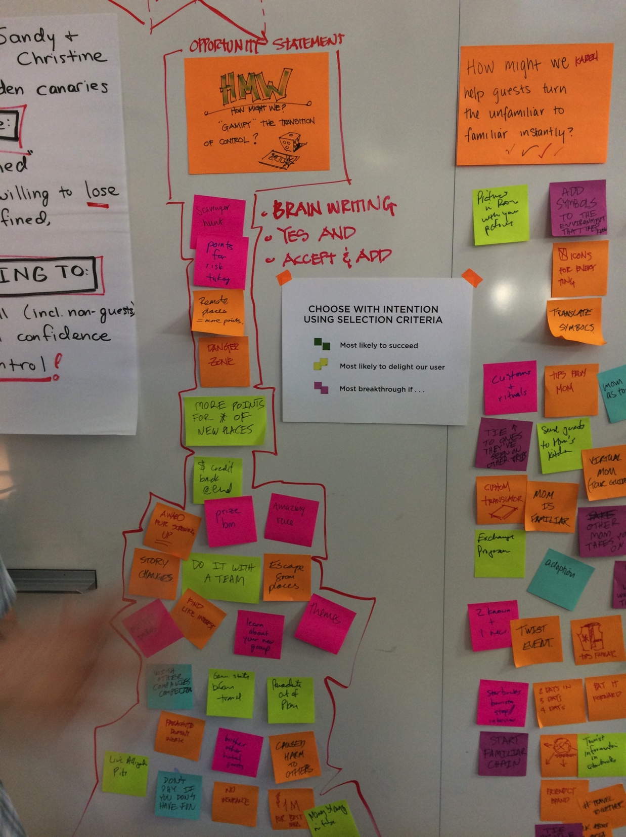
Notes:
generating 27 ideas in only 10 minutes or so… and then trying to decide on how to select among the two “How Might We” statements we brainstormed on

Slide 55
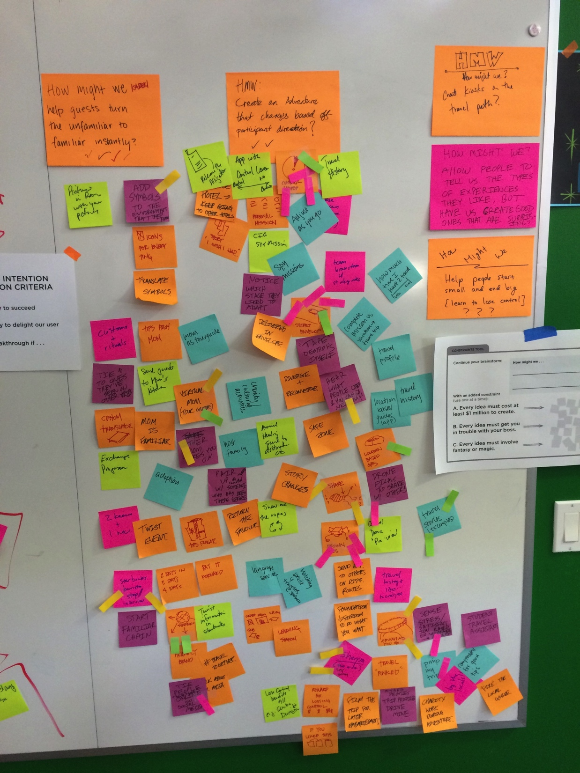
Notes:
everyone got 3 votes

Slide 56
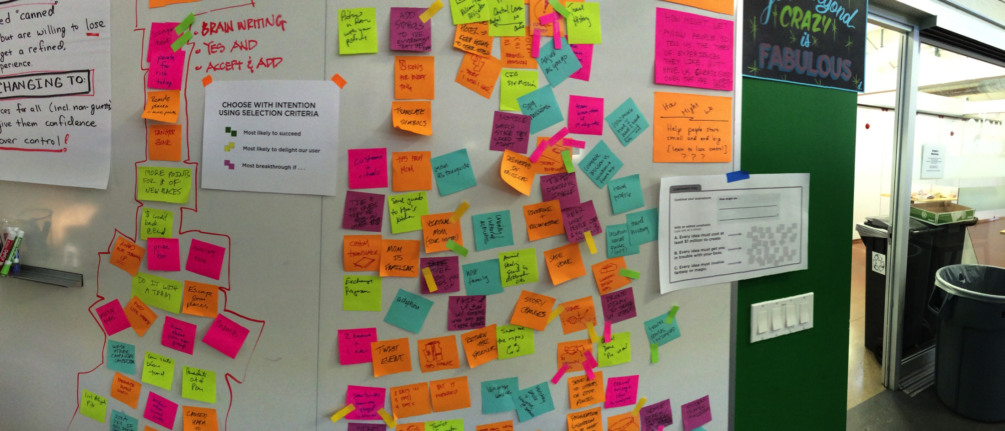
Notes:
we then selected an idea to go further with and create a rapid prototype to learn more

Slide 57
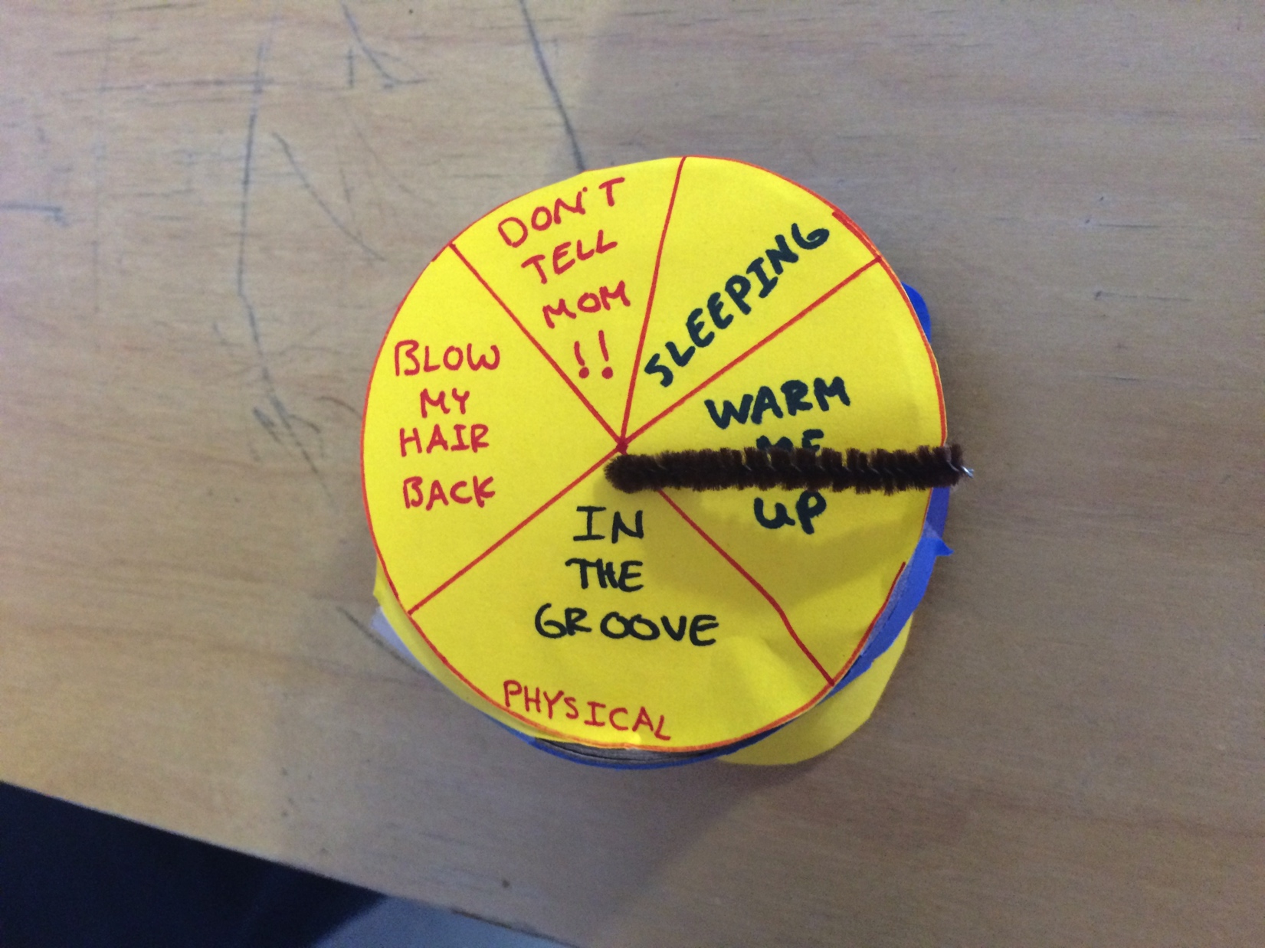
Notes:
This is what we ended up with. A special Activity Watch.
We did NOT think this would be a product. It was purely to let us explore the assumption of letting go of control, but somehow giving feedback on how the experience was going.

Slide 58
Notes:
This is how you do this.

Slide 60
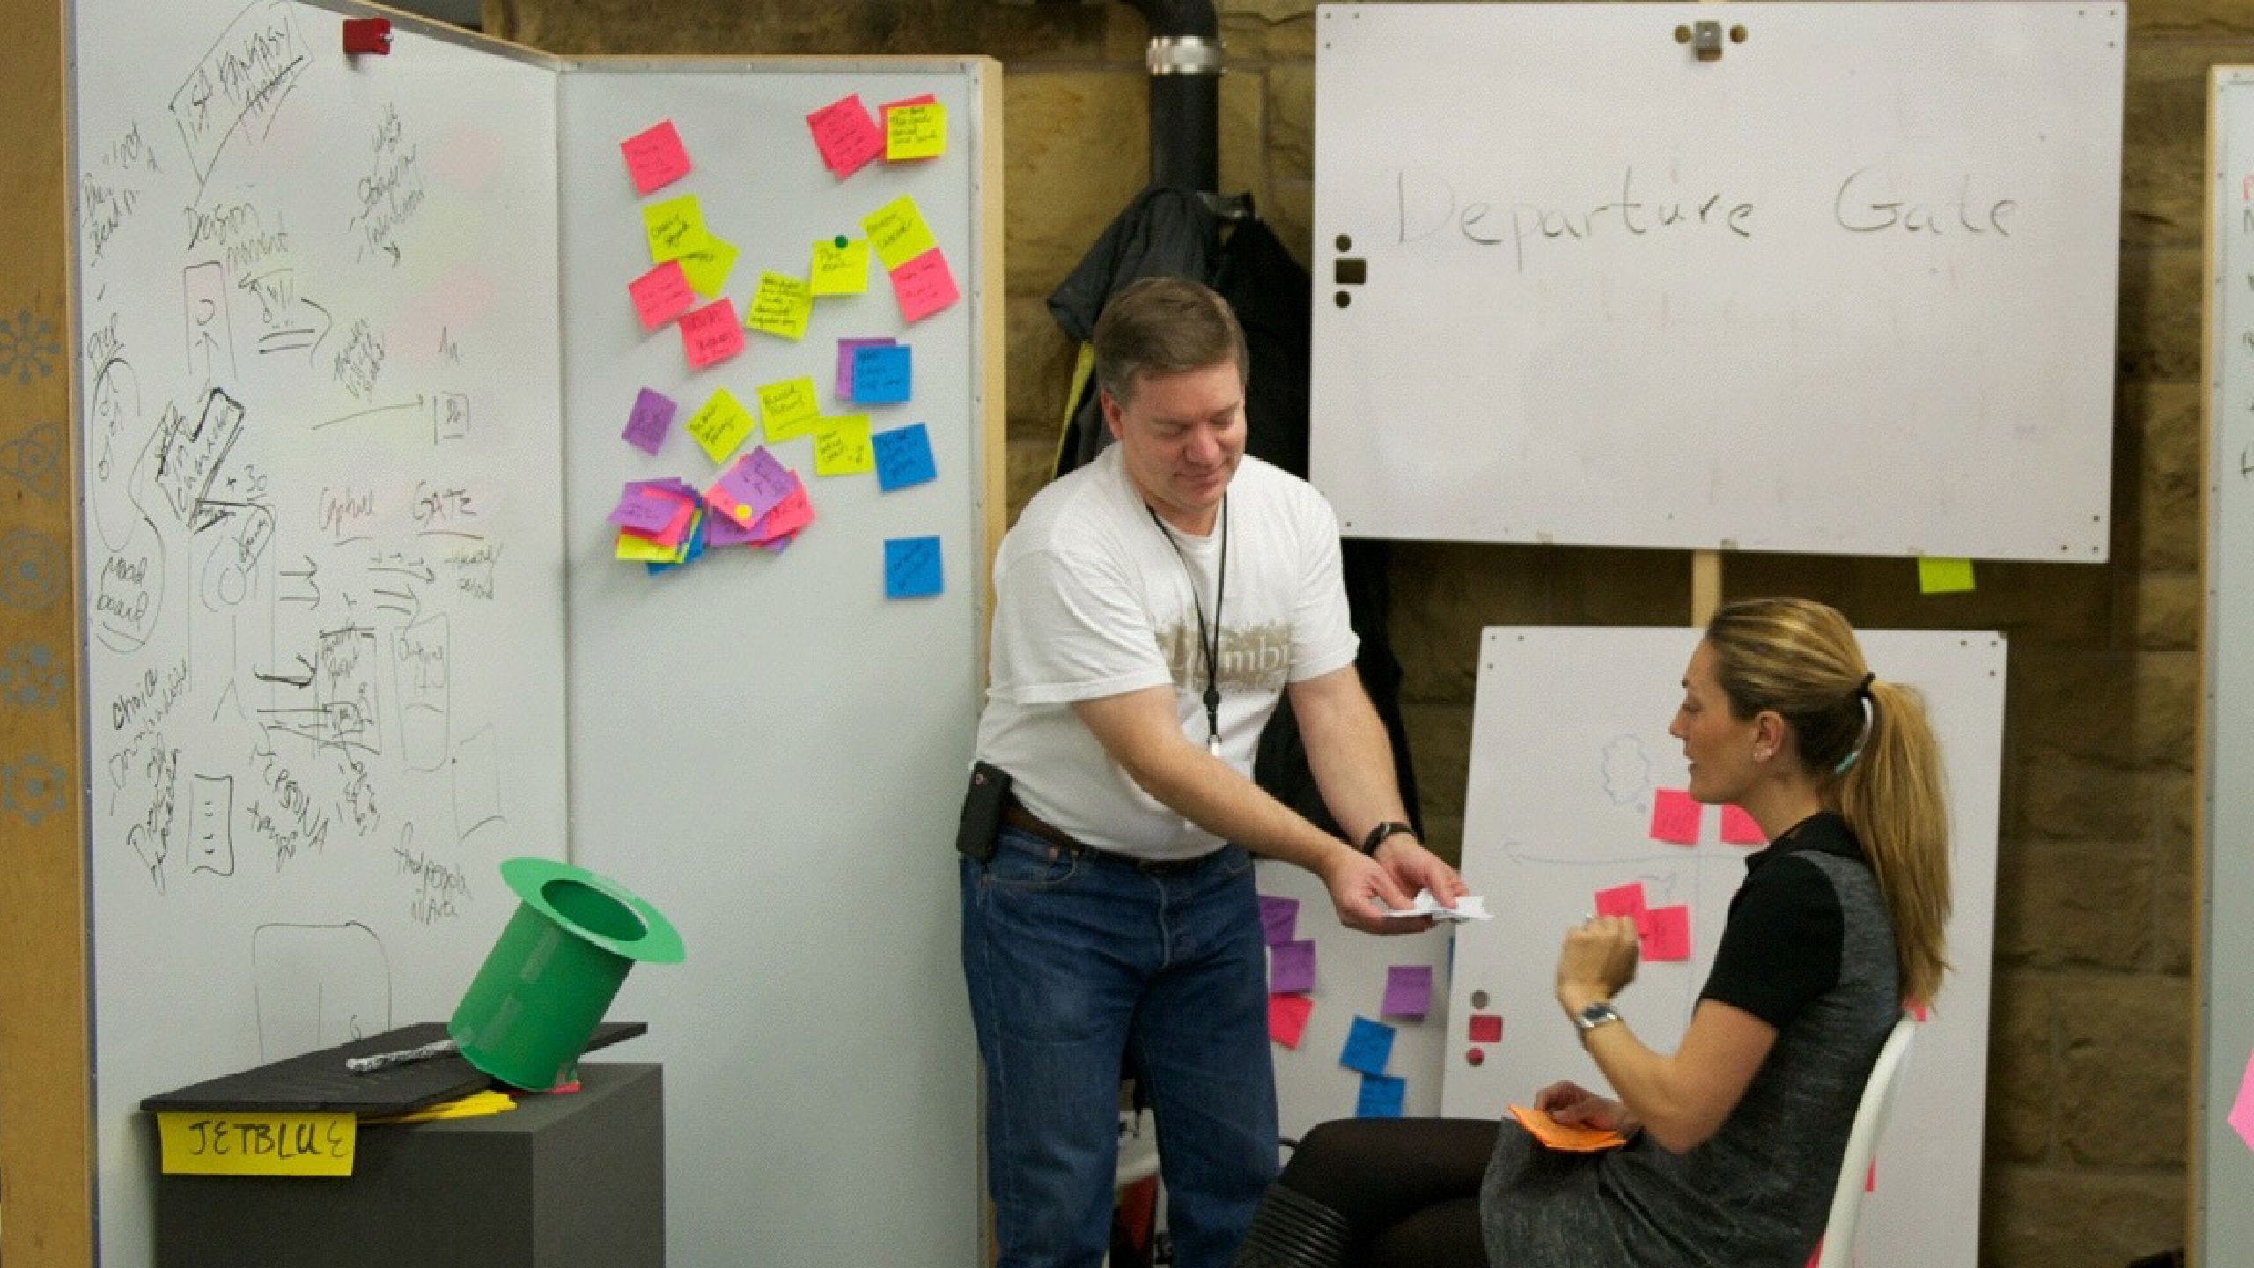

Slide 61
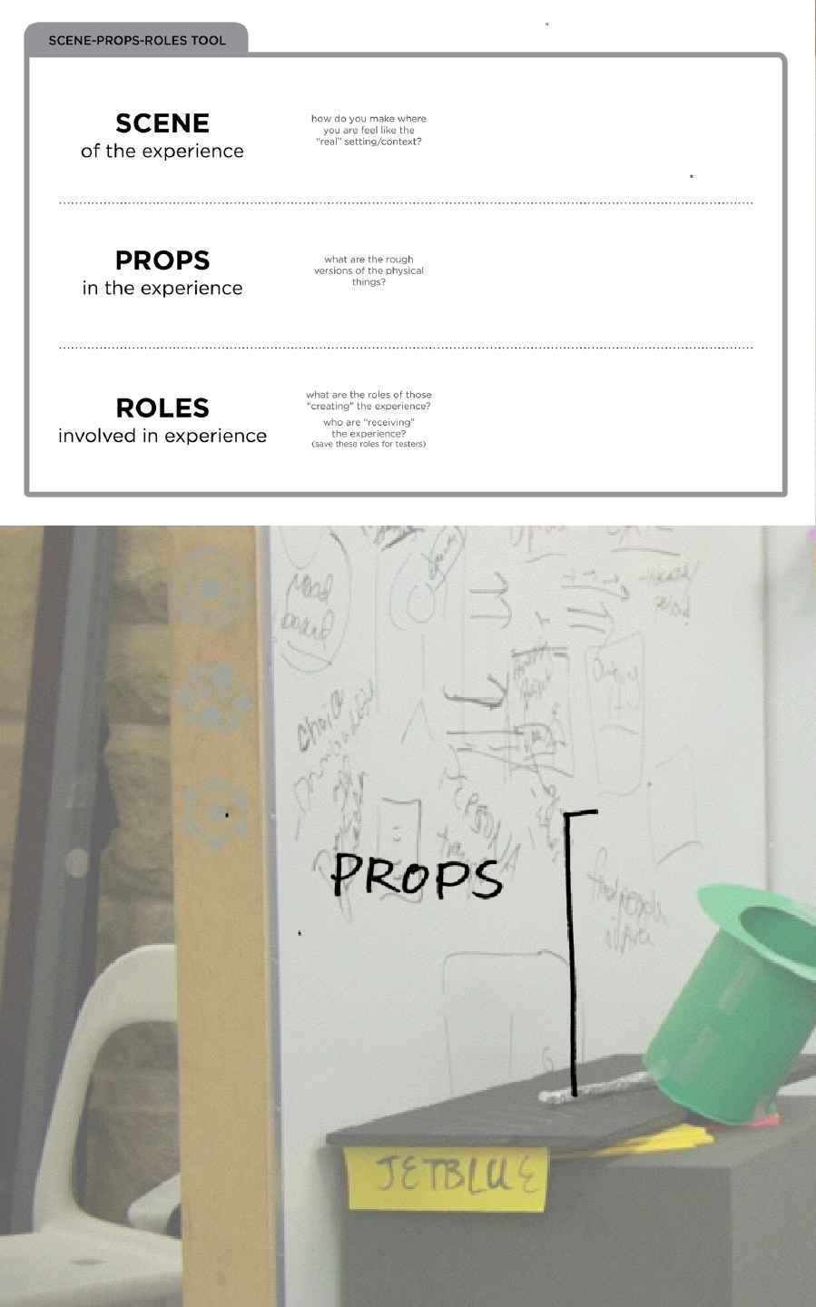
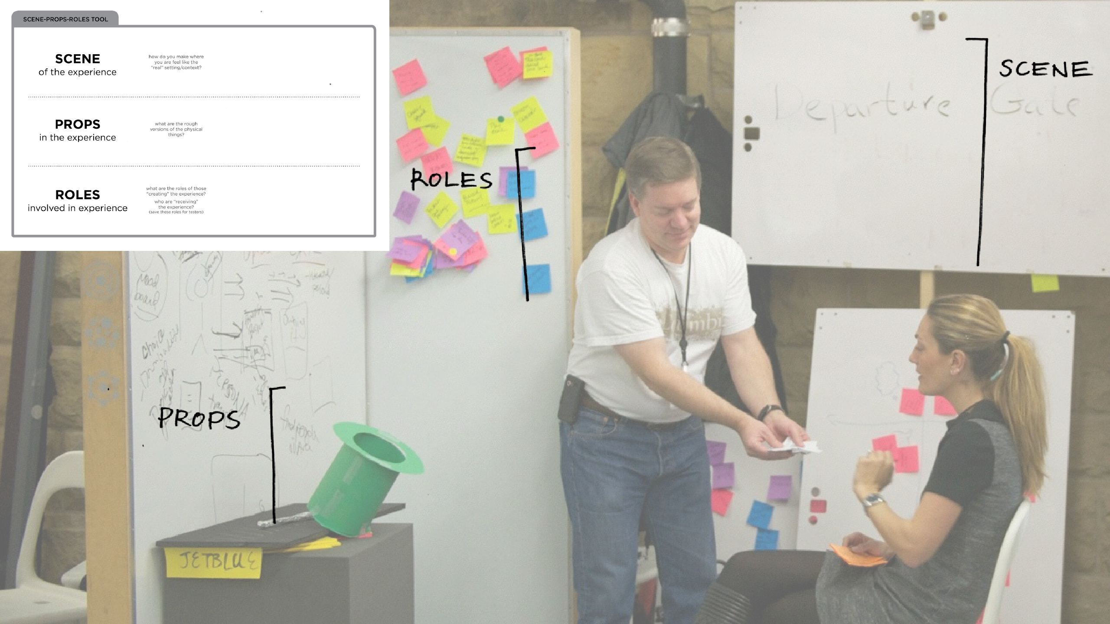
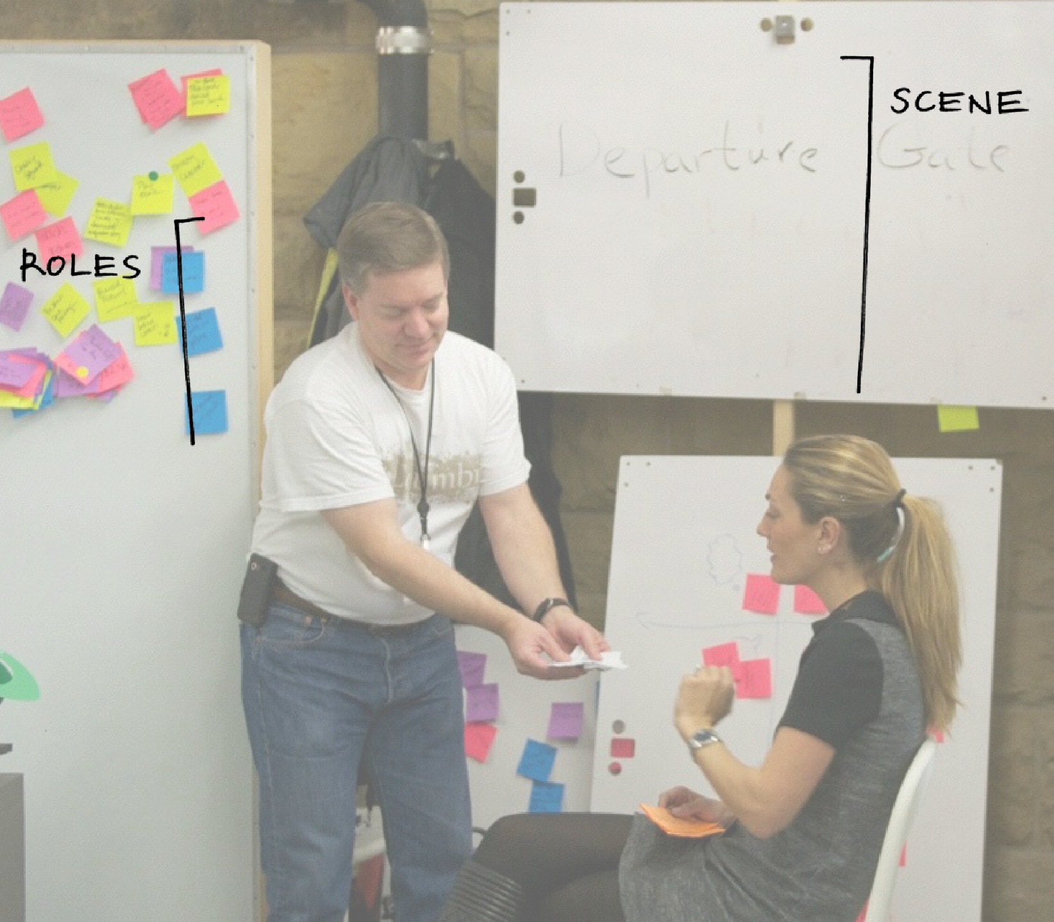

Slide 62
Parallel Experience Prototyping Goal
Prototype to test an assumption
Prototype can be a piece of idea rather than a complete solution
Think of it as another needfinding technique

Slide 63
Summary
Sketching allows exploration of many concepts in the very early stages of design
As investment goes up, need to use more and more formal criteria for evaluation
Experience prototyping allows us to try many ideas quickly & learn more about the problem & solution space (prototype to learn)

Slide 64
Next Time
Web Workshop on HTML/CSS/Git led by Cathy Zhu
Tonight, 7-8 PM, Lathrop
Assignment 3: Project Web Site
online later today
not graded until near the end of quarter (but you should create it now)
all project assignments need to be linked off this site (relative links)
Lecture
Concept Videos
Project (due Thursday/Friday in studio)
Create/test experience prototypes for top 3 solutions
Test each prototype with at least 1 target users
In presentation, get across what you learned!

Slide 65
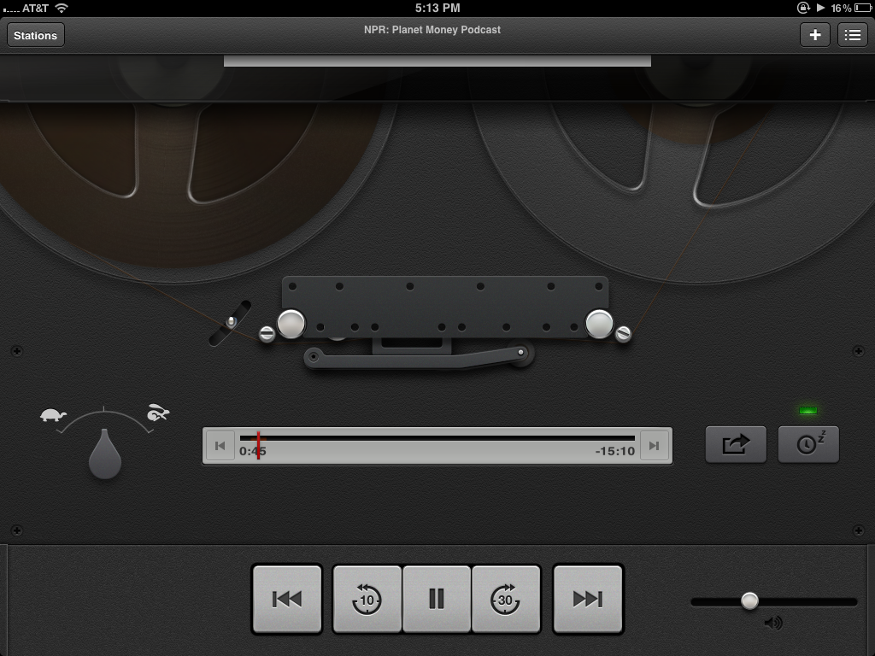
Hall of Fame or Shame?
Podcasts App
Apple Inc.
Notes:
prime example of Apple's foray in excessive skeuomorphism
A skeuomorph is a derivative object that retains ornamental design cues from structures that were necessary in the original.[

Slide 66
Hall of Shame!
Good
At first glance, is fun and unique
Well polished, aesthetically pleasing
Bad
What does a tapedeck have to do with podcasts? – confused metaphor is difficult to understand
Focus on ‘retro’ means the user has to wait 5 seconds to watch animation of tape loading before anything plays
Podcasts App
Apple Inc.

