Slide 1

Ideate
This work is licensed under the Creative Commons Attribution-Noncommercial-Share Alike 3.0 Unported License. To view a copy of this license, visit http://creativecommons.org/licenses/by-nc-sa/3.0/
October 1, 2015
Slides adapted from d.leadership Define + Ideate slides (https://dschool.stanford.edu/groups/dleadership/wiki/59f08/dleadership_2015.html)
Additional resources from bootcamp bootleg (http://dschool.stanford.edu/wp-content/uploads/2011/03/BootcampBootleg2010v2SLIM.pdf)
Notes:
Got to Team Break at 12:25 pm – 50 minutes into lecture – started 5 minutes late (start on time and cut TEAM BREAK to 25 minutes so last part has enough time)

Slide 2


Hall of Fame or Shame?
Sony Google TV Remote
Notes:
What do you like about it? What don’t you like about it?

Slide 3

Hall of Shame!
Sony Google TV Remote
Very complex
So large that it requires two hands
So many controls that you can’t use in the dark (watching movie?)
Two navigation pads. When to use which?
But, does have typing input…

Slide 4

Hall of Fame or Shame?
Apple TV Remote
Notes:
Compare this Apple TV Remote to the Sony Google TV Remote
These two products seem to be the EXTREME opposites in terms of the design space for a remote
(I have BOTH in my office)
What do you like about it? What don’t you like about it?

Slide 5
Hall of Shame!
Apple TV Remote
Overly simple
Many things require navigating menus
Text entry is almost impossible
So small that it is easily lost
Common tasks easy

Slide 6

Hall of Fame or Shame?
New Apple TV Remote
Still limited number of buttons, but adds
Voice Input
Touch pad w/ navigation, swipes & clicks
Slightly larger ➔ no longer lost in the cushions?

Slide 7
Ideate
This work is licensed under the Creative Commons Attribution-Noncommercial-Share Alike 3.0 Unported License. To view a copy of this license, visit http://creativecommons.org/licenses/by-nc-sa/3.0/
October 1, 2015
Slides adapted from d.leadership Define + Ideate slides (https://dschool.stanford.edu/groups/dleadership/wiki/59f08/dleadership_2015.html)
Additional resources from bootcamp bootleg (http://dschool.stanford.edu/wp-content/uploads/2011/03/BootcampBootleg2010v2SLIM.pdf)
Notes:
Today we will talk about how you move from your POV to coming up with potential solutions that make a breakthrough for your customers

Slide 8
Outline
Review Define: unpacking field data & POVs
Ideation
Exercise
Team Break
How might we?
Ideating with your POVs

Slide 9
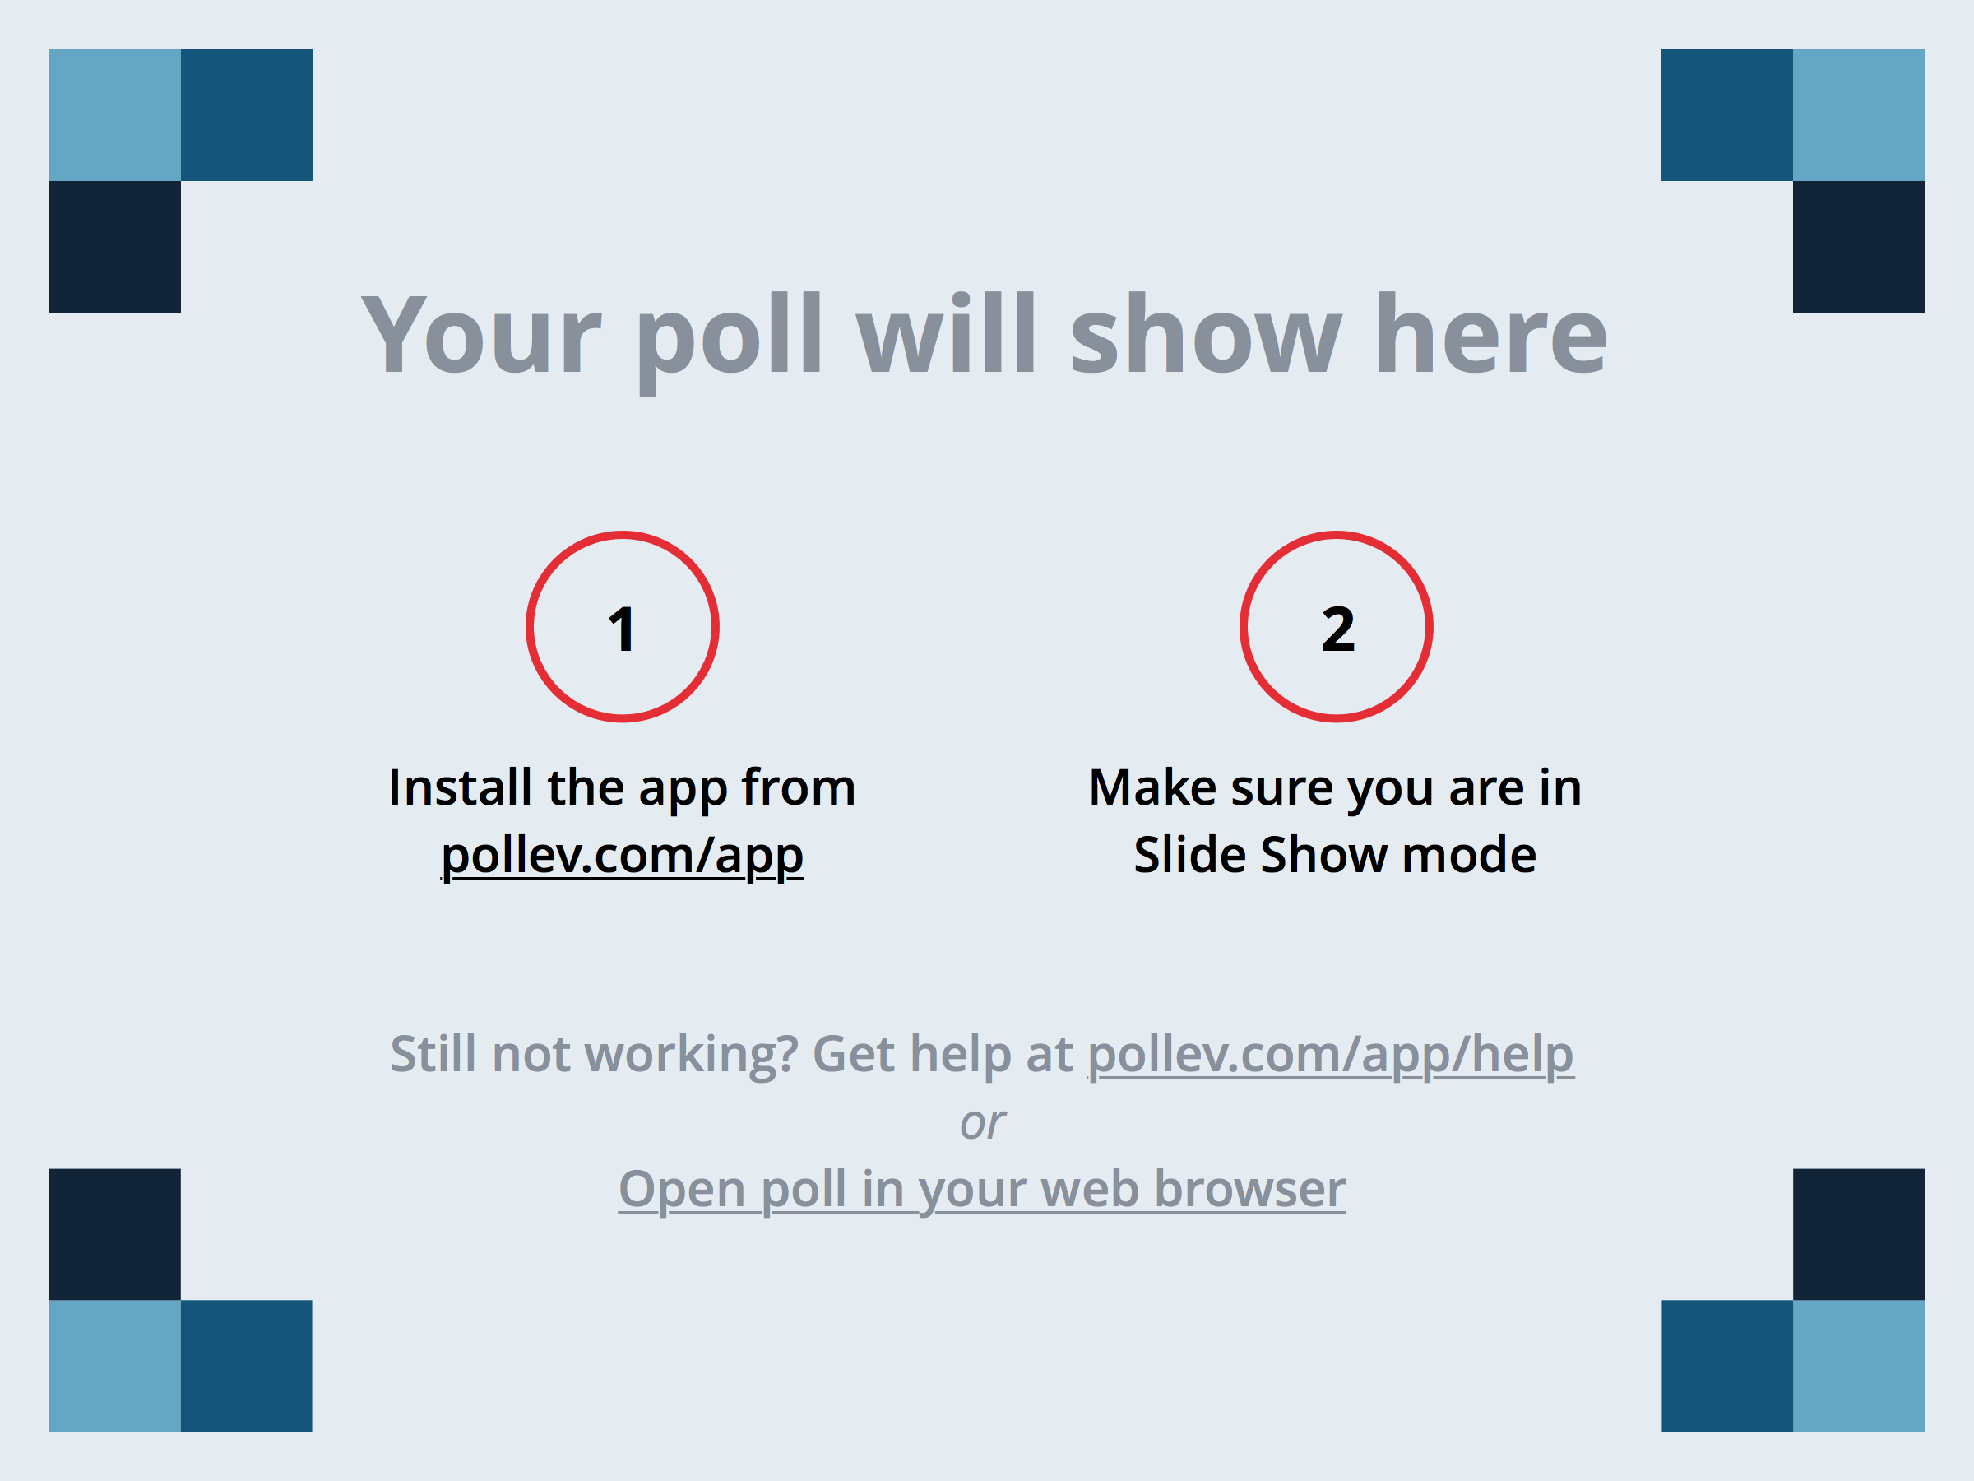
Notes:
Which of these is NOT a quality that makes for a great team?
https://www.polleverywhere.com/multiple_choice_polls/AdCzW3GpdrBLioH

Slide 10
Notes:
What did MIT NOT find correlated with overall team "smartness"?
https://www.polleverywhere.com/multiple_choice_polls/kIGGAkXfgaQ4mjY

Slide 11
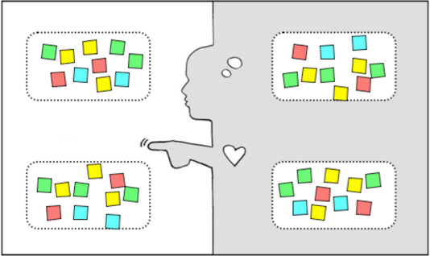

Empathy Map
say
think
KEEP A LIST OF
TENSIONS, CONTRADICTIONS, SURPRISES
Observations
Inferences
USE TO FIND NEEDS & INSIGHTS
do
feel
Notes:
As we unpack we look for Tensions, Contractions, and Surprises – put them to the side!
We use these to help identify Needs and Insights
Needs are human emotional or physical necessities -- verbs (activities and desires with which your user could use help)
An “Insight” is a remarkable realization that you could leverage to better respond to a design challenge

Slide 12

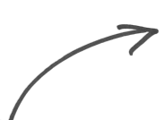
I wonder if this means . . .
TENSIONS,
CONTRADICTIONS,
SURPRISES
INSIGHTS
think
feel
Notes:
We use the tensions, contradictions and surprises to find insights
These are key to establishing our Point of View

Slide 13
Characteristics of A Good Point of View
Provides focus & frames the problem
Inspires your team & people you meet
Fuels brainstorms
Gives a reference to evaluate competing ideas
Saves you from the impossible task of creating concepts that are all things to all people
Revisit/reformulate as you learn by doing

Slide 14
Point of View
WE MET . . .
(extreme user you are inspired by)
WE WERE AMAZED TO REALIZE . . .
(what did you learn that’s new? What is their need?)
IT WOULD BE GAME-CHANGING TO . . .
(frame up an inspired challenge for yourself – the insight.)
(don’t dictate the solution.)
Notes:
Focus your work by writing a Point of View. Three straight-forward sentences.
We use the user, their need, and the insight to write the Point of View.
(We met): “What specific person did you meet that inspires your work?”
(We were amazed to realize:) “This is your insight. Tell us something we didn’t know or wouldn’t have thought about before we started this project. What unique new perspective do you have now?”
(A game-changer would be to:) “This is your call to action. Build on your insight and take an aspirational stance on what you can do as a team. This isn’t your solution -- it is the problem to be solved. A problem with a more informed perspective.”
As a test, a good point of view (POV) is one that: • Provides focus and frames the problem • Inspires your team • Provides a reference for evaluating competing ideas • Empowers your team to make decisions independently in parallel • Fuels brainstorms by suggesting “how might we” statements • Captures the hearts and minds of people you meet • Saves you from the impossible task of developing concepts that are all things to all people • Is something you revisit and reformulate as you learn by doing • Guides your innovation efforts

Slide 15
Truck Owner’s POV
https://vimeo.com/9212719
Notes:
[can we download and embed this video instead? Can we also do the mechanic video afterwards?]
Pay careful attention to this video
Take notes
Afterwards you are going to analyze it in teams of 4.
Let’s call her Maria.

Slide 16
DO IT NOW:
UNPACK: note the say, do, think, & feel
INSIGHTS: infer from observations
POINT OF VIEW: 1 written sentence
We met X
We were amazed to realize…
It would be game-changing to…
Notes:
Improve the car maintenance experience
first discuss what they found & then spend 5 minutes with a partner trying to develop at POV
Share out at the end

Slide 17
5 Top Suggested Team Break Activities
Schedule some (more) interviews
Unpack some more interviews
Work on your empathy map(s)
Start outlining/writing your presentation
Practice your presentation

Slide 18
TEAM BREAK
Notes:
25 minutes (got here at 12:25 – 50 minutes into lecture – started 5 minutes late)
Take questions about assignment at this point

Slide 19
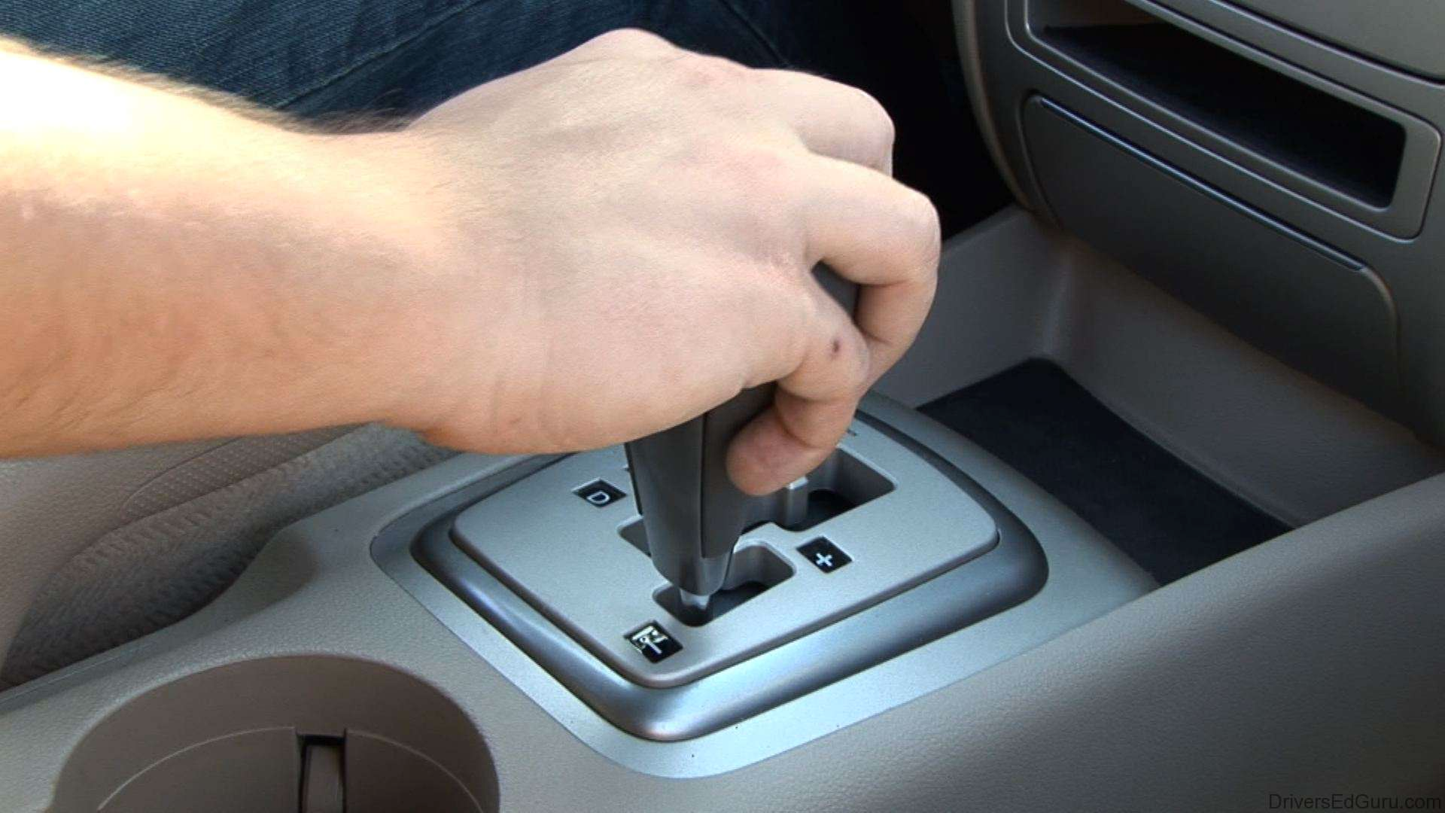
Shifting gears…
Notes:
Now you know how to unpack data and get a POV, how do we use it.

Slide 20
Design Thinking
Empathize
Ideate
Define
Prototype
Test

Slide 21
Design Thinking
Ideate

Slide 22

innovation
potential
separate generation
and evaluation
Notes:
Ideate is about building innovation potential – not necessarily about finding that one great idea.
Brainstorming gets you the seed of what can become innovative solutions (through prototyping and iteration).
We will use brainstorming for ideation.
(Regardless of what ideation technique you use), the core principle is to separate idea generation and evaluation.
Let yourself and your team explore, and turn off the critical part of your brain for just this period of time.

Slide 23

How do we start?

Slide 24

How do we start?
Notes:
The words “How might we” are important
As soon as you start using words like can and should, you’re implying judgment: Can we really do it? And should we?”

Slide 25
“Might” lets you defer judgment
helps people to create options freely
opens up more possibilities
Notes:
“you’re able to defer judgment, which helps people to create options more freely, and opens up more possibilities.”

Slide 26

Seeds for brainstorming!
Notes:
How might we statements are seeds for brainstorming
Your good ideas will grow from these seeds

Slide 27

POV: Harried mother of 3, rushing through the airport only to wait hours at the gate, needs to entertain her playful children because “annoying little brats” only irritate already frustrated fellow passengers.
Notes:
How do we take that POV and find “How Might We” statements that are directions for solutions
We have some tools that help you turn a POV into HMWs

Slide 28
POV: Harried mother of 3, rushing through the airport only to wait hours at the gate, needs to entertain her playful children because “annoying little brats” only irritate already frustrated fellow passengers.
Break POV into pieces
HMW entertain kids? HMW slow a mom down?
Amp up the good/Remove the bad
HMW separate kids from fellow passengers?
Explore the opposite
HMW make the wait the most exciting part of the trip?
Question an assumption
HMW entirely remove the wait time at the airport?
http://dschool.stanford.edu/wp-content/uploads/2012/05/HMW-METHODCARD.pdf
Notes:
How do we take that POV and find “How Might We” statements that are directions for solutions
8 How Might We Generators!

Slide 29
POV: Harried mother of 3, rushing through the airport only to wait hours at the gate, needs to entertain her playful children because “annoying little brats” only irritate already frustrated fellow passengers.
Go after adjectives
HMW we make the rush refreshing instead of harrying?
ID unexpected resources
HMW leverage free time of fellow passengers to share the load?
Create an analogy from need or context
HMW make the airport like a spa?
Change a status quo
HMW make playful, loud kids less annoying?
http://dschool.stanford.edu/wp-content/uploads/2012/05/HMW-METHODCARD.pdf
Notes:
Some of these generators might overlap, but that is OK. You are just trying to find new solution spaces.
Again, these are NOT the solutions themselves, but more specific problems that if you solve, might make the breakthrough for your customer.

Slide 30
DO IT NOW:
Generate some HMW statements!
Notes:
5 minutes

Slide 31
POV: Harried mother of 3, rushing through the airport only to wait hours at the gate, needs to entertain her playful children because “annoying little brats” only irritate already frustrated fellow passengers.
Break POV into pieces
Amp up the good/Remove the bad
Explore the opposite
Question an assumption
Go after adjectives
ID unexpected resources
Create an analogy from need or context
Change a status quo
http://dschool.stanford.edu/wp-content/uploads/2012/05/HMW-METHODCARD.pdf
Notes:
Use these to generate

Slide 32
POV: Harried Mother at Airport
How might we make the wait the most exciting part of the trip?
How might we change the general feeling towards kids at the airport?
How we might provide accurate information about wait time at the airport… so you don’t need to wait at the gate?
How might we might make the waiting time at the gate productive?
How might we allow the kids to have more fun while shielding the passengers from frustrating noise?
How might we make it so people think of kids as endearing instead of irritating?
How might we reduce the stress for a mother trying to navigate the airport with young kids?
Notes:
Type what the students said here
last year:
Create a story about an adventure to the destination that kids start on online before trip & continue while in waiting area
Have video games in the waiting area
Have a place to meet other kids who will be on the same plane in the waiting area

Slide 33
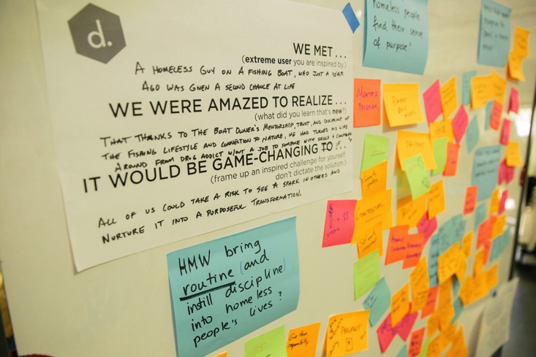
Brainstorm “How Might We”s Solutions
Notes:
We met a homeless guy on a fishing boat, who just a year ago was given a second chance at life
We were amazed to realize that thanks to the boat owner’s mentorship, trust, and display of the fishing lifestyle and connection to nature, he has turned around his life from drug addict without a job to someone with success and compassion
It would be game-changing if all of us could take a risk to see a spark in others and nurture it into a purposeful transformation.

Slide 34
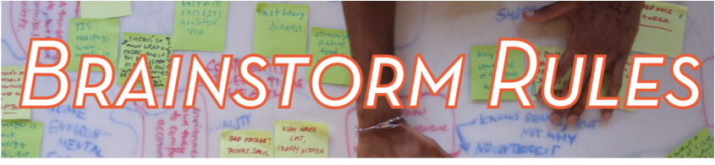
one conversation at a time
go for quantity
headline!
build on the ideas of others
encourage wild ideas
be visual
stay on topic
defer judgment
Notes:
“ . . . This is one of the few times in a design process when we have rules laid out. It may seem counter-intuitive to have rules for a mind-blowing-free-for-all-idea-fest. But these rules are actually to help be your best as a brainstorming team.”

Slide 35
Constraints Can Engergize
“How would you design it with the technology of 100 years ago?”
“What if we had to spend at least a million dollars?”
“Only ideas that would get you fired”
“All ideas must use magic.”
http://dschool.stanford.edu/wp-content/themes/dschool/method-cards/facilitate-a-brainstorm.pdf

Slide 36

Selecting a Good Problem
3 Favorites!
OR
Rational, Delightful, Long shot
http://dschool.stanford.edu/wp-content/uploads/2011/03/BootcampBootleg2010v2SLIM.pdf
Notes:
Some people do something as simple as this…

Slide 37
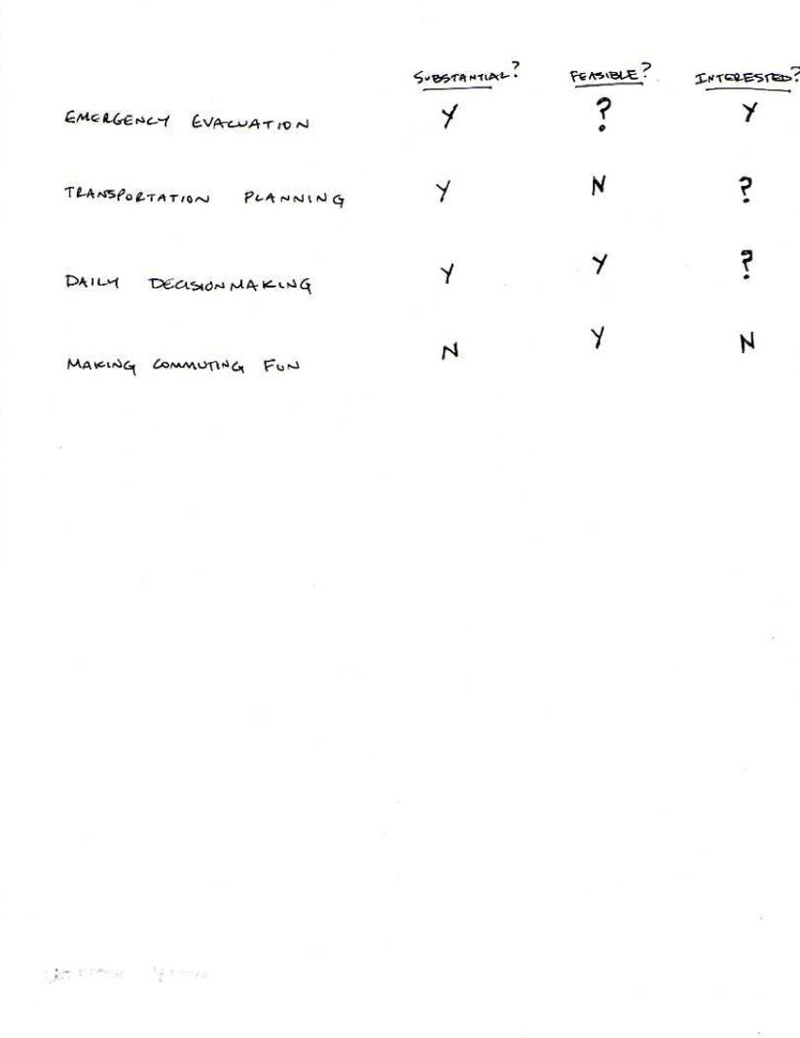
Prioritizing Problems
Notes:
Sometimes a more quantitative approach is better

Slide 38
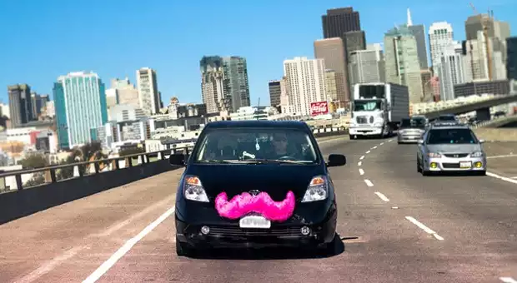
Selecting a Good Problem
Frequency
  want something that occurs often
Density
  lots of people experience it
Pain
  more than a small annoyance
Interested
  your team is motivated
  to work on this problem
* see Manu Kumar’s blog post on this topic: http://www.k9ventures.com/blog/2015/02/10/finding-problem-worth-solving/
Notes:
I like this framework (maybe combined with the last one)

Slide 39
Research/Analysis
How big a problem is it? (market)
Whose problem is it? (stakeholders)
What’s already out there? (competition)
How are things done currently? (status quo)
How can they be improved? (innovation)
Notes:
You can put more meat on your analysis by thinking through/researching these questions

Slide 40
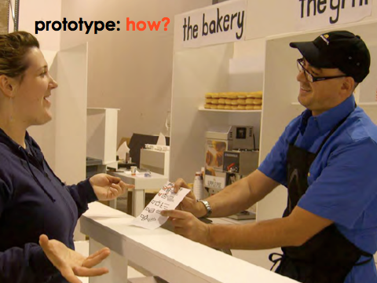
EXPERIENCE PROTOTYPE
Notes:
So how can we get from all the problem ideas we generated in our brainstorm to making a prototype that helps us learn from users

Slide 41
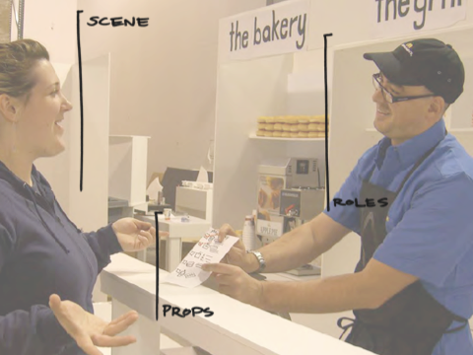
Notes:
We need to think about the various components of the interacts-like prototype. Think about it like a developing a play.
You’ve got the props – i.e. the physical objects. These could be the things you are actually testing (the prototype itself) – or they could be objects in the larger prototype.
Then, you have the scene or scenario surrounding the objects – you’re not just giving things to people in a vacuum. You are helping people imagine and experience the possible situation they are in.
And finally, you may have roles that you play within the prototype – you become part of the prototype.

Slide 42
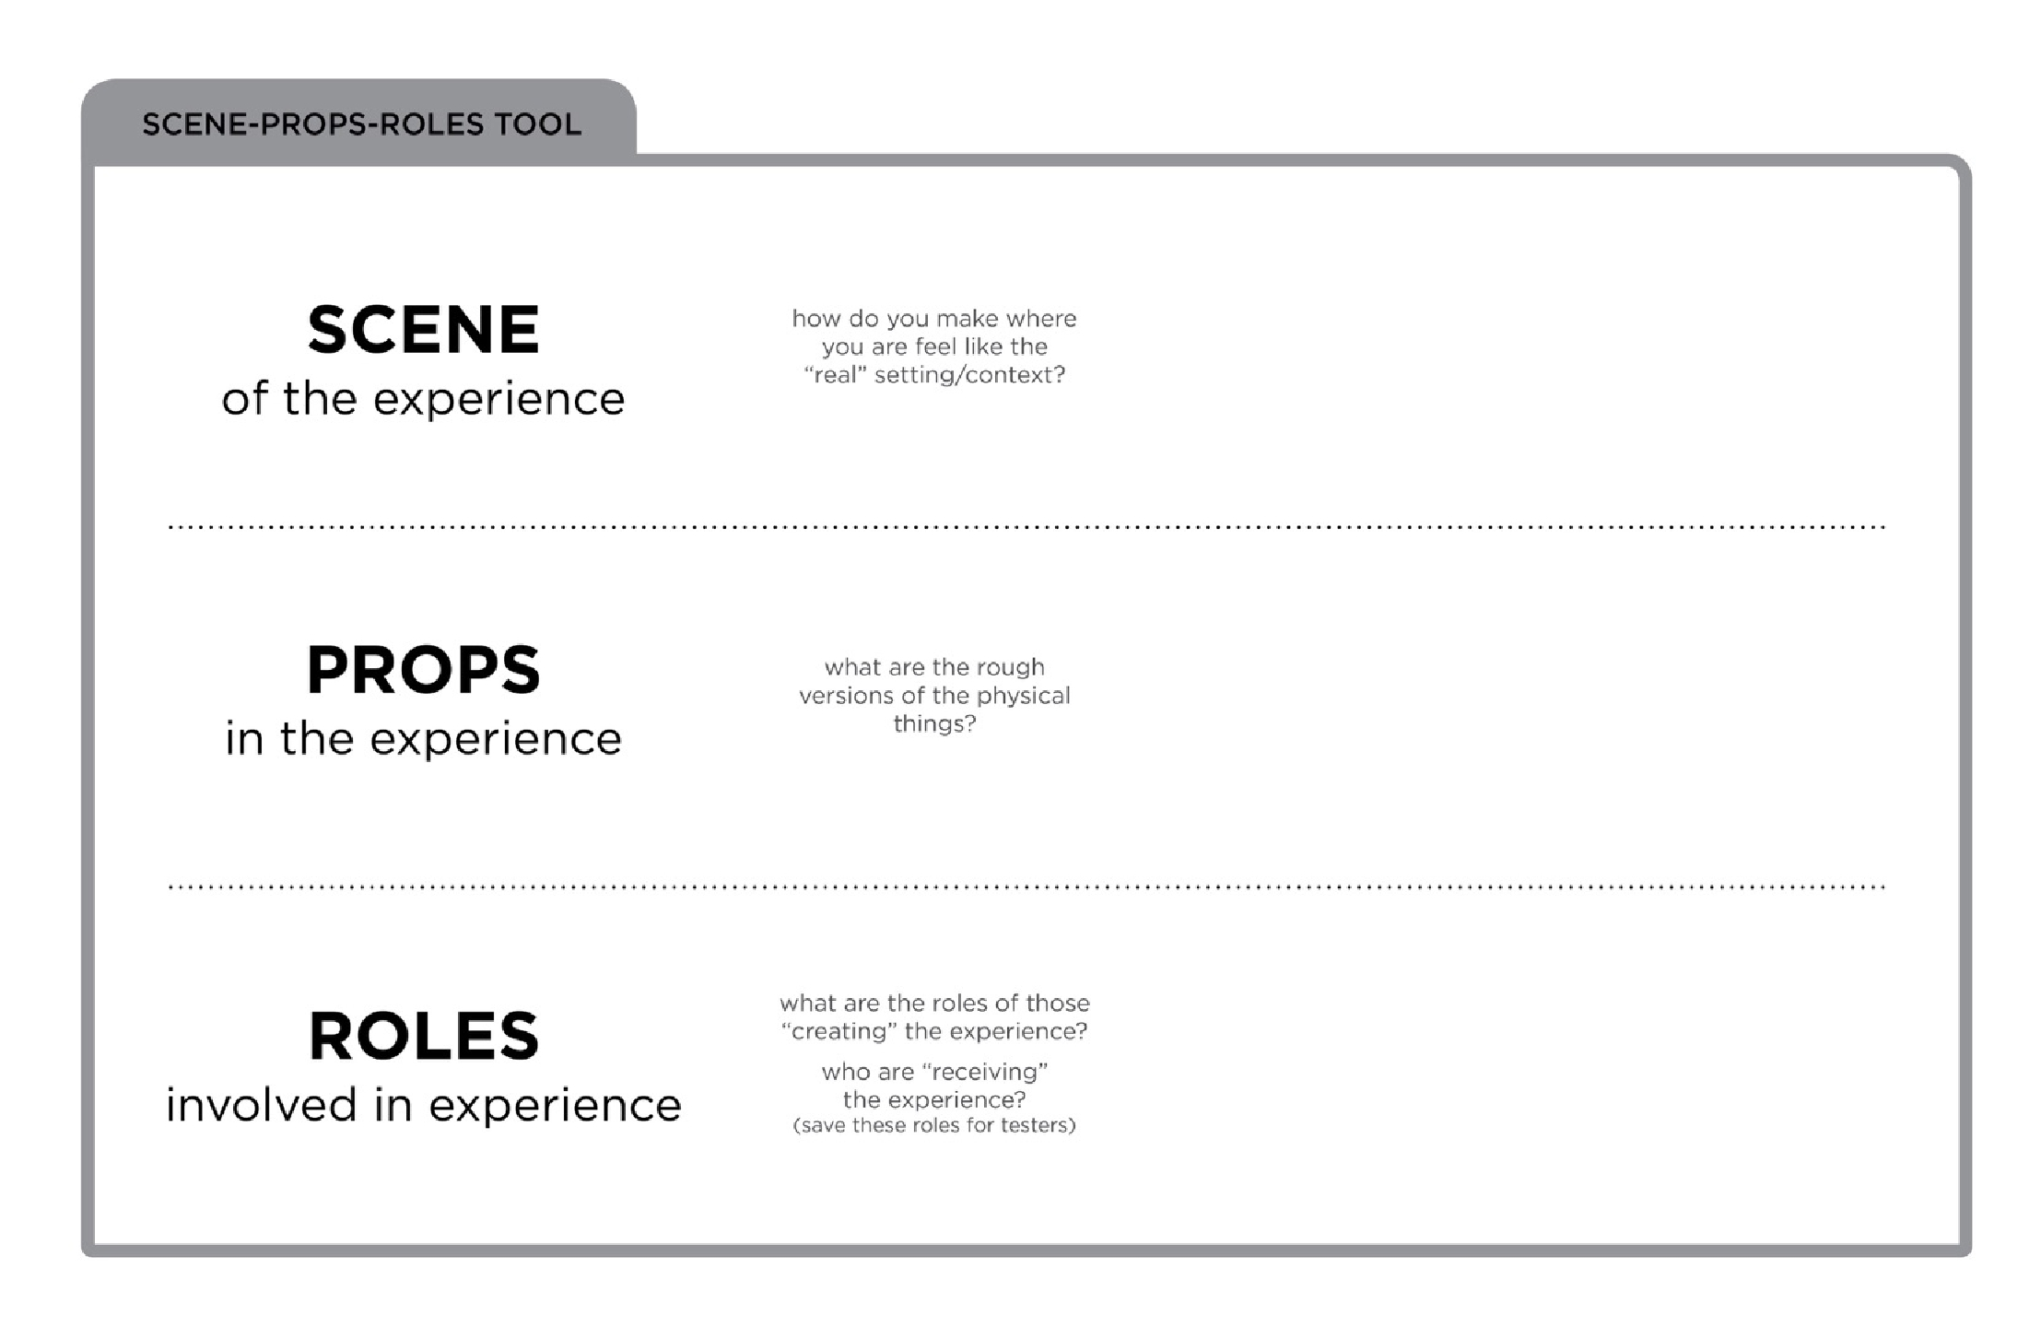

Slide 43
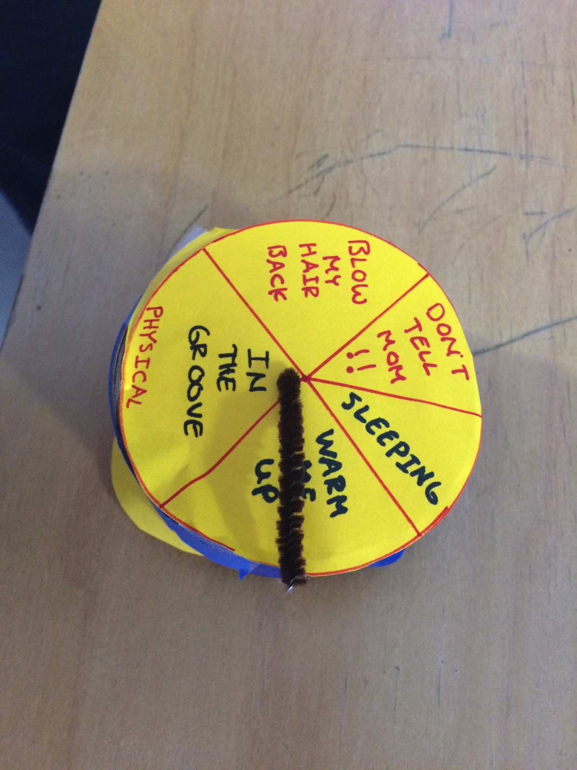
Notes:
This is what we ended up with. A special Activity Watch.

Slide 44
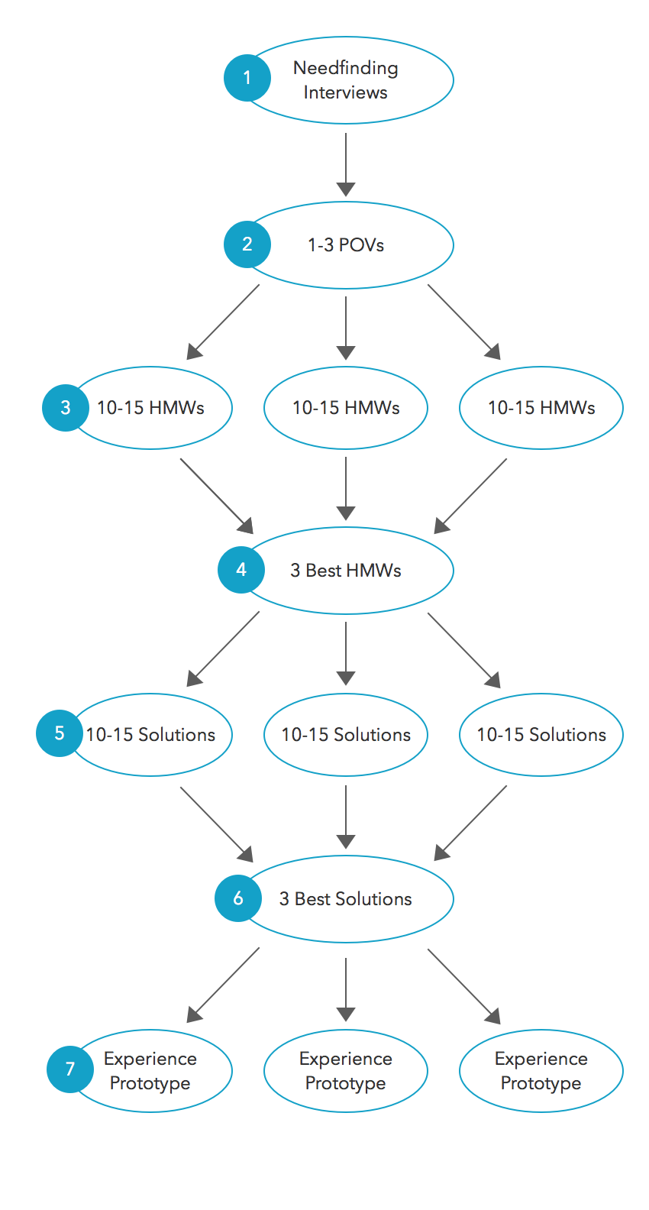
Next Assignment (due at next week’s studio)

Slide 45
Next Time
Studio
  Present your initial needfinding
  If you can, read “How to Survive a Critique: A Guide to Giving and Receiving Feedback” by Karen Cheng
  http://www.aiga.org/how-to-survive-a-critique/
  Develop some POVs in studio
Lecture (Tue., 10/6)
  Design exploration
Reading
  Pg. 135-151 from Buxton’s Sketching User Experience

